Slide 1
Experience with SPS RF and outlook
Sam Pitman, Eric Montesinos, Gino Cipolla, Sebastien Calvo, Flory Matthia Ten Broeke, Fred Killing, Christophe Renaud, Joan Revoltos, Calum Sharp, Christian Schachtner, Francesco Repola, Luciano Ciampo, Odin Ervik, Kim Wagener, Alessandro Cazzaniga, Giulia Papotti, Ivan Karpov, Bartek Bielawski, Rama Calaga
10/12/2024

Slide 2
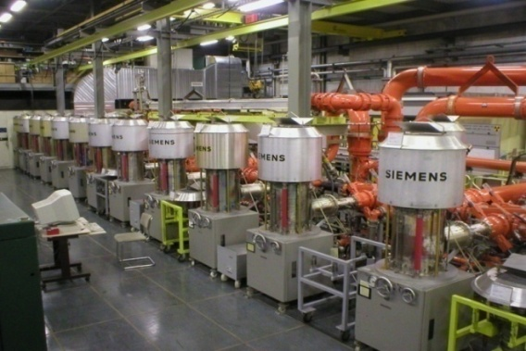
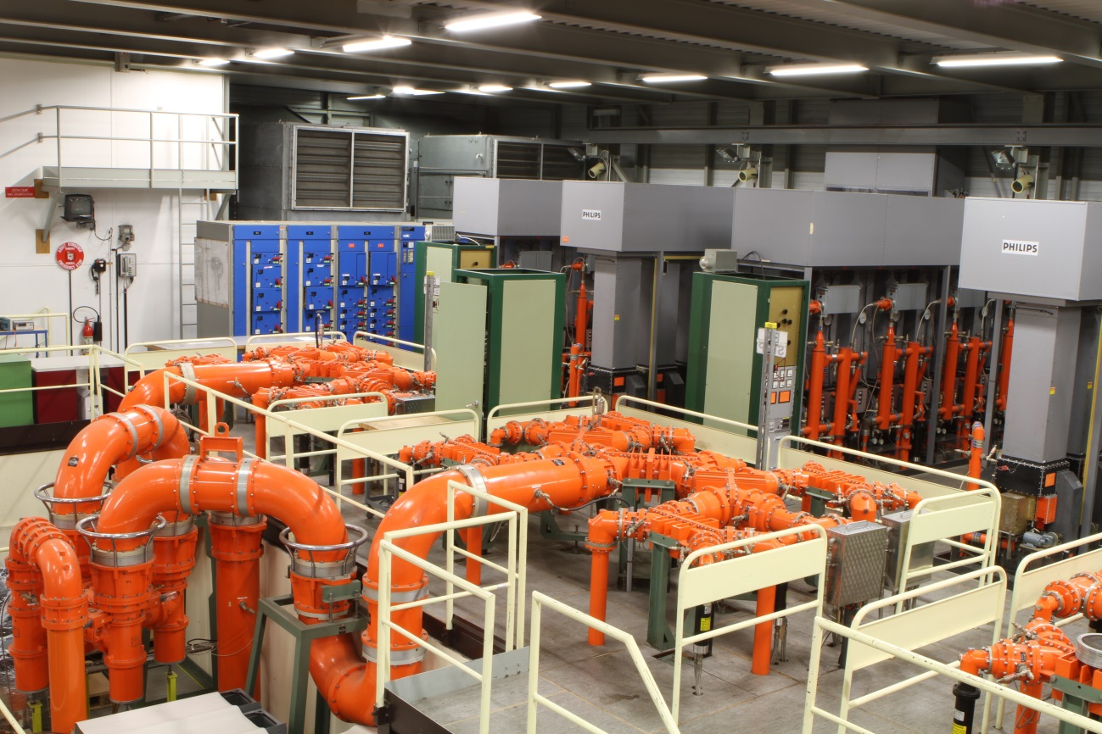
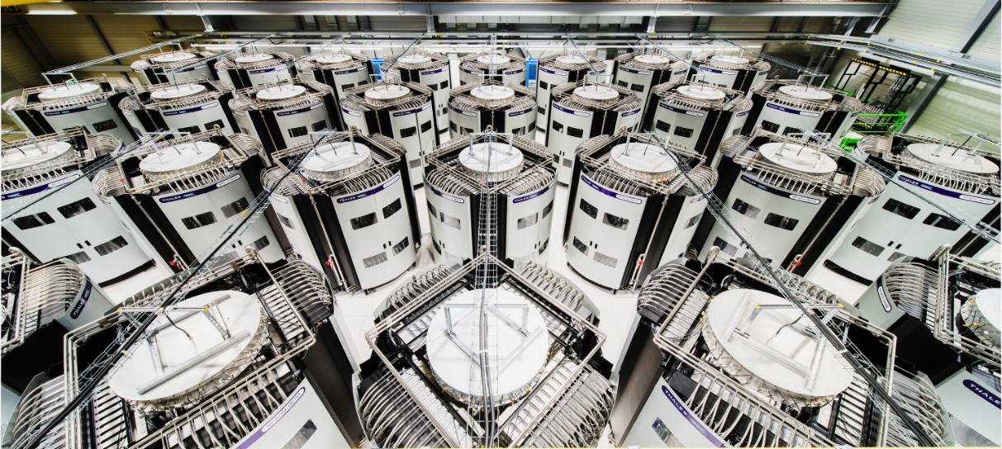
Introduction and outline
Cavity 1 & 2
6 x 200 MHz cavities in SPS
2 x tetrode systems
1 x solid state
Single exceptional failures
High failure rate
Siemens update
Cavity 4 & 5
Cavity 3 & 6
Notes:
30 sec
6 200 MHz cavities
Tetrode based systems + SSPA
This talk mainly thales with a comment on cavity 1 + 2

Slide 3
Introduction
One Transmitter is composed of
  16 x 144 kW RF amplifiers
One RF amplifier is composed of
  1:80 cavity splitter
  80 x 1.8 kW RF blocs (160 transistors)
  80:1 cavity combiner
In total
  Two transmitters
  32 RF amplifiers
  2560 RF blocs
  5120 transistors
Notes:
30 secs
2 transmitter 1 per cavity
16 towers for each cavity

Slide 4
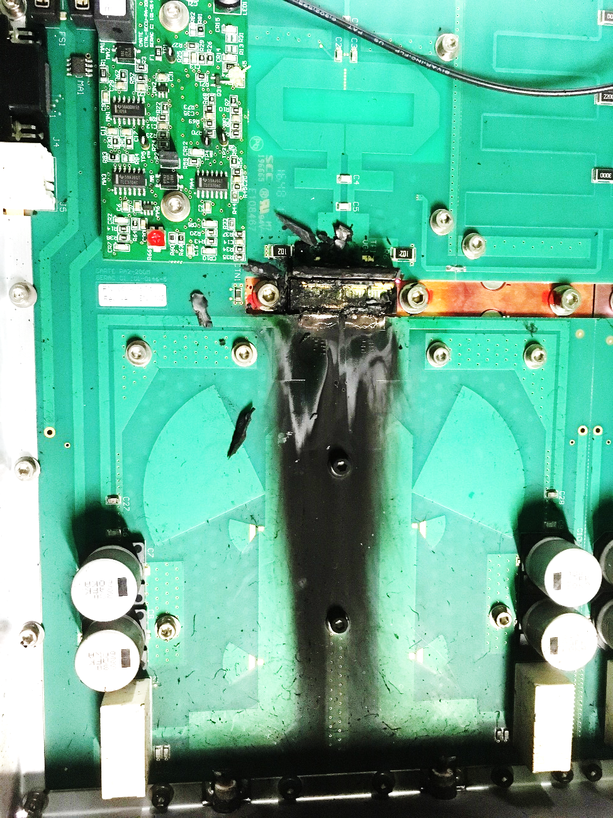
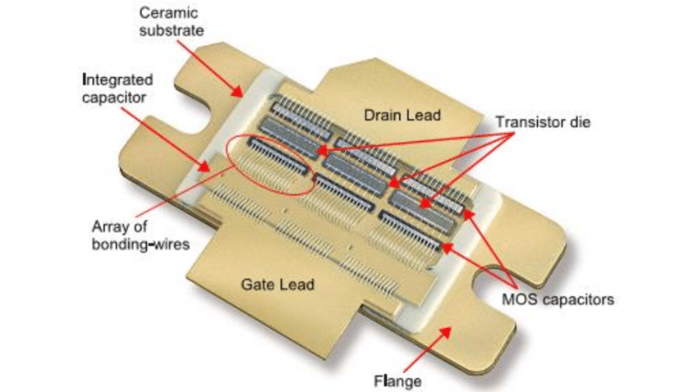
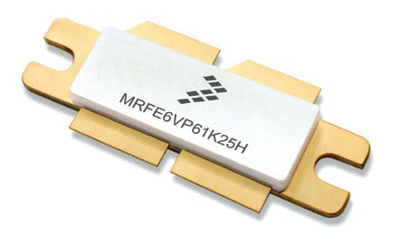
Introduction
One Transmitter is composed of
  16 x 144 kW RF amplifiers
One RF amplifier is composed of
  1:80 cavity splitter
  80 x 1.8 kW RF Modules (160 transistors)
  80:1 cavity combiner
In total
  Two transmitters
  32 RF amplifiers
  2560 Modules
  5120 transistors
2 x
From Beam Control
1/16 splitter
1.6 MW at cavity input ~120 to 180 m away
4 stages of 3 dB combiners = - 0.6 dB
120 to 180 m Coaxial lines = - 0.4 dB
Final Amplifier output = 1.6 MW + 1 dB = 2 MW
16 towers of minimum 125 kW
Notes:
1.5 min
4x1cm

Slide 5
HOM Coupler burned Cav 3
Half towers not driven Cav 6
Broken Load on H1-04
Collars modification on Cav 3 & Cav 6
Collars modification & matching steps & new air-outlets on Cav 6
Cavity 6 Conditioning
Cavity 3&6 Conditioning & Scrubbing run
SPS Beam commissioning & scrubbing run polar loop instabilities
Cavity 6 Conditioning
Cavity 3 Conditioning
Scrubbing run
Ions to SPS & SFT_pro intensity between 2.7E+13eV to 3.3E+13eV
LIU parallel MD and LHC ions setting up flow monitoring all ok
AWAKE Beam water problems
MTEbeam nominal to SPS & LHC 25ns
SPS cold checkout
Notes:
1 min
Cav 6 used to be worse changed after matching step changed
Scrubbing and broken loads theme

Slide 6
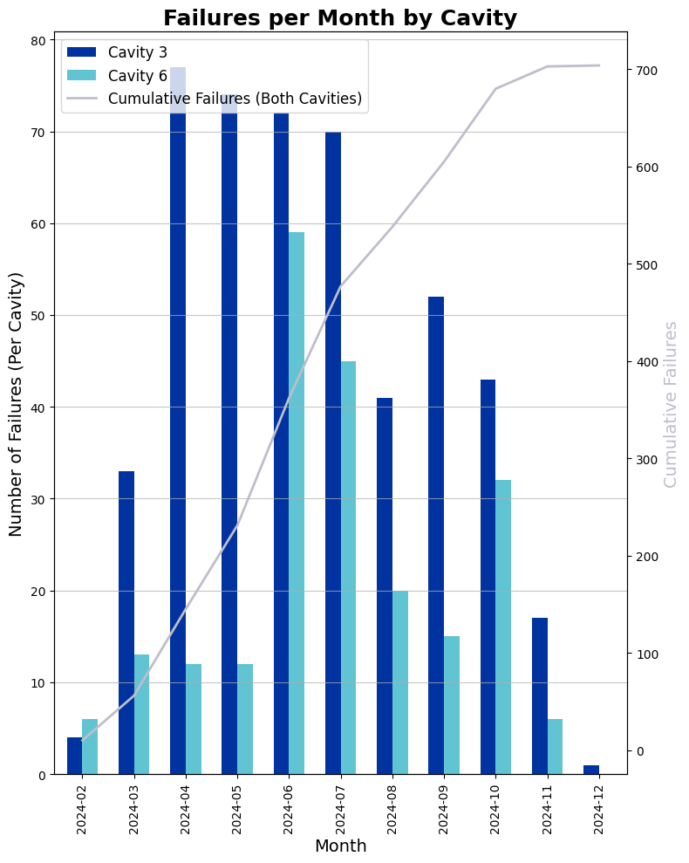
SSPA exceptional failures
2
3
1
Scrubbing
  Large vacuum spike on cavity 3, 14 modules broken within 30 minutes, around 30 in total.
  Degraded mode for 4 days, scrubbing at flat bottom only.
  Reduced number of modules that can break before calling piquet to 3
Half towers unpowered
  LLRF signal cable disconnected from half towers, around 100 modules lost (over around 3 months)
  2 x high power loads broken
  Towers are thought to have been overdriven
  Interlocks have since been connected to prevent this happening again
No AM modulation
  AM turned off in HIRADMAT cycle – 14 modules lost at once
    For 2 batches to be spaced half a ring apart
  Peak power only achievable with AM – Mandatory not interlocked
  Working on average power interlock
HOM coupler burned
  10 modules lost in 30 mins prior to HOM burning
  Same coupler in Cav 6 to be inspected in YETS
Broken Loads
  Loads on isolated port of combiners have been broken
  Not clear what impact this had on failure rate
  All loads to be replaced in YETS (14/30 replaced during the run)
4
2
5
1
3
4
5
Notes:
2 mins

Slide 7
Measures taken
Improved brazing
Tightened acceptance criteria
Cleaned cooling water circuit
Line length analysis
Measurements of whole system
Reduced gain of individual towers
Changed high power loads
Modules PCB improvements
Module position analysis
Installed additional logging
Commissioned test bench
Isolating problem tower
Notes:
1 min

Slide 8
SSPA Failures
What we know
What we don’t understand
Overdrive
    Modules are very sensitive to overdrive. Overdriving a small amount on the test bench resulted in rapid failure.
    Instances of known overdrive have correlated with high rates of module breakage.
  Cavity 3 has higher failure rate than Cavity 6
    Cavity 3 has poor impedance matching step
    Higher baseline vacuum level
Loads need maintenance
Thermal problems lead to high loss.
    Brazing to coldplate is essential
    Integrity of the cooling system
Reflected power
    Installed scopes to monitor reflected power to towers on Cav 3
    Could not correlate reflected power transients to module breakage (ongoing)
Different tower breakage rates
    No understanding of why some towers experience next to no loss, and some very high loss.
  Failure rate vs Cycle
    Difficult to analyse as SFTPRO1 is running all of the time
Notes:
1 min

Slide 9
YETS & Future Operation
YETS
Spares
Cavity 3 matching
  Reduce reflected power back to modules but also maximise power into cavity.
Inspection of HOM coupler in Cav 6
Replacement of high-power loads
New mechanical passive gain and phase adjustment.
Overdrive protection upgrade
  Average power interlock
This should enable us to operate with nominal power values from 2025
Spares management is what has limited us operating at full power this year.
Worst case 3 modules broken per day we would need to replace 1500 transistors in 25-26 run.
  We will have 1430 spares
  >1000 need to be brazed to baseplate
Ceramic transistors
  More robust
  Better for pulsed power operation
plastic case absolute maximum drain-source voltage 133 V
ceramic case absolute maximum drain-source voltage 177 V
Notes:
1 min
250 complete modules delivered in January 2025
180 transistors delivered in April 2025 which will need brazing onto cold plate
1000 from October 2025 that must also be brazed onto cold plate
We can repair 3 modules per day internally at CERN

Slide 10
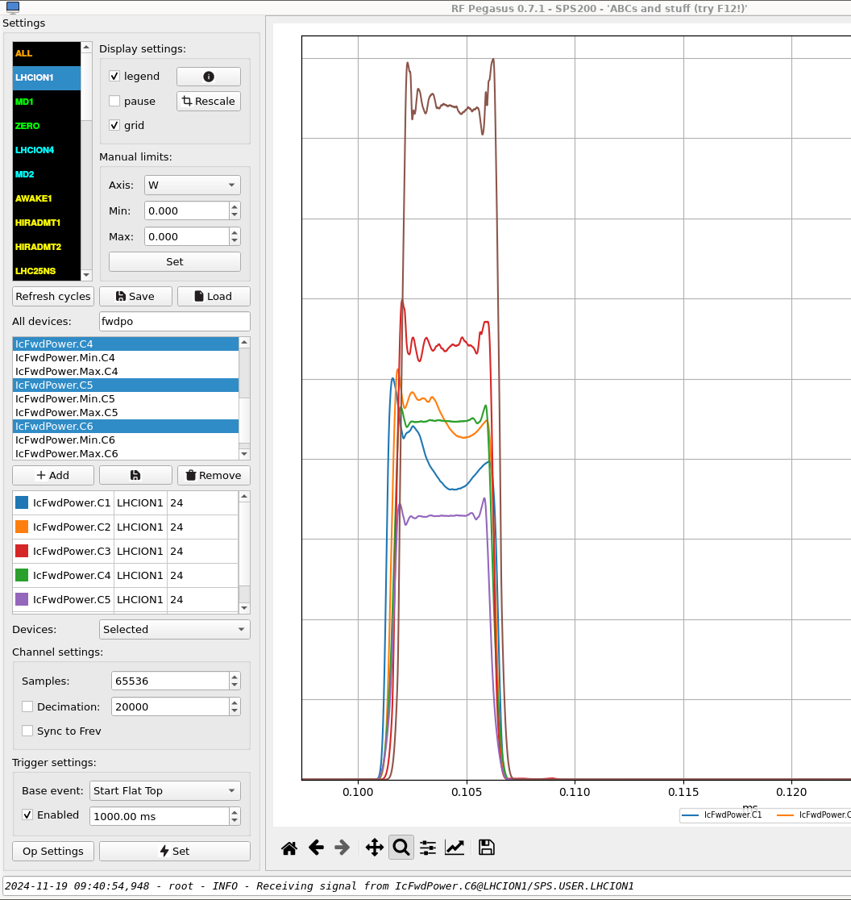
C1&2 missing power
Reduction in gain within pulse for C1 and C2 needs to be addressed
  See I.Karpov at JAP23
Filament voltage was reduced to expand the lifetime of the tubes
  See E. Montesinos at IEFC23
This means less gain and less peak power
Can be increased if we are prepared to consume more tubes
  Would need to be discussed with supplier
  Would also require more person power
No filament transformer spares
  About to launch a tender for delivery in 2025
Notes:
1 min

Slide 11
Summary
SPS high power RF caused a lot of downtime and degraded operation this run
Some events were unavoidable, those that were avoidable have informed improvements already actioned or to be done in this YETS
Ongoing efforts to understand the root causes of the high failure rate
Nonetheless improvements are being made to reduce the failure rate
More spares should enable us to run at nominal values next run
Excluding exceptional events, we have benefitted from the granularity of the system
  Broken modules changed mostly in shadow
  Opportunity to benefit even more from this next run by reviewing piquet procedure
Notes:
30 secs

Slide 13
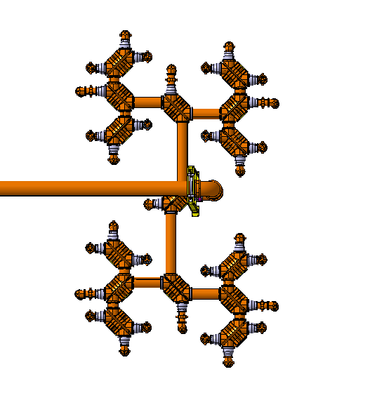

Technical stop event
A connection error lead to the LLRF signal being missing on one half of system
Some towers were full power and some zero
This was very unbalanced due to the integration
T26 first lost 13 modules
Then the load broke
Next the final load broke
Finally the signal was re-established to the other towers
Around 100 modules broken as a result of this event
30
21
28
19
25
23
17
18
27
29
20
22
31
24
32
26
Notes:
Interlocks were re-established afterwards

Slide 14
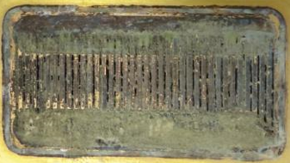
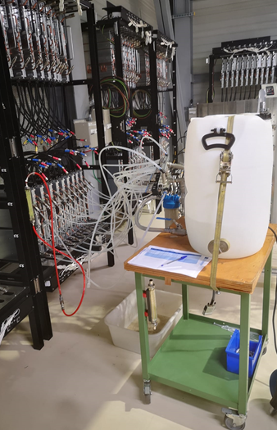
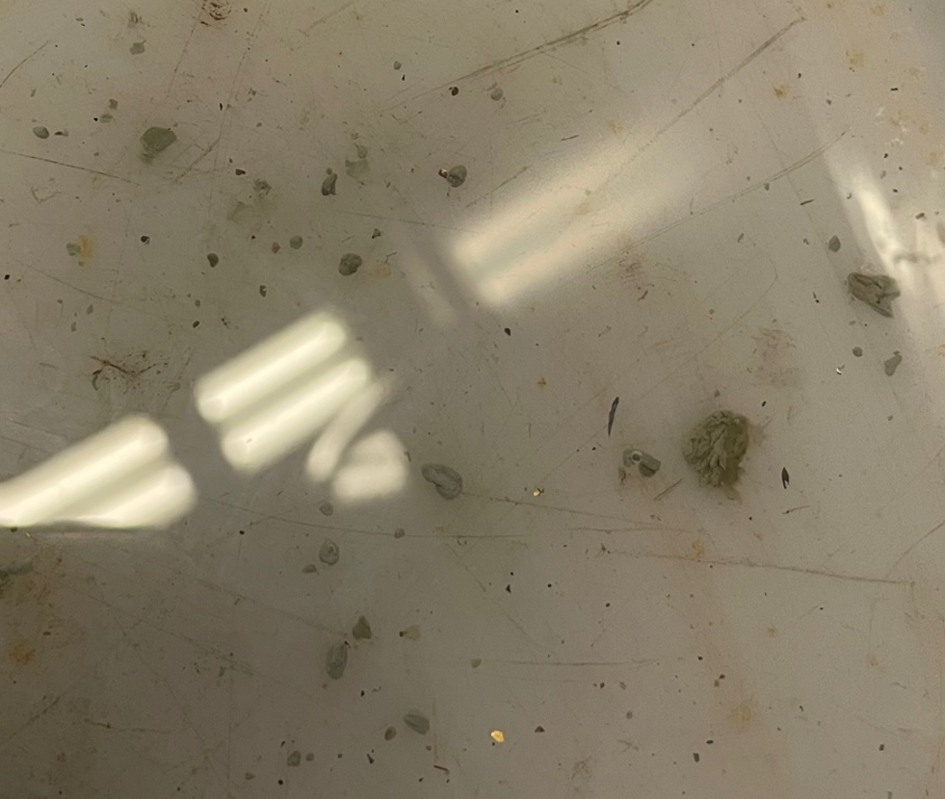
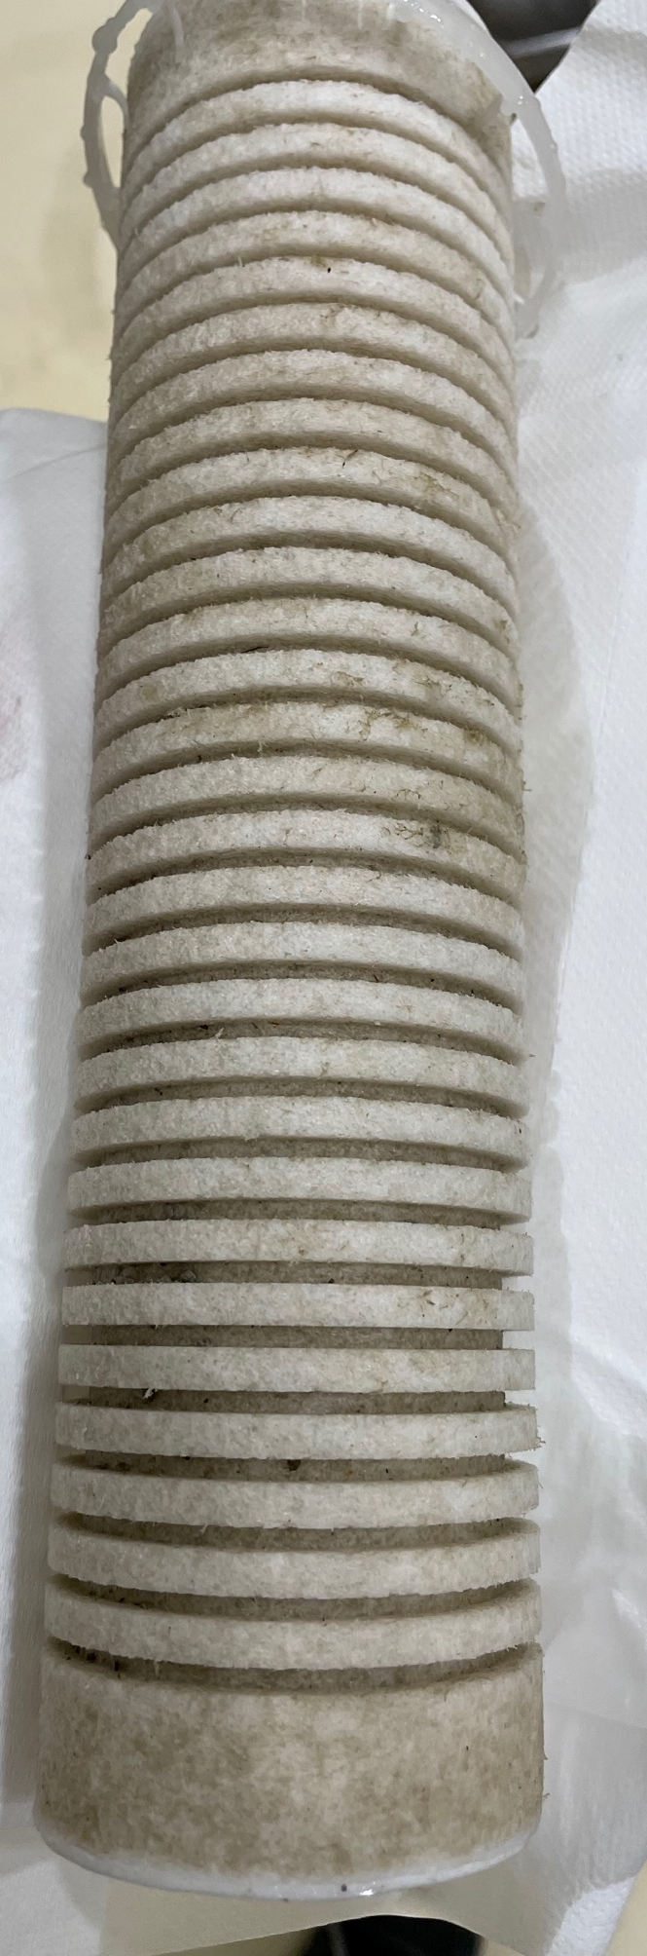
Thermal Paste
Thermal paste was introduced to the cooling system
This blocked the cooling channels of the transistors and caused overheating
System was flushed of impurities
Uncertain if there are still blockages causing problem
We still see burned transistors

Slide 15
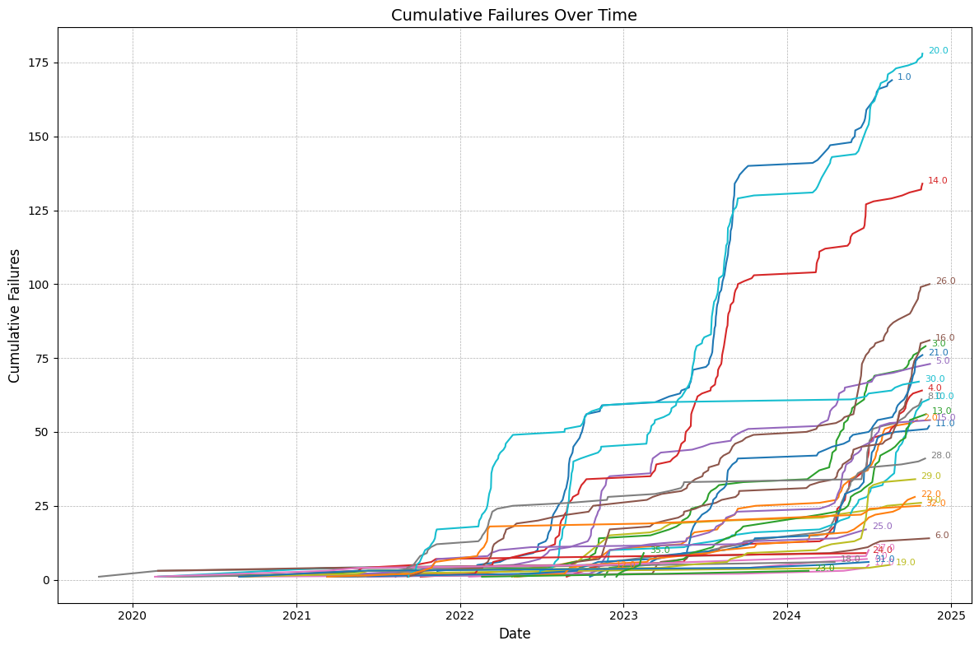

Slide 16
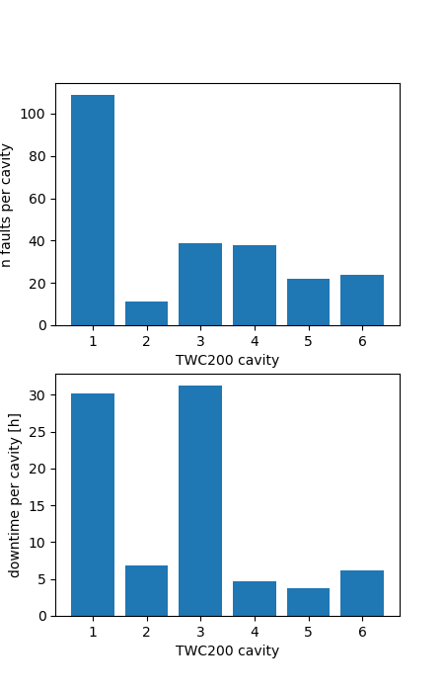
SPS Downtime
>200h downtime for SPS attributed to RF Power
  For downtime and fault statistics see G. Papotti at RF internal Operations Review on 21.11
Significant faults:
  SSPA module failures
    See next slides
  Cavity 1 elbow arcing, exchanged and solved
    See F. Killing at SPS MPC on 30.07
  Cavity 3 burned HOM coupler
    Single event – not linked to beam intensity
  Cavity 6 half towers not powered
    Human error, covered by interlock now.

