Slide 1
ABT Equipment: Operational Insights and Future Perspective
M. Barnes, W. Bartmann, C. Boucly, C. Bracco, J. Borburgh, P. Burkel, M. Diaz, L. Ducimetière, Y. Dutheil, G. Favia, L. Feliciano, L. Fernandez, T. Kramer, V. Namora, N. Magnin, F. Pelloux, V. Senaj, D. Standen, T. Stadlbauer, P. Trubacova, F. Velotti, N. Voumard, C. Zannini

Slide 2
Outline
Operational insights
  2024 ABT equipment operation
  2024 operational experience:
    KFA71
    KFA14
    MKP-L
    MKI
Looking forward
    MKP-S
    MKDH
    AC dipole
Conclusions

Slide 3
Outline
Operational insights
  2024 ABT equipment operation
  2024 operational experience:
    KFA71
    KFA14
    MKP-L
    MKI
Looking forward
    MKP-S
    MKDH
    AC dipole
Conclusions

Slide 4
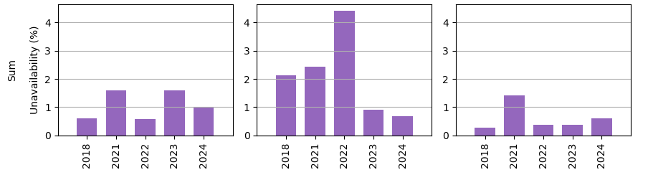
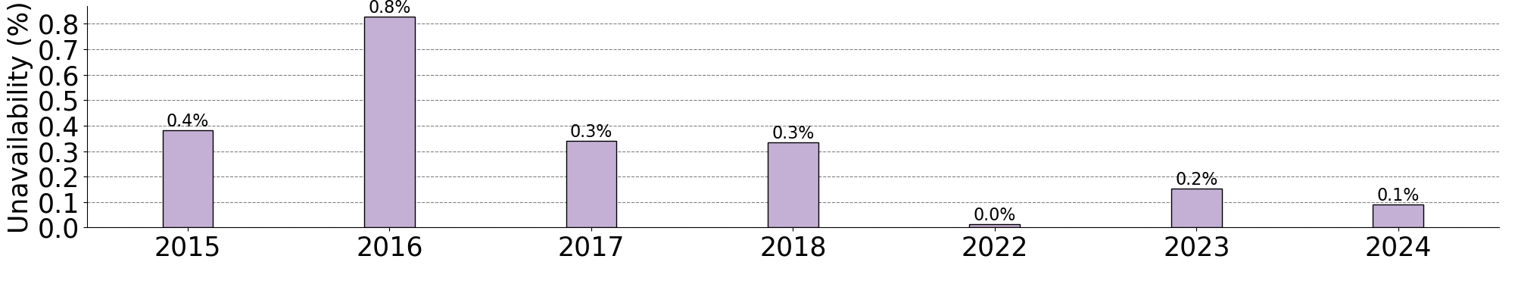
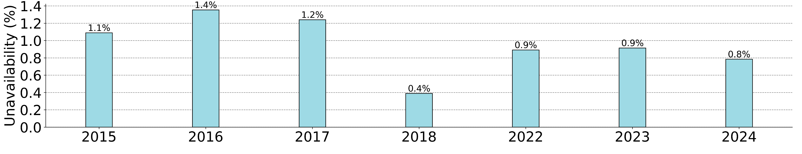
2024 performance in a glance
Injectors (AD, PSB, PS, SPS)
Injection systems
Extraction systems
Dump system
Very reliable operation with > 99% availability, both for injectors and LHC equipment
Reached ultimate LIU beam intensities in the LHC injectors, without any limitation from ABT equipment
No major HW change, but continuous effort on improving operation, relying on experience and enhancing AI and automation
LHC
Injection system
Dump system
Courtesy of J. Heron

Slide 5
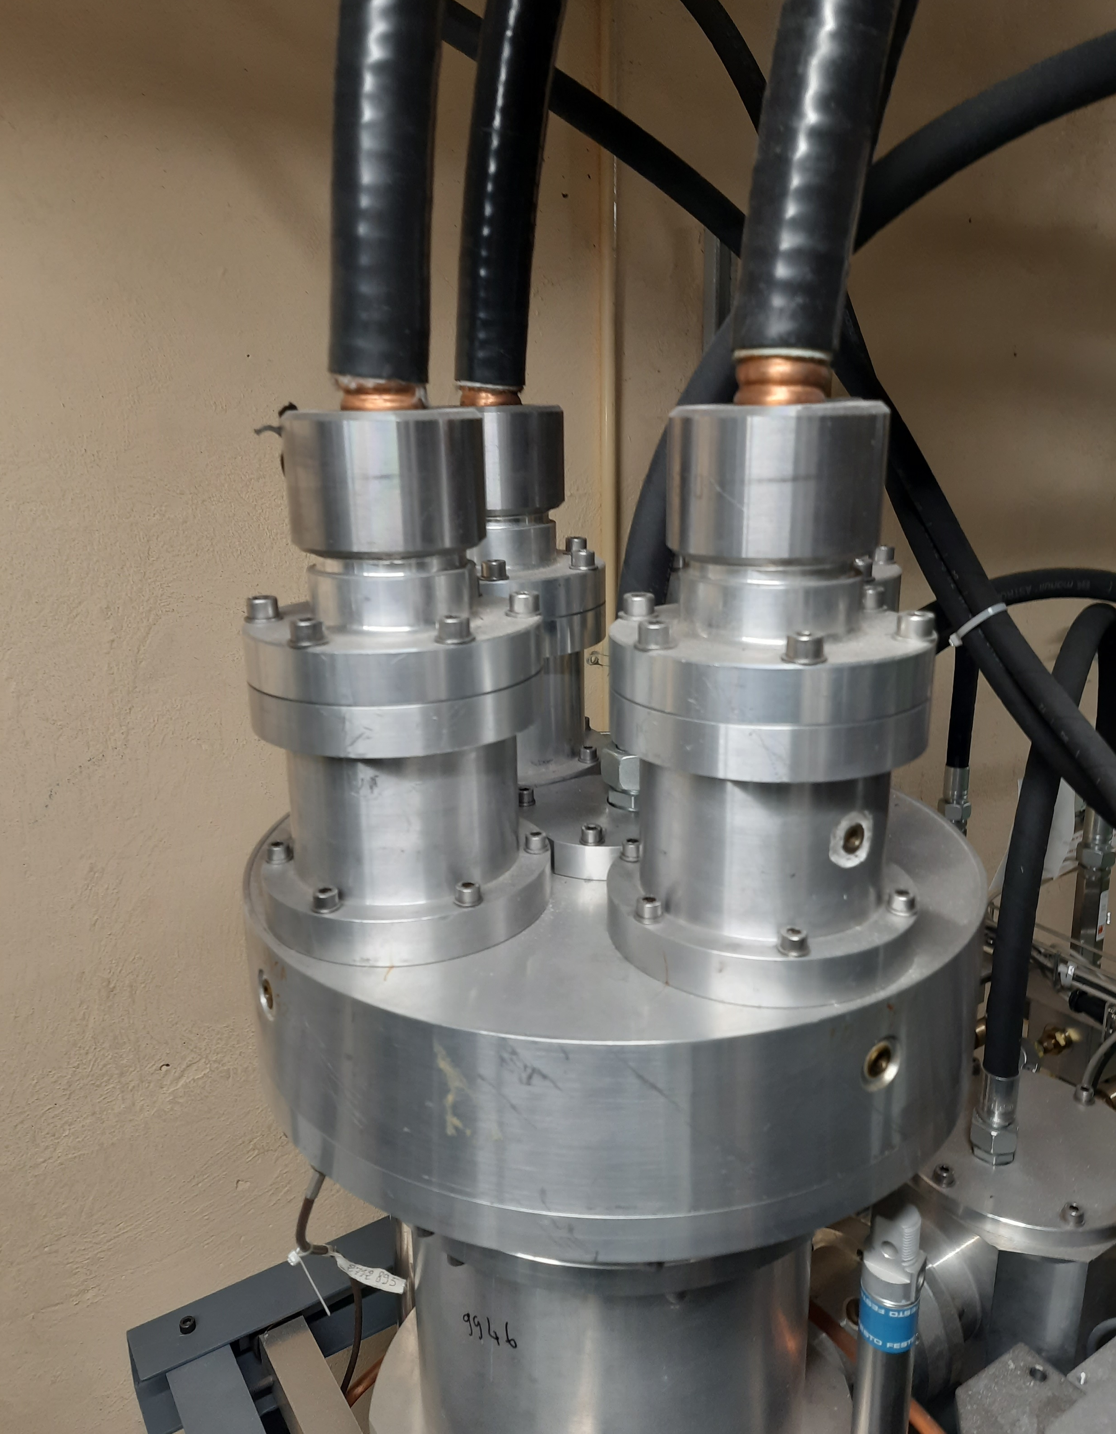
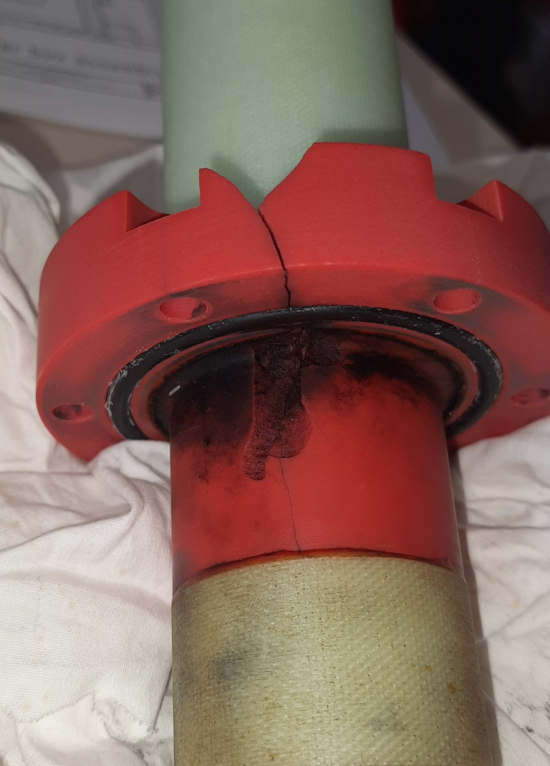
PSB / KFA14
Dump switch
Broken feedthrough
Four magnet modules per ring, to extract beams from the PSB. The connection boxes, PFL and TX lines are filled with SF6 gas
On March 29th a SF6 leak developed in Ring3 generator, originated by an electrical breakdown in the SF6 feedthrough insulation of the dump switch
  Likely air bubbles generated during previous oil filling
  12 kg out of 100 kg SF6 lost
  > 11 hours blocking time

Slide 6
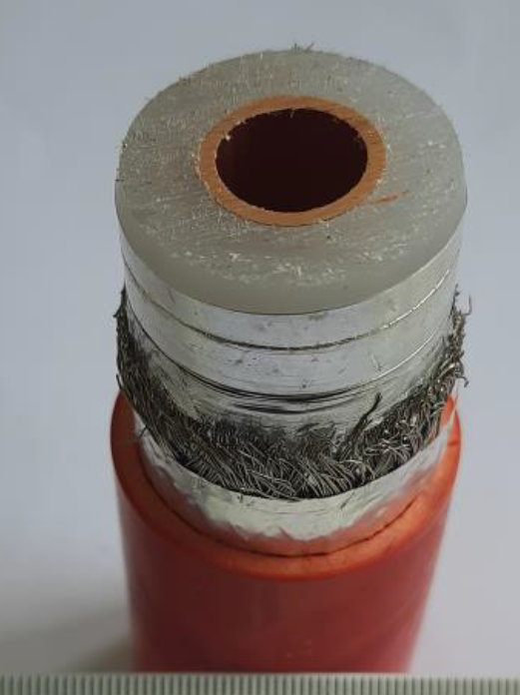
PSB / KFA14
Dump switch
Broken feedthrough
Four magnet modules per ring, to extract beams from the PSB. The connection boxes, PFL and TX lines are filled with SF6 gas
On March 29th a SF6 leak developed in Ring3 generator, originated by an electrical breakdown in the SF6 feedthrough insulation of the dump switch
  Likely air bubbles generated during previous oil filling
  12 kg out of 100 kg SF6 lost
  > 11 hours blocking time
PE HV Low Attenuation Cable
Actions:
Improved KFA14 SF6 fault prevention to be implemented:
  Check status of all generators to identify early signs of deterioration
  Refine switch maintenance and oil filling procedures
Improved feedthrough design under study
Replace SF6 cables: R&D campaign ongoing to find alternatives
Established safety procedure to ensure safe interventions performed on still operational equipment

Slide 7
PS / KFA71-79
12 magnet modules: nine located section 71 and three in section 79 used for the fast extraction of all PS beams
> 164 hrs downtime in 2021 → Consolidation of generator modules and control systems started during YETS21/22
  6 out of 12 modules already upgraded, full renovation expected to be completed by LS3 (2027)
  Downtime was reduced to ~12 hrs in 2023

Slide 8
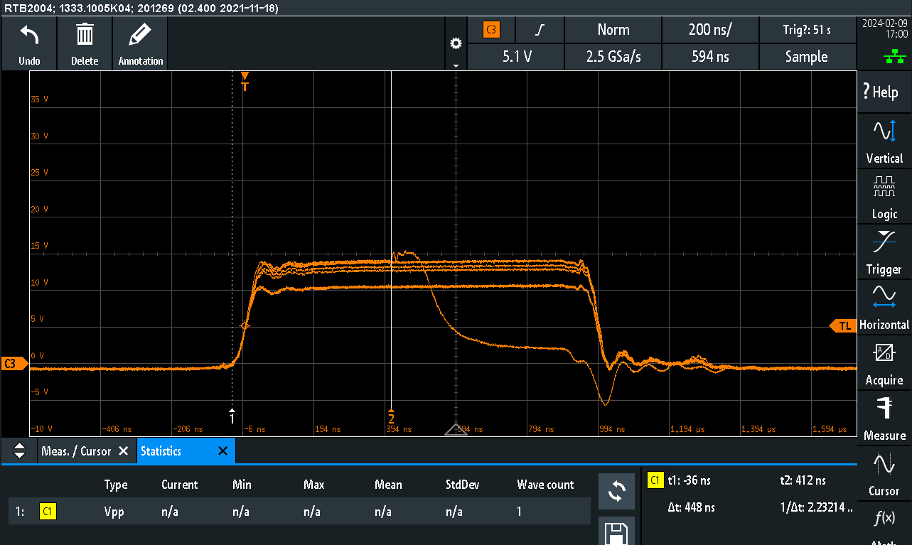
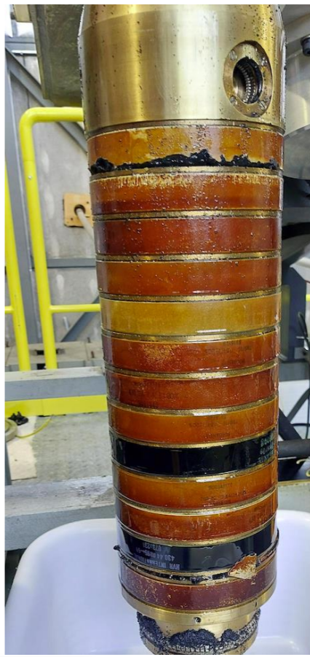
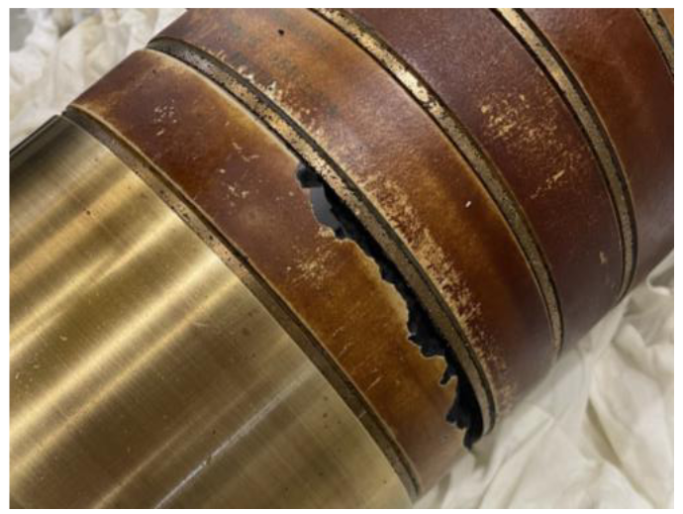
PS / KFA71-79
KFA71 nominal and distorted pulses
12 magnet modules: nine located section 71 and three in section 79 used for the fast extraction of all PS beams
> 164 hrs downtime in 2021 → Consolidation of generator modules and control systems started during YETS21/22
  6 out of 12 modules already upgraded, full renovation expected to be completed by LS3 (2027)
  Downtime was reduced to ~12 hrs in 2023
During 2024 run all the three recently upgraded dump switches failed:
  Not blocking, as operation with less modules still possible
  Fault originated from TDR discs assembly operations
Broken DS resistor

Slide 9
PS / KFA71-79
KFA71 nominal and distorted pulses
12 magnet modules: nine located section 71 and three in section 79 used for the fast extraction of all PS beams
> 164 hrs downtime in 2021 → Consolidation of generator modules and control systems started during YETS21/22
  6 out of 12 modules already upgraded, full renovation expected to be completed by LS3 (2027)
  Downtime was reduced to ~12 hrs in 2023
During 2024 run all the three recently upgraded dump switches failed:
  Not blocking, as operation with less modules still possible
  Fault originated from TDR discs assembly operations
Actions:
New documented discs validation and assembly procedures
EPA anomaly detection and forecasting
Established safety procedure to ensure safe interventions performed on operational equipment
Broken DS resistor

Slide 10
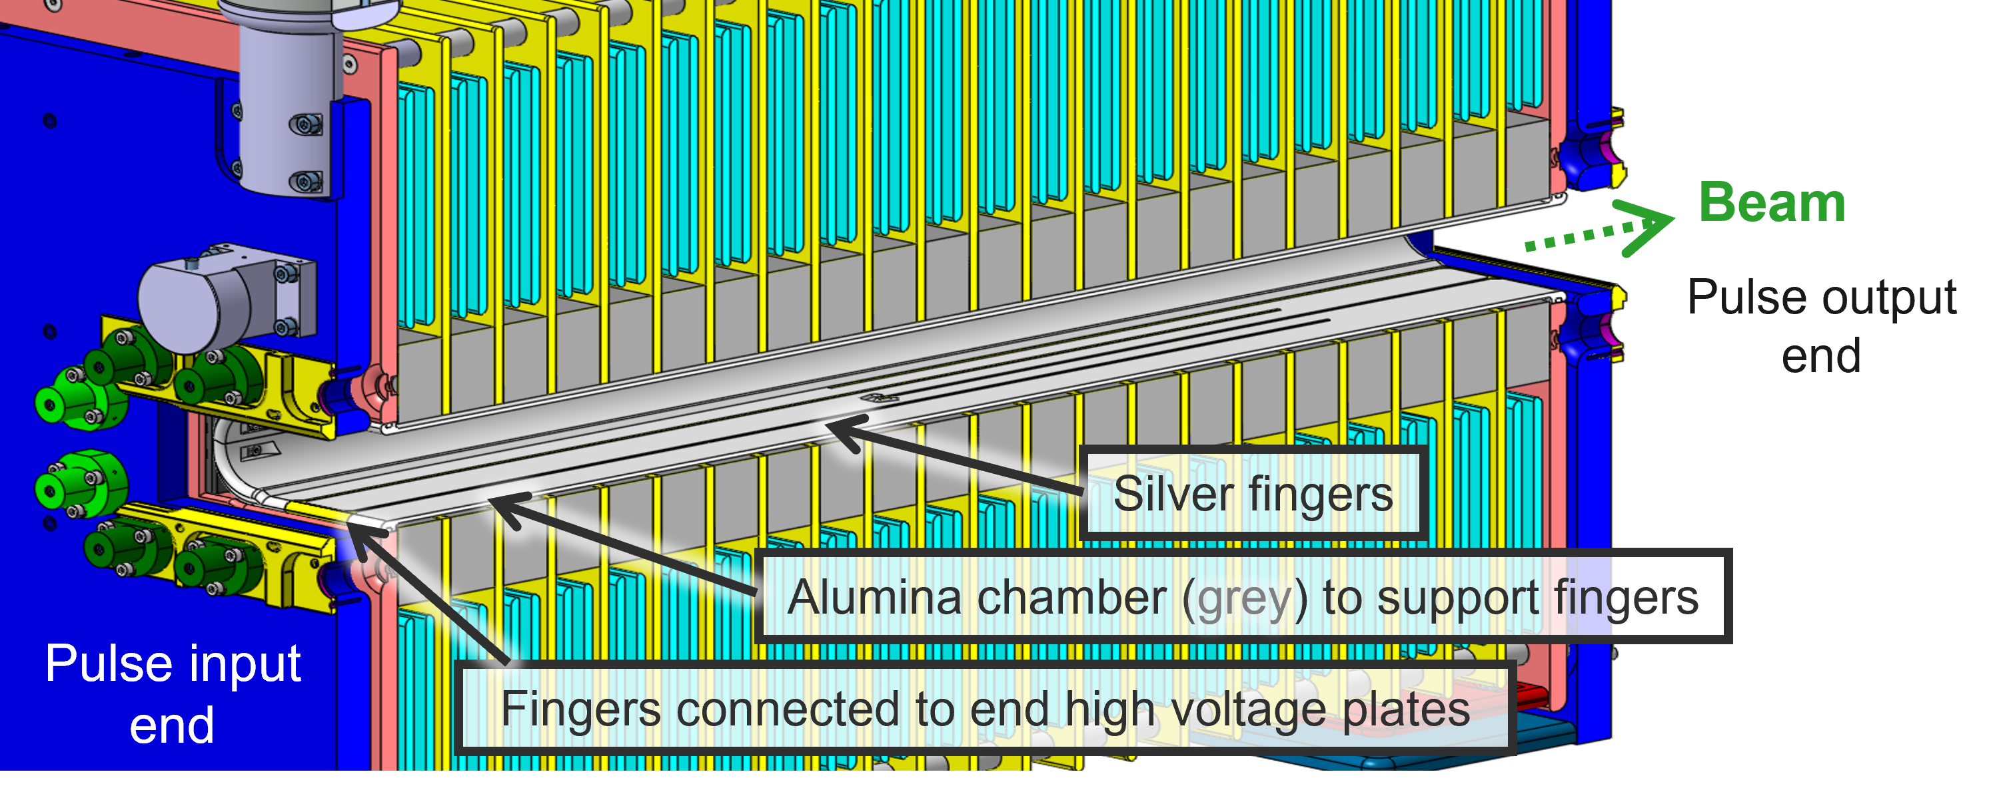
SPS / MKP-L
System designed to inject LHC beams in the SPS together with the MKP-S
MKP-L was identified as a limitation for the HL beam intensity reach:
  In 2016 high voltage weaknesses were addressed by limiting the operational voltage (36.8kV vs 49 kV nominal), increasing MKP-S voltage and introducing transfer line steering
  New low impedance MKP-L installed during YETS 22/23:
    Significantly lower beam induced heating and fast beam conditioning
    Kept reduced voltage as no available low-impedance spare
    Reached LIU intensities in 2024
Low impedance MKP-L

Slide 11
SPS / MKP-L
System designed to inject LHC beams in the SPS together with the MKP-S
MKP-L was identified as a limitation for the HL beam intensity reach:
  In 2016 high voltage weaknesses were addressed by limiting the operational voltage (36.8kV vs 49 kV nominal), increasing MKP-S voltage and introducing transfer line steering
  New low impedance MKP-L installed during YETS 22/23:
    Significantly lower beam induced heating and fast beam conditioning
    Kept reduced voltage as no available low-impedance spare
    Reached LIU intensities in 2024
Low impedance MKP-L
During 2024 run the operating voltage has been increased up to 43 kV:
  Planned tests on old module to understand HV weakness
  Spare assembly ongoing, validation tests will follow → ready in 2025
  Expected loss reduction and lighter beam commissioning with full voltage at zero bump

Slide 12
LHC / MKI
2 systems inject counterrotating beams in the LHC
Significant beam induced heating in Post-LS1 design magnets
MKI Cool upgrade started during YETS 22/23, to be completed in LS3

Slide 13
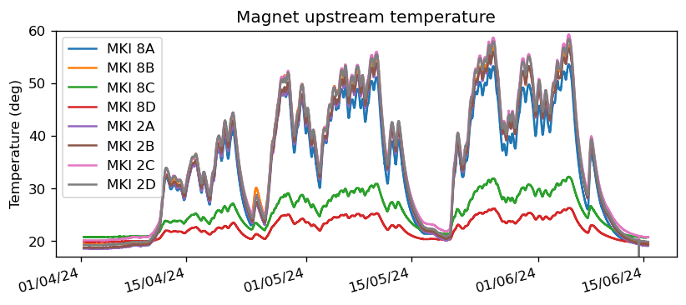
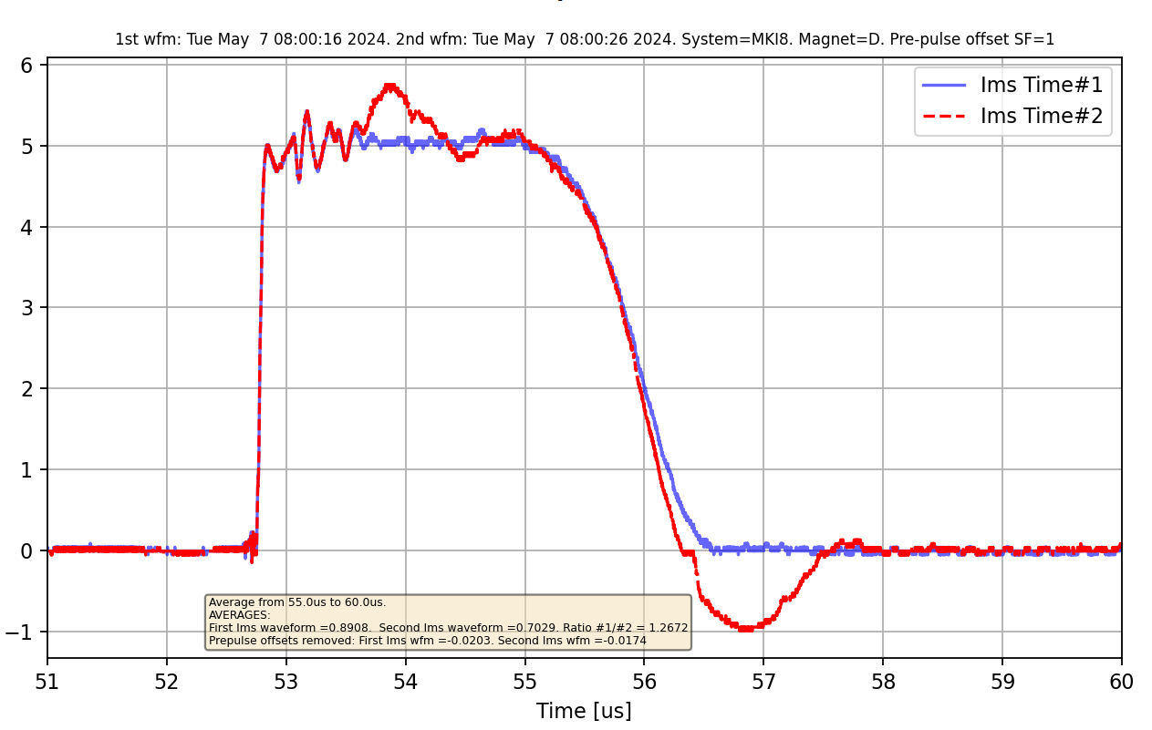
LHC / MKI
Post-LS1
2 systems inject counterrotating beams in the LHC
Significant beam induced heating in Post-LS1 design magnets
MKI Cool upgrade started during YETS 22/23, to be completed in LS3
Two MKI Cool magnets already installed in Pt8
  Temperature rise, near ferrite yoke, is only 30% of Post-LS1 MKIs
  Rapid beam conditioning
  HV Sparks or discharges occurring on screen conductors:
    emittance growth and some beam dumps triggered by BLM losses and BPM
MKI8C
MKI8D
MKI nominal vs distorted pulse

Slide 14
LHC / MKI
Post-LS1
2 systems inject counterrotating beams in the LHC
Significant beam induced heating in Post-LS1 design magnets
MKI Cool upgrade started during YETS 22/23, to be completed in LS3
Two MKI Cool magnets already installed in Pt8
  Temperature rise, near ferrite yoke, is only 30% of Post-LS1 MKIs
  Rapid beam conditioning
  HV Sparks or discharges occurring on screen conductors:
    emittance growth and some beam dumps triggered by BLM losses and BPM
MKI8C
MKI8D
MKI nominal vs distorted pulse
Actions:
Improved conditioning of magnets following a beam dump
  Event frequency has drastically reduced, with events almost disappearing in MKI8C
HV tests on coated samples to rule out issues related to coating charge-up or deterioration

Slide 15
Outline
Operational insights
  2024 ABT equipment operation
  2024 operational experience:
    KFA71
    KFA14
    MKP-L
    MKI
Looking forward
    MKP-S
    MKDH
    AC dipole
Conclusions

Slide 16
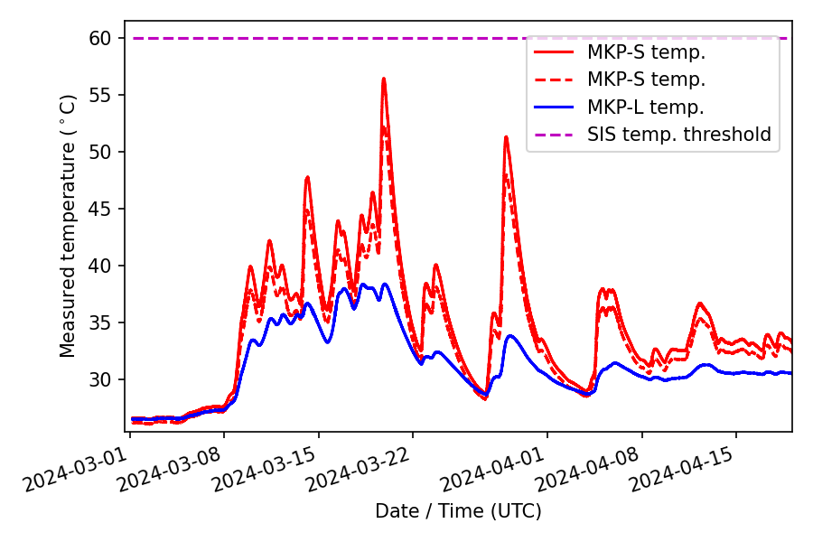
SPS / MKP-S limitations and performance improvement studies
Observed MKP-S heating since low-impedance MKP-L installation:
  LHC physics operations not affected
  it limited the duty cycle of the 2024 scrubbing run
  It poses potential risks to magnet integrity

Slide 17
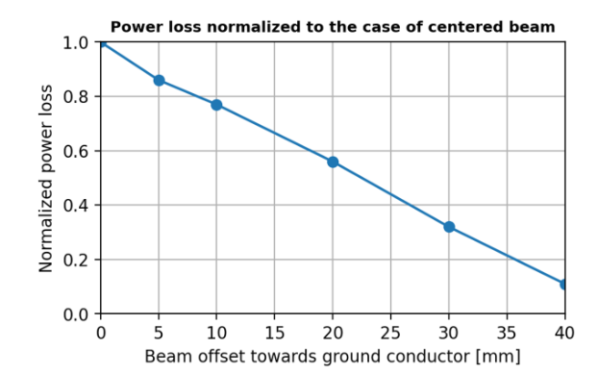
SPS / MKP-S limitations and performance improvement studies
Observed MKP-S heating since low-impedance MKP-L installation:
  LHC physics operations not affected
  it limited the duty cycle of the 2024 scrubbing run
  It poses potential risks to magnet integrity
Various mitigation strategies are being examined:
.
  Hardware solutions → new magnet design or implementation of a cooling system
  Beam offset → Power losses expected to be halved by 22mm beam offset
Courtesy of C. Zannini

Slide 18
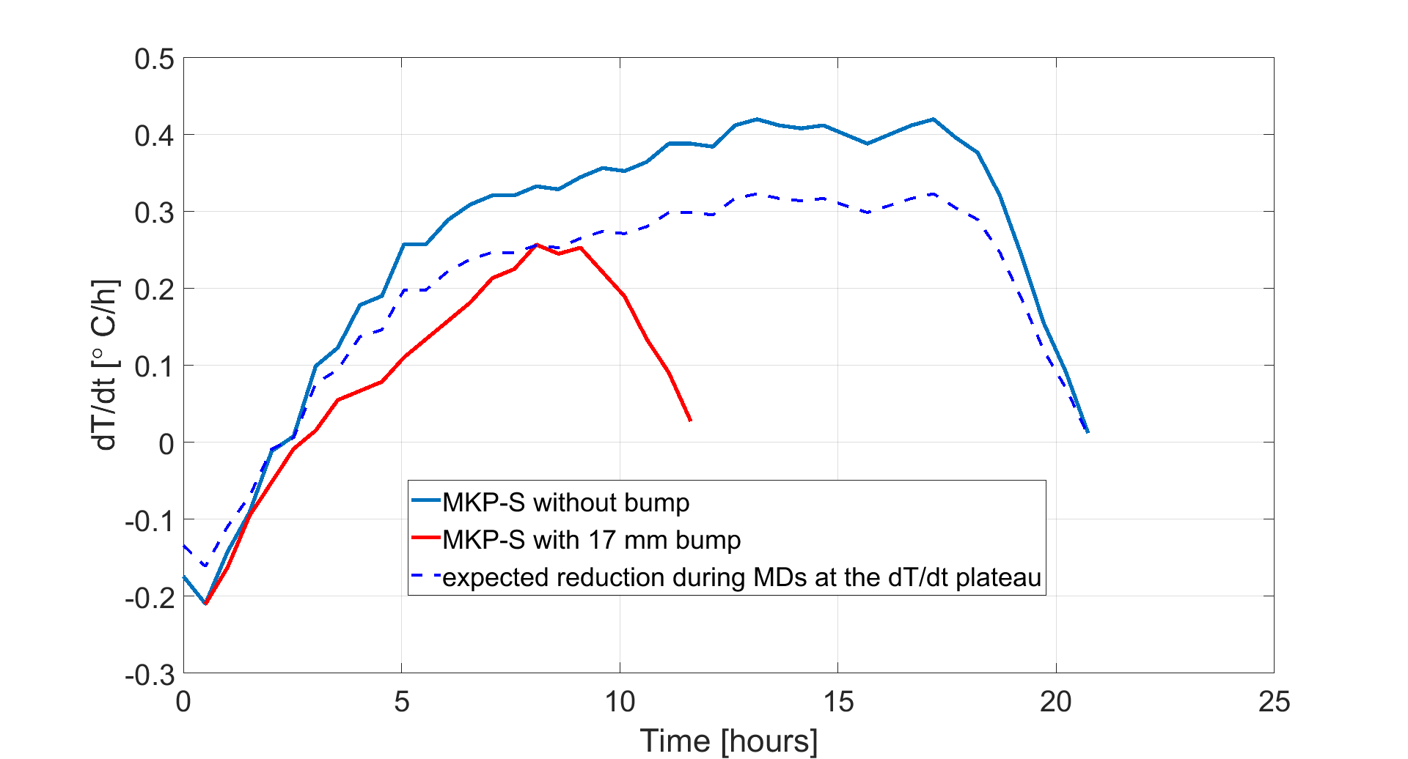
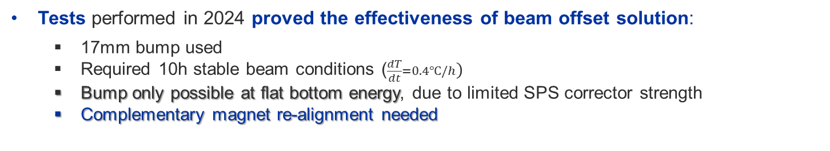
SPS / MKP-S limitations and performance improvement studies
Observed MKP-S heating since low-impedance MKP-L installation:
  LHC physics operations not affected
  it limited the duty cycle of the 2024 scrubbing run
  It poses potential risks to magnet integrity
Various mitigation strategies are being examined:
.
  Hardware solutions → new magnet design or implementation of a cooling system
  Beam offset → Power losses expected to be halved by 22mm beam offset
Tests performed in 2024 proved the effectiveness of beam offset solution:
  17mm bump used
  Required 10h stable beam conditions ($\frac{dT}{dt}=0.4℃/h)$
  Bump only possible at flat bottom energy, due to limited SPS corrector strength
  Complementary magnet re-alignment needed
Courtesy of C. Zannini

Slide 19
SPS / MKP-S limitations and performance improvement studies
Observed MKP-S heating since low-impedance MKP-L installation:
  LHC physics operations not affected
  it limited the duty cycle of the 2024 scrubbing run
  It poses potential risks to magnet integrity
Various mitigation strategies are being examined:
.
  Hardware solutions → new magnet design or implementation of a cooling system
  Beam offset → Power losses expected to be halved by 22mm beam offset
Tests performed in 2024 proved the effectiveness of beam offset solution:
  17mm bump used
  Required 10h stable beam conditions ($\frac{dT}{dt}=0.4℃/h)$
  Bump only possible at flat bottom energy, due to limited SPS corrector strength
  Complementary magnet re-alignment needed
Only 5mm re-alignment possible without venting the sector:
  Aperture studies still pending
  Investigate possibility of realignment during LS3
  Dedicated scrubbing of both MKP and newly installed MKDH
Courtesy of C. Zannini

Slide 20
SPS / MKDH limitations and performance improvement studies
Three dump kicker magnets used for sweeping SPS particles on TIDVG
From 2023 operation experience:
  Long beam conditioning and vacuum interlocks limiting LIU beam intensity reach
  Significant missing kick from two magnets due to eddy currents → ok for TIDVG
  Raised concern about blocking time in case of accident:
    ~7 weeks, including ~10days of beam conditioning (assuming 50% availability)

Slide 21
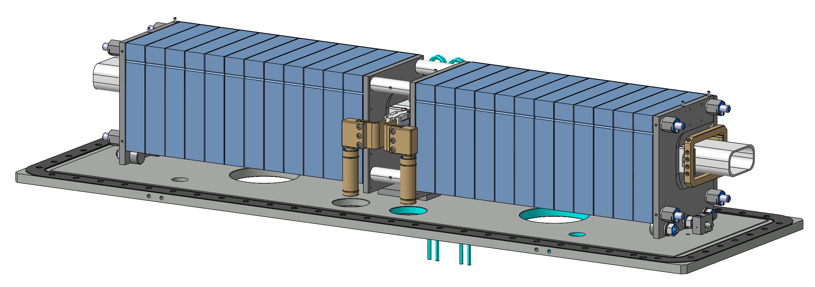
SPS / MKDH limitations and performance improvement studies
Three dump kicker magnets used for sweeping SPS particles on TIDVG
From 2023 operation experience:
  Long beam conditioning and vacuum interlocks limiting LIU beam intensity reach
  Significant missing kick from two magnets due to eddy currents → ok for TIDVG
  Raised concern about blocking time in case of accident:
    ~7 weeks, including ~10days of beam conditioning (assuming 50% availability)
Upgraded MKDH design
A mitigation strategy is being examined:
  Installation of a coated chamber to improve vacuum performance:
    Ti coating for beam impedance reduction → already tested and validated in LBDS-MKD
    aC coating for SEY reduction → already tested and validated in MKP
  Replace weaker magnets with lower-eddy current ones:
    They can be operated at lower voltage → improvement of HV and vacuum performance as well as relaxed vacuum interlock

Slide 22
SPS / MKDH limitations and performance improvement studies
Three dump kicker magnets used for sweeping SPS particles on TIDVG
From 2023 operation experience:
  Long beam conditioning and vacuum interlocks limiting LIU beam intensity reach
  Significant missing kick from two magnets due to eddy currents → ok for TIDVG
  Raised concern about blocking time in case of accident:
    ~7 weeks, including ~10days of beam conditioning (assuming 50% availability)
Upgraded MKDH design
A mitigation strategy is being examined:
  Installation of a coated chamber to improve vacuum performance:
    Ti coating for beam impedance reduction → already tested and validated in LBDS-MKD
    aC coating for SEY reduction → already tested and validated in MKP
  Replace weaker magnets with lower-eddy current ones:
    They can be operated at lower voltage → improvement of HV and vacuum performance as well as relaxed vacuum interlock
  Feasibility study ongoing:
    Beam aperture check for all beams
    Magnets have different apertures: ongoing compatibility check
    Ongoing beam impedance simulations and tests

Slide 23
SPS / MKDH limitations and performance improvement studies
Three dump kicker magnets used for sweeping SPS particles on TIDVG
From 2023 operation experience:
  Long beam conditioning and vacuum interlocks limiting LIU beam intensity reach
  Significant missing kick from two magnets due to eddy currents → ok for TIDVG
  Raised concern about blocking time in case of accident:
    ~7 weeks, including ~10days of beam conditioning (assuming 50% availability)
Upgraded MKDH design
A mitigation strategy is being examined:
  Installation of a coated chamber to improve vacuum performance:
    Ti coating for beam impedance reduction → already tested and validated in LBDS-MKD
    aC coating for SEY reduction → already tested and validated in MKP
  Replace weaker magnets with lower-eddy current ones:
    They can be operated at lower voltage → improvement of HV and vacuum performance as well as relaxed vacuum interlock
  Feasibility study ongoing:
    Beam aperture check for all beams
    Magnets have different apertures: ongoing compatibility check
    Ongoing beam impedance simulations and tests
2024
2025
2026
2027
Q1 ’25 Feasibility studies
Q2 ’25 Price inquiry
Q1 ’26 Chambers manufacturing
Q1 ’27 Upgrade of 4 MKDH

Slide 24
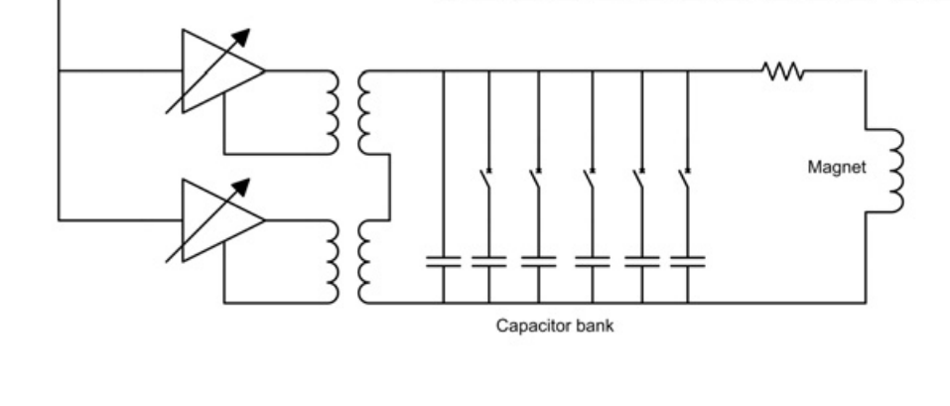
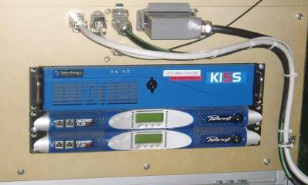
LHC / MKQA spare strategy
MKQA is used for measuring beam dynamics parameters (‘A’ or ‘Q’ mode) and overcome spin resonances (‘ACdipole mode’)
Simplified schematics of AC dipole configuration
FPGA to generate the waveform
ACD FEC
settings/state/timing/amplifier control
From 2024 operational experience:
  FPGA failing several times, temporarily fixed:
    Not blocking OP
    20 years old cards → need replacement!
  Amplifiers failing due to aging:
    All four spares were used, running out of spare during reparation
    Amplifiers out of production and reparation possible depending on component availability
18kW amplifiers
AC dipole FEC and power amplifiers

Slide 25
LHC / MKQA spare strategy
MKQA is used for measuring beam dynamics parameters (‘A’ or ‘Q’ mode) and overcome spin resonances (‘ACdipole mode’)
Simplified schematics of AC dipole configuration
FPGA to generate the waveform
ACD FEC
settings/state/timing/amplifier control
From 2024 operational experience:
  FPGA failing several times, temporarily fixed:
    Not blocking OP
    20 years old cards → need replacement!
  Amplifiers failing due to aging:
    All four spares were used, running out of spare during reparation
    Amplifiers out of production and reparation possible depending on component availability
Actions:
New FPGA design already tested, validated and ready for installation (YETS24/25)
Amplifier replacement strategy under definition (no equivalent solution available):
  Contact with industries ongoing to find possible technical solutions
  In house development or outsourcing?
  Consolidation planned for LS3
18kW amplifiers
AC dipole FEC and power amplifiers

Slide 26
Conclusion
Achieved excellent ABT operational performance, with less than 1% unavailability across both injectors and the LHC
Successfully managed significant incidents involving KFA71 and KFA14 through prompt expert intervention, alongside ongoing efforts to enhance fault detection and prevention measures
Conducted interventions during operation shadowing to minimize blocking time. Safety procedures have been established
Confirmed performance improvements in the recently upgraded MKP-L and MKI systems, with room for further enhancement
Identified potential limitations in the MKP-S and MKDH systems; upgrade strategies are currently being explored for LS3
Addressed AC dipole spare limitations, with final consolidation foreseen during LS3

Slide 27
Spare Slides

Slide 28
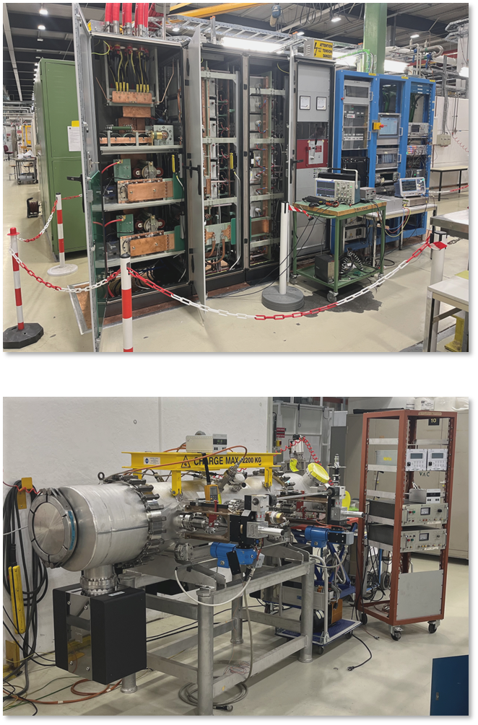
SMH16 eddy current septum installation
Scope:
Present system based on direct drive topology, with limited lifetime (magnet exchange every 2yrs)
Present power converter (SY/EPC) at the end of its life. Regular wrong pulses
Consolidation strategy:
Novel eddy current topology, under vacuum, with expected longer lifetime
New power generator design (SY/ABT)
Planning foresaw installation during YETS 24/25
Current status:
2 generators: 1 in lab 867 under test, 1 in blg 151 ready for pulsing with dummy load
Reliability run not yet completed, generator requiring still minor adjustment to be within specs. Timing and control systems being finalized
Installation of SMH16CF during YETS 25/26 has been proposed:
  1 yr of life left for present SMH16DD, exchange is needed
  The nToF run would need to be concluded earlier to enable immediate intervention after end of run (in compliance with RP constraints)
  Cabling and generator installation done in YETS 24/25 already

Slide 29
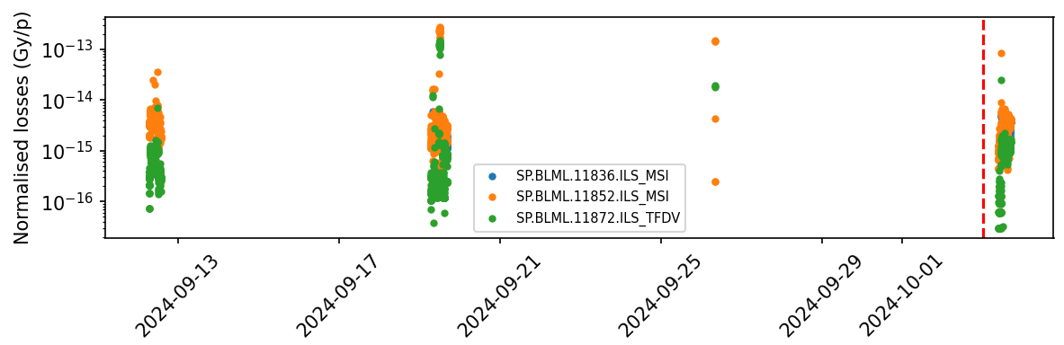
MKP-L losses at 43kV
Increased aperture due to the reduced bump
Insufficient data points available to draw a conclusion
A dedicated measurement campaign is required to better evaluate impact

Slide 30
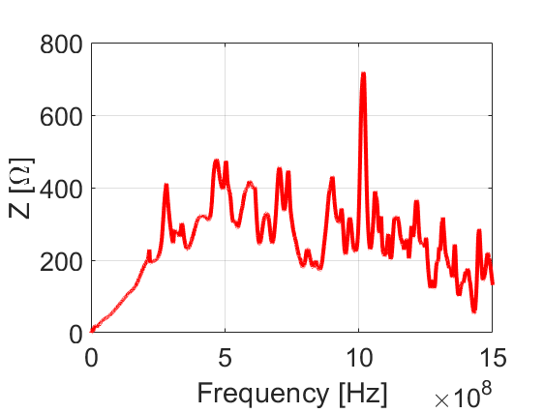
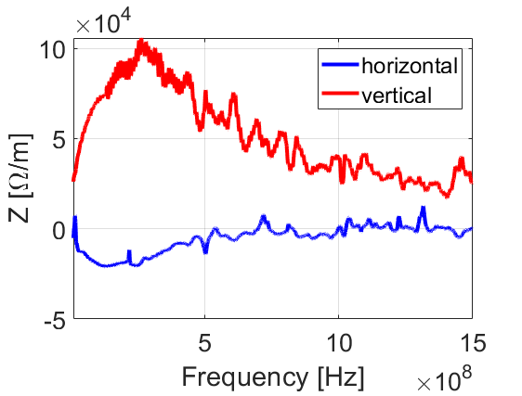
MKDH impedance measurements
Longitudinal Impedance
Transverse Impedance

