Slide 1
Longitudinal Modelling and Operational Optimization Across the Complex
Birk Emil Karlsen-Bæck, S. Albright, T. Argyropoulos, R. Bruce, R. Calaga, J. Flowerdew, N. Gallou, L. Intelisano, I. Karpov, S. Kostoglou, A. Lasheen, M. Marchi, O. Naumenko, G. Papotti, J. A. Rodriguez, H. Timko, N. Triantafyllou, D. Valuch, M. Zampetakis
Joint Accelerators Performance Workshop, Montreux, Switzerland, 11th December 2024

Slide 2
Outline
Modelling longitudinal control loops and their applications
  Optimizations of equipment across the chain
LHC power limitations at injection
  Detuning and RF power transient optimization
Longitudinal aspects of BCMS and standard beams
  Evolution along the flat bottom in the LHC
Outlook

Slide 3

Beam Dynamics Modelling and Equipment
Operational optimisation
Changing of settings and timings
RF equipment and impedance
RF manipulations
Beam stability
LLRF control loops
Beam losses
Amplifiers
Injection dynamics
Beam dynamics
model
Cavities
Transient beam loading
Impedance

Slide 4
Outline
Modelling longitudinal control loops and their applications
  Optimizations of equipment across the chain
LHC power limitations at injection
  Detuning and RF power transient optimization
Longitudinal aspects of BCMS and standard beams
  Evolution along the flat bottom in the LHC
Outlook

Slide 5
Applications of Modelling Across the Chain
Accelerator | Scenario | What was modelled | Achievement
REX/HIE-ISOLDE | Various ion beams | Energy gain and time of flight via transit time factor from simulation | Faster rephasing of the cavities when switching beam types
PSB | Most operational beams | Multi-harmonic cavity controller | Understanding origin of slow instability
PS | Fixed target beam | Phase jump and beam control loops | Reduction of EAST losses and increase of TOF intensity
SPS | LHC-type beam | Beam control and cavity control | Accurate prediction of losses and beam parameters at flat bottom
SPS | Ion slip stacking | Voltage and frequency manipulation | Optimization tool used for the cycle
LHC | Proton beams | bunch length feedback | Improvement of regulation and a flat bunch length target
LHC | Ion beams | Intra-beam scattering | Improved lifetime of the ion beam at capture

Slide 6
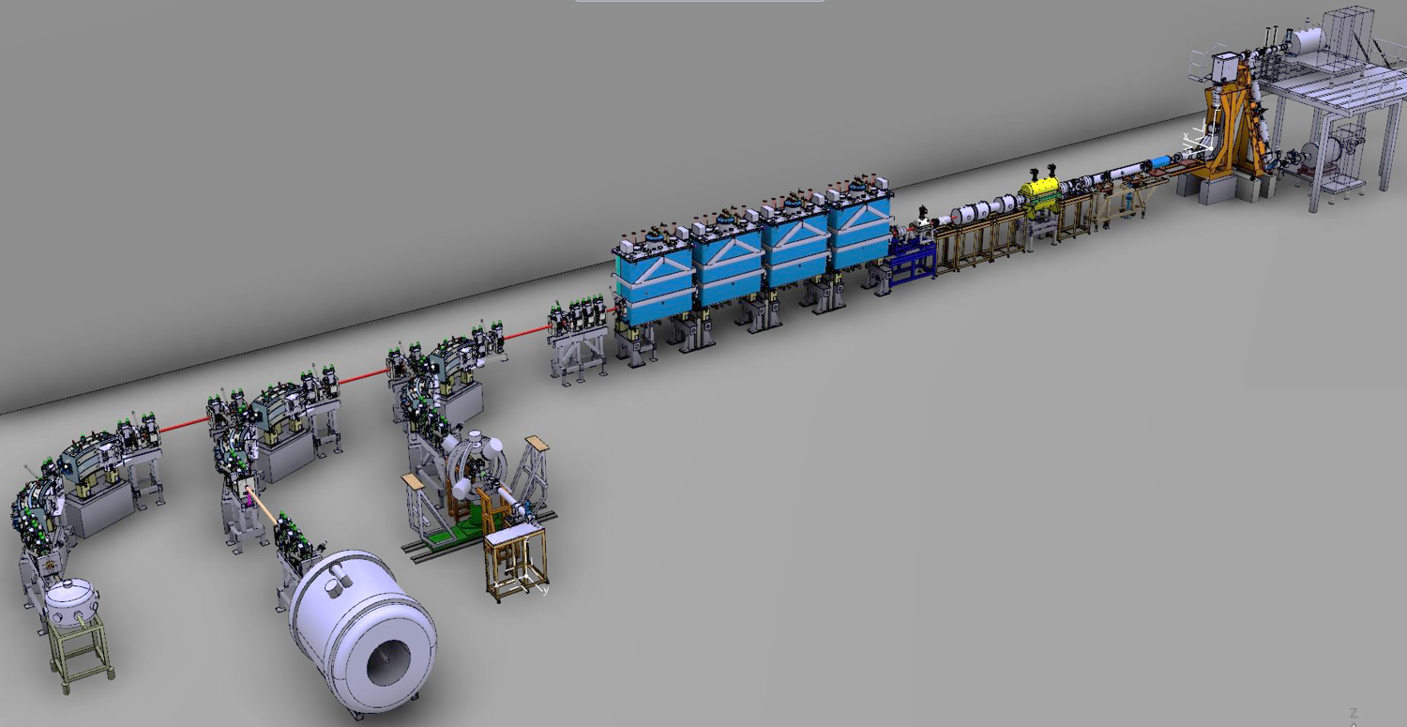
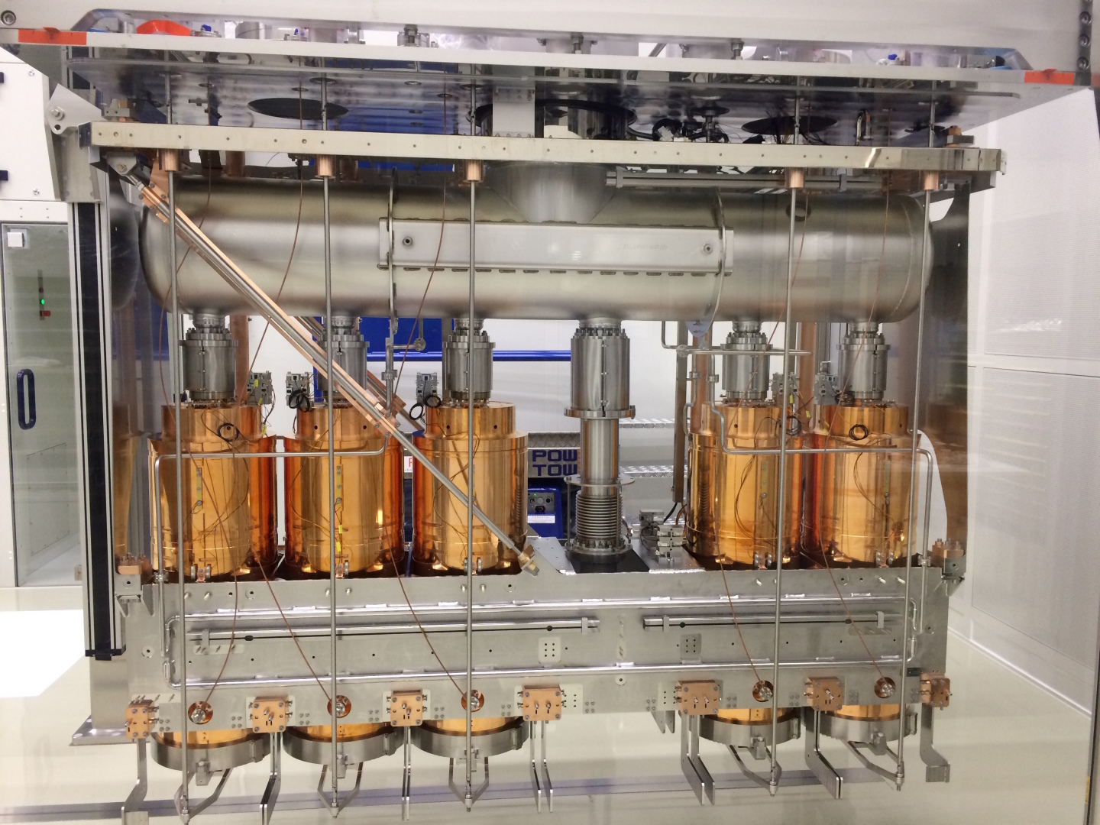
REX/HIE-ISOLDE – Cavity Rephasing for Different Beams
Motivation
  Linac accelerating around 25 different beam-types
  Rephasing with beam was very time consuming
What is being modelled?
  Zero-order transit time factor behaviour
  Time of fight between cavities
Operational outcome
  Model successfully applied and used systematically in 2024
    Saving shifts dedicated to setup
    Reduced downtime during physics campaign
Room temperature REX linac
Courtesy of
J. A. Rodriguez

Slide 7
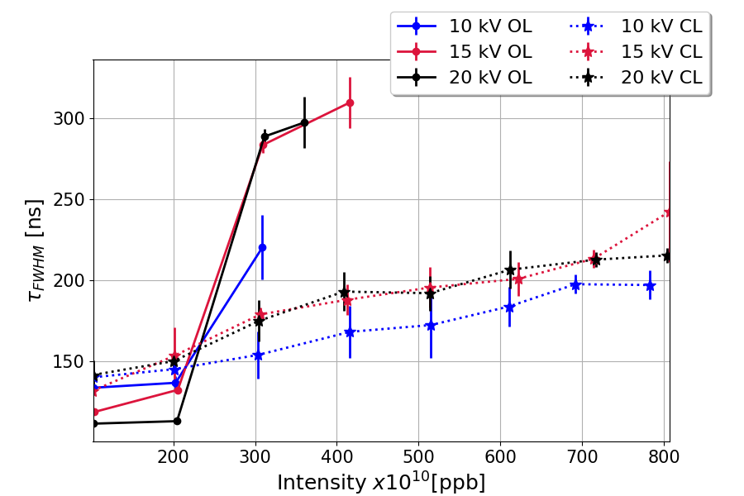
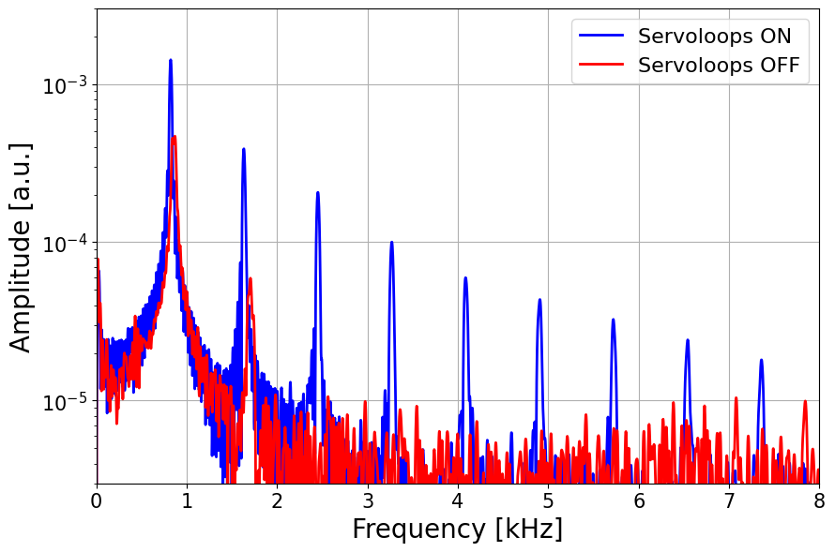
PSB – Most Operational Beams
Motivation
  Servo-loop-dependent slow instability
    Could not be explained with current beam dynamics model
What is being modelled?
  Dynamic behaviour of the cavity controller
  Intensity effects
Strong impact from configuration of servoloops on longitudinal stability
Courtesy of M. Marchi
Loops amplifying the spectrum of bunch length oscillations at flat top
Courtesy of M. Marchi

Slide 8
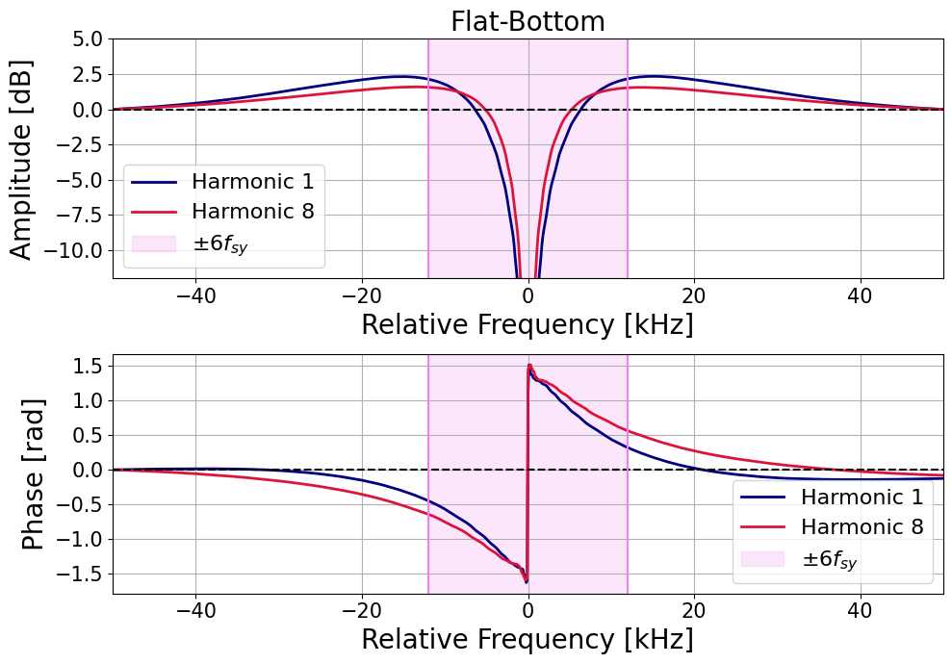
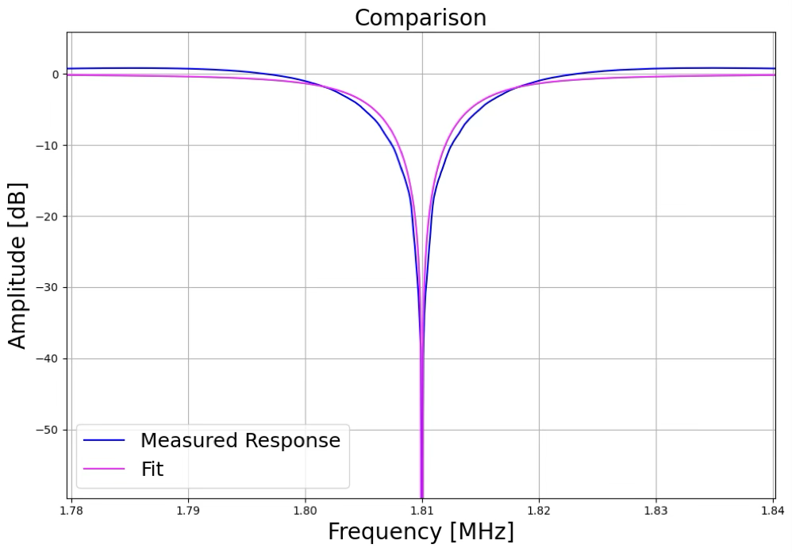

PSB – Most Operational Beams
$$±6f_{s}$$
Outcome
  Imperfect loop regulation at some of the synchrotron side bands
Next steps
  Explore different implementation of the loops in tracking simulations
  Optimize settings of notch filters
Over-shoot in a frequency span including synchrotron side-bands
Courtesy of M. Marchi
Courtesy of M. Marchi

Slide 9
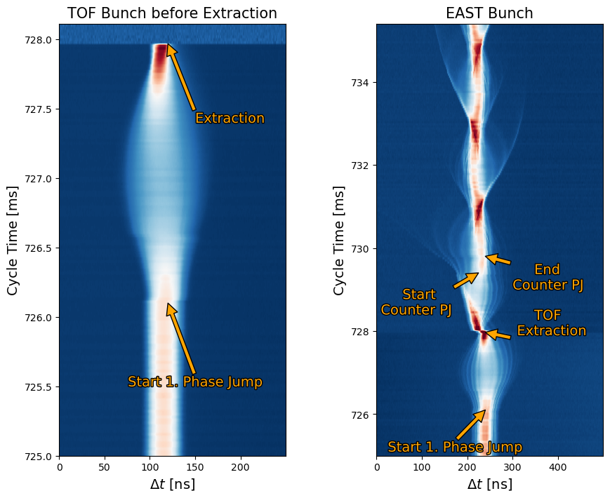
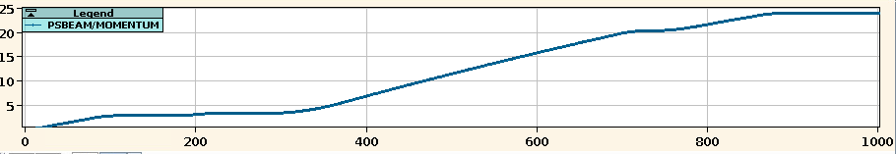
PS – Parasitic TOF with EAST
Motivation
  Deliver beam to two destinations with one cycle
  Manipulation of TOF induces losses in EAST beam
2. Flat Top (EAST extraction)
1. Flat Top (TOF extraction)
Courtesy of O. Naumenko

Slide 10
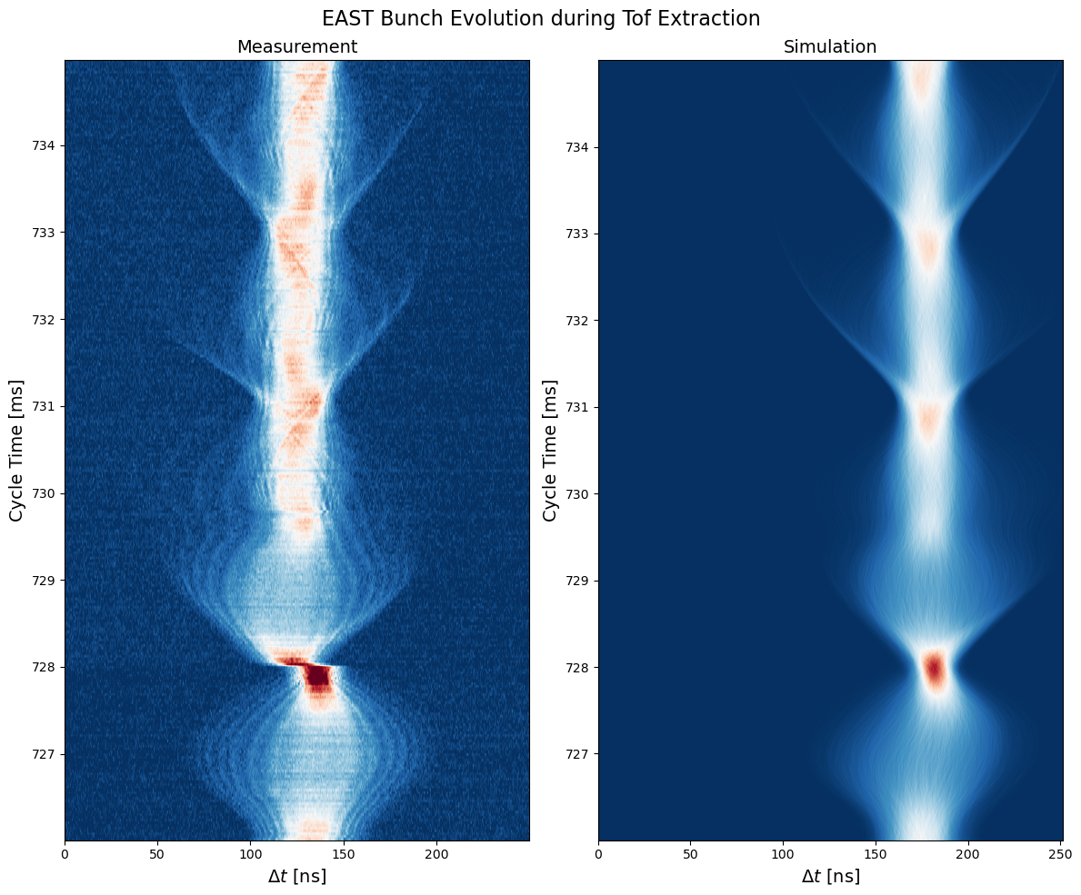
PS – Parasitic TOF with EAST
What is being modelled?
  New implementation of PS beam control
  PS impedance model
Operational outcome
  Optimization in simulation
    EAST losses decreased from 7% to 1.5%
  Contributed to doubling of TOF intensity
    3.5 x 10¹² p/b to 8.0 x 10¹² p/b
Measurement
Courtesy of O. Naumenko
Simulation

Slide 11
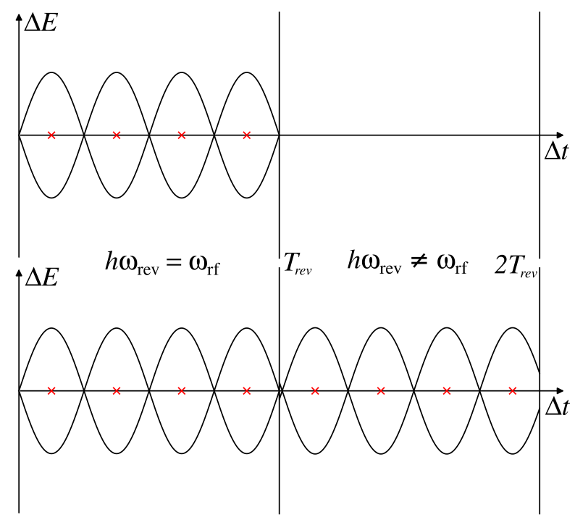
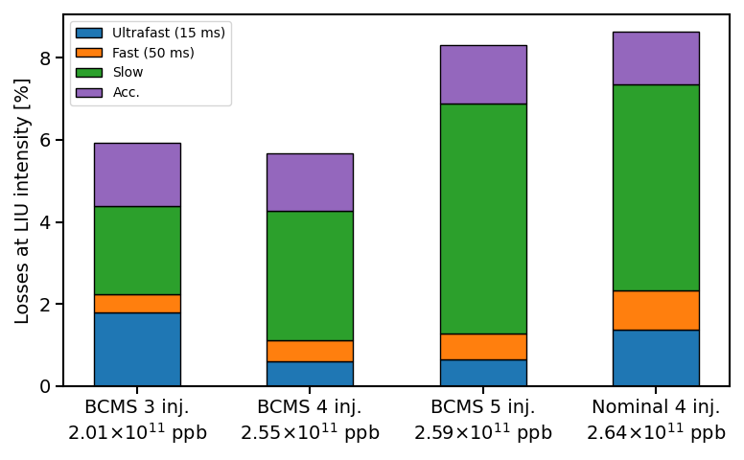
SPS – Capture of LHC-type LIU Beams
Motivation
  Help analyse and disentangle sources of beam losses at transfer
  Coupling of beam and cavity control models in simulation
What is being modelled?
  Strong transient beam loading with LIU intensity
  Complex dynamics during beam transfer
  SPS impedance model
Measured losses with LIU intensities
Courtesy of J. Flowerdew
Coupling of beam and cavity models

Slide 12
SPS – Capture of LHC-type LIU Beams
Outcome
  Benchmarked simulation model against measured beam parameters and beam losses
Next steps
  Apply the full model for PS-SPS transfer studies
Simulated and measured 200 MHz bunch phases after filamentation
Simulated (lines) and measured (dots) beam losses
Simulated and measured bunch lengths at injection and after filamentation

Slide 13
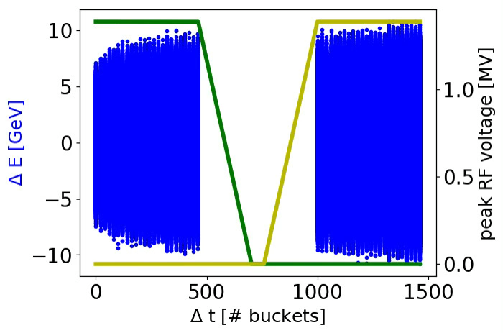
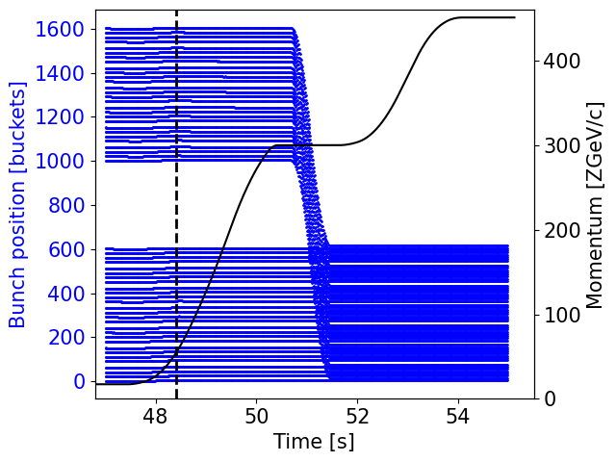
SPS – Slip Stacking with Ions
Motivation
  Complex RF manipulation to merge ion batches
  Complicated orchestration of timings and functions
What was modelled?
  Two groups of cavities with different voltage and frequency programs
  Beam phase and radial loop
  SPS impedance model
Simulation of slip stacking of two ion bunch trains in the SPS
Position of the bunches through the cycle
Courtesy of D. Quartullo
Courtesy of T. Argyropoulos

Slide 14
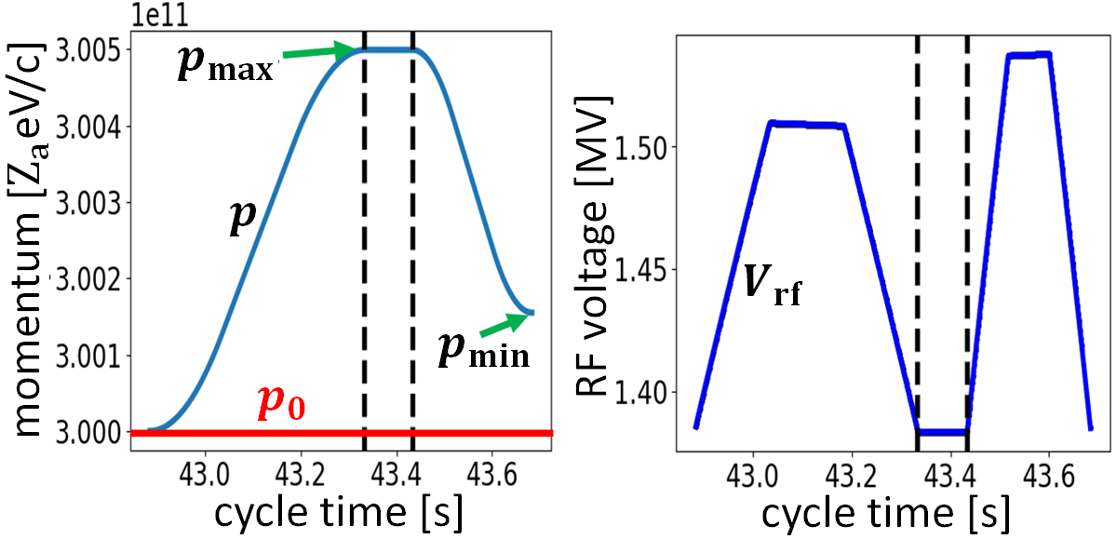
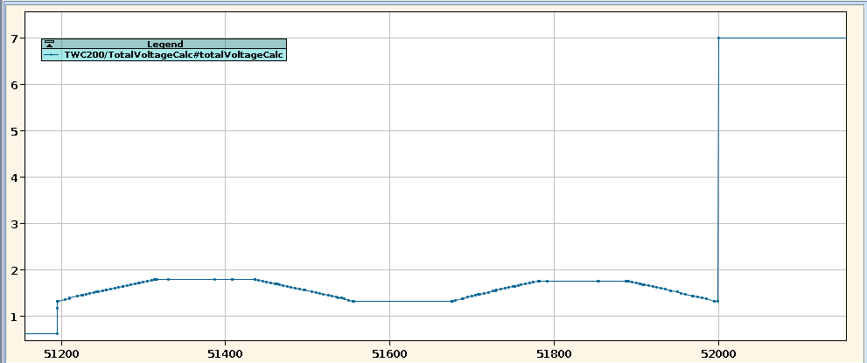
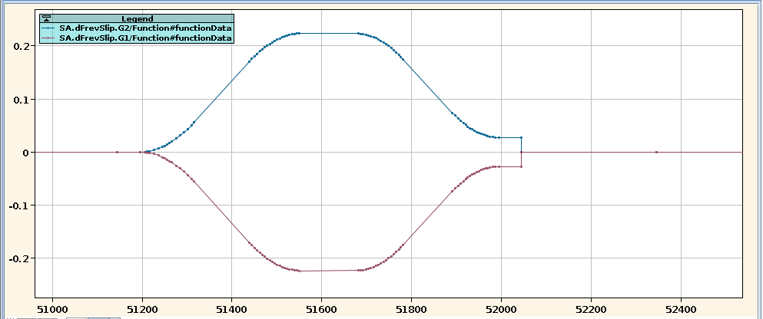
SPS – Slip Stacking with Ions
Operational outcome
  Voltage and frequency programs worked as predicted in simulation
  Simulations/calculations integrated in operational expert application for use in the CCC
  Importance of 800 MHz system for beam stability
  Usual optimization required for the rest of the cycle
Simulated voltage and frequency programs
Courtesy of D. Quartullo
Re-capture
Re-capture
Voltage program
Frequency program
Operational voltage and frequency programs

Slide 15
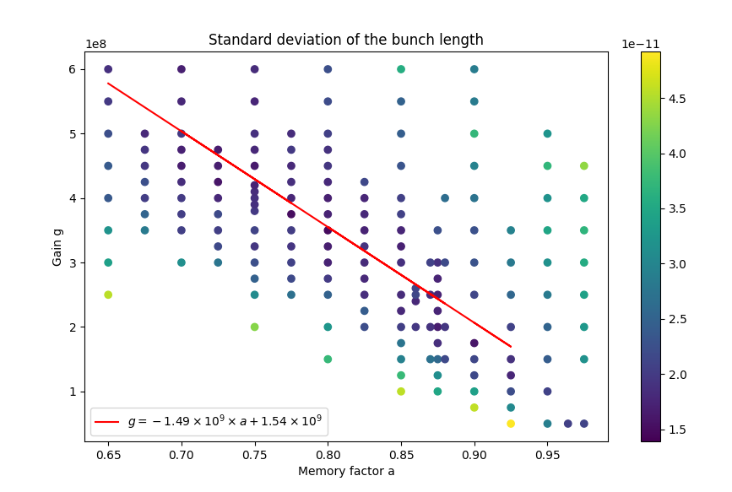
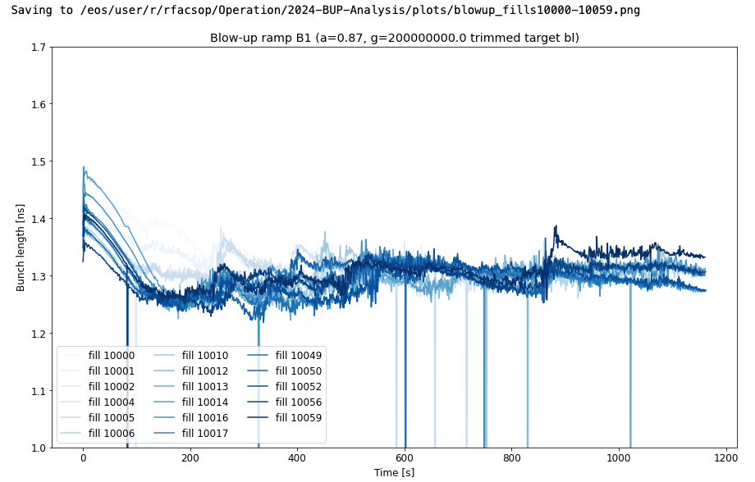
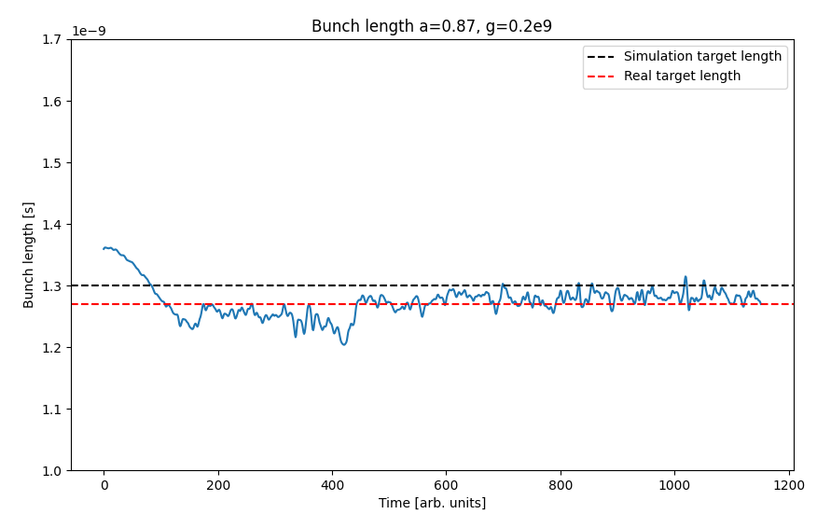

LHC - Blow-up Optimization in the Ramp
Motivation
  Heating issue due to short bunches
    Avoid over and under shoots of the bunch length with better regulation
What was modelled?
  Bunch length feedback used to regulate the noise amplitude during the ramp
  LHC impedance model
Operational outcome (see talk by A. Calia)
  Significantly improved regulation of the bunch length
    Better set of feedback parameters
    Flat bunch length target is now being used during the ramp
Courtesy of N. Gallou
$$x_{n+1}=ax_{n}+g\left(τ_{targ}−τ_{meas}\right)$$
Courtesy of N. Gallou

Slide 16
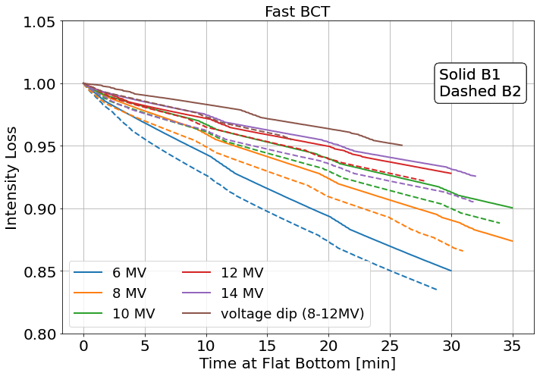
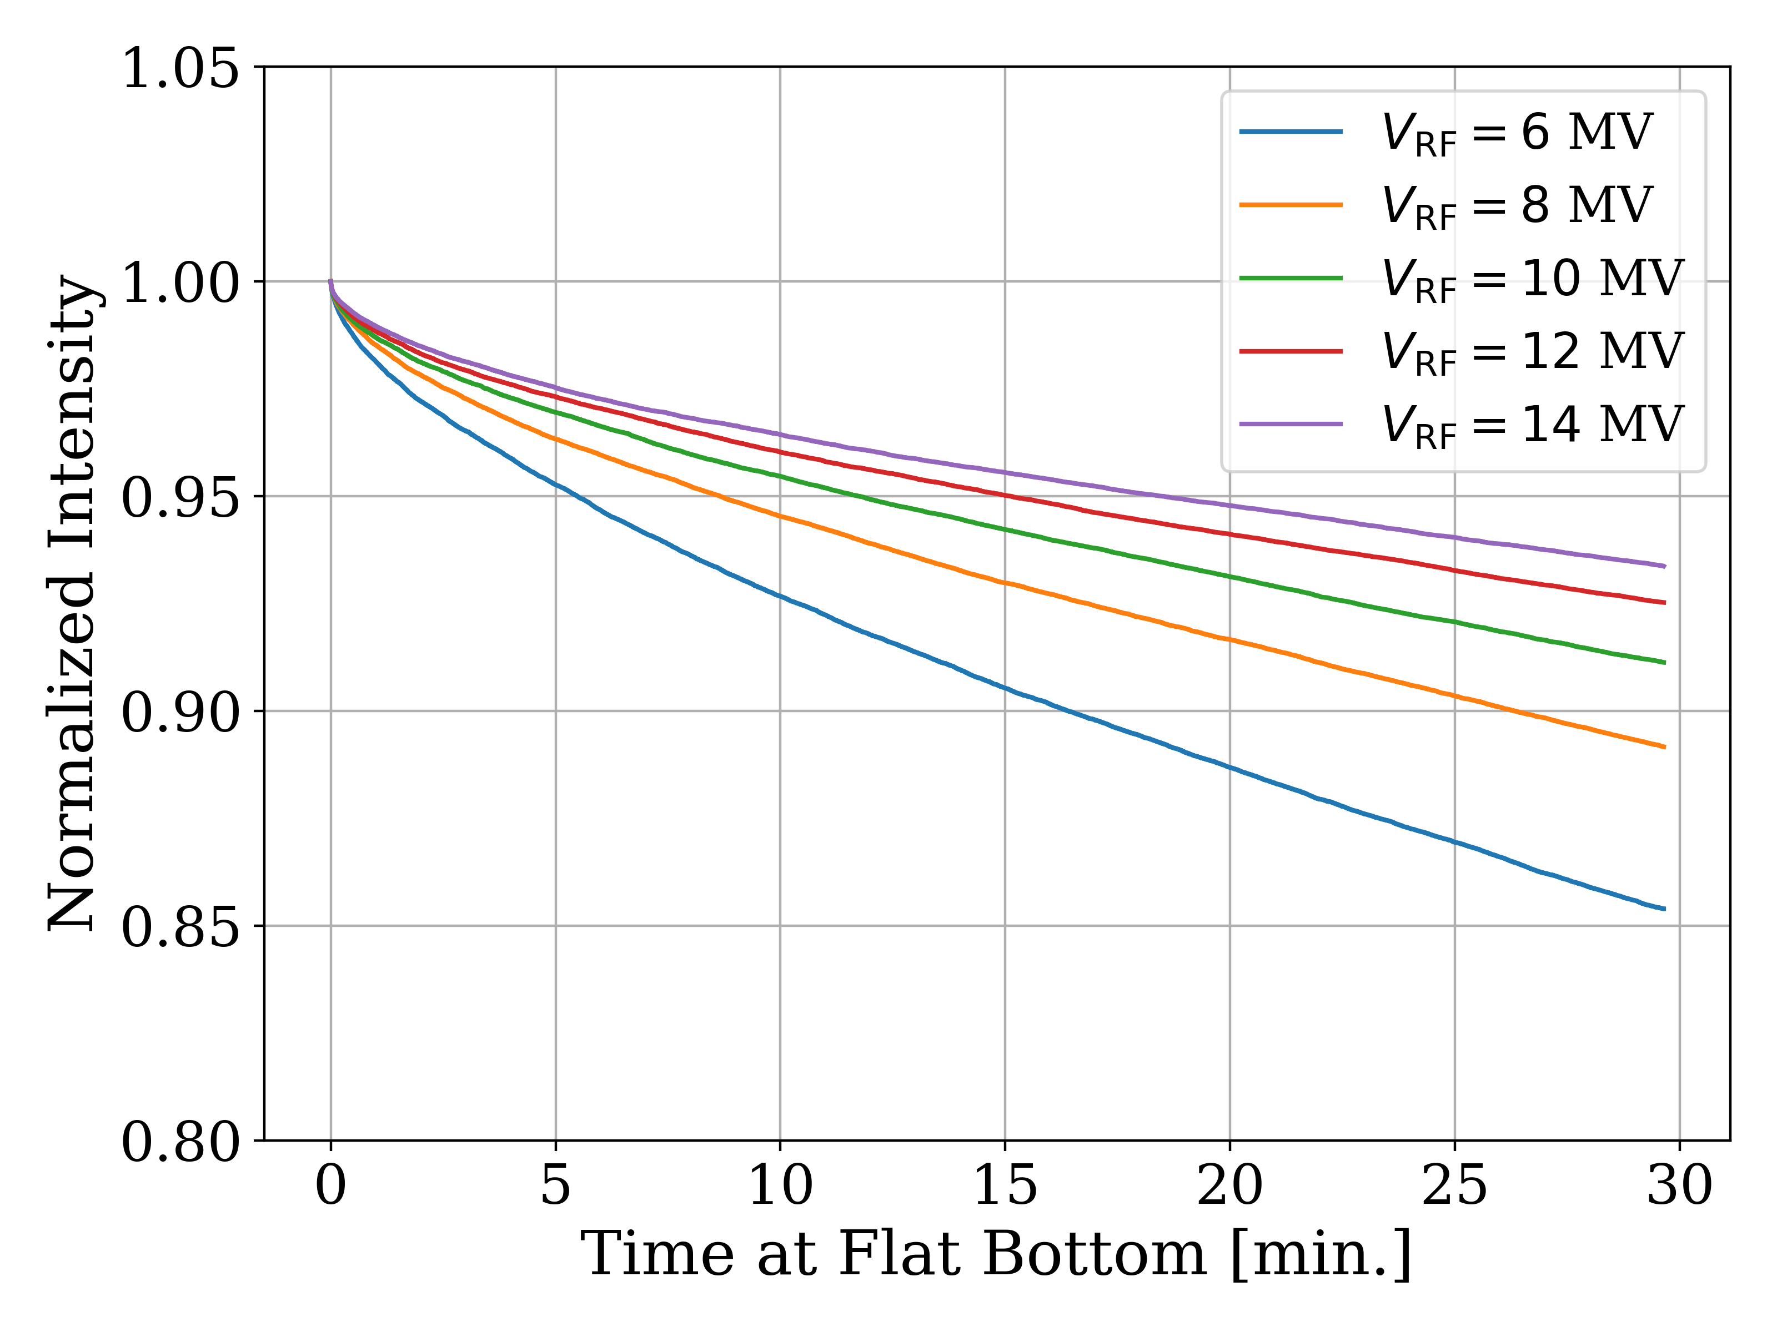
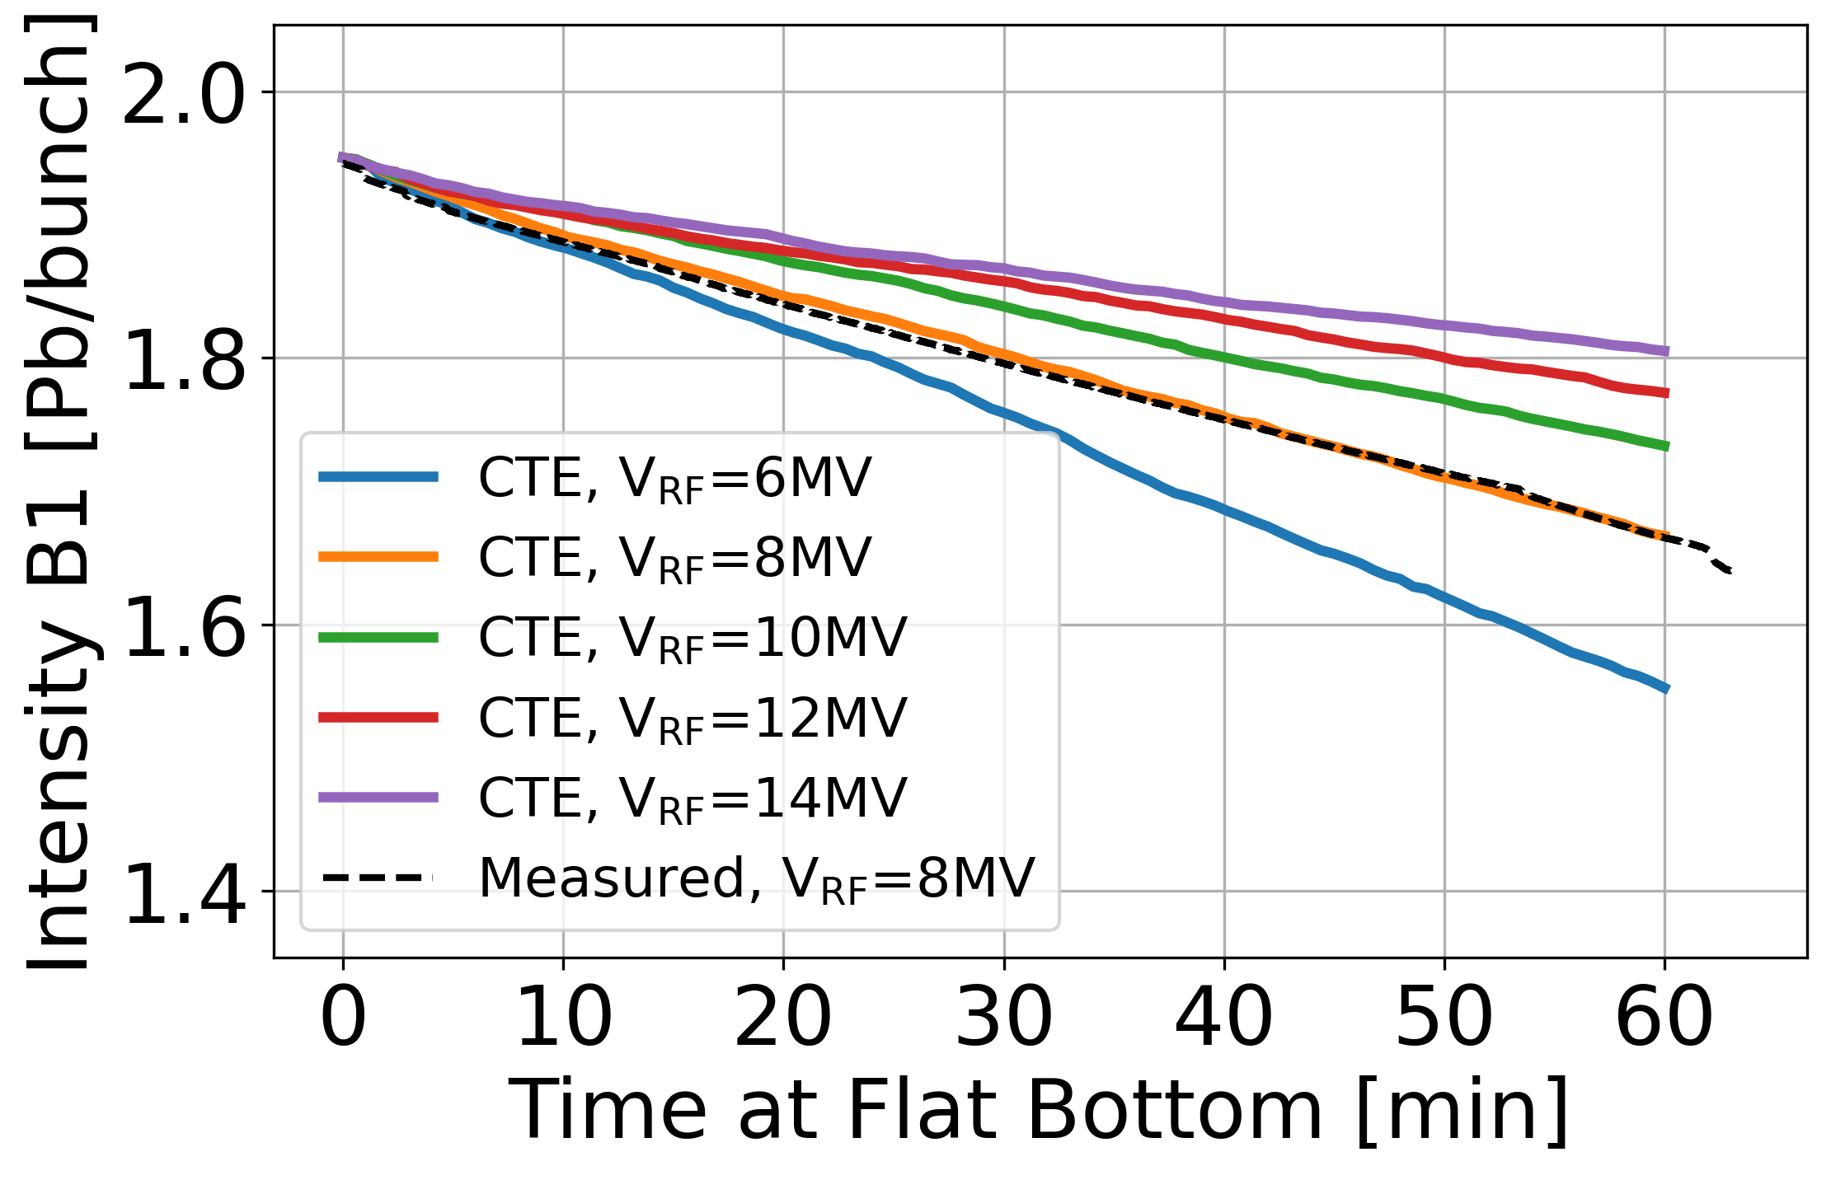
LHC – RF Optimization of Lifetime with Ions
12 MV
14 MV
10 MV
8 MV
6 MV
Motivation
  Significant beam losses at the start of the ramp with 8 MV
What is being simulated?
  Predicted using 3D intra-beam scattering (IBS) tracking model with non-Gaussian bunches
  Confirmed also with 1D IBS model assuming Gaussian bunches
Operational outcome
  Reduction of start-of-ramp losses with ions
  Improvement of beam lifetime with higher RF voltage
Lifetime improvement as a function of voltage from the Ion MD
Measurement
Simulation (1D model)
Initial simulation scan using the 3D IBS model
Courtesy of N. Triantafyllou
Courtesy of N. Triantafyllou
Courtesy of M. Zampetakis

Slide 17
Outline
Modelling longitudinal control loops and their applications
  Optimizations of equipment across the chain
LHC power limitations at injection
  Detuning and RF power transient optimization
Longitudinal aspects of BCMS and standard beams
  Evolution along the flat bottom in the LHC
Outlook

Slide 18
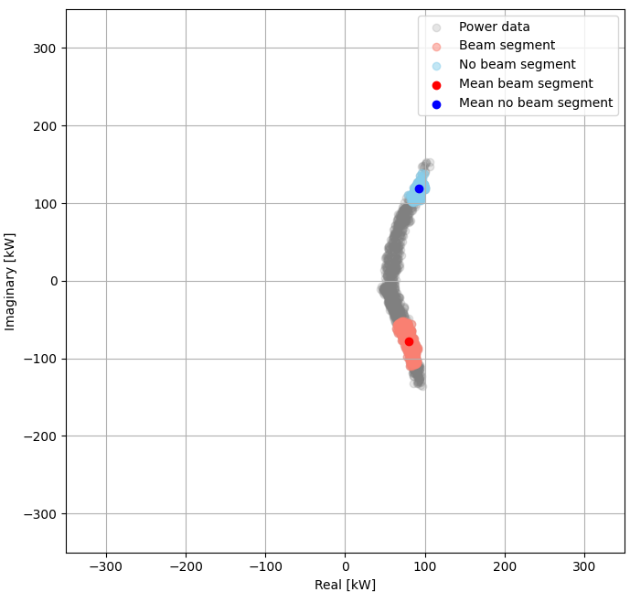






Model of half-detuning and cavity tuning in BLonD
Motivation
  Minimize RF power at injection and during flat-bottom
What is being modelled?
  Beam dynamics at injection including intensity effects
  Regulation of beam and cavity control loops
  Detuning of the RF cavities and the tuner controller
$$I_{g}$$
Klystron
Circulator
Tuner controller
$$I_{g}$$
$$ω_{r}$$
$$V_{g}$$
RF Cavity
LLRF
$$V_{a}$$
$$V_{a}$$
I- and Q-part of the RF power in half-detuning

Slide 19
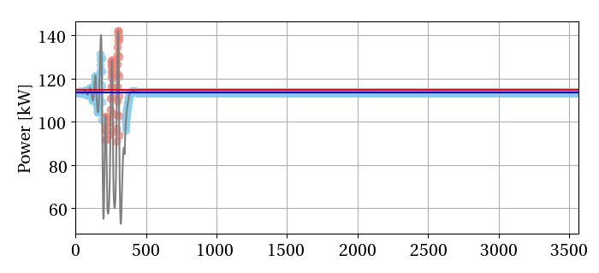
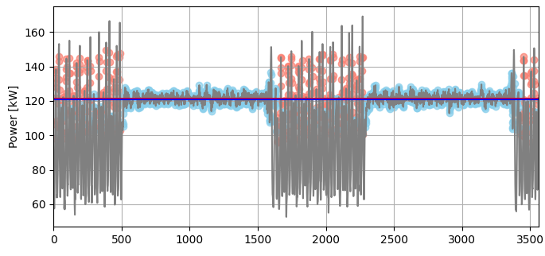
Optimization of Half-detuning in the LHC
Half-detuning scheme
  Set up during commissioning with beam
  Set up during high-intensity MDs
In the past
  Manually line-by-line
Algorithm to optimize half-detuning scheme
  Based on simulation model using of LHC cavity controller
  Faster and more precise setting up of the scheme
Algorithm applied on simulated data. Detected beam segment in red and no-beam segment in blue.
Algorithm applied to optimize a real LHC RF cavity. Detected beam segment in red and no-beam segment in blue.

Slide 20
LHC Pre-detuning Optimization
Last year
  Preliminary scan in pre-detuning scan was done
  Simulations predicted a minimum in power
    Greater understanding of the scheme
In 2024
  Operationally 25 deg. was used
  Large operational scan in pre-detuning
  Systematic difference between beams
    Possibly due to difference in bunch length
  Minimum found experimentally and validates the simulation model
Measured optimum pre-detuning setting from operational scan in 2024

Slide 21
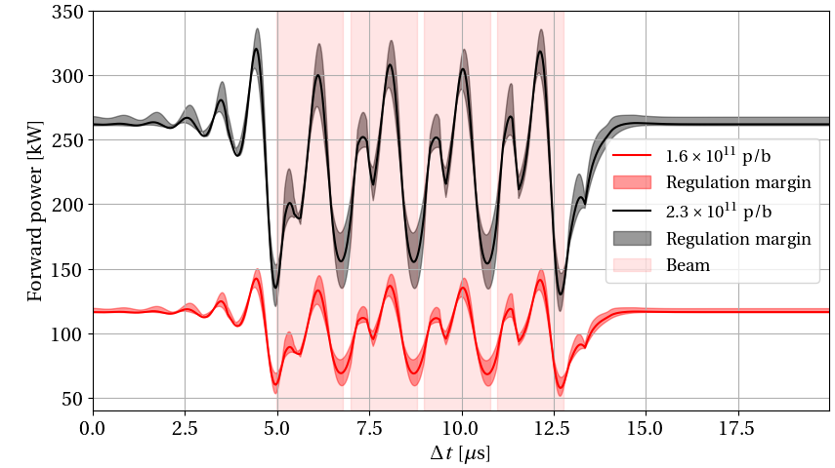
Most recent projections for HL-LHC
Measured power has a large spread (±20%)
  Use cavity controller model to compute RF power
Results from high-intensity MDs in 2024
  With 2.0 x 10¹¹ p/b with 2x48b batches
    Confirmed required voltage found in 2023 (with 72b trains) for HL-LHC
    Power at the limit of the present system
  With 2.3 x 10¹¹ p/b with 2x48b batches
    Maximum voltage achieved during MD was 6.5 MV without one-turn delay feedback due to high beam loading as predicted in simulations
    Unacceptable lifetime due to lack of RF power
Predicted RF power with the nominal HL-LHC beam
Measured and simulated RF power with BCMS beams this year
Year | Intensity | SPS bunch length | SPS Voltage 200 MHz | SPS Voltage 800 MHz | LHC Voltage | LHC bunch length | Simulated peak power at optimum Q_{L}
2023 | 2.0 x 10¹¹ p/b | 1.55 ns | 9.4 MV | 1.69 MV | 7 MV | 1.20 ns | 263 kW
2024 | 2.0 x 10¹¹ p/b | 1.50 ns | 8.5 MV | 1.45 MV | 7 MV | 1.11 ns | 269 kW
2024 | 2.3 x 10¹¹ p/b | 1.60 ns | 8.5 MV | 1.53 MV | 6.5 MV | 1.19 ns | 238 kW (with OTFB 283 kW)
HL-LHC | 2.3 x 10¹¹ p/b | 1.65 ns | 10 MV | 2 MV | 7.9 MV | 1.25 ns | (320 ± 15) kW

Slide 22
Outline
Modelling longitudinal control loops and their applications
  Optimizations of equipment across the chain
LHC power limitations at injection
  Detuning and RF power transient optimization
Longitudinal aspects of BCMS and standard beams
  Evolution along the flat bottom in the LHC
Outlook

Slide 23
Bunch Length during Flat Bottom in the LHC
1%-limit for experiments
Batch Compression Merging Splitting (BCMS)
  More complex RF manipulation in the PS
    Generation of more satellites at LHC flat top
  Higher brightness than the standard beam
  Identical longitudinally at injection in the LHC
Increase in satellites at flat top with BCMS
Relative difference in average bunch parameters with BCMS compared with standard 25ns beam after filamentation,
see talk by S. Kostoglou
Beam | Bunch length | Bunch intensity | Horizontal emittance | Vertical emittance
Beam 1 | -4% | 2% | -24% | -20%
Beam 2 | -2% | 2% | -25% | -23%
Longitudinal emittance from injectors is the same

Slide 24
BCMS and Standard Beam at the Start of the Ramp
Large increase in start-of-ramp losses when switching to BCMS
  Increase RF voltage from 5 MV to 5.5 MV
Yet at the start of the ramp
  The BCMS beam is longer, even with larger voltage
  More protons lost out of the bucket
Bunch length at the start of the ramp
More population at the tail of the distribution for BCMS
Distribution of bunch intensity loss at the start of the ramp

Slide 25
Off-position Beam Analysis
Off-position beam
  Combination of DC BCT and FBCT measurements
Analysis for this year
  More off-position beam is off-momentum this year
    Losses driven by uncaptured beam, IBS and RF background noise
Conclusion:
  More losses driven by IBS due to higher brightness with BCMS
    supported by preliminary IBS simulations (20% increase in losses after 20 minutes)
  Based on 2024 we need 10% more voltage with BCMS
Fills in 2023
Off-momentum
Satellites or ghosts
Off-position beam
Bunches
Fills in 2024

Slide 26
Summary of Key Points
Complex models of RF systems with high prediction accuracy
  Applied to large verity of scenarios across the complex
  Simulations give experience which be applied in operation
  Use beam dynamics models already at the design stage of control loops to give specifications for parameters?
LHC MD with 2.3 x 10¹¹ p/b confirmed the projections for HL-LHC RF power demand
  Implement OP tools for pre-detuning and half-detuning
  By how much will BLM thresholds be increased and how will this affect us? See talk by S. Morales
  How does the bandwidth of the high-efficiency klystrons affect the projections?
Due to the higher brightness, the BCMS beam is harder to retain with the RF system at flat bottom
  Retain BCMS for HL-LHC? See also talk by S. Kostoglou
    Will be addressed in discussion session

Slide 28
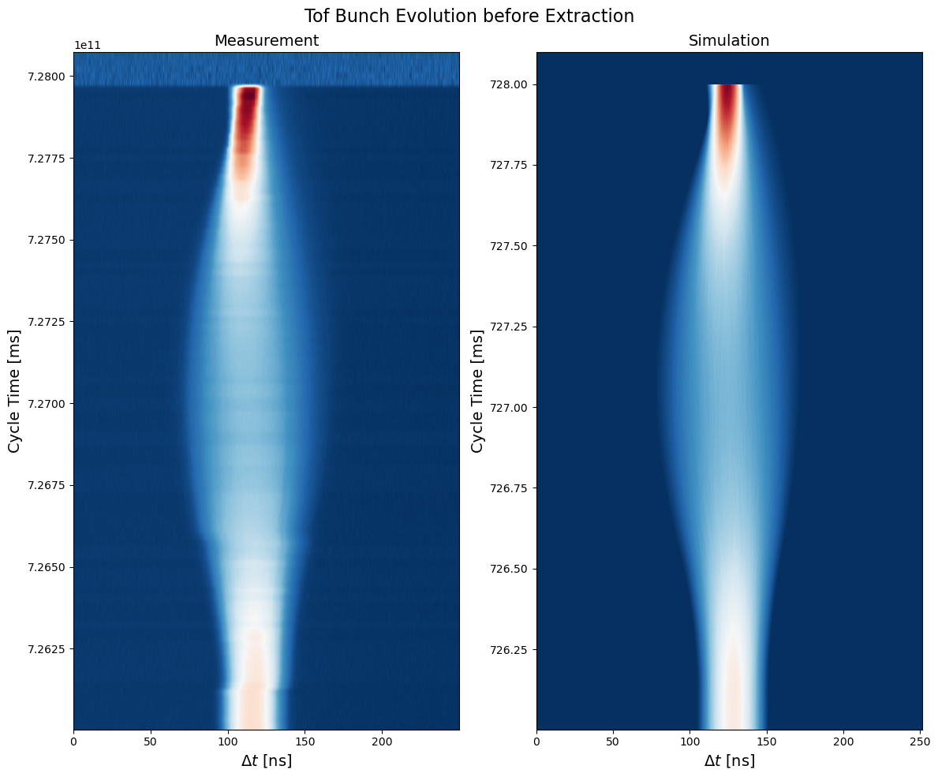
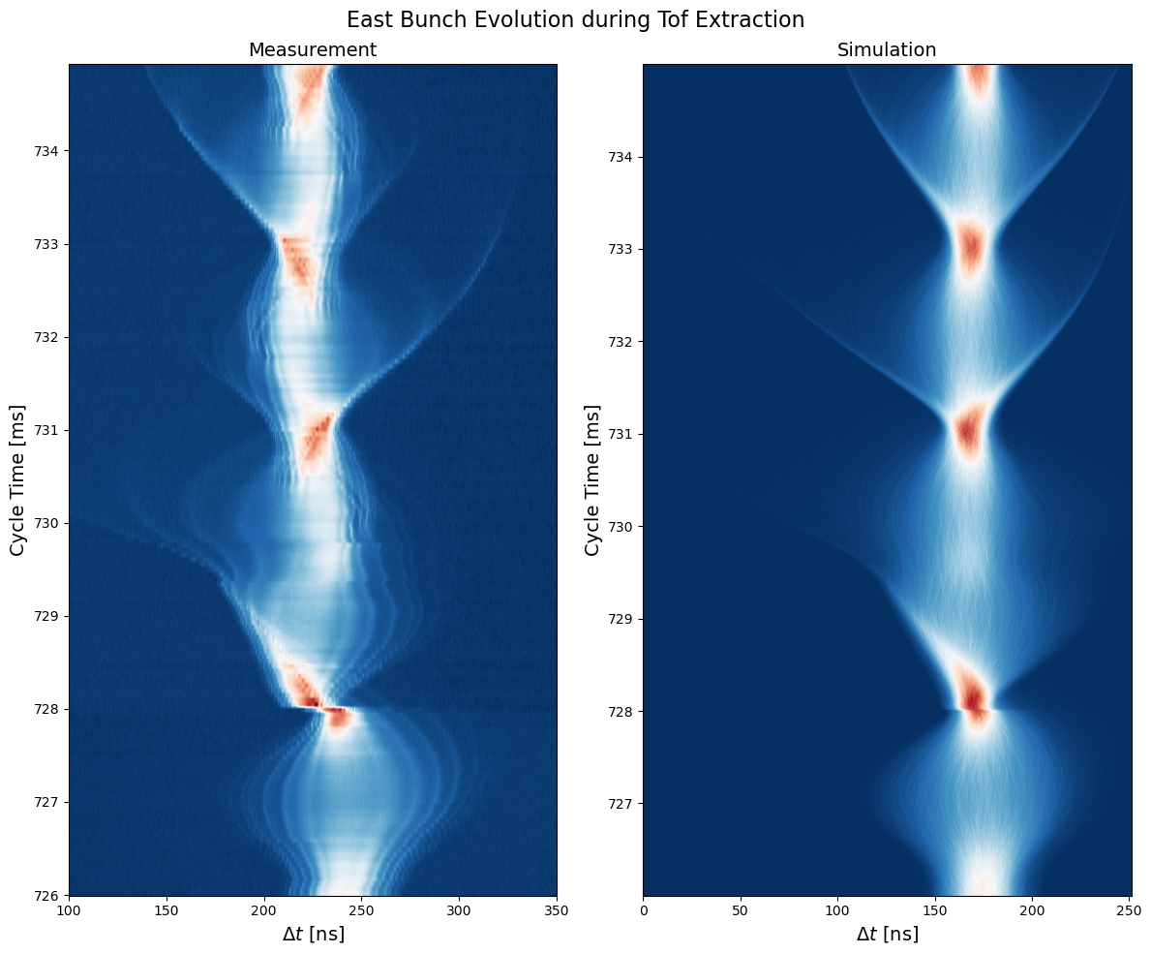
PS – Parasitic TOF with EAST
BLonD Simulations: Use new H8H16 beam feedback control model, PS Impedance Model

Slide 29

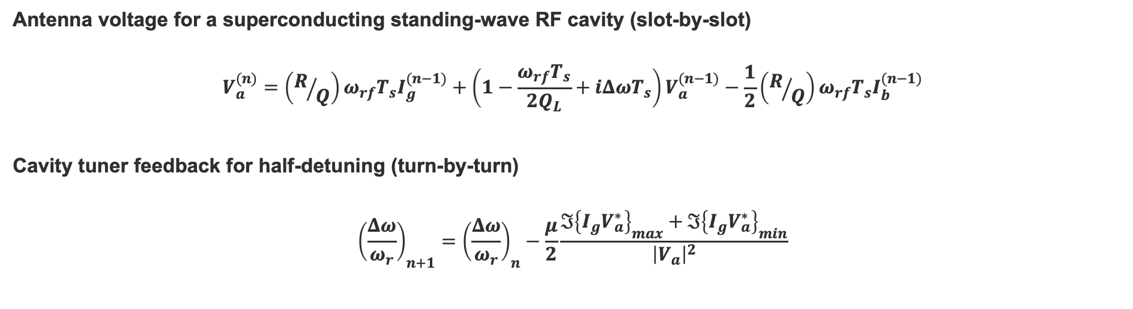





Model of half-detuning and cavity tuning in BLonD
Antenna voltage for a superconducting standing-wave RF cavity (slot-by-slot)
$$V_{a}^{(n)}=\left(R/Q\right)ω_{rf}T_{s}I_{g}^{(n−1)}+\left(1−\frac{ω_{rf}T_{s}}{2Q_{L}}+iΔωT_{s}\right)V_{a}^{(n−1)}−\frac{1}{2}\left(R/Q\right)ω_{rf}T_{s}I_{b}^{(n−1)}$$
Cavity tuner feedback for half-detuning (turn-by-turn)
$${\left(\frac{Δω}{ω_{r}}\right)}_{n+1}={\left(\frac{Δω}{ω_{r}}\right)}_{n}−\frac{μ}{2}\frac{ℑ{\left\{I_{g}V_{a}^{∗}\right\}}_{max}+ℑ{\left\{I_{g}V_{a}^{∗}\right\}}_{min}}{{\left|V_{a}\right|}^{2}}$$
LLRF controls and amplifier
RF cavity
Beam
I/Q-plot of detuning
$$I_{g}$$
Klystron
Tuner controller
$$I_{g}$$
$$V_{g}$$
$$ω_{r}$$
RF Cavity
LLRF
$$V_{a}$$
$$V_{a}$$

Slide 30
BCMS and Standard Beams in Simulations
From simulation
  After 20 minutes:
    BCMS and STD have the same length
    BCMS has 20% more losses than STD
  Higher brightness give longer bunches and more debunched beam
NB! BLonD model assumes gaussian bunches
FWHM bunch length evolution
Relative losses out of the bucket

Slide 31
Power Limitations at Injection into the LHC
Injection transients
SPS beam distributions
Example simulated injection transient in the LHC
Steady-state power and cavity tuning
Measured and simulated bunch phase of the 72-bunch BCMS train in 2024
Example steady-state RF power slot-by-slot in the LHC

Slide 32
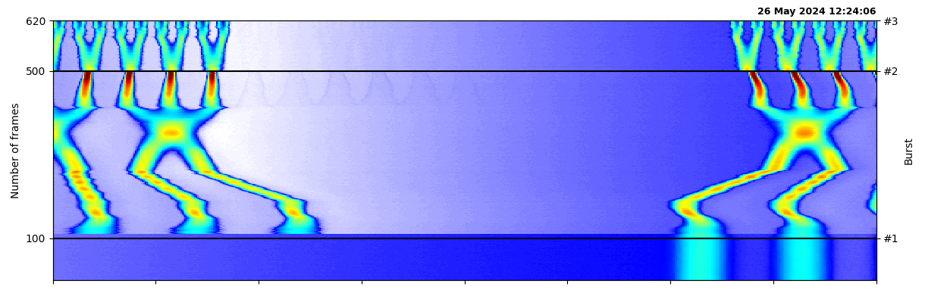
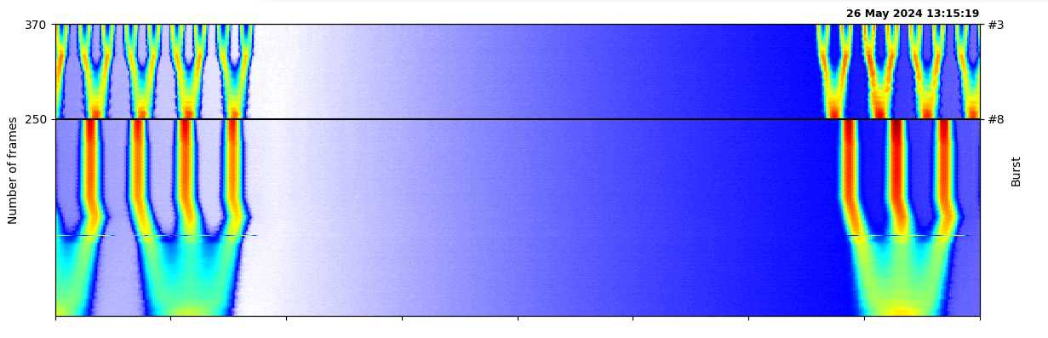
Ghosts and Satellites at the Flattop in the LHC
BSRL show a clear step when switching beam types
In the PS the extra merging generate tails which one cannot get rid off
Before
After

Slide 33
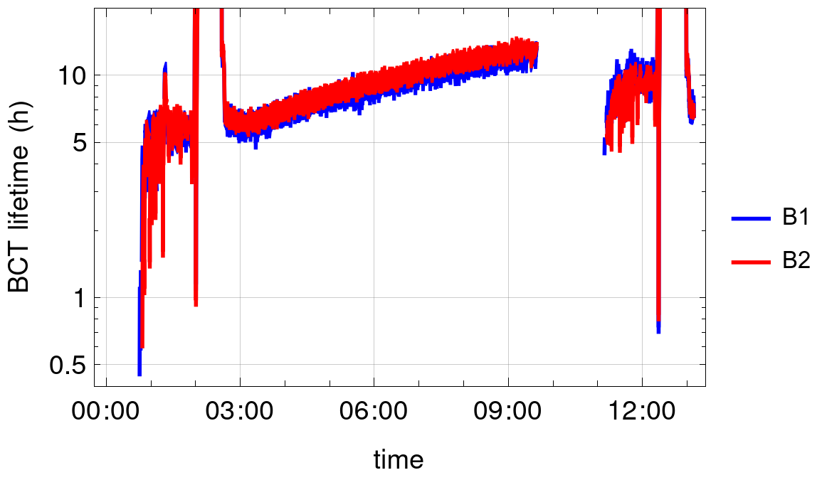
Lifetime at injection for different RF voltages
Lifetime @ injection
with 8 MV
Lifetime @ injection
with 12 MV
Courtesy of R. Bruce

