Slide 1
Impedance modelling and equipment design
Chiara Antuono, Michela Neroni on behalf of
H. Bursali, E. De La Fuente, M. Diaz, G. Favia, L. Giacomel, I. Karpov, P. Krkotic, A. Lasheen, J. Li, N. Mounet, B. Salvant, L. Sito, C. Vollinger, M. Zampetakis, C. Zannini
and the big support of:
W. Andreazza, M. Barnes, G. Bregliozzi, S. Calatroni, J. A. Ferreira Somoza, R. Franqueira Ximenes, D. Mirarchi, C. Pasquino, A. Perillo Marcone, S. Redaelli, R. Seidenbinder, J. Sestak.
11th December 2024, JAP Workshop, Montreux

Slide 2
Introduction

Slide 3
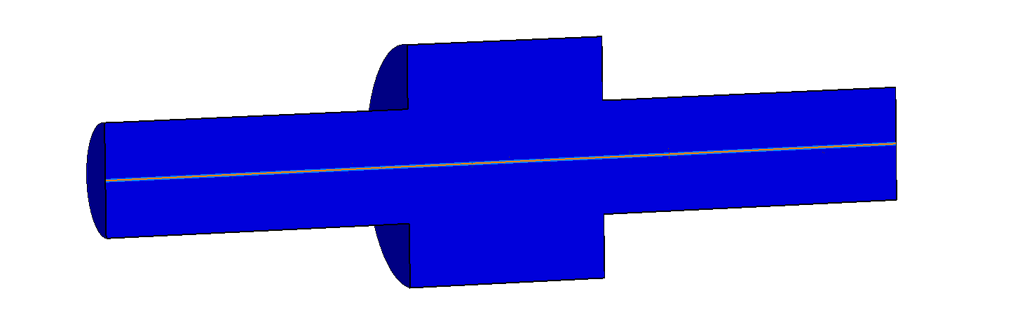
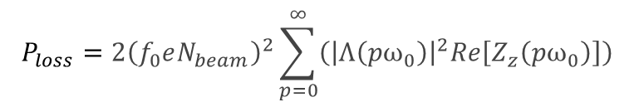

Introduction
When facing cross section variations of the vacuum chamber wall, as well as its finite resistivity, charged particles travelling in the accelerator, induce electromagnetic fields mainly left behind the source particle.
➔ Wakefield
FFT
Effect can be quantified through
Beam coupling impedance $Z\left(f\right)$
Impedance-induced effects
Equipment degradation or damage due to beam induced heating and/or sparking, perturbation to electronics (EMI issues)
Beam quality degradation and beam instabilities
$$P_{loss}=2{\left(f_{0}eN_{beam}\right)}^{2}\sum_{p=0}^{∞}{\left({\left|Λ\left(pω_{0}\right)\right|}^{2}Re\left[Z_{z}\left(pω_{0}\right)\right]\right)}$$
➔ Accurate and up-to-date accelerator impedance model is crucial

Slide 4
Methodology
New equipment design
Ʃ
Impedance modelling of each component and optimization
Accelerator impedance model
Beam dynamics simulations
Beam dynamics observations and accelerator upgrades
Electromagnetic simulations
e.g. CST Studio Suite®
RF bench measurements
➔ Needed for validation of
component before any installation
Accurate prediction of accelerator performance
Close collaboration between impedance team and equipment owners,
Allocation of time for impedance validation.

Slide 5
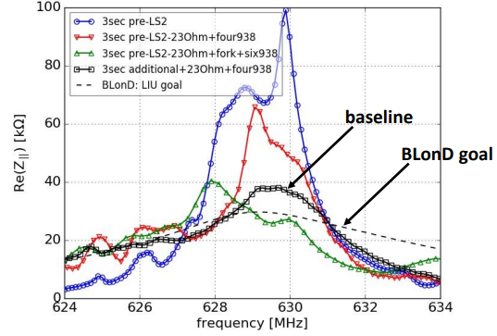
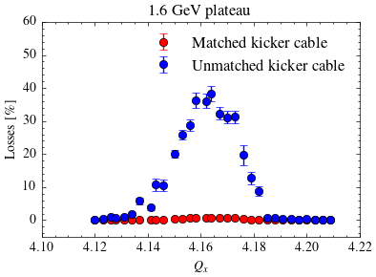
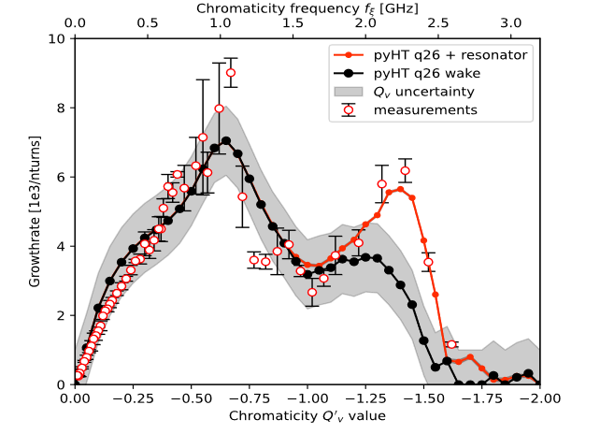

Methodology
Complex loads installation on 630 MHz HOM-couplers - SPS 200 MHz cavity
PSB horizontal instability post LIU
P. Kramer, PhD Thesis
Beam dynamics observations and accelerator upgrades
SPS dark impedance
C. Antuono, et al., IPAC24
New region explored
E. De La Fuente, et al., HB2023

Slide 6
Impedance studies in the CERN complex
Impedance modelling is a constant work on going and it often requires dedicated students' projects.
Here covering impedance related studies and observations in the CERN complex for 2023-24.
 | 2023 | 2024
Unshielded pumping manifold
Rotary wire scanners
Injection kicker MKI-cool
TDIS
Vacuum modules
PS
Close to limit, requires impedance optimization
SPS
Not limited beam operation with no hardware failure
Limited beam operation with no hardware damage
Limited beam operation with hardware damage
LHC
Many other accelerator components to be followed up…
➔ Complete overview for 2025 and HL-LHC in conclusions

Slide 7
Impedance-related observations in the CERN complex in 2023/24

Slide 8
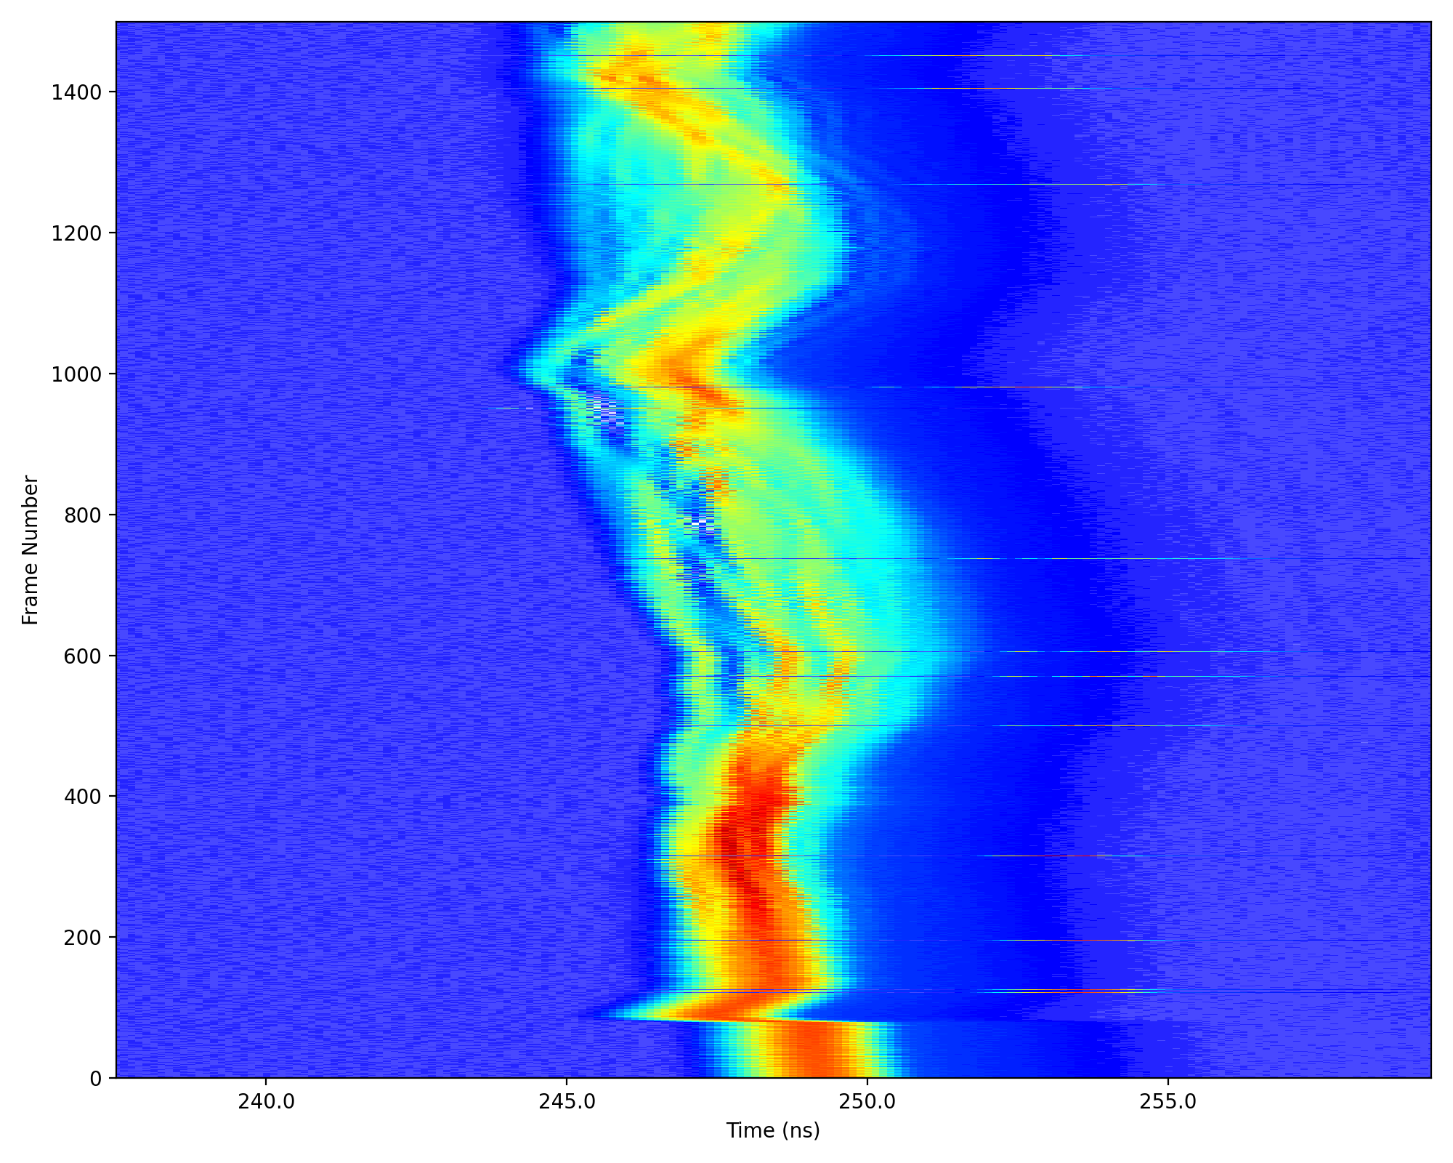
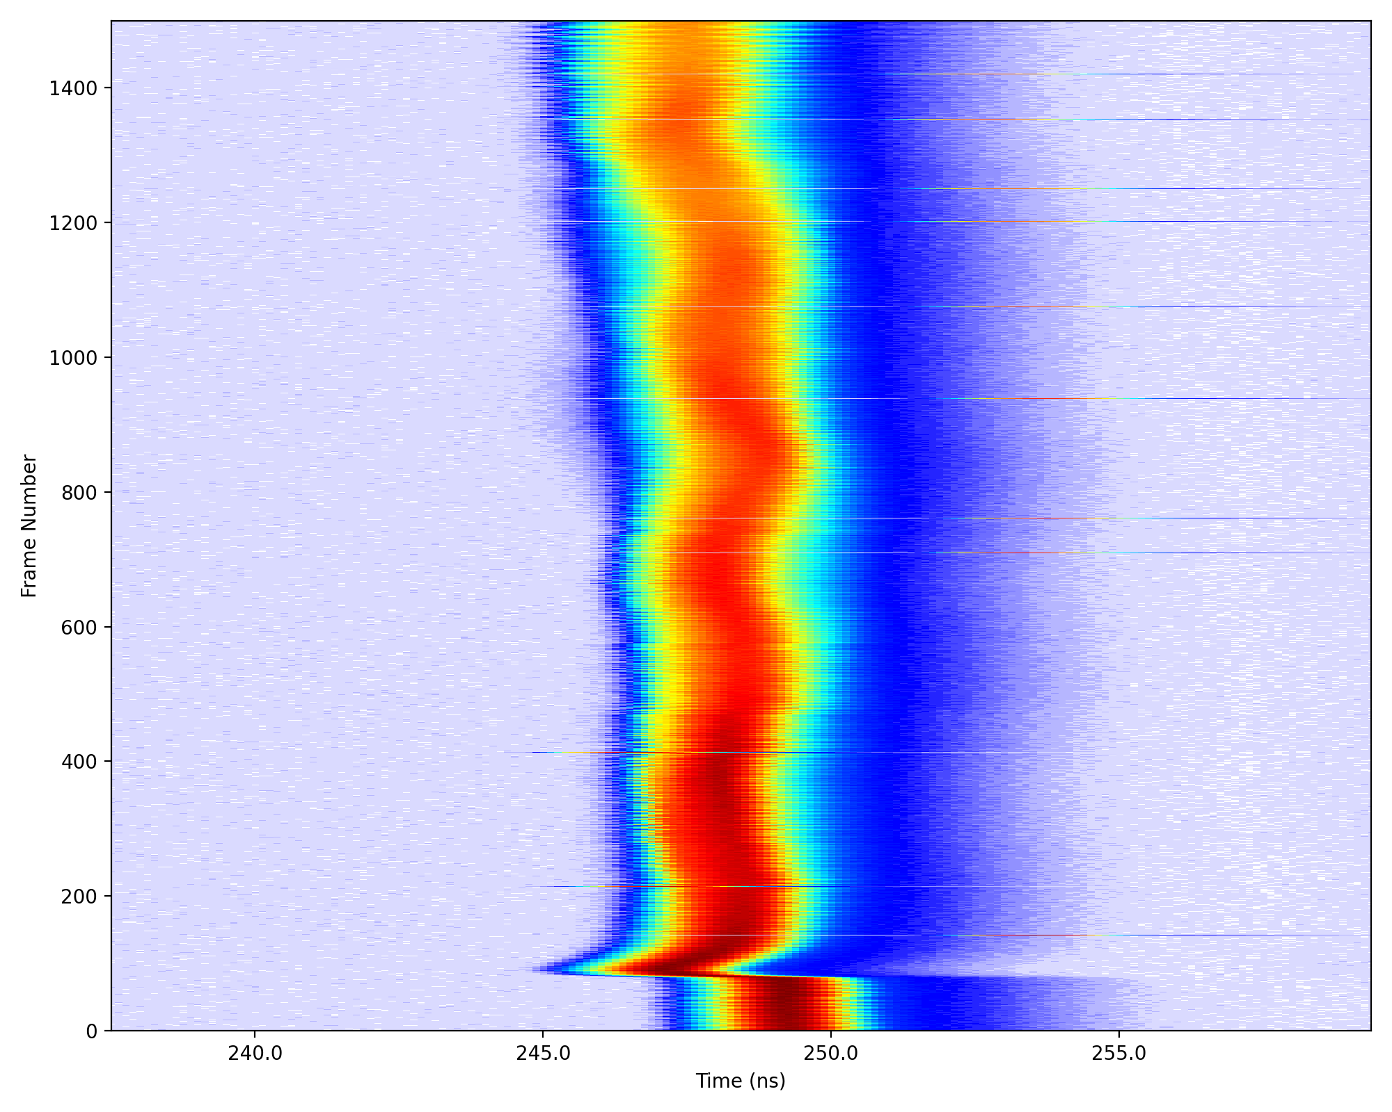
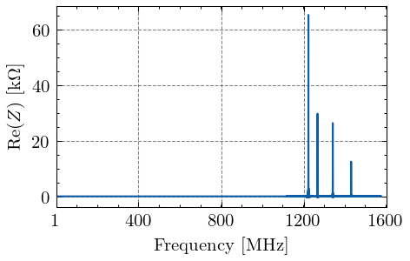
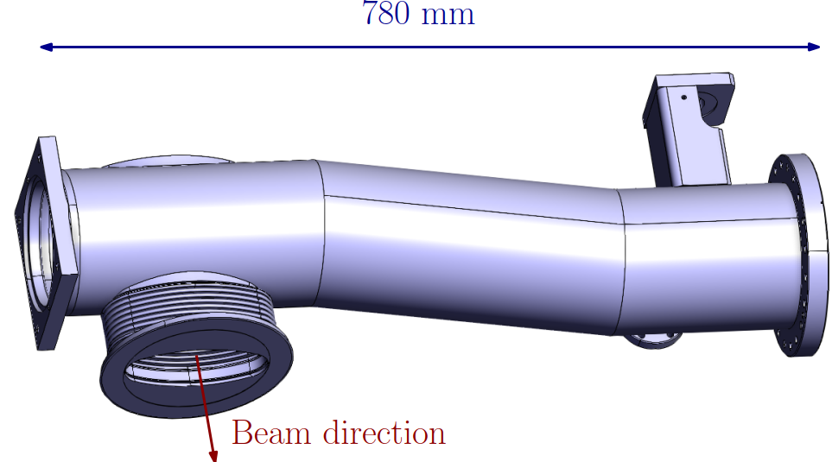
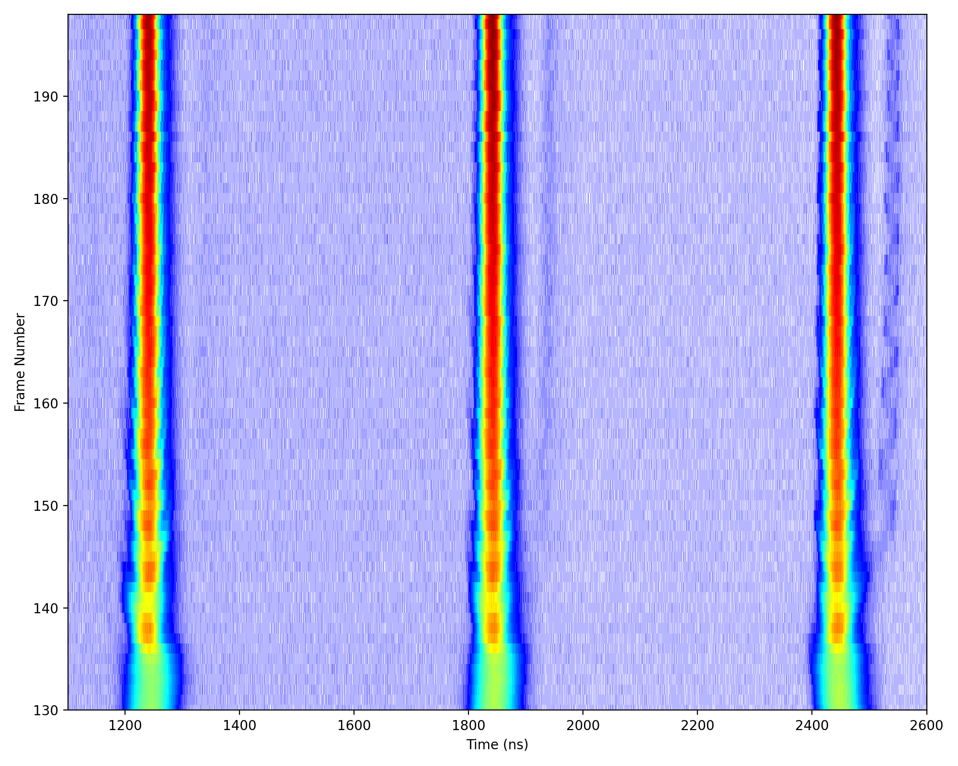
Unshielded pumping manifold (PS)
Observations in 2023 and 2024 of high frequency modulation at transition crossing for ion and proton beams (AWAKE)*.
E. Vinten, et al., IPAC23
ILHC75ns#3b
28/11/2024
Impedance source identified in high frequency range (1.2 GHz) ➔ vacuum equipment: unshielded pumping manifold.
Avoided through emittance blow up
However, uncaptured beam observed at flat top.
Close to longitudinal stability limit also for AWAKE beam: about 15-20% margin in longitudinal emittance.
See talk by A. Lasheen at IPP
Current operational conditions close to the stability limit. Further improvements in beam quality or performance requires impedance optimization.
Combined impedance and beam dynamics study necessary for a full understanding of limitations and possible future bottlenecks.
Courtesy of J. Flowerdew
➔ Follow up for prototype shield is ongoing
* Impact on other beams to be evaluated.

Slide 9
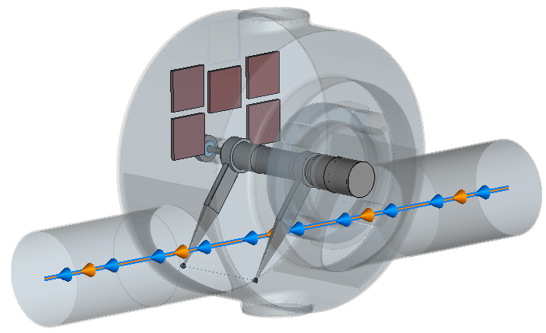
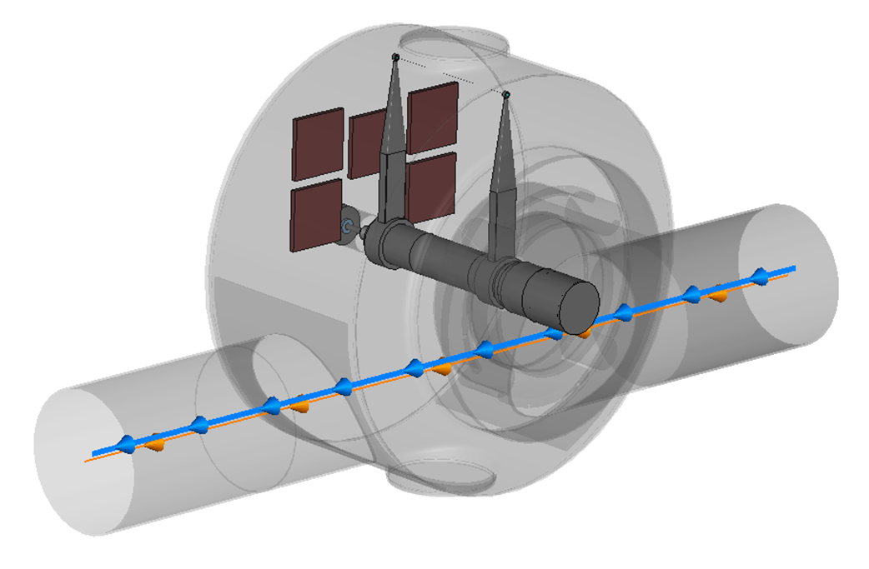
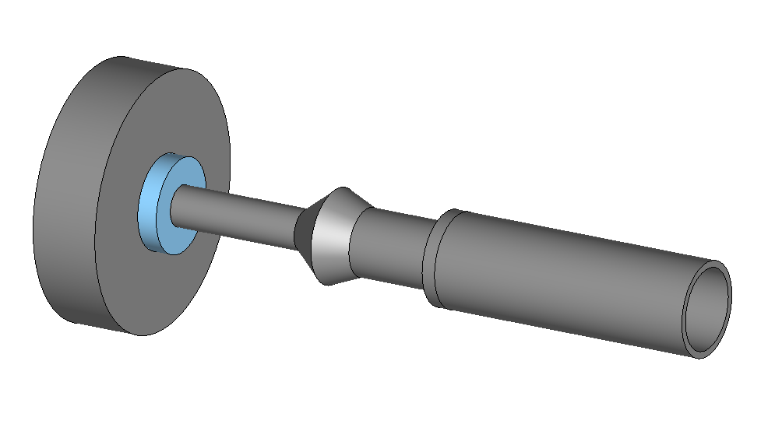
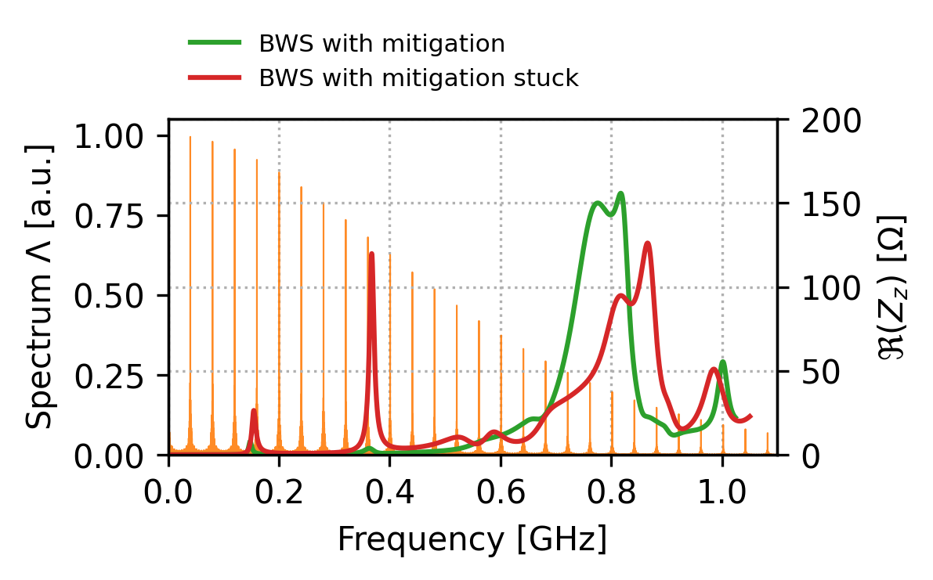
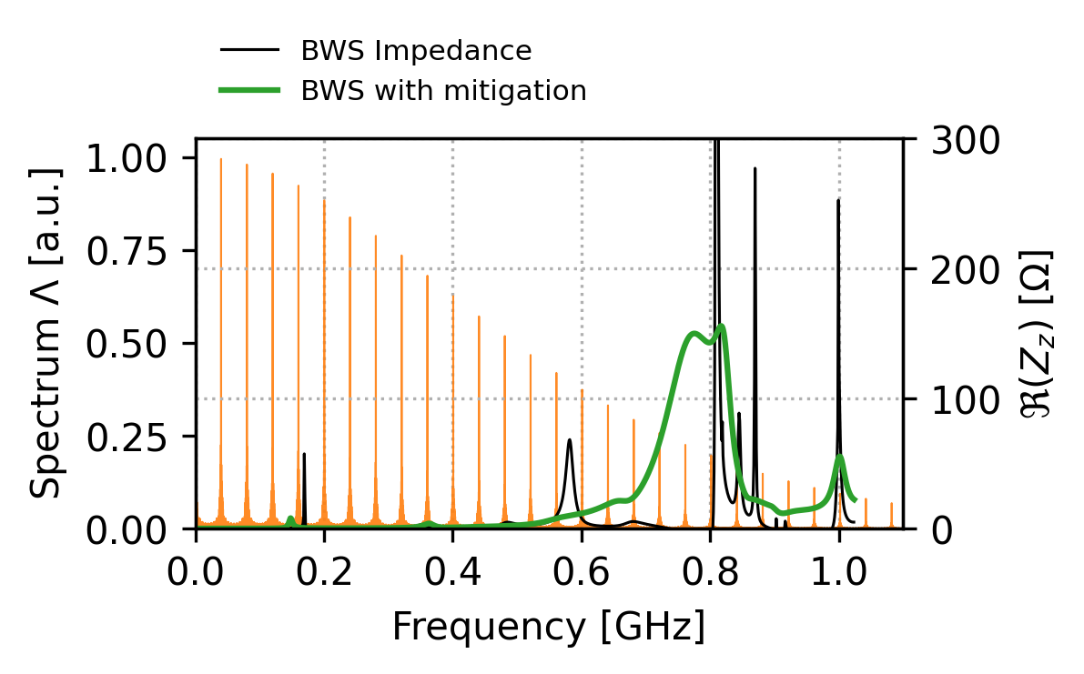
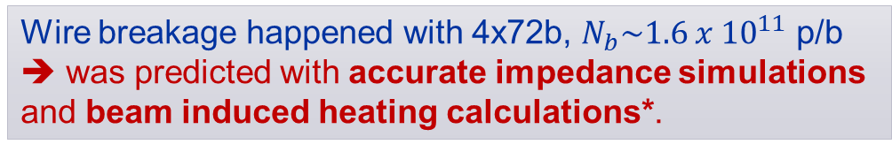
Rotary wire scanners (SPS)
Fork in parking position
Observations in 2024 run:
Task force impedance study 2023:
RF coupler
Fork in stuck configuration in July 2024 for one wire scanner (more info in I. Ortega Ruiz talk, “Beam instrumentation (focus up to 2026)”).
  Following the failure of 4 wire scanners in April 2023, impedance mitigation was put in place with 5 ferrite tiles and RF coupler.
strong resonance at 380 MHz, lead to 70% power dissipated on the wire
Up to 10 kΩ
Wire breakage happened with 4x72b, $N_{b}\sim 1.6 x {10}^{11}$ p/b
➔ was predicted with accurate impedance simulations and beam induced heating calculations*.
Impedance mitigation put in place in 2023 remains effective.
No limitations foreseen if the fork is in parking position.
*L. Sito, ABP meeting
*E. De La Fuente, IPP

Slide 10
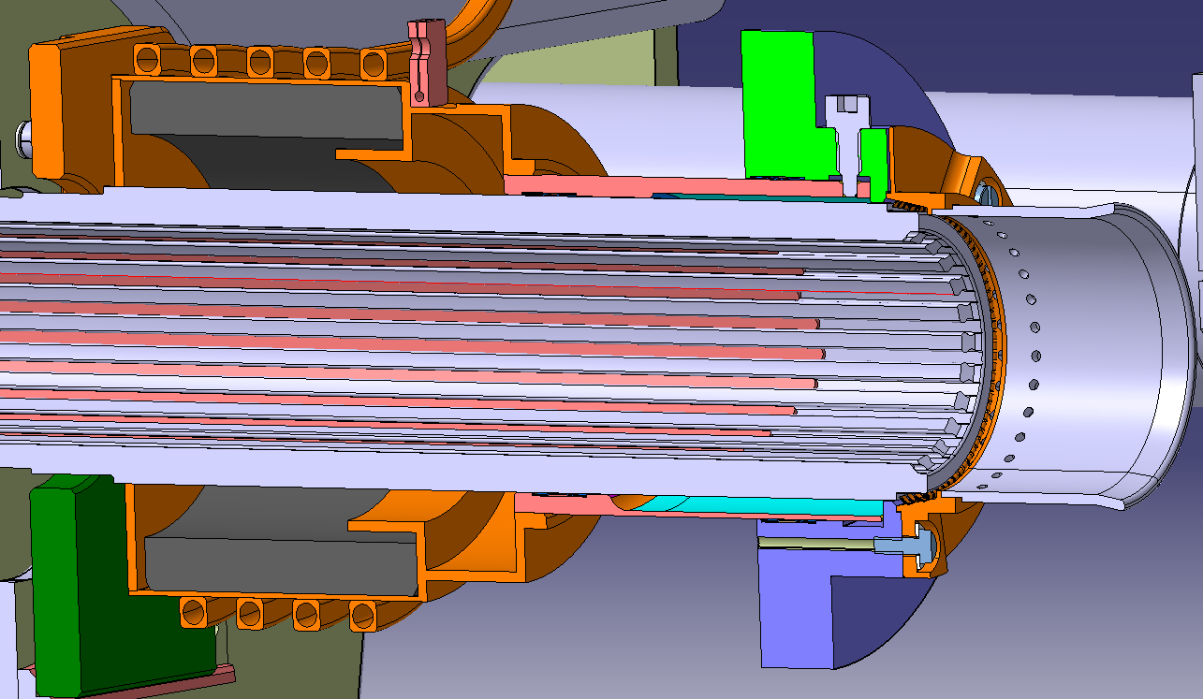
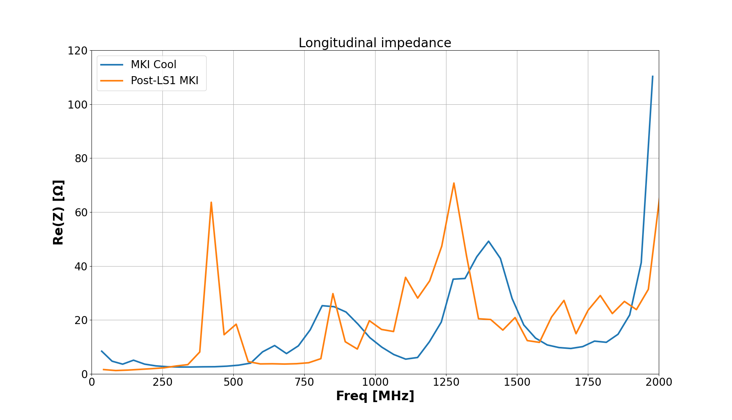
LHC injection kickers - MKI-cool
MKI-cool:
water cooling of RF damper was necessary in view of HL-LHC beams
Metallization
Cooling pipes
Reduction of beam induced heating in view of HL-LHC beams required an impedance optimization of the design* verified with simulations and benchmarked through stretched wire measurements.
Beam
Screen conductors
Alumina tube
RF Damper
(ferrite ring)
Magnet
2 MKI-cool already installed and successfully tested in 2023 and 2024 in Point 8 (more info in G. Favia talk, “ABT Equipment: Operational Insights and Future Perspective”).
2 more MKI-cool to be installed in Point 8 during YETS24/25.
  Full upgrade of Point 2 with 4 MKI-cool foreseen for LS3 (plus 4 additional spares)
Courtesy of G. Favia
* M. J. Barnes, 13th HL-LHC meeting
H. Day, PhD Thesis

Slide 11
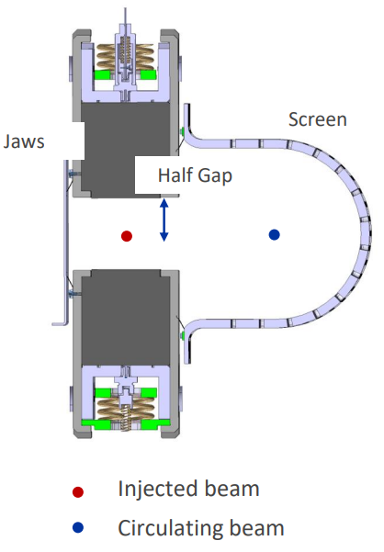
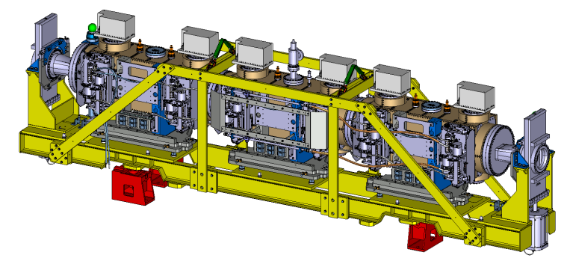
TDIS high temperature readings
In the LHC injection beam dumps protection elements are installed, particularly two Target Dump Injection Segmented (TDIS):
  TDIS002 in point 2
  TDIS001 in point 8
Module A
Module B
Module C
Carbajo Perez, David, et al. at IPAC2021
5.8 m
For each TDIS module:
  6 temperature probes : 4 on jaws and 2 on the screen
2023: Unexplained high temperature signals in the RF screen: caused interlocks and limited LHC filling

Slide 12
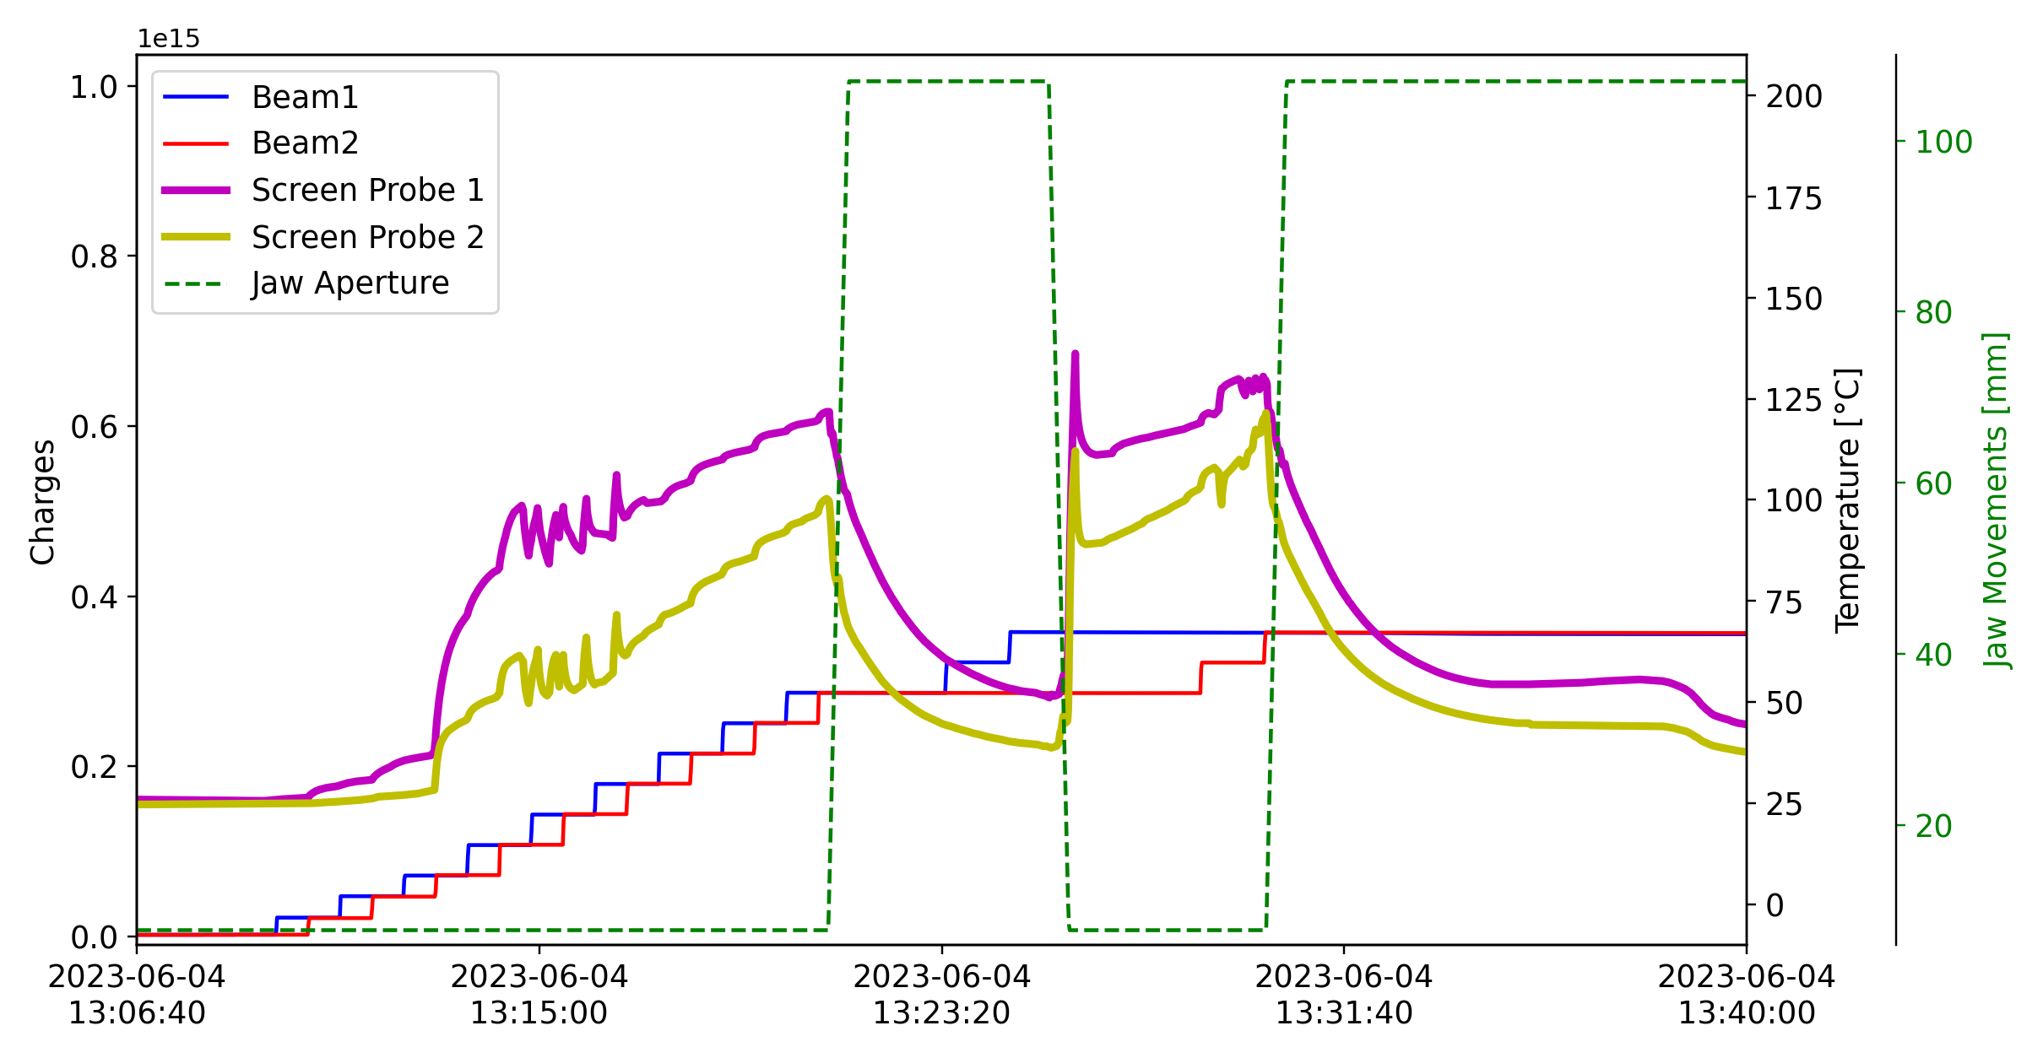
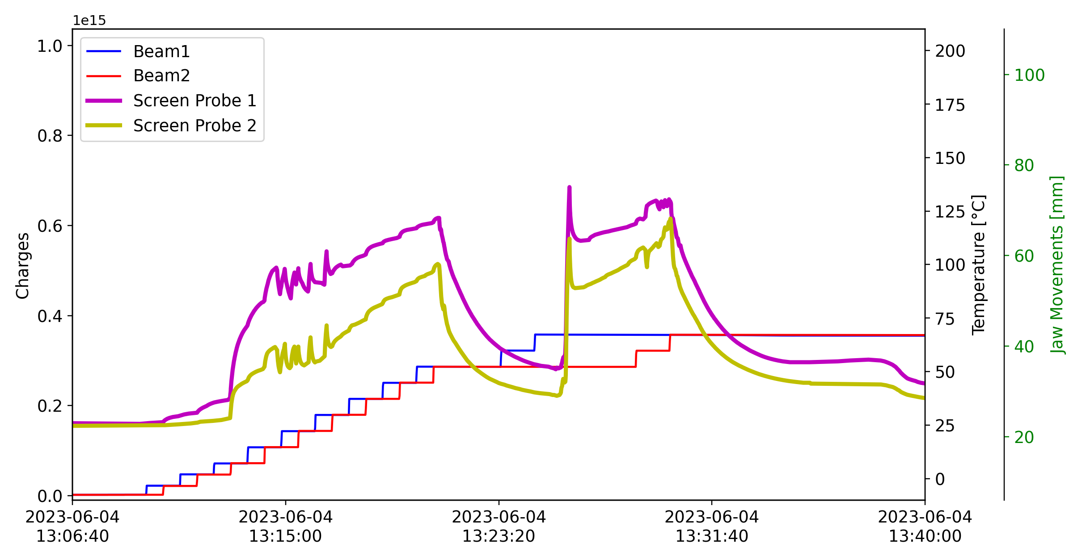
TDIS high temperature readings
2023: Unexplained high temperature signals in the RF screen: caused interlocks and limited LHC filling
Temp. decrease with opened jaws
Temp. decrease with opened jaws
interlock
Reaching the interlock…
Temp. increase with closed jaws

Slide 13
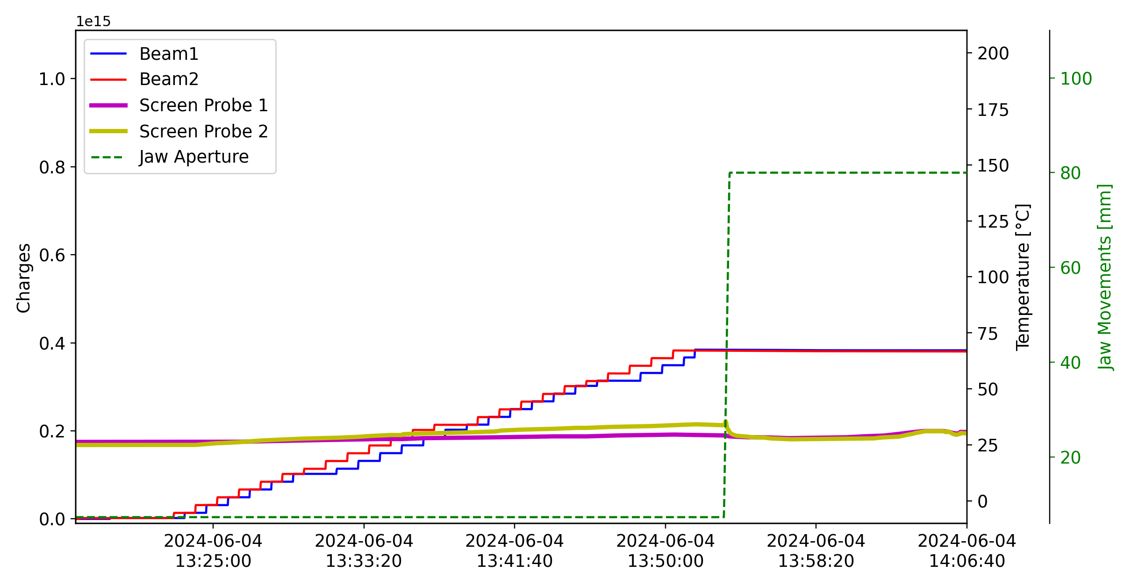
TDIS: 2023 Vs 2024
2023:high temperature signals$→$caused interlocks and limited LHC filling
2024:significantly lower temperature signals $→$no limitations in the LHC
2023: Hybrid filling scheme beam
2024: Standard beam with 3x36b
2024: spare TDIS were installed
The 2023 and 2024 TDIS are supposed to be identical
Which is the cause of the different behavior?

Slide 14
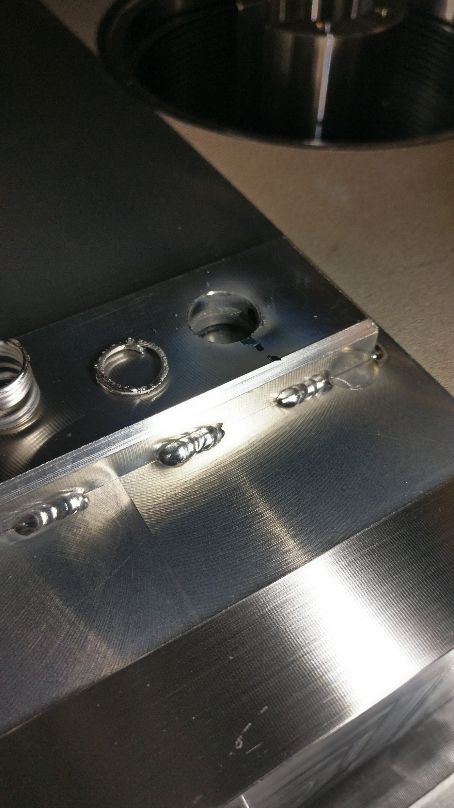
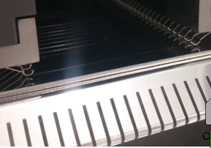
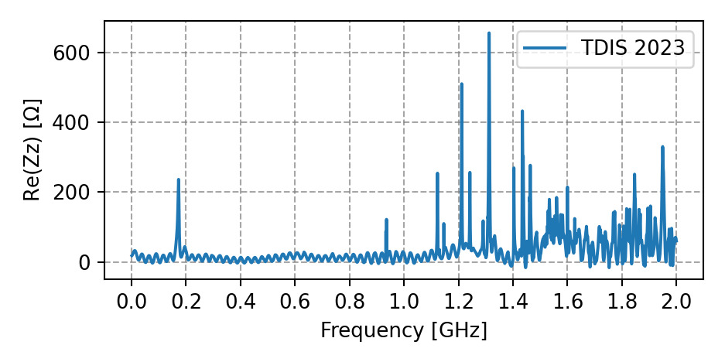

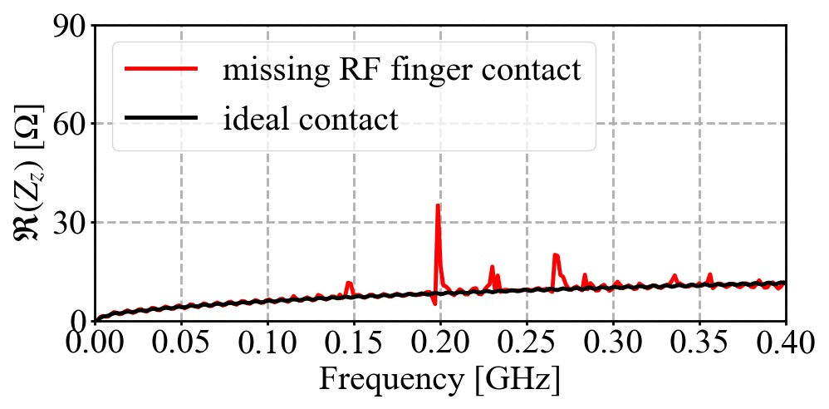
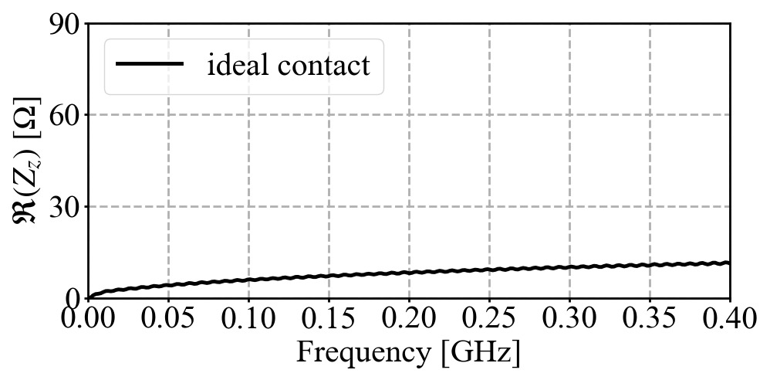
TDIS : correlations with impedance studies
2023 TDIS: presence of non-conformities:
  Partially lost finger contact
  Melted spring
Impedance measurements on 2023 TDIS*:
  Electromagnetic (EM) coupling with probes
    Correlations with temperature readings:
      EM coupling higher with closed jaws
      EM coupling higher with screen probes (interlock)
      EM coupling significantly higher for TDIS in point 8 (interlock)
  Unexpected low frequency resonance detected
Preliminary model results
Development of impedance model ongoing:
  Low frequency resonances with missing contact
  Factor 4 higher beam induced power on the probe with missing contact
The non-conformities might explain the higher temperature readings and the different behavior observed on 2023 TDIS
* L. Giacomel et al. at the 81st IWG, * L. Sito et al. at the 92nd IWG

Slide 15
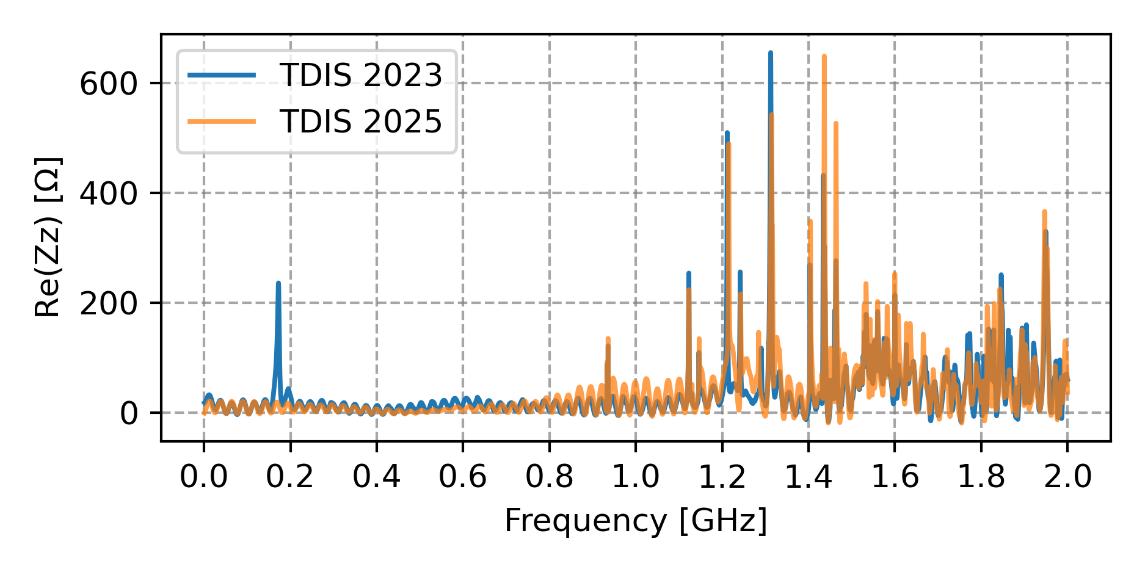
TDIS in 2025 Run
2025 TDIS will benefit of several improvements
  Improved shielding of existing screen temperature probes
  Two additional fully shielded screen temperature probes
Impedance measurements* on 2025 TDIS:
  Contrary to 2023, no correlations with jaw aperture, probe type and
  TDIS device
  Moreover, the unexpected low frequency resonance not detected
Impedance measurements on 2024 TDIS desirable
Impedance measurements
The issue in 2023 seems to be correlated with the observed non-conformities
To be confirmed after inspecting the 2024 TDIS
However, the origin of the non-conformity is unknown
For conforming TDIS no impedance induced issues are expected
* L. Sito et al. at the 92nd IWG meeting

Slide 16
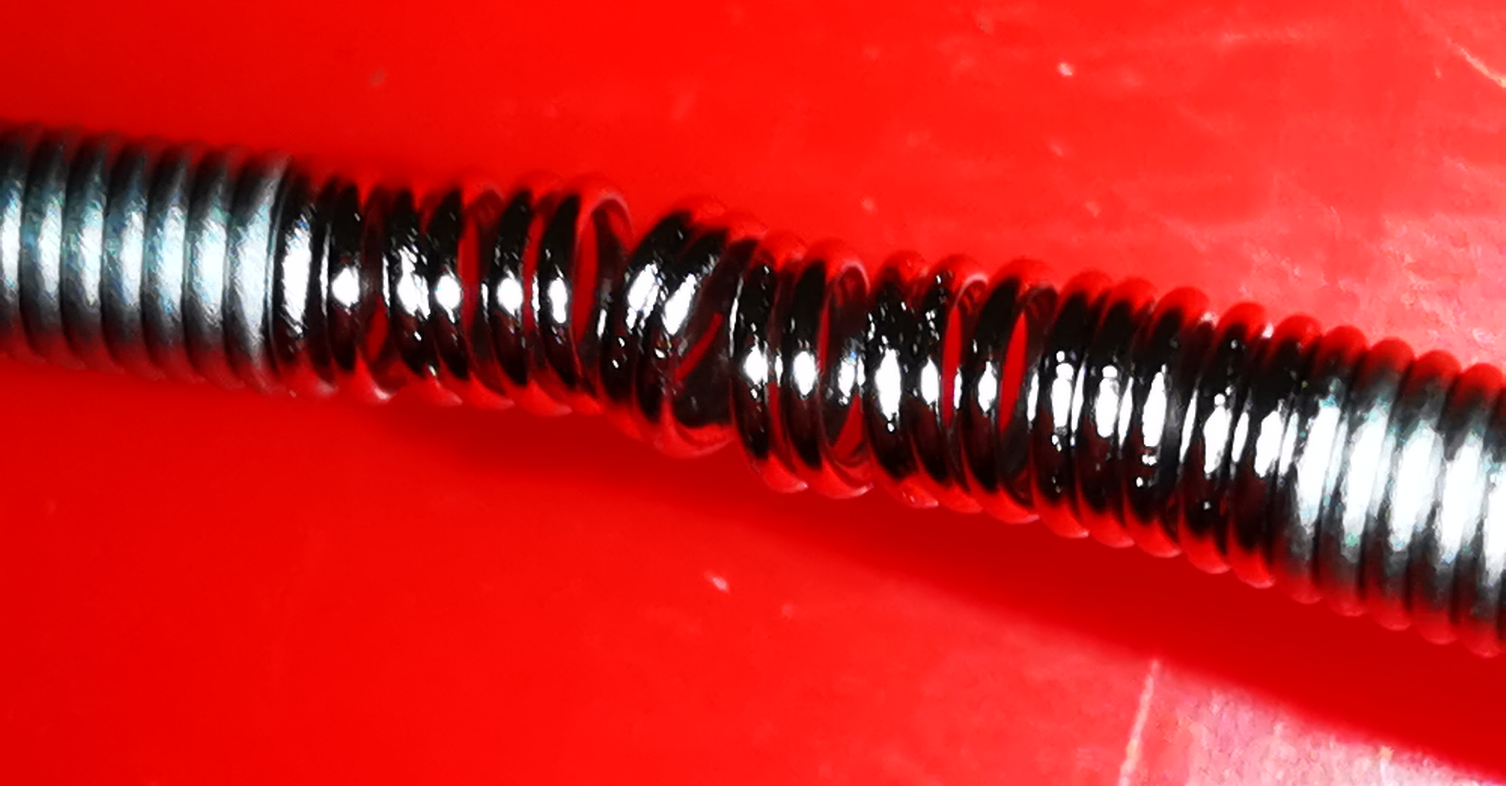
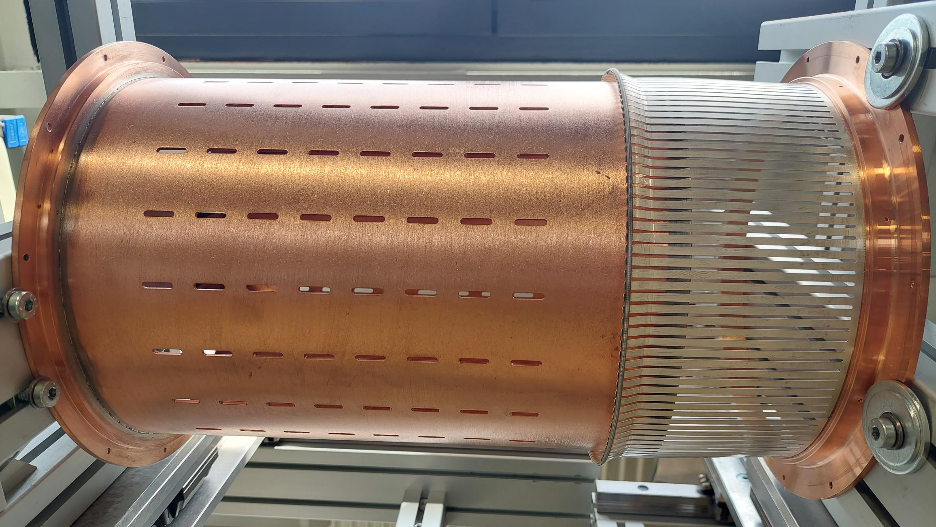
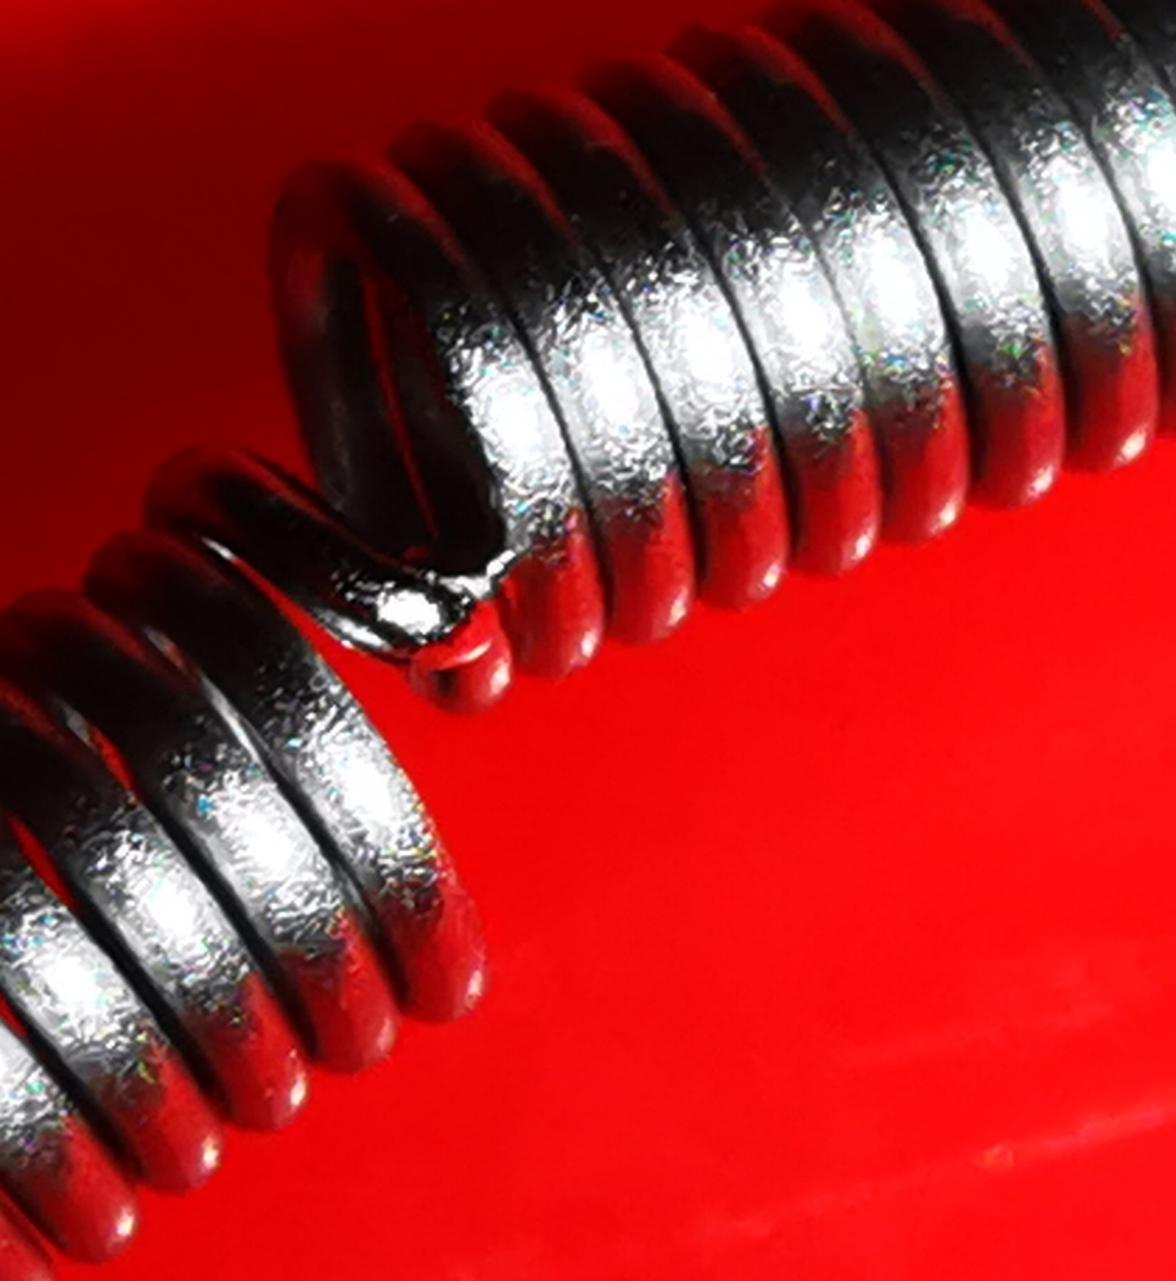
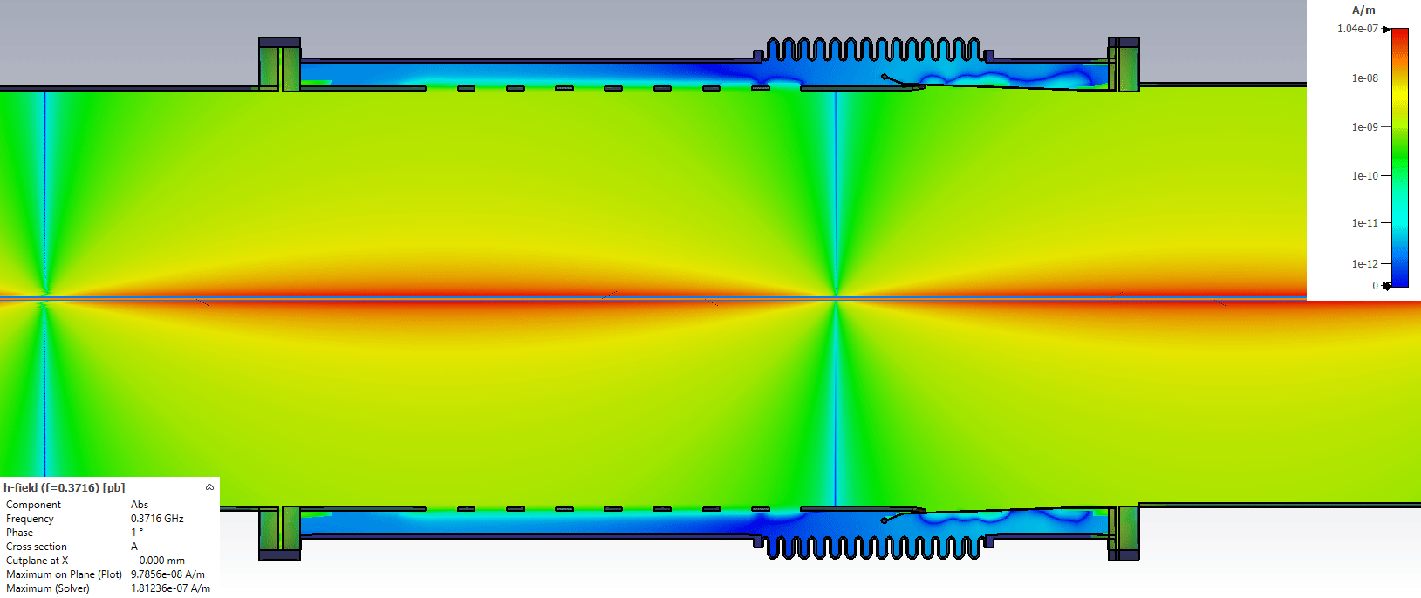
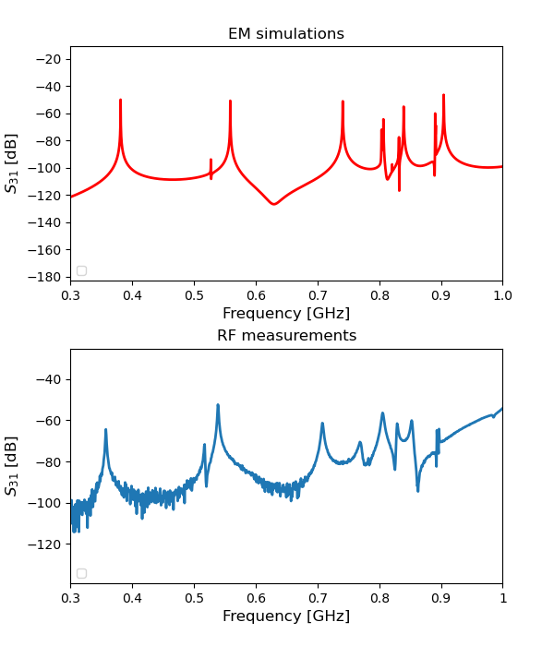
LHC vacuum module: impedance understanding
2023: Pressure spikes and impossibility to fill the LHC
Localized heating on the tension spring of ID212
ID212
Tension spring
1 week downtime for LHC
RF fingers
Big effort to build an accurate impedance model to address the issue
  impedance bench measurements
  impedance simulations
Pipe tube
2023 JAP talk, C.Antuono & P.Krkotic
Validation of the impedance model

Slide 17
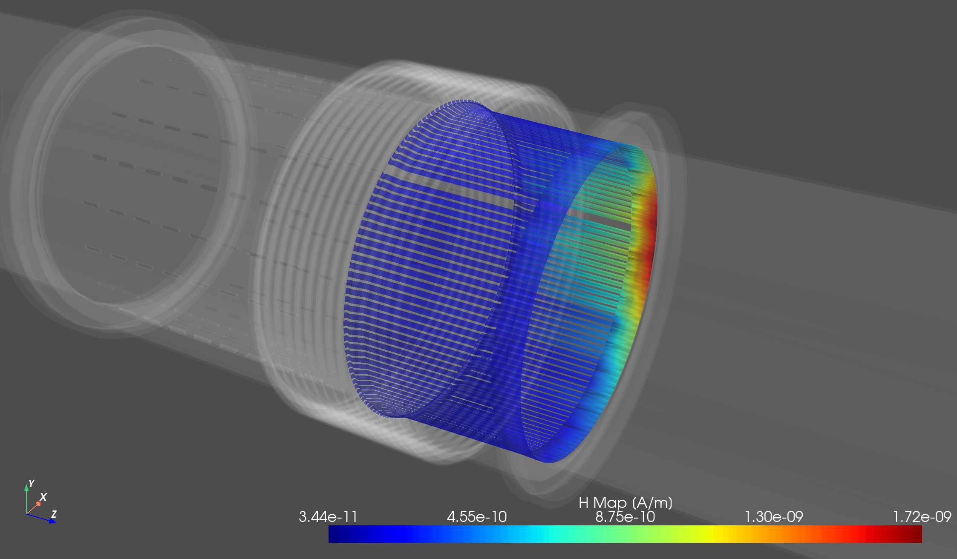
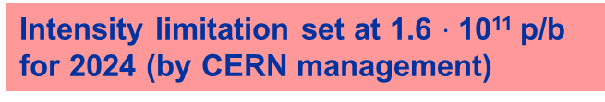
LHC vacuum module: impedance understanding
2023: Pressure spikes and impossibility to fill the LHC
Localized heating on the tension spring of ID212
ID212
Tension spring
1 week downtime for LHC
RF fingers
Big effort to build an accurate impedance model to address the issue
  impedance bench measurements
  impedance simulations
  Analytical computations using BIHC*
Pipe tube
2023 JAP talk, C.Antuono & P.Krkotic
Impedance studies revealed EM field leakage inducing localized heating on the spring compatible with the spring breakage
two beams
beam offset
non ideal contact fingers/tube
In presence of
3D plot generated with wakis
beam
Intensity limitation set at 1.6 $⋅$ 10¹¹ p/b for 2024 (by CERN management)
* https://github.com/ImpedanCEI/BIHC

Slide 18
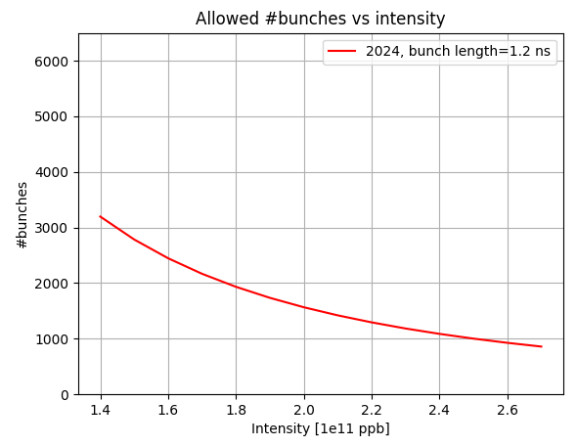

LHC vacuum module in 2024 Run
Deformable RF fingers (DRF)
Optimized unshielded bellows
Mitigation strategy:
  1. Beam operation in 2024:
    intensity limitation at 1.6e11 p/b
    interlock for bunch length lower than 1.2 ns (never reached, more on A. Calia talk)
Replace/transform ID212 spring+fingers
with newly designed modules wherever it is possible
More at the 2023 JAP talk-C.Antuono and P.Krkotic
Year | Numbers of . ID212
2023 | 71
2024 | 24
Intensity limitation 1.6 $⋅$ 10¹¹ p/b
2358
No pressure spikes or failure detected in 2024

Slide 19
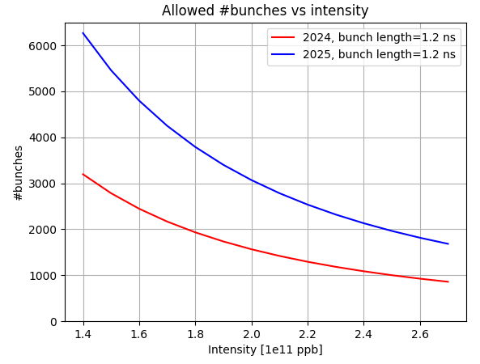
LHC vacuum module in 2025 Run
Mitigation strategy:
  1. Beam operation in 2024:
    intensity limitation at 1.6e11 p/b
    interlock for bunch length lower than 1.2 ns (never reached, more on A. Calia talk)
  Replace/transform ID212 spring+fingers with newly designed modules wherever it is possible
Year | Numbers of . ID212
2023 | 71
2024 | 24
2025 | 4
Beam induced heating at least halved compared to the heating of the failed ID212
1 beam

Slide 20
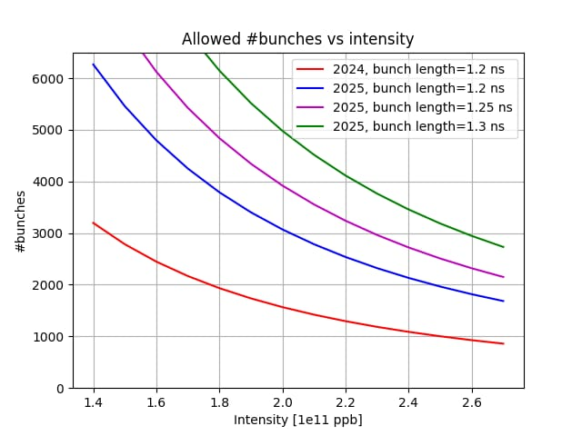
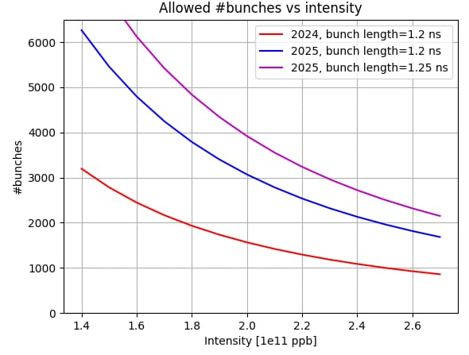
LHC vacuum module in 2025 Run
Mitigation strategy:
  1. Beam operation in 2024:
    intensity limitation at 1.6e11 p/b
    interlock for bunch length lower than 1.2 ns (never reached, more on A. Calia talk)
  Replace/transform ID212 spring+fingers with newly designed modules wherever it is possible
Year | Numbers of . ID212
2023 | 71
2024 | 24
2025 | 4
2700
Beam induced heating at least halved compared to the heating of the failed ID212
1 beam

Slide 21
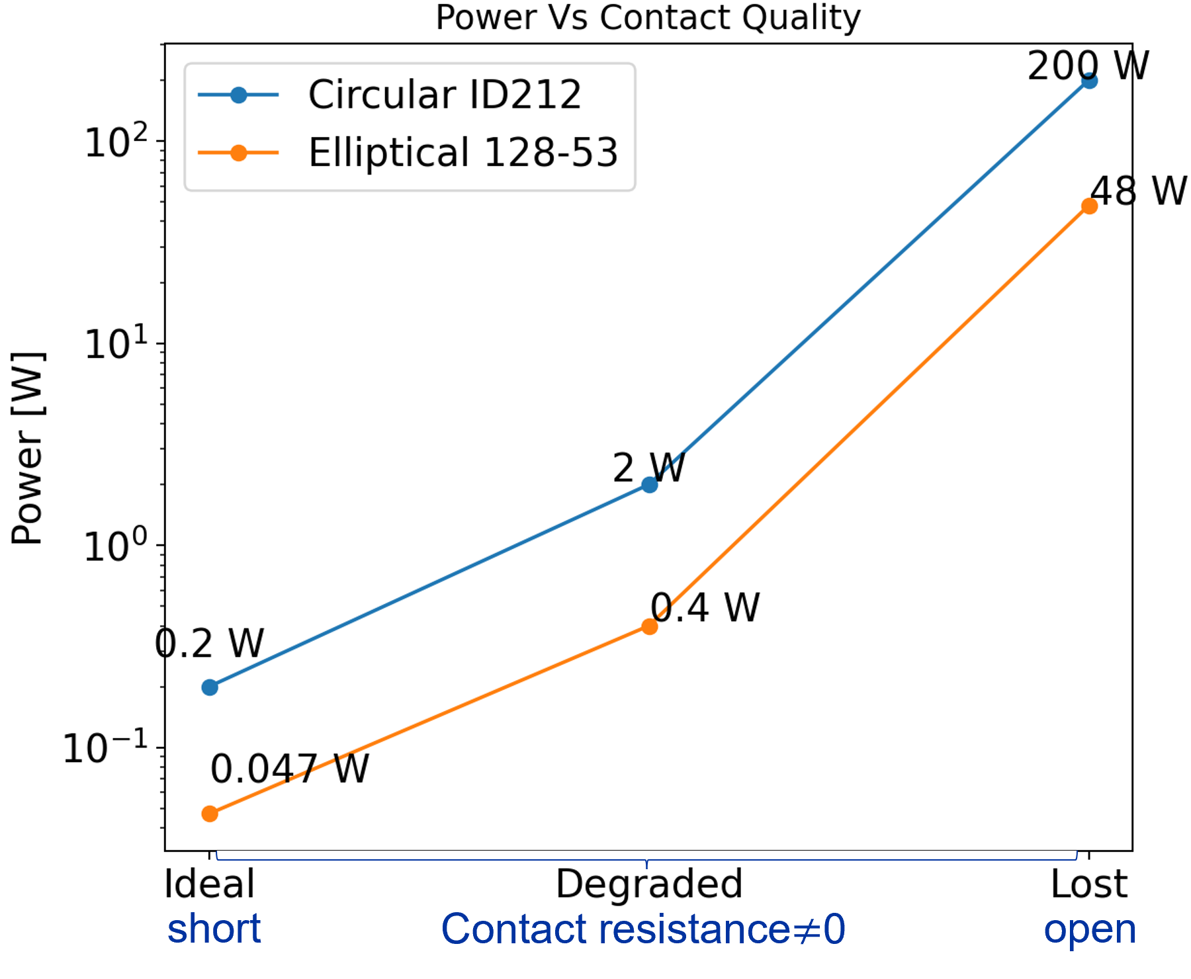
LHC vacuum module in 2025 Run
What about the other modules with the critical spring+fingers design ?
1. Smaller ID expected to be less critical (C. Zannini talk at Chamonix ‘24)
Elliptical modules
  The most dangerous (bigger aperture 128-53) already significantly less critical w.r.t circular ID212
  Failure can still be reached depending on the contact quality
The bottleneck is the circular ID212
These curves can be lifted up by removing the remained 4 ID212
Expected failure

Slide 22
3. LHC Impedance model update

Slide 23
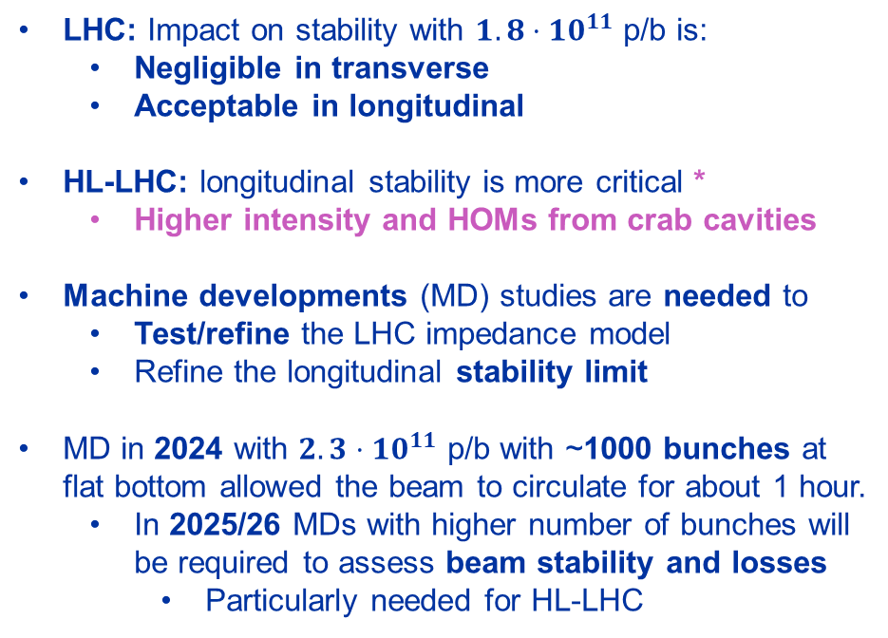
Update on LHC impedance
LHC: Impact on stability with $1.8⋅10^{11}$ p/b is:
  Negligible in transverse
  Acceptable in longitudinal
HL-LHC: longitudinal stability is more critical *
  Higher intensity and HOMs from crab cavities
Machine developments (MD) studies are needed to
  Test/refine the LHC impedance model
  Refine the longitudinal stability limit
MD in 2024 with $2.3⋅10^{11}$ p/b with ~1000 bunches at flat bottom allowed the beam to circulate for about 1 hour.
  In 2025/26 MDs with higher number of bunches will be required to assess beam stability and losses
    Particularly needed for HL-LHC
Devices to be installed during YETS 24-25
 | Longitudinal Increase of effective Im(Z/n) w.r.t . baseline* | Transverse Increase of octupolar current w.r.t .baseline*
Unshielded bellows | 0.35 mΩ | < 0.001
DRFs | 0.13-0.67 mΩ | < 0.01 A
TWO CRYST | < 0.02 mΩ | < 0.01 A
Rotated Roman Pots
CMS Double bellows | 0.45 mΩ | 0.03 A
MKIs-cool | TBC | -0.1 A
Vacuum module consolidation
Double crystal experiment in IR3
In only with stable beams
Longitudinal baseline: 75-135 mΩ *
Transverse baseline> 300 A *
current to keep the beam stable
* M. Zampetakis's talk at the HiLumi annual meeting
* C. Lannoy’s talk at the HiLumi annual meeting

Slide 24
Conclusions
Beam impedance limitations observed in the LHC and injectors during RUN 3
 | 2023
Unshielded pumping manifold
Rotary wire scanners
Vacuum module
TDIS
Injection kicker MKI-cool
2023
2024
Not limited beam operation with no hardware damage
PS
Limited beam operation with no hardware damage
SPS
Limited beam operation with hardware damage
LHC

Slide 25
Conclusions
Beam impedance limitations observed in the LHC and injectors during RUN 3
  Most of them have been addressed, particularly thanks to the development of accurate impedance models
 | 2023
Unshielded pumping manifold
Rotary wire scanners
Vacuum module
TDIS
Injection kicker MKI-cool
2024
Not limited beam operation with no hardware damage
PS
Limited beam operation with no hardware damage
SPS
Limited beam operation with hardware damage
LHC

Slide 26
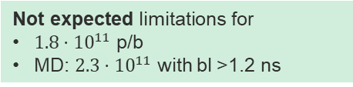
Conclusions
Beam impedance limitations observed in the LHC and injectors during RUN 3
  Most of them have been addressed, particularly thanks to the development of accurate impedance models
 | 2023 | 2024
Unshielded pumping manifold
Rotary wire scanners
Vacuum module
TDIS
Injection kicker MKI-cool
2025/26
Not limited beam operation with no hardware damage
PS
Limited beam operation with no hardware damage
SPS
Limited beam operation with hardware damage
LHC
Not expected limitations for
$1.8⋅10^{11}$ p/b
MD: $2.3⋅10^{11}$ with bl >1.2 ns
Others… | 2023 | 2024
Extraction kicker KFA14
MKP-S
Beam Gas Ionization (BGI) | Not yet installed
MKDH
Crystal goniometers
TCLD and E4R5
2025/26
To be followed up for Run 3
PSB
To be followed up for HL
- Mitigation studies
- Continuous monitoring
- Finalizing understanding
- Finalizing installations
SPS
LHC
Further understanding for higher intensity MDs
Reaching $1.8⋅10^{11}$ p/b is a key step to further exploit additional limitations during the remaining time of Run 3
  MDs with $2.3⋅10^{11}$ p/b at injection provide valuable input for refining impedance models and stability limit
Step forward the readiness of HL-LHC

Slide 27
Thank you! ☺

Slide 28
Backup

Slide 29
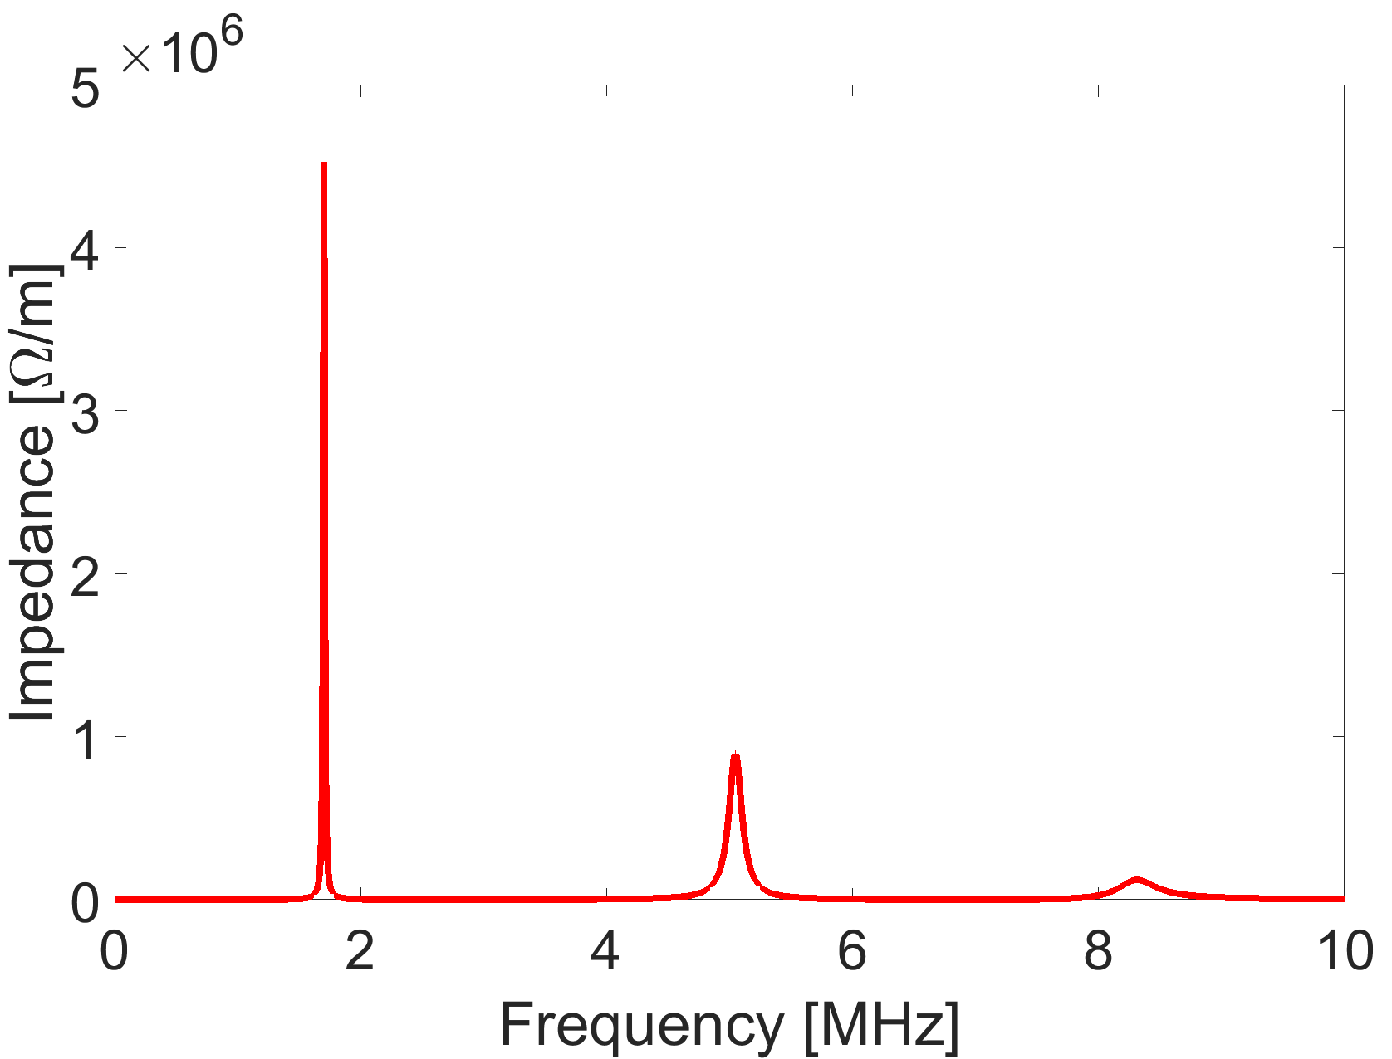
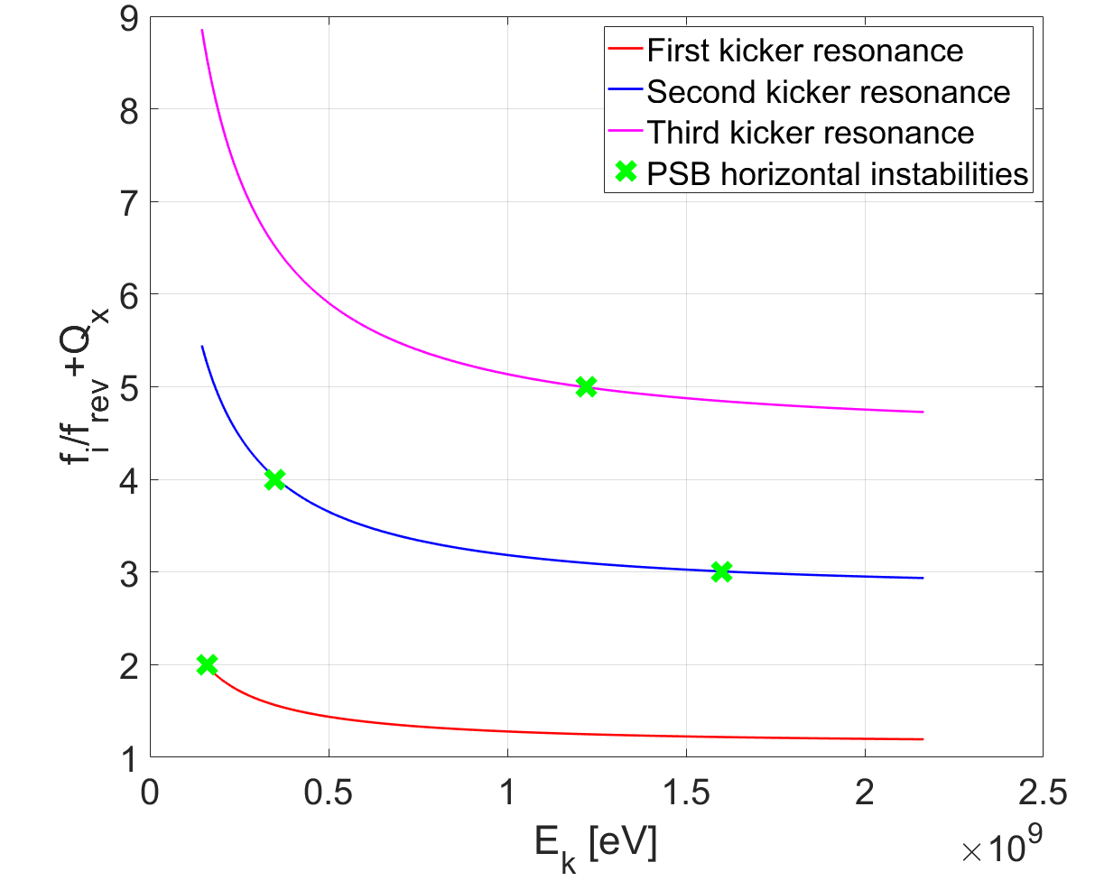
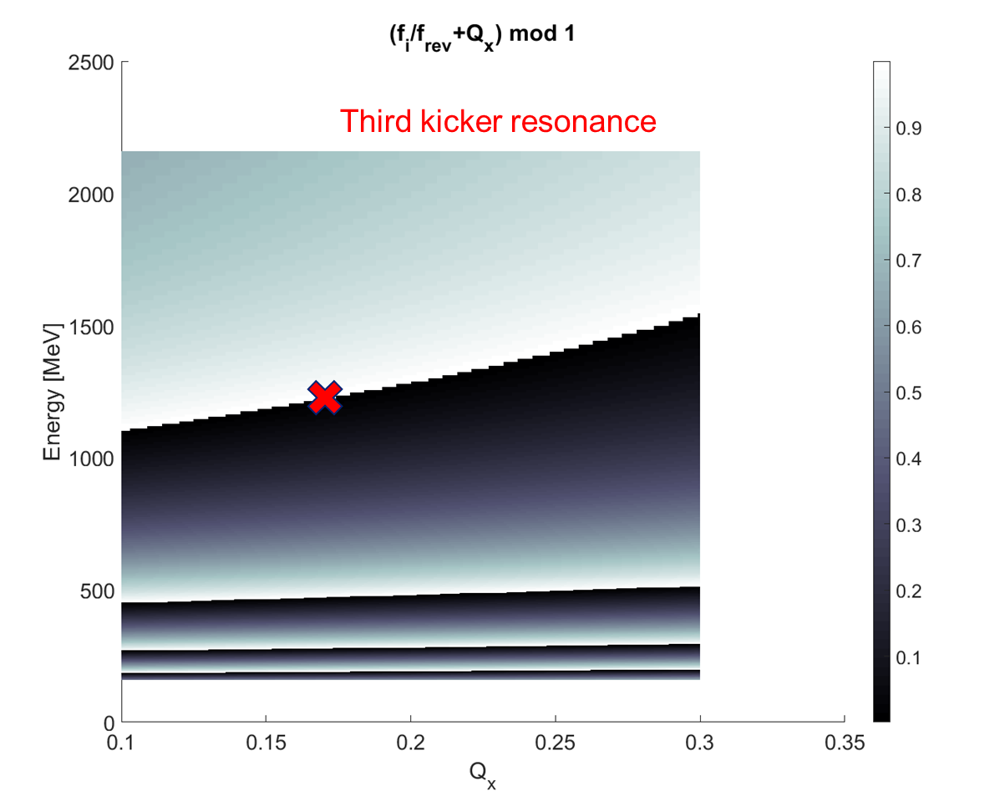
PSB extraction kicker KFA14
Latest impedance model based on more precise kicker circuit info (including filters)
C. Zannini et al. at Zermatt 2019 MCBI proceeding
PSB horizontal instability post LIU
Sacherer stability criteria
C. Antuono, et al., IPAC24
PSB horizontal kicker instability
-Not limited 2024 Run
-However, with the aim of increasing intensity (and the energy , e.g. ISOLDE) both the instabilities at 1.6 GeV and 1.3 GeV might be a limitation
Activity already observed during measurements for the 1.3 GeV instability increasing the intensity up to 1.28e13 p/b with the TFB on.
The change of tune for the 1.3 GeV to mitigate the instability (as for 1.6 GeV) cannot be done easily since the curve of energy with tune is quite flat
  tune has to change a lot to push the instability!

Slide 30
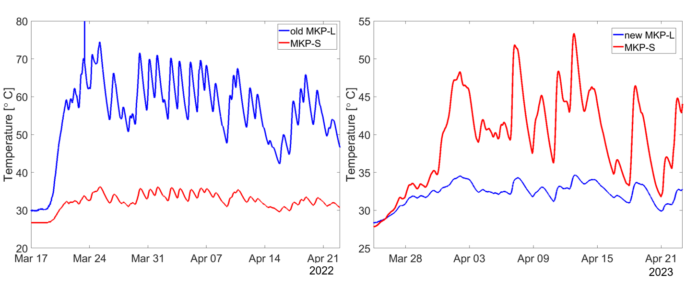

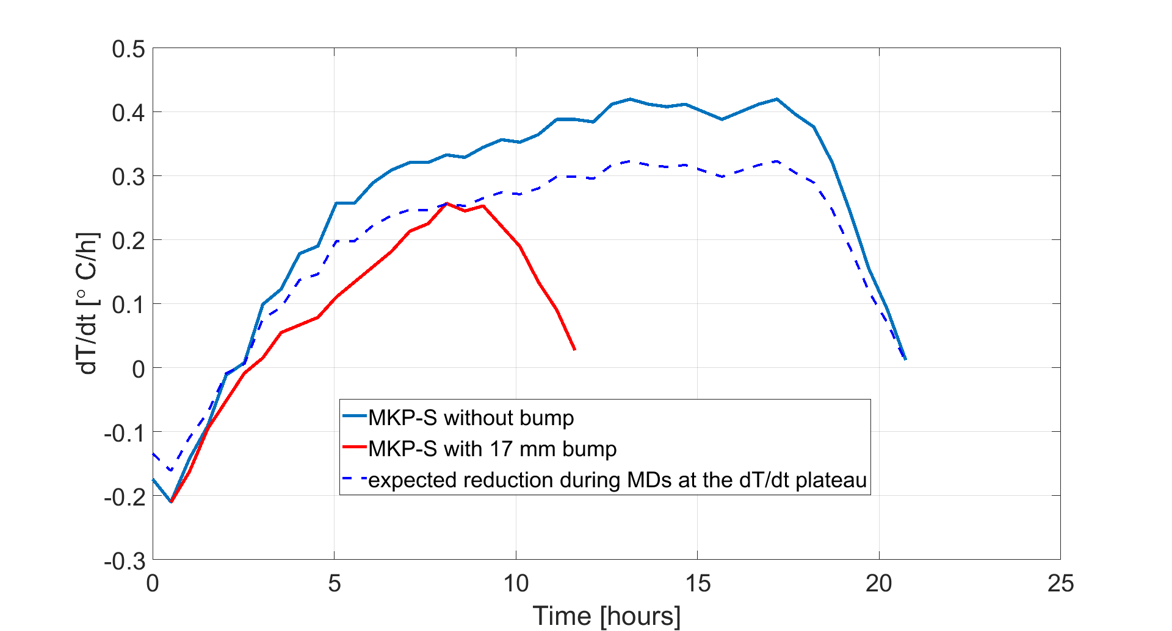
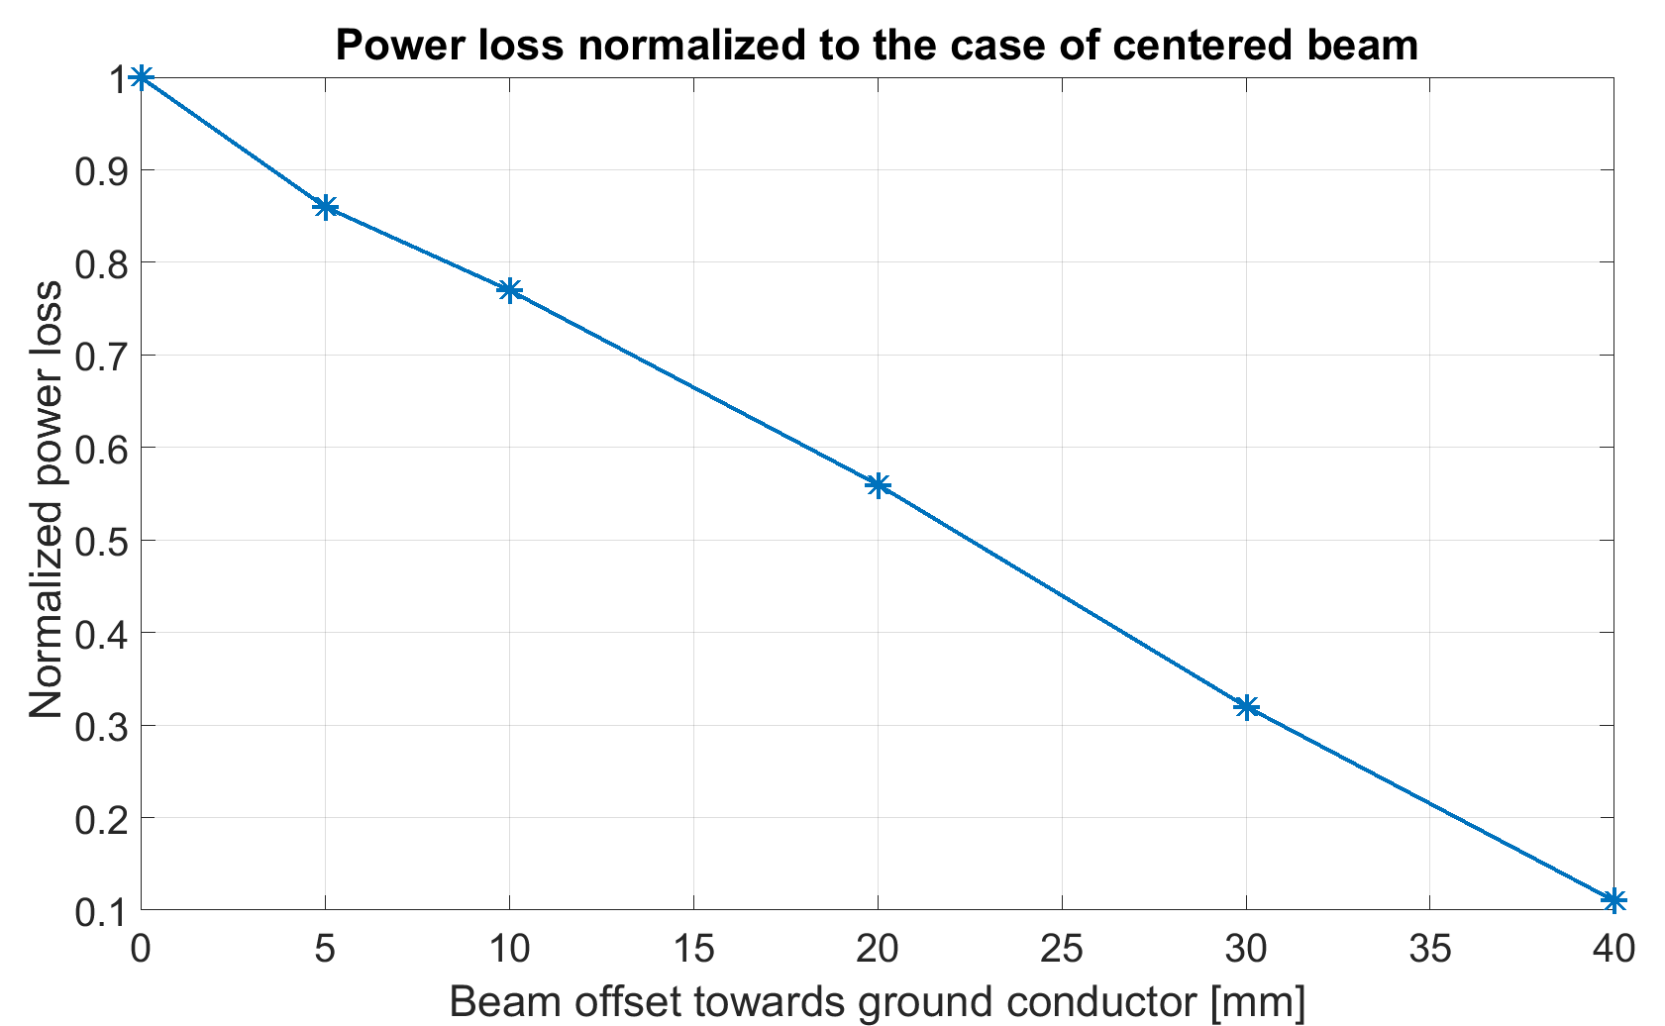
MKP-S kicker
The new MKP-L exhibits a beam induced heating significantly lower than the present MKP-S
C. Zannini at the CEI section meeting-22-02-24
Critical kicker for beam induced heating is now the MKP-S: 2023 scrubbing had to be modulated to accommodate MKP-S heating
MKP-S impedance mitigation option
10-20 mm beam offset towards ground conductor
  First test foreseen during 2024 scrubbing run
Circulating
beam
Impedance mitigation successfully tested in the SPS!
Power loss expected to be almost halved with 20 mm offset
Mitigation will be implemented during LS3

Slide 31
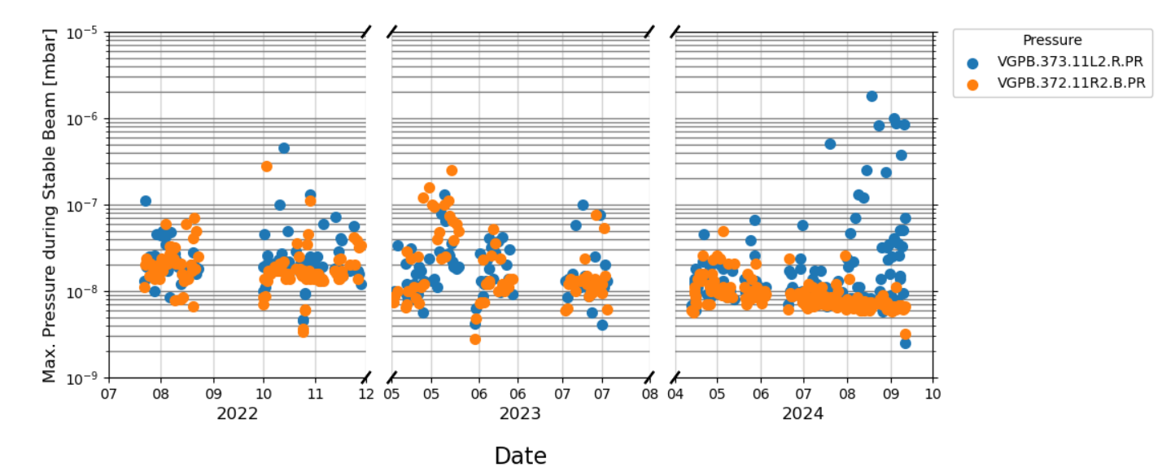

TCLD pressure spikes in the LHC
TCLD:
  Pressure spikes observation for some fills during injection and energy ramp
  Not clear if impedance is involved
  Movement of TCLD jaws show no direct correlation with the pressure spikes and with measured temperatures on the jaws
  Higher spikes (>1e7 mbar) stopped from 16th Sept. 2024

Slide 32


Pressure spikes in E4R5 sector of LHC
Courtesy of E. Metral (451st LMC meeting)
4R5:
  Pressure spikes close to interlock observation during MD at 2.3e11p/b with 1000 bunches at inj.
    They might reach interlock for future MDs with 2.3 and higher No.bunches
  Already some spikes in 2022
  Suspects:
    RF bridge close to a sector valve (possible inspection during LS3)
    Non-conformity on the BQS revealed so far (already detected during intervention in YETS 22-23)

Slide 33

Vertical Scan In Between the Jaws (half Gap 6 mm)
TDIS
Longitudinal Impedance
L. Teofili at the 37th IWG meeting
Notes:
Vertical Scan in between the jaws with half gap 6 mm.
When really close to the jaw, two modes at approximately 800 Mhz appears, in red in the picture.
The mode at 1.06 it is present in the figure.

Slide 34





TDIS
hybrid
standard

Slide 35
LHC crystal goniometers
  After years of crystal collimation in the LHC in IR7
    From 2023 channelling position of crystal was drifting during operation with strange temperature readings
      newly installed goniometers (2 devices, 1 Hor. and 1 Ver.)
    Observations demonstrated that the drift was related to the beam intensity
    Suspect on beam induced heating from Impedance on crystal and holder
      However, the expected crystal drift from was in the opposite direction of the observed one
      Suspect fell on tank movements (maybe coming from different causes) and sensor will be installed in YETS24/25
      Ongoing studies/to be followed up
    No limitation in 2024 ion RUN thanks to an implemented automatized crystal positioning correction
      HL ion intensity already surpassed the HL goal
  Crystal goniometers might be a concern for new experiments using crystal with higher proton intensity
    TWOCRYST plans low-intensity tests
    Future experiments based on double-crystal setups, like ALADDIN ,need new design compatible with nominal HL proton beam

Slide 36





SPS-BGI impedance study
NEG coated ceramic cathode
Titanium coated ceramic rod
H. Bursali, C. Vollinger, CERN internal note
Problem
Loss of communication (synchronisation) with Timepix3 dataout signals & corruption of pixel matrix registers during:
  AWAKE cycle after bunch rotation, and
  LHC25NS cycles.
Timepix3 recovered after reloading registers (100 ms - 1 s).
Communication problem not observed on any other beams (SFTPRO, LHC3.)
Courtesy of H. Bursali, J. Storey, E. De La Fuente

Slide 37


SPS-BGI Impedance Study
Beam
Signal & Low Voltage Feedthroughs
EMC Lab* Findings & Actions
Radiated RF from the HV cable, coupling to the signal cables, is a plausible mechanism for the SPS BGI EMI problems.
Found -45dB coupling between stretched wire & HV cable, but no direct coupling between stretched wire and Timepix3 signals.
Timepix3 inside Faraday Cage
High Voltage Feedthrough
Actions during YETS 24/25:
Add shielding to both HV & signal cables;
Fit ferrites to the HV cable.
On the new SPS BGI-Vertical install denser Faraday shield over the detectors.
Courtesy of J. Storey , 94th IWG meeting
(*) Many thanks to Daniel Valuch (SY-RF)

Slide 38

MKDH – SPS beam dump kicker system
Feasibility study ongoing for a ceramic chamber that can fit spares and operational magnets MKDH (currently 3 MKDH, 2 different types).
Ceramic chamber mainly foreseen to improve conditioning and avoid missing kicks.
Optimization of the chamber design ongoing to prevent impedance issues as well as high voltage ones.
  Alumina tube coated on the inside with Cr₂O₃:
    has a low SEY
    does not produce dust in the vacuum system
    is beneficial for high voltage issues
More info in G. Favia talk, “ABT Equipment: Operational Insights and Future Perspective”).
Courtesy of Dylan Standen

Slide 39


LHC longitudinal impedance and Loss of Landau Damping
Instability thresholds at flat bottom for 𝑉rf = 8 MV:
HOM - $R_{sh}=4×71 kΩ, f_{r}=582 MHz$
BB - ${\left(ImZ/n\right)}_{eff}=0.075 Ω$, $f_{r}=5 GHz$
*
I. Karpov, Special Joint WP2/WP4/WP7 meeting, June 2024
*LHC design report

Slide 40



LHC longitudinal impedance and Loss of Landau Damping
Observation of oscillation amplitude (measurements vs. simulations) allows extraction of effective impedance ImZ/n and cut-off frequency
➔ Discrepancy between recent measurements and simulations was observed (M. Zampetakis, et al., HL-LHC collaboration meeting 2024)
Investigation of the validity of the longitudinal impedance model is crucial. Missing components?
Larger oscillation amplitude in measurements wrt simulations suggests that:
→ Lower cut-off frequency is needed to match
with simulations,
→ Keeping same LLD threshold for lower cut-off
means to have higher Im(Z/n).
$$N_{p}^{th}∝\frac{V_{rf}τ^{4}}{{\left(\frac{ImZ}{n}\right)}_{eff}f_{r}}$$
LLD intensity threshold:
¹I. Karpov, T. Argyropoulos, E. Shaposhnikova, Phys. Rev. Accel. Beams 24, 011002, 2021

Slide 41

I.Karpov at IWG
[6] O. S. Bruning et al.,“LHC Design Report”, CERN Yellow Reports: Monographs, CERN, Geneva, Switzerland, 2004

