Slide 1
Fixed Target Beams & Challenges for the Future
Beam dynamics modelling ← → Operation
P. Arrutia
with contributions from S. Albright, M. Algelly, C. Antuono, F. Asvesta, D. Banerjee, M. Calviani, H. Damerau, G. P. Di Giovanni, Y. Dutheil, L. Dyks, M. Fraser, A. Gorn, A. Huschauer, L. Le, B. Mikulec, T. Prebibaj, S. Rothe, F. Velotti, Q. Vuillemin
JAPW 2024 (15’ + 10’)
11/12/2024

Slide 2
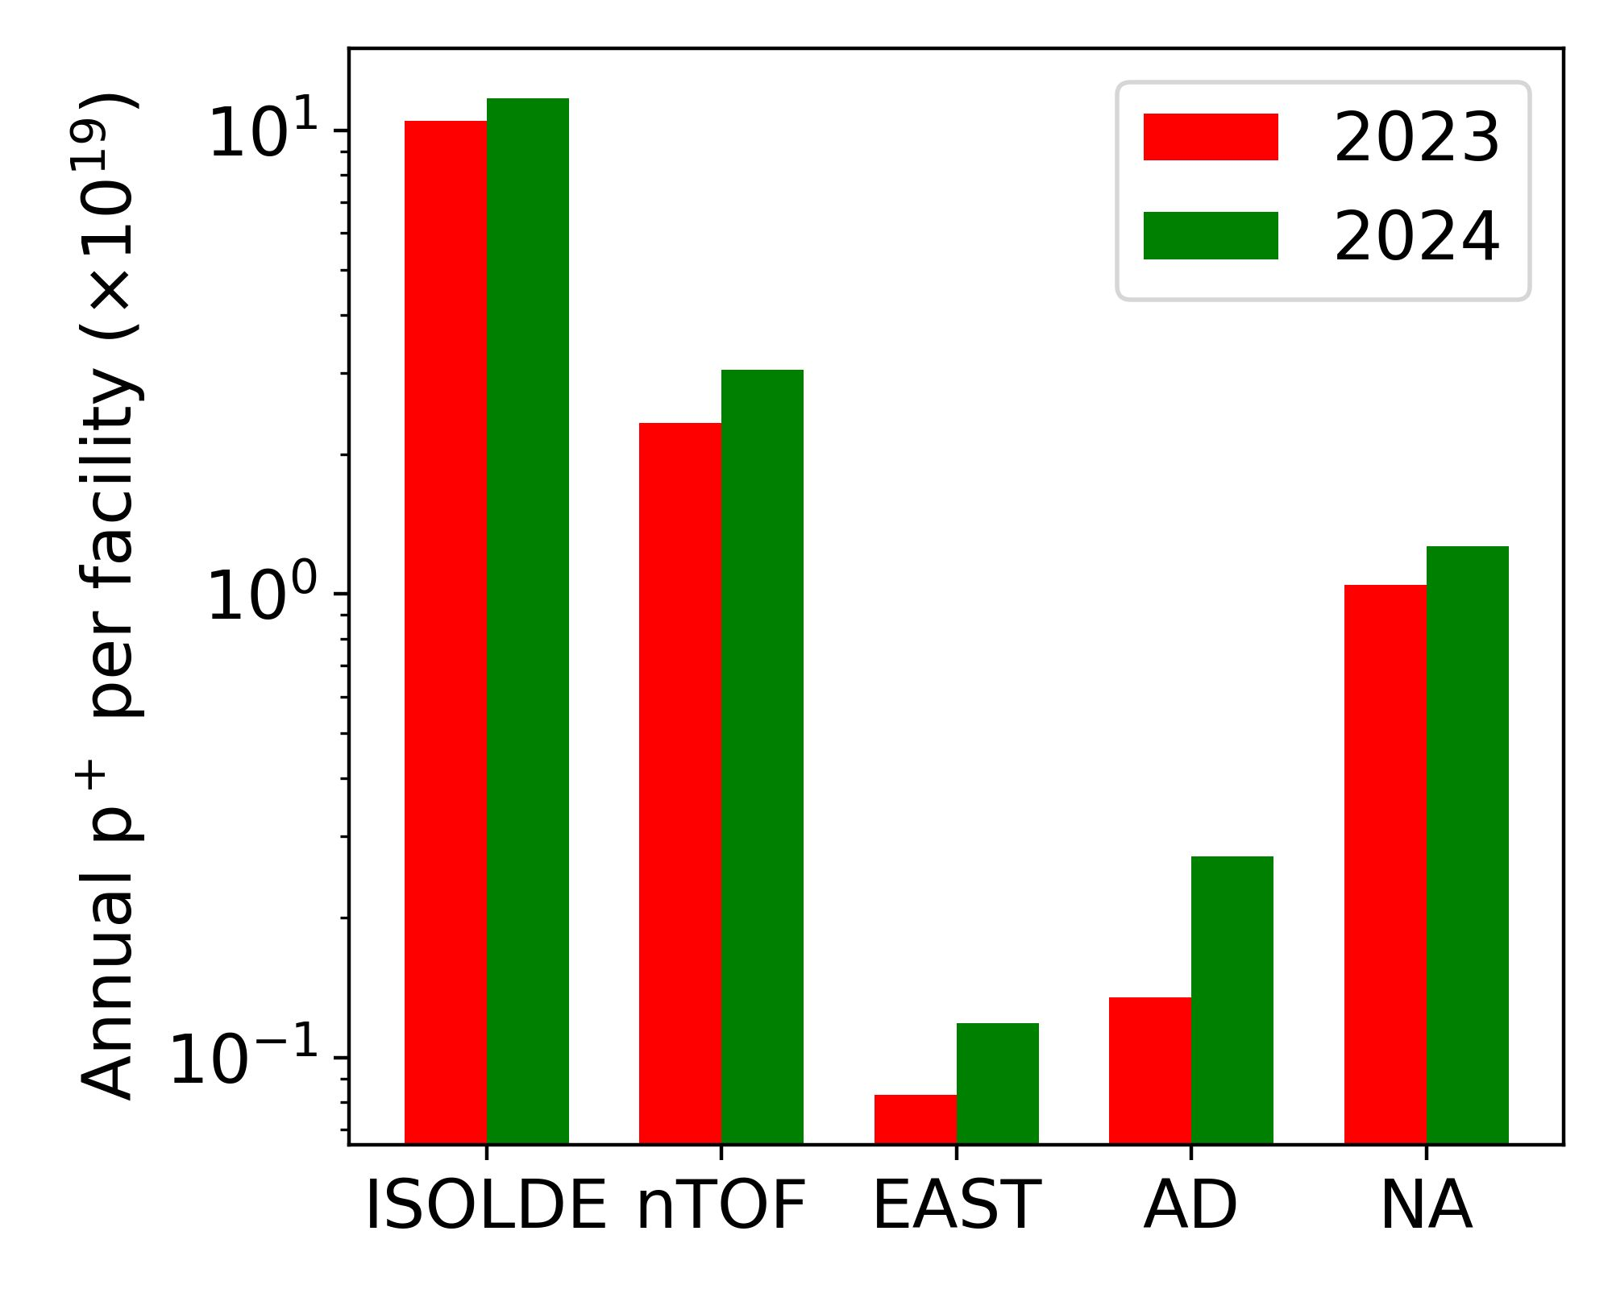
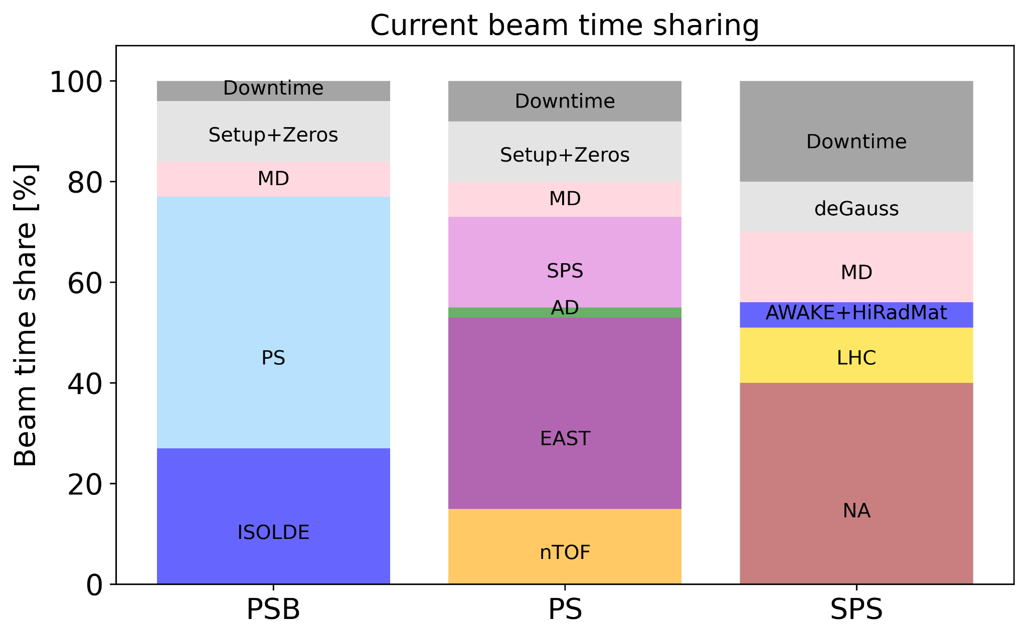
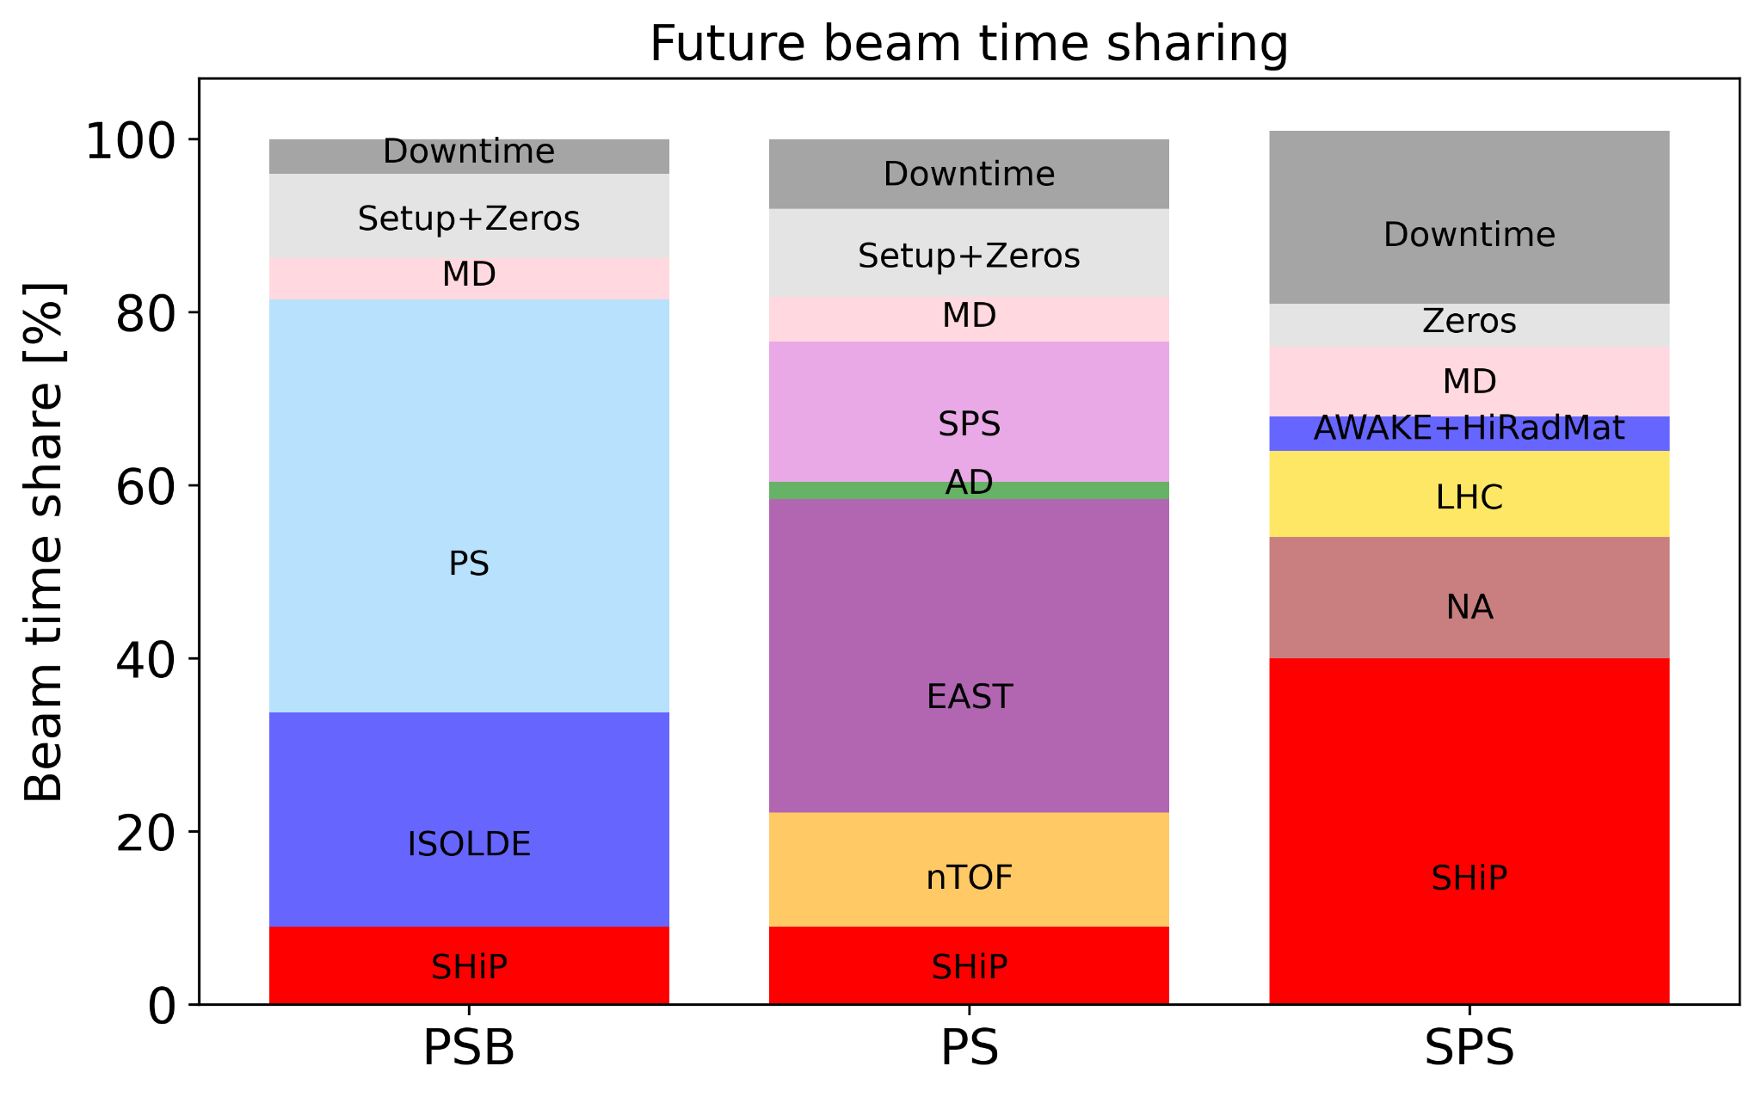
Introduction
Fixed target destinations are the largest “particle and cycle consumers” across the complex.
Demand expected to increase post LS3, with SHiP entering the North Area.
Requests to extend ion runs (incl. proton+ion parallel operation) must also be considered within this landscape.
Efforts split across different projects and working groups: IPP, SLAWG, bSAC, SOX, CONS, Future Ions, Hi-ECN3…
Challenge for the future: make the particle-pie bigger and/or share it more effectively.
*
SHiP
[1]
[1] T. Prebibaj
(*) indicative only

Slide 3
Outline
*Underlined references typically contain hyperlink
ISOLDE
nTOF
North Area

Slide 4
Outline
ISOLDE
nTOF
North Area

Slide 5
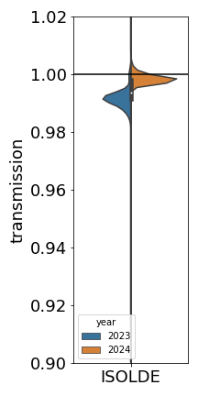
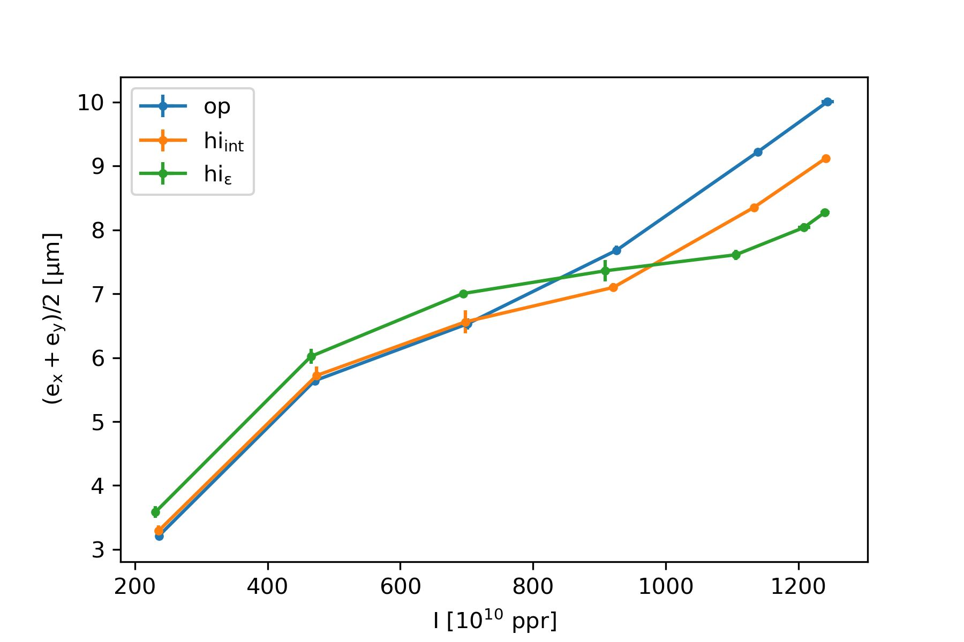
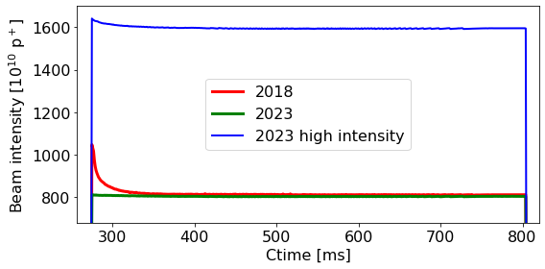
High(er) intensity
Successful ISOLDE operation, with better transmission w.r.t. 2023 (e.g. improved octupole resonance correction) [1]. High intensity MDs:
Up to 5e13 protons per pulse both to HRS and GPS (nominal 3.2e13).
Exploration of maximising transmission and minimising emittance w.r.t. Intensity.
Remaining: emittance limits due to extraction apertures, exploration of limitations for 2 GeV (impedance/instabilities & RF).
[3]
Max RF
@1.4GeV
Max SC
@1.4GeV
Max inj
1300
1600
1800
[1] F. Asvesta, PSB MPC 2024
[2] F. Asvesta, G.P. Di Giovanni, 2024
[3] T. Pebibaj, IEFC 2024

Slide 6
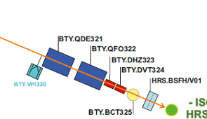
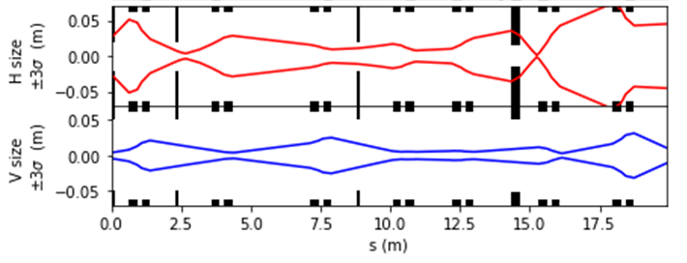
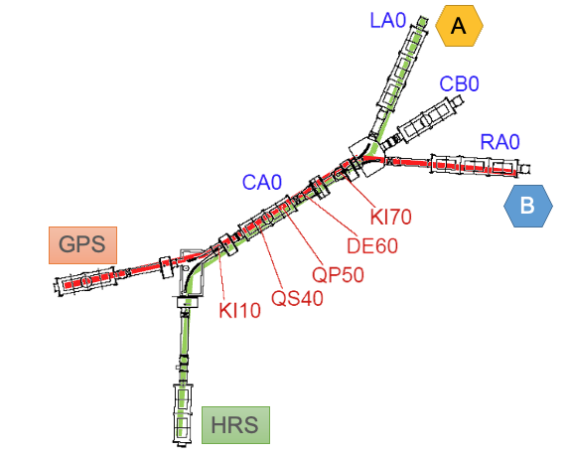
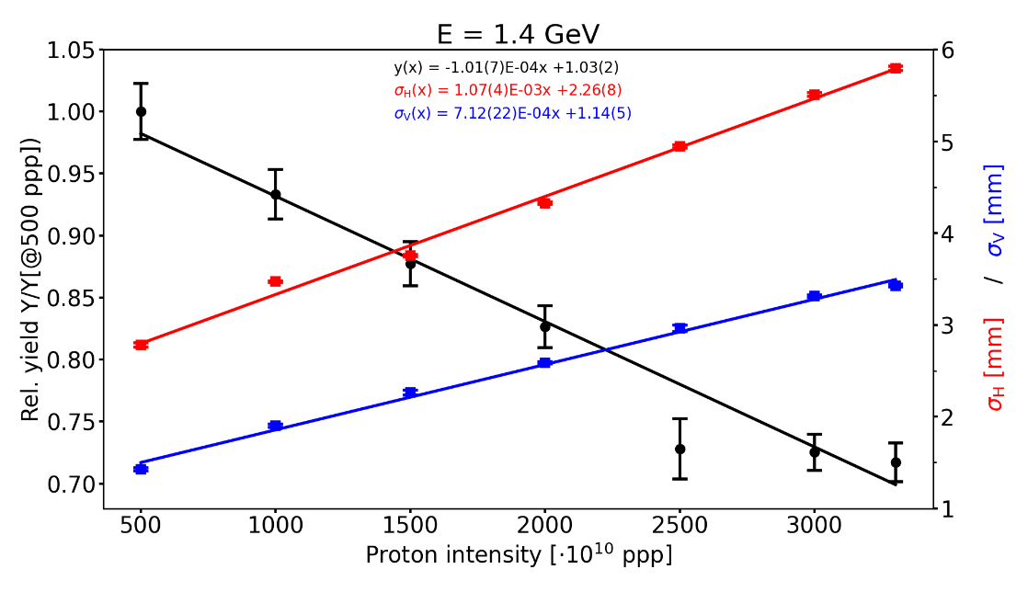
Facility upgrade
[1]
Opti
nOpti
Aiming to have multi-energy/target/intensity operation -> with great flexibility comes…
Ongoing: Auto-optimisation of BTY steerers and final focus (using yield and/or RP monitors) [1].
Ongoing: optics models for low-energy lines -> migrate to LSA paradigm (planned LS3) [2].
Ongoing: design limit for ISOLDE Beam Dump Replacement need to be finalised.
Post LS3: HRS/GPS parallel operation (software and/or hardware upgrades needed) [3].
Yield vs. pulse intensity
[2]
[3]
[1]
[1] S. Rothe, IPP 2024
[2] Q. Vuillemin, ITC 2024
[3] L. Le, S. Rothe

Slide 7
Outline
ISOLDE
nTOF
North Area

Slide 8
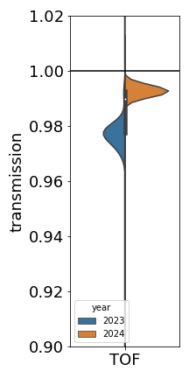
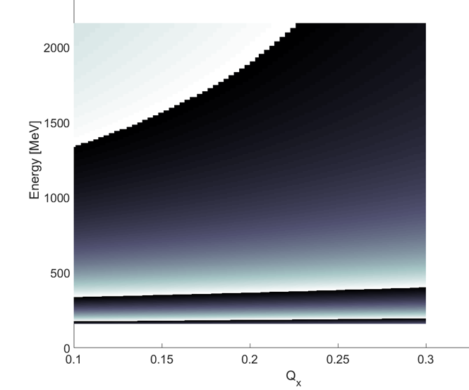
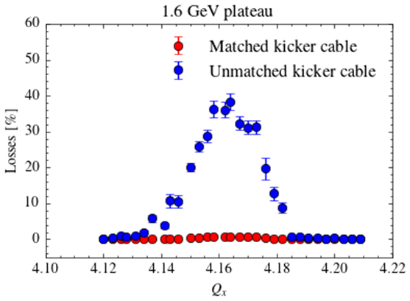
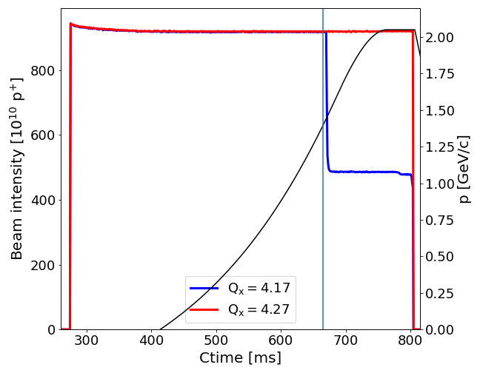
@ PSB
Successfully operated @ 2GeV with better transmission w.r.t. 2023 [1].
Identified cause of instability found @1.6 GeV -> unmatched kicker impedance.
Found new Qx working point, pushing instability threshold beyond 2 GeV.
Beam current (Before/After)
Unstable
Stable
Old limit, ~1.6 GeV
New limit, beyond 2 GeV
[1] F. Asvesta, PSB MPC 2024
[2] C. Antuono, IPP MD 2023

Slide 9
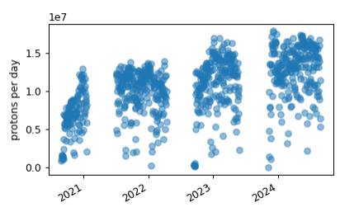
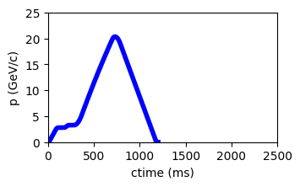
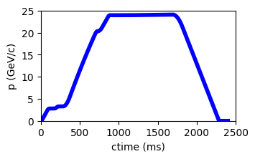
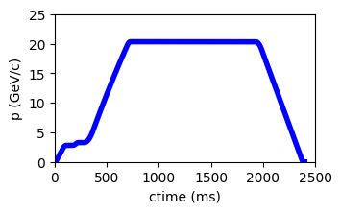

High-flux TOF @ PS
1e17
High-flux run Aug-Sep 2024, pushing the limits for all TOF cycles [1].
Running close to target limit (2.2e12 p+/s -> 1.9e17 p+/day).
Double-TOF as option to sustain high-flux during supercycles with high demand from ISOLDE -> interlocks being discussed to avoid extracting both bunches together.
 | Dedicated | Parasitic
Pre high-flux ppp | 0.85e13 | 0.35e13
High-flux ppp | 0.92e13 | 0.82e13 (T9, TN), 0.35e13 (T8)
Double (formerly BAT)
2x0.7e13
TOF extr.
EAST extr.
[1] A. Huschauer, Y. Dutheil, IPP 2024

Slide 10
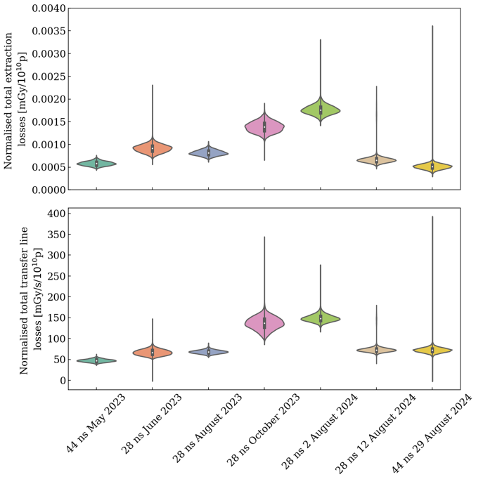
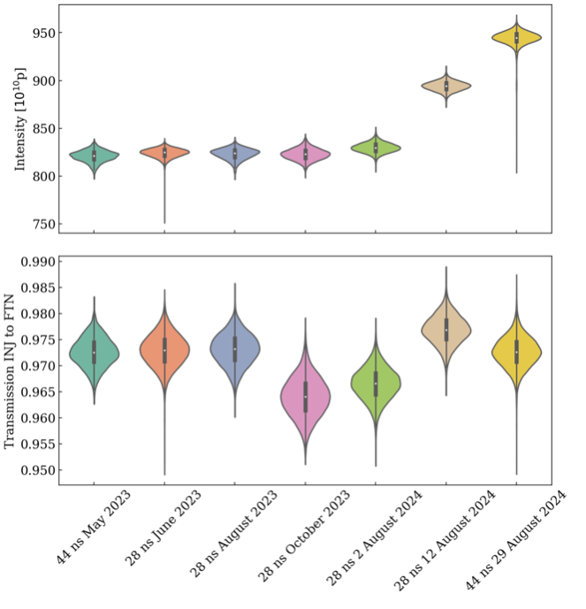
High-flux TOF @ PS: Losses
Transmission and norm. losses kept under control. Ongoing:
Interlock update to use brightness instead of beam size just upstream of target (remains a software interlock*).
Assessment of required RP cooldown time in case of equipment failure requiring intervention in FTN.
Optimisation of PS and FTN
1000
Target limit
Without loss in transmission
[1] A. Huschauer, Y. Dutheil, IPP 2024
*The interlock prevents sending the NEXT SHOT to the target.

Slide 11
Outline
ISOLDE
nTOF
North Area

Slide 12
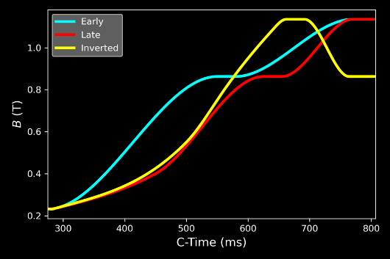
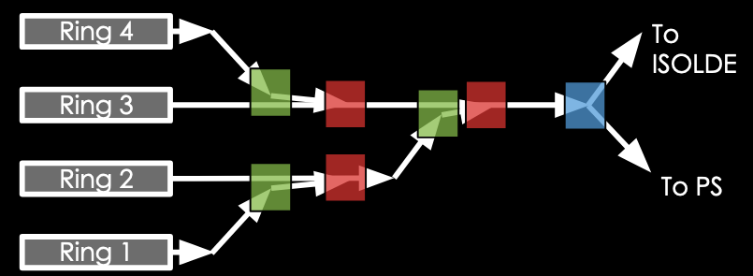
PSB Ring sharing
RMS too high
155 ms switch
113 ms switch
Idea since 2000s to provide nTOF and ISOLDE beams within same PSB cycle using ring-by-ring destinations [2].
TOF extr.
ISOLDE extr.
Option 1, “slow” switching:
Hardware required: BT.BHZ10 power converter for polarity switch (? CHF), BE3.SMH15 separate tank (100kCHF) and converter (100kCHF).
Condition: ISOLDE 1.4GeV* AND TOF + ISOLDE in SCycle AND not double-TOF
*Due to mains RMS current limit
[1]
New PC + chamber
New PC
[1]
Option 2, “fast” switching:
Hardware required: kicker, 2 septa replacing BHZ deflecting into 2 independent dipoles (one to BTM, one to BTP) -> 2.5 MCHF in 2000
Condition: TOF + ISOLDE in SCycle AND not double-TOF
Replace w/ septa
New Kicker
[1]
Kicker
Septum
Switching magnet
[1] S. Albright, IPP 2024
[2] C. Carli, PPC 2000

Slide 13
Outline
ISOLDE
nTOF
North Area

Slide 14
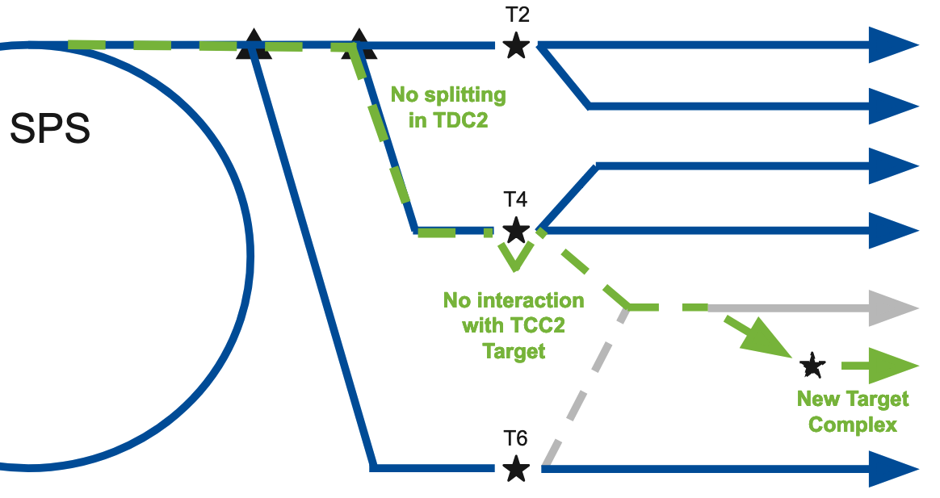
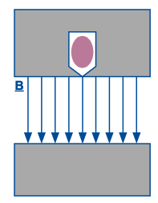
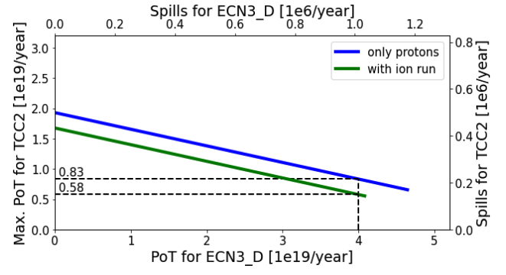
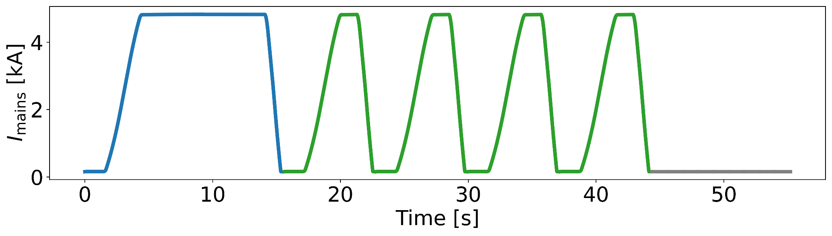
Sharing scenarios
Post-LS3, the SPS will aim to provide 4e19 p/year to SHiP in the HI-ECN3 facility, in addition to 1e19 p/year to T2+T4+T6 (comparable to 2023, 2024).
Baseline: 4.2e13 p/spill slow extracted for both SHIP (not shared in TT20) and SFTPRO (shared in TT20) [1].
bSAC and SOX efforts developing “super-cycle models” to further optimise situation -> MDs requested pre-LS3 for super-cycle composition.
(1.24 if 4.8 s flattop)
(0.83 if 4.8 s flattop)
SFTPRO: 9.6 s flattop (4.8 s flattop also possible: worse for other PS/PSB users)
SHIP: 1.2 s flattop
deGauss: required to stay within NA RMS current limit (more constraining than SPS mains)
[1] T. Prebibaj, IPP 2024

Slide 15
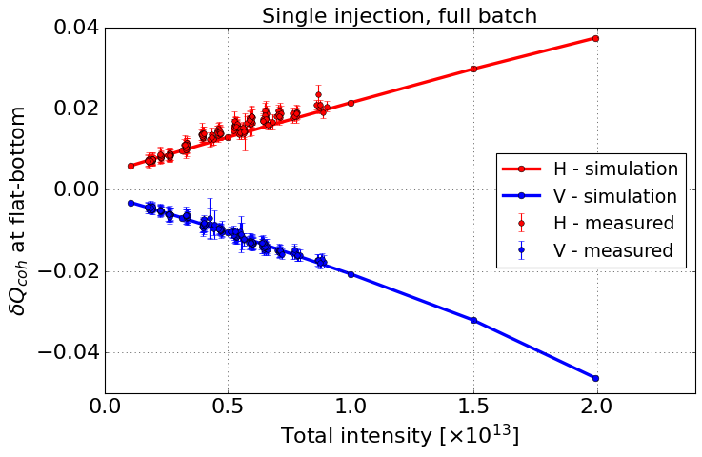
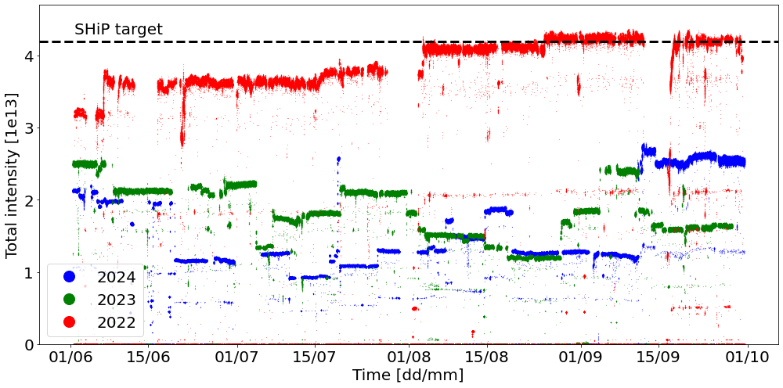
High intensity
To run at 4.2e13 p/spill and 5e19 PoT/year, extensive studies and upgrades performed and under way [1, 2].
@PSB: experience delivering intensities well beyond SHiP -> working on smaller V-emittance.
@PS: running reliably with barrier bucket, demonstrating extractions at/beyond SHiP intensity.
@PS-to-SPS, ongoing: beam loss between PS extraction and SPS flat-bottom.
@SPS, ongoing: systematic understanding of intensity-dependent tune shift.
@SPS sloex, ongoing: systematic understanding of spill quality and losses at high-intensity (not easy to study since it requires extraction all the way to the targets).
2022: reached SHiP p/spill*, but typically well below [2]
SHiP
Single injection [2]
[1] M. Fraser, IPAC 2024
[2] T. Prebibaj, IPP 2024
*Additionally, transmission was rather low across the complex.

Slide 16
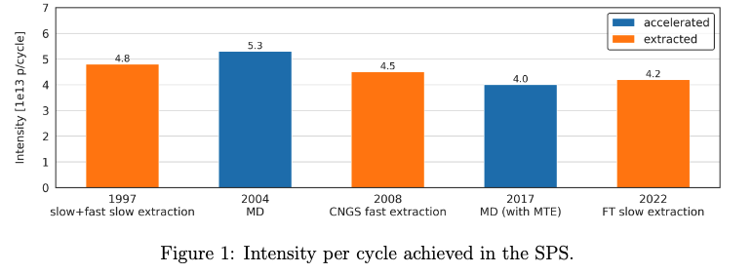
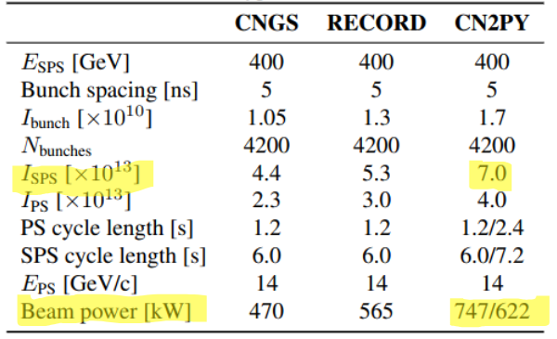
(Even) High(er) intensity
Moving beyond 4.2e13 p/spill would provide a means to provide more PoT/year or reduce the number of spills*. In addition to limitations in previous slide [2]…
@SPS: SPS internal dump (TIDVG#5) limit at 7e13 p/spill (while respecting also average power limits).
@NA, ongoing: power limits for NA interceptive devices. SHIP: BDF target. SFTPRO: TCSC, TAX, T2/T4/T6 targets.
@PS, ongoing: beam-loading compensation of Finemet to avoid barrier bucket distortion.
[1]
CN2PY aiming at 7e13 p/pulse FAST EXTRACTED (CDR)
[1] T. Prebibaj, PBC 2023
[2] BDF/SHiP, 2023
*SHiP searches extremely rare processes and is thus not rate limited. The same is NOT true for other users.

Slide 17
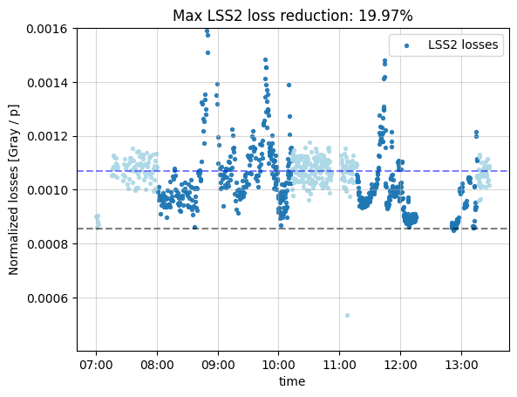

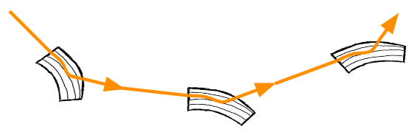
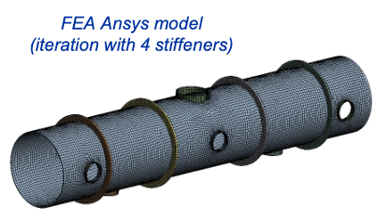

Extraction losses
MD 2024: octupole folding
[2]
Goal to keep dose to LSS2 unchanged, even when POT will be increased by 4x.
Crystal shadowing of ZS: DECRYCE project advancing to build optimised single crystals and multi-volume array (possibly pre-LS3) [1].
MD: bump, septa, octupole-folding optimisation -> 20% loss reduction [2].
Building Al ZS tank (-40% activation w.r.t. stainless steel), after extensive R&D [3,4].
Channelling
Big kick, low efficiency
Volume reflection
Small kick, high efficiency
TECA (LSS4)
To TT20
deflected
up
(...)
x
Deflected beam
ZS
circulating
down
To SPS
s
[3] F. Pirozzi SLAWG 2023
[4] H. Vincke SLAWG 2023
[1] F. Velotti, L. Esposito, SLAWG 2024
[2] A. Gorn, 2024

Slide 18
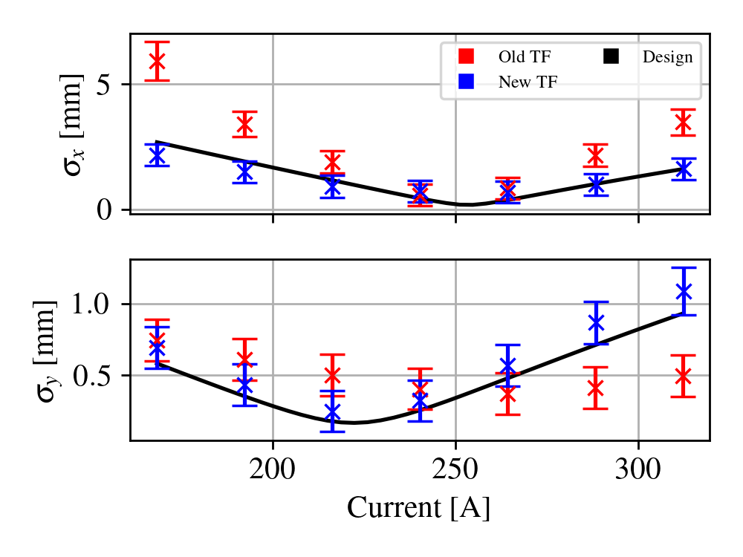
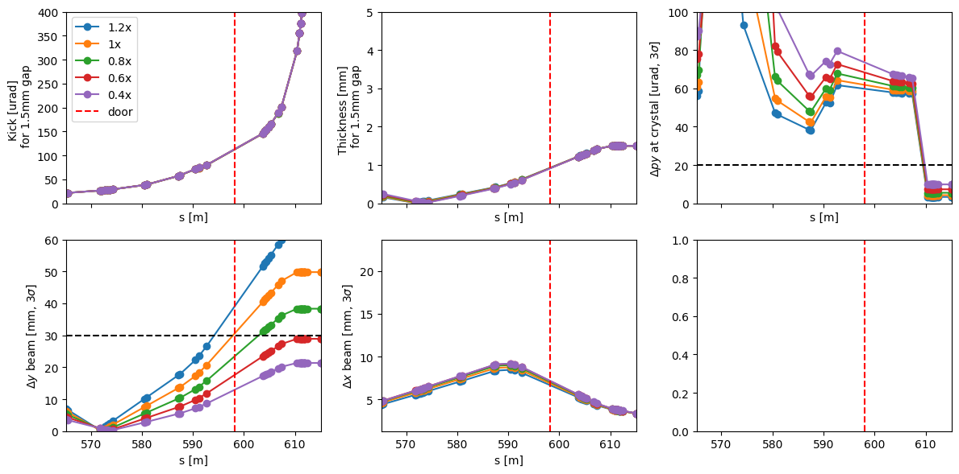
TT20 optics
Identified errors in I-to-B transfer functions for QTN, QTL (4%), QTA (1%). Deployment planned in 2025 commissioning (LHC B1 and HiRadMat lines also contain QTL).
Significantly improved agreement between model and measurements [1,2].
MD/Commissioning 2025: correct vertical beam size at splitters using optics, instead of requesting large V-emittance from PSB (would improve transmission, especially at SPS inj.).
Meas: quad scan in P42 [2]
Sim: V-size at splitter [3]
(controlled with optics)
[1] F. Velotti, SPS MPC 2024
[2] L. Dyks, 2024
[3] Y. Dutheil, 2023

Slide 19
Input from users
To ensure efficient operation and R&D, tight collaboration with users is crucial. Spill Optimisation for eXperiments (SOX) effort ongoing [1]:
Collected requirements & limitations from NA62, SHiP, AMBER, MUonE and NA64 -> direct input for beam sharing scenarios, report being written.
Developing online analysis pipeline to profit from user-relevant KPIs -> minimal example to be tested before LS3.
SY-BI using this input to inform their spill monitor R&D.
NXCALS
Offline analysis
DIP
Users compute and publish KPIs
CMW team
Creates virtual devices
UCAP converter
virtual device combines data and links it to cycle
Live applications
- GUI
- automatic feedforward
- (...)
[1] SOX, 2024

Slide 20
Outline
ISOLDE
nTOF
North Area

Slide 21
Conclusion
Exciting fixed-target beams program ahead, pushing new limits for intensity and beam quality.
Challenges spread across all machines & FT beam types.
R&D opportunities over all aspects: beam dynamics, operations, equipment, automation & controls.
Need to combine input from this presentation with input from users to prioritize amongst different options.

Slide 22
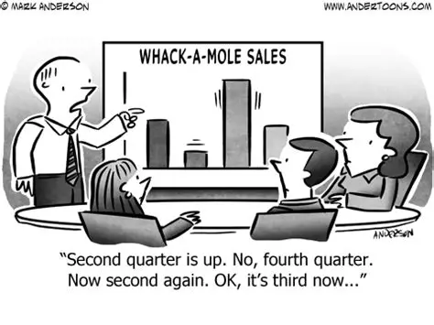
WHACK-A-MOLE BEAM SHARING

Slide 23
Extra slides

Slide 24
Topics:
Prospect of running ISOLDE with higher intensity per shot in 2025 in view of future proton sharing, and status of upgrade project
Higher intensity for TOF
Fixed-target beams: bunch length/momentum spread/beam size (PSB, PS), spill quality (PS/SPS), losses
Higher intensity requests for North-Area post-LS3 + Beamline acceptance.
Beam for BDF/SHiP and intensity increase to 7e13, future beam sharing (different scenarios for proton sharing in the SHiP-BDF time) MDs related and proposed tests before LS3.
Where do we stand concerning losses and activation for high intensity beams?
Check BPT: https://bpt.web.cern.ch
CodiMD: https://codimd.web.cern.ch/2DjlMqkCQ3uI1X-RiXJkKw?both#

Slide 25
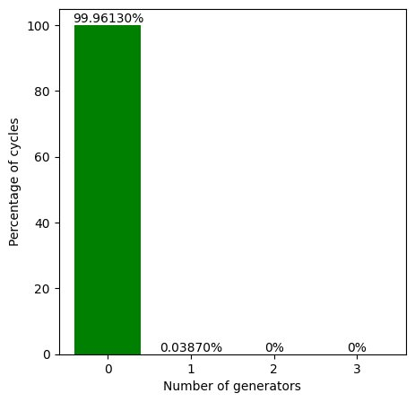
double-TOF @ PS
Not the cycle CERN deserves, but the one it needs right now?
Cycle ready & nTOF DAQ modified to take both bunches. Ongoing: Interlocks discussion to ensure bunches are not extracted together*. Collecting failure modes:
(i) all twelve KFA71-79 dump switches fail to trigger.
  Preliminary analysis of 10 million shots indicates this is highly unlikely to happen.
  Trim range can be limited and protected by MSC settings (standard across other kickers at CERN).
(ii) bunches spaced too closely from PSB.
(iii) Others
# of failed dump switches per cycle
Kick
Dump switches
trigger
All switches fail
-> extraction to TOF
One switch fails
-> dumped/lost in PS
~0.7e13 p
~0.7e13 p
time
[1] A. Huschauer, Y. Dutheil, IPP 2024
[2] M. Algelly, 2024
*SY-STI: Target limit 1e13 ppp. 10-20% excess may be tolerated for a single shot. Needs further study.

Slide 26
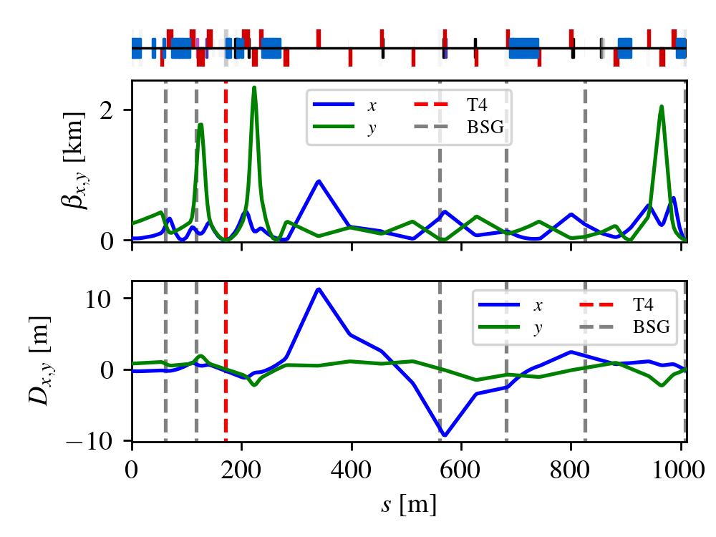
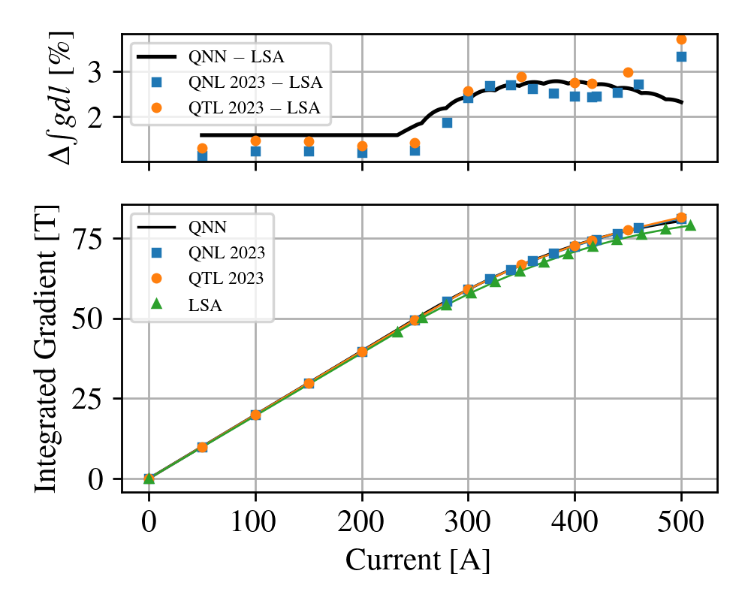
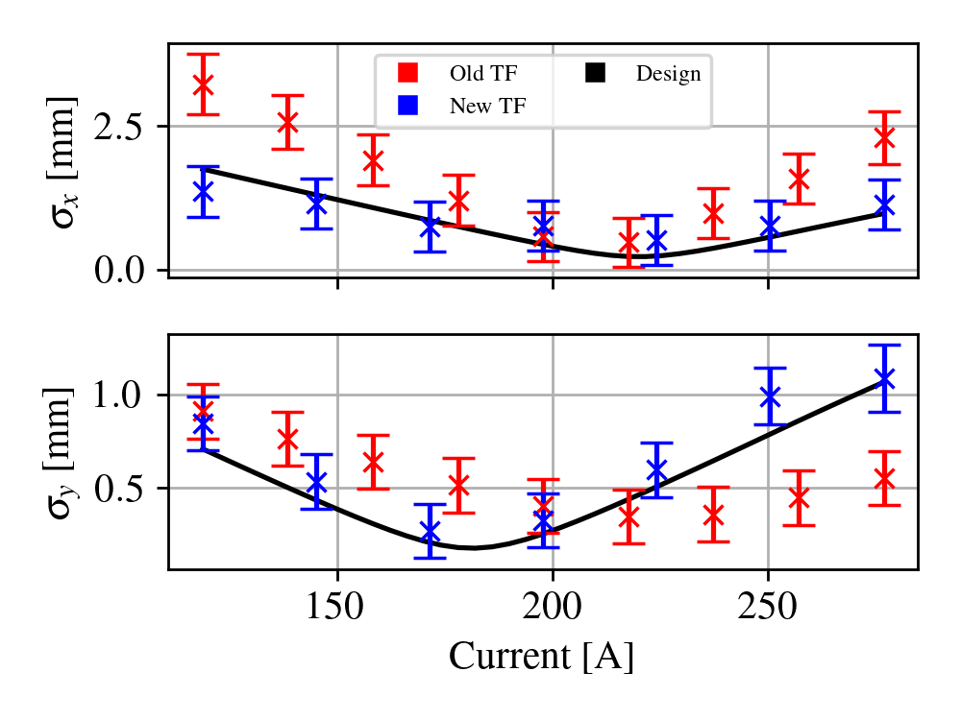
L. Dyks
TT20-P42 Optics Measurements
TODO: same with QTA
Tie it back to beam size control at splitter using optics instead of vertical emittance? -> Tie it to Foteini’s reduction in transmission.
Beam to HI-ECN3 will use dedicated optics
  Beam is not split
  Optics changed cycle to cycle
Beam loss prompted optics studies in TT20-P42 [JAPW23]
  Implied error source → QNL/QTL settings in TT20.
  P42 was already using the new QNL transfer function.
  Further studies showed QTA as 2nd leading source of error.
Big effort under NACONS to measure the transfer functions of various magnets.
  Measurements showed ~4% error in TF for QNL/QTL and ~1-2% error in TF for QTA.
MDs done using measured magnet TFs for the TT20 magnets.
Optics substantially closer to design
QTL-QNL magnetic transfer functions
TT24-P42 Dedicated Optics
Example quadrupole scans: New Vs old TFs
Measuring beam size as a function of magnet current

Slide 27
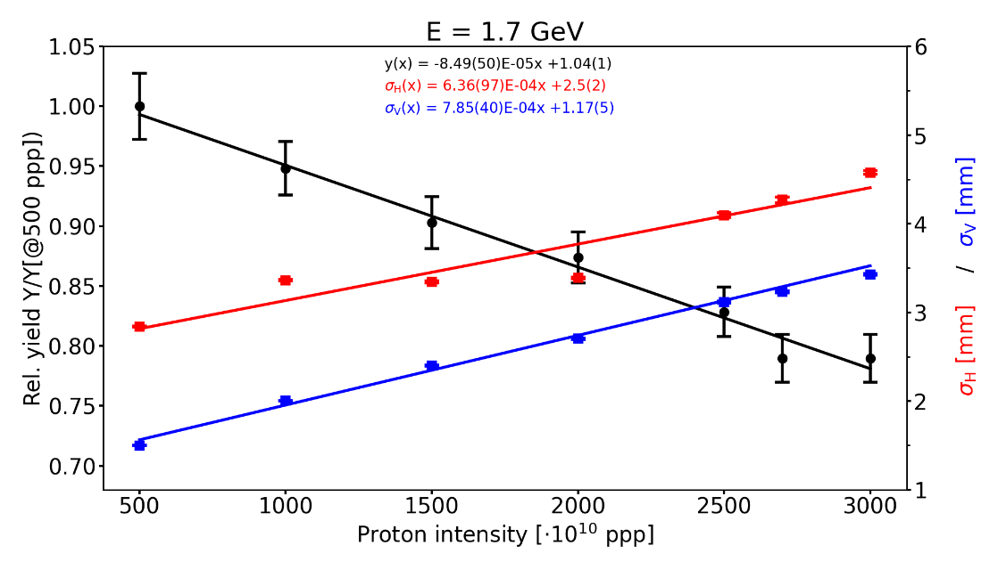
Beam size vs. yield
Better focus with higher energy – as expected
-> MD

Slide 28
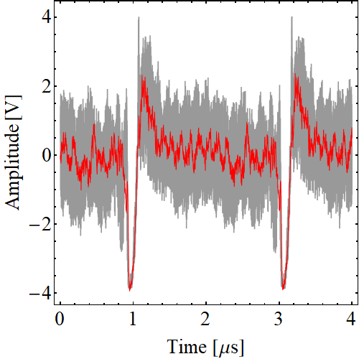

Slide 29
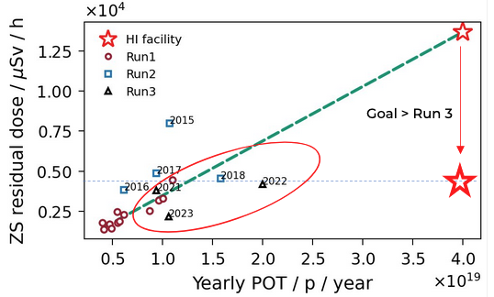

Slide 30
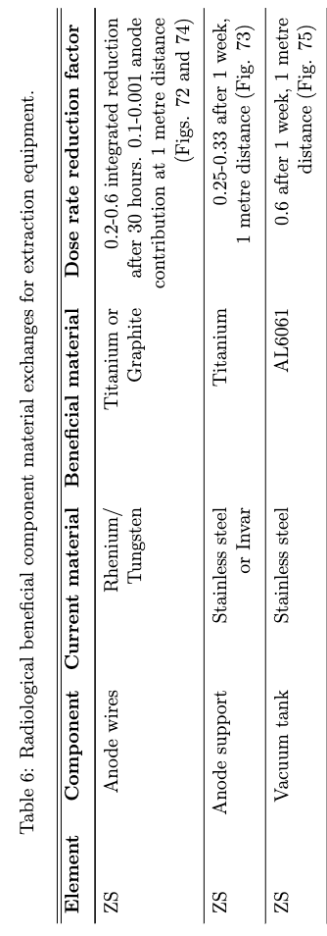
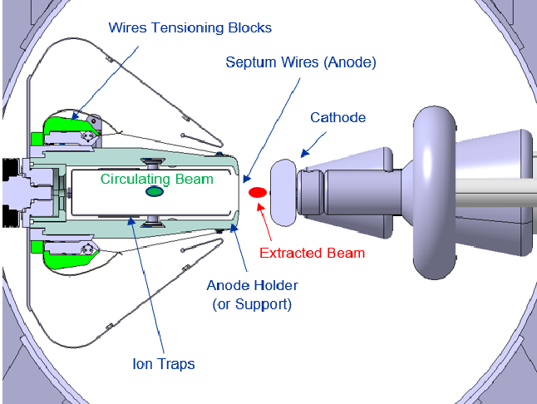
New septum materials
Hazards related to residual dose can be tackled by looking for viable low-Z materials for different septum components.
M. Fraser 2019
Slow-Extraction R&D at CERN
P. Arrutia
June 28th 2024

Slide 31
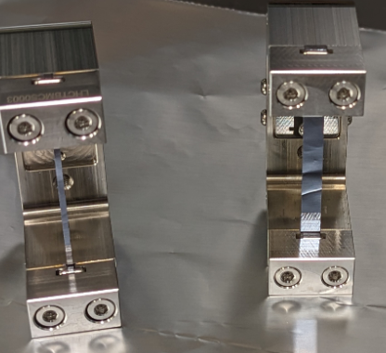
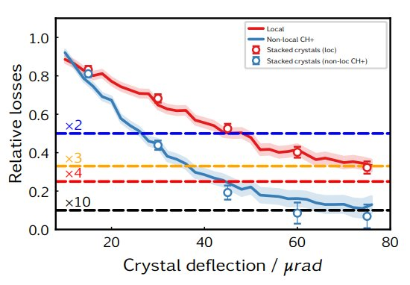
In-house crystals
DECRYCE (DEvelopment of CRYstals for Collimation and Beam Extraction) project established for CERN’s crystal needs [1]: LHC collimation, septum shadowing…
Procurement of crystal wafers
Cutting and polishing
Bender system and integration
Validation with X-ray and particle beams
Simulation: SPS with MVR array [2]
Multi-volume reflection
Slow-Extraction R&D at CERN
P. Arrutia
June 28th 2024
[1] G. Daher, L. Esposito 2024
[2] F. Velotti 2024

Slide 32
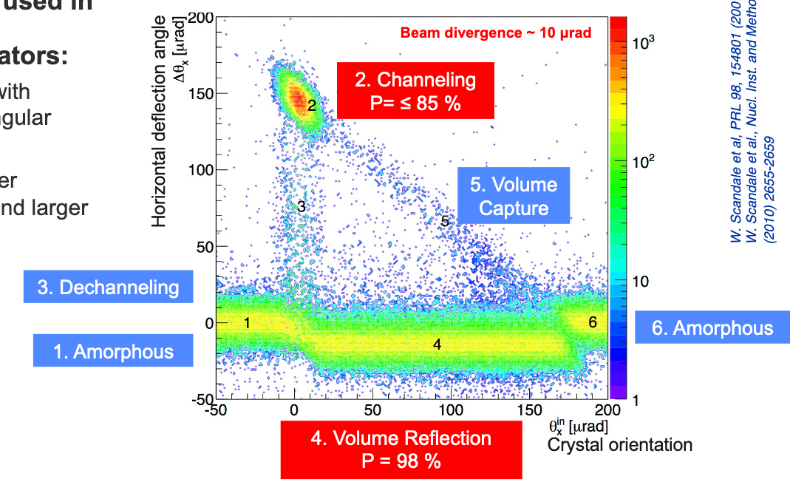
Crystal shadowing (ii)
Two regimes can be exploited for bending:
Channelling: large kick, low efficiency
Volume reflection: small kick, high efficiency
SPS crystal
at 400 GeV/c
Amorphous
scatter
Volume reflection
dechannel
channel
Slow-Extraction R&D at CERN
P. Arrutia
June 28th 2024

Slide 33
Spa review: great dry sauna, humid sauna does not get hot enough

