Slide 1
Evolution of beam quality from the injectors to the LHC
S. Kostoglou, H. Bartosik, I. Efthymiopoulos, Y. Papaphilippou, G. Sterbini on behalf of BE-ABP
With invaluable contributions from:
F. Asvesta, M. Bozatzis, X. Buffat, D. Butti, R. Bruce, A. Calia, R. De Maria, Y. Dutheil, B. Emil Karlsen-Baeck,
S. Fartoukh, J. Flowerdew, P. Hermes, M. Hostettler, G. Iadarola, E. Lamb, T. Lefevre, G. Marek,
F. Maria Velotti, I. Mases Sole, L. Mether, D. Mirarchi, C.E. Montanari, S. Morales Vigo, T. Persson,
S. Redaelli, M. Rakic, B. Salvachua, M. Solfaroli Camillocci, F. Soubelet, A. Lasheen, T. Levens, H. Timko,
R. Tomas Garcia, G. Trad, J. Uythoven, A. Valeri Radoslavova, J. Wenninger
Joint Accelerator Performance Workshop 2024

Slide 2
Motivation
Main indicators of beam quality:
  Emittance: avoiding emittance growth
  Intensity: minimizing losses & preventing beam dumps
  Tail population: preserving tails & avoiding tail increase
  from the injectors to the LHC.
Degradation starts already in the injectors and continues throughout the LHC.
Goal is to:
  Identify where the degradation occurs.
  Understand the cause.
  Evaluate the impact on LHC performance & define priorities.
  Provide recommendations to optimize performance for next year & next runs.

Slide 3
Overview
Beam quality in the injectors:
  Emittance growth PSB→ PS → SPS, standard vs BCMS beams.
  Tail population from PSB→ PS → SPS & “low-tail” BCMS.
  Losses from PS → SPS.
Beam quality in the LHC:
  Tail population SPS→ LHC & transfer line mismatch.
  Injection losses: 2024 vs 2023.
  Emittance with standard & BCMS beams.
  Emittance growth at injection beyond IBS & tail evolution.
  Debunched beam at injection & losses at the start of ramp.
  Power supply ripple at the end of ramp.
  Losses at the end of adjust & correlation with tails.
  Losses during leveling & DA.
  Losses beyond burn-off due to collisions in IP8
  Emittance growth during collisions.
Impact on integrated luminosity:
  BCMS vs standard: model vs measurements
  Reduction of losses with ”low-tail” BCMS.
  Impact of emittance growth beyond IBS.
Injection
Ramp
Lessons learned from 2024.
Collisions

Slide 4
Overview
Beam quality in the injectors:
  Emittance growth PSB→ PS → SPS, standard vs BCMS beams.
  Tail population from PSB→ PS → SPS & “low-tail” BCMS.
  Losses from PS → SPS.
Beam quality in the LHC:
  Tail population SPS→ LHC & transfer line mismatch.
  Injection losses: 2024 vs 2023.
  Emittance with standard & BCMS beams.
  Emittance growth at injection beyond IBS & tail evolution.
  Debunched beam at injection & losses at the start of ramp.
  Power supply ripple at the end of ramp.
  Losses at the end of adjust & correlation with tails.
  Losses during leveling & DA.
  Losses beyond burn-off due to collisions in IP8
  Emittance growth during collisions.
Impact on integrated luminosity:
  BCMS vs standard: model vs measurements
  Reduction of losses with ”low-tail” BCMS.
  Impact of emittance growth beyond IBS.
Injection
Ramp
Lessons learned from 2024.
Collisions

Slide 5
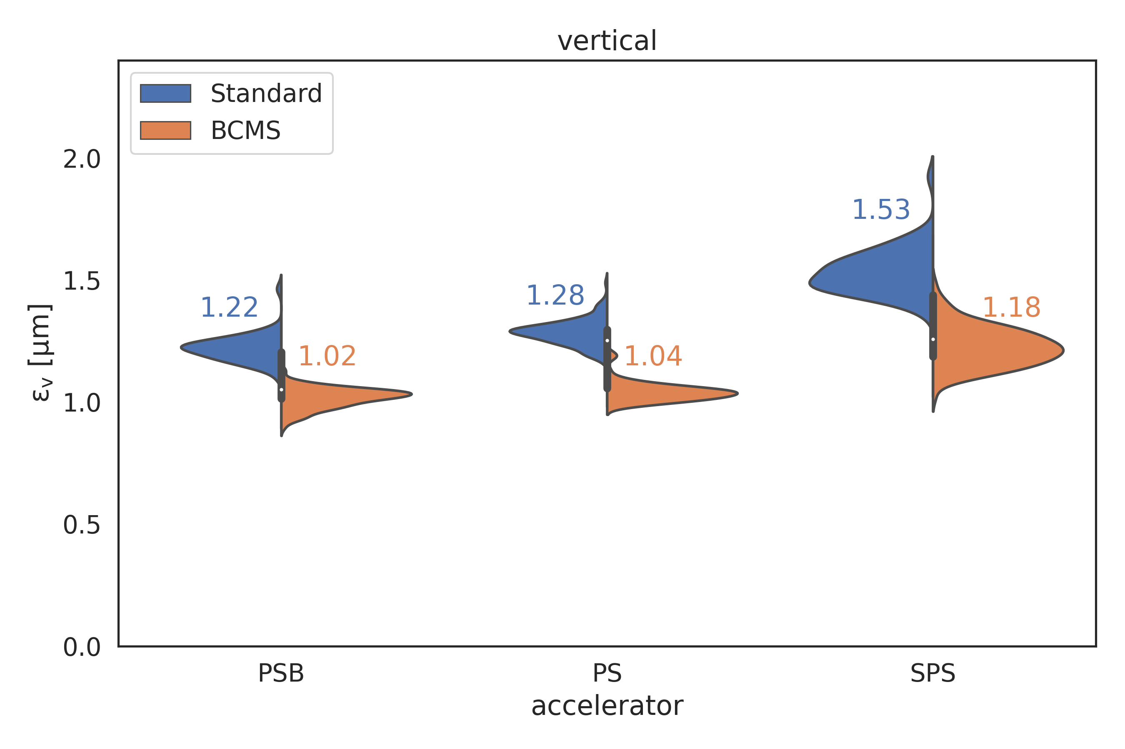
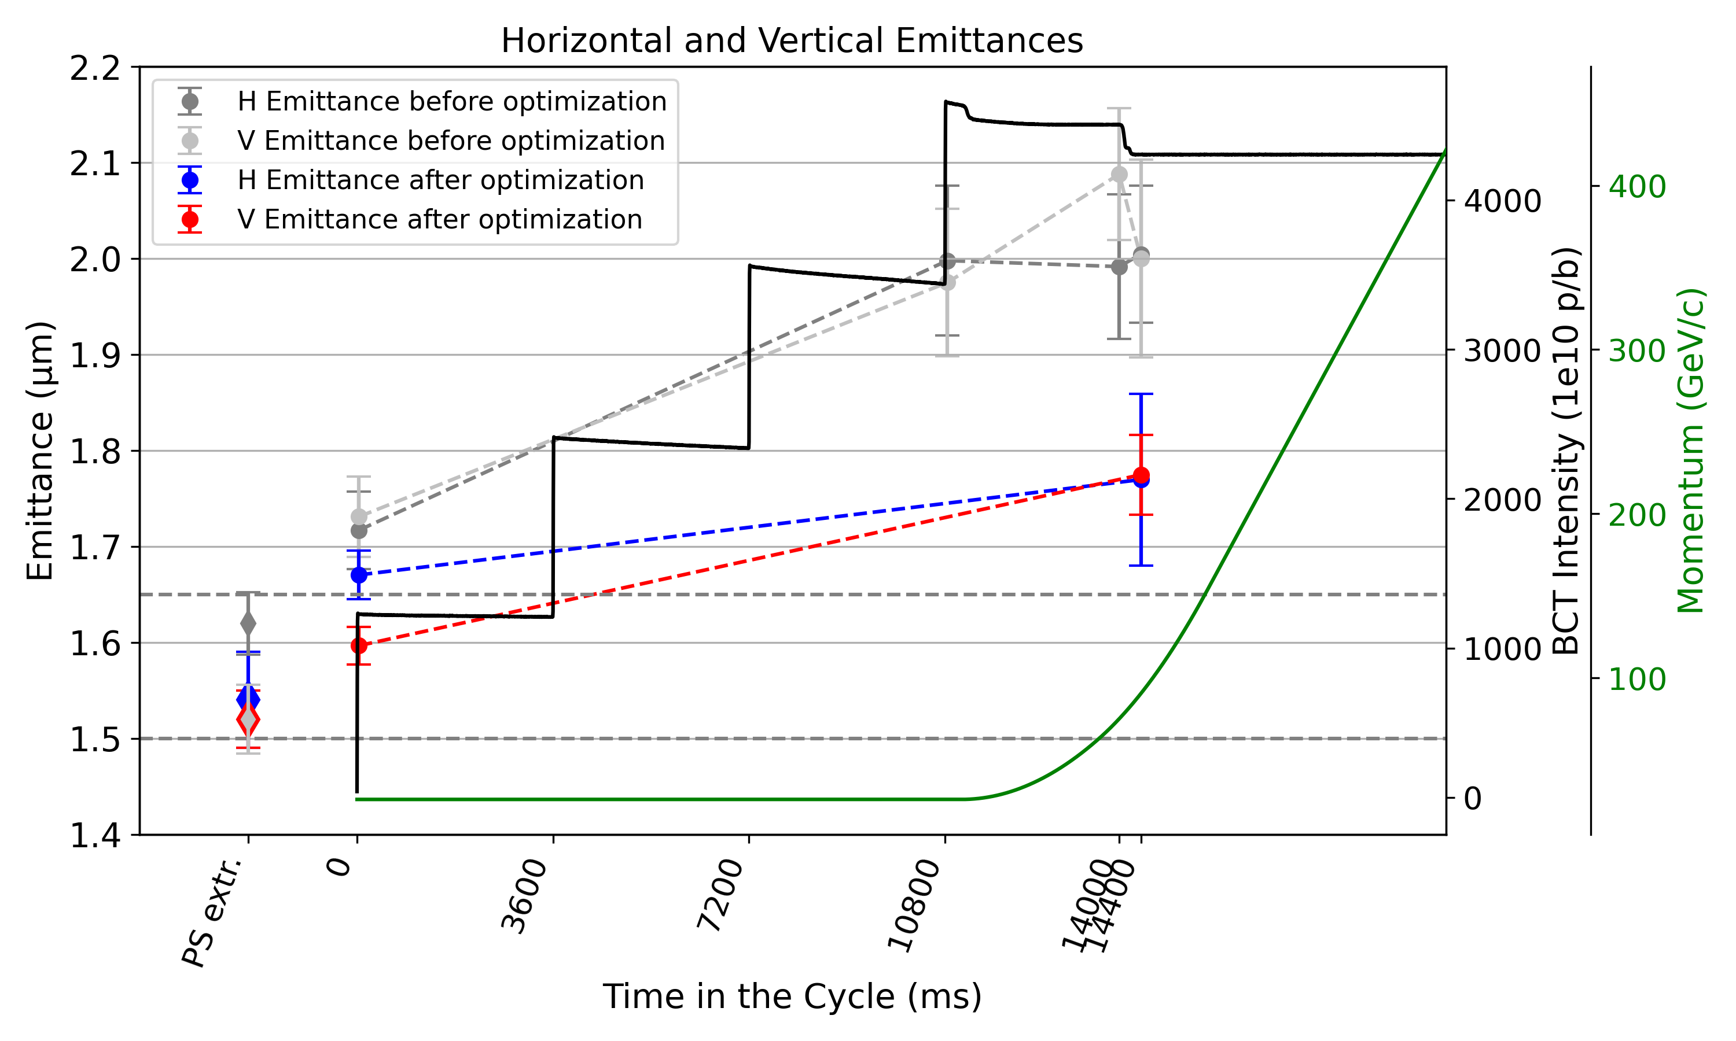
Emittance evolution in the injectors
Emittance measurements at PSB→ PS → SPS:
  Emittance blowup along the chain:
    ~5% PSB extraction→ PS extraction
    ~15-20% PS extraction → SPS after scraping:
      PS extraction → SPS injection: emittance growth & tail population, trends similar to observation from SPS → LHC transfer line mismatch, under investigation.
      SPS flat bottom: improved with tune optimizations IPP I. Mases Sole.
  Standard vs BCMS: ~25% reduction in emittance with BCMS at SPS after scraping.
F. Asvesta, I. Mases Sole

Slide 6
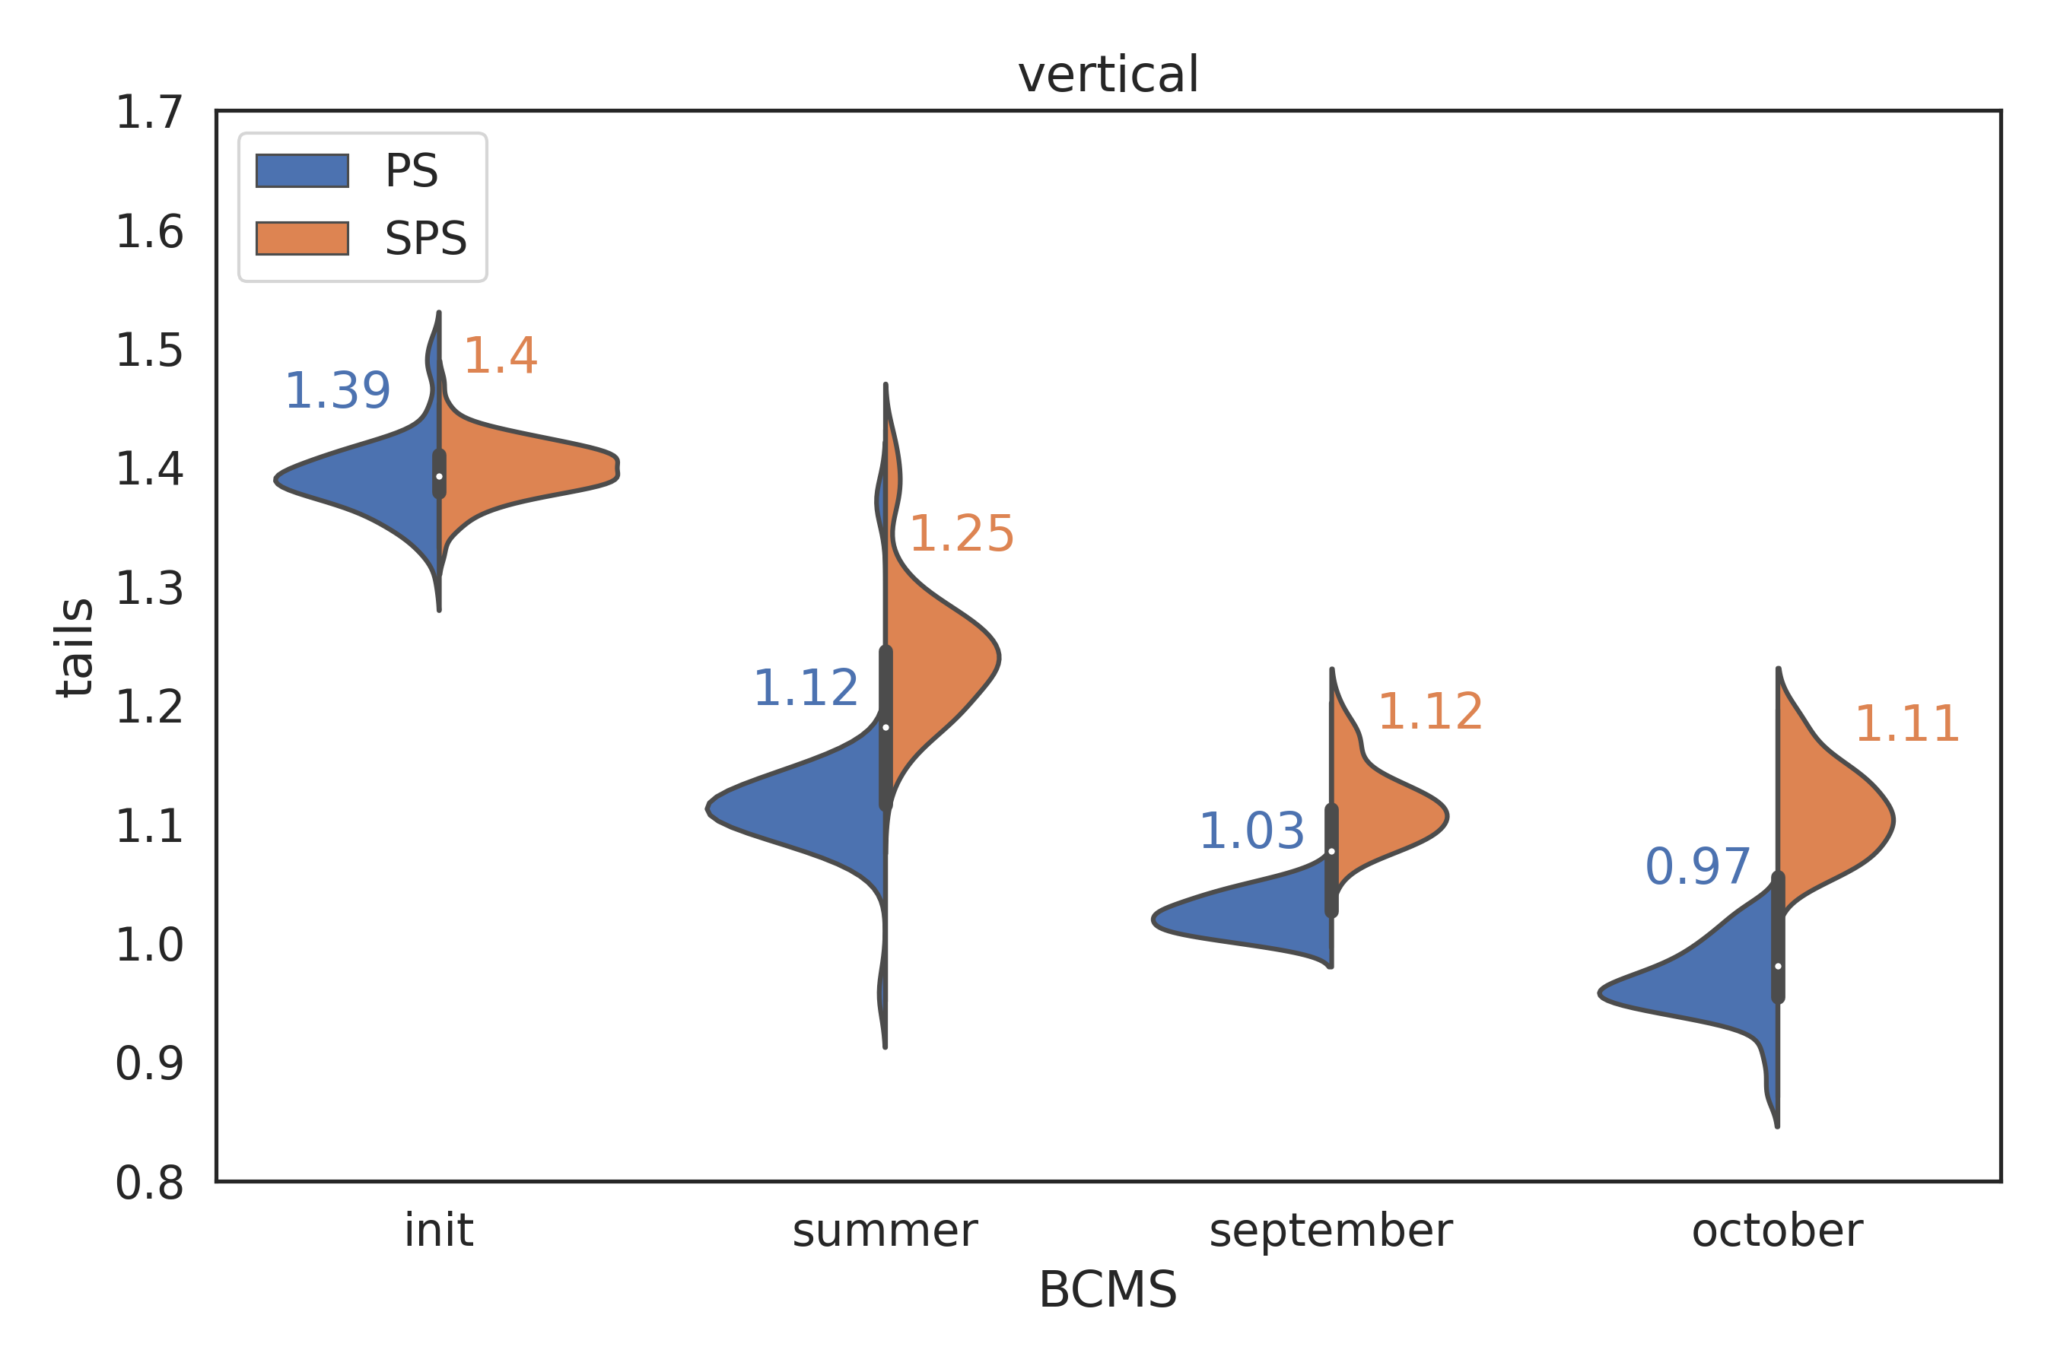
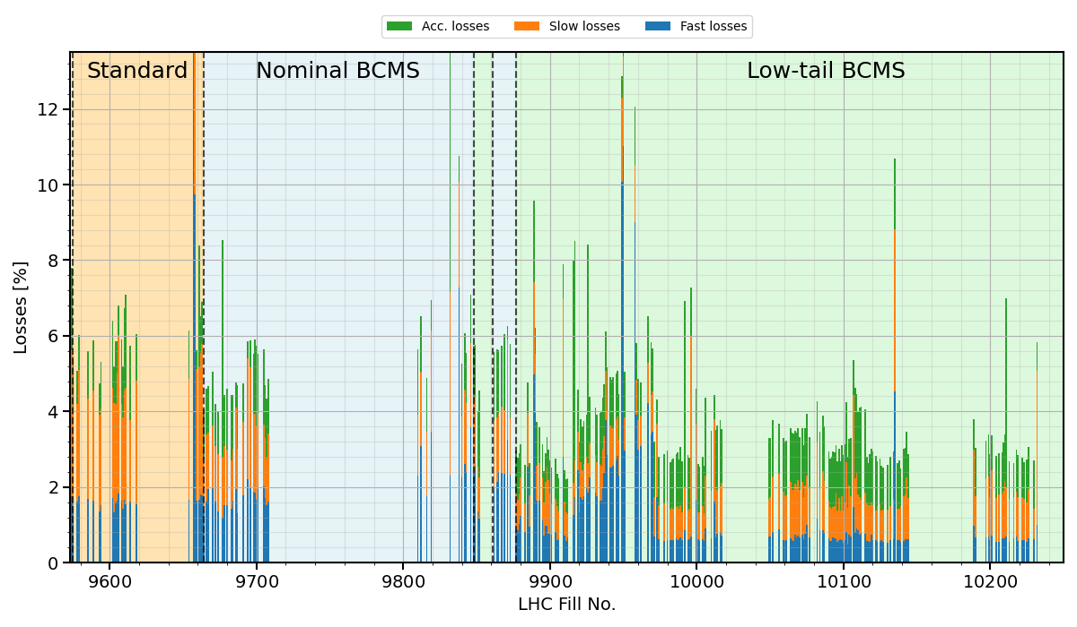
Tail evolution & losses in the injectors
F. Asvesta, M. Bozatzis, I. Mases Sole
Systematic q-factor increase (~5-15%) PS extraction → SPS after scraping.
Significant improvements in tail population during 2024:
  1st ”low-tail” BCMS variant:
    Introduction of PSB scraping, achieving q=1 at extraction.
    Significant tail increase during PS γ_{trans} transition crossing related to space charge: improved with PS tune optimizations IPP M. Bozatzis.
    No clear tail improvement at LHC injection.
  2nd ”low-tail” BCMS variant:
    Source of improvement not fully understood, traced back to PS.
    Clear tail reduction at LHC injection.
~5% losses in SPS before scraping:
  Injection losses, slow losses, losses during ramp.
  Improvement with “low-tail” BCMS.
Reduction also seen at LHC injection
J. Flowerdew, A. Lasheen

Slide 7
Tail evolution & losses in the injectors
F. Asvesta, M. Bozatzis, I. Mases Sole
Systematic q-factor increase (~5-15%) PS extraction → SPS after scraping.
Significant improvements in tail population during 2024:
  1st ”low-tail” BCMS variant:
    Introduction of PSB scraping, achieving q=1 at extraction.
    Significant tail increase during PS γ_{trans} transition crossing related to space charge: improved with PS tune optimizations IPP M. Bozatzis.
    No clear tail improvement at LHC injection.
  2nd ”low-tail” BCMS variant:
    Source of improvement not fully understood, traced back to PS.
    Clear tail reduction at LHC injection.
~5% losses in SPS before scraping:
  Injection losses, slow losses, losses during ramp.
  Improvement with “low-tail” BCMS.
Reduction also seen at LHC injection
Further tail & emittance improvements from PS extraction → SPS extraction.
Try to understand origin of tail reduction in the PS on the 10th of September.
Need for online analysis of SPS losses & automatic profile measurements to monitor quality of injected LHC profiles & detect changes fast and efficiently.
Follow-up
J. Flowerdew, A. Lasheen

Slide 8
Overview
Beam quality in the injectors:
  Emittance growth PSB→ PS → SPS, standard vs BCMS beams.
  Tail population from PSB→ PS → SPS & “low-tail” BCMS.
  Losses from PS → SPS.
Beam quality in the LHC:
  Tail population SPS→ LHC & transfer line mismatch.
  Injection losses: 2024 vs 2023.
  Emittance with standard & BCMS beams.
  Emittance growth at injection beyond IBS & tail evolution.
  Debunched beam at injection & losses at the start of ramp.
  Power supply ripple at the end of ramp.
  Losses at the end of adjust & correlation with tails.
  Losses during leveling & DA.
  Losses beyond burn-off due to collisions in IP8
  Emittance growth during collisions.
Impact on integrated luminosity:
  BCMS vs standard: model vs measurements
  Reduction of losses with ”low-tail” BCMS.
  Impact of emittance growth beyond IBS.
Injection
Ramp
Lessons learned from 2024.
Collisions

Slide 9
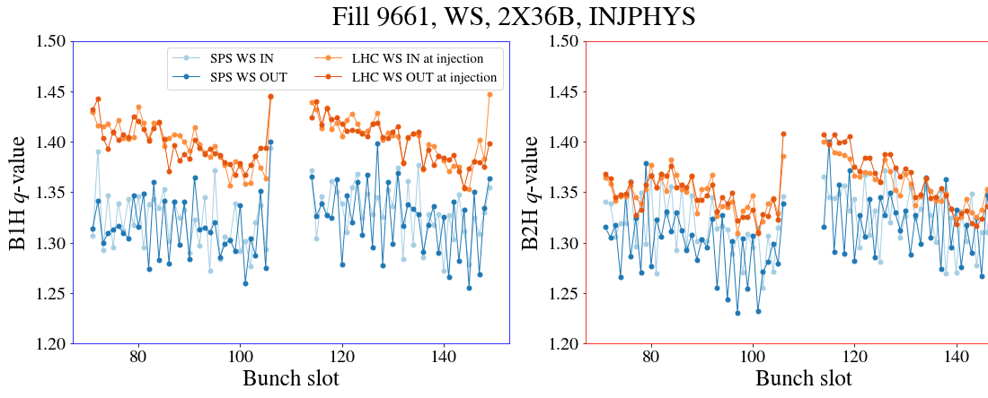
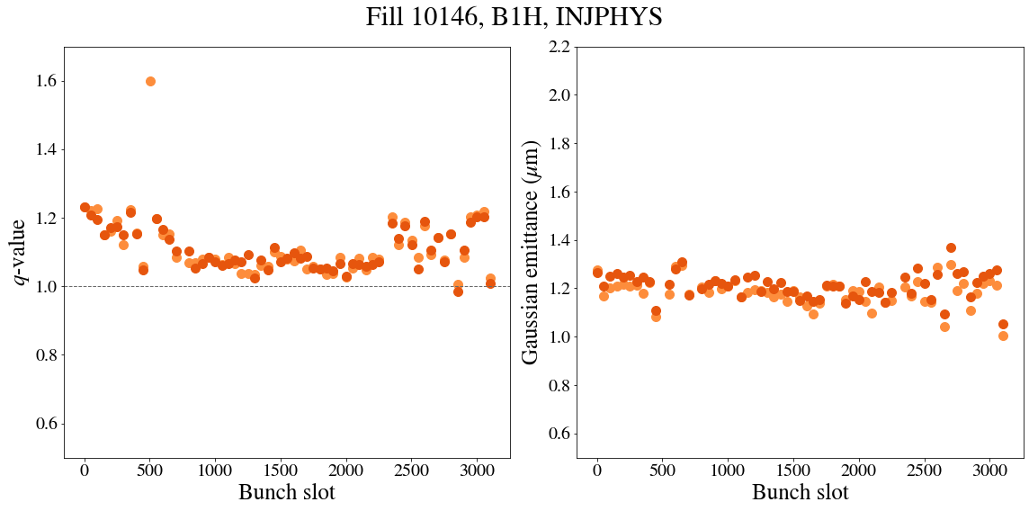
SPS extraction to LHC injection
B1H
B2H
Systematically observed tail population increase in B1H pointing to transfer line mismatch.
Tested new QTL transfer function prepared by ABT:
  MD with INDIVs q=1 at SPS extraction, achieved with ~18% scraping.
  q=1 maintained for B1V and B2H & V at LHC injection, while q=1.2 for B1H.
  Tail comparison at LHC injection with nominal and new QTL transfer functions clearly shows mismatch improvement.
Optimizations to be deployed in 2025.
WS in SPS
F. Velotti, Y. Dutheil,
C. Bracco, M. Hostettler
WS in LHC
B1H
New TF

Slide 10
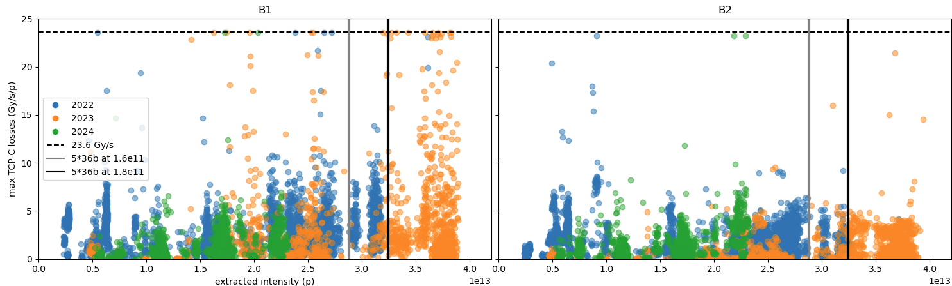
Injection losses
In 2023:
High and fast losses during B1 injection: BLM saturation limits in TCP-C/B (horizontal & skew) in IR7 for RS01.
Losses correspond to < 10⁹ protons (less than 1 pilot per injection).
Correlated with losses in TL & steering. Mitigated with aggressive SPS scraping (~10% → ~20 nominal bunches per injection).
In 2024:
Significant improvement while SPS scraping at ~4% (BLM talk by S. Morales Virgo & LBOC Y. Dutheil).
Interlock moved to new BLMs on the WALL increasing margin by factor of ~2 (HL S. Morales Virgo).
Exact origin of losses remains unclear:
  2024 vs 2023: shorter trains per LHC injection (i.e. lower intensity per injection).
  Small improvement with “low-tail” BCMS.
Y. Dutheil, F. Velotti, C. Bracco,
B. Salvachua, S. Morales
BLM limit

Slide 11
Injection losses
In 2023:
High and fast losses during B1 injection: BLM saturation limits in TCP-C/B (horizontal & skew) in IR7 for RS01.
Losses correspond to < 10⁹ protons (~1 pilot per injection).
Correlated with losses in TL & steering. Mitigated with aggressive SPS scraping (~10% → ~20 nominal bunches per injection).
In 2024:
Significant improvement while SPS scraping at ~4% (BLM talk by S. Morales Virgo & LBOC Y. Dutheil).
Interlock moved to new BLMs on the WALL increasing margin by factor of ~10 (HL S. Morales Virgo).
Exact origin of losses remains unclear:
  2024 vs 2023: shorter trains per LHC injection (i.e. lower intensity per injection).
  Small improvement with “low-tail” BCMS.
New QTL transfer function for B1 → expect to reduce B1H tails.
Improved margin with new B1 BLMs on the WALL by a factor of 2 & improved injection losses could allow for longer trains next year.
As soon as possible, prepare BLM system for higher acceptable injection losses.
Follow-up
Y. Dutheil, F. Velotti, C. Bracco,
B. Salvachua, S. Morales
BLM limit

Slide 12
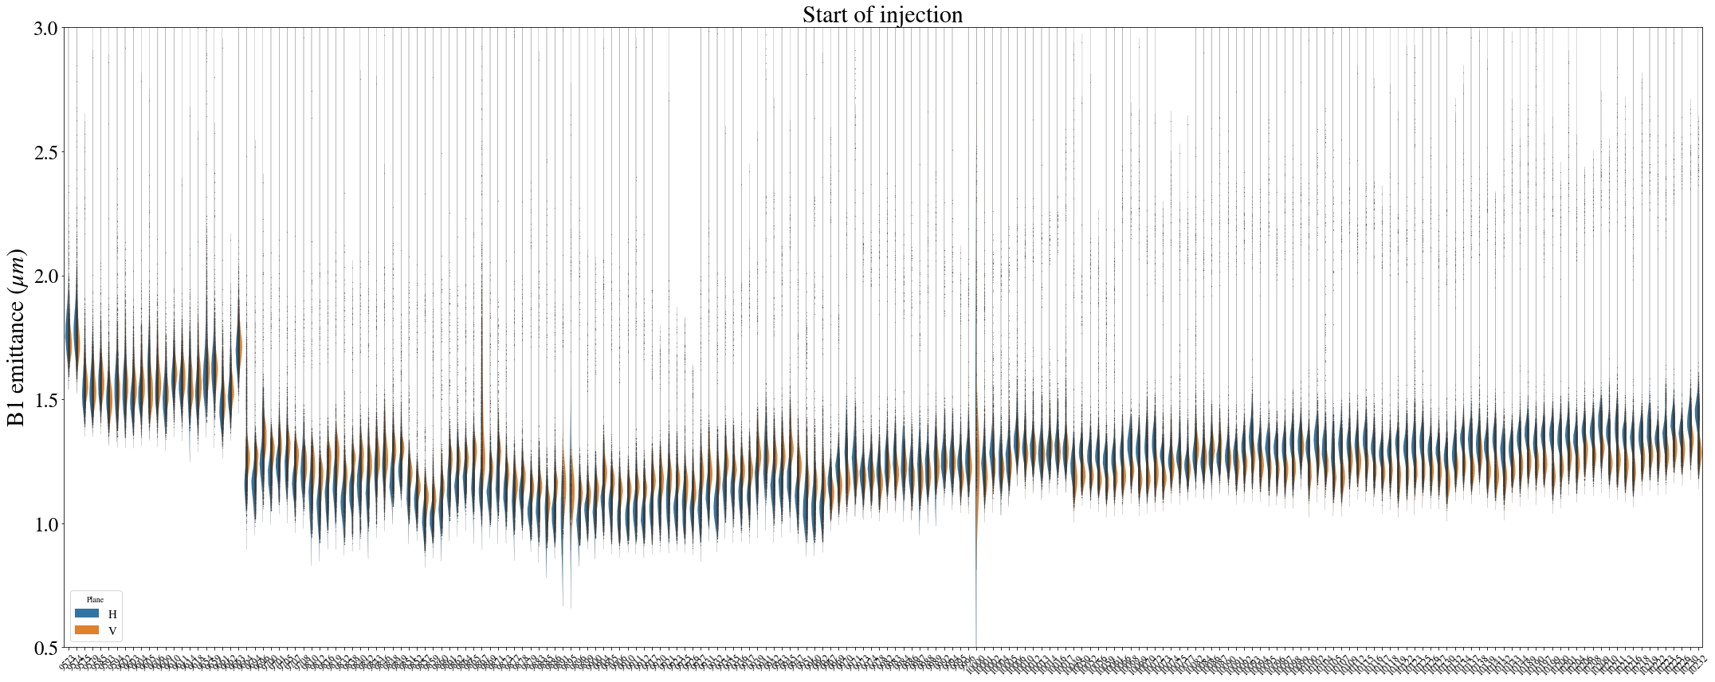
Emittance at injection: standard vs BCMS
20-25% emittance reduction at LHC injection with BCMS w.r.t to standard, 10-15% at start of SB.
BSRT H-plane
BCMS
Low-tail BCMS
BSRT V-plane
Standard
BCMS
Low-tail BCMS
Impact on integrated luminosity:
15% smaller emittance start of collisions (nominal BCMS)
  β_{min}≥ 36cm: 5% gain, confirmed with experimental data.
    β_{min}= 30cm & 1.65e11 ppb: 2-2.5% gain.
Start of injection
End of injection
Start of Stable Beams
Emittance (μm) | B1H | B1V | B2H | B2V
Standard | 1.56 | 1.58 | 1.5 | 1.5
BCMS | 1.19 | 1.27 | 1.13 | 1.17
% | -23.8 | -19.84 | -24.96 | -22.33
Emittance (μm) | B1H | B1V | B2H | B2V
Standard | 1.77 | 1.71 | 1.63 | 1.61
BCMS | 1.47 | 1.42 | 1.31 | 1.31
% | -16.85 | -16.77 | -19.55 | -18.97
Emittance (μm) | B1H | B1V | B2H | B2V
Standard | 1.84 | 1.67 | 2.25 | 2.3
BCMS | 1.57 | 1.54 | 1.97 | 2.02
% | -14.74 | -7.38 | -12.48 | -12.06

Slide 13
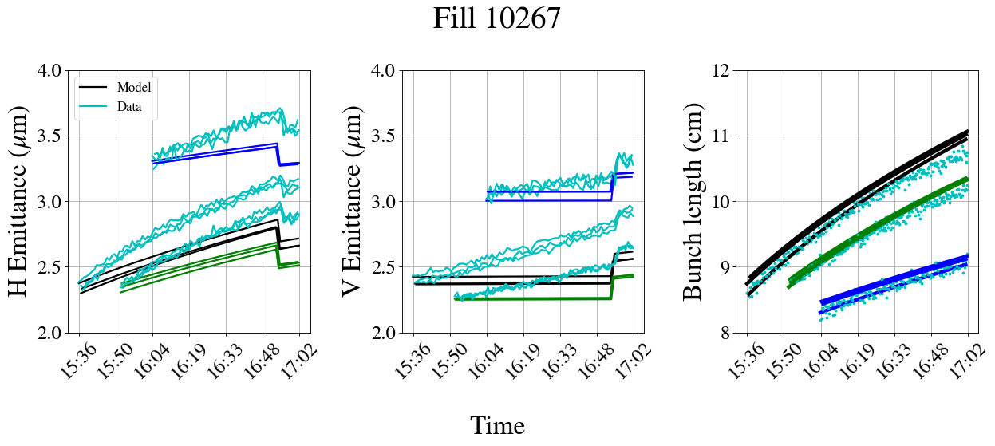
Emittance growth at injection
Emittance growth mechanism at injection not fully understood.
Max. brightness
-20% brightness
-60% brightness
Measurements
  Comparison of measured emittance growth & bunch length evolution against theoretical IBS model.

Slide 14
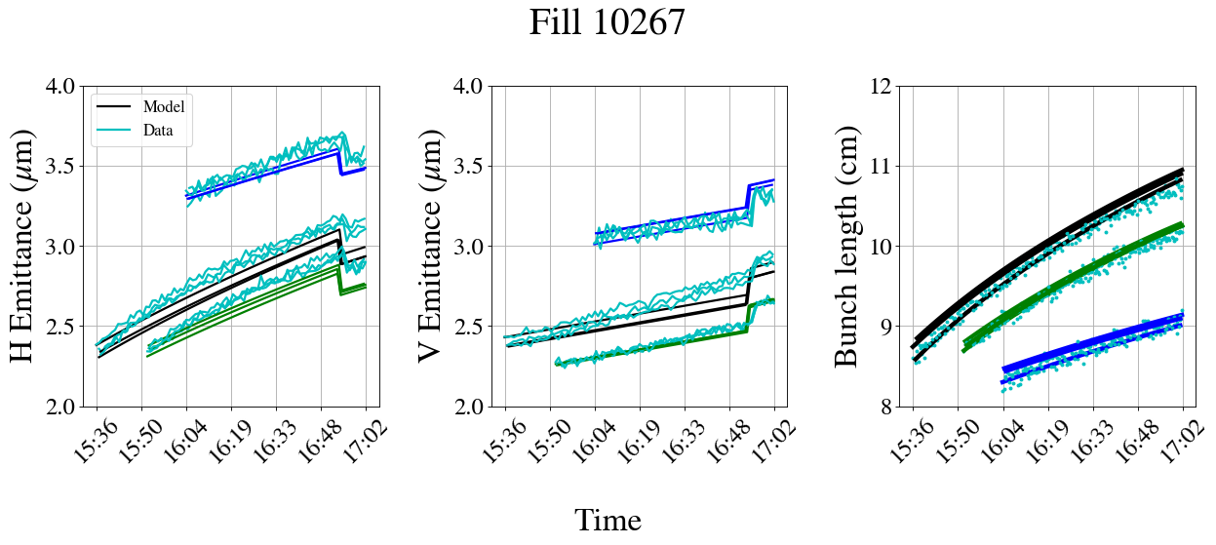
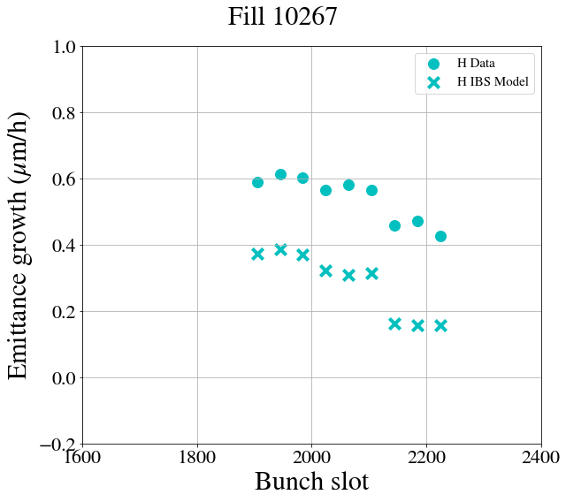
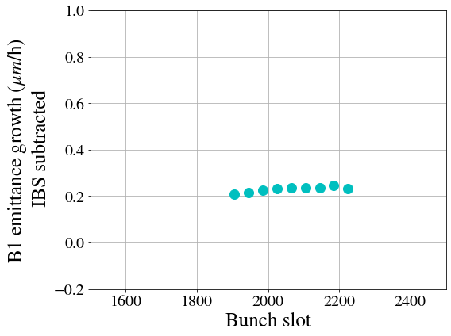
Emittance growth at injection
Emittance growth mechanism at injection not fully understood.
Max. brightness
-20% brightness
-60% brightness
Measurements
  Comparison of measured emittance growth & bunch length evolution against theoretical IBS model.
  Horizontal plane:
    Systematically larger in B1H: ~0.6 μm/h in addition to e-cloud:
      0.4 μm/h from IBS.
      0.2 μm/h of unknown origin:
        even with single bunches.
        brightness independent.
IBS + 0.2 μm/h
o Measured emittance growth for H & V
x IBS model emittance growth for H & V
Emittance growth in H with unknown origin after subtracting IBS contribution

Slide 15
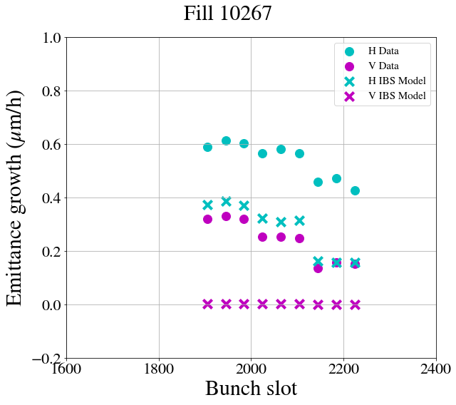
Emittance growth at injection
Emittance growth mechanism at injection not fully understood.
Max. brightness
-20% brightness
-60% brightness
Measurements
  Comparison of measured emittance growth & bunch length evolution against theoretical IBS model.
  Horizontal plane:
    Systematically larger in B1H: ~0.6 μm/h in addition to e-cloud:
      0.4 μm/h from IBS.
      0.2 μm/h of unknown origin:
        even with single bunches.
        brightness independent.
  Vertical plane:
    ~0.1-0.3 μm/h in addition to e-cloud (B1 & B2).
      Low vertical dispersion & good coupling control → small IBS contribution.
      Measurements suggest some brightness dependence → possibly underestimating IBS or emittance exchange with horizontal in the modeling.
      Linear increase of emittance over time.
IBS + 0.2 μm/h
o Measured emittance growth for H & V
x IBS model emittance growth for H & V
Emittance growth in H with unknown origin after subtracting IBS contribution

Slide 16
Emittance growth at injection
Emittance growth mechanism at injection not fully understood.
Max. brightness
-20% brightness
-60% brightness
Measurements
  Comparison of measured emittance growth & bunch length evolution against theoretical IBS model.
  Horizontal plane:
    Systematically larger in B1H: ~0.6 μm/h in addition to e-cloud:
      0.4 μm/h from IBS.
      0.2 μm/h of unknown origin:
        even with single bunches.
        brightness independent.
  Vertical plane:
    ~0.1-0.3 μm/h in addition to e-cloud (B1 & B2).
      Low vertical dispersion & good coupling control → small IBS contribution.
      Measurements suggest some brightness dependence → possibly underestimating IBS or emittance exchange with horizontal in the modeling.
      Linear increase of emittance over time.
IBS + 0.2 μm/h
Continue investigation of unexplained emittance growth.
Minimize time spent at injection.
Follow-up
o Measured emittance growth for H & V
x IBS model emittance growth for H & V
Emittance growth in H with unknown origin after subtracting IBS contribution

Slide 17
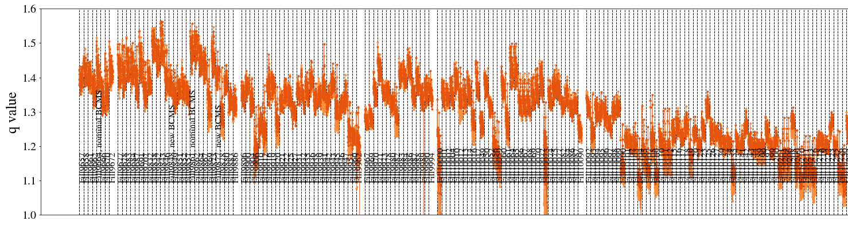
Tails at injection
Systematic profile monitoring in 2024:
  From Fill 9912 (July), full-cycle bunch-by-bunch BSRT profile logging in NXCALS thanks to D. Butti.
Profiles at injection had heavily populated tails: q~1.4 at the start of 2024.
No significant tail reduction with the 1st “low-tail” BCMS variant (July).
Tail reduction (q~1.2) at LHC injection > Fill 10100 (September), linked to injector tail improvement traced back to PS with unknown origin.
Profile evolution:
  Tend to converge to Gaussian over time, no mechanism of tail population during nominal operation.
  However, tail increase during LHC injection observed during specific MDs.
10th of September

Slide 18
Tails at injection
Systematic profile monitoring in 2024:
  From Fill 9912 (July), full-cycle bunch-by-bunch BSRT profile logging in NXCALS thanks to D. Butti.
Profiles at injection had heavily populated tails: q~1.4 at the start of 2024.
No significant tail reduction with the 1st “low-tail” BCMS variant (July).
Tail reduction (q~1.2) at LHC injection > Fill 10100 (September), linked to injector tail improvement traced back to PS with unknown origin.
Profile evolution:
  Tend to converge to Gaussian over time, no mechanism of tail population during nominal operation.
  However, tail increase during LHC injection observed during specific MDs.
Further improvements on ”low-tail” BCMS.
Continue systematic BSRT profile logging & monitoring during whole LHC cycle to:
  Monitor quality of injected profiles & detect changes.
  Correlate with loss or gain of LHC performance.
Follow-up

Slide 19
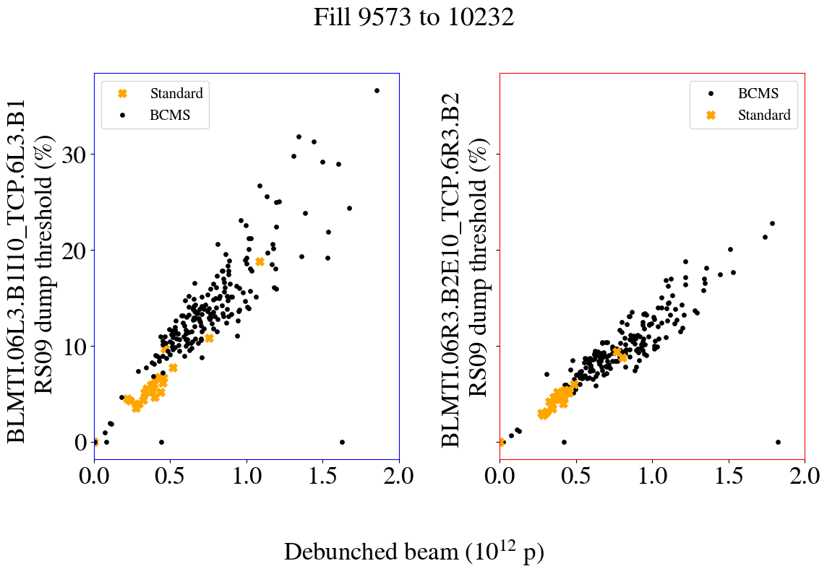
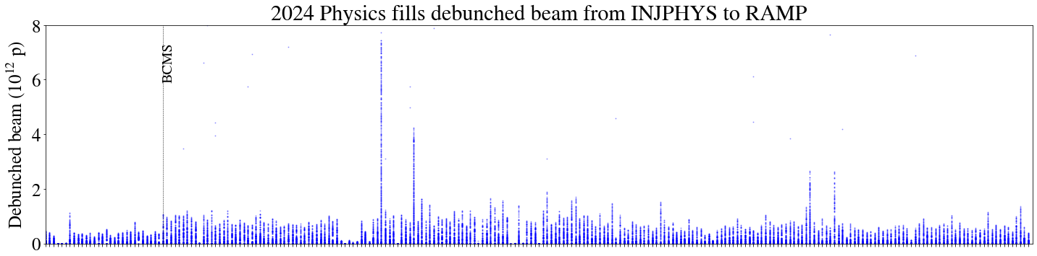
Debunched beam at injection & losses during ramp
H. Timko, B. Karlsen-Baeck, M. Zampetakis, HL-WP5
Debunched beam vs IR3 losses
IR3 high losses at start of Ramp, reaching warning levels on BLMs & causing 3 dumps.
Strong correlation between IR3 losses and debunched beam (~up to 50 nominal bunches).
Correlation of debunched beam with:
  Brightness.
  Time spent at injection.
  possibly indicating IBS related mechanism.
More critical for BCMS compared to standard due to higher brightness.
Mitigations:
  Clearly demonstrated by RF that increase of RF voltage is beneficial (talk by B. Karlsen-Baeck).
  Increase of BLM thresholds (talk by S. Morales).
Debunched beam in 2024 fills

Slide 20
Debunched beam at injection & losses during ramp
H. Timko, B. Karlsen-Baeck, M. Zampetakis, HL-WP5
Debunched beam vs IR3 losses
IR3 high losses at start of Ramp, reaching warning levels on BLMs & causing 3 dumps.
Strong correlation between IR3 losses and debunched beam (~up to 50 nominal bunches).
Correlation of debunched beam with:
  Brightness.
  Time spent at injection.
  possibly indicating IBS related mechanism.
More critical for BCMS compared to standard due to higher brightness.
Mitigations:
  Clearly demonstrated by RF that increase of RF voltage is beneficial (talk by B. Karlsen-Baeck).
  Increase of BLM thresholds (talk by S. Morales).
Investigate possibility to increase RF voltage (see talk by B. Karlsen-Baeck) & review BLM thresholds.
Minimize time spent at injection.
Follow-up
Debunched beam in 2024 fills
Debunched beam in 2024 fills

Slide 21
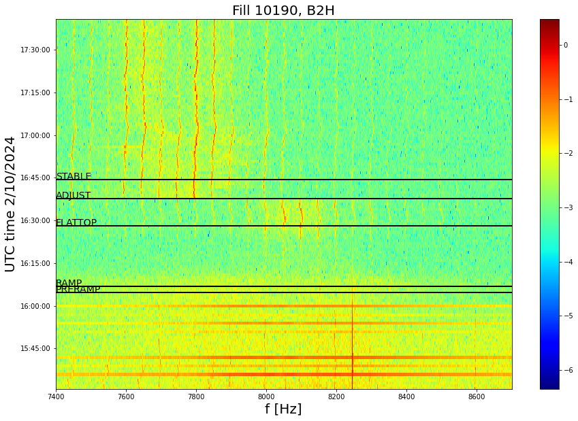
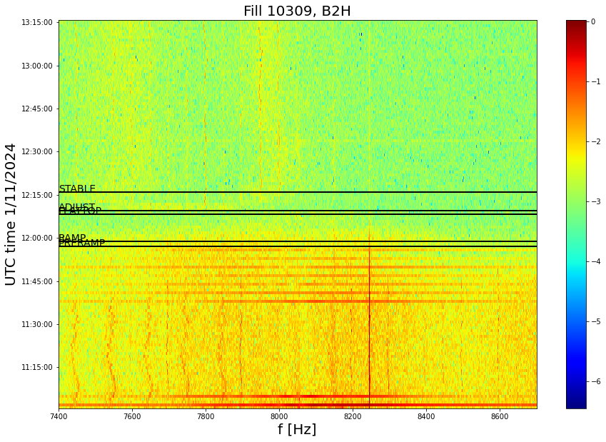
Power supply ripple at the end of ramp
50 Hz power supply ripple constantly present throughout LHC cycle, real dipolar beam excitation.
Origin of high-frequency 8 kHz cluster is not understood:
  Clear amplitude increase at the end of the ramp when reaching 6.8 TeV.
  Sensitivity to tune trims consistent with dipolar excitations.
  Significantly attenuated amplitude during p-p ref Run (2.68 TeV).
  Impact on performance is unclear, reproducible fill-by-fill.
Nominal fill
p-p ref
A. Valeri Radoslavova

Slide 22
Power supply ripple at the end of ramp
50 Hz power supply ripple constantly present throughout LHC cycle, real dipolar beam excitation.
Origin of high-frequency 8 kHz cluster is not understood:
  Clear amplitude increase at the end of the ramp when reaching 6.8 TeV.
  Sensitivity to tune trims consistent with dipolar excitations.
  Significantly attenuated amplitude during p-p ref Run (2.68 TeV).
  Impact on performance is unclear, reproducible fill-by-fill.
Based on the successful compensation of 50Hz in the SPS, should we finally make a similar effort for the 50Hz ripple in the LHC?
Follow-up
Nominal fill
p-p ref
A. Valeri Radoslavova

Slide 23
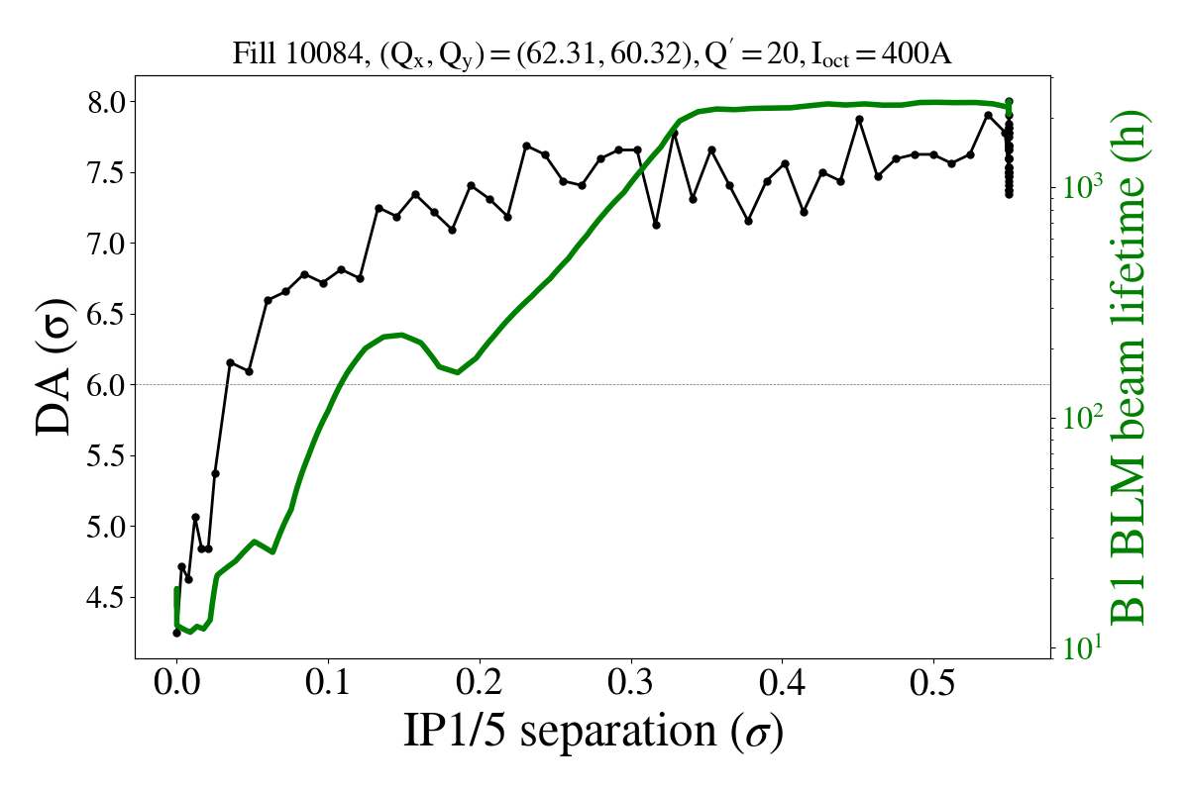
Losses at the end of adjust/start of collisions
Large beam lifetime drop (<10 h in some fills) during final seconds of Adjust.
Driving mechanism:
  DA reduction when entering head-on beam-beam dominated regime.
DA target of 6σ
Beam lifetime
DA

Slide 24
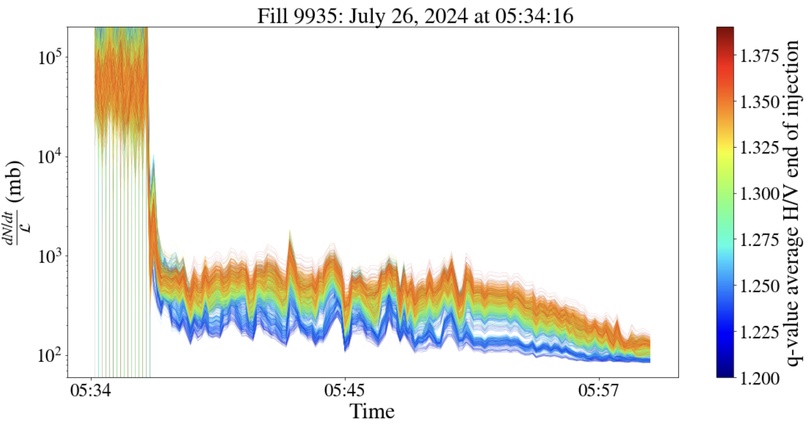
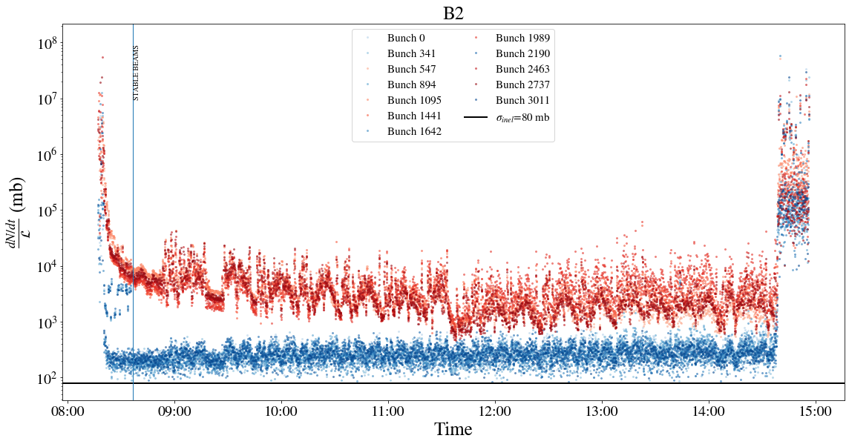
Losses at the end of adjust/start of collisions
Large beam lifetime drop (<10 h in some fills) during final seconds of Adjust.
Driving mechanism:
  DA reduction when entering head-on beam-beam dominated regime.
  Clear correlation between tails & losses:
    First observations from MDs with groups of low-tail & large-tail bunches.
    Confirmed in nominal fills.
Low tails → Large tails
Large tails
Low tails
Burn-off limit

Slide 25
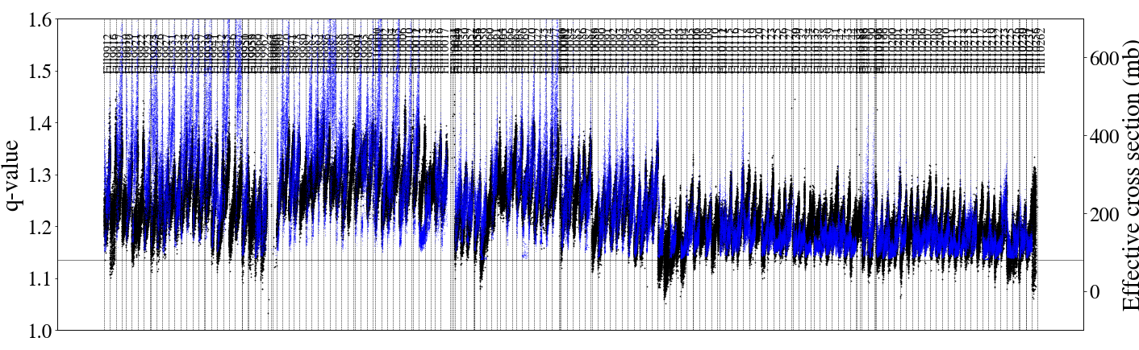
Losses at the end of adjust/start of collisions
Large beam lifetime drop (<10 h in some fills) during final seconds of Adjust.
Driving mechanism:
  DA reduction when entering head-on beam-beam dominated regime.
  Clear correlation between tails & losses:
    First observations from MDs with groups of low-tail & large-tail bunches.
    Confirmed in nominal fills.
    Losses reduced close to burn-off limit by September with “low-tail”: strong correlation of tail reduction & loss reduction at the start of SB.
10th of September

Slide 26
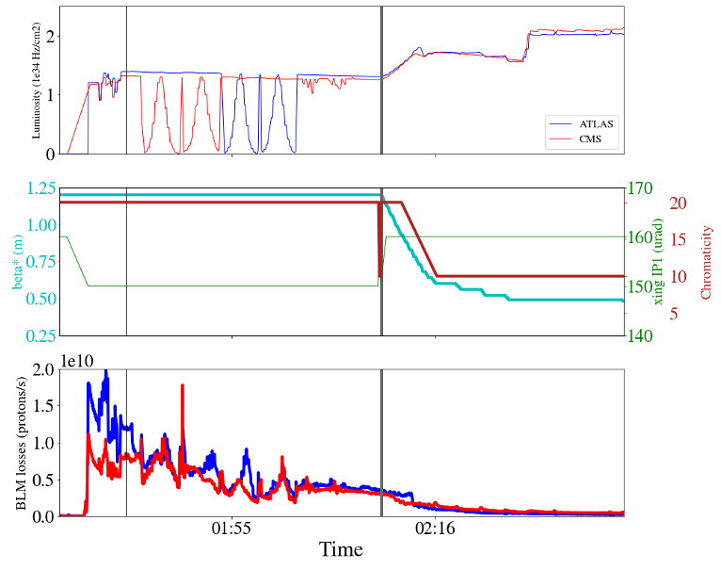
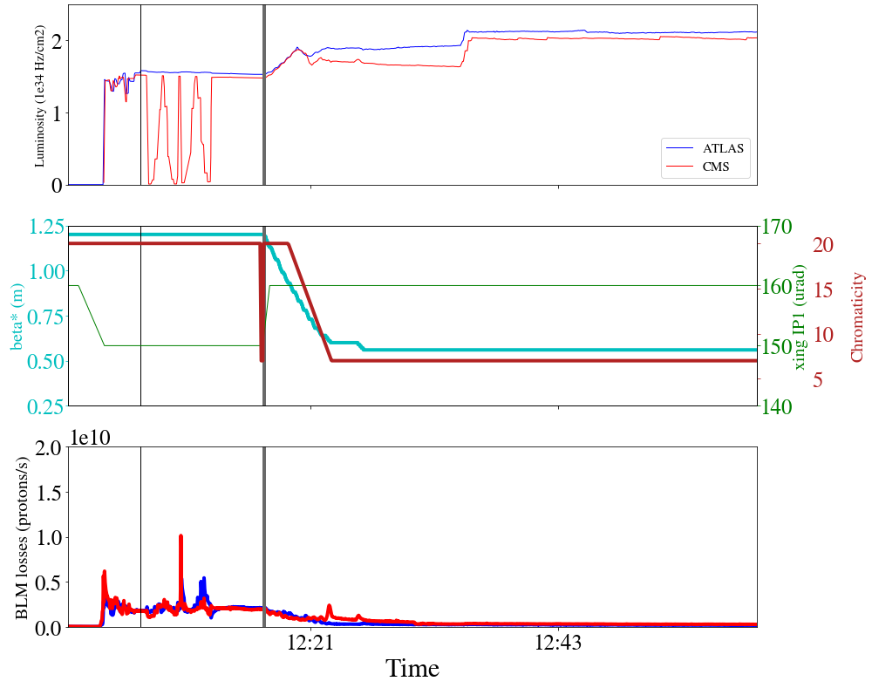
Losses during collisions
Observed beam lifetime degradation with extended stay at 1.2 m, μ_{max}<μ_{target} before leveling.
Fill 9864 in July:
Nominal BCMS
Extended stay at 1.2 m
Fill 10100 in September:
“Low-tail” BCMS
Short stay at 1.2 m
Losses equivalent to ~90 nominal bunches in 1st hour of SB
Losses equivalent to ~20 nominal bunches in 1st hour of SB

Slide 27
Losses during collisions
Observed beam lifetime degradation with extended stay at 1.2 m, μ_{max}<μ_{target} before leveling.
Fill 9864 in July:
Nominal BCMS
Extended stay at 1.2 m
Fill 10100 in September:
“Low-tail” BCMS
Short stay at 1.2 m
1. DA < 6σ due to:
High brightness
High chromaticity
High octupoles
Small crossing angle
2. DA > 6σ due to:
Chromaticity reduction (major contributor).
Bunch intensity decrease (major contributor).
Crossing angle increase (minor contributor).
Losses equivalent to ~90 nominal bunches in 1st hour of SB
Losses equivalent to ~20 nominal bunches in 1st hour of SB

Slide 28
Losses during collisions
Observed beam lifetime degradation with extended stay at 1.2 m, μ_{max}<μ_{target} before leveling.
Fill 9864 in July:
Nominal BCMS
Extended stay at 1.2 m
Fill 10100 in September:
“Low-tail” BCMS
Short stay at 1.2 m
Impact on integrated luminosity:
Up to* 5.2% loss
for fills that reached optimal fill length
Impact on integrated luminosity:
Up to 1.5% loss
for fills that reached optimal fill length
*Exact contribution of tails on luminosity to be refined
Losses equivalent to ~90 nominal bunches in 1st hour of SB
Losses equivalent to ~20 nominal bunches in 1st hour of SB

Slide 29
Losses during collisions
Observed beam lifetime degradation with extended stay at 1.2 m, μ_{max}<μ_{target} before leveling.
Fill 9864 in July:
Nominal BCMS
Extended stay at 1.2 m
Fill 10100 in September:
“Low-tail” BCMS
Short stay at 1.2 m
Aim to inject in LHC profiles as close as possible to Gaussian from the injectors.
Reaching DA ≥ 6σ at end of adjust/start of leveling is critical to minimize losses:
  chromaticity reduction after emittance scans or as quickly as possible.
  combined with “low-tail” BCMS.
Follow-up
Up to* 5.2% loss of integrated lumi for fills that reached optimal fill length
Up to 1.5% loss of integrated lumi
for fills that reached optimal fill length
*Exact contribution of tails on luminosity to be refined
Losses equivalent to ~90 nominal bunches in 1st hour of SB
Losses equivalent to ~20 nominal bunches in 1st hour of SB

Slide 30
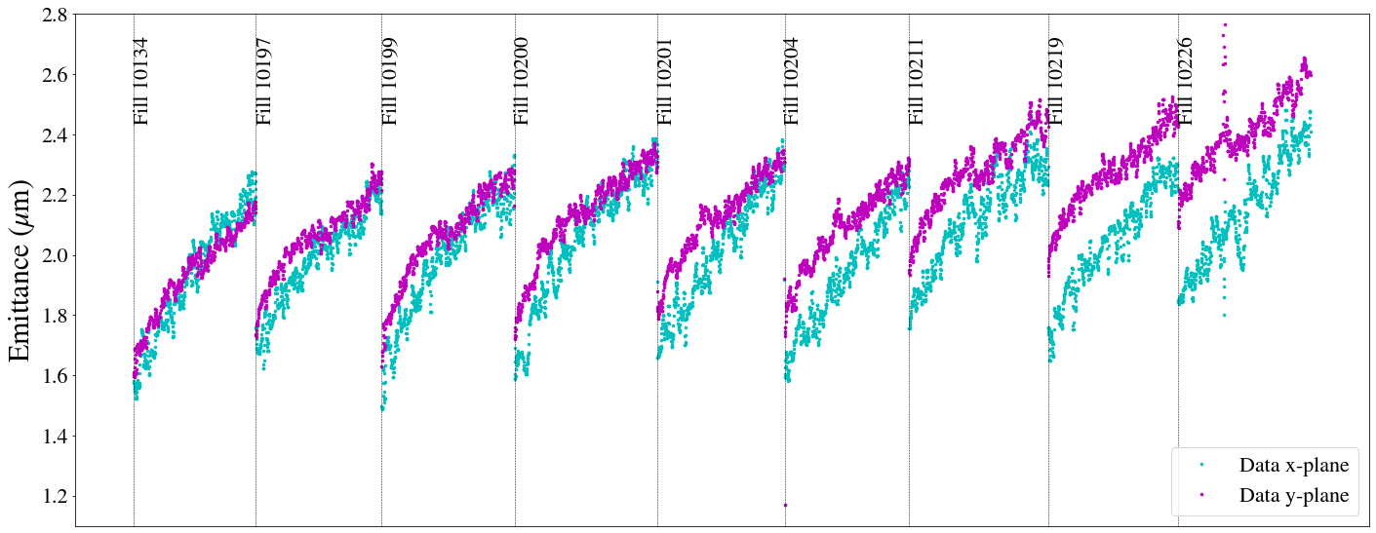
Emittance growth at collisions
Emittance growth of unknown origin also during collisions:
  Cannot be fully explained by IBS models.
  Vertical emittance expected to be shrinking due to SR.

Slide 31
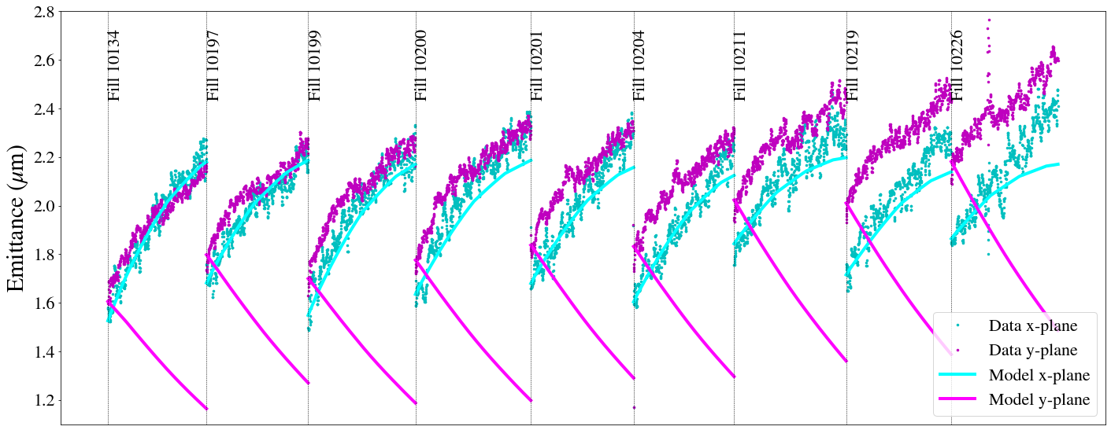
Emittance growth at collisions
Emittance growth of unknown origin also during collisions:
  Cannot be fully explained by IBS models.
  Vertical emittance expected to be shrinking due to SR.
Luminosity model with IBS & SR

Slide 32
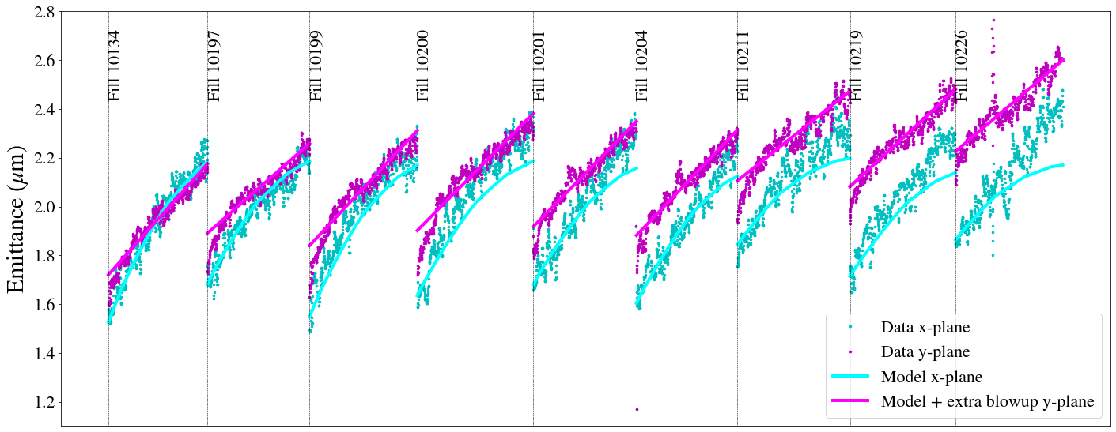
Emittance growth at collisions
Emittance growth of unknown origin also during collisions:
  Cannot be fully explained by IBS models.
  Vertical emittance expected to be shrinking due to SR.
Luminosity model with IBS & SR & extra emittance growth
Impact on integrated luminosity:
2-3% loss for fills that reached optimal fill length & τ=2.5 h

Slide 33
Lessons learned from 2024
Need to minimize time spent at LHC injection due to:
  Unexplained emittance growth at injection.
  Increase of debunched beam & eventually losses during ramp.
  Longer trains for 2025 due to faster injection time & gain in integrated luminosity (see X. Buffat):
    Injection losses: source remains unclear, increase of margin to BLM saturation for B1 w.r.t 2023.
Standard vs BCMS:
  Start of collisions with 10-15% smaller emittances.
  Depending on virtual luminosity, 2-5% gain in performance w.r.t to standard for fills that reached optimal fill length.
  Main gain comes from “low-tail” BCMS:
    Clear correlation between losses at the end of collapse/start of collisions and tail population: reduction of tails observed Fills>10100 (10th of September), starting from tail reduction in the injectors, resulted in loss improvement at start of collisions:
  Preparation from the injectors has direct impact on LHC performance: to be considered not only for nominal operation but also for special beams (VdM & BSRT calibration fills).

Slide 34
Lessons learned from 2024
Minimize losses during collisions:
  Start LHC injection with profiles as close as possible to Gaussian from the injectors.
    Tail increase for B1 from SPS to LHC due to transfer line mismatch, expected to improve with new transfer function.
    Further improve & optimize “low-tail” BCMS in the injectors.
  Critical to maintain DA target of 6σ at end of adjust/start of leveling:
    2024 DA below target at this stage & improved during leveling → seen on beam lifetime.
    DA can be increased by reducing non-linearities (e.g. chromaticity reduction after emittance scans, switching to negative octupole polarity).
Other issues: unknown emittance growth at injection & collisions, 50 Hz ripple..
Need for more automatic tools for profile monitoring and losses in the injectors & throughout the whole LHC cycle to detect changes fast & efficiently and eventually connect with gain or loss of LHC performance.
Thank you!

Slide 35
Backup

Slide 36
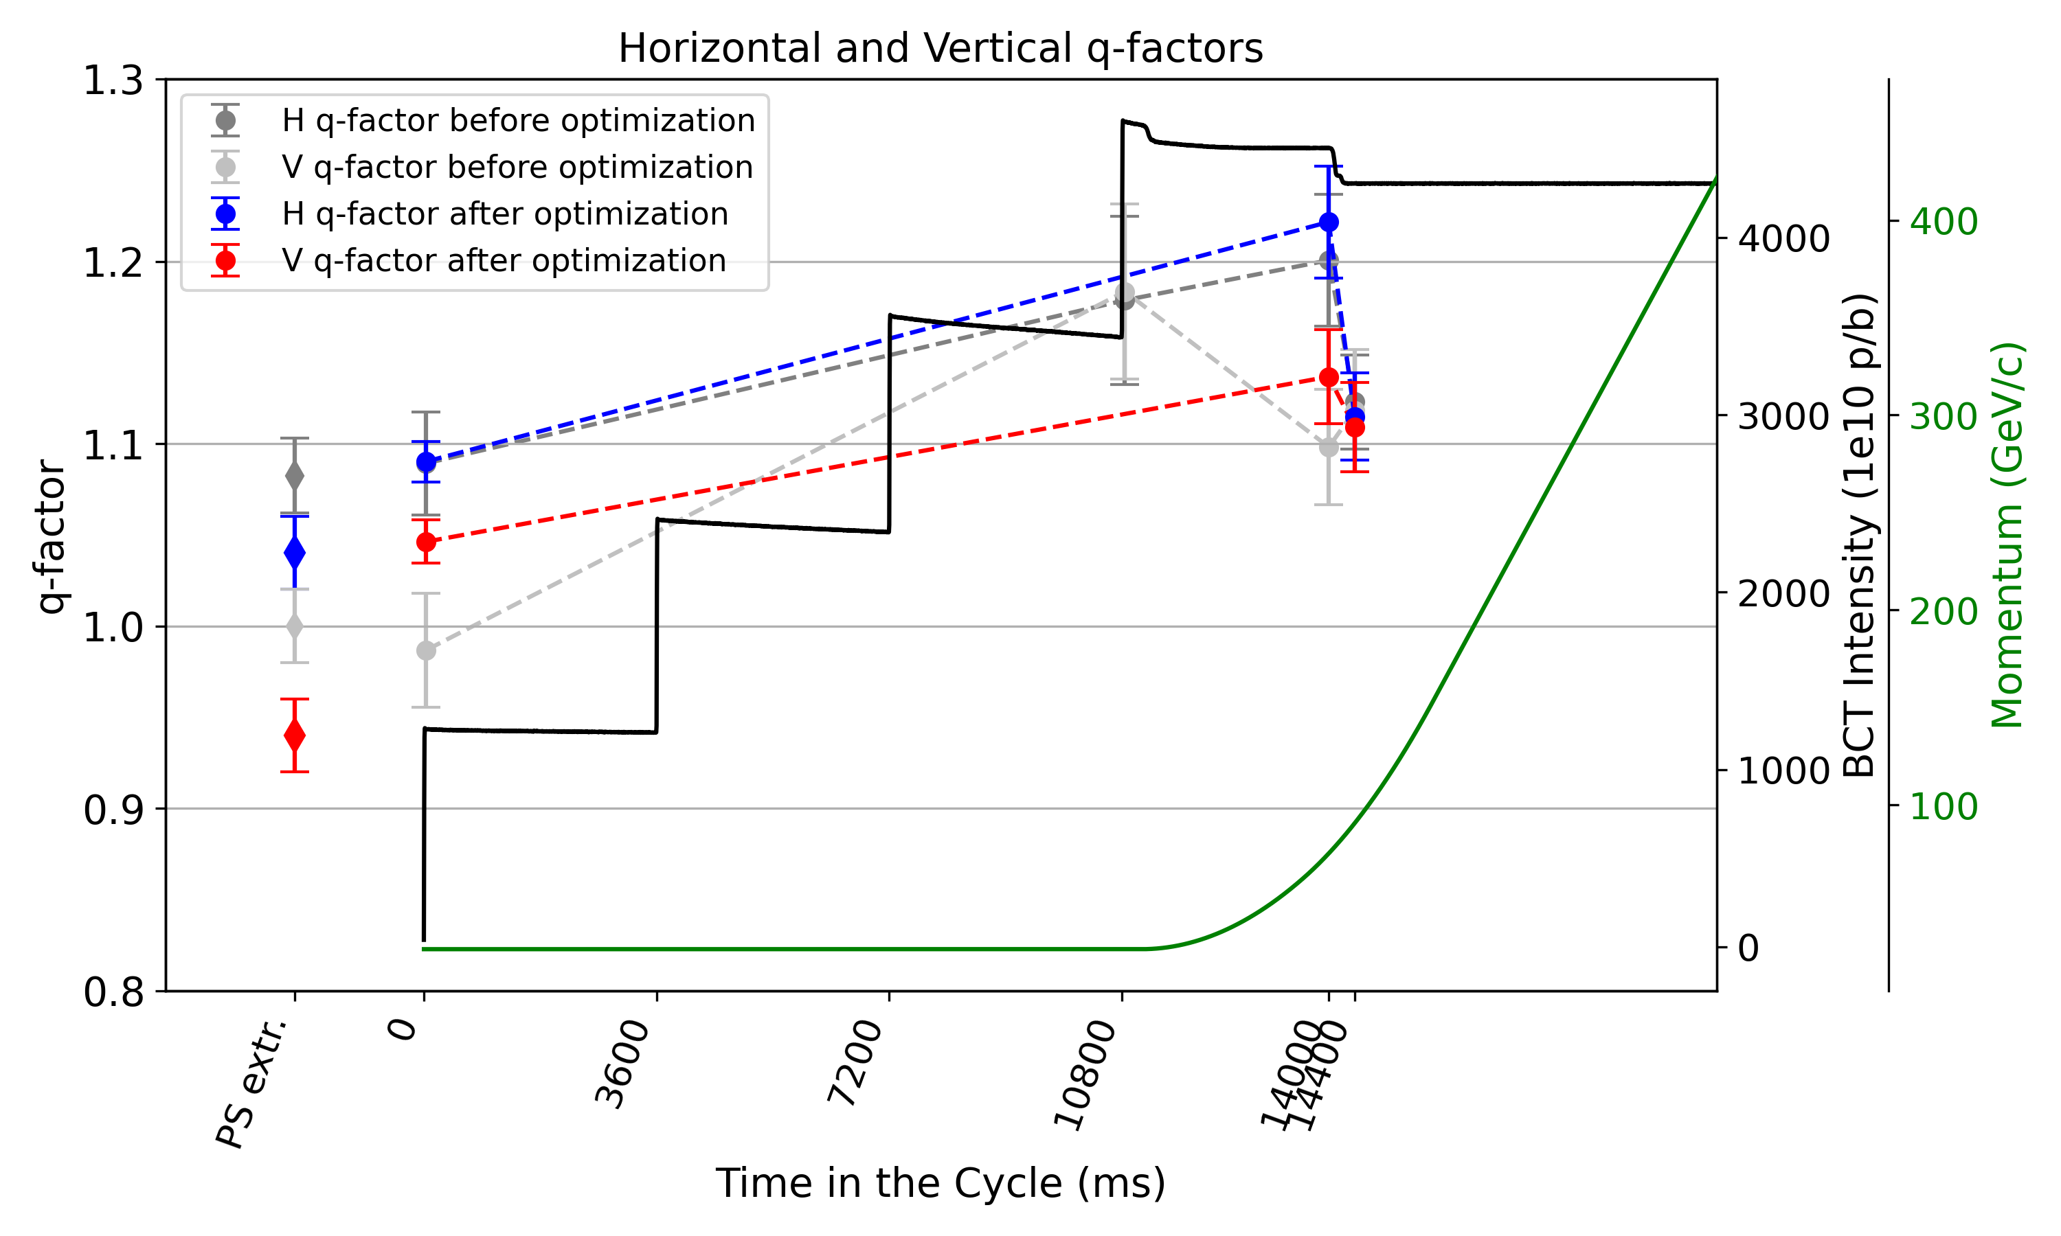
A closer look in the SPS
Measurements from high-intensity MDs (4x48b, ~2.3e11 ppb at SPS extraction), similar observations with 2024 nominal configuration.
  Emittance and q-factor increase PS extraction→SPS injection:
    Similar trends observed between SPS extraction→LHC injection due to transfer line mismatch.
  Emittance blowup & tail population at SPS flat bottom:
    Emittance reduction through tune optimizations.
  SPS scraping fully correlated with tails at SPS extraction/LHC injection: In 2024, Gaussian bunch profiles and nominal intensity with ~15% scraping.
I. Mases Sole, F. Asvesta

Slide 37
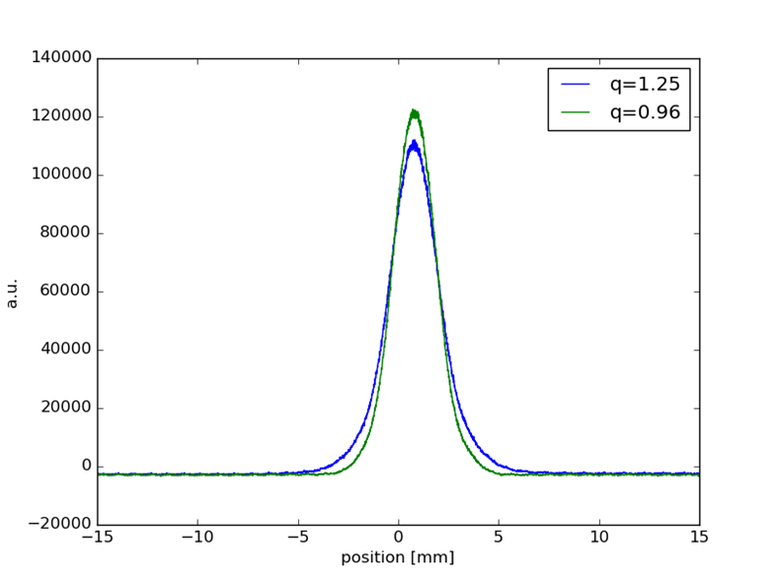
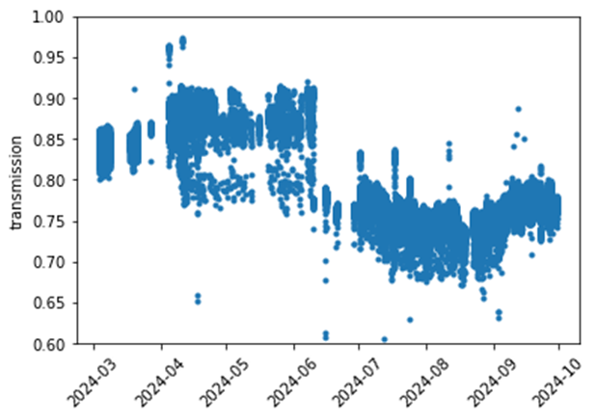
PSB scraping
PSB Transmission
Tails before/after scraping
F. Asvesta

Slide 38
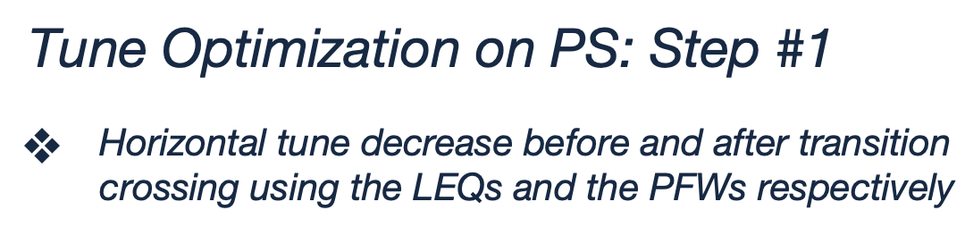
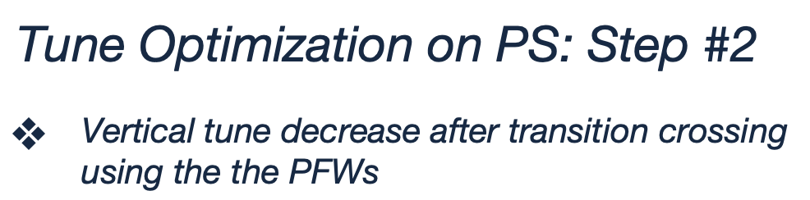
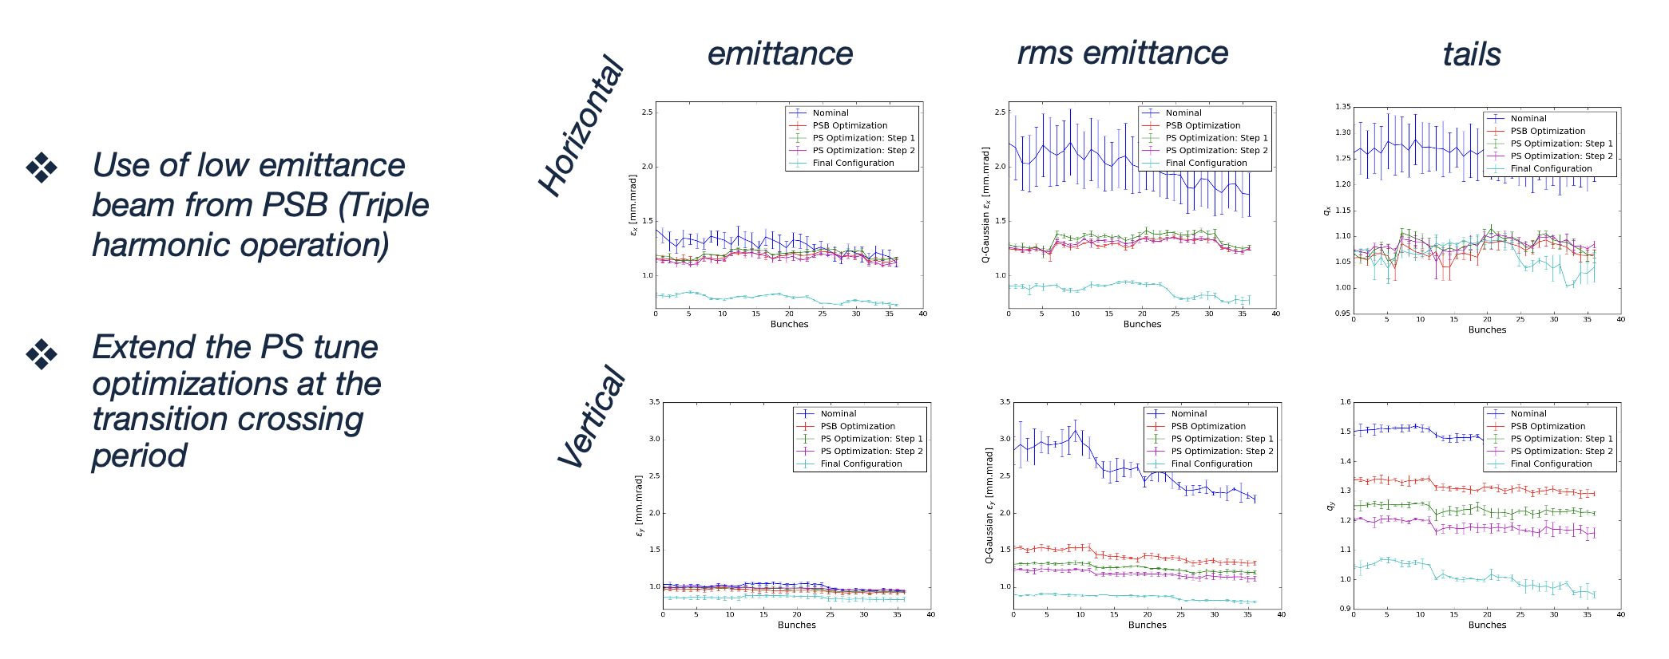
PS optimization during γ_{trans} crossing
M. Bozatzis, F. Asvesta

Slide 39
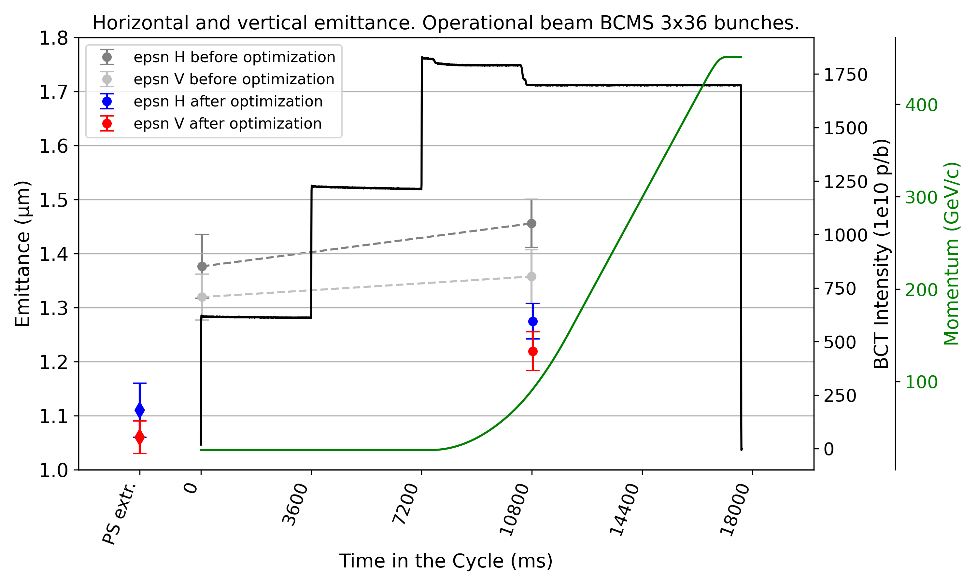
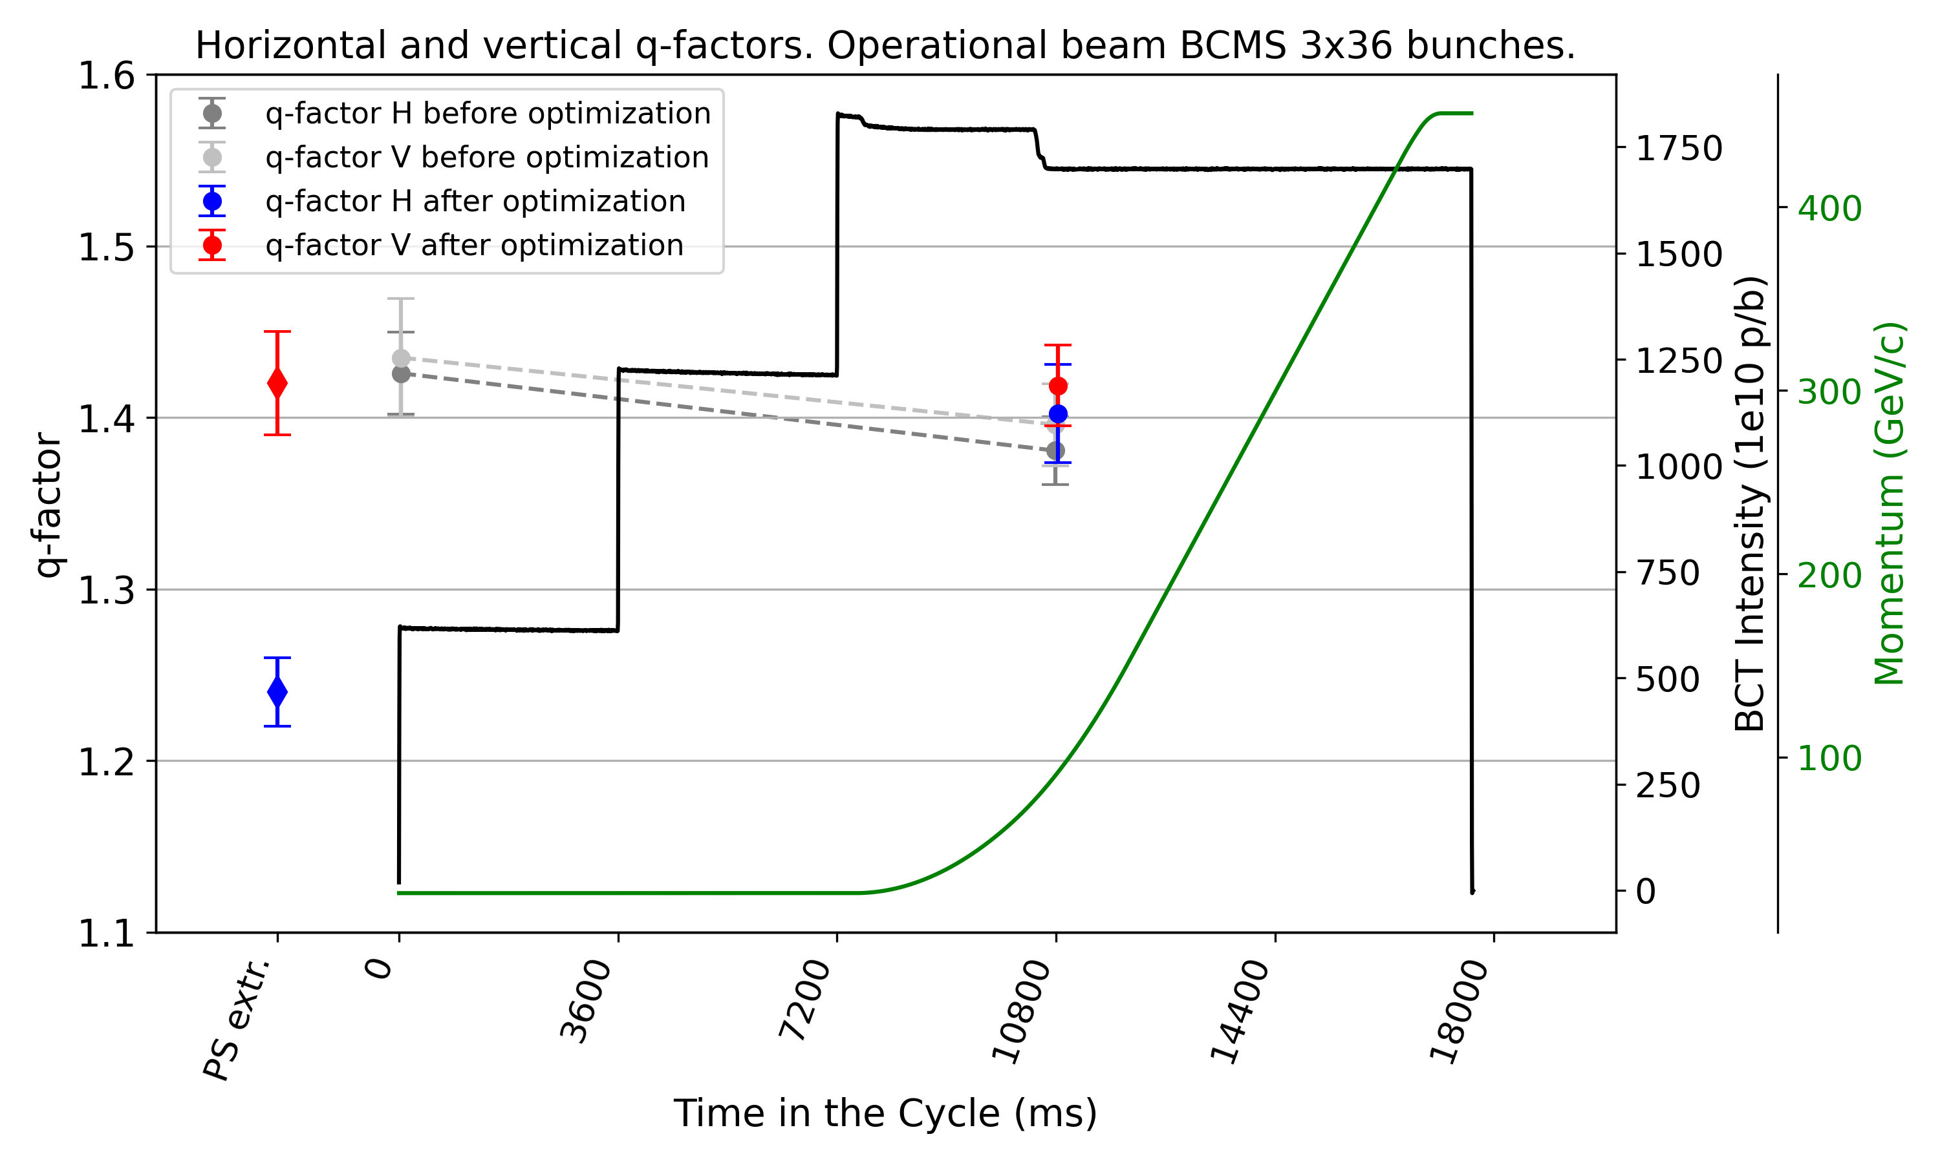
SPS measurements with 3x36 1.6e11 ppb
I. Mases Sole, F. Asvesta

Slide 40
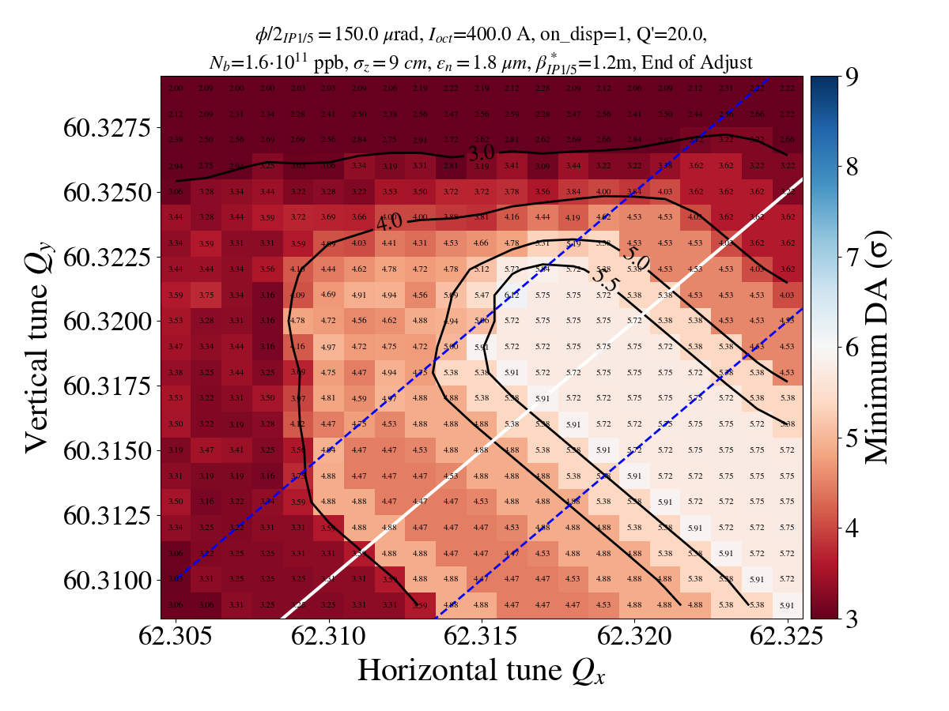
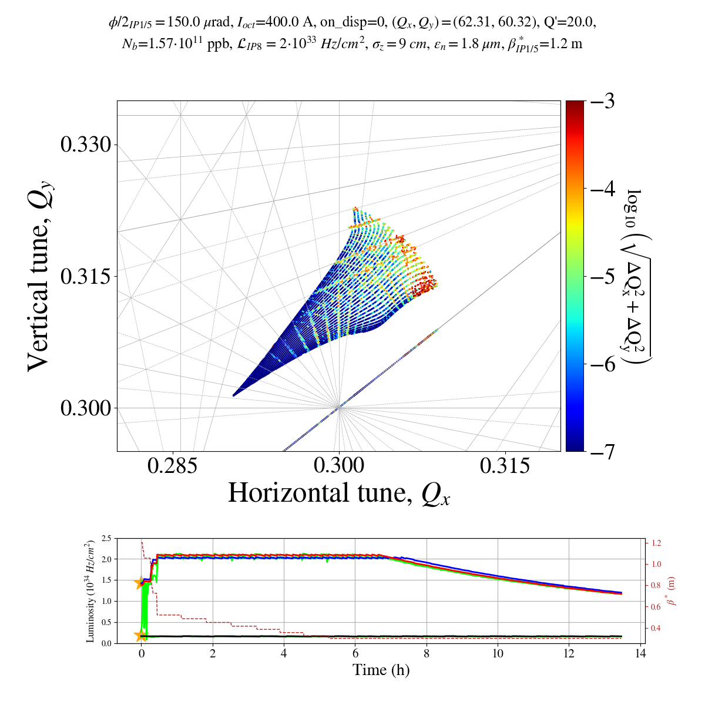
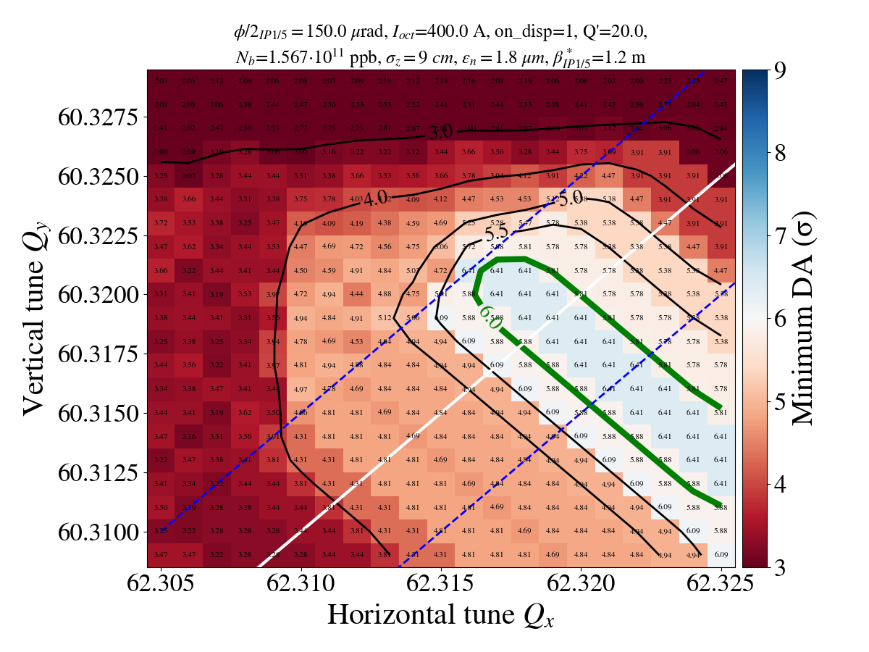
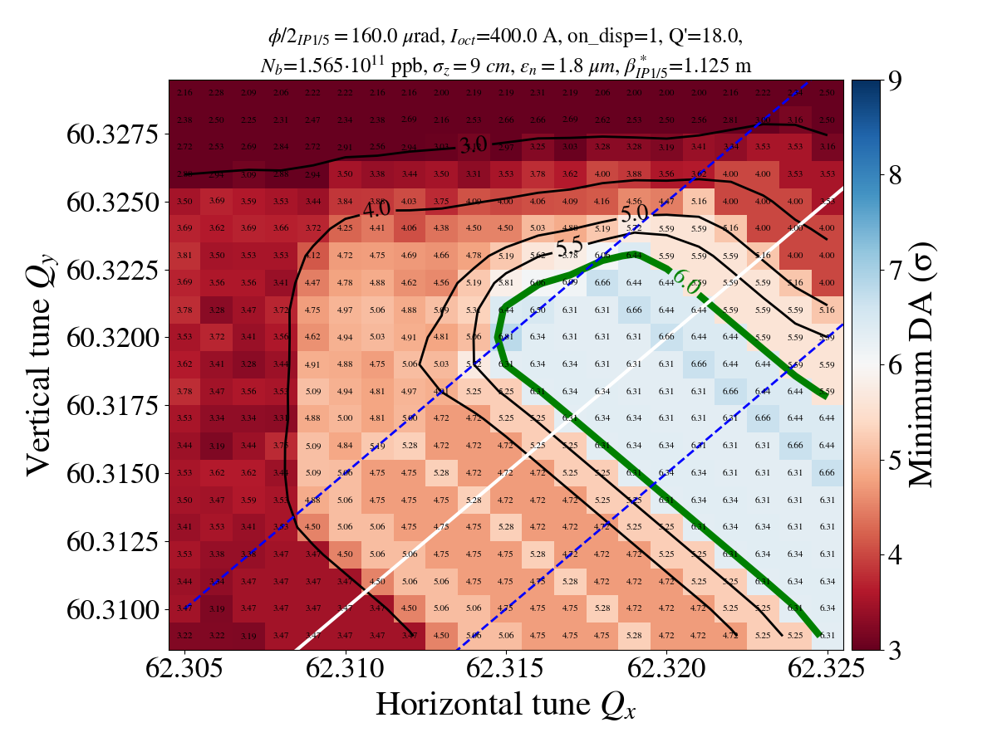
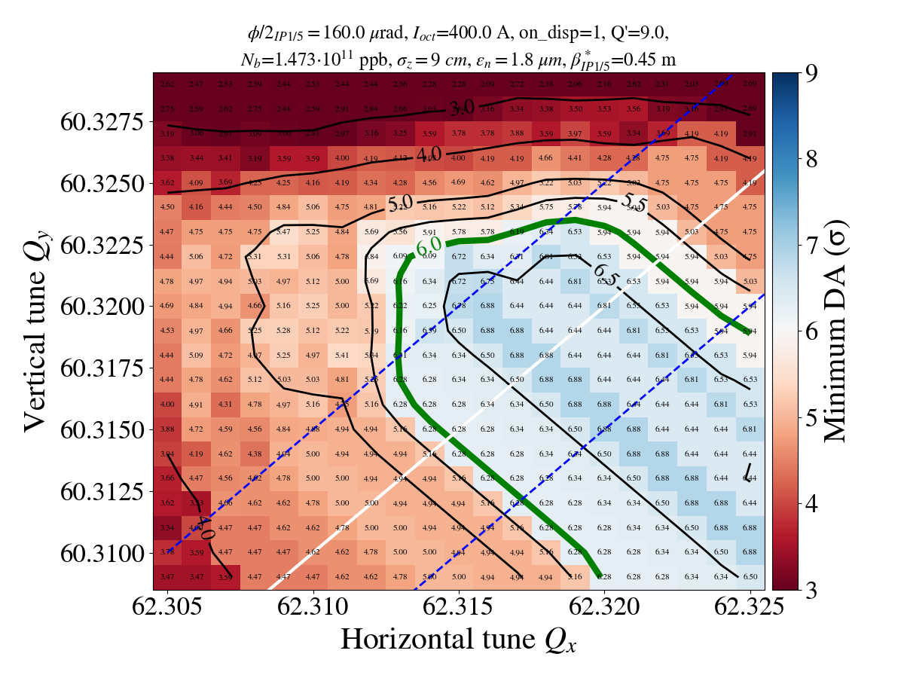
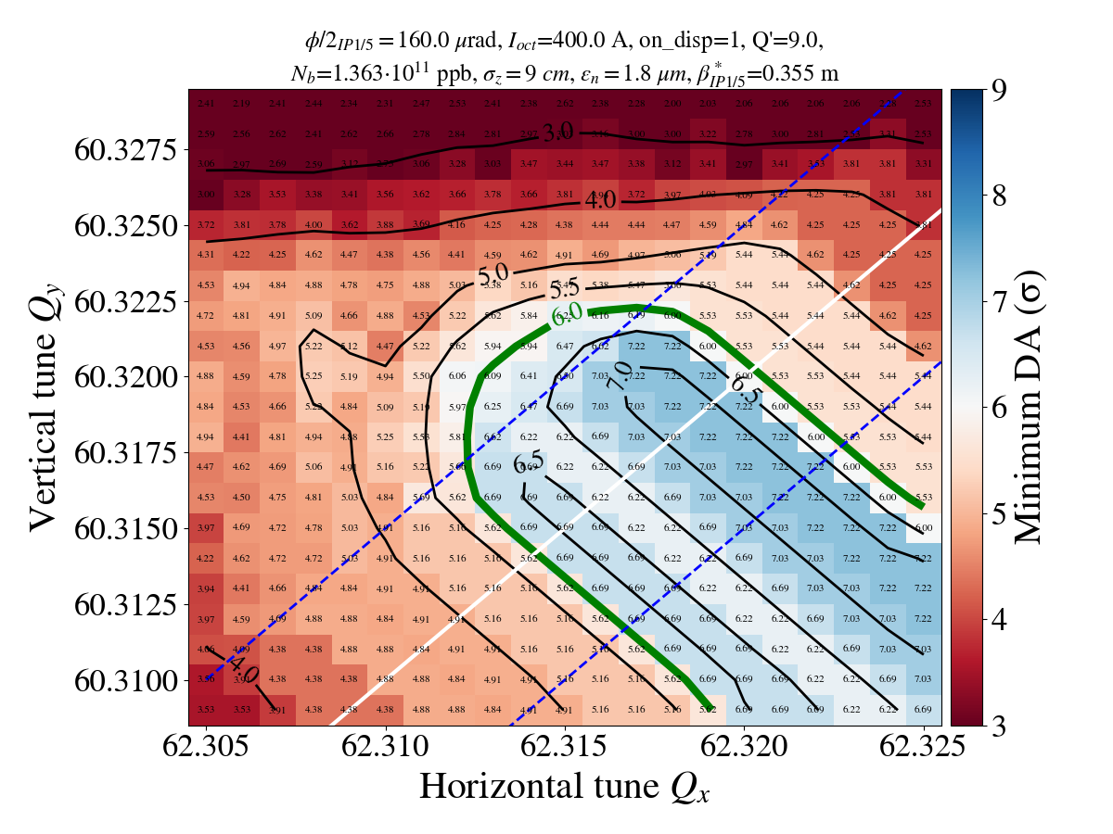
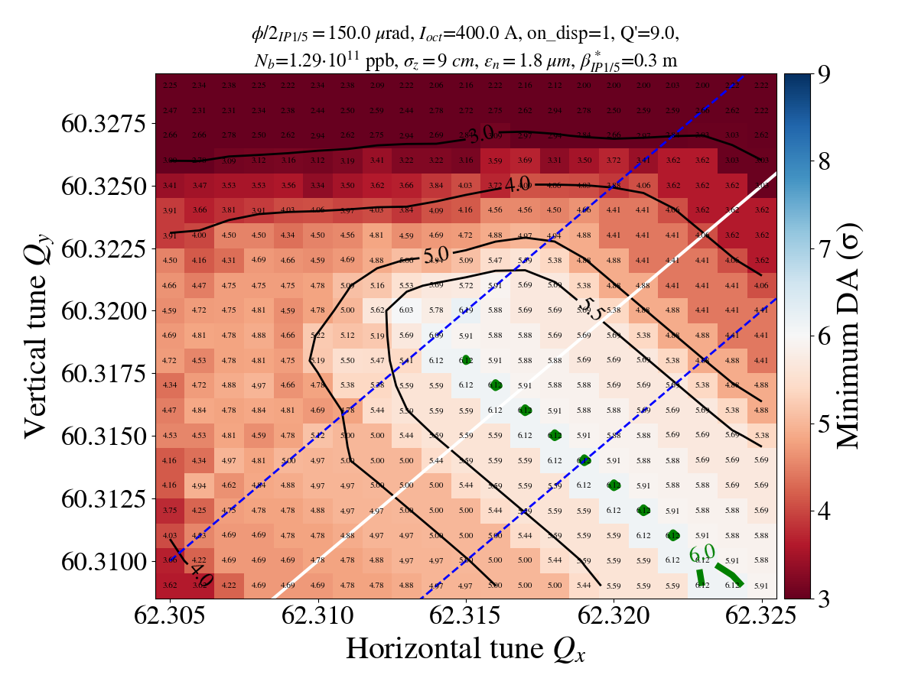
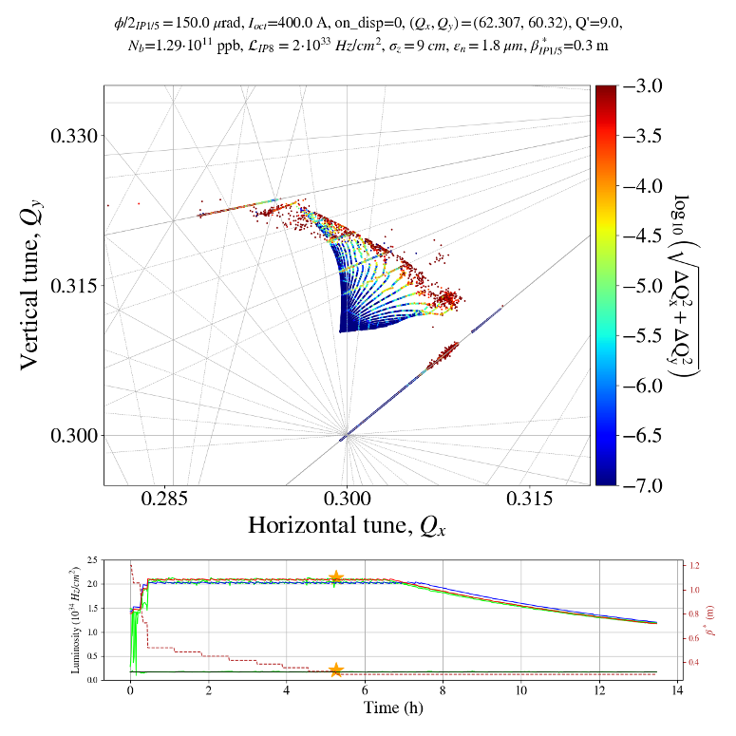
Losses during collisions: DA for 2024

Slide 41
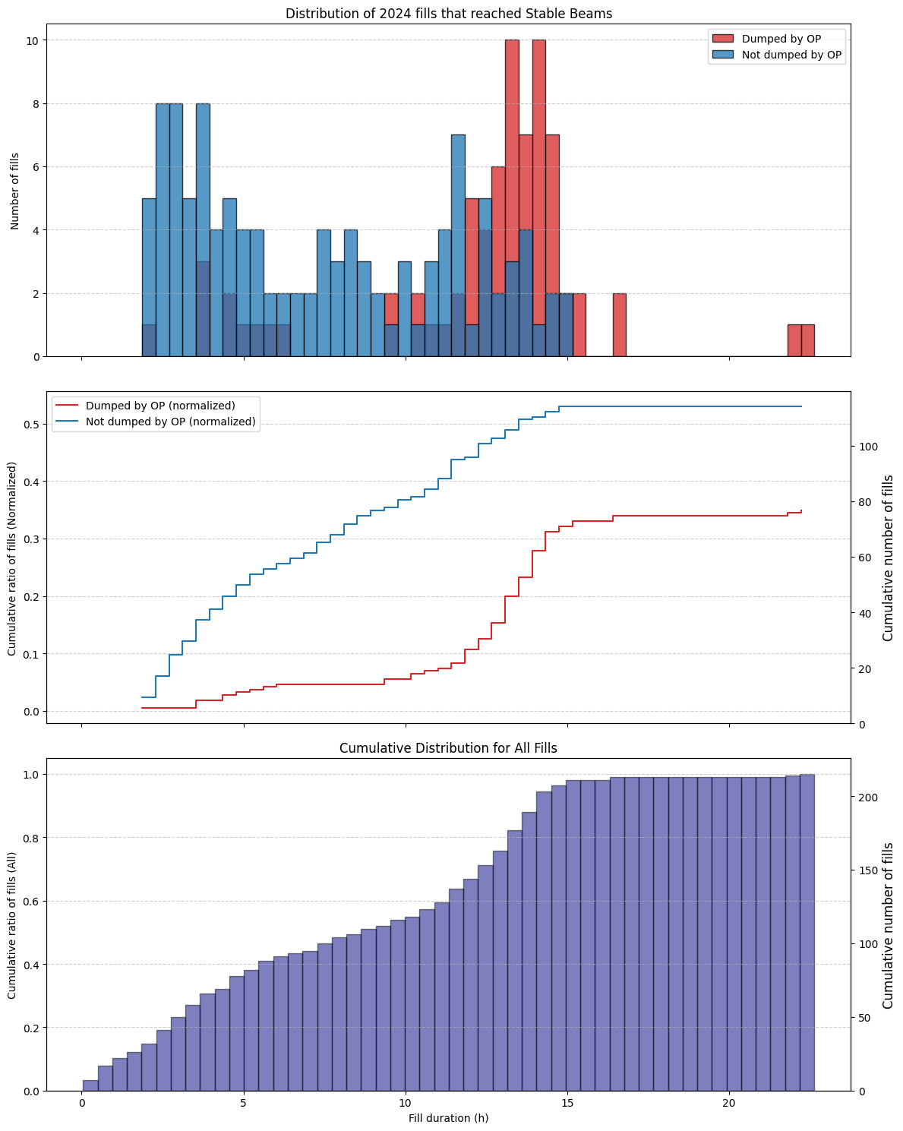
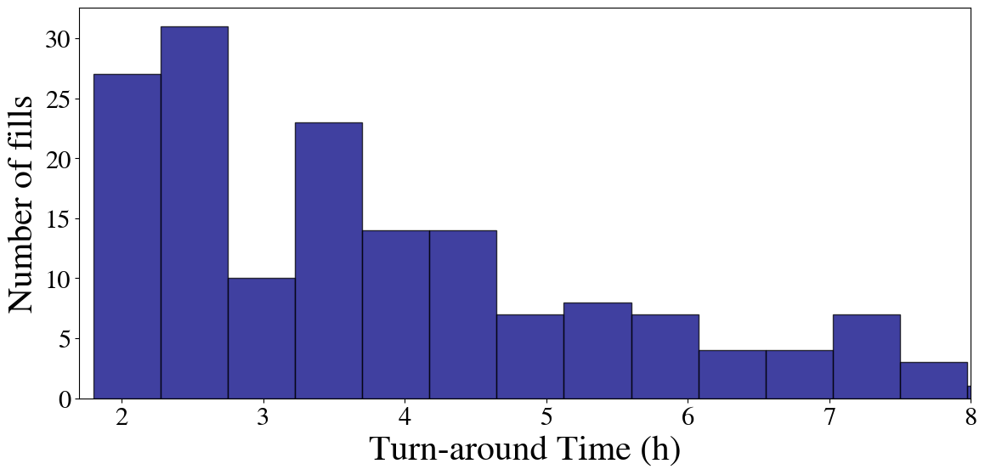
Statistics from 2024

Slide 42
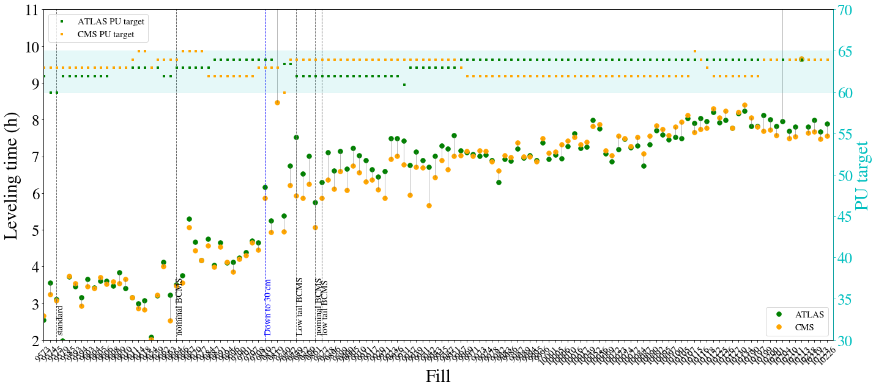
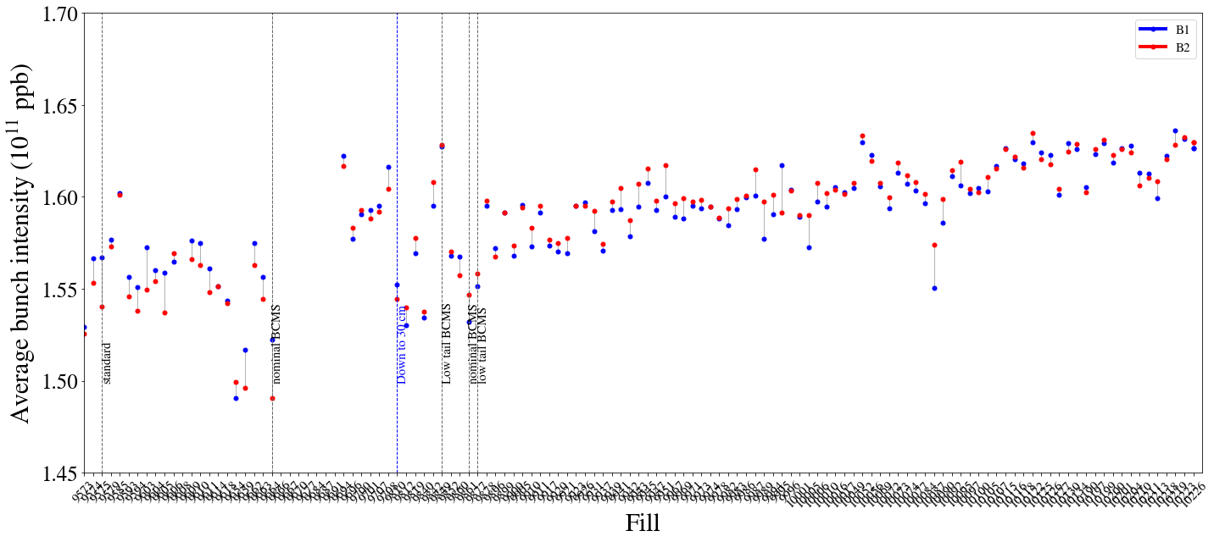
Leveling time

Slide 43
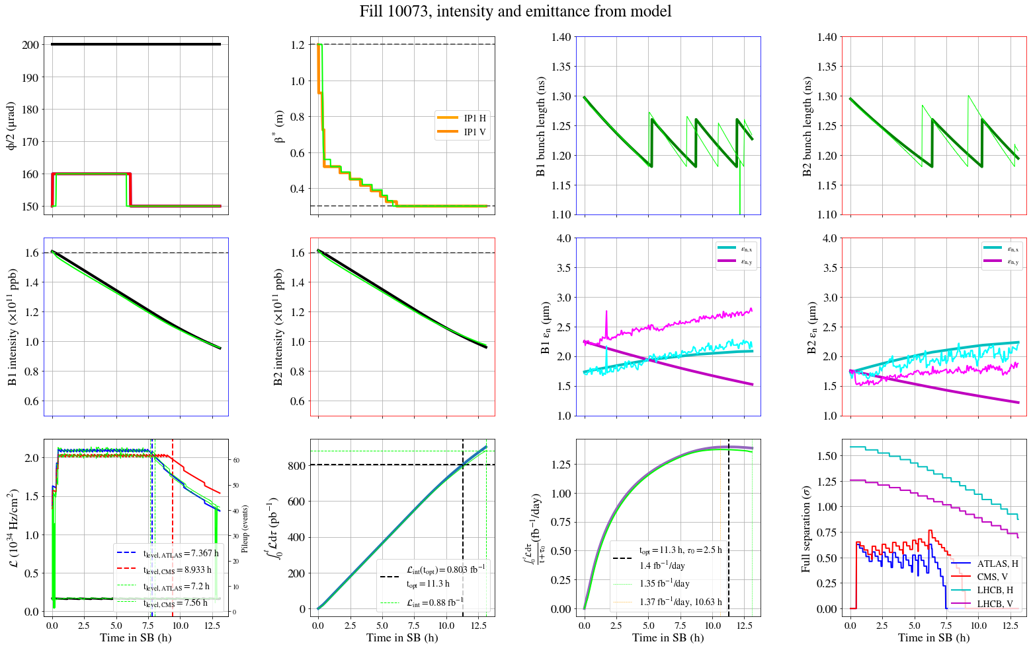
Luminosity model: pure model

Slide 44
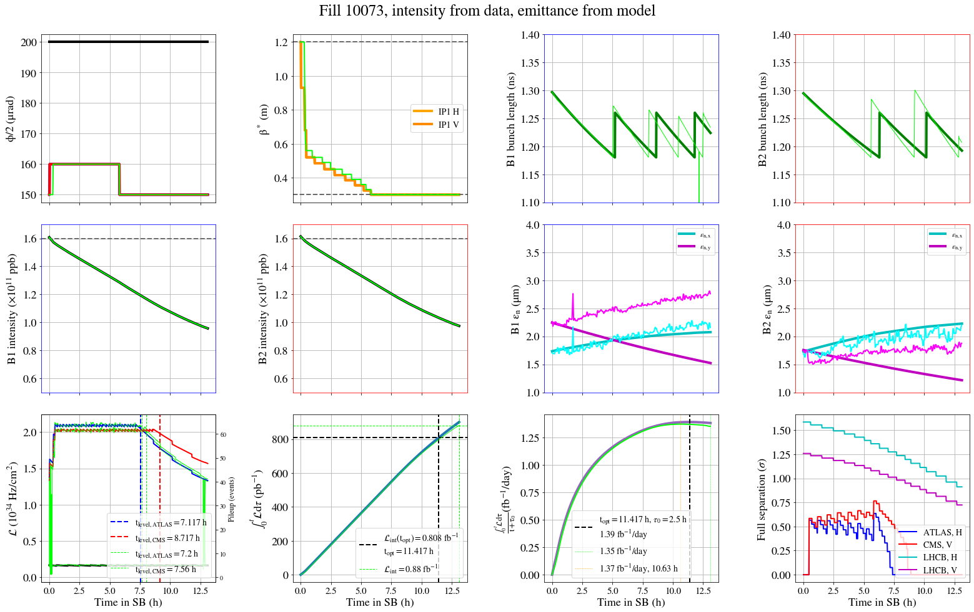
Luminosity model: extra losses

Slide 45
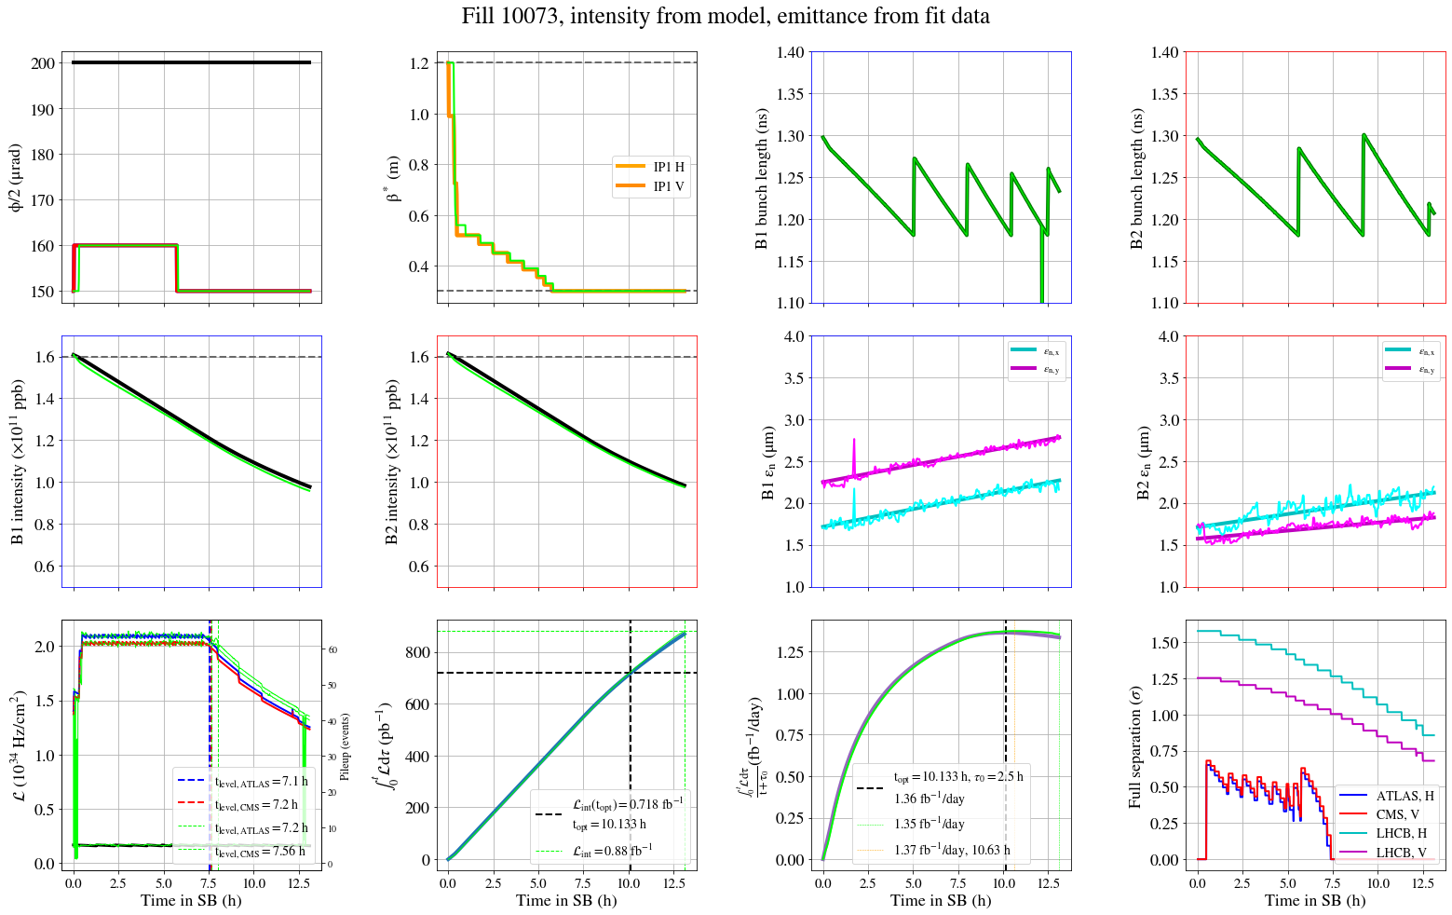
Luminosity model: extra losses & emit growth

Slide 46

LHC injection profiles vs SPS scraping

Slide 47


Losses during the collapse of the separation bump & start of collisions
Collisions in IP1/2/5/8
Collisions in IP1/2/5
First year where we also observe impact from LHCb: LHCb luminosity 2e33 Hz/cm² while ATLAS/CMS 2e34 Hz/cm²

Slide 48

Losses during the collapse of the separation bump & start of collisions
Collisions in IP1/2/5/8
Collisions in IP1/2/5
First year where we also observe impact from LHCb: LHCb luminosity 2e33 Hz/cm² while ATLAS/CMS 2e34 Hz/cm²

Slide 49

Losses during collapse and collisions
Good correlation between DA and beam lifetime.
Beam lifetime of ~10h indicates DA<4.5 σ

Slide 50
Luminosity model

Slide 51


Performance gain BCMS vs standard
Fill 9614, Standard
Fill 9667, BCMS
Considering a turn-around time of 2.5h:
        From 1.22 fb⁻¹/day with standard to 1.32 fb⁻¹/day with BCMS: +8.2% integrated luminosity for fills that make it to the optimal fill length (>8h), 5% from the lower emittance and 3.2% from the intensity increase.

Slide 52

Emittance growth at injection
Emittance growth mechanism at injection not fully understood:

Slide 53

Emittance growth at injection
Emittance growth mechanism at injection not fully understood:

Slide 54





Impact of improved losses
Nominal
Fill 9864
Fill 10100

Slide 55
Tails at injection
Systematic profile monitoring in 2024:
  From Fill 9912 (July), full-cycle bunch-by-bunch BSRT profile logging in NXCALS thanks to D. Butti.
Note on special beams (1/2):
    BSRT profiles must be deconvoluted.
    Deconvolution relies on specific information obtained during BSRT calibration fills.
    In 2024 preparation & effort from the injectors to provide Gaussian beams during these fills & simplify deconvolution, similar type of preparation for next year.

Slide 56


Impact on integrated luminosity
Luminosity model provides accurate predictions for beam parameter evolution & luminosity estimates throughout a fill: can include additional effects beyond theoretical models to match the data.
Considering ideal case where fills are dumped at optimal fill length and turn-around of 2.5 h.
Standard vs nominal BCMS in 2024
Assuming -15% emittance reduction at start of SB as only difference:
  β_{min}≥ 36cm: 5% gain, confirmed with experimental data.
    β_{min}= 30cm & 1.65e11 ppb: 2-2.5% gain.
    for fills that made it to optimal fill length (10h) with τ=2.5 h
“Low-tail” BCMS:
On average, reduction of σ_{eff} from ~100 mb to ~85 mb after Fill 10100.
Exact contribution of tails on luminosity to be studied.
Maximum gain up to 4% for fills reaching optimal fill length with τ=2.5 h.

