Slide 1
Dynamic beam scheduling and automated LHC filling
Status of the EPA WPs
Amaury Beeckman with input from A. Huschauer, A. Lasheen, M. Schenk, V. Kain, G. Trad, H. Pahl, M. Jaussi, D. Lampridis, M. Cejp, Z. Ansari, D. Cotte, G. Papotti, T. Argyropoulos, S. Albright, F. Irannejad, J. Wulff, R. Maillet and many others…
11th December 2024

Slide 2
Outline
Introduction on EPA
Dynamic Beam Scheduling
Automated LHC filling
Progress across the injector complex
  Transverse
  Longitudinal
  Transfer lines
Outlook & Next steps

Slide 3
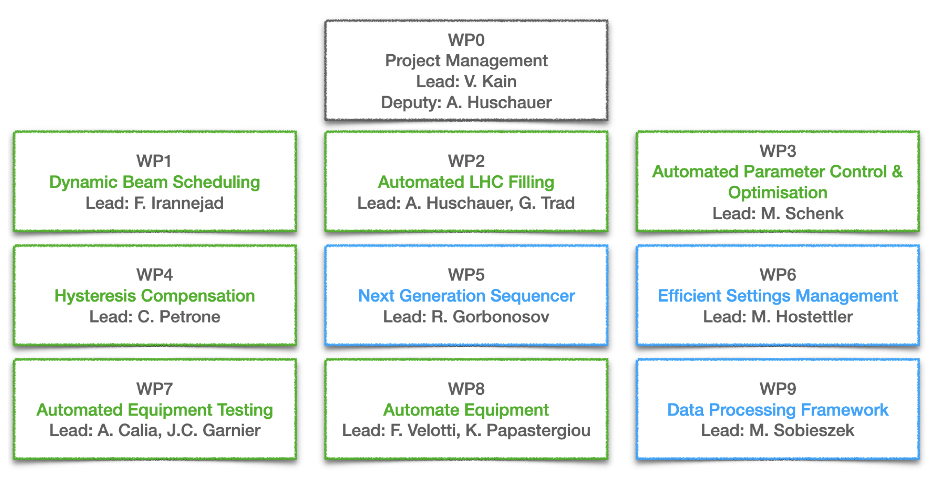
Introduction
Main progress coming from the Efficient Particle Accelerator project (EPA):
The focus is on automation to increase efficiency, reproducibility, flexibility, and margins for operation
WP1 - Dynamic Beam Scheduling
WP2 - Automated LHC Filling
WP5 - Next Generation Sequencer
EPA Mini-Workshop

Slide 4
Dynamic allocation of cycles in the super-cycle
Optimize beam delivery for “physics” users

Slide 5
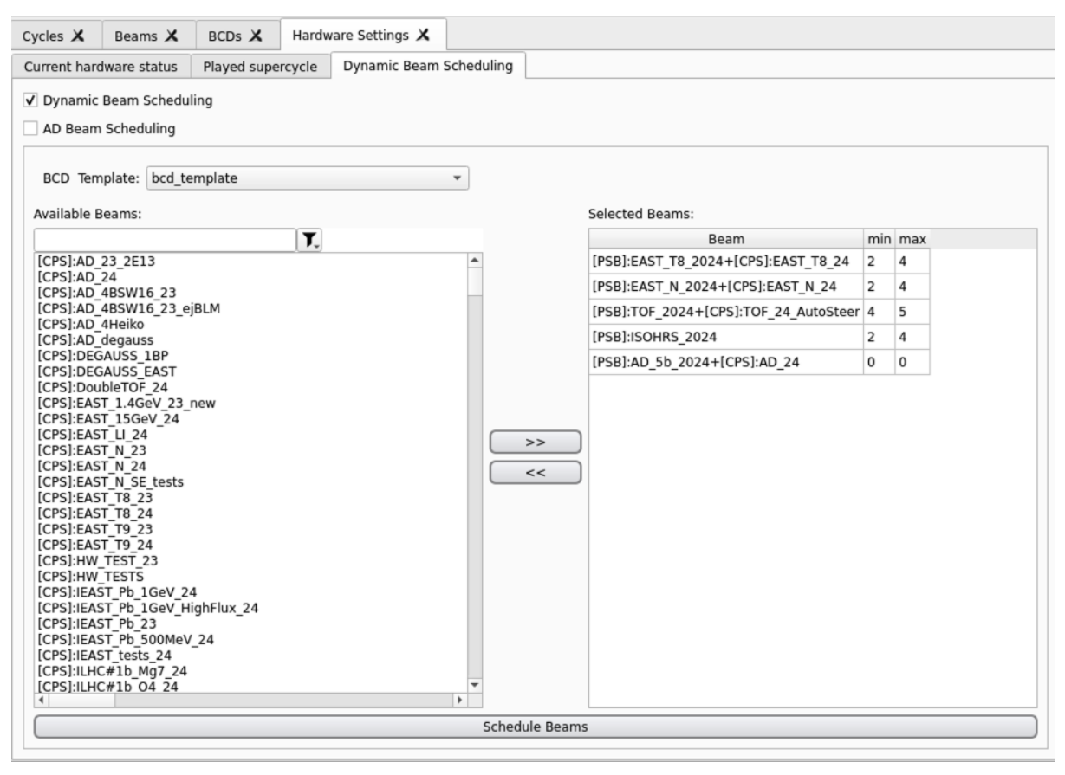
Dynamic Beam Scheduling
Automatic configuration of the super-cycle composition to optimize physics
Schedule beams based on user requests
  Trigger a new BCD proposition at change of requests
Incorporate constraints according to the needs
  Flexible algorithm with the aim of providing stable and reproducible performance for physics users
Hardware Settings Panel
Reference Link @F. Irannejad

Slide 6
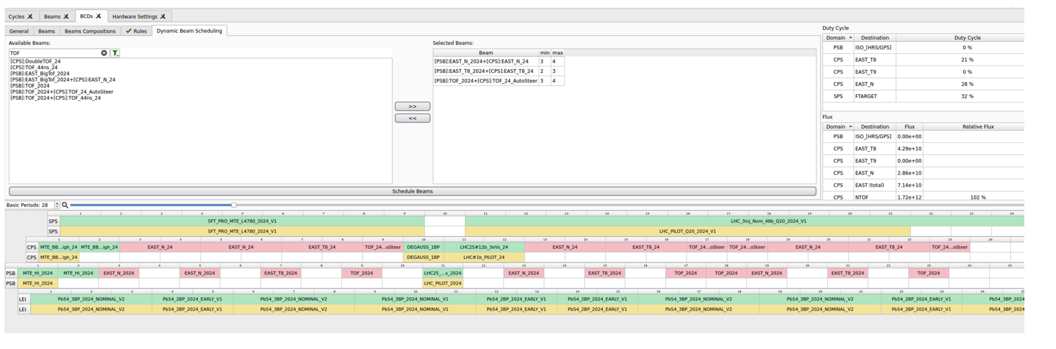
Dynamic Beam Scheduling
First stage: automated scheduling of PSB and PS beams based on an SPS template
Reference Link @F. Irannejad

Slide 7
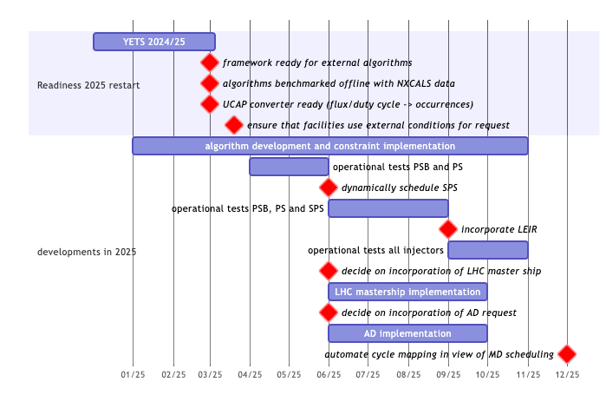
Dynamic Beam Scheduling
Next steps
Evolve framework and test algorithm
  Launch in operation early 2025 to gain experience
Adding constraints in the current solution
    Exploring constraint programming
    In terms of accepted previous cycles / requests for equidistant spacing in supercycle
Add SPS & LEIR in the dynamic scheduling
Deal with AD request and discuss concept of LHC mastership
Reference Link @F. Irannejad

Slide 8
Automated LHC Filling
What are the key components

Slide 9
What is the aim of automated LHC Filling
The ability to fill the LHC without human intervention to improve efficiency, reproducibility and performance
Dynamic allocation of dedicated cycles in the super-cycle
  Make room for LHC cycles during the preparation stage in the injectors and the actual filling
Continuous monitoring of beam quality
  Longitudinal & transverse beam quality metrics in the synchrotrons and transfer lines
  Equipment status
Implementation of automatic procedures for orchestration, optimization and recovery
  Improvement of beam and equipment performance

Slide 10
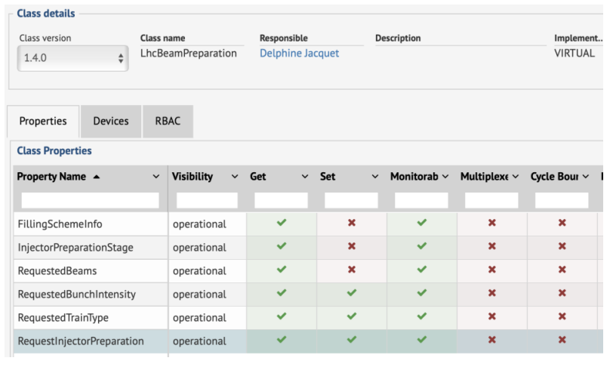
Information/forewarning from the LHC
LHC Beam Preparation Server
Injector Preparation Stage:
  “beamPreparationRequested”
  “injectionImminent”
Information displayed on PS2SPS transfer vistar
Dynamic Beam scheduling should change BCD
  Progressively filling cycles to avoid blocking SPS while optimizing beam
(@M. Hostettler & D. Jacquet)

Slide 11
Automated LHC Filling
Booster
Prepare injectors to filling scheme
beam type
Bunch intensity
Adjust Bunch intensity
Monitor longitudinal beam quality
Bunch intensity/lengths
Tomography
Monitor transverse beam quality
Bunch shaving to reduce tails
Transverse emittance measurement
Monitor
Transfer Line steering
PS

Slide 12
Automated LHC Filling
PS
Prepare injectors to filling scheme
beam type
#bunches per PS extraction
max. # SPS batches
Optimize longitudinal beam quality
Bunch splitting (triple/double)
Bunch rotation
Bunch intensity/lengths
Tomography
Monitor transverse beam quality
Transverse emittance measurement
Correct Transfer Line steering
TT2/TT10 trajectory quality
SPS
Monitor/adjust? Energy matching
.

Slide 13
LHC filling flowchart
SPS
Prepare injectors to filling scheme
Beam type
Bunch intensity
Monitor longitudinal beam quality
BQM checks: Bunch intensity/lengths
Injection phase adjustments
Longitudinal emittance
Monitor/Adjust transverse beam quality
Scraping
Intensity dependent settings
  Laslett tunes, TFB etc…
Transverse emittance measurement
Correct Transfer Line steering
Trajectory quality
LHC

Slide 14
Observable and metrics
Focus on online metrics computation

Slide 15
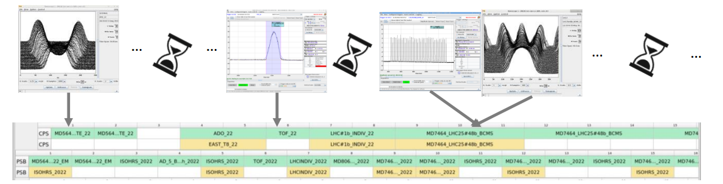
New longitudinal acquisition layer needed
Prepare injectors
Longitudinal
Transverse
Transfer Line
Previously no common framework for online monitoring (BQM @SPS, OASIS @PSB/PS)
Difficult to update the BQM to the other injectors
Measurement and adjustment longitudinal beam characteristics with OASIS
  Only manual and on-demand measures; effort required to automate
  No PPM acquisition
PS Longitudinal characterization based on Tomoscope and bunch shape measurement (BSM)
  Single acquisition on a single user, only two channels available

Slide 16
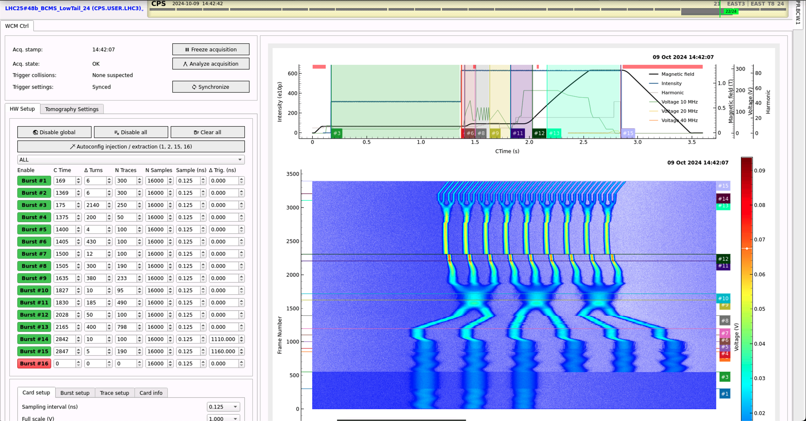
Enabler of longitudinal beam quality monitoring and optimization
Prepare injectors
Longitudinal
Transverse
Transfer Line
New longitudinal acquisition layer – FESA class BCWLBO
FESA - Fully multiplexed class
  Settings can be changed between cycles
  Every trace can be set differently (even inside a burst)
Start Acquisition Event
  Timing / On-demand event that starts one acquisition
End Acquisition Event
  Timing / On-demand event from which we abort the “wait” acquisition
The device publishes as soon as data is available
Generic implementation for all synchrotrons
  Enables online beam monitoring and optimization for multiple users at once and along the full cycle
    permanent PPM acquisition
  IPP Meeting Slides
(PS) Longitudinal BQM app
(@H. Pahl)​​

Slide 17
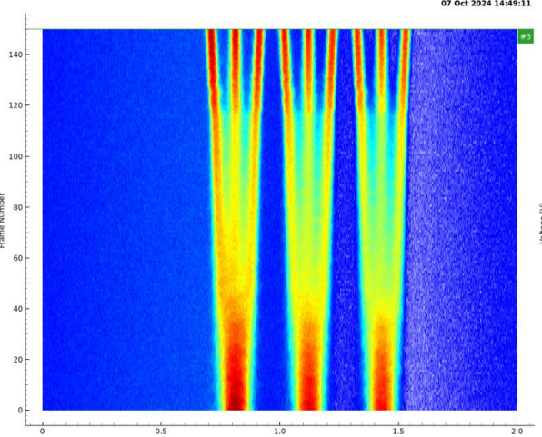
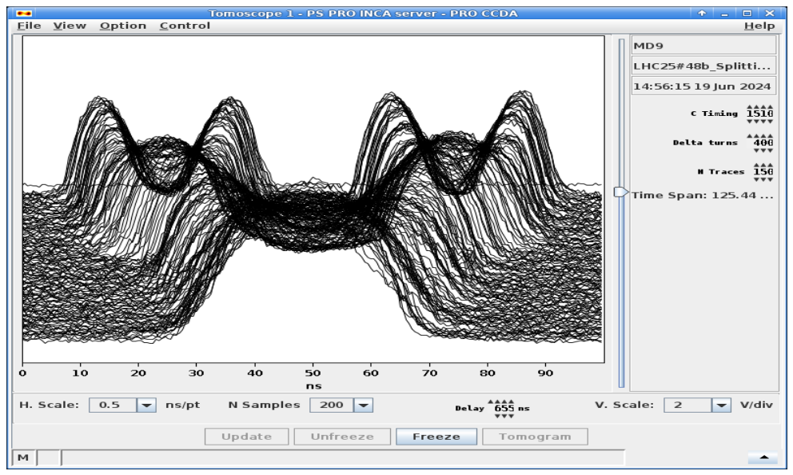
PS – LHC Double/Triple splitting
Prepare injectors
Longitudinal
Transverse
Transfer Line
Triple Splitting
Double Splitting
Data coming from BCWLBO class
Measure + monitoring
    Bunch intensity & bunch length after splitting
    Act on the Phase & Voltage of the cavities
Current CNN/RL implementation flexible enough to be tested operationally
  Last update
Data coming from BCWLBO class
Measure + monitoring
    intensity after each double split
    Act on the Phase of the cavities
Current implementation: PID controller
  Last update
(@J. Wulff, Z. Ansari)

Slide 18
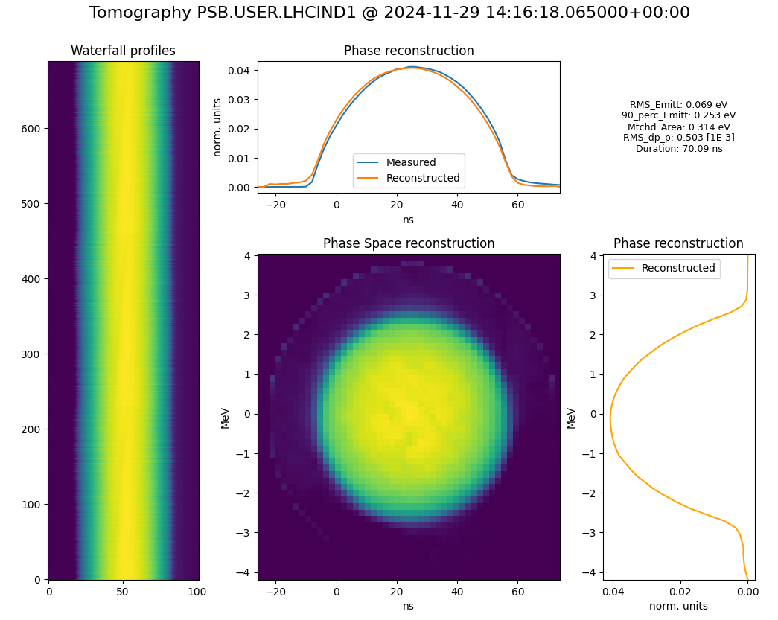
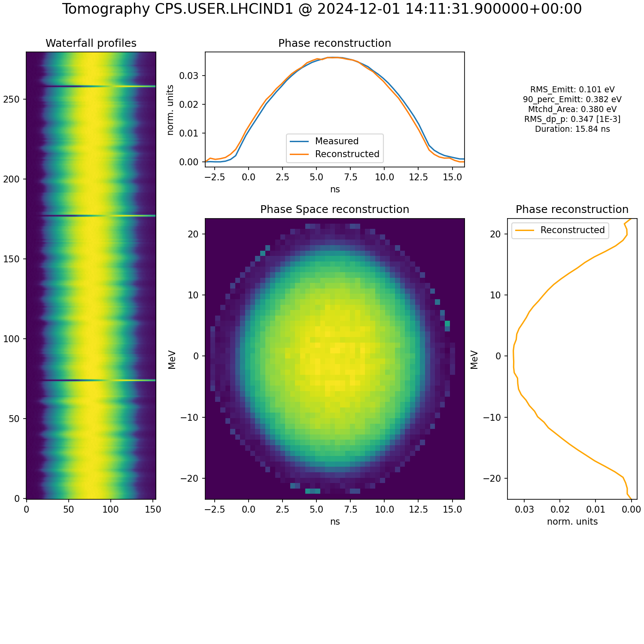
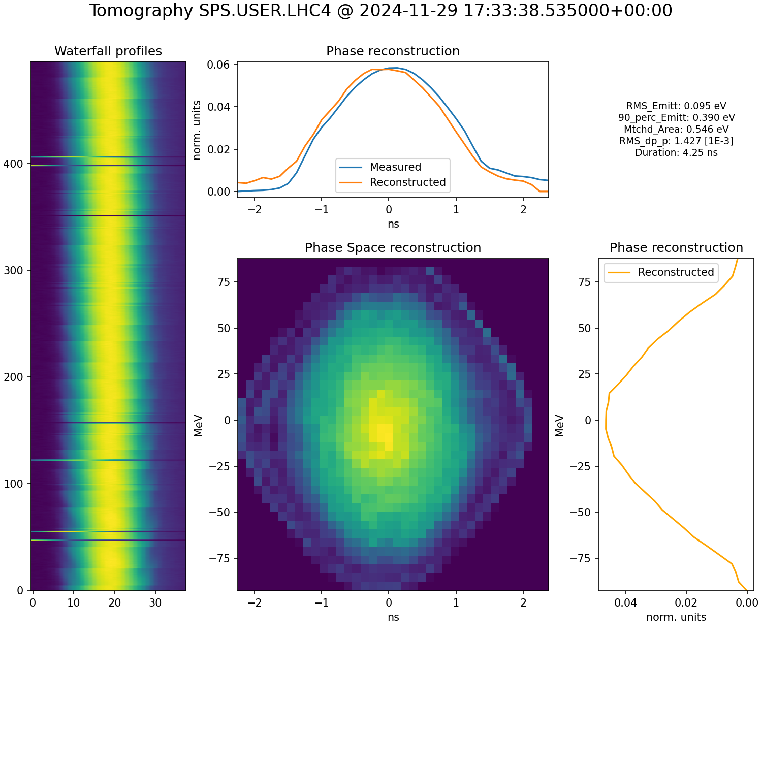
Monitoring all along the injector’s chain
LHC INDIV beam – automated tomography
Prepare injectors
Longitudinal
Transverse
Transfer Line
PSB
PS
SPS
Extraction
Bef. Rotation
Injection
Automated multi-bunch tomography based on several UCAP devices for every machine at different timings in the cycle.
Permanent logging (NXCALS) for the PS

Slide 19
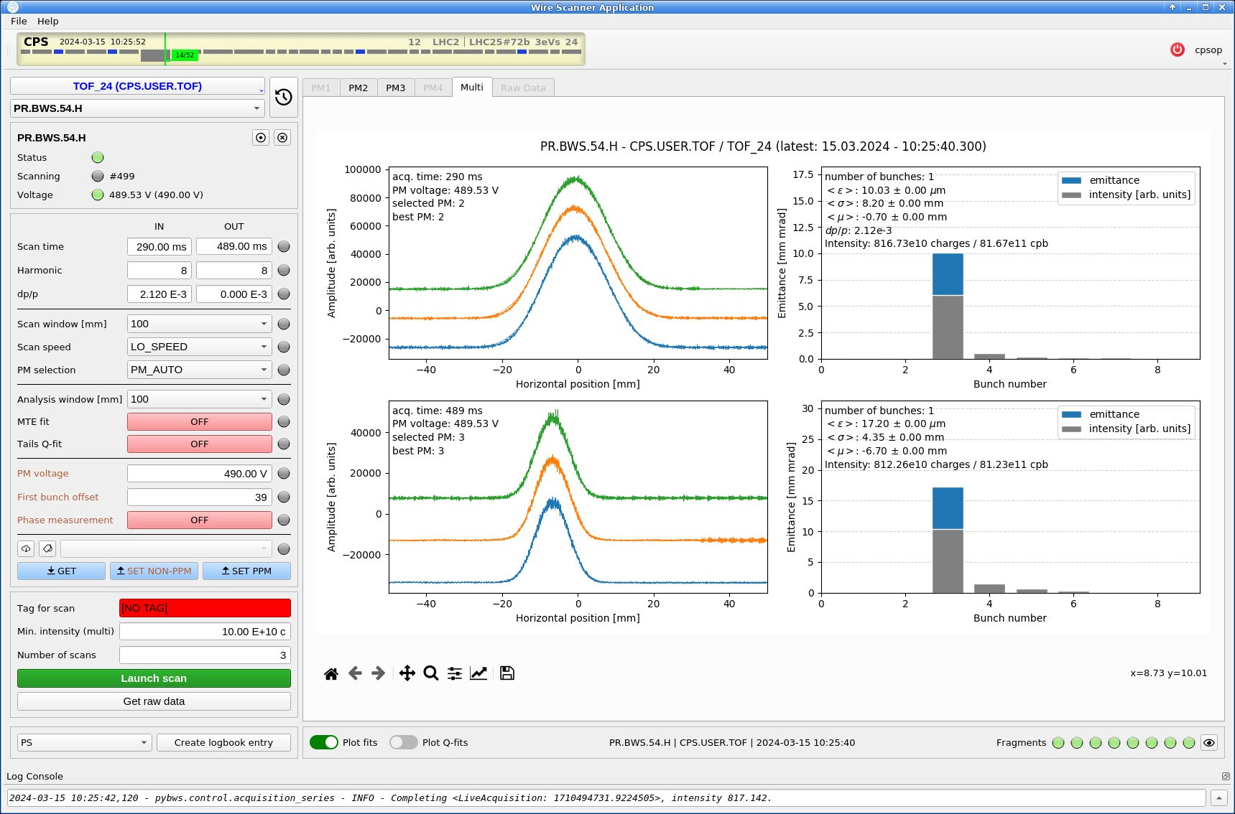
Wire scanner application
Prepare injectors
Longitudinal
Transverse
Transfer Line
Automation of wire scans for emittance measurements
  Regular beam quality measurements (BPT)
  Beam preparation and qualification during automated LHC filling
Backend on UCAP; Permanent logging (NXCALS)
Low-effort, repeatable measurements
  Use of prepared (“tagged”) acquisition and analysis parameters
  Recovery & filtering of historical data based on tags
Next step:
  Incorporate bunch-by-bunch dp/p from auto-tomo
  Auto-launch emittance measurements
  Ensure measurement only at allowed moments in the cycle
    Especially important in the SPS
  Wire scanner functionalities slides
(@H. Pahl, G. Trad)​​

Slide 20
Trajectory auto-pilot
Prepare injectors
Longitudinal
Transverse
Transfer Line
Steering framework “YASP steering on UCAP” (@G. Trad, F. Velotti)
  Generic solution, easy to extend, add measured response matrix
    Reduce rms trajectory, losses and optimize transmission
  GUI for monitoring trajectories & corrector changes
  Request to make trim sanity checks possible for MUXin
Lots of initiatives:
  Target steering, FTN line steering etc.
Next step:
  PS-SPS & SPS-LHC tests to follow next year
More info in next talk:
Results and plans for integration of automation and optimization in operation

Slide 21
Online Monitoring
Ensure high beam quality 24/7

Slide 22
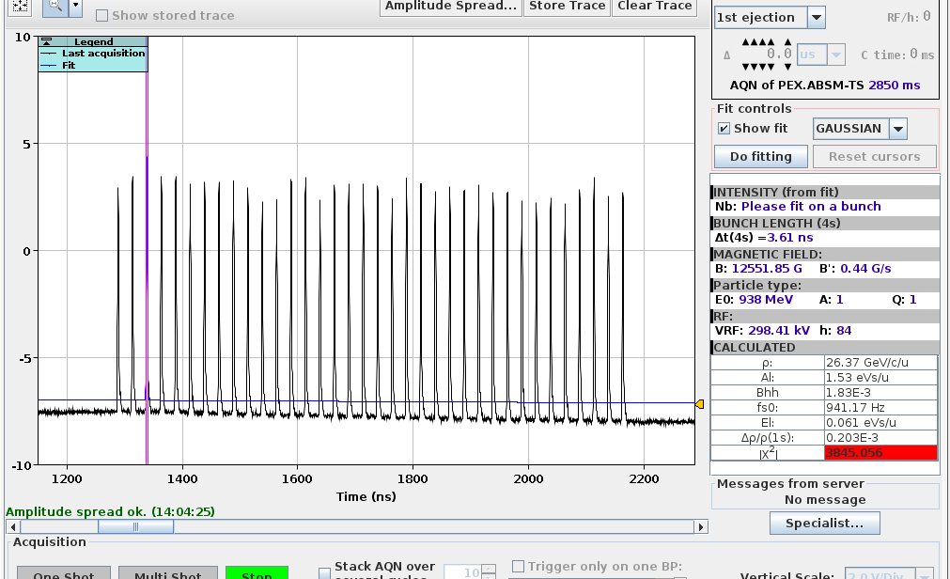
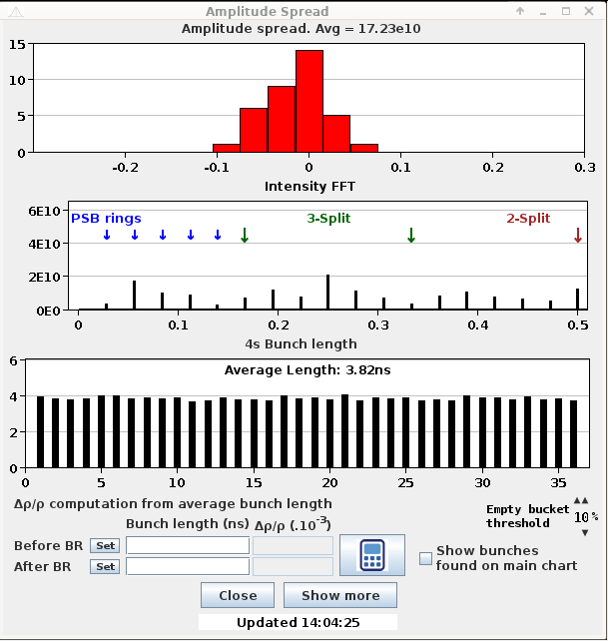
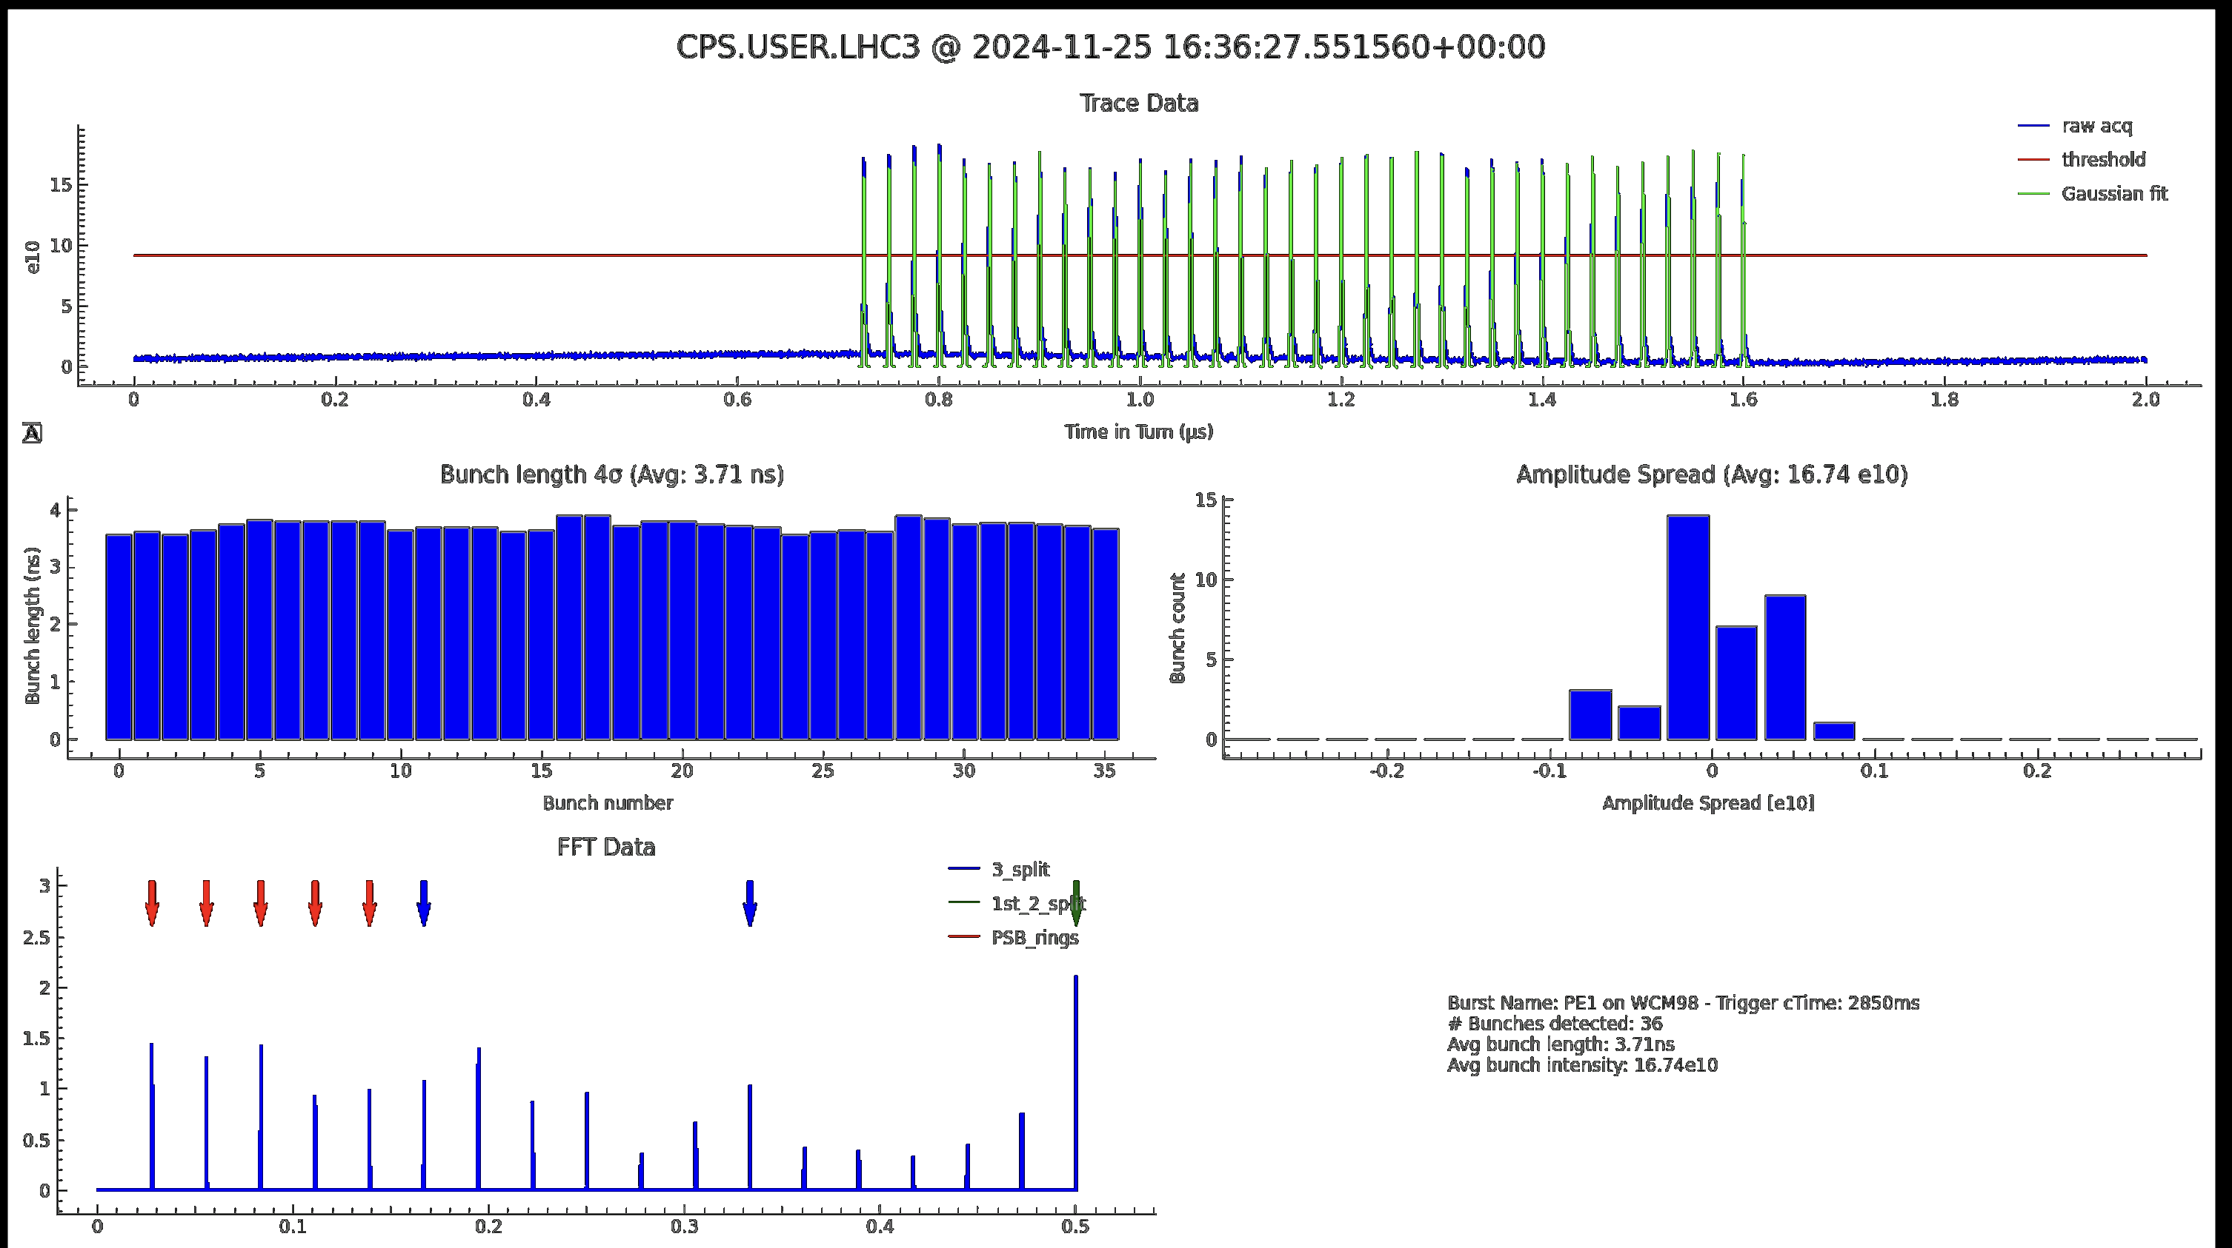
PS – Bunch Shape Measurement
“BSM” bunch-by-bunch analysis
On-demand analysis
OASIS based - Non-PPM
OP application based
New “BSM”
Online analysis (permanent)
BCWLBO - PPM
UCAP based (@M. Coly) + GUI

Slide 23
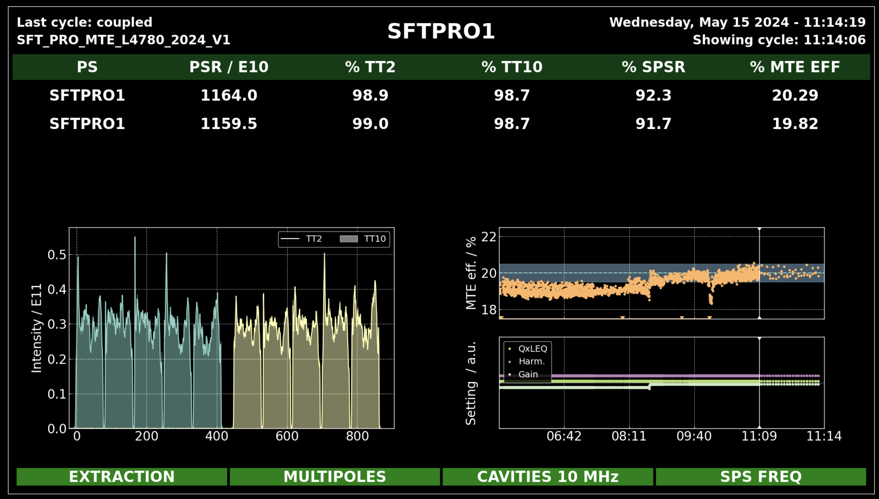
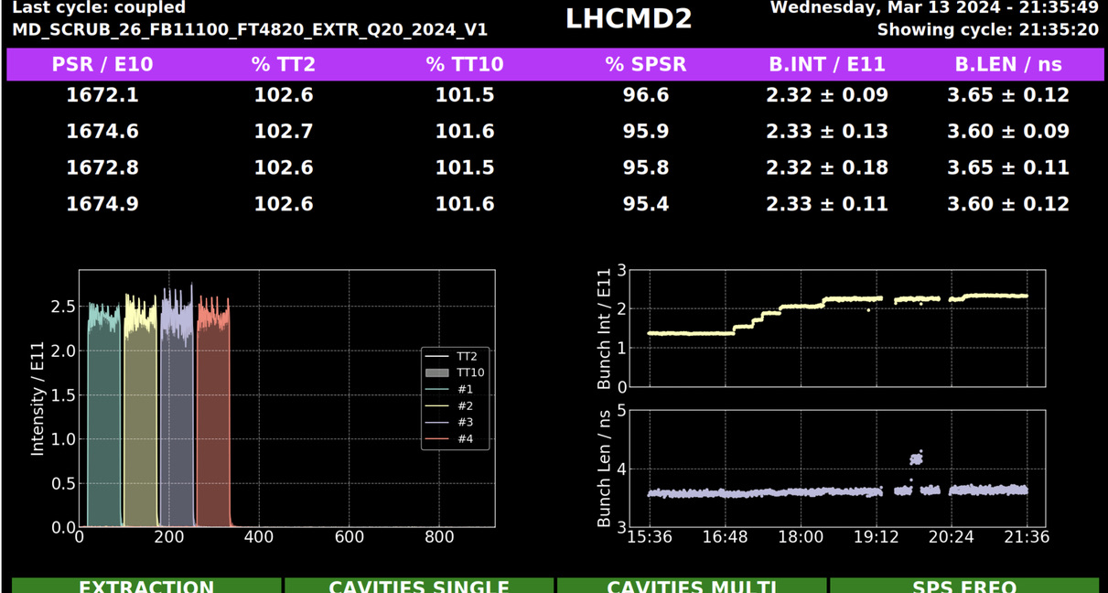
PS – SPS vistar
Two instances available in the OP webtools
  https://op-webtools.web.cern.ch/vistar/?usr=PS2SPS1
  https://op-webtools.web.cern.ch/vistar/?usr=PS2SPS2
Currently two modes available
  SFTPRO and LHC
  Will add additional mode for ion beams
Triggering on SPS cycle, user selection from PS non-multiplexed LSA setting
Backend including cross-machine event building on UCAP
  Good feedback from operations
  Allowed to spot drifting MTE efficiency, incorrect bunch lengths on LHC beams
(@H. Pahl)​​

Slide 24
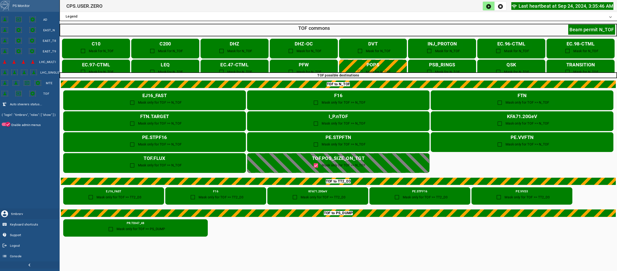
PS performance monitoring
PS performance monitoring developments
Cavities, magnets, kickers, etc. status monitored via UCAP
Auto-resets in place for 10, 20, 40 and 80 MHz systems and KFA71 modules
  Fruitful collaboration with RF and ABT experts
Auto-start in place for 20 MHz system
  Triggered by LHC forewarning or presence of LHC type beam in the super cycle
(@R. Maillet et al.)​​
  Status of PS performance monitoring

Slide 25
Outlook
Future plans and missing pieces across complex

Slide 26
Putting things together
Missing pieces:
One orchestrator to rule it all!
Cross machines metrics
Prepare injectors to filling scheme
BCWLBO
+ UCAP
Longitudinal beam quality
BWSLIU
+ UCAP
Transverse beam quality
Auto-pilots
Transfer Line

Slide 27
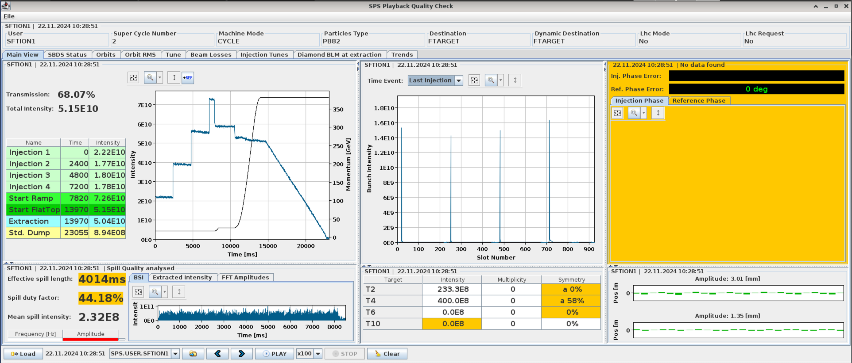
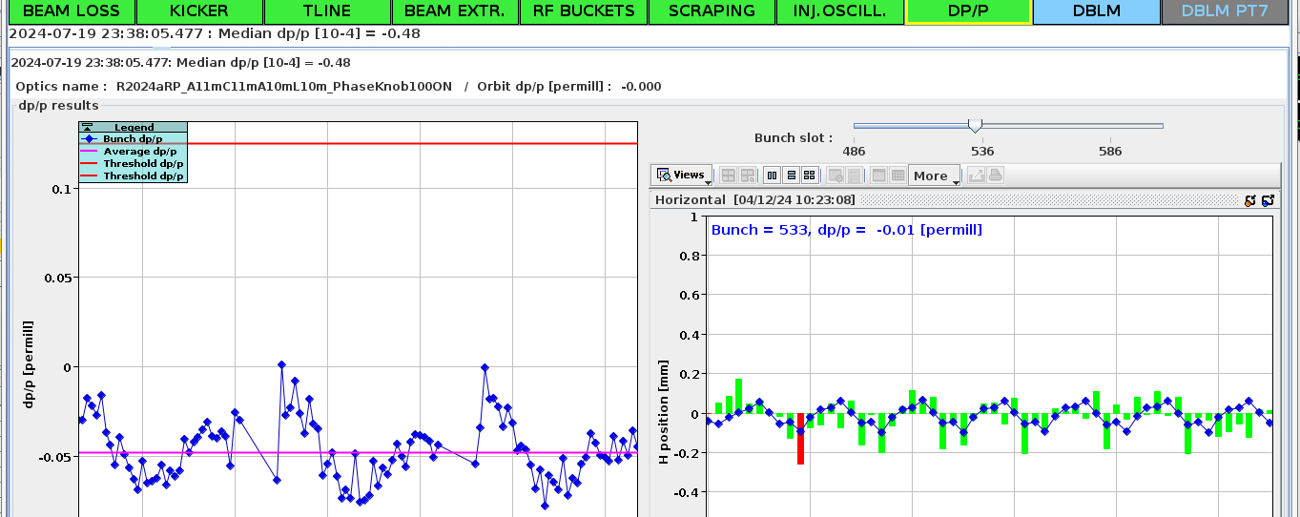
Cross machines metrics: quality control
Current setup (SPS QC | LHC IQC) not suitable enough for PS/PSB
Link to post-mortem
Be able to reload data and reprocess it
There is a need for a generic solution where we can collect information on the beam quality metrics across machines!
Online / NXCALS for data recovery
  One shot every ~ 1BP
Event collector via identifier management
  Should be a dynamic set of input
Data processing & analysis could be done anywhere
Visualize data from different machines on the same app (from PSB – LHC, PSB – North area, …)
Ideally be able to reload data and reprocess it

Slide 28
Orchestrator
Instance on top of all machines (state machine)
  This the “Brain” of the procedure
    Knows all the optimization steps required
    Keep track on where it is on the sequence of tasks
Launch UCAP/scripts/auto-reset processes on the fly
Launch task in
  Parallel
  Sequentially
Beam coupling to the next machine once success criteria
  Able to restart processes if conditions are degraded
  Inhibit beam production
Have its own GUI to monitor the optimization advancements

Slide 29
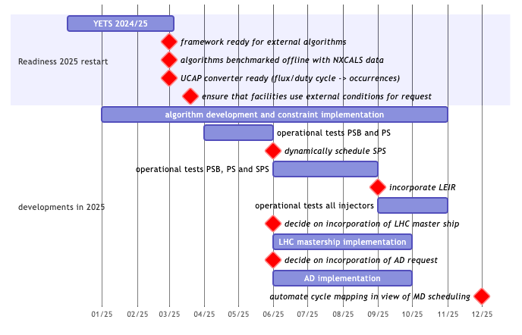
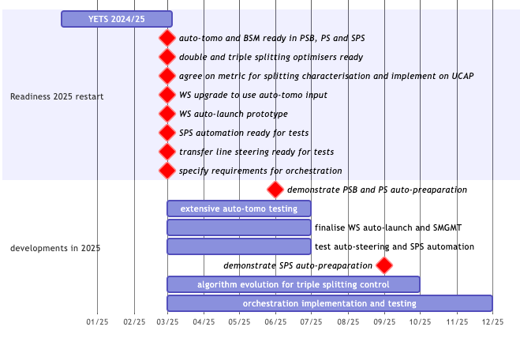
Next steps
WP1 - Dynamic Beam Scheduling
WP2 - Automatic LHC Filling

Slide 30

Thank you for listening
Any questions

