Slide 1
OP feedback and recommendations as we move towards automation
JAPW ’24, Montreux 10th – 12th of December 2024
Y.Le Borgne, S.Cettour Cave, L.Pereira, S.Massot, J.Dalla-Costa, D.Jacquet, D.Cotte, B.Mikulec, V.Barbet, E.Veyrunes, A.Calia, G.Trad, M.Schenk, JC Dumont, R.Maillet, GP Di Giovanni, P.Skowronski, O.Hans, G.Imesh, JL.Sanchez, R.Scrivens, T. Argyropoulos, L.Ponce, E.Piselli, M.Hostettler, B. Rodriguez Mateos, M. Schenk, V. Kain, T. Agryopoulos and many others…
Notes:
Hello, my name is Denis, and I work on operations for the PS machine. Andrea and Mickael asked me to present a brief feedback on automation in operations,. I’d like to take this opportunity to thank everyone who provided feedback for this presentation (the list might not be exhaustive)

Slide 2
OUTLINE
Operation Tasks and the Role of Automation
How Automation Has Helped
Proposed Workflow for Effective Automation
Key Recommendations for Moving Forward
Conclusion
Notes:
I’ll start by discussing the main tasks of operations, how automation has helped us, and then share some proposals and recommendations for the future.

Slide 3

Overview of key operational tasks in 2024
Many parameters to monitor, control and optimize for each user in the Super Cycle !
Discussed during Efficiency Think Tank (ETT) process.
Symmetry/Sharing
Efficiency
Beam Measurements
Splitting
Beam scheduling
Steering
Accesses
MDs
Notes:
The main task of operations is to run the machines in CERN's accelerator complex. Among these tasks, we find many common to accelerators, including beam programming in the SC, managing access and safety, beam parameterization and monitoring, steering, sharing, splitting, symmetry, and all aspects related to beam measurements for the various beams.

Slide 4
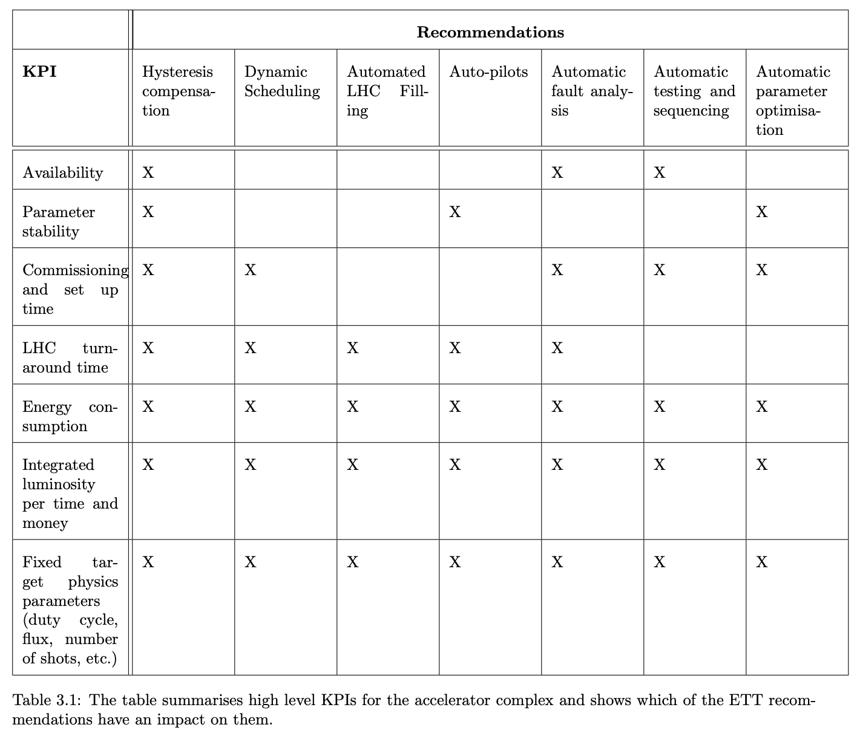
Role of Automation
Implementation of the ETT recommendations with the establishment of a dedicated Efficient Particle Accelerators (EPA) project until the end of LS3.
Until LS3: development and operational tests of prototypes.
Automation : increase efficiency, reproducibility, flexibility and margins for Operation
D.G Denis Cotte BE-OP-PS | JAP Workshop 2024
Notes:
All these tasks were discussed during the ETT two years ago. This resulted in a list of recommendations that became work packages within the EPA project.
Testing and development are expected to continue until the end of LS3.
The use of automation should assist machine operations in several areas.

Slide 5
OUTLINE
Operation Tasks and the Role of Automation
How Automation Has Helped
Proposed Workflow for Effective Automation
Key Recommendations for Moving Forward
Conclusion
Notes:
I’ll start by discussing the main tasks of operations, how automation has helped us, and then share some proposals and recommendations for the future, followed by a conclusion.

Slide 6


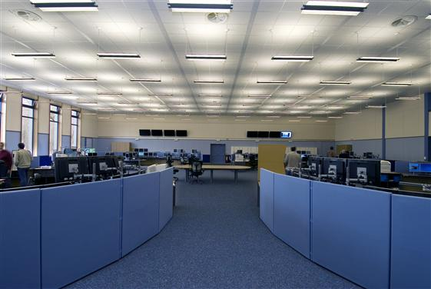
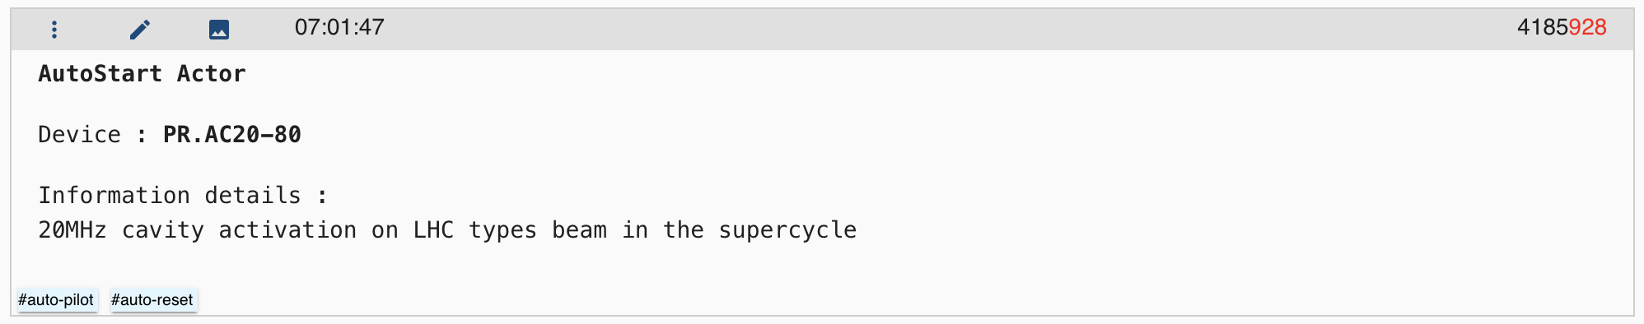

How Automation Has Helped : « Auto-Start »
Recurrent absence of high frequency cavities for LHC beams
Auto-start of the cavities introduced on the 30th of September 2024
92 automatic starts logged in the logbook under #auto-pilot. (30/09 to 03/12)
Implementation G.Imesh (OP)
Cavités !!!
PS Logbook Automatic entry
Some inversion issues between proton and ion cavities (currently being resolved)
… Euh … Oui on sait elles chauffent !!!
Picture from JAP22. A.Lasheen’s talk
D.G Denis Cotte BE-OP-PS | JAP Workshop 2024
* Faults > 2min downtime
Notes:
Auto start
https://logbook.cern.ch/elogbook-server/GET/showEventInLogbook/4153515
How has automation already helped us?
For example, with the automatic restarts of RF cavities for LHC beams. Over two months of implementation, nearly a hundred restarts have been carried out automatically.

Slide 7
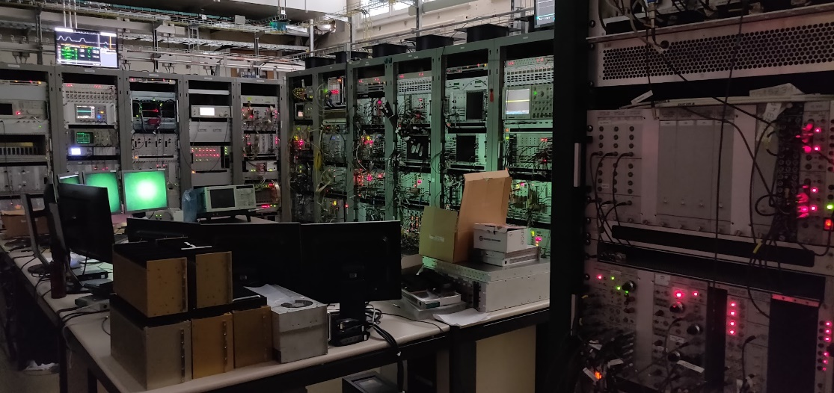
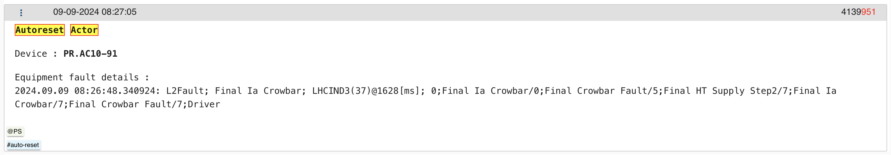
How Automation Has Helped : « Auto-Reset »
10MHz cavity frequent trips
Auto reset introduced on the 15th of April 2024
Same Auto reset introduces for 20,40,80MHz on the 30th of August 2024
296 automatic resets logged with #auto-reset. (not #auto-pilot)
KFA 71/79 module trips
Also 20 automatic resets logged for KFA71 modules. (from 14/11/2024)
.
Implementation G.Imesh (OP)
Oops, tripped the cavity…
A small reset… Nobody will have noticed…
PS Logbook Automatic entry
There is a limit to the number of allowed resets, after which the on-call team has to be called.
The implementation of auto-starts and auto-resets have been elaborated in close collaboration with the equipment experts.
Picture from JAP22. A.Lasheen’s talk
D.G Denis Cotte BE-OP-PS | JAP Workshop 2024
Notes:
Auto Reset
https://logbook.cern.ch/elogbook-server/GET/showEventInLogbook/4183983
The auto-resets of equipment, such as cavities and kickers, have been heavily used this year, with nearly 300 resets. It’s worth noting that the implementation of these systems was carried out in direct consultation with the experts of these devices, as not all faults are necessarily resettable.

Slide 8
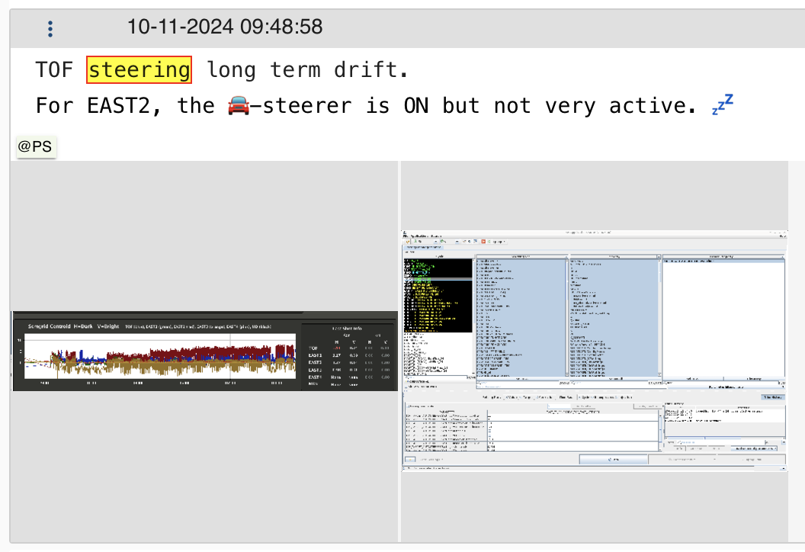
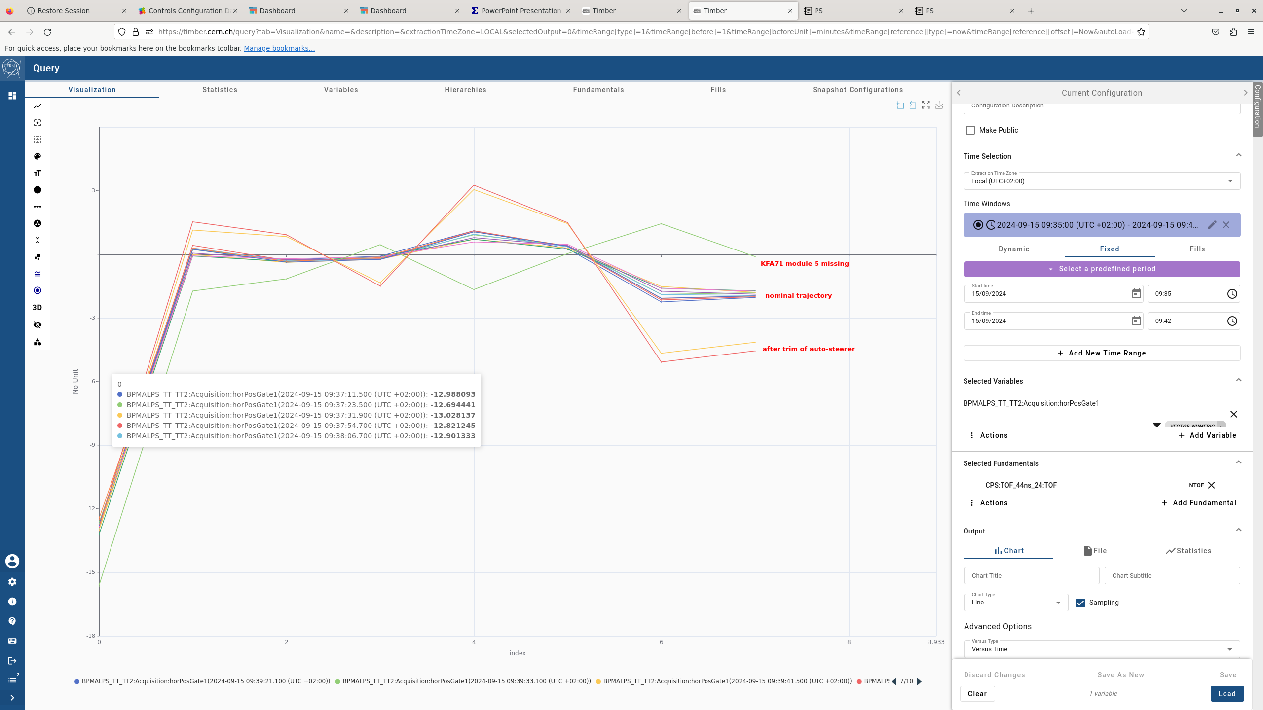
How Automation Has Helped : « Auto-Steering »
Continuous auto-steering in TT2.
Long commissioning phase to make it efficient.
  Still in the process of finding the best trigger thresholds.
    Overly sensitive settings lead to excessive small trims (tens of mA).
    Insufficient sensitivity results in no trims at all.
  PS-specific constraints : Avoid trimming on LSA corrections !
      Seen thanks to LSA sanity check -> cockpit online checks !
  Also helped to diagnose problems with new TT2 ALPS Pick-Ups.
  Attention, the system is trying to compensate for sporadic hardware errors.
    include a correct treatment of equipment faults or supercycle composition.
Limitations for AD
  Limited by only three Pick-Ups in TT2 before the bend to FTA. (no Pick-Ups in FTA)
Logbook entry with long drift without any trim
Different trajectories when HW errors
D.G Denis Cotte BE-OP-PS | JAP Workshop 2024
8
Notes:
We also put in place the continuous auto-steering in TT2.
We're still in the process of fine-tuning the trigger thresholds, as they’re critical for balancing sensitivity. Overly sensitive settings can result in excessive small trims, sometimes in the range of just milliamps, while insufficient sensitivity can mean no trims at all.
In PS, we must avoid trimming based on LSA corrections, which is something we’ve been able to detect with LSA sanity checks ilike online checks.
The system has also proven useful in diagnosing issues, particularly with the new TT2 ALPS pick-ups.
However, we’ve noticed that the system sometimes tries to compensate for sporadic hardware errors, which isn’t ideal.
This highlights the need for a better treatment of equipment faults or even changes in supercycle composition.
Change of sequence : https://logbook.cern.ch/elogbook-server/GET/showEventInLogbook/4152063
Missing kick 71 : https://logbook.cern.ch/elogbook-server/GET/showEventInLogbook/4144598

Slide 9
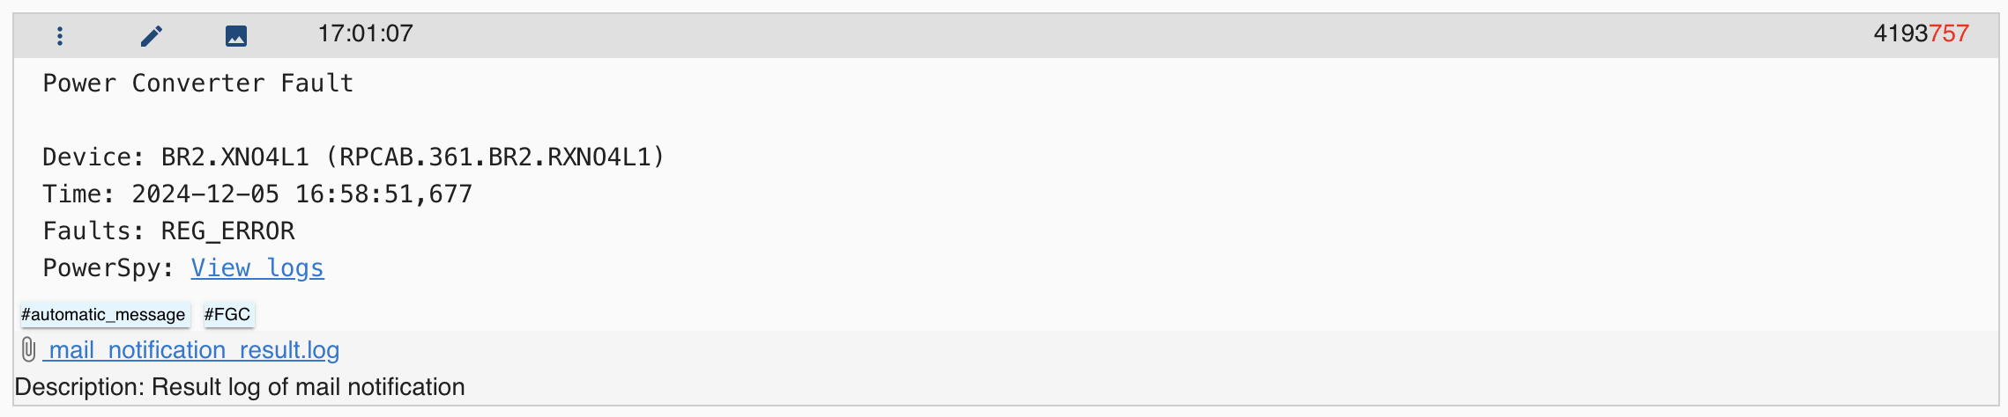
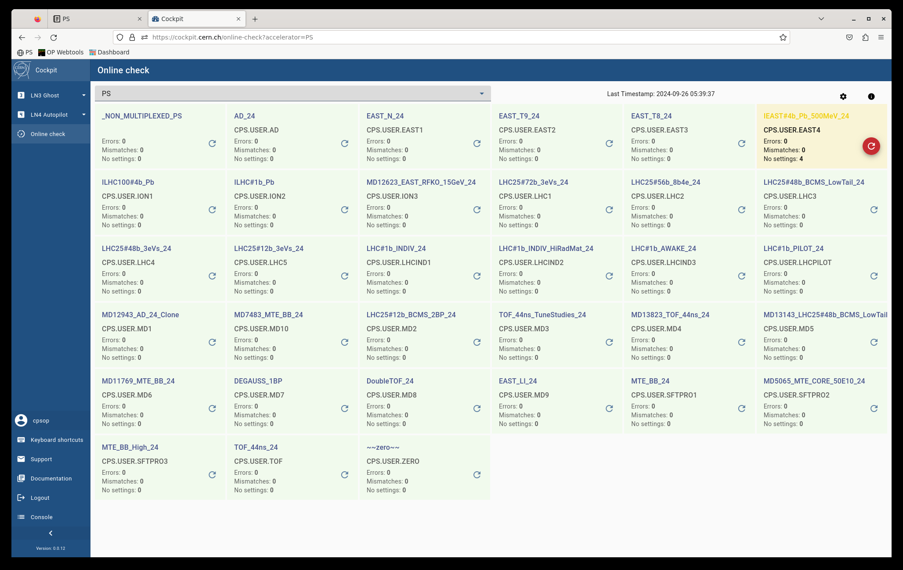
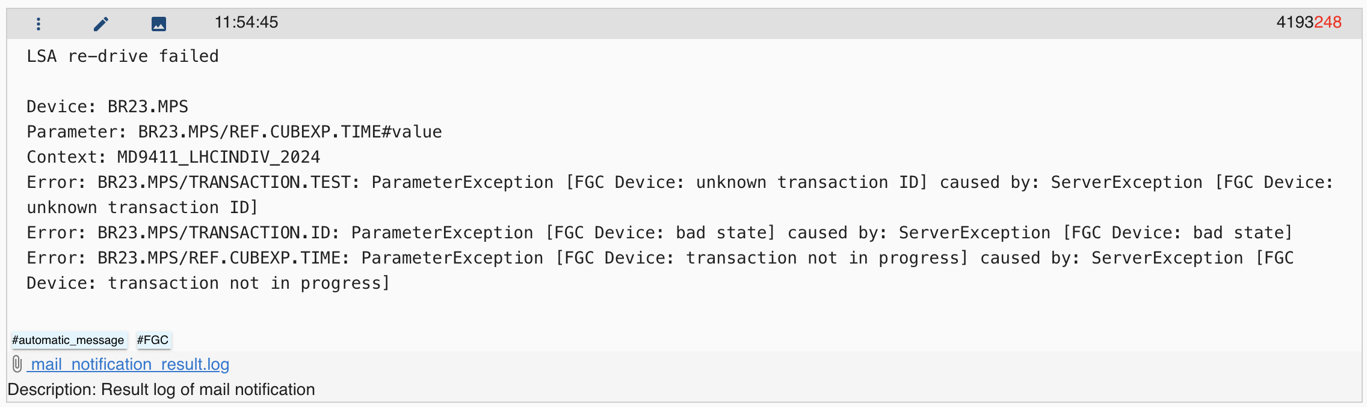
How Automation Has Helped : « PS-Booster »
Optimizer for Extraction and Transfer Line improving losses in the extraction and recombination regions.
Based on optimization framework «Generic Optimization Frontend and Framework» (GeOFF)
Very nice and complete documentation. https://recomb.docs.cern.ch/userguide.html
Improvements in the losses every year.
FGC logger : FGC automatic notification in logbook (Power Converter Fault, LSA re-drive failed, …)
Logbook entries are a bit lengthy when there are too many elements in fault.
LSA sanity checks and notifications (too many trims, online checks incoherences, …)
PSB Logbook Automatic entry from FGC
LSA Online checks in cockpit
D.G Denis Cotte BE-OP-PS | JAP Workshop 2024
9
Notes:
PSB.
The optimizer for the extraction and transfer lines combined with BLMs data.
Thanks to this framework, we’ve been able to see consistent yearly improvements in loss reduction.
Moving on, we also have the FGC logger, which automates notifications directly into the logbook for faults like power converter errors or LSA re-drive failures. While this system is very helpful, one challenge is that the logbook entries can become lengthy when there are too many elements in fault.
Finally, the help of LSA sanity checks and notifications to monitor for inconsistencies (LSA vs HW), too many trims.
These checks have been a great addition to improving operational reliability and catching potential issues before they escalate.
Optimizer for extraction and TL https://indico.cern.ch/event/1303992/,
improving losses in the extraction and recombination, improvements in the losses every year, https://indico.cern.ch/event/1412220/

Slide 10
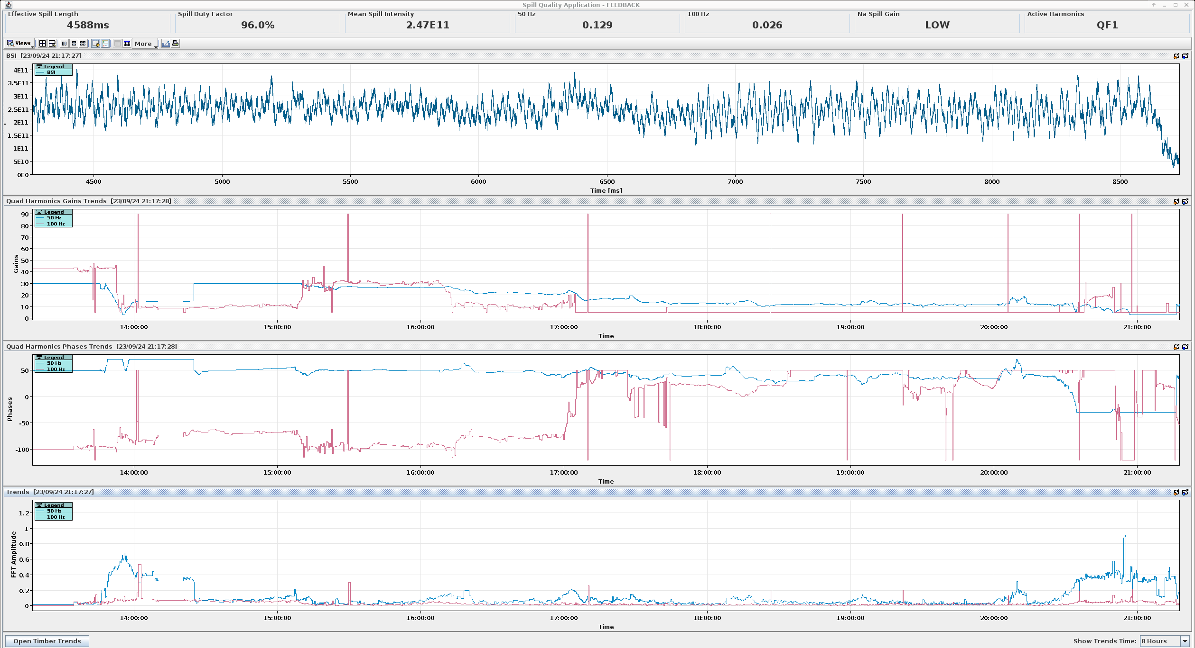
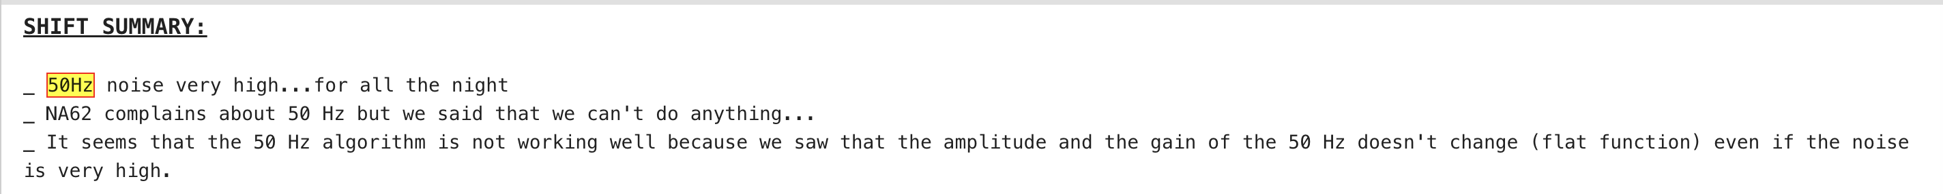
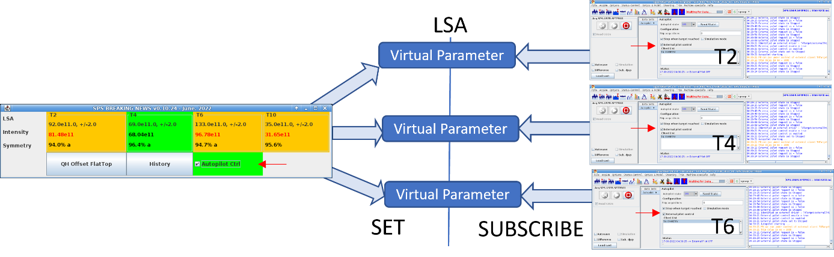
How Automation Has Helped (or not) : « SPS »
Continuous noise compensation (50Hz/100Hz) on SPS QF (based on SX spill):
Far from being an optimal experience for SPS operation team
Sometimes takes a very long time to converge
Loss of control: cannot be stopped or restarted or rolled back easily.
Frequently requires expert intervention.
Major Bug Fix on 07.10.24 – Impacted 50Hz
SPS Target autopilot application is monitoring LSA References, Target intensities and symmetries
Good experience already since 2023.
Auto-pilot triggered when target symmetry drops below 90% using YASP
No correction if no beam
Already mentioned as good use case during :
IPP on Efficiency and Automation from E.Veyrunes
50Hz and 100Hz compensation
SPS logbook summary
D.G Denis Cotte BE-OP-PS | JAP Workshop 2024
10
Notes:
While this system is valuable, the experience so far has not been optimal for the SPS operations team. One of the challenges we face is that it can sometimes take a very long time to converge, and there’s a risk of losing control over the system. Unfortunately, it's difficult to stop, restart, or roll back the process once it’s running. This often requires expert intervention to resolve.
There was also a major bug fix applied on 07.10.24, which had an impact on the 50Hz operation. This highlights the ongoing need for improvements in this area.
SPS team had a much better experience with SPS target /Symmetry program since 2023. When the symmetry drops below 90%, a correction request is automatically activated via YASP.
No correction is made if there is no beam.

Slide 11
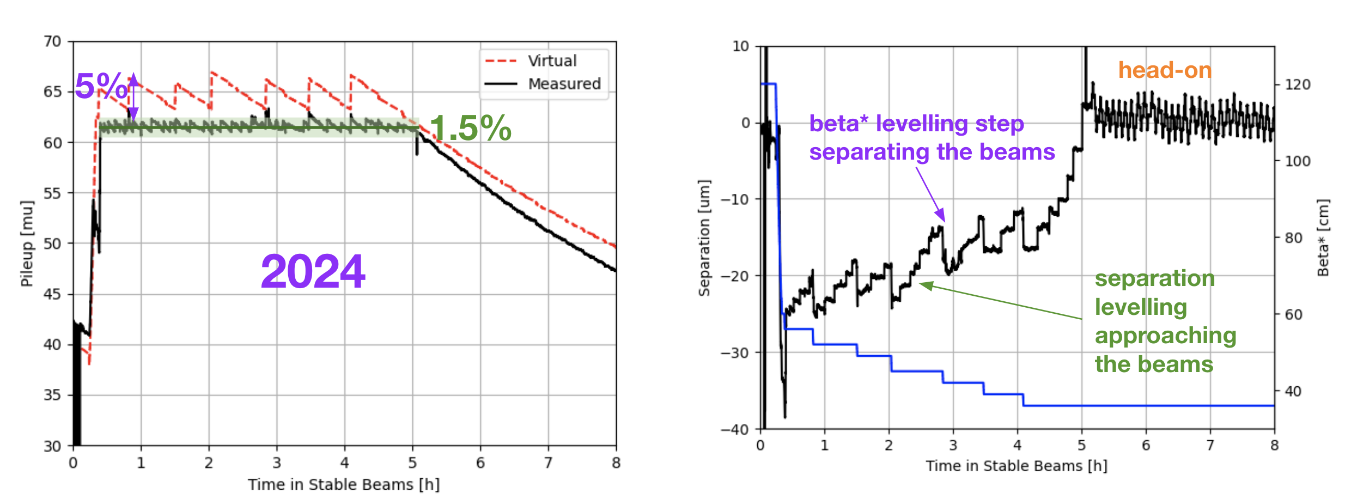
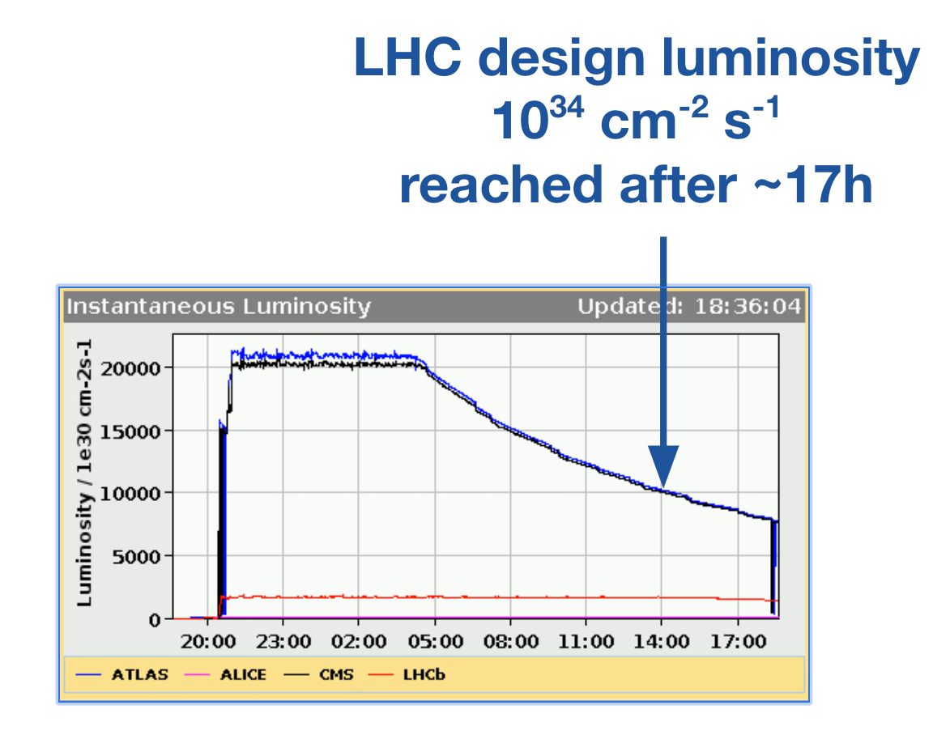
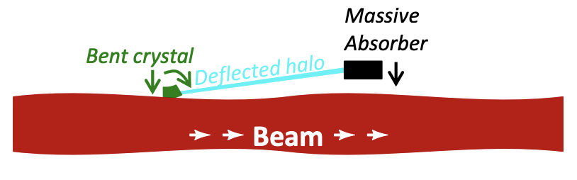
How Automation Has Helped : « LHC »
When LHC is in stable beam, keep a constant luminosity with Luminosity levelling : beta* and separation
This automation makes the life of LHC-OP easier in stable beam, around 20 clicks needed in 12 hours (if everything goes well)
Crystal collimation during ion run.
Automatic optimization of channeling orientation.
Implemented periodic automatic optimizations at intervals tuned to avoid channeling loss
Full cycle covered; real-time trims in the ramp
D.G Denis Cotte BE-OP-PS | JAP Workshop 2024
11
Notes:
Let’s begin with luminosity leveling for the LHC when it’s in stable beams.
This process ensures a constant luminosity by dynamically adjusting parameters like beta* and beam separation. By automating this, it makes operating the LHC in stable beam conditions much easier and more efficient.
Moving on to crystal collimation during the ion run, an automation implemented automatic optimization of the channeling orientation. This system is designed to periodically perform automatic optimizations, with intervals of 2 minutes to prevent channeling losses.

Slide 12
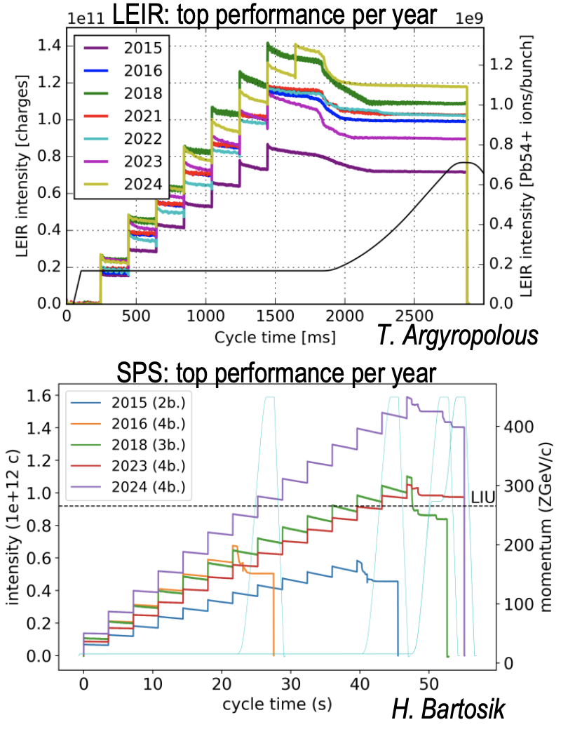
How Automation Has Helped : « LN3 / LEIR »
Very good performances up to LHC in 2024.
Thanks to the performance of the optimizers implemented at LN3 and LEIR, the ion beam intensity was optimal in 2024.
A key strategy for improvement has been the use of optimizers on MD cycles first, followed by copying the best settings to the operational cycle.
  This approach is only possible thanks to the ability to easily clone cycles, a method that is also widely used in PSB and PS.
This approach allows for gradual improvement of operational beams as the optimizers progress and demonstrate their effectiveness.
LEIR and SPS BCTs
D.G Denis Cotte BE-OP-PS | JAP Workshop 2024
12

Slide 13
OUTLINE
Operation Tasks and the Role of Automation
How Automation Has Helped
Proposed Workflow for Effective Automation
Key Recommendations for Moving Forward
Conclusion
Notes:
I’ll start by discussing the main tasks of operations, how automation has helped us, and then share some proposals and recommendations for the future, followed by a conclusion.

Slide 14
Proposed Workflow for Effective Automation
Adaptation Period is Essential
Operators emphasize the need for time to adapt to a new system.
Automation documentation and knowledge transfer is important !
A gradual transition is preferred to ensure confidence and efficiency.
Preference for "Automation on Demand"
Initial preference for automation triggered and validated during Machine Development (MD) sessions.
Allows operators to build trust in the system and maintain control during critical phases. (ex : PS LHC splittings)
Long-Term Goal: Full Automation
The primary challenge is achieving reliable full automation with minimal human intervention.
  Always maintain control and the ability to stop or restart an automation. (SPS Main noise 50Hz-100Hz)
Focus is on optimizing the system to ensure stability, efficiency, and safety during continuous operation.
D.G Denis Cotte BE-OP-PS | JAP Workshop 2024
14

Slide 15
OUTLINE
Operation Tasks and the Role of Automation
How Automation Has Helped
Proposed Workflow for Effective Automation
Key Recommendations for Moving Forward
Conclusion
Notes:
I’ll start by discussing the main tasks of operations, how automation has helped us, and then share some proposals and recommendations for the future, followed by a conclusion.

Slide 16
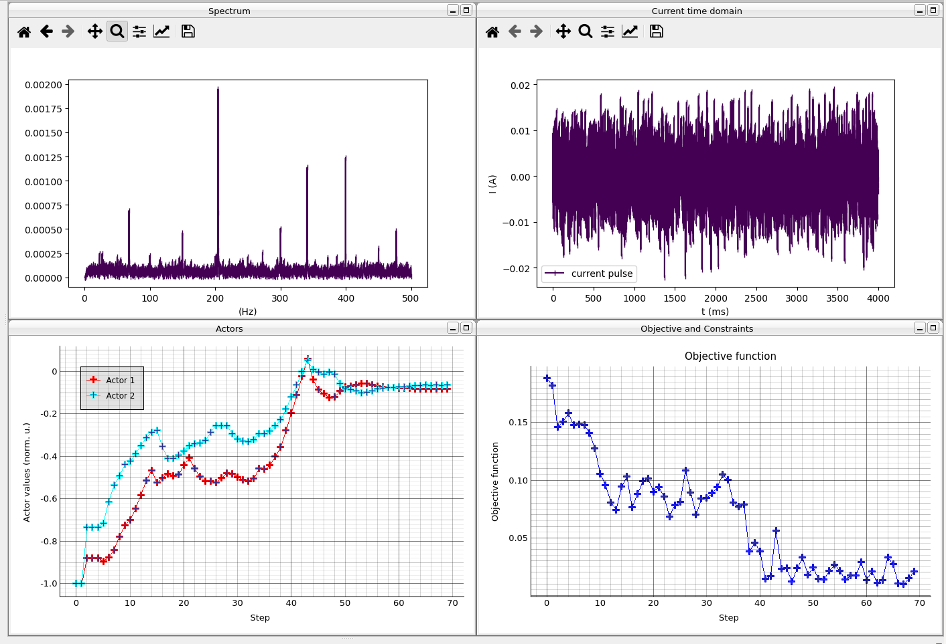
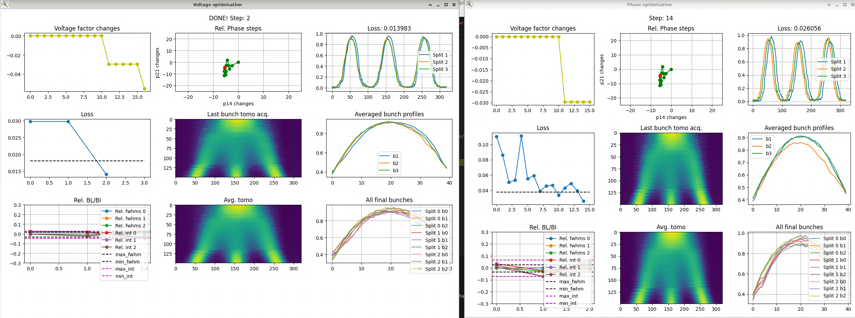
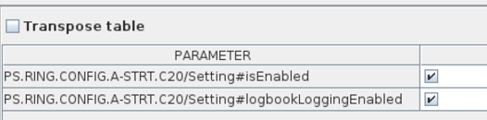
Enhanced Monitoring of automation and auto-pilots
SPS main noise - LHC ion beam
Visibility: Ability to see, at a glance, the current status:
  Enabled, disabled, or paused (on a PPM basis).
Problem Detection:
  Identify issues such as no trims for an extended period,
  excessive trims, incorrect inputs, or system exceptions.
Limitation Awareness:
  Detect when a corrector/actor approaches its limits
  (e.g., outside safety margins or nearing maximum current).
Integration of a Monitoring Dashboard
  Implement a dedicated dashboard or Vistar.
  Centralized overview, quick status checks, and early detection of anomalies.
  Develop a generic monitoring tool to quickly check beam quality in each machine.
Triple Splitting PS
Enable/disable in LSA
D.G Denis Cotte BE-OP-PS | JAP Workshop 2024
16
Notes:
First, visibility. It's important to have the ability to see, at a glance, the current status of the system — whether it’s enabled, disabled, or paused — and ideally on a PPM (Pulse-to-Pulse Modulation) basis. This allows operators to instantly understand the current state of the system.
Next, problem detection. Here, the goal is to quickly identify issues like when no trims have been made for an extended period, when there are excessive trims, incorrect inputs, or system exceptions. The faster we can detect these issues, the faster we can react to them.
Then, limitation awareness. It’s essential to know when a corrector or actor is approaching its operational limits, whether that’s being outside safety margins or nearing the maximum current. Early detection of these limits can help avoid system failures or unnecessary interruptions.
Finally, integration of a monitoring dashboard. The idea is to implement a dedicated dashboard or even a Vistar-like tool that provides a centralized view. This would allow for quick status checks, a clear overview of operations, and early detection of anomalies. The goal is to create a generic monitoring tool that can quickly check beam quality across all machines, making it easier for operators to react before problems escalate.
Altogether, these measures aim to give operators the right tools to see, detect, and act on issues as early as possible, improving the overall reliability of operations

Slide 17
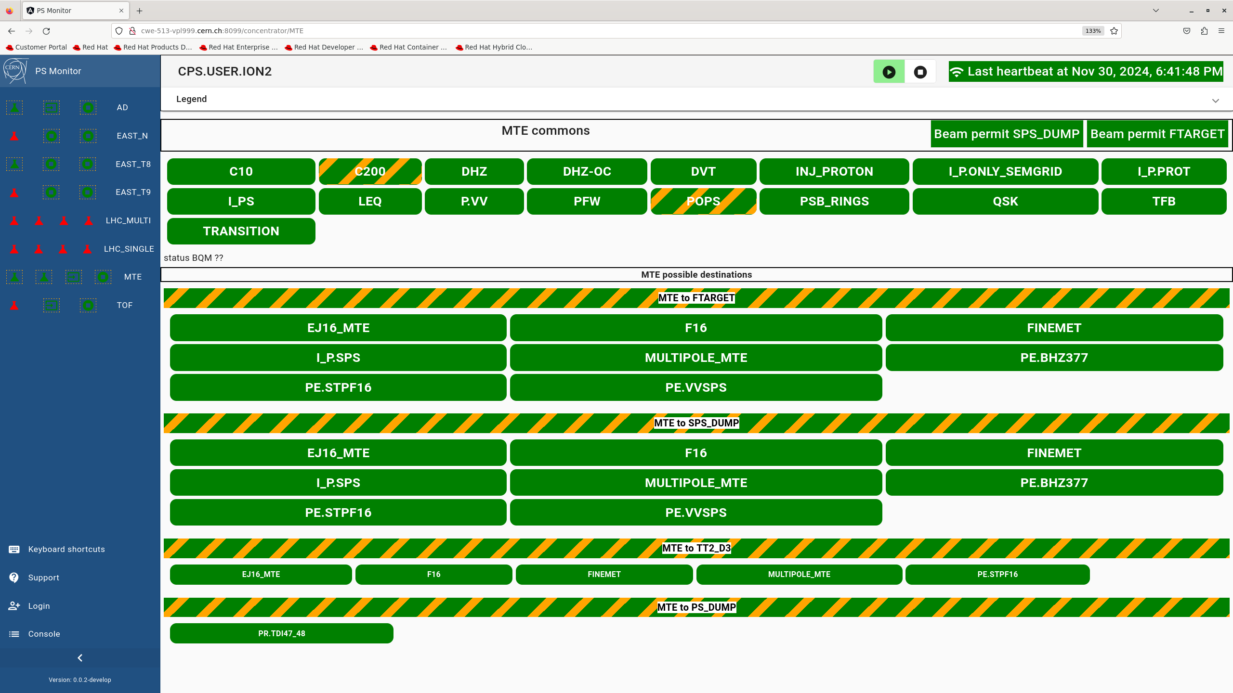
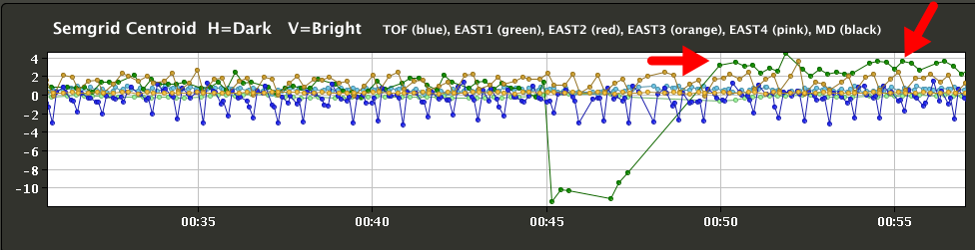
Challenges in Diagnosing Issues
Automation and Optimizers
  These systems often operate well autonomously.
  An optimizer can work on one user but not on another
  Running multiple layers simultaneously can obscure the root cause of a problem.
Post-Mortem Analysis
  Perform detailed detective work to:
    Trace the sequence of actions taken by AI and optimizers.
    Understand the triggers and determine why these actions occurred.
      Hard to find when not documented.
Ensuring clear diagnostics and transparency is critical for maintaining reliable operations.
Equipment monitoring system
Position on nTOF Target
D.G Denis Cotte BE-OP-PS | JAP Workshop 2024
17
Notes:
Starting with automation and optimizers, these systems are designed to operate autonomously, and most of the time, they do this quite well. However, the challenge arises when multiple layers of automation are running simultaneously. This can make it difficult to identify the root cause of a problem, as it’s not always clear which system triggered a specific action or change.
Post-mortem analysis is essential for understanding what went wrong after an incident. This process involves performing detailed detective work to trace the sequence of actions taken by AI and optimizers. The goal is to understand what triggered these actions and why they happened. But here’s the challenge — if these actions aren’t properly documented, it becomes very difficult to track down the source of the problem.
This is why ensuring clear diagnostics and transparency is absolutely critical for maintaining reliable operations. If we have a clear trail of events and actions, it becomes much easier to trace issues, identify their root causes, and implement better solutions in the future.

Slide 18
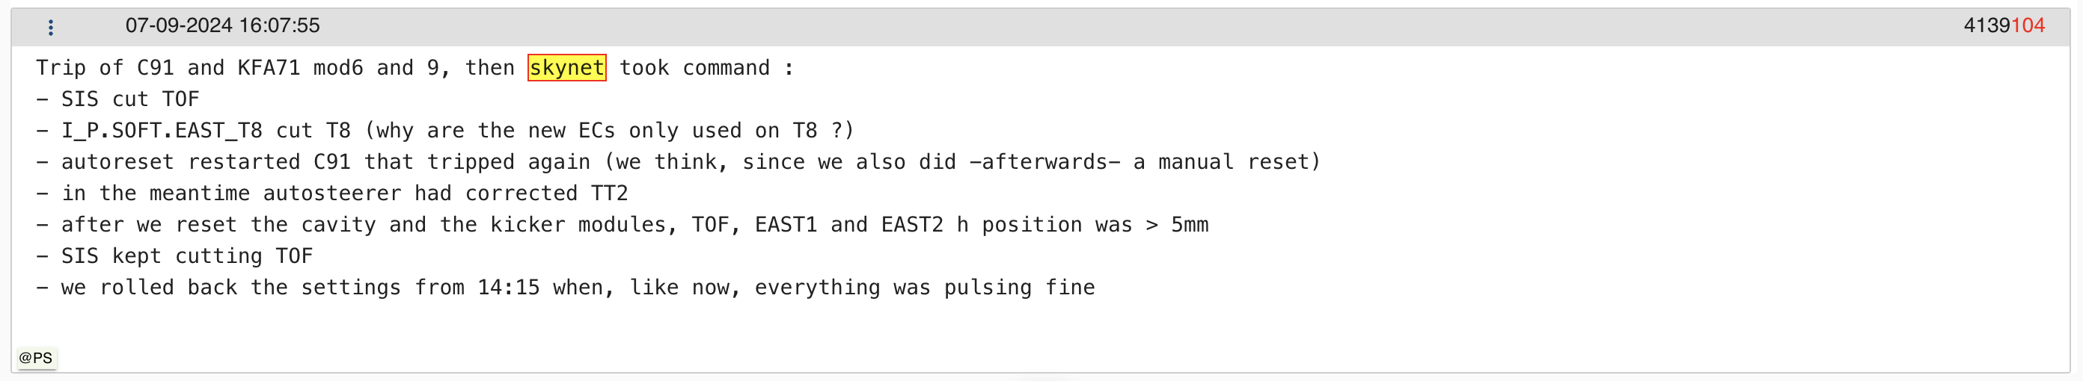


Challenges in Diagnosing Issues
Example of logbook entry following a beam cut to nTOF.
  Illustrate the detective work needed in case of equipment failure.
  Often, the automation does not restore the initial conditions once the equipment is back.
  A manual action is required to find and restore initial settings.
Proposal : introduce a kind of “Hardware sanity check” would be nice to have on top of all automation system as a prerequisite to keep it running. Checking at least if the destination ok.
D.G Denis Cotte BE-OP-PS | JAP Workshop 2024
18

Slide 19
Announcer and Communication
Sequencer and orchestration
Task Automation:
Facilitates the sequential execution of repetitive tasks (e.g., switching zones to access mode or beam mode).
Error Prevention: Ensures no critical step is missed during complex procedures
Acts as a reference in case of mistakes or omissions, improving operational consistency
Feature Proposal: Enable the launch of LSA TAGs directly from the sequencer.
LHC Filling orchestration still to be defined (what to do and when ?)
Operators express concerns about excessive vocal messages from automation systems. (1 announcer per CCC island)
A better use of filtering system is suggested to prioritize important notifications.
Adjust the volume settings to minimize interference with other islands, ensuring clear and efficient communication.
Investigate other announcer ?
D.G Denis Cotte BE-OP-PS | JAP Workshop 2024
19

Slide 20
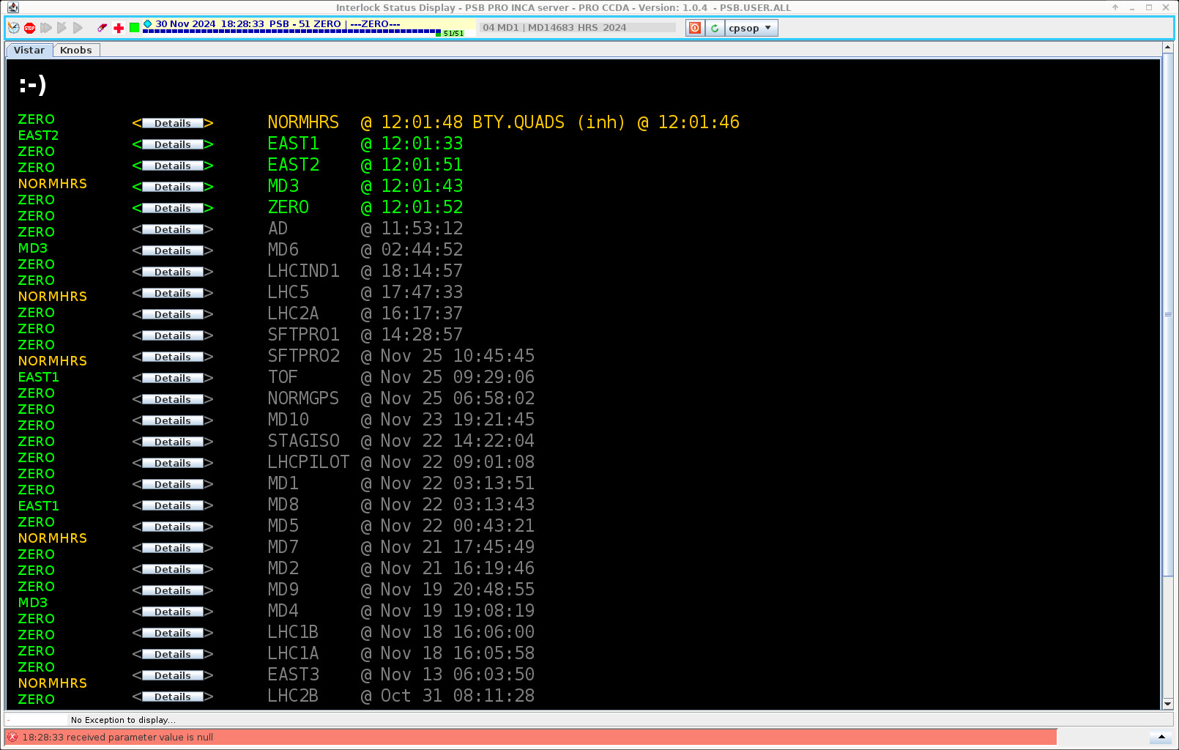
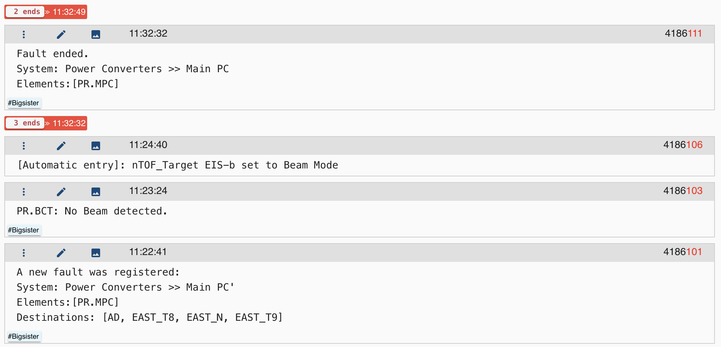
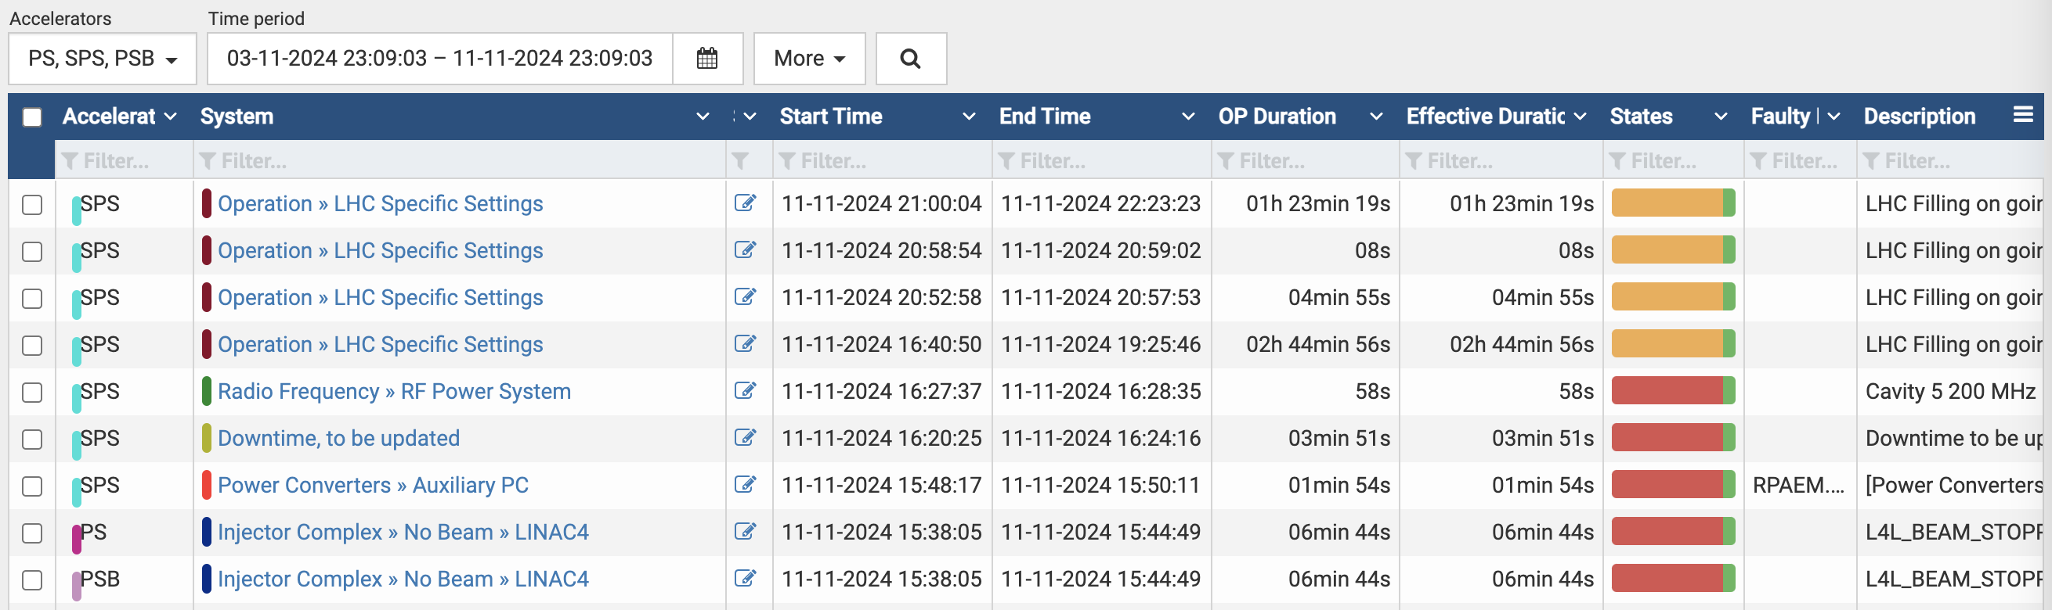
Automatic Fault analysis and AFT reporting
  Varied Implementations with Positive Feedback from OP
  Different approaches for fault generation across CERN machines.
  Manual Fault Creation:
    LN3/LEIR: AFT faults still require manual intervention.
    AD : Suggestion for automatic AFT creation for AD/ELENA based on BCT7049
  Automatic Fault Creation:
    LN4/PSB: Faults generated via Piotr’s Interlock application, establishing the root cause of ”no beam” while SIS is used in PSB.
    PS/SPS: Highly effective automatic fault creation using SIS and/or UCAP.
      The system can deduce the source “AFT system” responsible for the fault
    LHC :
      Post-Mortem analysis: Faults are manually categorized.
      Automatic creation triggered when faults occur around or just before injection.
  Ongoing Developments : Enhancing the automatic linking of machine faults using UCAP devices.
LN4 Interlock status display
Automatic Fault entry in logbook
AFT faults
D.G Denis Cotte BE-OP-PS | JAP Workshop 2024
20
Notes:
Let’s now look at the varied implementations of fault generation across CERN machines, which have received positive feedback from the operations team.
The approach to fault generation differs from one machine to another, with a mix of manual and automatic processes.
A suggested that we introduce automatic AFT creation, potentially triggered by BCT7049.
On the side of automatic fault creation, we have more advanced implementations. For LN4 and PSB, faults are generated automatically via Piotr’s interlock application, which allows us to identify the root cause of “no beam” situations. In PSB, the SIS system is also used to support this process.
For PS and SPS, the system is even more effective. Faults are automatically generated using SIS and/or UCAP, and the system can deduce which part of the AFT system is responsible for the fault.
At the LHC, the process is a bit more hybrid. Faults are categorized manually through post-mortem analysis, but automatic fault creation can still be triggered when issues arise around or just before injection.
Looking ahead, one of the key development areas is to enhance the automatic linking of machine faults using UCAP devices.

Slide 21
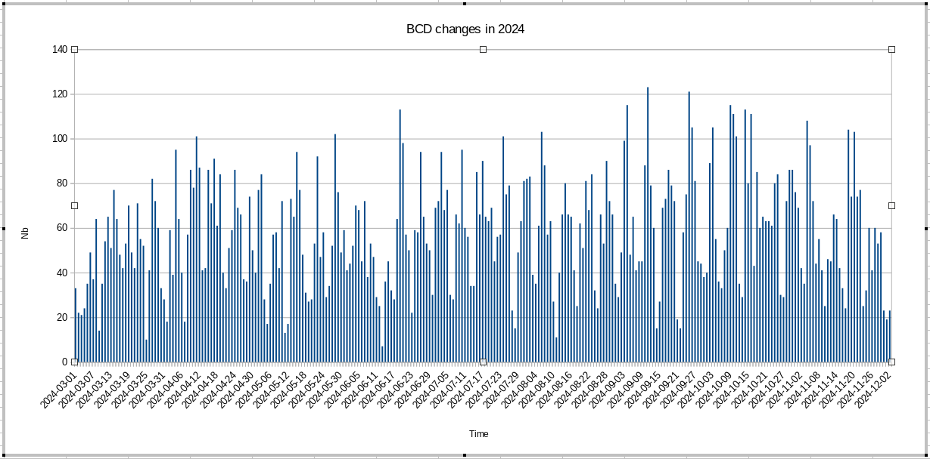
What is the next priority ?
  One important and recurrent point is the Dynamic Beam Scheduling.
    Automatically and dynamically schedule beams
  Today, the manual edition task is highly time-consuming, requiring significant effort to program the sequence.
  In 2024, we modified the super cycle composition 16700 times.
  Involve AD team in the discussion in case of issues with AD beam.
Daily Super Cycle Changes in 2024
Statistics
 | 2021 | 2022 | 2024
Average | 42 | 51 | 58
Maximum | 102 | 108 | 123
D.G Denis Cotte BE-OP-PS | JAP Workshop 2024
21
Notes:
One important and recurring topic to highlight is the Dynamic Beam Scheduling.
Theidea is to automatically and dynamically schedule beams.
Currently, manually editing and programming the sequence is an extremely time-consuming task that requires a lot of effort from the team.
To give you an idea of the scale, in 2024 alone, we modified the super cycle composition 16,700 times.
This highlights just how demanding and repetitive this task can be.
Looking ahead, it’s also crucial to involve the AD team in discussions, especially when dealing with issues related to the AD beam.
Dynamic Beam Scheduling represents a significant opportunity to reduce manual workload, and improve efficiency.

Slide 22
Conclusions / Summary
Improve knowledge transfer, how the optimizer work and how to react in case of issue and document it !
  Automation is not about replacing human operators but enhancing their ability to focus on higher-value tasks.
  When automation fails, keep the possibility to take alternative action manually. (keep control)
Monitoring optimizer, autopilot, automation in general is very important !
  Let’s improve the monitoring in all machines.
  Transparent structure for the organisation of optimisers across machines, to reinforce synergies.
Next subject where we would like to see automation is the beam scheduling.
  Common problem in several machines.
  LHC filling with an Orchestrator.
D.G Denis Cotte BE-OP-PS | JAP Workshop 2024
22
Notes:
First, improving knowledge transfer is essential.
It’s important that we all understand how the optimizers work and, more importantly, how to react when issues arise.
Secondly, it’s important to remember that automation is not about replacing human operators. Instead, it’s about enhancing their ability to focus on higher-value tasks.
Operators should remain in control, which is why it’s critical to ensure that, if automation fails, there’s always an option to take alternative manual action. Maintaining control is key.
Another important point is monitoring. Whether it’s optimizers, autopilots, or automation in general, effective monitoring is essential to maintain system reliability.
There’s a clear opportunity to improve monitoring across all machines to ensure problems are detected and addressed.
Finally, one of the next big steps for automation is in beam scheduling. This is a common challenge across several machines, and we believe automation could make a big difference here.

Slide 23
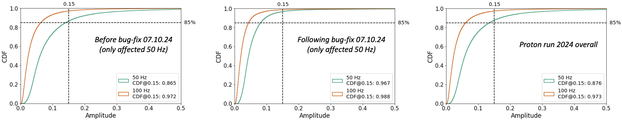
50 Hz compensation in SPS
If we look purely at the spill noise performance for the proton run 2024 overall, the requirements from North Area experiments (NA62 in particular) are fulfilled. The goal is to be below 0.15 in 50 Hz (and 100 Hz) noise amplitude for at least 85% of the extracted spills :
Left: performance since start of proton run 2024, and until the bugfix,
even with the bug, and the associated phone calls, we were fulfilling the requirements from the user perspective.
Middle: performance after bug-fix and for the remainder of the proton run (only 3 weeks);
much more margin and no more phone calls during that period ;)
Right: proton run overall. Based purely on that data, you might think everyone was happy since the requirements are fulfilled ...
D.G Denis Cotte BE-OP-PS | JAP Workshop 2024
23

Slide 24
Centralized Overview in Automation
Proposed Solution:
  Develop a generic framework to unify automation processes across machines.
  Create dedicated folders for optimizers to provide a global view and facilitate reuse.
  Develop a generic monitoring tool to quickly check beam quality in each machine.
Benefits:
  Avoid duplication development, ensure reusability, conflicting objectives between optimizers.
Considerations:
  Account for the different time constants of optimizers (e.g., shot-by-shot in TT2 vs. averaging 3 shots in FTA).
D.G Denis Cotte BE-OP-PS | JAP Workshop 2024
24

