Slide 2
Beam Physics/Simulation Software Evolution: Challenges, Opportunities
Szymon Łopaciuk, Giovanni Iadarola, Riccardo De Maria, CERN, Geneva, Switzerland
We sincerely thank the Xsuite users and contributors for their enthusiasm and invaluable input. Special thanks to Yannis Papaphilippou and the ABP management for their guidance and for supporting these developments.

Slide 3
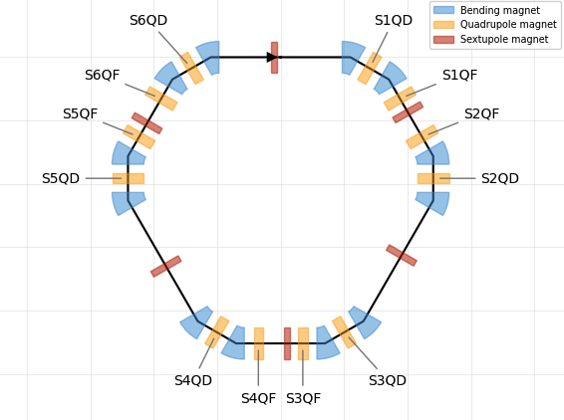
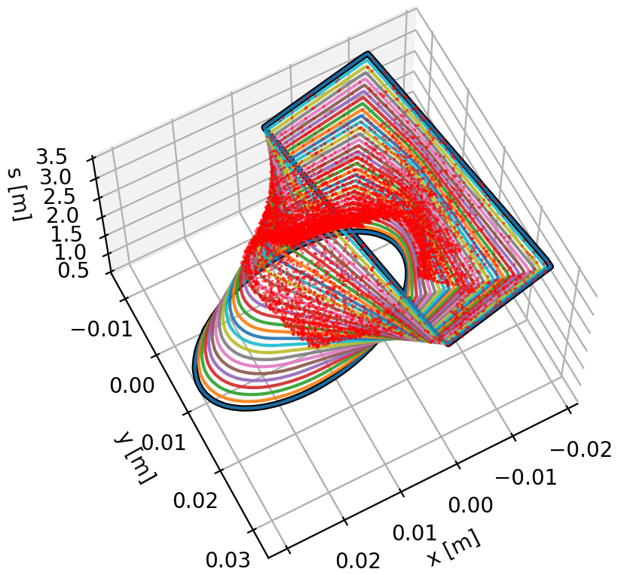
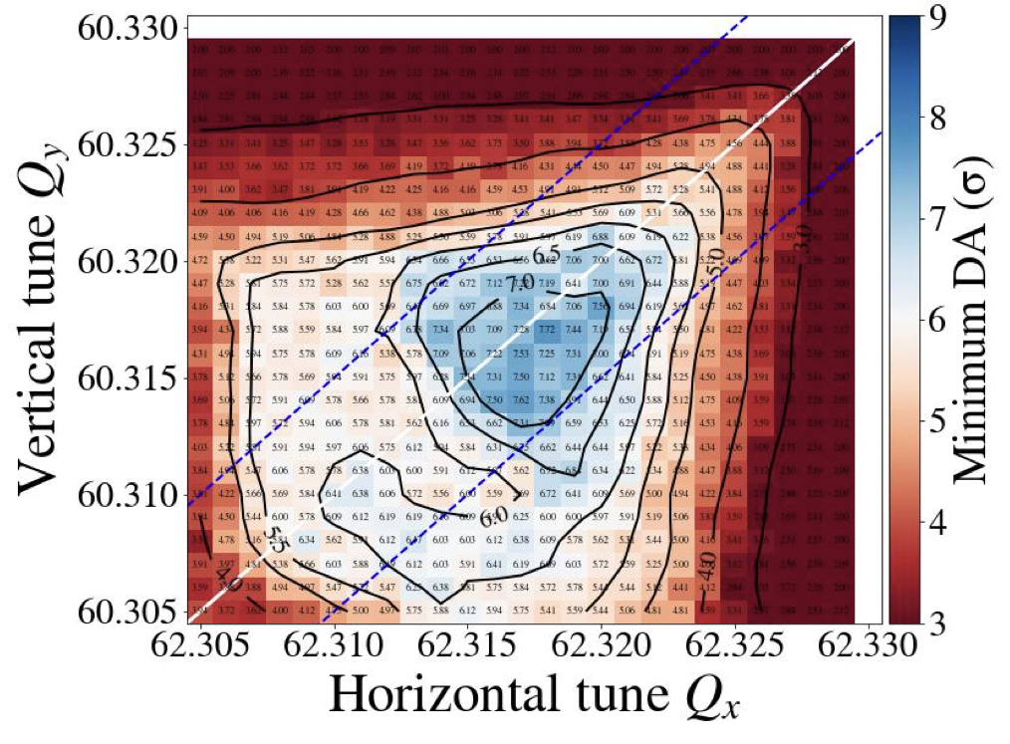
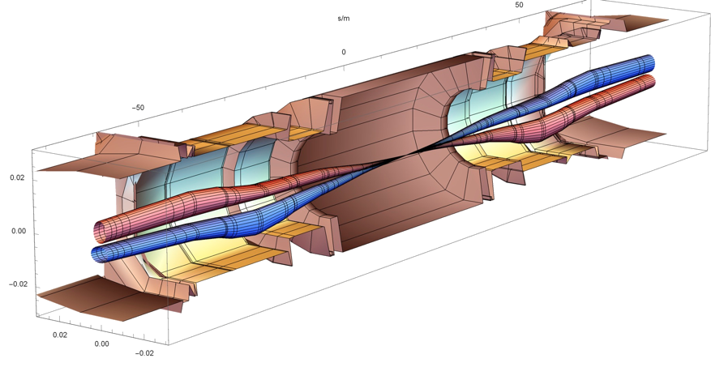
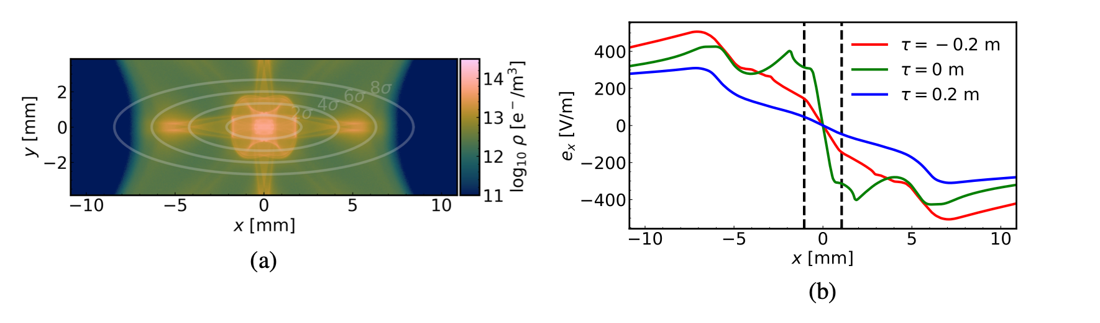
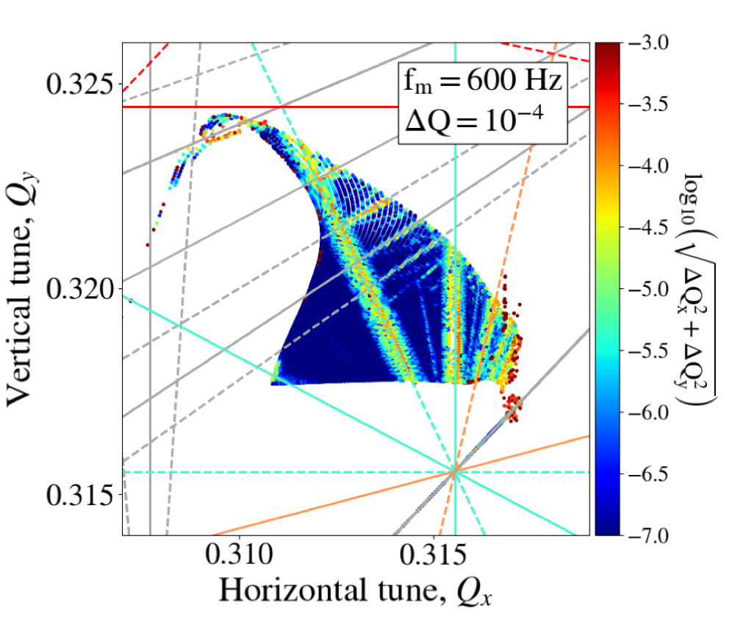
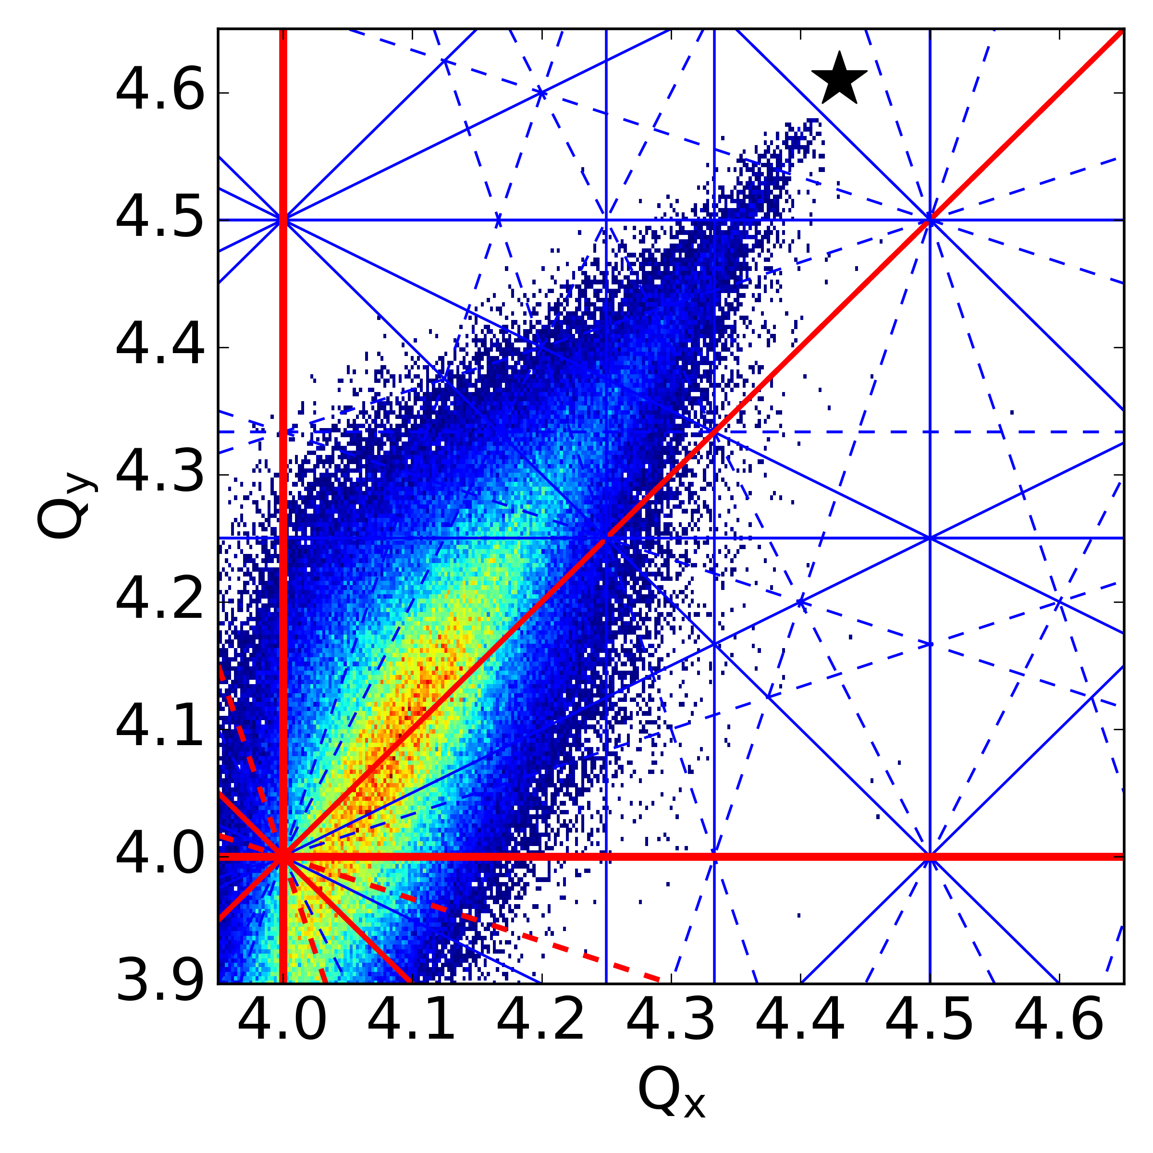
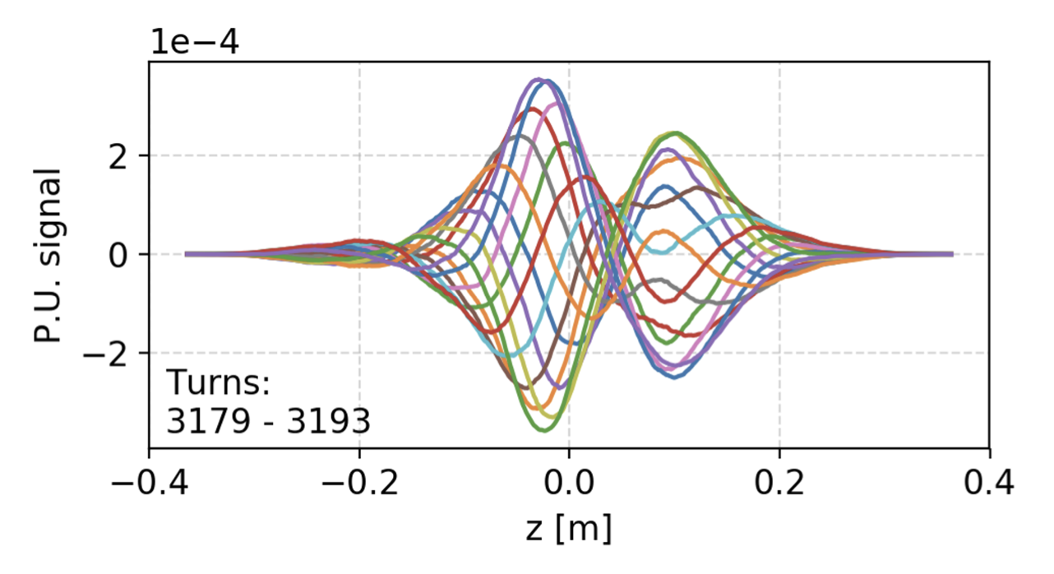
What is ‘software for beam dynamics’?
CERN has a long tradition of powerful software tools for beam physics applications, typical examples (ABP):
MAD-X (2002)
MAD-X (2002)
SixTrack (1990)
SixTrack (1990)
Lattice Design
Optics (calculation & design)
Tracking (dynamic aperture)
Collimation
pyHEADTAIL (2014)
COMBI (2007)
SixTrack (1990)
pyORBIT (2003)
pyECLOUD (2015)
Impedances
Beam-Beam Effects
Space Charge
Electron/Ion Cloud

Slide 4
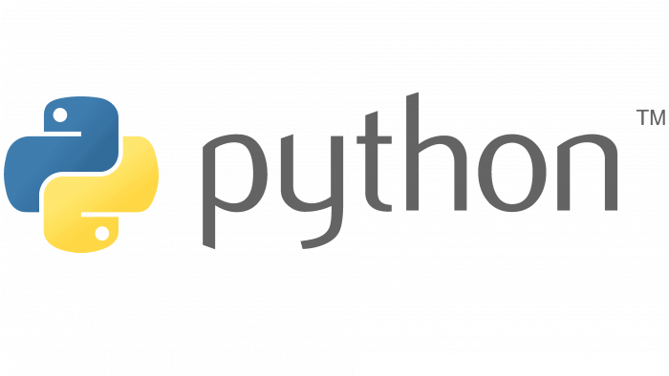
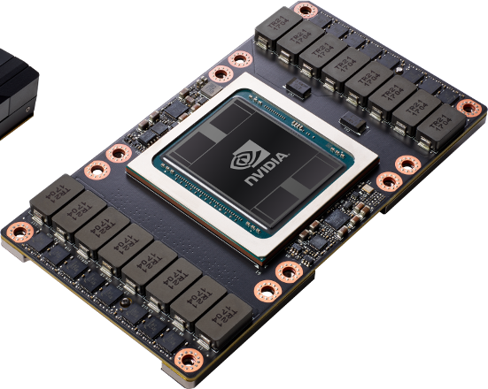
Need to do better
This configuration with legacy tools has several limitations:
Integration issues
  Present studies often require heterogeneous studies with interplay of optics, non-linear tracking, collective effects, collimation, etc.
  With legacy tools this means dealing with model translations, ad-hoc interfaces between codes, which is complicated, time-consuming, error prone, and slow.
Extendibility
  Very hard to extend legacy tools to present needs (notably FCC).
  Many experts have left or retired; working on old Fortran code often difficult and not really appealing for young colleagues.
Outdated user interfaces – today users want Python
  Python is a standard in scientific computing, especially among younger researchers.
  Many high-quality tools are available in the Python ecosystem also due to ML boom. Maintaining custom tools for plotting, scripting, etc. wastes effort, increases complexity, and lowers quality.
Performance
  GPU acceleration is a must-have in many applications, but often infeasible to retrofit.
Notes:
Optics only code is not needed anymore

Slide 5

Xsuite project launched in 2021 to address these issues using the know-how acquired in the development of the earlier tools.
Goals: 1st class Python, 1st class collective, 1st class GPU.
One toolkit for many applications: from low-energy hadron rings to high-energy lepton colliders.
Heterogeneous simulations made natural.
Support different computing platforms – single- and multi-threaded CPU, GPU acceleration.
References for full list of features:
Documentation: xsuite.web.cern.ch.
“Xsuite: An Integrated Beam Physics Simulation Framework,” JACoW HB2023 (2024), TUA2I1.
“Xsuite: a multiplatform toolbox for optics design, fast tracking, collimation and collective effects,” ICAP’24.

Slide 6







Xsuite approach
Orthogonal architecture: split the software into independent functional blocks at all levels.
  This means well-defined and cleaner interfaces, which lower overall complexity of the codebase.
  Simpler codebase scales better and it is easier to add new features.
  Lower learning curve for users & developers
  ⇒ users can (and do!) become developers.
Agile development:
  From the beginning big effort to support users: user feedback and involvement visibly increases the quality of the package.
  Thanks to investment in continuous testing, we can afford a fast release cycle with new versions coming out multiple times a month, incorporating modifications/extensions based on user feedback.
Xtrack
Single particle
tracking engine
Xpart
Generation of particles distributions
Xfields
Computation of EM fields from particle ensembles
Xdeps
Data flow manager,
deferred expressions
Physics modules
Xcoll
Particle-matter interaction and collimation
Xwakes
Wakefields and impedances
Xobjects
Interface to different computing platforms
(CPUs and GPUs of different vendors)

Slide 7
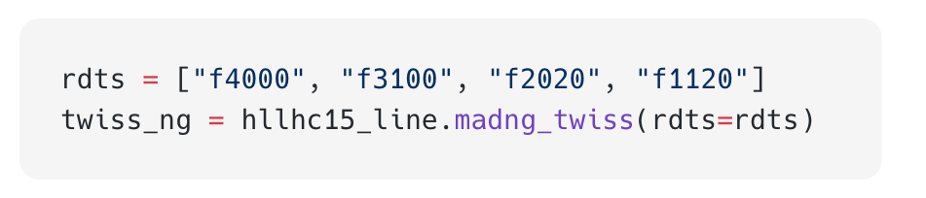
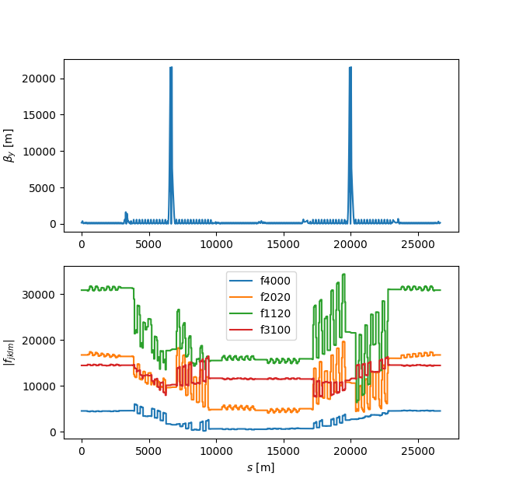
Interfaces to other tools
By design Xsuite is easy to interface and extend using other tools providing a Python API.
Several examples of interfaces providing Xsuite with features that are not natively available:
MAD-NG – computation and optimisation of parametric nonlinear normal forms, resonant driving terms, automatic differentiation.
RF-Track – particle tracking in complex field maps.
FLUKA – simulation of particle-matter interaction
(e.g. LHC collimation studies).
BDSIM-GEANT4 – particle-matter interaction
(mostly for FCC).
BLonD – advanced modelling for RF systems.
Notes:
Madng plot

Slide 8
Xsuite adoption
By now Xsuite became a production tool for many beam dynamics studies, allowing development discontinuation for many legacy tools.
Xsuite
Xsuite
Xsuite
Xsuite
Lattice Design
Optics (calculation & design)
Tracking (dynamic aperture)
Collimation
Xsuite
Xsuite
Xsuite
Xsuite
Impedances
Beam-Beam Effects
Space Charge
Electron/Ion Cloud

Slide 9
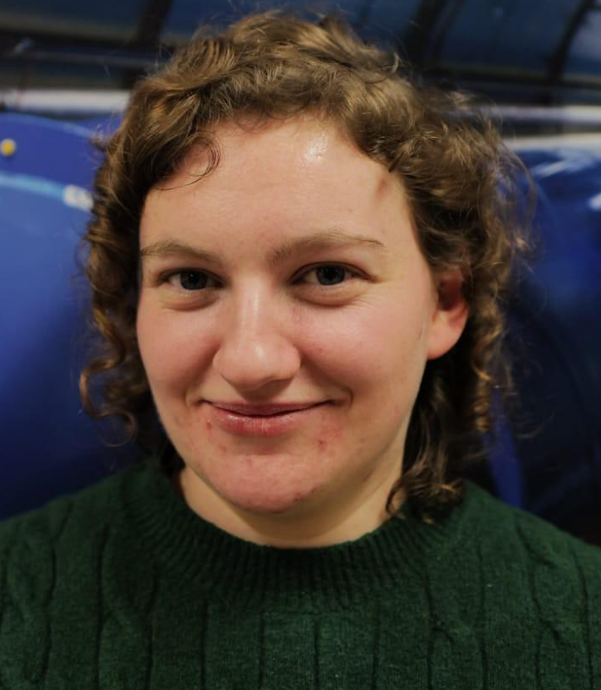



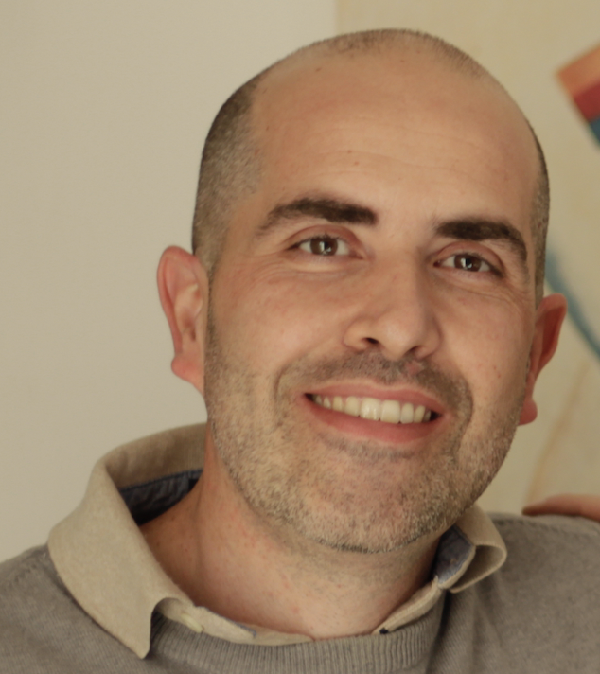
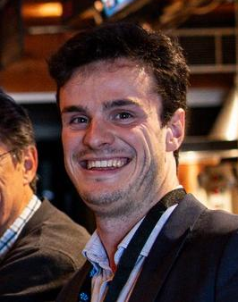

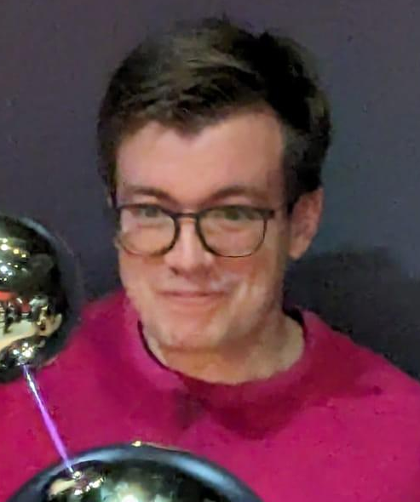
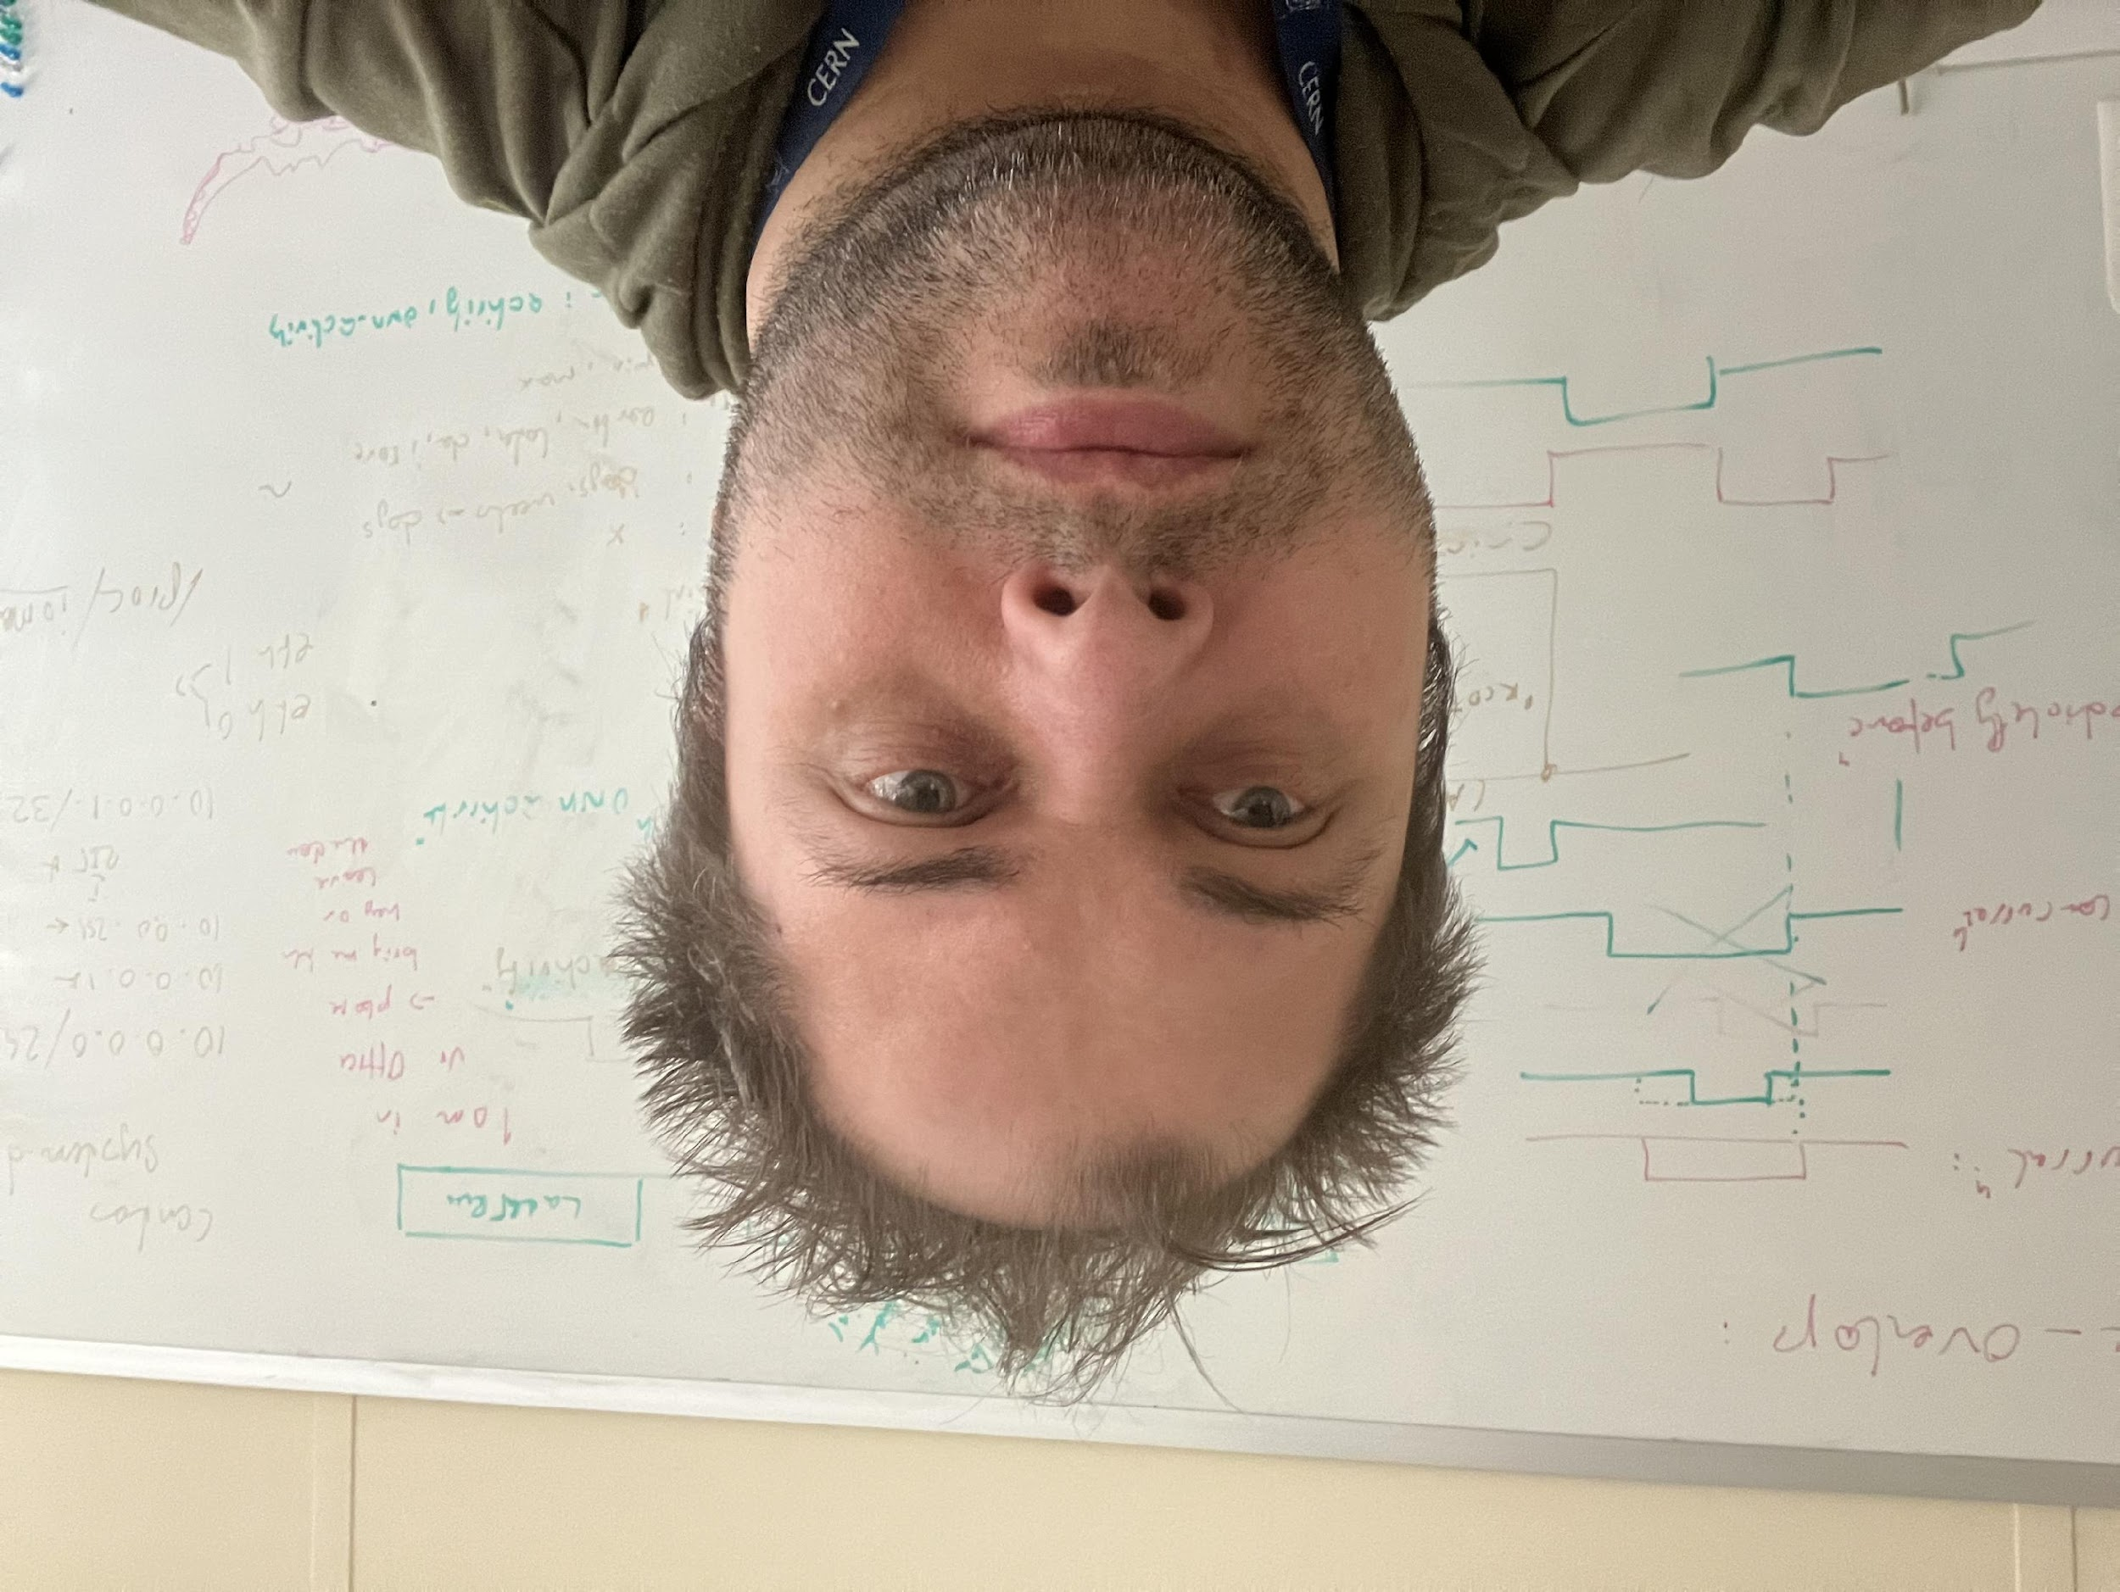
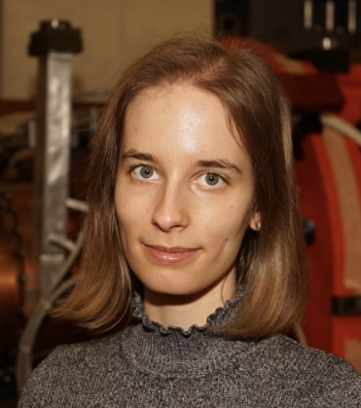

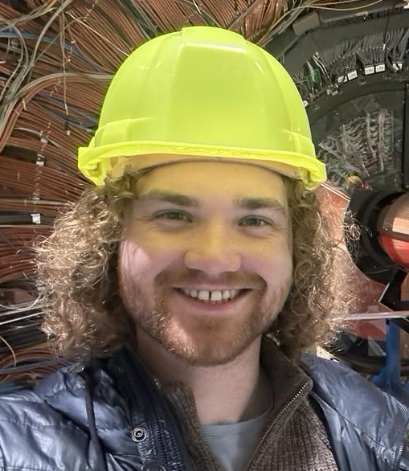

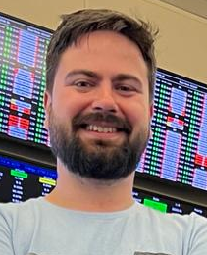
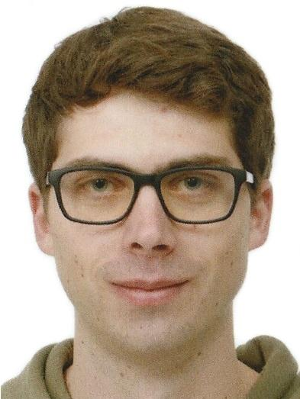
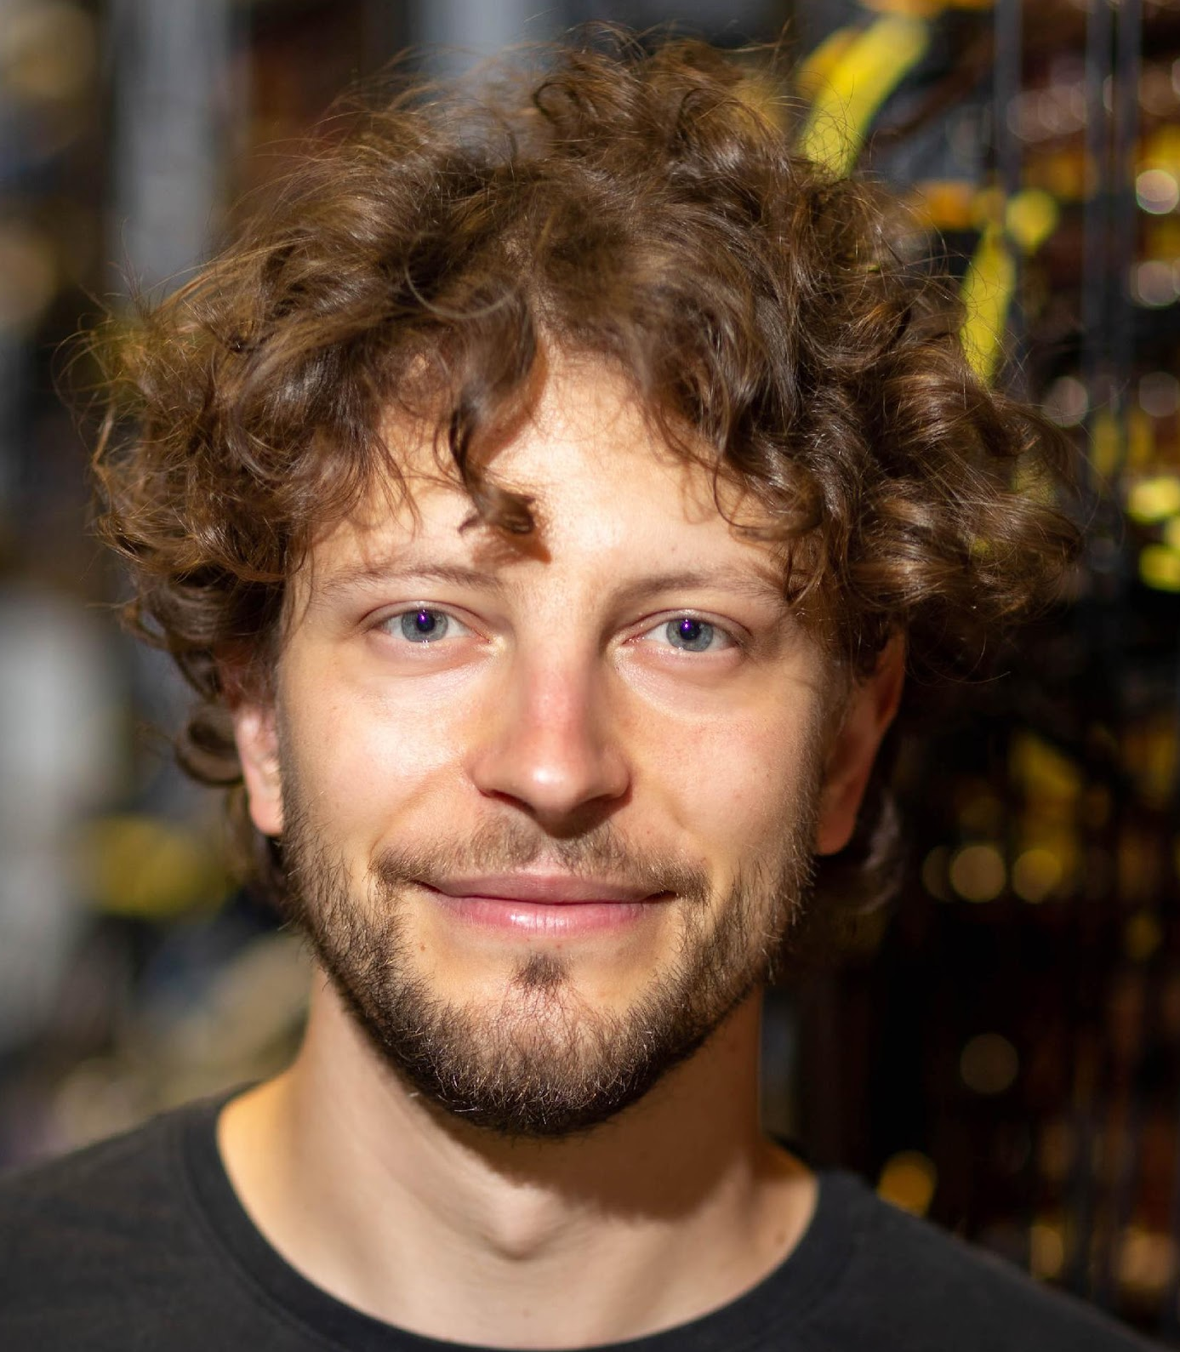
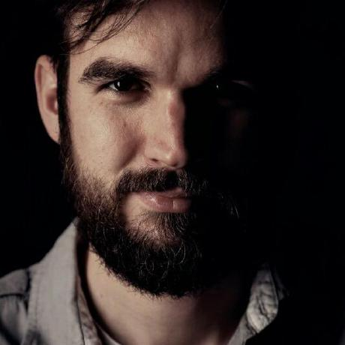


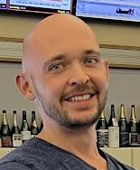
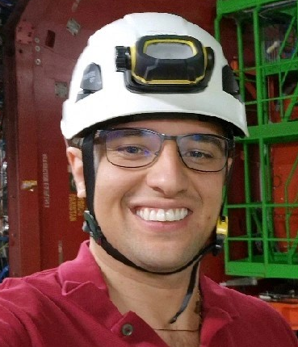
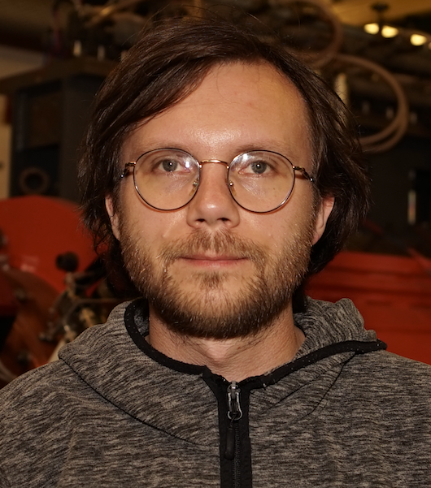

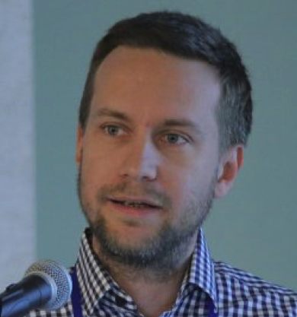

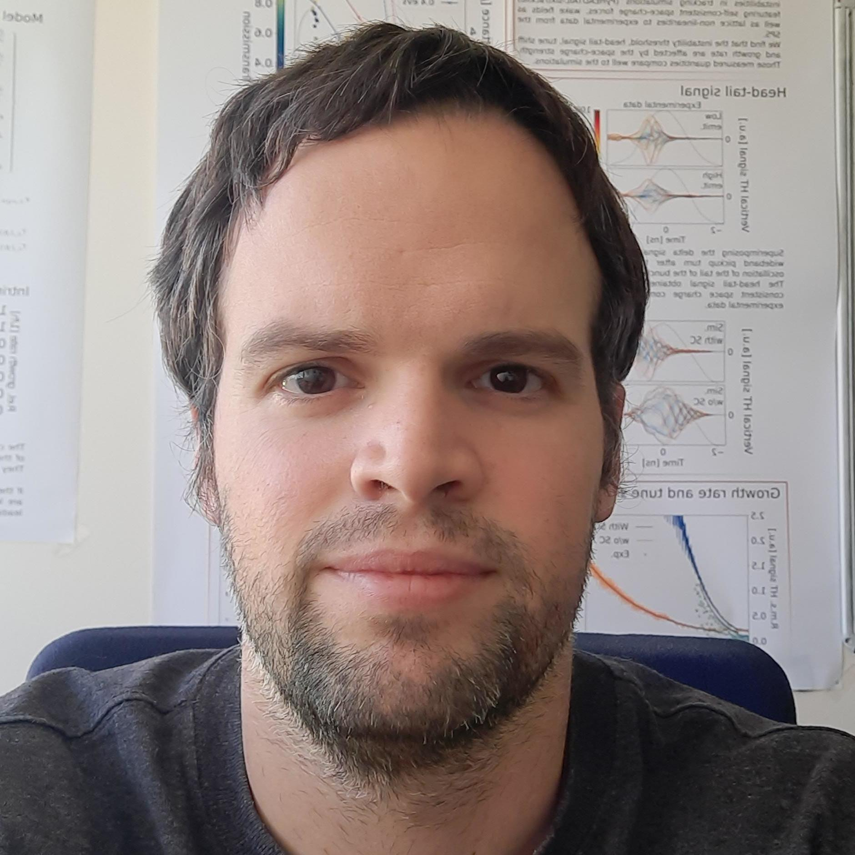




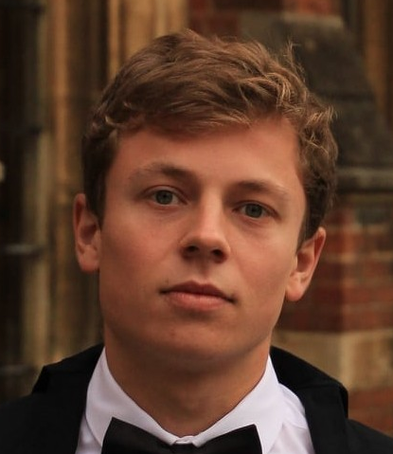

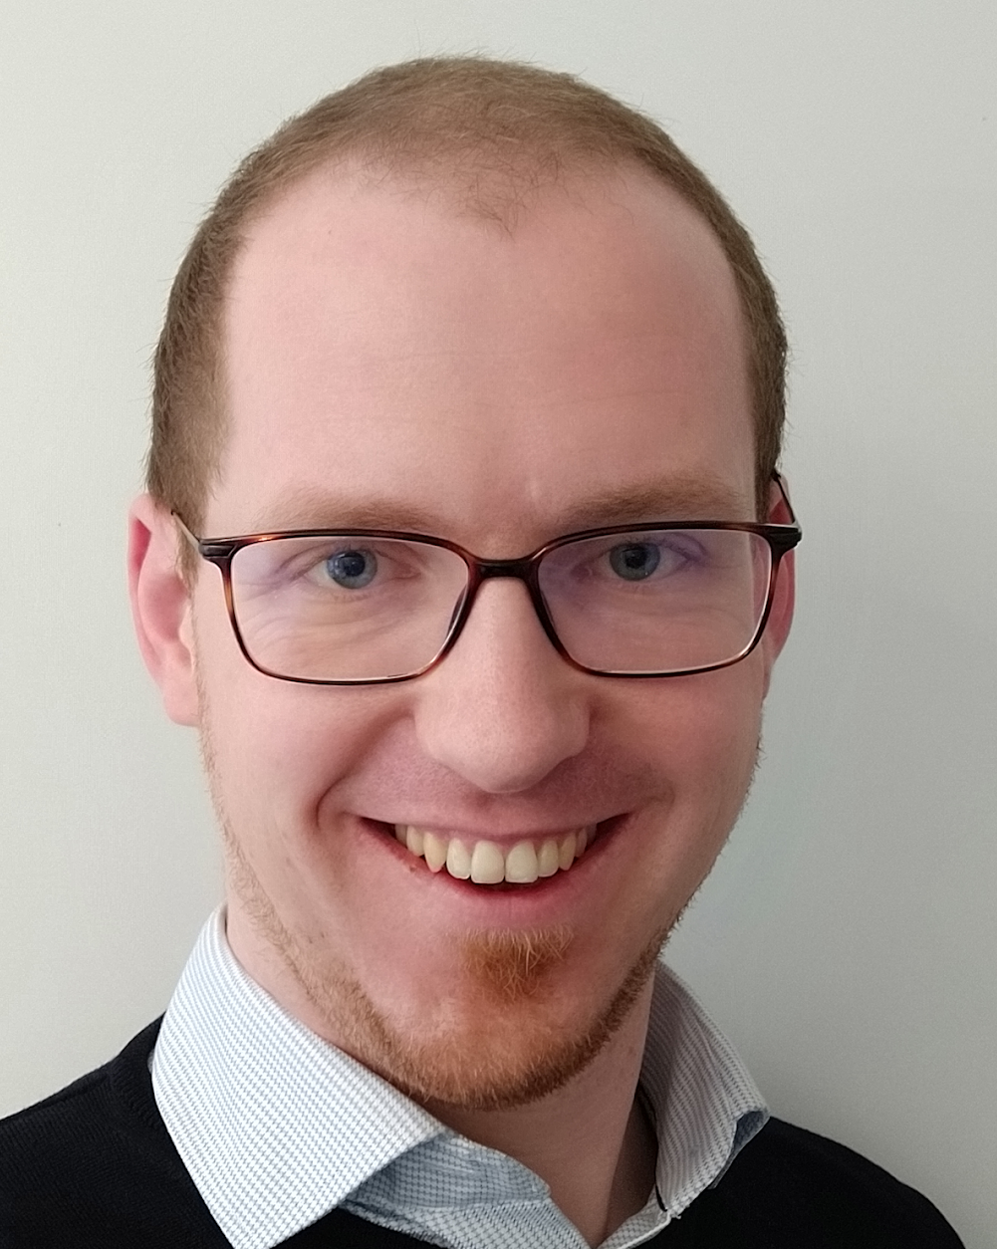


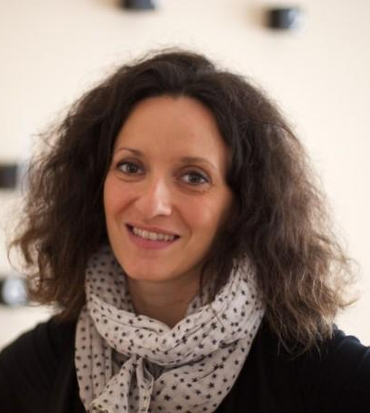

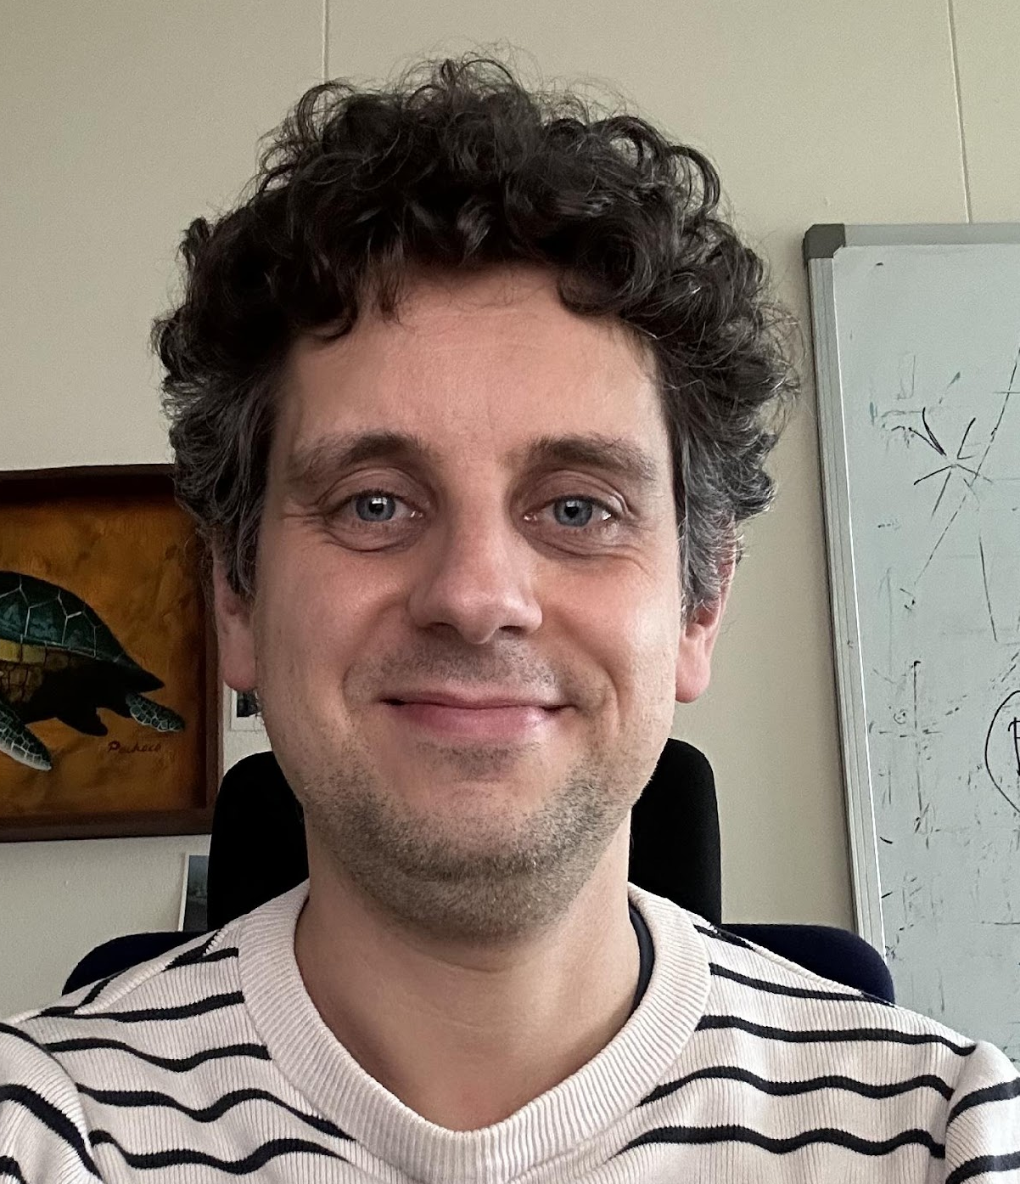





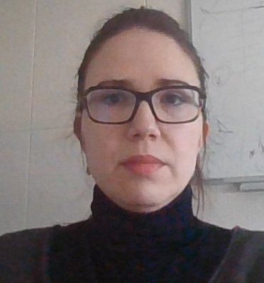
Lively user base
Users’ and developers’ response well beyond our expectations!
>30 contributors
>100 active users world-wide
>200 Xsuite mentions in IPAC24 proceedings
Accelerator schools (USPAS, CAS) used Xsuite for tutorials in 2024.
Critical mass matters ⇒ can afford a reasonably-sized team and professional workflows.
CERN
AD
ELENA
LEIR
PSB
PS
SPS, TI2, TI8
LHC
FCC-ee, FCC-hh
Muon Collider
Fermilab
Main injector
Recycler
Booster
IOTA
GSI
SIS-18
SIS-100
BNL
RHIC
Booster
EIC
J-PARC
Main Ring
KEK
SuperKEKB
Medical facilities
HIT (Heidelberg)
MEDAUSTRON
PIMMS
NIMMS
Light sources/damping rings:
PETRA
DESY injector ring
ELETTRA
BESSY III
PSI SLS 2.0
Canadian Light Source
CLIC-DR
and more...
…

Slide 10

Xsuite in action
Xsuite allows loading, exploring, and manipulating accelerator models directly in a Python environment, and launching advanced simulations.
Usage is very dynamic and interactive, as we illustrate in the following example.
Demo code available at https://github.com/xsuite/tutorial_jap24.

Slide 11
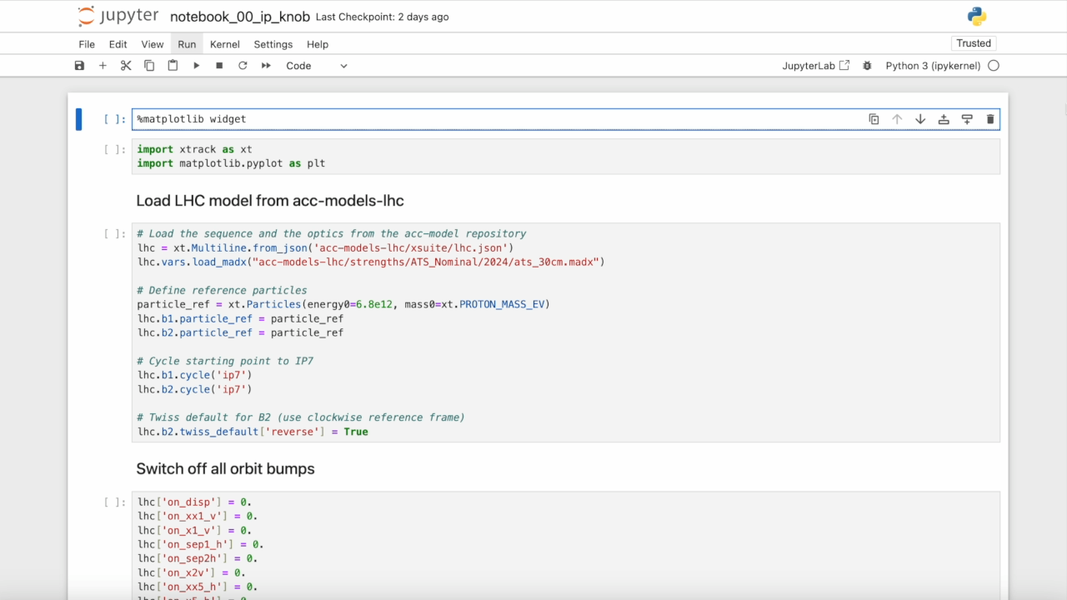

Slide 12
SPS Example
Having the beam dynamics code in the Python ecosystem makes it very natural to combine it with other tools, to manipulate measurement data, interact with the control system, perform numerical optimisation, data analyses, signal processing, etc.
In the following we show an example in which Xsuite was used online during an SPS MD.
Credit to K. Paraschou and H. Bartosik.
Demo code available at https://github.com/xsuite/tutorial_jap24.

Slide 13
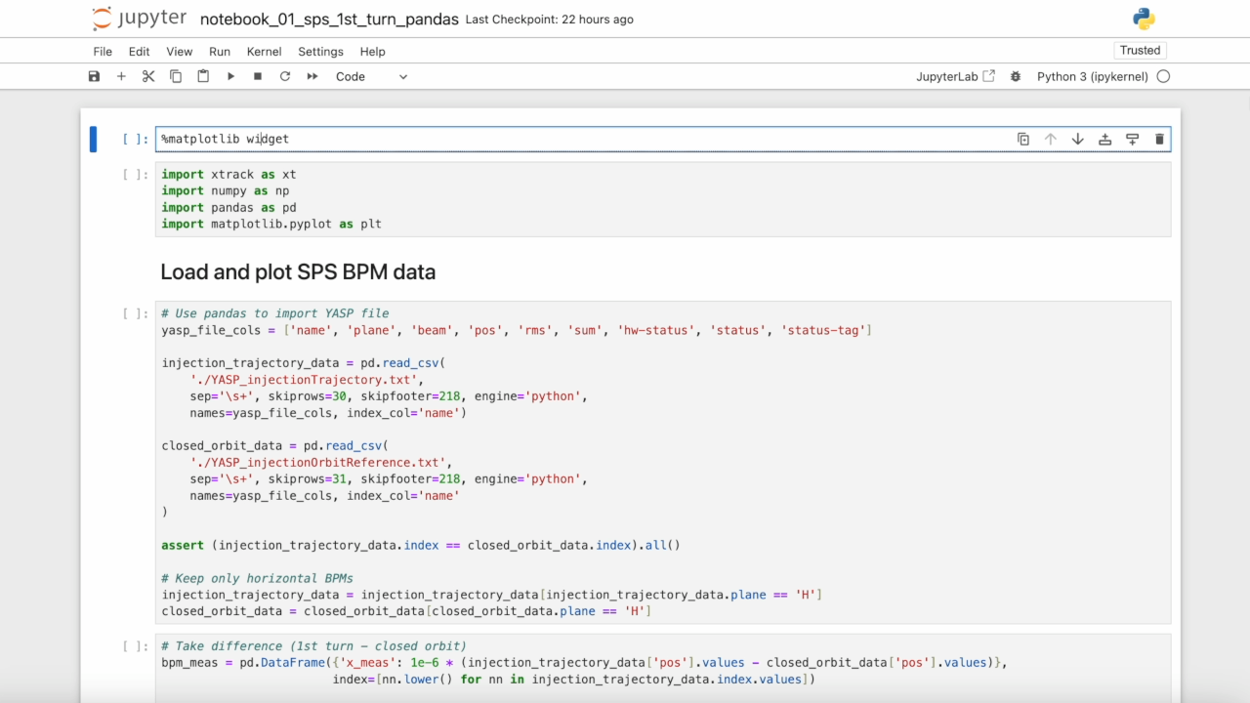

Slide 14
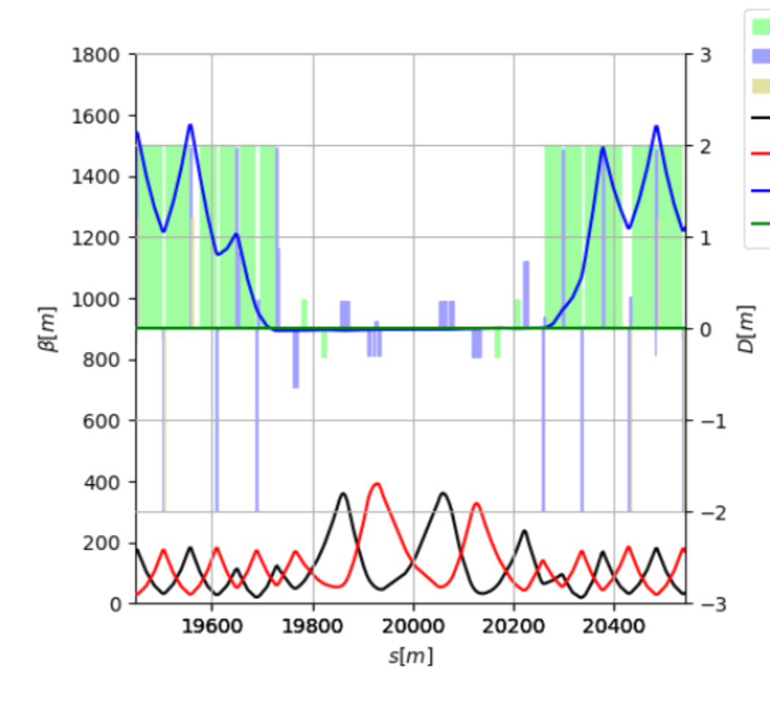
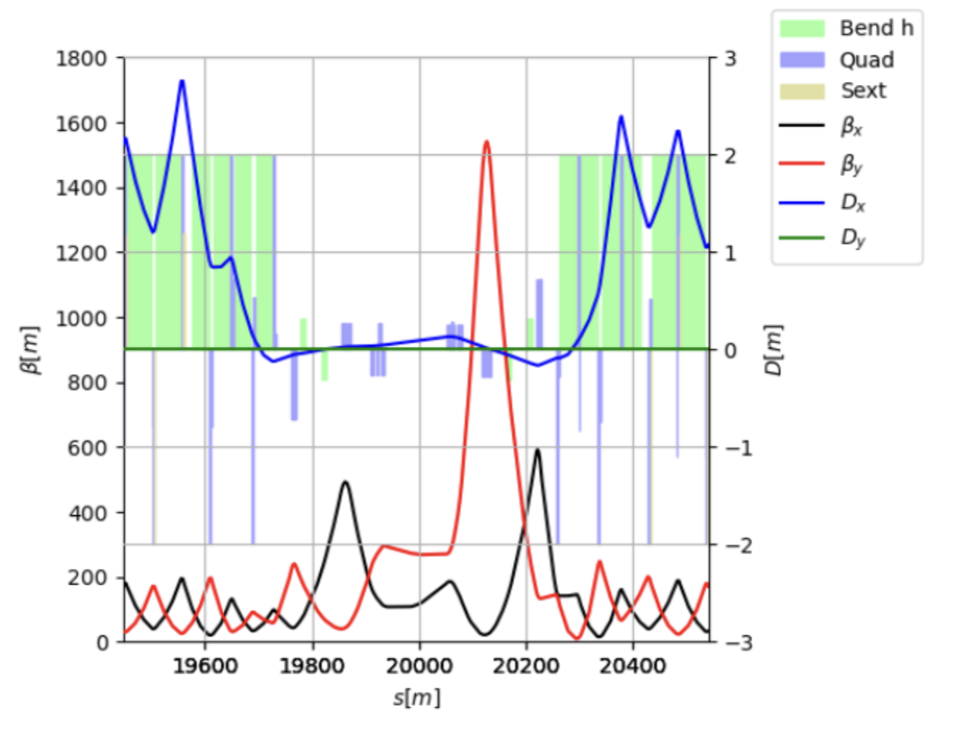
Xsuite towards Operations
Today operation of the CERN complex (accelerators, transfer lines, experimental areas) uses MAD-X as standard tool for lattice modelling, survey, optics calculations, knob generation, etc.
First tests of Xsuite also in this context went very smoothly.
Notably, the first full LHC cycle was designed entirely with Xsuite in 2024 and tested in MDs.
Including optics matching, squeeze functions design, knob design (cross./sep. bumps, tune, chromaticity, coupling, etc.), link with LSA.
IR7 (450 GeV)
IR7 (7 TeV)
Courtesy of R. De Maria and B. Lindstrom

Slide 15

Moving forward: Xsuite towards Operations
Going forward we want to move to Xsuite for operational tasks, aiming at not depending on MAD-X for critical applications by the start of Run 4.
Several benefits:
Advantageous to use the same tool for the present complex and design studies for future machines – development synergies, using same tools makes it more natural for people to work in both environments.
Overcome shortcomings of MAD-X that today are worked around:
  e.g., modelling of optics distortion from the PSB injection chicane, reference frame curvature kept independent of bend powering, general handling of tilted magnets.
Economy of resources: high-quality support for MAD-X is expensive.
  Requires a very specific skill-set training, not beneficial in other contexts.
  Plan to reinvest these resources to support users during the migration.
Notes:
Madx -> xsuite picture

Slide 16
Moving forward: Xsuite towards Operations
Preliminary discussions with main stakeholders (BE-EA, BE-OP, SY-ABT) already took place.
Response so far was very positive
  General perception that advantages of modern and supported tools outweigh the cost of transition.
We will continue engaging with the user community to get an accurate and complete overview of needs and wishes.
  Don’t hesitate to give Xsuite a try for your applications and reach out to us with feedback.
  Early feedback is important to ensure that all relevant needs are correctly incorporated in the design.
The migration of the ‘acc-models’ repositories for all accelerators and lines will be an important milestone. BE-ABP is committed to work on this task during LS3 in collaboration with repository owners.
Notes:
Madx -> xsuite picture

Slide 17
Thank you!

