Slide 1
Integrated management of accelerator models
R. De Maria, G. Iadarola
Based on discussions with S. Chemli, J. De Jonghe, V. Kain,
L. Fiscarelli, A. Hauschauer, C. Petrone, P. Le Roux, P. Ledo, C. Scoero

Slide 2
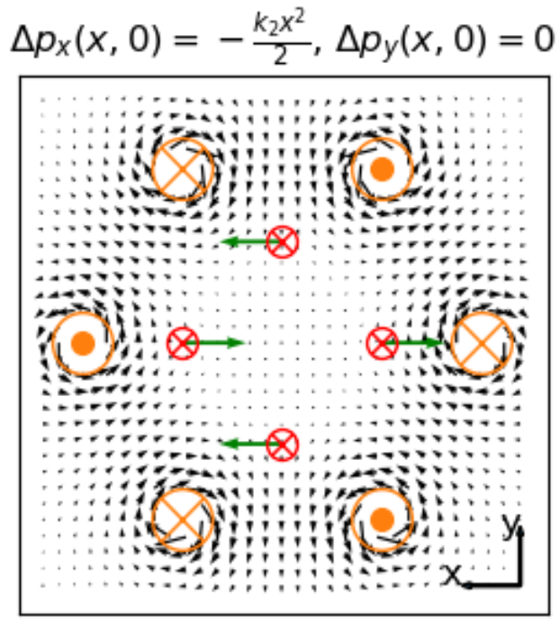
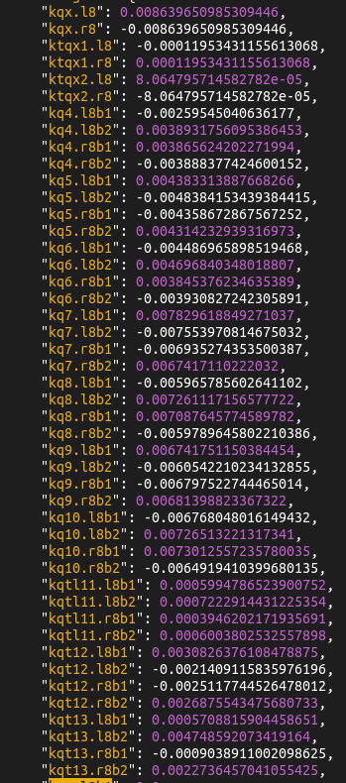

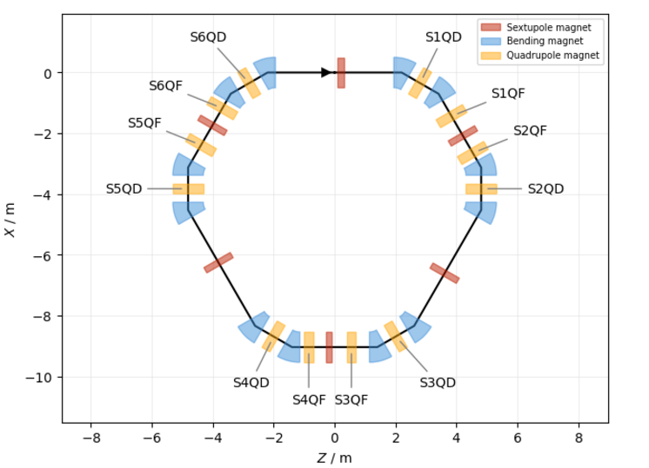
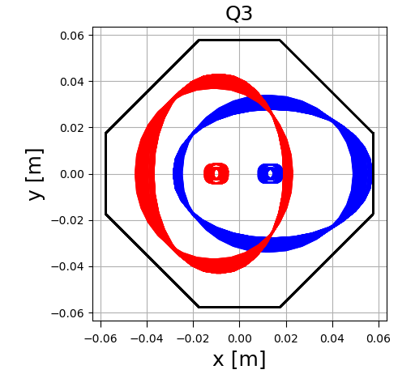
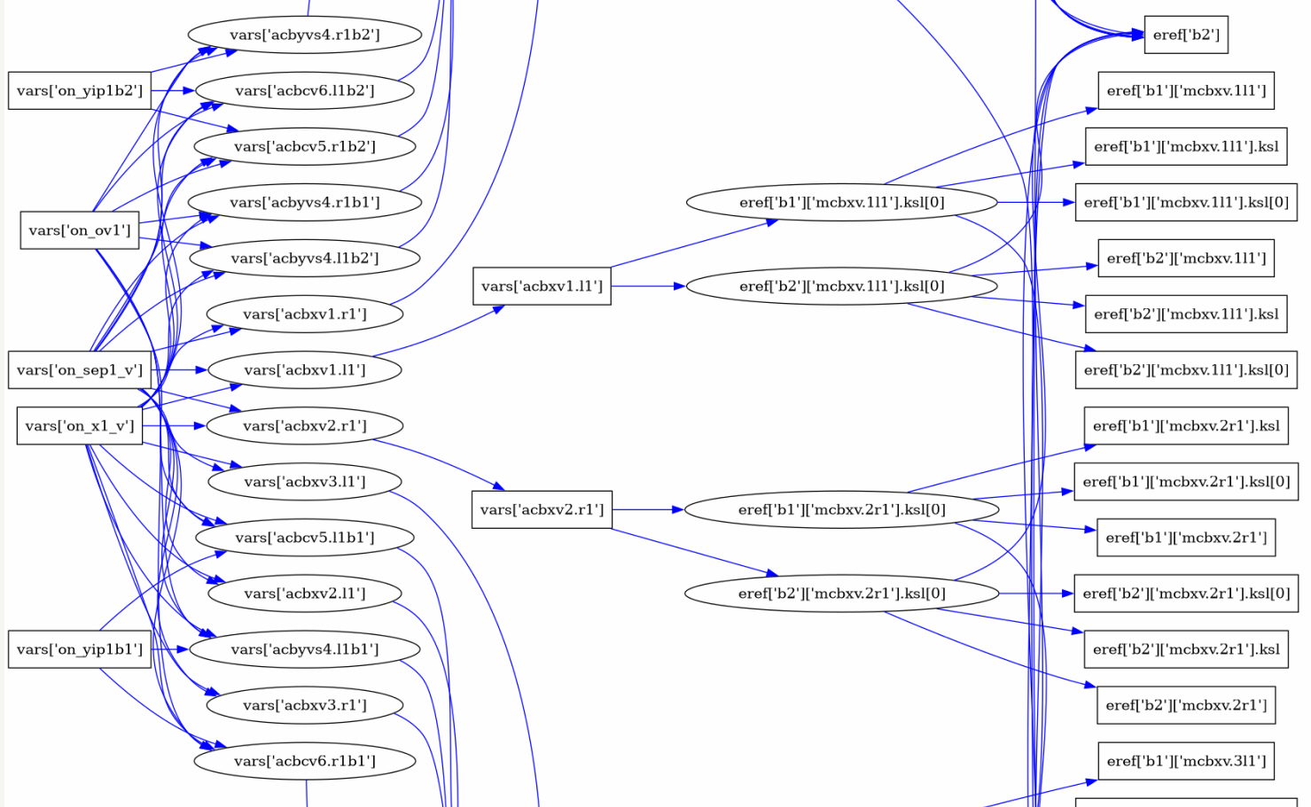
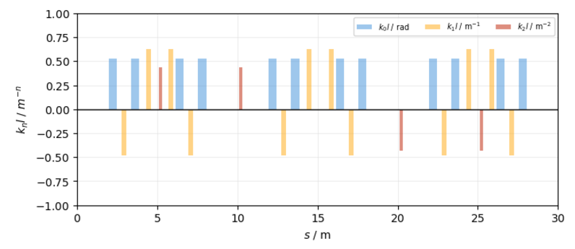
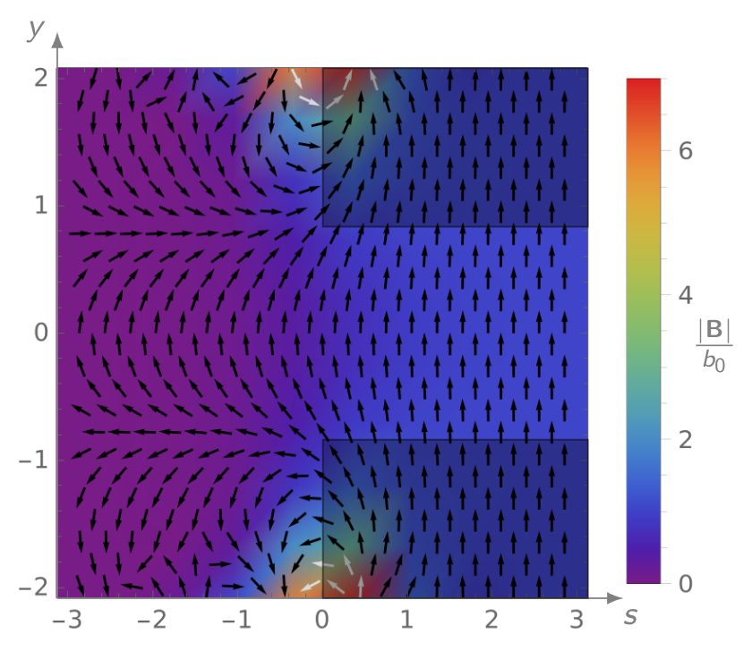
Accelerator models
Accelerator
Model
Design
Construction
E. de la Fuente
Layout
Lattice
Elements
Apertures
Controls
S. Van der Schueren
Settings
Operation
Simulations
Accelerator physicists and operators inject or extract information into models to design, construct, operate and optimize accelerators.

Slide 3
Accelerator data domains
Accelerator modelling for studies and operation requires, among others, collecting a large quantity of data, the largest the machine, the larger data, from different domains.
Configuration management EN-ACE
Accelerator Model
Product lifetime management EN-IM
Layout
Magnetic measurements TE-MSC
Lattice
Elements
Survey references
Metrology and alignment (GEODE) BE-GM
Metrology and alignment BE-GM
Apertures
Controls
Settings
Optics
Design offices EN-MME
Powering SY-EPC, TE-MPE
Controls (LSA) BE-CCS
Beam Physics
Operation
Controls BE-CCS
A digital thread connecting all the sources is key to coping with scale and accuracy: automatic workflows, validation, deduplication, consistency, error correction, lifetime.

Slide 4
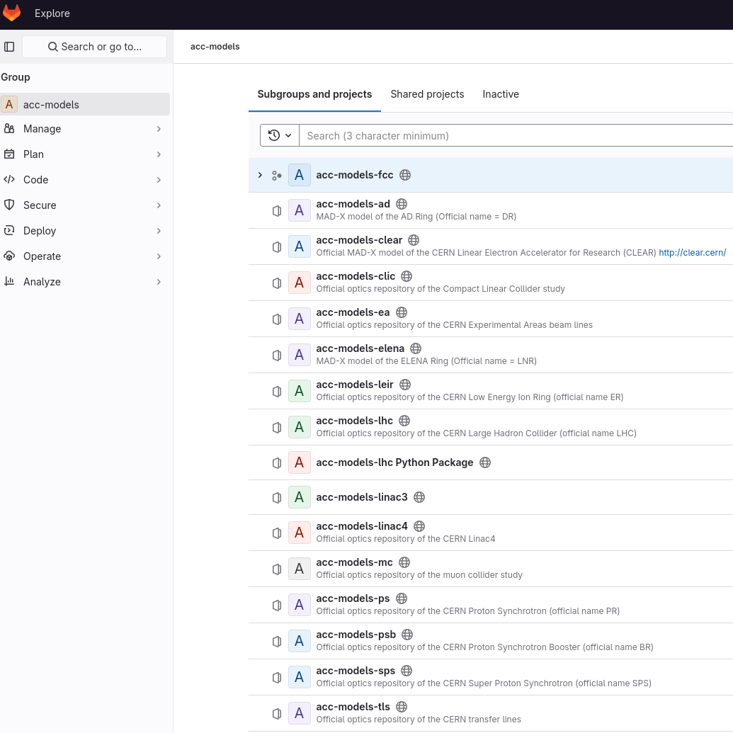
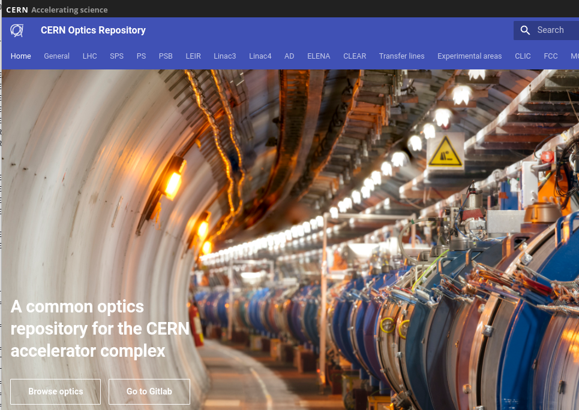
acc-models
Gitlab repository and website that contains optics models for operations and studies.
Managed by BE-OP and BE-ABP/BE-EA/SY-ABT optics experts.
We aim at continuing building on top of acc-models: increase coverage, add integration with existing database and workflows, improve robustness.
We now look at the connections with the relevant data domains….

Slide 5
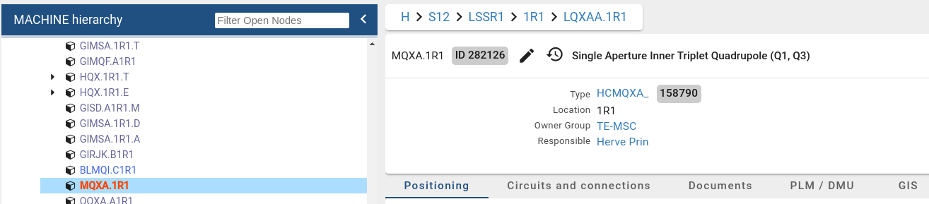
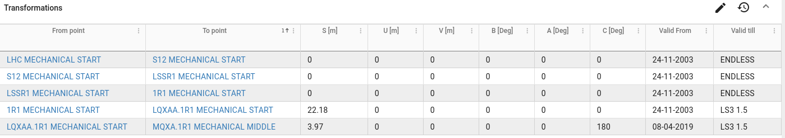
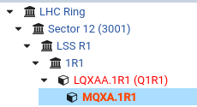
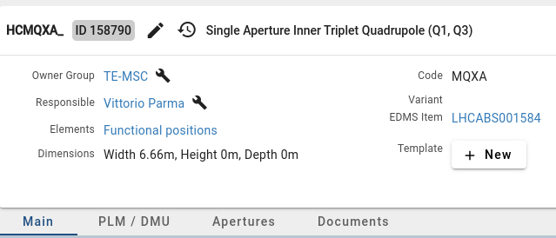
Layout database
LDB contains many types of data, among which, functional positions, expressed as a tree of rigid transformations (but no explicit bends!), and associated circuits when relevant.
Data is entered mostly by configuration managers, vacuum experts (LHC only) and MPE (circuits).
Data quality saves resources, and we shall see what it means and how to improve it…
Functional positions are connected with types, which add additional info such as apertures.

Slide 6
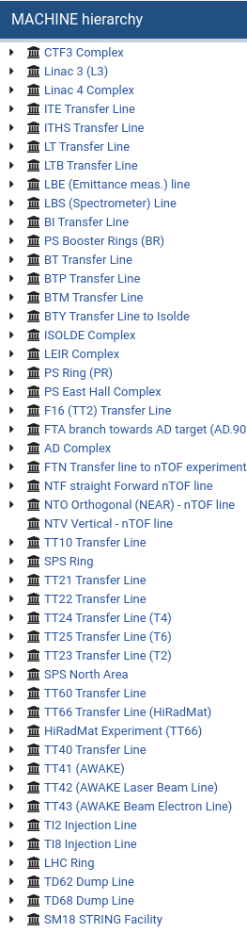
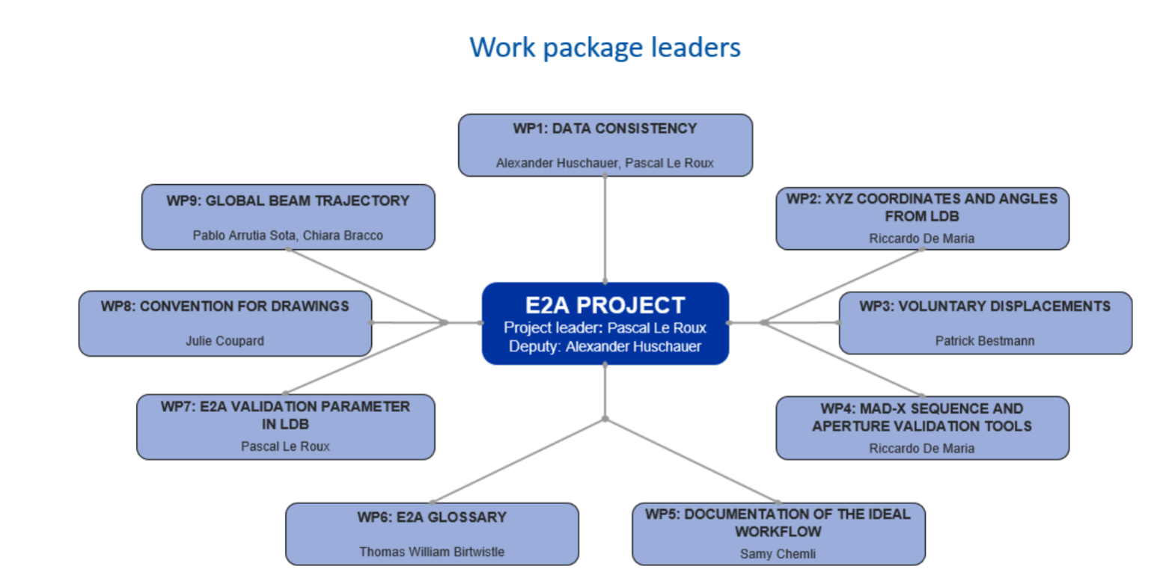
Layout database data and acc-models
The layout database contains data for most of the rings and lines. The Layout database generates MAD-X sequence for most of them (and aperture definitions for LHC and SPS), nightly. However, this data is not fully exploited in acc-models!
The large majority of the LDB data is correct, at the same time, a model can break with a single error.
Some data is not used immediately and validated ➡ quality issues and gradual degradation over time.
Data based on informal definitions and ad-hoc agreements ➡ a lack of coherence between and within machines.
The layout database is the keystone of the Engineering to Alignment project (E2A) that aims at improving the speed and quality of beam line construction and alignment. Some WPs directly address those issues:
WP1: Data consistency
WP2: Survey references
WP4: Automatic Validation
WP7: Validation parameter
WP8: Glossary
Remarkable progress!

Slide 7
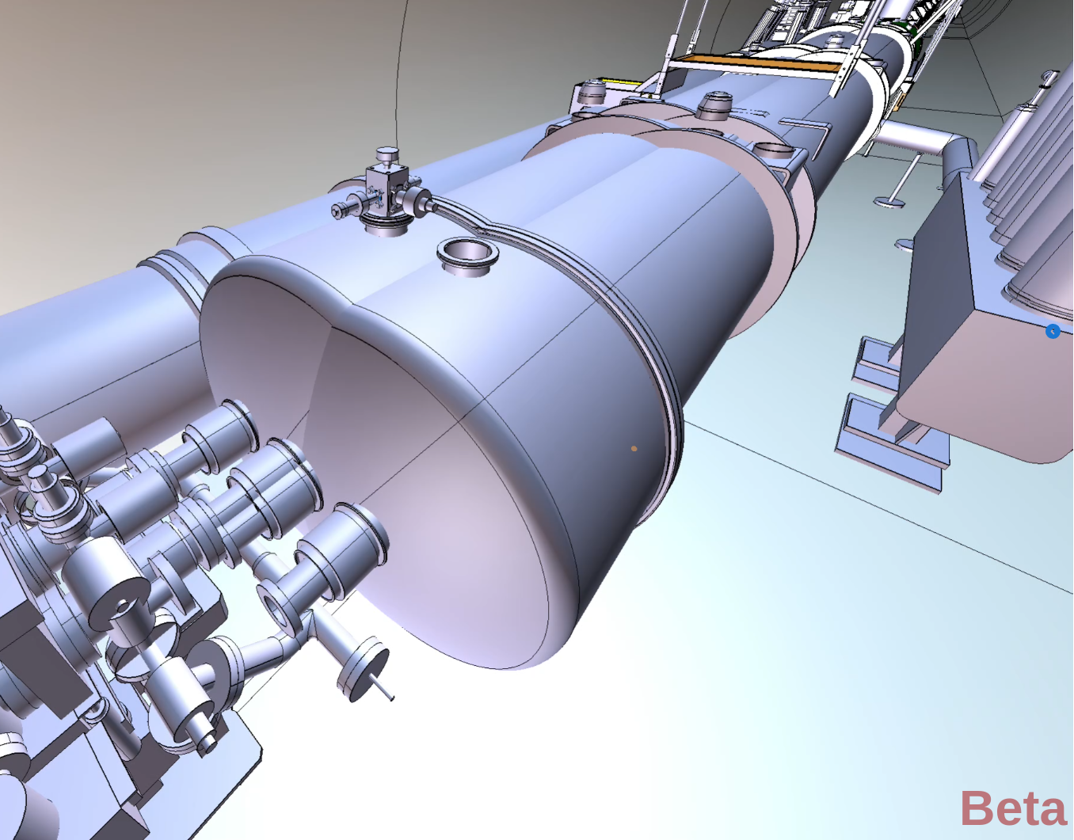
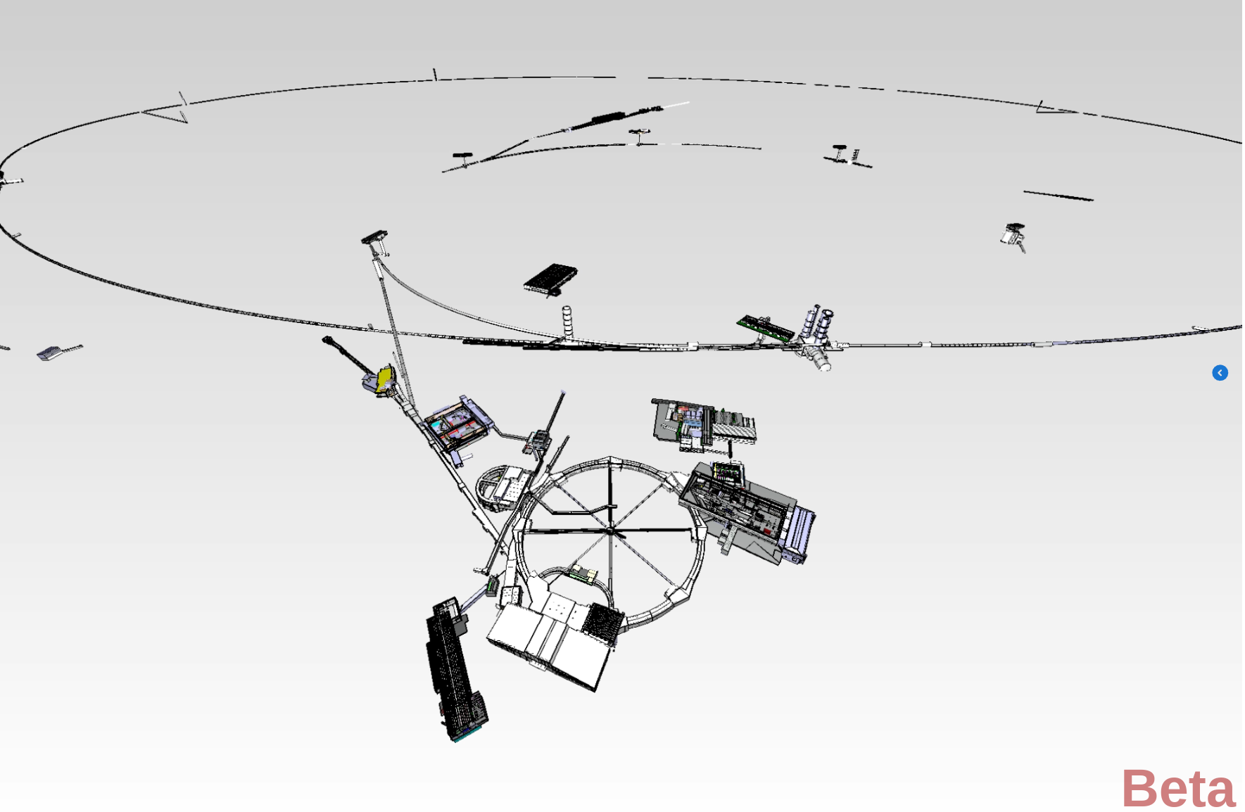

Layout visualizations
However, the data does not show as expected…
Here you see a recurring issue: missing the explicit link between the element model and the corresponding global reference points.
This is an innocent virtual artefact, but we had real installation artefacts in LS2!
Need investment in quality and focus.
PLM team has launched a remarkable layout viewer, integrating the layout database and GEODE data with their equipment data and allowing connecting to equipment 3D models.
See with your own eyes, it is truly remarkable!

Slide 8
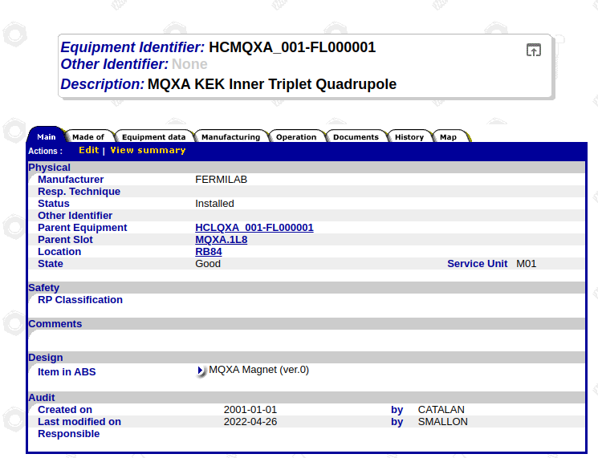
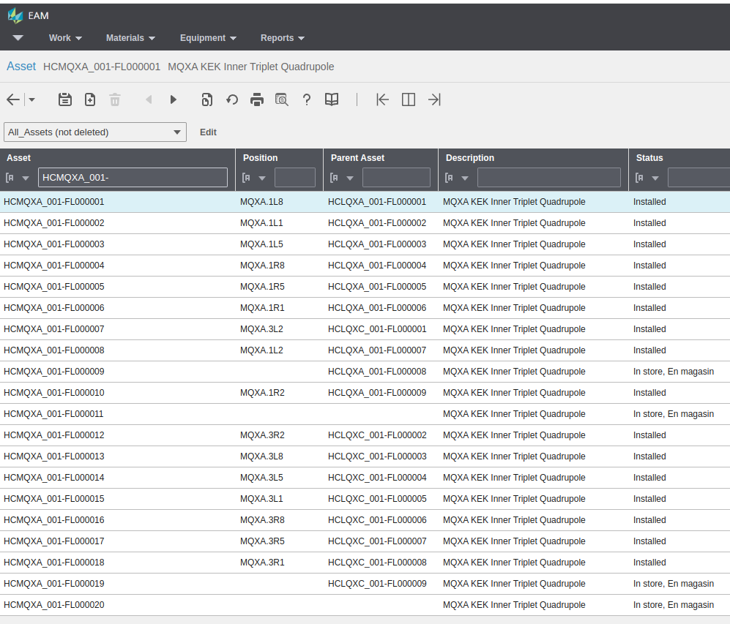
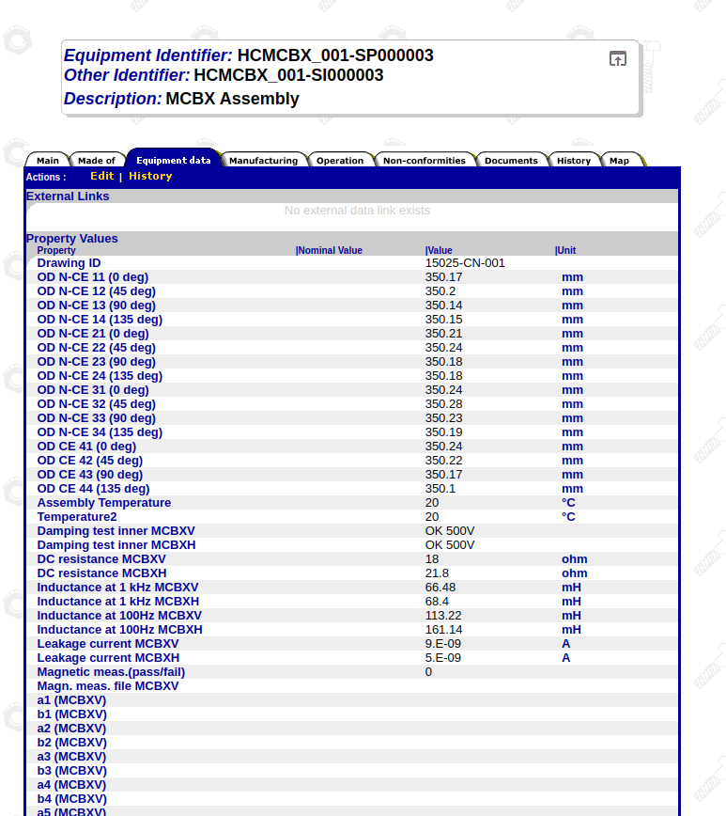
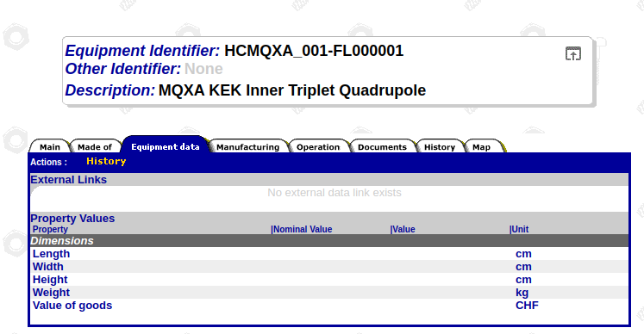
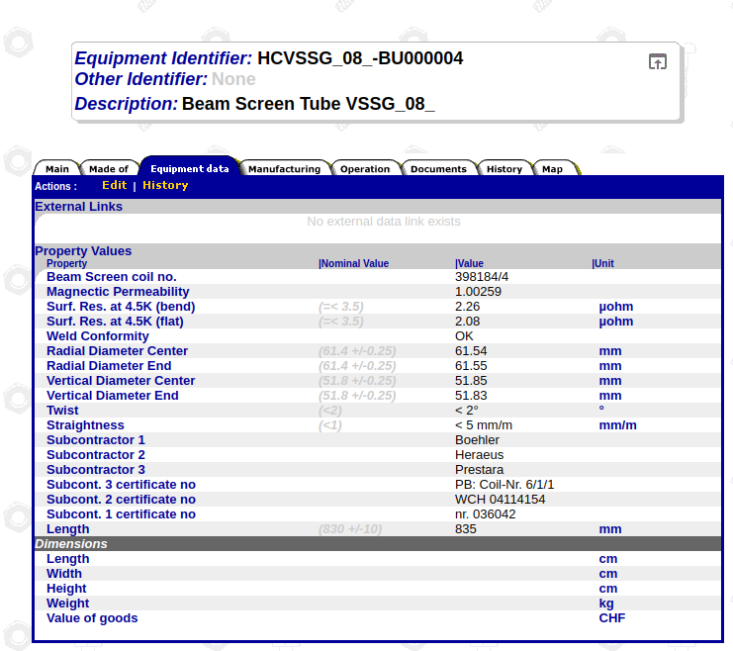
Equipment data
acc-models should contain measured properties of the installed equipment. Infor EAM (MTF) contains the connections between functional positions and assets and some equipment data…
Effort needed to understand what is available, reliable and maintained…

Slide 9

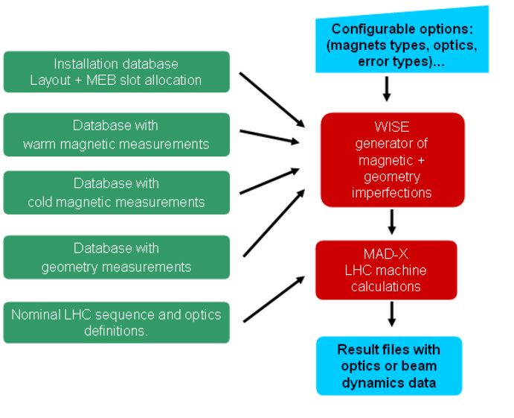
Magnetic models
Magnetic models are essential for operation, and very accurate models are especially useful for machines like the LHC that are slow and expensive to measure.
WISE was developed to integrate magnetic field model (FIDEL) in a complete workflow that considers strengths from optics, geometrical measurements and creates magnetic imperfections.
We need to revive and extend the tool for HL-LHC, other initiatives are already starting for other machines.
A good occasion to have a common approach happening at the same time as the restructuring of acc-models around Xsuite.
Windows Interface to Simulation of Errors

Slide 10
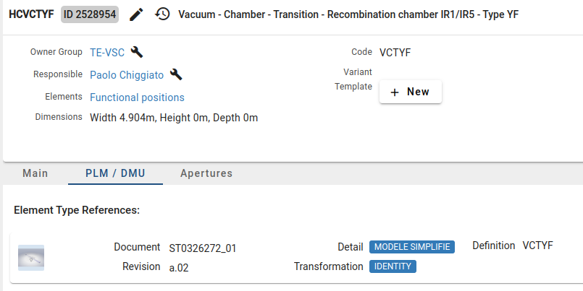

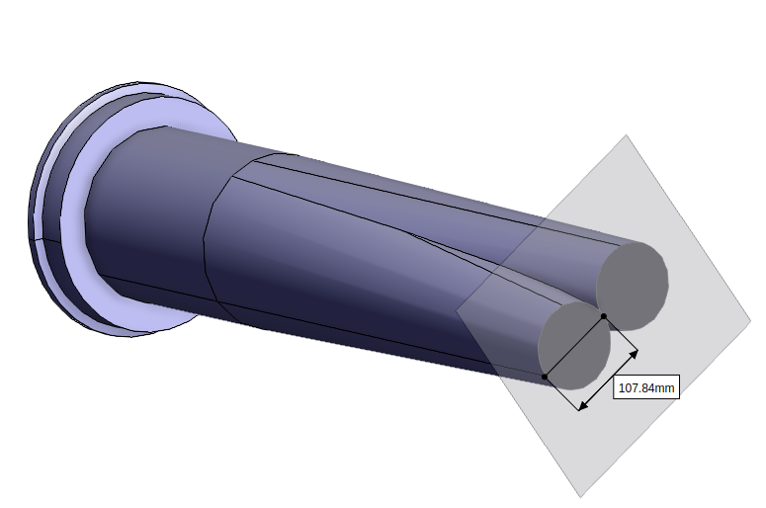
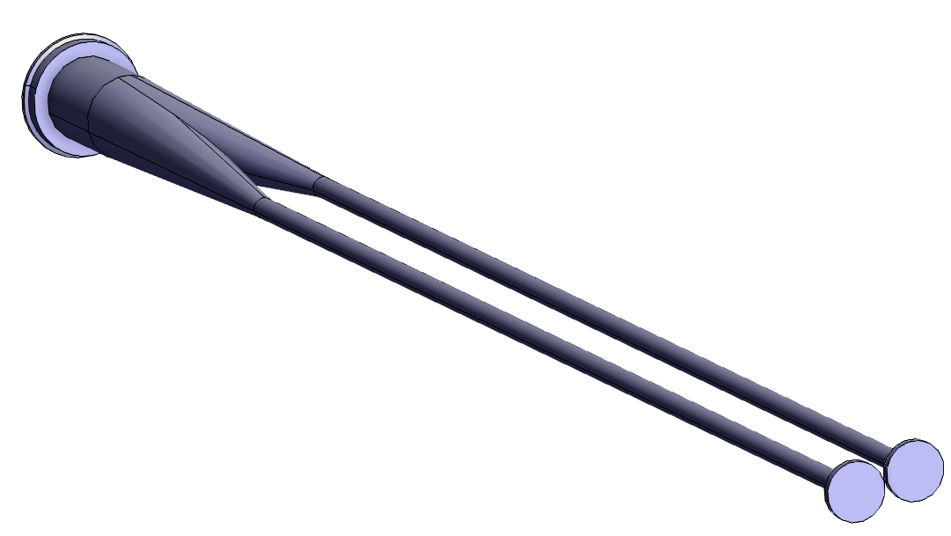
Aperture models
Aperture models are essentials to design and deploy operational configurations.
Vacuum cross-sections need to be extracted from drawings and inserted into the database.
So far, all manual, thankfully not too many aperture types. As STEP files are available, one could try to extract them automatically, pilot from Alex for PS.
Layout database can now have arbitrary profiles using SVG Path standard.
Important to connect 3D models to types consistently by configuration manager and equipment owners!

Slide 11
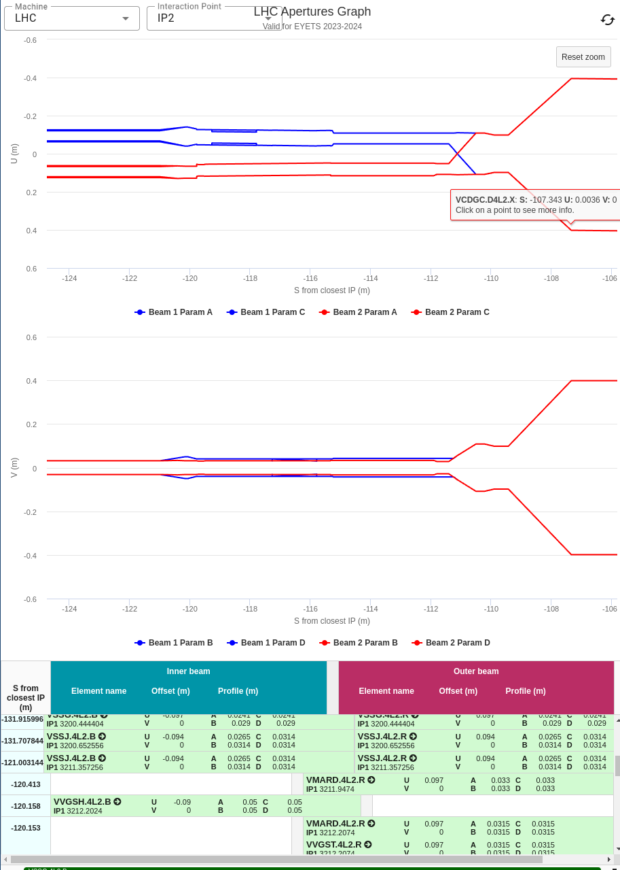
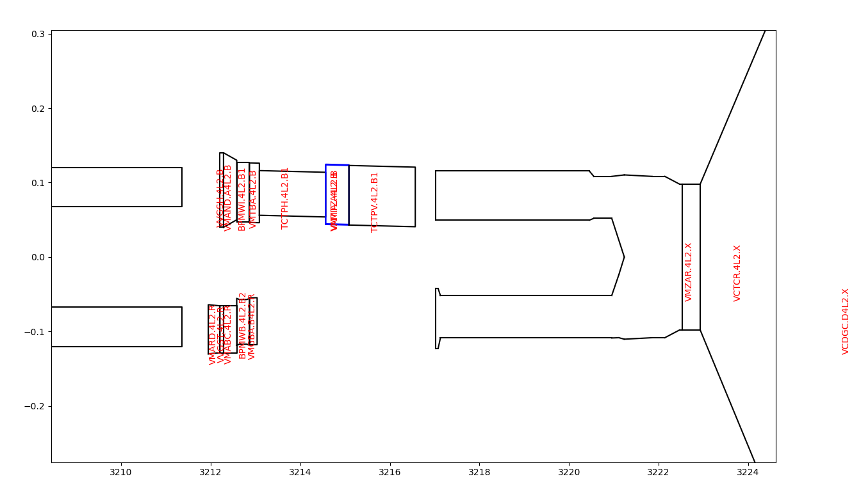
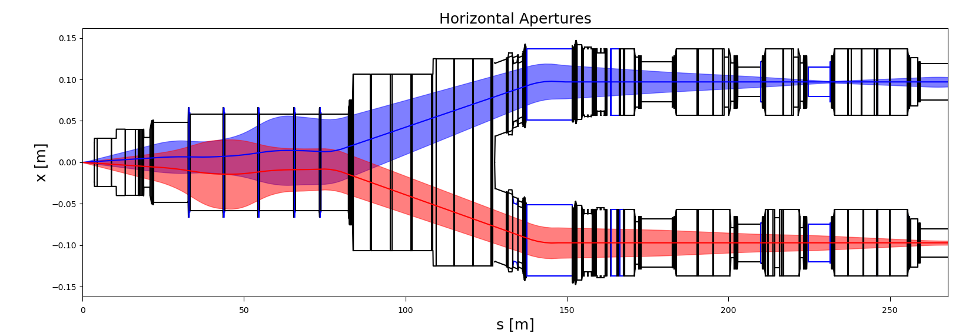
Aperture graphs
Improving aperture visualization is key to entering data correctly. Below examples of different approaches.
Present graph in LDB,
angular based.
Recent approach:
pylayout: fast prototyping, Python oracle access, Python plotting, Python connection with beam dynamics. Costs and time to first release much reduced. Used by TE-VSC already for a year.
Embracing open data access API, rapid prototyping, early release cycles is paying off!

Slide 12
Wrap-up…
Accelerator models need to integrate data from many sources. It is a resource heavy effort!
Economy of scale: join efforts, re-use and re-scope existing data sources and descope duplicated information, develop tooling to reduce constraints, minimize manual work, establish automatic testing and continuous integration.
ABP is restructuring the simulations and modelling efforts along those lines, in particular around the Xsuite framework. So far, the response has been positive.
Run 3 will be used to complete features along pilot projects (e.g. full LHC cycle developed for LHC in 2024) and LS3 to complete transitions.
We also plan to improve the integration of acc-models with the data domains.

Slide 13
A digital thread for acc-models
LDB
Survey references
Geode
E2A
Configuration managers
F. positions, types
PLM
Measurements
Checks
Equipment owners
3D Models
acc-models
Assets
Infor EAM
Operation
Magnetic measurements
Measurements
Settings
online models
Magnetic
models
Beam physicists
Metrology
LSA
Today, each arrow represents an unstructured process driven by the needs of the users.
We ultimately miss structures in which data owners and users share responsibility and resources for ensuring data quality, checks, data flow and data lifetime.

Slide 14
Back-up

Slide 15
Accelerator models
Accelerator
Model
Design
Construction
An accelerator model contains:
Layout: The position of a set of physical beam elements positioned in space: magnets, cavities, BPMs, etc.
Lattice: A sequence of tracking maps representing the physical beam elements that are needed to track the beam trajectories.
Element physics models: parametric physics models (magnetic, electric, materials, impedance) that characterize the elements.
Aperture model: A description of vacuum geometries around the beam.
Control model: a set of relations between quantities that can be used to control or manipulate the parameters of beam element models.
Settings: a specific set of values that fully specify a model during an operation cycle.
Lattice
Layout
Elements
Apertures
Controls
Settings
Operation
Simulations
Accelerator physicists and operators inject or extract information into models to design, construct, operate and optimize accelerators.

Slide 16
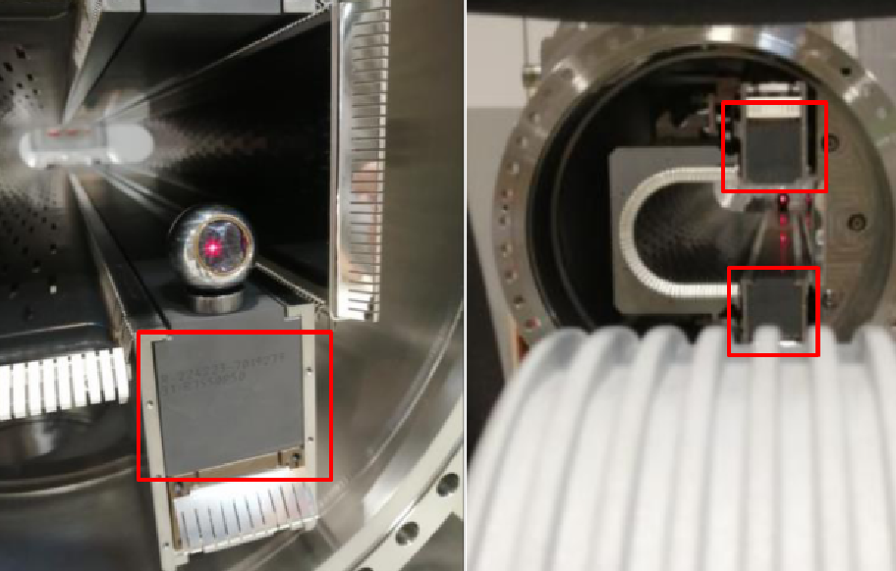

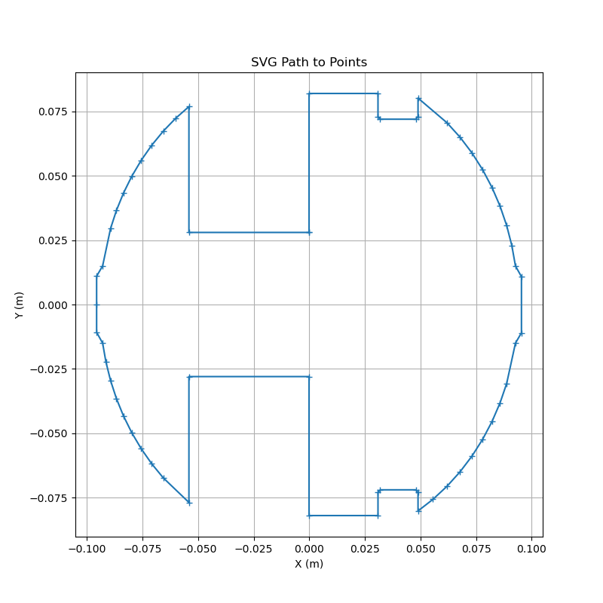
SVG Path and editor
third modules
https://acc-models.web.cern.ch/svg-path-editor/#P=_m_0_4_h_78.4_a_60_60_0_01_0_120_h_-78.4_h_-4_v_-56_h_-62_v56_h-4.5_v_-120_h_4.5_v_56_h_62_v_-56_z
svgpath = "M -0.1 -28 L -54.1 -28 L -54.1 -76.9 A 94 94 0 0 0 -92.9 -15 L -95.6 -11 L -95.6 0 L -95.6 10.8 L -92.9 15 A 94 94 0 0 0 -54.1 76.9 L -54.1 28 L -0.1 28 L -0.1 82 L 30.9 82 L 30.9 73 L 31.9 72 L 47.9 72 L 48.9 73 L 48.9 80.2 A 94 94 0 0 0 92.7 15 L 95.4 11 L 95.4 -10.8 L 92.7 -15 A 94 94 0 0 0 48.9 -80.2 L 48.9 -73 L 47.9 -72 L 31.9 -72 L 30.9 -73 L 30.9 -82 L -0.1 -82 Z"
x, y = svg_to_points(svgpath, scale=0.001, curved_steps=10)

Slide 17
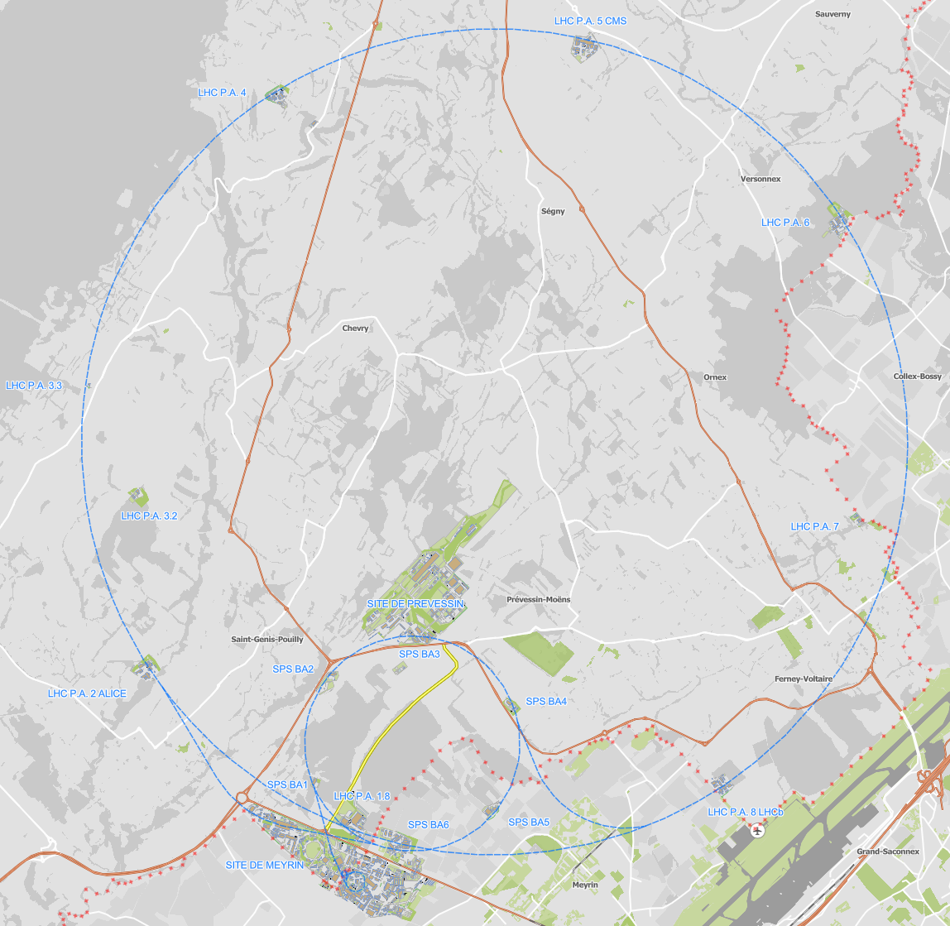
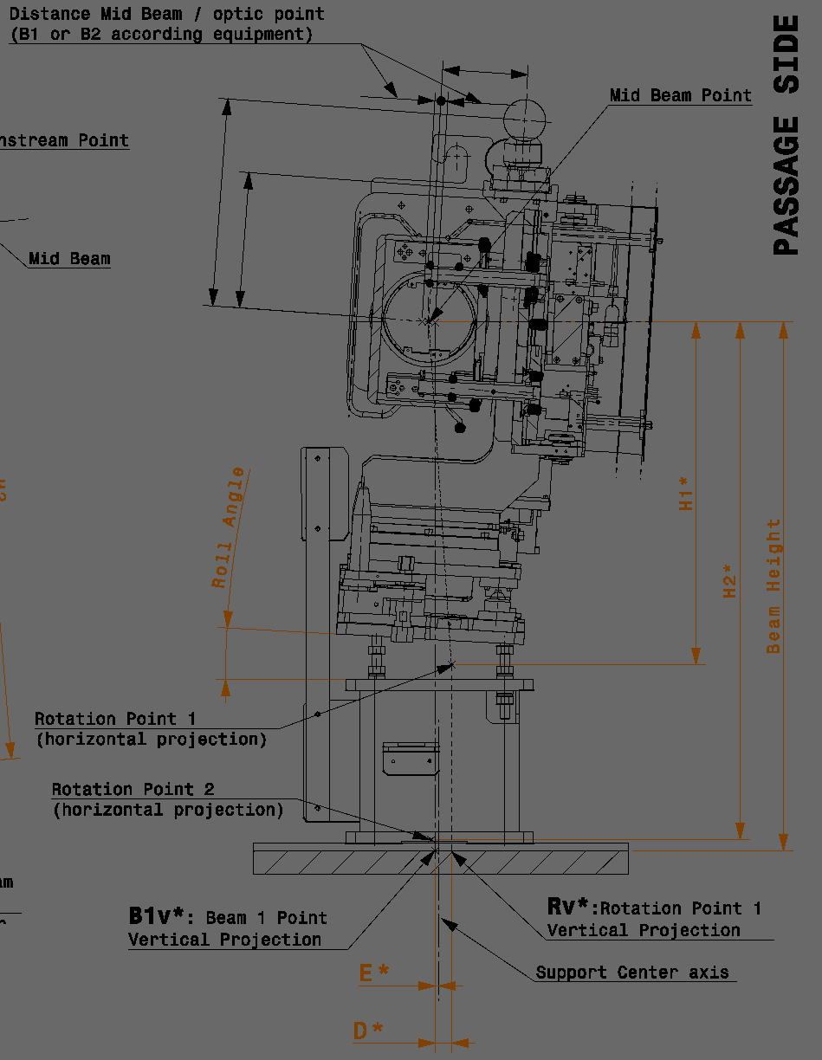
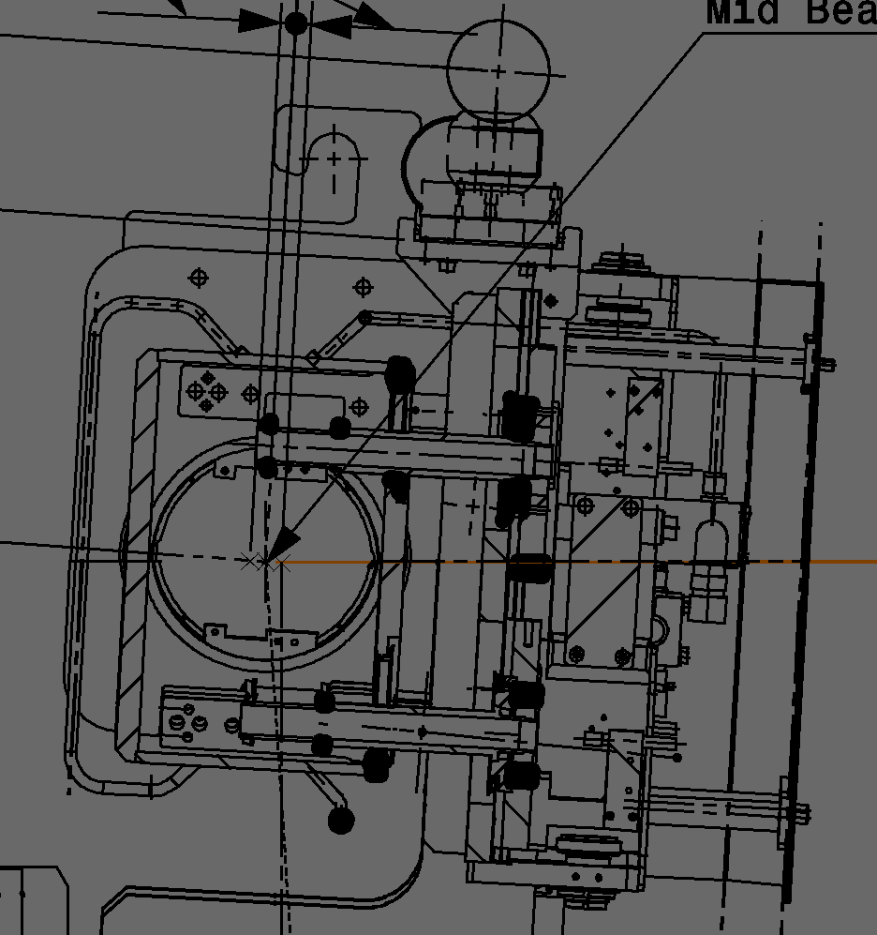
Position of a beam line elements
An accessible reference in the tunnel
A reference point related to the element and the beam line.
… and relations between them.
A mechanical feature to align.

Slide 18
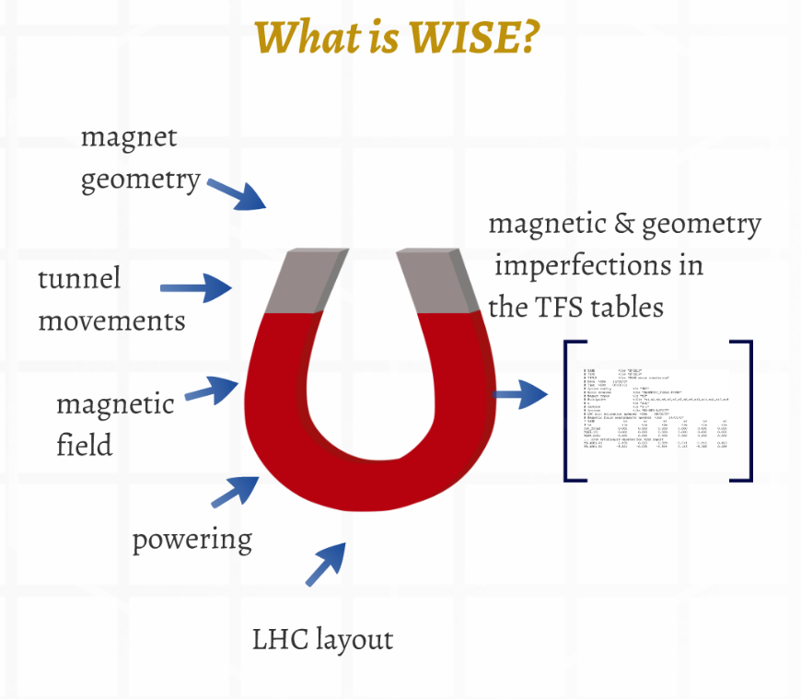
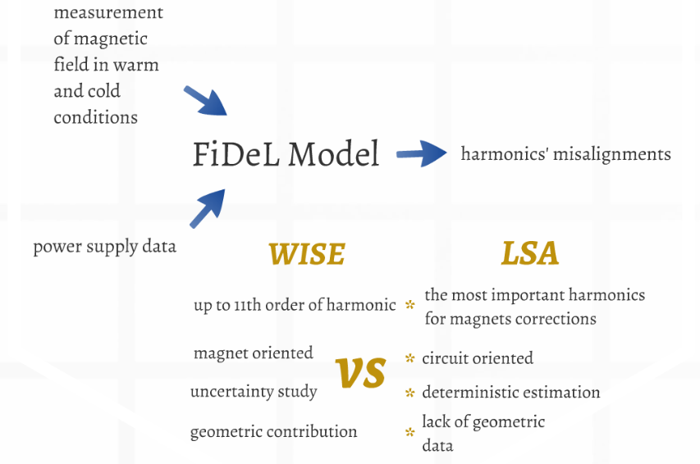
https://indico.cern.ch/event/813002/contributions/3389661/attachments/1826585/2989584/16-03-08_abs_WISE2.0.pdf
https://cds.cern.ch/record/1089857/files/lhc-project-report-1056.pdf

Slide 19
Layout
Accelerator models
Configuration management
Geodesy and metrology
Lattice
Survey
Drawing,ECR
Layout database
Construction
Measurements
Lattice
Survey
Positions
3D Models
Assets
Design office, equipment owners

Slide 20
From MAD-x variables to the magnetic field seen by the beam
Value in MAD variable
Optics file
Value in MAD element
Sequence file
Value in KnL, KnSL calculated by Twiss
Twiss table file
K value in LSA
LSA importer
I value in LSA
Calibration and Calibration Sign
IREF value in LSA
Down sampling
IREF in Power converter
Sequencer
Installation orientation
Layout drawing
I to A or B terminals
Circuit drawings
I in A, B terminals to coils
Magnet drawings
There are only two signs, but ten passages where it can flip!

Slide 21
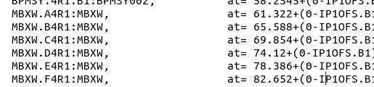
LHC D1
LHC D2
MBXW.D4R1.BEAM1.START.OPTIC
MBRC.4R1.B1.START.OPTIC (94mm)
MBRC.4R1.BEAM1.END.OPTIC (97mm)
Voluntary displacement
Arbitrary
element
MBRC.4R1.BEAM1.START.OPTIC
MBRC.4R1.B1.END.OPTIC (94mm)
MBRC.4R1.START.OPTIC
MBRC.4R1.MIDBEAM.START.OPTIC
MBRC.4R1.END.OPTIC
MBRC.4R1.MIDBEAM.END.OPTIC
MBRC.4R1.B2.END.OPTIC
MBRC.4R1.BEAM2.START.OPTIC
MBXW.D4R1.START.OPTIC
MBXW.D4R1.MIDBEAM.START.OPTIC
MBRC.4R1.BEAM2.END.OPTIC
MBRC.4R1.B2.START.OPTIC
MBXW.D4R1.BEAM2.END.OPTIC

Slide 22
To do better
Remove inconsistencies between data sources, add connection and then remove duplications.
Replace document driven process to data driven processes.

