Slide 1
Data and processing resources for analysis
Marcin Sobieszek BE/CSS
EPA WP9
with input from
G. Iadarola, G. Sterbini, R. De Maria, F. Asvesta, A. Lasheen, M. Berges, JC. Garnier, V. Kain, A. Huschauer, M. Schenk, M. Hostettler, A. Calia, G. Trad, V. Baggiolini, C. Roderick and others

Slide 2
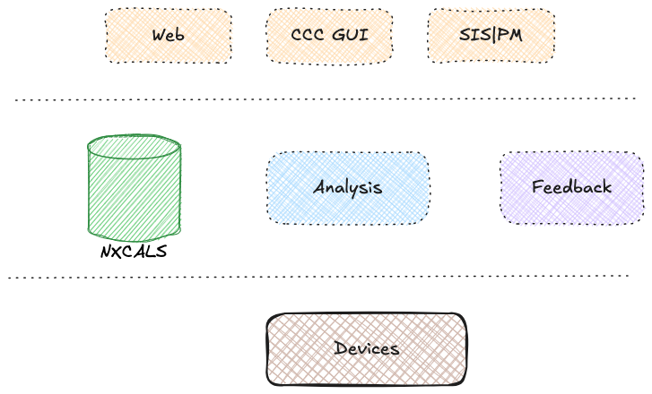
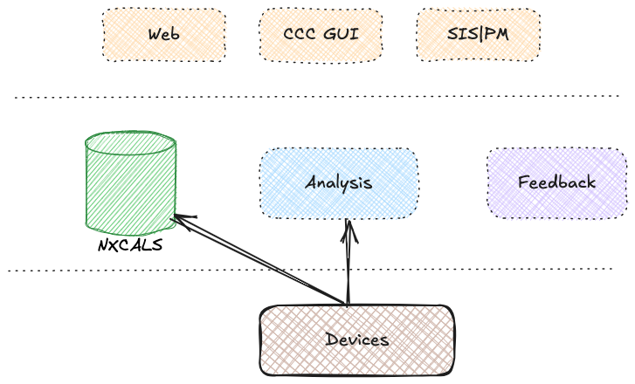
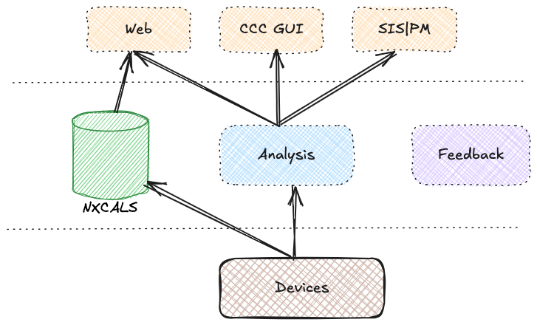
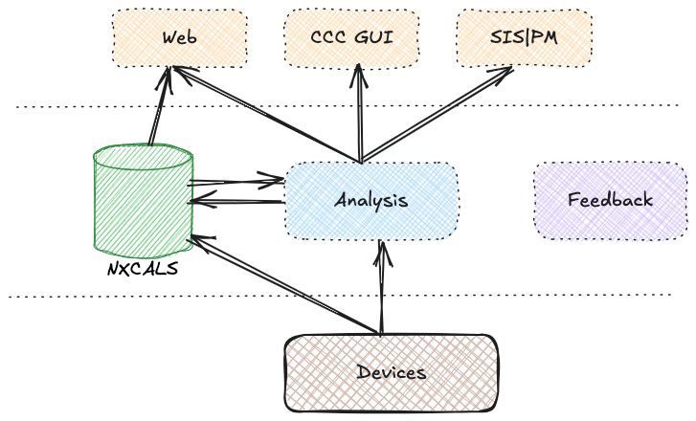
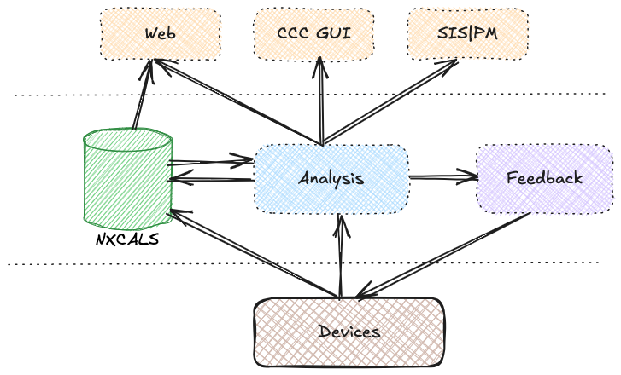
Overview

Slide 3
Online Data Processing

Slide 4

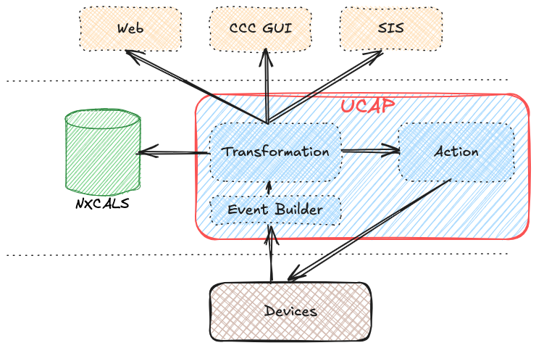
UCAP – the primary choice for online data processing
Common pattern: Data aggregation → Process → Publish + Store [Notify]
Many different use cases:
Processing & concentration of operational signals
Wire Scanner analysis
Diamond BLMs
Automatic Fault Recording (see talk by A. Asko)
SISv2 complex logic
Automated multi-bunch tomography (see. talk by A. Beeckman)
etc...

Slide 5
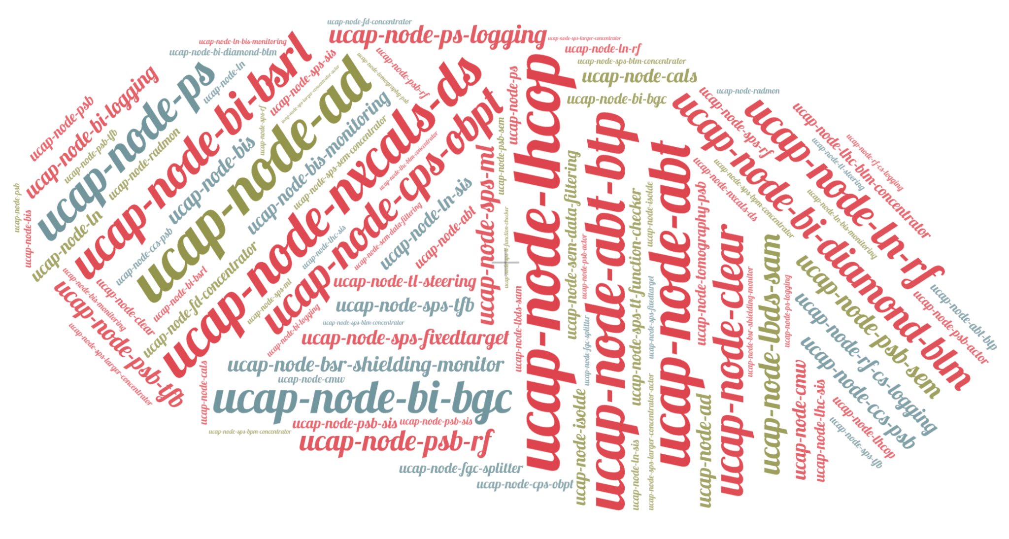
UCAP overview
10 bare-metal machines (cs-ccr-[1:10])
2 machines with GPU (cs-513-ml002, cs-ccr-ml004)
Node count: 203 nodes : 95 PRO, 102 TEST, 6 TESTBED

Slide 6
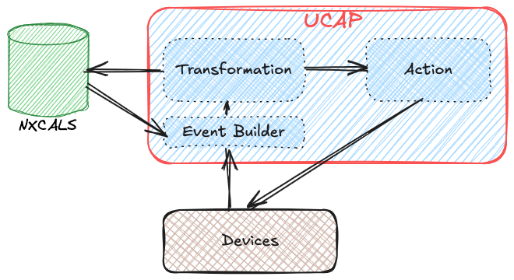
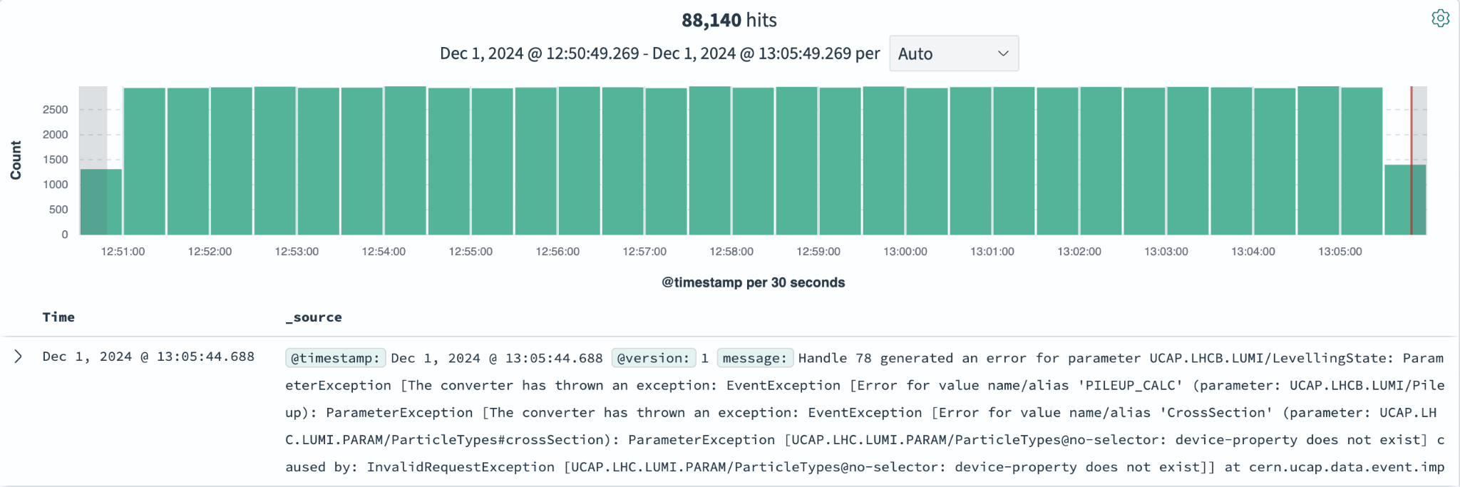
UCAP extensions and improvements
Recent developments driven by EPA & community
Combine online and offline data → integration with NXCALS
Simplifying debugging → logs are now stored in OpenSearch
  Still room for improvement for Python (debugging from IDE)
LSA Trim, AFT, Email Actors, SET support, and many more.
Planned improvements
Automatic device declaration in CCS
  No more manual declarations in the CCDE web interface
ucap-persistence to keep Converters state when UCAP node is rebooted
Support for event recording & replaying
Streamline configuration with automated JSON generation
Limitations:
UCAP is not a virtual device framework, i.e. unsuitable to implement e.g. Orchestration server → We need something else
In UCAP all data is expressed in JAPC-style, however, operating on domain-specific types would be more convenient

Slide 7
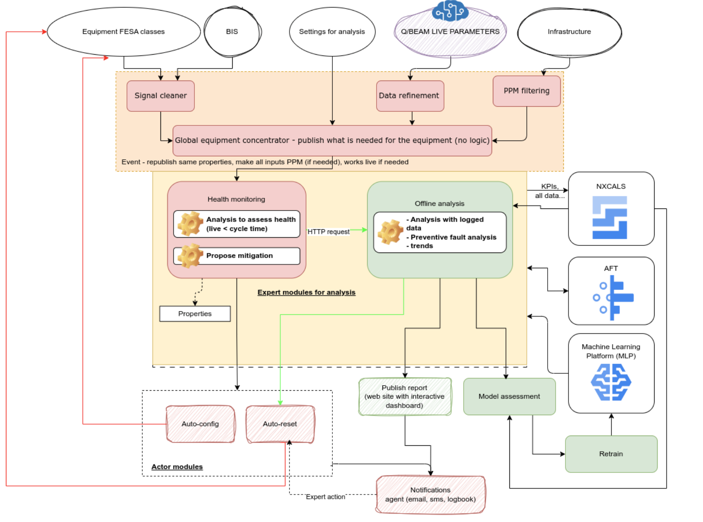
New Data Processing Requirements from EPA
EPA WP8 – towards equipment automation aka “smart and agile equipment”
A framework that allows equipment experts to design automation for their machinery
=> A more powerful and flexible analysis framework is needed
Courtesy to F. Velotti and K. Papastergiou (JAP23)

Slide 8
Offline Data Processing

Slide 9
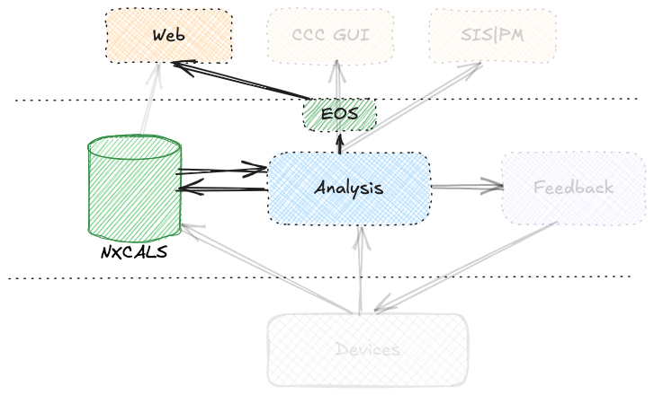
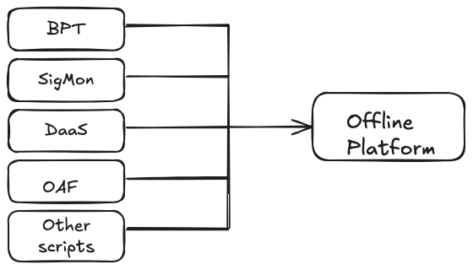
Offline Data Processing Overview
Common pattern: Query data from NXCALS → process → publish + store + visualize
Several different implementations exist with similar functionality
  Offline Analysis Framework – regular analysis of instrument data for tracking performance, aging, etc. (SY-BI)
  Beam Performance Tracking - operation performance of the different accelerators (BE-OP, BE-ABP)
  Signal Monitoring – hardware commissioning, powering tests, circuit performance, quench analysis (TE-MPE)
  Data Analysis as a Service – water consumption, Cryo instrumentation and operation (BE-ICS, TE-CRG)
  Several other systems from ABT, STI, TE-VSC
Conceptually similar but with different implementation
  mainly written in Python, different frameworks chosen
  often operate on ad-hoc infrastructure that might not always be reliable enough
Endorsed by the CTTB => Converge and provide a common solution

Slide 10
Vision/ideas for a unified offline solution
Ideally all data that needs to be analysed is stored in NXCALS
  Data from devices ✓ (Data can be logged on-demand, e.g. only during an MD)
  LSA settings ✓ (no need to use pjLSA)
  Optics and other information ➔ to be addressed
Analysis scripts
  Are written in any supported language (e.g., Python, Java)
  Triggered by a fixed schedule (cron) or an external event (e.g. End-of-Fill)
  Results can be stored in NXCALS, published (CMW, email etc)
You (users) take care of:
  Developing the analysis scripts and defining its configuration (e.g., trigger, result publication etc.)
We take care of all the rest
  Infrastructure, monitoring, upgrades
  APIs, integration between services, deployments, triggers ...

Slide 11
Bringing offline & online together

Slide 12
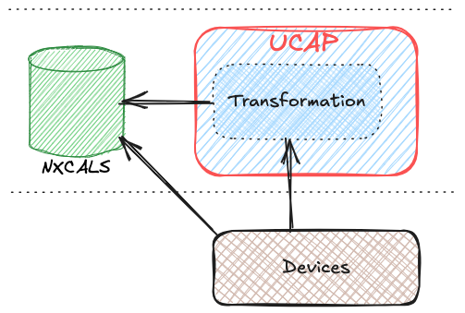
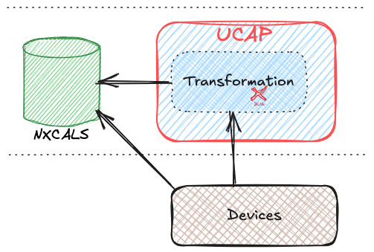
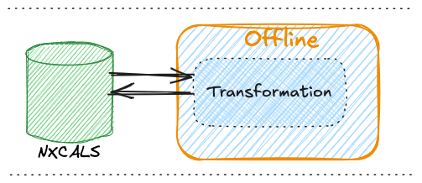

Online and offline – why and how to merge?
Having distinct solutions for online and offline is inefficient
Having the same (e.g., SWAN?) algorithm used for online and offline could be very useful
=> These two approaches are complementary and should be combined.
Challenges to achieve this: Finding a common way of expressing an algorithm for online and offline == common tools, data structures and APIs

Slide 13
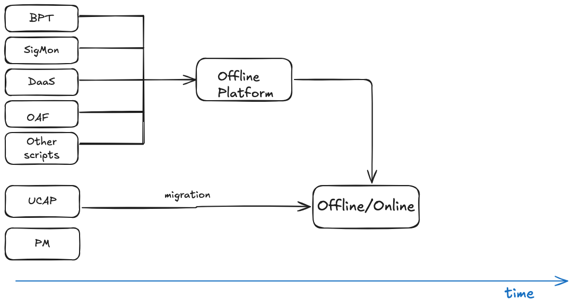
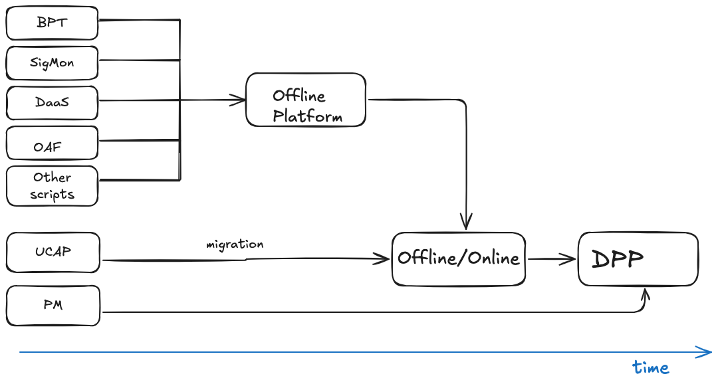
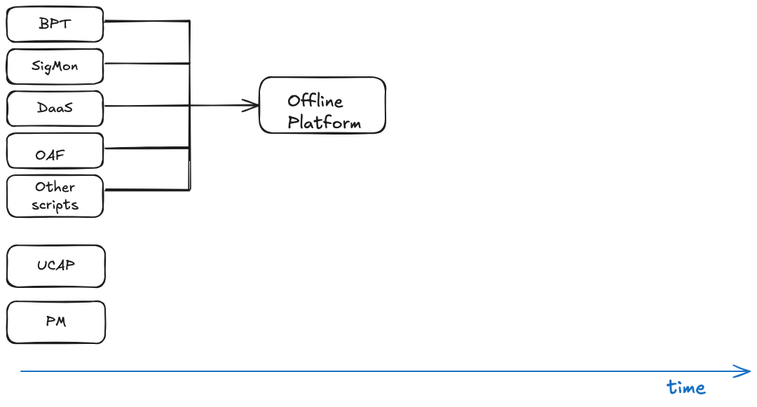
Bringing online & offline together
CTTB Endorsed

Slide 14
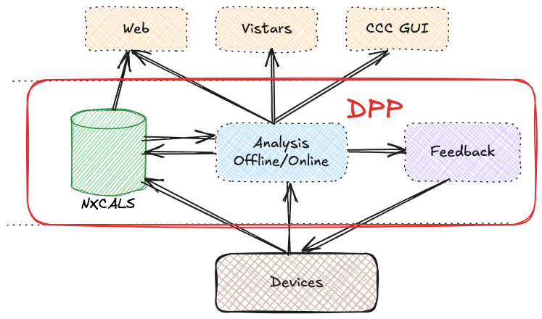
Data Processing Platform
One tool for Online and Offline Analysis adopting the UCAP philosophy: focus on solving your problems and performing your analysis – we’ll take care of the rest

Slide 15
Miscellaneous
NXCALS: More sophisticated logging-on-demand needed for MD
  Support for predefined time windows (e.g., for the next 8 hours)
  Nice to have: conditional logging triggered by external events (e.g., when there’s a beam)
NXCALS: Data post-processing, down sampling, repartitioning
NXCALS: Simplified API, UTC → local time, pandas for seamless Analysis
  Help people use Spark efficiently
NXCALS: Even more data into NXCALS (Optics + Settings + Meas) for even more seamless Analysis
UCAP, NXCALS: Even more support for Python
  “if Python was not supported we wouldn’t use UCAP at all”
  “Do we actually need Java in Client Facing API?”
MISC: Controls orchestration service strategy - clarify needs and roles between DPP and Sequencer 2.0 (WP5)
MISC/DPP: EventBuilder as a specialized Python library or a service
MISC: API for cross-accelerator correlation (e.g. to follow an LHC bunch back to the PS cycle that produced it)

Slide 16
Plans for 2025
UCAP
Implementation of ucap-persistence
Integration with Controls Configuration (CCS)
Simplify configuration, hide JSON
DPP (offline)
Technology research
  Leveraging a rich Cloud-native (Kubernetes) landscape
  Data Streaming solutions
PoC Delivery: targeted for Q3 2025 including:
  Two offline use cases from SigMon and OAF
  EPA dashboards
MISC
NXCALS/CCDB: Extend logging-on-demand
More and better Python APIs (pyJapc → pyDA, …)

Slide 17
Summary
There is a clear and growing need to provide a Data Processing Platform as a Service
  UCAP is successful and widely adopted for online use case
  Multiple group in ATS have also implemented offline solutions their own way
DPP is aimed to address both
  It is endorsed by CTTB
  Recruitment is ongoing
  It factors in additional, emerging requirements, e.g., from EPA Work Packages
  It brings more data in NXCALS, better Python support, better APIs
A Proof-of-Concept will be done in 2025 and we’re looking forward to reporting back here in 1 year ☺

Slide 18
Extra Slides

Slide 19
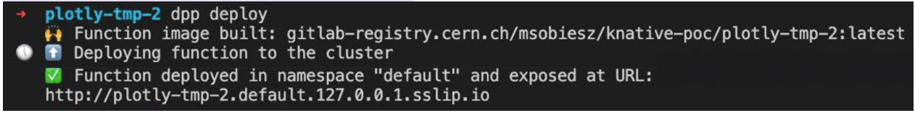
DPP - Ideas for the implementation
User-Friendly Service Submission
  Users can submit their code without worrying about the infra
  Resources are scaled as needed
Declarative usage: simplified interaction with existing systems (e.g., UCAP)
Beginner friendly: prepare a simple analysis in less than 1 hour
  Create a skeleton from a template → develop & test & run locally → deploy
Powered by a Kubernetes/Knative service, aka Function as a Service (FaaS)
  Knative’s Serving, Eventing, Func, Akka
Plus: more powerful and convenient Python libraries to work with NXCALS
  Pandas-on-Spark to run analysis in the NXCALS cluster;
  API for cross-accelerator correlation (e.g. to follow an LHC bunch back to the PS cycle that produced it)
  Local time by default (not UTC)

Slide 20
Online and offline – why and how to merge?
Having distinct solutions for online and offline is inefficient
Online use case:
  Scenario: A UCAP transformation processes raw data from devices and publishes the results to NXCALS
  Advantage: real-time availability of data e.g. for GUIs
  Downside: the UCAP device must run continuously, else there are data losses
Corresponding offline use case as an alternative:
  Scenario: All raw data from devices is stored in NXCALS, and the same algorithm as above is executed in offline mode
  Advantage: transformation can be run at anytime. If the algorithm changes, the whole year can be re-calculated
  Downside: data cannot be displayed in real-time.
=> The two are complementary and should be combined.
Challenges to achieve this: Finding a common way of expressing an algorithm for online and offline == common tools, data structures and APIs

