Slide 1
Surrogate models
F.M. Velotti, F. Huhn, V. Baggiolini, R. Gorbonosov,
V. Kain, B. Rodriguez Mateos, M. Schenk, M. Sobieszek

Slide 2
Outline
What are surrogate models?
Cherry picked CERN applications
Integration in the control system
Conclusions

Slide 3
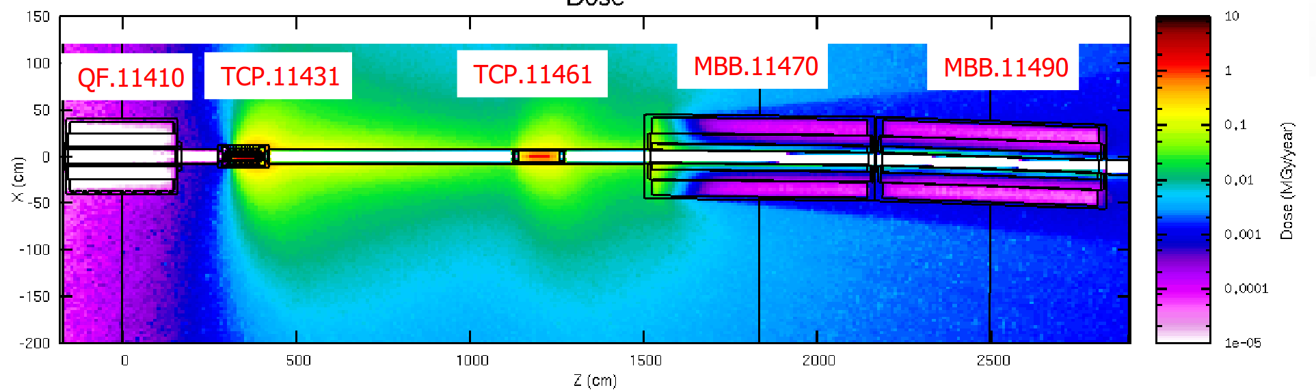
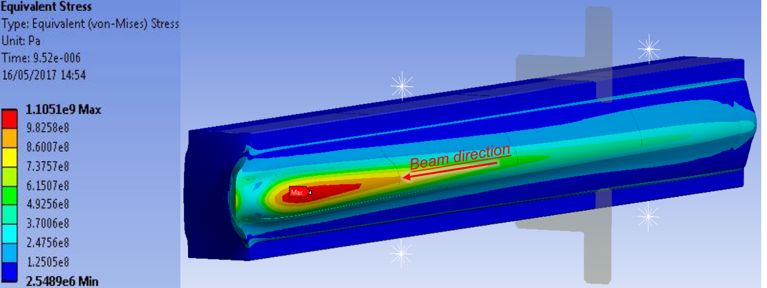
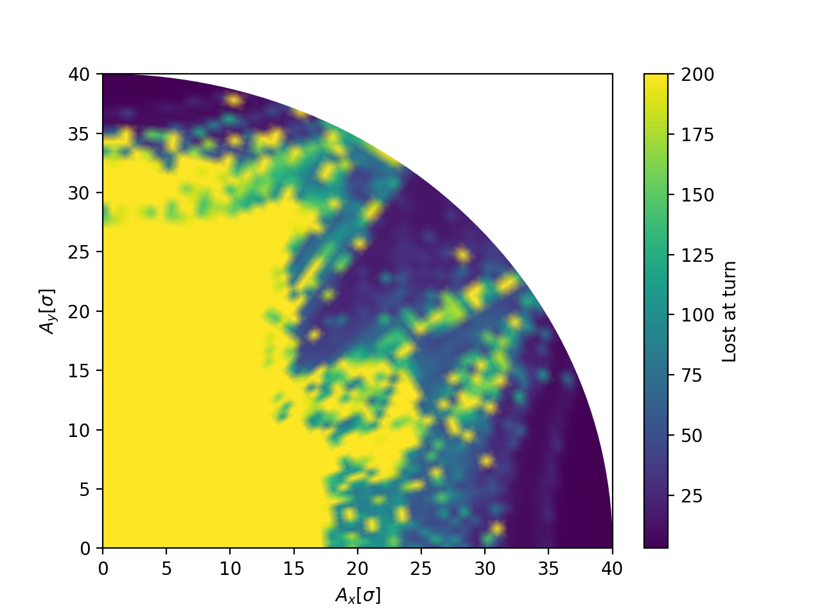

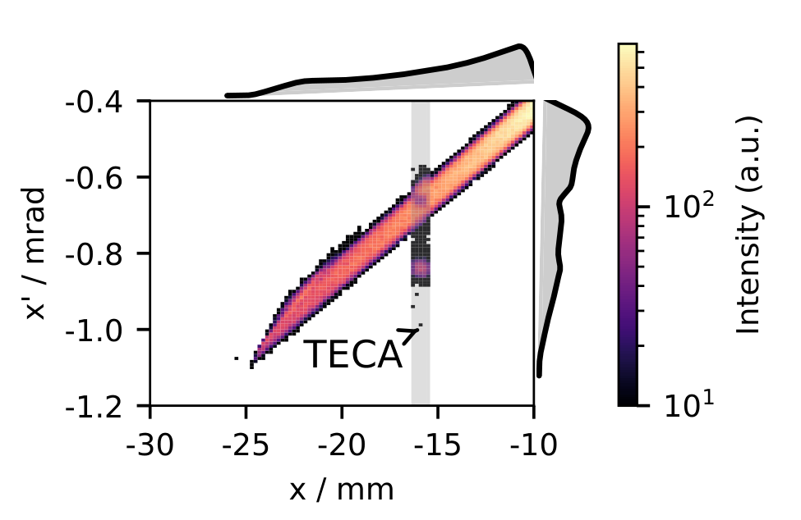
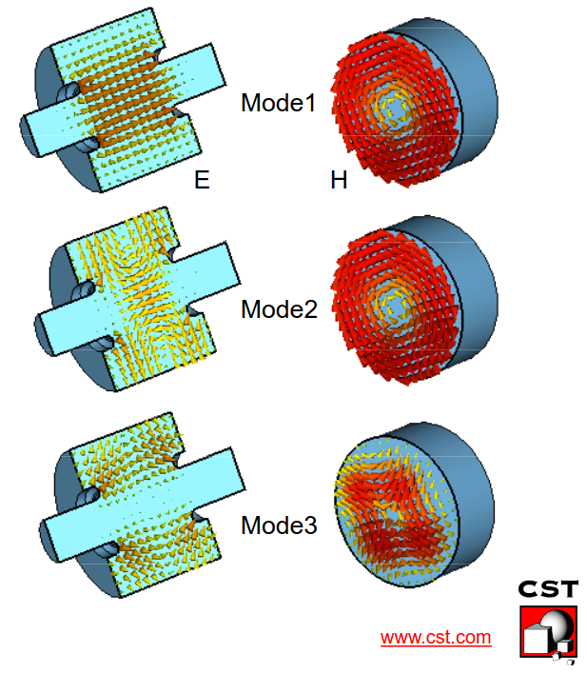
TL;DR: What are surrogate models?
Surrogate models (SM) are simplified mathematical models that approximate complex, computationally expensive simulations - they can also include directly data from the real system
O(min, hours, days)
Complex lengthy simulations

Slide 4
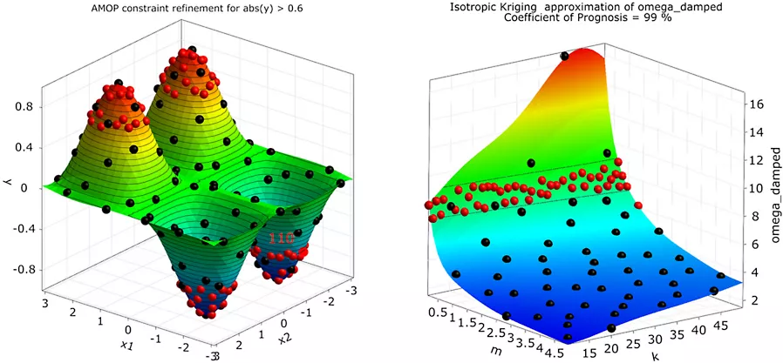
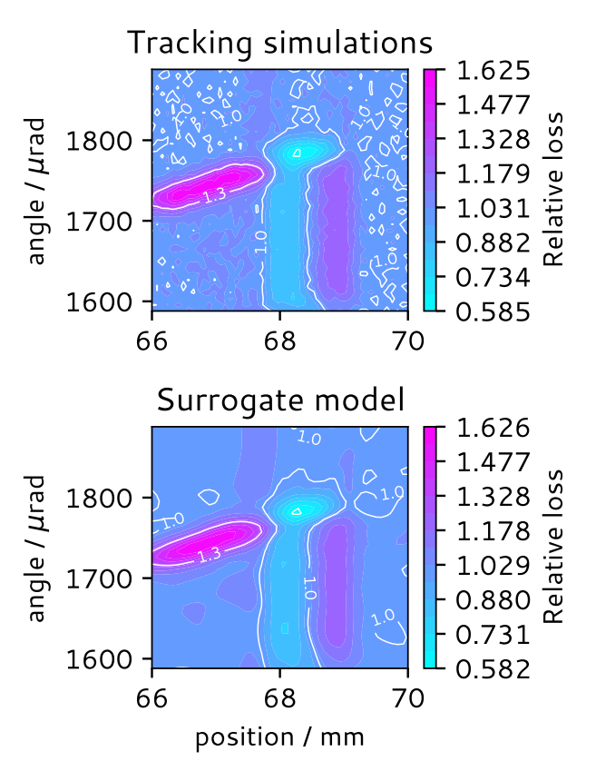
TL;DR: What are surrogate models?
Surrogate models (SM) are simplified mathematical models that approximate complex, computationally expensive simulations - they can also include directly data from the real system
O(min, hours, days)
O(us, ms)
Complex lengthy simulations
Simple fast surrogate

Slide 5
TL;DR: What are surrogate models?
Surrogate models (SM) are simplified mathematical models that approximate complex, computationally expensive simulations - they can also include directly data from the real system
They are commonly used in optimization, sensitivity analysis, and uncertainty quantification to reduce computation time
O(min, hours, days)
O(us, ms)
Complex lengthy simulations
Simple fast surrogate

Slide 6
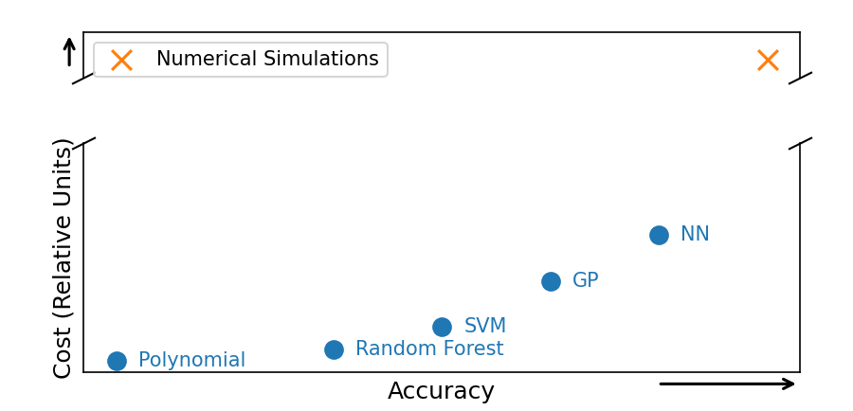
Why to use surrogate models
Main benefits:
Enabling Large-Scale Optimization and Sensitivity Analysis
  Make feasible optimization of simulations that take long to run
Order of magnitudes

Slide 7
Why to use surrogate models
Main benefits:
Enabling Large-Scale Optimization and Sensitivity Analysis
  Make feasible optimization of simulations that take long to run
Facilitating Real-Time Decision Making and Control
  Enable to have a real-time controller on arbitrary complex response
  Possibility to study real system behavior to controllers and optimizers
Order of magnitudes

Slide 8
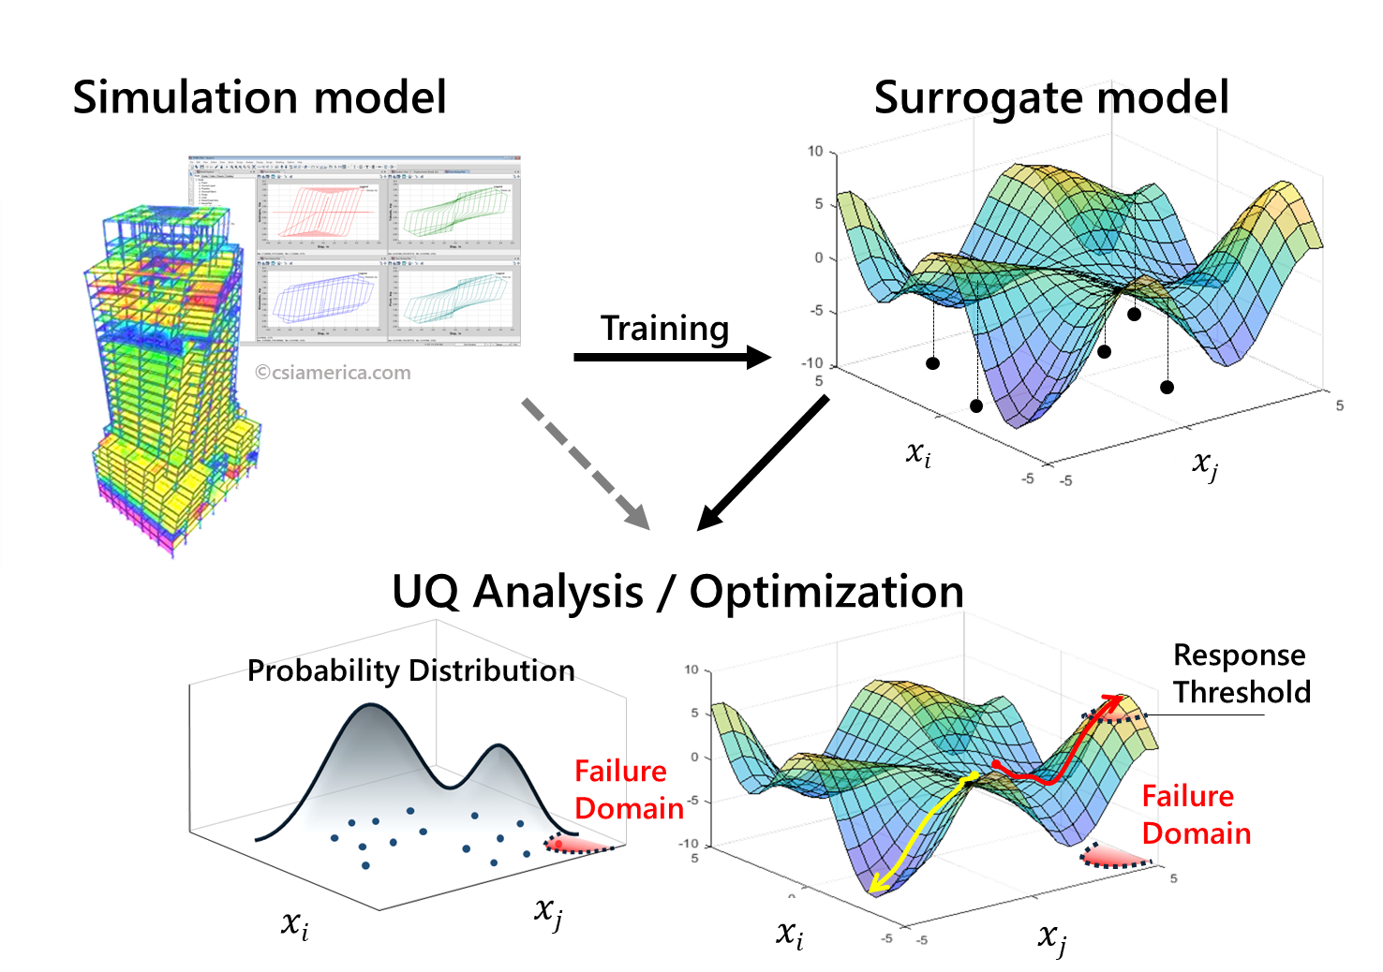
Why to use surrogate models
Main benefits:
Enabling Large-Scale Optimization and Sensitivity Analysis
  Make feasible optimization of simulations that take long to run
Facilitating Real-Time Decision Making and Control
  Enable to have a real-time controller on arbitrary complex response
  Possibility to study real system behavior to controllers and optimizers
Improved Interpretability and Understanding of Complex Systems
  Enable the exploration of system parameter relationship and correlations
Order of magnitudes

Slide 9
Why to use surrogate models
Main benefits:
Enabling Large-Scale Optimization and Sensitivity Analysis
  Make feasible optimization of simulations that take long to run
Facilitating Real-Time Decision Making and Control
  Enable to have a real-time controller on arbitrary complex response
  Possibility to study real system behavior to controllers and optimizers
Improved Interpretability and Understanding of Complex Systems
  Enable the exploration of system parameter relationship and correlations
Enhanced Robustness and Simplicity
  Smooth functions to reduce sensitivity to noise
Order of magnitudes

Slide 10
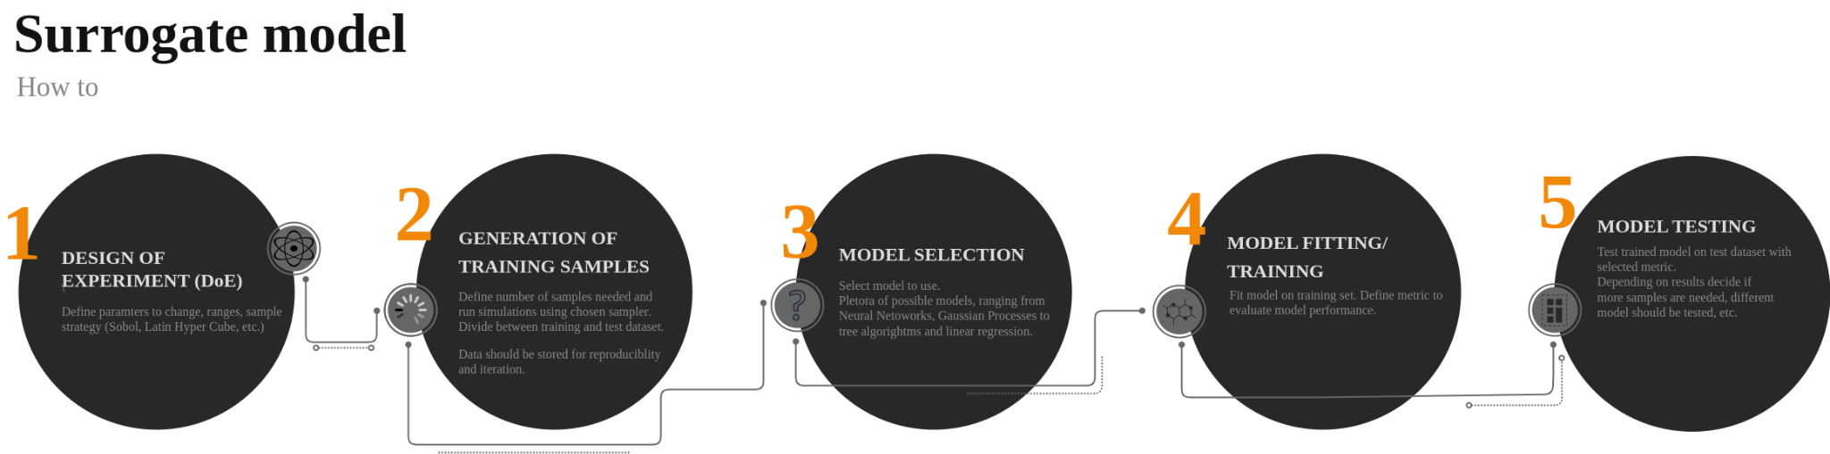
How to make a surrogate model

Slide 11
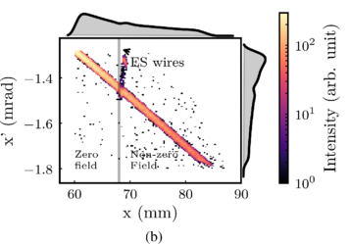
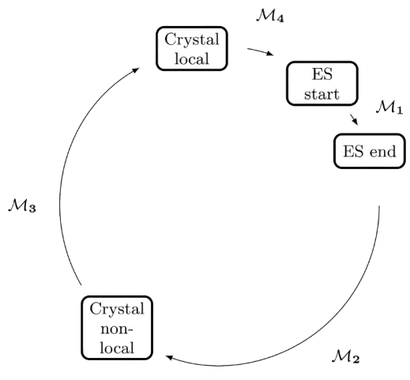
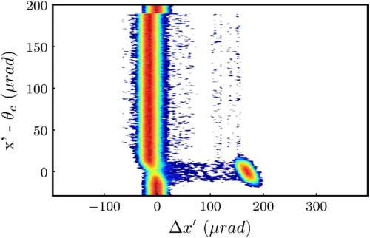
1D example - crystal shadowing
We have a simulation model (e.g. crystal shadowing simulations) that depends on a single parameter (e.g. angle)
  Each simulation point takes some time O(10’)
Input
Crystal angle
Output
Losses ZS

Slide 12
How to make a surrogate model
Input
Crystal angle
np.linspace(-175, 175, 50)
Aim: use the minimum number of samples to cover reasonably the space to explore
Rather old concept (Fisher in 1926 [1])

Slide 13
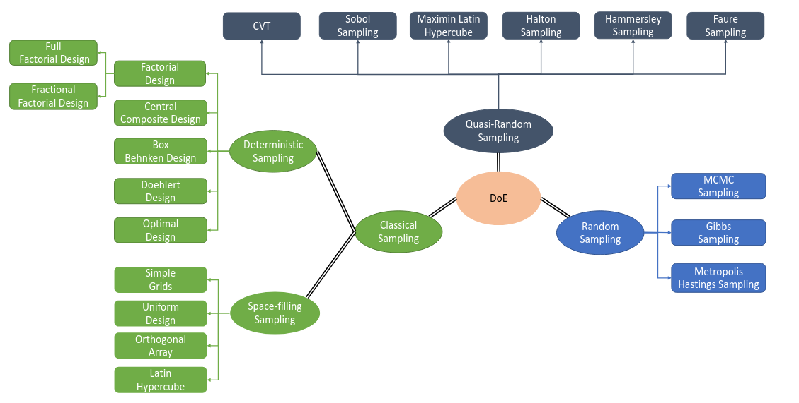
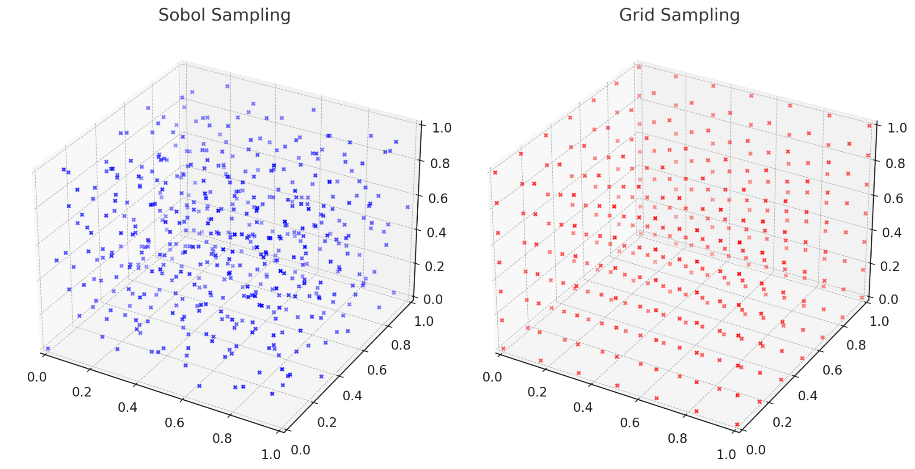
How to make a surrogate model
[1]
Aim: use the minimum number of samples to cover reasonably the space to explore
Rather old concept (Fisher in 1926 [1])

Slide 14
How to make a surrogate model
[1]
Aim: use the minimum number of samples to cover reasonably the space to explore
Rather old concept (Fisher in 1926 [1])
Grid scans are incredibly inefficient!!

Slide 15

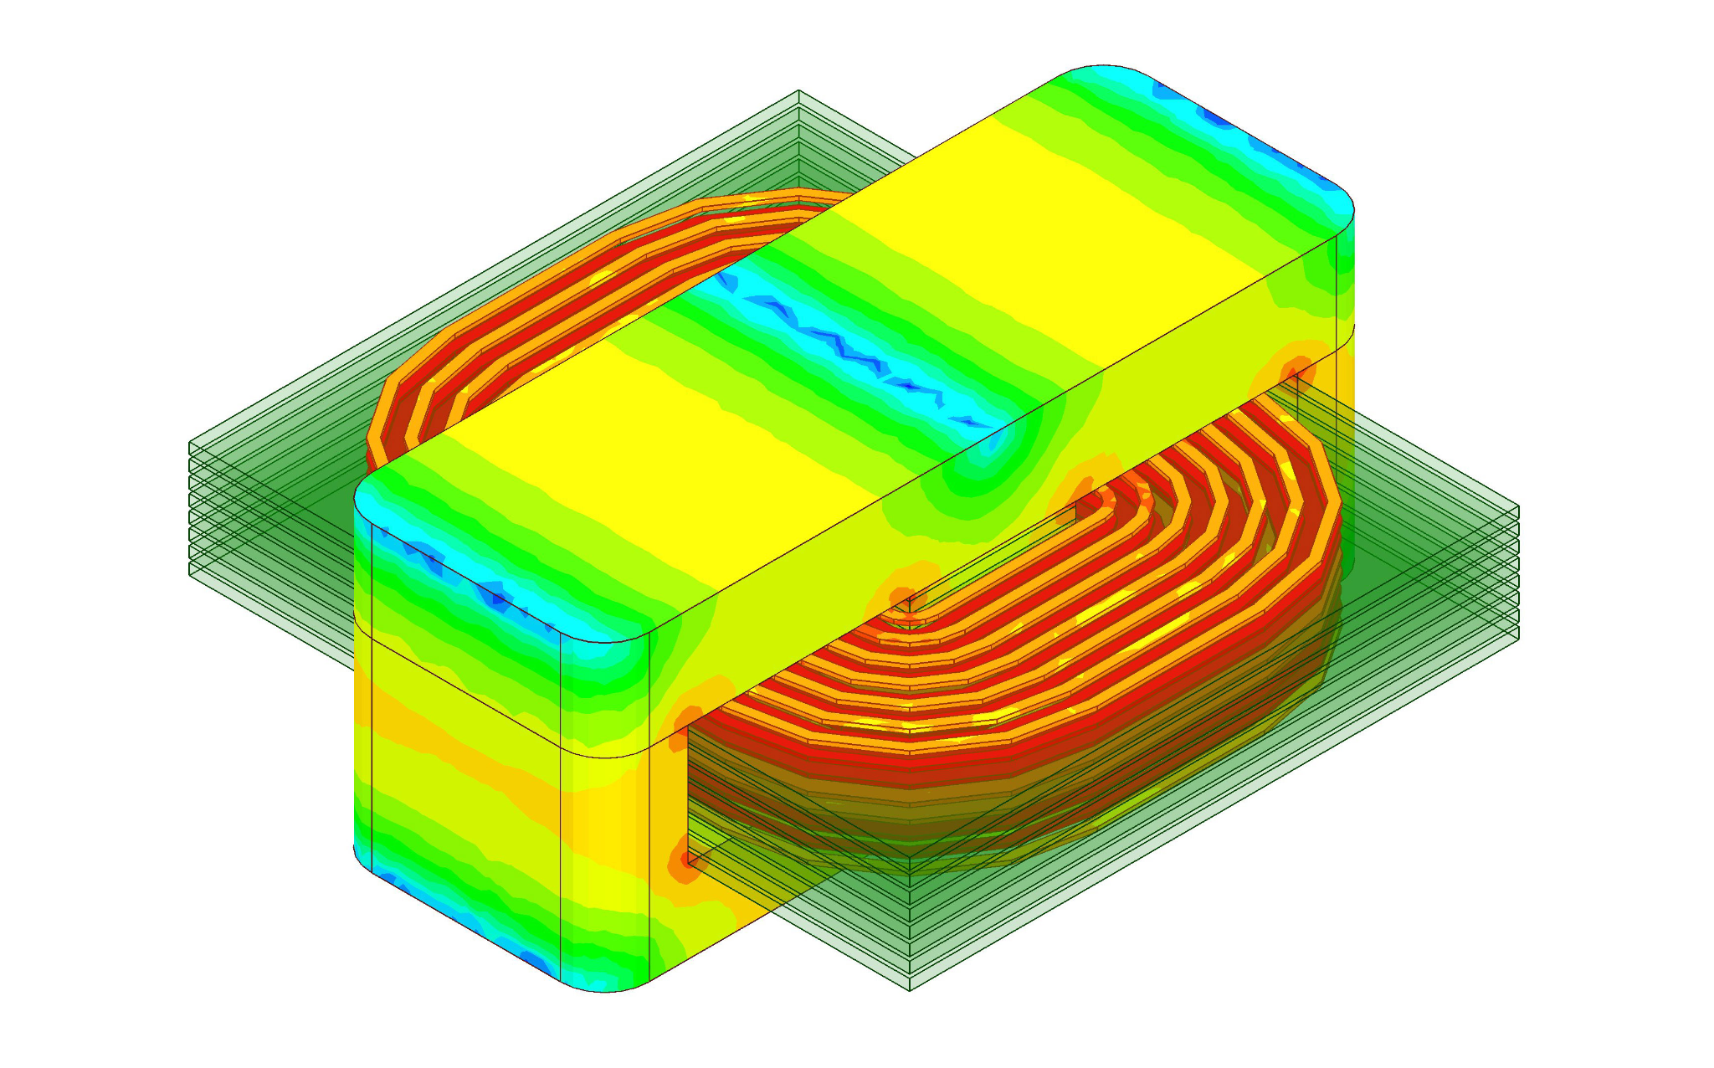
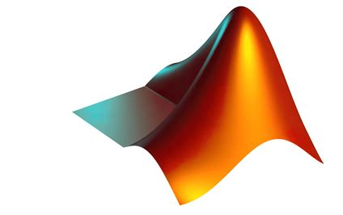
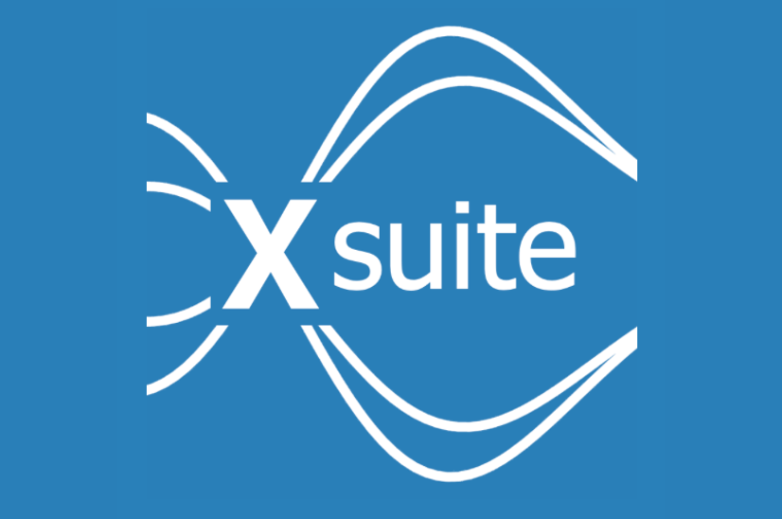
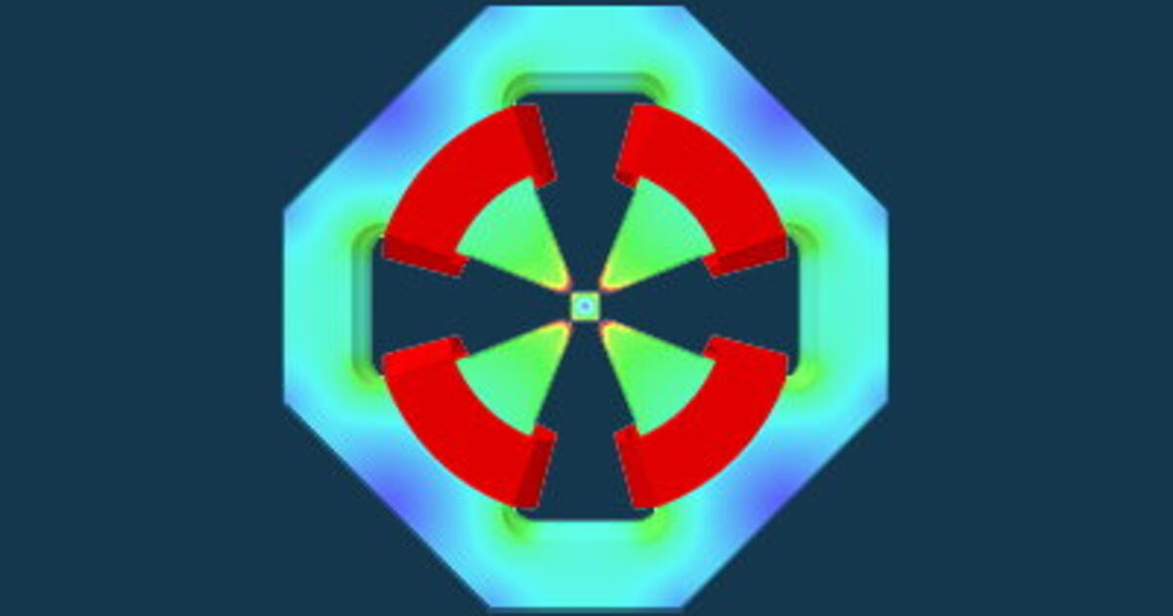
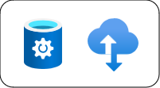

How to make a surrogate model
Data
Change inputs
Store results
Generate the datasets
It can be iterated with the DoE to optimize the space coverage
Data can be from both simulations and data
Training
Test

Slide 16
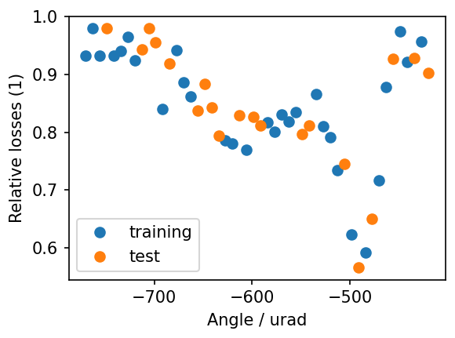
1D example - crystal shadowing
We have a simulation model (e.g. crystal shadowing simulations) that depends on a single parameter (e.g. angle)
  Each simulation point takes some time O(10’)
We collect simulations changing the angle

Slide 17
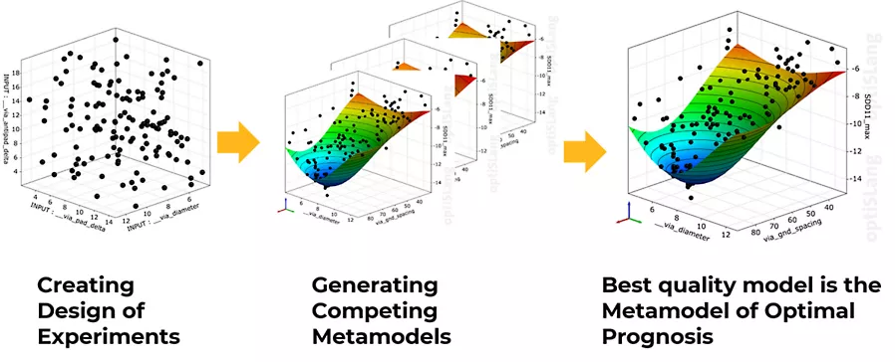
How to make a surrogate model
Model selection and fitting go together
  Usually very dependent on the problem at hand
  One of the main decision is if uncertainty should be estimated too → need probabilistic model in case
Models to be modified on testing of part of the training dataset
[ansys]

Slide 18
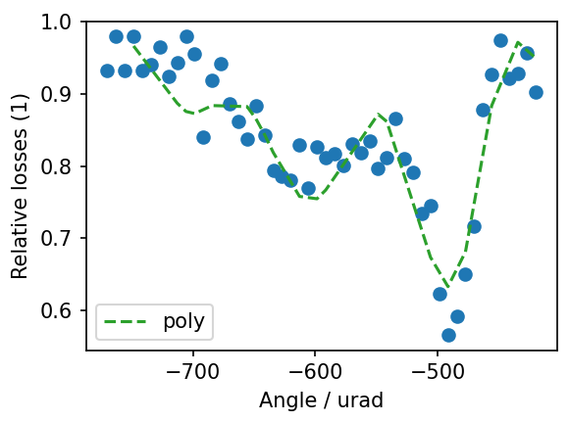
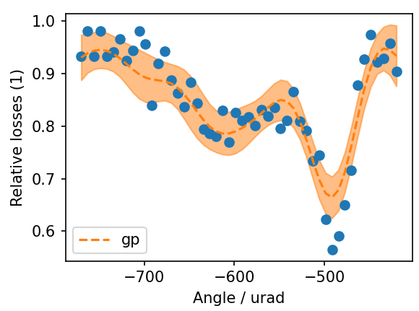
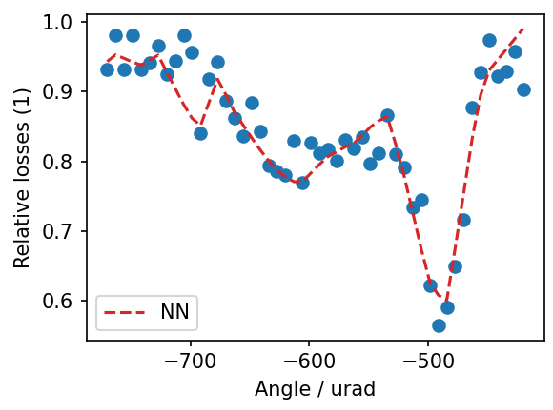
1D example - crystal shadowing
We have a simulation model (e.g. crystal shadowing simulations) that depends on a single parameter (e.g. angle)
  Each simulation point takes some time O(10’)
We collect simulations changing the angle
Then we fit a few models:
  A 15 degree polynomial
  A Gaussian Process [2]
  A neural network…

Slide 19
How to make a surrogate model
Model then tested on test set

Slide 20
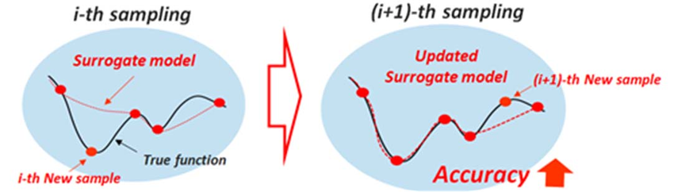
How to make a surrogate model
Not good enough
Good enough
Model then tested on test set
if not good enough get more samples
⇒ Ideally, samples from DoE or from optimization!
DONE!

Slide 21
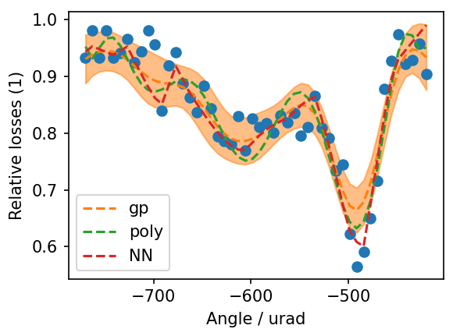
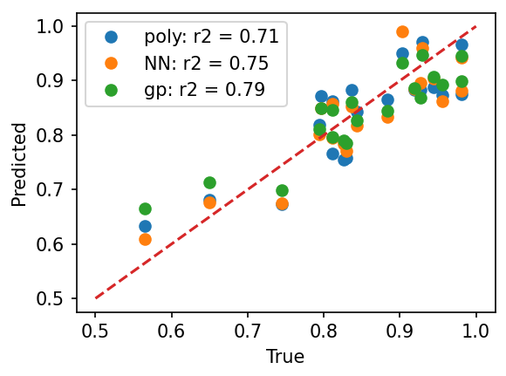
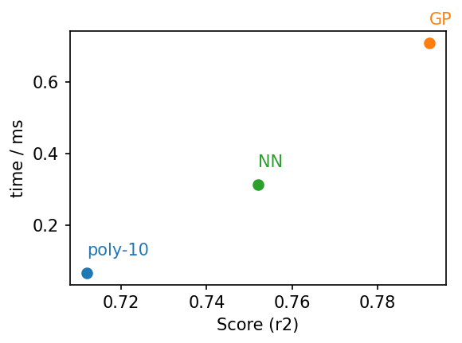
Real example 1D - crystal shadowing
We have a simulation model (e.g. crystal shadowing simulations) that depends on a single parameter (e.g. angle)
  Each simulation point takes some time O(10’)
We collect simulations changing the angle
Then we fit a few models:
  A 15 degree polynomial
  A Gaussian Process [2]
  A neural network…
And finally we test them → if results are satisfactory, we have our SM!

Slide 22
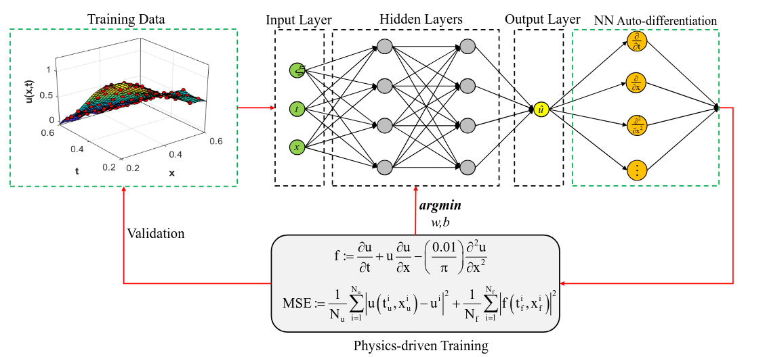
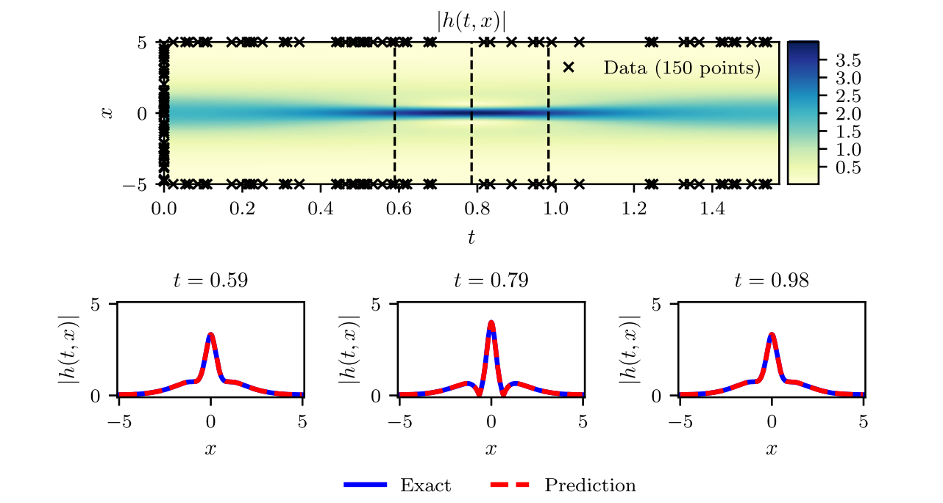
[Advanced] surrogate models: PINN
To make SM more accurate, one can exploit known physics of the system
Training can be constrained by imposing that the solution should satisfy a given physical law ⇒ Physics Informed Neural Networks (PINN)
  Basically one can use a NN as a generic PDE solution…quite some applications!

Slide 23
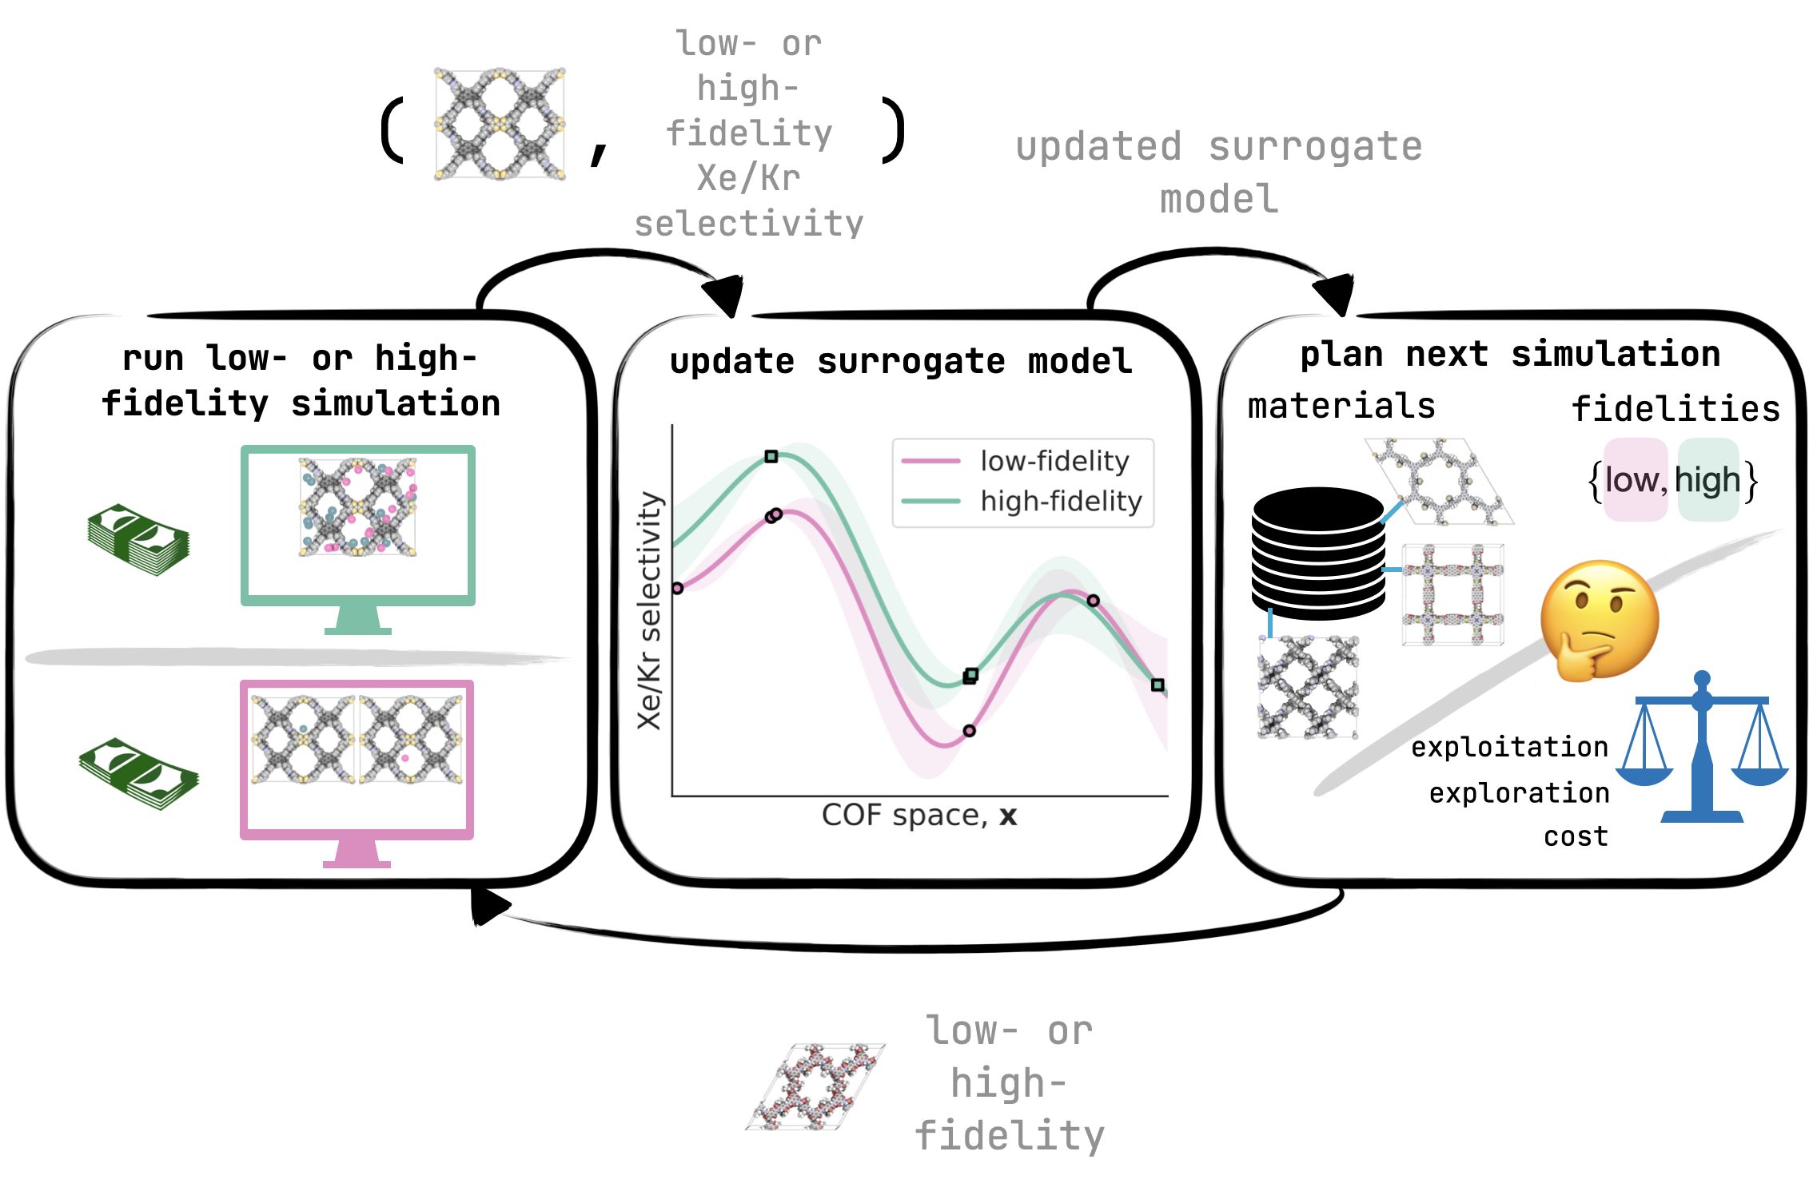
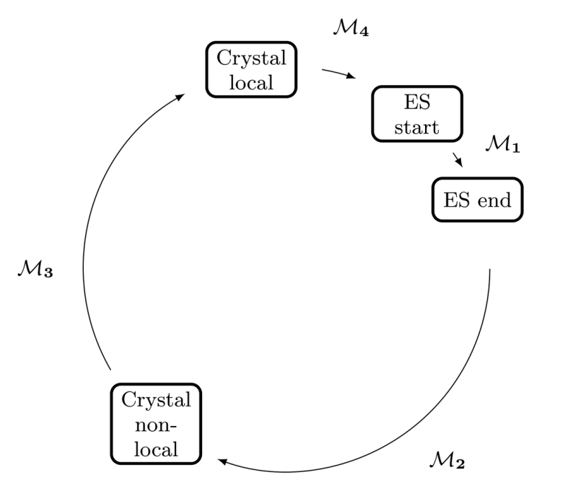
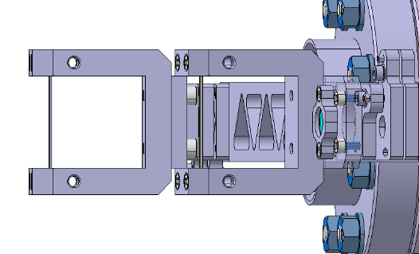
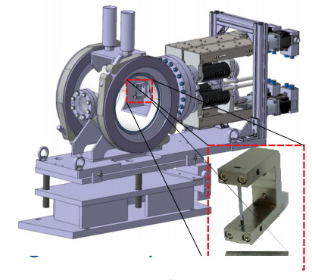
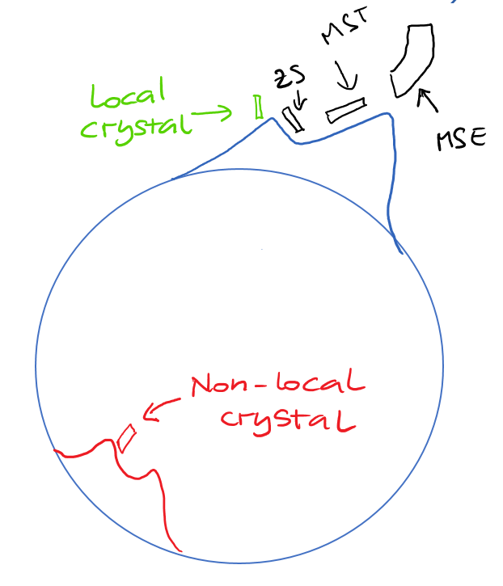
[Advanced] surrogate models: multi-fidelity
Simulations can be made more or less accurate → more or less fidelity¹
Data are the highest fidelity
Fidelity can be treated as additional dimension and hence have the model be able to distinguish it and exploit it
  High fidelity comes with a cost!
More details in F. Huhn’s talk [3]
Add low or high-fidelity data to dataset
Update surrogate model
parameters
ZS losses
MVRA parameters
Get next point: low or high fidelity
1: level of accuracy and detail with which a model represents a system or process. High-fidelity (HF) models provide precise and detailed simulations but are computationally intensive. Low-fidelity (LF) models, while less accurate, are computationally cheaper and faster to execute
Notes:
Maybe to be removed?

Slide 24
Cherry picked CERN applications

Slide 25
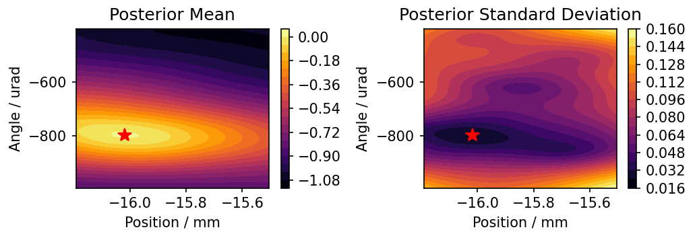
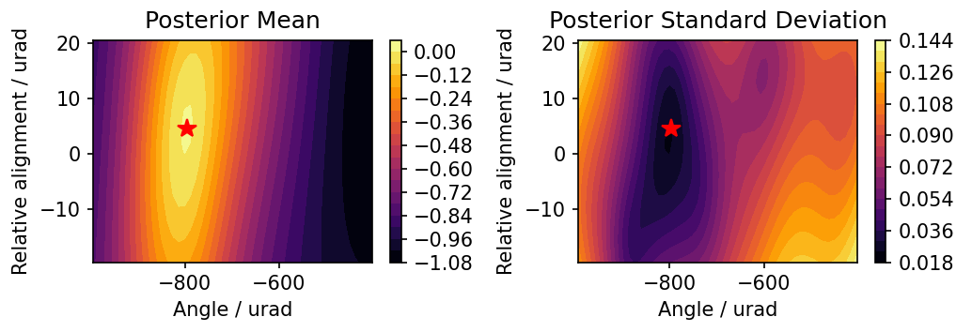
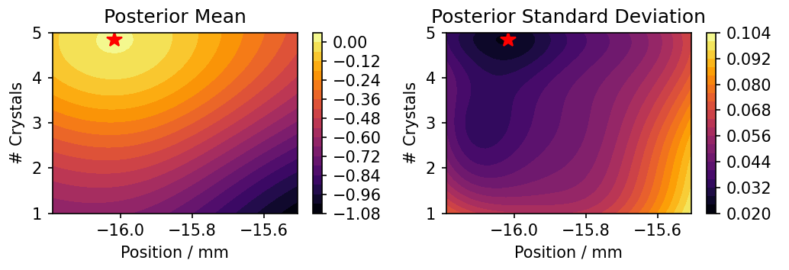
Crystal shadowing → from 1D to 6D
New crystal technology can lead to x10 loss reduction: Multi Volume Reflection Array (MVRA)
Series of N crystals → many parameters to optimize for in design phase
  Angle
  Position
  # crystals
  Relative alignment
  Bending direction
  Crystal width
Multi-fidelity Bayesian Optimization to find optimal configuration ⇒ hopefully to be tested in the SPS in 2026!
Direction | Angle (urad) | Position (mm) | Width (mm) | Relative angle (urad) | N. Crystals (1)
VR inside | -789 | -16.03 | 1.4 | -7 | 5
VR outside | -562 | -15.96 | 1.3 | -9 | 5

Slide 26
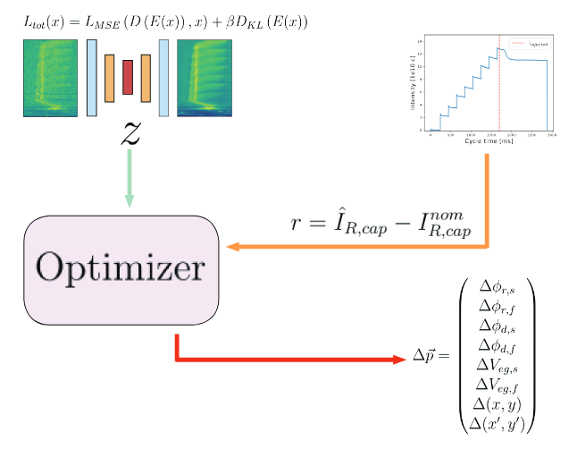
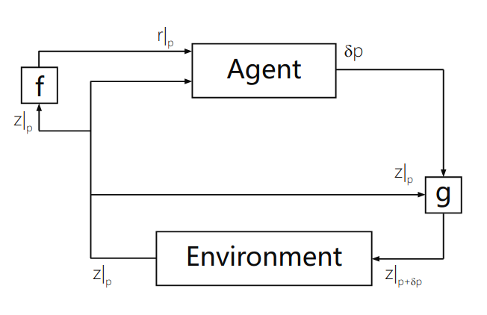
LEIR data-driven surrogate modeling
LEIR injection efficiency optimization
  Today done using VAE to encode Schottky spectrum in low dimensions and ring intensity → optimizer to correct energy ramping and debunching cavity phases, e- gun voltage, cooler and injection bump and BHN10
Move towards offline training of an RL agent on the surrogate model
  Data-driven surrogate model of the injection
[Borja Rodriguez Mateos]

Slide 27

LEIR data-driven surrogate modeling
LEIR injection efficiency optimization
  Today done using VAE to encode Schottky spectrum in low dimensions and ring intensity → optimizer to correct energy ramping and debunching cavity phases, e- gun voltage, cooler and injection bump and BHN10
Move towards offline training of an RL agent on the surrogate model
  Data-driven surrogate model of the injection
There is so much more!
Fully data-based models (PFW [4], ZS-TT20 activation [5], etc.)
Virtual diagnostics (hysteresis compensation [6], MKP temperature [7], etc.)
Simulation optimization (FCC EM separator [3], MKDH model [3], etc.)
Digital twins
Online models (MTE optimization [10], spill
optimization [11], etc.)
More details in F. Huhn talk [3] and A. Lu [6]
[Borja Rodriguez Mateos]

Slide 28
Integration in the control system

Slide 29
Infrastructure needed to scale it up
In first approximations, nothing is needed → simulations outputs can be stored on local HDs (??) and on EOS/AFS/other could systems
  Models can be “pickled” or “jsoned” and stored too

Slide 30
Infrastructure needed to scale it up
In first approximations, nothing is needed → simulations outputs can be stored on local HDs (??) and on EOS/AFS/other could systems
  Models can be “pickled” or “jsoned” and stored too
Why do we need an “infrastructure” for SM?
  Continuity → Ensure that a model “survives” the owner change
  Sharing → easily share a SM with others that may need the same one
  Deployment → SMs can be used as quick online models in operation

Slide 31
Storage of simulations data for SM
Fundamental to preserve source data for SM

Slide 32
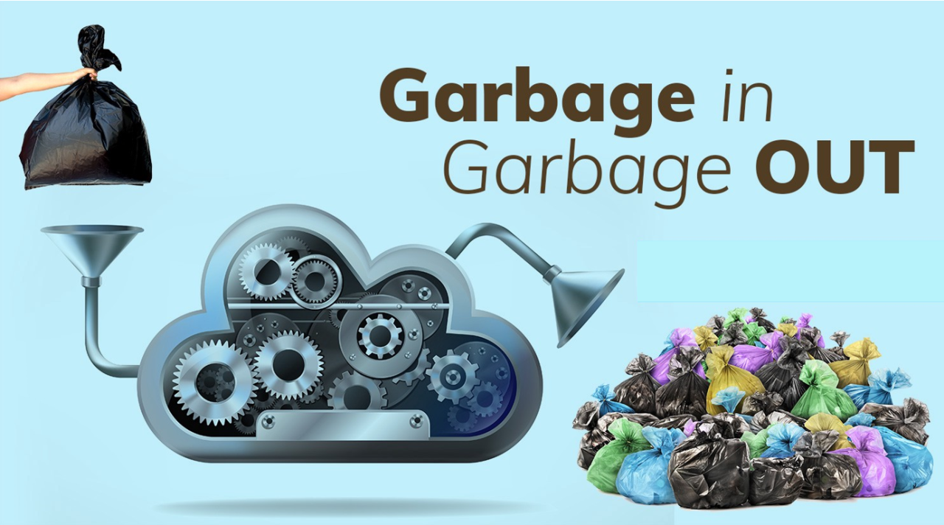
Storage of simulations data for SM
Fundamental to preserve source data for SM
  The SM is only good as its source data…

Slide 33
Storage of simulations data for SM
Fundamental to preserve source data for SM
  The SM is only good as its source data…
Ideally we can use NXCALS with the ingestion API in python
  Already available in Java
  Python native API should be possible and needed for most of our use-cases
  Timescale to be agreed upon given resources (action to follow up)

Slide 34
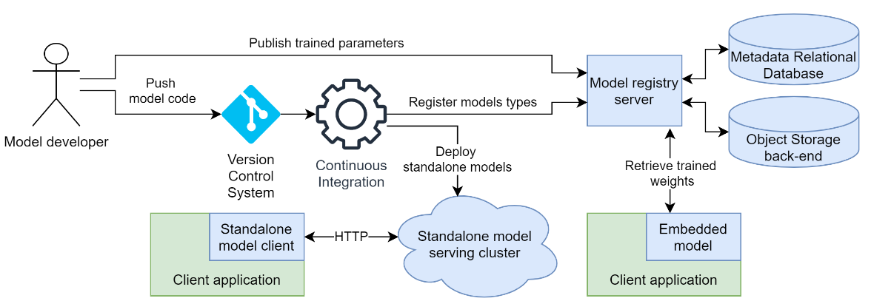
Serving and monitoring @ CERN
Serving:
  We have the Machine Learning Platform [12] ⇒ used in operation in a few cases
  It offers both standalone and local inference
  Great for model versioning and integration in the control system ⇒ simplification needed to be streamlined
neptune.ai

Slide 35
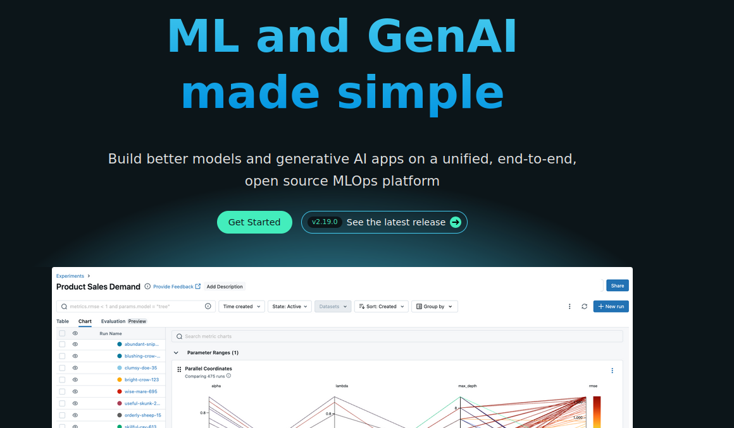
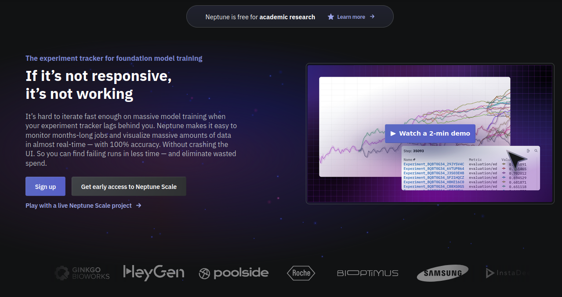
Serving and monitoring @ CERN
Serving:
  We have the Machine Learning Platform [12] ⇒ used in operation in a few cases
  It offers both standalone and local inference
  Great for model versioning and integration in the control system ⇒ simplification needed to be streamlined
Monitoring:
  Need to use own tools (so many available open source)
  Hard then to close the loop on updating model in MLP…
  GitLab already offers way to monitor and register models via MLflow [13] - can this be a good way to explore? ⇒ need to solve this to be able to have up-to-date models automatically!
MLFlow
neptune.ai

Slide 36
Conclusions
Surrogate modelling is a tool that can be used to tackle quite a few problems

Slide 37
Conclusions
Surrogate modelling is a tool that can be used to tackle quite a few problems
Still not fully exploited as in other domains/industry

Slide 38
Conclusions
Surrogate modelling is a tool that can be used to tackle quite a few problems
Still not fully exploited as in other domains/industry
Infrastructure for full deployment potentially there
  Missing NXCALS ingestion API in python ⇒ solution identified
  MLP as is can be used for model versioning and standalone/local inference ⇒ done
  Missing monitoring/performance tracking for continuous deployment ⇒ decision needed

Slide 39
Thanks!

Slide 40
Definitions
Training/fitting: In classic terms, training or fitting in machine learning is the process of finding the best mathematical function or model that matches (or "fits") a set of data points. Just like in classical curve fitting (e.g., fitting a line to a scatter plot), the goal is to adjust the model's parameters so it accurately captures the underlying patterns in the data
Bayesian optimization: is a method for finding the best solution to a problem when evaluating each option is expensive or time-consuming. It uses a probabilistic model (like a Gaussian process) to predict the outcomes of different choices and focuses on testing the most promising ones to find the optimal solution efficiently.
Dataset: is a collection of data, usually organized in a structured format like tables or files, that is used for analysis, training machine learning models, or drawing insights. It typically includes rows representing examples (like people, images, or events) and columns representing features or attributes (like age, color, or time).
Multi-fidelity model: it combines information from multiple sources with varying levels of accuracy and cost to make predictions or solve problems more efficiently. It uses low-fidelity models (cheaper, less accurate) and high-fidelity models (more expensive, more accurate) together to balance cost and accuracy.
Physics-Informed Neural Network (PINN): is a type of neural network that incorporates the laws of physics (like equations or constraints) into its training process. This helps it solve problems more accurately and efficiently by combining data-driven learning with physical principles.

Slide 41
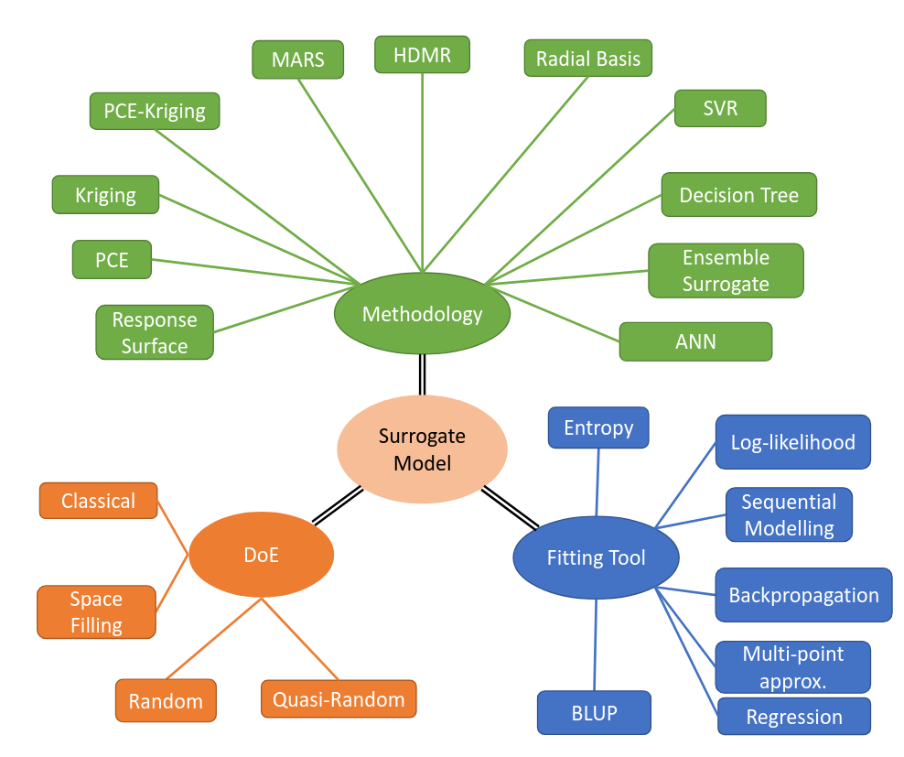
Common methods
Large possibilities on the choice of models, DoEs, fitting strategies…
There is no solution that fits all problems!

Slide 42
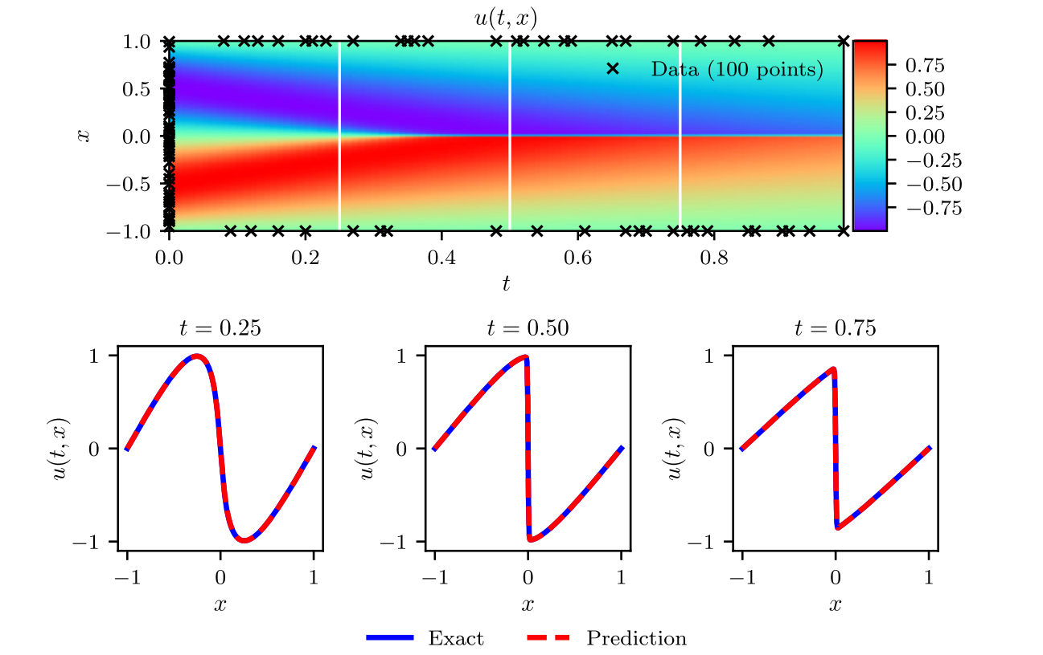
Physics Informed Neural Networks
First proposed to solve nonlinear PDE [10] (all plots from [10])
Basically using boundary and initial conditions values, NN can interpolate the whole system dynamics “knowing” the PDE that describe the system
  At the same time though, one can just use a physics loss term…it doesn’t have to be a PDE system

Slide 43
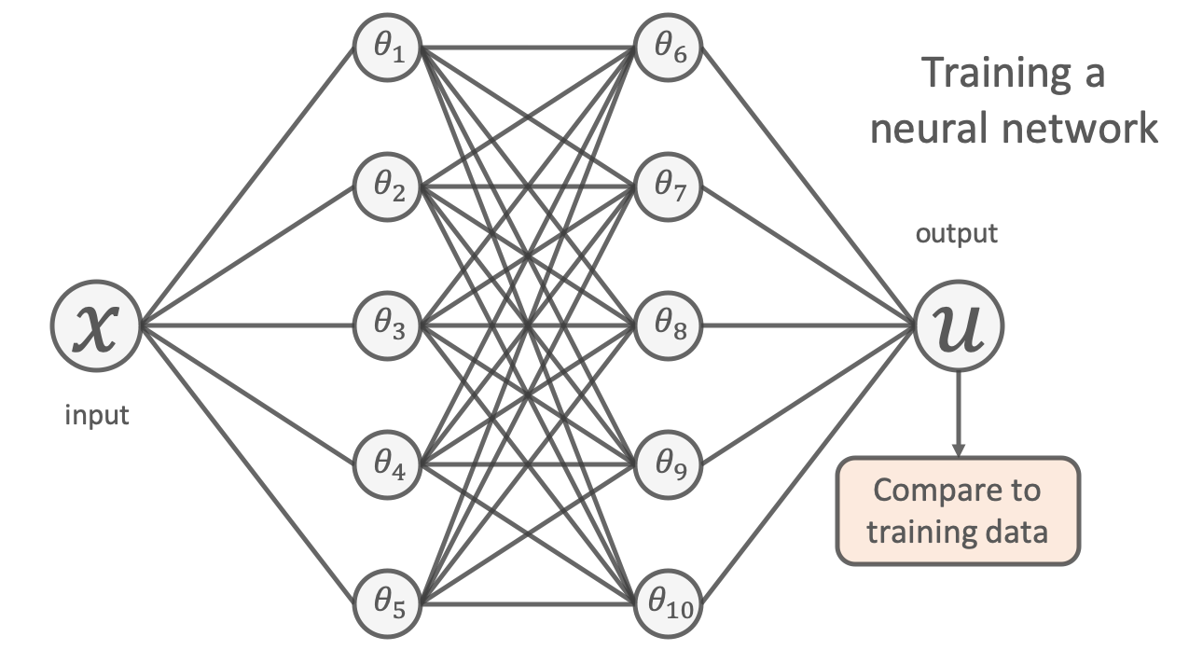
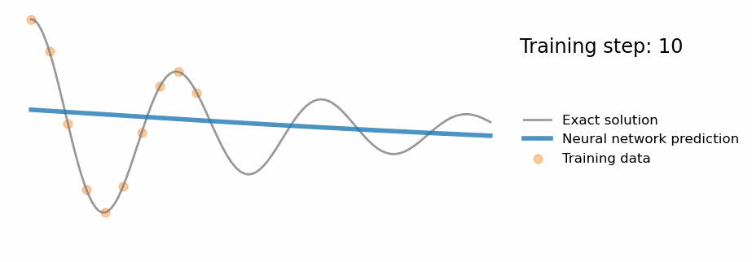
Physics Informed Neural Networks
DNN cannot extrapolate beyond the training domain…which is exactly what we would expect from interpolation function
min(Loss) => Loss = Mean(data - prediction)²
Source: [8]

Slide 44
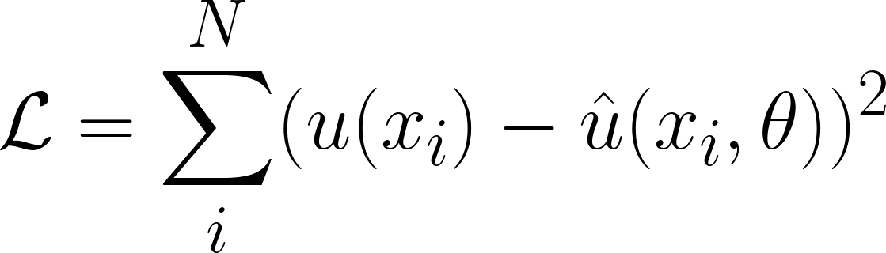
Physics Informed Neural Networks
DNN cannot extrapolate beyond the training domain…which is exactly what we would expect from interpolation function
Source: [8]

Slide 45
Physics Informed Neural Networks
DNN cannot extrapolate beyond the training domain…which is exactly what we would expect from interpolation function
Go beyond data domain => more information needed:
Source: [8]
min(Loss) => Loss = Mean(data - prediction)²
Additional_info(prediction)

Slide 46



Physics Informed Neural Networks
DNN cannot extrapolate beyond the training domain…which is exactly what we would expect from interpolation function
Go beyond data domain => more information needed:
Source: [8]
min(Loss) => Loss = Mean(data - prediction)²
Additional_info(prediction)

