Slide 1
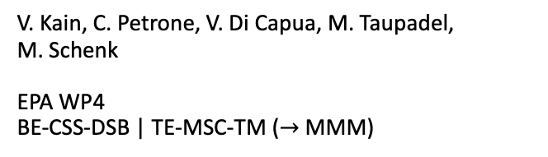
Hysteresis Modeling and Compensation
Experience from SPS and prospects for other machines
Anton Lu
V. Kain, C. Petrone, V. Di Capua, M. Taupadel,
M. Schenk
EPA WP4
BE-CSS-DSB | TE-MSC-TM ($→$ MMM)
Notes:
Hysteresis a recurring phrase during this workshop
HystComp part of EPA WP4 – essential for success of dynamic beam scheduling and automated LHC filling with dynamic supercycles, in addition to improving operational efficiency with today’s methods

Slide 2
Outline
Hysteresis in accelerator magnets and impact on operations
Feed-forward hysteresis compensation (with artificial intelligence)
  Significant achievements
  … and challenges encountered
  Magnetic modeling
  Controls integration
  Guardrails and monitoring
  Magnetic measurement lessons and improvements
Operational status of hysteresis compensation
Outlook and conclusion

Slide 3
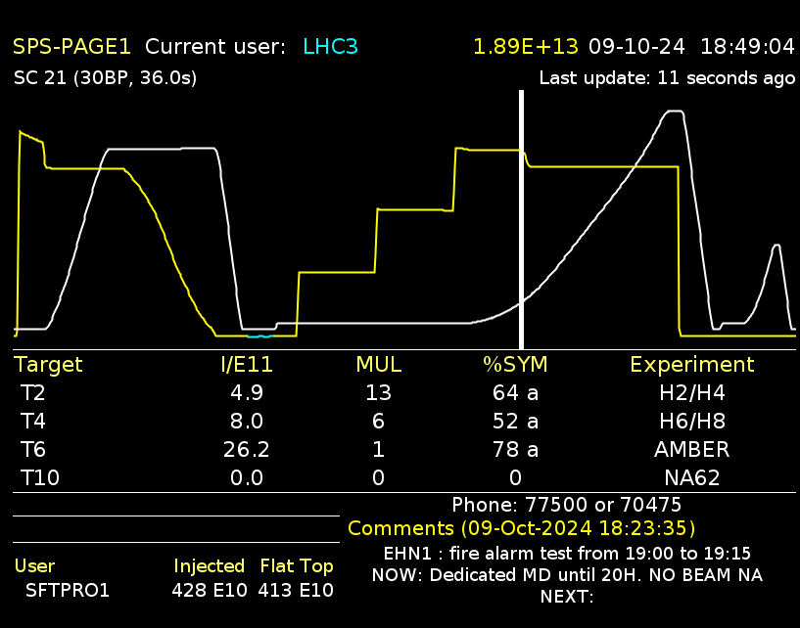
Hysteresis in the accelerator magnets
And the need for reproducible fields
Nonlinear static and dynamic effects in accelerator magnets, when uncorrected …
  … hinder the efficiency and flexibility of (multi-cycling) accelerator operations
SPS status quo
  MD1 quasi-degaussing cycle
  Manual change of SFT beam tune whenever LHC requests beam
  Still beam losses / degradation at injection
Other accelerators
  Degaussing cycles and constrained cycle sequences due to hysteresis
! N.B. Only PSB and PS dipoles have feed-back field control
Injection losses
Eddy current decay
Hysteresis
Waste of energy
5 kWh every cycle
… for quasi-degauss
… and for reproducible eddy currents
(Extracted) beam quality degradation
Changing spill macrostructure
Notes:
* Uncompensated hysteresis restricts cycle sequences in all multi-cycling machines, and prevents going towards dynamic beam scheduling and other high-level operations optimization
* Feed-back correction requires an online field measurement system infrastructure, and integrating into the power converters

Slide 4
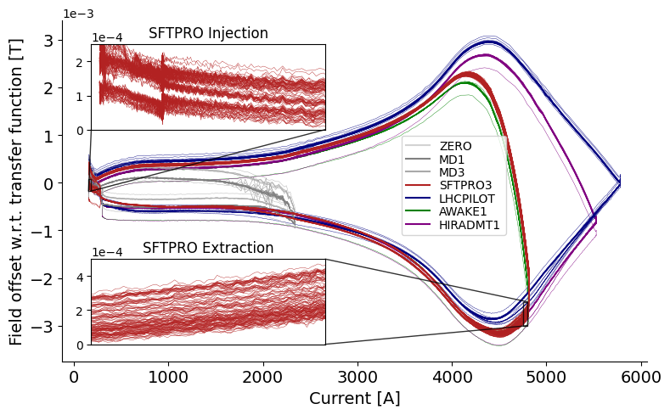
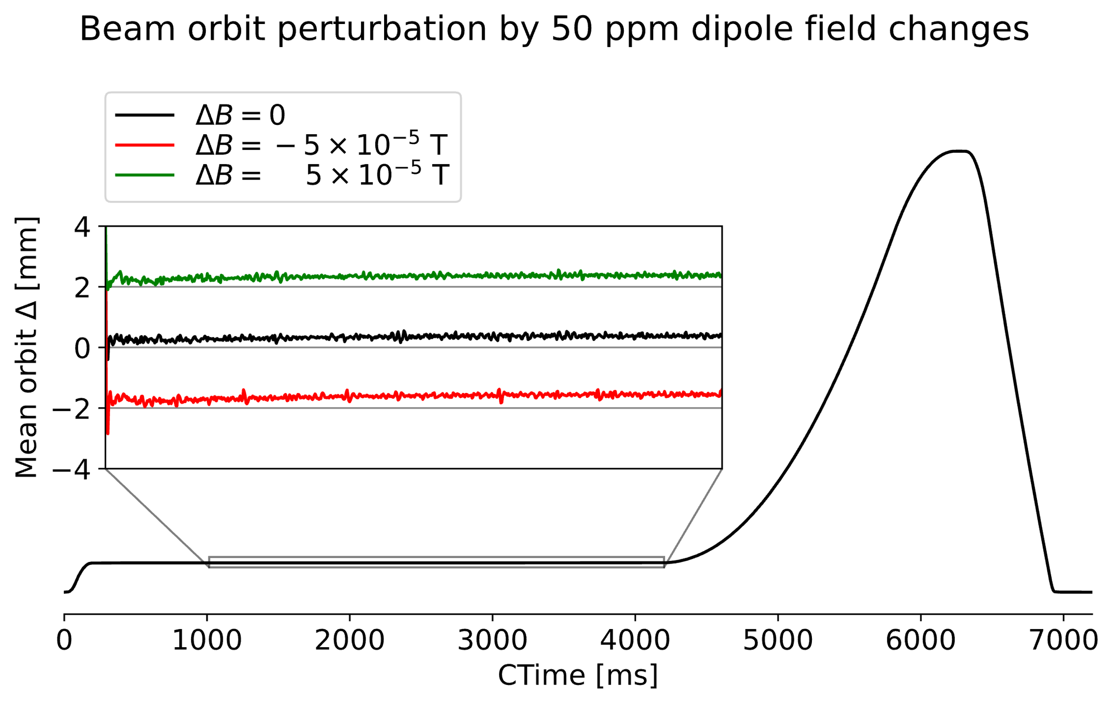

Hysteresis in the accelerator magnets
And the need for reproducible fields
SPS MBI Cycle-to-cycle hysteresis
Cycle-to-cycle differences are small …
  Hysteresis effects $±1 permil$, but cycle-to-cycle differences are $±100 ppm$ or less … (in SPS MBIs)
… But still significant effects on beam
  $100 ppm$ tolerance on SFT $400 GeV$ flat top
  $10 ppm$ tolerance on $14$ or $26 GeV$flat bottom
Notes:
* Uncompensated hysteresis restricts cycle sequences in all multi-cycling machines, and prevents going towards dynamic beam scheduling and other high-level operations optimization
* Feed-back correction requires an online field measurement system infrastructure, and integrating into the power converters

Slide 5
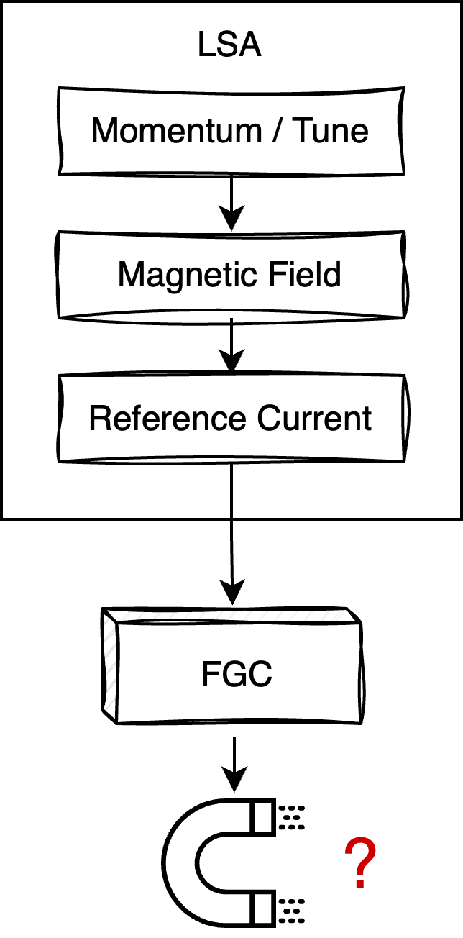
What if we could have reproducible fields…
Through feed-forward field compensation
Most magnetic circuits are controlled in current by translating momentum / tune / correction etc.

Slide 6
What if we could have reproducible fields…
Through feed-forward field compensation
Most magnetic circuits are controlled in current by translating momentum / tune / correction etc.
  Control system is agnostic to actual field response in the machine

Slide 7
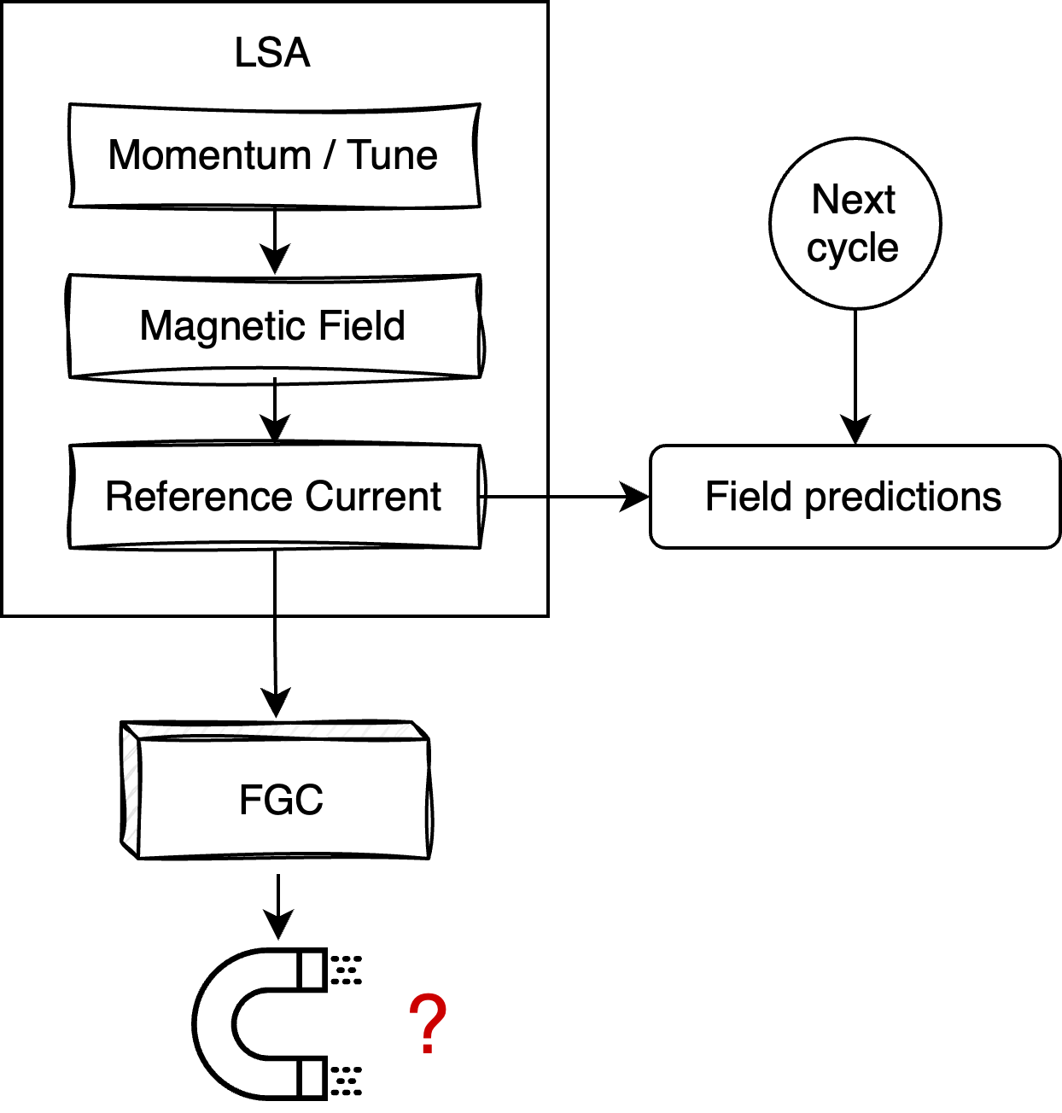

What if we could have reproducible fields…
Through feed-forward field compensation
Most magnetic circuits are controlled in current by translating momentum / tune / correction etc.
  Control system is agnostic to actual field response in the machine
Instead: model magnetic field response $I→B$ with ML, from measurements

Slide 8
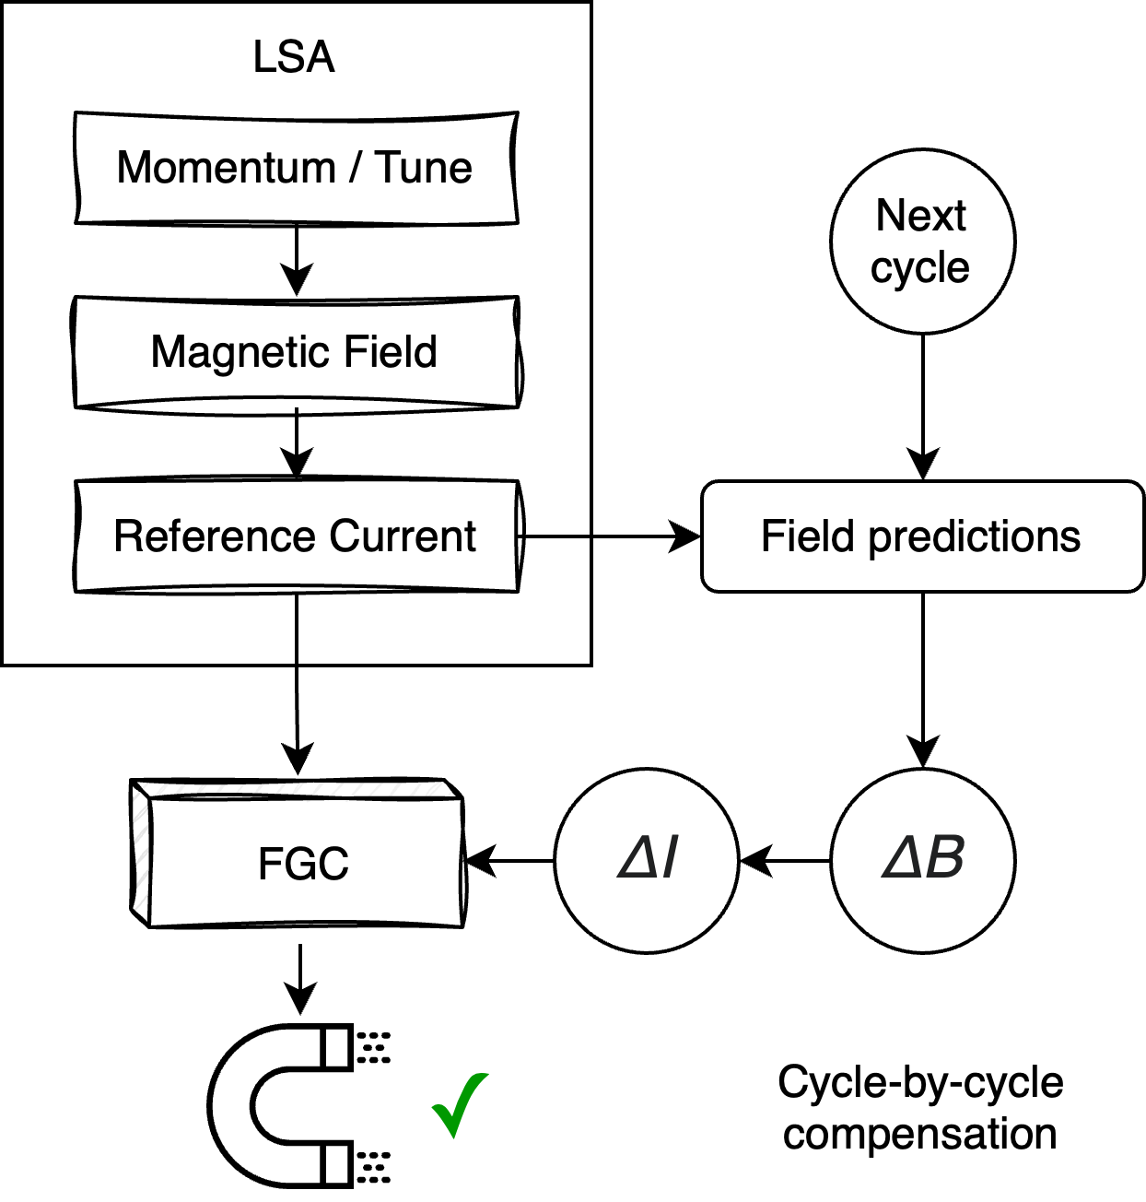
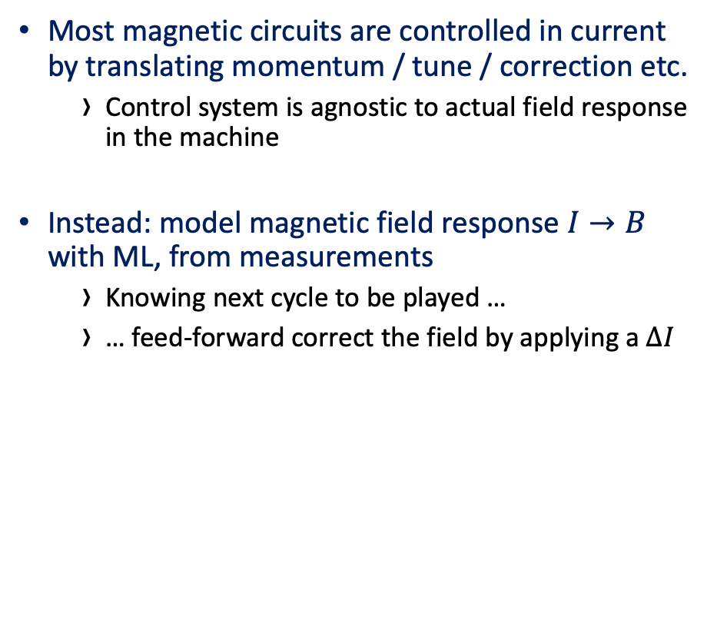
What if we could have reproducible fields…
Through feed-forward field compensation
Most magnetic circuits are controlled in current by translating momentum / tune / correction etc.
  Control system is agnostic to actual field response in the machine
Instead: model magnetic field response $I→B$ with ML, from measurements
  Knowing next cycle to be played …
  … feed-forward correct the field by applying a $ΔI$

Slide 9
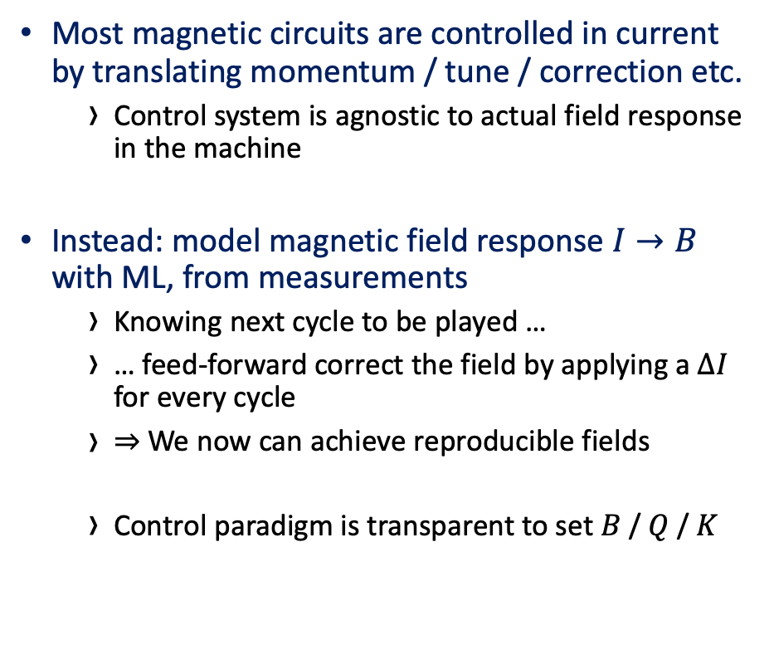
What if we could have reproducible fields…
Through feed-forward field compensation
Most magnetic circuits are controlled in current by translating momentum / tune / correction etc.
  Control system is agnostic to actual field response in the machine
Instead: model magnetic field response $I→B$ with ML, from measurements
  Knowing next cycle to be played …
  … feed-forward correct the field by applying a $ΔI$ for every cycle
  $⇒$We now can achieve reproducible fields
  Control paradigm is transparent to set $B$ / $Q$ / $K$
! N.B. Assume that all effects can be modeled by measuring field

Slide 10
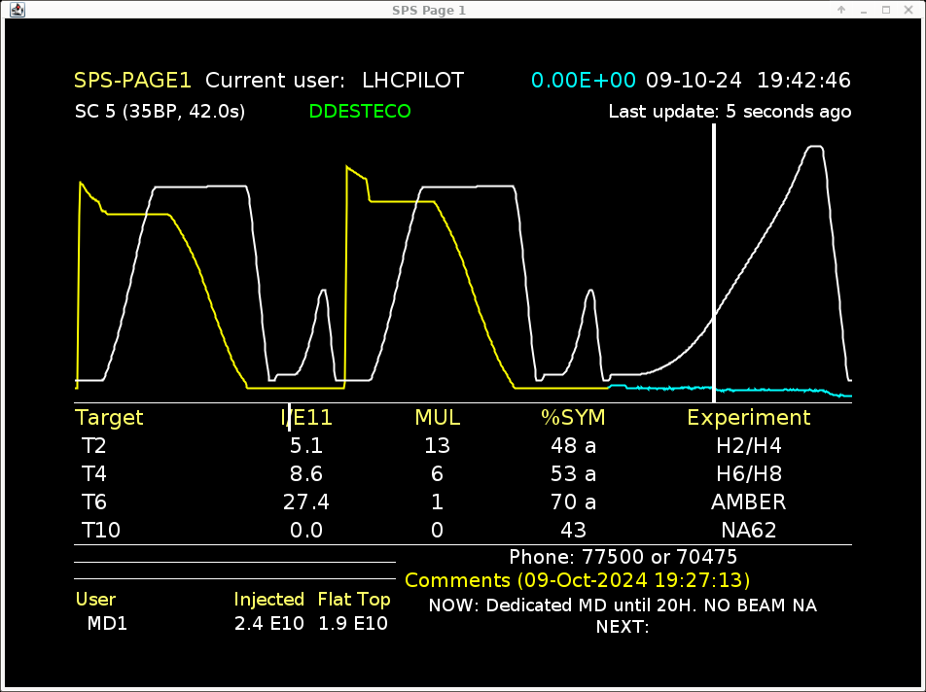
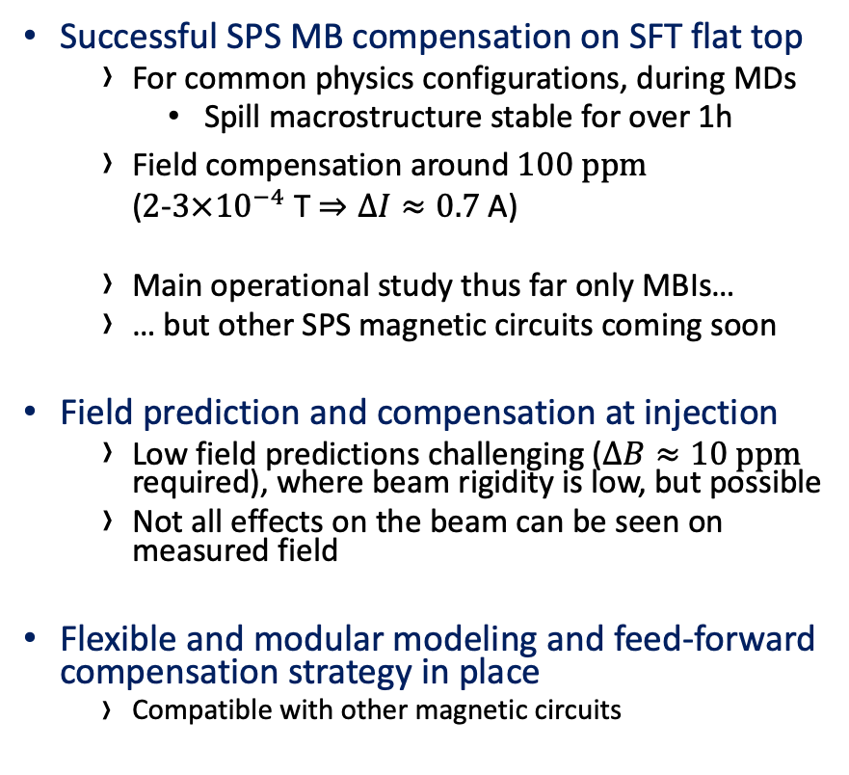

Significant achievements in 2024
Operations-ready field compensation
Successful SPS MB compensation on SFT flat top
  For common physics configurations, during MDs
    Spill macrostructure stable for over 1h
  Field compensation around $100 ppm$
  ($2$-$3×{10}^{−4}$ T $⇒ΔI≈0.7$ A)
  Main operational study thus far only MBIs…
  … but other SPS magnetic circuits coming soon
Field prediction and compensation at injection
  Low field predictions challenging ($ΔB≈10 ppm$ required), where beam rigidity is low, but possible
  Not all effects on the beam can be seen on measured field
Flexible and modular modeling and feed-forward compensation strategy in place
  Compatible with other magnetic circuits
(Field compensation OFF)
FT + LHC $→$ 2x FT
Field compensation ON – worst case
Notes:
Spill macrostructure stable in most cases
Worst case is still better than when hysteresis compensation is off and switching from FT $→$ LHC+FT SSC
Most cases preserves spill macrostructure through supercycle changes, or when there are 1+ FT in the same supercycle
Modular field prediction and compensation strategy, allowing integration of different models into compensation infrastructure, and easily adaptable to different magnetic circuits through control systems

Slide 11
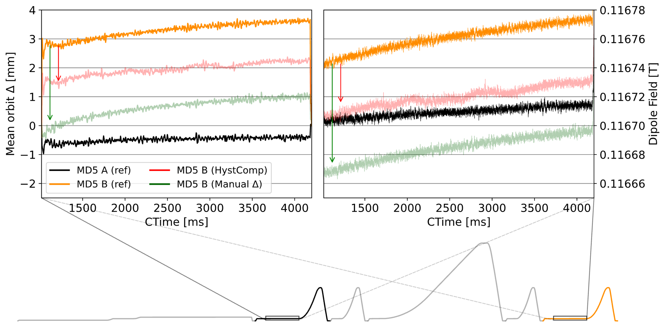

Significant achievements in 2024
… and challenges
Only effects from measured field can be compensated by field prediction
  Field predictions satisfy the required accuracy $10 ppm$
  But some (dynamic) effects on beam still not explained
  … and highly accurate field predictions, (and hence compensation) are difficult to achieve for 100 % of scenarios
Notes:
Limitations from modeling, which in turn comes down to accurate measurements.
Lab cannot measure SFTPRO (MB) in sequence, and does not show significant eddy current decays vs machine
Is the magnetic field completely representative of the beam dynamics ?
Lab measurements show significant drift which is difficult to compensate with pulsed measurements
Hall sensors introduce too much noise…

Slide 12
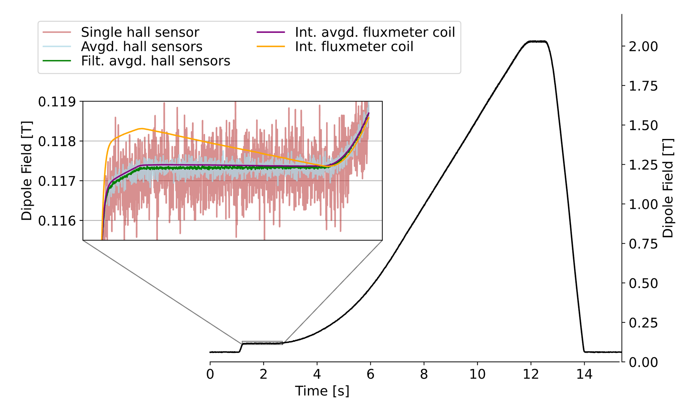
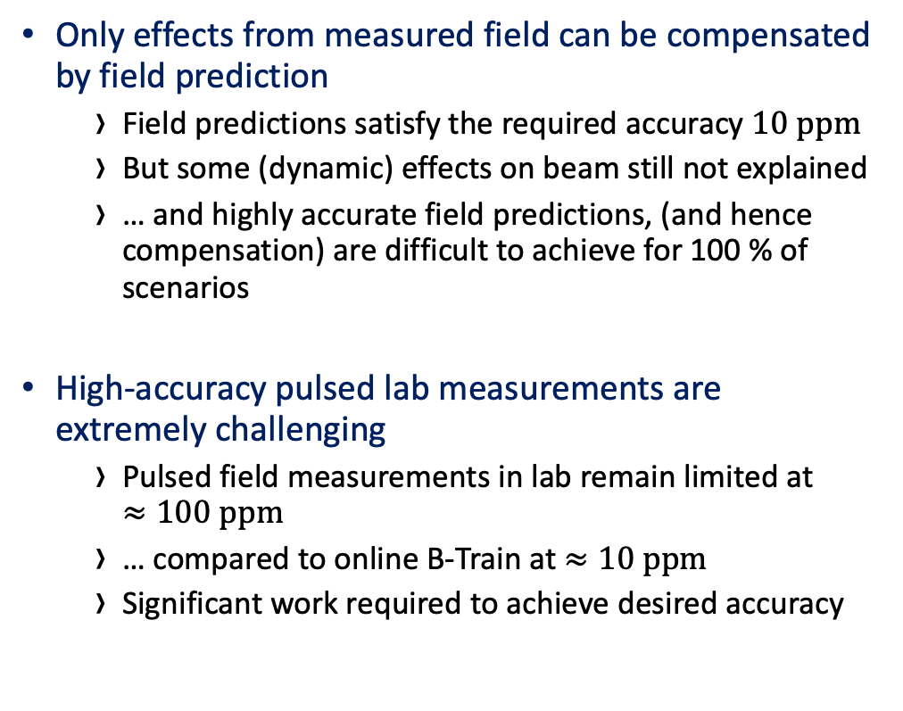
Significant achievements in 2024
… and challenges
Only effects from measured field can be compensated by field prediction
  Field predictions satisfy the required accuracy $10 ppm$
  But some (dynamic) effects on beam still not explained
  … and highly accurate field predictions, (and hence compensation) are difficult to achieve for 100 % of scenarios
High-accuracy pulsed lab measurements are extremely challenging
  Pulsed field measurements in lab remain limited at
  $≈100 ppm$
  … compared to online B-Train at $≈10 ppm$
  Significant work required to achieve desired accuracy
Notes:
Limitations from modeling, which in turn comes down to accurate measurements.
Lab cannot measure SFTPRO (MB) in sequence, and does not show significant eddy current decays vs machine
Is the magnetic field completely representative of the beam dynamics ?
Lab measurements show significant drift which is difficult to compensate with pulsed measurements
Hall sensors introduce too much noise…

Slide 13
Significant achievements in 2024
… and challenges
Only effects from measured field can be compensated by field prediction
  Field predictions satisfy the required accuracy $10 ppm$
  But some (dynamic) effects on beam still not explained
  … and highly accurate field predictions, (and hence compensation) are difficult to achieve for 100 % of scenarios
High-accuracy pulsed lab measurements are extremely challenging
  Pulsed field measurements in lab remain limited at
  $≈100 ppm$
  … compared to online B-Train at $≈10 ppm$
  Significant work required to achieve desired accuracy
! … and we cannot model what we cannot measure
! We cannot model more accurately than we can measure
Notes:
Limitations from modeling, which in turn comes down to accurate measurements.
Lab cannot measure SFTPRO (MB) in sequence, and does not show significant eddy current decays vs machine
Is the magnetic field completely representative of the beam dynamics ?
Lab measurements show significant drift which is difficult to compensate with pulsed measurements
Hall sensors introduce too much noise…

Slide 14
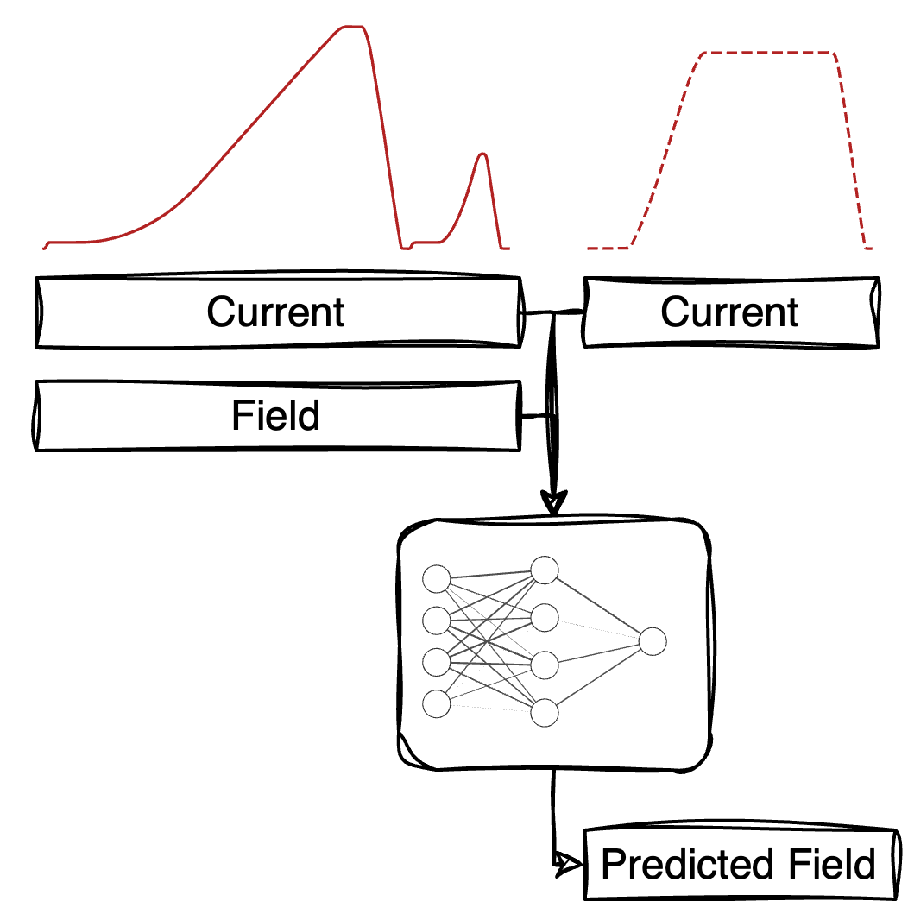

Field prediction
High-Accuracy Field Modeling Techniques
Model measured $\left\{I, B\right\} →B$ as a multivariate time series
  $1×{10}^{−5} T$ ($10 ppm$) accurate field predictions using (NN) transformers, learning from only data
  Variables used for training restricted to what is available online
Notes:
10 ppm accurate field predictions only for known operational sequences – generalization stays around 100 ppm accuracy

Slide 15
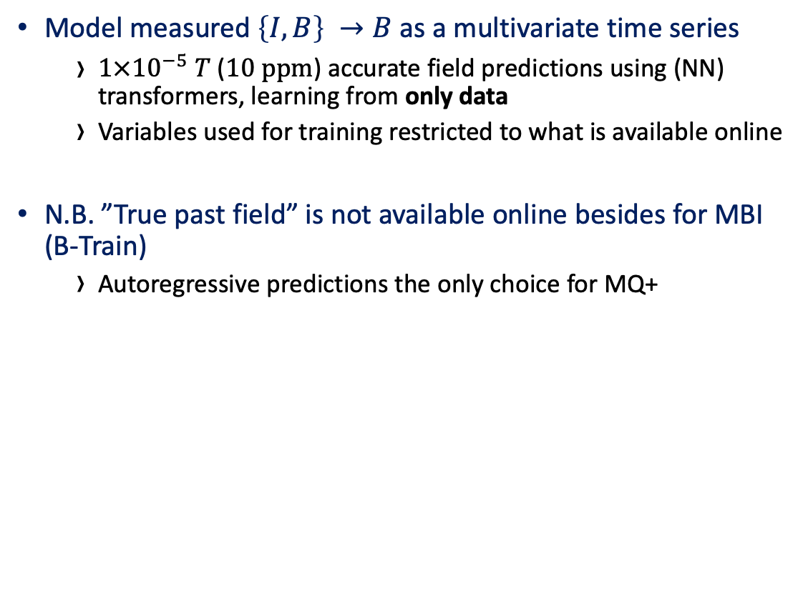
Field prediction
High-Accuracy Field Modeling Techniques
Model measured $\left\{I, B\right\} →B$ as a multivariate time series
  $1×{10}^{−5} T$ ($10 ppm$) accurate field predictions using (NN) transformers, learning from only data
  Variables used for training restricted to what is available online
N.B. ”True past field” is not available online besides for MBI
(B-Train)
  Autoregressive predictions the only choice for MQ+
Notes:
B-Train provides input to online models for MBI only, otherwise we must predict autoregressively (“blind”)

Slide 16

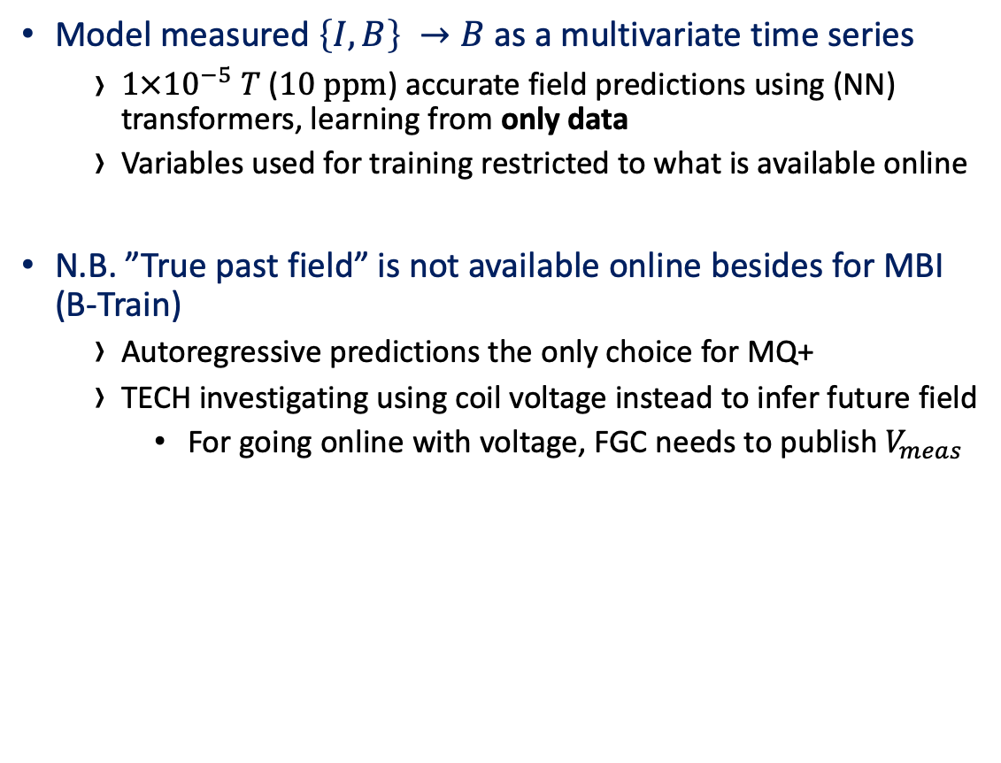
Field prediction
High-Accuracy Field Modeling Techniques
Model measured $\left\{I, B\right\} →B$ as a multivariate time series
  $1×{10}^{−5} T$ ($10 ppm$) accurate field predictions using (NN) transformers, learning from only data
  Variables used for training restricted to what is available online
N.B. ”True past field” is not available online besides for MBI
(B-Train)
  Autoregressive predictions the only choice for MQ+
  TECH investigating using coil voltage instead to infer future field
    For going online with voltage, FGC needs to publish $V_{meas}$
Notes:
Future investigation into using magnet coil voltage as auxiliary input, which is measured (but not published to CMW), and therefore only available in the lab atm

Slide 17
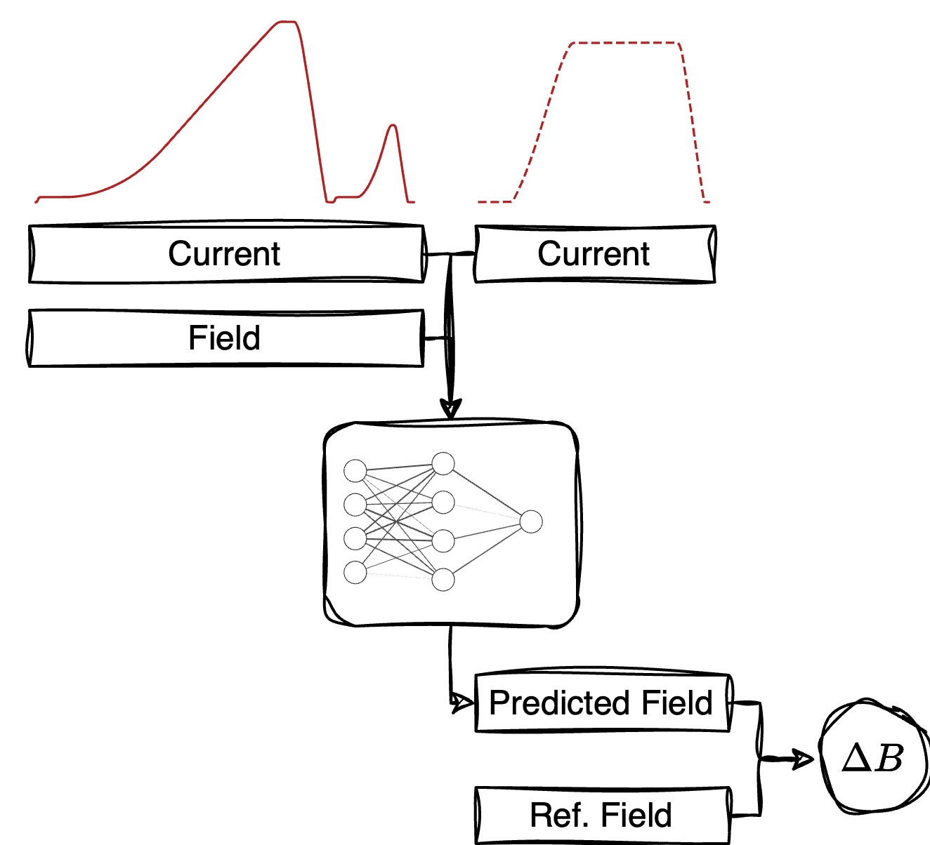

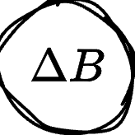



Field prediction
High-Accuracy Field Modeling Techniques
Model measured $\left\{I, B\right\} →B$ as a multivariate time series
  $1×{10}^{−5} T$ ($10 ppm$) accurate field predictions using (NN) transformers, learning from only data
  Variables used for training restricted to what is available online
N.B. ”True past field” is not available online besides for MBI
(B-Train)
  Autoregressive predictions the only choice for MQ+
  TECH investigating using coil voltage instead to infer future field
    For going online with voltage, FGC needs to publish $V_{meas}$
Cycle-by-cycle
predictions
MLP / GitLab
Notes:
We can take our model, which outputs what we think the field will be (pred).
When compared to what we want it to be (ref), we know dB to apply
We put it on UCAP with MLP or GitLab as model storage and run inference continuously, been running online since October 2024 to monitor prediction performance over time
Prediction pipeline abstracted away from model architecture – we can swap out models and architectures as we want (based on whatever performs better).

Slide 18
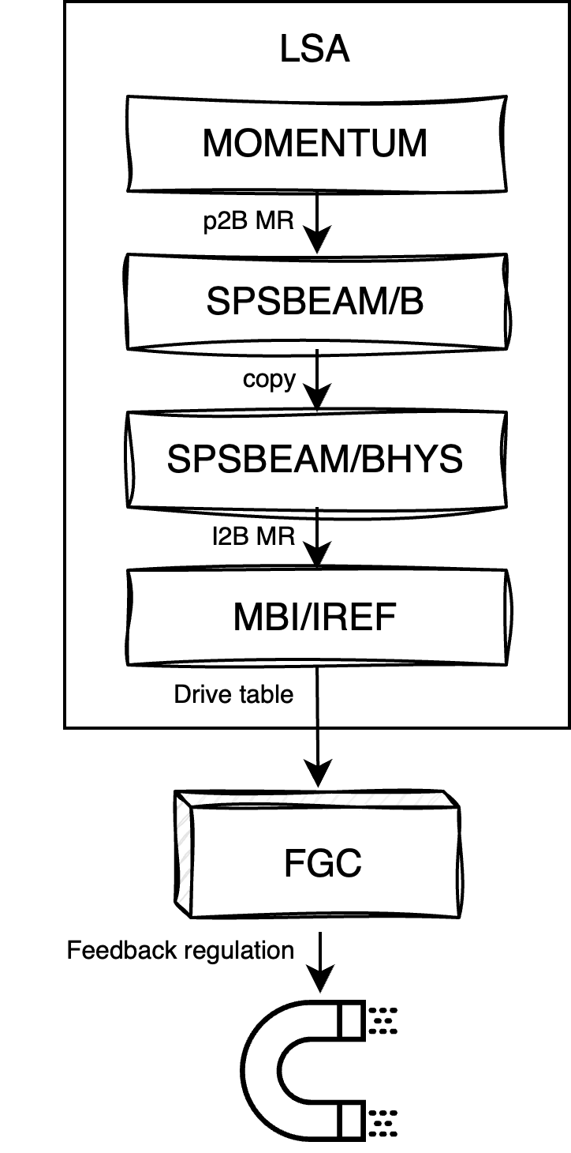
Feed-forward control strategy
Vertical integration of control stack
Notes:
Now we have computed dB, for each cycle, we apply it to the magnets, through the existing control system infrastructure

Slide 19

Feed-forward control strategy
Vertical integration of control stack
New $ΔB$ ($ΔI$) to to be applied every cycle before cycle start
Now: trim LSA parameter
  Leverage LSA to figure out $ΔI$ and drive to FGC
Notes:
Need to apply correction at each cycle to get rid of need to have predictable and repeatable cycle sequences.
Example using SPS MBI control stack

Slide 20

Feed-forward control strategy
Vertical integration of control stack
New $ΔB$ ($ΔI$) to to be applied every cycle before cycle start
Now: trim LSA parameter
  Leverage LSA to figure out $ΔI$ and drive to FGC
  Trim transient settings on every cycle
  … but suitable for initial tests
Notes:
Need to apply correction at each cycle to get rid of need to have predictable and repeatable cycle sequences.
We leverage LSA MRs to drive correct dI to FGC with transfer function

Slide 21
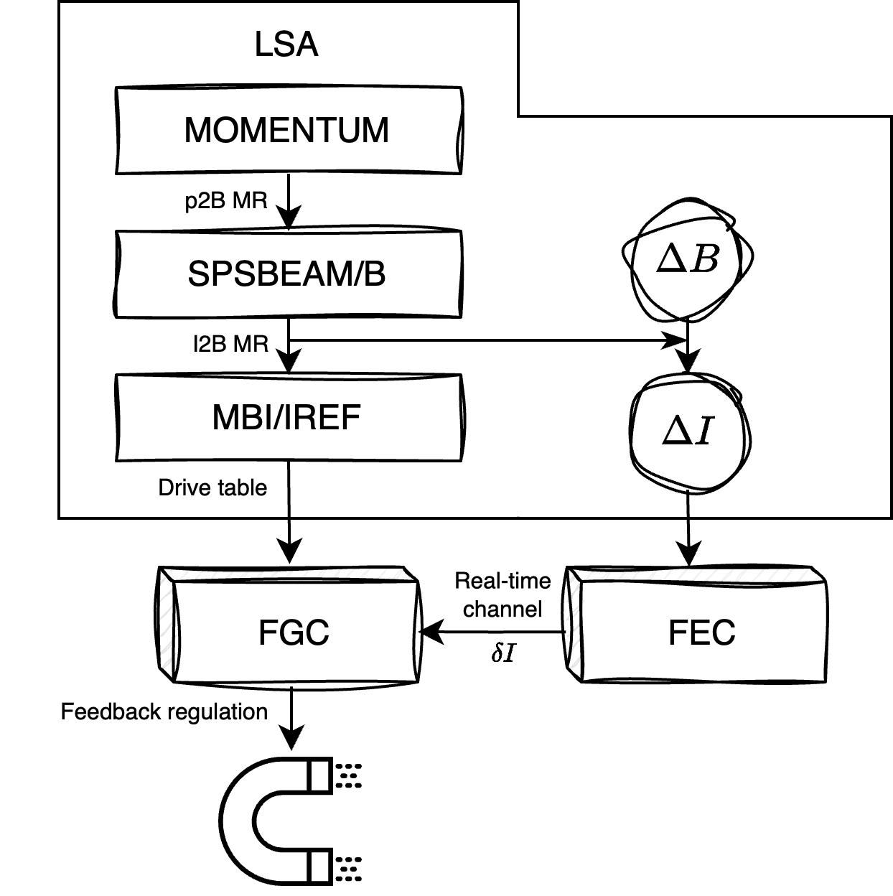
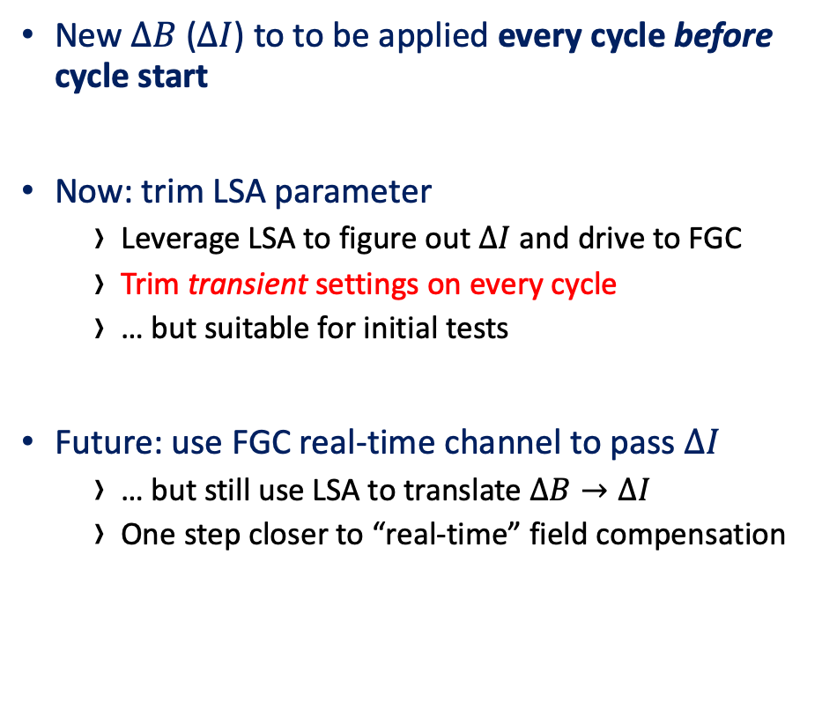
Feed-forward control strategy
Vertical integration of control stack
New $ΔB$ ($ΔI$) to to be applied every cycle before cycle start
Now: trim LSA parameter
  Leverage LSA to figure out $ΔI$ and drive to FGC
  Trim transient settings on every cycle
  … but suitable for initial tests
Future: use FGC real-time channel to pass $ΔI$
  … but still use LSA to translate $ΔB→ΔI$
  One step closer to “real-time” field compensation
Notes:
… but we shouldn’t trim LSA on every cycle (both for LSA and for FGC)
Coming next year: still leverage LSA MRs, but use real-time channel for applying dI

Slide 22
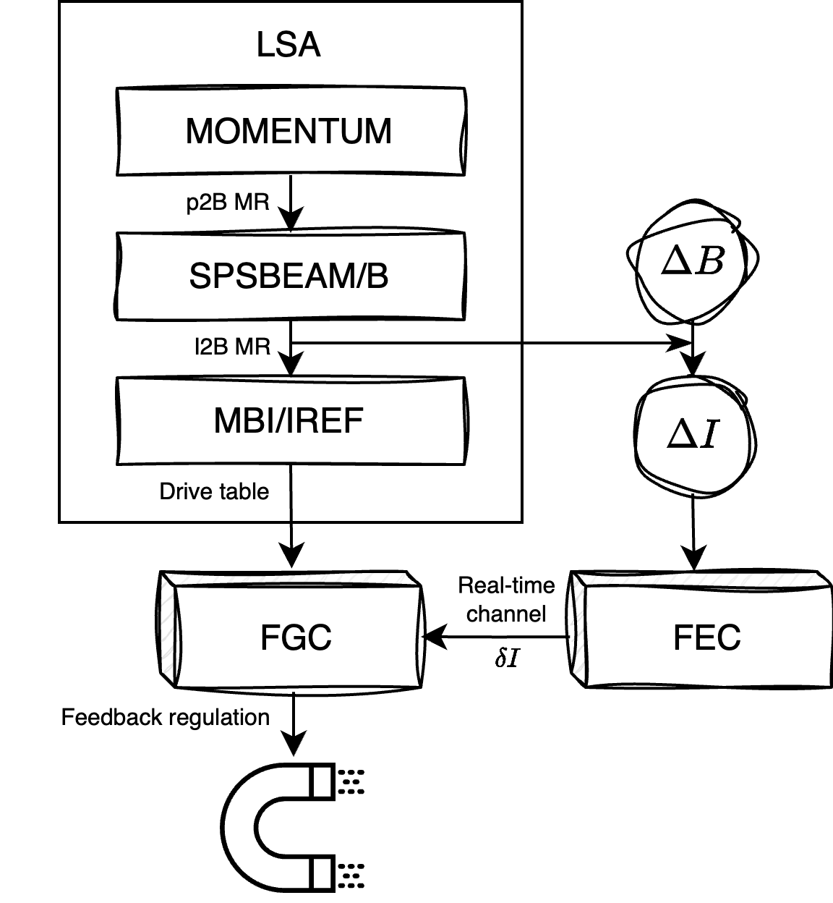
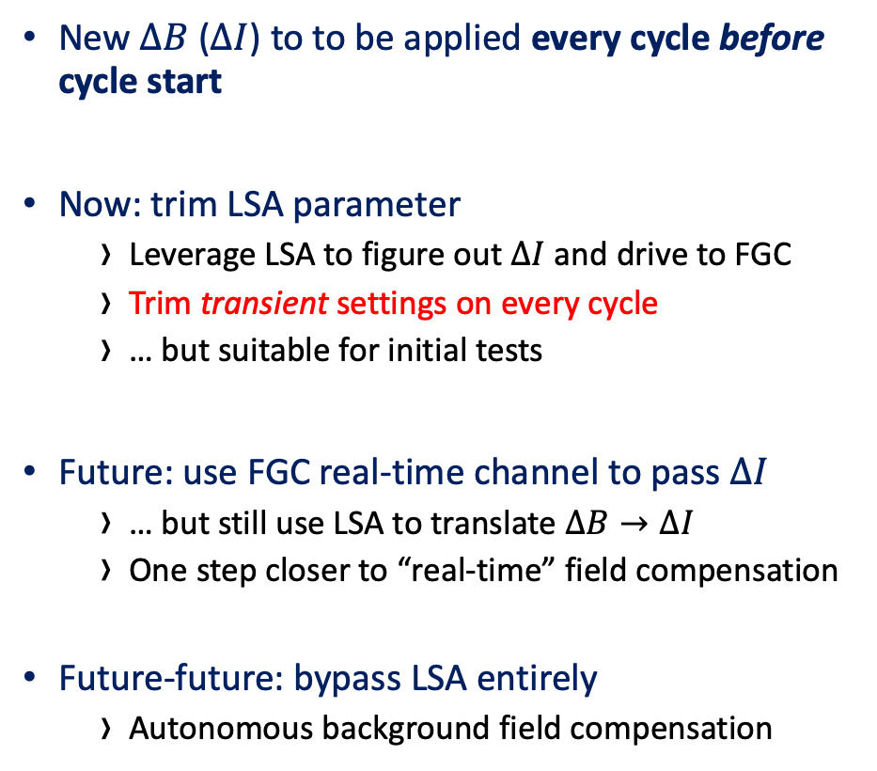
Feed-forward control strategy
Vertical integration of control stack
New $ΔB$ ($ΔI$) to to be applied every cycle before cycle start
Now: trim LSA parameter
  Leverage LSA to figure out $ΔI$ and drive to FGC
  Trim transient settings on every cycle
  … but suitable for initial tests
Future: use FGC real-time channel to pass $ΔI$
  … but still use LSA to translate $ΔB→ΔI$
  One step closer to “real-time” field compensation
Future-future: bypass LSA entirely
  Autonomous background field compensation
Notes:
For future, go directly to hardware, control in I or B?
Should be transparent to set field

Slide 23

Controlling the AI
Going towards full automation
SPS MBI Cycle-to-cycle hysteresis
Limiting compensation range
  Hysteresis effects $±1 permil$, but cycle-to-cycle differences are $±100 ppm$ or less
  $⇒$ We can bound compensation ranges to safe (and known) limits
Notes:
Autonomous AI is a concern – but it can be limited and studied
Compensation range is quite small, no risk to damage machine if we limit dB ranges
Field compensation within safe limits, can be guaranteed on multiple levels of the control stac

Slide 24
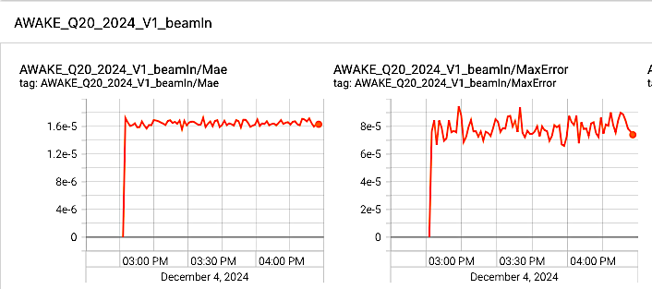
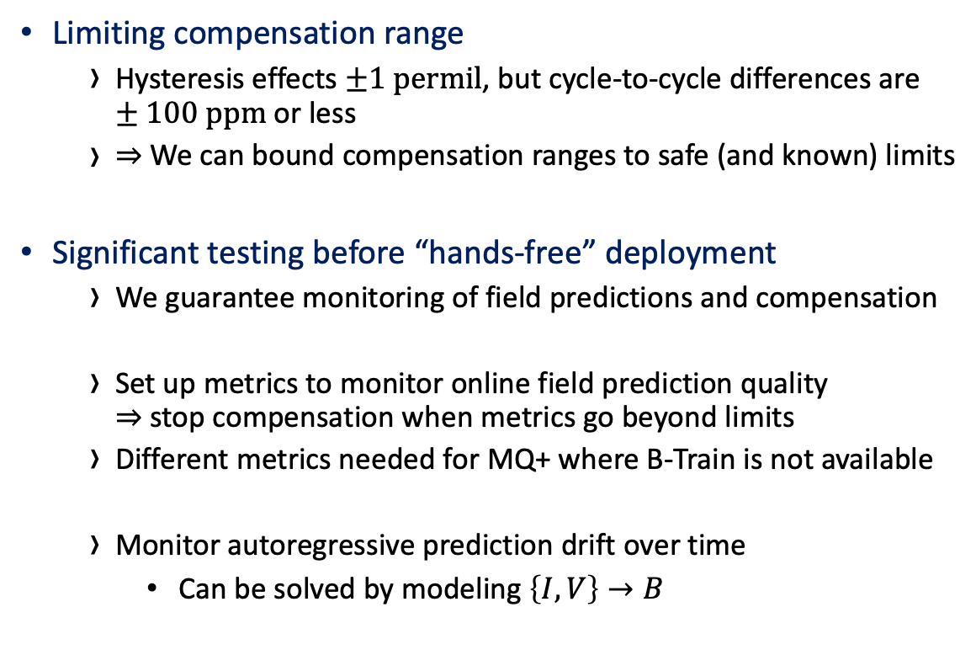
Controlling the AI
Going towards full automation
SPS MBI Cycle-to-cycle hysteresis
Limiting compensation range
  Hysteresis effects $±1 permil$, but cycle-to-cycle differences are $±100 ppm$ or less
  $⇒$ We can bound compensation ranges to safe (and known) limits
Significant testing before “hands-free” deployment
  We guarantee monitoring of field predictions and compensation
  Set up metrics to monitor online field prediction quality
  $⇒$ stop compensation when metrics go beyond limits
  Different metrics needed for MQ+ where B-Train is not available
  Monitor autoregressive prediction drift over time
    Can be solved by modeling $\left\{I, V\right\}→B$
Notes:
We need to monitor AI significantly before going hands-free
Prediction quality already monitored (see figure) on MBI since online field measurements available
We need to develop metrics to decide when to stop compensating, especially since model is not trained for all scenarios (this is impossible).
Re-training online not possible since no GT.
MQ+ has no ground truth field - only beam can be observed
So far, SFT flat top compensation outperforms no compensation, but to be monitored over time.
Autoregressve prediction drift for MQ+ to be studied since there is a lack of ground truth field.
Use of Voltage coming

Slide 25
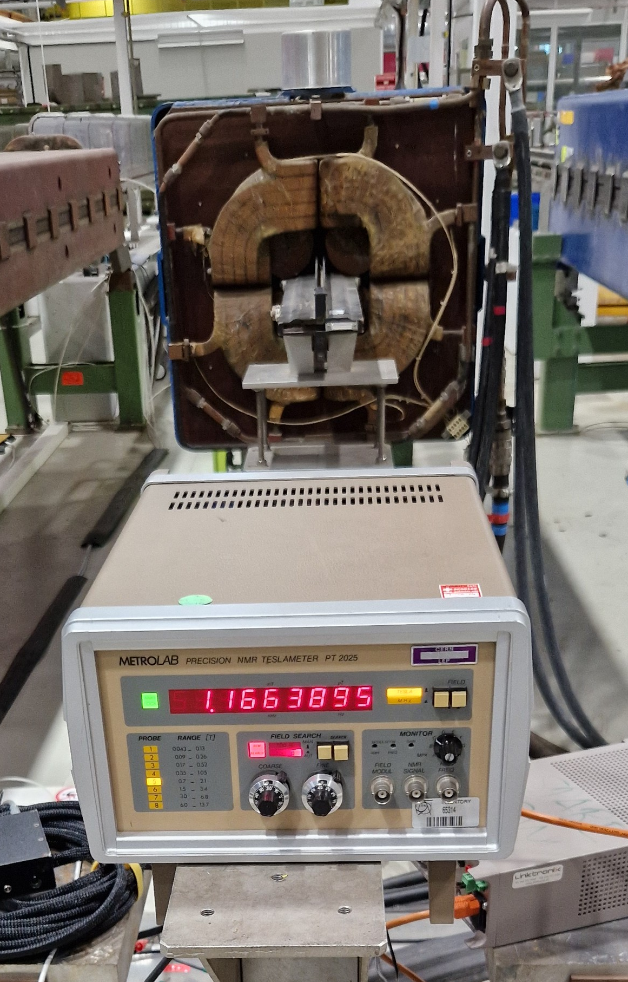
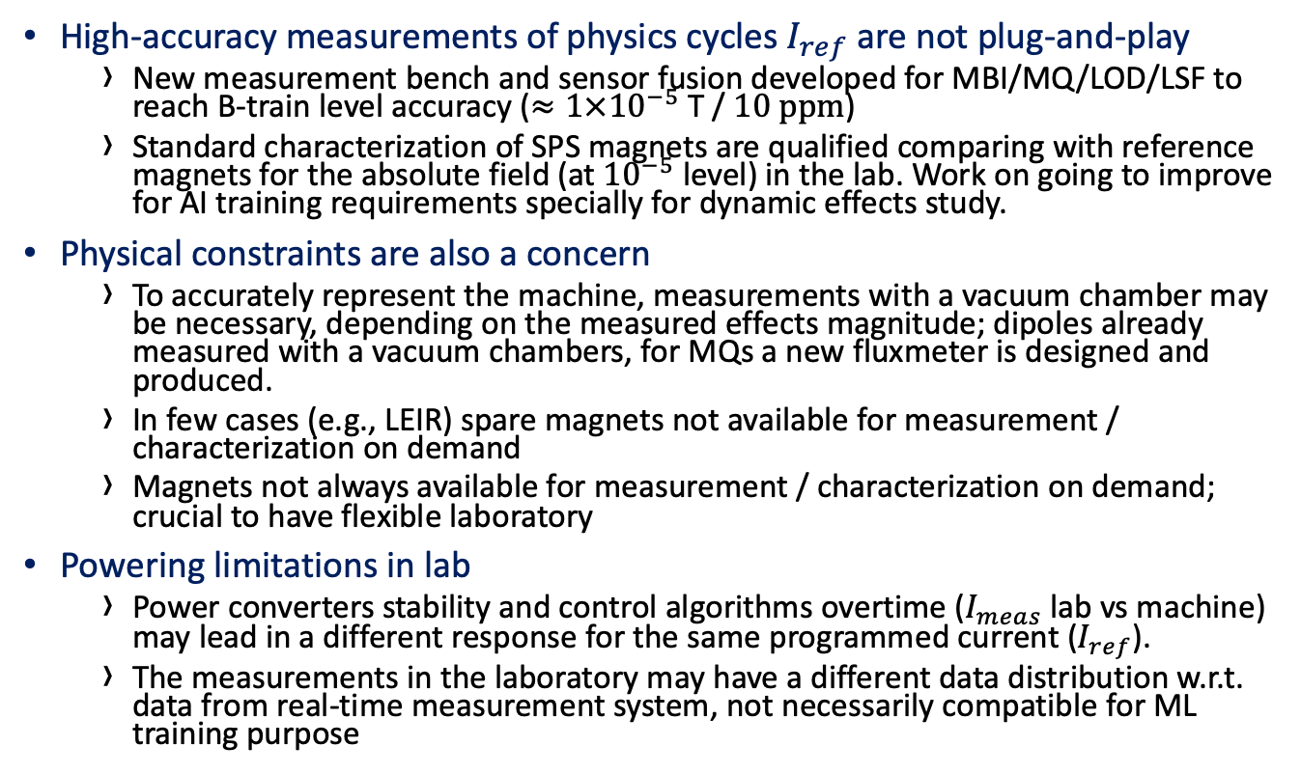
New magnetic measurement / magnetic preparation paradigm
Lessons learned – for the future
High-accuracy measurements of physics cycles $I_{ref}$ are not plug-and-play
  New measurement bench and sensor fusion developed for MBI/MQ/LOD/LSF to reach B-train level accuracy ($≈1×{10}^{−5}$ T / $10 ppm$)
  Standard characterization of SPS magnets are qualified comparing with reference magnets for the absolute field (at ${10}^{−5}$ level) in the lab. Work on going to improve for AI training requirements specially for dynamic effects study.
Physical constraints are also a concern
  To accurately represent the machine, measurements with a vacuum chamber may be necessary, depending on the measured effects magnitude; dipoles already measured with a vacuum chambers, for MQs a new fluxmeter is designed and produced.
  In few cases (e.g., LEIR) spare magnets not available for measurement / characterization on demand
  Magnets not always available for measurement / characterization on demand; crucial to have flexible laboratory
Powering limitations in lab
  Power converters stability and control algorithms overtime ($I_{meas}$ lab vs machine) may lead in a different response for the same programmed current ($I_{ref}$).
  The measurements in the laboratory may have a different data distribution w.r.t. data from real-time measurement system, not necessarily compatible for ML training purpose
! We cannot model more accurately than we can measure
Notes:
High-accuracy pulsed measurements at 10 ppm level very difficult
Existing system (B-train) already at the limit.
We would like to have higher measurement accuracy for improved modeling, but impossible without significant investment. So B-Train instrumental for success.
We cannot go further than 10 ppm compensation.

Slide 26
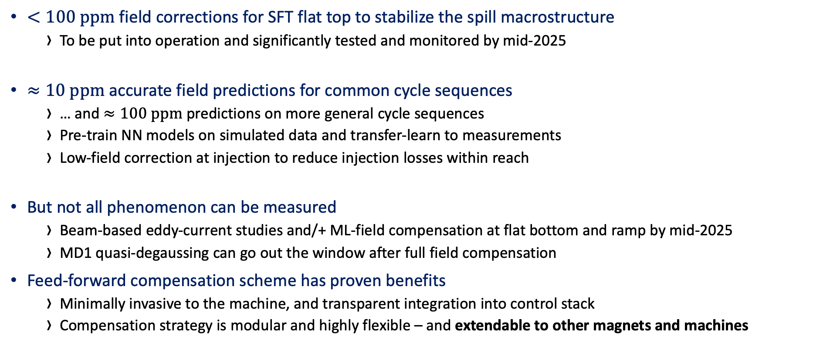
Operational status of hysteresis compensation
Summary
$<100 ppm$ field corrections for SFT flat top to stabilize the spill macrostructure
  To be put into operation and significantly tested and monitored by mid-2025
$≈10 ppm$ accurate field predictions for common cycle sequences
  … and $≈100 ppm$ predictions on more general cycle sequences
  Pre-train NN models on simulated data and transfer-learn to measurements
  Low-field correction at injection to reduce injection losses within reach
But not all phenomenon can be measured
  Beam-based eddy-current studies and/+ ML-field compensation at flat bottom and ramp by mid-2025
  MD1 quasi-degaussing can go out the window after full field compensation
Feed-forward compensation scheme has proven benefits
  Minimally invasive to the machine, and transparent integration into control stack
  Compensation strategy is modular and highly flexible – and extendable to other magnets and machines
Notes:
We can do SFT flat top hysteresis compensation, better than without compensation.
We can achieve high accuracy on general cycle sequences. For flat bottom more work needs to be done on measurement and modeling to reach robust and generalizable model.
Low field compensation is challenging!
Need to study dynamic effects on the beam with dedicated MD, we will have prototype

Slide 27
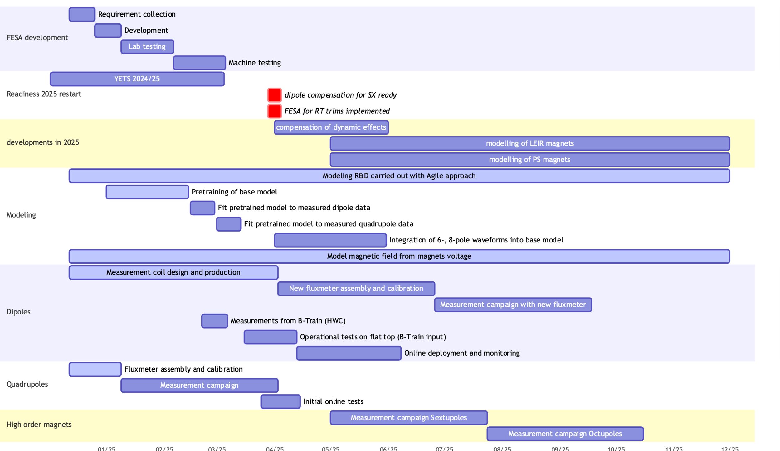

EPA WP4 in 2025
Summary and Outlook
SPS MB full-cycle compensation
SPS other magnets field compensation
  Initial tests of MQ field compensation from beam commissioning 2025 and through the year
  … and sextupole and octupole field compensation tests to follow after MQ
Towards other machines
  Soon™ QUEST in BE-ABP for simulating LEIR dipole and PS combined function magnets
  Field compensation for other machines during LS3 following SPS
    Pulsed magnetic measurement procedures learnt from SPS experiences in lab critical for success

Slide 28
Questions

Slide 29
Extra slides

Slide 30
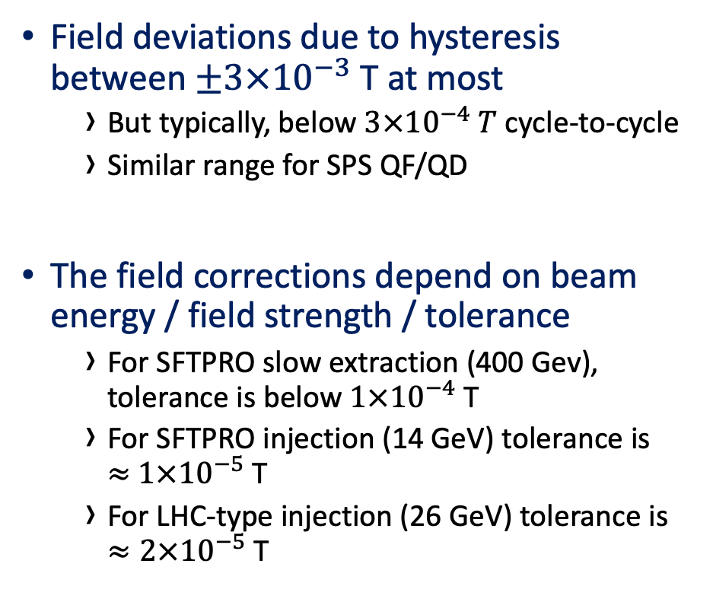
Analysis – Hysteresis in SPS main dipoles
Overview
Field deviations due to hysteresis between $±3×{10}^{−3}$ T at most
  But typically, below $3×{10}^{−4} T$ cycle-to-cycle
  Similar range for SPS QF/QD
The field corrections depend on beam energy / field strength / tolerance
  For SFTPRO slow extraction (400 Gev), tolerance is below $1×{10}^{−4}$ T
  For SFTPRO injection (14 GeV) tolerance is
  $≈$ $1×{10}^{−5}$ T
  For LHC-type injection (26 GeV) tolerance is
  $≈2×{10}^{−5}$ T
Notes:
which dp/p are allowed
tolerance at FT at 2e04

Slide 31
Magnetic measurements
Know
Measure dipole magnetic response with online B-train
  Problems with drift to reach desired accuracy, especially at SFTPRO FB
Lab measurements for quadrupoles, sextupoles, octupules
  Challenges to reach desired accuracy using induction coil (drift) or hall sensors (noise)
Accurate pulsed measurements very challenging in the lab
Power converter in lab is different from FGC
  Lab not entirely representative of SPS conditions
Notes:
B-train challenges with marker

Slide 32
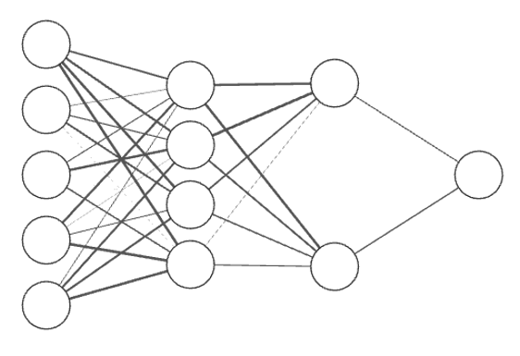


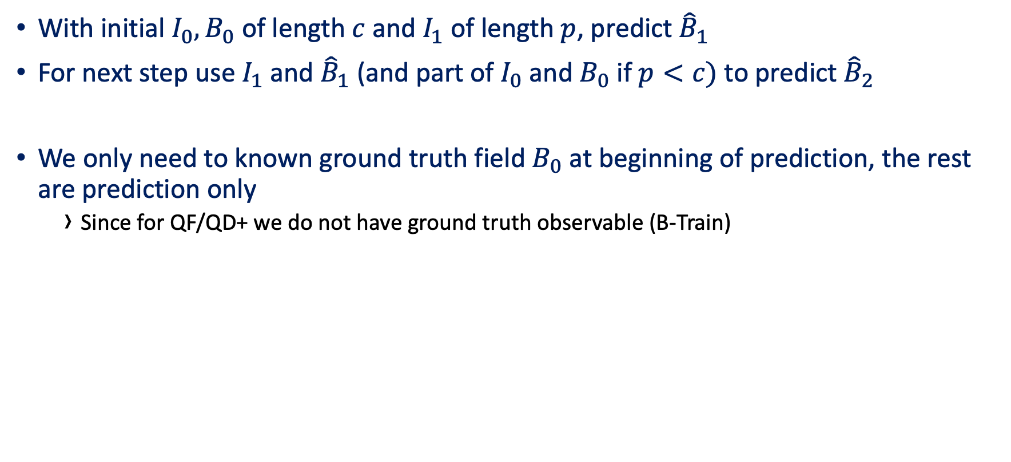








Autoregressive predictions
Predict
With initial $I_{0}, B_{0}$ of length $c$ and $I_{1}$ of length $p$, predict ${\hat{B}}_{1}$
For next step use $I_{1}$ and ${\hat{B}}_{1}$ (and part of $I_{0}$ and $B_{0}$ if $p<c)$ to predict ${\hat{B}}_{2}$
We only need to known ground truth field $B_{0}$ at beginning of prediction, the rest are prediction only
  Since for QF/QD+ we do not have ground truth observable (B-Train)
$$I_{0}$$
$$I_{1}$$
$$I_{0}$$
$$I_{1}$$
$$I_{2}$$
$${\hat{B}}_{1}$$
$$B_{0}$$
$${\hat{B}}_{2}$$
…
$$B_{0}$$
$${\hat{B}}_{1}$$
Akin to unrolling an RNN

Slide 33
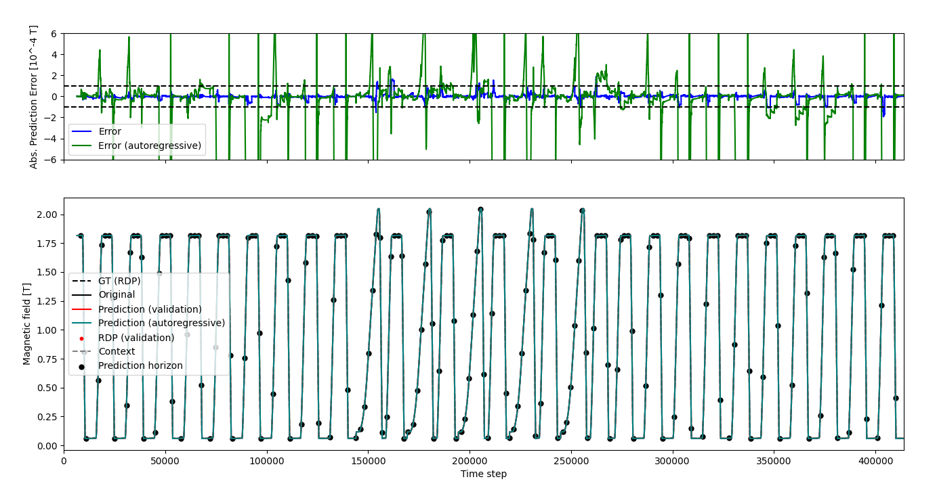
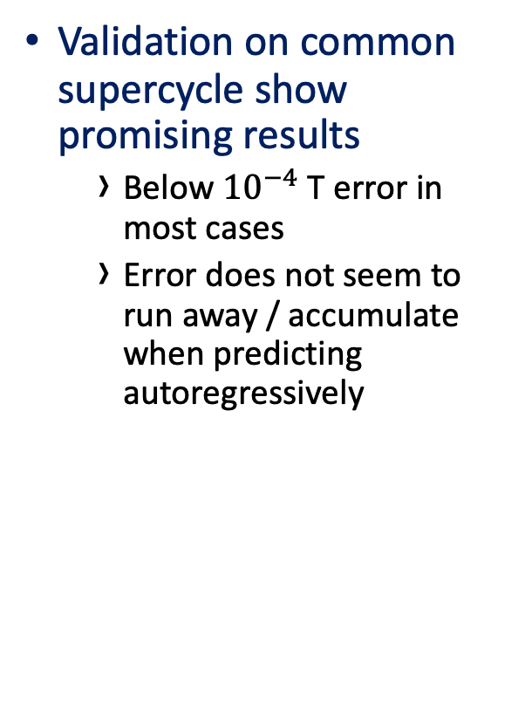
Validation
Predict
Validation on common supercycle show promising results
  Below ${10}^{−4}$ T error in most cases
  Error does not seem to run away / accumulate when predicting autoregressively

Slide 34
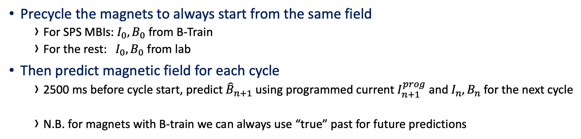
Cycle-by-Cycle Online inference
Predict
Precycle the magnets to always start from the same field
  For SPS MBIs: $I_{0},B_{0}$ from B-Train
  For the rest: $I_{0}, B_{0}$ from lab
Then predict magnetic field for each cycle
  2500 ms before cycle start, predict ${\hat{B}}_{n+1}$ using programmed current $I_{n+1}^{prog}$ and $I_{n}, B_{n}$ for the next cycle
  N.B. for magnets with B-train we can always use “true” past for future predictions
…
Precycle
Notes:
How long can we predict autoregressively
Special cases for dynamic economy cycles where we don’t know the machine mode 2500ms in advance
From timing system know which cycle is coming next, with 2500 ms forewarning
Previous ”state” is provided as input o network together with future programmed current, to give future field
Initial ”state” is provided by B-Train for MBIs, but must be bootstrapped with measurements for higher order magnets, probably with a precycle
Autoregressive predictions must be used since true past field is never known
We must feed the previous predicted field as “state” to the next prediction step
Predictions running on GPU in GUI
Predictions are also running on UCAP in parallel for future use
Challenges
Still require pre-cycle to start predictions in a known state, pre-cycle to be defined
Not known how long we can predict autoregressively – how long can we do without a pre-cycle
Initial tests suggest error does not tend to accumulate
Timing system does not correctly deliver the correct next cycle

Slide 35
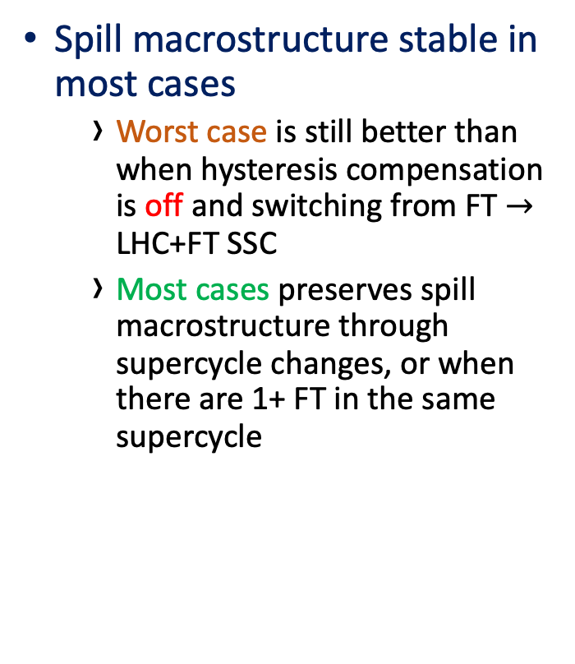
Significant and consistent improvements on spill quality
Results
Spill macrostructure stable in most cases
  Worst case is still better than when hysteresis compensation is off and switching from FT $→$ LHC+FT SSC
  Most cases preserves spill macrostructure through supercycle changes, or when there are 1+ FT in the same supercycle
(Field compensation OFF)
FT + LHC -> 2x FT
Field compensation ON – worst case
Notes:
Normalize the BCT due to low intensity
Worst case (orange) still better than uncompensated (red)

Slide 36
Significant and consistent improvements on spill quality
Results
Evolution of spill quality over time, with autoregressive field predictions + compensation
  Corrections only on SFTPRO1 flat top, on every cycle
Reference taken at the beginning and unchanged throughout the MD
  Spill duty factor remains largely unchanged
  … But RMSE between reference and measured BCT is significant when field is poorly / uncorrected
Notes:
SPS QC values aren't sensitive enough, not a good enough metric
* we use RMSE between reference and measured BCT instead at flat top (since orbit information is not available)
* Significant improvements over baseline , even in the worst case
* MD used exotic supercycles (by accident) that would not be played in operations
* MD1 was present during tests, but we expect the same result without it

