Slide 1
Time spent on interventions from equipment experts/piquet
Kostas Papastergiou with thanks to EPA team for feedback
Pulsed Power Engineering, Accelerator Beam Transfer Group
Efficient Particle Accelerators Project
Joint Accelerator Performance Workshop
Montreux, 12 December 2024

Slide 2
Outline
Why analyse stand-by service data
Description of the dataset
Anatomy of an intervention
Statistics and trends of interventions at CERN
Automation in the service of Teams
Take away messages

Slide 3
Why analyse stand-by data
Interventions a key element of technical People’s job
  They happen out-of-hours/night
  They are unpredictable (time, duration)
  They are performed under pressure
  Lonely, exposed to risks
Interventions drive safety and availability (machine time)
  More intervention time tends to mean less availability
  Consume resources that could be used for other reasons
  Impact general wellbeing

Slide 4
Dataset & Thanks
The dataset comprises 200,000 rows of anonymised overtime (out-of-hours) and shift work data from HRT from the year 1st Jan 2011 to 4th Nov 2024. The following results are focused on ATS departments and HSE. Shift hours of BE-OP are excluded.
Sincere thanks to Nicole Polivka (HR-CBS) and Matthias Braeger (FAP-BC) for the effort of modifying HRT to allow extracting useful data about remote/local interventions.
Thanks to Rodolphe Maillet for extracting data from the OP logbook too. Thanks to ABT and EPA colleagues for their feedback.

Slide 5
2,749,340 h
1,843,312 h
151,396 h
Stand-by at CERN
Stand-by in ATS
Total of overtime hours
1431 personnel-years
102 person/year
960 personnel-years
69 person/year
~ 79 personnel-years since 2011
~5.6 person/year

Slide 6
42,629 15,398
On-site
Remote
Hours
Hours
1.6% of stand-by time spent in interventions not counting daytime and travel
out-of-hours intervention since 2011
total 30.2 person-years
*14 years of data, 1 person=240 working days/year. Including travel time. Not including adjustment for weekends and holidays

Slide 7
















Anatomy of an on-site intervention
One Intervention = 295min
25min
132min+ travel time
90min
BEFORE
DURING
AFTER
fault
CALL
BEAM BACK
10min
15min
20min
25min
30min
60min
20min
25min
20min
30min
5min
15min
20min
Parts +
repair
logbook
OP meeting
AFT review
Stand-by
OP
diagnostic
Overtime sheet (EDH)
Planning & occasional modifications
On-site diagnostic
Verification+ hand-over to OP
Remote diagnostic
Logistics item for repair
overtime approvals

Slide 8
Anatomy of a remote intervention
25min
48min
90min
BEFORE
DURING
AFTER
CALL
BEAM BACK
10min
15min
30min
20min
20min
5min
15min
20min
logbook
OP meeting
AFT review
Stand-by
OP
diagnostic
Overtime sheet (EDH)
Planning & occasional modifications
Verification+ hand-over to OP
Remote diagnostic+ repair
overtime approvals

Slide 9
Do remote interventions cut time/cost
Actual time refers to the time spent by the person carrying out the intervention. This corresponds to the actual “machine down time”.
Accounted time refers to the intervention time including travel time. This reflects better the actual overtime paid out cost.

Slide 10
What is the trend of remote interventions
LS1
LS2

Slide 11
What is the trend of interventions duration
3.28h
3.03h
3.12h
*actual intervention time, not including travel time and adjustments

Slide 12
Machines run with 99% availability
What can be improved?

Slide 13
What is the cost of machine availability
84.3 person-years
77.9 person-years
73.6 person-years
*actual time, not including travel time and adjustments

Slide 14
What is the cost of machine availability
Shift hours
Stand-by hours
20.4 persons/year*
68.6 persons/year*
*one person working 1920 hours per year. Calculation excludes years of machine stop.
+0.97
persons/year*
+1.07
persons/year*
50 weeks
Operation weeks/year

Slide 15
What is the potential benefit from automation?
On-site
Interventions: 730/year
Actual intervention time: 1880h/year
Travel time: 1460h
Remote
Interventions: 730/year
Actual intervention time: 750h/year
Travel time: 730h
Max* potential gain of machine time
31days
Per year
Max* gain of machine time with automation of 10%
8days
per year
744 hours
Max* potential gain of intervention time
1330h
Per year
192 hours
* Cumulative time across all machines. Only refers to accounted intervention time (no travel, preparation, logbook writing etc). Out-of-hours interventions tend to be blocking Operation, however, Interventions on services (EL, CV) are not always beam blocking. Interventions can take place simultaneously and therefore the final figures might be lower.

Slide 16
Complex Interventions
How do they evolve?

Slide 17
Number of overtime claims per week
Example of a single technology Group at CERN
2011 baseline: If only stand-by team intervened this would be the colour every week of 2011
Colour intensity represents number of overtime sheets submitted
2024 baseline: If only stand-by team intervened this would be the colour every week of 2024

Slide 18
Number of overtime claims per week
Example of a single technology Group at CERN
2011 baseline: If only stand-by team intervened this would be the colour every week of 2011
Baseline+9 overtime sheets in this week
Colour intensity represents number of overtime sheets submitted
Baseline+12 overtime sheets in this week
2024 baseline: If only stand-by team intervened this would be the colour every week of 2024

Slide 19
Number of overtime claims per week
Example of a single technology Group at CERN
2011 baseline: If only stand-by team intervened this would be the colour every week of 2011
Baseline+9 overtime sheets in this week
Colour intensity represents number of overtime sheets submitted
Baseline+12 overtime sheets in this week
2024 baseline: If only stand-by team intervened this would be the colour every week of 2024

Slide 20
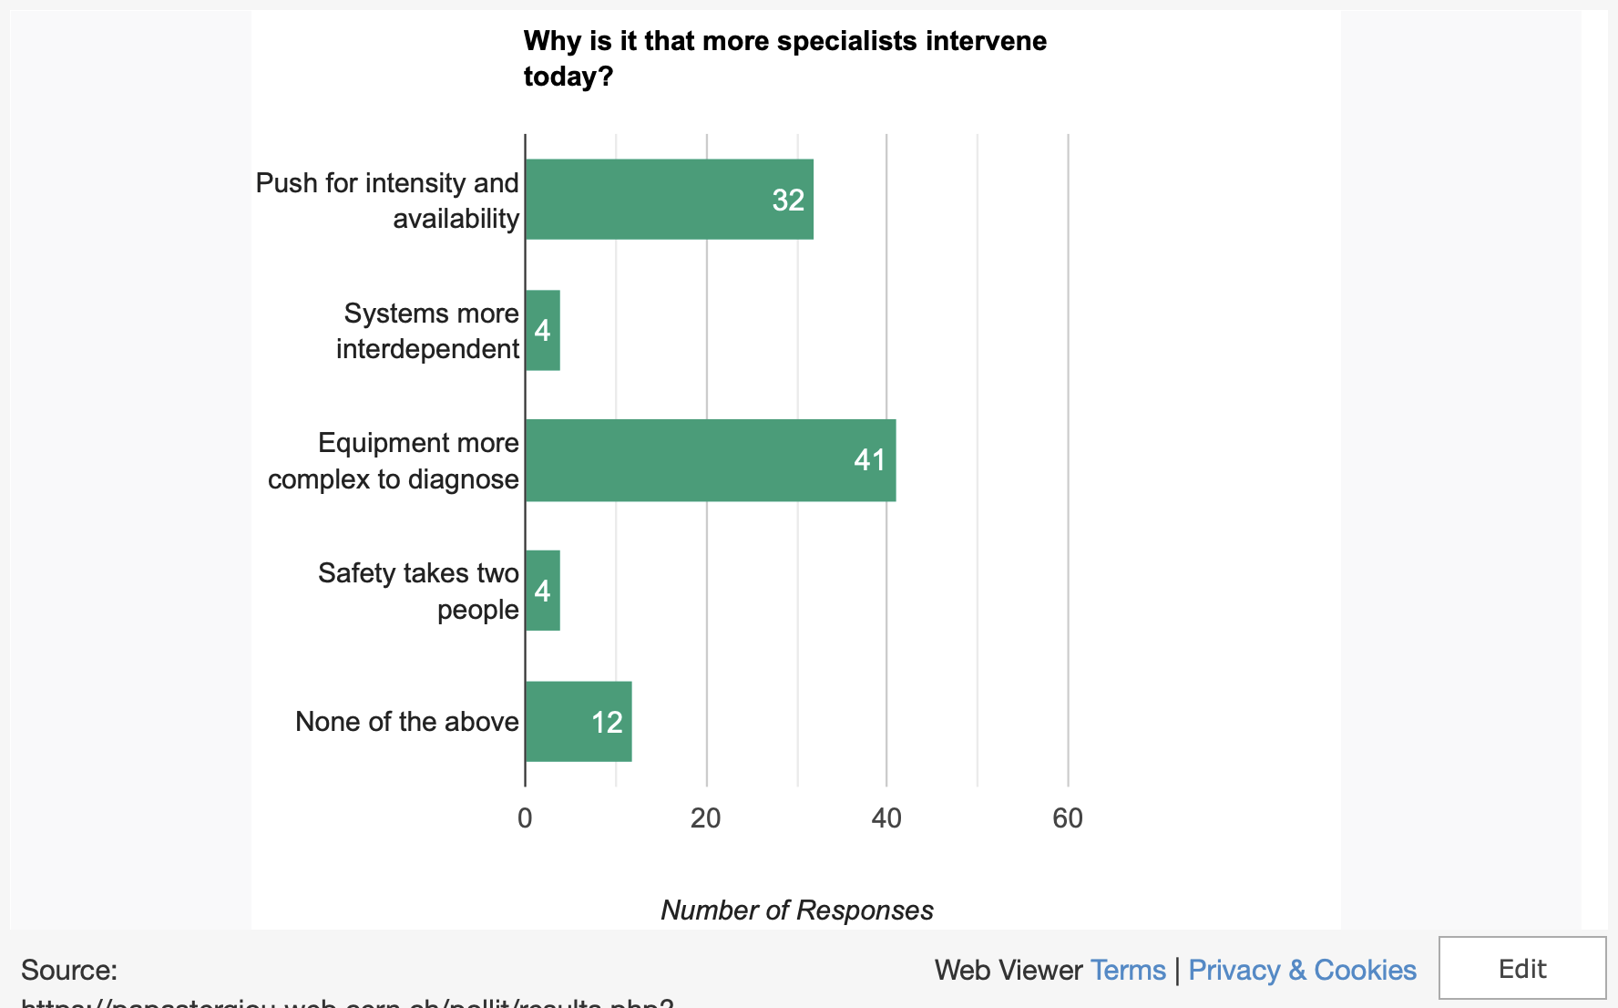

Slide 21
Anatomy of an on-site intervention
> 3 persons
> 12 steps
> 25 applications
One Intervention = 295min
BEFORE
DURING
AFTER
25min
CCM
IMPACT
GIS
FGC COMMANDER
TI APPS
WRAP
EXPERT APP
INSPECTOR
EXP APP 3
TIMBER
EXP LOG
EDMS
GLIDE
OP APPS
WINCC
EXP APP 2
EAM
SEQUENCER
EXP LOG
OASIS
ROG
EXP APP 1
PHONEBOOK
OP LOG
OP LOG
EXCEL
TRAINING
LASER
CCM
EXP LOG
PLANNING
ADAMS
15min
OP LOG
FGC LOGS/POWERSPY
10min
20min
EDH
EDH
OP LOG
AFT
EAM
AFT
Parts +
repair
logbook
OP meeting
AFT review
Stand-by
OP
diagnostic
Overtime sheet (EDH)
Planning & occasional modifications
On-site diagnostic
Verification+ hand-over to OP
Remote diagnostic
Logistics item for repair
overtime approvals

Slide 22
Efficient Particle Accelerators
TO SEEK CCTB
ENDORSEMENT
Tune in to Raul Murillo’s Talk
for applications of this

Slide 23
Conclusions
Intervention Trends Highlight Automation Potential
The data highlights a significant amount of time and resources allocated to out-of-hours interventions. With 30.2 person-years spent on interventions since 2011 and a notable portion of stand-by hours dedicated to these tasks, automation can play a critical role in reducing this load.
Potential Efficiency Gains
Automation has the potential to significantly cut intervention times, especially in repetitive tasks. With 730 on-site and 730 remote interventions annually, automation could save more than 1 month of machine time.
By automating at least 10% of interventions, up to 8 days of machine availability could be gained annually across all systems.
Safety and Well-Being
Night interventions are inconvenient, stressful, and potentially risky. By automating routine diagnostics and repair processes, technical personnel can focus on complex tasks, reducing stress and exposure to night work hazards.

Slide 24
Proposals
Low hanging fruit – 1 to 3 year
Automation, AI,
Key Areas for Automation
Preparation and Diagnostics: Automation can assist in fault diagnosis and intervention planning before an on-site visit, reducing preparation time.
Reporting and Logging: Standardizing and automating logbook entries and overtime claims can save administrative overheads.
Guided Interventions: Integrating expert systems with real-time suggestions can guide personnel during interventions, enhancing efficiency and accuracy.
Interoperability of systems for more efficient interventions
Common fault tracking (AFT), Logbook intervention & overtime reporting across the teams
Produce AI-ready data/applications
Asset management
Promote-encourage trend for remote interventions
Medium term 1 to 5 year
Forums, projects
Long term effort
requires R&D, new skills etc

Slide 25
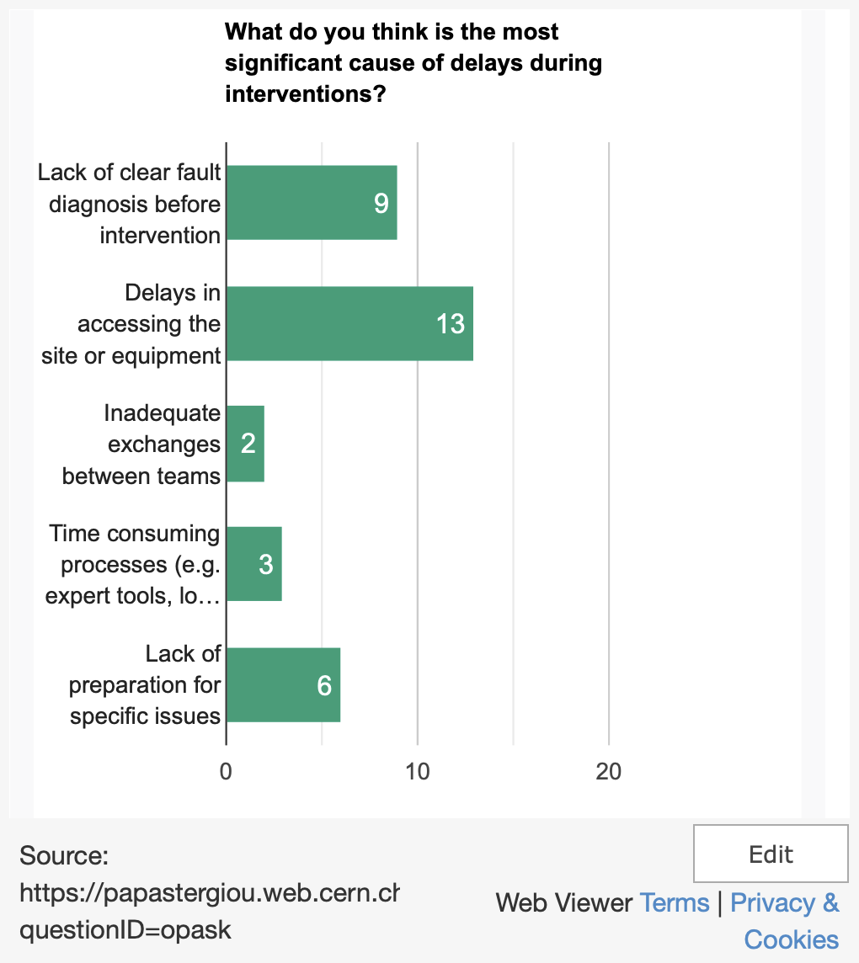
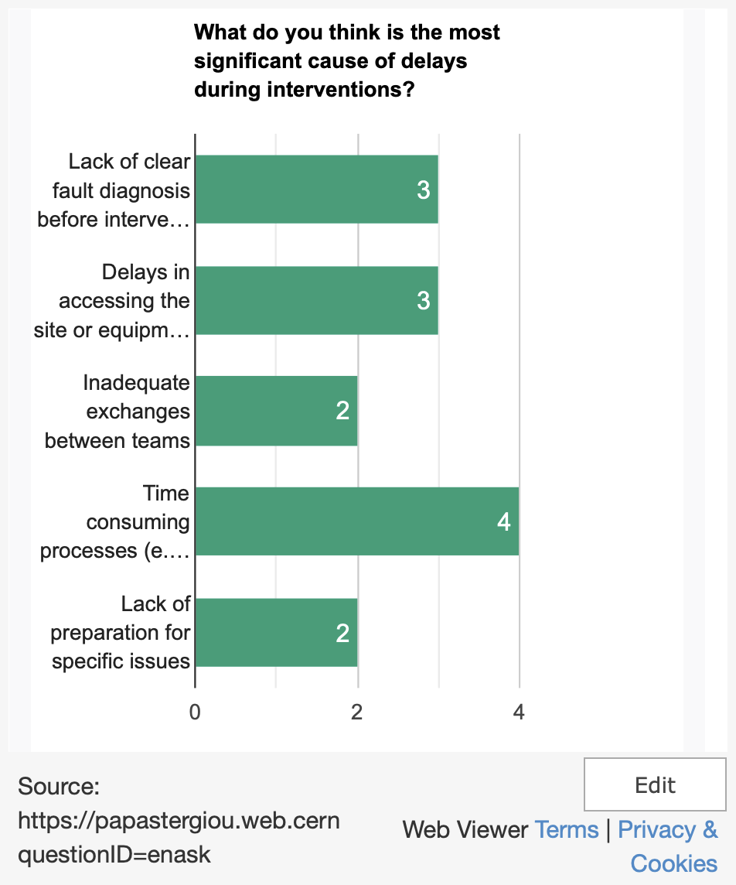
Equipment Experts
Operation-Physics Experts

Slide 26
Annex

Slide 27
On-site vs remote interventions per technology
as an indicator of readiness for automation

Slide 28
On-site vs remote interventions per service
as an indicator of readiness for automation

Slide 29
Example of standby hours evolution
* Single Technology group in ATS. Highlighted hours are reported weekly and are the sum of all hours declared by piquet personnel. Deeper colour corresponds to more hours

Slide 30
Example of total interventions evolution
* Single Technology group in ATS. Highlighted hours are reported weekly and are the sum of all hours declared by piquet personnel. Deeper colour corresponds to more hours

Slide 31
Definitions
Overtime sheet – an EDH document submitted for each accounting period by persons involved in :
  Shift work
  Stand-by service
  Out of hours interventions
Compensation hours – the hours of overtime adjusted for travel time and night, weekend, sundays and holidays. This corresponds to the actual paid sum.
Overtime – are hours of regular overtime in addition to the following:
  On-site intervention – requires the personnel to come on site. The person declares their actual intervention time and two hours (one in advance, one after) are added for travel time
  Remote Intervention – one that can be performed from home. This type of intervention also includes interventions of a second person that gave advice remotely.
Read more on admin guide:
Heures de travail
https://admin-eguide.web.cern.ch/procedure/heures-de-travail?check_logged_in=1
Rétribution des heures de travail spéciales
https://admin-eguide.web.cern.ch/content/retribution-des-heures-de-travail-speciales

