Slide 1
Automation of equipment commissioning, setting up and recovery
JAP Workshop 2024
Raul Murillo-Garcia
December 12th, 2024

Slide 2
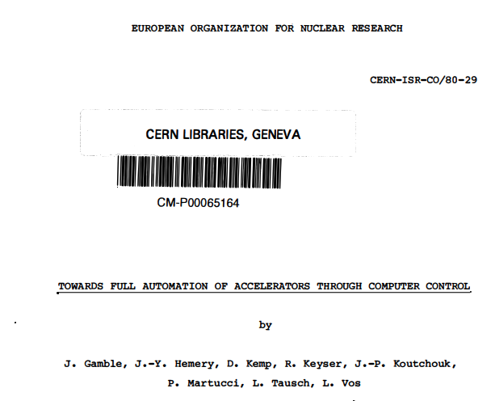
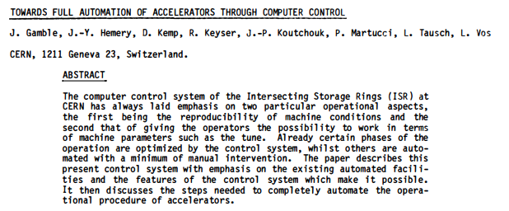
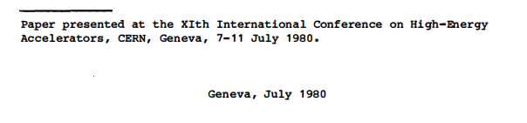
Why automation?
https://cds.cern.ch/record/1023439/files/CM-P00065164.pdf
Notes:
Hubble’s repair mission 700 million dollars.

Slide 3
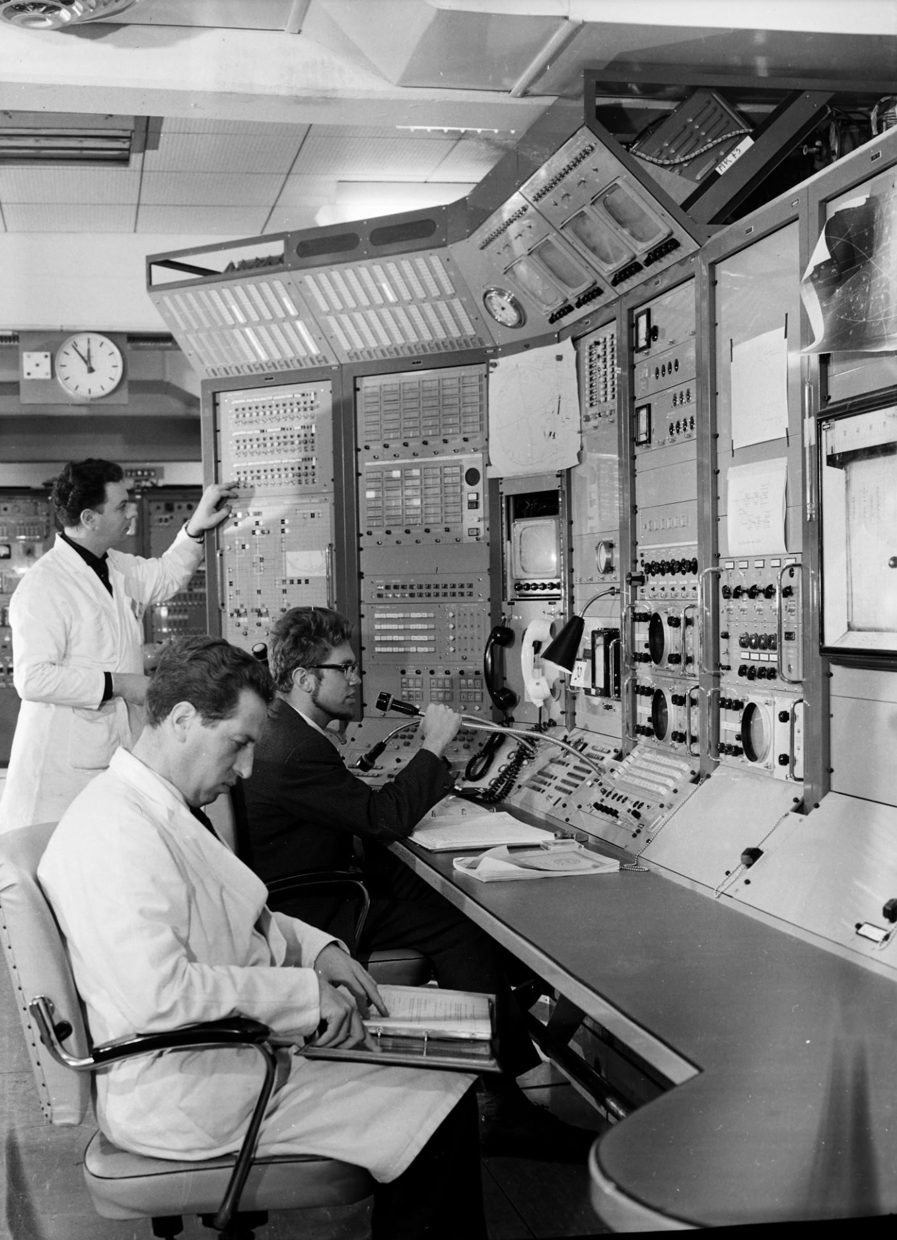
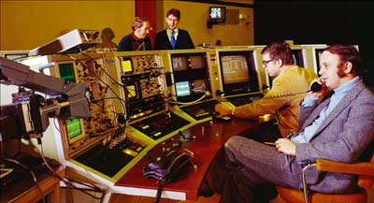
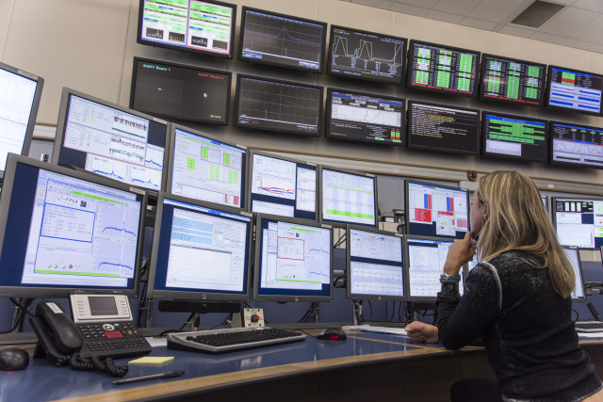
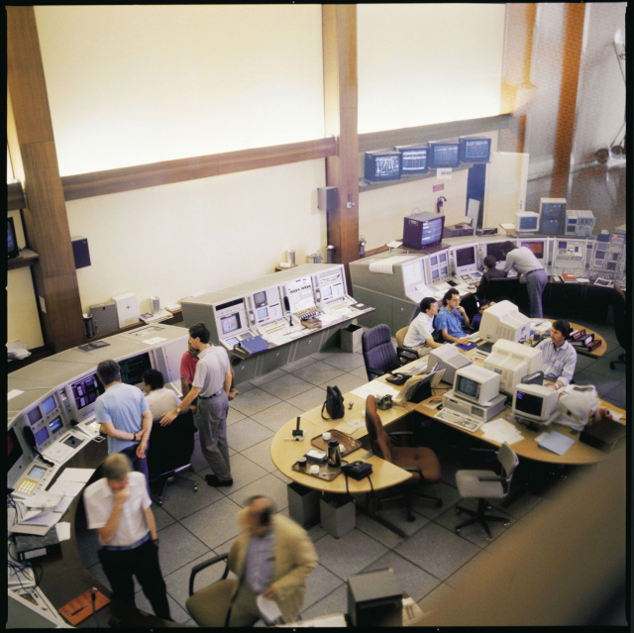
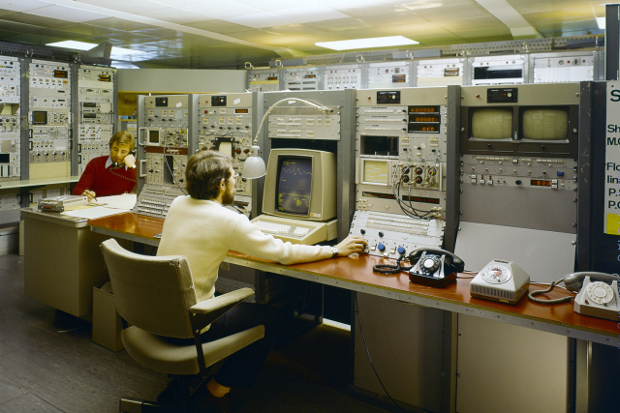
Why automation?

Slide 4
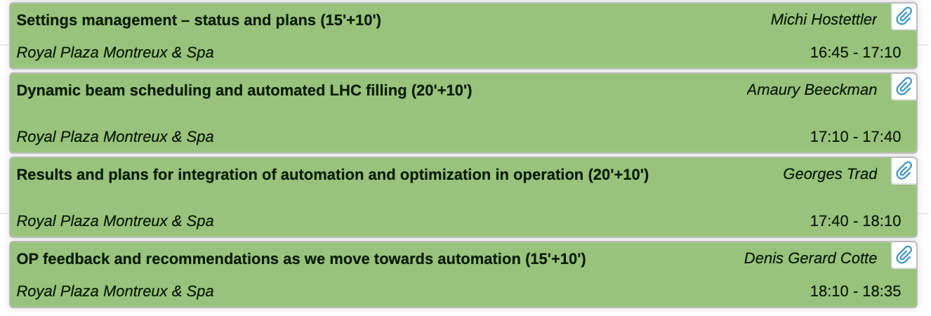
Automation evolves
To operate the LHC efficiently: orbit and tuner feedback, luminosity leveling, sequencer, automatic collimator alignments, etc.
Some of these tools have been ported to other machines.
In PS, the beam performance tracking logs the beam characteristics to detect beam drifts and trigger auto-steering.
SPS Mains harmonic compensation implemented in a ML algorithm.
Would be useful to have an automatic loss model to discern the intensity in PSB for an LHC beam given the losses across the complex.
Efficient LHC operation relies on advanced tools such as orbit and tune feedback, luminosity leveling, sequencers, and automatic collimator alignments, and many more.
Auto-pilot, auto-start of PS HF cavities, auto-reset of PS RF cavities, auto-steering in TT2, FGC notification, automatic optimizers, etc.

Slide 5



Why automation?
Lots of data produced by equipment devices.
Are we exploiting this data at its fullest?
Automation is everywhere: powerful processing units have facilitated AI, ML, etc.
Automation within a system and across systems, commission, analysis, recovery, etc.
Remote experiments, accessibility is not easy.
Redundancy, robotics, prognosis.
Notes:
Hubble’s repair mission 700 million dollars.

Slide 6
Why not to automate
To operate the LHC efficiently: orbit and tuner feedback, luminosity leveling, sequencer, automatic collimator alignments, etc.
Some of these tools have been ported to other machines.
In PS, the beam performance tracking logs the beam characteristics to detect beam drifts and trigger auto-steering.
SPS Mains harmonic compensation implemented in a ML algorithm.
Would be useful to have an automatic loss model to discern the intensity in PSB for an LHC beam given the losses across the complex.
Automation remains limited due to several key challenges:
  A trade-off exists between the required investment and the expected output.
  Resource constraints hinder progress.
  Existing hardware is not designed to support automation.
  Users ‘loose control’.
  Certain processes still require visual inspection (after beam stop check collimators, water leaks, etc.).
  Available tools and solutions are often not widely known or utilized.

Slide 7
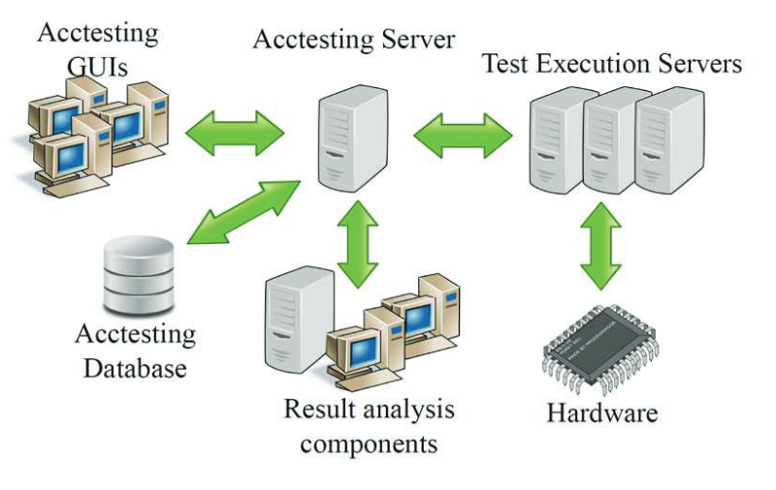
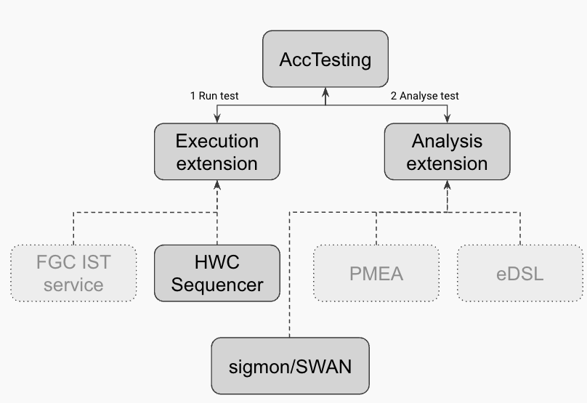
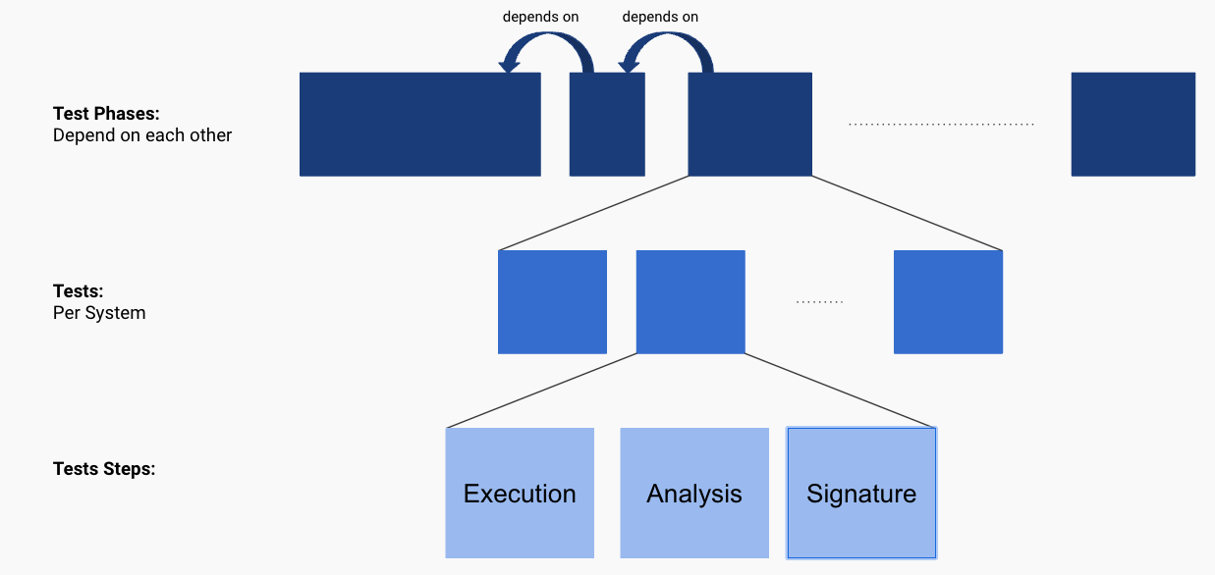
AccTesting
AccTesting is an extensible framework for orchestration and tracking tests executions, analysis and/or signatures.
GUI, server and Oracle DB.
Delegates to third party services (extensions) the execution and analysis.
AccTesting status and plans 2023 by JC Garnier

Slide 8
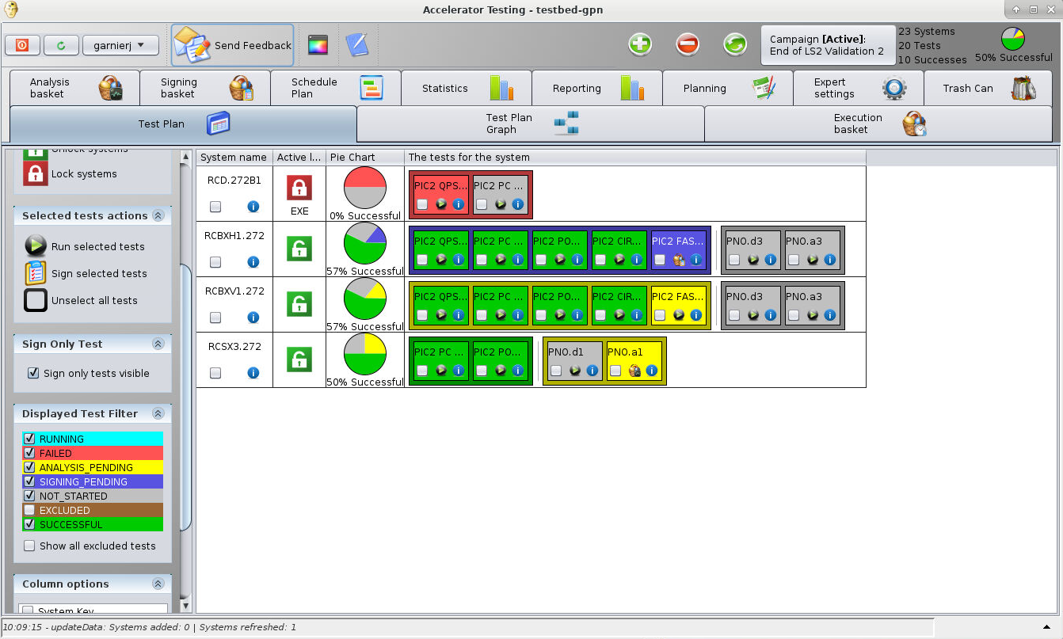
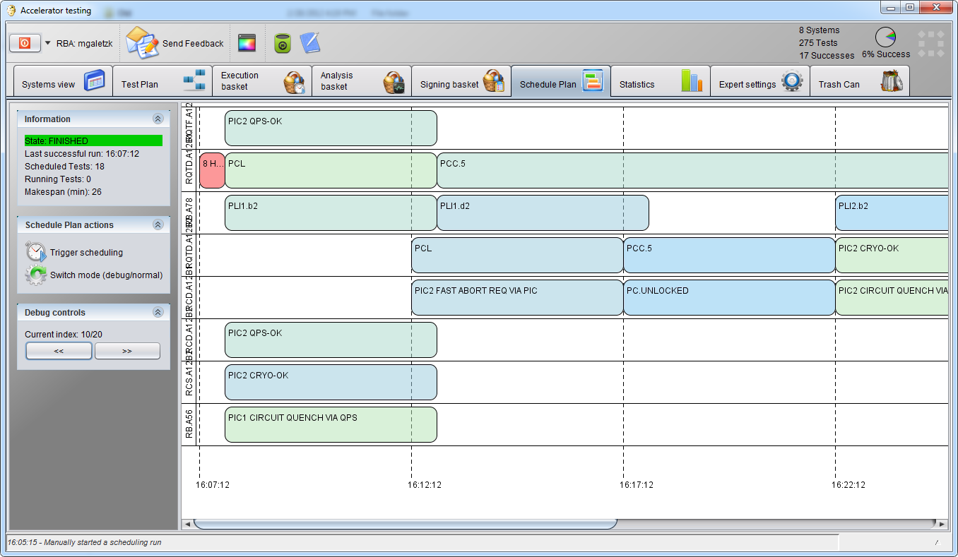
AccTesting
AccTesting status and plans 2023 by JC Garnier

Slide 9
AccTesting
AccTesting is used during the LHC hardware commissioning.
First tests using AccTesting in the injectors for PS power converter commissioning during HWC 2025
For more information or to evaluate how AccTesting could meet your needs, contact Jean-Christophe Garnier (MPE) or Andrea Calia (OP).
As part of EPA WP7:
  An upcoming collaboration between equipment experts and OP to assess AccTesting’s potential as a tool to further optimize machine and equipment commissioning.
  AccTesting is being restructured to leverage its features for use in other machines and campaigns, such as IST.
AccTesting status and plans 2023 by JC Garnier

Slide 10
Four phases of automation:
QA, efficiency and reliability
IST
LAB
LAB
HWC
BC
Beam agnostic
Equip
Failure
Beam present
Equip experts
Operators

Slide 11
Four phases of automation:
QA, efficiency and reliability
IST
LAB
LAB
HWC
BC
Beam agnostic
Equip
Failure
Beam present
Equip experts
Operators

Slide 12
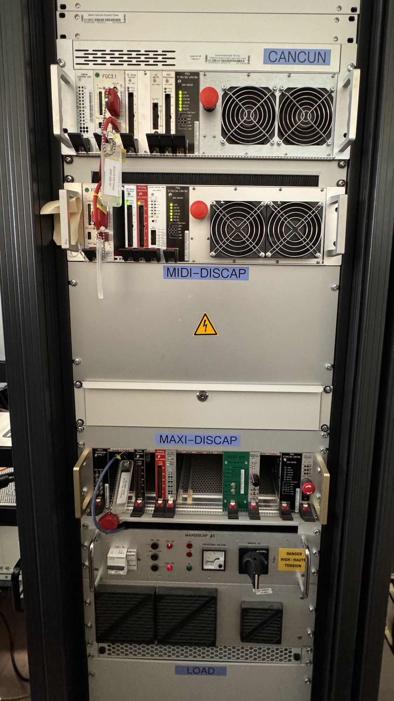
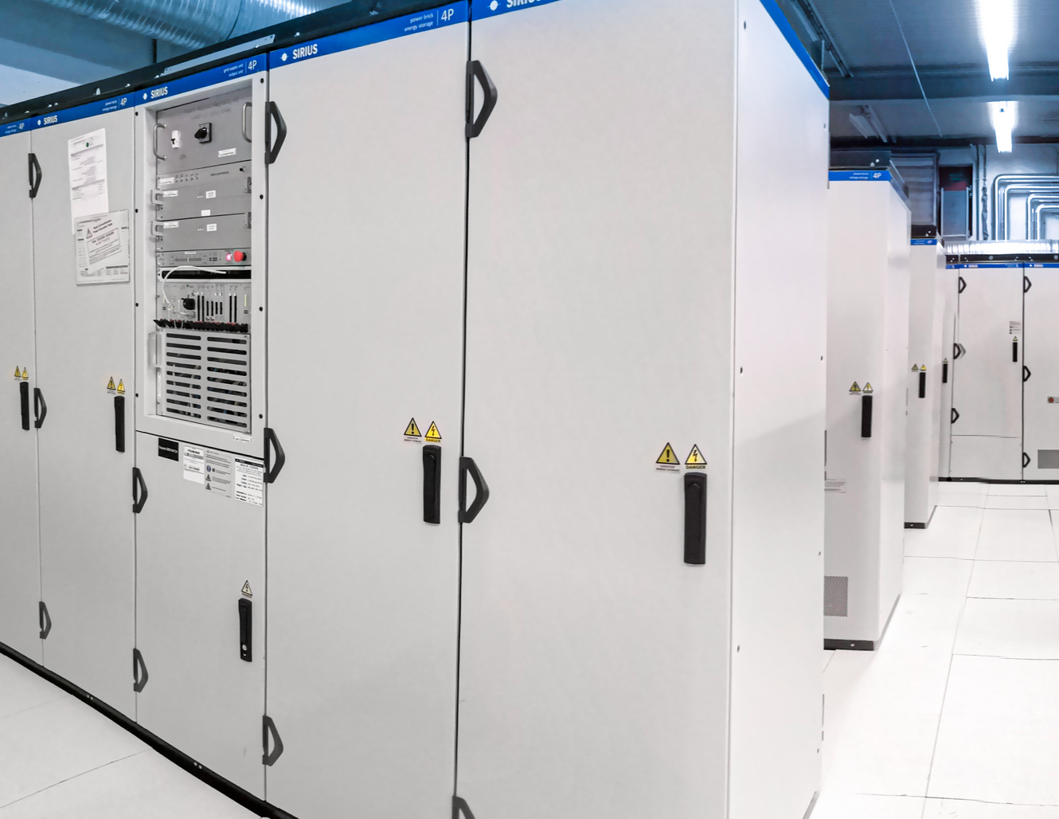
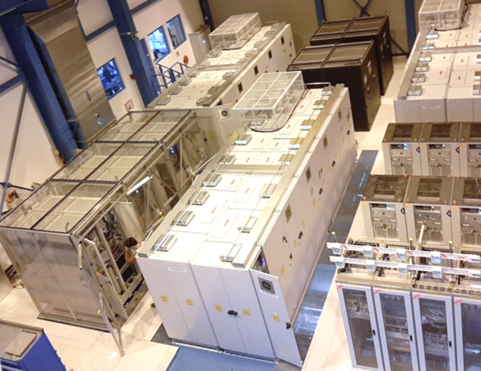


Automation in equipment labs: EPC

Slide 13
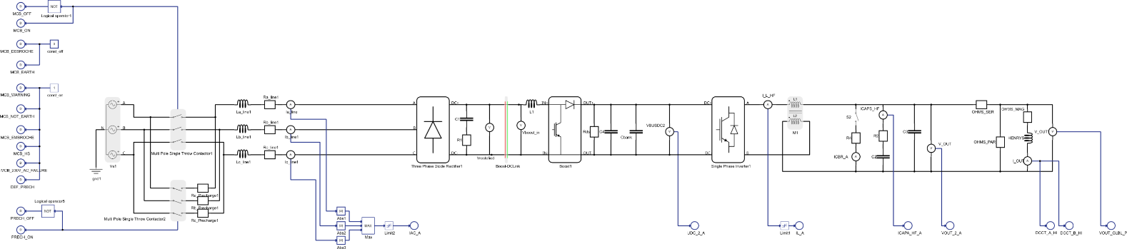
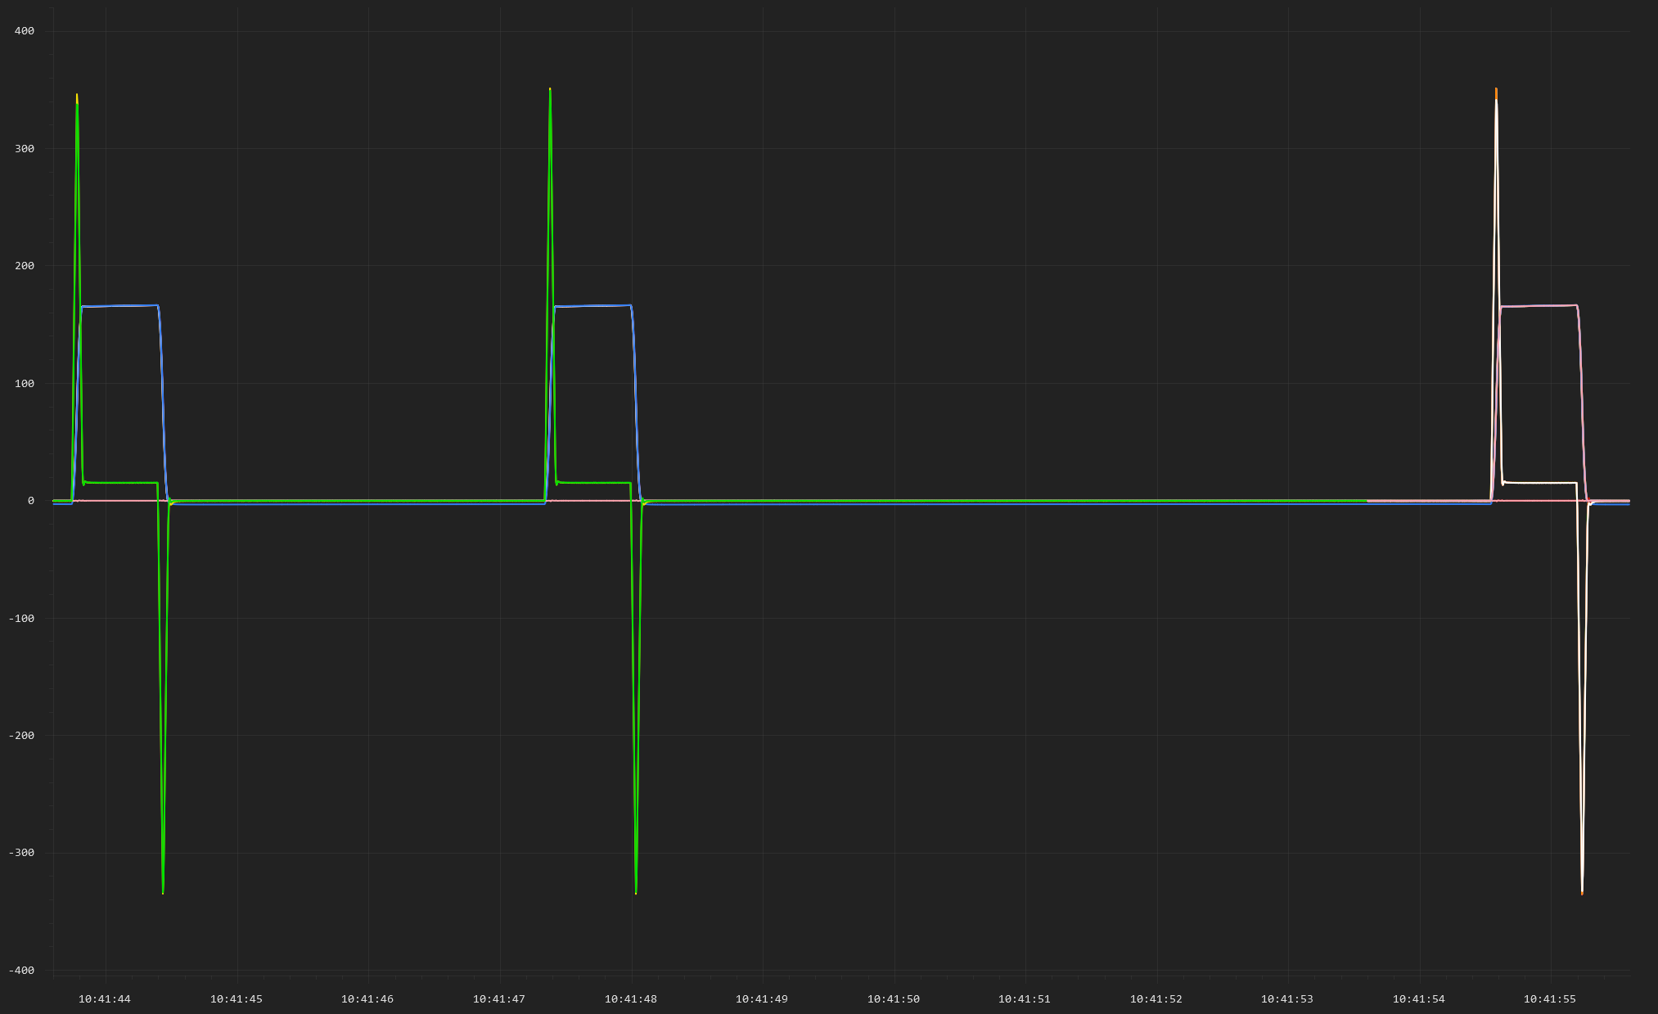
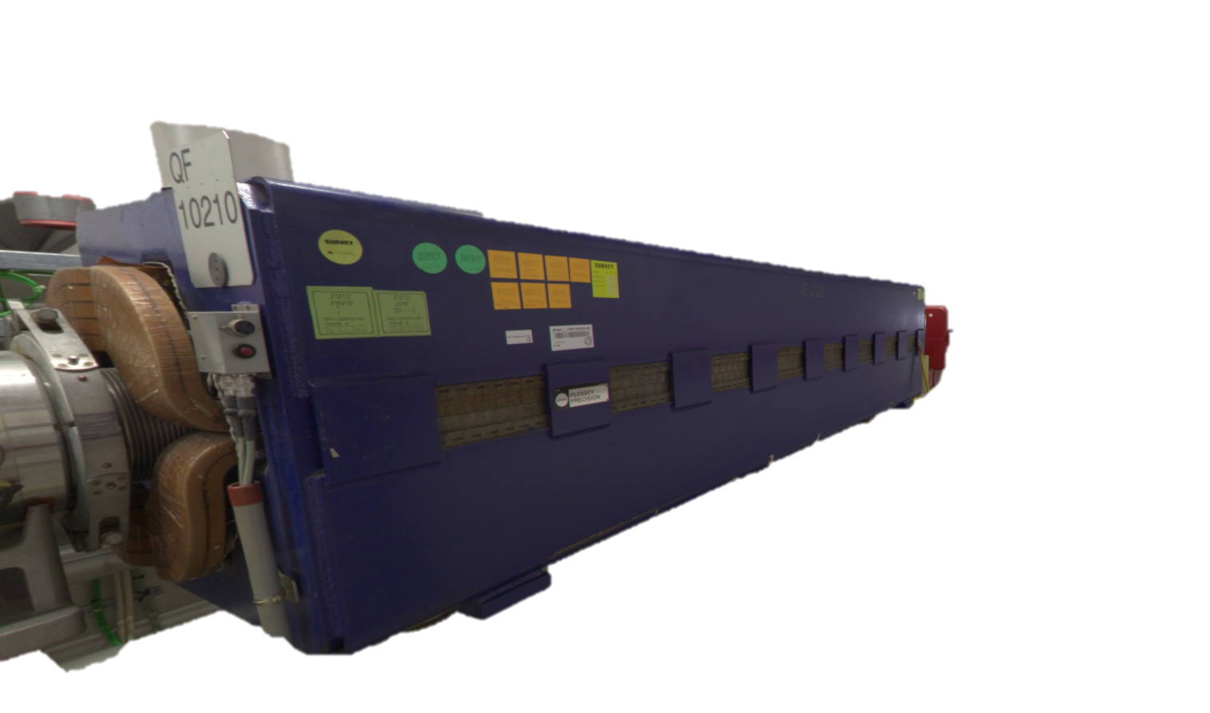
Automation in equipment labs: EPC
Model the converter, the magnet and the timing (if need be)

Slide 14
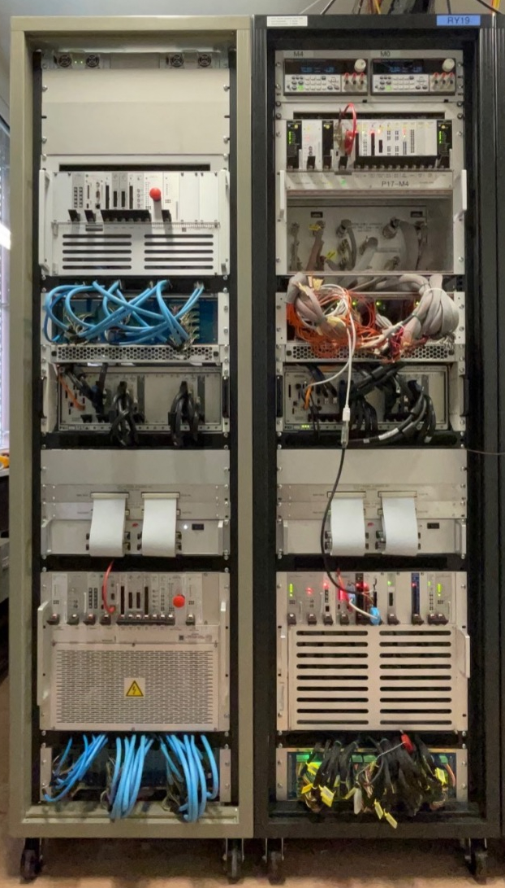
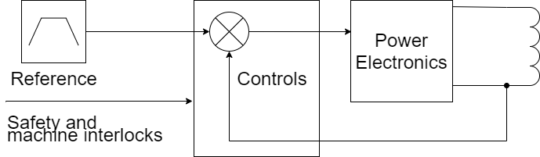
Automation in equipment labs: EPC
Magnet
Hardware In the Loop (Typhoon & SpeedGoat)
One system can emulate different types of converters by loading different models.

Slide 15
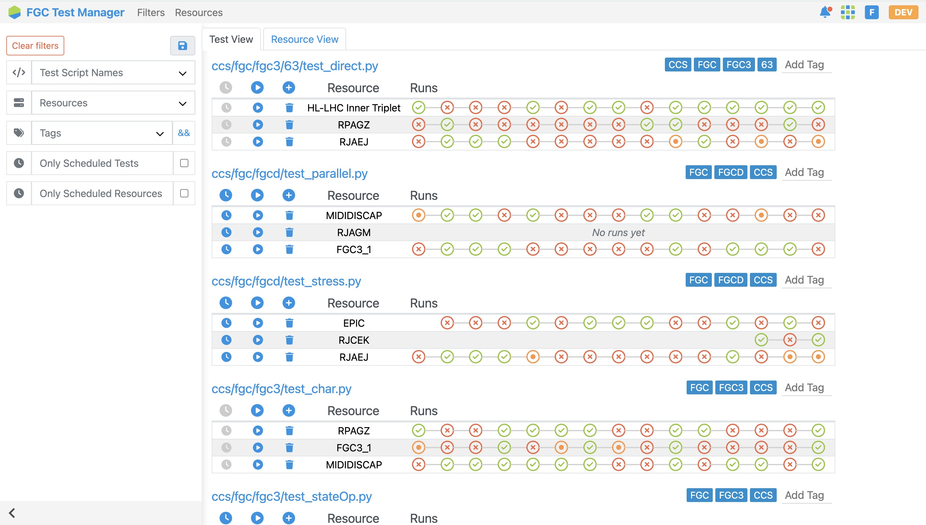
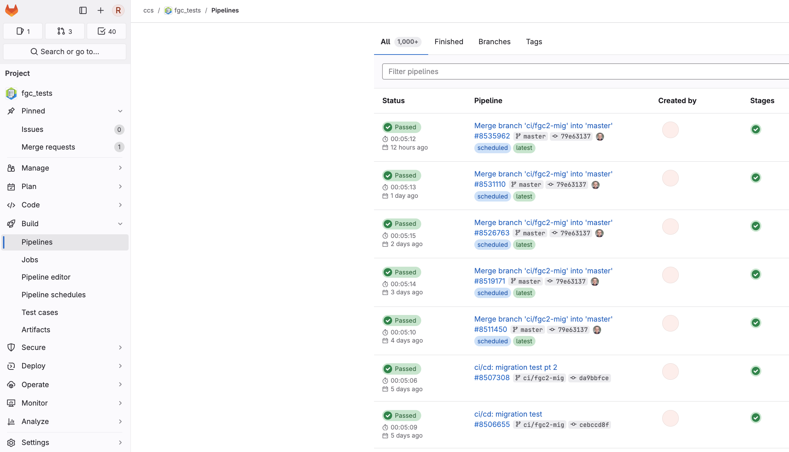
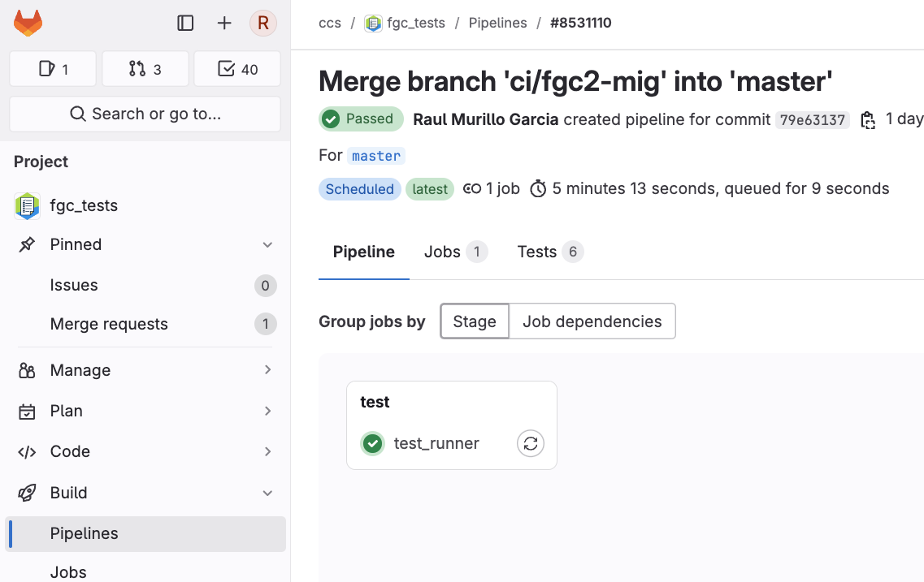
Automation in equipment labs: EPC
Python based library: test scripts that interact with FGC devices.
Test Manager GUI to associate tests to resources.
CI/CD with Gitlab to run test nightly or on demand.

Slide 16

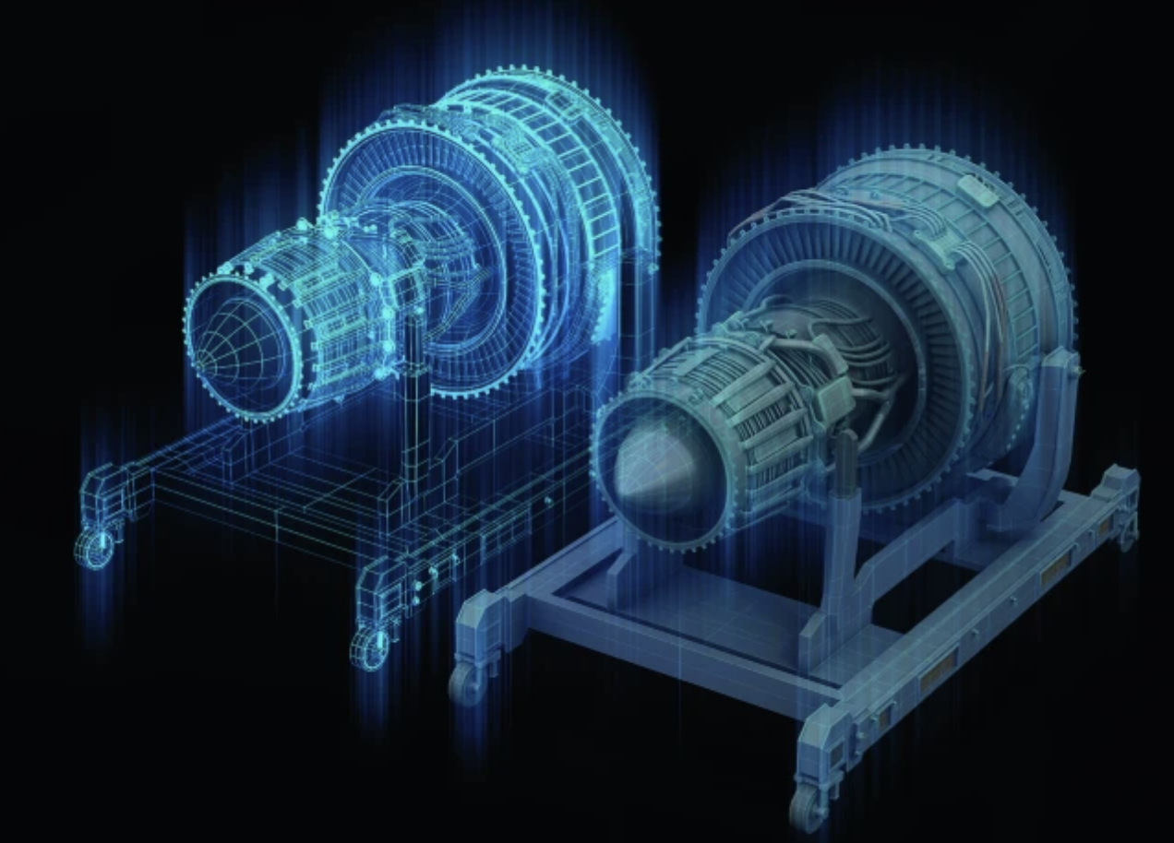
Automation in equipment labs
GitLab CI/CD is widely used across the lab to automate various processes, including VHDL functional tests, unit tests (Python, C++), builds, and releases.
Teams not yet using GitLab have expressed strong interest in adopting it.
  Real hardware setups.
  Testbenches for ABT mission-critical projects.
  Vertical slices (detector-to-interlock) for BI systems.
  Mock-ups or real hardware for STI systems.
  BE-CEM use digital twins to simulate equipment behaviour.
  Virtual and simulated hardware environments.
Some tests are performed manually, while others leverage automation with expert tools.
Certain upgrades, such as low-level RF systems that require a beam, can only be fully tested in the machine. This necessitates system integration tests during beam commissioning.

Slide 17
Four phases of automation:
QA, efficiency and reliability
IST
IST
LAB
HWC
BC
Beam agnostic
Equip
Failure
Beam present
Equip experts
Operators

Slide 18
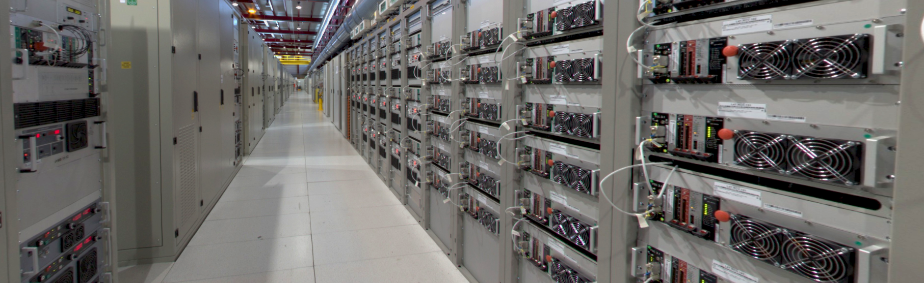
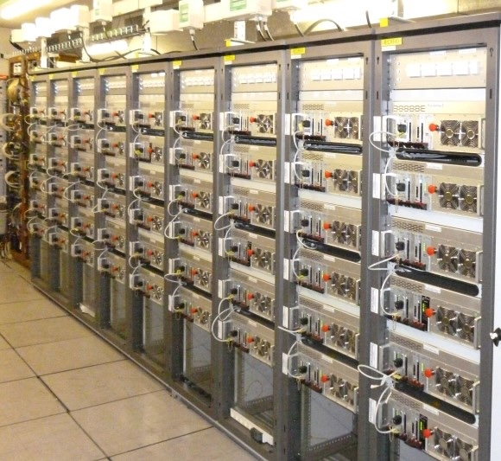
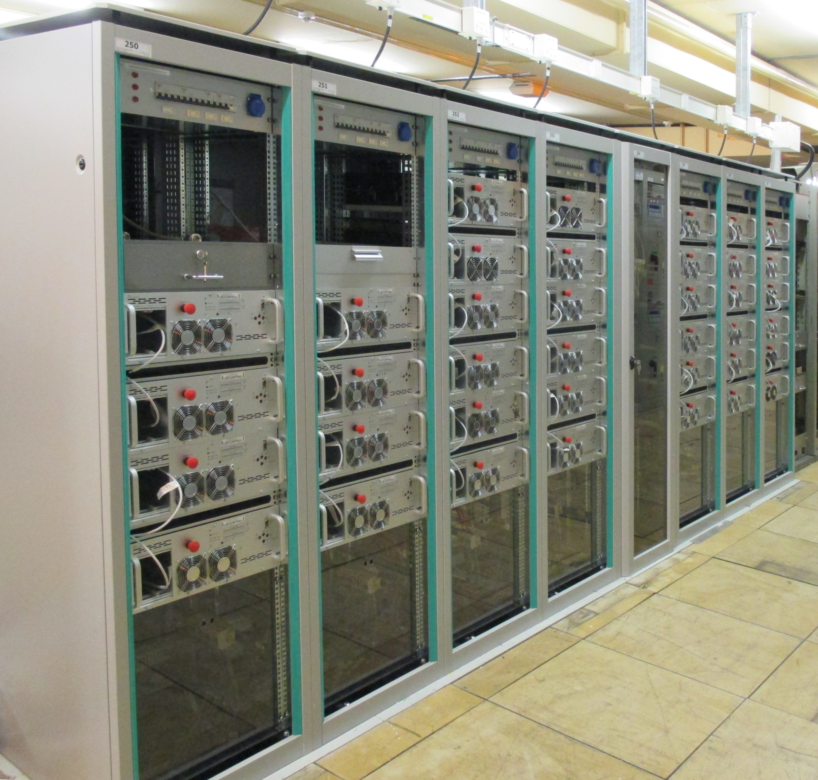
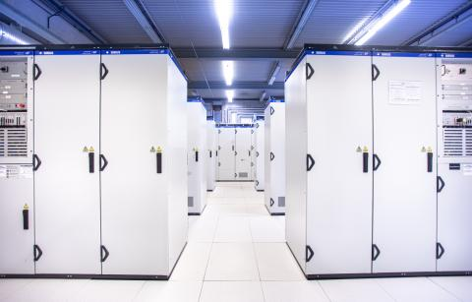
EPC upgrade deployment

Slide 19
EPC upgrade deployment
Upgrade deployed on thousand of devices during the IST period.
Converter experts validate the release manually: low coverage, no tracking.
Evaluate the use of AccTesting to automatize the validation of upgrades and increase test coverage.
Discuss with OP if the same tests can be run during hardware commissioning or further system integration tests are needed.

Slide 20
Deployment
Upgrades are deployed during IST or throughout YETS, depending on equipment availability.
Testing is primarily conducted manually by experts.
In some cases, validation is automated using the sequencer and/or specialized expert tools.
The validation of LHC/SPS RF systems is automated due to their design, but the process still takes approximately two weeks. For legacy systems, such as those in the PS, validation remains a manual process.

Slide 21
Four phases of automation:
QA, efficiency and reliability
IST
LAB
HWC
BC
Beam agnostic
Equip
Failure
Beam present
Equip experts
Operators

Slide 22
Hardware and beam Commissioning
Hardware and beam commissioning processes are complex and vary depending on the machine.
Checklists are validated by equipment groups, experts, OP, or a combination
The level of automation differs across machines: LHC HW commissioning using AccTesting; in other machines, tests are automated using the Sequencer, but there is room for improvement; certain checks still require manual execution.
AccTesting is being evaluated as part of an effort to gradually automate processes. As part of the EPA project, a dialogue will be initiated between OP and equipment experts to support this effort.
Reducing HW or beam commissioning makes a difference if the other machines can start HW or beam commissioning earlier.

Slide 23
Four phases of automation:
QA, efficiency and reliability
IST
LAB
HWC
BC
Beam agnostic
Equip
Failure
Beam present
Equip experts
Operators

Slide 24






Equipment failure
Reset
Device
Fault
Diagnostics
Piquet
Expert
Reset
Fault
Diagnostics
Repair

Slide 25
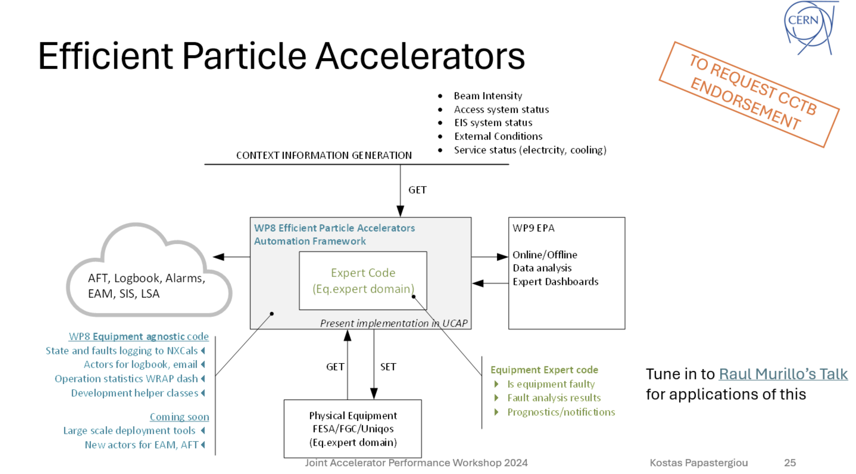
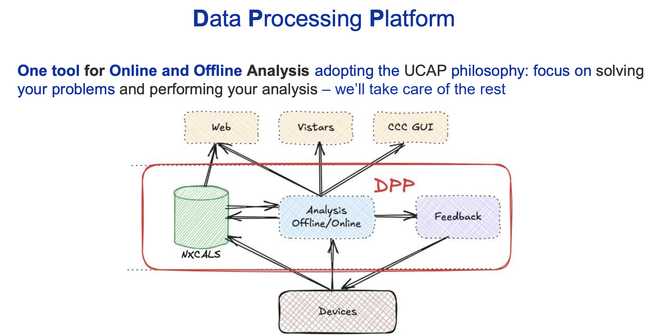
Automation framework: EPA WP8 & WP9

Slide 26
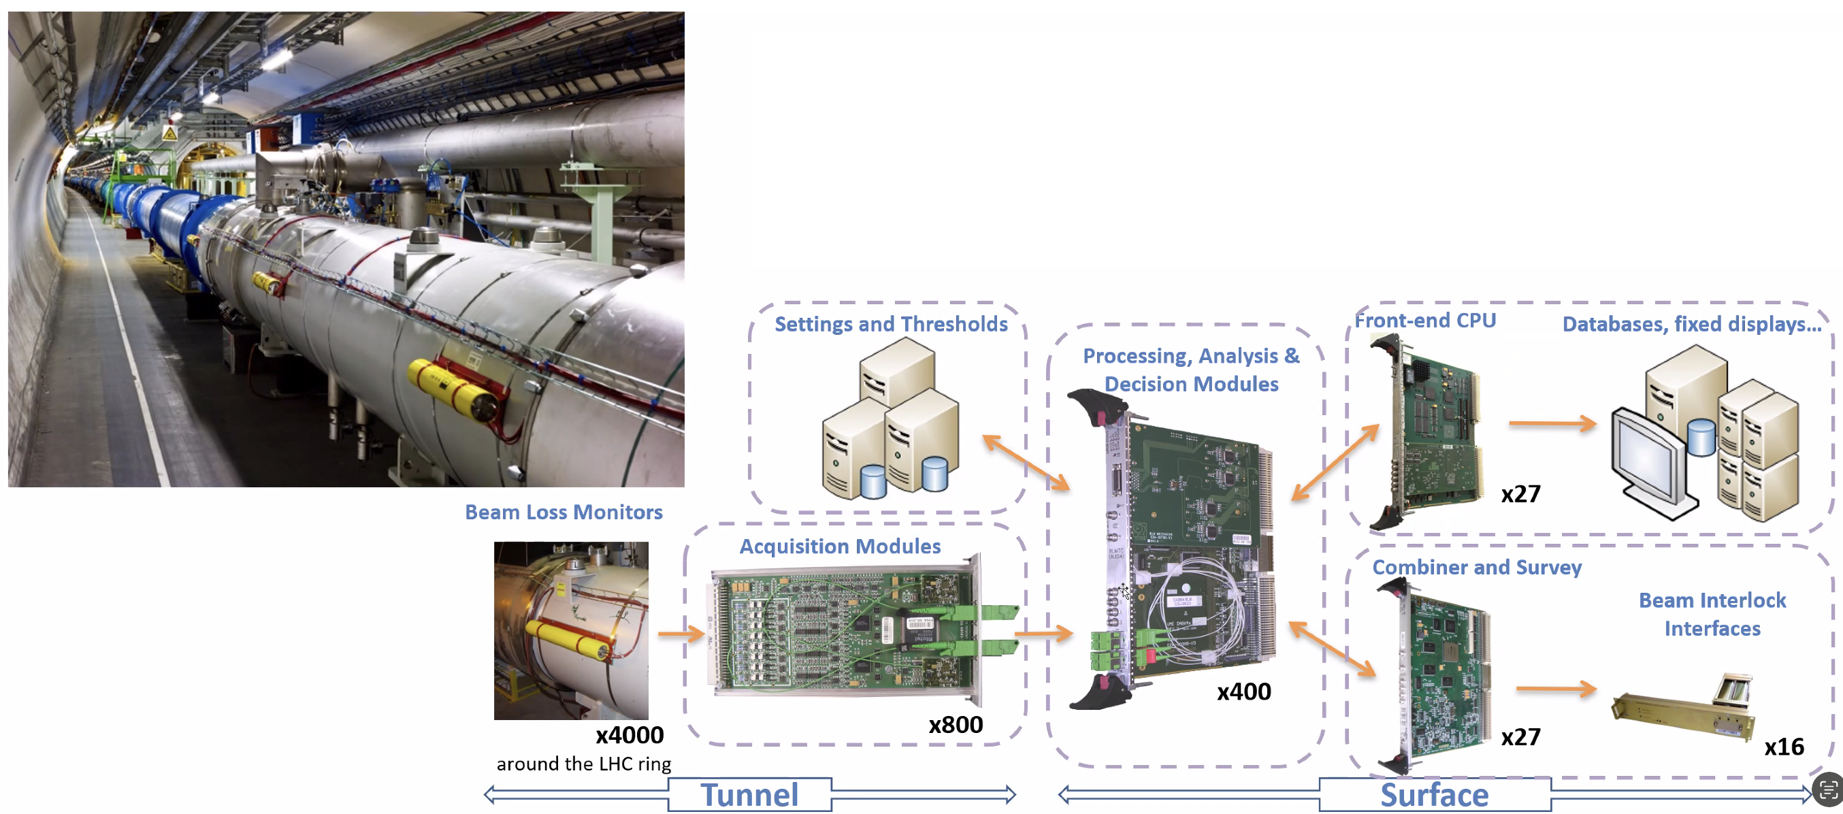
Automation framework: BLM monitoring
Monitoring the connection status between the BLM acquisition boards and the processing modules.

Slide 27
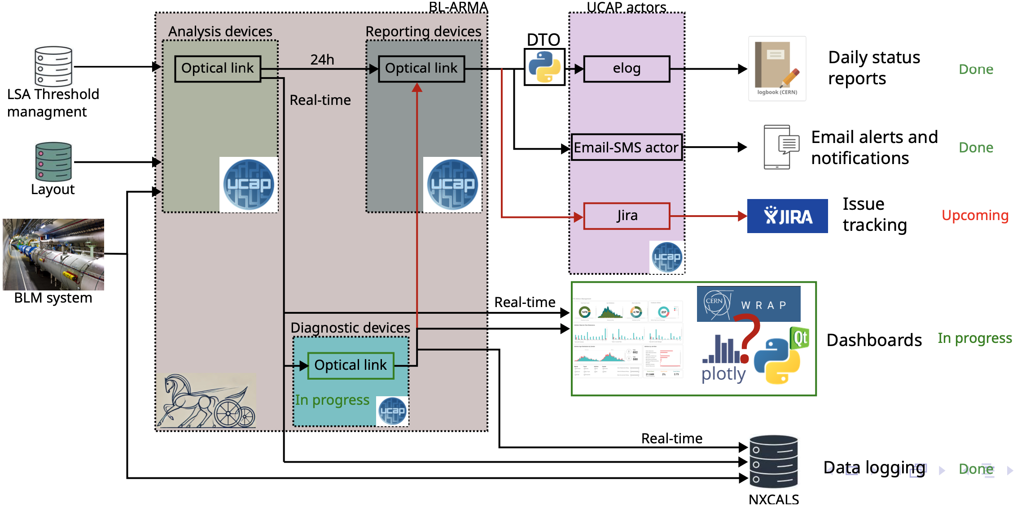
Automation framework: BLM monitoring
Connection status of 4,000 BLMs.
Diagnostic produce real-time data logged in NXCALS, WRAP dashboards…
Every 24 hours, reporting to emails, logbook, Jira issues, notify the piquet directly.
Equipment already auto-reset, so auto-recovery not meaningful.
Human intervention is required for fault resolution.

Slide 28
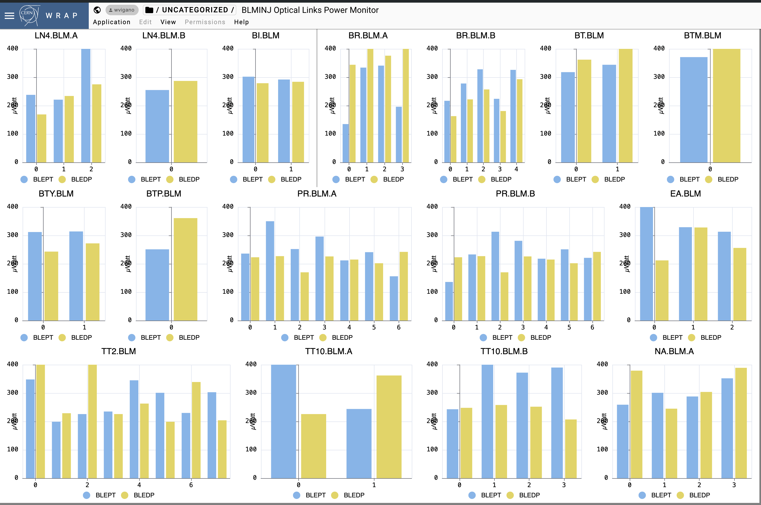
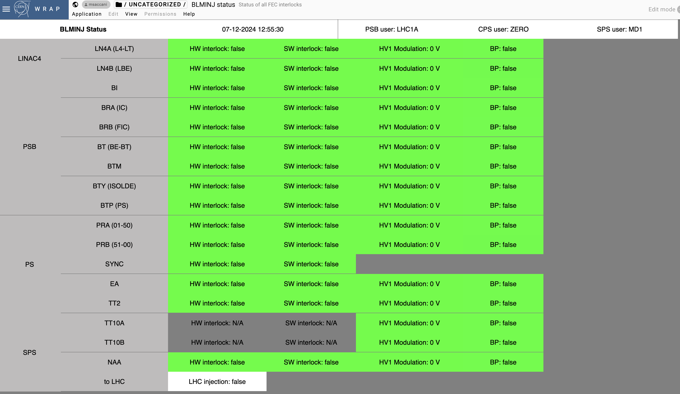
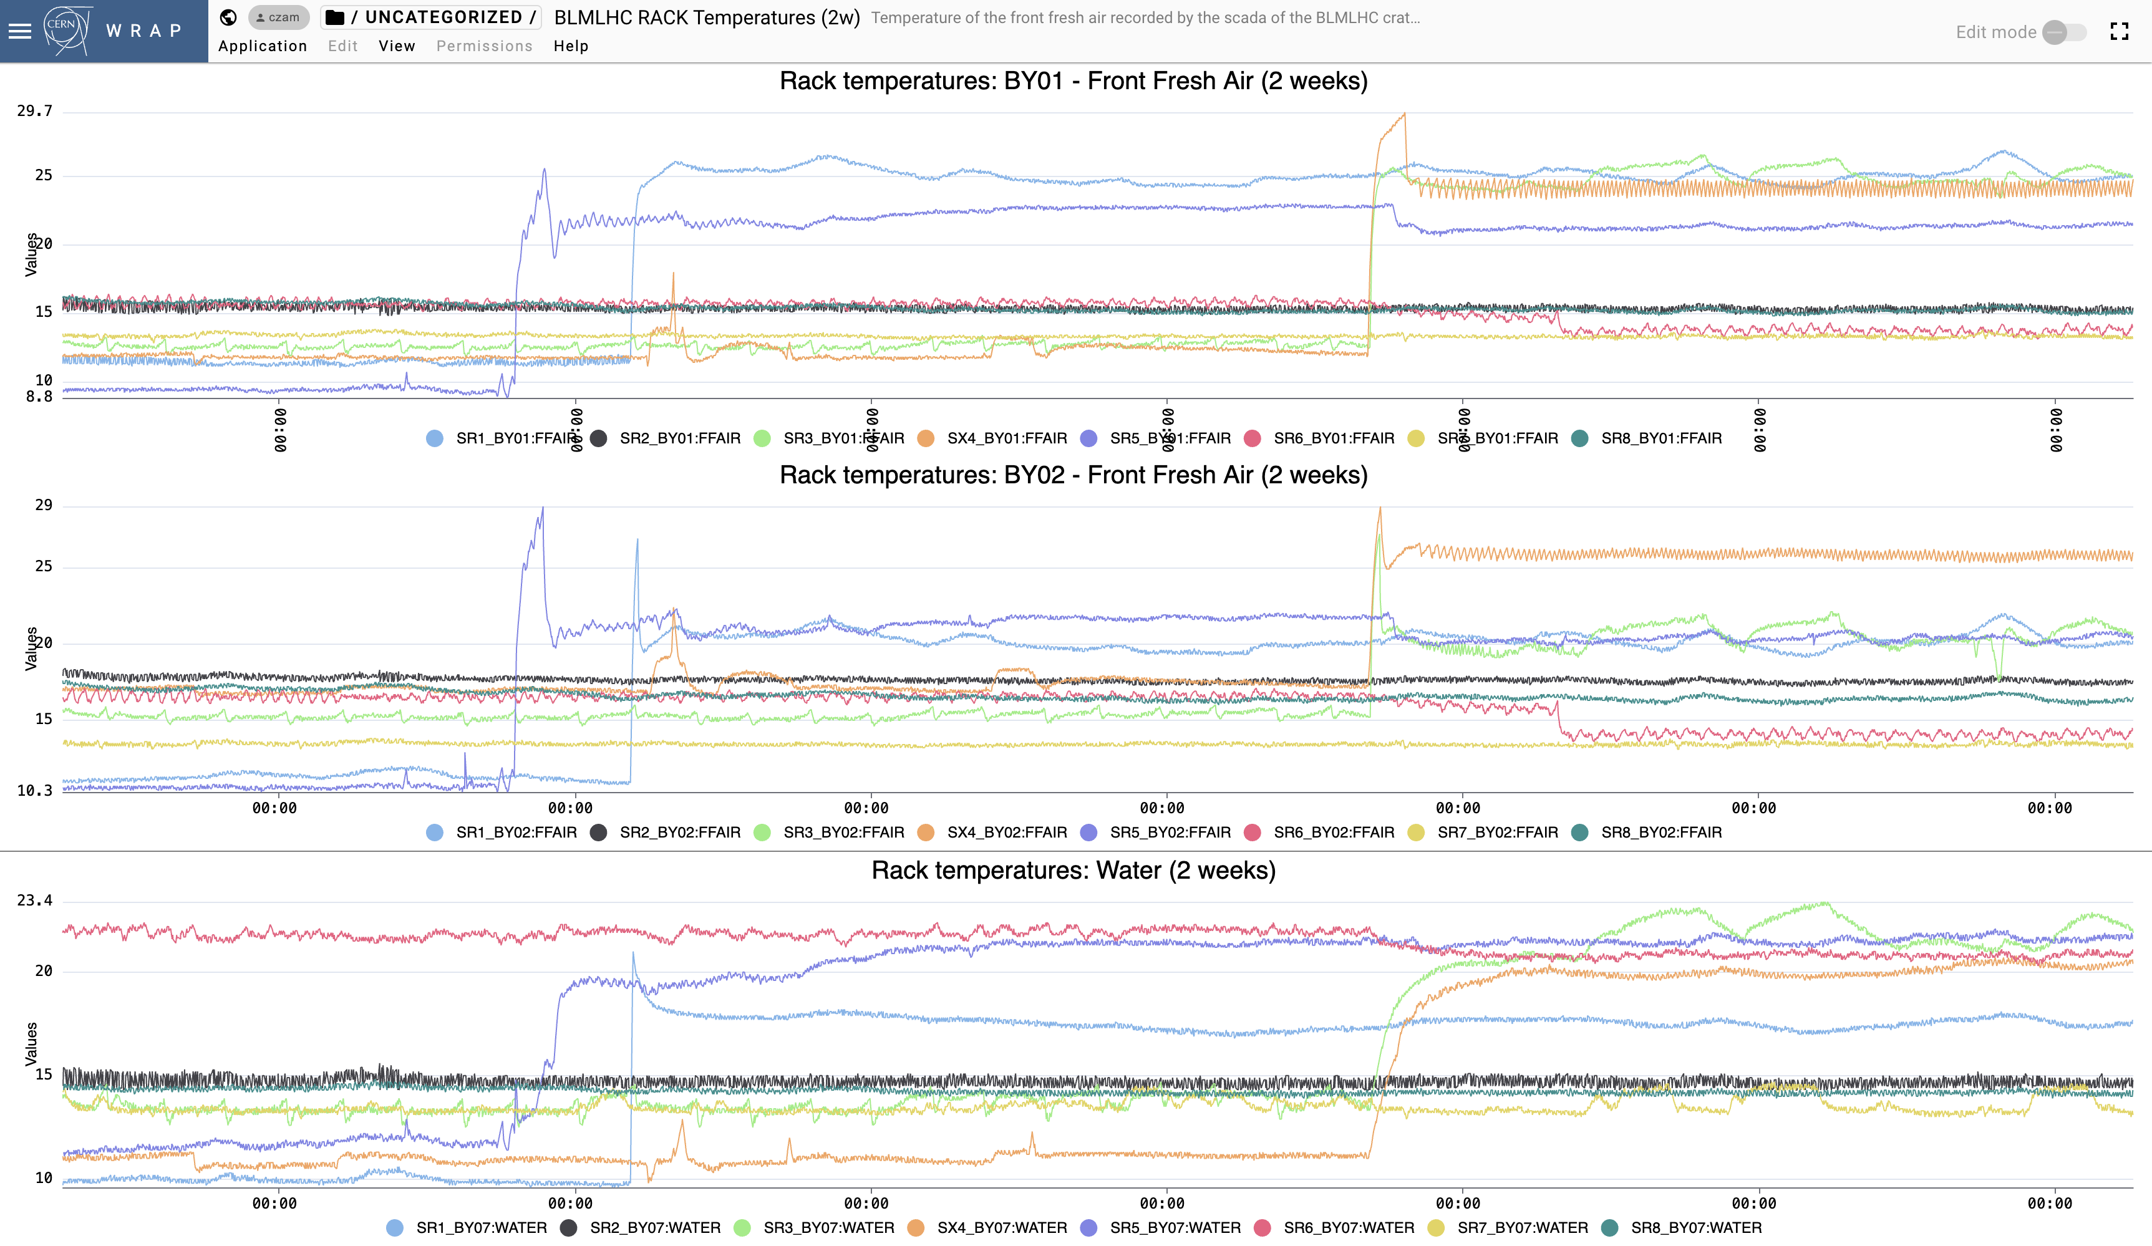
Automation framework: BLM monitoring

Slide 29
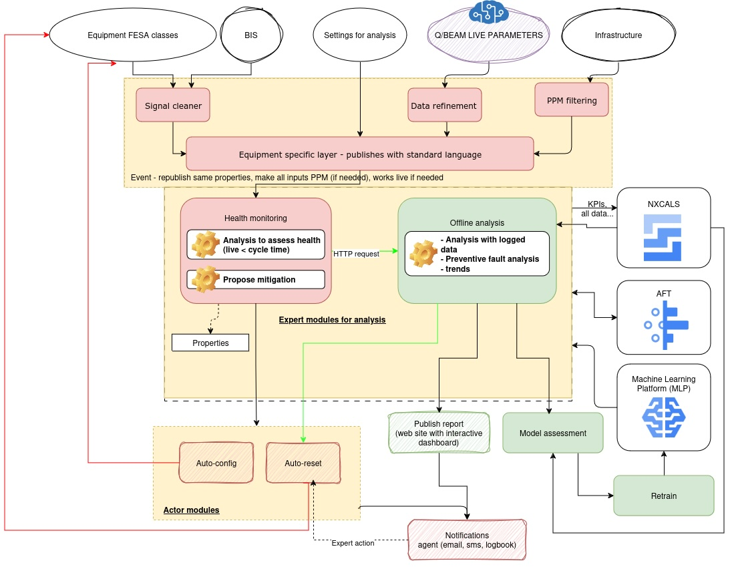
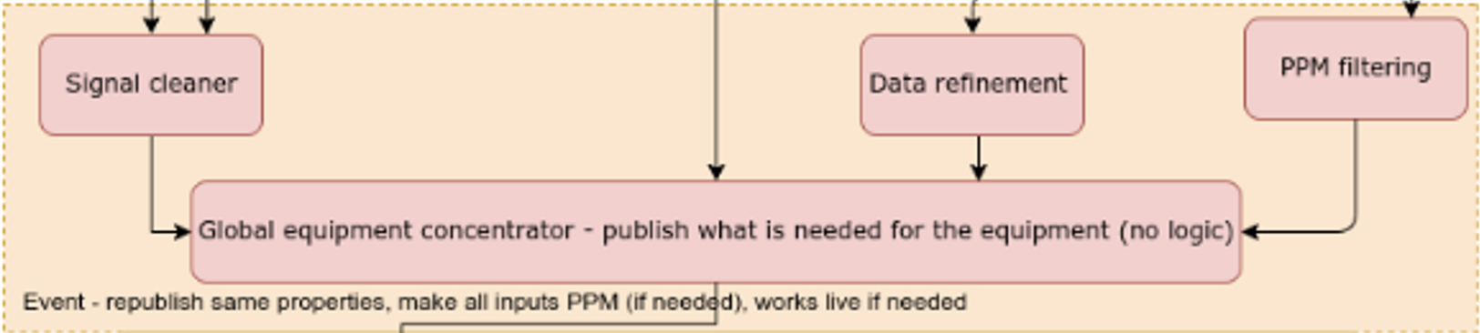
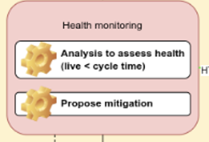
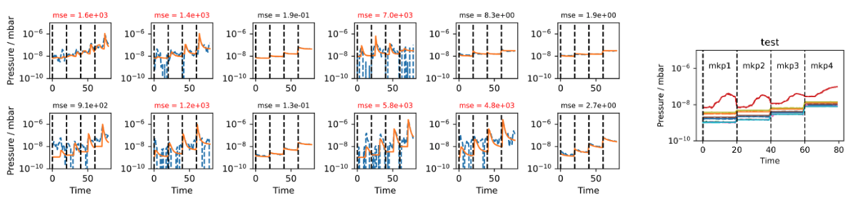
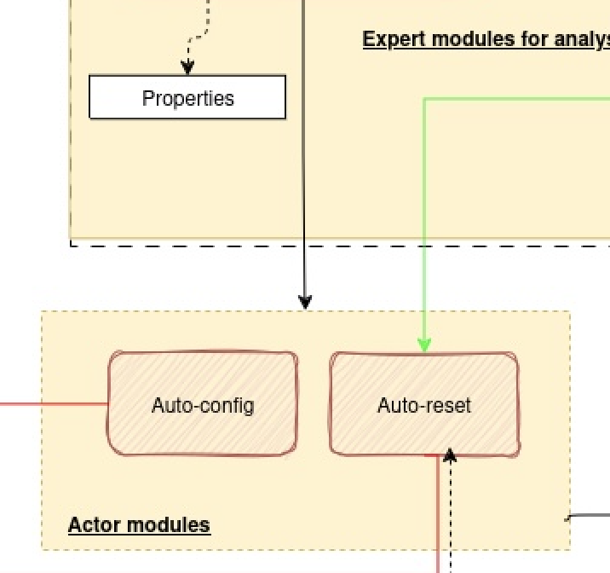
Automation framework: kicker spark detection
MKP faults are reported through the standardized UCAP.
When a fault occurs, the analysis monitoring logic retrieves vacuum pressure data and inputs it into an autoencoder (neural network).
The autoencoder has been trained using real, non-anomalous data. If the actual input deviates from the predicted input, the logic can determine whether the root cause was a spark.
Next step is to automate the start of conditioning or the interlock reset.

Slide 30
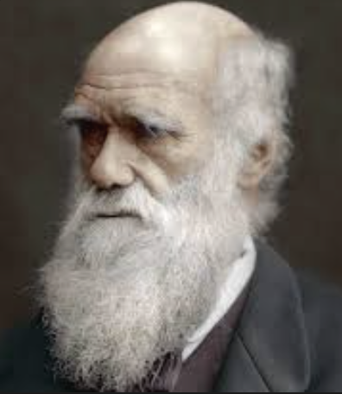


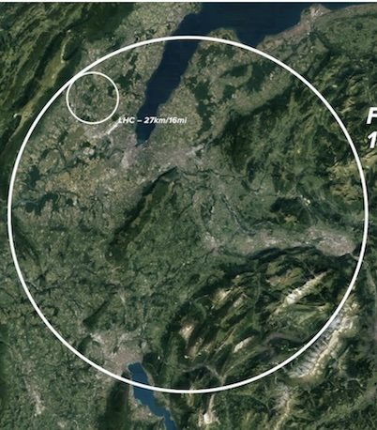

Conclusion
Foundation for Future
Evolution
Collaboration
Forum
Revolution

Slide 31
Conclusion
“So far, we've automated as much as we can … with the resources we have. The next step would be a big investment in time… that of course, would outweigh the benefits in the long term, but the fact is that today we just don't have these resources, sadly enough.”
There is a strong collective desire to improve processes.
But allocation of resources is essential to drive this effort forward.

Slide 33
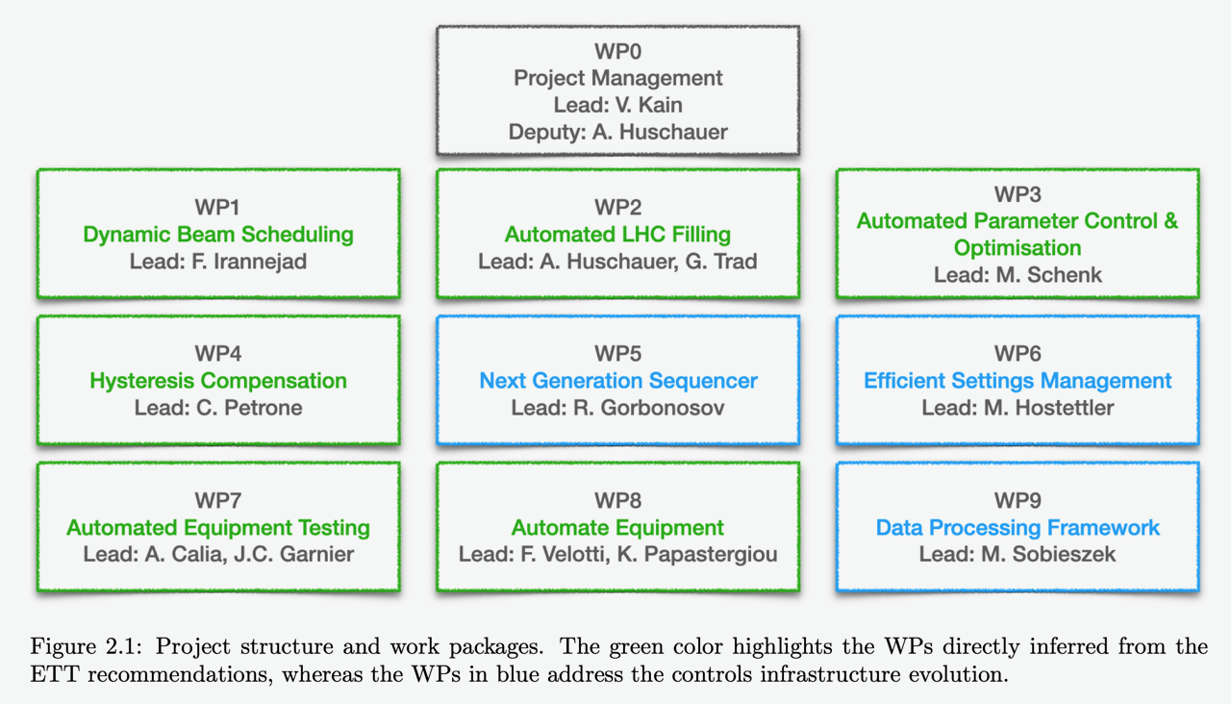
EPA organigram

