Slide 2
Third Joint Accelerator Performance Workshop
10-12 December 2024
Chairs: H. Damerau, M. Solfaroli
Co-chairs: G. Rumolo, J. Wenninger
Core team: R. Alemany, D. Banerjee, H. Bartosik, F. Carra, V. Kain, A. Lasheen, B. Mikulec, C. Pasquino, E. Todesco

Slide 3
JAP24
MAIN SCOPE:
Identify lessons and achieved performance of 2024 + discuss machine configuration and target performance for 2025
EXPECTED OUTCOME:
Updated performance limitations
Collect input on 2025 operational configuration and performance targets
Priorities for studies and operational improvements to be done before LS3
Provide input to Chamonix 2025 Workshop
Looking forward for open and detailed technical discussions

Slide 4
‘Experimental’ JAP24 setup – Pillars for accelerator performance
Operation
Equipment
Beam dynamics modeling
Controls, data and automation
Sessions built on “Bilaterals” between each pair of pillars

Slide 5
Programme outline
Tuesday | Setting the scene | G. Rumolo, J. Wenninger
 | Operation ↔ Equipment | G. Papotti, N. Charitonidis
Wednesday | Beam dynamics modelling ↔ Equipment | C. Hernalsteens, H. Timko
 | Beam dynamics modelling ↔ Operation | D. Mirarchi, F. Asvesta
 | Controls, data and automation ↔ Operation | A. Calia, M. Schenk
Thursday | Beam dynamics modelling ↔ Controls, data and automation | G. Iadarola, V. Kain
 | Equipment ↔ Controls, data and automation | A. Huschauer, F. Velotti

Slide 6
Organizational stuff 1/2
Not a hybrid workshop, but ZOOM link is available on the INDICO page: https://indico.cern.ch/event/1439972/videoconference/
WIFI: Name: CERN, PSW: 996447330
Check-in is from 3:00 pm and the check-out BEFORE 12:00 pm on Thursday
  Extra costs (mini-bar, bar, etc.) should be declared and paid individually
Dietary requirements: Each participant with a special diet will receive a colored card with a number corresponding to their requirement. This card should be kept and placed in front of the plate at each meal
  Please go and see Eleanor during the first coffee break to get the card
For any organisational matter please contact Eleanor
For any technical matter please contact Herve

Slide 7
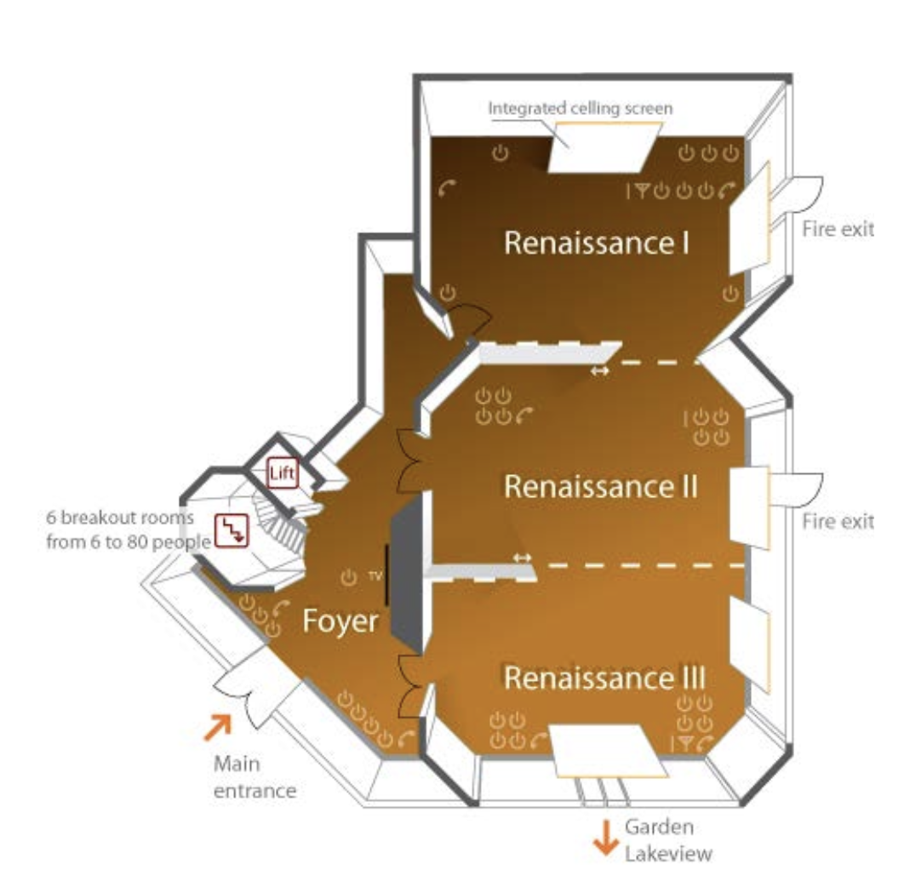
Organizational stuff 2/2
RESTAURANT (Café Bellagio) is located in the nearby building. Go through the garden and straight into the building, until you find the restaurant
LUNCHES (water, coffee, tea) will be served in the restaurant on buffet (not standing)
DINNERS (water, coffee, tea + soft drinks and wine) are served in the restaurant at 20h
COFFEE breaks will be hosted in the lobby outside the room AND in the area downstairs
TOILETS are downstairs

Slide 8
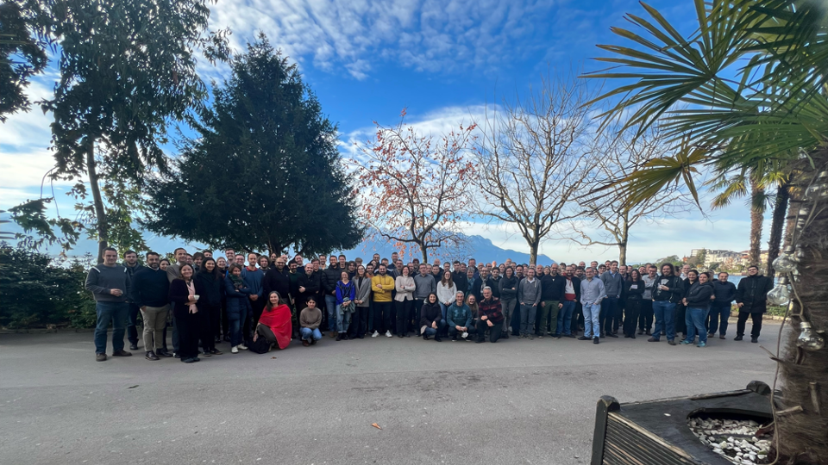
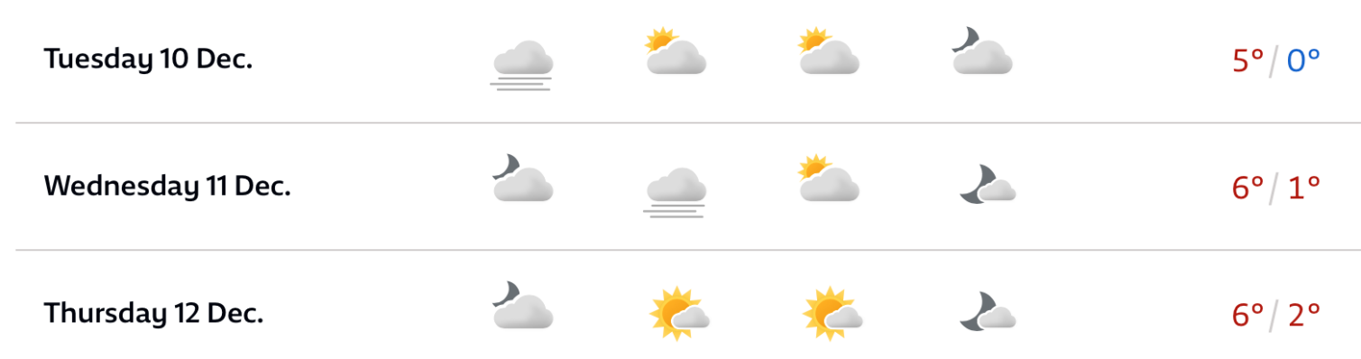
Group photo
We aim at taking the group picture this afternoon, as meteo looks good and we have to compete with the sunny one from 2023

Slide 9


