Slide 1




Simulating and Analyzing Crystal Channeling in the Large Hadron Collider
Francie Wharton
August 9th, 2024

Slide 2
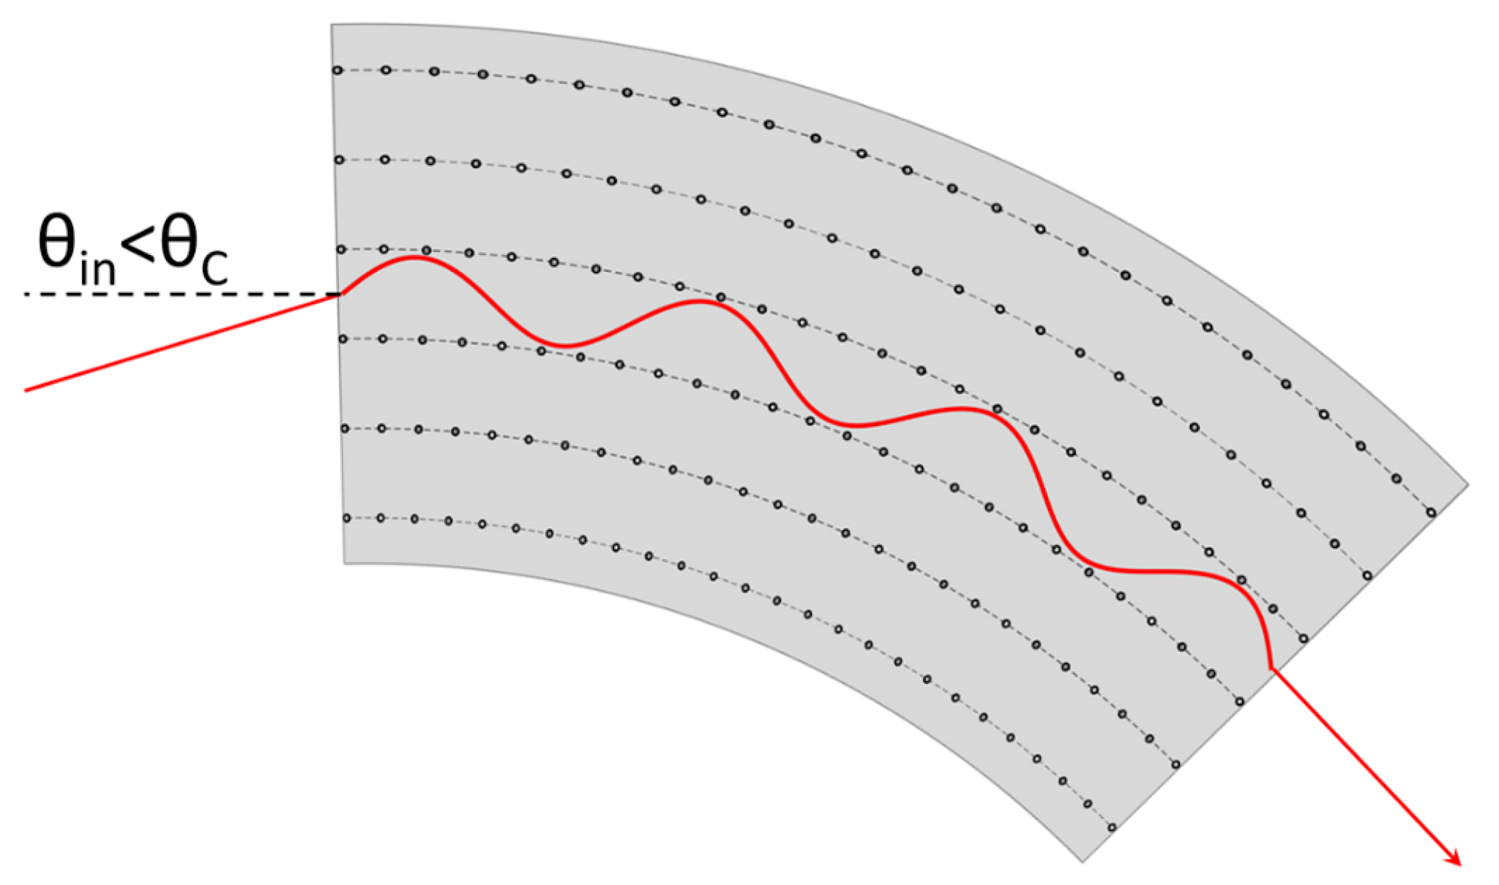
What is crystal channeling?
Lattice structure
Channeling: when particles are confined between crystalline planes
  Incident Angle (θ_{in}) < Critical Angle (for channeling) (θ_{c})
Bent crystals used to control/redirect particles

Slide 3
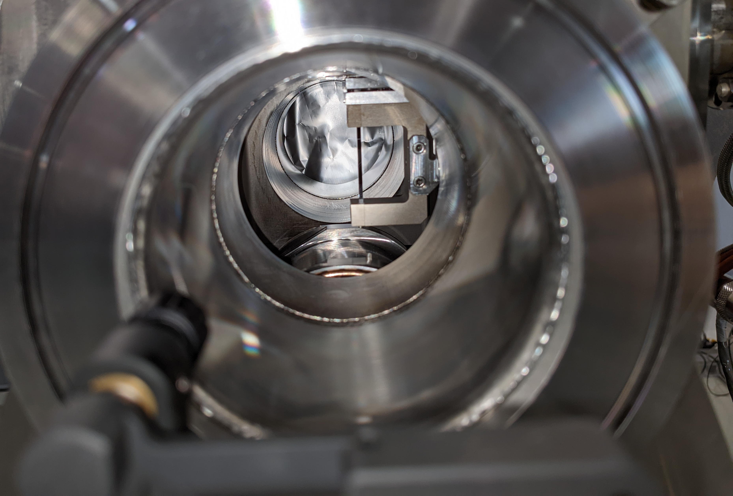
Crystal collimation
B2H Crystal
4 mm length
Bending Angle: 45 μrad
Crystal
Collimators
Absorber
Beam Halo
Conventional collimation relies on random scattering
Crystal collimation is deterministic
Effect is equivalent to a magnetic field of 100s of Tesla

Slide 4
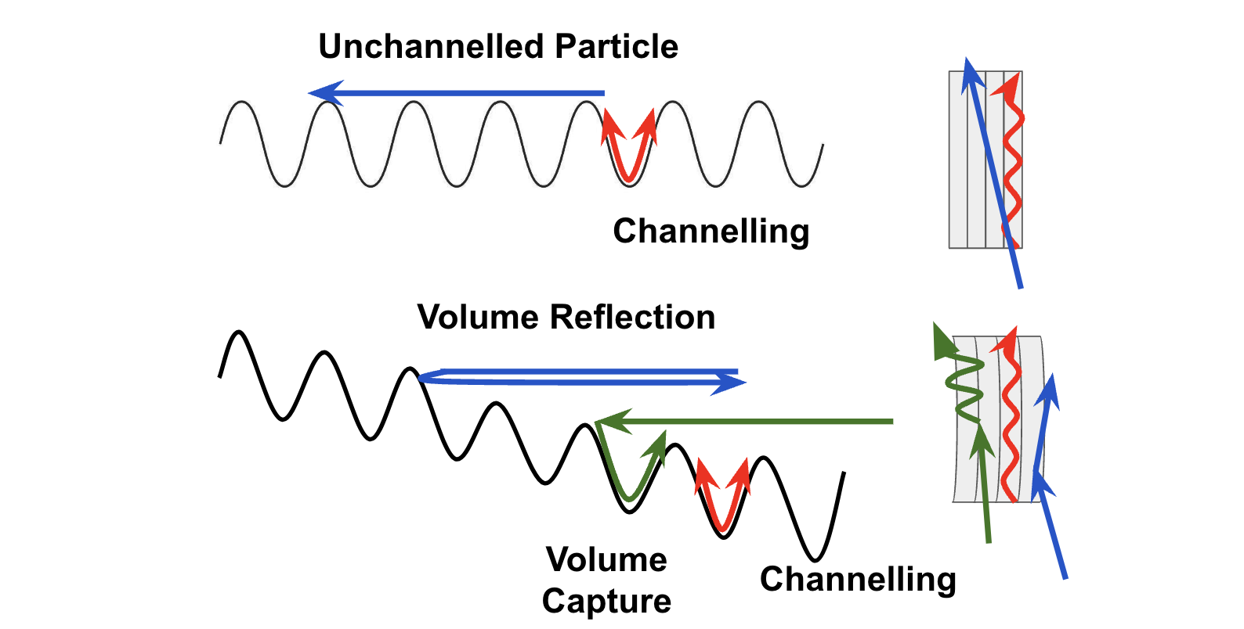
Other phenomena

Slide 5
Project overview
Develop a data analysis script
Run SixTrack simulations
Make updates to the NDC Section Webpage

Slide 6
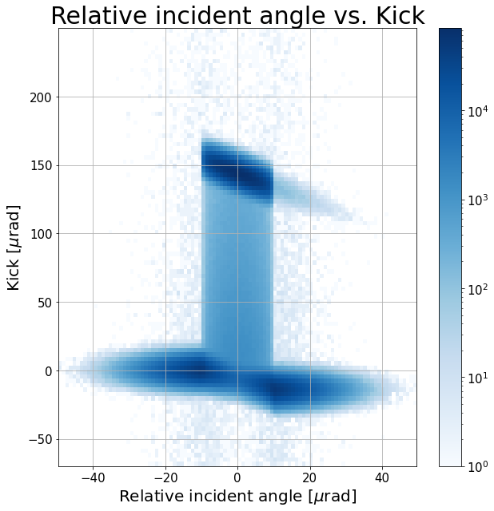
Building the analysis script
Develop a data analysis script
Main Goals
Learn how to differentiate and recognize different channeling phenomena
Isolate channeled particles from simulated data
Calculate channeling efficiency
Compare results to previous papers
Channeling
Volume Capture
Dechanneling
Volume Reflection
Amorphous

Slide 7
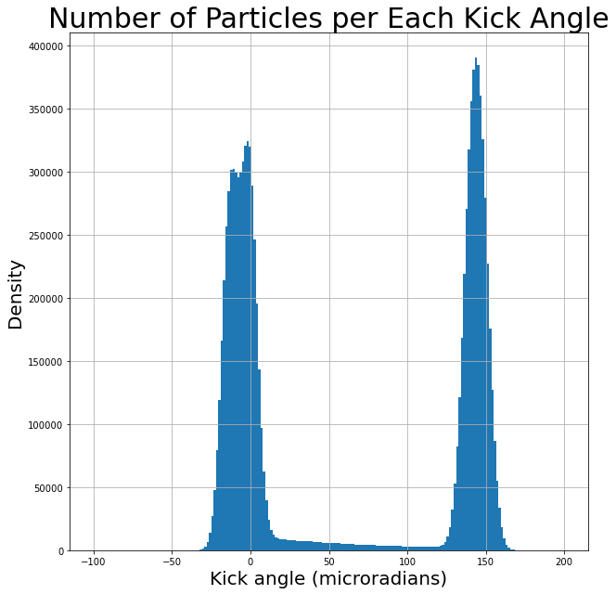
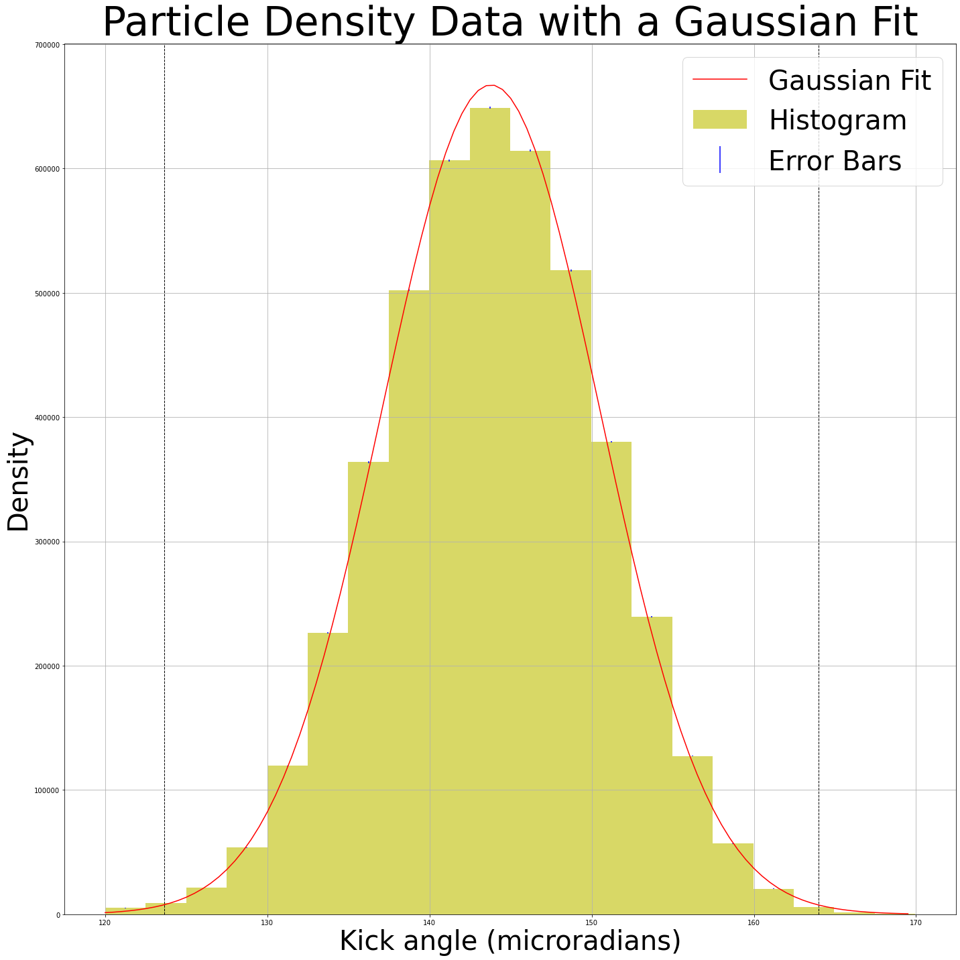
Building the analysis script
Develop a data analysis script
Total number of particles in the critical angle: 6.8 x 10⁶
Number of particles within ±3σ: 4.5 x 10⁶
Channeling Efficiency: 66.1%

Slide 8
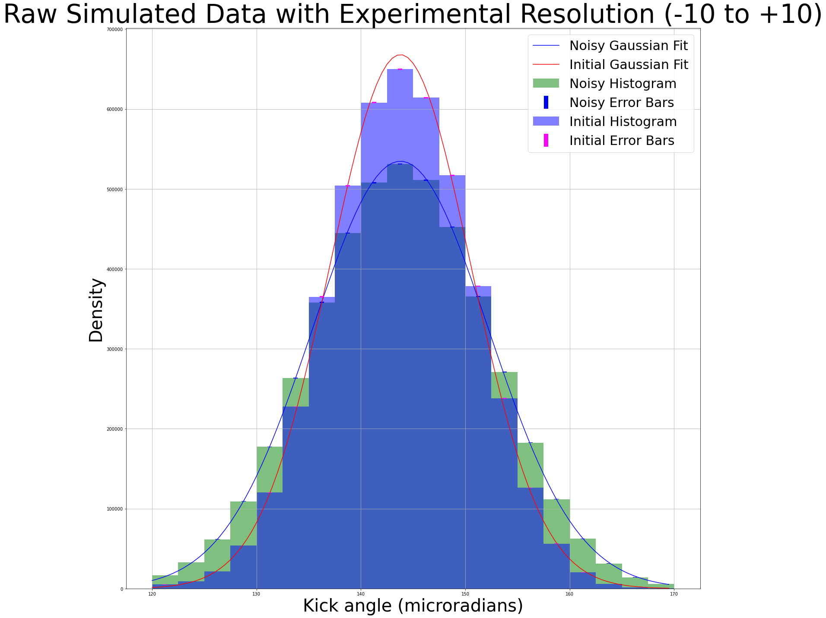
Adding experimental resolution
Develop a data analysis script
Add random noise: [-5,+5] urad
Total number of particles in the cut: 6.8 x 10⁶
Number of particles within ±3σ: 4.5 x 10⁶
Channeling Efficiency: 66.1%
Total number of particles in the cut: 6.8 x 10⁶
Number of particles within ±3σ: 4.5 x 10⁶
Channeling Efficiency: 66.2%

Slide 9
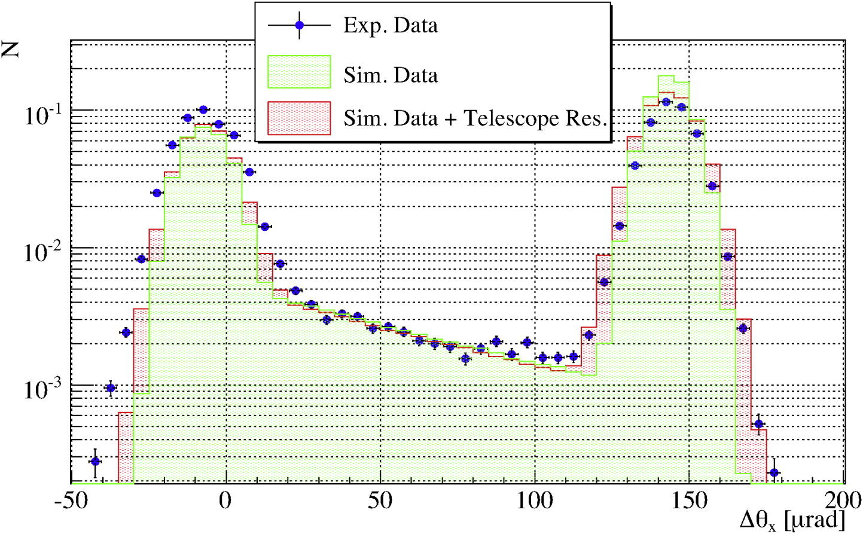
Comparing Results
Develop a data analysis script
My analysis script:
Previous Paper [1]:
Raw Channeling Efficiency: 66.1%
Resolution Channeling Efficiency: 66.2%
Raw Channeling Efficiency: 60.8%
Resolution Channeling Efficiency: 63.9%

Slide 10
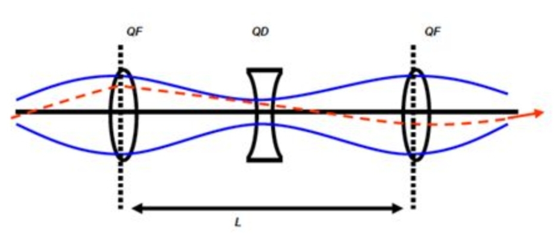
Running SixTrack simulations
Run SixTrack simulations
Main Goals:
Learn how to use SixTrack
Use SixTrack to simulate results of a recent Machine Development (MD)
Compare results to recent paper
What is SixTrack?
A simulation tool
Tracks position and momentum of particles
Records interactions of particles with elements of the accelerator
Notes:
SixTrack: a sim tool keeping a record of the position and momentum of a particle in the LHC as it passes through each element of the accelerator (element=crystal, collimator, cavity, magents, ect.)
Simulates 60 particles at a time
Runs the simulation for 100,000 to 1,000,000 loops around the ring
Collimator and Crystal Positions are determined by a python script (which is then compared to the Logbook and Timber (
SixTrack tracks many particles through the accelerator lattice. It calculates the particles' positions and momenta at each element

Slide 11
Creating and editing input files
Run SixTrack simulations
Energy Level
450 GeV
1000 GeV
3000 GeV
5000 GeV
6800 GeV
Aim: simulate multi-turn efficiency & compare to measurement
Find collimator/crystal settings
  Use various logging systems to find settings
Edit settings -> Input file
Run MAD-X
Run SixTrack
Repeat for all energy levels
Injection
Intermediate energies
Top-Energy
Notes:
SixTrack: a sim tool keeping a record of the postion and momentum of a particle in the LHC as it passes through each element of the acceletor (element=crystal, collimator, cavity, magents, ect.)
Simulates 60 particles at a time
Runs the simulation for 100,000 to 1,000,000 loops around the ring
Collimator and Crystal Positions are determined by a python script (which is then compared to the Logbook and Timber (
SixTrack tracks many particles through the accelerator lattice. It calculates the particles' positions and momenta at each element

Slide 12
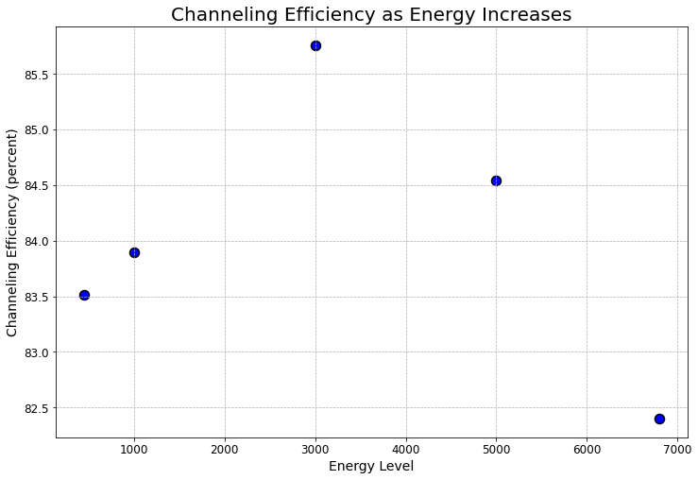
Results of the simulation
Run SixTrack simulations
Energy Level | Total Particles [10⁶] | Channeled Particles [10⁶] | Channeling Efficiency
450 GeV | 8.96 | 7.48 | 83.51%
1000 GeV | 9.52 | 7.99 | 83.90%
3000 GeV | 9.81 | 8.41 | 85.76%
5000 GeV | 9.78 | 8.27 | 84.54%
6800 GeV | 9.78 | 8.06 | 82.40%

Slide 13
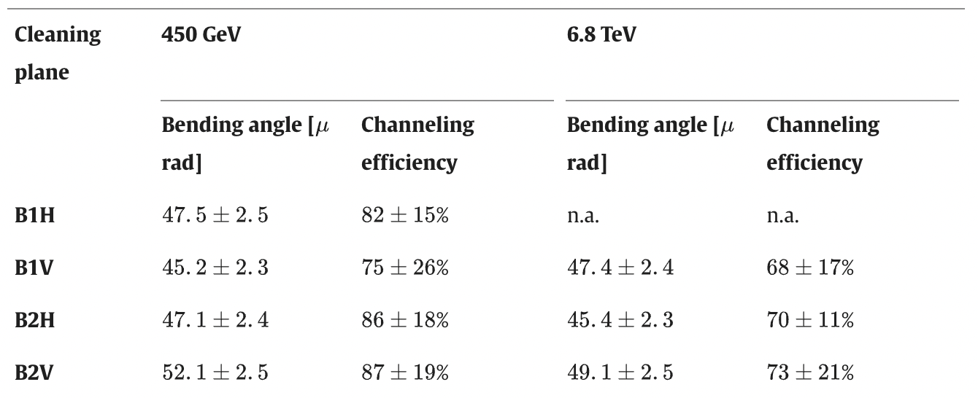
Results of the simulation
Run SixTrack simulations
[2]:
Energy Level | Total Particles [10⁶] | Channeled Particles [10⁶] | Channeling Efficiency
450 GeV | 8.96 | 7.48 | 83.51%
1000 GeV | 9.52 | 7.99 | 83.90%
3000 GeV | 9.81 | 8.41 | 85.76%
5000 GeV | 9.78 | 8.27 | 84.54%
6800 GeV | 9.78 | 8.06 | 82.40%

Slide 14
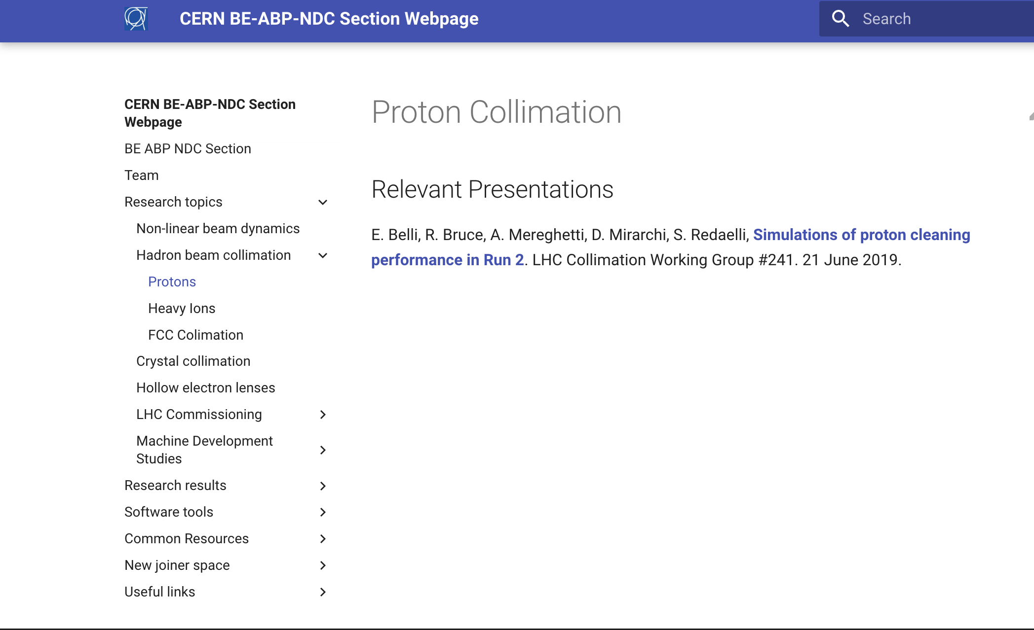

Updates to the webpage
Updates to the webpage
Main Goals:
Correct any typos and update out of data information
Add new topics and members to the website
Edit sections to ensure they are not too complicated for a section webpage
Learn how to use a git repository

Slide 15
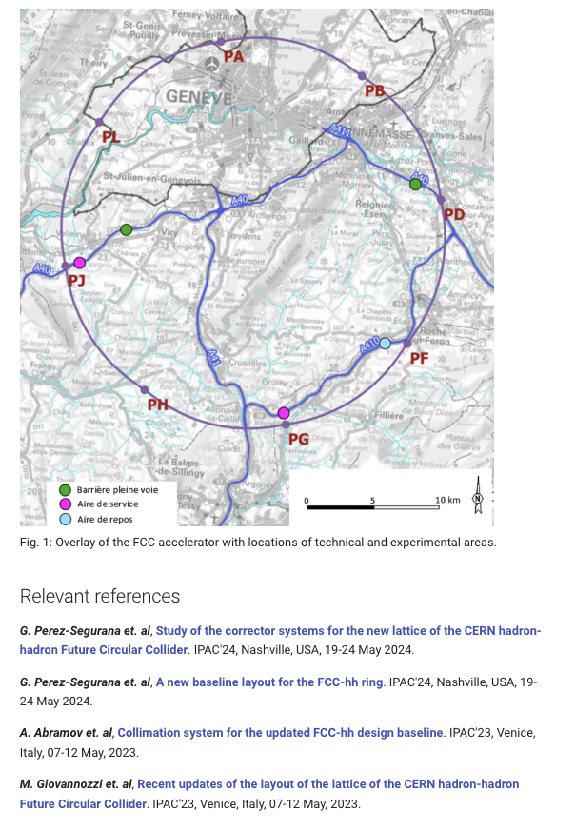
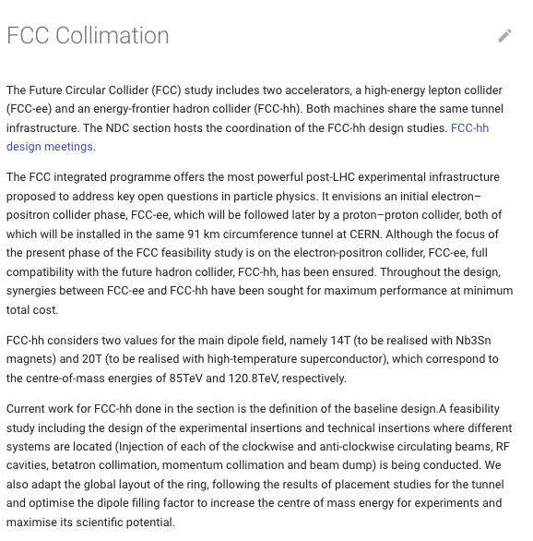
Updates to the webpage: example
Updates to the webpage

Slide 16
Thank you!
Special thanks to my supervisors Dr. Kay Dewhurst, Dr. Pascal Hermes, and Dr. Stefano Redaelli, as well as the full NDC section.
Thank you to the University of Michigan, Dr. Steve Goldfarb, Dr. Junjie Zhu, and Dr. Myron Campbell.
Thank you to the National science foundation and CERN for your support this summer!
[1] D. Mirarchi et. Al, “A crystal routine for collimation studies in circular proton accelerators,” 2015.
[2] M. D’Andrea et. al, “Characterization of bent crystals for beam collimation with 6.8 TeV proton beams at the LHC,” 2024.

