Slide 1
Processing and Analysis of HiRadMat Beam Line Data
Julia White, Supervisors: Nikos Charitonidis, Alice Goillot
7/25/2024

Slide 2
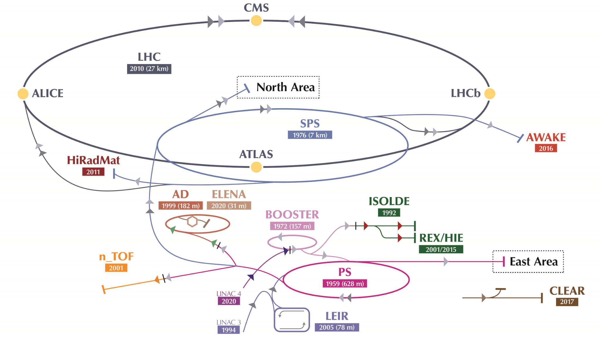
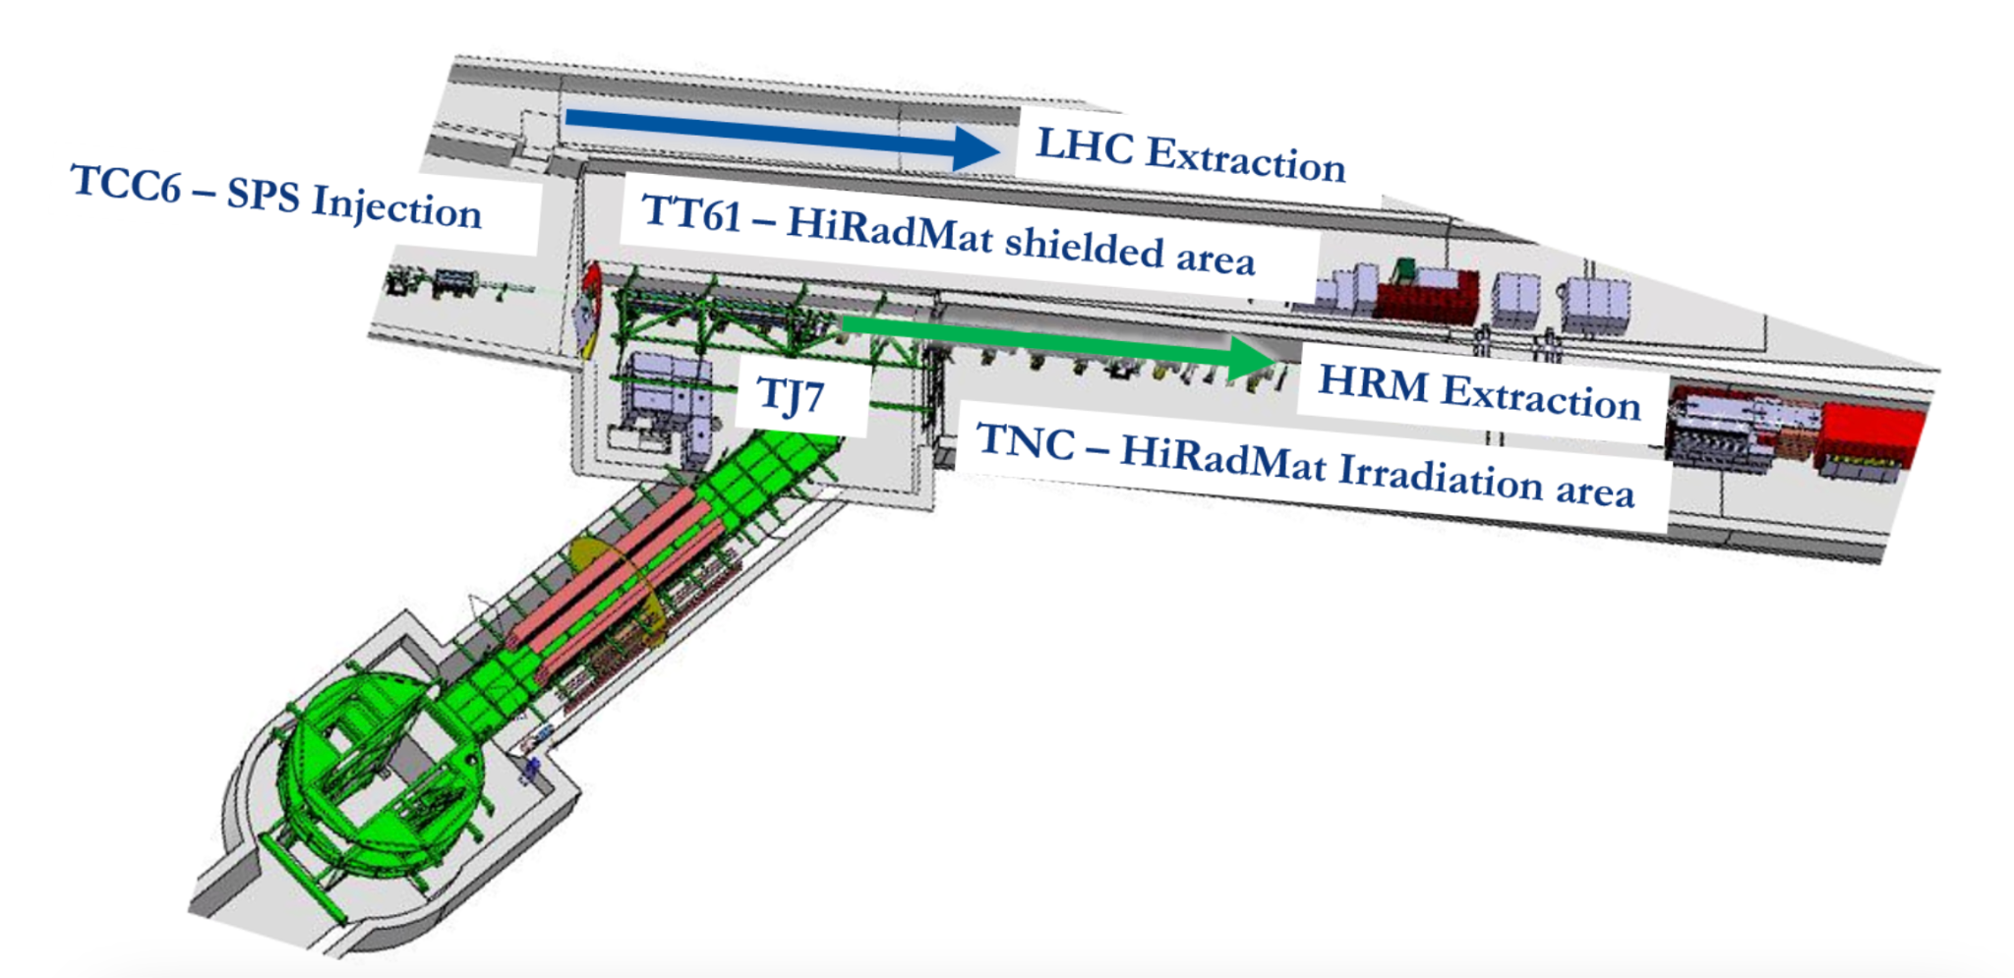
HiRadMat
High Intensity Radiation to Materials
Test the effects of short beam pulses on materials and accelerator components
Julia White | Processing and Analysis of HiRadMat Beam TV Data
25 July 2024
‹#›

Slide 3
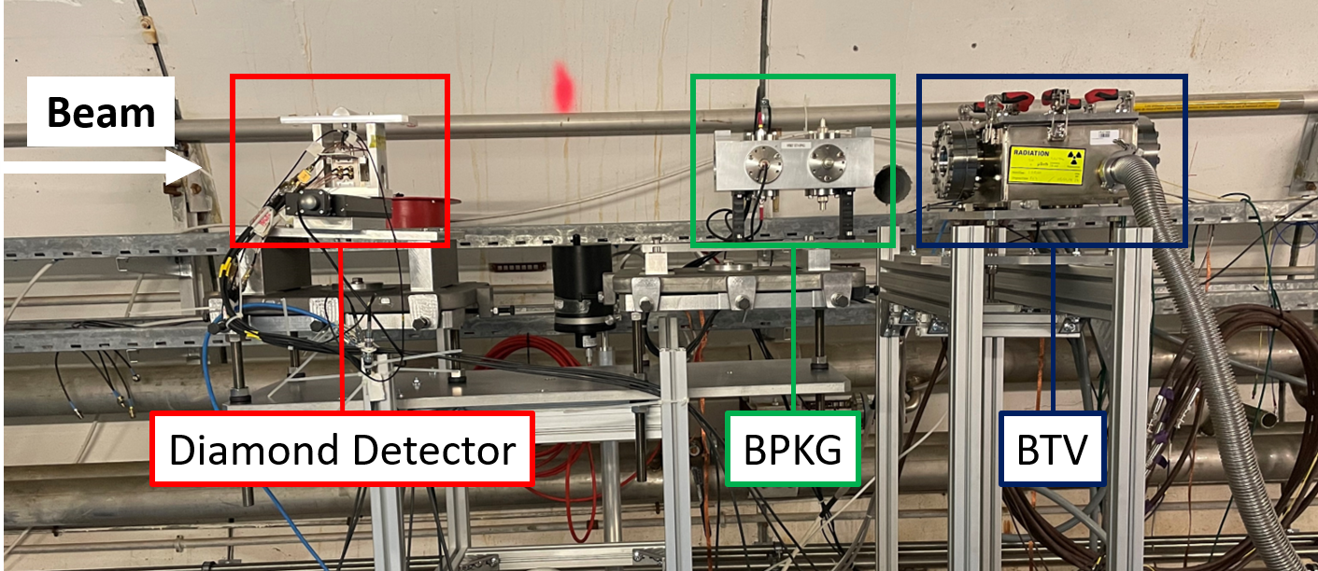
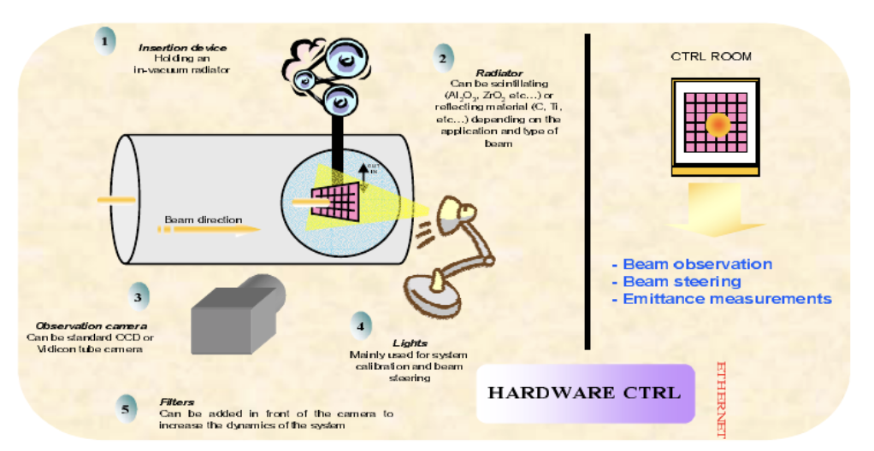
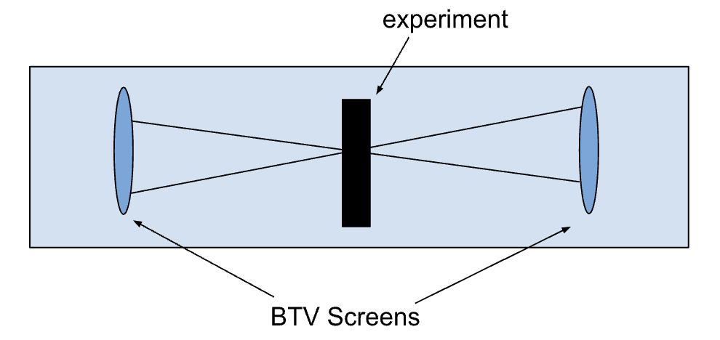
S. Berger
Julia White | Processing and Analysis of HiRadMat Beam TV Data
25 July 2024
‹#›
Notes:
I’m going to explain how a BTV works here.

Slide 4
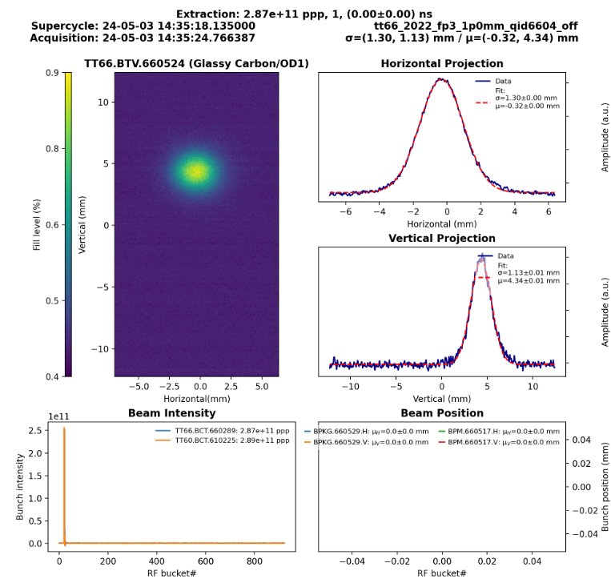
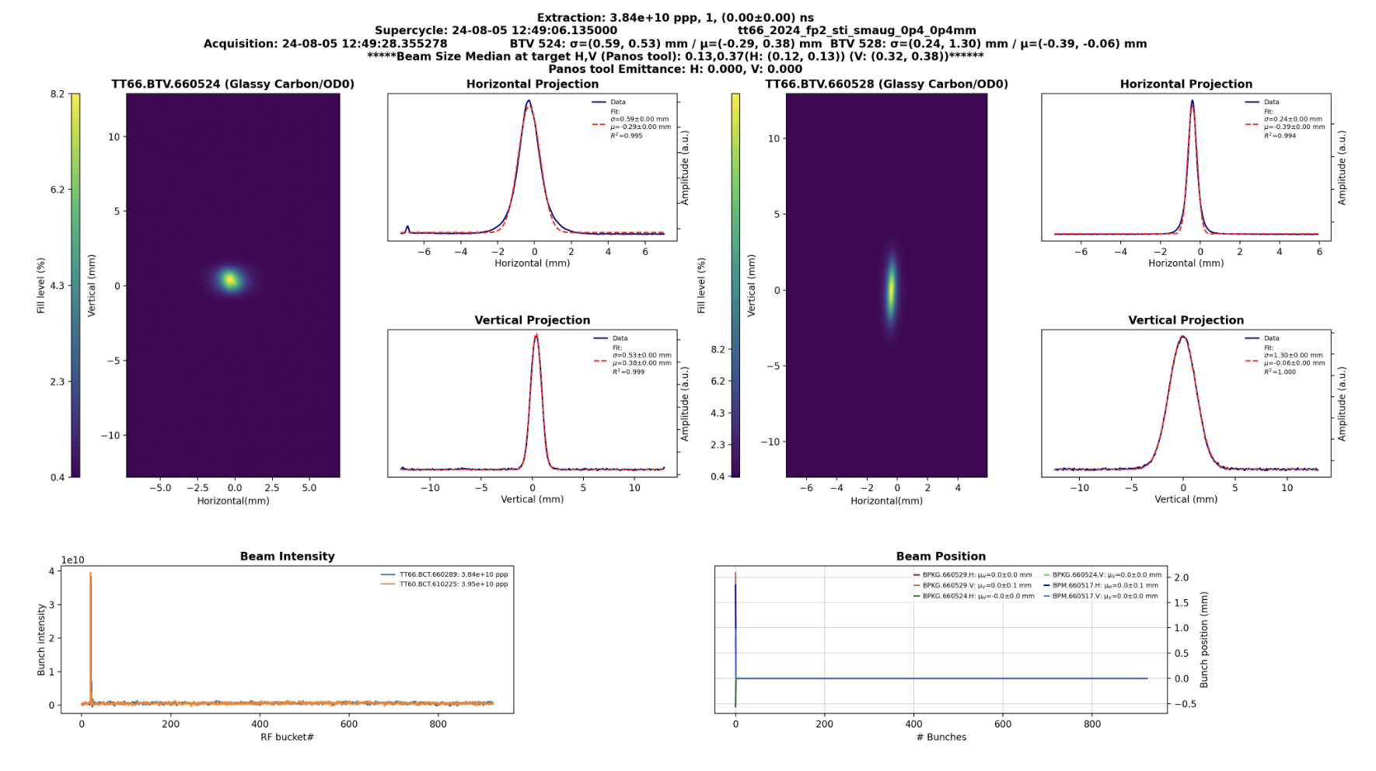
Real-Time BTV Script
Added the downstream BTV to the VISTAR screen
Fixed the acquisition of the beam position monitor data and updated the plots
Added data from a new tool that calculated the emittance and the spot size
Julia White | Processing and Analysis of HiRadMat Beam TV Data
25 July 2024
‹#›

Slide 5
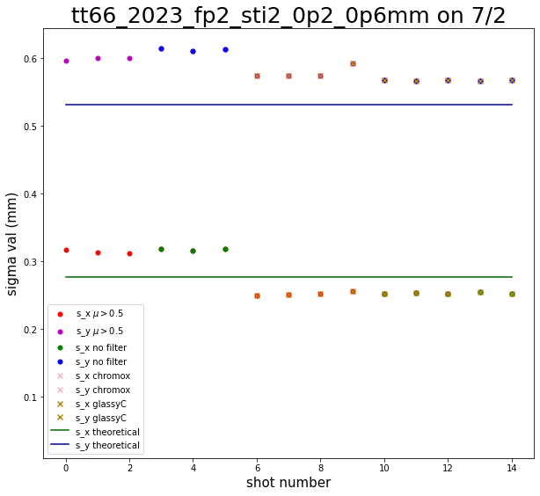
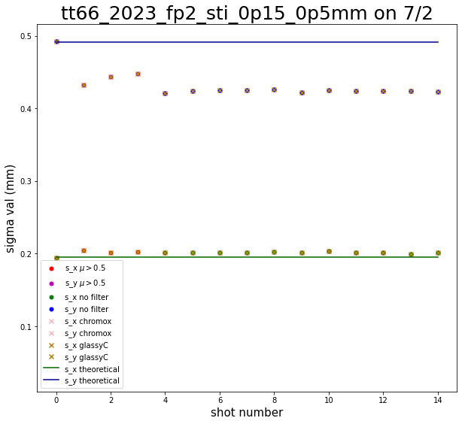
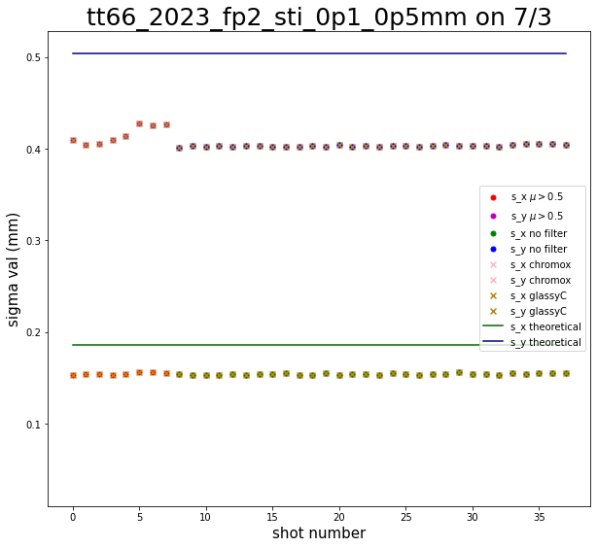
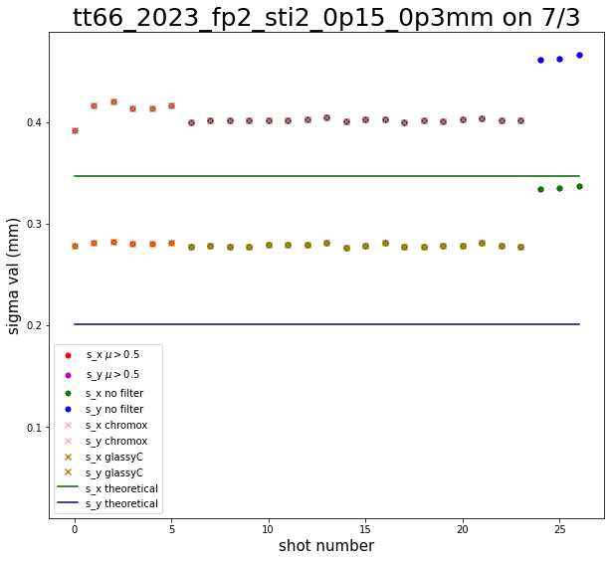
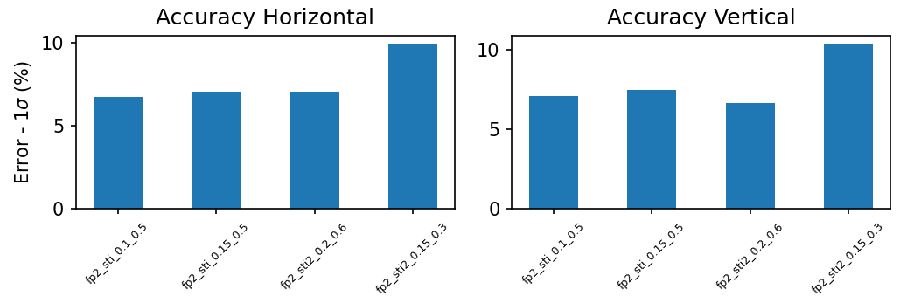
Results From July 2 and 3
Analyzed the measured beam widths vs the expected ones.
  The expected ones are calculated in a MAD-X file.
Compared these values with the expected error of the BTV.
Compared these values with the expected error of the optic.
s_x : ~8%
s_y : ~6%
s_x : ~4%
s_y : ~15%
s_x : ~18%
s_y : ~23%
s_x : ~20%
s_y : ~70%
F. Velotti
Julia White | Processing and Analysis of HiRadMat Beam TV Data
25 July 2024
‹#›
Notes:
https://confluence.cern.ch/pages/viewpage.action?pageId=386891859

Slide 6
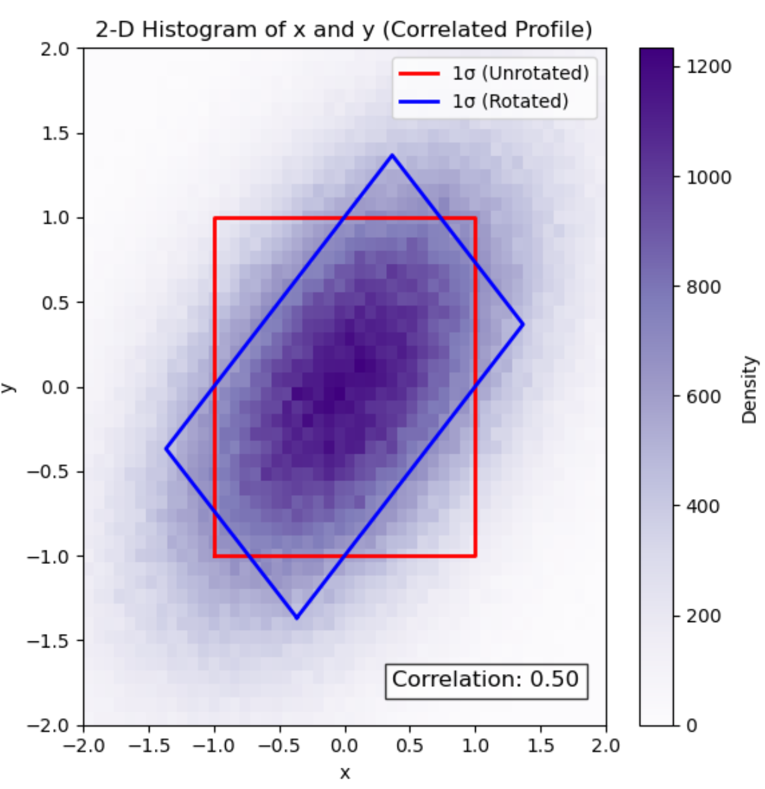
Rotated beams can cause problems in the theoretical beam density calculations.
Calculation of the beam spot size must be done in the laboratory frame.
  This is not an explanation for the error in the sti2_0p15_0p3mm optic results.
When calculating the beam density a rotated ellipse must be used.
  The beam density is helpful when finding the predicted intensity.
N. Charitonidis
Julia White | Processing and Analysis of HiRadMat Beam TV Data
25 July 2024
‹#›

Slide 7
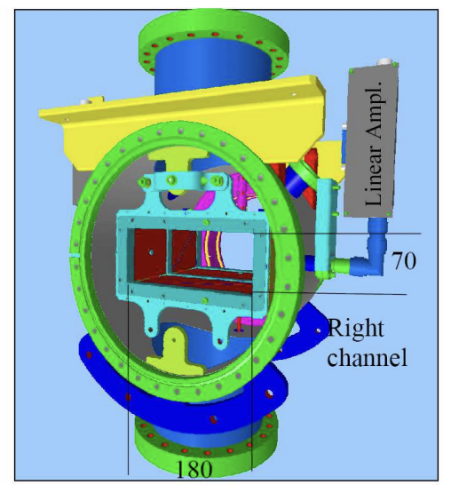
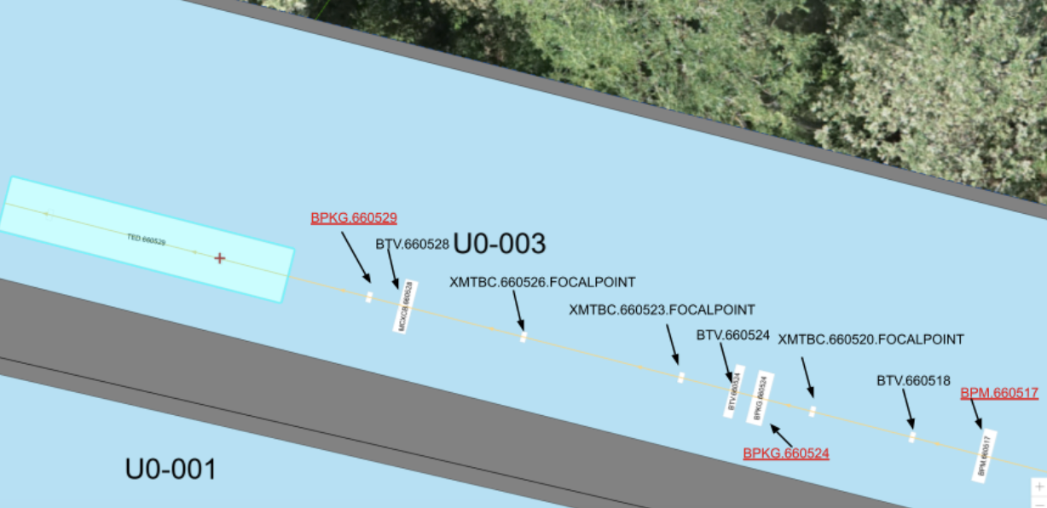
BPM / BPKG
Beam position monitors give the center of mass of the beam and the ‘longitudinal bunch shape’
No magnets between the BPMs and BPKGs being analyzed
P. Forck, P. Kowina, and D. Liakin
Julia White | Processing and Analysis of HiRadMat Beam TV Data
25 July 2024
‹#›

Slide 8
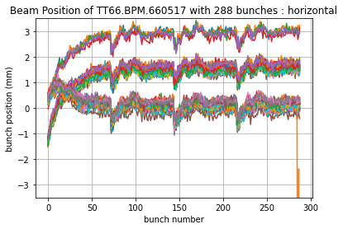
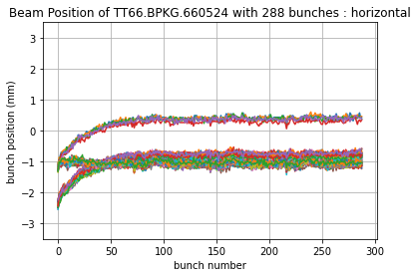
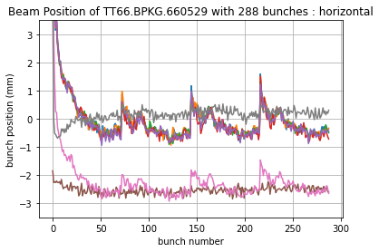
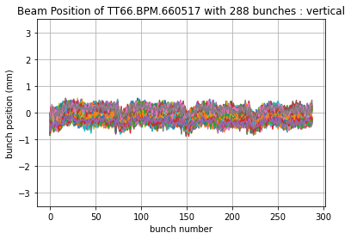
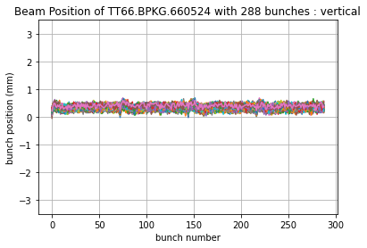
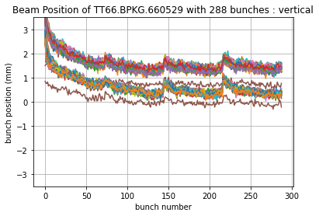
288-Bunched Shot Results
0p4_0p4 |μ| > 0.5
0p25_0p25
0p4_0p4 |μ| > 0.5
0p25_0p25
0p4_0p4 |μ| > 0.5
0p4_0p4 |μ| < 0.5
0p4_0p4 |μ| < 0.5
0p25_0p25
0p4_0p4 |μ| < 0.5
0p4_0p4
0p25_0p25
‹#›
Notes:
I’m going to go graph by graph and explain how the optics affect the bunch positioning but the screens don’t.
I will also discuss how the dispersion is likely to happen in the horizontal because we have a much narrower margin for error in the vertical so we don’t see nearly as much of this behavior. The kicker is also claimed to affect the horizontal more than the vertical so if it was indeed off, this would also be a result of it.

Slide 9
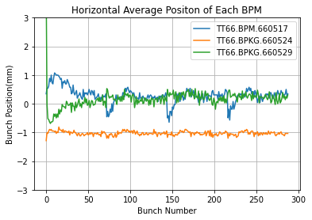
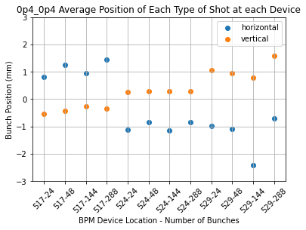
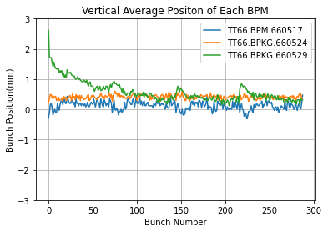
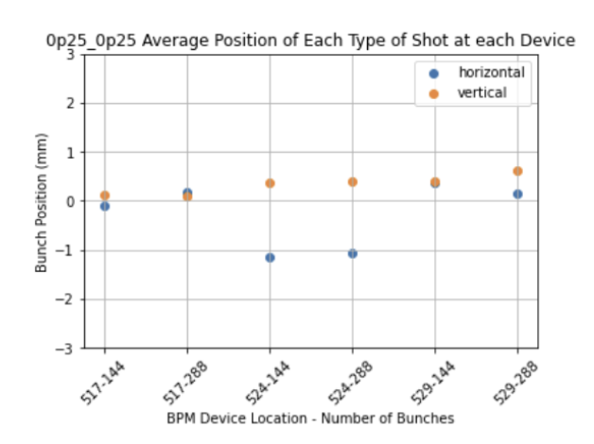
BPM Averages
Jumps in the bunch position occur every 72.3 ± 0.5 bunches.
  PS produces 72-bunched shots
Odd behavior is observed in the horizontal of BPKG 524.
Many fewer results at BPKG 529 may affect these averages.
Julia White | Processing and Analysis of HiRadMat Beam TV Data
25 July 2024
‹#›

Slide 10
Conclusions
Functioning VISTAR Screen deployed to be run on the SPS OP console as an acc-py app.
  Added the downstream BTV to the logbook.
  Fixed the Beam Position monitor data acquisition and plotting in the logbook.
Optics Analysis:
  Emittance needs to be calculated more consistently to obtain better expected beam widths – added it to the logbook.
  Rotations in the beam can affect its beam density or intensity – added the rotation adjusted area to the logbook.
Beam Position Monitor Analysis:
  Optics choice has a significant effect on the bunch position behavior.
  Screen choice has a limited effect on the bunch position behavior.
  Will follow up with SY/BI and SY/ABT to further understand these results
Julia White | Processing and Analysis of HiRadMat Beam TV Data
25 July 2024
‹#›

Slide 11
