Slide 1
Report on ICHEP2024
Accelerator Design Meeting - July 25th, 2024
K. André

Slide 2
Agenda - I
Accelerator sessions: 4 on Thursday and 2 on Friday
  Accelerators: Physics, Performance, and R&D for future facilities
Present and approved accelerator facilities
Panel discussion on Future colliders
Future facilities and advances in accelerator technologies
FCC integrated program and R&D in accelerator technologies

Slide 3
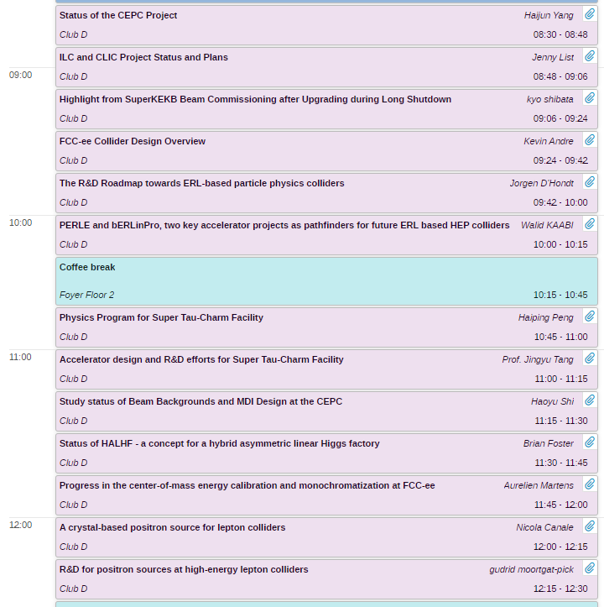
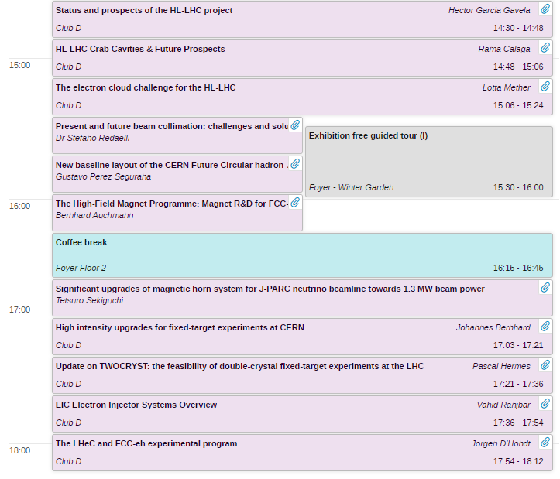
Agenda - II

Slide 4
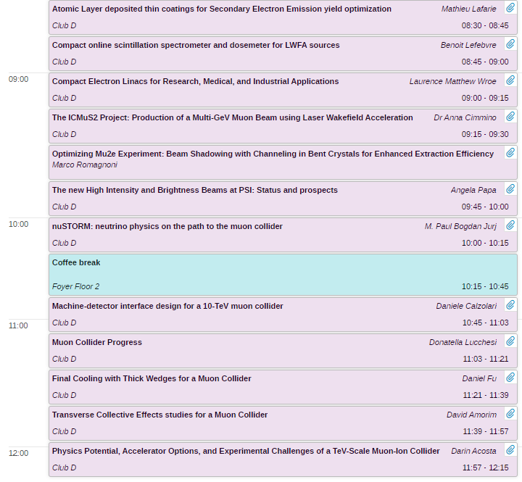

Agenda - III

Slide 5
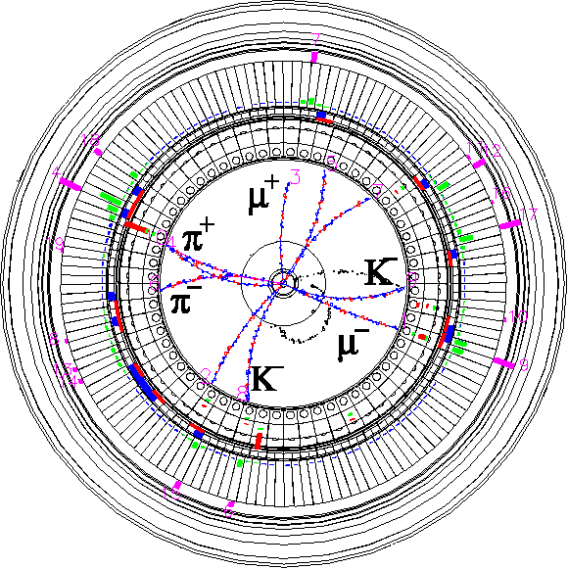


Highlight from SuperKEKB Beam Commissioning after
Upgrading during Long Shutdown 1 (LS1)
ICHEP 2024
18th July 2024
Kyo Shibata (KEK Accel. Lab. & SOKENDAI)
On behalf of the SuperKEKB and Belle II Commissioning Group
Inter-University Research Institute Corporation High Energy Accelerator Research Organization (KEK)
大学共同利用機関法人 高エネルギー加速器研究機構 (KEK)

Slide 6
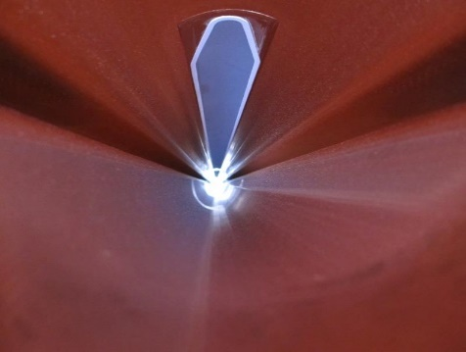
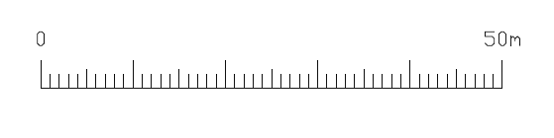
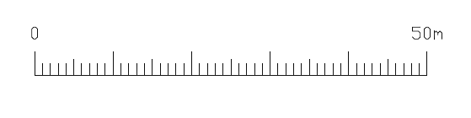
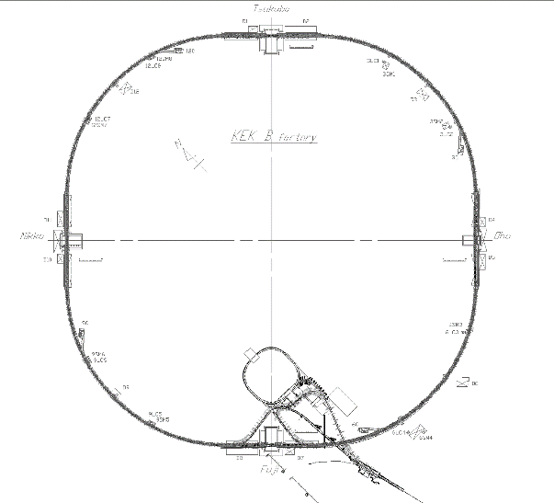
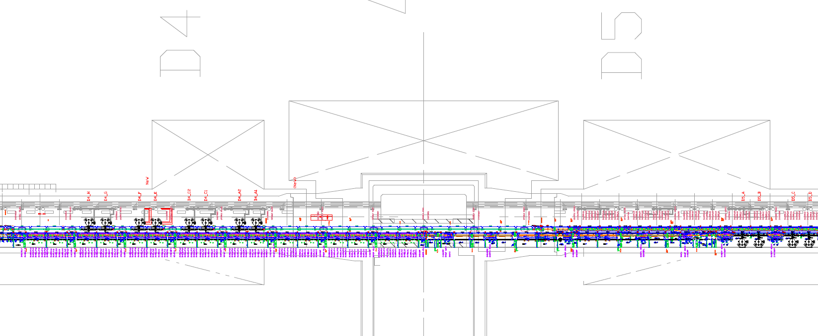
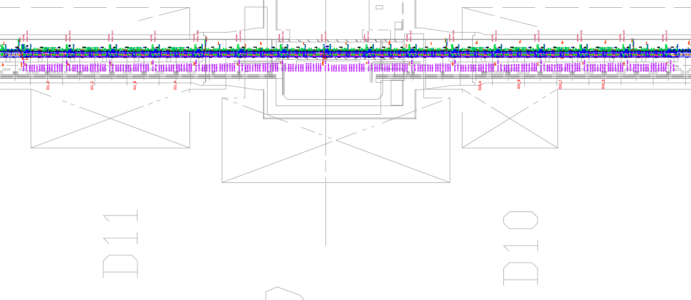
Sudden Beam Loss (SBL) #3
Countermeasure against SBL during summer shutdown
  Turning beam pipes with electron clearing electrode upside down
    15/50 beam pipes will be turned upside down. (56 m/185 m = 30 %)
    Oho straight section : 13/16 beam pipes (D04 wiggler section) and 2/4 beam pipes (D05 NLC section) will be turned upside down.
      It takes over 1 month to turn 13 beam pipes upside down at D04 wiggler section.
    Nikko straight section : 30 beam pipes at Nikko wiggler section will not be turned upside down.
  Visual check and dust cleaning of beam pipes which will not be turned upside down.
  Knocking as many beam pipes (with electron clearing electron or groove structure) as possible.
upside down
Tsukuba (Belle II)
Beam pipes will be turned upside down.
Nikko straight section
Oho straight section
Radiation shielding
(concrete)
Radiation shielding
(concrete)
Radiation shielding
(lead)
D11
wiggler section
D04
wiggler section
Nikko straight section
D10
wiggler section
Oho straight section
D05 NLC section
D11 Wiggler section D10 Wiggler section
(Beam pipes with electron clearing electrodes)
Wiggler section NLC section
(Beam pipes with electron clearing electrodes)
e⁺ beam
e⁺ beam

Slide 7
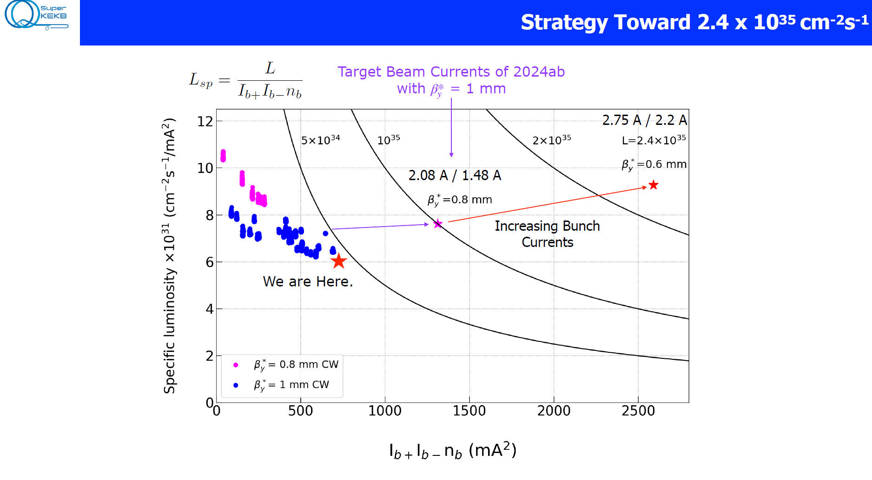
Beyond 10³⁵ strategy
Y. Ohnishi

Slide 8
Summary
2024ab run was conducted as scheduled from January 29th to July 1st.
  First run after Long Shutdown 1
    NLC system construction, upgrade of HER injection point, etc.
  Peal luminosity : 4.47×10³⁴ cm⁻²s⁻¹
  Integrated luminosity : 103 fb⁻¹
  βy* squeezing : mostly 1.0 mm, finally 0.9 mm
There are many findings from 2024ab run
  First demonstration of the effectiveness of the NLC system
  Improvement of HER injection efficiency at last (30% -> 80%)
  Still struggle with SBL, but on track to solve it for LER
    Turning beam pipes with electron clearing electrodes upside down during summer shutdown
  Also struggle with difficulty to increase beam currents and poor machine stability
2024c run will start on October 9th.
  Operation period : 2 months
    Extending operation time is difficult due to rising electricity prices.
  Target luminosity : 1×10³⁵ cm⁻²s⁻¹
    Need to overcome many challenges.

Slide 9
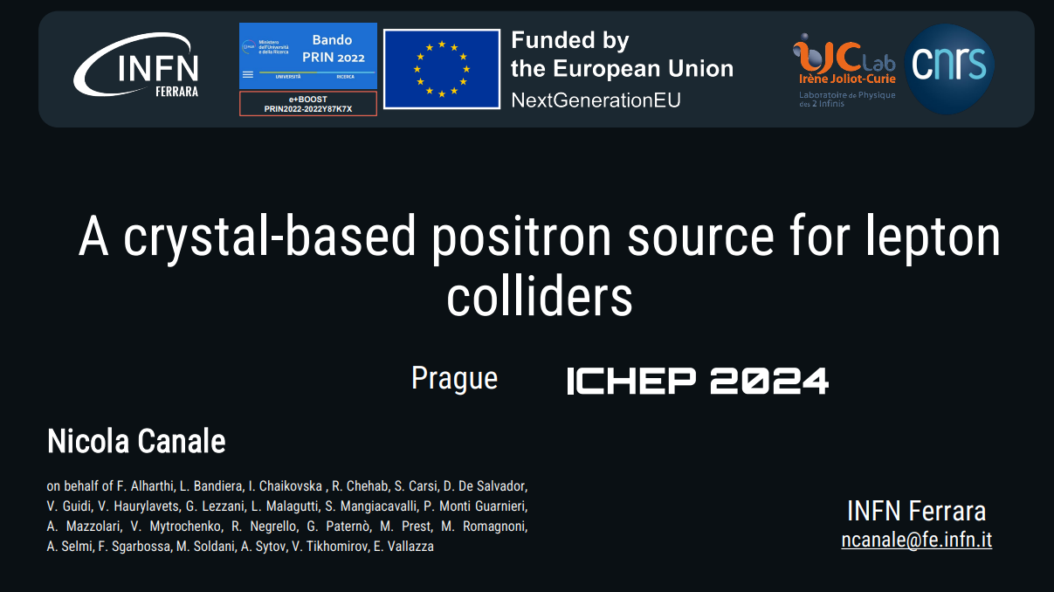

Slide 10
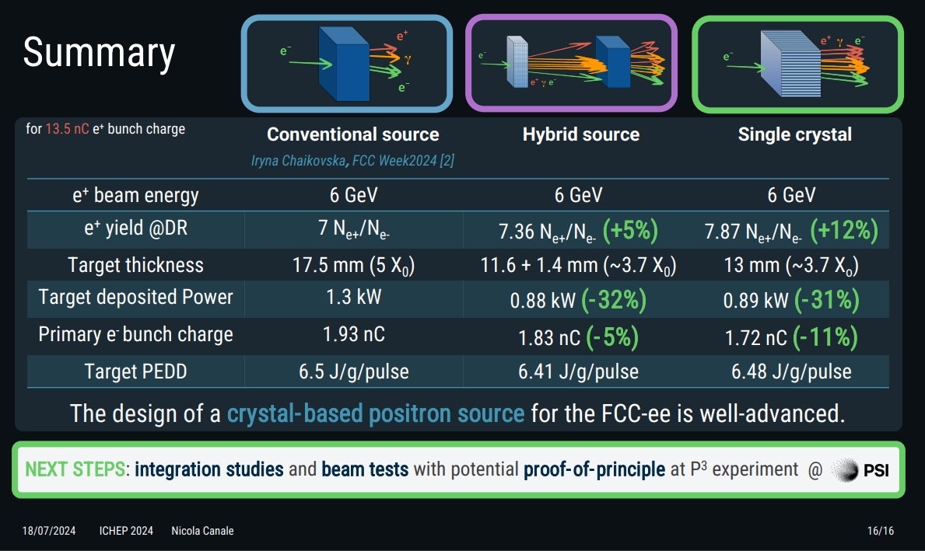

Slide 11
Present and approved accelerator facilities
Sergei Nagaitsev
EIC Technical Director
Brookhaven National Laboratory
23 July 2024

Slide 12
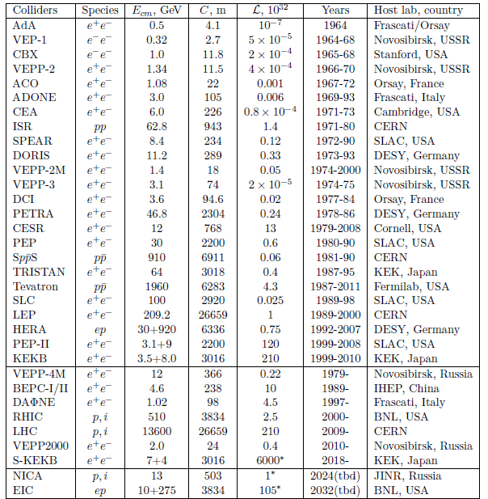
Colliders – Important considerations
Energy
Luminosity
  Target density in collider >10 orders of
  magnitude lower than in fixed target
Interaction Region design
  Detector space
  Experimental background
  Forward particles
  …
Also
Cost
Reliability
Flexibility (energy, species for ion colliders)
Energy efficiency / operating cost
…
Present (7)
Approved
(adapted from [Shiltsev and Zimmermann, 2021]).

Slide 13
Colliders e⁺e– (factories): VEPP-2000, VEPP-4M, BEPC-II, DAΦNE, SuperKEKB
[Reported numbers, not design]
 | DAΦNE | VEPP-2000 | BEPC-II | VEPP-4M | SuperKEKB
Start of operation [year] | 1999 | 2010 | 2008 | 1994 | 2018
Species | e⁺e– | e⁺e– | e⁺e– | e⁺e– | e⁺e–
Circumference [m] | 97 | 24 | 238 | 366 | 3016
Beam energy [GeV] | 0.51 | 1 | 1.89 (2.474 max) | 6 | 4 / 7
CoM energy [GeV] | 1.02 | 2 | 3.78 (5.56 max) | 12 | 10.58
Average beam current [mA] | 800 / 1250 | 160 | 851 | 80 | 1400 / 1000
Peak luminosity [10³⁰ cm⁻²s⁻¹] | 453 | 50 | 1000 | 20 | 3810
Focus | Φ meson | u,d,s interactions | tau-charm | Y(1S) meson | B meson
[PDG, Tables 32.1, 32.3;
Q. Qin, ”Overview of the low energy colliders”, proceedings eeFACT2016, Daresbury (2016)]

Slide 14
Colliders e+e-
Ongoing discussion concerning DAFNE’s future:
In the next future DAFNE might be used for short periods, 4-5 months per year.
DAFNE Synchrotron Light Facility could be also operated.
DAFNE LINAC will continue to power two Beam Test Facility lines.
This plan requires a minimal refurbishment of the accelerator complex that can also be implemented progressively
Maintaining DAFNE infrastructure operative could be also very much synergic with Future CERN developments in the lepton colliders field.
Status and upgrade of BEPC-II discussion:
Increase luminosity by factor 3 and energy up to 2.8 GeV.
Requires: double beam power, optics upgrade and new high field magnets. Commissioning planned for January 2025.
SuperKEKB:
During Long Shutdown 1: Improvements of the Belle II detector and the SuperKEKB accelerator.
Countermeasures to sudden beam loss should be implemented during summer maintenance period.
Target luminosity is 1x10³⁵ cm⁻²s⁻¹ for this year.
Parameters | Design | Achieved
 |  | BER | BPR
Beam energy (GeV) | 1.0-2.1，1.89 | 0.92-2.47，1.89 | 0.92-2.47，1.89
Beam current (mA) | 910 | 950 | 950
Bunch number | 93 | 118 | 118
Beam-beam parameter | 0.04 | 0.041
β_{x}*/β_{y}* (m) | 1.0/0.015 | 1.0/0.0135 | 1.0/0.0135
Lum. (× 10³³cm⁻²s⁻¹) | 1.0 | 1.1
BEPC parameters

Slide 15
Colliders hh and eh: RHIC, LHC, EIC, NICA
Nuclotron-based Ion Collider fAcility
 | RHIC pp (actual) | LHC pp (actual) | RHIC AA (actual) | LHC AA (actual) | EIC ep, eA (design) | NICA pp, dd, AA
Start of operation [year] | 2001 | 2009 | 2000 | 2010 | 2032 (planned) | 2025 (planned)
Species | ph+ph (polarized p) | p+p | ph+Al, ph+Au, d+Au, h+Au, O+O, Cu+Cu, Cu+Au, Zr+Zr, Ru+Ru, Au+Au, U+U | Pb+Pb, p+Pb, Xe+Xe | eh+ph to eh+U (polarized e,p, He-3) | ph dh A
Circumference [km] | 3.8 | 26.7 | 3.8 | 26.7 | 3.8 | 0.5
Beam energy [GeV] | 255 | 6500 | 100 A | 2560 A | 5-18 / 40-275 | 1 – 4.5
CoM energy [GeV] | 510 | 13000 | 200 A | 5120 A | 28-140 (eh+ph) | 4 – 11
Average beam current [mA] | 257 | 510 | 224 (Au+Au) | 24 (Pb+Pb) | 2500 / 1000
Peak luminosity [10³⁰ cm⁻²s⁻¹] | 245 | 2100 | 0.015 (Au+Au) | 0.006 (Pb+Pb) | 10000 (eh+ph)
Spin polarization | 55-60% | 0 | 0 | 0 | 70% e,p,h
Notes:
LHC data for end of Run 2; Energy for LHC Run 3 starting 5 July 2022: 13.6 TeV, add NICA?

Slide 16
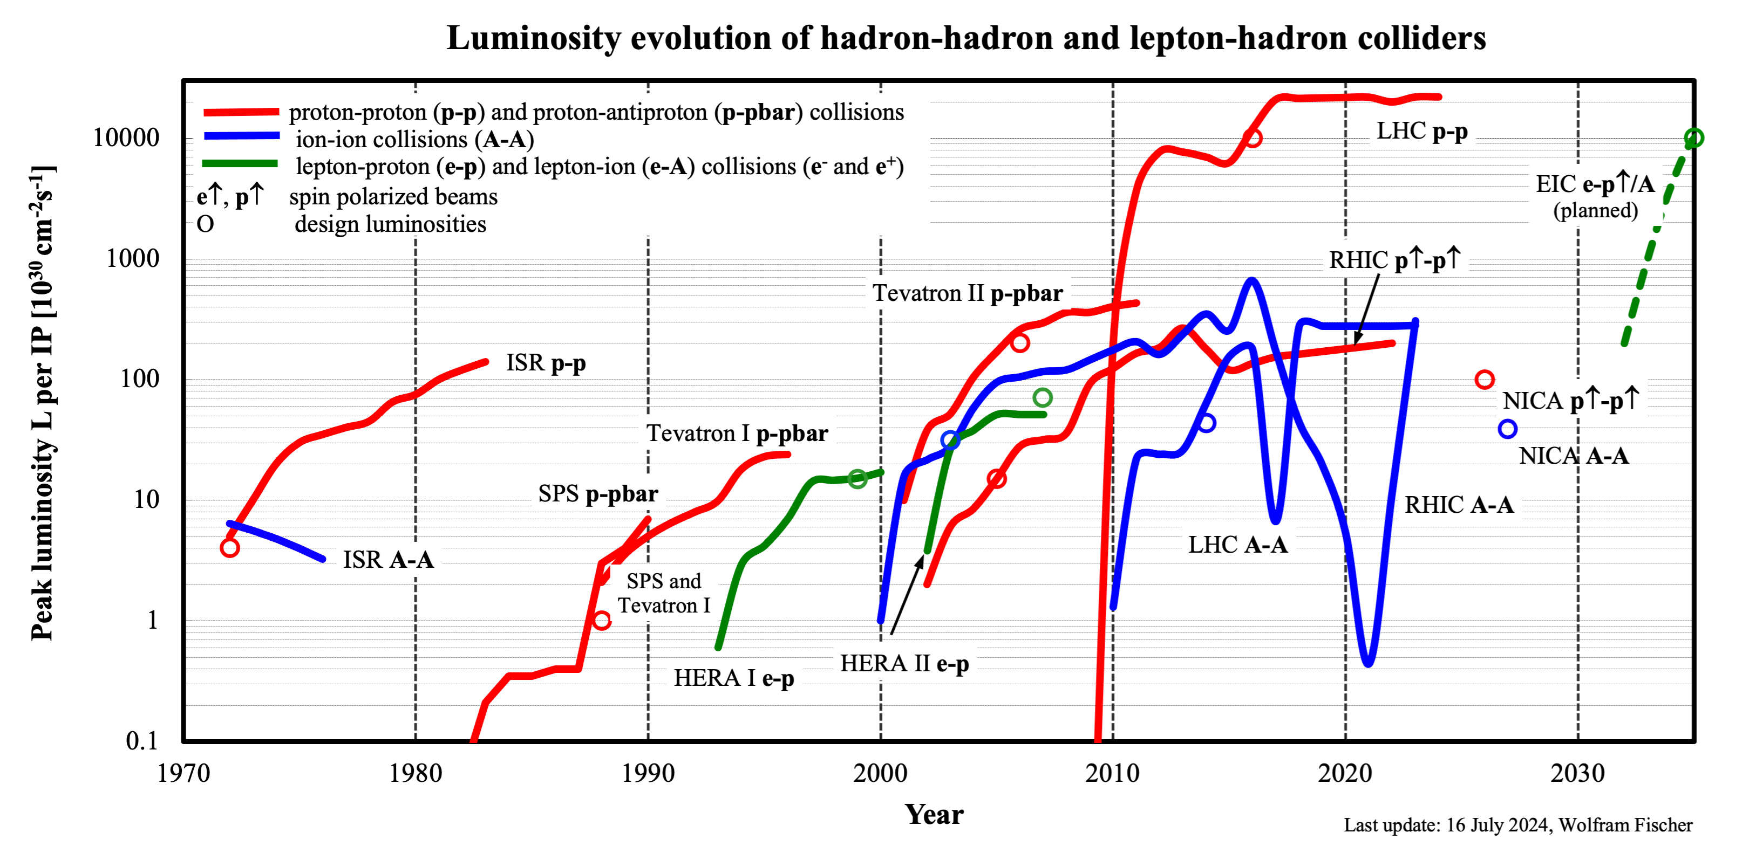
variations in AA luminosity
due to energy/species

Slide 17
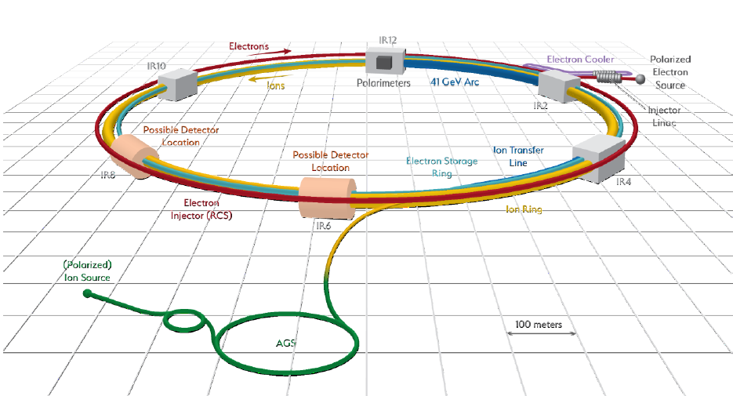
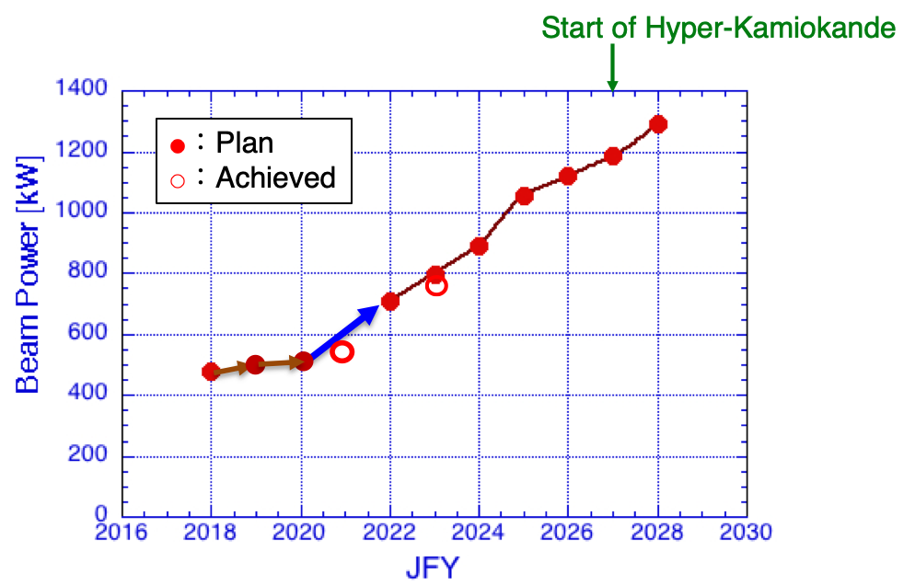
Summary – present accelerators and approved facilities
BNL EIC project –
working towards baseline
collisions 2032 (planned)
Present colliders: 5x e⁺e– and 2x hh
  Low-energy colliders are technology test beds
  (beam-beam compensation, crab crossing,
  beam cooling, collimation, …)
  SuperKEKB (very high L) prototype for future e⁺e– colliders, EIC
  hh colliders – increasing flexibility (energy, species)
Colliders under construction:
  BNL Electron-Ion Collider: ~100x HERA luminosity,
  polarized e,p,He-3 and heavy ions
  NICA
Present high-intensity machines
  >1 MW beam power available, ν beams drive increases
  Synergies with other applications: spallation neutron
  sources, nuclear physics, Accelerator Driven Systems (ADS)
Present high-intensity projects:
  FNAL PIP-II goal: 1.2 MW
  J-PARC MR goal: 1.3 MW
EIC

Slide 18
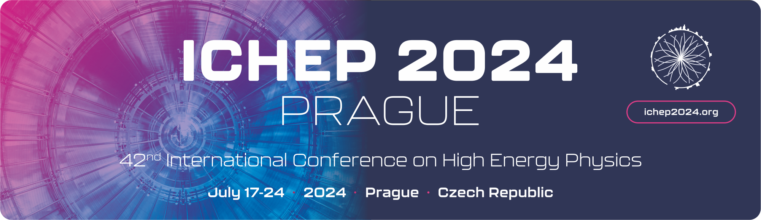

Future facilities and advances in accelerator technologies
Rende Steerenberg – CERN
With thanks to Mike Lamont and all others from who I ‘borrowed’ material
23 July 2024

Slide 19
Possible future main facilities
Foreseen to start operations within the time frame until 2045:
    EiC (approved)
    FCC-ee
    ILC/CLIC
    CEPC
    CCC
Beyond 2045:
    FCC-hh
    Muon Collider
    SppC
Other ideas were also presented and discussed at ICHEP-2024:
Energy Recovery Linac (ERL) based facilities (LHeC, FCC-eh, etc.)
PERLE and bERLinPro, pathfinders for future ERL based colliders
Wakefield-acceleration-based muon facility
Hybrid Asymmetric Linear Higgs Factory (HALHF) partially based on Wakefield acceleration
Tau-Charm facility in China
Compact Electron Linacs for Research, Medical, and Industrial Applications

Slide 20
Summary of Rende’s slides
Mostly presented FCC integrated program (ee + hh),
and the following key technologies:
  SRF technology R&D, highlighting the new SRF facility at CERN (mid 2029)
  High field magnet NbTi → Nb₃Sn → HTS, FCC-hh requires higher temperature magnets, current LHC dipoles at 1.8K in FCC would lead to 4TWh, 4 times CERN electric consumption!
  Briefly covered muon collider as the magnets should have high gradients and survive `high’ heat load (5-10kW) and high radiation dose (20-40MGy)

Slide 21
How to further optimise SRF?
Increasing the accelerating gradient
Reduction in number of cavities, less space required, reduced cryogenic power, reduced RF power distribution,…
Increasing the quality factor Q
Less power deposited, reduction of cryogenic needs hence reduction in electricity consumption
Using higher temperature superconducting materials
Could allow RF cavities to run at 4.5K instead of 1.9K as used for high performance Nb cavities – reduced cryogenic needs
Thin film SRF technology offers a pathway to enhance performance and cost-effectiveness
Substantial R&D required and ongoing.

Slide 22
A new superconducting
RF facility at CERN
Purpose:
    R&D on single and multi-layer thin film coated and bulk superconducting cavities
    R&D on higher temperature superconducting cavity materials
    Prototyping and pre-series for FCC-ee
    R&D on the process to maximise throughput, reproducibility and minimise resources
  Goal:
    Limit the operational cost of new large projects
    Reduce capital investment in SRF systems
Start operation mid-2029

Slide 23
Concluding Remarks
Multiple, competitive, complementary, and challenging design studies for future facilities are being undertaken
    The FCC feasibility study will conclude in March 2025, followed by a resource loaded pre-TDR phase
    The ESPPU process has been launched and will conclude in 2026, providing direction
Each generation of facilities pushes the boundaries of technology
    This requires substantial R&D and collaboration in various key domains
    New technological developments can enhance societal well-being and drive economic economic growth
Studies of future facilities provide a fertile ground for developing new technologies, while currently operational facilities serve as test-beds for these innovations.
    The HL-LHC will contain with Nb3Sn superconducting magnets, experienced gained will feedback into the R&D
No new facility can be considered if sustainability is not fully embedded in the design process

Slide 24
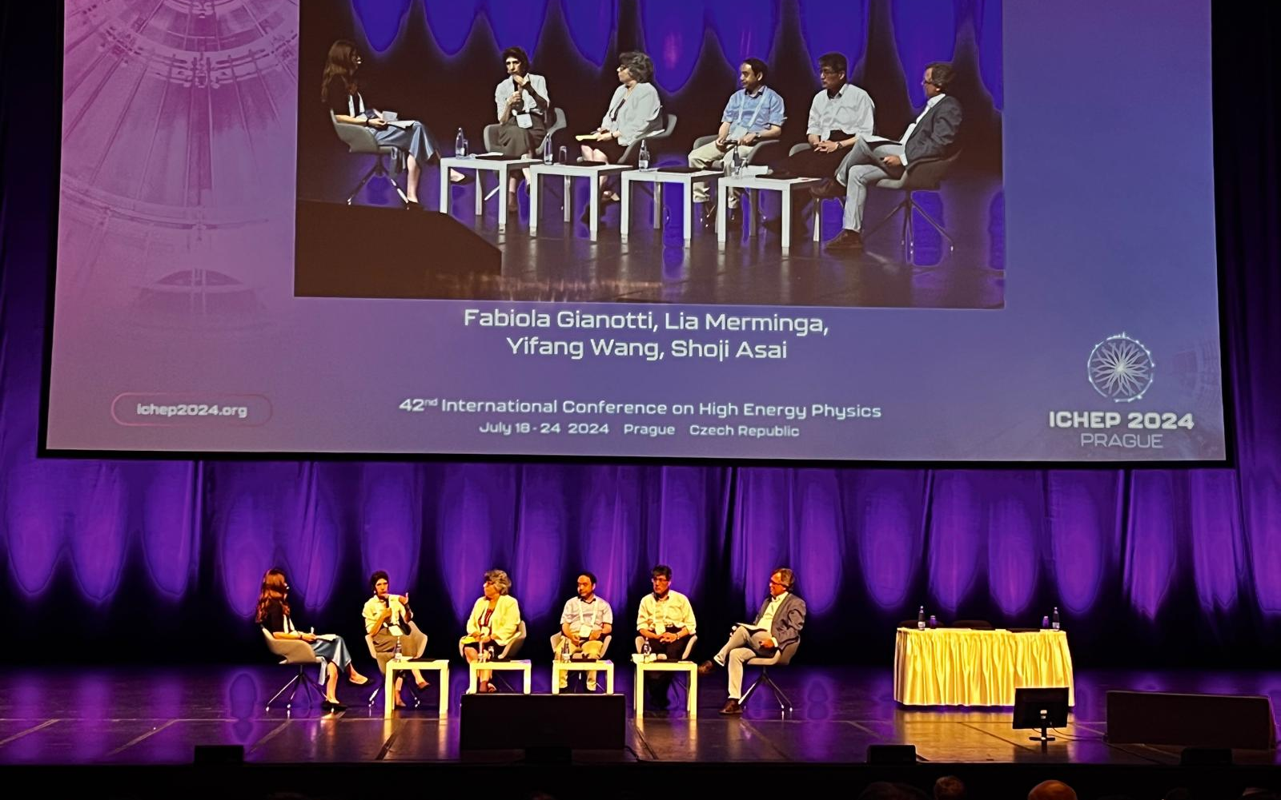
Panel discussion on future colliders

