Slide 1


2025 CERN openlab
Technical Workshop
Dr. Maria Girone, Head of CERN openlab

Slide 2




About
CERN openlab
Collaboration is the core of CERN openlab, where industry and scientific researchers co-develop innovative solutions. Together, we embark on four primary missions:
Establishing strategic industry collaborations
For nearly 25 years, CERN openlab has been the bedrock of partnership, providing a structured and collaborative framework for industry and research organisations to engage with CERN researchers.
Fuelling technological innovation
Exposing technology to researchers
Nurturing knowledge and growth in young STEM researchers

Slide 3
Sustainable Infrastructures
Emerging Technologies
R&D Directions
Heterogeneous Computing, Platforms and HPC systems
New Materials for
Long-Term Digital Storage
Advanced Storage, Data Management and Networks
Digital Twins
Projects within the CERN openlab framework are dedicated to accelerating computing for science, particularly under the R&D directions of ‘Sustainable Infrastructures’ and ‘Emerging Technologies’.
Computing Architectures and Software Engineering
Infrastructures and Techniques for Artificial Intelligence
Applications for Society and Environment

Slide 4





















Our members
Established Industry and Research Members
Industry and Research Members
in Pre-Agreement Stage
Prospective Industry and
Research Members

Slide 5
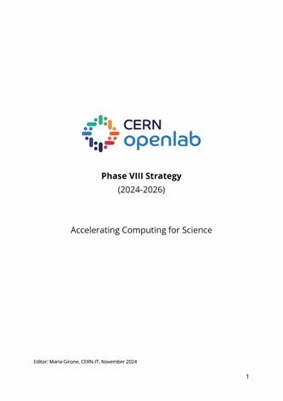
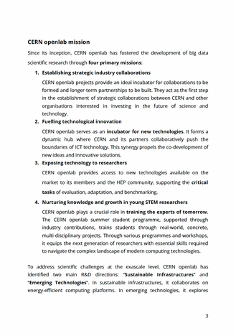
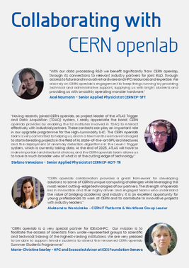
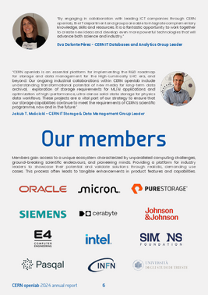
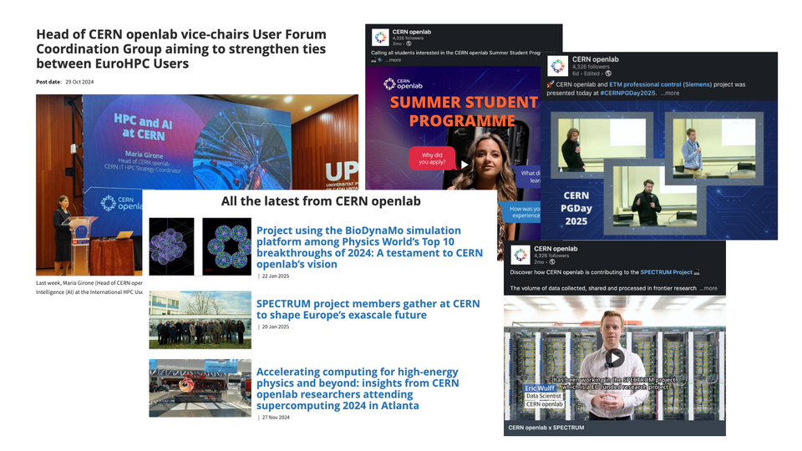

Communication & Outreach
The CERN openlab annual report was revived, a vital tool for communication and outreach, serving as a comprehensive showcase of the collaboration’s achievements, initiatives, and future aspirations. The CERN openlab Phase VIII Strategy document was also finalised and launched on our website.
We have significantly enhanced our social media presence with the launch of the CERN openlab LinkedIn account. Through LinkedIn, we have shared multiple articles highlighting our projects, achievements, and opportunities, broadening our reach and fostering connections with stakeholders.
New website!
Phase VIII Strategy
2024 Annual Report

Slide 6
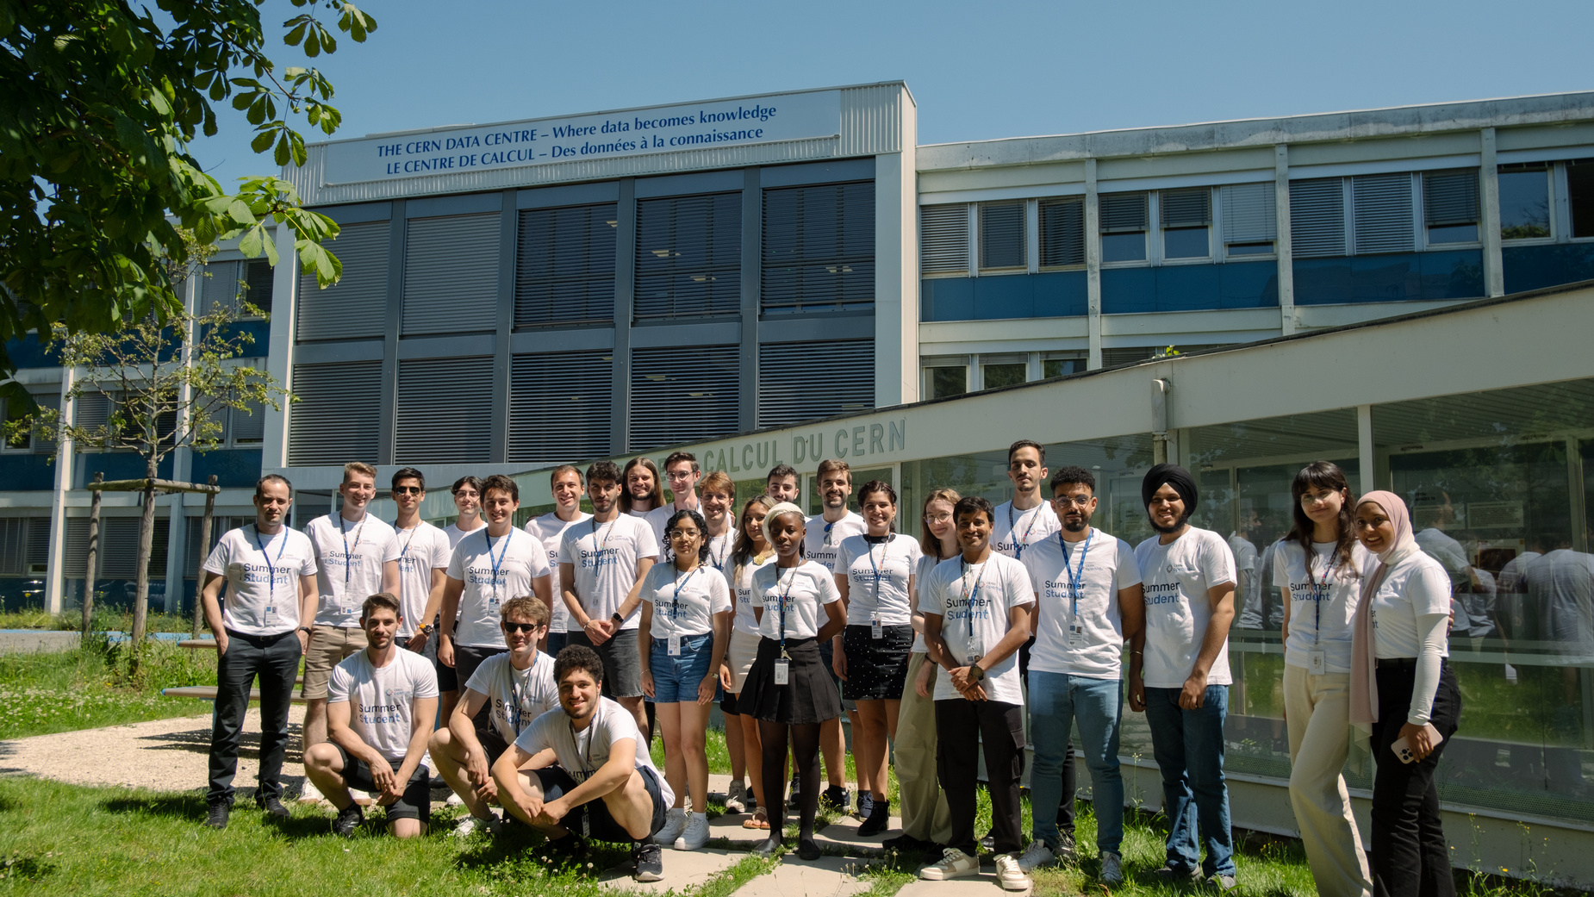
CERN openlab
Summer Student Programme
The CERN openlab summer student programme provides undergraduate and master’s level students with an opportunity to work on one of the R&D projects for nine weeks under experts’ supervision.
CERN openlab joined forces with IDEAS4HPC to sponsor a CERN openlab Summer Student, promoting the participation of women in high-performance computing research. CERN openlab is committed to diversity, equity and inclusion in ICT and will continue championing it.

Slide 7
2025 CERN openlab
Technical Workshop
Tuesday
Wednesday
13:15pm
to
14:05pm
9am
to
10:10am
Digital Twins, Applications for Society and Environment
Welcome & Keynotes
Infrastructures and Techniques for AI and HPC
14:05pm
to
15:40pm
10:45am
to
15:35pm
Heterogeneous Computing, Platforms and HPC
16:10pm
to
17:45pm
15:35pm
to
16:50pm
Infrastructures and Techniques for AI and HPC
Advanced Storage Solutions

Slide 8
Industry
Talks
Wednesday
11am
Micron CXL and SSD Solutions
11:45am
Intel Solutions on AI and HPC Convergence
Tuesday
Evaluating HPC Architectures for Scientific Computing in E4: Performance, Scalability, and Energy Efficiency
12:50pm
NVIDIA Compute Update and Recent Developments in HPC Software
15:05pm
16:25pm
AI for Source Code: A Practitioner’s Insights into Automating DevOps at Oracle
14:10pm
Cerabyte Ceramic Glass Storage Technology

Slide 9
Don’t forget to network!
Wednesday
The goal of the annual CERN openlab technical wokshop is to promote networking, create links between CERN, industry and research industries. Moments for networking: lunch, coffee breaks, poster sessions and networking cocktail.
10:10am
Group Photo!
10:15am
Coffee Break & Poster Session
Tuesday
15:40pm
12:05pm
Coffee Break & Poster Session
Lunch Break
17:45pm
14:35pm
Networking Cocktail
Coffee Break & Poster Session

Slide 10
Thank you for joining us!

