Slide 2
Environmental efficiency of tape storage at CERN
Vladimír Bahyl
IT-SD-TAB

Slide 3
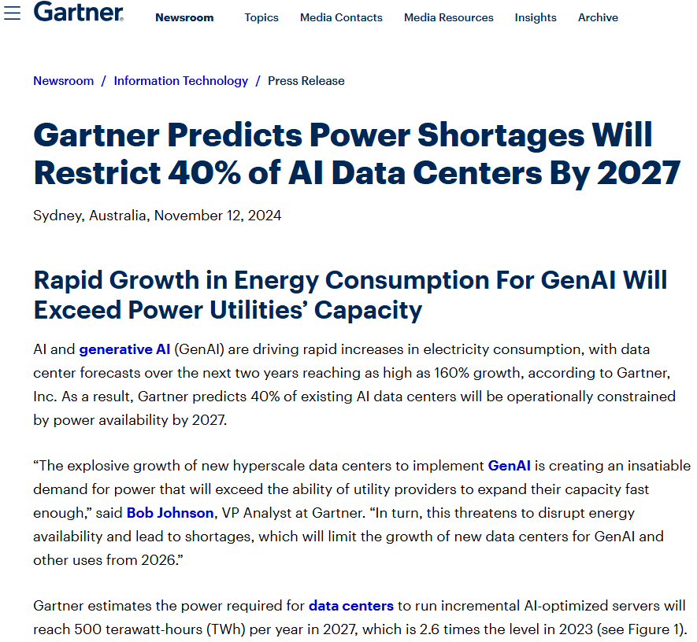

Slide 4
CERN
electricity consumption structure
CERN Data Centre
electricity consumption structure
Source: M. Schulz: CERN-IT Sustainability

Slide 5
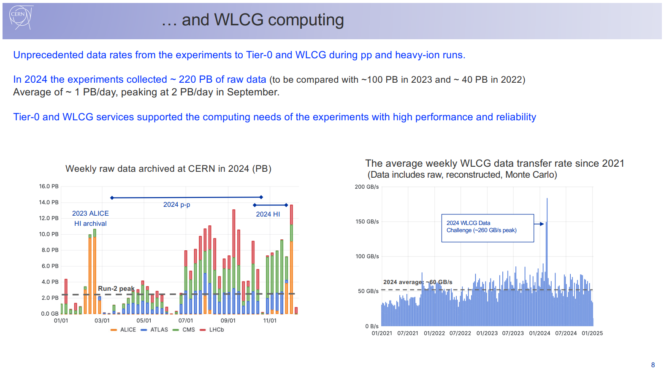
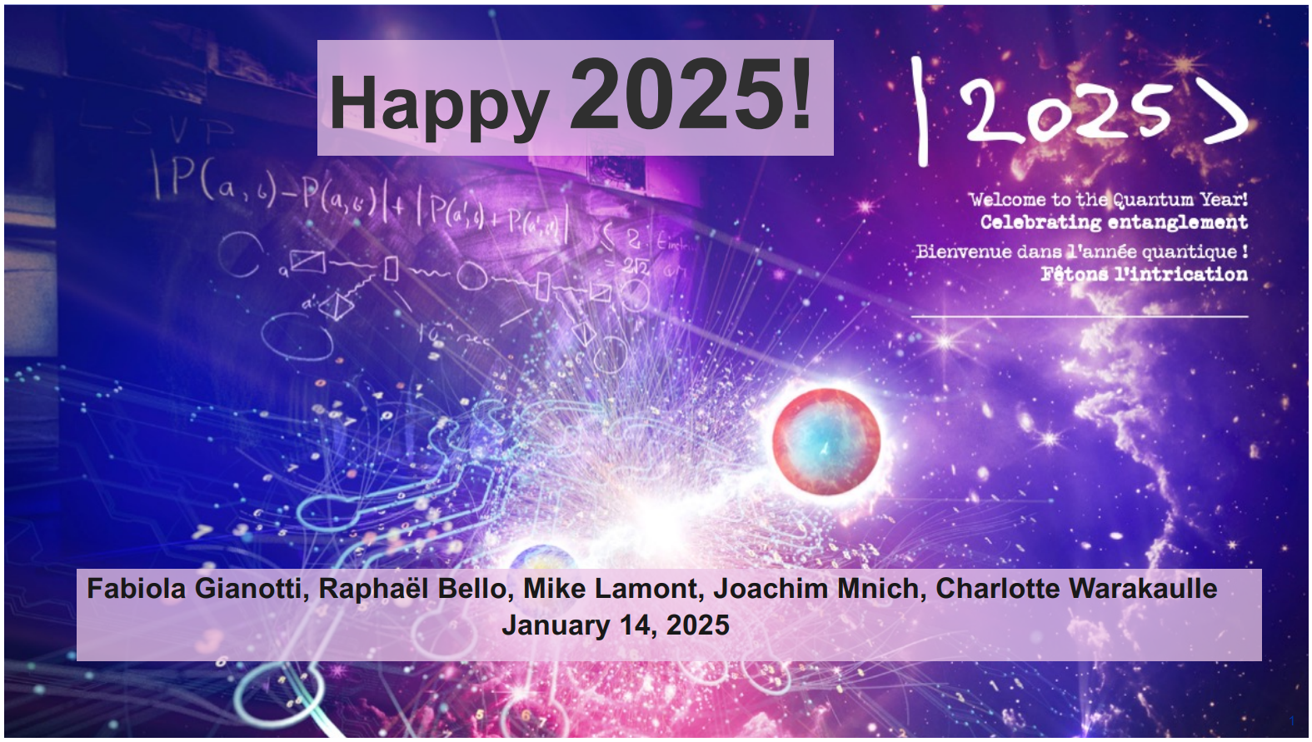

Slide 6
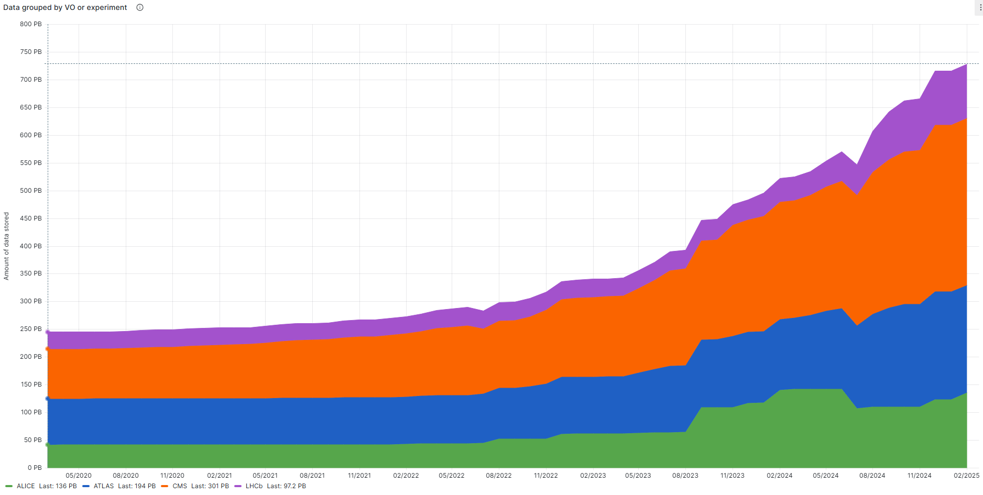
Amount of LHC data stored

Slide 7


Tape Infrastructure (February 2025)
Archive of the physics data
Provisioned capacity: ~1.25 EB
Libraries:
  4 x IBM TS4500
  3 x Spectra Logic TFinity
Drives:
  40 x IBM TS1170, 46 x IBM TS1160
  88 x LTO-9, 10 x LTO-8
Media:
  250 PB on 3592JF, 150 PB on 3592JE, 227 PB on 3592JD
  551 PB on LTO-9, 17 PB on LTO-8, 59 PB on LTO-7M
Backup of the business data
Licensed capacity: ~15 PB
Libraries:
  1 x IBM TS4500 (partitioned)
  1 x Spectra Logic TFinity (partitioned)
Drives:
  10 x LTO-9
  10 x LTO-8
Media:
  12 PB on LTO-8
  11 PB on LTO-7M

Slide 8
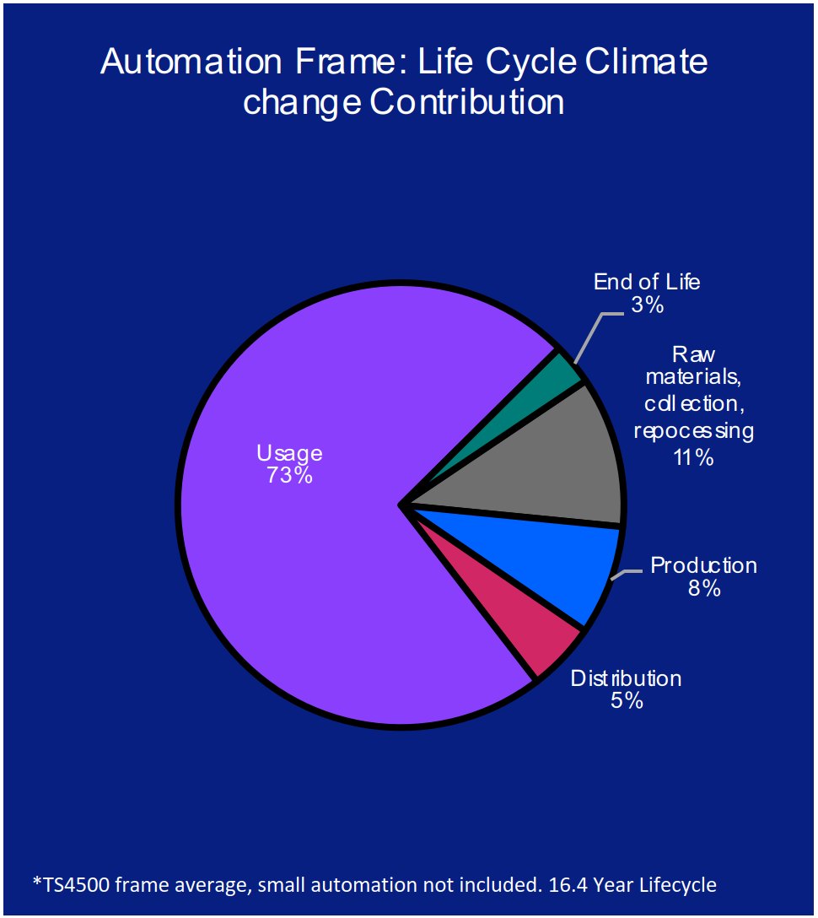
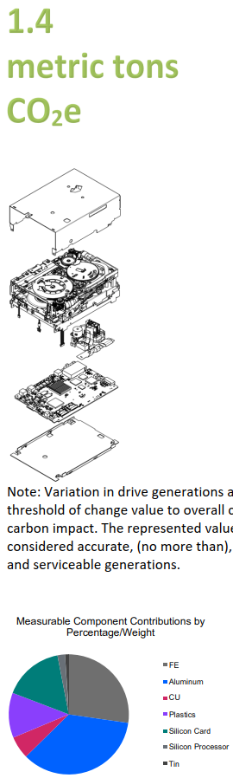
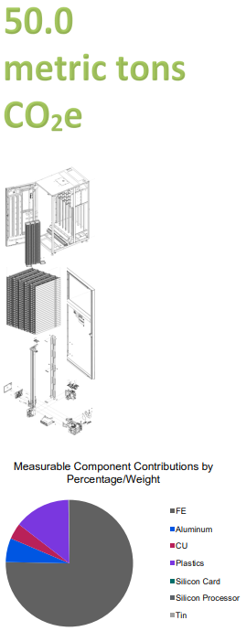
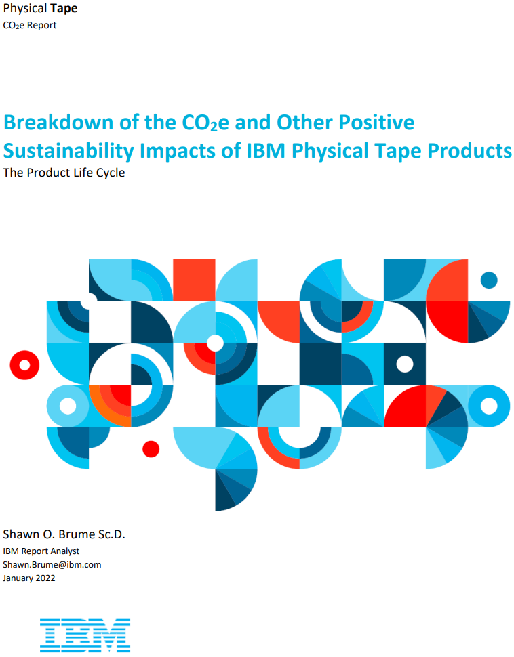
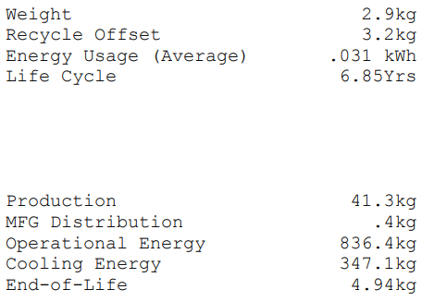
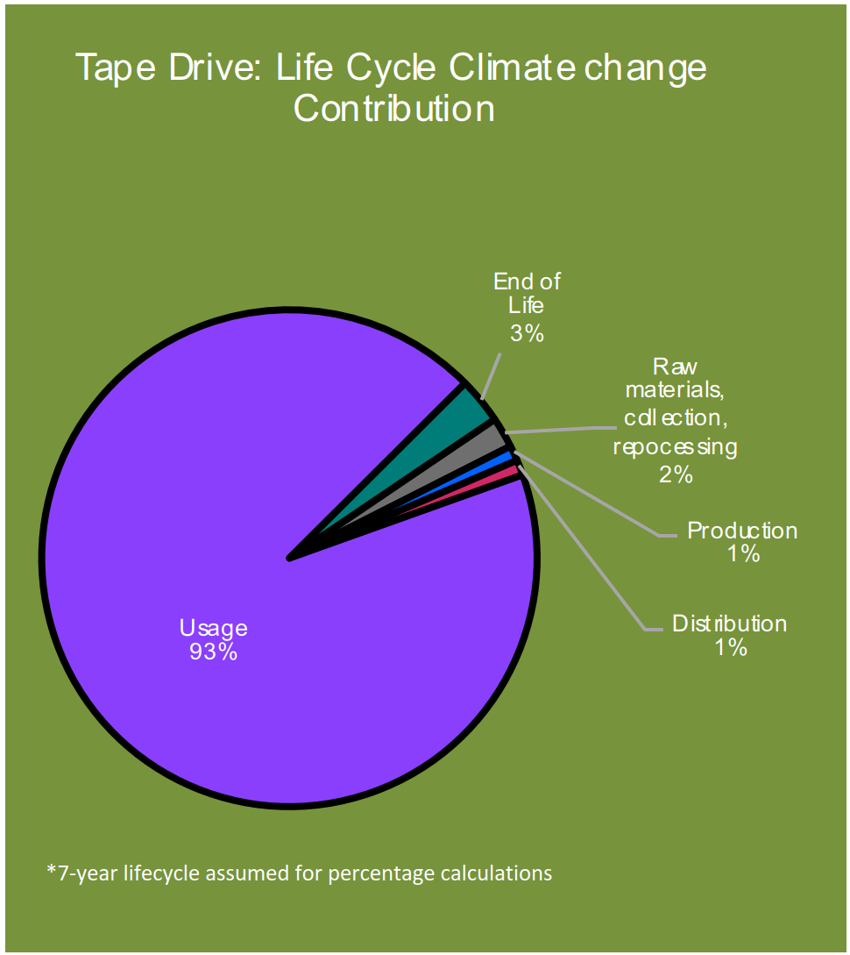
IBM CO₂e Report

Slide 9
Environmental footprint of 1.2 EB – best case
Could comfortably fit into two IBM TS4500 tape libraries, each with 15000 slots (IBM TS1170 drives and 3592JF cartridges)
Reality – more hardware is needed:
  Throughput requirement – at least 40 GB/s
  Cost optimisation = using cheaper media
  Multiple generations of tape drive technologies
  Protection against library failures / outages
  Avoiding vendor lock-in
  Configuration not constant / Variable growth
Tape solution being chosen: | TS4500
Geographic region of deployment: | Europe
TS4500 Library frame | 1
Number of TS4500 Drive frames: | 2
Number of TS4500 S-frames: | 15
Number of TS1100 tape drives: | 48
Number of LTO Full High tape drives: | 0
Enter number of Cartridges: | 15000
Enter type of media: | 3592 Media
The total CO₂e contribution for a TS4500 configuration as listed, with all shipping to Europe is: | 530 mt
Based on the TS4500 having a 9-year life cycle.
Disclaimer: First version of the sustainability calculator tool
2 x 530 mt = 1060 mt / 9 years = 118 mt per year
118 mt / 1200 PB = ~0.1 mt of CO₂e per PB per year
118 mt of CO₂e = ~30 petrol cars driving 15000 km per year
Source: https://www.epa.gov/energy/greenhouse-gas-equivalencies-calculator

Slide 10
Environmental footprint of 1.2 EB – reality – 1/2
Disclaimer:
Extrapolated calculation, using IBM methodology
on Spectra Logic TFinity product

Slide 11
Environmental footprint of 1.2 EB – reality – 2/2
Summary:
  IBM: 250 + 296 + 534 + 520 = 1800 mt / 9 years
  Spectra Logic: 332 + 334 + 232 = 898 mt / 9 years
  Total: 2698 mt / 9 years = 300 mt / year
300 mt / 1200 PB = 0.25 mt of CO₂e per PB per year
300 mt of CO₂e = ~80 petrol cars driving 15000 km per year
Source: https://www.epa.gov/energy/greenhouse-gas-equivalencies-calculator
Comparison: The Dirty Secret of SSDs: Embodied Carbon (https://arxiv.org/pdf/2207.10793)
  Table 1 – 1 TB HDD generates 100 Kg of CO₂e per 5 years = 20 Kg per year
    This includes server hardware
  With ~100000 HDDs at CERN, that would be around 2000 tons of CO₂e per year

Slide 12
Energy consumption of 1.2 EB tape archive – 1/2
IBM
  Considering maxiumum values from: https://www.ibm.com/docs/en/ts4500-tape-library?topic=planning-power-consumption-cooling-requirements
  IBMLIB1 : 1925 W
  IBMLIB2 : 939 W
  IBMLIB3 : 3543 W
  IBMLIB4 : 3543 W
  Total IBM (maximum continuous): 9950 W
  Maximum continuous power is consumed when the drives are actively
  reading or writing to the tape and the cooling fan rotates at normal speed.

Slide 13
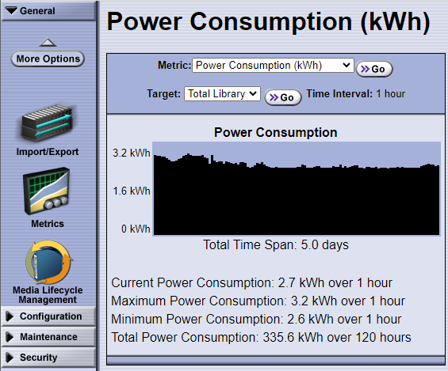
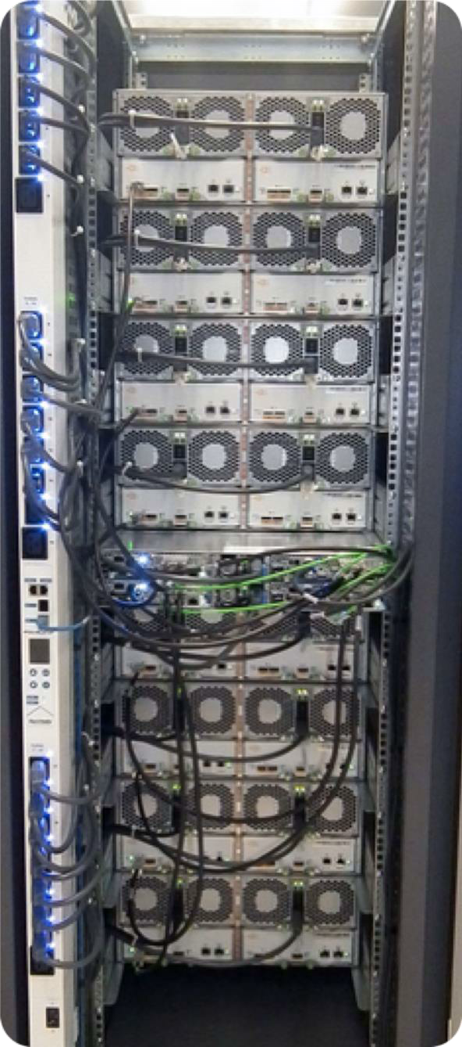
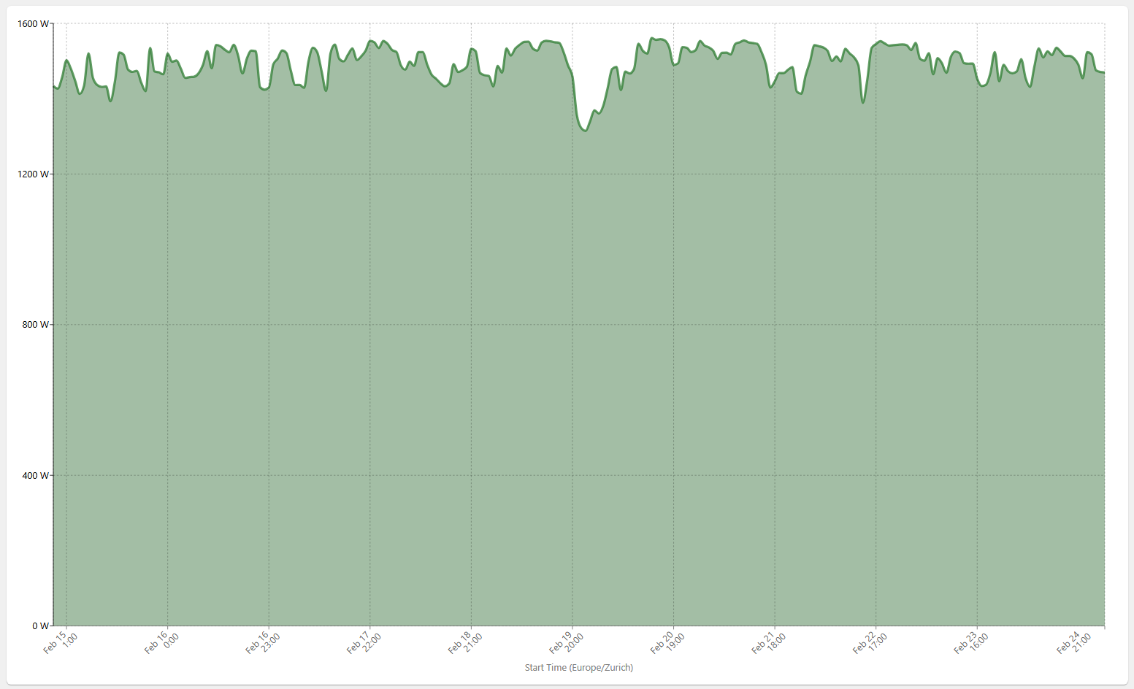
Energy consumption of 1.2 EB tape archive – 2/2
Spectra Logic
  Considering maximum values as reported by the libraries:
  SPECTRALIB1: 3200 W
  SPECTRALIB2: 3200 W
  SPECTRALIB3: 1600 W
  Total Spectra Logic (estimation): 8000 W
TOTAL: ~18 kW per 1.2 EB = ~15 W per PB
Comparison: According to PDU monitoring,
one rack at CERN usually consumes ~3 kW
(example PDU-SJ06-01)

Slide 14
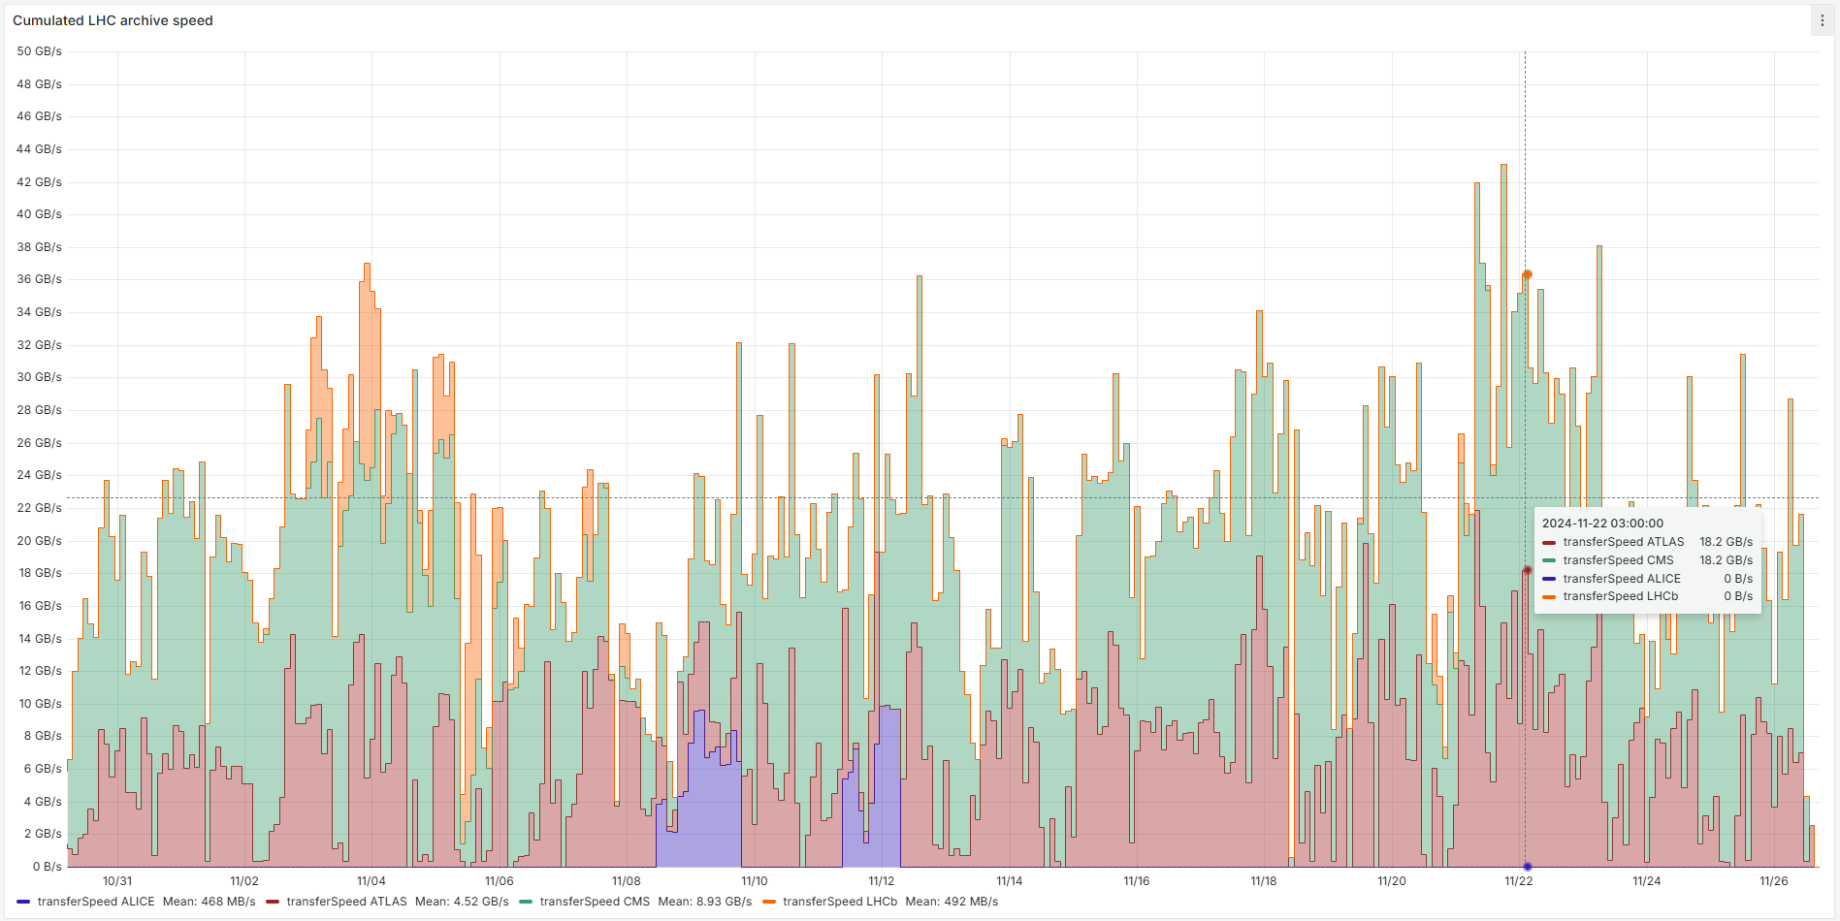

33 PB in 4 weeks = ~1 PB/day

Slide 15
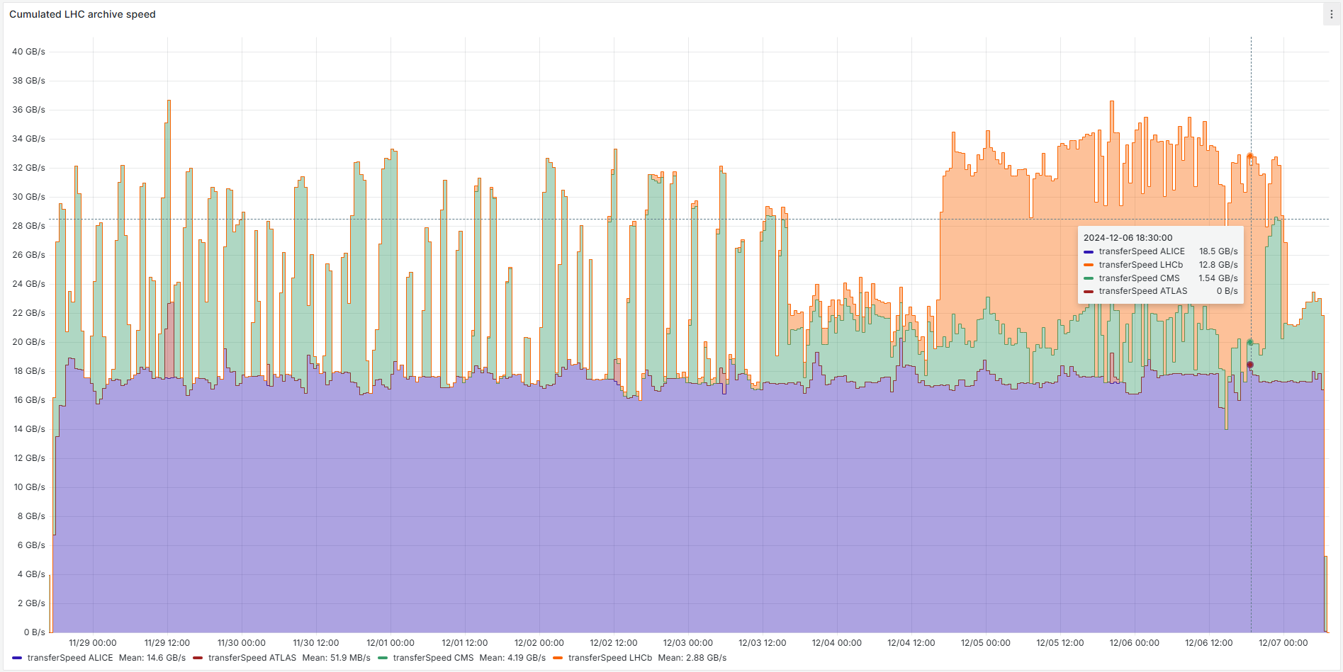

18 PB in 9 days = ~2 PB/day

Slide 16
Conclusion
Quantify environmental and sustainability impact of any (IT) equipment is a complex exercise
The carbon footprint is dominated by the usage pattern and the capacity (number of tape cartridges)
Calculations are based on IBM report (Spectra Logic extrapolated (as drives and cartridges are the same))
CERN Tape Archive:
  Generates around 300 mt CO₂e per year (80 petrol cars driving 15000 km per year)
  Consumes around 18 kW (around 15 W per PB)
Spikey usage demands larger configuration and has bigger environmental footprint
Adding more:
  Capacity will generate more CO₂e, but will not increase power consumption
  Throughput (assuming same drive generations) will generate more CO₂e as well as increase power consumption
Future work:
  Include server hardware
  Improved IBM tool (allow for different energy sources; consider growth of the archive)
Notes:
Interesting article:
Data center emissions probably 662% higher than big tech claims. Can it keep up the ruse?
https://www.theguardian.com/technology/2024/sep/15/data-center-gas-emissions-tech

