Slide 1
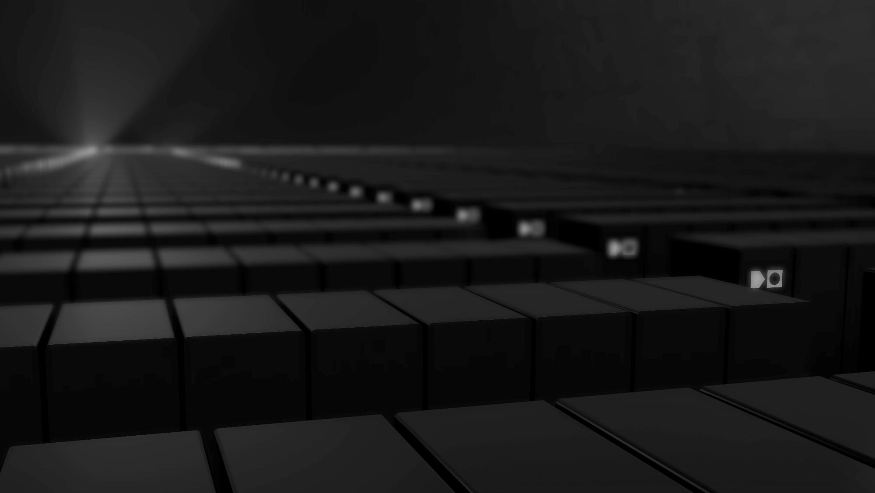
Sustainable Data Storage
to keep data accessible forever
© 2025 www.cerabyte.com

Slide 2
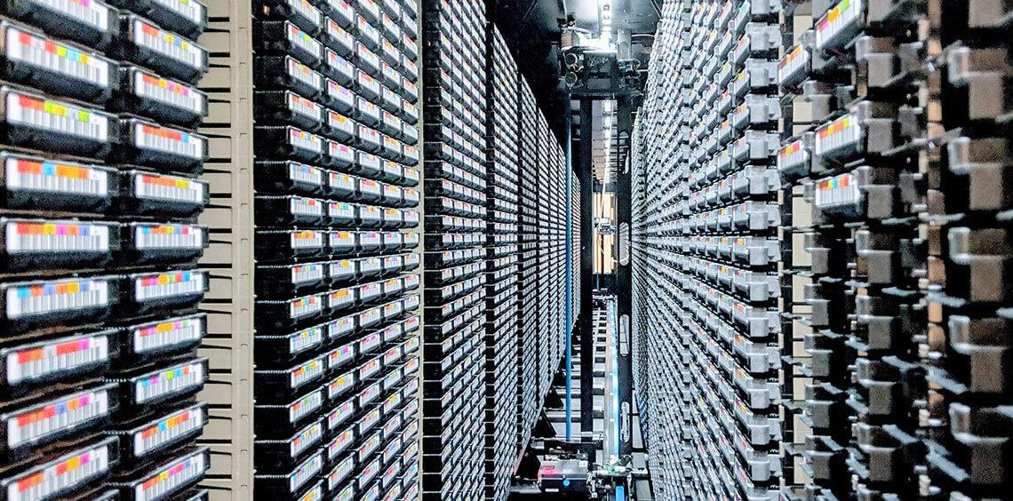
CERN's tape library is the world's largest archive of scientific data
Notes:
in the field of high-energy physics

Slide 3
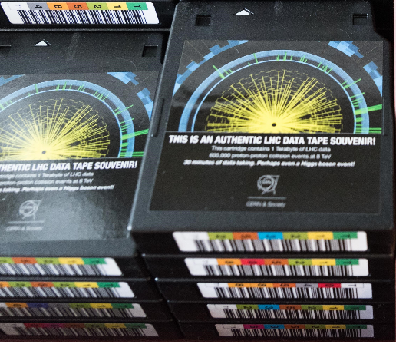
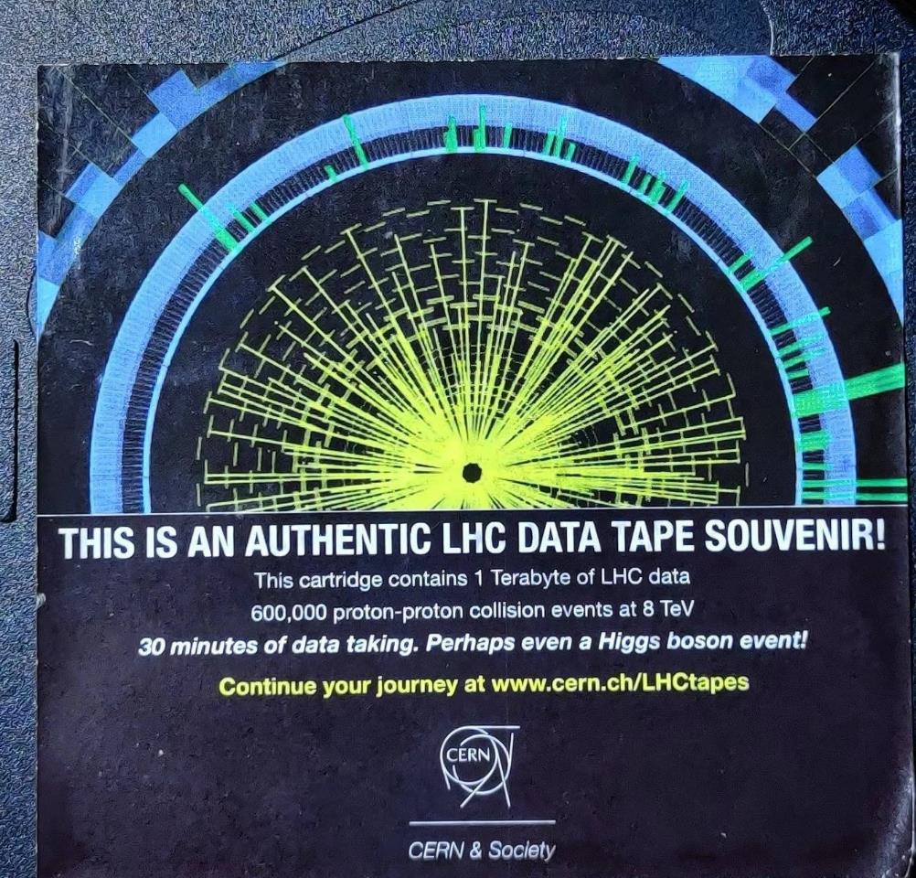
Obsolete Tape - a souvenir like no other – creative reuse!

Slide 4

CERN Archival demand by 2033 from the LHC: 6 EB

Slide 5



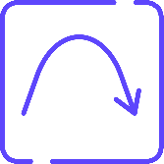


Data from the LHC: stored for… ever?
Looking with new insights into old data
Challenges of digital long-term preservation:
Regular acquisition costs for media + W/R HW
Limited media lifetime
Limited data retention due to bit rot
Workload of migration & fixity checks
Energy supply, climate control, vulnerable to EMP
In fact using the wrong media is unsustainable
© 2025 www.cerabyte.com
5

Slide 6
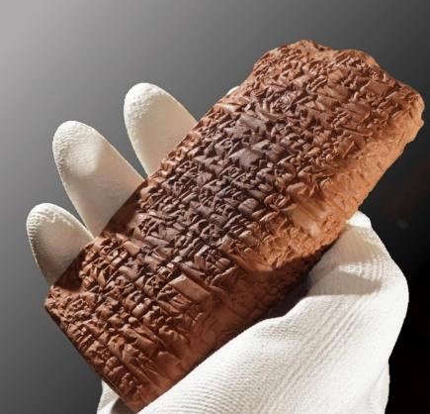
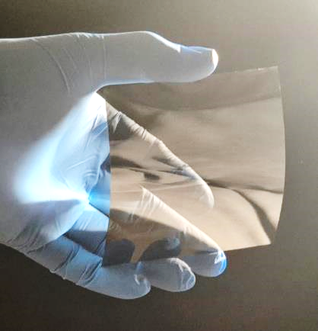
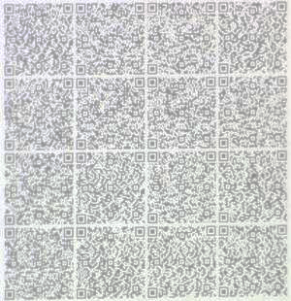
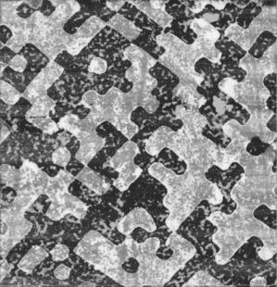
From Clay Tablets to Ceramic-on-Glass Sheets
Ceramic-on-glass
sheets
Data matrix
Physical bits ablated in dark cermic layer
© 2025 www.cerabyte.com
6
Notes:
There is a material for information storage that has been proven for thousands of years.
Cerabyte uses thin flexible glass from the display industry and coats it with an ultra-thin dark ceramic layer, in which data matrices are punched into.
This are physical bits and they remain virtually forever, even in harsh environment. No energy is required to retain data. This is innovation no 1

Slide 7










Durable & Sustainable Permanent Data Storage
-272 °C
-459 °F
Energy free retention,
no AC for storage
+500 °C
+930 °F
Immutable record,
cyber secure / WORF media
Moisture & flood proof
No media degradation forcing periodic replacement
Corrosion
resistant
No data migration, no bit rot nor periodic fixity check
Radiation & EMP proof
Deletable,
100% recyclable
© 2025 www.cerabyte.com
7

Slide 8
Cerabyte – Ceramic Data Storage
Martin Kunze, a ceramist, identified the need for permanent storage
Together with Christian & Alex Pflaum founded Cerabyte in 2022
The team has raised an initial $10M seed round & $4M grant funding
Raising Series A, support from flash, disk, clean tech & IC companies
Cerabyte is headquartered in Munich, Germany
With offices in Vienna, Silicon Valley and Colorado
© 2025 www.cerabyte.com
8

Slide 9
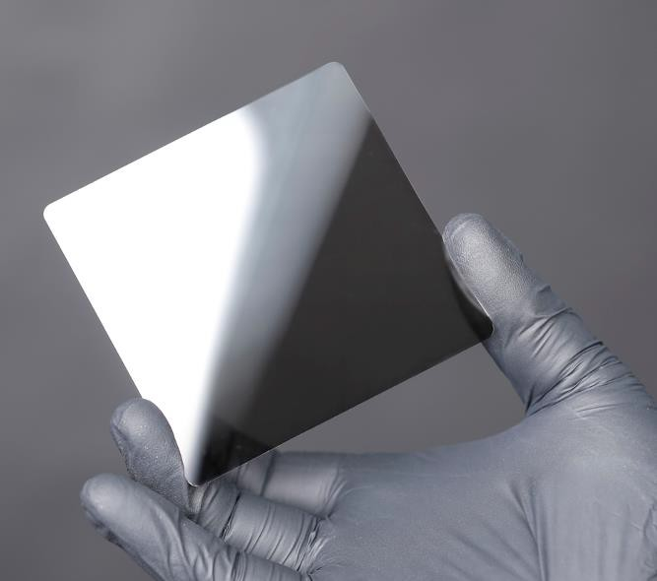
Cerabyte Company Overview
Key Innovations & Levers:
  Ceramic on Glass Media Technology – high volume thin glass ecosystem
Ceramic-On-Glass Sheets
© 2025 www.cerabyte.com
9

Slide 10
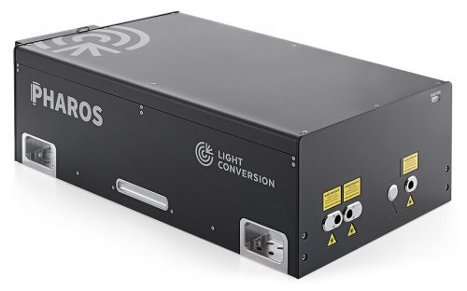
Cerabyte Company Overview
Key Innovations & Levers:
  Ceramic on Glass Media Technology – high volume thin glass ecosystem
  WORM Technology punching holes through fs laser/particle beam matrix
Ceramic-On-Glass Sheets
Femtosecond
Laser
© 2025 www.cerabyte.com
10

Slide 11
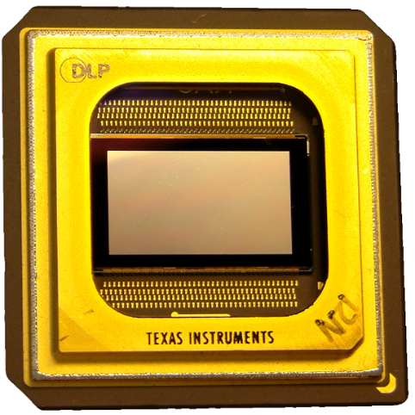
Cerabyte Company Overview
Key Innovations & Levers:
  Ceramic on Glass Media Technology – high volume thin glass ecosystem
  WORM Technology punching holes through fs laser/particle beam matrix
  Leverage semiconductor product and manufacturing fab tool technology
Ceramic-On-Glass Sheets
Femtosecond
Laser
Matrix Writer
with DMD
© 2025 www.cerabyte.com
11

Slide 12
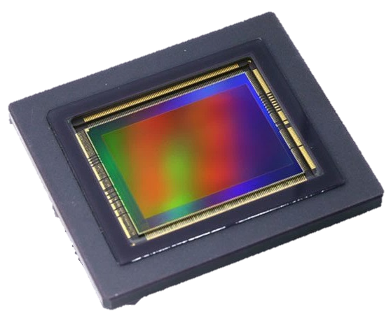
Cerabyte Company Overview
Key Innovations & Levers:
  Ceramic on Glass Media Technology – high volume thin glass ecosystem
  WORM Technology punching holes through fs laser/particle beam matrix
  Leverage semiconductor product and manufacturing fab tool technology
  Reading via HiRes MegaPixel CMOS sensor, leveraging sensor ecosystem
Ceramic-On-Glass Sheets
Femtosecond
Laser
Matrix Writer
with DMD
CMOS MegaPixel
Sensor Reader
© 2025 www.cerabyte.com
12

Slide 13
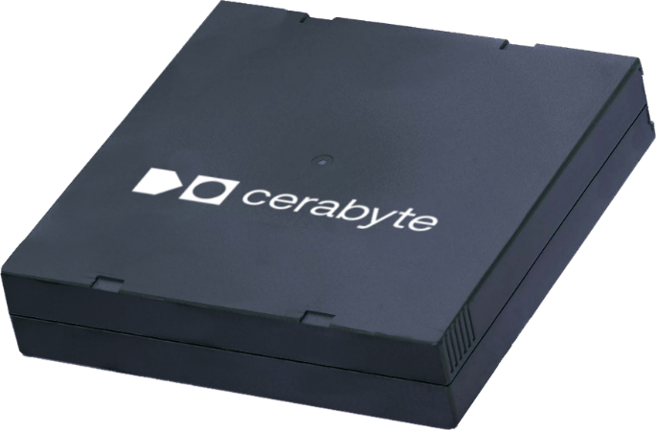
Cerabyte Company Overview
Key Innovations & Levers:
  Ceramic on Glass Media Technology – high volume thin glass ecosystem
  WORM Technology punching holes through fs laser/particle beam matrix
  Leverage semiconductor product and manufacturing fab tool technology
  Reading via HiRes MegaPixel CMOS sensor, leveraging sensor ecosystem
  Leveraging LTO tape form factor & tape library automation ecosystem
Ceramic-On-Glass Sheets
Femtosecond
Laser
Matrix Writer
with DMD
CMOS MegaPixel
Sensor Reader
Existing Form Factors & Automation
© 2025 www.cerabyte.com
13

Slide 14
Cerabyte Company Overview
Key Innovations & Levers:
  Ceramic on Glass Media Technology – high volume thin glass ecosystem
  WORM Technology punching holes through fs laser/particle beam matrix
  Leverage semiconductor product and manufacturing fab tool technology
  Reading via HiRes MegaPixel CMOS sensor, leveraging sensor ecosystem
  Leveraging LTO tape form factor & tape library automation ecosystem
Evolving technology from working prototype to the first commercial system
Ceramic-On-Glass Sheets
Femtosecond
Laser
Matrix Writer
with DMD
CMOS MegaPixel
Sensor Reader
Existing Form Factors & Automation
© 2025 www.cerabyte.com
14

Slide 15


Slide 16

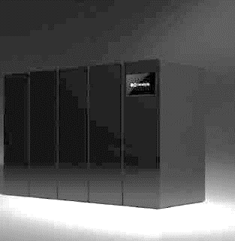
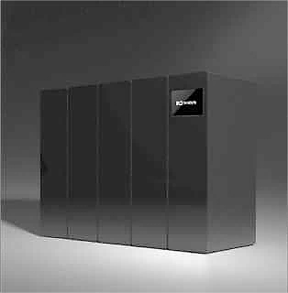
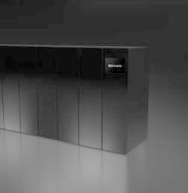
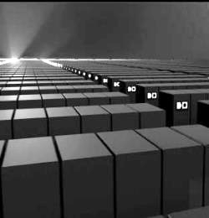

From Pilot to Cloud System
Pilot
On-Prem
Data Center
Cloud
90 sec to first byte
$1000/TB
160+ TB/cartridge
2+ GB/s
1 TB/cartridge
100 MB/s
< 10 sec to first byte
$1/TB
2025-26
2026-27
2027-28
2028-30
© 2024 www.cerabyte.com
16

Slide 17
Early Access From Prototype to Product
2023 # end-to-end prototype built from components off-the-shelf, QR codes, FPGA
# quick feasibility demo for system and media
# limited compatibility between components prevents acceleration
© 2025 www.cerabyte.com
17

Slide 18
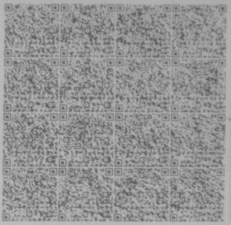
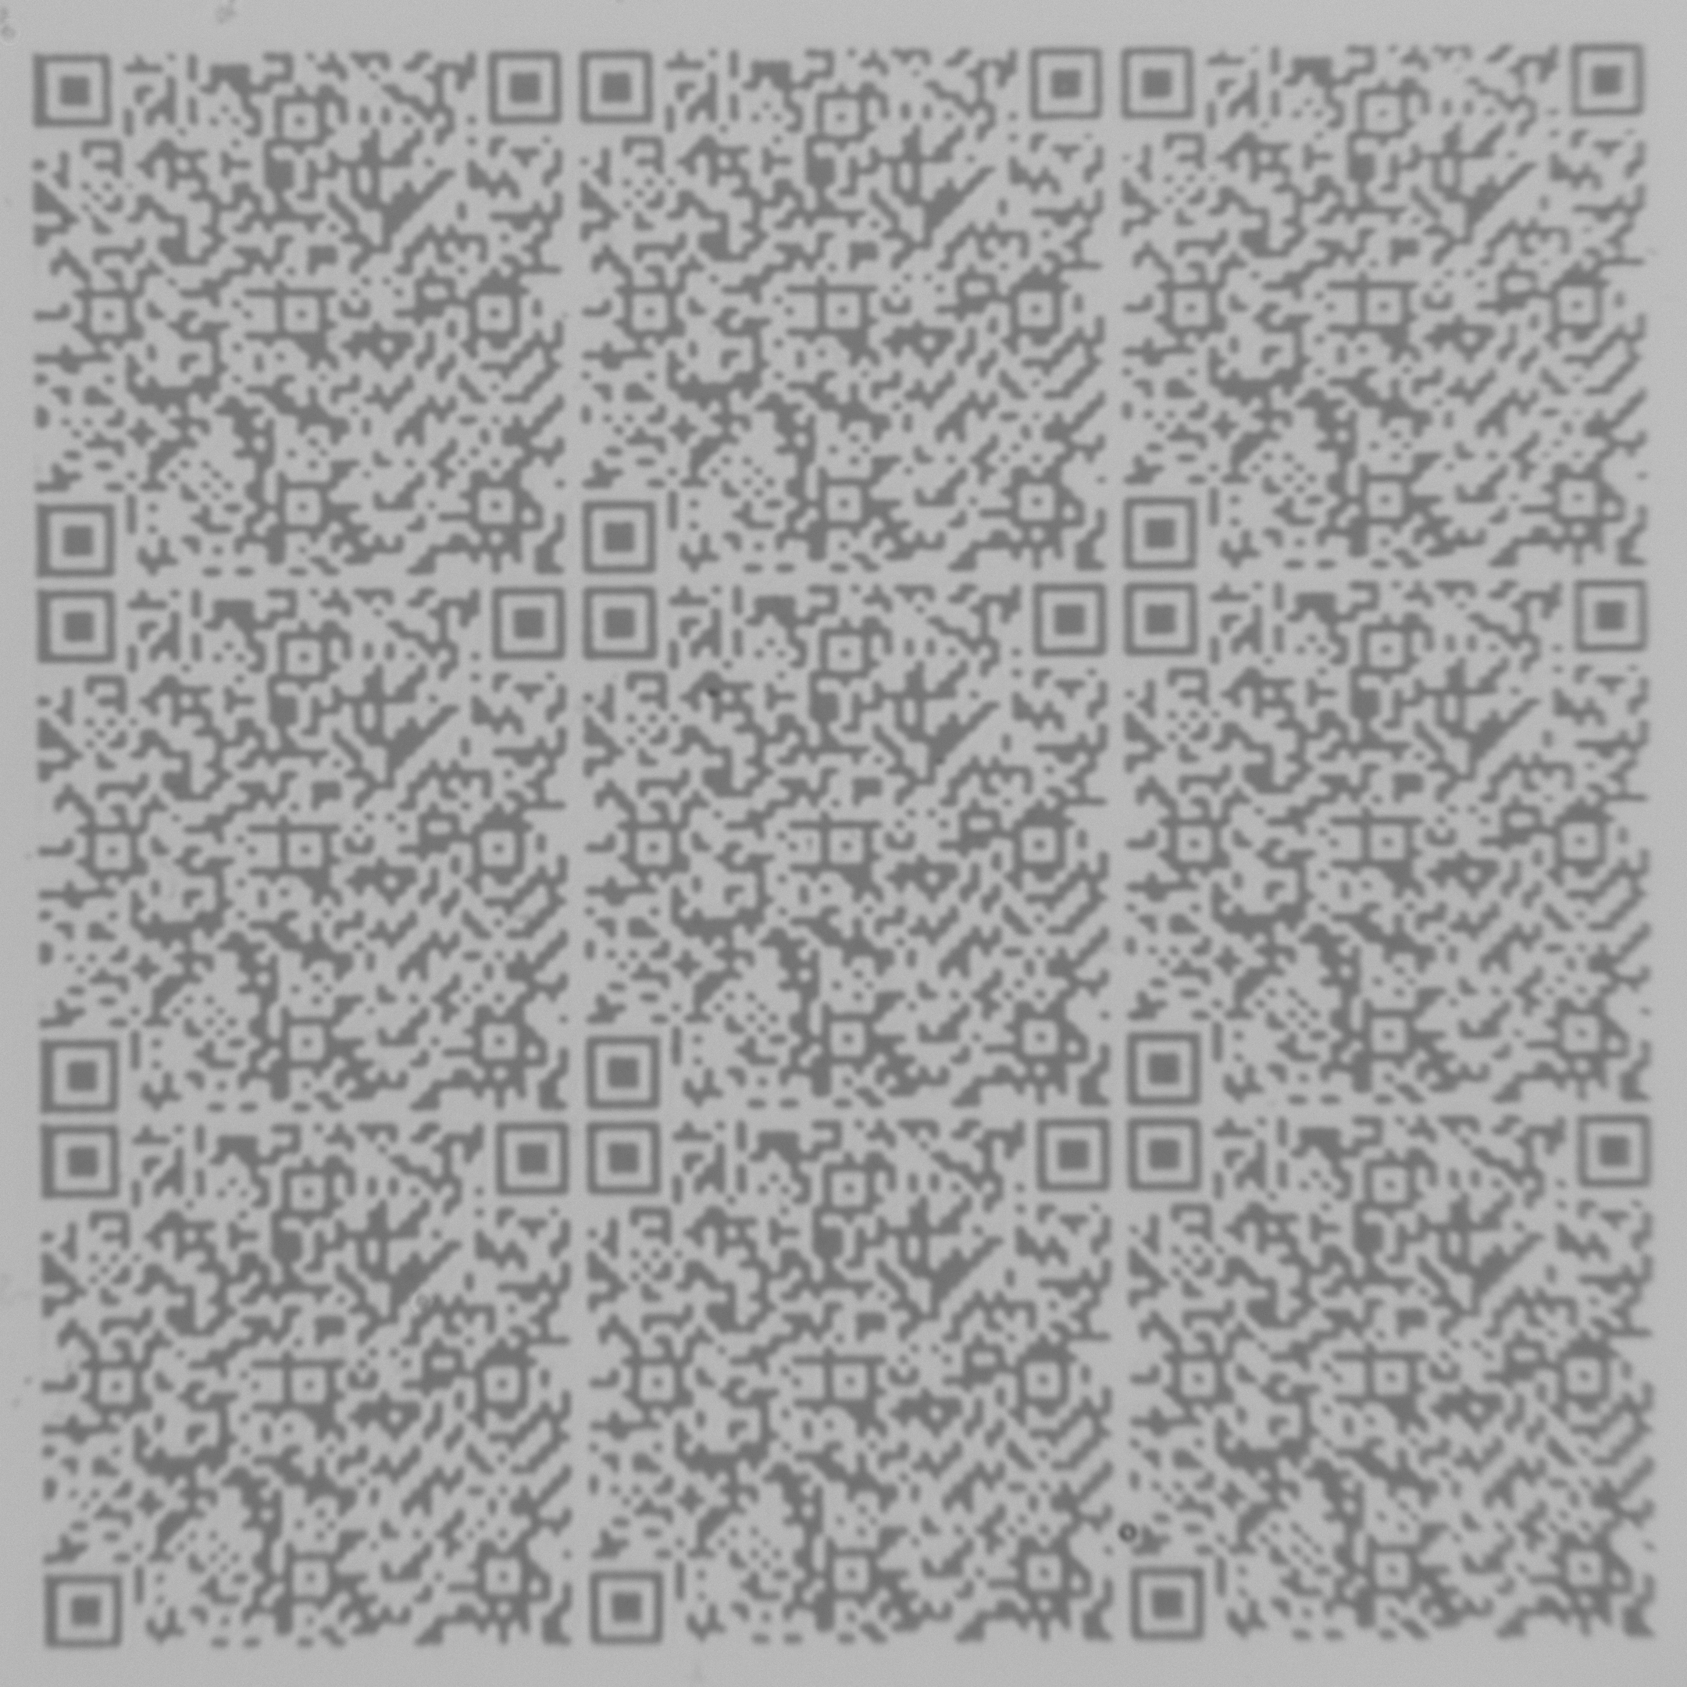
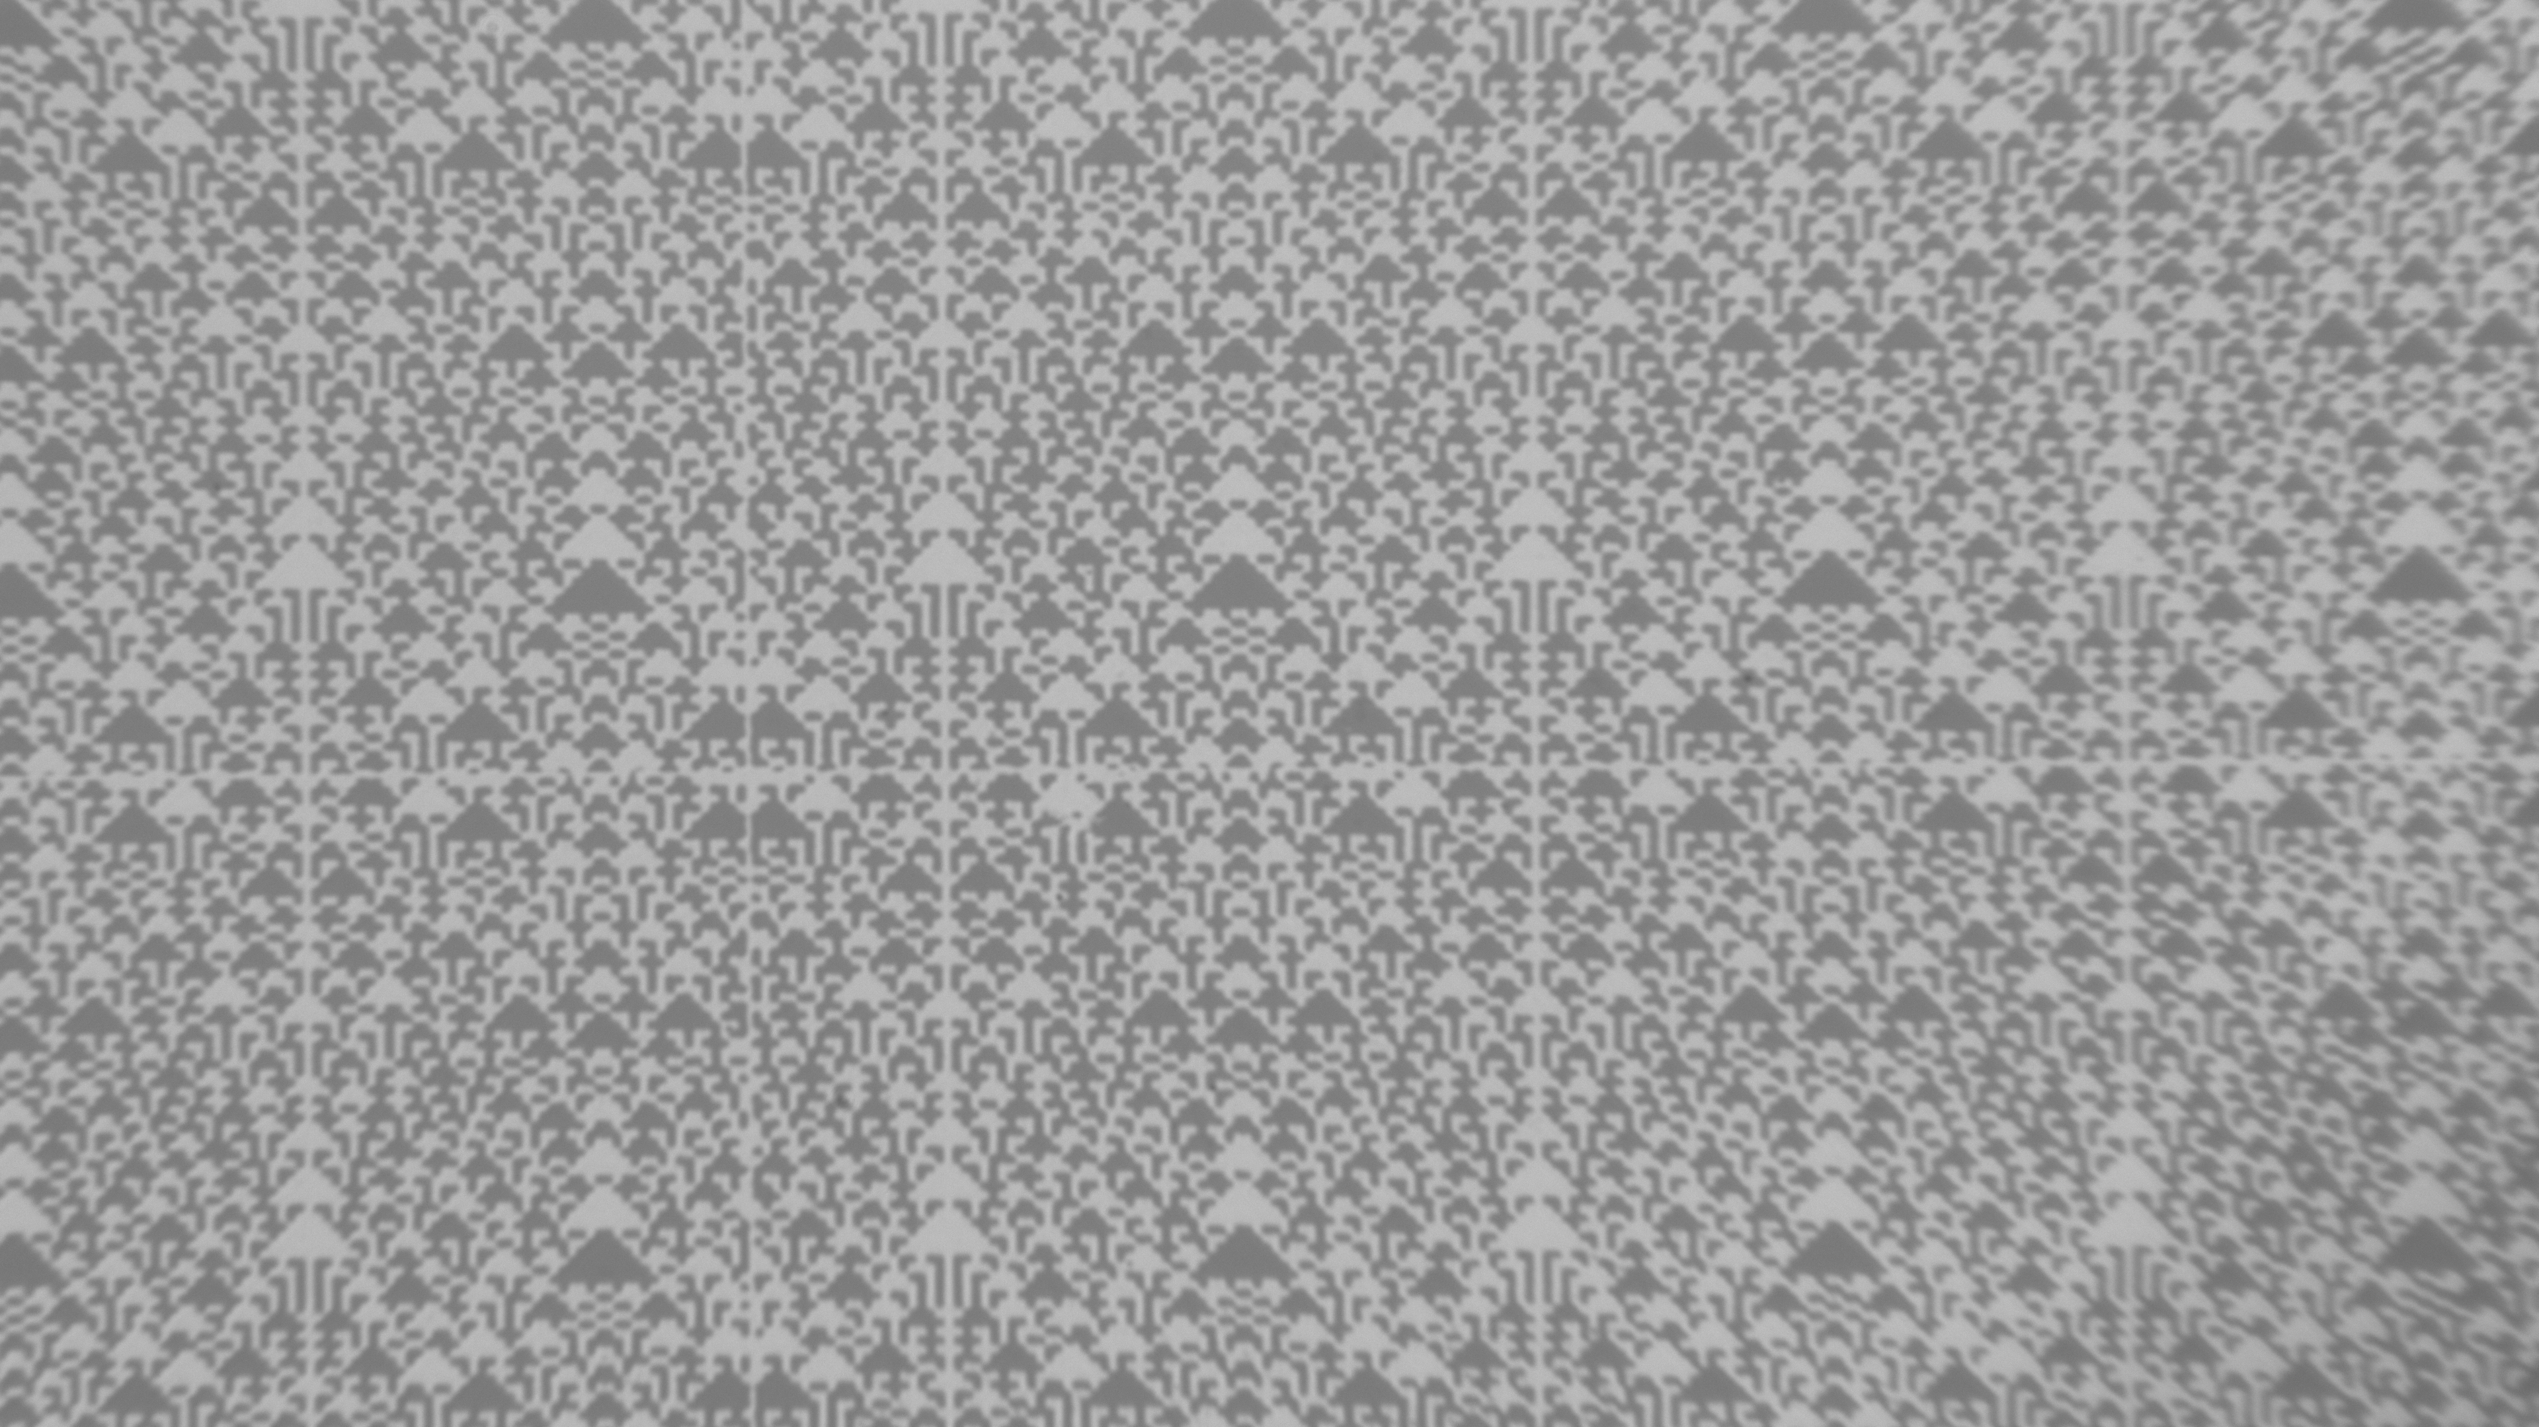
Early Access From Prototype to Product
2023 # end-to-end prototype built from components off-the-shelf, QR codes, FPGA
# quick feasibility demo for system and media
# limited compatibility between components prevents acceleration
2024 # design custom-tailored components : align DMD framerate with laser pulserate
# DMD for UV light for smaller structures/higher density
# Create efficient data matrix
# handling of media
1000 nm
- medium quality
500 nm
- improved quality
8 x shots: 200 x 200 pixel
One shot: 800 x 400 pixel
© 2025 www.cerabyte.com
18

Slide 19
Early Access From Prototype to Product
2023 # end-to-end prototype built from components off-the-shelf, QR codes, FPGA
# quick feasibility demo for system and media
# limited compatibility between components prevents acceleration
2024 # design custom-tailored components : align DMD framerate with laser pulserate
# DMD for UV light for smaller structures/higher density
# Create efficient data matrix
# handling of media
2025 # reliability test runs to find optimal overhead for EC, processing on CPU to stay flexible (MB/s)
# minimizing the stucture size – increasing capacity
# write/read GB data sheets with customer data, write entire TB cartridges
© 2025 www.cerabyte.com
19

Slide 20
Early Access From Prototype to Product
2023 # end-to-end prototype built from components off-the-shelf, QR codes, FPGA
# quick feasibility demo for system and media
# limited compatibility between components prevents acceleration
2024 # design custom-tailored components : align DMD framerate with laser pulserate
# DMD for UV light for smaller structures/higher density
# Create efficient data matrix
# handling of media
2025 # reliability test runs to find optimal overhead for EC, processing on CPU to stay flexible (MB/s)
# minimizing the stucture size – increasing capacity
# write/read GB data sheets with customer data, write entire TB cartridges
2026 # speed up reading with FPGA/ASIC 100+MB/s
# shipping 1000 slot library systems with reading unit
© 2025 www.cerabyte.com
20

Slide 21












Data from LHC: stored forever.
Looking with new insights into old data
Digital long-term preservation with Cerabyte
One time media & HW acquisition costs
Unlimited media lifetime, WORF, cyber secure
Unlimited data lifetime, no migration & fixity checks
No energy & A/C, sustainable, recyclable
Resistant to water, corrosion, heat, radiation, EMP
Significantly lower TCO
© 2025 www.cerabyte.com
21

Slide 22
Cerabyte CERN openlab Engagement
2025
Q1 Discuss on open/self describing format/index standard for the Cerabyte data carrier
Q2 GB of real data written on Cerabyte media and evaluated by CERN team
Q3 CERN’s validation of the carriers in stress/environmental conditions will be very valuable
Q4 Writing of TB+ cartridges of CERN data with new coding scheme by Cerabyte
2026
H1 Installing a 1000 slot library incl reader on CERN premises, testing reading reliability
H2 Installing a write unit into the library for writing on CERN premises
© 2025 www.cerabyte.com
22

Slide 23
CERN openlab: innovative storage technology
CERN LOI
“Cerabyte’s innovative storage technology suggests that it may be
able to create new options to store this digital data in the long term
in a secure, cost-effective, and environmentally friendly manner.”
“Additionally, Cerabyte’s long-term particle beam technology roadmap
is potentially enabling storage areal densities required for the Yottabyte Era,
which could also provide a European technology leadership opportunity.”
Helped to secure EIC & EIB Funding
© 2025 www.cerabyte.com
23

Slide 24
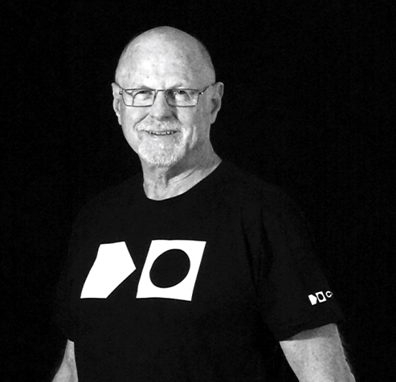
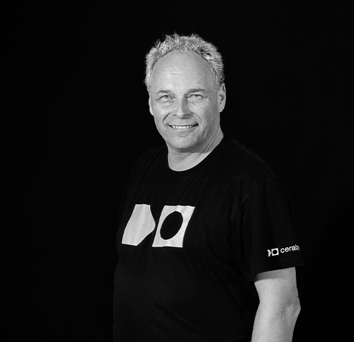
Steven Campbell, CTO
steven.campbell@cerabyte.com
Cerabyte GmbH
Franz Grill Strasse 9
1030 Vienna
Austria
Steffen Hellmold, President
steffen.hellmold@cerabyte.com
Cerabyte, Inc.
2445 Augustine Dr #150
Santa Clara, CA 95054
USA

