Slide 1




Integration of Oracle Cloud Resources into CERN IT Business Continuity & Disaster Recovery
2025 CERN openlab Technical Workshop
5th March 2025
Miro Potocky

Slide 2
Goals & Milestones
Build a replica of on-premise DR datacenter in Oracle Cloud
Create repeatable deployment configuration as code
Automate replication using Oracle Data Guard
Collect standardized infrastructure usage details
Summarize costs of running such infrastructure

Slide 3

Infrastructure / Connectivity
Oracle
Cloud infrastructure
GÉANT Network
CERN

Slide 4



Infrastructure / Network
FRA REGION
CERN TENANCY
GPN/DC VCN
PROTECTED VCN
CERN DATACENTER
GENERAL PURPOSE SUBNET
TECHNICAL SUBNET
TECHNICAL NETWORK
DNS
Database Systems
Route Table
Database Systems
Route Table
FastConnect
Security Lists
Security Lists
DC SUBNET
Dynamic Routing Gateway
EXPERIMENT SUBNET
GPN / ITS NETWORK
EXPERIMENT NETWORK
Database Systems
Route Table
Database Systems
Route Table
Security Lists
Security Lists

Slide 5


Infrastructure / Hardware
x 7
x 56
x 16
3500 GB
320 TB
10 Gbps

Slide 6
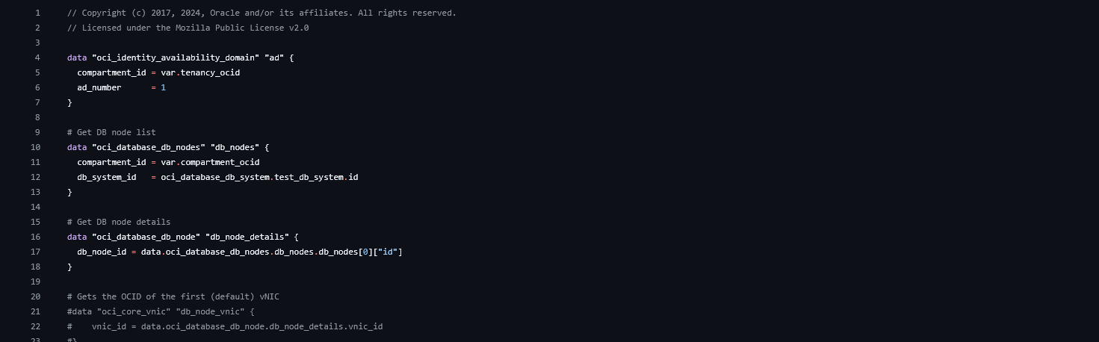
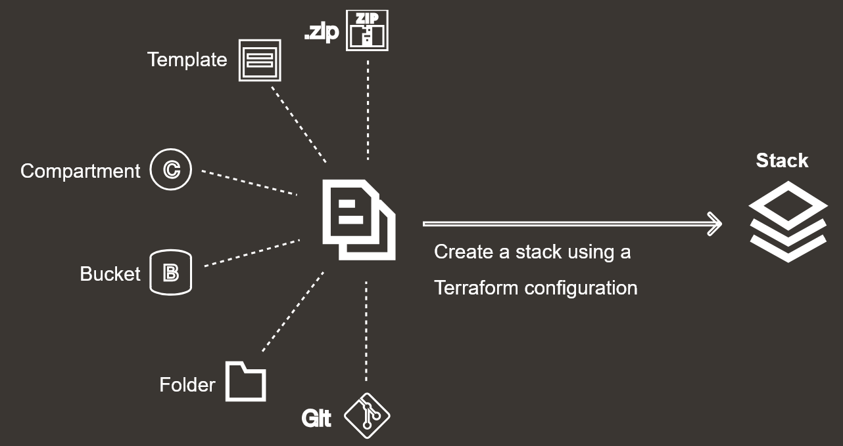
Configuration / Code
Oracle/oci terraform provider

Slide 7
Data Guard / Replication
RMAN duplication from backups
  Bash script automation of cloning
  Consistent 4TB/h replication speed
Data Guard broker configuration
  Failover built in DB connection strings
  One command switchover
  Consistent sub 20s switchover time for simple Data Guard

Slide 8
Costs / Caveats
Collection via OCI FinOps FOCUS reports
On-premise cost
  Existing CERN Oracle licensing
  Measured power requirement
  HW purchase (5 years deprecation)
  No manpower
Cloud cost
  Same Oracle licensing (or BYOL)
  No egress/ingress

Slide 9
Cost / Comparison
Yearly cost difference

Slide 10
Cost / Comparison
Yearly cost breakdown

Slide 11
Summary / Takeaways
Disaster Recovery site in cloud can be deployed rapidly once template is created
Cost of maintaining a Disaster Recovery site in Oracle Cloud is approaching* cost of running it on premise
Change of approach to resource consumption is necessary to retain cost control
Further work needs to be done to estimate the cost of Business Continuity use-case

Slide 12
Thank you / Questions
Special thanks to:
Oracle team – Şengül, Sebastien, Audrey, Chris, John and Stefan
CERN Openlab members – Antonio, Alexandros, Adrian
CERN Network support team

