Slide 1

Co-designing and Prototyping Interdisciplinary Digital Twins
Matteo Bunino, Maria Girone, Anna Lappe, Jarl Sondre Saether

Slide 2
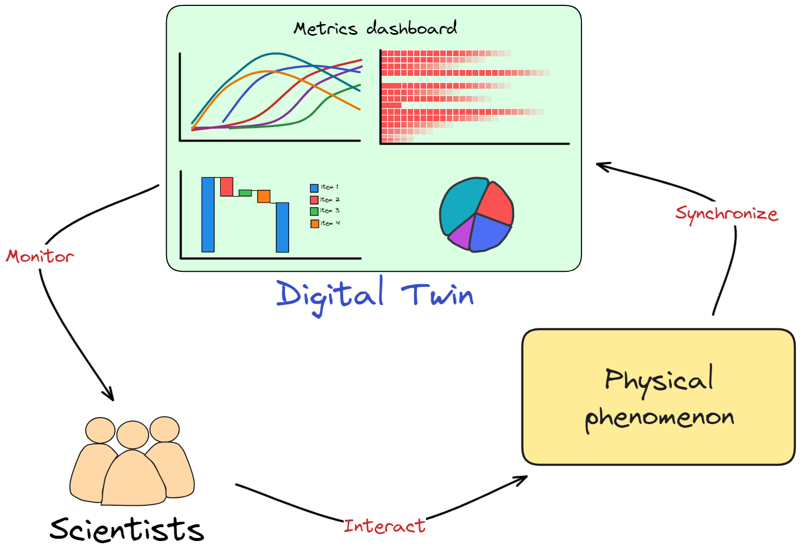
interTwin: a Digital Twin Engine for science
Co-design and implement the prototype of an interdisciplinary Digital Twin Engine
Open-source platform based on open standards
Large spectrum of diverse use cases from physics and earth observation sciences
Notes:
interTwin is a project funded by the EC
DTE.. Which is open source… and supports…

Slide 3
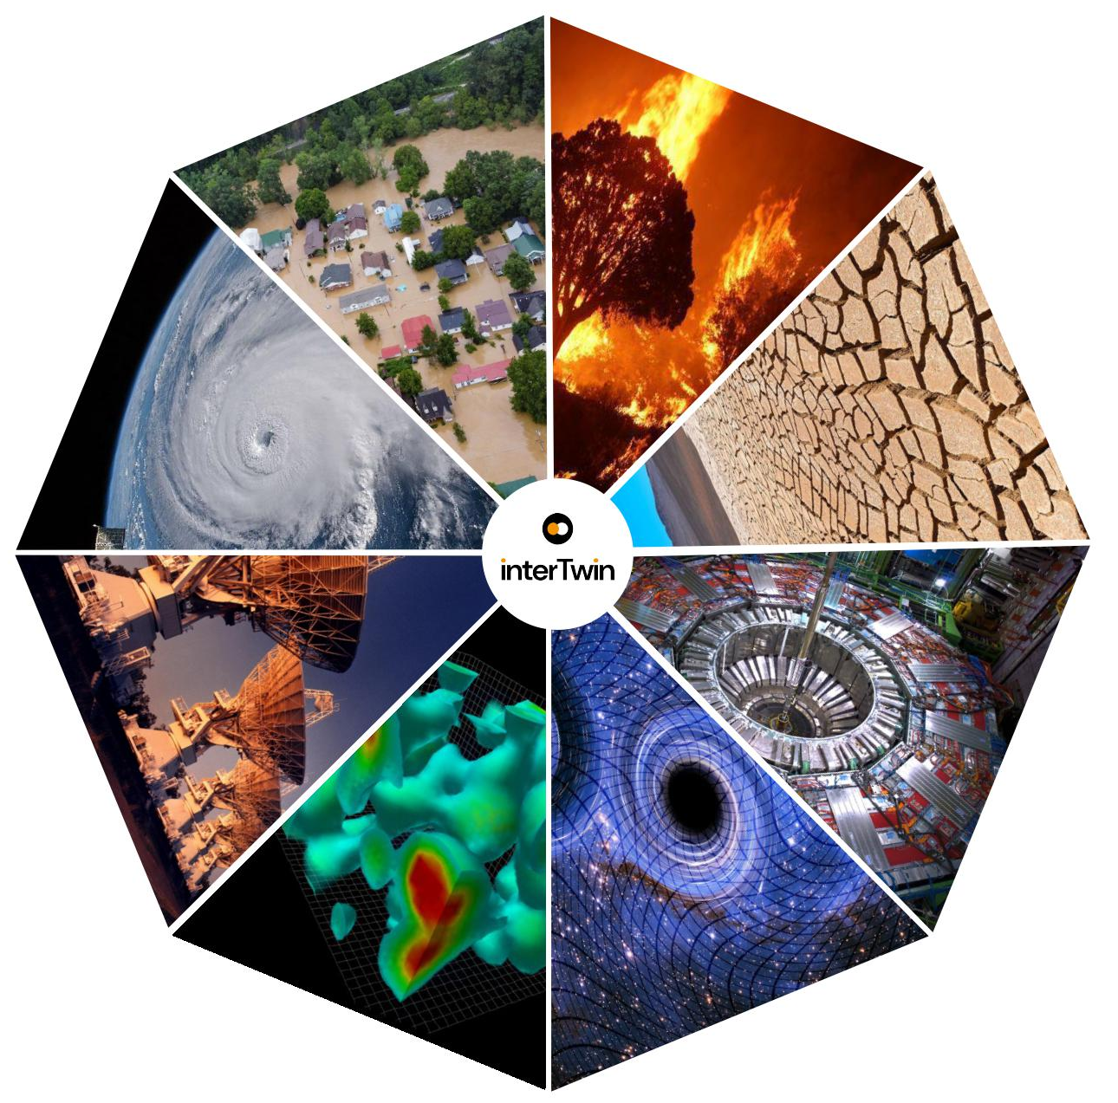
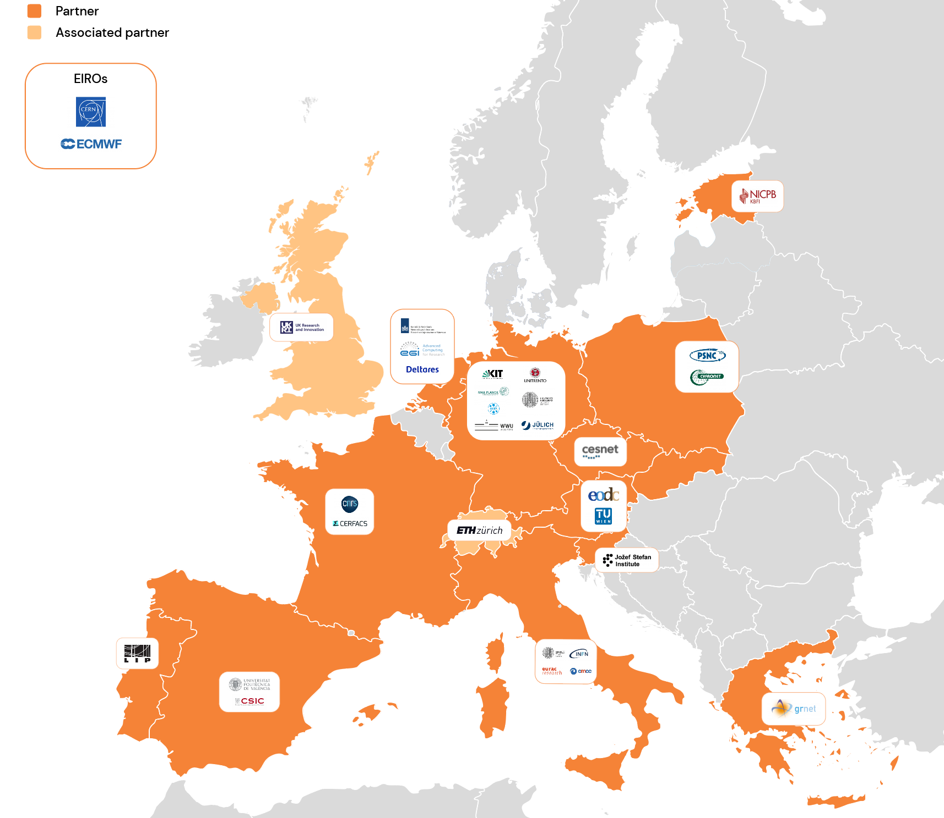
interTwin: a Digital Twin Engine for science
Early flood warnings
Fire hazard
prediction
29
Participants, including sciences, technology and resource providers.
Drought
prediction
Storm
prediction
Radio
astronomy
High-energy
physics
Lattice
QCD
Gravitational
waves
Notes:
Going into more details, these are the use cases that we have in interTwin… wheel…
The interTwin consortium is composed of 29 participants…
What we are developing for us. It’s going to support other sciences…

Slide 4
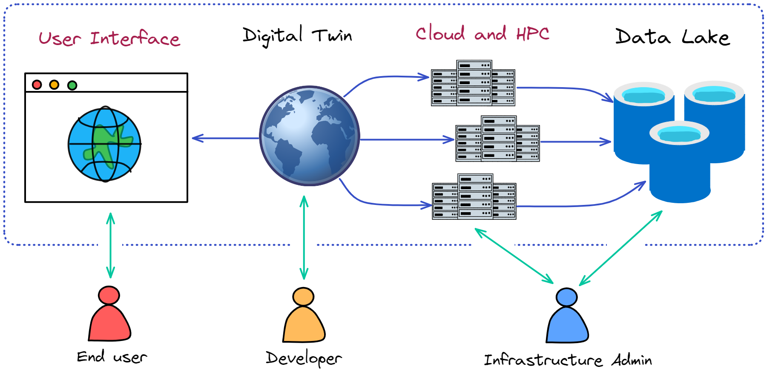
interTwin: a Digital Twin Engine for science
Notes:
The scientific applications that we develop need to scale to large resources… Need for HPC.
DT apps distributed on multiple resources at the same time.
Users.
Policymakers and decision making

Slide 5
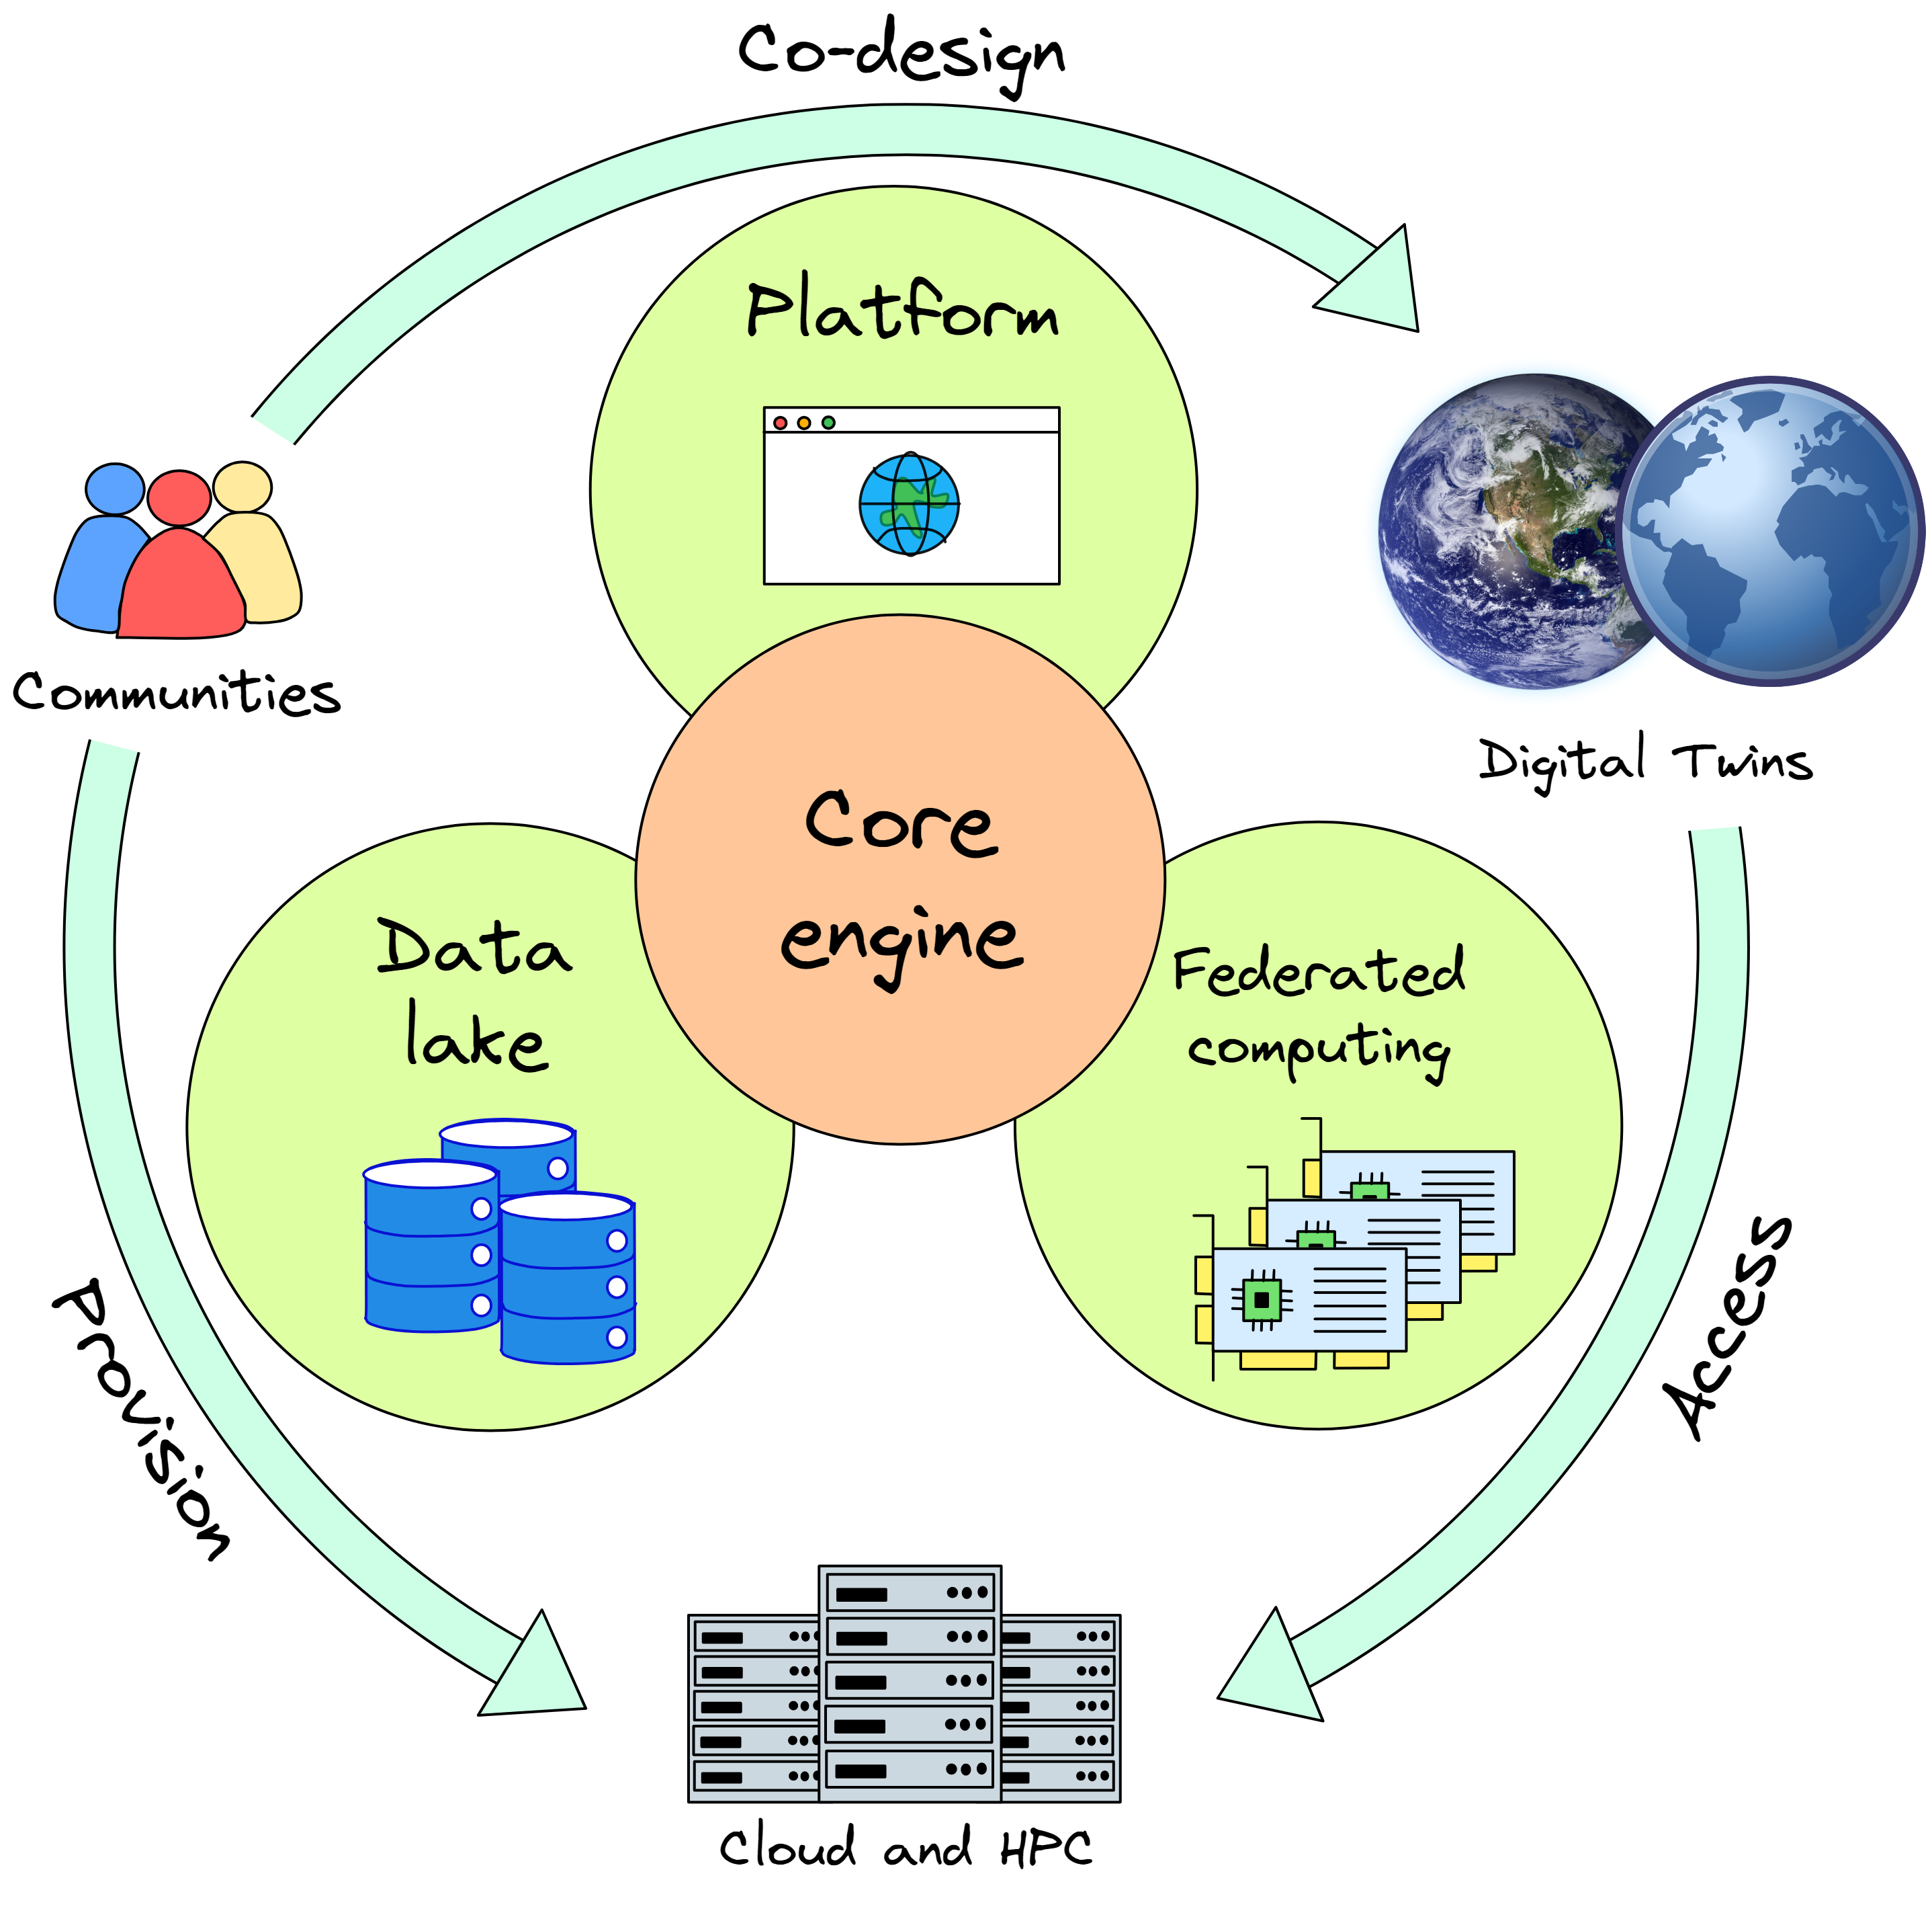
Notes:
The scientific applications that we develop need to scale to large resources… Need for HPC.
DT apps distributed on multiple resources at the same time.
Users.
Policymakers and decision making

Slide 6


AI workflows
and
method lifecycle
DT core engine – AI workflows

Slide 7
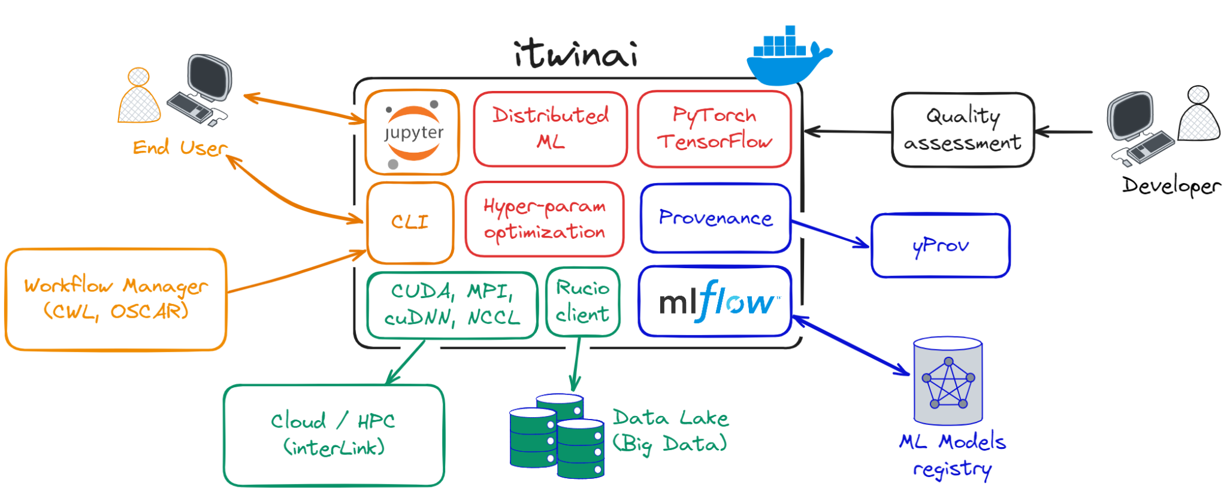
Our contribution to the Core Engine
itwinai.readthedocs.io
Notes:
Itwinai requirements. Reduce engineering overheads for scientists

Slide 8
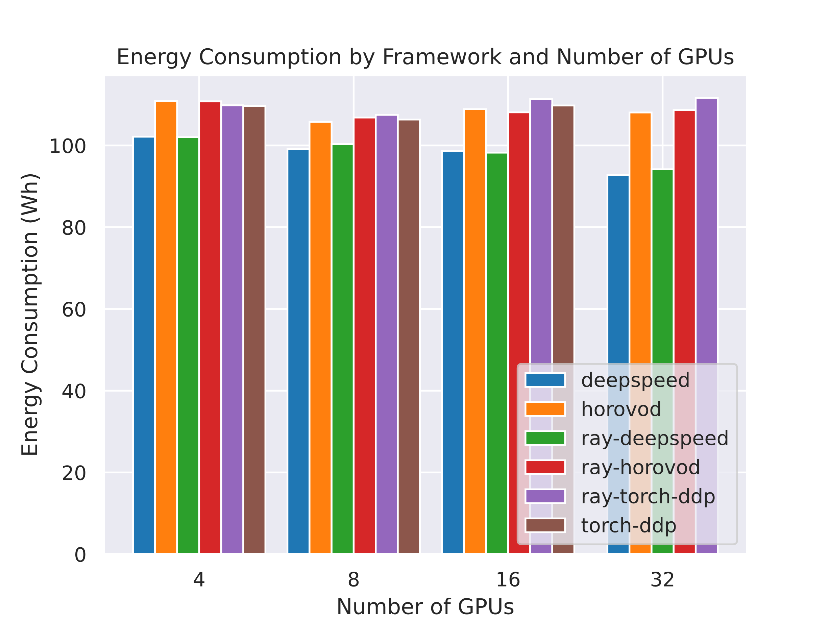
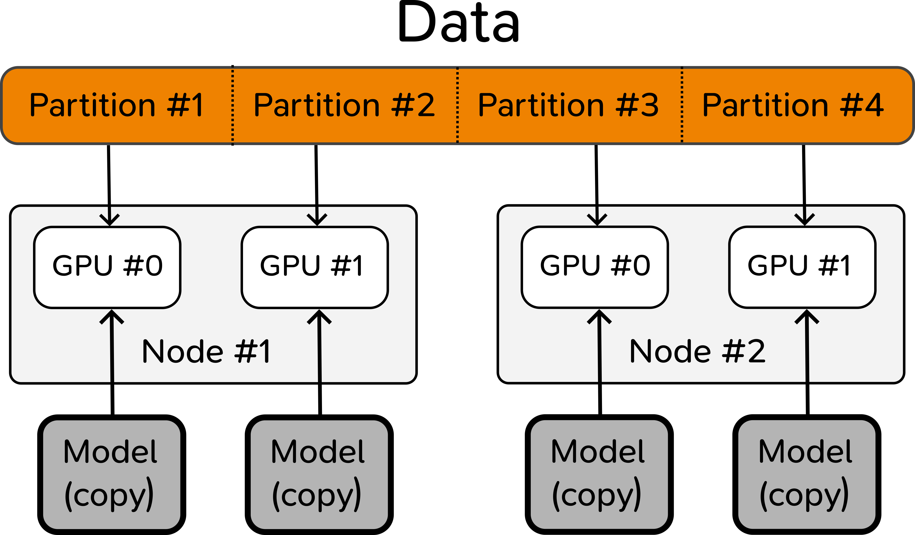
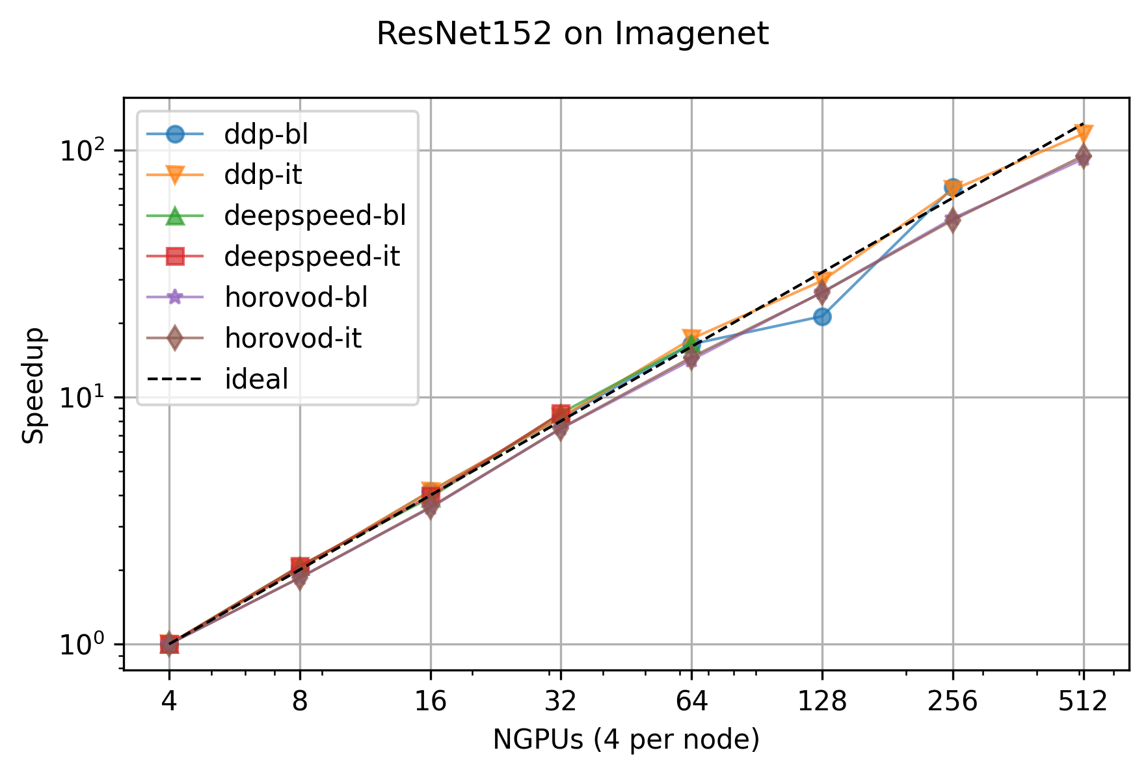

Scalable machine learning on HPC
Distributed ML training, HPO, scalability analysis and GPU energy analysis
Comparison of the GPU
energy consumption of
different frameworks
Scaling test on up to
512 GPUs on Juwels (Juelich)
itwinai.readthedocs.io
Notes:
Abstract user code from distributed ML strategy.

Slide 9
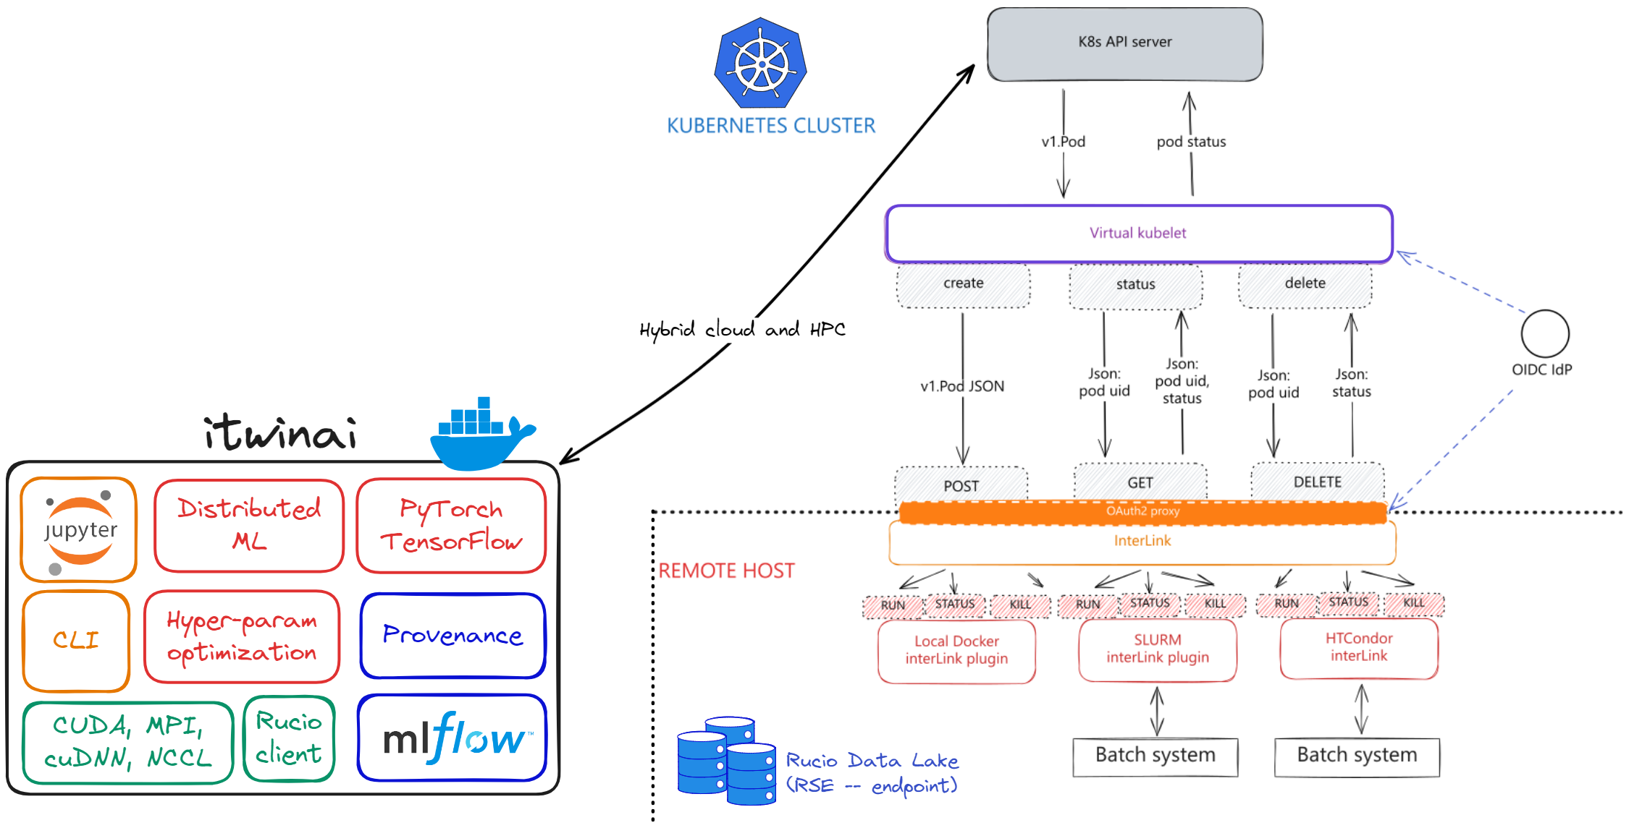
Cloud-HPC integration
Unified access to computing
InterLink: leverages k8s’ Virtual Kubelet and microservice architecture of the DTE.
OCI containers are the common language
Cloud
HPC

Slide 10
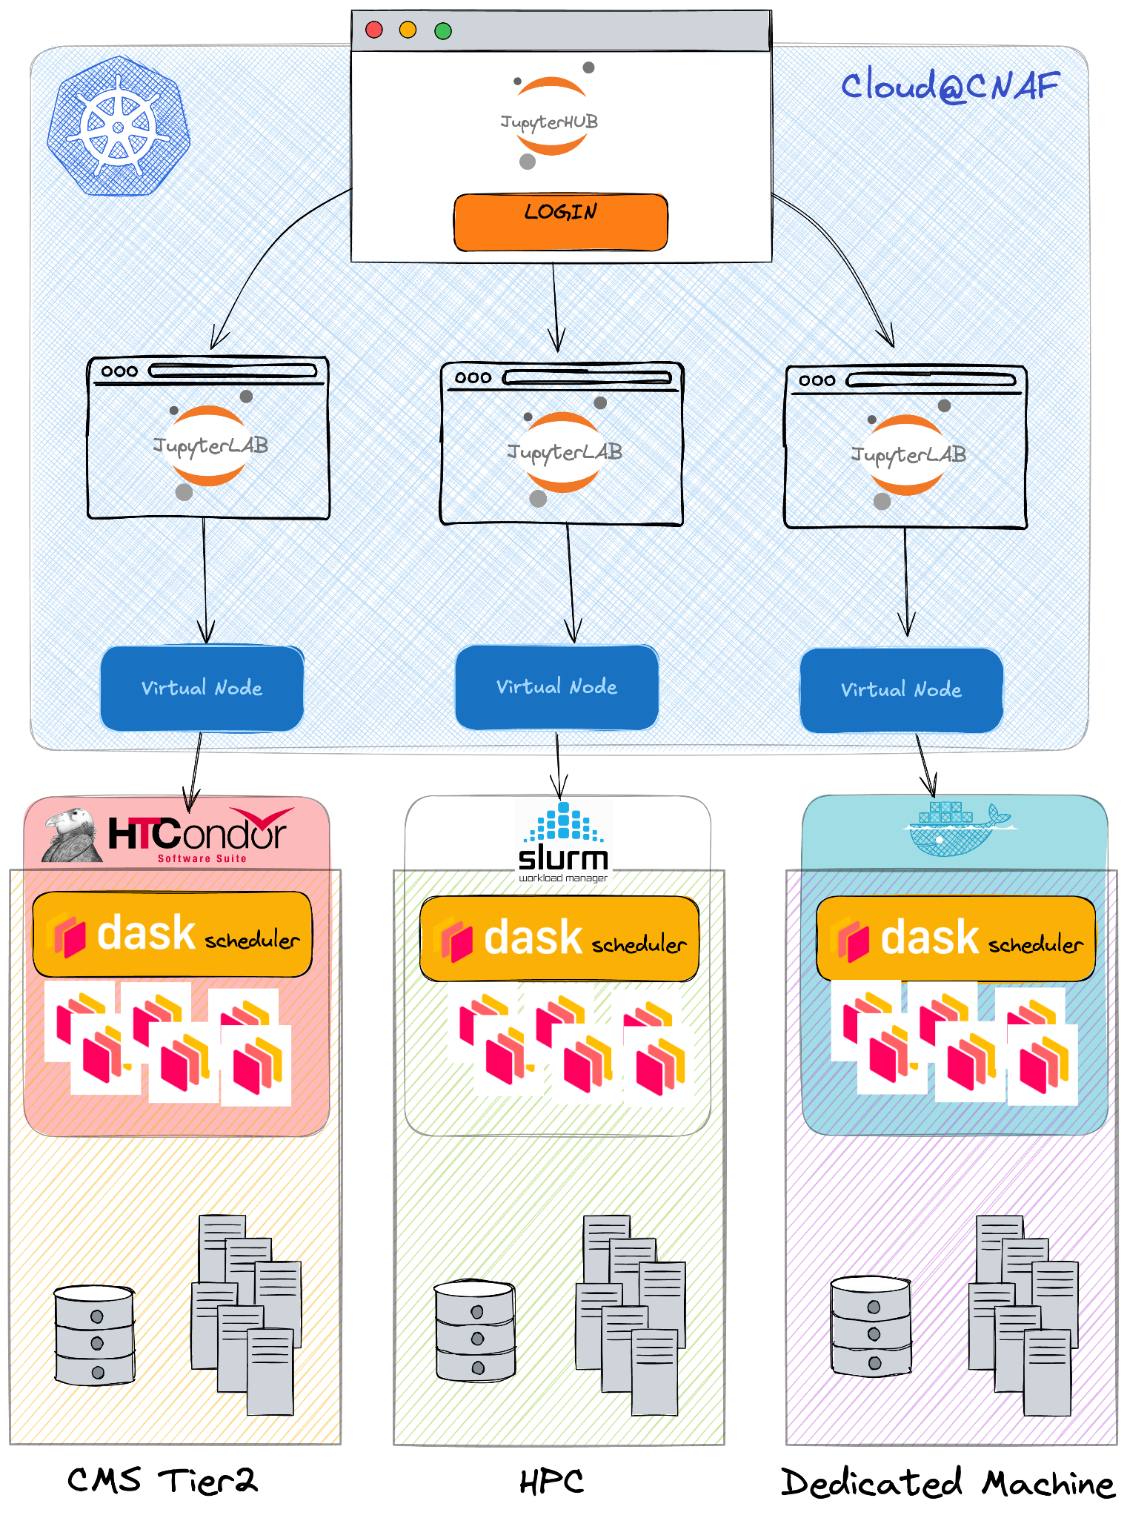
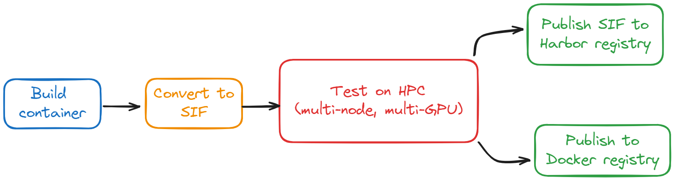

Cloud-HPC integration
OCI containers are the common language...
…need for a systematic way to build, test, and distribute them.
Example container use case:
seamless integration of HPC through JupyterLab
interface
Containers are also “unpacked” to CVMFS
/cvmfs/unpacked.cern.ch/ghcr.io/intertwin-eu/itwinai*
Testing AI Containers for Digital Twins in Science: A Cloud-HPC Workflow
HTC
HPC
Other
https://itwinai.readthedocs.io/latest/getting-started/containers.html
Image credits to Diego Ciangottini, INFN

Slide 11
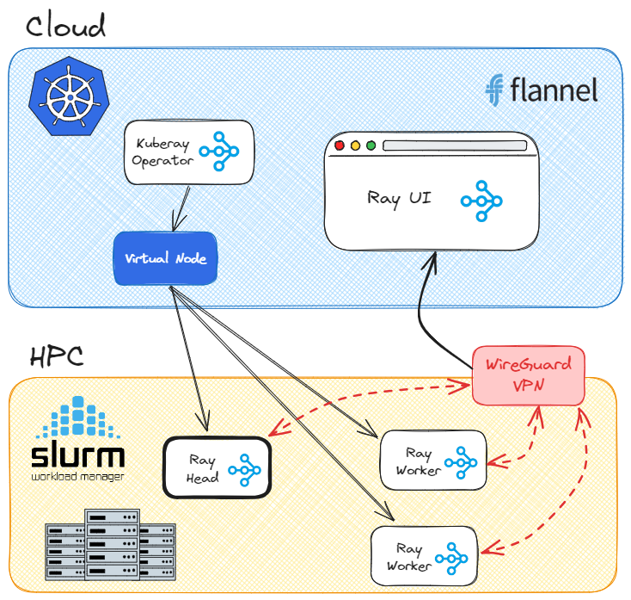
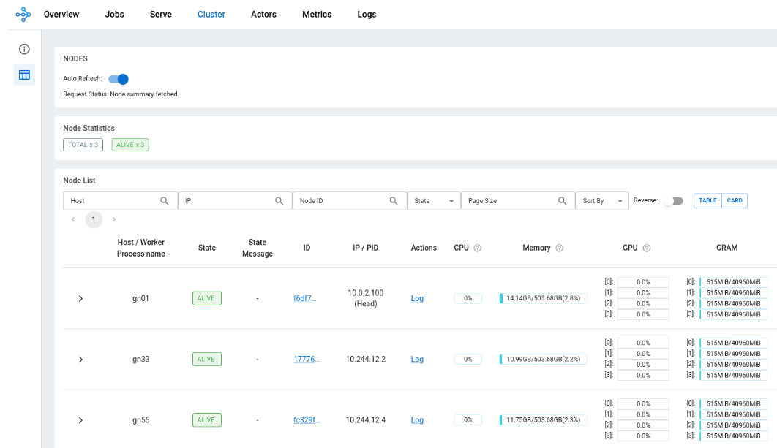

Cloud-HPC integration
How does this apply to AI at scale?
Ray cluster UI
Scaling tests planned on Vega HPC on up to 240 GPUs, starting from May

Slide 12
itwinai beyond interTwin

Slide 13
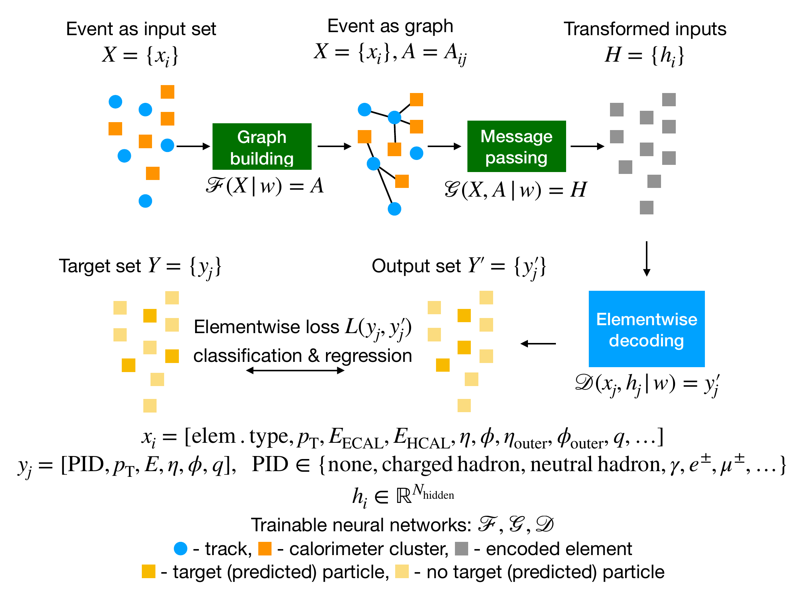
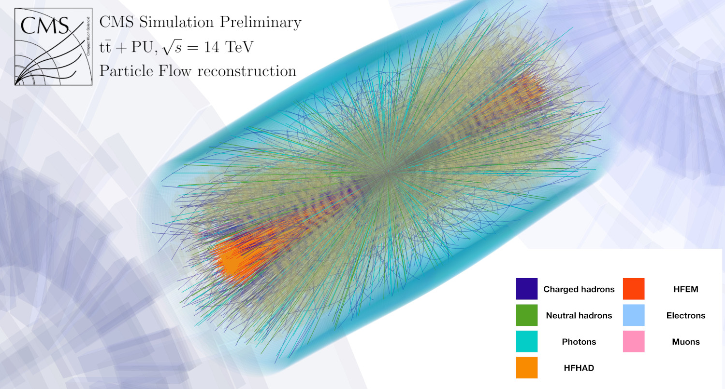
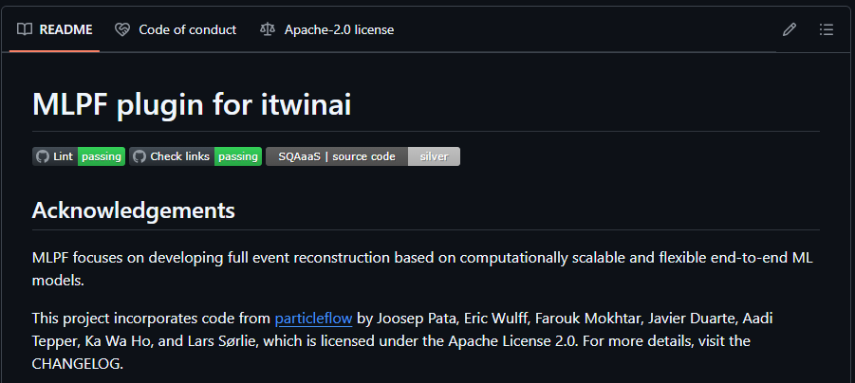
Machine-learned Particle Flow Reconstruction
MLPF focuses on developing full event particle flow reconstruction based on computationally scalable and flexible end-to-end ML models.
It integrates HPC resources both for distributed training (PyTorch DDP) and HPO.
Integration with itwinai: distributed ML, HPO, and accessible as a plugin.
New features:
DeepSpeed and Horovod distributed training for PyTorch (in addition to PyTorch DDP).
MLFLow, WandB, and ML provenance loggers
itwinai plugin (e.g., itwinai-based Docker/Singularity JupyterLab container images)
Joosep Pata, Eric Wulff, Farouk Mokhtar, Javier Duarte, Aadi Tepper, Ka Wa Ho, & Lars Sørlie. (2025). jpata/particleflow: v2.2.0 (v2.2.0). Zenodo. https://doi.org/10.5281/zenodo.14650991
See also:
Talk by Joosep (MLPF)
Talk by Eric (HPO for MLPF)
https://github.com/matbun/mlpf-itwinai-plugin

Slide 14
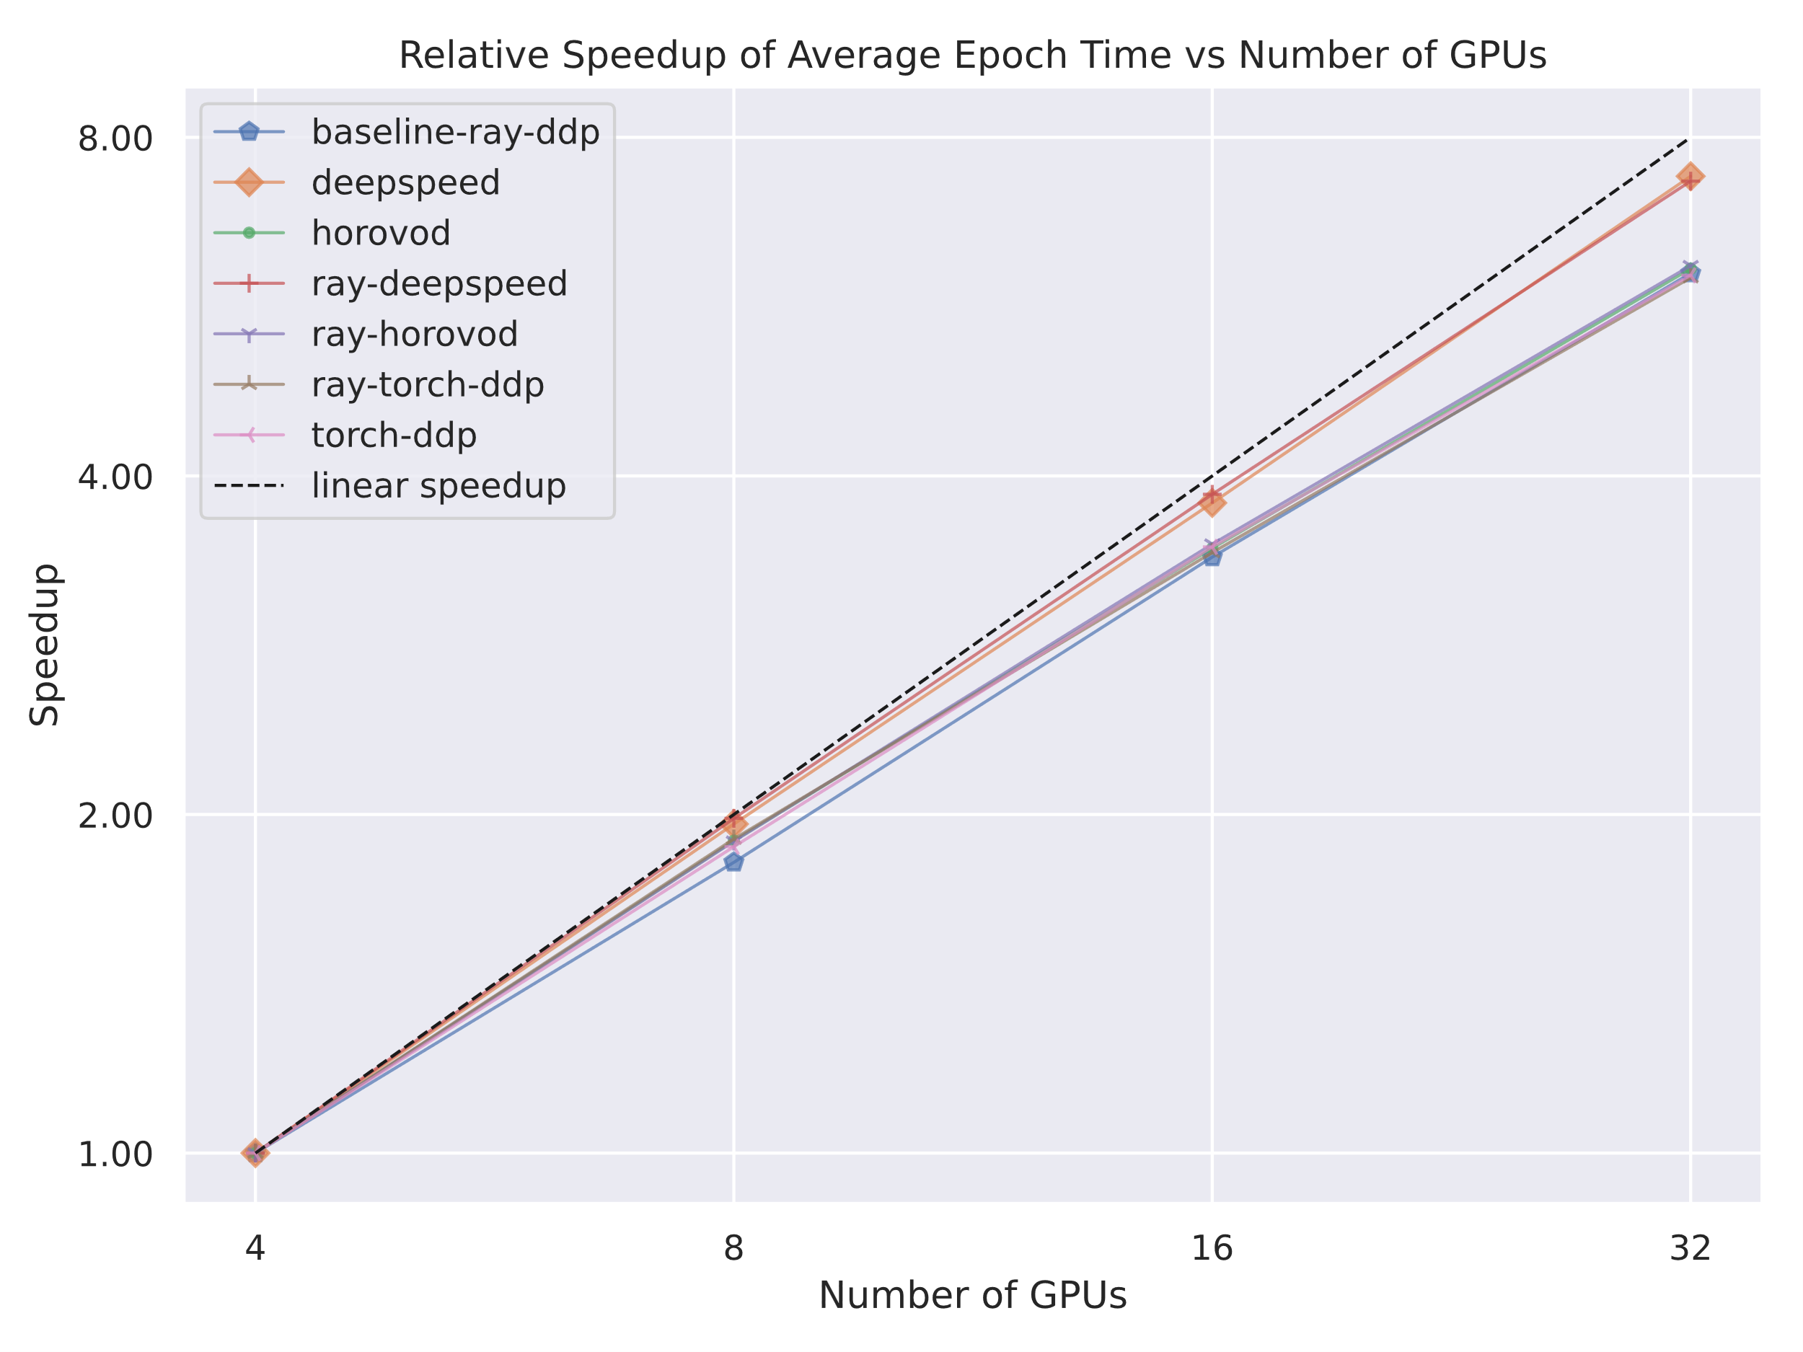
Machine-learned Particle Flow Reconstruction
Scalability analysis on Vega HPC using up to 32 GPUs
The results were obtained on MLPF v2.2.0 on CLIC dataset v2.5.0
F. Mokhtar et al, Fine-tuning machine-learned particle-flow reconstruction for new detector geometries in future colliders, 10.48550/arXiv.2503.00131
itwinai.readthedocs.io

Slide 15
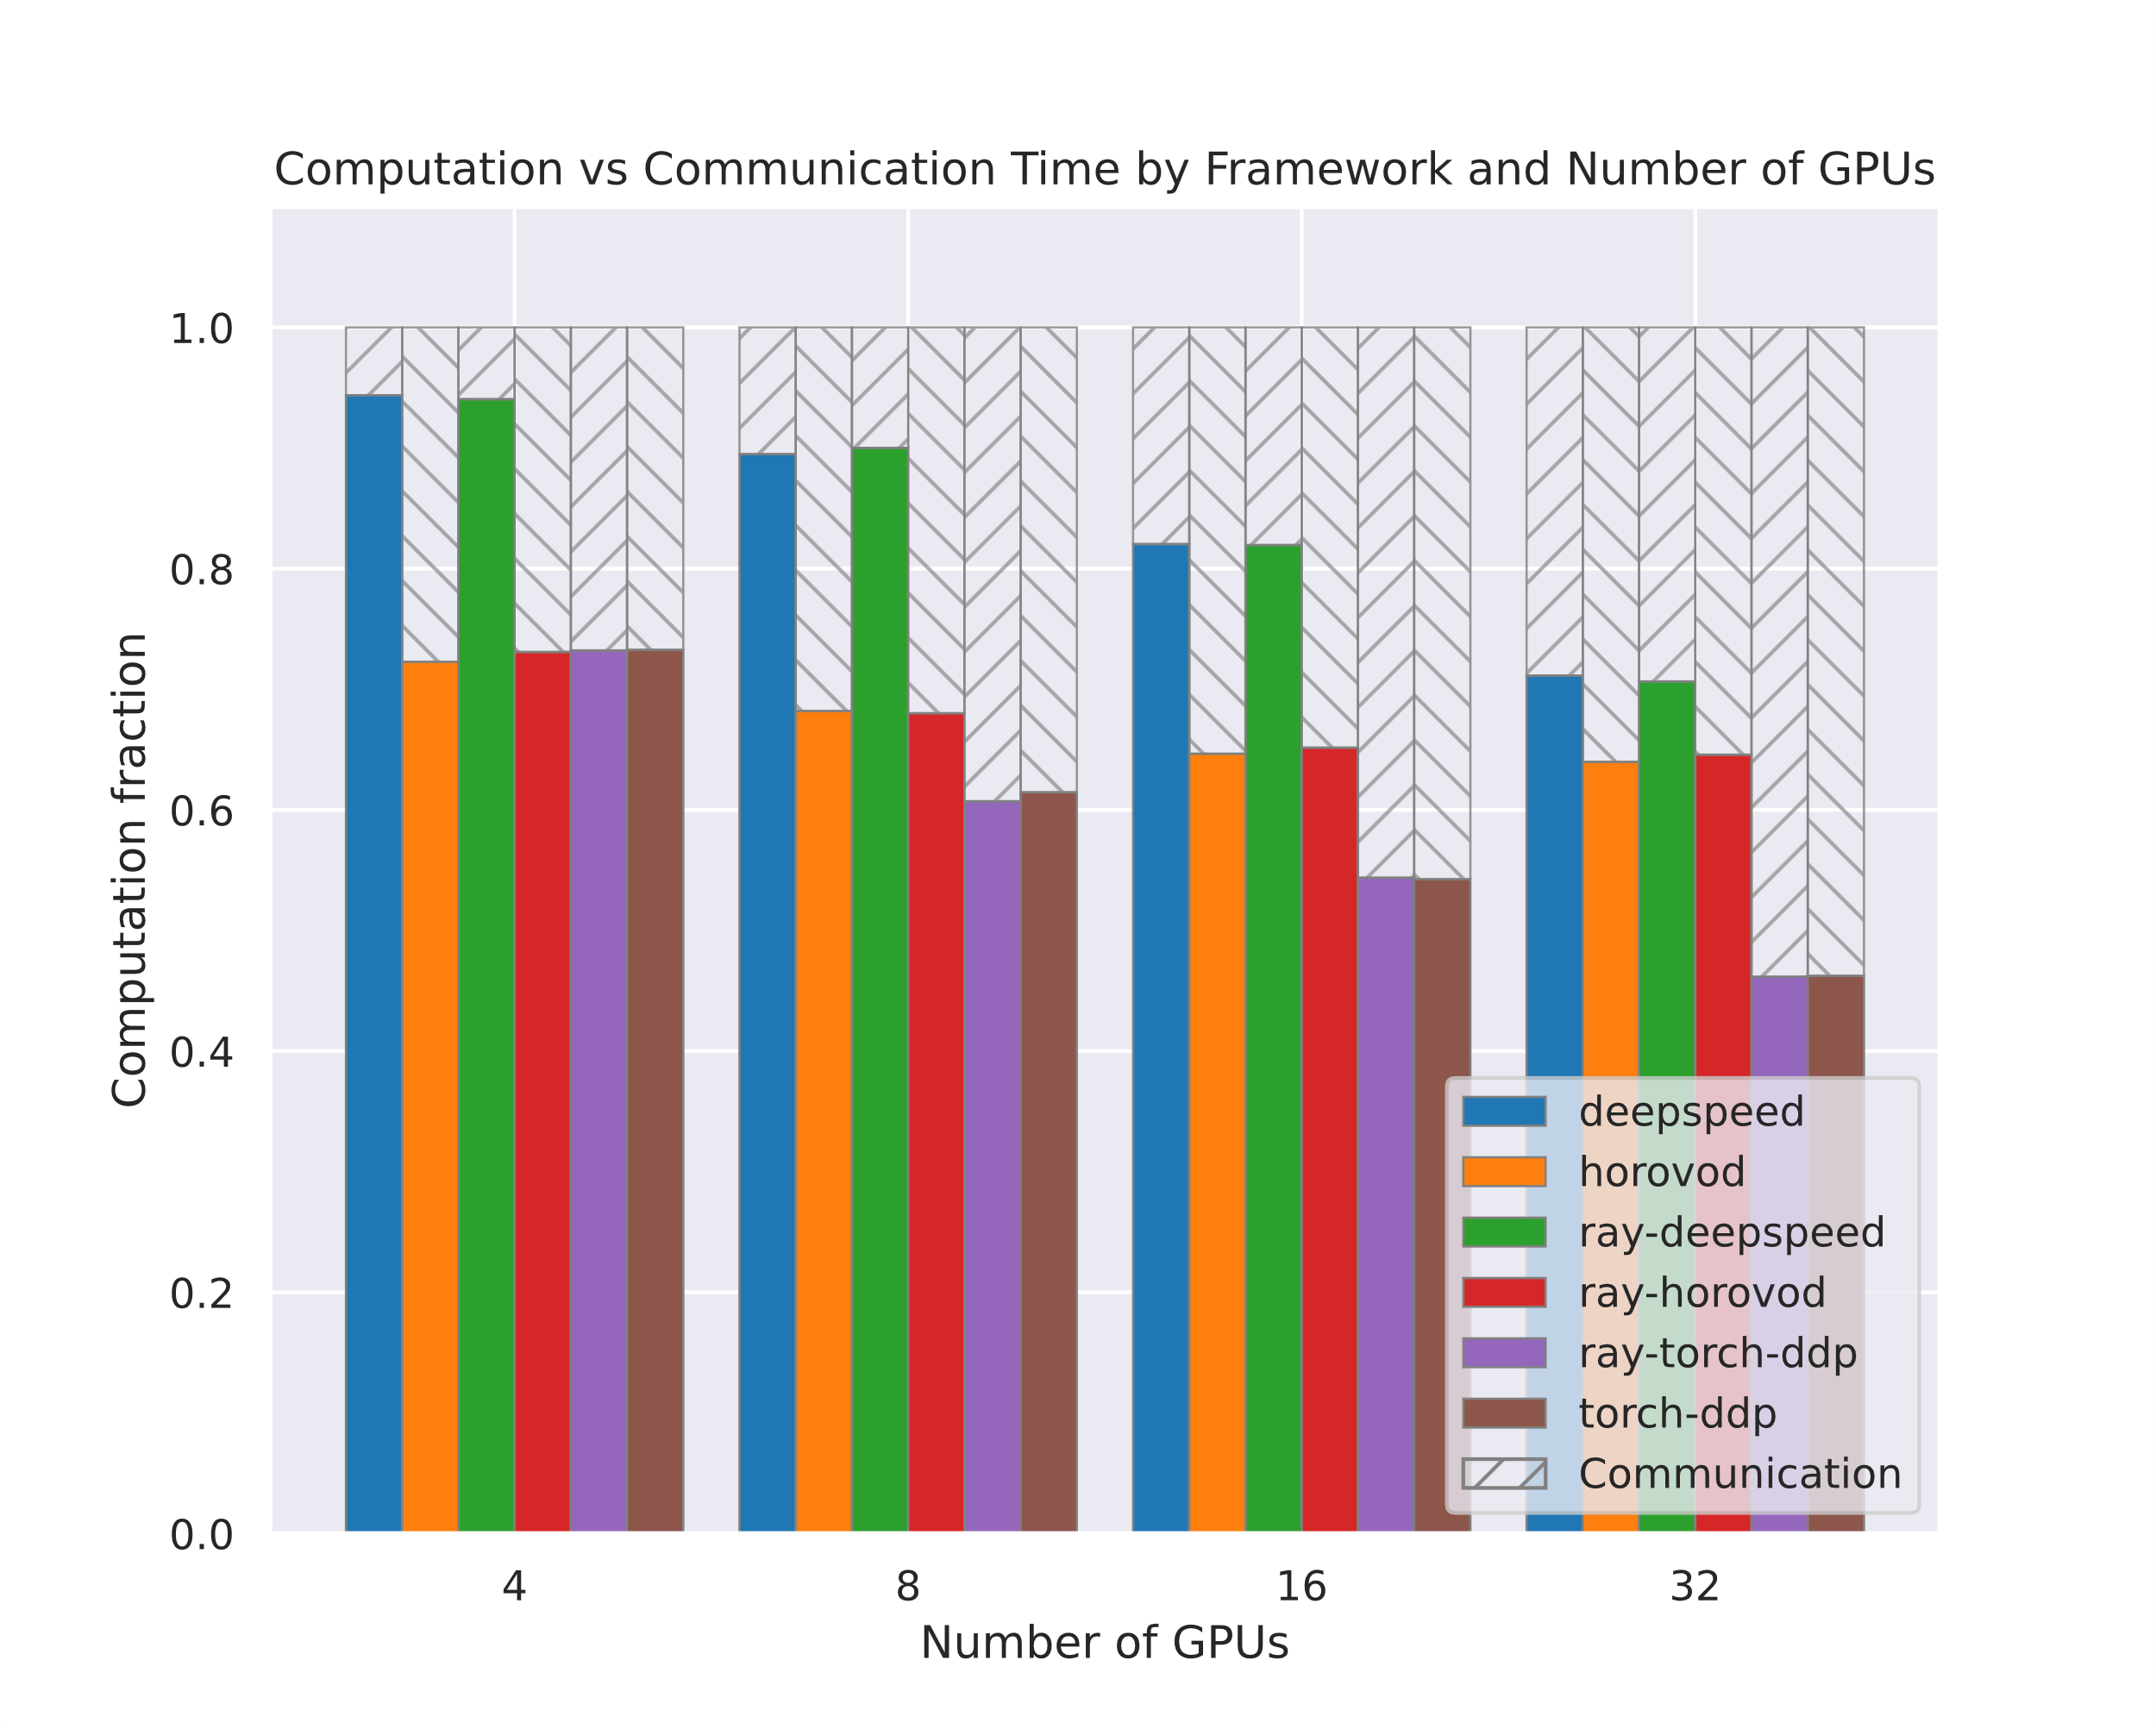
Machine-learned Particle Flow Reconstruction
Scalability analysis on Vega HPC using up to 32 GPUs
The results were obtained on MLPF v2.2.0 on CLIC dataset v2.5.0
F. Mokhtar et al, Fine-tuning machine-learned particle-flow reconstruction for new detector geometries in future colliders, 10.48550/arXiv.2503.00131
itwinai.readthedocs.io

Slide 16
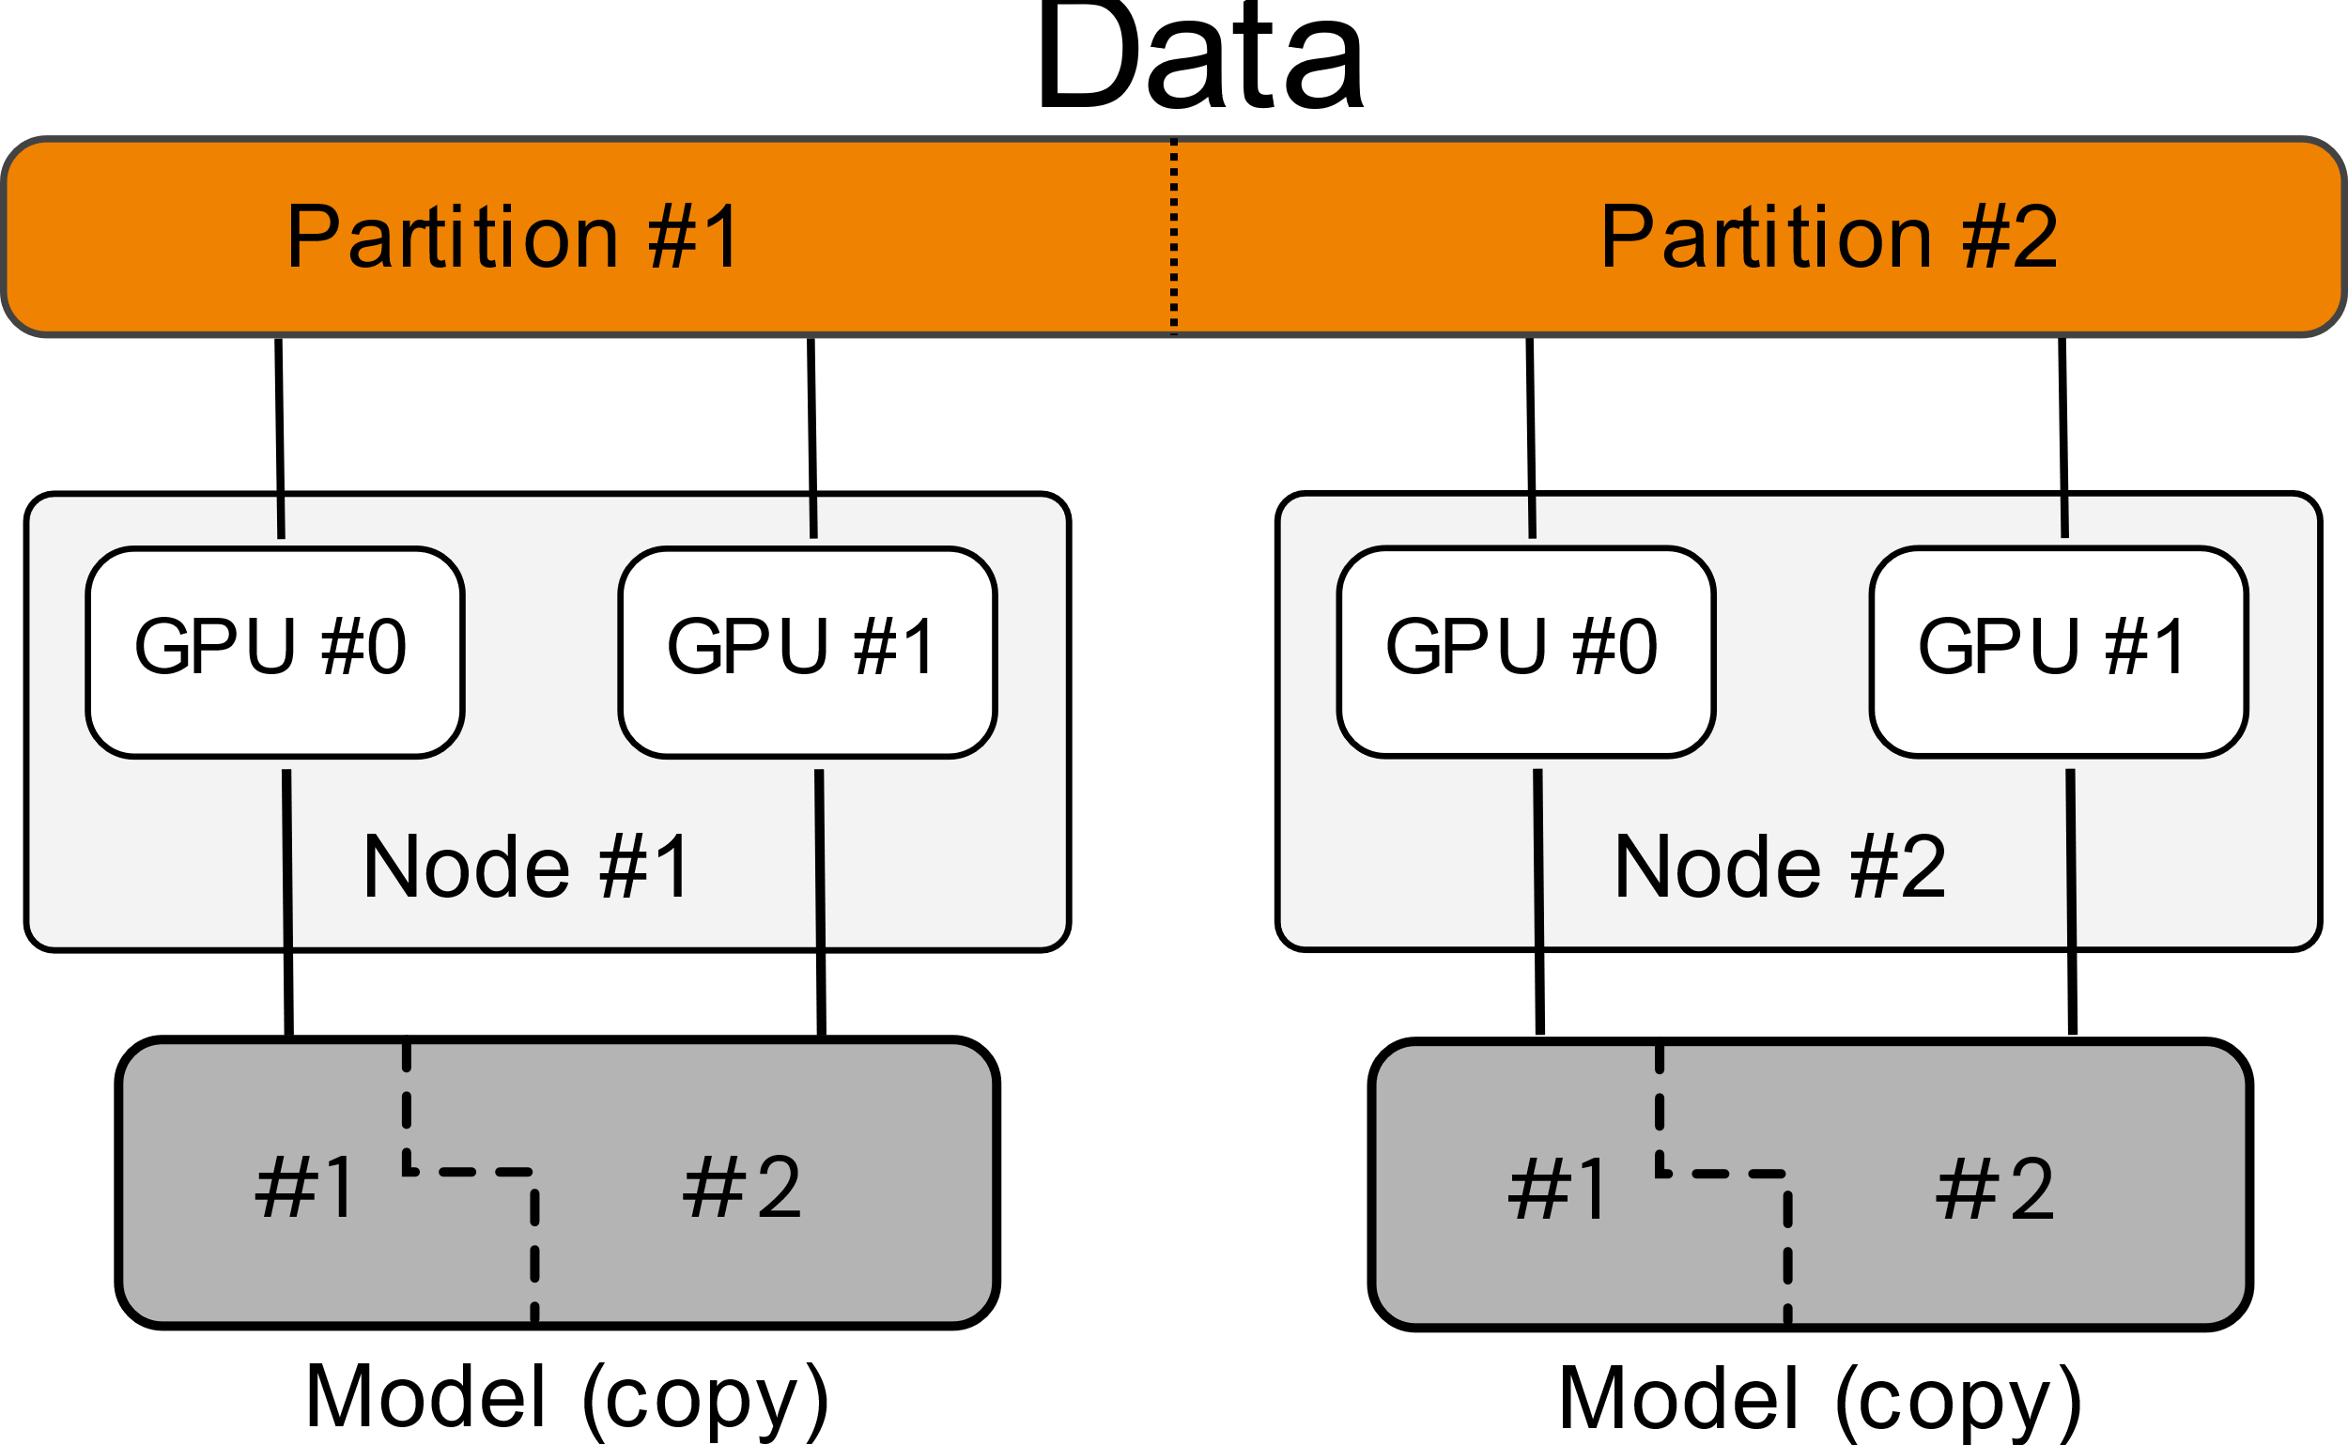
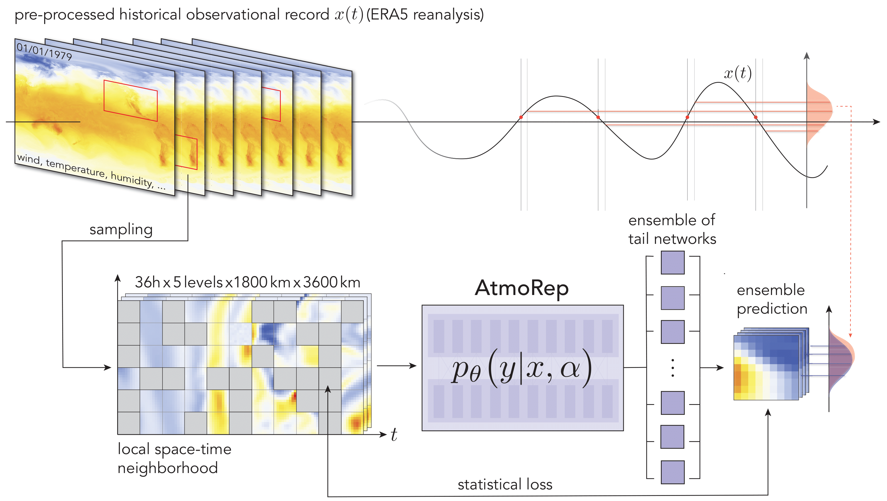
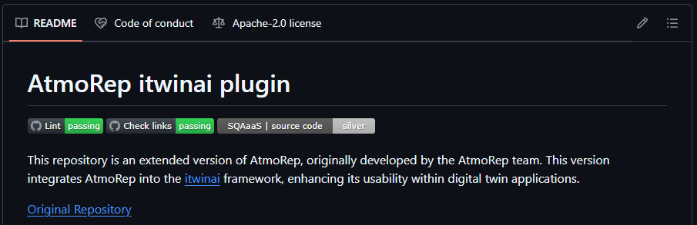
AtmoRep
AtmoRep is a vision transformer for atmospheric modelling. Its training is distributed on HPC using both data and model parallelism together.
Lessig, Christian, Ilaria Luise, Bing Gong, Michael Langguth, Scarlet Stadtler, and Martin Schultz. ‘AtmoRep: A Stochastic Model of Atmosphere Dynamics Using Large Scale Representation Learning’. arXiv, 7 September 2023. https://doi.org/10.48550/arXiv.2308.13280.
https://github.com/matbun/atmorep-itwinai-plugin

Slide 17
Digital Twin collaborations and interTwin at CERN openlab

Slide 18
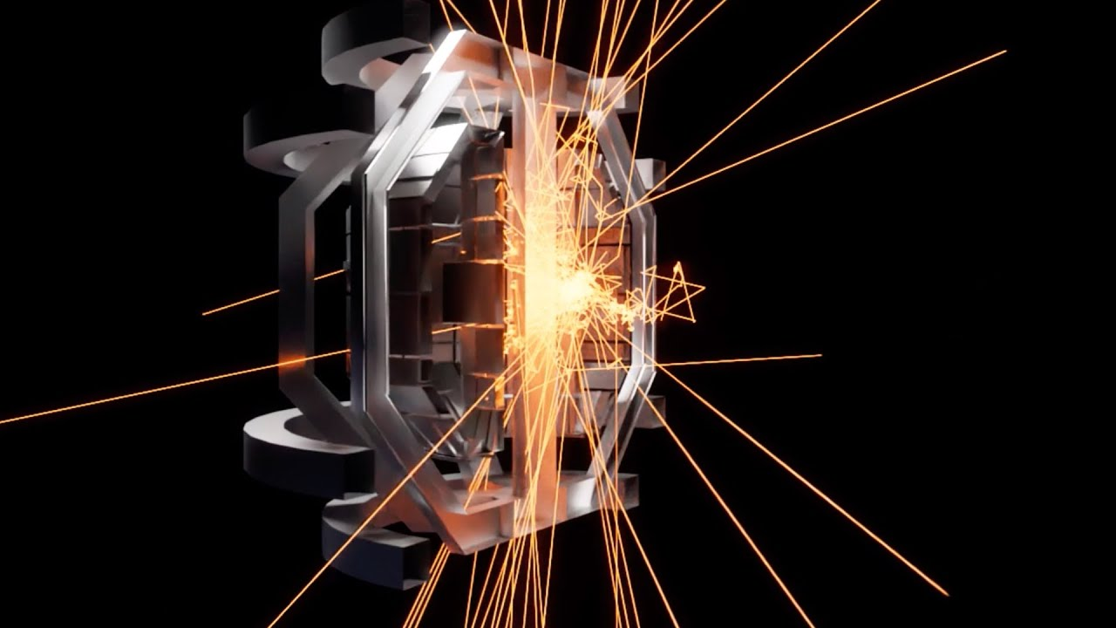

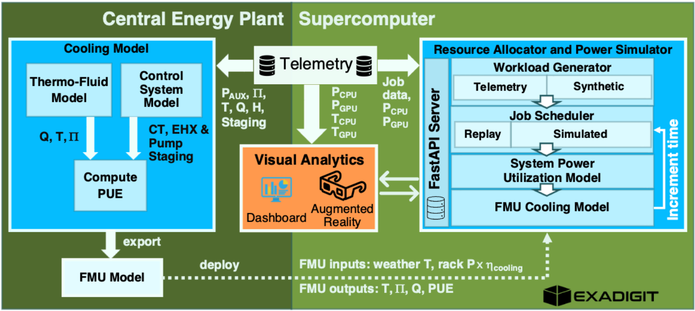
Digital Twin initiatives at CERN openlab
Nvidia Omniverse
Visualization of scientific data (HEP)
Support the design of new detectors and accelerators by integration and simulation tests
Training of RL-based agents (e.g., robots) in simulated environments (IsaacGym)
ExaDigiT (ORNL)
Open-source data centre digital twin engine for modelling and optimization of job scheduling and cooling system
Imperial College London
AI-Based Digital Twin for Data Quality Monitoring in the CMS Detector Using Continual Learning
International Supercomputing 2025
BoF session: “Shaping the Future of Scientific Digital Twins: Tales from Physics, Climate Research, and Data Centre Operations”
Co-designing and prototyping an interdisciplinary Digital Twin Engine for science
https://www.intertwin.eu/
https://blogs.nvidia.com/blog/ukaea-digital-twins-omniverse/
https://exadigit.github.io/

Slide 19
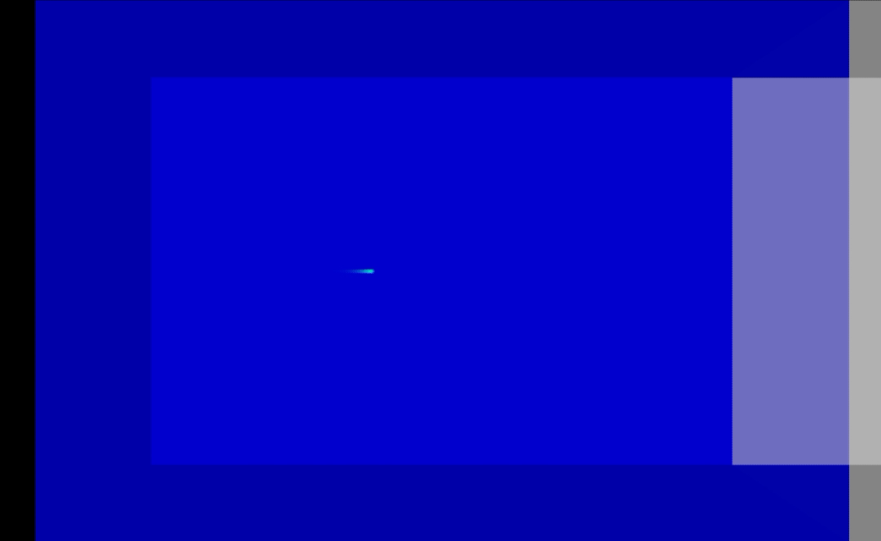
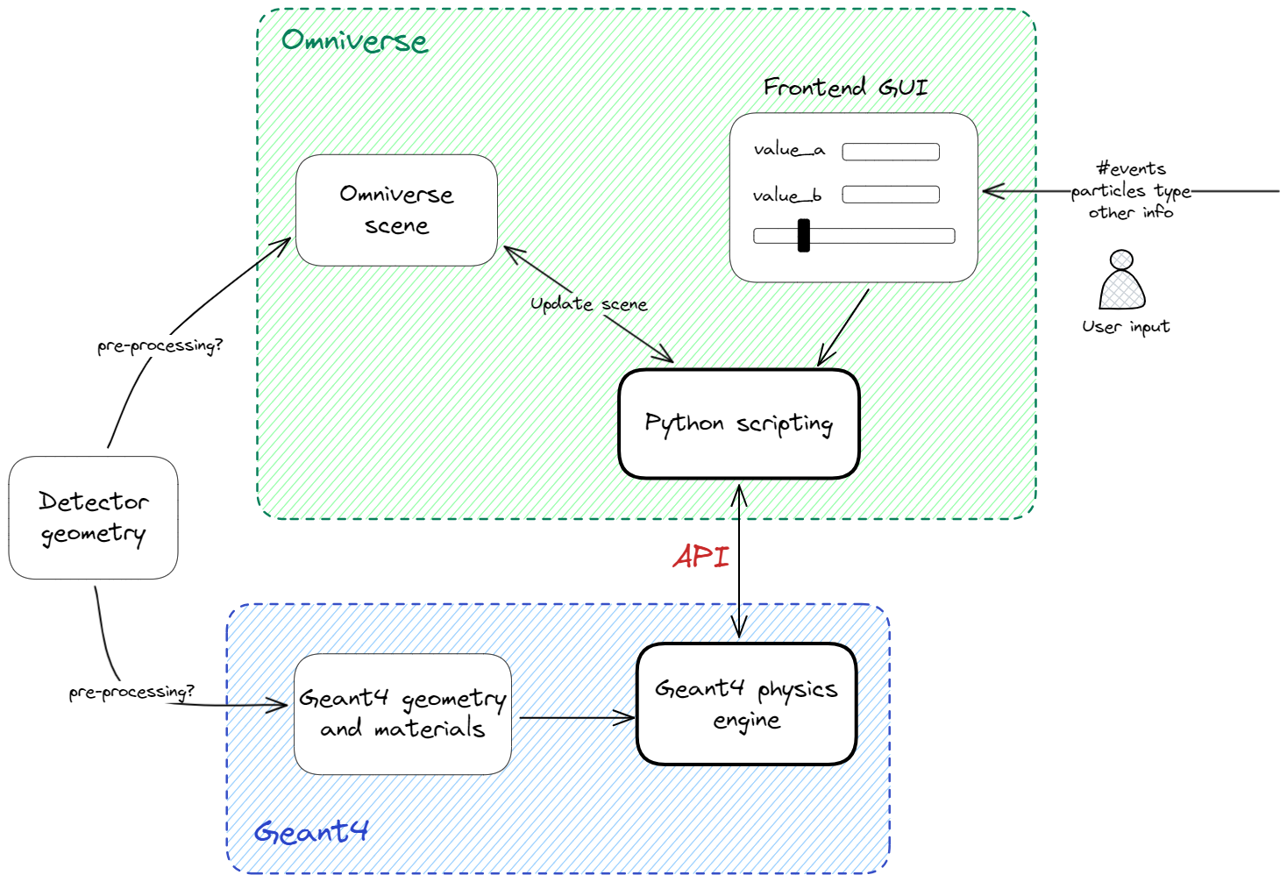
Nvidia Omniverse and Geant4
Combine Physics simulation toolkits (Geant4, GARFIELD++) and Omniverse visualization to develop a user-friendly application for detector and particle motion rendering.
Interactive simulations to support particle detector design
Felice Nenna, Matteo Bunino, Marcello Maggi

Slide 20
matteo.bunino@cern.ch

Slide 21
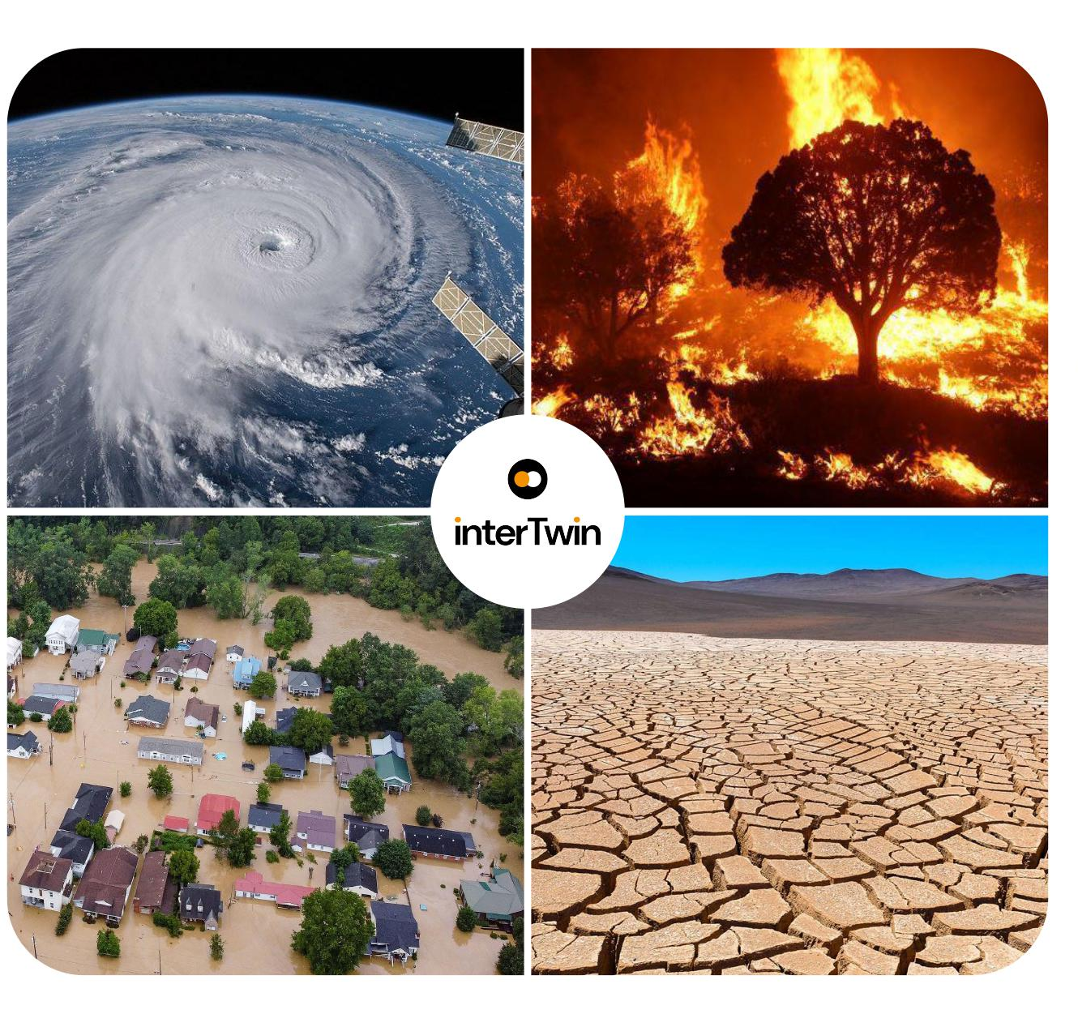
Climate research and monitoring
Climate Change Future Projections of Extreme Events (storms & fire)
CMCC, CNRS (IPSL), UNITN
Climate Change Impacts of Extreme Events (storms, fire, floods, drought)
CERFACS, Deltares, EURAC
Early Warning for Extreme Events (floods & droughts)
Deltares, EURAC, TU Wien
Notes:
Let’s see now which use cases are running on this DT engine
Climate research investigating future impacts of extreme events caused by climate change.
Climate monitoring to produce early warnings for extreme events.

Slide 22
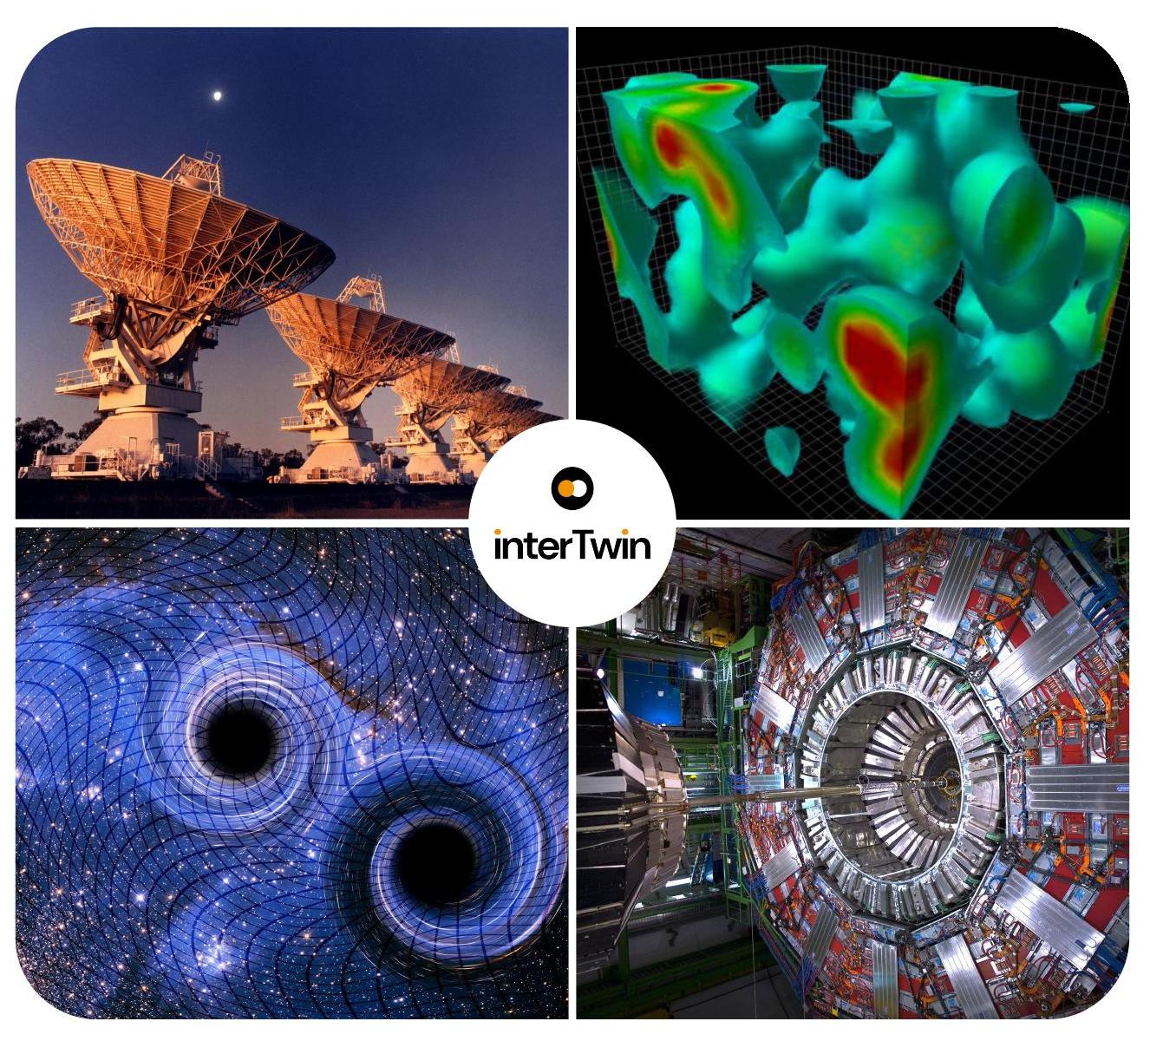
Physics research
Noise Simulation for Radio Astronomy
Max Planck Society
Lattice QCD Simulations for High Energy Physics
ETHZ, CSIC
VIRGO Noise Detector for Astrophysics
INFN
Detector Simulation for High Energy Physics
CERN, CNRS (IN2P3-IRES)

Slide 23
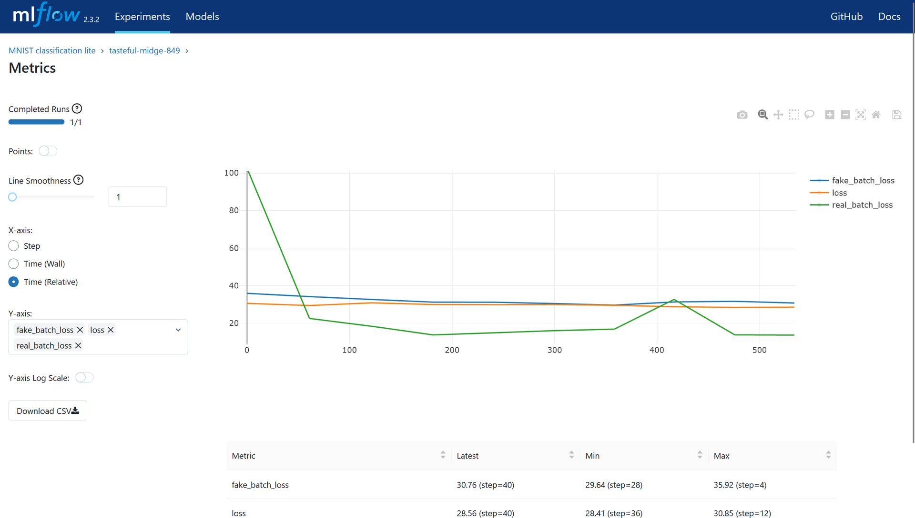

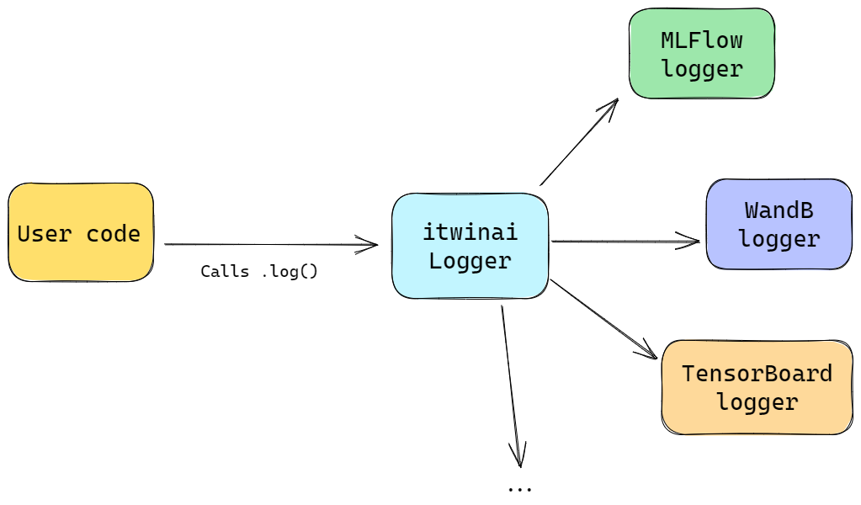
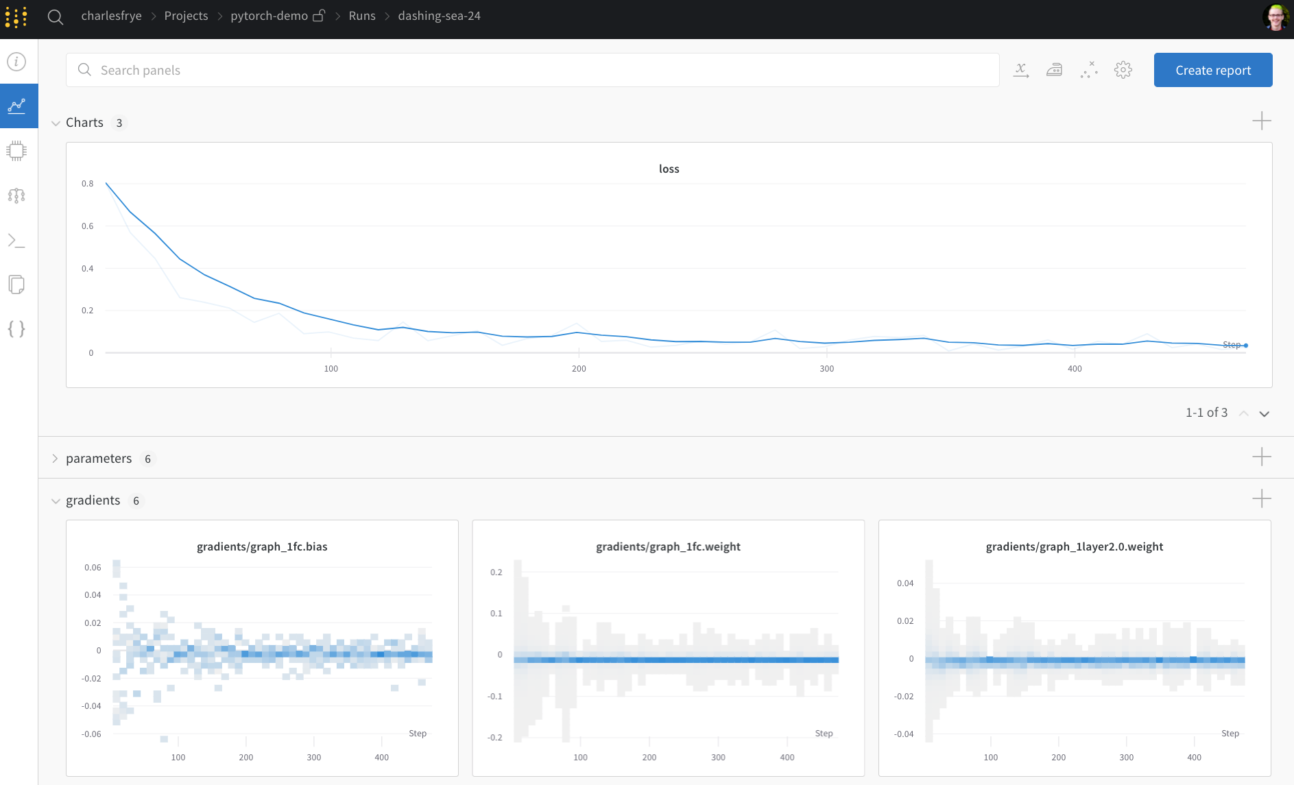

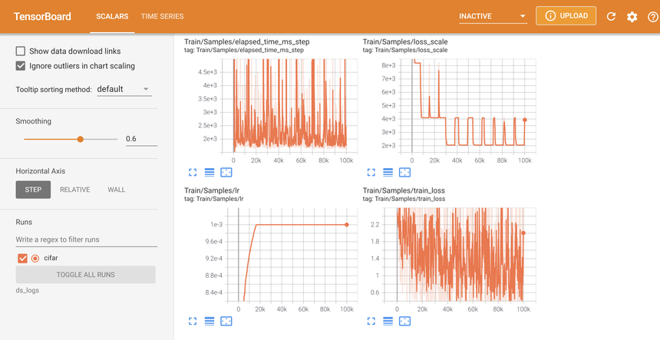

Our contribution to the Core Engine
Unified logger interface to track ML metadata.
yProvML
https://github.com/HPCI-Lab/yProvML
Notes:
Abstract user code from logging framework.

Slide 24
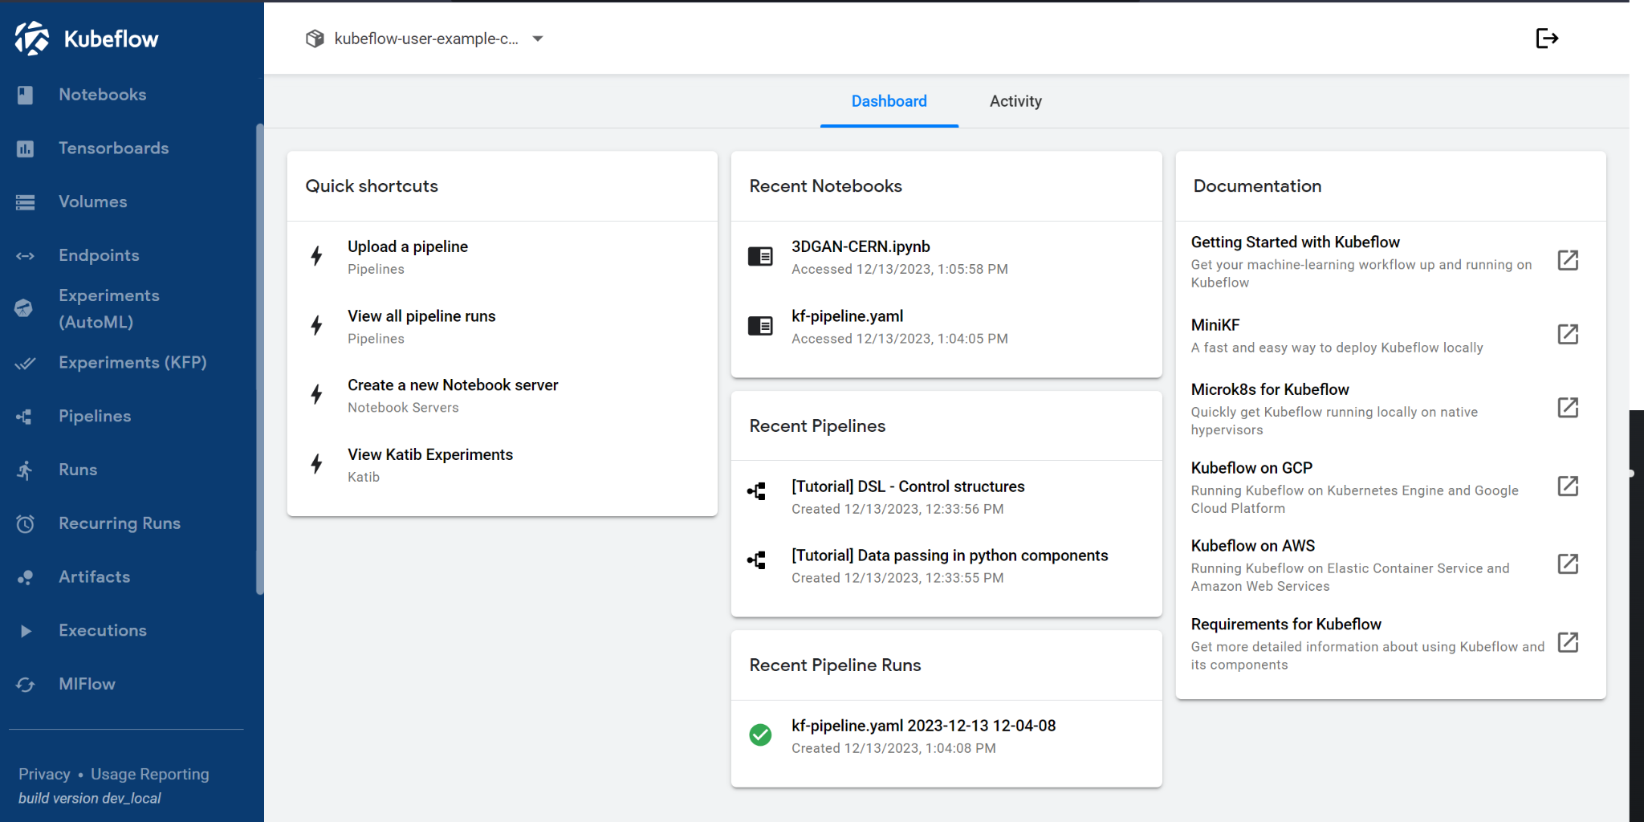
UX/UI: KubeFlow

Slide 25
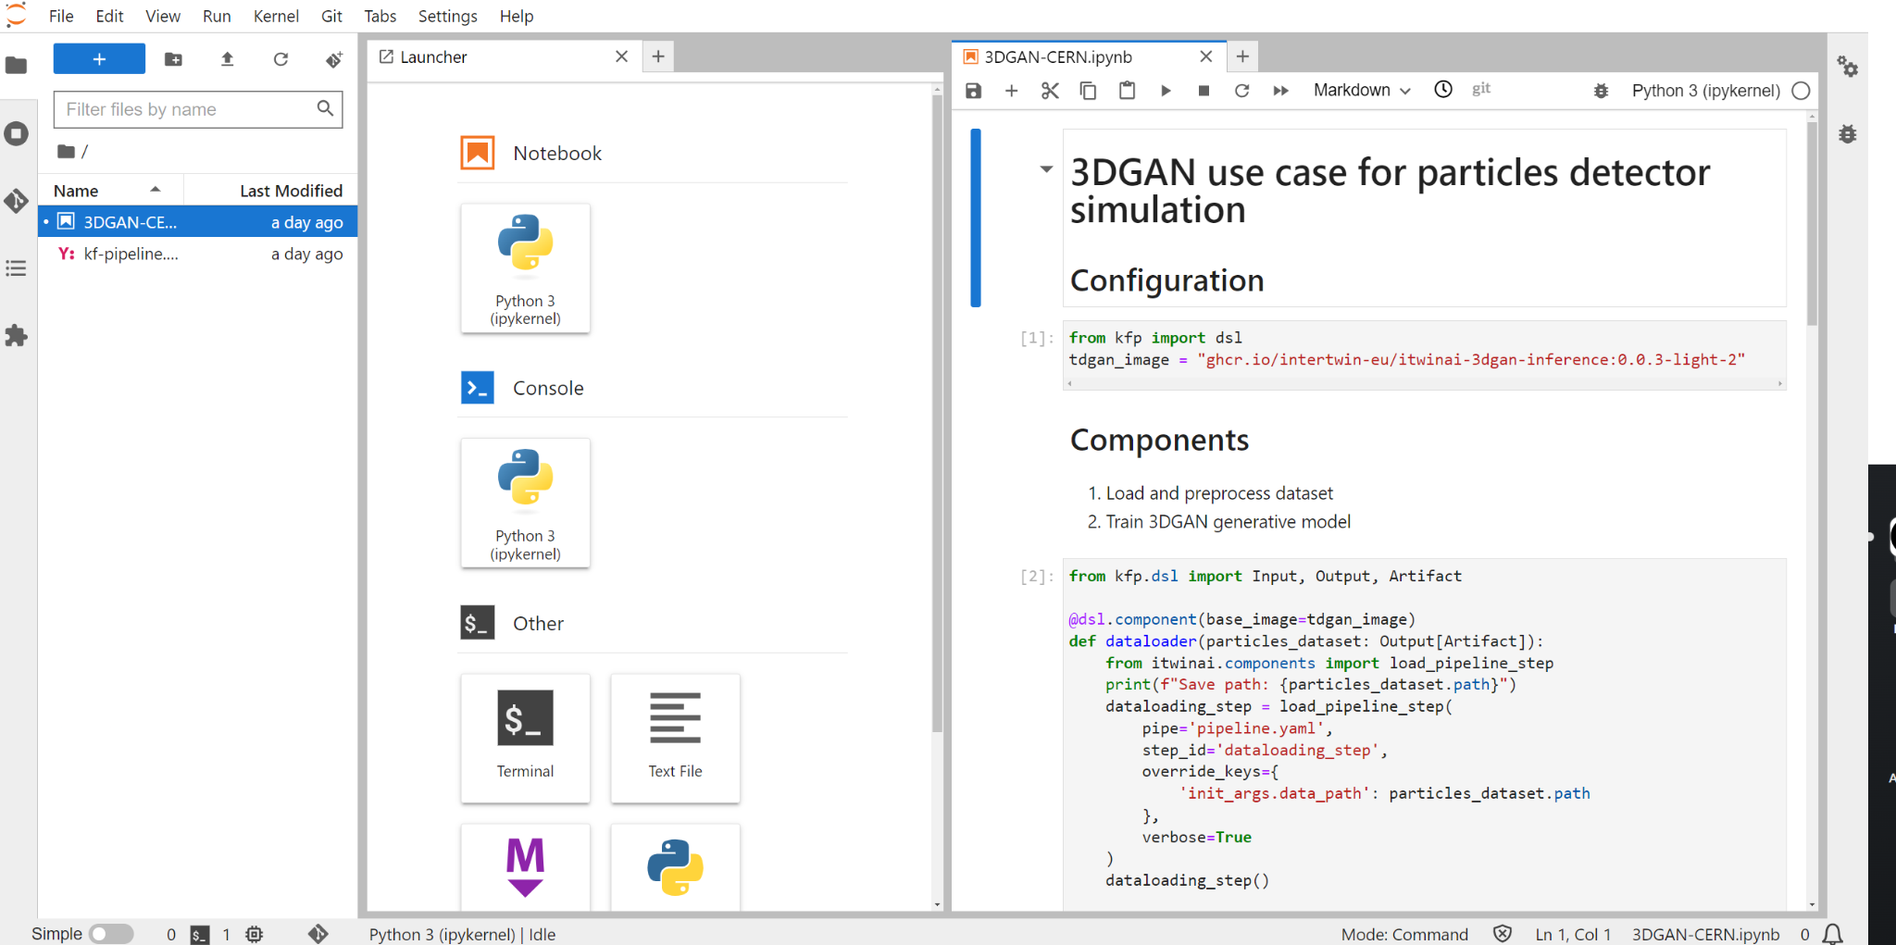
UX/UI: KubeFlow and JupyterLab

Slide 26
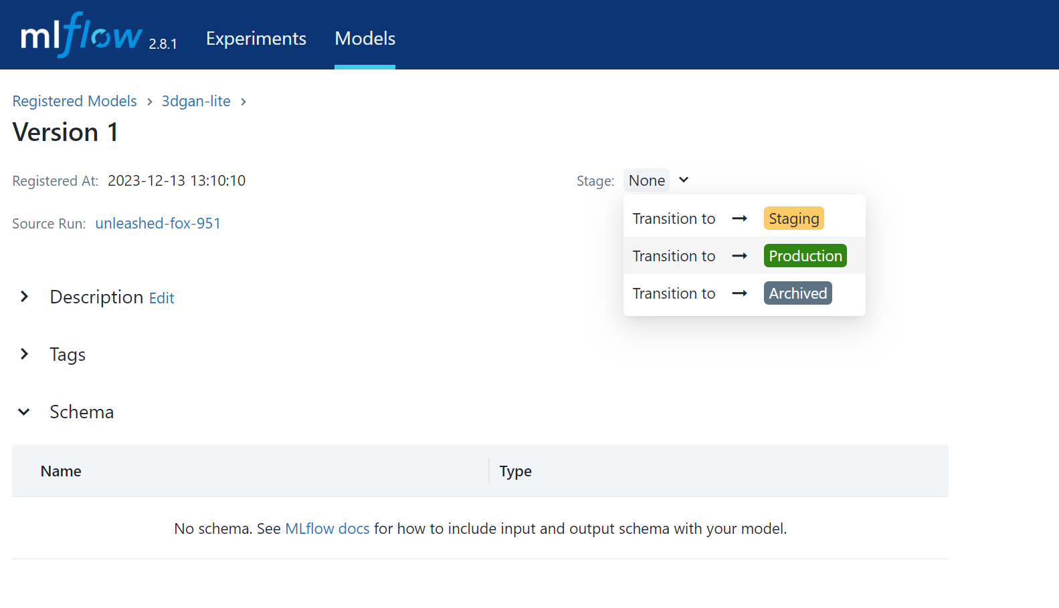
UX/UI: MLFlow models registry

Slide 27
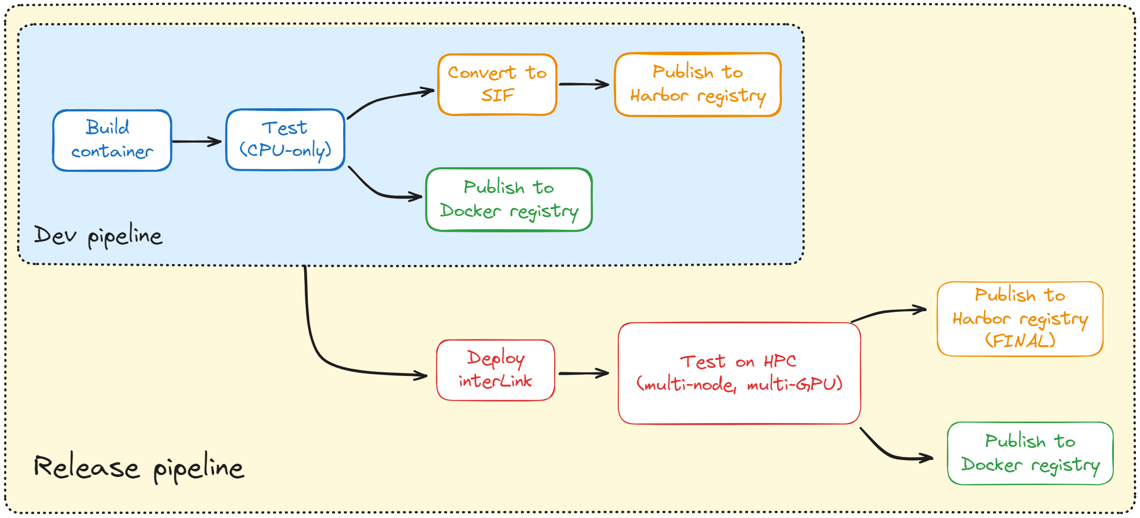
Cloud-HPC integration
…OCI containers are the common language.

Slide 28
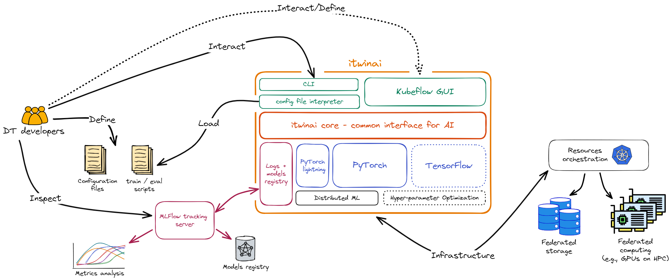
itwinai - ML tooling for DT applications

