Slide 1
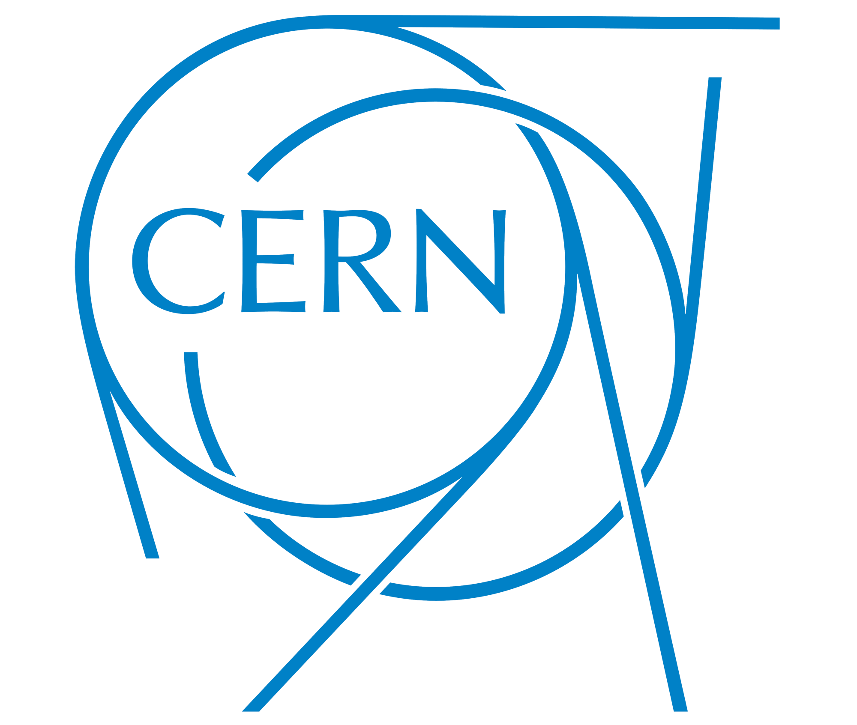


BioDynaMo: Biology Dynamics Modeller
Portokalidis Stavros
5 March 2025

Slide 2
Agent-Based Simulations
Agent-Based Modeling (ABM) simulates interactions of autonomous entities (agents).
Each agent operates independently and follows simple rules.
Local interactions lead to emergent behavior (complex system-level effects).
Used in biology, medicine, epidemiology, neuroscience, economics, and more (e.g. tumor progression, brain activity, and even economic trends).
March 5, 2025

Slide 3
What is BioDynaMo?
BioDynaMo is an open-source, high-performance agent-based simulation platform.
Designed for scalable and modular simulations of biological, social, and physical systems.
Supports large-scale simulations, handling billions of agents efficiently.
Founded by CERN and Newcastle University.
Available under the Apache 2.0 license
March 5, 2025

Slide 4
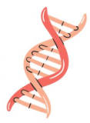
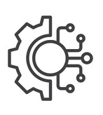
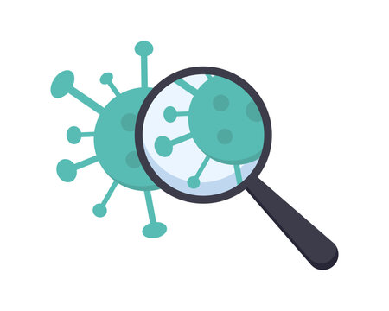
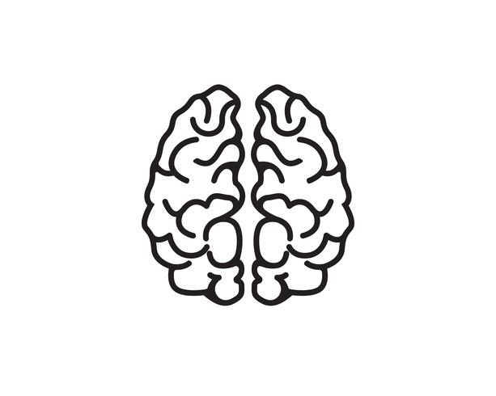
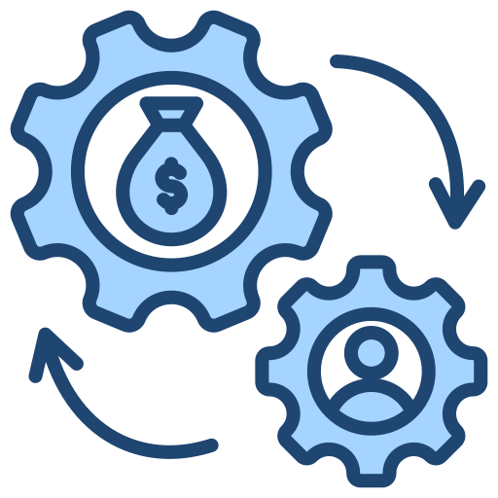
Applications in Science & Engineering
Biology and Medicine
(tumor growth and drug interactions)
Epidemiology
(disease spreads e.g. COVID-19)
Neuroscience
(Neuron development and brain disorders)
Social and Economics Systems
(Market behavior analysis)
Physics and Engineering
(Urban planning)
March 5, 2025

Slide 5
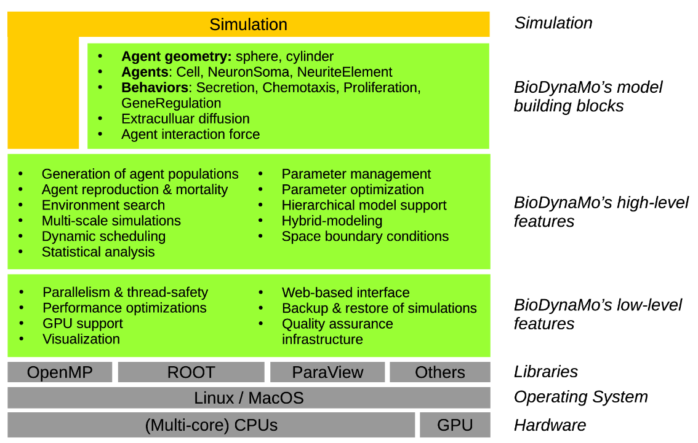
BioDynaMo Features
Low-level features handle critical aspects of performance and usability
High-level features commonly used across different agent-based modeling domains
Model building blocks simplify the development of specific simulations, tailored for different scientific domains
Ref: Breitwieser et al. 2021, https://doi.org/10.1093/bioinformatics/btab649
March 5, 2025

Slide 6
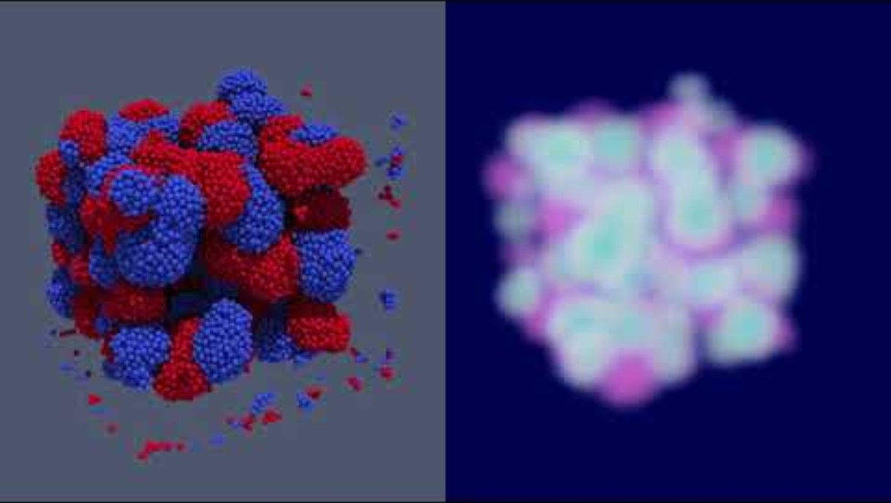
Example: Cell Clustering Model
Cells as agents – spherical, two types (red & blue)
Two behaviors:
  Secretion – cells release substances into the environment
  Chemotaxis – cells move toward higher concentrations
Initial state: Random distribution in 3D space
Result: Cells are organized in clusters
Ref: https://www.youtube.com/watch?v=jlOk_Y3SUHo
March 5, 2025

Slide 7
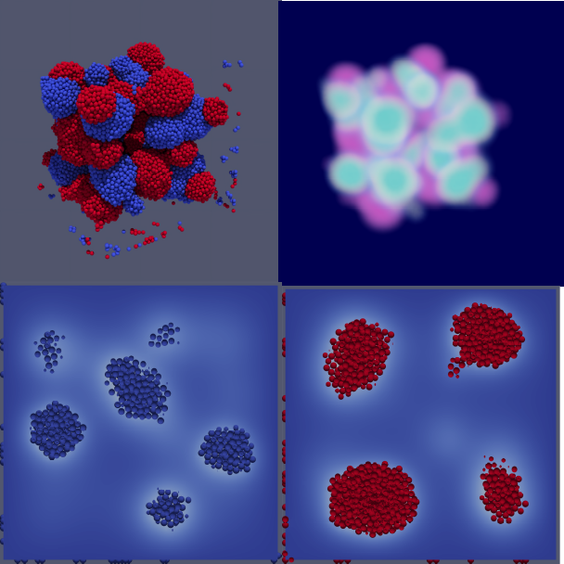
Example: Cell Clustering Result
Ref: Breitwieser et al. 2021, https://doi.org/10.1093/bioinformatics/btab649
March 5, 2025

Slide 8

Example: Tumor Growth Model
Simulates tumor growth in a structured environment.
Initial state: Layered cells, different tissue regions.
Tumor cells emerge and begin expanding.
March 5, 2025

Slide 9
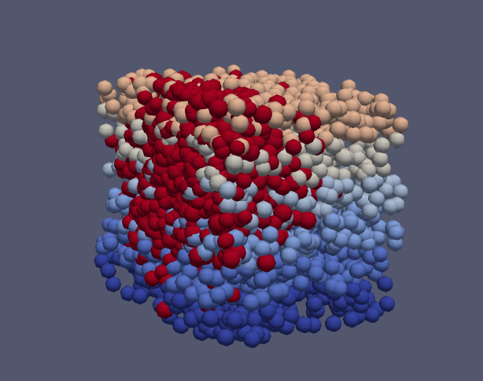
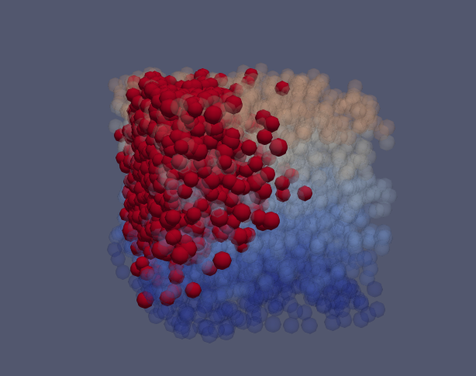
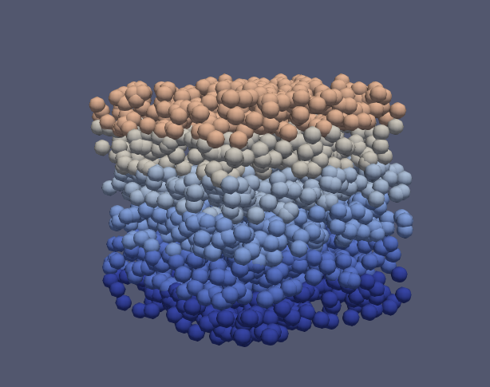
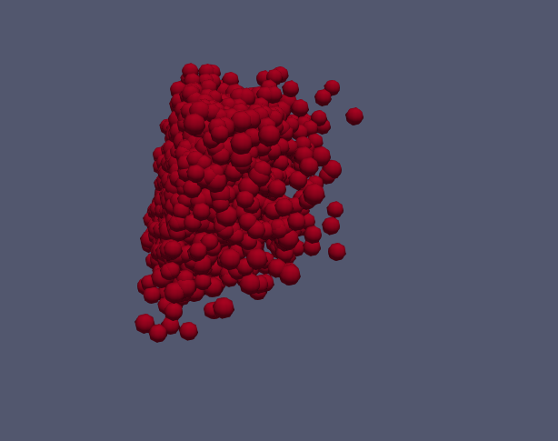
Example: Tumor Growth Result
March 5, 2025

Slide 10


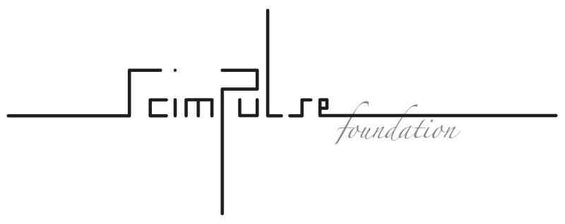




BioDynaMo Members
March 5, 2025

Slide 11
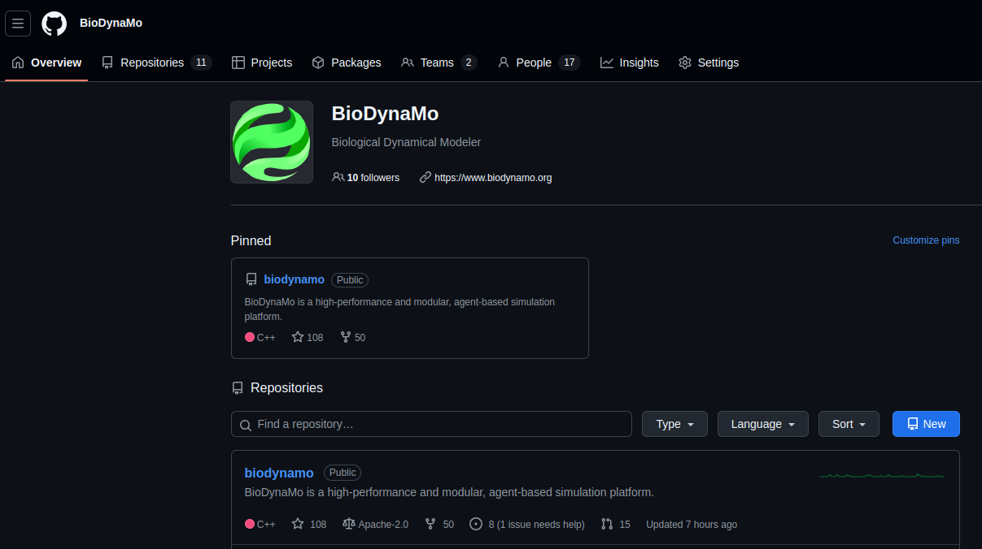
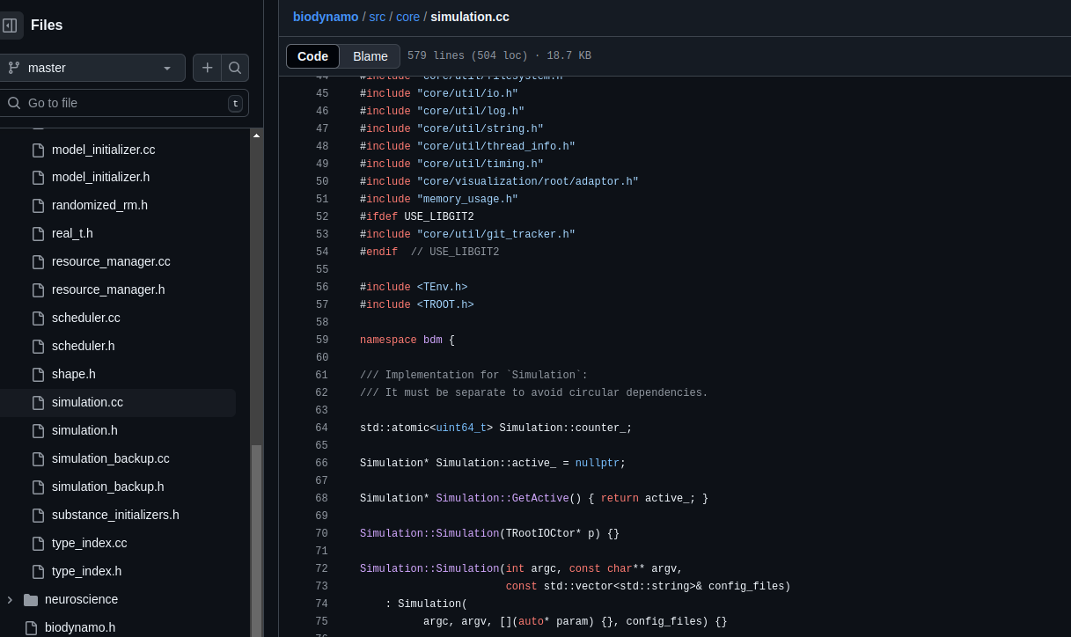
BioDynaMo Community
GitHub project: https://github.com/BioDynaMo/biodynamo
Contributions welcome – open-source collaboration.
March 5, 2025

Slide 12
Conclusion
BioDynaMo is a powerful, scalable agent-based simulation platform.
It supports applications in medicine, biology, engineering, and more.
Open-source and free to use.
Encouraging researchers and developers to get involved.
March 5, 2025

Slide 13
Thank you!
March 5, 2025

Slide 14
References and Extra Information
Breitwieser et al. 2021, https://doi.org/10.1093/bioinformatics/btab649
Breitwieser et al. 2023, https://doi.org/10.1145/3572848.3577480
BioDynaMo web site: https://www.biodynamo.org
GitHub: https://github.com/BioDynaMo
Tumor Concept: https://www.biodynamo.org/user-guide/from-installation-to-1st-steps
March 5, 2025

Slide 15
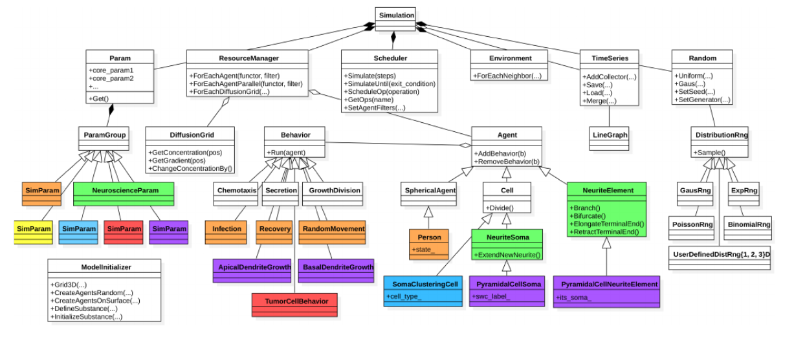
Software Design and Modularity
Ref: Breitwieser et al. 2021, https://doi.org/10.1093/bioinformatics/btab649
March 5, 2025

