Slide 1

Hyperparameter optimization studies of an environmental use-case with InterTwin
Dorcas Mulaye
Supervisor: Dr Ilaria Luise

Slide 2
Table of Contents
01
Introduction
02
Contribution
03
Results
04
XXXXXXX
Project Scope Emphasis
12/08/2024
outline
<number>

Slide 3

Digital Twin: Virtual representation of a physical system
InterTwin Project
-Co-designing and prototyping an interdisciplinary Digital Twin Engine.
-Aims to provide a versatile platform that can be used for various scientific applications, such as climate modeling and particle physics simulations.
-Crucial in handling data-intensive and computationally demanding tasks, making it a key tool for researchers dealing with large-scale simulations and predictions.
12/08/2024
Intertwin Project
<number>

Slide 4
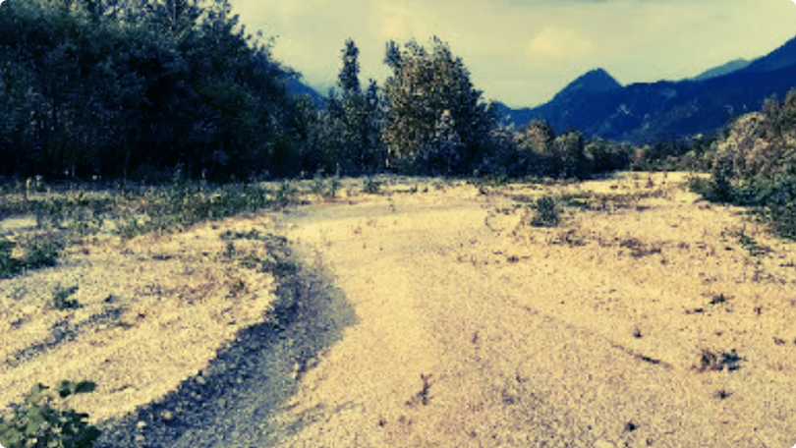
Use Case
interTwin Use Case A Digital Twin for Drought Early Warning in the Alps
EURAC Trento in the context of InterTwin
12/08/2024
Environmental Use Case
<number>

Slide 5

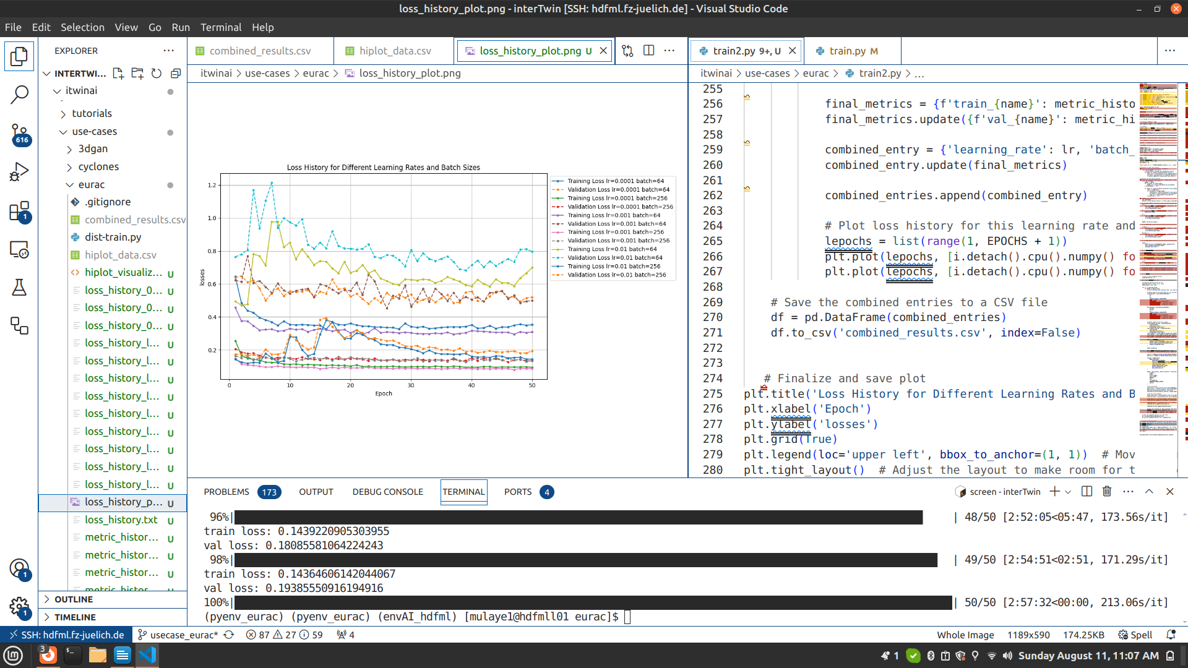
Hyperparameter optimization
Title
Involves fine-tuning the parameters of a model to achieve the best performance
can lead to more accurate and reliable models,
which are essential for making informed decisions.
12/08/2024
Optimization
<number>

Slide 6
Results
Baseline - Reference point for comparison sake with intertwin integration
Lr=1e-4 BS=64 BS=256
8:12min/ep 4:02min/ep
Time Allocation
epoch=50
Grid search for the lr and batch size and timed the rate at which each epoch was completed
Lr=1e-3 BS=64 BS=256
4:24min/ep 2:08min/ep
Lr=1e-2 BS=64 BS=256
18:53min/ep 2:81min/ep
12/08/2024
Results
<number>

Slide 7
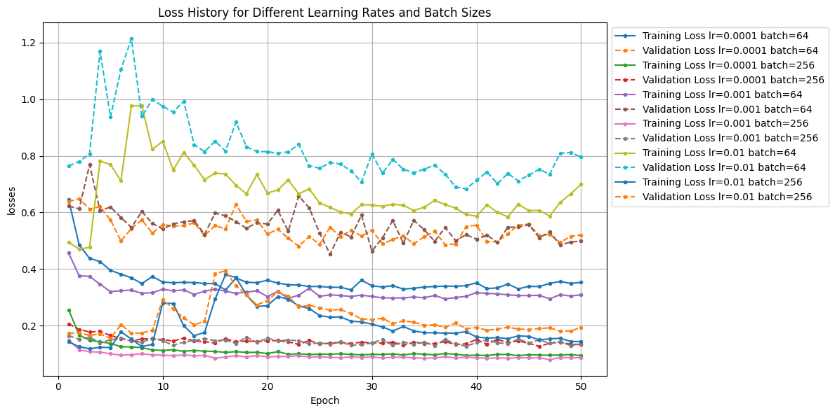
lr:learning rate
BS: Batch size
Best Performance:
-lr=0.0001, BS=64
-lr=0.0001, BS=256
-lr=0.001, BS=256

Slide 8
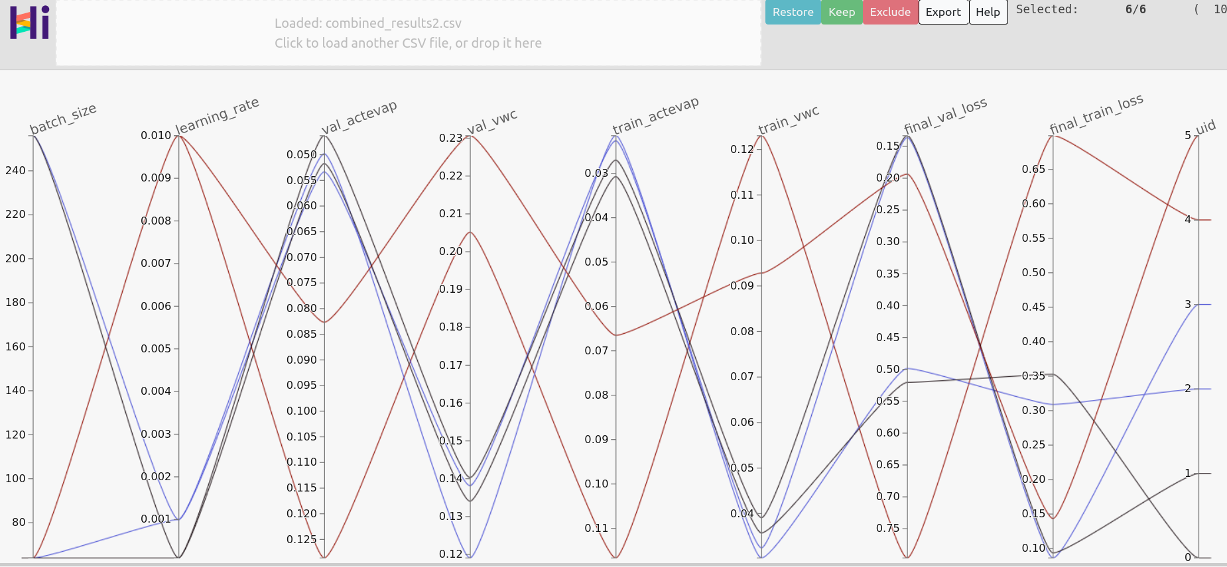
Plotting tool to visualize a more detailed outlook of the the relationships among parameters used in the model

Slide 9
Next steps
Take note of the differences in model perfomance for the baseline model and when intertwin is incorporated.
Same Config as baseline
Incorporate Intertwin
Same config as baseline
Run in Parallel
Simultaneously
synchronized
GPU
GPU
GPU
GPU

Slide 10
Thank you!
merci

