Slide 1

A cloud-native approach for managing Kubernetes clusters in a hybrid cloud environment
Realised by: Mouad El Haouari
Supervised by: Antonio Nappi

Slide 2
Table of Contents
01
Context
02
Problem Statement
03
Objective
04
Investigations
05
Solution
06
Current vs Proposed Approach
07
Conclusion & Perspectives
13/08/2024
IT-PW-ARW
2

Slide 3
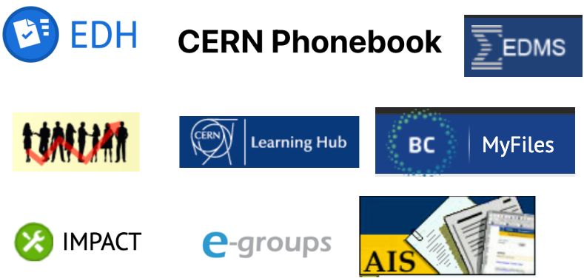
Context
IT-PW-ARW
(Applications and Reusable Workflows)
Providing hosting infrastructure based on Kubernetes for:
SSO (Single Sign On)
CERN critical java applications for Finance and Administrative Processes (FAP) and engineering (EN) departments such as EDH and EDMS.
13/08/2024
IT-PW-ARW
3

Slide 4
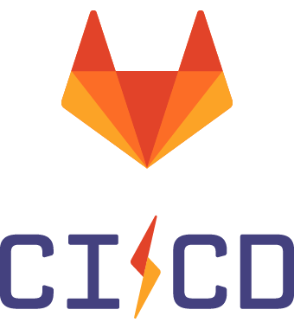

Problem Statement
Current approach
+
13/08/2024
IT-PW-ARW
4
Notes:
Terraform offers a declarative approach of managing infrastructure
CI/CD to automate operations on clusters

Slide 5
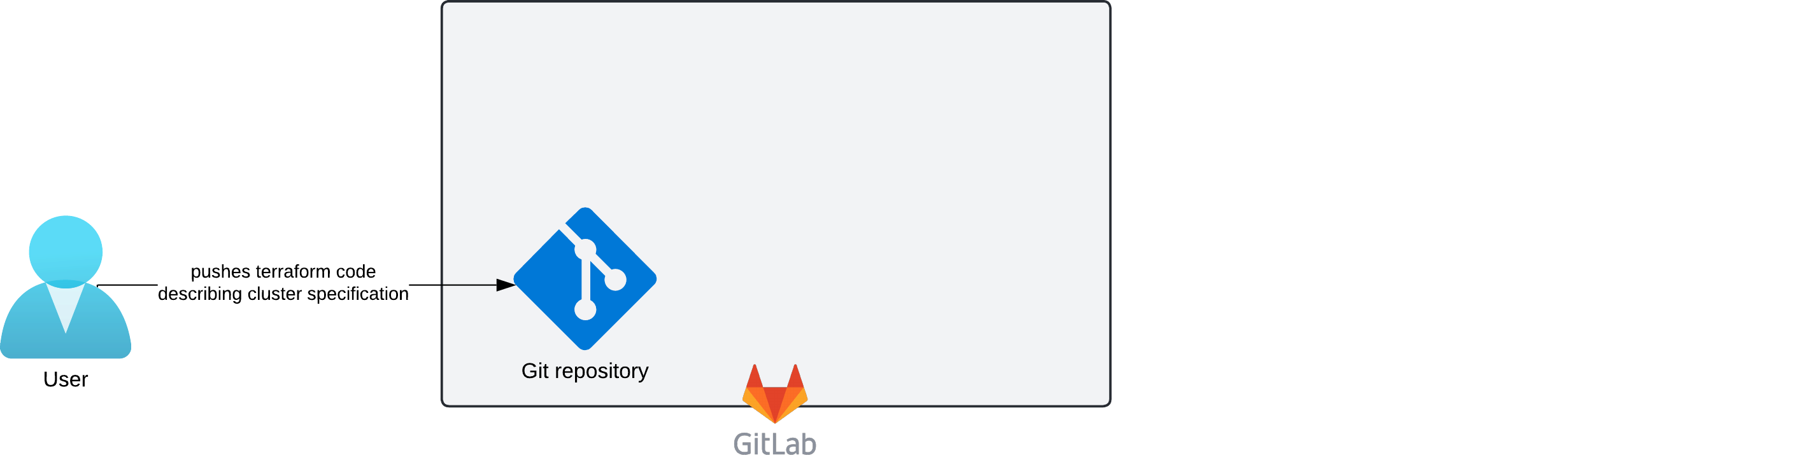
Problem Statement
Current approach
13/08/2024
IT-PW-ARW
5

Slide 6
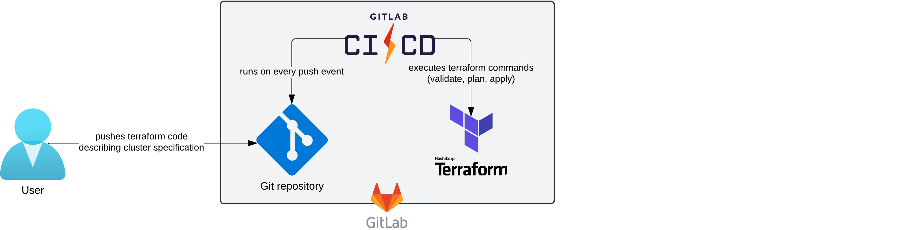
Problem Statement
Current approach
13/08/2024
IT-PW-ARW
6

Slide 7
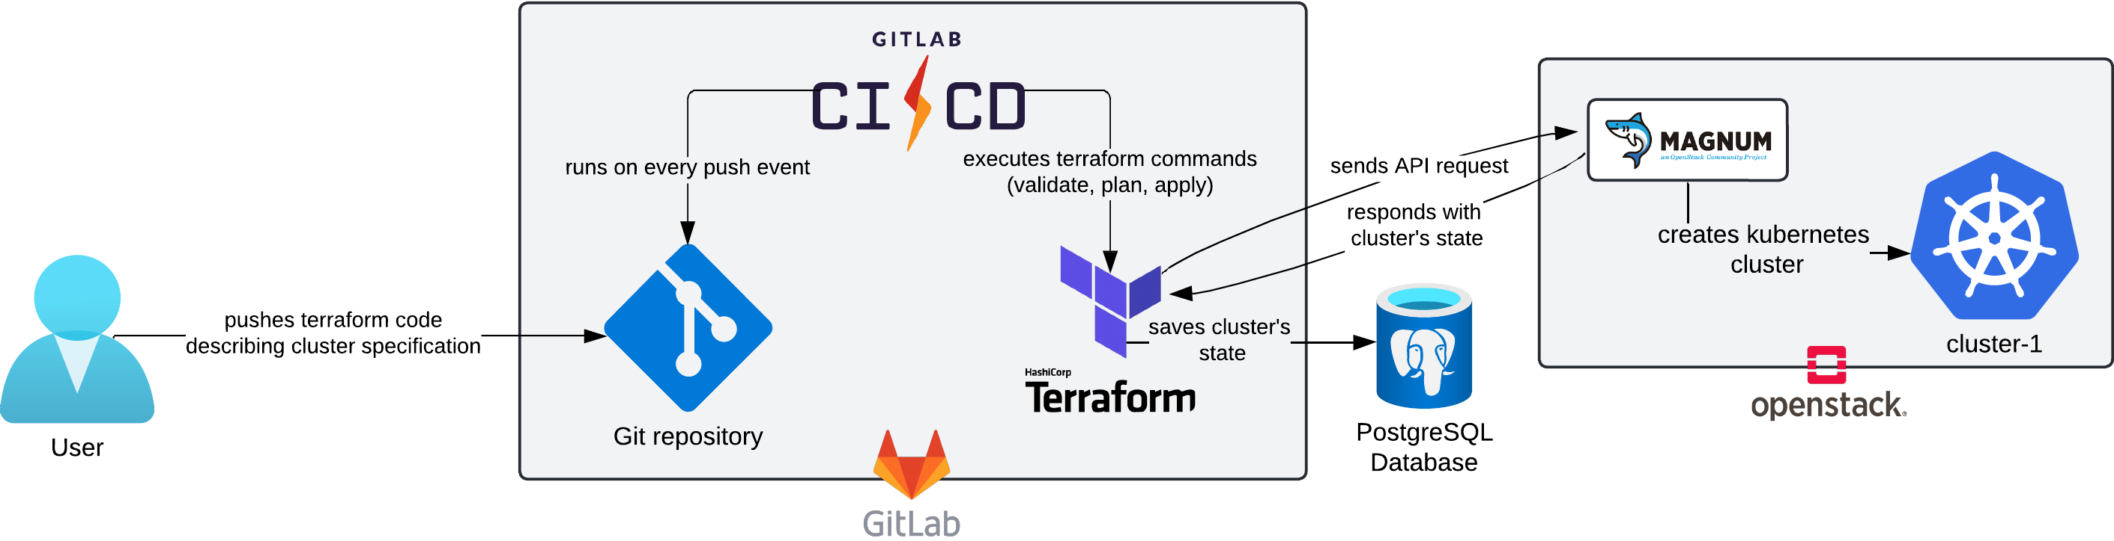
Problem Statement
Current approach
13/08/2024
IT-PW-ARW
7
Notes:
Advantages: declarative approach + versioning with git (version control)

Slide 8
Problem Statement
Current approach
Drawbacks
Terraform is not Kubernetes-native
Not effective for disaster recovery (strong dependency on an external CI/CD and a database)
13/08/2024
IT-PW-ARW
8
Notes:
Terraform is not Kubernetes native (terraform was built to run through CLI and not within a Kubernetes cluster and since we are already deploying applications on Kubernetes, we would like also to have our infrastructure as Code tool running on Kubernetes and our clusters represented as Kubernetes objects, so that we can interact with both applications and infrastructure through Kubernetes objects)

Slide 9


Objective
Propose a unified and cloud native approach for managing Kubernetes clusters on both on-premise (Openstack) and public cloud (Oracle Cloud Infrastructure)
* IaC: Infrastructure as Code
13/08/2024
IT-PW-ARW
9
Notes:
By unified we mean we use custom resources (Kubernetes objects) for representing clusters running in different cloud environement
By cloud native we want our IaC to be running within Kubernetes as controller that will run a reconciliation loop trying to get the desired state of the infrastructure defined in kubernets object to its actual state in the cloud environment

Slide 10
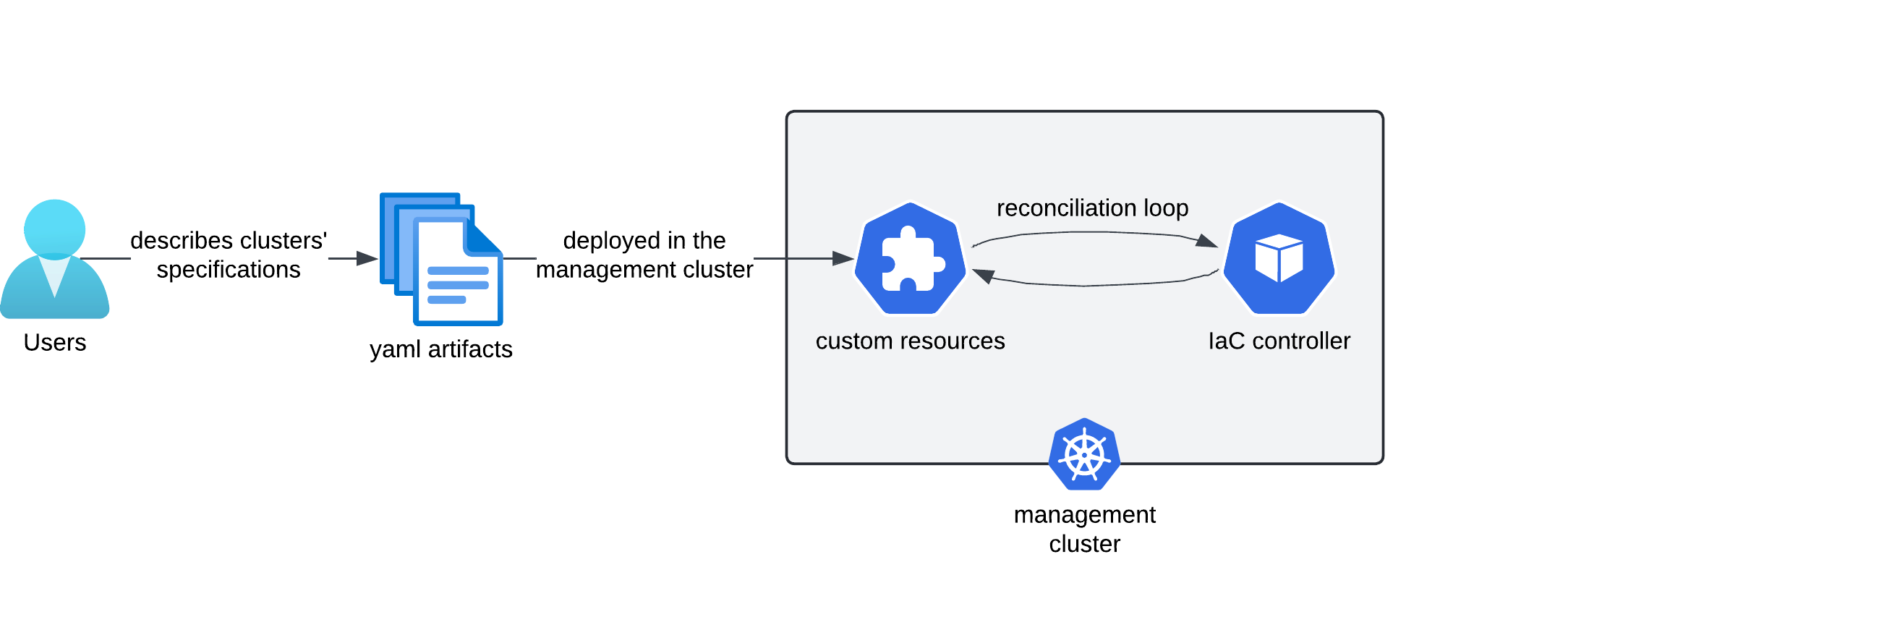
Objective
Propose a unified and cloud native approach for managing Kubernetes clusters on both on-premise (Openstack) and public cloud (Oracle Cloud Infrastructure)
* IaC: Infrastructure as Code
13/08/2024
IT-PW-ARW
10
Notes:
You talk about the management cluster: responsible for hosting the custom resources and the IaC controller

Slide 11
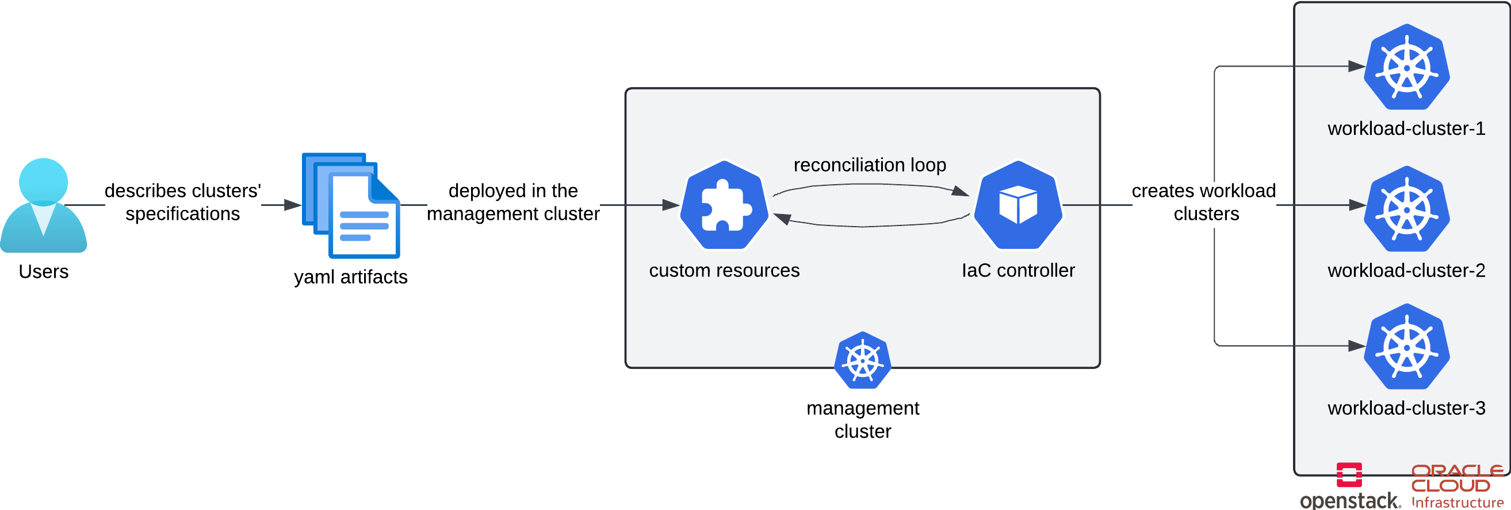
Objective
Propose a unified and cloud native approach for managing Kubernetes clusters on both on-premise (Openstack) and public cloud (Oracle Cloud Infrastructure)
* IaC: Infrastructure as Code
13/08/2024
IT-PW-ARW
11
Notes:
Workload cluster where the applications will actually be running

Slide 12
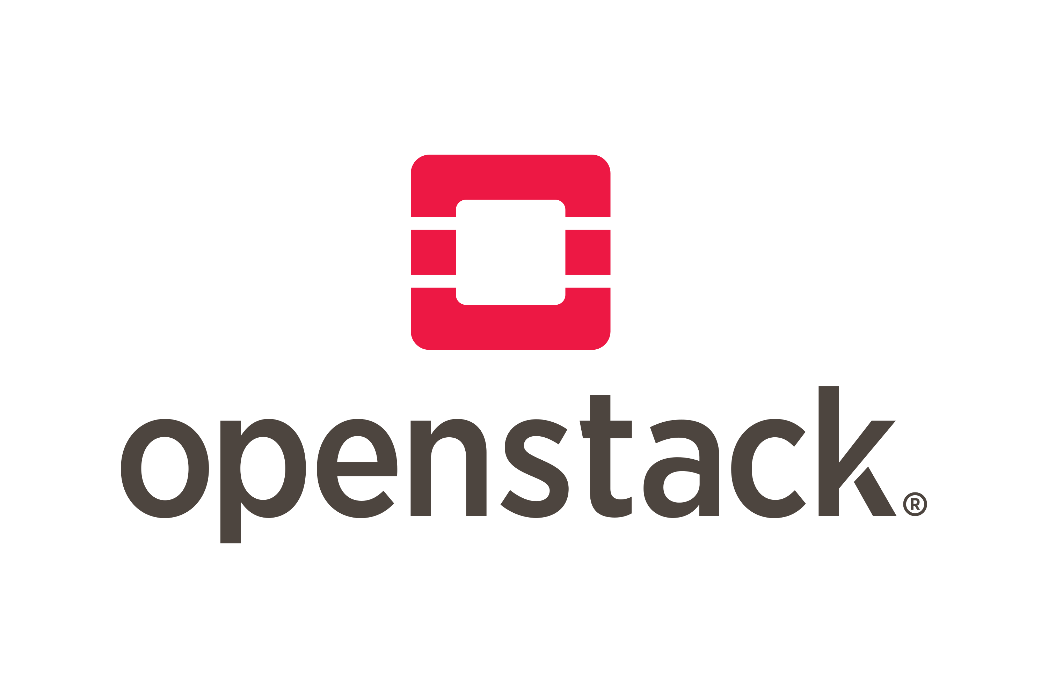



Investigations
Cloud-native IaC tools | Overview
 | focused on the lifecycle management of Kubernetes clusters | Does not support creating Kubernetes clusters through Magnum service It can be used as a backend for Magnum instead of Heat service Creating clusters using Nova service does not work with CERN Openstack cloud due to networking constraints | Supports creating both self-managed and managed clusters
 | a general purpose IaC tool based on terraform under the hood providers are created using a code generation tool called Upjet that allows code generation of a crossplane provider from a terraform provider | Supports creating clusters through Magnum | No provider available (there is one, but it has been abandoned by oracle and it is not officially recognized by crossplane)
ClusterAPI
* IaC: Infrastructure as Code
13/08/2024
IT-PW-ARW
12
Notes:
ClusterAPI : offers many advanced features such us rollout of nodes which will allow for in place upgrades of Kubernetes versions
Crossplane : reconciliation is not that strong for if you update a cluster specification from cloud dashboard the state of that cluster will not be update in their respective Kubernetes object

Slide 13
Investigations
Cloud-native IaC tools | Overview
 | focused on the lifecycle management of Kubernetes clusters | Does not support creating Kubernetes clusters through Magnum service It can be used as a backend for Magnum instead of Heat service Creating clusters using Nova service does not work with CERN Openstack cloud due to networking constraints | Supports creating both self-managed and managed clusters
 | a general purpose IaC tool based on terraform under the hood providers are created using a code generation tool called Upjet that allows code generation of a crossplane provider from a terraform provider | Supports creating clusters through Magnum | No provider available (there is one, but it has been abandoned by oracle and it is not officially recognized by crossplane)
ClusterAPI
* IaC: Infrastructure as Code
13/08/2024
IT-PW-ARW
13

Slide 14
Investigations
Cloud-native IaC tools | Overview
 | focused on the lifecycle management of Kubernetes clusters | Does not support creating Kubernetes clusters through Magnum service It can be used as a backend for Magnum instead of Heat service Creating clusters using Nova service does not work with CERN Openstack cloud due to networking constraints | Supports creating both self-managed and managed clusters
 | a general purpose IaC tool based on terraform under the hood providers are created using a code generation tool called Upjet that allows code generation of a crossplane provider from a terraform provider | Supports creating clusters through Magnum | No provider available (there is one, but it has been abandoned by oracle and it is not officially recognized by crossplane)
ClusterAPI
* IaC: Infrastructure as Code
13/08/2024
IT-PW-ARW
14

Slide 15
Investigations
Cloud-native IaC tools | Overview
 | focused on the lifecycle management of Kubernetes clusters | Does not support creating Kubernetes clusters through Magnum service It can be used as a backend for Magnum instead of Heat service Creating clusters using Nova service does not work with CERN Openstack cloud due to networking constraints | Supports creating both self-managed and managed clusters
 | a general purpose IaC tool based on terraform under the hood providers are created using a code generation tool called Upjet that allows code generation of a crossplane provider from a terraform provider | Supports creating clusters through Magnum | No provider available (there is one, but it has been abandoned by oracle and it is not officially recognized by crossplane)
ClusterAPI
* IaC: Infrastructure as Code
13/08/2024
IT-PW-ARW
15

Slide 16
Investigations
Cloud-native IaC tools | Overview
 | focused on the lifecycle management of Kubernetes clusters | Does not support creating Kubernetes clusters through Magnum service It can be used as a backend for Magnum instead of Heat service Creating clusters using Nova service does not work with CERN Openstack cloud due to networking constraints | Supports creating both self-managed and managed clusters
 | a general purpose IaC tool based on terraform under the hood providers are created using a code generation tool called Upjet that allows code generation of a crossplane provider from a terraform provider | Supports creating clusters through Magnum | No provider available (there is one, but it has been abandoned by oracle and it is not officially recognized by crossplane)
ClusterAPI
* IaC: Infrastructure as Code
13/08/2024
IT-PW-ARW
16
Notes:
We are kind of stuck here, currently none of the two tools support both openstack and oracle

Slide 17

Solution
Technology Choice
+
Why ?
Why ?
Openstack is the priority because all our productions clusters are running on OpenStack at the moment
A CD pipeline that runs within Kubernetes to automate Kubernetes objects deployment from a git repository
13/08/2024
IT-PW-ARW
17
Notes:
Despite crossplane not being the optimal solution, we ended up using it.

Slide 18
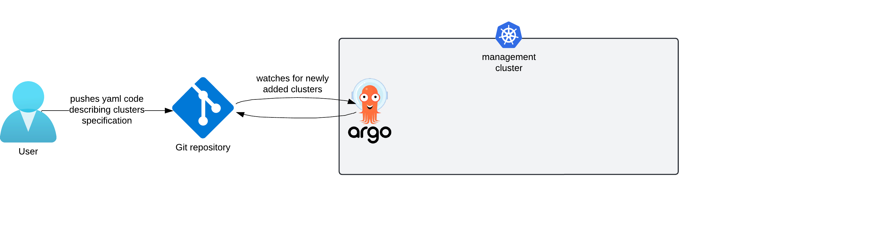
Solution
Proposed approach
13/08/2024
IT-PW-ARW
18

Slide 19
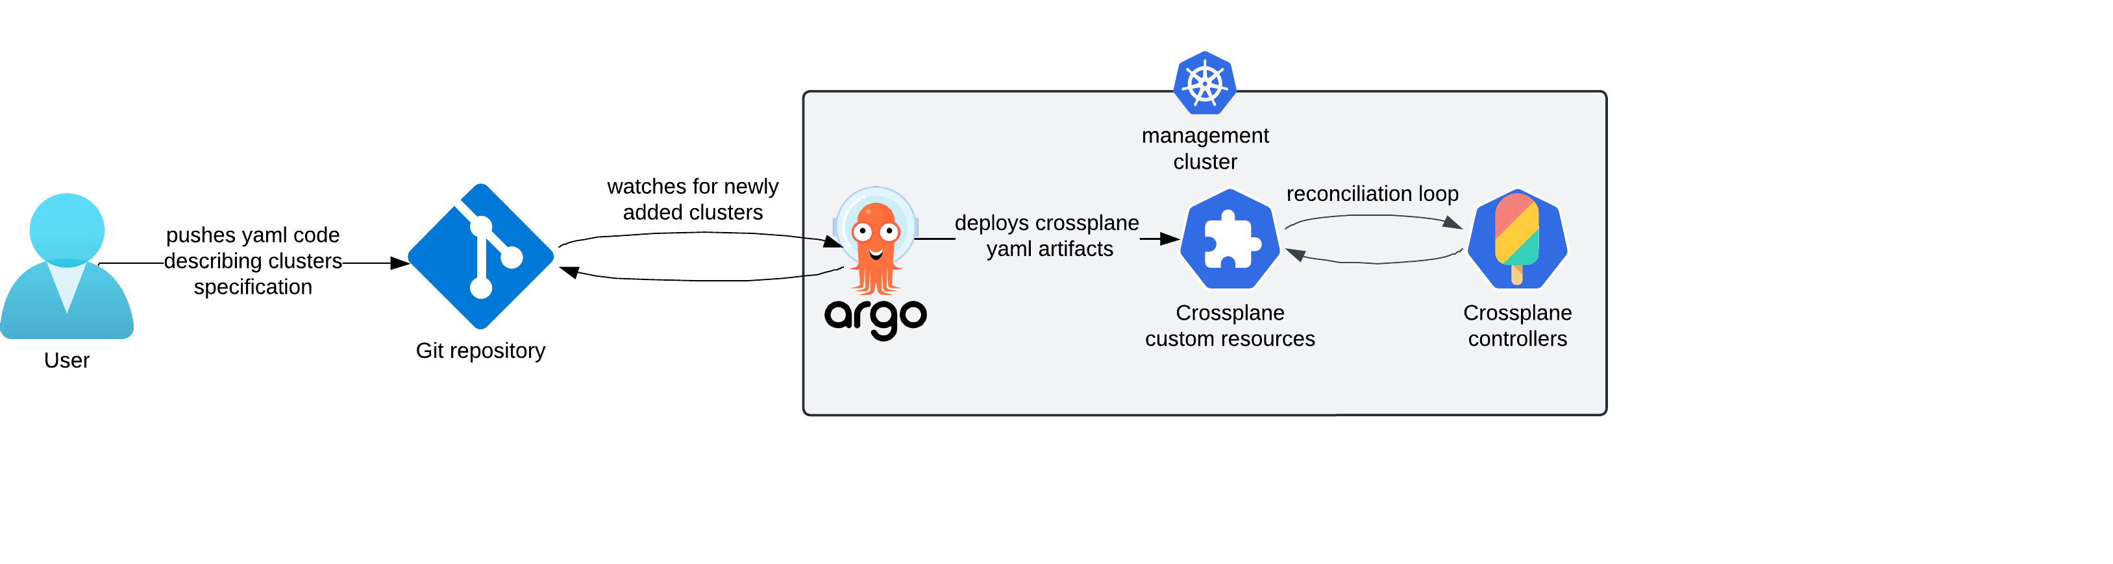
Solution
Proposed approach
13/08/2024
IT-PW-ARW
19

Slide 20
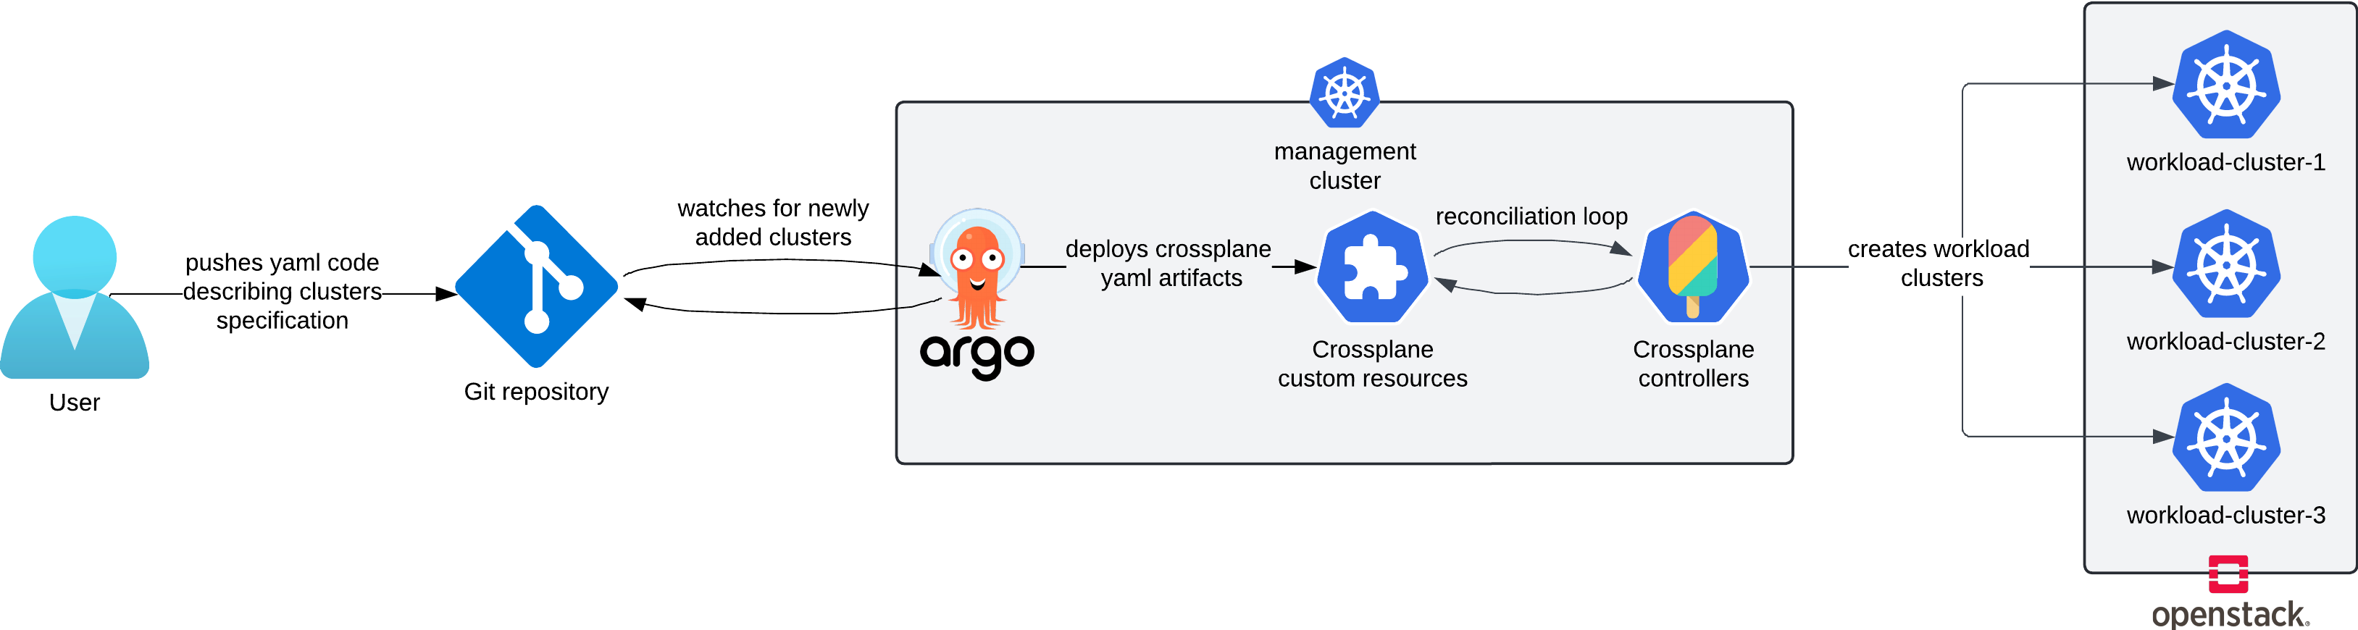
Solution
Proposed approach
13/08/2024
IT-PW-ARW
20

Slide 21
Solution
Proposed approach
Advantages
A unified approach for deploying applications and infrastructure
Faster recovery of Kubernetes clusters (It takes only few steps)
13/08/2024
IT-PW-ARW
21
Notes:
Git repo can be hosted in github, gitlab or even on a the local machine
Similarly for the cluster which can be running locally or on any on-premise or public cloud

Slide 22
Current vs Proposed Approach
Approach | Declarative | Version control | Requirements | Maintenance
Current | Yes | Yes | Gitlab repository Gitlab CI/CD PostgreSQL database | Not Straightforward (HCL - HashiCorp Configuration Language)
Proposed | Yes | Yes | A Kubernetes cluster with ArgoCD installed | Easy (Kubernetes Object)
13/08/2024
IT-PW-ARW
22
Notes:
maintainance

Slide 23

Conclusion & Perspectives
Relying on a cloud-native IaC tool allows for both Kubernetes oriented infrastructure deployment and effective disaster recovery
We will pass the feedback to Oracle to highlight the missing provider for Crossplane
Integrating ClusterAPI with CERN Openstack could be possible but requires collaborative efforts between multiple teams
* IaC: Infrastructure as Code
13/08/2024
IT-PW-ARW
23
Notes:
For crossplane ( it does not work with oracle but works with all other cloud providers)
With some effort from the openstack team , the networking requirements of clusterAPI can be fulfilled on CERN openstack cloud

Slide 24
Thank you!
Questions ?
mouadelhaouari1@gmail.com
mouad.el.haouari@cern.ch

