Slide 1
Modernise log collection of OKD deployments
CERN OpenLab 2024
Christian Klempau
__________________
Supervisors:
Alberto Pimpo
Chrysoula Dikonimaki

Slide 2
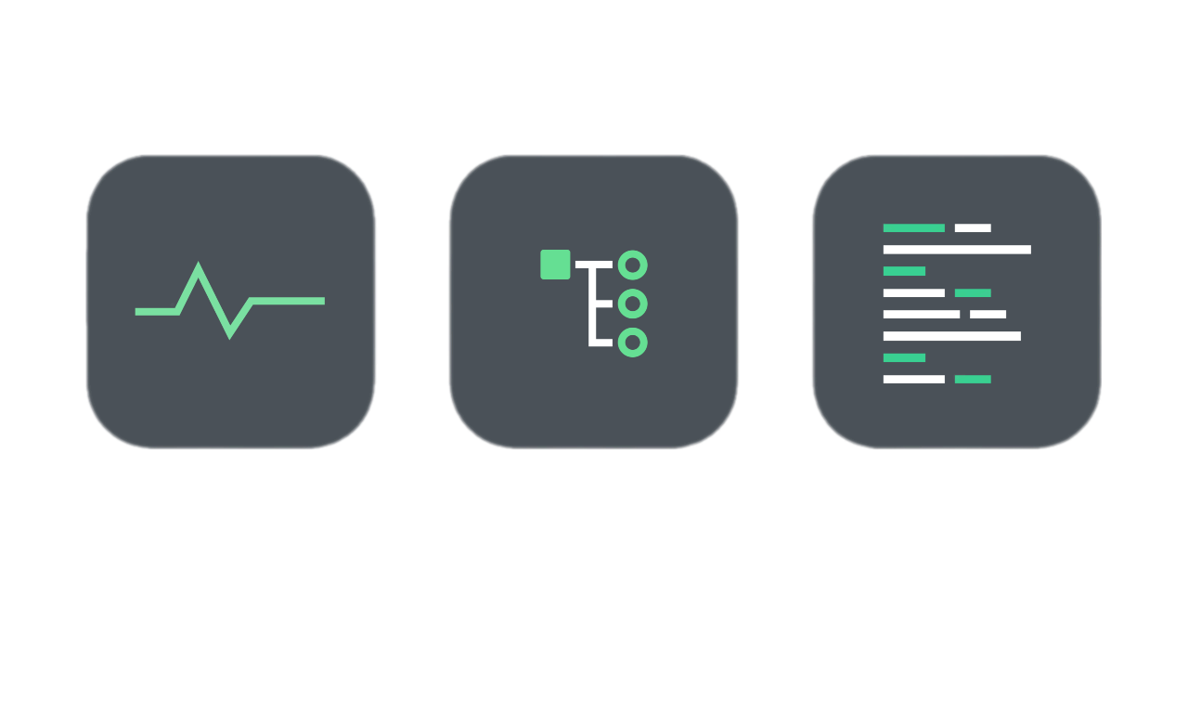
Telemetry
01. Introduction
Metrics
Traces
Logs
Measurement of a service → Performance, availability
Structured logs, correlation, hierarchy → Big picture
Timestamped text record → Debug, diagnostic, security

Slide 3
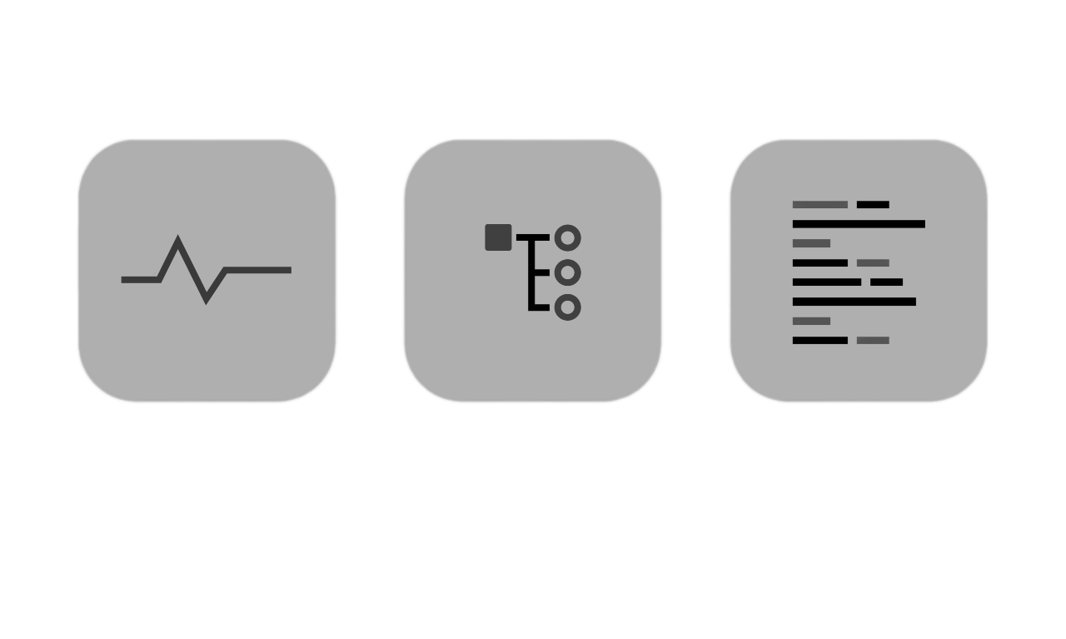
Telemetry
01. Introduction
Metrics
Traces
Logs
Measurement of a service → Performance, availability
Structured logs, correlation, hierarchy → Big picture
Timestamped text record → Debug, diagnostic, security

Slide 4


Telemetry
01. Introduction
Metrics
Traces
Logs
Measurement of a service → Performance, availability
Structured logs, correlation, hierarchy → Big picture
Timestamped text record → Debug, diagnostic, security
+

Slide 5
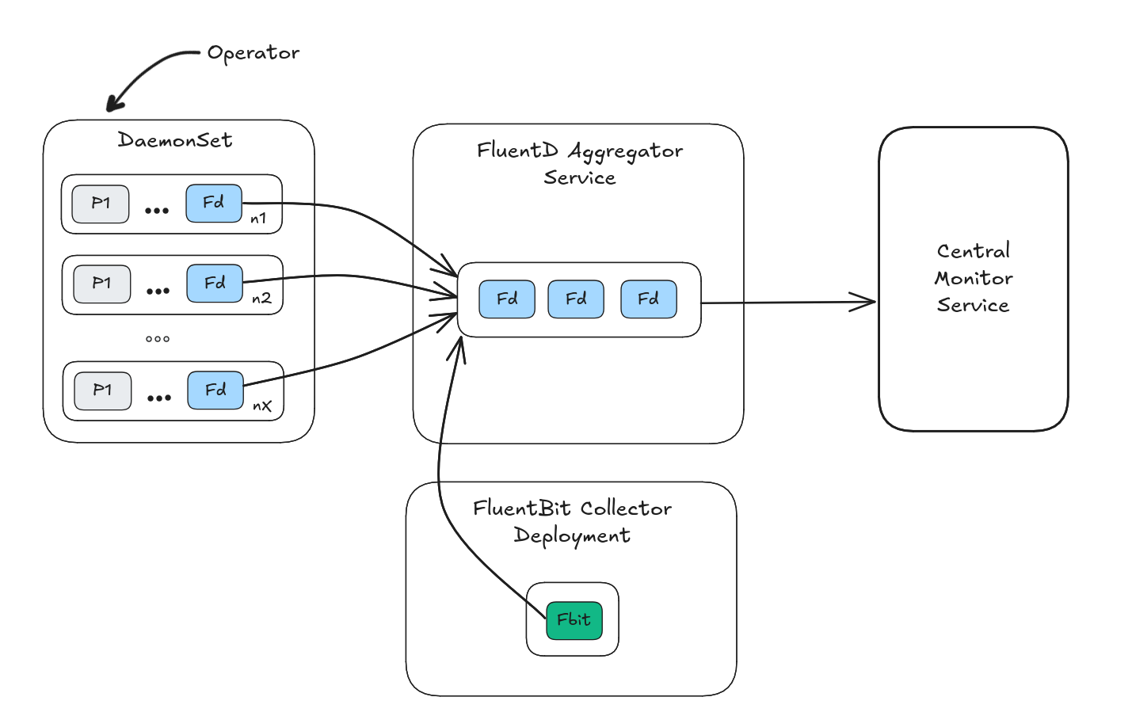

Current logging pipeline
02. What we have
Inside every OKD cluster
+

Slide 6


Why we need an upgrade
02. What we have
Control
Inefficient,
less supported
Operator
deprecation

Slide 7

Alternatives: Vector
03. Research
Future default Operator
  RedHat OKD support
Rust
  Memory safe, efficient
Full-fledged
  logs, metrics, plugins

Slide 8

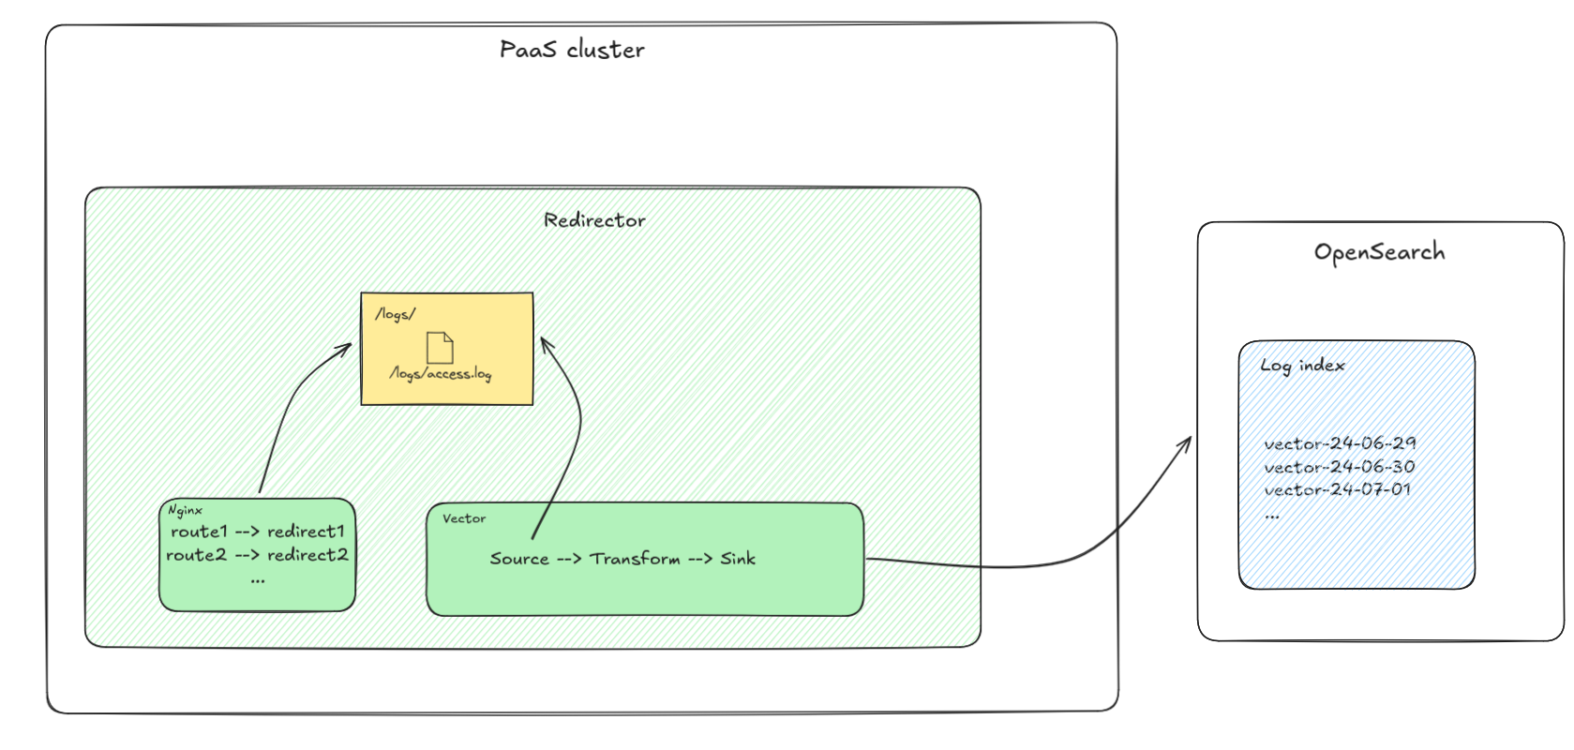
Technology validation pilot
03. Research
Inside legacy-web-redirector

Slide 9
Technology validation pilot
03. Research
Rust
  Memory safe, efficient
Default future Operator
  RedHat OKD support
Full-fledged
  logs, metrics, plugins
Low extensibility
Lacking documentation
Imperative code, not declarative
Limited VRL language support

Slide 10
Proof of concept
04. Proof of concept
C
  Efficient
CNCF support
  Active deployment, OSS
Inspired by FluentD
  Easier transition

Slide 11
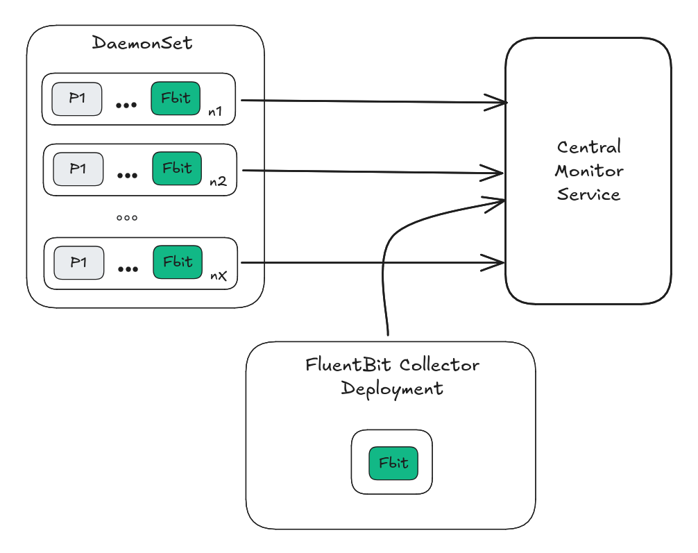
Proof of concept
04. Proof of concept

Slide 12
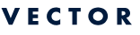
Where we are now
05. Status
Research
Technology validation pilot
Proof of concept
[Future] FluentD phase out

Slide 13
Thanks
Do you have any questions?
christian.alex.klempau.funk@cern.ch
Credits:
This presentation template was created by Slidesgo
Images:-
Kubernetes
Red Hat, OKD
vector.dev, DataDog
Fluent, fluentD, fluent-bit
sokube.io
shutterstock.com

