Slide 1



Anomaly Detection in Grid Compute Nodes:
A Machine Learning Approach Leveraging HEP Benchmark Suite
13th August 2024
Author:
Kacper Kamil Kozik
AGH University of Krakow
Supervisors:
Natalia Diana Szczepanek
Ewoud Ketele

Slide 2
What is Benchmarking ?
Benchmark Scores: Compare performance of systems or system components (e.g. smartphones, CPU models)
Purpose: Identify the best value based on your specific needs and tasks
In Computing: Measure system performance using specific predefined tests or workloads
Outcome: Determine the most efficient option for your requirements
13/08/2024
Anomaly Detection in Grid Compute Nodes:
A Machine Learning Approach Leveraging HEP Benchmark Suite
2

Slide 3
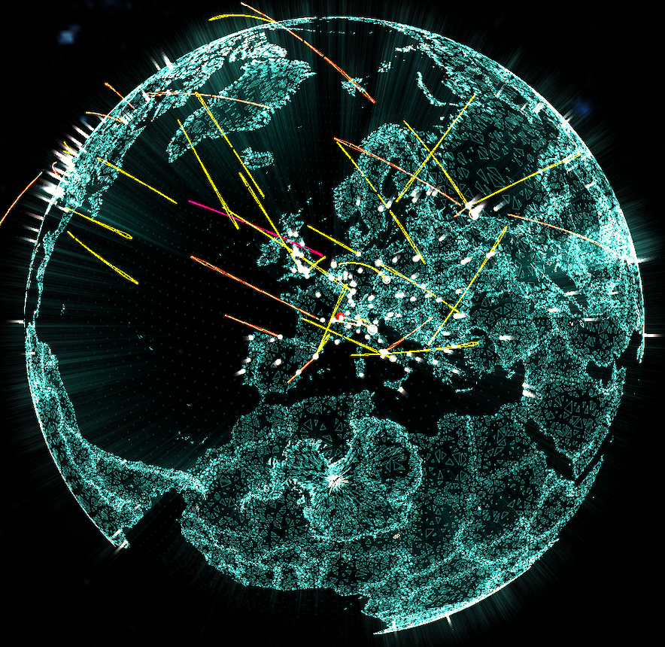
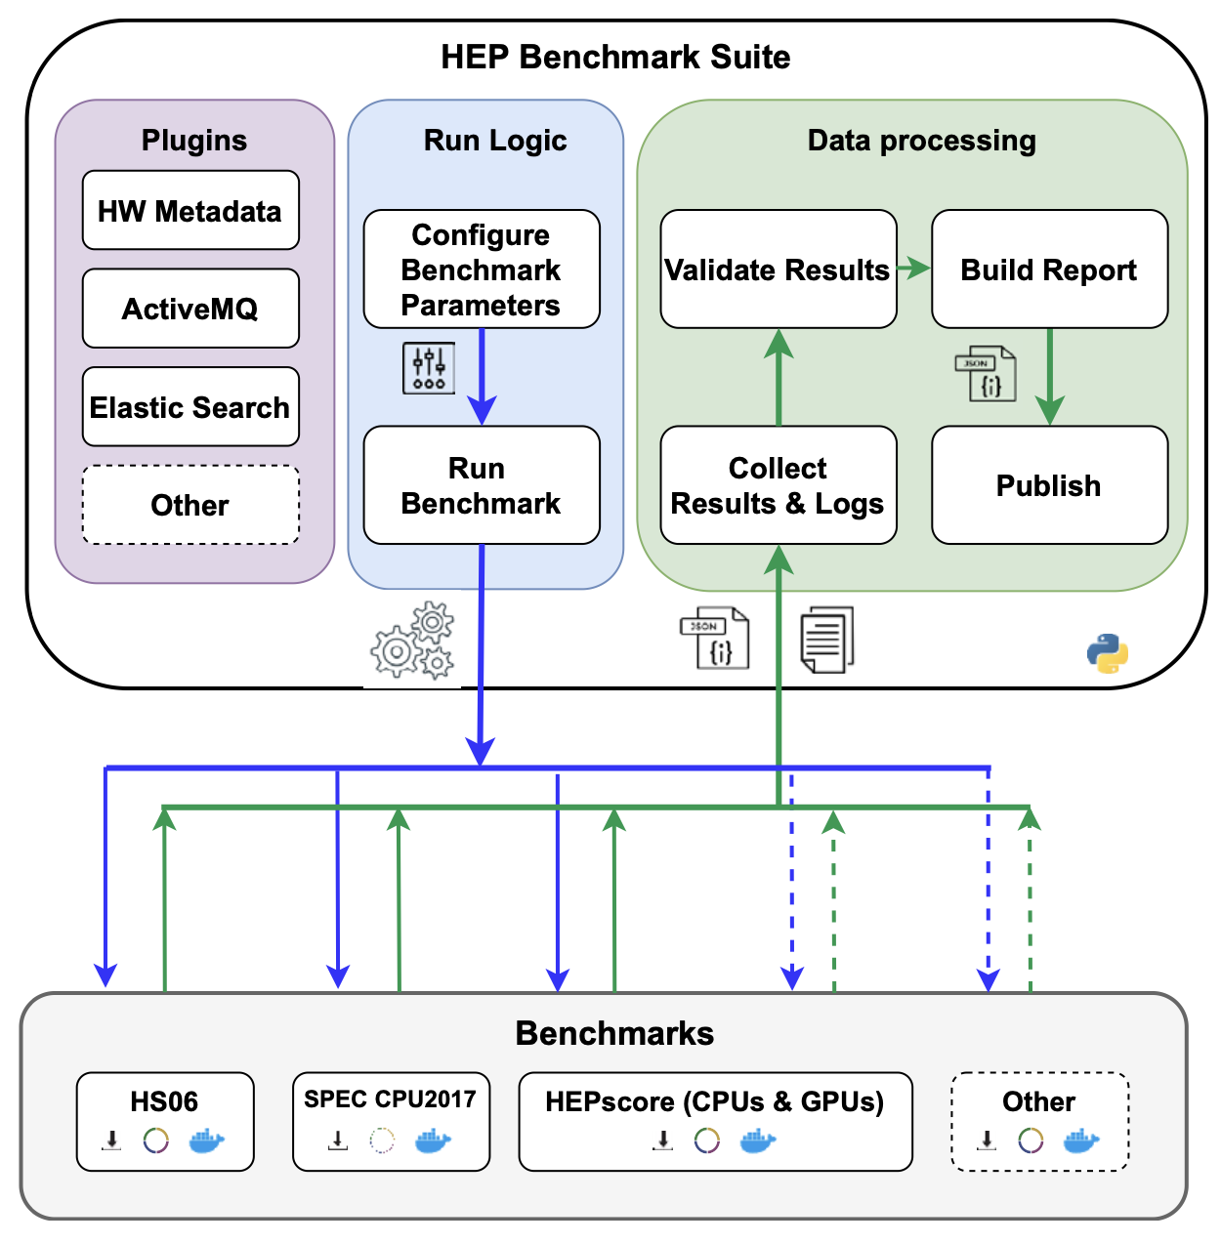

CPU Benchmarking on the Worldwide LHC Computing Grid
HEP Benchmark Suite:
Purpose:
  Compare different CPU models
  (for accounting and financial planning)
HEPScore23:
  Includes 7 workloads from 5 experiments: ATLAS, CMS, ALICE, Belle II, LHCb
13/08/2024
Anomaly Detection in Grid Compute Nodes:
A Machine Learning Approach Leveraging HEP Benchmark Suite
3

Slide 4
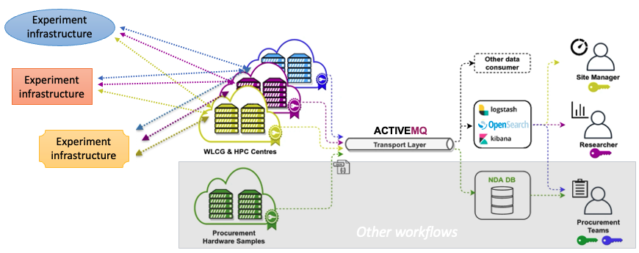
CPU Benchmarking on the Worldwide LHC Computing Grid
The HEP Benchmark Suite is submitted
as a standard job to the grid
  Probing the performance of the grid servers in production environment
  Results, together with metadata such as load, memory usage and power consumption are sent back to us
The collected data can also be used
to detect misconfigured servers
  Correlation between Load of the server and the HEPScore (performance of the server) can be used to detect those misconfigurations (anomalies)
  This process is done manually right now
  The goal of the project is to automate it
Statistics:
  Over 200k jobs finished:
  - 139 unique sites
  - 227 unique CPU Models
  - 28246 unique hosts
13/08/2024
Anomaly Detection in Grid Compute Nodes:
A Machine Learning Approach Leveraging HEP Benchmark Suite
4

Slide 5
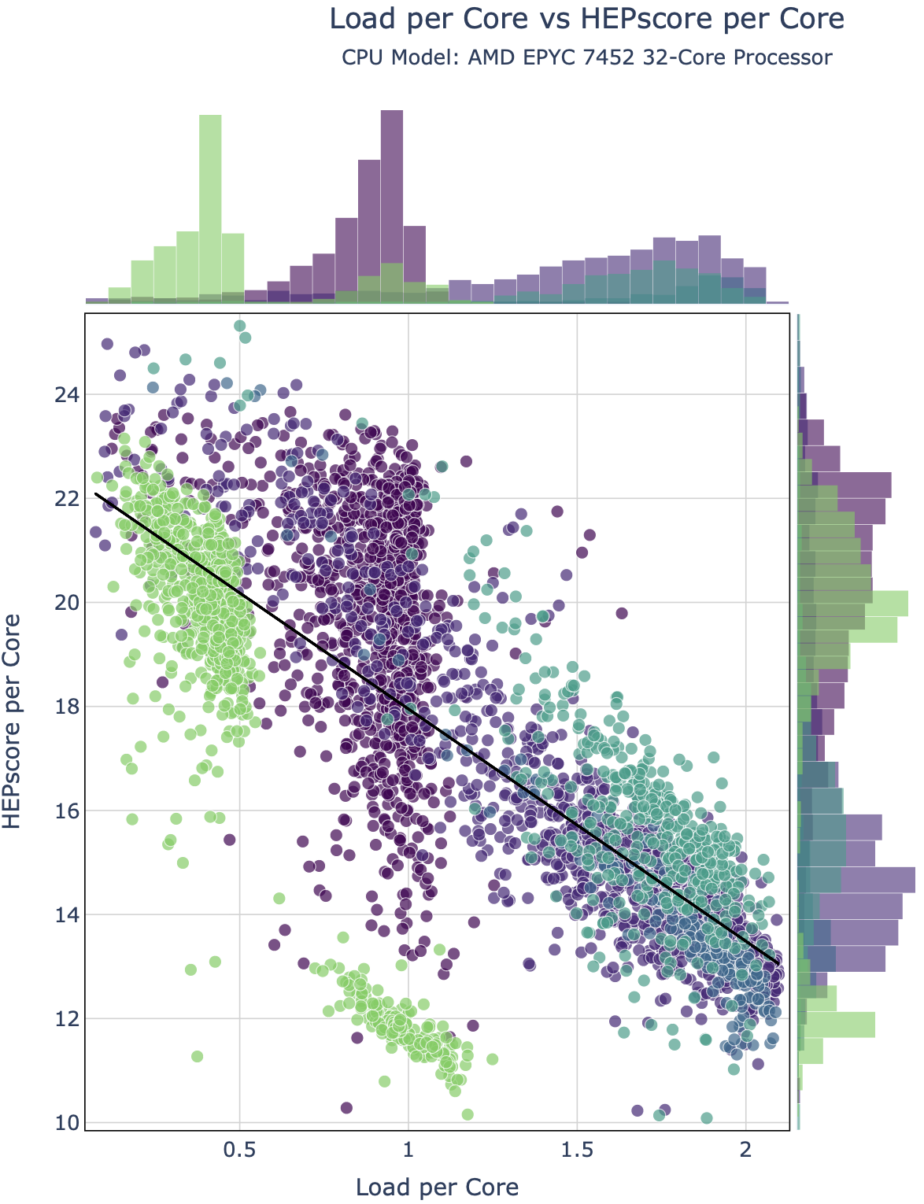
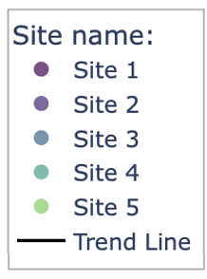
Not All Anomalies Are the Same
Global Clustered Anomalies
Exhibit similar characteristics
Grouped closed together
Located far from trendline
Global Scattered Anomalies
Differ significantly from normal data
Spread far apart
Located far from trendline
For the purposes of this analysis, we focus only on identifying global clustered anomalies using machine learning techniques
Global
scattered
Global clustered
13/08/2024
Anomaly Detection in Grid Compute Nodes:
A Machine Learning Approach Leveraging HEP Benchmark Suite
5

Slide 6
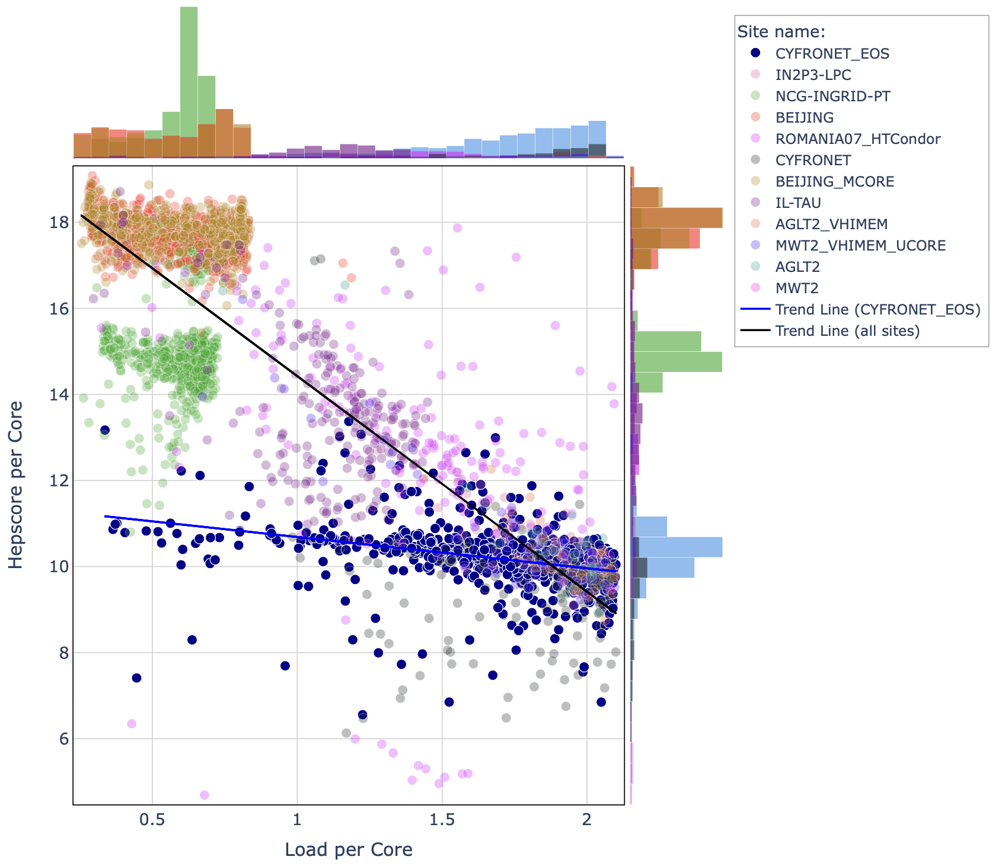
Three Types of Clustered Anomalies on the Grid
”Underperformance” type of anomalies
Identified by a cluster of points that fall below the general trendline
Typically, far from the all-sites trendline
”Overperformance” type of anomalies
Identified by a cluster of points that fall above the general trendline
Typically, far from the all-sites trendline
”Other” type of anomalies
This type of anomaly can be characterized by a “flat” area of data points (highlighted on the plot) or any other trendline which is “unusual” comparing to the general trend
Underperformance
anomaly cluster
“Other” type of anomaly
13/08/2024
Anomaly Detection in Grid Compute Nodes:
A Machine Learning Approach Leveraging HEP Benchmark Suite
6

Slide 7
Anomaly Detection Machine Learning Models
Types of Anomaly Detection Models:
Z-Score
K-Nearest Neighbors (k-NN)
Local Outlier Factor (LOF)
DBSCAN
One-Class SVM
Isolation Forest
Isolation Forest with Split-selection Criterion (SCiForest)
Autoencoders
Principal Component Analysis (PCA)
T-Distributed Stochastic Neighbor Embedding (t-SNE)
Isolation Forest:
Effective at detecting global scattered anomalies
Uses random splits with hyperplanes in the feature space to isolate anomalies
Generalizes well
Preliminary results shown on the next slide
13/08/2024
Anomaly Detection in Grid Compute Nodes:
A Machine Learning Approach Leveraging HEP Benchmark Suite
7

Slide 8
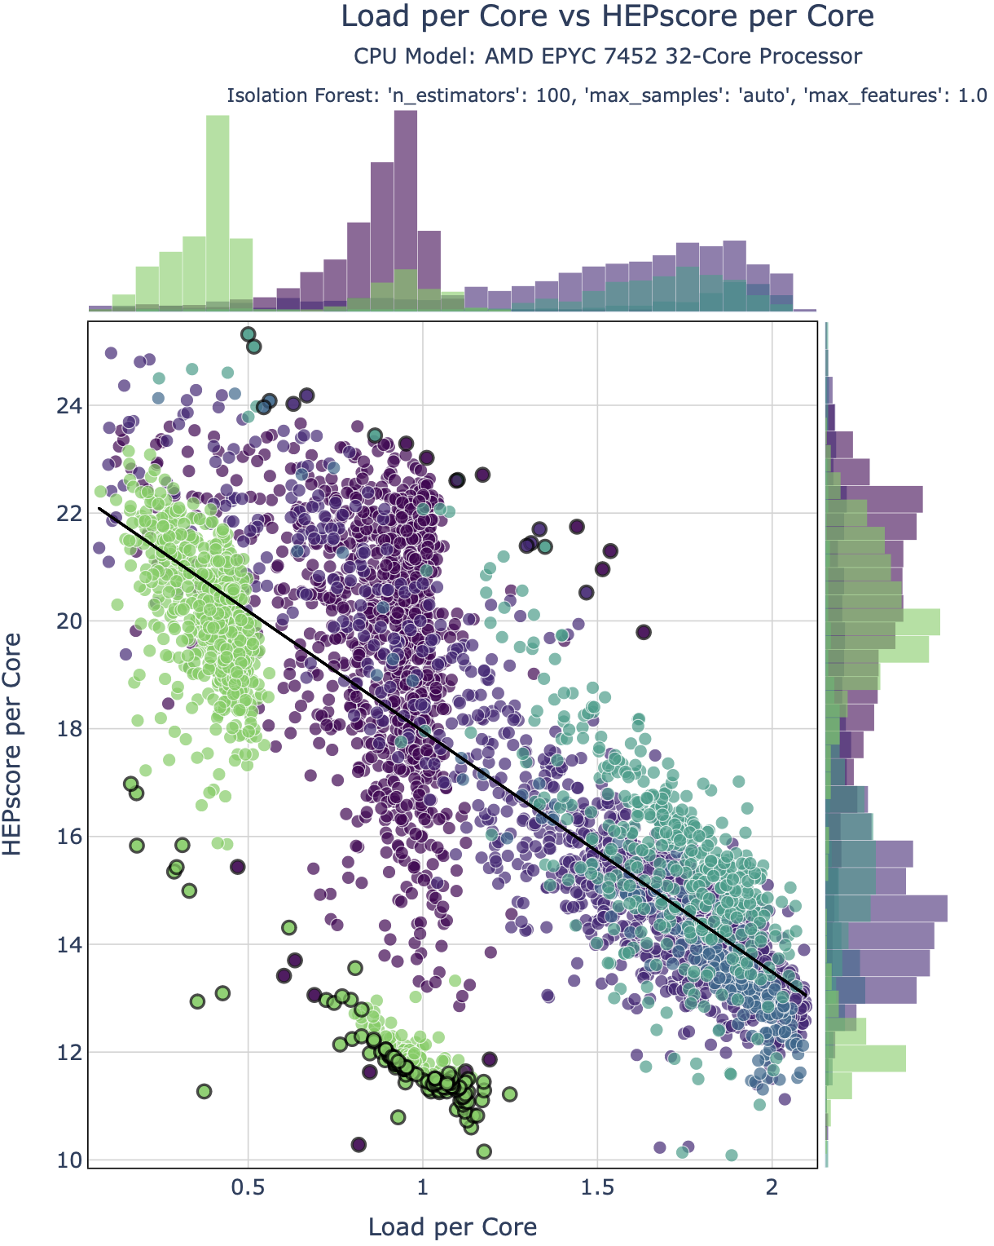

Isolation Forest Preliminary Results
Effectively detects global scattered anomalies
Sometimes fails to detect global clustered anomalies
A lot of False Positives and False Negatives
13/08/2024
Anomaly Detection in Grid Compute Nodes:
A Machine Learning Approach Leveraging HEP Benchmark Suite
8

Slide 9

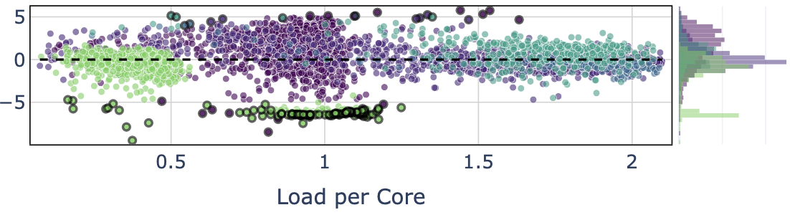
Isolation Forest Preliminary Results
Effectively detects global scattered anomalies
Sometimes fails to detect global clustered anomalies
A lot of False Positives and False Negatives
SCiForest should help with this based on the literature review
  Well-suited for detecting both global scattered and clustered anomalies
  Utilizes improved split selection with hyperplanes to better separate local distribution peaks
13/08/2024
Anomaly Detection in Grid Compute Nodes:
A Machine Learning Approach Leveraging HEP Benchmark Suite
9

Slide 10
Next Steps
Implementation of Isolation Forest with Split-selection Criterion (SCiForest)
Results validation and different models comparison
Add labels or anomaly score from the unsupervised learning algorithm to the dataset as ”ground truth”
Apply a semi-supervised learning algorithm, such as XGBoost Outlier Detection (XGBOD),
on the entire dataset with all features and “ground truth”
Generate JSON report file with results and save plots with anomalies
Example JSON:
September
October
13/08/2024
Anomaly Detection in Grid Compute Nodes:
A Machine Learning Approach Leveraging HEP Benchmark Suite
10

Slide 11



Thank you for your attention
Questions?
kacperkozik999@gmail.com
kacper.kamil.kozik@cern.ch
linkedin.com/in/kacper-kozik
@Kacper0199

Slide 12
References
Giordano D. et. al. HEPScore: A new CPU benchmark for the WLCG.
arXiv:2306.08118v2 [hep-ex] (2023).
https://doi.org/10.48550/arXiv.2306.08118
Giordano D., Alef M., Atzori L. et al. HEPiX Benchmarking Solution for WLCG Computing Resources.
Comput Softw Big Sci 5, 28 (2021).
https://doi.org/10.1007/s41781-021-00074-y
Valassi A. et. al. Using HEP experiment workflows for the benchmarking and accounting of WLCG computing resources.
EPJ Web Conf 245:07035 (2020).
https://doi.org/10.1051/epjconf/202024507035
Han S. et. al. ADBench: Anomaly Detection Benchmark.
arXiv:2206.09426v2 [cs.LG] (2022).
https://doi.org/10.48550/arXiv.2206.09426
Liu F.T. et. al. On Detecting Clustered Anomalies Using SCiForest.
In: Balcázar J.L., Bonchi F., Gionis A., Sebag M. (eds) Machine Learning and Knowledge Discovery in Databases. ECML PKDD 2010. Lecture Notes in Computer Science, vol 6322.
Springer, Berlin, Heidelberg (2010).
https://doi.org/10.1007/978-3-642-15883-4_18
13/08/2024
Anomaly Detection in Grid Compute Nodes:
A Machine Learning Approach Leveraging HEP Benchmark Suite
12

