Slide 1

Evaluation of HPC Storage Systems for HEP Analyses
Asal Mehrabi
Supervisors: Jonas Hahnfeld, Vincenzo Padulano
Notes:
"Good afternoon, everyone. I’m Asal Mehrabi, an AI bachelor student. Over the past two months, I have been working with the ROOT team on a project focused on the 'Evaluation of HPC Storage Systems for HEP Analyses.' I’m excited to share the results of this project with you today."

Slide 2
Table of Contents
1
Introduction to RNTuple
2
High-Performance Computing Systems
3
Performance Analysis and Benchmarking
4
Conclusions and further work
13/08/2024
Evaluation of HPC Storage Systems for HEP Analyses
2

Slide 3
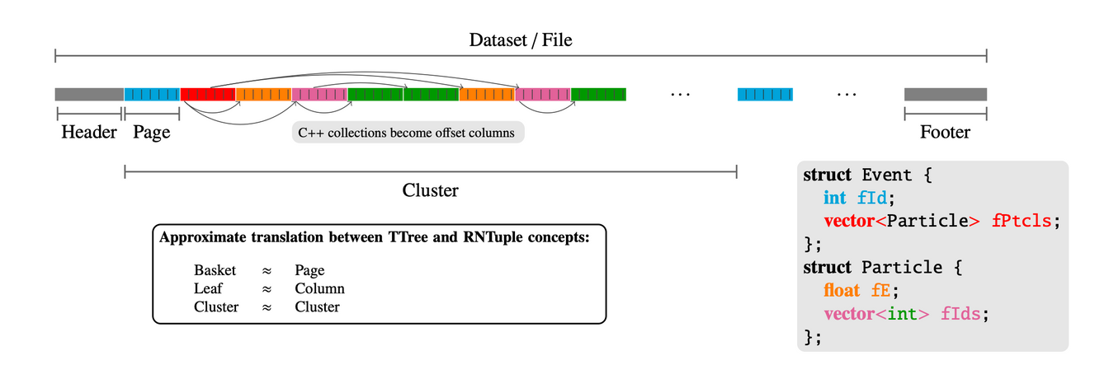
Introduction to RNTuple
  RNTuple:
    Data Storage format
    Structure: Columnar data format
    Fast access, optimized for modern hardware.
  Analysis Grand Challenge
13/08/2024
Evaluation of HPC Storage Systems for HEP Analyses
3
Notes:
RNTuple is an advanced data storage format developed by CERN. It manages large-scale data efficiently using a columnar format that supports complex nested structures. This format enhances data management and access, leading to fast processing, optimized memory usage, and improved performance.
Our project aimed to run the Analysis Grand Challenge using ROOT on HPC systems, with data converted into the new RNTuple format. RNTuple is planned to become the event storage format for the High-Luminosity LHC (HL-LHC), where it will handle multiple exabytes of data.
AGC is one example analysis that is used for benchmarking. (It could be used anything )

Slide 4



High Performance Computing Systems
CPU Nodes: 128 cores per node
Memory: Up to 512 GB per node
Storage: Parallel file system (Lustre)
CPU Nodes: 128 cores per node
Memory: Up to 256 GB per node
Storage:Parallel file system (Lustre)
Job scheduling and Resource allocation
13/08/2024
Evaluation of HPC Storage Systems for HEP Analyses
4
Notes:
For this benchmarking, we used high-performance computing systems, specifically LUMI and Eiger.
LUMI: Located at CSC in Finland, LUMI offers a large-scale computing environment with diverse nodes and high throughput.
Eiger: Part of CSCS in Switzerland, Eiger is specialized for large-scale computations and has high-performance nodes optimized for parallel processing.
Both systems: 128 cores, different filesystems.
Job Scheduling: SLURM for job scheduling and resource allocation.

Slide 5



Workflow
NanoAOD dataset
Analysis Grand challenge
HPC systems
Benchmarking Storage with
Performance Metrics
13/08/2024
Evaluation of HPC Storage Systems for HEP Analyses
5
Notes:
Here’s an overview of the workflow we followed:
Data Preparation: after building ROOT in both HPC systems, getting familiarised with AGC, and by using NanoAOD dataset we submitted the program using slurm to the HPC systems we used: LUMI and Eiger.
Execution: SLURM manages the job scheduling and resource allocation on these systems.
Once the jobs are completed, we collected the output and perform a detailed performance analysis to assess metrics such as processing speed and efficiency.

Slide 6




Challenges
Data Handling and Storage
Different HPC System Configurations
Performance Variability
Software and Tool Compatibility
13/08/2024
Evaluation of HPC Storage Systems for HEP Analyses
6
Notes:
The main challenges for this project are firstly:
- data storage: a limited quota in each hpc system.
- different hpc systems they work partially different so getting ROOT build and running the program on each could be struggling.
- making sure that the output wasn't influenced by other factors in hpc systems to measure the performance.
And finally, some incompatibilities between softwares and different libraries for example were problematic.

Slide 7
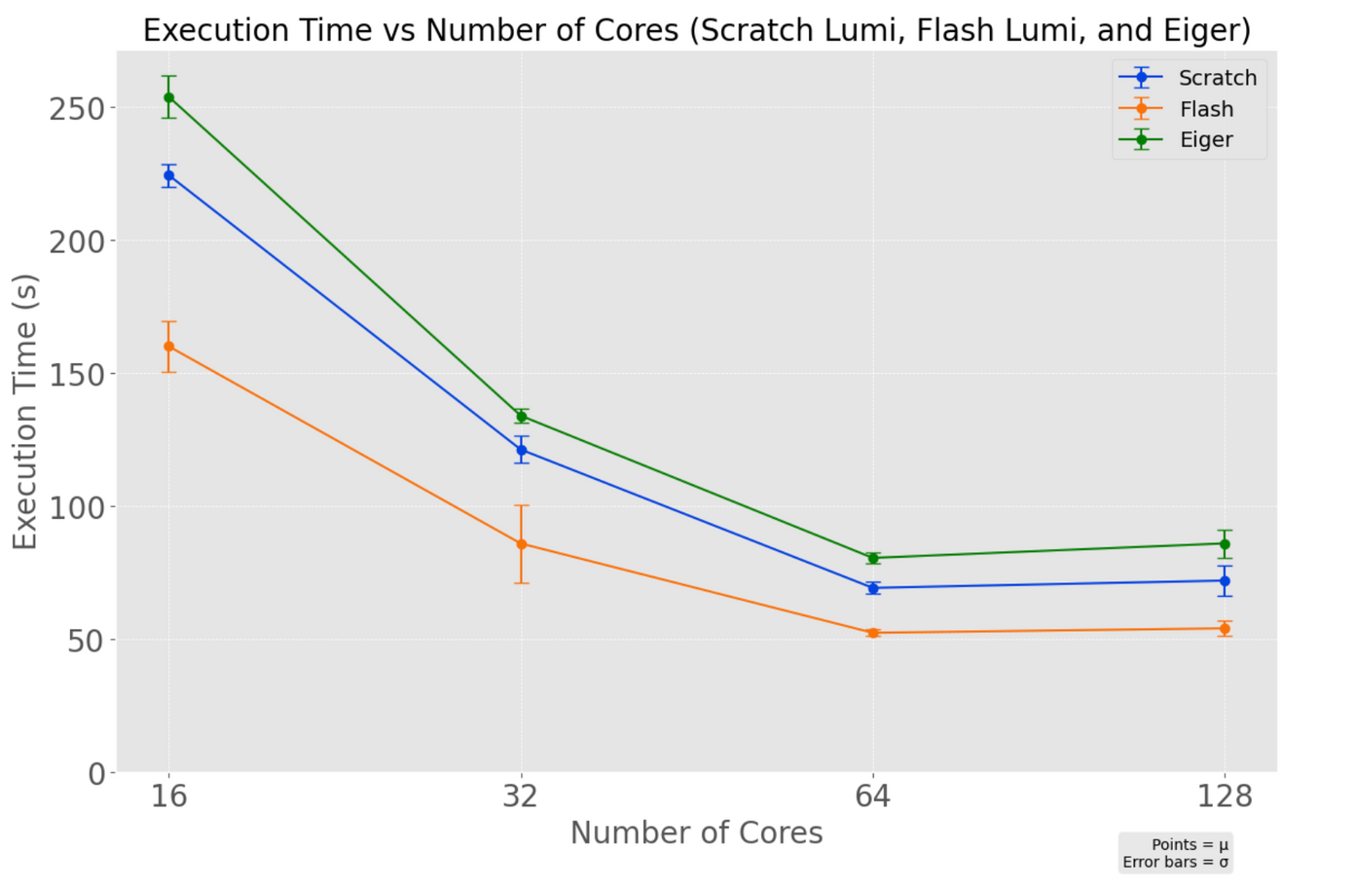
Impact of Storage on Execution Time
  Scratch Storage: Spinning disks, Lustre
  Flash Storage: Based on SSDs, Faster access times.
  Eiger Storage
13/08/2024
Evaluation of HPC Storage Systems for HEP Analyses
7
Notes:
One of the main goals was seeing how different filesystems can actually affect the performance and the execution time. In this case, we compared scratch filesystem of lumi with flash and eiger default filesystem.
For our runs in one node getting different number of cores, we perfectly see that different filesystem result to different numbers, clearly in this case flash filesystem has the best performance, following up with scratch and finally eiger.
less quota on flash

Slide 8



Further Work
Analysis on HPC systems
Benchmarking the Distributed RDF
13/08/2024
Evaluation of HPC Storage Systems for HEP Analyses
8
Notes:
Firstly, it’s important to note that we confirmed RNTuple’s capability to efficiently run on HPC systems and handle large-scale data. Our benchmarking demonstrated that RNTuple effectively manages large datasets,
We observed that the filesystem type significantly affects performance, with the flash filesystem outpacing others in terms of speed and efficiency.
Further work:
Explore more extensive testing across different HPC configurations and filesystems.
Multithread RDF by default
Investigate distributed RDF performance using dask in HPC systems-

Slide 9

Thank you!
asal.mehrabi@cern.ch
linkedin.com/in/asal-mehrabi

Slide 10
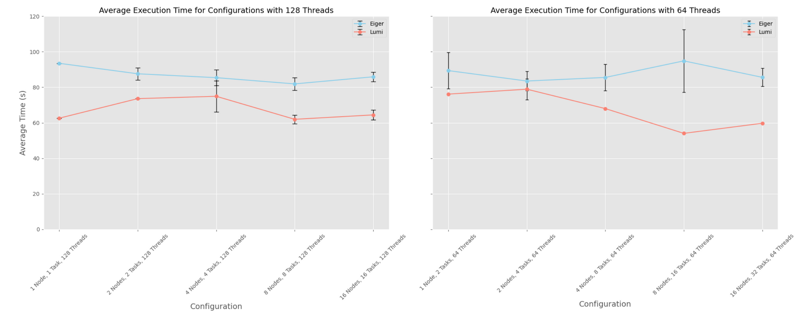
Multithreading
Full Node
Half Node
13/08/2024
Evaluation of HPC Storage Systems for HEP Analyses
8

Slide 11
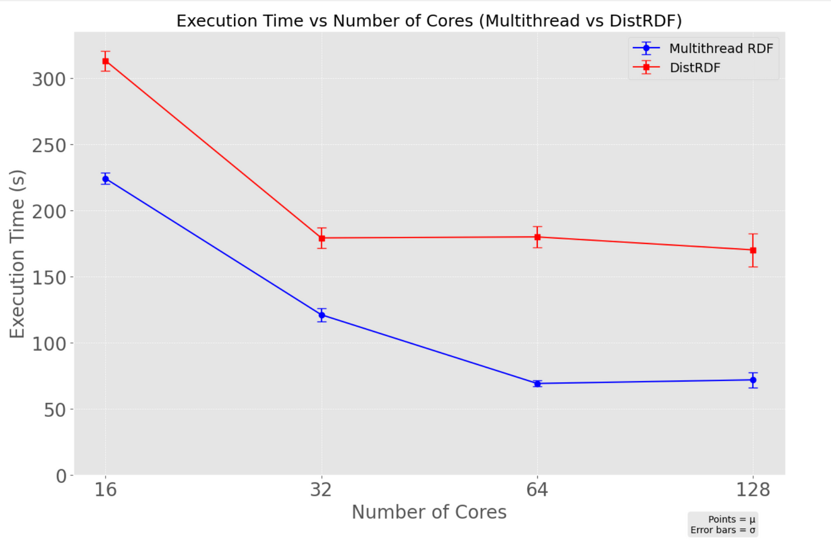
Multithread RDF vs Distributed RDF

