Slide 1


CXL Memory Management for the CMS L1 Scouting System and Beyond
Guilherme Paulino
CERN Openlab Summer Student
July 8 – September 6, 2024
Supervisors:
Giovanna Lazzari Miotto
Thomas Owen James
openlab partner

Slide 2
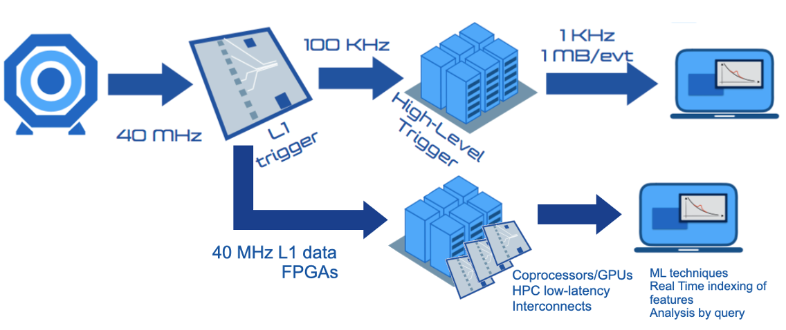
L1 Data Scouting
CMS
  40MHz bunch crossing rate
  Not feasible for full readout
  L1 Trigger selects by signatures
L1 Data Scouting
  Capture L1 primitives from trigger processors
    For every bunch crossing
  Full access to physics
    Unconstrained by the L1 latency and accept rate
L1 Data
Scouting
https://indico.cern.ch/event/1356148/contributions/5818261/
L1DS Online Processing
  Upcoming Hi-Lumi LHC upgrade will substantially increase data volumes,
  requiring advanced data processing techniques.
13/08/2024
CXL Memory Management for the CMS L1 Scouting System and Beyond
2
Notes:
CMS receives data from bunch collisions at 40MHz, but it is not feasible to readout all the detectors in this rate,
This is why we need the L1 trigger
Selects the most interesting events for full read-out and processing
>
To address these, we must explore and evaluate emerging technologies, such as AI acceleration and real-time indexing, to maintain and enhance our processing capabilities.”

Slide 3
L1DS: Run 3
1. A few ingestion servers receive data from the L1DS over 100G
Experimental setup (in operation)
2. Incoming data stored to a local ramdisk buffer
3. Immediately available to processing farm (mounted over NFS) ~2min latency
IU
IU
PU
PU
AU
AU
SU
SU
SU
(DAQ) Ingestion
Units x 8
Processing
Units
Accelerator
Units
Storage
Units
< 2 GB/s
Tier 1 Local Storage
data streams over
100 Gbps TCP/IP
https://indico.cern.ch/event/1356148/contributions/5818261/
13/08/2024
CXL Memory Management for the CMS L1 Scouting System and Beyond
3
Notes:
This is our current L1 Data Scouting infrastructure >
>
The primary challenges we face are high latency in data access and the memory management.
These limitations turns difficult to scale and efficiently process the increasing data volumes."

Slide 4


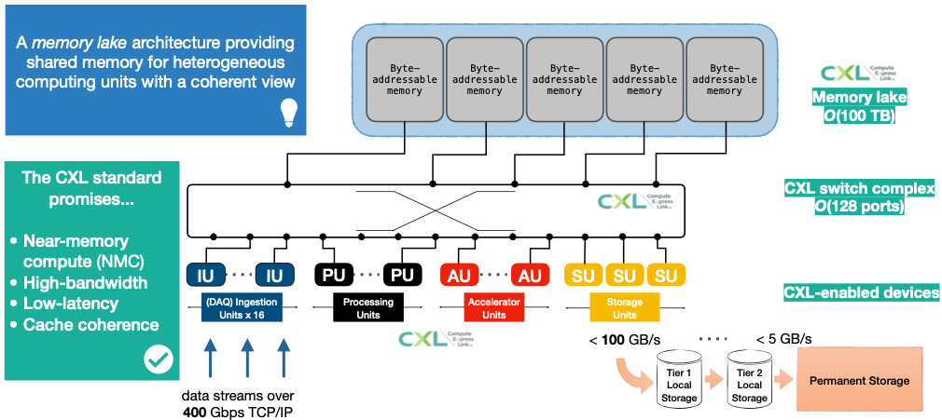


Memory Lake
Disaggregated shared files
Cache coherency in
Multi host data management
Byte-addressable memory
Byte-addressable memory
Byte-addressable memory
Byte-addressable memory
Byte-addressable memory
High Bandwidth
Low latency
IU
IU
PU
PU
AU
AU
SU
SU
SU
(DAQ) Ingestion Units x 16
Processing
Units
Accelerator
Units
Storage
Units
< 100 GB/s
< 5 GB/s
Tier 1 Local Storage
Tier 2 Local Storage
Permanent Storage
data streams over
400 Gbps TCP/IP
https://indico.cern.ch/event/1356148/contributions/5818261/
13/08/2024
CXL Memory Management for the CMS L1 Scouting System and Beyond
4
Notes:
"To overcome these challenges, we propose the use of CXL-enabled devices.
The emerging Compute Express Link protocol offers a transformative approach by enhancing the data ingestion and processing pipeline.
With CXL Switching devices, we can achieve high bandwidth and low latency access, all while maintaining cache coherency in a multi-host data management environment.
This is achieved through the use of disaggregated shared files in byte-addressable memory.
This will make it possible to create a memory lake in the order of hundreds of terabytes."

Slide 5
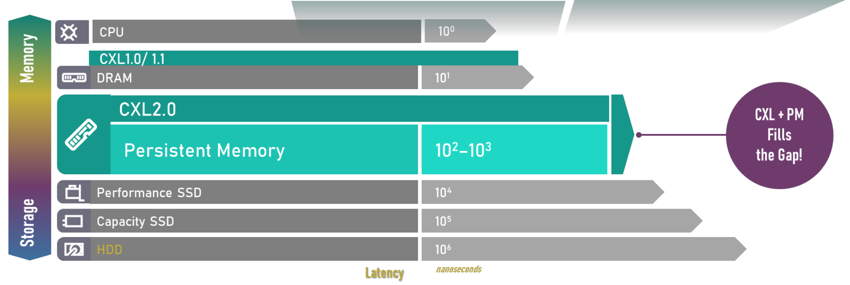
Memory Tiering
Standardized Memory Management and Interfaces
Pmem capability to function as both
memory and Storage
DAX direct access eliminates
OS-level file caching
Adapted from CXL 2.0 White paper
https://computeexpresslink.org/resource-library/
13/08/2024
CXL Memory Management for the CMS L1 Scouting System and Beyond
5
Notes:
"CXL memory tiering architecture introduces significant advancements in memory management.
The direct access feature, known as DAX, leverages persistent memory’s capability to function as both storage and memory.
This eliminates the need for operating system-level file caching in volatile memory.
By combining CXL with direct access memories, we can achieve lower latency, higher bandwidth, and increased capacity, effectively bridging the gap in current memory technologies."

Slide 6
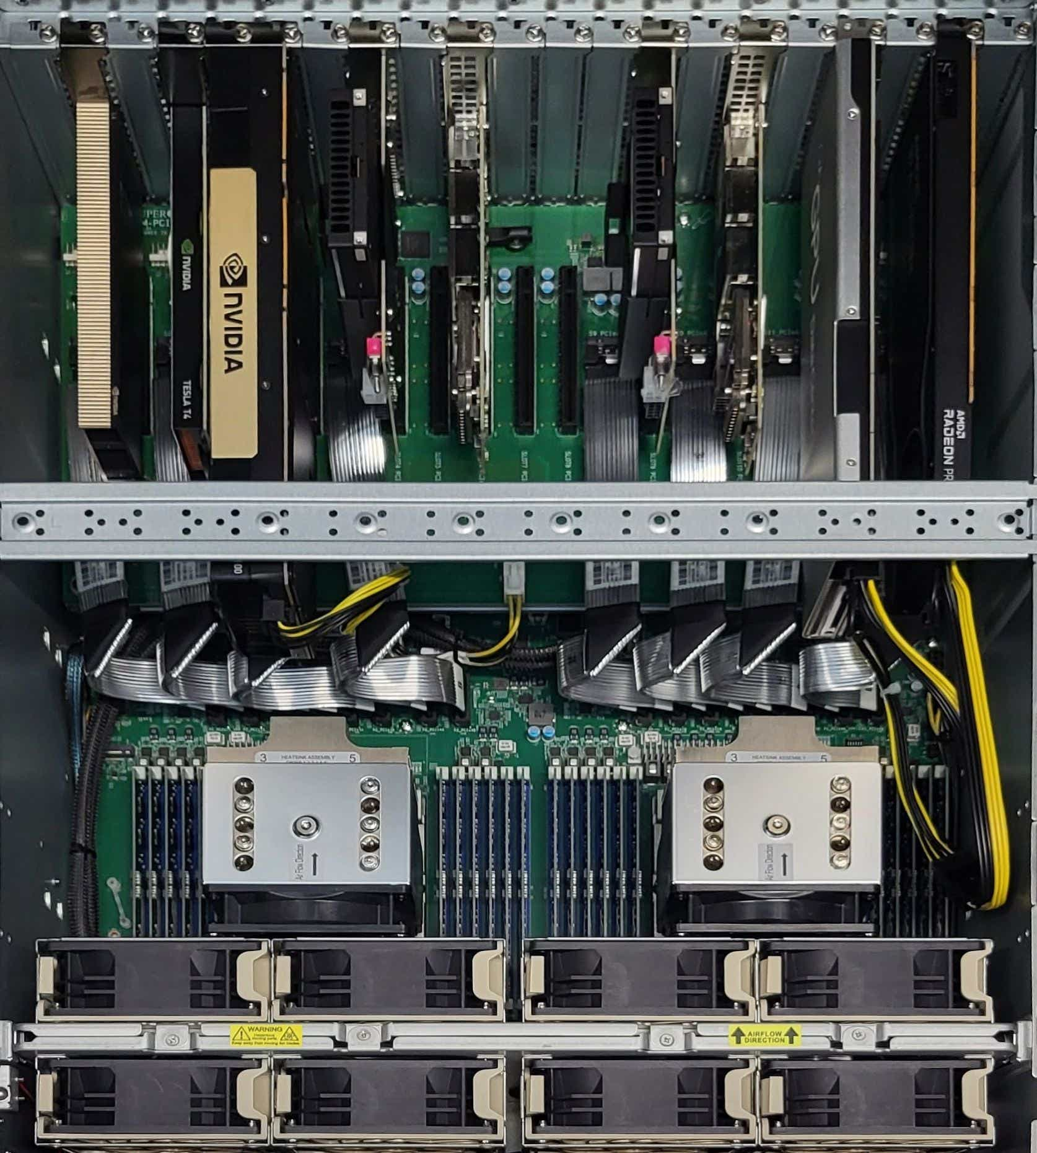
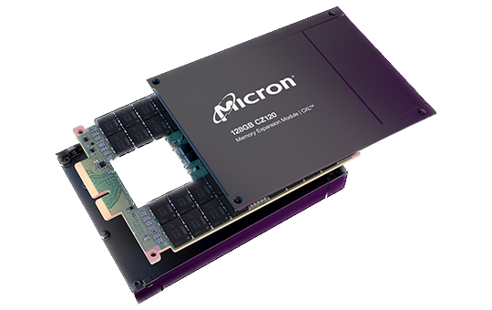

CMS Prototype
Supermicro server
2x AMD EPYC 9454 Genoa
  96 CPU cores, 460 GB/s peak bandwidth per socket
  24x 16 GB DDR5-4800 RDIMM
  PCIe gen 5.0 x128
2x Micron CZ120 256 GB
  CXL 2.0 compliant Type 3 memory expansion
  Support to CXL.mem transactions to attached DDR4 media
  and CXL.io for inband device management
  PCIe Gen5 x8 data lanes
  36 GB/s peak memory R/W bandwidth
Software:
  Linux RHEL 9.3 (kernel 6.8-rc4 Famfs-enabled)
CZ120
Provided by
openlab partner
https://github.com/cxl-micron-reskit/famfs
CXL host node at CMS USC.
Server supplied by E4 Computer Engineering
13/08/2024
CXL Memory Management for the CMS L1 Scouting System and Beyond
6
Notes:
"Our hardware prototype for the CMS L1 Scouting system consists of a Supermicro server equipped with two AMD EPYC CPUs
and two CXL Type 3 memory expansion devices.
This setup is designed to leverage the benefits of CXL technology, providing a robust platform for testing and benchmarking."

Slide 7
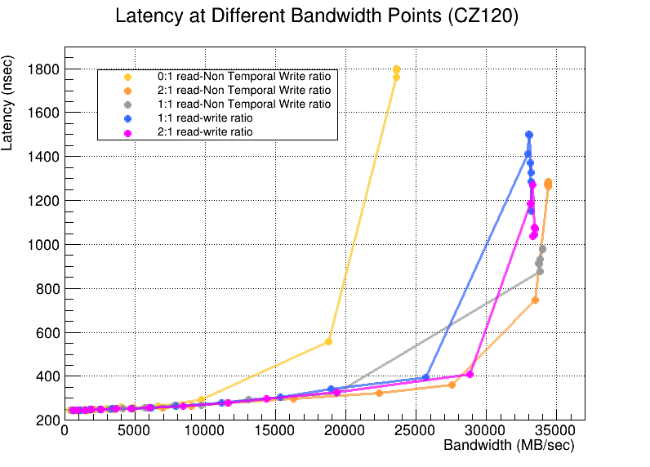
CZ120 Benchmark Results
MLC
NUMA mode (System-RAM)
Intel Memory Latency Checker (MLC)
Modified to support
DAX attached memory
Local DRAM: Lat. ~110ns, BW. ~32GB/s per channel
STREAM
STREAM in DAX mode using Famfs files
Multichase
Function | Rate MB/s | Avg time | Min time | Max time
Copy: | 20060.3 | 0.807057 | 0.797596 | 0.816493
Scale: | 19964.4 | 0.809129 | 0.801426 | 0.816096
Add: | 22306.9 | 1.082312 | 1.075900 | 1.101913
Triad: | 22317.9 | 1.081636 | 1.075371 | 1.090843
StressAppTest
Array size = 1G
13/08/2024
CXL Memory Management for the CMS L1 Scouting System and Beyond
7
Notes:
"To evaluate the performance of our CXL-enabled prototype, we conducted benchmarks using applications like >
>
Here, we focus on the results from MLC and STREAM.
MLC measures latency and bandwidth across different read/write operations, both temporal and non-temporal.
STREAM benchmark is used to calculate the memory bandwidth of a system in MB/s and the corresponding computation rate for simple vector kernels.
These benchmarks highlight the significant performance improvements achieved with CXL-enabled DAX devices."

Slide 8
Thank you!
Guilherme Paulino
gpaulino@cern.ch
ra117119@students.ic.unicamp.br
openlab partner
Notes:
The integration of these technologies is ongoing within the SCDAQ software for demonstration purposes.

Slide 9
Backup Slides
openlab partner

Slide 10
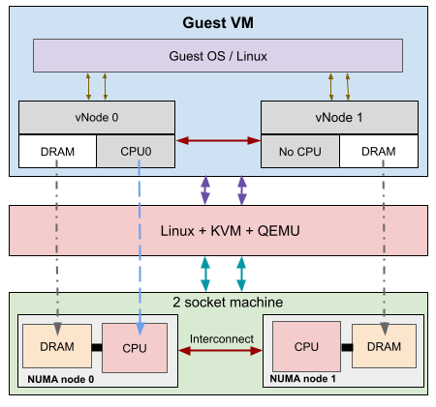
What’s next?
Next steps:
  Compare performance using shared files
    ramdisk + NFS
    CXL + Famfs
  Define benchmark test cases
    Workload type
    File sizes, access patterns, concurrency levels
  Emulation (QEMU + KVM)
    Multi-host environment
  Integrate SCDAQ software for demonstration
  System design
    FPGA-based AI Accelerators
emucxl Framework https://arxiv.org/html/2404.08311v1
13/08/2024
CXL Memory Management for the CMS L1 Scouting System and Beyond
10

