Slide 1


Statistic models of price dynamics
Chapter 8 of Mantegna and Stanley’s book
T. Csörgő^{1,2}
¹ Wigner RCP, Budapest, Hungary
² MATE KRC, Gyöngyös, Hungary
R. N. Mantegna and H. E. Stanley:
An introduction to econophysics
Correlations and complexity in finance
Chapter 8:
Levy stable model
Student’s t-distribution
Mixture of Gaussians
Truncated Levy flights
Comments on St. Peterburg paradox

Slide 2
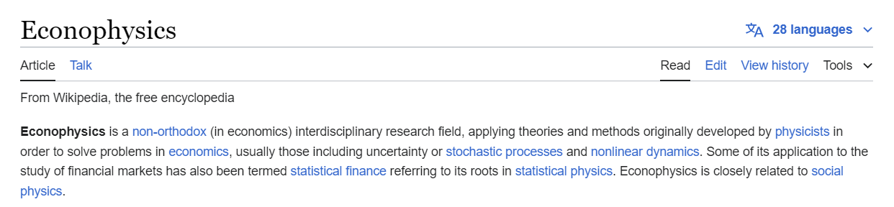
Motivation: News from Z. Lakner, S. Hegyi
Basic problem: develop models adopted to practice.
New input from Zoltán Lakner
New book from S. Hegyi:
Székely J. Gábor
Paradoxonok a véletlen matematikájában
2

Slide 3


News from S. Hegyi
Székely J. Gábor
Paradoxonok a véletlen matematikájában
3

Slide 4
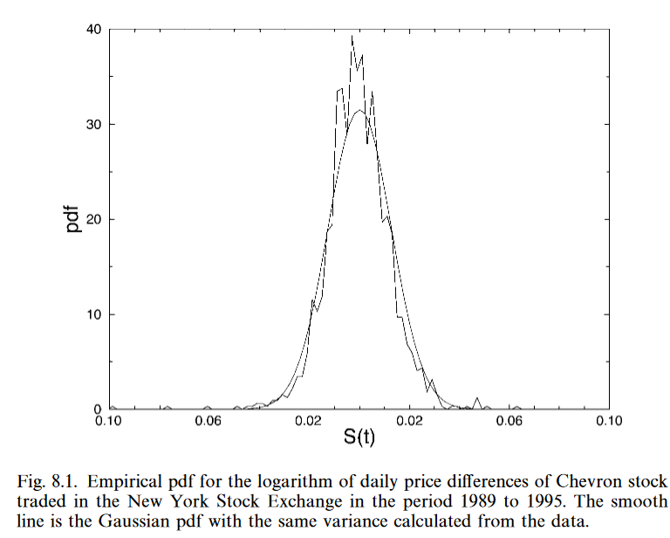
Stochastic models of price dynamics
Prices of financial assets have a stochastic nature.
Crutial for rational pricing of derivative products issued on it.
The full characterization of a stochastic processs requires the knowledge of conditional probablities of all orders:
A mission impossible.
Simplifying assumptions for stock price dynamics:
E.g.: ln Y(t) is a diffusive process, increments Gaussian distributed –
Results in a geometric Brownian motion model,
Good first approximation, but
Better/more detailed data have stronger peaks and heavier tails
= more leptocurvic.
4

Slide 5
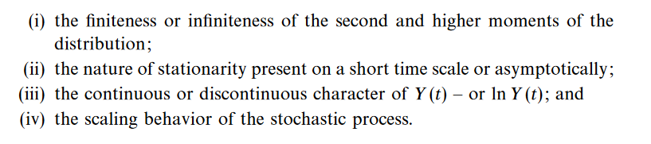
Chapter 8: examples for GGD
Similarly the famous Black and Scholes formula assumes Gaussian.
Several improvements, generalized Gaussians are available by now.
Some generalizations are based on the followings:
Examples for generalized Gaussian distributions (GGD):
8.1 Levy stable (non-Gaussian) model
8.2 Student’s t distribution
8.3 Mixture of Gaussians
8.4 Truncated Levy flight
5

Slide 6
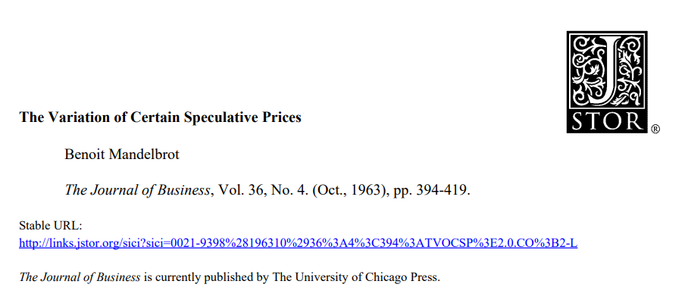
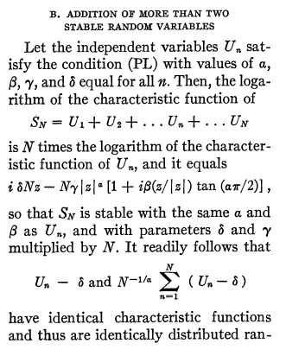
Section 8.1: Levy stable model
Proposed by B. Mandelbrot in 1963 for modeling cotton ln Y(t).
Seconded by Fama (1965)
Stable for convolution
Generalized central limit theorems
Infinite second moment for α < 2.
Infinite first moment for α < 1.
Gaussian is recovered for α = 2.
Top cited, paradigm shifting paper.
6

Slide 7
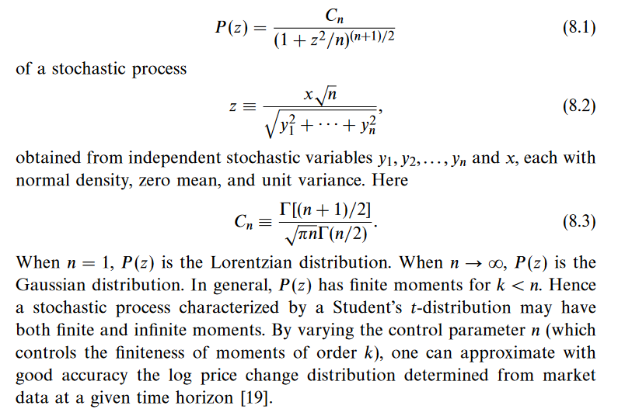
Section 8.2: Student’s t distribution
Proposed by P. K. Clark, Econometrica 41 (1973) 135-256
Finite k-th moment for k < n.
Both finite and infinite moments.
Shape not stable.
No scaling relations.
7

Slide 8
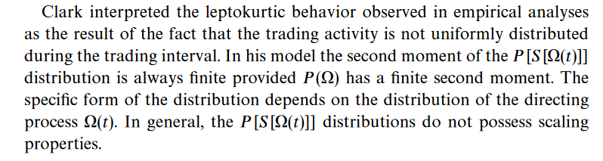
Section 8.3: Mixture of Gaussians
No scaling relations.
Not very interesting for us.
With sufficiently large number of mixed Gaussians, datasets with large number of peaks can be described.
8

Slide 9
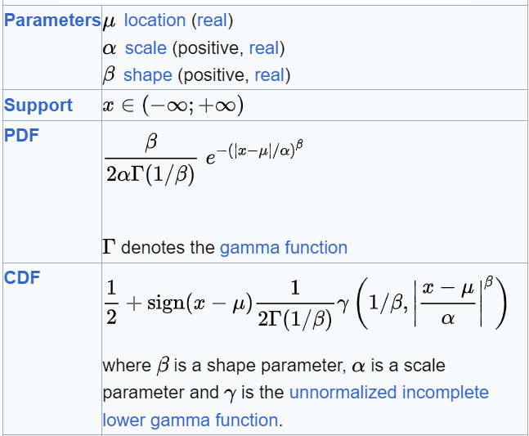
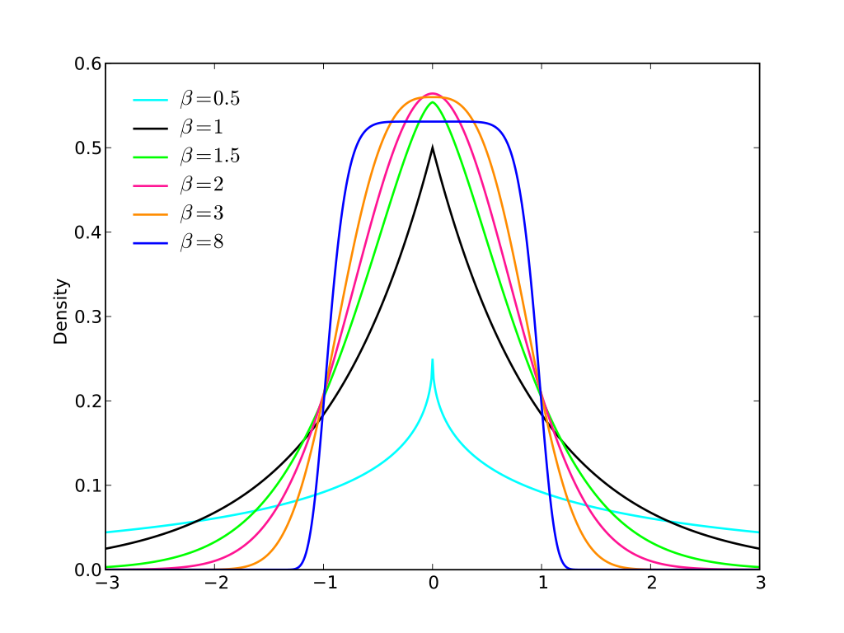
Added: Generalized Gaussian Distributions
Parameter β similar to Levy index of stability α for 0 < β ≤ 2,
but 2 < β is allowed,
in this case it is not a Fourier-transform of a positive definite probability density.
9
See: https://en.wikipedia.org/wiki/Generalized_normal_distribution

Slide 10
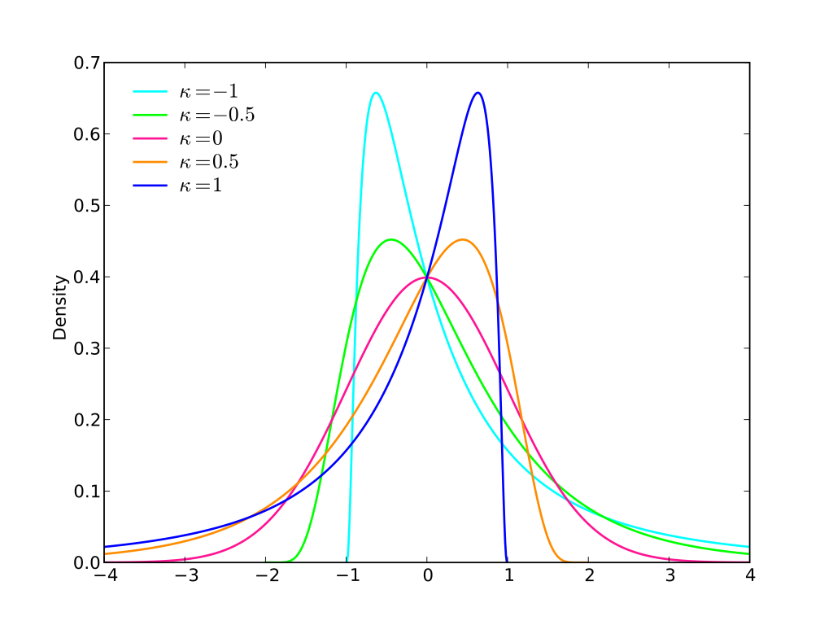
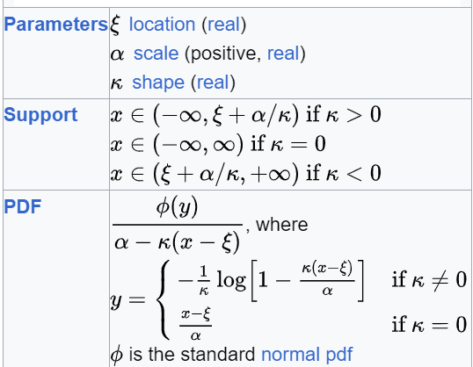
Asymmetric Generalized Gaussian Ds
Parameter κ similar to Levy asymmetry parameter β but -1 ≤ β ≤ 1,
But in this case support is finite if κ is non-vanishing, while
Levy asymmetric has finite support only if Levy β = ± 1.
Only location, scale and asymmetry but no exponent for the tails.
10
See: https://en.wikipedia.org/wiki/Generalized_normal_distribution

Slide 11
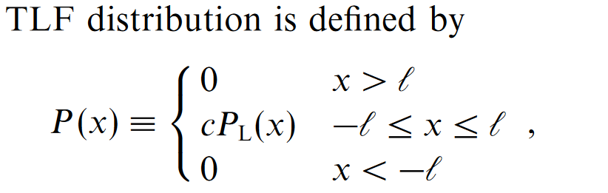
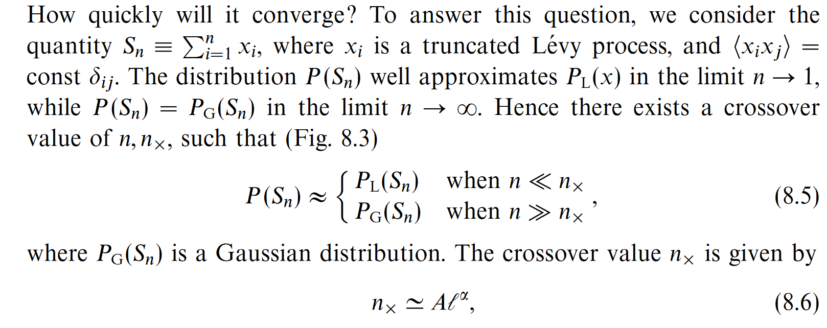
Section 8.4: Truncated Levy Flights (TLF)
Not stable for convolution.
It has finite means and variances: asymptotically Gaussian.
But how quickly?
11
Very interesting.

Slide 12
Section 8.4: Truncated Levy Flights (TLF)
Not stable for convolution.
It has finite means and variances: asymptotically Gaussian.
But how quickly?
12
Very interesting.

Slide 13
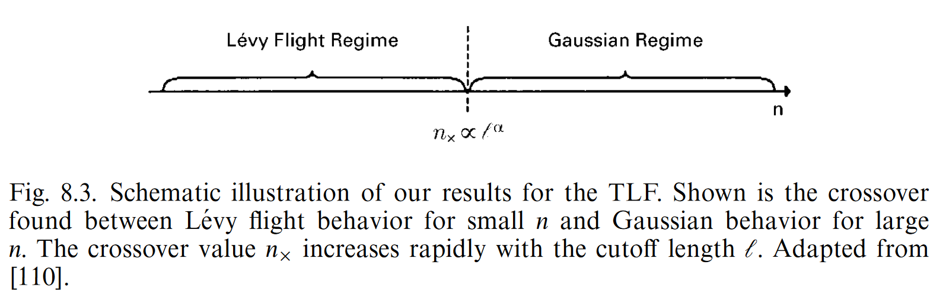
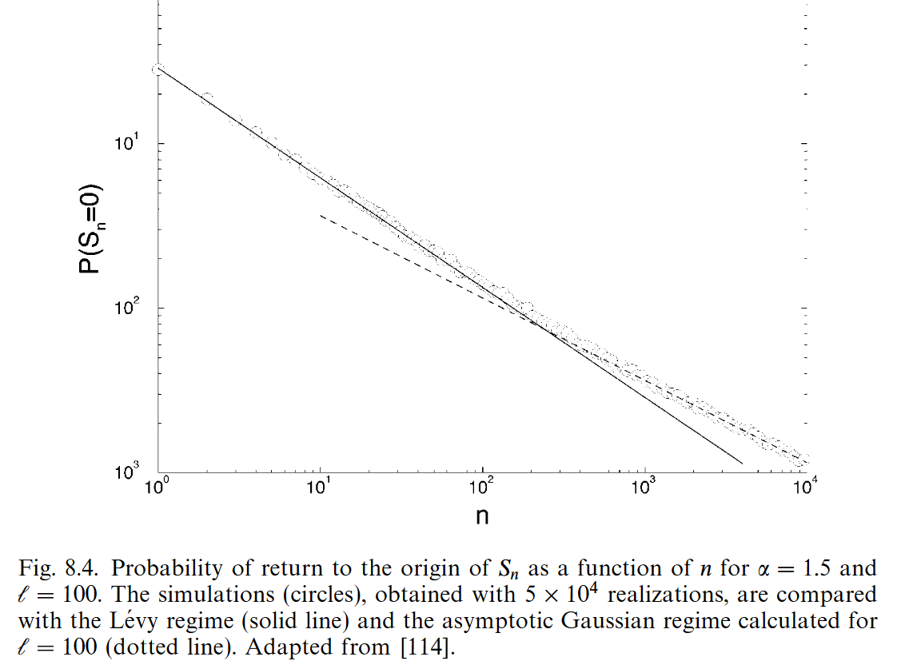
Section 8.4: Truncated Levy Flights (TLF)
[110] R. N. Mantegna and H. N. Stanley, Phys. Rev. Lett. 73 (1994) 2946
Two regimes, can be tested on data.
13
[114] R. N. Mantegna and H. N. Stanley, Physics Investigation of Financial Markets In: The physics of complex systems. Book issued by IOS Press, (1997) pp. 473-489.

Slide 14
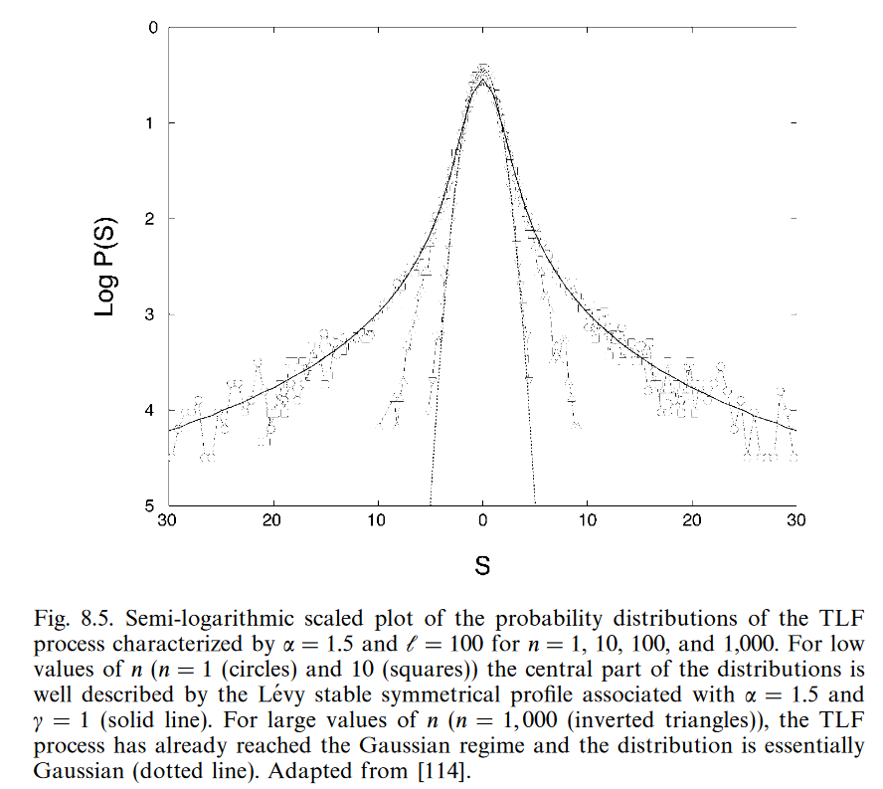
Section 8.4: Truncated Levy Flights (TLF)
Transition from Levy to Gaussian regime. From [114].
Very interesting: effect of truncation dominant for long term.
Similar effects for St. Peterburg
Paradox (for next time).
14
[114] R. N. Mantegna and H. N. Stanley, Physics Investigation of Financial Markets In: The physics of complex systems. Book issued by IOS Press, (1997) pp. 473-489.

