Slide 1
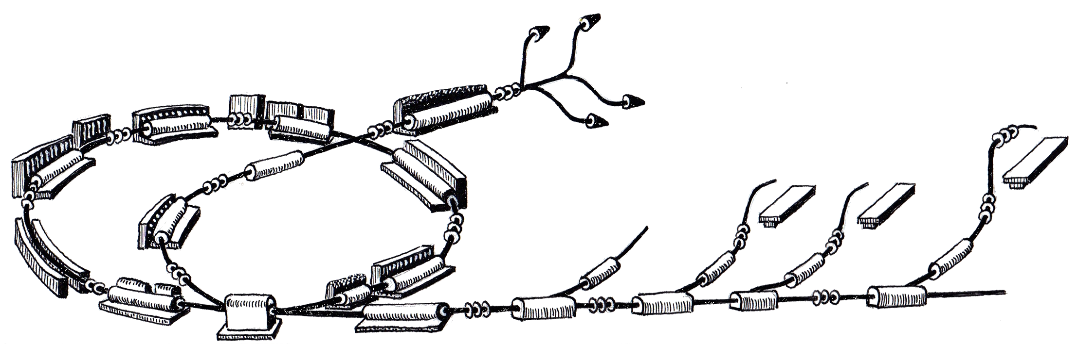
IWeek Achievements

Slide 2

MACS Column

Slide 3
MACS Column
Represents a Vertical cut through the control system
A test setup was assembled in December 2010 with Cosylab in 37-R-023 (MACS /RF lab)
The idea at the time was to:
  To validate if the chosen technology can meet the requirements
  to demonstrate development achievements of the last 3Qs of a year
  to set an example for a device integration
But We kept it alive and use it to validate our and Cosylab’s development to see how all the pieces work together, hence integration week

Slide 4
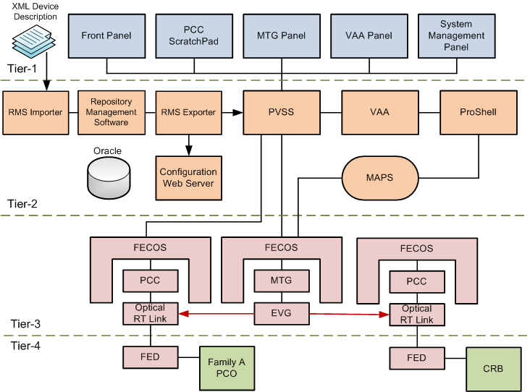
MACS Column

Slide 5
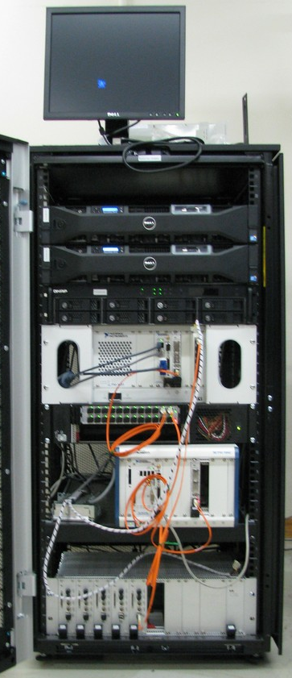
Macs Column Test Setup
FECOS
REDNET
MTS
MTG
MTR
PCC
PCC
FlexRIO
fiber link protocol
FED

Slide 6
Iweek Achievements

Slide 7
Where we are so far
We will have 7 IWeeks this year, roughly one each 2 months, 3 done 4 to go.
  February 21st-25th 2011
  April 11th-14th 2011
  May 23rd-27th 2011
  August 8th-12th 2011
  September 19th-23rd 2011
  October 31st - November 4th 2011
  December 12th-14th 2011

Slide 8

February Achievements
XML Device Description
PCC
ScratchPad
Front Panel
MTG
Panel
VAA
Panel
PVSS Control
Panels
Tier-1
RMS Importer
RMS
RMS Exporter
PVSS
VAA
ProShell
PCC set-point generation
Events from MTG to PCC
First test of the VAA
PVSS Front Panel
Synoptics Panel
VAA PVSS Panel
Oracle
Configuration Web Server
MAPS
Tier-2
FECOS
FECOS
FECOS
PCC
MTG
PCC
Tier-3
Optical
Link
EVG
Optical
Link
FED
Family A PCO
CRB
FED
Tier-4

Slide 9
IWeek April
XML Device Description
PCC
ScratchPad
Front Panel
MTG
Panel
VAA
Panel
PVSS Control
Panels
Tier-1
RMS Importer
RMS
RMS Exporter
PVSS
VAA
ProShell
First commands to MTG through SIM
VAA integrates with MTG
Basic FECOS device
FECOS XML configuration
FTP PVSS extension
RMS importer
First device definition (VAA)
MTG and PCC hardware was not used (simulated in software)
Oracle
Configuration Web Server
MAPS
Tier-2
FECOS
FECOS
FECOS
PCC
MTG
PCC
Tier-3
Optical
Link
EVG
Optical
Link
FED
Family A PCO
CRB
FED
Tier-4

Slide 10
IWeek May
XML Device Description
PCC
ScratchPad
Front Panel
MTG
Panel
VAA
Panel
PVSS Control
Panels
`
Tier-1
XML Definition of PCC and MTR devices
RMS exporter (ASCII exporter)
FECOS dynamic loading of devices
Heinzinger Family A PCO integration
PCC generation of sequences of set-points on events (events simulated in the MTR FPGA)
1 MTS slot all commands implemented.
Full allocation VAA, MTG, PVSS panels, real PCC
RMS Importer
RMS
RMS Exporter
PVSS
VAA
ProShell
Oracle
Configuration Web Server
MAPS
Tier-2
FECOS
FECOS
FECOS
PCC
MTG
PCC
Tier-3
Optical
Link
EVG
Optical
Link
FED
Family A PCO
CRB
FED
Tier-4

Slide 11
Test plan for August
Multiple instances of PCCs running in the same crate
PVSS distributed project
Full MTG:
  5 slots
  Final SIM interface
  REDNET hardware
  acknowledgement mechanism
  heartbit.
RMS Shared Variable Engine exporter
Column “test run”

Slide 12
PCC
ScratchPad
Front Panel
MTG
Panel
VAA
Panel
PVSS Control
Panels
`
Tier-1
RMS Importer
RMS
RMS Exporter
PVSS
VAA
ProShell
Oracle
Configuration Web Server
MAPS
Tier-2
FECOS
FECOS
FECOS
PCC
MTG
PCC
Tier-3
Optical
Link
EVG
Optical
Link
FED
Family A PCO
CRB
FED
Tier-4

Slide 13

Conclusions

Slide 14
Tests are performed in vertical cut through the system to see how all the things work together.
Things are far from finalized, they are (still) changing a lot
But a lot of pieces of the control system are here already and they talk to each other! (some tiny massaging involved)
Less and less use of labview panels and less and less manual intervention (RMS, PVSS panels)

Slide 15
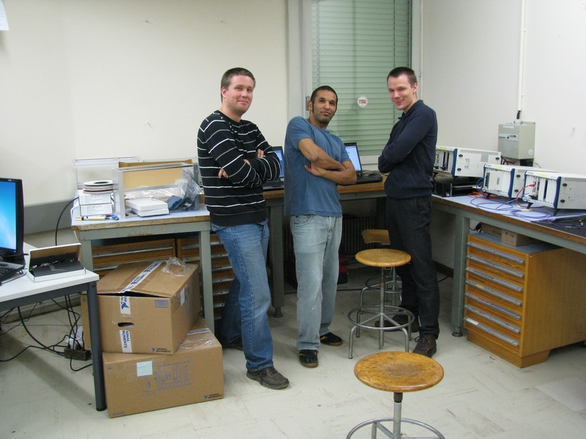
That’s it!

