Slide 1
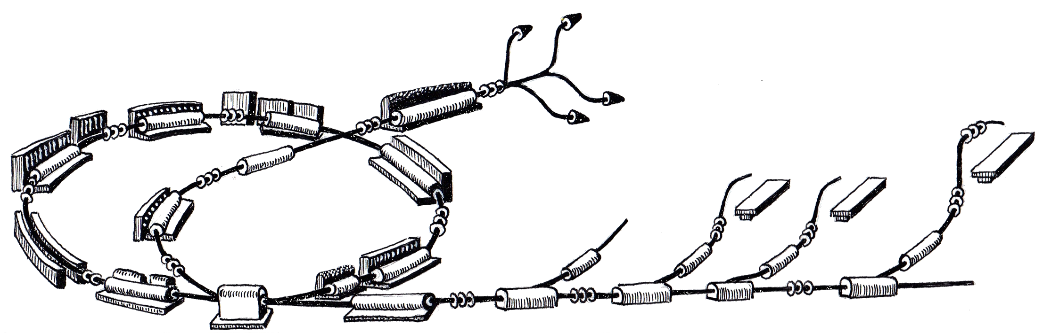
WP CO
Progress and Status Q2 2011
June 27th, 2011
Johannes Gutleber
R. Gutleber

Slide 2
Summary
Development is advancing well with resources
No contingency in schedule
Continuous integration has highest priority
2011 – The year in which we conclude!
Core functionality by end of year

Slide 3
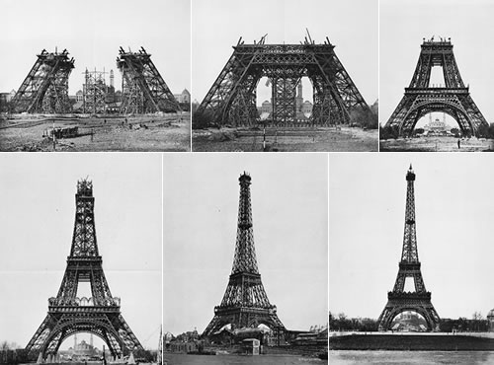
Progress
Report

Slide 4
Next Project Milestones
+4m (Oct. 2011) – Control system setup ready for source tests
+6 m (Dec. 2011) - ITS beam from source to spectrometer
+9 m (Mar. 2012) – ITS beam to RFQ
+15m (Sept. 2012) – Control system installation begins
+1.5y (Jan. 2013) – Control system ready for testing
March 2013 – Accelerator ready for commissioning
  Requires complete control system

Slide 5
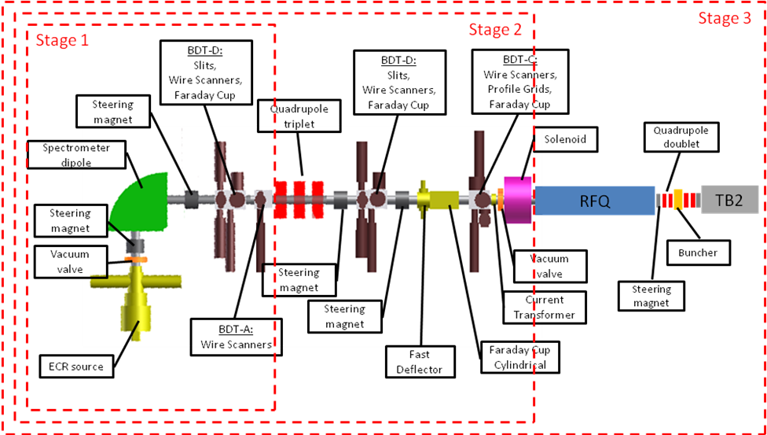
Injector Test Stand

Slide 6
Current Phase (Elaboration)
Focus on requirements consolidation, architecture, design
Implementation of core functionality
Initiate deployment definition

Slide 7
Project Organisation
Accelerator Management
M. Benedikt, A. Wrulich
Injector Coordination
W. Pirkl
Synchrotron/HEBT Coordination
U. Dorda
IBTS Coordination
R. Mayer, S. Vatnitsky, A. Wrulich
Project Planning and Tracking
A. Fabich
Consultant
EBG employee
Student
Work package leader
Junior partner
Purchasing Officer
S. Mitchell
Technical Safety Officer
Administrative Support J. Schueler
Risk Management
work packages
Ion Beam Therapy System (IBTS)
Source(s)
Linac
Radio-Frequency
Optics/
Dynamics
Beam Diagnostics
Vacuum
Power
Special Magnets
Controls
Radiation Protection
Magnets
Interception Devices
Integration
Gantry
BDS
PAS
MSS
W. Pirkl
E. Sargsyan
H. Grill
B. Lutzer (10/11)
N. Chatzigeorgiou (9/11)
U. Dorda
P. Bryant
H. Schönauer
F. Moser
M. Jimenez
G. Hulla
J. Wallner
Jan Borburgh
T. Kramer
T. Stadlbauer
F. Mueller (???)
H. Vincke
E. Feldbaumer
L. Jaegerhofer
O. Aberle
K. Asvestas
D. Grenier
A. Koschik
O. Nairz
P. Trnkova
O. Nairz
M. Schokker
S. Trovati
M. Palm
S. Vatnitsky
O. Nairz
P. Trnkova
F. Coreth
L. Penescu
W. Pirkl
G. Kotzian
J. S.-Quesada
F. Osmic
A. Gyorgy
S. Schwarz
A. Kerschbaum
M. Repovz
S. Engelhardt
J. Bosser
A. Beuret
I. De Cesaris
P. Fraboulet
M. Veenstra
J. Gutleber
R. Moser
M. Marchhart
A. Brett
C. T. De Matos
M. Thonke
M. Hager
H. Pavetits
J. Junuzovic
T. Zickler
M. Stockner
C. Siedler
A. Beaumont
P. Schwarz (8/11)
B. Langenbeck
T. Tortschanoff
B. Nicquevert
W. Rupprecht
T. Hauser
F. Luiz
D. Gabriele
P. Landrot
S. Marinics
S. Pelletier
S. Bailly
J. Heimann
G. Magrin

Slide 8
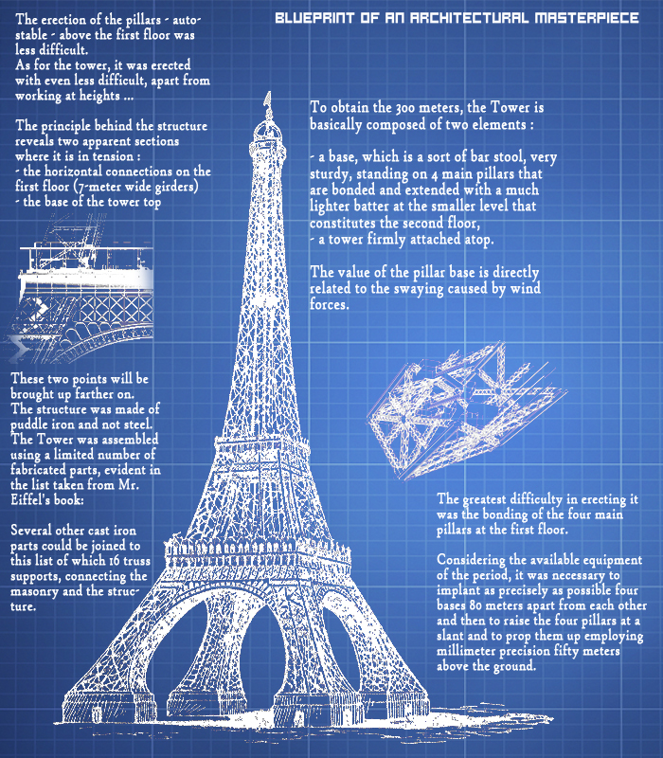
Development on
Progress

Slide 9
Architecture Overview

Slide 10
Plan until Q4 2011

Slide 11
Current Status

Slide 12
Roadmap Towards Commissioning
12/2010
Column demo
09/2011 ITS intermediary release
12/2011 ITS+CRB column
06/2012 Pre-release
07/2012 Start IT installation
12/2012 Functional release
10/2012 Start CO installation
03/2013 Commissioning
2010
2011
2012
2013
2014

Slide 13

Integration Weeks (iWeek)
Validate components and concepts continuously!
Learn using our system!
Identify gaps!
Run the system!
Test Pilot
Big Success!
To be continued…

Slide 14
Organization of iWeeks
One week at distance of about five weeks
  Step-by-step integrate all available components
  Operate vertical column (tier 1 to tier 3)
Planning and Execution
  Plan prepared and communicated to entire team
  Integration carried out by core team at CERN
  Results are documented in a record and communicated
  Results must be be taken into consideration for developments

Slide 15
iWeek Schedule 2011
6
4
2
7
5
1
3
PR-110328-a-JGU, March 28th, 2011
J. Gutleber
15
15

Slide 16
Column

Slide 17

Detailed
Status

Slide 18
Operations Concepts
Started with Ion Source
  Idle operation, stability feedback
Initiated specifications on how to operate individual devices
  UDO will compile use-cases
Cycle Configuration Generator
  MHA started to work with MAD-X
  Frequent sessions with UDO on needs
  Start with C# API and library to generate timing/PCO sequences

Slide 19







Status of Work with Other WPs
WP/Subsystem | Requirements | Design | Implementation | Integration
Power
Spec. Mag. (BTS)
Vacuum
Injector RF
Synchrotron RF
BDI
BID
Magnets
Sources
MSS
IBTS (TCS,BDS)
Building
IT

Slide 20
What we have Today
Completed and frozen frozen architecture
MTS real-time event distribution transport layer
PCC real-time links, custom hardware, Family A PCO
FECOS core and documentation (RT programming framework)
PVSS/C# integrated, additional tools (STEP viewer, libs) done
Virtual Accelerator Allocator implemented to large extent
Generic GUIs (FrontPanel, ScratchPad, VAcc/WSE)
PVSS script libraries for state-driven devices
ProShell architecture and code skeleton
RMS adapted 70% - remain extensions (cable, rack, elements)
RMS importer and exporter for PVSS, OPC

Slide 21
Planning 2011
Cosylab
  CWO-3 running until July 2011
  Planning for CWO-4 (12/2011) delayed!
Working sessions on schedule with WPs for 2011
  SRC, VAC, PO, INJ/RF done
  Building infrastructure, IT done
  Integration (cabling, racks) many items addressed, but work delayed
  Agreement on principle of development with BD, done
Remain to be defined for 2012
  BTS, Sync/RF, BD, BID, RP, operations, integration
  Interface medical systems
  Ion Beam Therapy System
  what else? – please get in contact!

Slide 22

Summary and outlook

Slide 23
Conclusions
Good progress made with continuous integration (iWeeks)
Good progress made in completing requirements
  Sources, injector RF
Schedule remains tight
NEXT STEP - ITS RELEASE 09/2011

