Slide 1

Power Converter Controller
Status overview
Luka Sepetavc luka.sepetavc@cosylab.com
Rok Stefanic rok.stefanic@cosylab.com
the best people make cosylab

Slide 2
Outline
Quick overview
1) What has been done
2) What is working
3) What needs to be done
Notes:
-very quick overview of the system
-see what we have developed
-what remains to be done in future CWOs

Slide 3

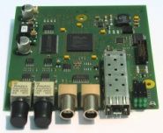
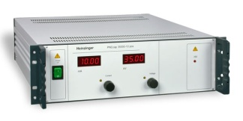
PCC – quick overview
Notes:
PXI controller runs LabVIEW Real-Time
accepts commands from the PVSS, sequences from the webserver, receives events from the MTG
has FlexRIO FPGA Modules with custom developed Adapter Modules
FEDs connect to the PCC over an real-time optical link
FED has different interfaces to which different types of PCOs connect to
PCC generates single set-points or set-point sequences, takes measurements from PCOs etc.

Slide 4
What has been done – legend
GREEN – task went well
ORANGE – slight issues with the task
RED – show-stopper

Slide 5
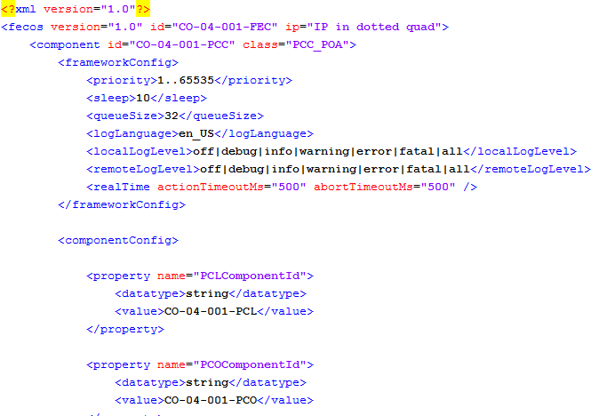
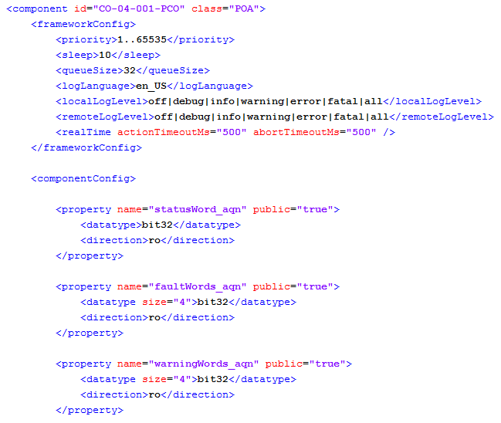
1) What has been done
Fully configurable PCC with XML
  multiple instances
  select fiber channels
PCO driver skeleton and PCO basic device
  PCO has its own component
Notes:
PCC can be fully configured with the use of XML: how many active fiber channels it has, which Power Converter connects to which channel etc.
We have implemented PCO driver skeleton which is the basis for all specific drivers (family A, CRB, special magnet Power Converters...)
We have implemented PCO basic device component which represents each PCO to the operator/WinCC – PCO is configurable with XML parameters and over shared variables (datapoint elements)
@ previous MW: only design, now we also have implementation

Slide 6
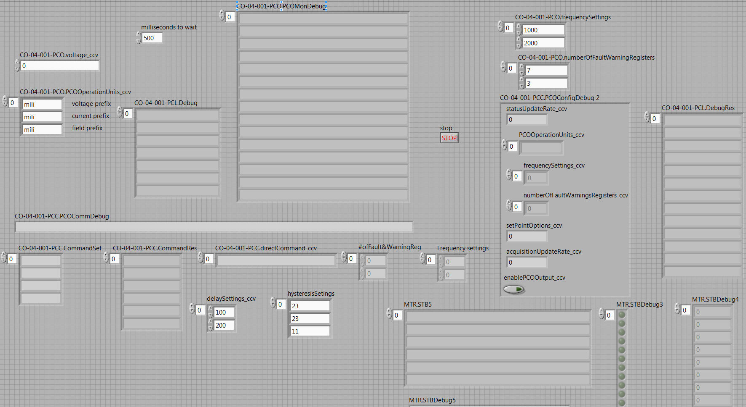
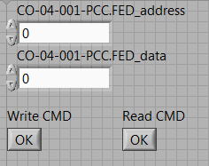
1) What has been done
Interface between WinCC and PCC/PCO
  configure and monitor PCC/PCO
  expert GUI – avaliable are all datapoint elements
Notes:
-WinCC-PCC interface is composed of shared variables (datapoint elements)
-using our expert GUI we can monitor/controll all available shared variables in the PCC system

Slide 7
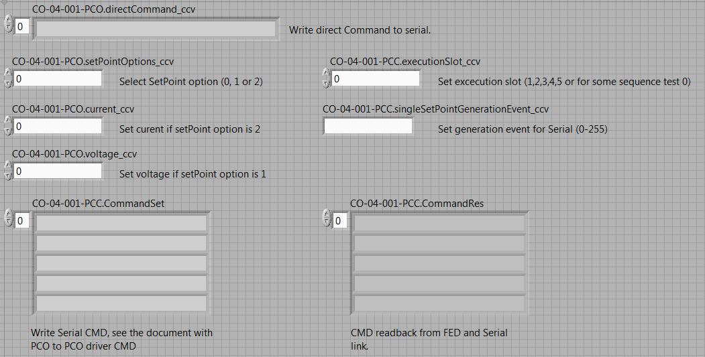
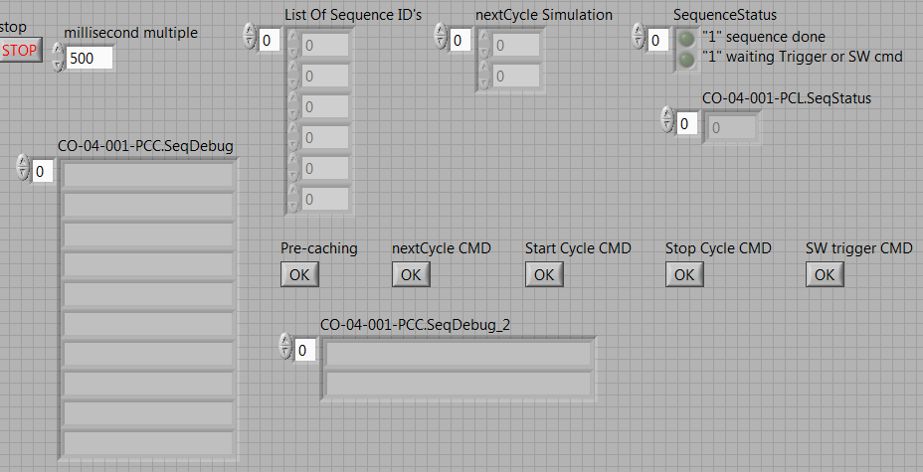
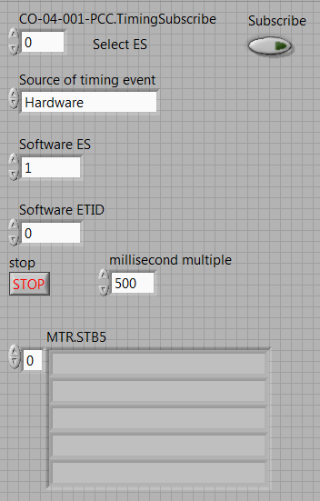
1) What has been done
Single set-point generation
  trigger on real timing events
Set-point sequence generation
  loading, pre-caching
  trigger on real timing events
Timing simulator
  emmit software events
  arm for real timing events
Notes:
-Single set-point generation using the agreed WinCC datapoint elements (example of our WinCC emulation GUI)
-Set-point sequence generation using the agreed DPEs (emulatiom GUI)
-Timing simulator for configuring how PCC accepts events

Slide 8
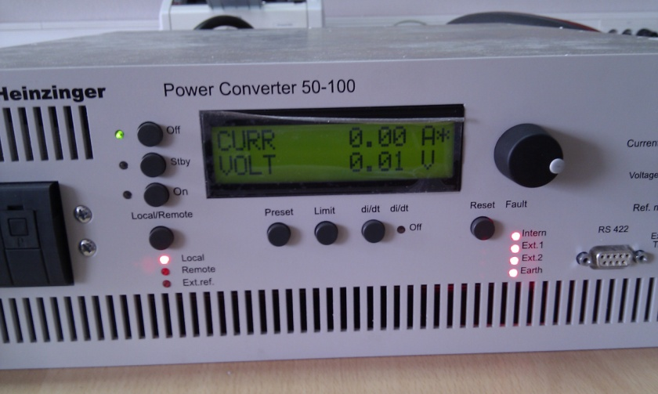
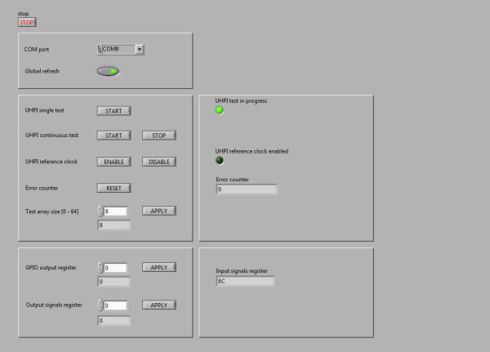
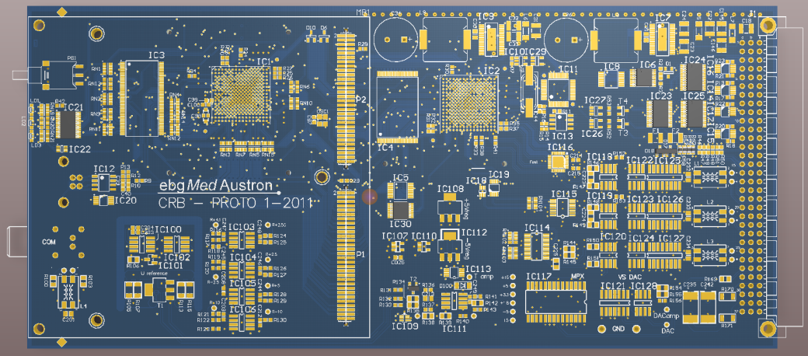
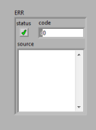
1) What has been done
Basic family A PCO driver
  waited for family A PCO
  buggy firmware in PCO
  successfully configure and
    apply voltage over PCC
CRB support in FED, LabVIEW test app
  waited for CRB
  CRB boots and responds to commands
Family A PCO - Heinzinger
Notes:
We have implemented basic support for family A driver but had to wait quite some time to receive an actual Power Converter which can be a bit tough to work with (buggy)
Implemented CRB support in FED and developed a testing application in LabVIEW – had to wait quite some time to receive CRB prototype to work with

Slide 9
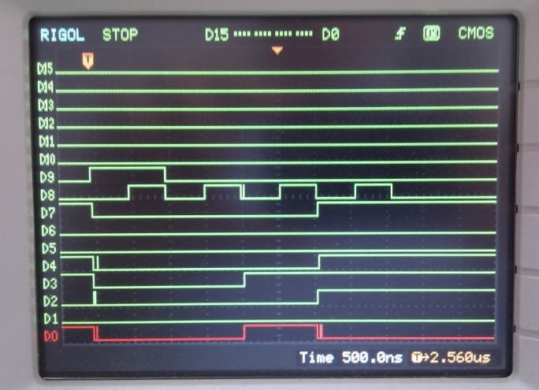
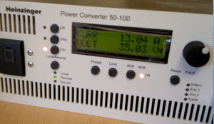
2) What is working
Single set-point generation
Set-point sequence generation
  verified over SCSI (debug) interface
family A PCO basic integration
  applying voltage over the MACS column
taken from an actual video ☺
Notes:
Single set-points and sequences fully functional, can be triggered with real timing of software event
Screenshot from the SCSI interface – can monitor actual values that come over fiber to Front End Devices
We have been able to successfully apply voltage on family A PCO through the whole MACS column – using operator’s GUI emulator

Slide 10
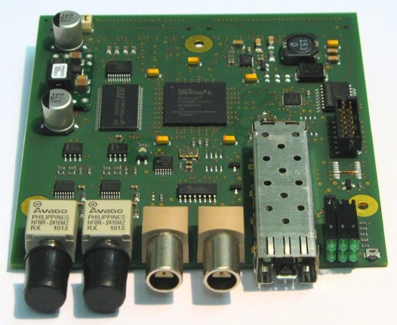
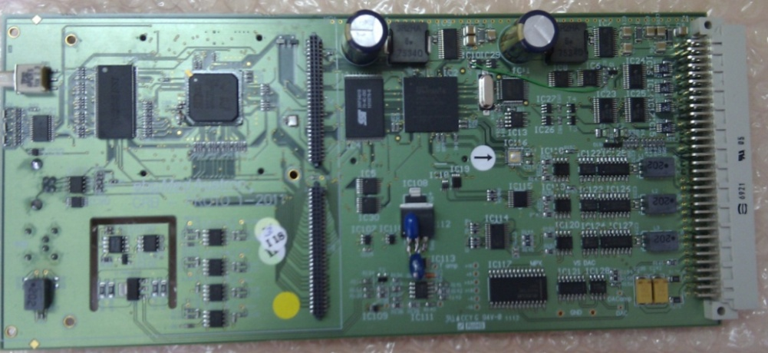
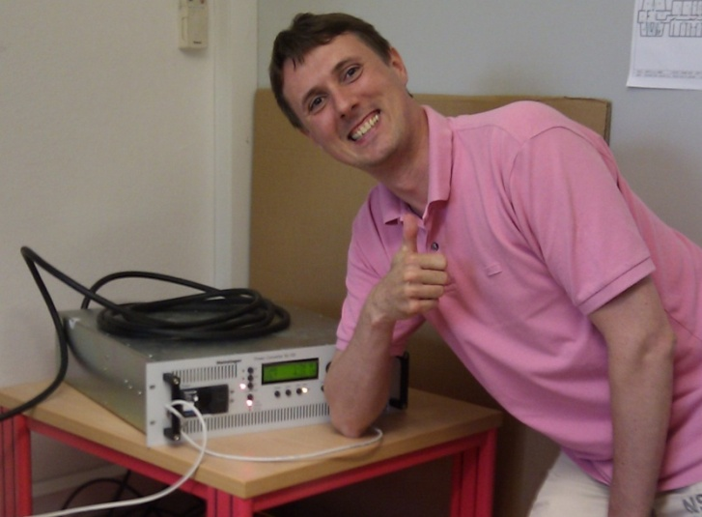
3) What needs to be done
Finalize Integration test with CRB prototype
  verify interface between FED and CRB
Finalize family A Power Converter driver
  test with an actual PCO
+
FED
CRB
Notes:
-We have to finish integration of FED and CRB (verify that interfaces between them work)
-We have to finalize family A Power Converter driver (e.g. initialization process, configuration process, command-response handling, timeouts, error handling)

Slide 11
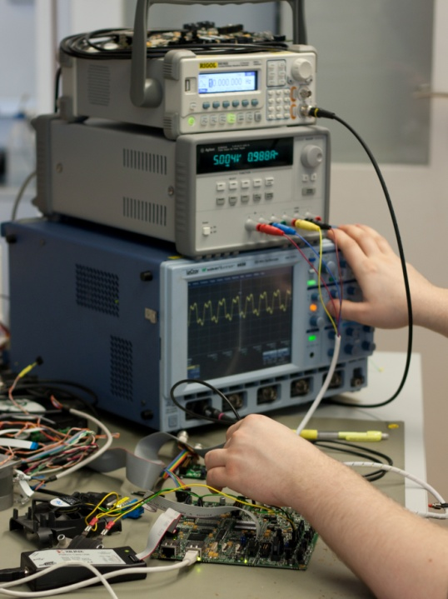
3) What needs to be done
Finish test cases
  PCC
  FED
  family A Power Converter
Documentation
  Family A driver release notes and manual
  Test reports
Notes:
We will carry out test cases for PCC, FED and family A PCO
We will finish documentation

Slide 12
Acceptance planning
~20 Trac tickets are still open on PCC project
Responsible people will have to find time for acceptance
This will happen at the end of July, begin. of August (iWeek)
Notes:
-23 tickets are still open on the PCC project
Depending on the nature of task, some will require more attention, others less
Reasponsible people from MedAustron team on this tickets will have to plan their time in order to review and accept them
Tickets will get implemented/resolved at the end of July and beginning of Augutst when next integration week is taking place

Slide 13
Questions
☺

