Slide 1

REDNet - Status overview
Rok Stefanic (rok.stefanic@cosylab.com)
the best people make cosylab
Notes:
REDNET – Real Time Event Distribution Network
Sistem za prenasanje timing eventov in podatkov (komand) v hard real time-u

Slide 2
Outline
Quick overview
1) What has been done so far
2) What is working
3) What needs to be done
4) Acceptance planning

Slide 3
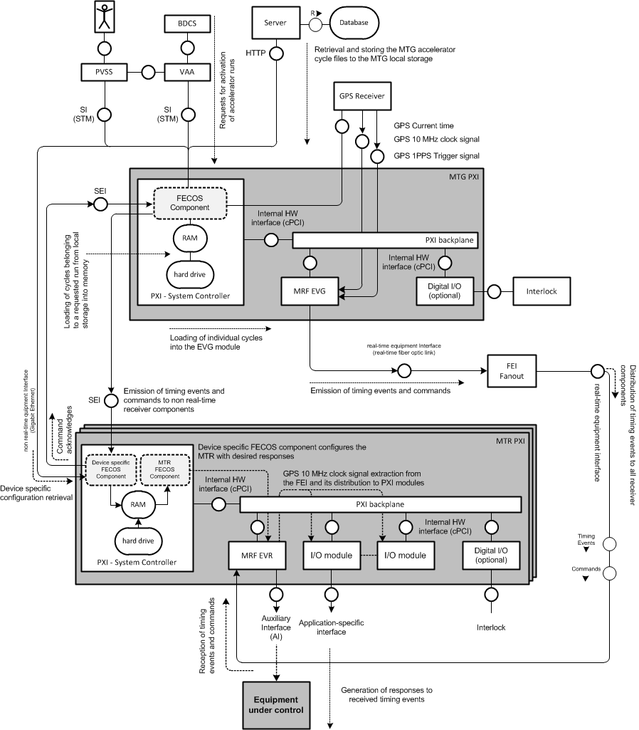
Quick overview
VAA Activates a Run (+ run file)
MTG redistributes the Run file with a list of cycles
MTG Generates timing events from the requested cycle
VAA requests the generation of a cycle from the run list
Receiver components generate responses
(digital signals, irq, triggers…)
Notes:
-VAA (Virtual Accelerator Alocator) – activates run (composed of multiple accelerator cyles, and each cycle of events)
-MTG lets everybody know about whats going to happen (which cycles are going to be generated)
-after that MTG receives acknowledgments from all receivers-devices
-VAA requests actual generation of cycles
-MTG start generating cycles by emitting events over fiber optics and MAPS
-MTR generates responses to events (either backplane, GPIOs, software…)

Slide 4
1) What has been done so far
GREEN – task went well
ORANGE – slight issues with the task
RED – task was underestimated, more effort spent

Slide 5
1) What has been done so far
Timing generator
  Configuration
    Timing generator configuration from XML
    Configuration from SV
  Communication
    Interface between VAA and MTG
    Acknowledge mechanism
    Real-time and non real-time interfaces
  Sequence generation
    Processing of all sequence related files
    Generation of sequences (SW and HW part)
    Cycle synchronization to Heartbeat timing event
  MRF EVG HW Support
    Generation of sequences in hard real-time
Notes:
-completed MTR arch.
-this fml actually defines shared variables through which it is configured, no static parameters
-interface through which e.g. PCC can configure MTR on the fly
-(!) not yet finalized

Slide 6
1) What has been done so far
Timing receiver
  Reception of timing events and commands
  Generation of sequences locally on MTR
    Asynchronous timing events
    Periodic events (heartbeat timing event)
  Response generation
    All responses can be generated
      Slots 3 and 4 can not be used at the moment for STB & STL
    Support for LLRF
Notes:
-completed MTR arch.
-this fml actually defines shared variables through which it is configured, no static parameters
-interface through which e.g. PCC can configure MTR on the fly
-(!) not yet finalized

Slide 7
1) What has been done so far
Test cases and testing
  Only half done so far
  A lot of time spent on implementation

Slide 8
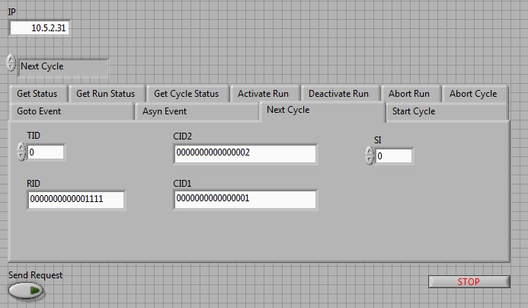
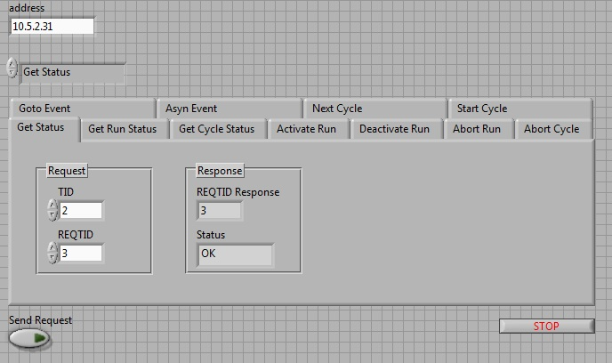
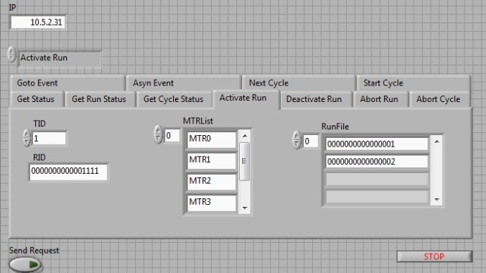
2) What is working
Timing generator
  Full receiver configuration
    from shared variables
    XML files
  SIM interface is fully
  functional
Notes:
-MTR is finished
-SW injection used for simulating MTG when it is not phisicaly present in the system
-10 MHz clock – used for sychronizing the PCC
-MTR configured with FECOS events on the fly and over shared variables during configuration phase (configure command)

Slide 9
2) What is working
Timing generator
  Entire chain for sequence generation is implemented
    All files (.etl, .dcl, .tsq) are processed
  Emission over RTEI and NRTEI
    Timing events
    Commands
  Monitoring
    Detailed generator’s status is available through SV or SI
Notes:
-MTR is finished
-SW injection used for simulating MTG when it is not phisicaly present in the system
-10 MHz clock – used for sychronizing the PCC
-MTR configured with FECOS events on the fly and over shared variables during configuration phase (configure command)

Slide 10
2) What is working
Main Timing Receiver
  Full receiver configuration
    by other FECOS components
    from configuration in shared variables and XML files
  Generation of responses to received timing events on all interfaces
    Auxiliary interface
    Software IRQ
    Shared real-time trigger
    Shared trigger lines
  SW injection of timing events from LV
  10MHz clock distribution
    MRF EVR extracts clock signal from optic link and distributes it over PXI backplane to other cards (PCC FlexRIO Modules)
Notes:
-MTR is finished
-SW injection used for simulating MTG when it is not phisicaly present in the system
-10 MHz clock – used for sychronizing the PCC
-MTR configured with FECOS events on the fly and over shared variables during configuration phase (configure command)

Slide 11
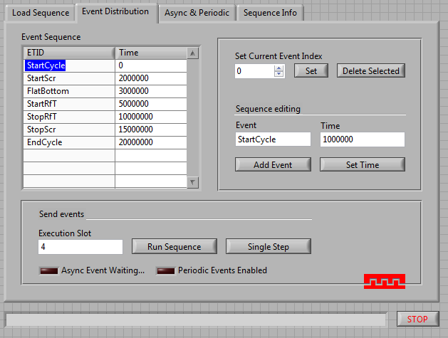
2) What is working
Main Timing Receiver
  Sequence generation on receiver
Notes:
-MTR is finished
-SW injection used for simulating MTG when it is not phisicaly present in the system
-10 MHz clock – used for sychronizing the PCC
-MTR configured with FECOS events on the fly and over shared variables during configuration phase (configure command)

Slide 12
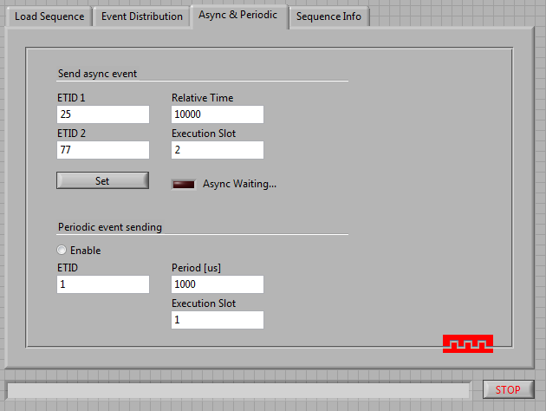
2) What is working
Main Timing Receiver
  Emission of periodic and asynchronous events
Notes:
-MTR is finished
-SW injection used for simulating MTG when it is not phisicaly present in the system
-10 MHz clock – used for sychronizing the PCC
-MTR configured with FECOS events on the fly and over shared variables during configuration phase (configure command)

Slide 13
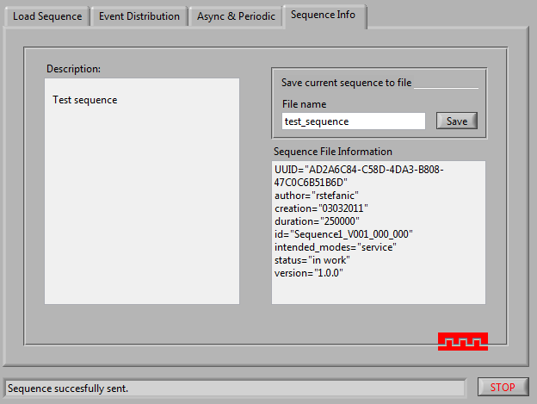
2) What is working
Main Timing Receiver
  Editing sequences during operation
Notes:
-MTR is finished
-SW injection used for simulating MTG when it is not phisicaly present in the system
-10 MHz clock – used for sychronizing the PCC
-MTR configured with FECOS events on the fly and over shared variables during configuration phase (configure command)

Slide 14
3) What needs to be done
Implementation
  Resolve issues with emission over RTEI
Documentation
  Design documentation shape-up
  Test cases
Scratchpad support on timing generator
  almost done
Carrying out test cases
  Test reports

Slide 15
4) Acceptance planning
Deliverables in the following period
May | W1 |  | 913 | 927
 | W2 |  | 914 | 926
 | W3 |  | 928 | 930
 | W4 |  | 953 | 932 | 929
June | W1 |  | 959 | 956 | 954
 | W2 |  | 934 | 962 | 963
 | W3 |  | 931 | 933
 | W4 |  | 968 | 958 | 967
July | W1 |  | 961 | 964 | 965 | 966 | 952
 | W2 |  | 957 | 960 | 997 | 998
 | W3 |  | 996 | 999 | 1000 | 1001 | 1002 | 914
Notes:
This is how REDNET will progress over the following months. First the MTR is being finalized, the MTG development follows and at the end, all the tests and reports will be provided.
The design documentation will be written and finalized during MTR and MTG development when all the requests are accepted and can be put into the document.

Slide 16
4) Acceptance planning
~20 Trac tickets are still open
  Not all need reviewing
Responsible people will have to find time for acceptance
This will happen in second half of July

Slide 17
Thank you for your attention
Questions?

