Slide 1
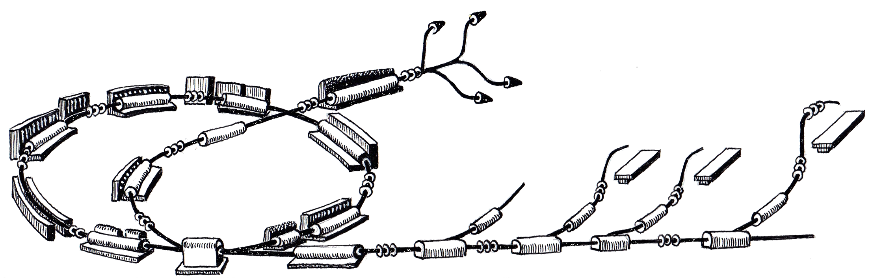
Guidelines for Graphical User Interfaces
Operation Panels
June 27th, 2011
Johannes Gutleber
R. Gutleber

Slide 2
Types of GUIs
Supervisory Panels
  For Operations
  WinCC OA
ProShell Procedures
  For machine development (machine physics mode)
  Interactive applications
  C# WPF
Expert applications
  For operations
  Custom applications
Third party
  Existing applications

Slide 3
Standards and Applied Guidelines
EN 60601-1-1 & -8 apply for medical device parts
  To date not possible to make absolute separation concerning GUIs
  Consequently, norm applies to all operation GUIs
  Norm is implemented via SCADA toolkit (WinCC OA & Navigator)
FAA (Federal Aviation Administration) Human Factors Design Standard 2003, updated. Feb. 24, 2011
NASA Space Shuttle Cockpit design description
US Army TM 5-601, Supervisory Control and Data Acquisition Systems for Command, Control, Communications, Computer, Intelligence, Surveillance and Reconnaissance Facilities, 2006
US Defense Information Systems Color Display Design Guide
Canadian Command Decision Aiding Technology (COMDAT) Operator-Machine Interface (OMI) Style Guide

Slide 4
Design Principles
Designed for ambient low-light operation
  Neutral background, many screens in control rooms
  Improve readability to reduce eye fatigue
  High contrast to achieve quick and unambiguous identification of exceptional situations
Standardize visual language
  Reduced (max. 7), defined colour coding
  Standardized icon set
Designed for “watch” rather than “continuous interaction”

Slide 5
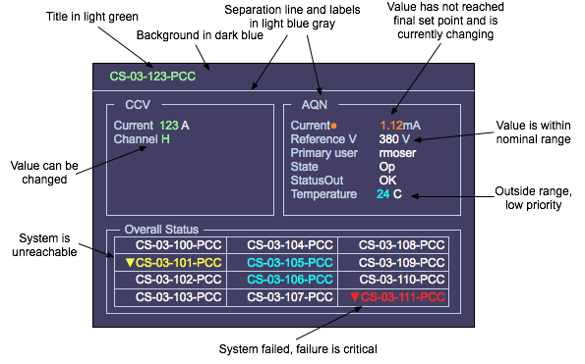
Color Scheme

Slide 6
Color Language
Dark Blue Background
Light blue gray Panel labels
White Nominal data
Light green Panel title and navigation
Data fields that can be changed
Red Hi priority alarm, error, failure
Yellow Medium priority alarm
Cyan Low priority alarm or information
Missing data
Orange Actual and set data mismatch

Slide 7
Icons
For important information compliant with EN 60601-1
For applications
  Microsoft Visual Studio 2010 standard icon library
  Made available to developers in SVN

Slide 8
Alarm Level Categories

