Slide 1
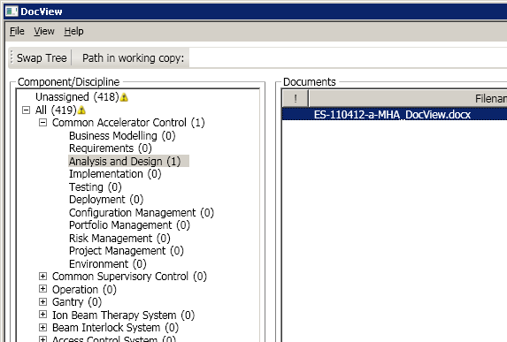
Document Viewer
Documentation Tree Tool

Slide 2

Why did we develop it?
Folder structure in subversion hides the actual documents
Required is a Component / Discipline view
Analysis and Design
  Injector RF
  Magnets
Injector RF
Analysis and Design
Requirements
Notes:
In: What documents are we talking about: SVN
Repository documents hidden in folders with many other files
Nice to have / Management requires a different view. View based on Component (Injector RF, Magnets, Beam Interlock System) and Disciplines (Analysis Design, Requrements, Testing, Project Mgmt)
> This is exactly what DocView can do! Filter all relevant (doc, pdf) document out of the repository and display them in different views
Out: manage it with metadata

Slide 3
Agenda
Why did we develop it
How does it work
Live demo
Next steps

Slide 4
How does it work
SVN properties are metadata associated to a file or folder
Key value pair : “ma-docview:discipline” = “Requirements”.
Properties are managed by SVN and are not stored in the documents
Properties are subject to version control themselves

Slide 5
DocView
Live demo…
Notes:
Start DocView from Program Files
Select working copy sdp
Type path: documents\analysisdesign\docview
Now we are down to 2 documents with exklamation marks
Select DocView.docx
Show identifier
- Swap tree
Set with drag and drop to AnalysisDesign / Common Accelerator Control
Show blue disciplines
Set version 0.3
Change to commit view
Commit it with ticket 1251
Orange colour gone
- Show export

Slide 6
Status
Status
Program, installer and user manual exist
but we haven't started to actually tag documents
Next steps
Review components/disciplines
Prepare guideline for how to use the properties
Goal
We tag all our documents /
we all tag our documents

