Slide 1
VAcc and WSE operation GUI

Slide 2
Panel purpose
Displaying allocation information
Displaying status, state and mode of operation
Displaying detailed information
Changing state
Changing mode of operation
Lock device configuration for medical treatment

Slide 3
Panel structure
Table with all defined VAccs and WSEs
List with detailed information of the selected VAcc, WSE or device
3D synoptic view of the selected VAcc or WSE
Area to control the selected VAcc or WSE

Slide 4
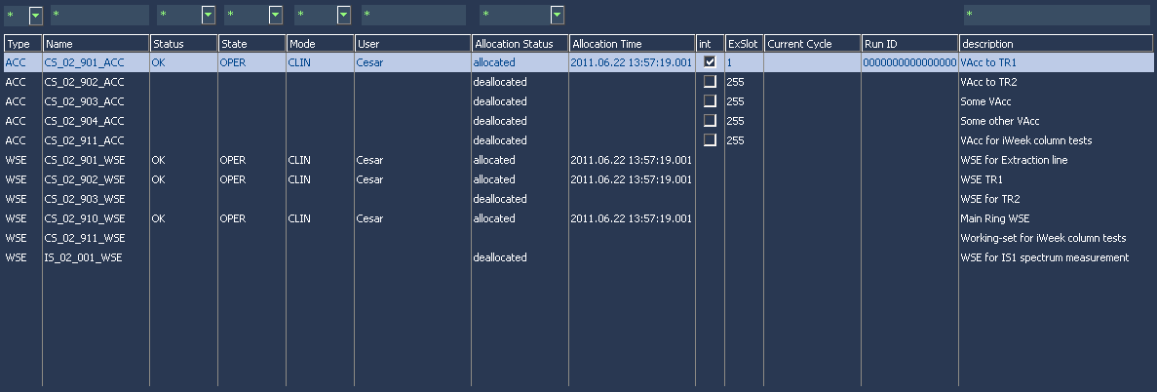
Table with defined VAccs/WSEs

Slide 5
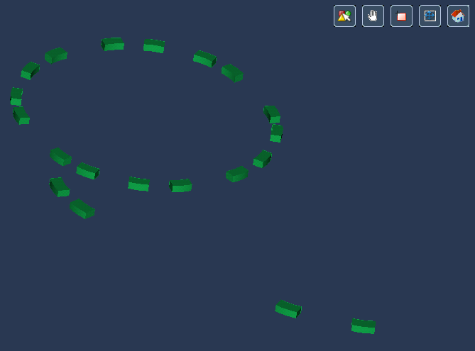
Synoptic view

Slide 6
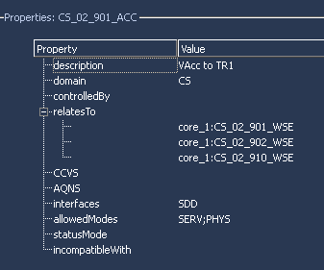
Detailed information

Slide 7
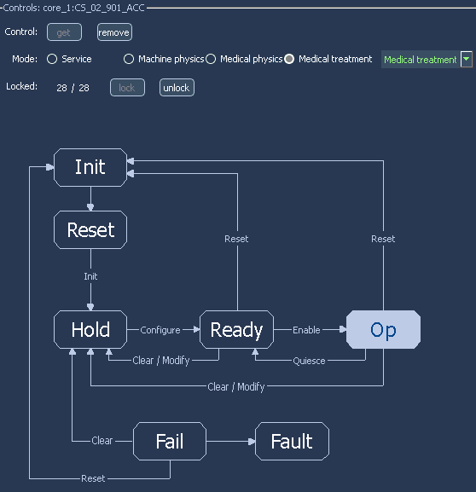
Control area

Slide 8
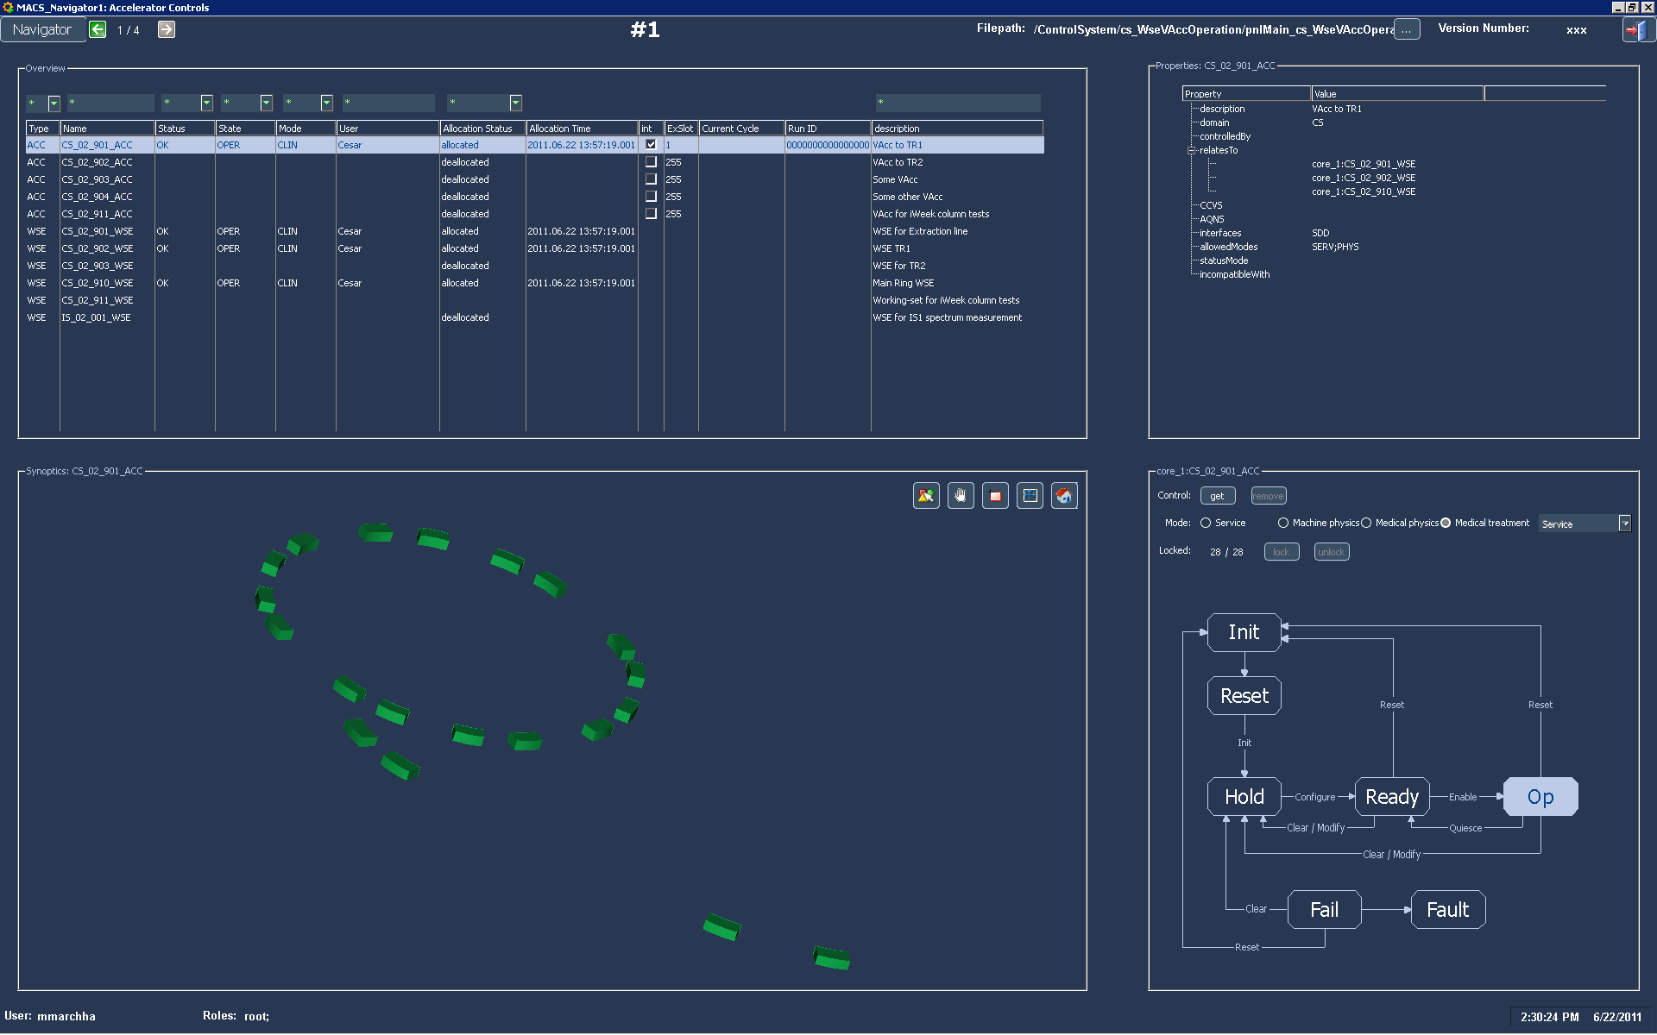
Live DEMO

