Slide 1
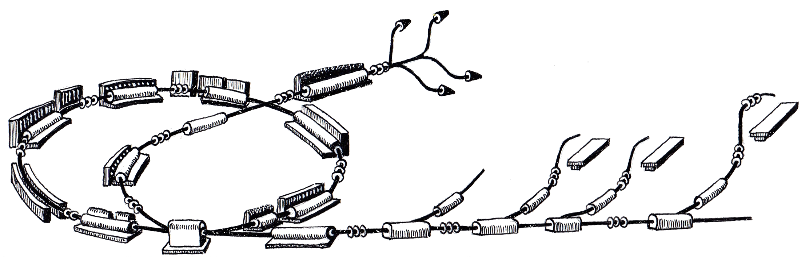
ProShell Procedure Framework Status
MedAustron Control System Week 2
June 27th, 2011
Roland Moser
R. Gutleber

Slide 2
Scope
Overview of ProShell Procedure Framework
Current status
  What was achieved since March 2011
  Plan till October 2011
Summary
Online Presentation

Slide 3
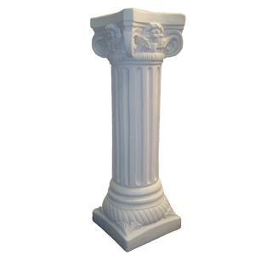
OVERVIEW

Slide 4
ProShell Procedure Framework
provides a graphical user interface that
dynamically loads procedures,
Manages procedures‘ lifecycles,
provides APIs to interact with control system components
  Allocate resources through VAA
  Communicate with resources for control and monitoring purposes

Slide 5
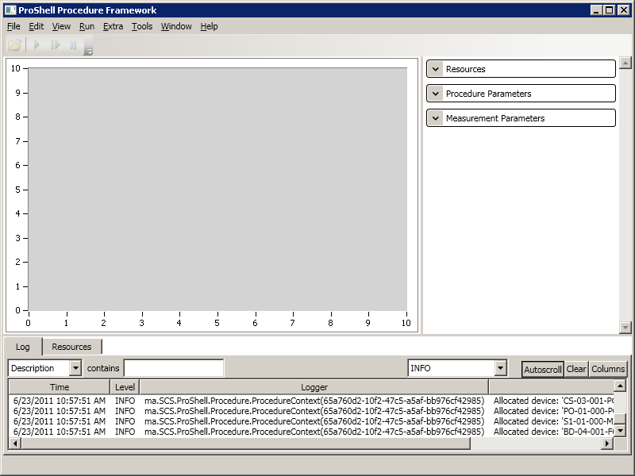
Screenshot

Slide 6
Screenshot
MenuBar
ToolBar
Main Panel
Input Panel
Output Panel
(Logger, Resource Allocation)
Status Bar

Slide 7
„Beam Spectrum“ Procedure Example
Move Faraday Cup into the beam line
For a list of currents perform the following actions
  Set a current on a power converter
  Wait until the current is reached on the power converter output
  Readout value from Faraday cup and add to plot
Perform a peak detection on the plot

Slide 8
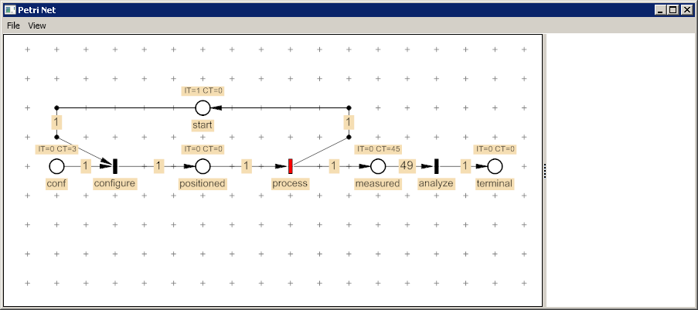
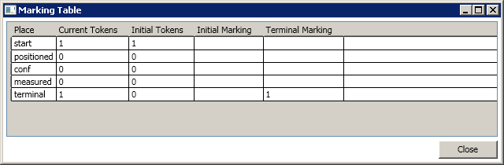
Petri Net Editor Integration

Slide 9
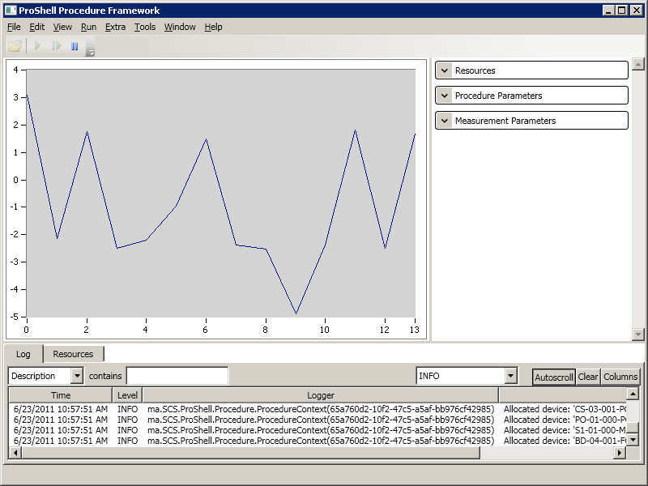
Executing Procedure

Slide 10
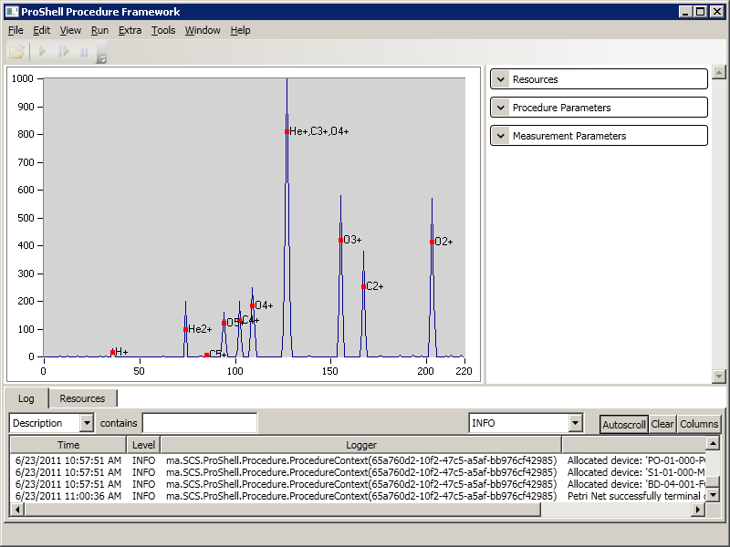
Procedure Finished

Slide 11
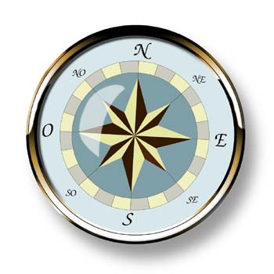
STATUS

Slide 12
Plan since March 2011
Documentation
  Improve Requirements
  Improve Architecture & Design
  Procedure Developer Manual
  API documentation
Implementation
  Freeze resource hierarchy API
  Complete Petri Net Editor (Cosylab, Sunil Sah)
  PetriNet Loading and Visualization (Cosylab, Sunil Sah)
  Publisher/Subscriber integration
    Main Timing System non-realtime network
    High-bandwidth data acquisition
  Implement Main Timing System device proxy in C#

Slide 13
Documentation Progress
ProShell Enterprise Architect Model
  Requirements
    Added for external developed components
  Architecture and Design
    Added for external developed components

Slide 14
Implementation Progress
ProShell
  Beam spectrum measurement example procedure
  Loading of PNML files(SSA)
  Visualize Petrinet execution (SSA)
  Revise procedure (context) lifecylce
  Integrate National Instruments graph widget
  Executing external programs (SSA)
Device Hierarchy
  Integrate with MAPS (for measurement acquisition)
  DeviceFactory creates device proxies by name
Petri Net Editor
  Finished first implementation iteration (SSA)

Slide 15
Plan since March 2011
Documentation
  Improve Requirements
  Improve Architecture & Design
  Procedure Developer Manual
  API documentation
Implementation
  Freeze resource hierarchy API
  Complete Petri Net Editor (Cosylab, Sunil Sah)
  PetriNet Loading and Visualization (Cosylab, Sunil Sah)
  Publisher/Subscriber integration
    Main Timing System non-realtime network
    High-bandwidth data acquisition
  Implement Main Timing System device proxy in C#
    Slow progress
    Slow progress
    Not started
    Good progress
    Good Progress
    Done
    Done
    Good progress
    Not started
    Done
    Not started

Slide 16
Plan till October 2011 (Documentation)
Procedure Developer Manual
API documentation
Design Scratchpad integration
(Improve Requirements)
(Improve Architecture & Design)

Slide 17
Plan till October 2011 (Implementation)
Implement revised interfaces
  measurement interface
  user login mechanism
  Configuration locking and mode change
Integration of Main Timing System
  Includes receiving MTG events distributed through MAPS
Integration with Virtual Accelerator Allocator (CTM)
Integration of Scratchpad mechanism (CTM)
Integration of MADX into ProShell (MHA)
Improvements to Petri Net Editor and View (SSA)

Slide 18
Questions?

Slide 19

ADDITIONAL
SLIDES

