Slide 1
RMS Importer & Exporter Status
MACS Week June 2011

Slide 2
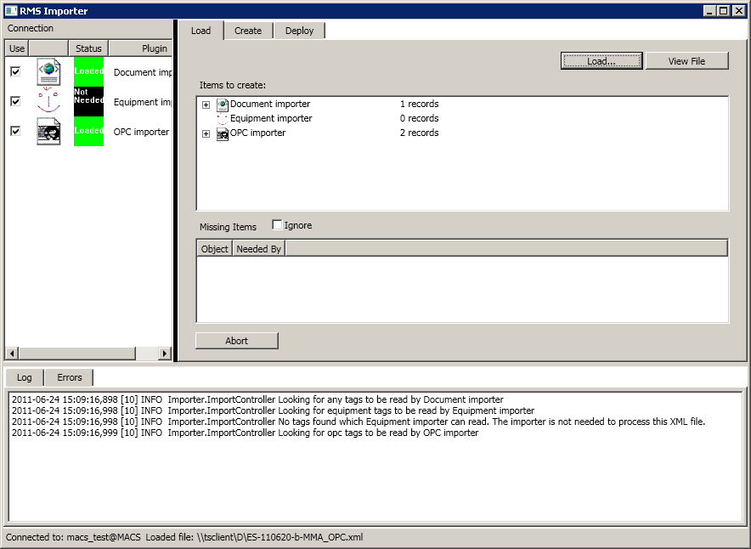
Importer
Reads information from XML files and imports it into the RMS database.
Importer ‘plugins’ read different XML tags and import different kinds of data.

Slide 3
To-do list from March MACS week
More testing of versioning
Read OPC group, OPC Server, Software Module, Description and System
Read clinical values (need a field in the database for this)
Make sure the plugins are run in the right order according to dependencies
Link data types to the document record
Some basic interface cleanup
  Make sure things are enabled/disabled when they should be
  Add missing icons
  Add ‘Abort’ button on all tabs
Check which items already have In-Work versions instead of assuming they all do.
Allow undo of deployment when adding a new version (this requires some changes in the RMS versioning functions.)

Slide 4
To-do list from March MACS week
More testing of versioning done
Read OPC group, OPC Server, Software Module, Description and System done
Read clinical values (need a field in the database for this) done
Make sure the plugins are run in the right order according to dependencies done
Link data types to the document record done
Some basic interface cleanup
  Make sure things are enabled/disabled when they should be
  Add missing icons done
  Add ‘Abort’ button on all tabs done
Check which items already have In-Work versions instead of assuming they all do. done
Allow undo of deployment when adding a new version (this requires some changes in the RMS versioning functions.) not done

Slide 5
To do
Change to use the new RMS locking functionality to lock the database while importing (needs a new function in RMS, which will be available at the end of July)
New importer plugins
  OPC servers and groups done
  PLCs and polling groups
  Working sets and virtual accelerators
  Software modules
  Rooms and racks
  Configurations (optional)

Slide 6
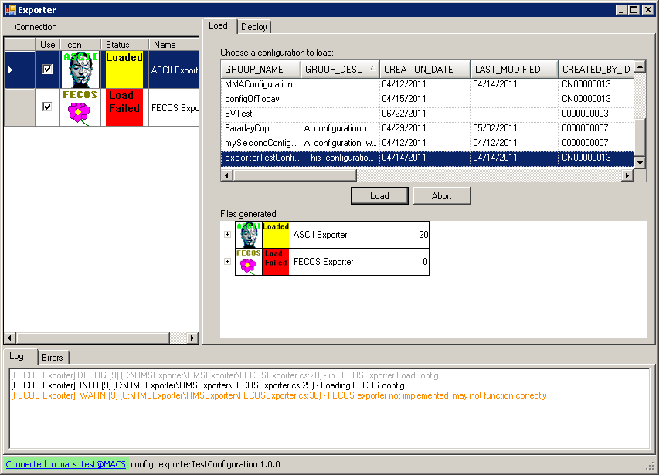
Exporter
Reads information from the RMS database and exports it as configuration files for various systems.
Exporter ‘plugins’ export data in different formats to be read by different software.

Slide 7
Planned Changes from March MACS Week
Current version | June 2011 version
Reads only individual data points from configuration lists, and exports them and their datapoint types. | Reads working sets and virtual accelerators from the configuration lists, and any datapoints included in the working sets (making sure not to import the same datapoints twice if they are in more than one working set.)
Infers system name from the name of the child configuration | Reads system names from the System field for each data point
(Mis)uses IP address field of child configuration as the name of the computer the system is running on | Reads Target CPU from a new PVSS Systems list that the System field links to

Slide 8
Planned Changes from March MACS Week
Current version | June 2011 version
Reads only individual data points from configuration lists, and exports them and their datapoint types. | Reads working sets and virtual accelerators from the configuration lists, and any datapoints included in the working sets (making sure not to import the same datapoints twice if they are in more than one working set.) done
Infers system name from the name of the child configuration | Reads system names from the System field for each data point done
(Mis)uses IP address field of child configuration as the name of the computer the system is running on | Reads Target CPU from a new PVSS Systems list that the System field links to done

Slide 9
Missing things at March MACS Week
By June 2011:
  ASCII Exporter
    OPC/S7 connection done
Not Scheduled:
  Plugin for shared variable generation – in progress by CTO
  Plugins for FECOS framework and applications
    REDNet generator
    Power Converter controller

Slide 10
To do
New exporter plugins:
  OPC Gen
  MTS/MTG configuration
  PCC configuration

