Slide 1
RMS Status
Definition of the general system information

Slide 2
Steps to do from 0→Configuration
Definition of the general system Information
Definition of device classes
Definition of device instances
Working Set definition
Virtual Accelerator definition
Create configuration

Slide 3
Definition of general system information
Rooms
CPUs
WinCC OA Systems
OPC Server / OPC groups
PLCs / polling groups
Software modules
Panels & topology
Cycle Group Entries
Cycle Groups

Slide 4
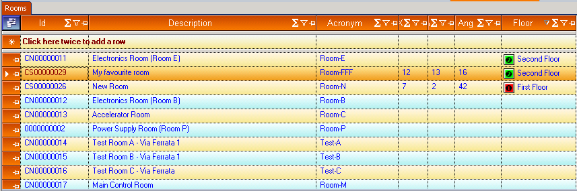
Rooms

Slide 5
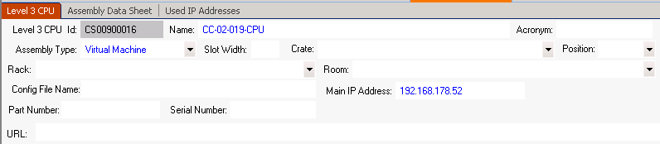
CPUs

Slide 6
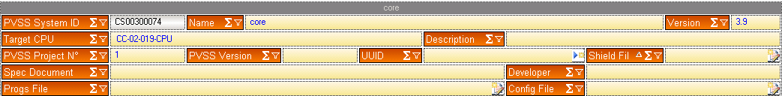
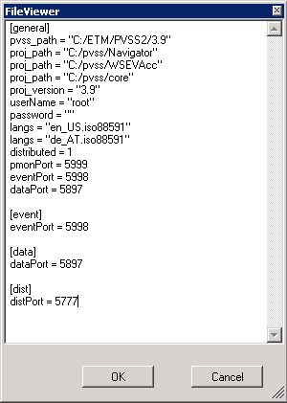
WinCC OA Systems

Slide 7
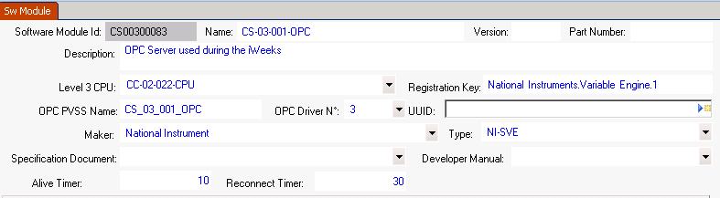
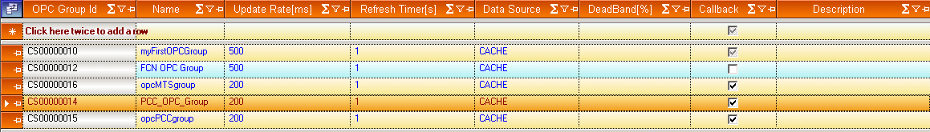
OPC server/groups

Slide 8
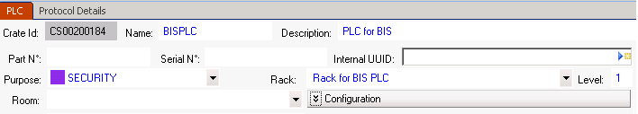
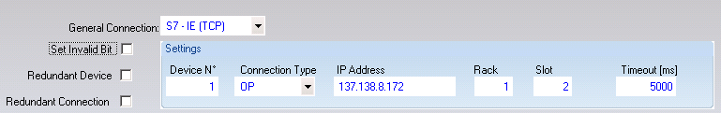
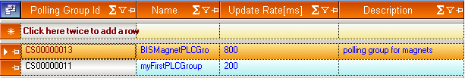
PLCs

Slide 9
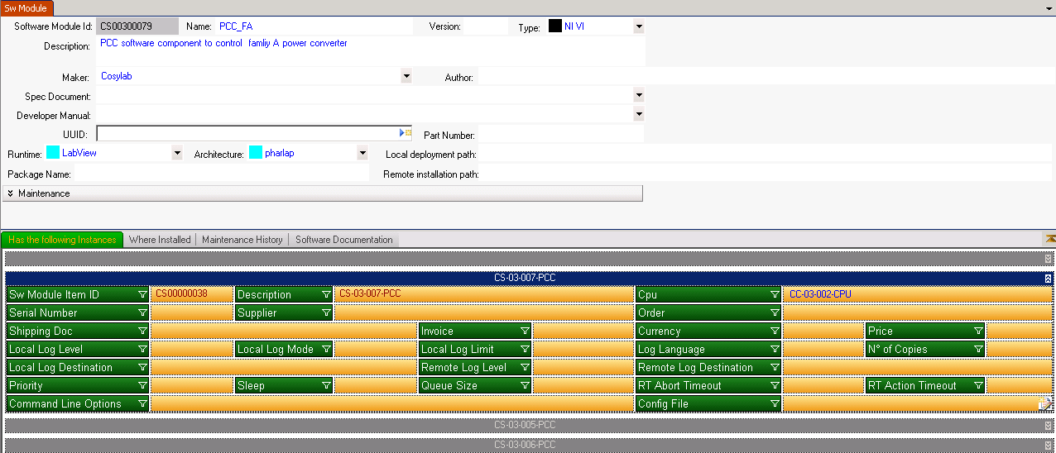
Software modules

Slide 10
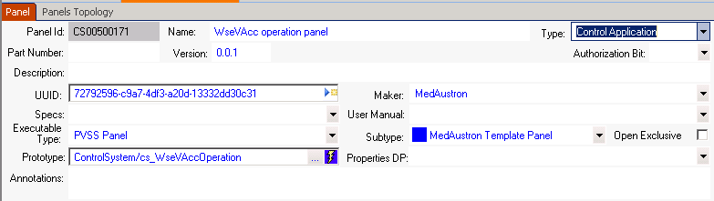
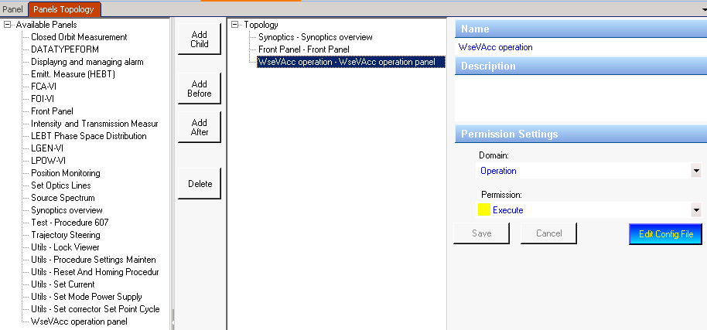
Panels & Navigator topology

Slide 11
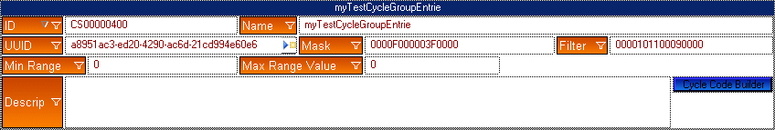
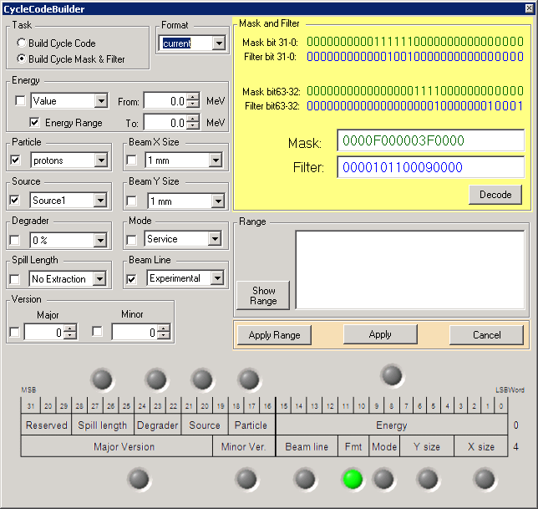
Cycle Group Entry
A cycle group entry is a
mask/filter pair

Slide 12
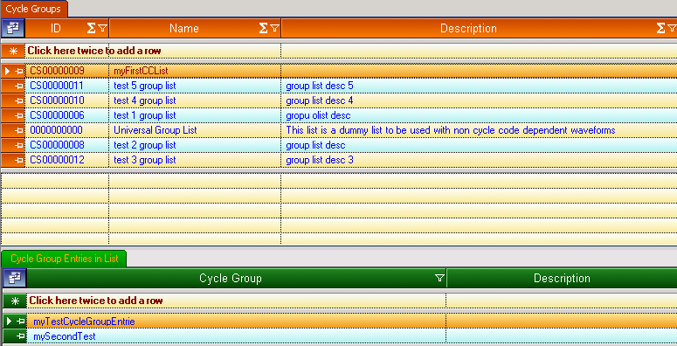
Cycle Group
A cycle group is a list of
mask/filter pairs

Slide 13
What is missing
Racks
Cables
Cycle Manager (definition of the available cycle codes)

