Slide 1
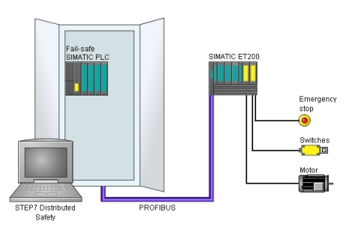
Beam Interlock System Design

Slide 2
Background
Causes
  Device malfunctions
  Unintended irradiation
Effects
  Damage of equipment
  Persons are harmed
Analysis
  Identify 1) hazards, 2) causes, 3) effects
  Determine 1) severity and 2) probability
  Risk = Severity x Probability
  If risk outside of accepted level foresee risk reduction measure
 | Small | Medium | Severe | Catastrophic
Always |  |  |  | 1
Often
Occasional
Seldom |  | 2
Unlikely | 3

Slide 3
Lines of Defense
Operate accelerator in a responsible manner
  Establishment of user manuals and rules
  Training of personnel
  Communication among persons
Mechanisms in software
  Exclusive allocation of machine partitions, devices before use
  Automatic control of protection mechanisms as part of automated procedures
  Patrol disables access to electronically controlled areas
Local safety functions in devices and device groups
Beam Interlock System steps in if all other measures fail

Slide 4

Remaining Risk Control
Primary risk control done through operation procedures
Operation procedures may fail
  Hazards that may occur due to software malfunction are assumed to occur with 100% probability
Remaining Risk Reduction Measures
  operation procedures fails -> address remaining risk first at device level
  local measures insufficient -> involve the BIS

Slide 5
Goals of the BIS
The BIS reduces the risks of harming people and damaging equipment due to device malfunction and unintended irradiation with respect to the particle accelerator’s operation
First reduce risk for persons to be harmed
  Due to conflicting commands intended for beam generation
Second protect machine components from damage
  Due to conflicting commands
The scope of the BIS is to act as a
functional safety mechanism
for the particle accelerator

Slide 6




Out of Scope
The following tasks are not addressed by the BIS
Ensure safe access to accelerator devices for service activities (to be covered by local safety measures)
Protect patients from beams that deviate from nominal characteristics
Protect people from hazards that do not
originate from the particle accelerator
Unforeseeable misuse including disregard
and ignorance of established intended uses

Slide 7
Concept
Scope of System
Sensor
Processor
Actuator
Input Module
Logic
Output Module
WPs need to identify WHAT are their sensors and WHAT are their actuators

Slide 8
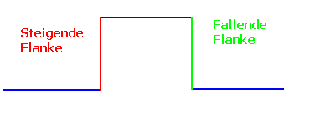

Separation of Concerns
Functionality covered by BIS
  Listen to signals
  Generate signals
  Process defined rules
To be covered by WPs
  Sensors
  Actuators
  Risk analysis for individual devices
  Common risk analysis with WP CO
  Definition of conditions to act together with other WPs

Slide 9
Sensors and Actuators

Slide 10
Characteristics
Reaction time
  Order of “cycle” durations
  Faster than human: look – decide – act
  Slower than dedicated safety systems
1500 Inputs / 900 Outputs
Central processing
Network with IO modules
Orthogonal to the other systems
System components
System components
System components

Slide 11
De-energize to Trip (DTT)
De-energize To Trip
    cause of harm is active when the input is logical “0” and
    when the effect is active the output is logical “0”.
Devices states may represent multiple harms
  Harm to other equipment, different harms to persons under different conditions
  Suggested to have interlock signal per harm condition
Examples
  Magnet overheated -> temperature switch open = circuit open
  Door open = circuit open
  Power converter fails -> circuit open
  Stop button pressed = circuit open

Slide 12
Orthogonality
BIS rules are only based on input levels: !Keep it simple!
No notion of operation modes
  Control of complexity due to multiplication and differentiation of rules
  Risk to set the wrong mode, forget mode switching
  There is no single accelerator mode (machine can be partitioned)
No notion of cycles
  Need to be able to work across cycle boundaries
Safety by design of components
  BIS does not signal interlock condition
    absence of a signal -> device moves to a state in which it does not represent harm to identified persons or equipment
    device remains in this state until a control action (human or procedure) happens
    Device does not react to control action that requests the device’s operation

Slide 13

Safe State/Operational State
Are device specific
Are defined by each WP for each device
  May require interaction with other WPs
Are documented by WP

Slide 14
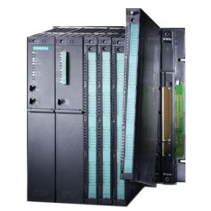
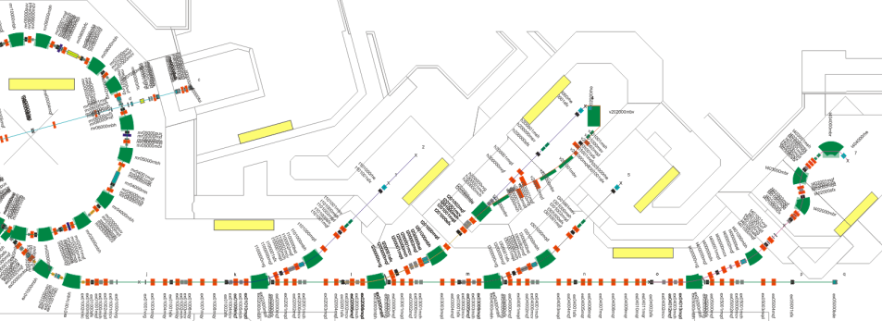
Hardware / Software Design
Siemens PLCs and I/O Modules
  Reliable, flexible and scalable
Profibus I/O network
  Distributed I/O Modules
  to interconnect racks
Siemens Simatic Safety Matrix
  Table based interface
  Cause & effect method

Slide 15
STEP 7
Safety-Matrix

Slide 16
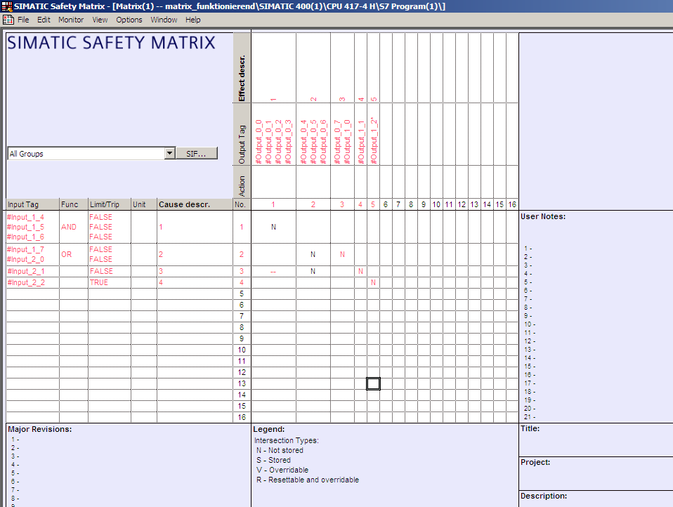
User Interface I
128
128
1024
Configured example Matrix

Slide 17
User Interface II - Causes

Slide 18
User Interface III - Effects

Slide 19
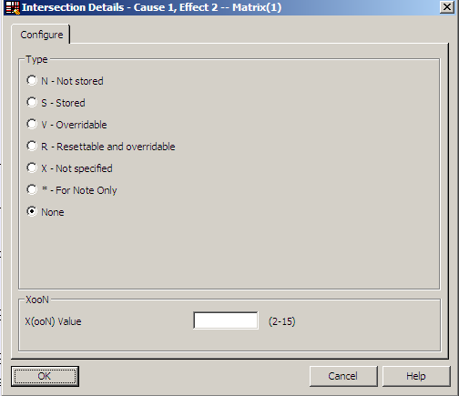
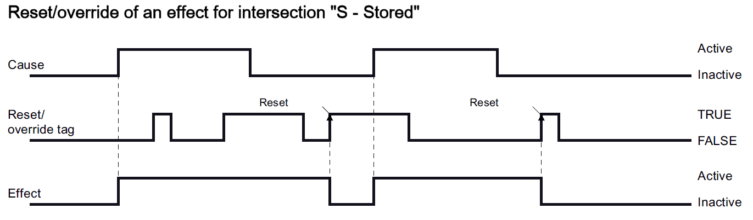
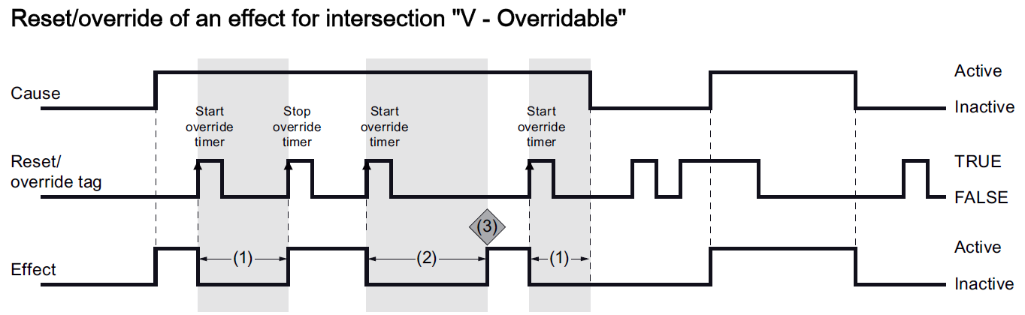
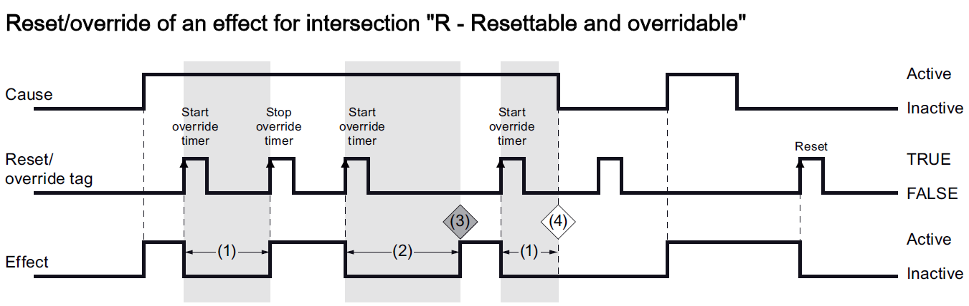
User Interface IV - Intersections

Slide 20
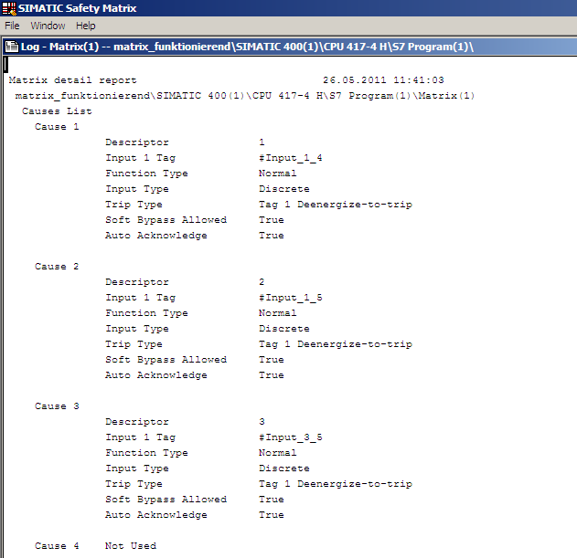
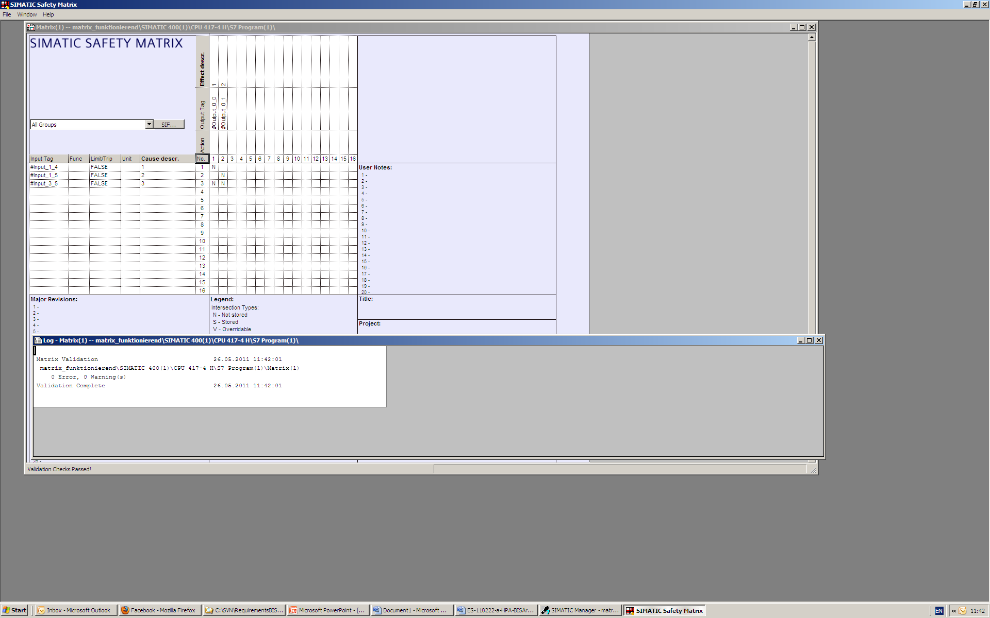
User Interface V - Reports
Automatically generated by Safety-Matrix
Required for approval of the safety program by the authorities
Event-report also generated

Slide 21
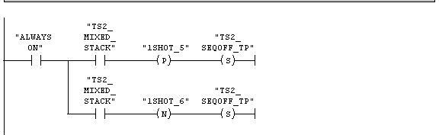
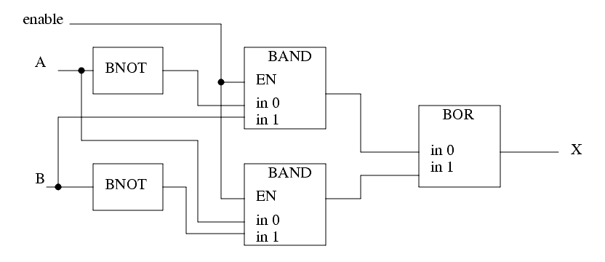
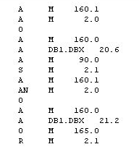
Structure of the PLC program
Siemens PLC programs are structured in OBs
Standard programming languages:
  LAD (ladder logic)
  STL (statement list)
  FBD (function block diagram)
Additional languages:
  CFC (continuous function chart)
  Safety-Matrix
Compiling steps:
  Safety-Matrix → CFC
  ↘
  Machine code
  ↗
  LAD, STL, FBD

Slide 22
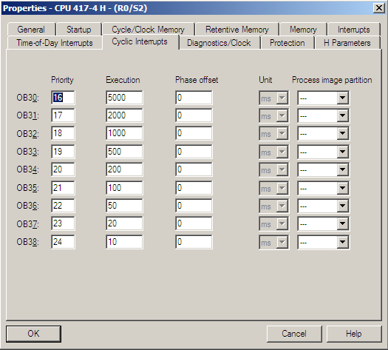
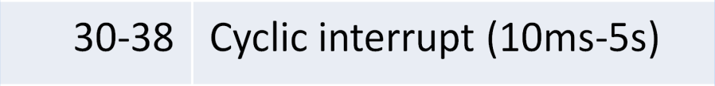
PLC program
Some OB definitions of Siemens systems
Different priorities of the OBs can be defined
OB no. | Purpose
1-9 | Cyclic program code
10-17 | Time of day interrupt
20-23 | Time delay interrupt
30-38 | Cyclic interrupt (10ms-5s)
40-47 | Hardware interrupt
100 | Warm restart
101 | Hot restart
102 | Cold restart

Slide 23
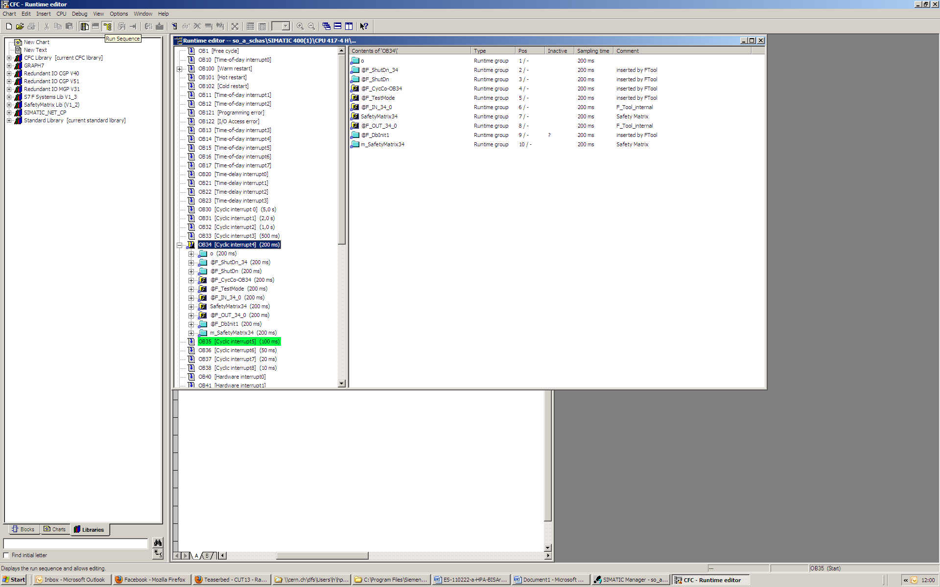
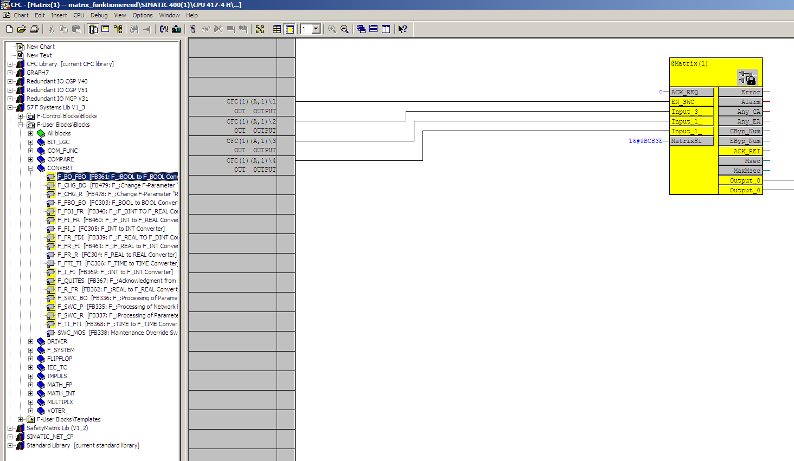
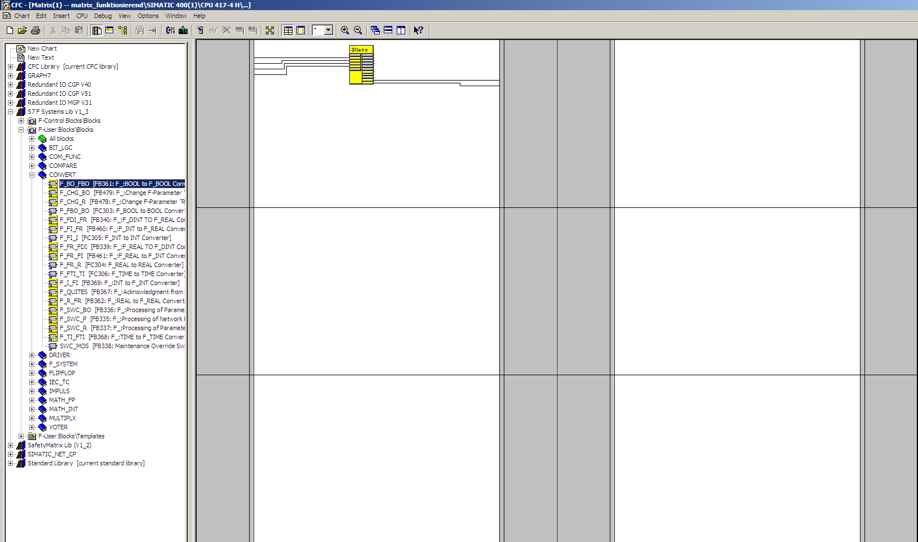
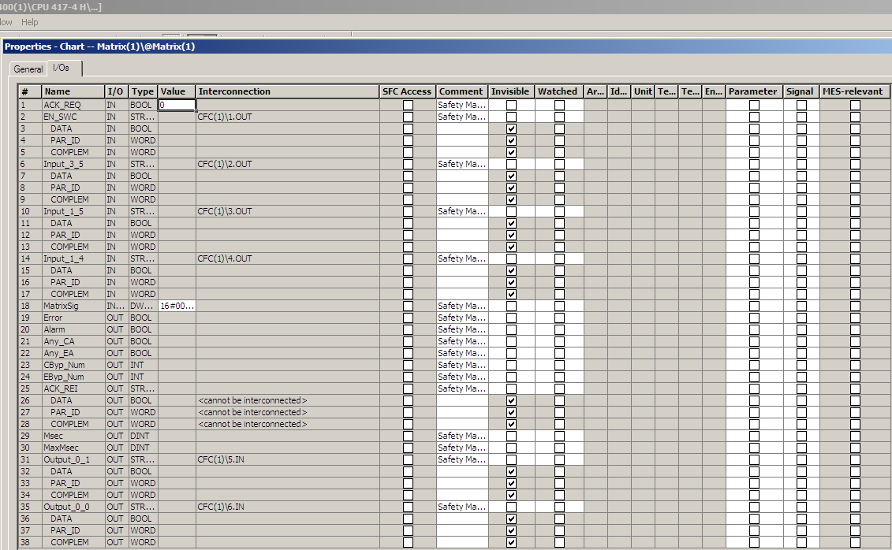
CFC – Safety-Matrix
Output runtime group
Matrix runtime groups

Slide 24
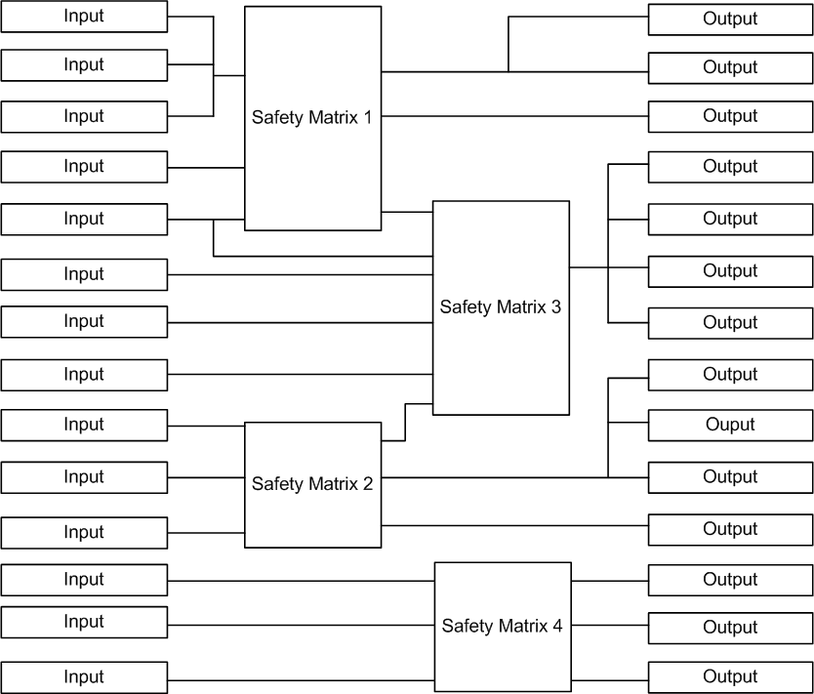
Characteristics of Safety-Matrix
Few matrices possible (recommended less than 10)
At most 128 causes and 128 effects per Matrix
Outputs cannot be shared by matrices

Slide 25
Constraints
Total number of I/Os per matrix (128 x 128)
An output to a device can only be controlled by 1 matrix
Hierarchies of matrices lead to uncontrolled reaction times
  Up to 2 seconds from input to output
Number of individual rules must be
  Flexible enough to allow selective activation of safety functions
  Prevent entire shutdown of plant due to isolated hazards
  Prevent selective shutdown of plant due to linked chains

Slide 26
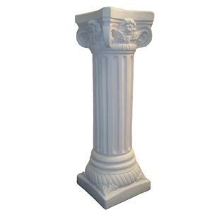
Realization

Slide 27
Defined Matrices
Emergency Inputs
Stop buttons
SMS
PCS
RP
...
PCO / Magnets
Sources + LEBT
Shared Inputs
Other matrices
RF devices
Vacuum controllers
Beam stoppers
PCO / Magnets
Injector RF + MEBT
PCO / Magnets
MR + EX
Emergency
devices
Shared
Outputs
Emergency Outputs
“2nd level interlock” of PCO’s
Other matrices
PCO / Magnets
EX
Shared Outputs
Beam stoppers
Sources
RF devices
...
PCO / Magnets + MTE
IR1 + IR2
PCO / Magnets + MTE
IR3 + IR4

Slide 28
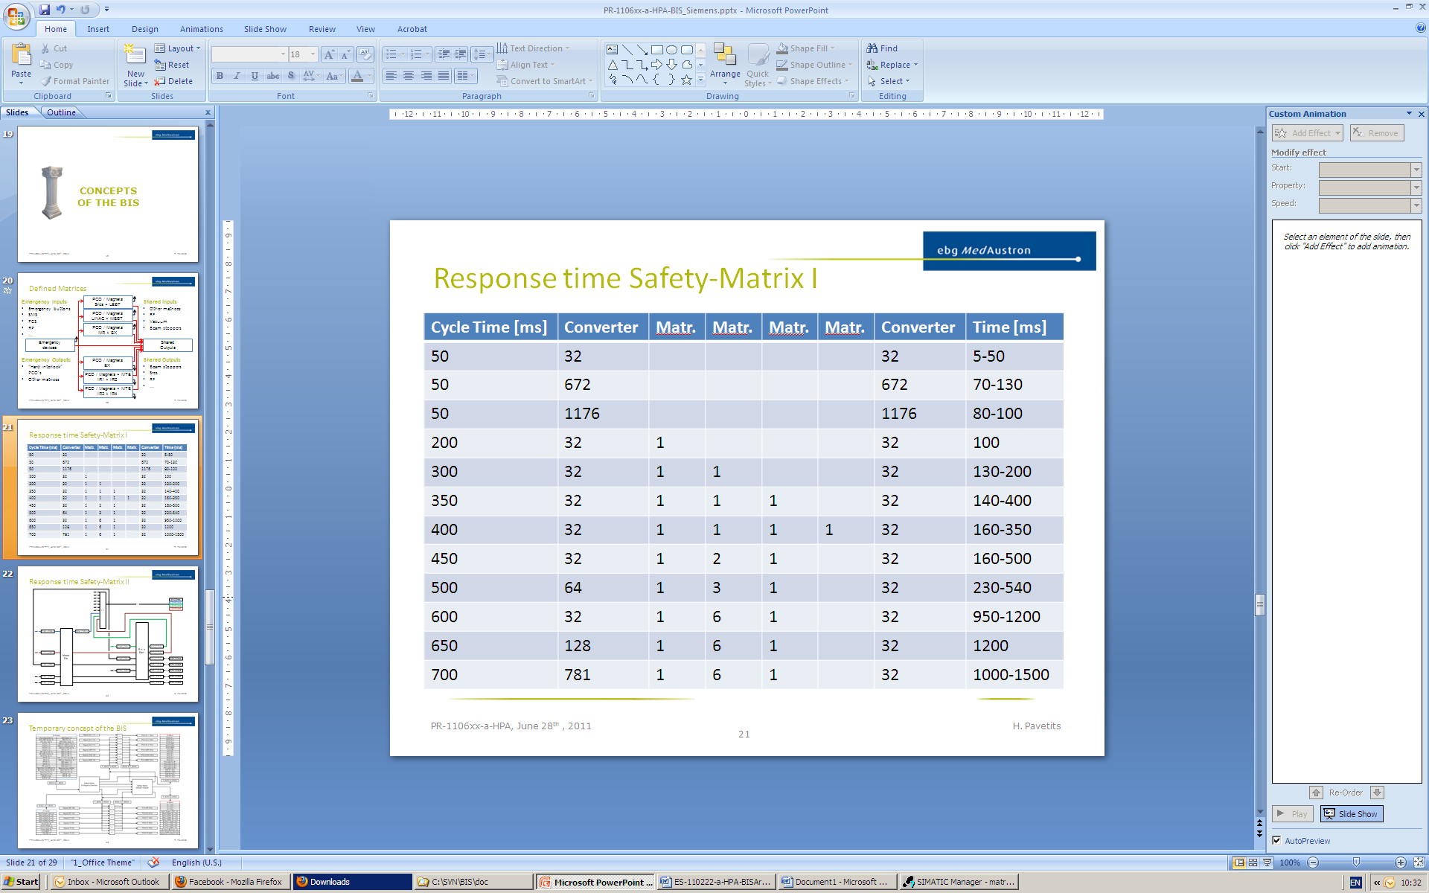
Response time Safety-Matrix I
Cycle Time [ms] | Converter | Matr. | Matr. | Matr. | Matr. | Converter | Time [ms]
50 | 32 |  |  |  |  | 32 | 5-50
50 | 672 |  |  |  |  | 672 | 70-130
50 | 1176 |  |  |  |  | 1176 | 80-100
200 | 32 | 1 |  |  |  | 32 | 100
300 | 32 | 1 | 1 |  |  | 32 | 130-200
350 | 32 | 1 | 1 | 1 |  | 32 | 140-400
400 | 32 | 1 | 1 | 1 | 1 | 32 | 160-350
450 | 32 | 1 | 2 | 1 |  | 32 | 160-500
500 | 64 | 1 | 3 | 1 |  | 32 | 230-540
600 | 32 | 1 | 6 | 1 |  | 32 | 950-1200
650 | 128 | 1 | 6 | 1 |  | 32 | 1200
700 | 781 | 1 | 6 | 1 |  | 32 | 1000-1500

Slide 29
Response time Safety-Matrix II

Slide 30
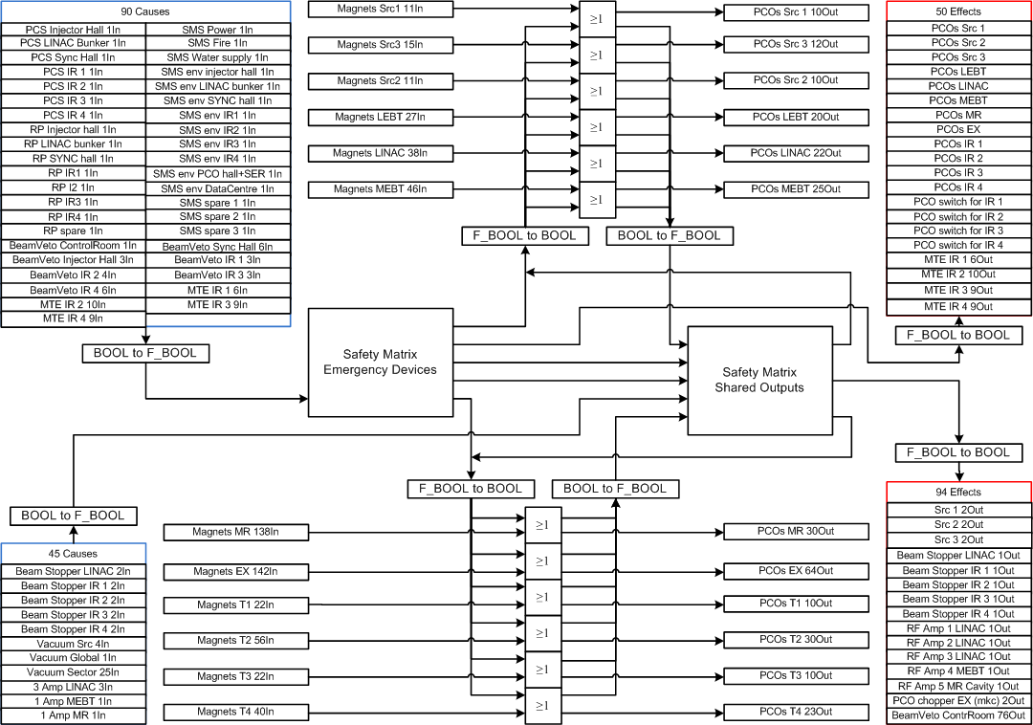
Current Design State of the BIS
Response time ≤ 400 ms

Slide 31

Device specific Interlock conditions

Slide 32

Injector RF
¬Veto
Amp 1
¬Op
=“1”
¬OFF
¬Error
¬Veto
Amp 2
¬Op
=“1”
OR
¬Veto
Inj. RF
¬Op
=“1”
¬OFF
¬Error
¬OFF
¬Error
¬Veto
Amp 3
¬Op
=“1”
¬OFF
¬Error
¬Veto
Amp 4
¬Op
=“1”
¬OFF
¬Error
¬Veto
LLRF
¬Op
=“1”
¬OFF
¬Error

Slide 33
Beam stoppers
Beam St.
¬OUT
¬IN
OUT
PCS
Safety-Matrix
delay
Switch Dp
Door
BS ¬IN
Safety-Matrix with delay
chopper
BS ¬OUT
All Sw. Dp

Slide 34
BDI-devices
Only for moveable devices in Sx, LEBT, MEBT
FCN
¬Error
FCN
Sx

Slide 35

Status

Slide 36
Conclusion
Safety-Matrix tool was evaluated
A design of the BIS was developed
  Solution for number of required inputs and outputs elaborated
  Solution for maximum response time from input change to actuation of corresponding outputs in the order of 600 msecs elaborated
Communication between the PLC and WinCC OA was tested

Slide 37

Outlook / Schedule
Low priority: Improvement of the Safety-Matrix response time
Date | Activities
Until 12/2011 | Risk workshops for all WPs
Until 02/2012 | Definition of all interlock chains | Description of PCS
Starting with 02/2012 | Programming the BIS

