Slide 1
Introduction
Components
Status
Details
AOB
Special Magnets Controls
Status
Tobias Stadlbauer,
Tony Fowler
Special Magnets
MedAustron
28 June 2011

Slide 2

Introduction
Components
Status
Details
AOB
Content
Our components under control
What has been done since last MACS Week
What tasks are planned in 2011
Interesting Details
AOB

Slide 3
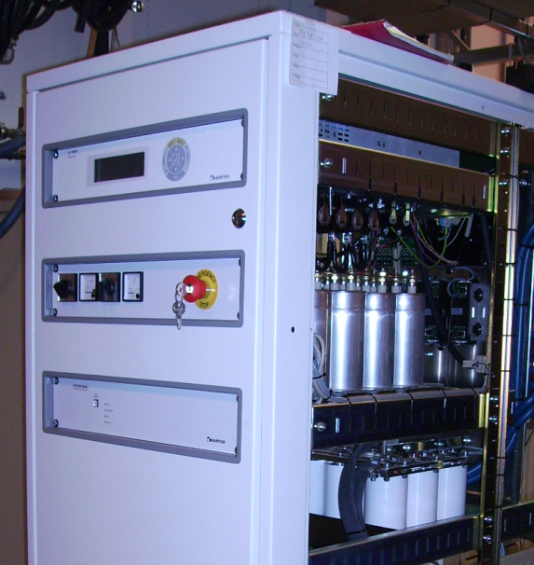
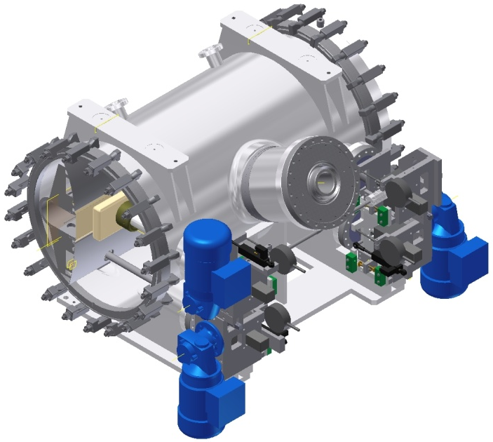
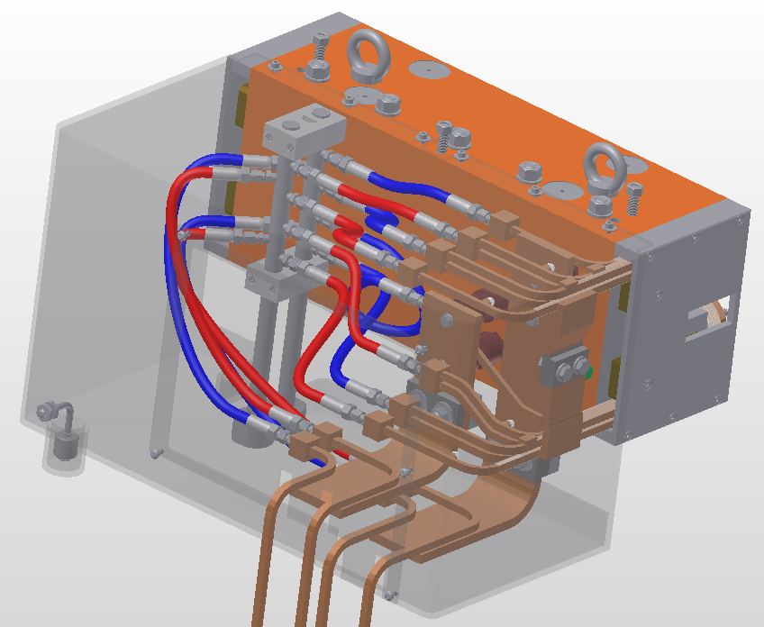
Introduction
Components
Status
Details
AOB
Controlled Components
Power supplies (9):
Set points,
trigger,
state control,
timing
Magnetic Septa and Chopper Dipole (10):
water flow,
water leakage,
coil temperature
Electrostatic Septa (2):
remote displacement system

Slide 4
Introduction
Components
Status
Details
AOB
What has been done since last MACS Week
Tendering: specification documents finished and offers received
Electrostatic septum displacement system:
      mechanical components defined: motors, potentiometer, switches
      control design document based on the components in progress
Special Magnets Controls Design Document in internal review:
      facilitate the implementation of controls
      overview of the operational functionality
      flow charts: how to control the special magnets PCOs

Slide 5
Introduction
Components
Status
Details
AOB
What tasks are planned in 2011
MKC risk assessment – impact on controls interfaces
Displacement system for electrostatic septa (PLC) (in progress)
PLC-system for water, temperature (monitoring/interlocking) (in progress)
Fast deflector power supply controls (in progress)
RS422 error detection implementation
Upcoming task during production like verification, validation, contract follow
up (in progress)
Design report

Slide 6
Introduction
Components
Status
Details
AOB
Work Allocation
- various parallel tasks
priority, urgency and availability of personal:
prescribes work flow and needs flexible planning
no fancy controls developments on BTS side only basic straight forward controls
but some advanced control sequences and precise trigger signals
a detailed planning (test, integration) in due course (production dates available) will
involve several WPs
- more detailed task breakdown in previous MACSW presentations

Slide 7
Introduction
Components
Status
Details
AOB
Electromagnetic Interferences, EMI
All kind of EMI sources inside the BTS-PCOs, which cannot be determined before production. The EMI will probably not be produced as the norms dictate.
and
From CERN experience: spontaneous triggers due to noise can occur.
Special Magnets has foreseen a EMI shielded compartment inside the PCO to put electronics in.
The PCO has to comply to the following norms:
  IEC 61000-2-4
  IEC 61000-4-4 (4)
  IEC 61000-4-9
  IEC 61204-3 (B)
Special Magnets
PCO
EMI shielded

Slide 8
Introduction
Components
Status
Details
AOB
Electromagnetic Interferences, EMI
To put an electronic device inside such an environment you have to take EMI into consideration.
The manufacturer puts the PCO LCS inside this cabinet.
But its the responsibility of the manufacturer to ensure that his components are working with this system.
Special Magnets
PCO
FED
Special Magnets
PCO
As for all important special magnets trigger signals and also for the communication interface, fibre optics could avoid these problems.
save area:
PCC
FED
Fibre optics

Slide 9
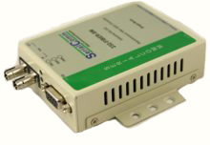
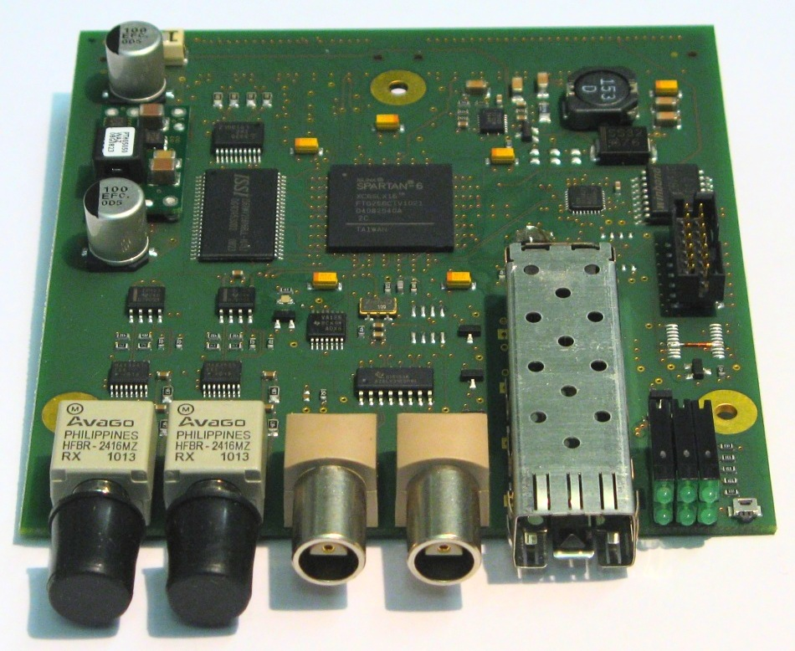
Introduction
Components
Status
Details
AOB
Electromagnetic Interferences, EMI
Example to avoid obvious problems:
PCO FED
Special Magnets PCO
RS422
RS422
RS422<->fibre
converter
Fibre optics
RS422<->fibre
converter
Tested of the shelf RS422 to fibre optic converter ->
Similar solution was used at CERN: old target modulator PCO (pulsed, 60kV)

Slide 10
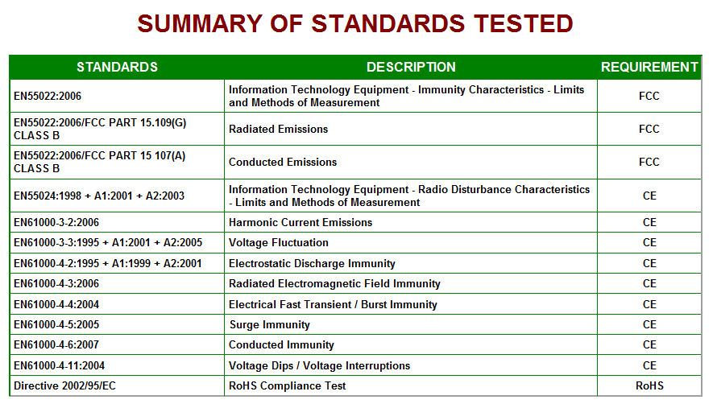
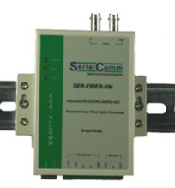
Introduction
Components
Status
Details
AOB
Electromagnetic Interferences, EMI
- reasonable? Please comment!
simple conversation module could save us development and testing work
Easy additional testing available e.g.:
- CO checks data communication with FED and this converter in normal lab
BTS checks functionality of this converter inside a similar PCO without FED instead
with normal PC, uC, ...

Slide 11
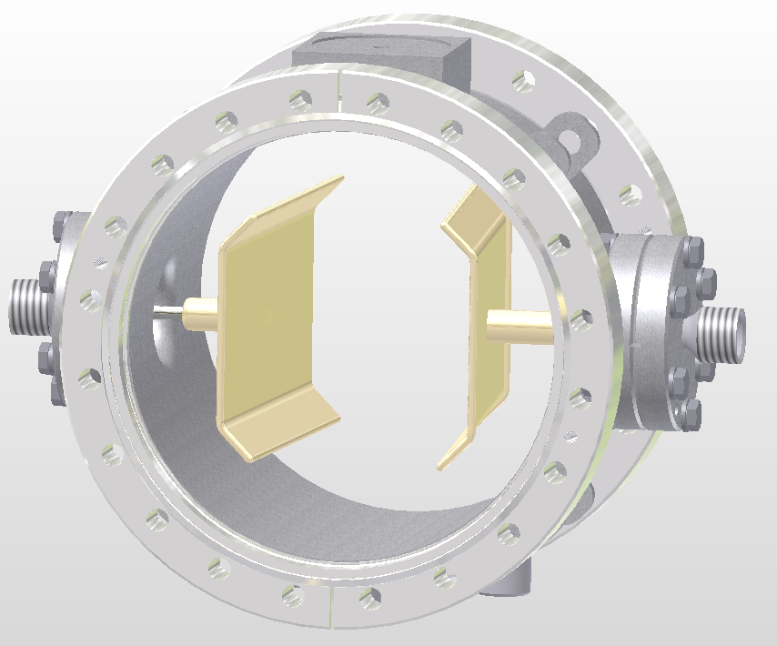
Introduction
Components
Status
Details
AOB
Fast Deflector System, EFE, PKF
PCO1
+3kV
Of the self
+3kV
-3kV
PCO2
-3kV
Of the self
0V
EFE
PKF
FED1
FED2
MTS
Start Trigger
Stop Trigger
Two FED cards for two of the self PCOs
MTS to synchronize PKF with other devices (e.g. MKI)

Slide 12
Introduction
Components
Status
Details
AOB
References
[1] J. Borburgh, M. Barnes, T. Fowler, M. Hourican, T. Kramer. T. Stadlbauer, Special Magnets - Final Design Report, CERN, 2010 (unpublished).
[2] J. Gutleber, R. Moser, MedAustron Control System Architecture and Design Document, MedAustron, ES-1000406-a-JGU.
[3] J. Gutleber, R. Moser, Main Timing System and Signal Distribution Services, MedAustron, unpublished.
[4] J. Borburgh, et al., “MedAustron Special Magnets - WP description”, CERN, Geneva, 2009
[5] M. Marchhart, T.Glatzl “Magnet Slow Control - Requirements”,
MedAustron
[6] T. Fowler, T.Stadlbauer “Special Magnets Controls Compendium”,
ES-110114-a-TST-V0.91
[7] BTS-Website: Tasks, Shared Documents, Discussions, Announcements: https://espace.cern.ch/te-dep-abt/Projects/MedAustron/default.aspx

