Slide 2
Welcome to the
1st CERN School of Computing on IT Services
Alberto Pace, school director

Slide 3
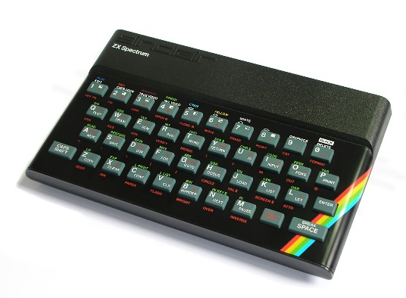

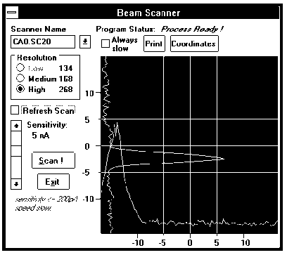
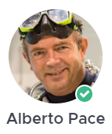
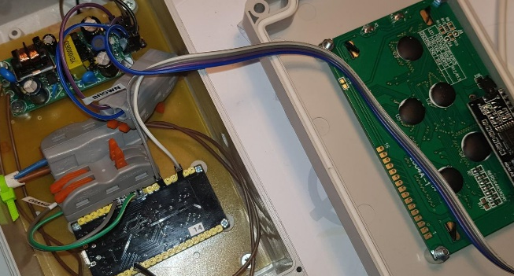

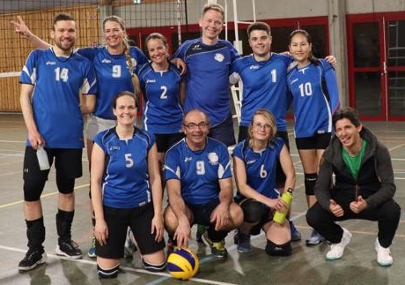

Who am I ? Alberto – your school director
Electronic Engineering (Politecnico di Milano), at CERN since 1986
I have led 5 groups (IT-IS, IT-DM, IT-DSS, IT-ST, IT-CD) and various sections at CERN, currently head of IT education. I have many years experiences in computing services, infrastructure, software engineering, accelerator control and accelerator operation.
I am passionate of mathematics, electronics, volleyball, scuba diving and sailing
Cryptography, Encryptions,
Algorithms, Optimal Controls

Slide 4



CERN’s mission
Innovation
Education
CERN
uniting people
The CERN School of Computing is here …
Research
?
Discovery
IT is everywhere
Accelerating beams
(accelerators)
Detecting particles
(experiments)
Large-scale computing (Analysis)

Slide 5
A school with a long history
The school was created in 1970, 2023 will be the 44th edition
The school has visited 22 countries
88 different nationalities
3400+ students have followed the school

Slide 6
Mandate and mission
Create a common culture in scientific computing among young scientists and engineers involved in particle physics or other sciences, as a strategic direction to promote mobility and to facilitate the development of large computing-oriented transnational projects.
  http://cern.ch/csc
Participants come from worldwide laboratories and universities with typically 20 to 30 different nationalities (61 different nationalities in the past 10 years).
  http://cern.ch/csc/alumni

Slide 7
Bridging science and computing
The unprecedented technological evolution in computing has profited directly to several scientific research projects, in particular in high energy physics
  Computing is today the main strategy for many sciences to boost their research productivity
It is nowadays essential that:
  Scientists master computing technologies as the main tool for their research
  Computer scientists understand the scientific domain of the investigation to deliver computing services that meet the needs of the research project

Slide 8
An additional side effect …
… knowledge transfer of (CERN) skills and (CERN) know-how in computing to academic, national laboratories, research institutes, institutional and industrial circles in Member States and other countries
  With direct or potential applications up to all spheres of the society.

Slide 9




The CERN Schools of computing
The Main School
  Two weeks, ~ 60 participants (64 this year)
  Multiple topics on scientific computing
The Thematic schools
  Goes more in depth on a particular topic
  Smaller participation, shorter duration (one week), clear goals
  Last year, two schools 23 + 30 participants
  Last school: 33 participants, 24 institutes, 21 nationalities
The Inverted school
  It is frequent to find among students real experts on specific topics, and the cumulated knowledge of the students exceeds the one of lecturers.
  At the end of each school, we invite students to propose some lectures, and we organize an “inverted” school. “Where students turn into teachers”
  In 2024, the 15th edition had 12 lecturers and more than hundred participants
The school on IT services (this school)

Slide 10
Focus on Knowledge
Knowledge versus Knowhow
Knowledge | Knowhow
Articulated to other knowledge of the learner | Generally stand-alone information
By nature, when taken by the learner, different between learners | Initially, the same for every learner
Transferable, adaptable to other environments | Transfer requires effort
When taken by the learner, persistent | Will be forgotten if not practiced
Requires related knowledge pre-exist | Limited pre-requirements

Slide 11
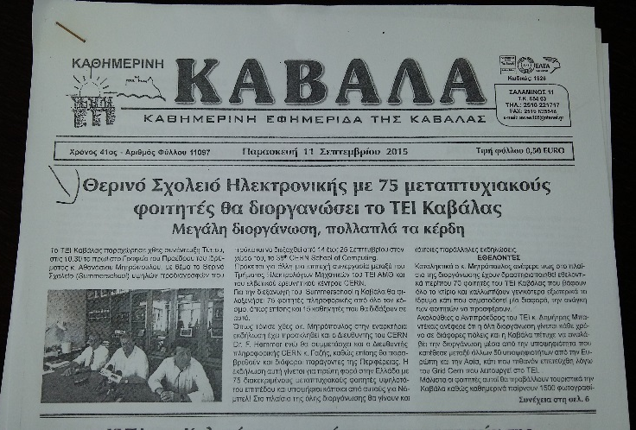
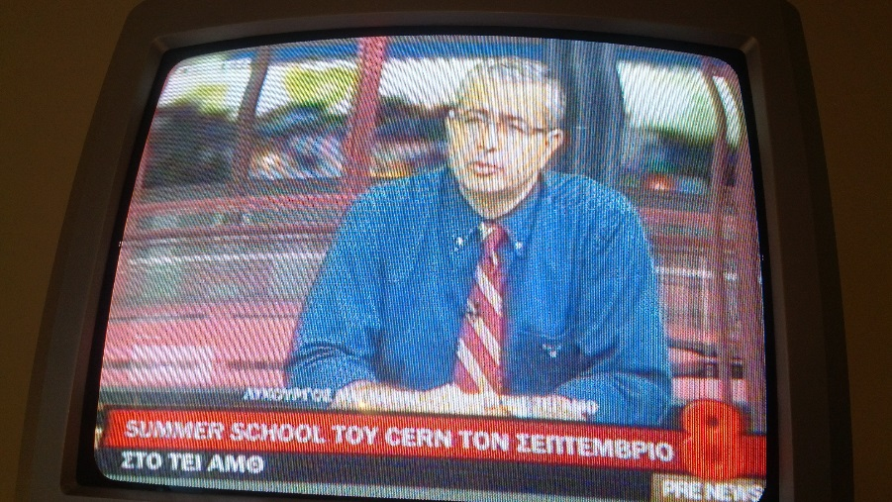
An outreach opportunity
For the local organizers

Slide 12
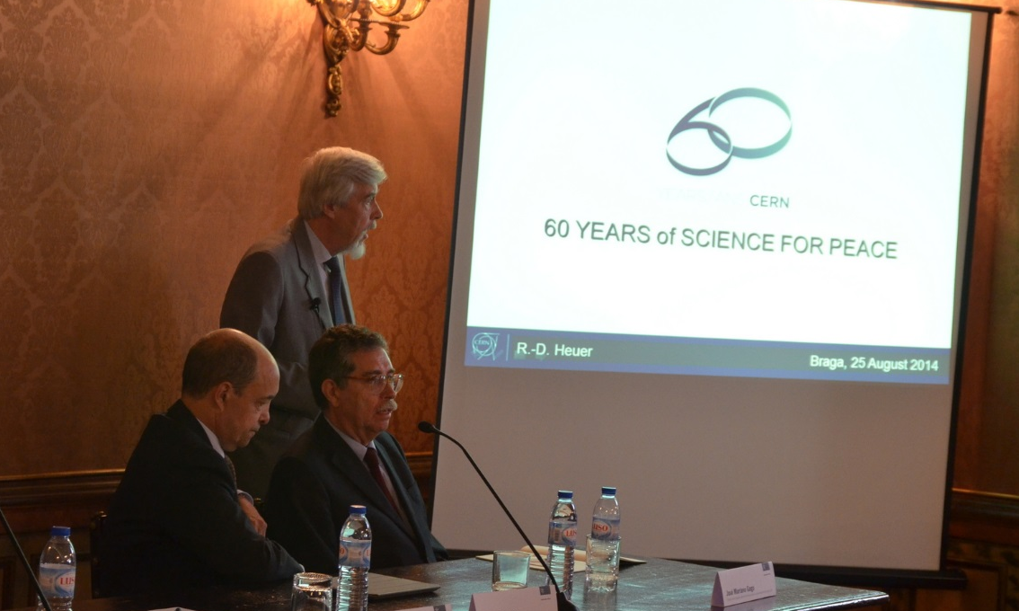
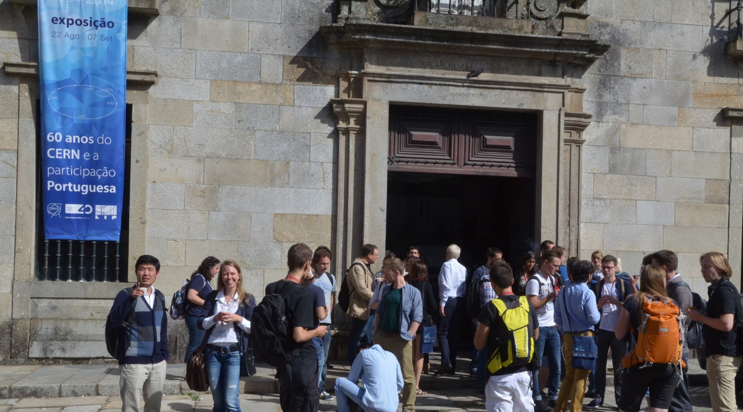
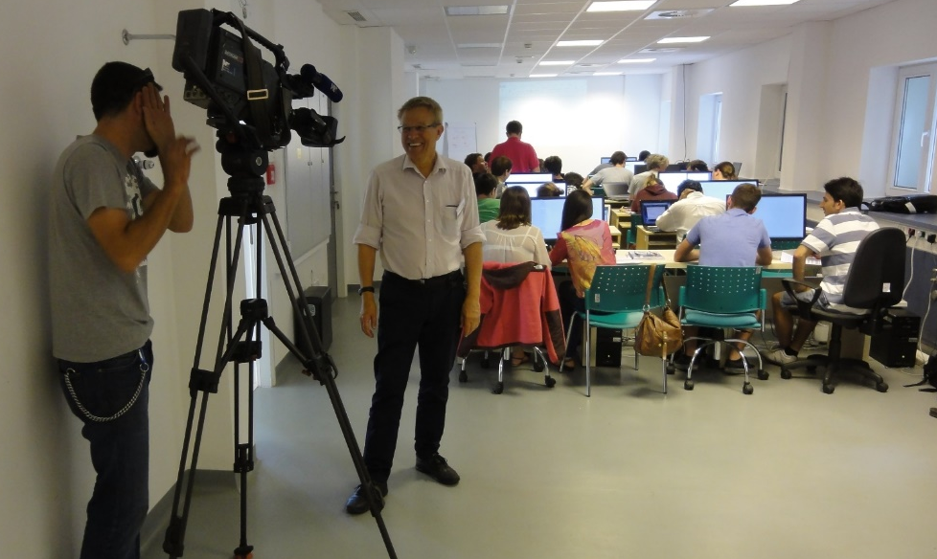
An outreach opportunity
For CERN

Slide 13
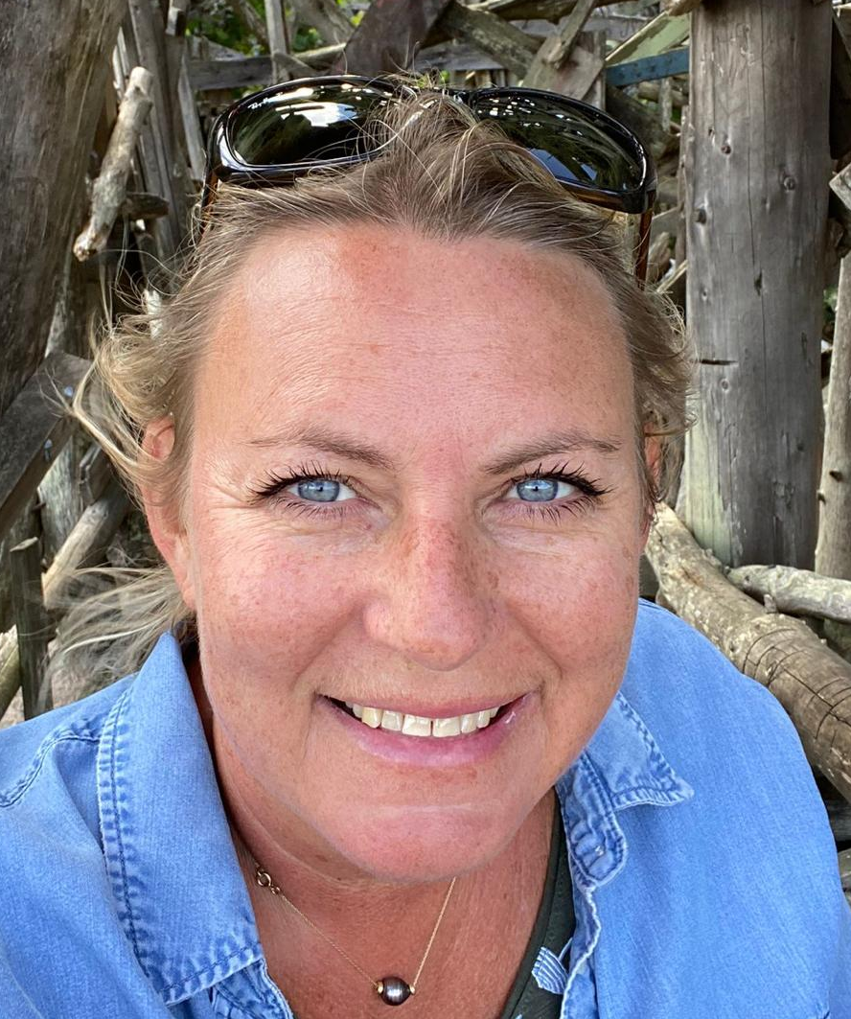
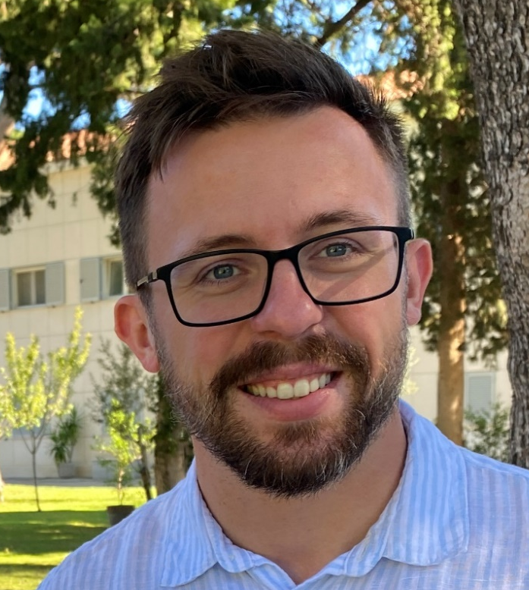
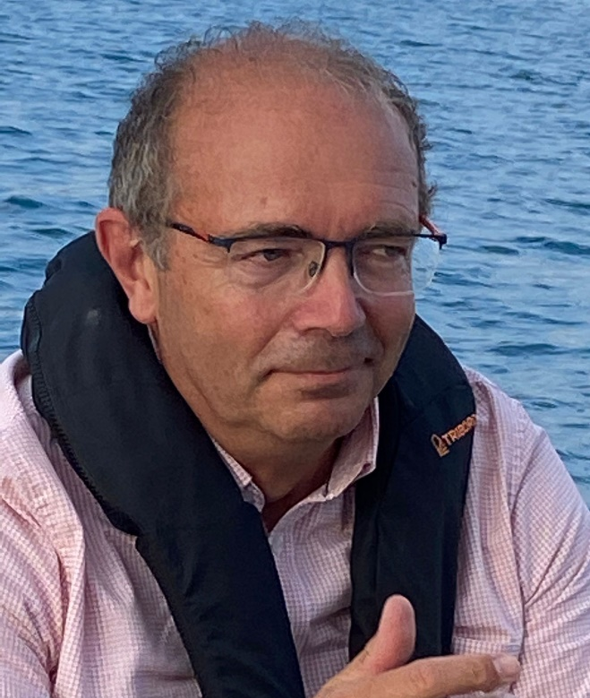
CSC Organizers
Kristina Gunne
Administrative Manager
Andrzej Nowicki
Technical Manager
Alberto Pace
School Director

Slide 14
The school governance
… is discussed at the School Advisory Committee
  http://csc.web.cern.ch/advisory-committe
Includes several fulltime university professors
from different countries
  Two meetings per year

Slide 15
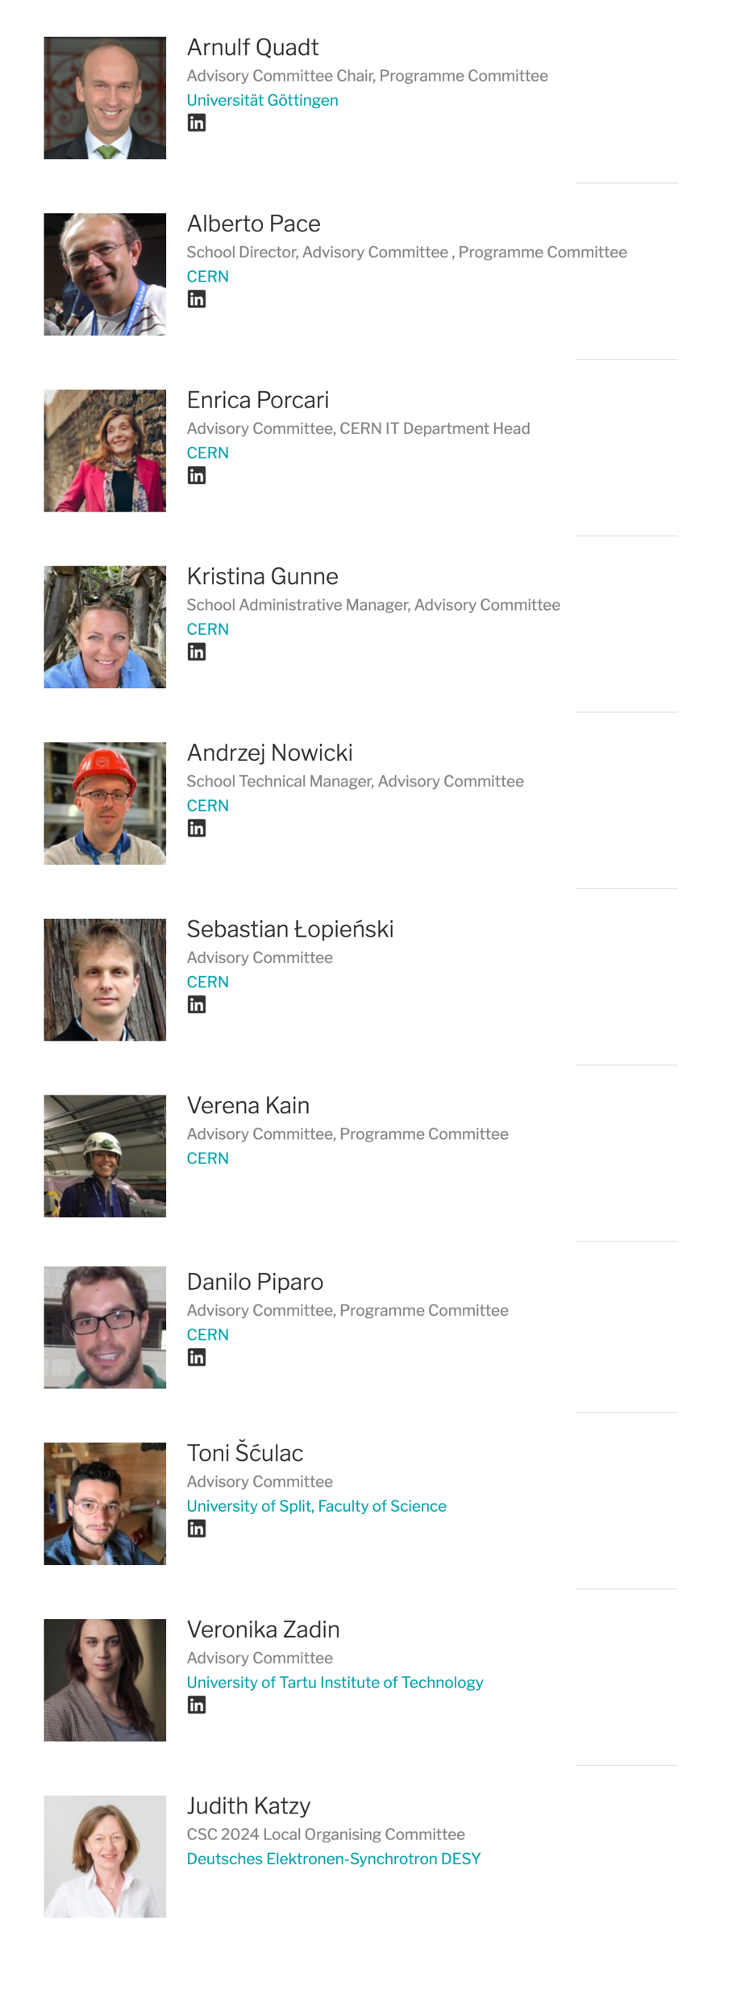
The School Advisory Committee

Slide 16
The 2024 School on IT Services

Slide 17
The School on IT Services
The school on IT Services aims to empower CERN members of personnel (including Students, Fellows, Origin, Quests, Staff, and Users) to get the most out of the computing services delivered by the CERN IT Department to the community.
The school is for any person that use CERN IT services to deliver information, or analyzes data, or automates tasks or works in engineering projects.
Participation is from both active users who would like to be more proficient and newcomers at CERN that would like to discover and get an introduction to the ecosystem of computing services available to all CERN users.

Slide 18
This is the first school on IT Services
A pilot school
  Your feedback will be extremely important
Everything can be changed
  Location: At CERN or outside ?
  Topics: basic IT Services or advanced IT Services
  Speakers: More speakers on shorter presentations or less speakers fovering services in depth ?
  Exercises: Hands-on (need time) ? Demos ? Interactive ?

Slide 19
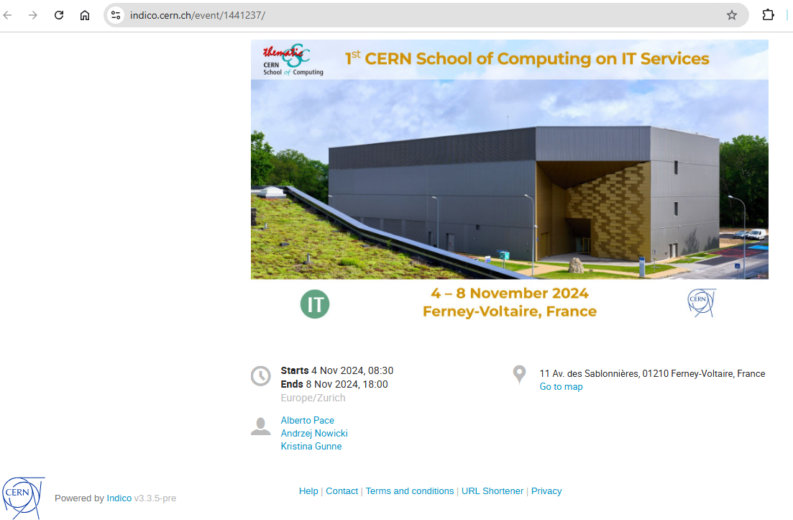
The School site is on indico
https://indico.cern.ch/event/1441237
Check it regularly for updates

Slide 20
The school learning process
Mandatory
Learning process
  Lectures
  Exercises
  Exam (Self Evaluation)
Meet special persons, build trust with colleagues
  Lunches, dinners, coffee breaks, (evenings)
  Excursions
  (Music events)
  (Sport programme)
Optional

Slide 21
The school learning process
Mandatory
Learning process
  Lectures
  Exercises
  Exam (Self Evaluation)
Meet special persons, build trust with colleagues
  Lunches, dinners, coffee breaks, (evenings)
  Excursions
  (Music events)
  (Sport programme)
Optional

Slide 22
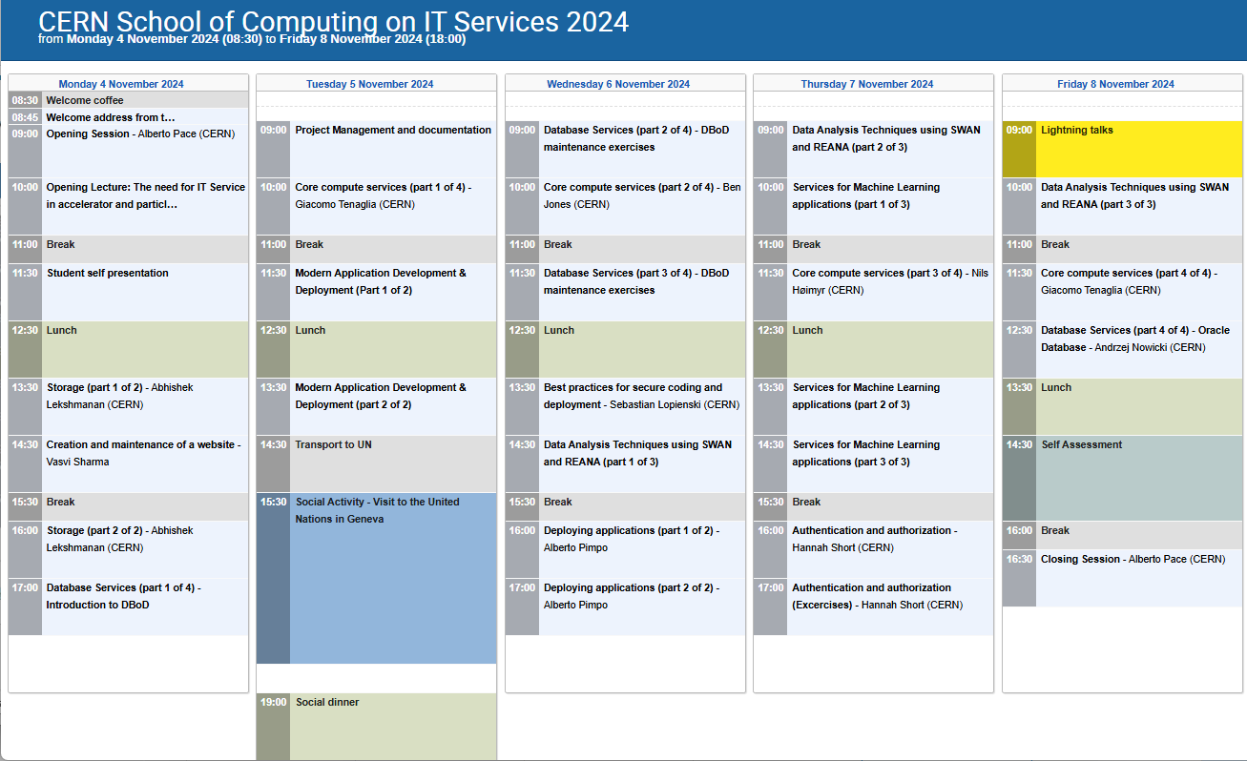
The Programme – 28 hours of lectures
Storage
Web content
Databases
Application Development
Security and authentication
Services for data analysis
Services for machine learning projects

Slide 23
We will have 20 (!) lecturers
Francisco Borges | IT-PW-WA
Diogo Castro | IT-SD-GSS
Raulian-Ionut Chiorescu | IT-CD-PI
Marco Donadoni | IT-CA-OSR
Diana Gaponcic | IT-CD-PI
Ben Jones | IT-CD-CC
Nils Høimyr | IT-CD-CC
Abhishek Lekshmanan | IT-SD-PDS
Sebastian Lopienski | IT-PW-WA
Pedro Miguel Esteves | IT-DA-ASM
Andrzej Nowicki | IT-DA-DB
Alberto Pace | IT-GOV
Alberto Pimpo | IT-PW-WA
Sebastien Ponce | EP-LBC
Ricardo Rocha | IT-CD-PI
Vasvi Sharma | IT-PW-WA
Hannah Short | IT-PW-IAM
Tibor Simko | IT-CA-OSR
Enric Tejedor | IT-DA-ASM
Giacomo Tenaglia | IT-CD-CC

Slide 24
The school learning process
Mandatory
Learning process
  Lectures
  Exercises
  Exam
Meet special persons,
Build trusts with colleagues across the world
  Lunches, dinners, coffee breaks, evenings
  Excursions
  Music events
  Sport programme
Optional

Slide 25
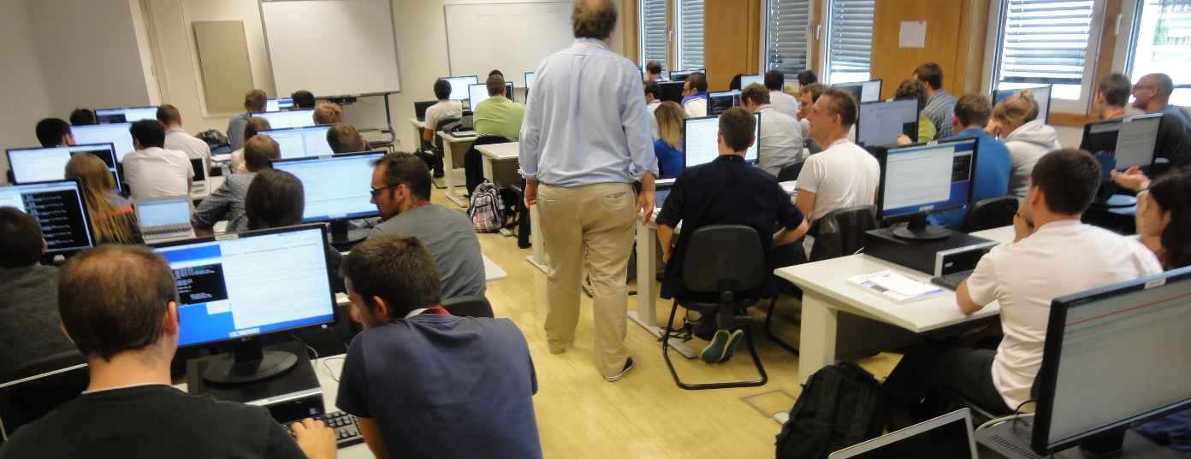
The School culture in “exercises” and “demoes”
The school will use the CERN-IT computing infrastructure for exercises.
Accessible to all participants
You should try to work in pair (2-student teams). If possible:
  1 student with physics background
  1 student with computing background
  Or at least: 1 student from the IT department with one student outside the IT department

Slide 26
The school learning process
Mandatory
Learning process
  Lectures
  Exercises
  Exam (Self Evaluation)
Meet special persons, build trust with colleagues
  Lunches, dinners, coffee breaks, (evenings)
  Excursions
  (Music events)
  (Sport programme)
Optional

Slide 27
The exam
The CSC has a tradition to have a final, serious and difficult exam, which delivers the diploma
This school will have a “Self evaluation” game towards the end ...
  (Kahoot)

Slide 28
The “self evaluation” is part of the learning process
The test statistic is usually a single number whose value ...
  ... reflects an agreement between the data and the hypothesis.
  ... is equivalent to the mean value of the data sample.
  ... must be equal to the most probable value of the distribution in question.
  ... is never larger than the difference between values of variances of two competing hypotheses.

Slide 29
The “self evaluation” is part of the learning process
The test statistic is usually a single number whose value ...
  ... reflects an agreement between the data and the hypothesis.
  ... is equivalent to the mean value of the data sample.
  ... must be equal to the most probable value of the distribution in question.
  ... is never larger than the difference between values of variances of two competing hypotheses.

Slide 30
The “self evaluation” is part of the learning process
In the process of hypotheses testing, we often define the null and the alternative hypotheses. The most robust final results are obtained for ...
  ... the acceptance of the alternative hypothesis.
  ... the rejection of the difference between null and alternative hypothesis.
  ... the acceptance of the ratio of null and alternative hypothesis.
  ... the rejection of the null hypothesis.

Slide 31
The “self evaluation” is part of the learning process
In the process of hypotheses testing, we often define the null and the alternative hypotheses. The most robust final results are obtained for ...
  ... the acceptance of the alternative hypothesis.
  ... the rejection of the difference between null and alternative hypothesis.
  ... the acceptance of the ratio of null and alternative hypothesis.
  ... the rejection of the null hypothesis.

Slide 32
The school learning process
Mandatory
Learning process
  Lectures
  Exercises
  Exam (Self Evaluation)
Meet special persons, build trust with colleagues
  Lunches, (dinners), coffee breaks, (evenings)
  Excursions
  (Music events)
  (Sport programme)
Optional

Slide 33
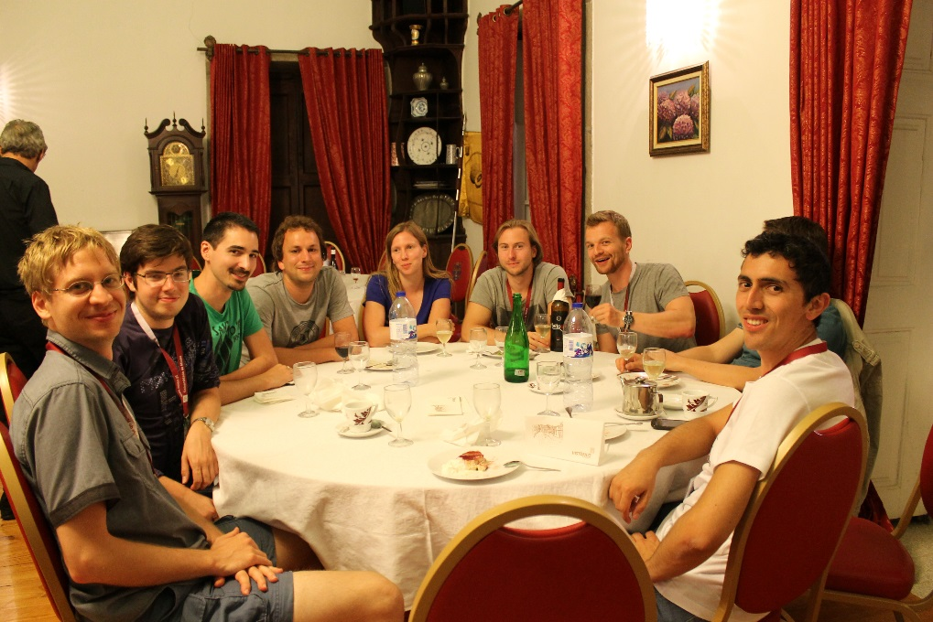
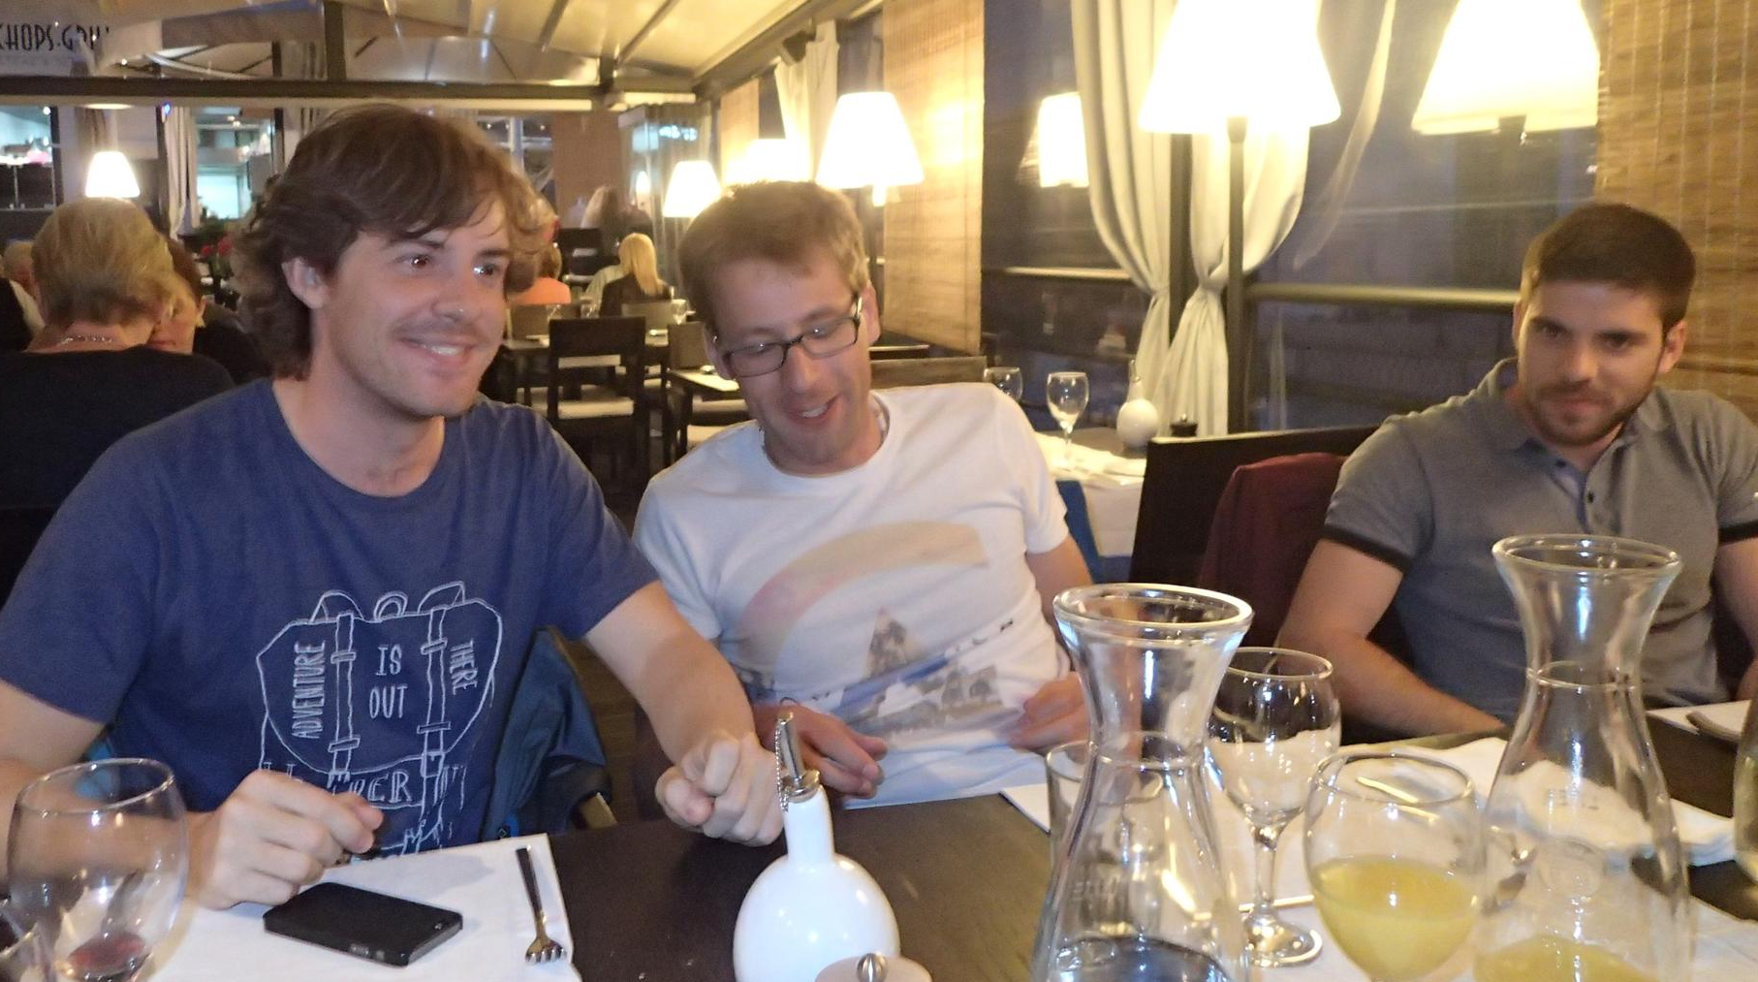
Lunches and Coffee breaks (and Tuesday Dinner)
We will always have some lecturers with us
Lectures are your IT colleagues
You are allowed and encouraged to harass them with your questions
  Unique opportunity, better now and here than later at CERN

Slide 34
School rules …

Slide 35
School rule #1
Participate
  Attendance at all lectures and exercises is mandatory
  You should attend all meals and coffee breaks
  Taking part in social events is optional
    You must let us know whether you participate or not

Slide 36

School rule #2
Be on time
Check what the schedule says:
  “Lecture starts at 9:00” => You must be in the room before 9:00
  (Sign the presence sheet beforehand – it will be removed at 9:00)
  “The bus leaves at 18:00” => It will leave at 18:00
If you’re late, we won’t wait
https://www.youtube.com/watch?v=1dZveoBfiww
Spaceballs, Mel Brooks, 1987

Slide 37
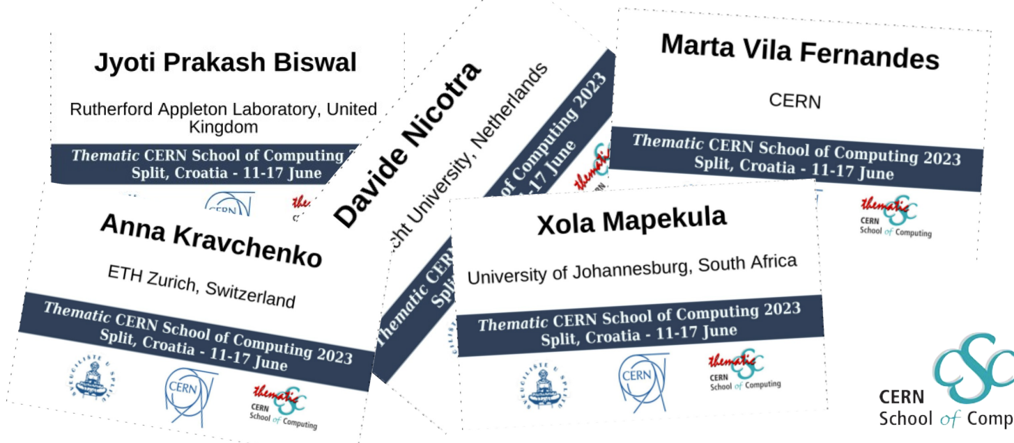
School rule #3
Wear your badge
  At least until I have learnt all your names !

Slide 38


WhatsApp group
Unofficial communication channel
We recommend you to join the group
Autojoin link:
https://chat.whatsapp.com/CTcwgba8LnC2sw6d0lVgrT

Slide 39
Why a new 2024 School on IT Services ?

Slide 40
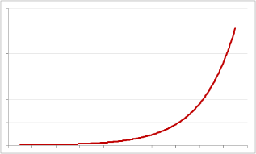
The need for computing in research
Scientific research in recent years has exploded the computing requirements
Computing performance has progressed exponentially (Moore's law)
  At constant cost, exponential growth of performances

Slide 41
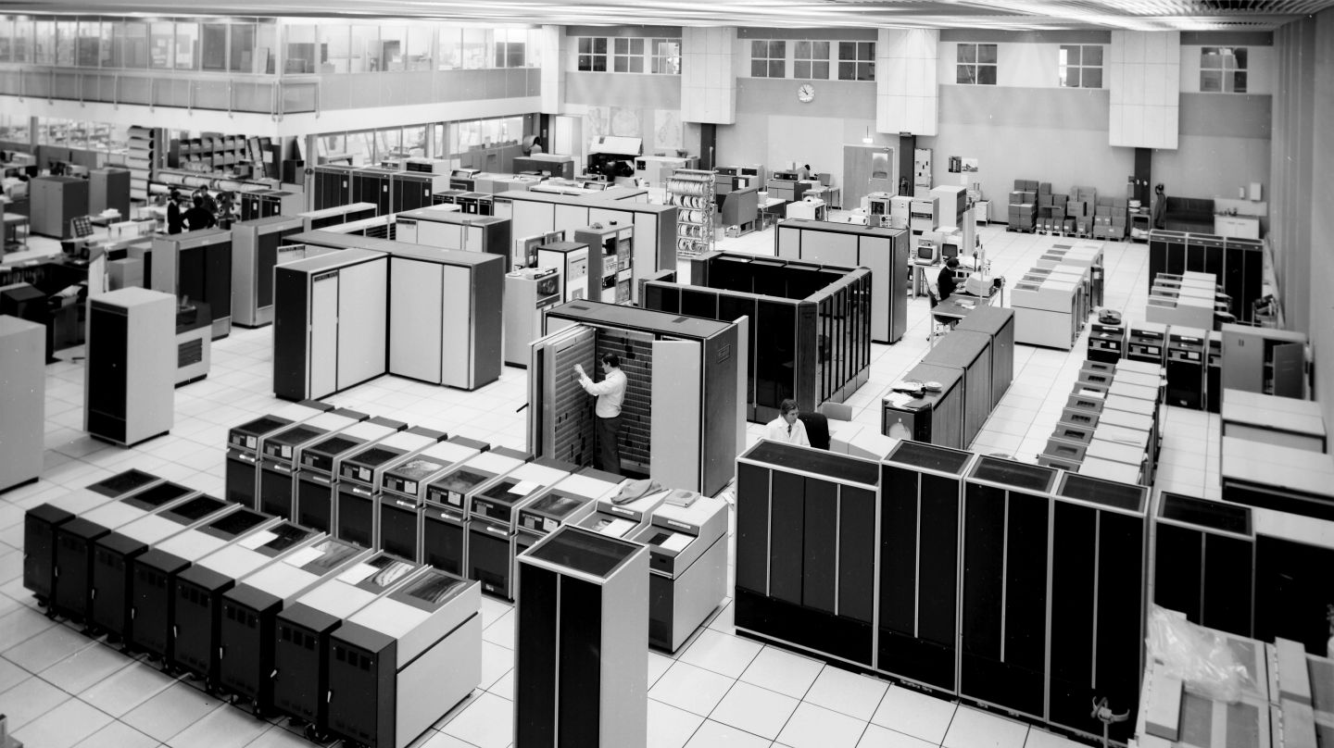
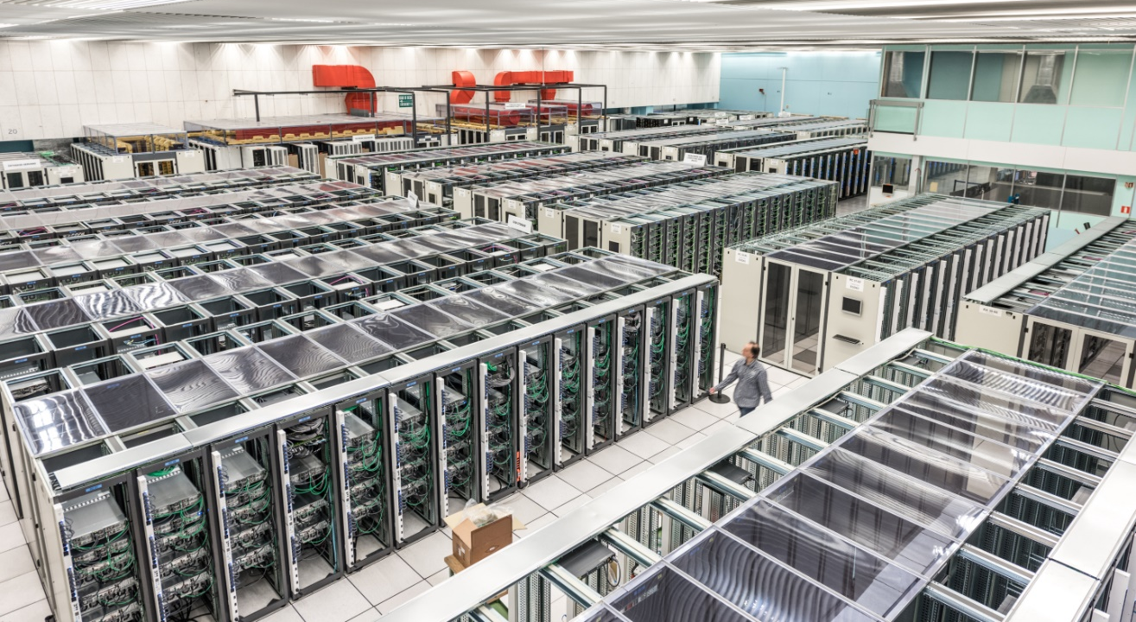
Computing performance has grown exponentially
If exponential growth was enough …no need to expand the data centre
1980
Today

Slide 42
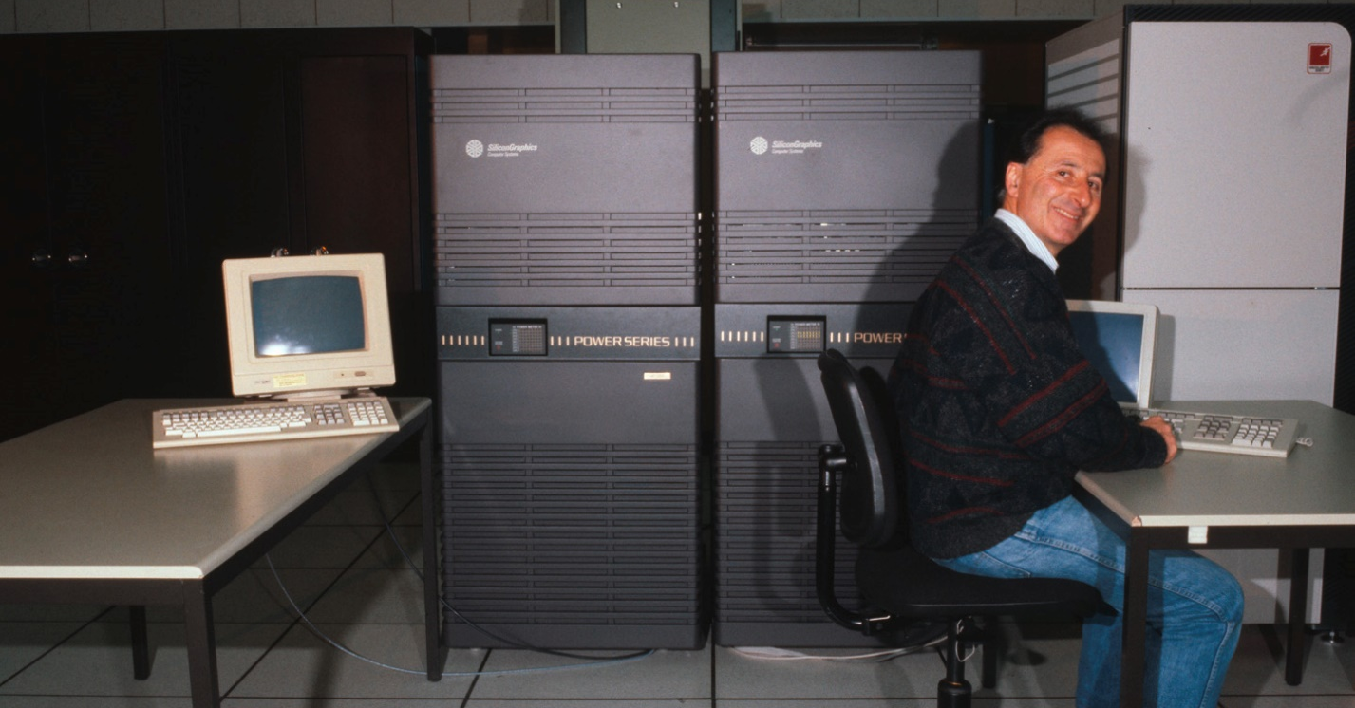
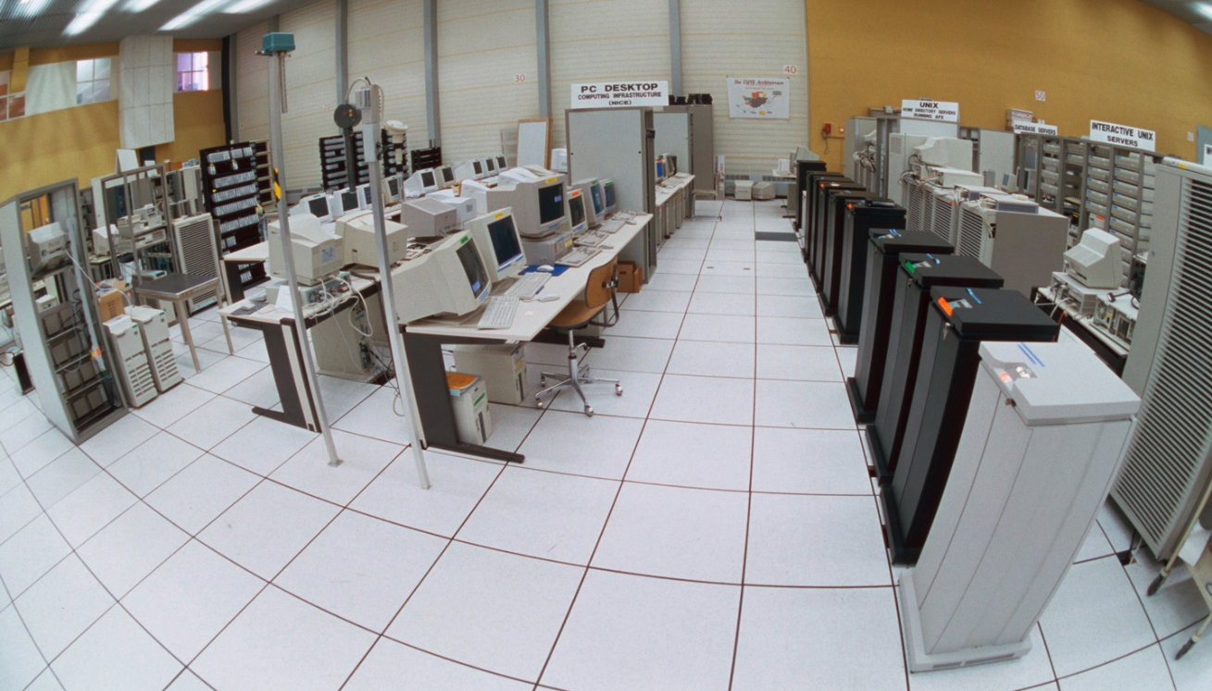
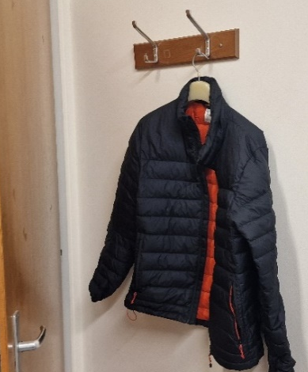
Computing performance has grown exponentially
Timeline of growth … one floor
1990
1998

Slide 43
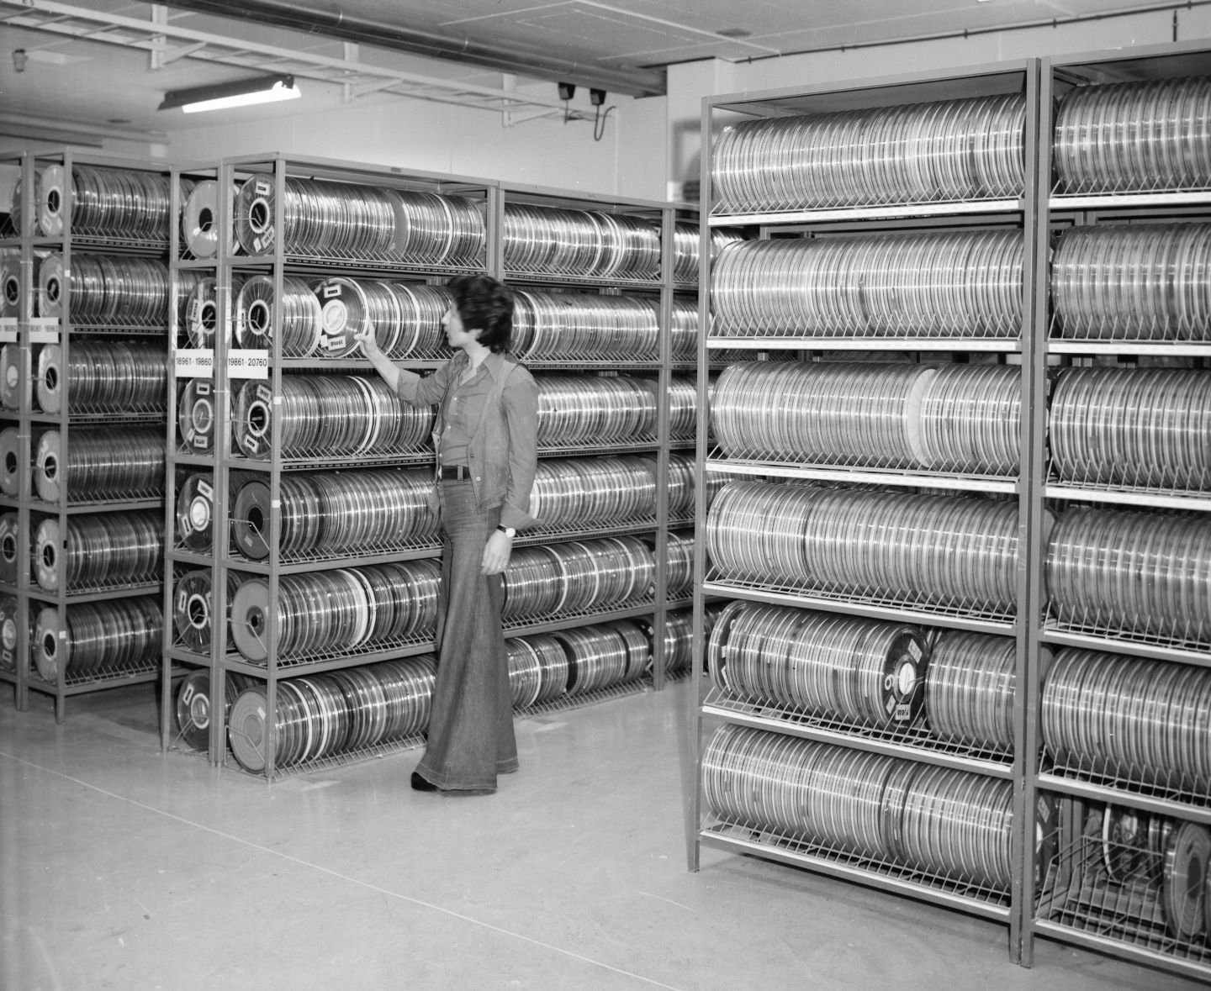
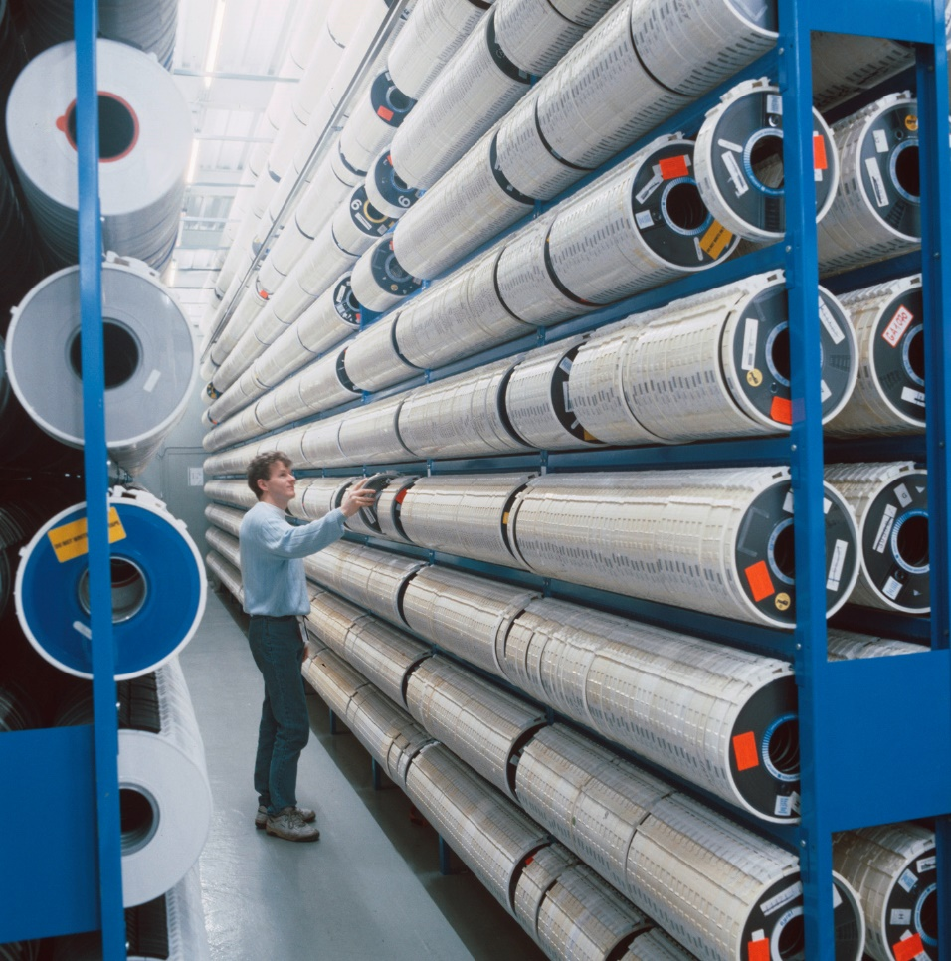
Computing performance has grown exponentially
Lower floor – no computers, only tapes
1978
1989

Slide 44
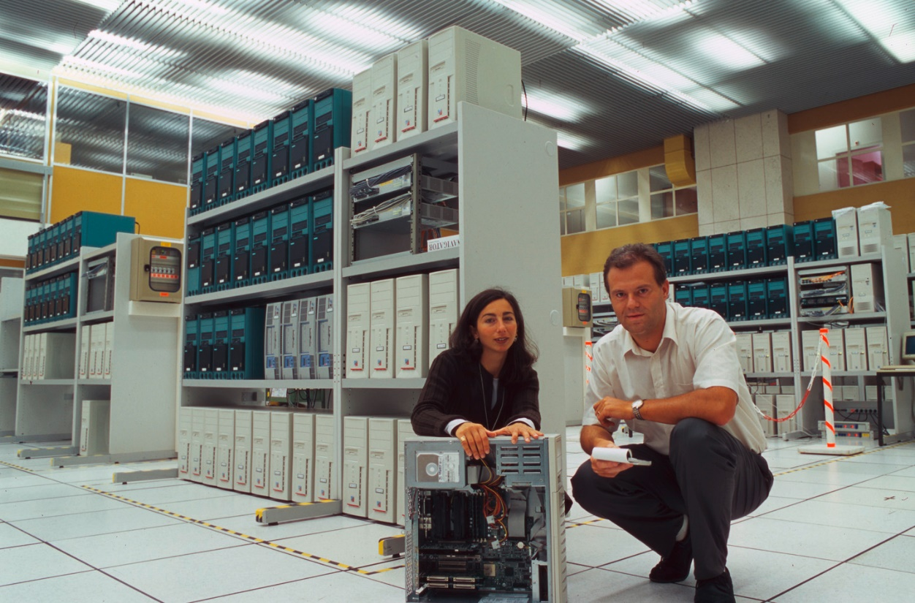
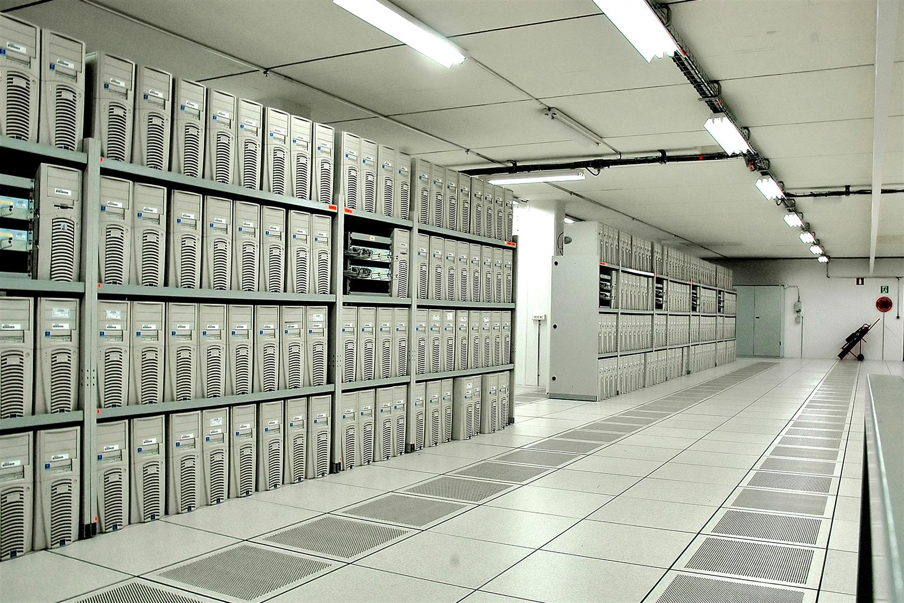
Computing performance has grown exponentially
need to expand the data centre to the lower floor of building 513
2001
2005

Slide 45
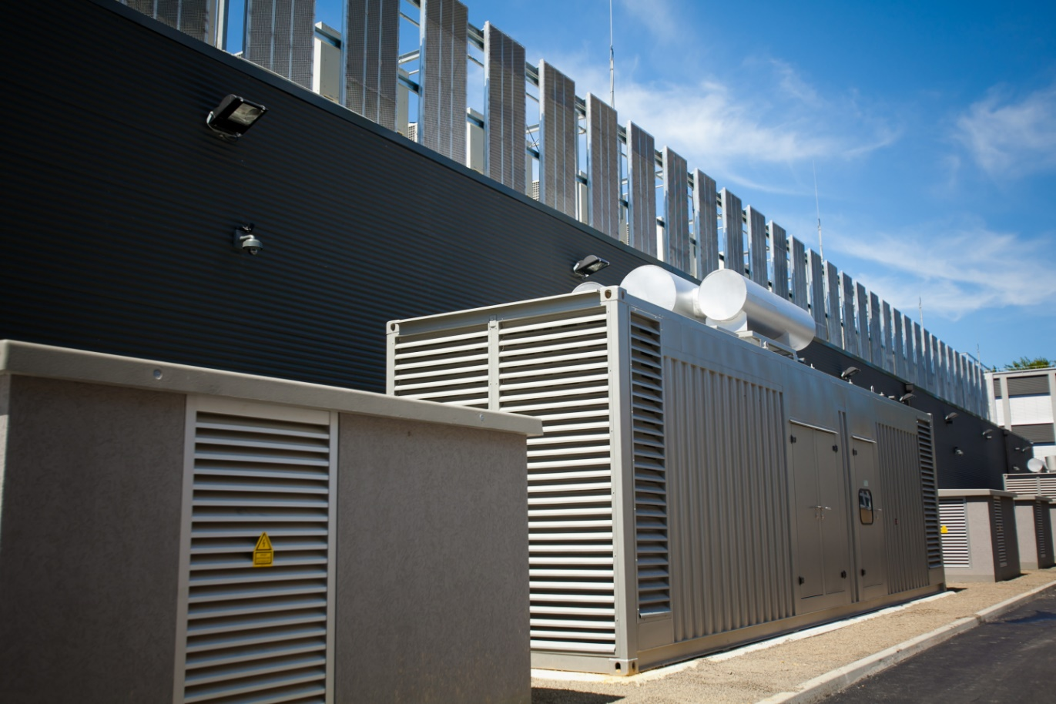
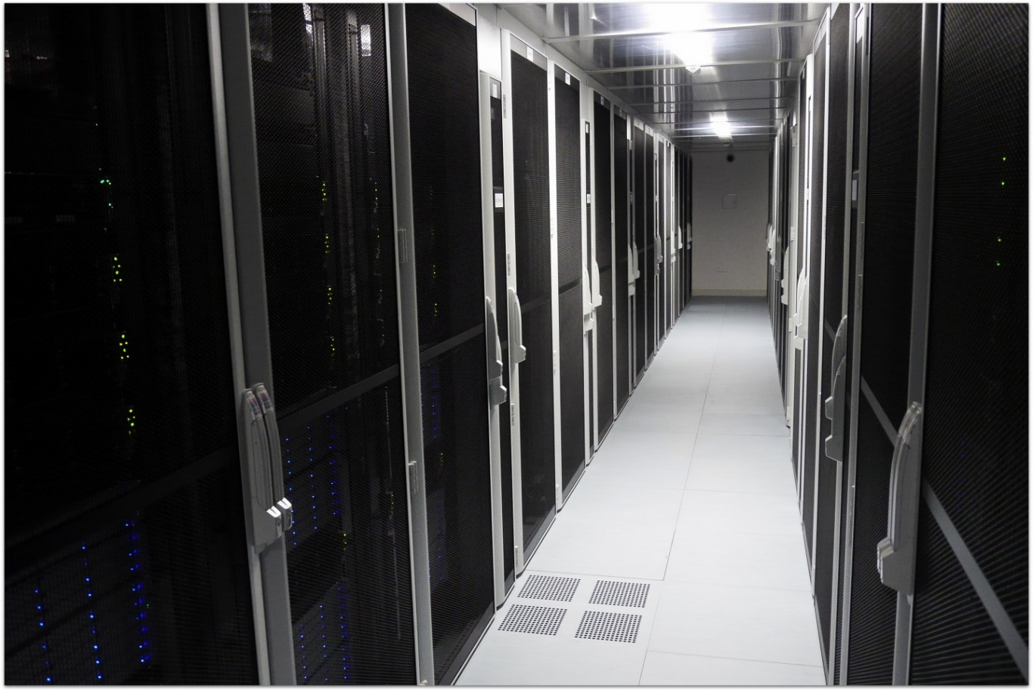
Computing performance has grown exponentially
need to expand the data centre to Wigner (Hungary)
2013

Slide 46
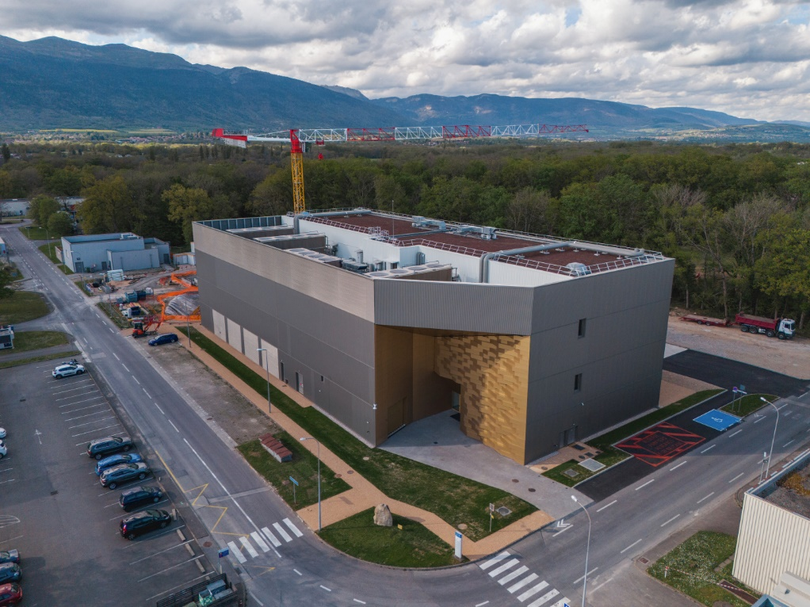
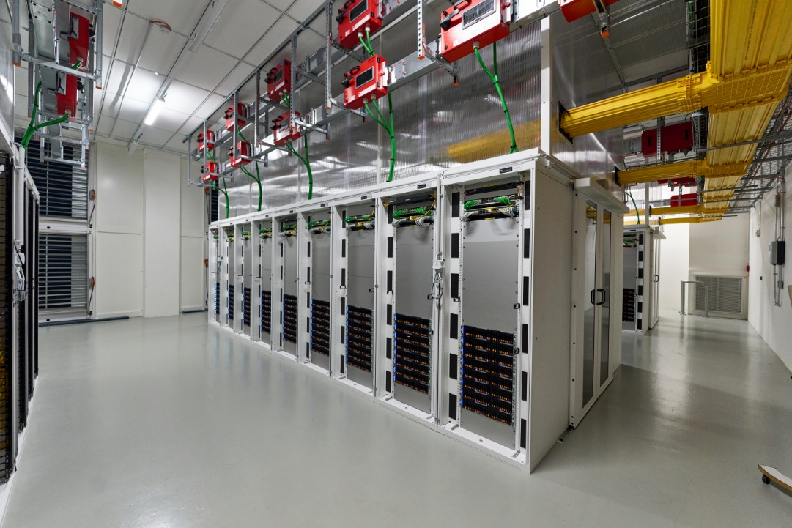
Computing performance has grown exponentially
need to build a 2nd data centre (Prevessin Data Centre)
2024

Slide 47
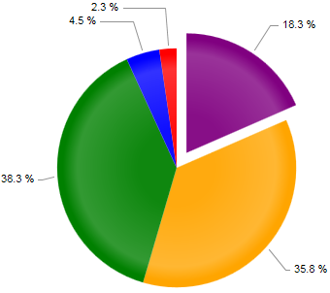
The need for computing in research
Scientific research in recent years has exploded the computing requirements
  Computing has been the strategy to reduce the cost of traditional research
  Computing has opened new horizons of research not only in High Energy Physics
  At constant cost, exponential growth of performances
  Return in computing investment higher than other fields: Budget available for computing increased, growth is more than exponential

Slide 48
What is a scientific computing infrastructure ?
Scientific computing requires a complex infrastructure
  One or more data centres
Several pillars
  Storage
    Files, disks, databases, …
  Computing
    CPUs, GPUs, FPGAs, …
  Networking
    In the Data Centre, on campus, Wide Area, …
... and services !
  Applications, workflows, monitoring, support, security, ….
Scientific Computing
DATA
CPU
NET

Slide 49
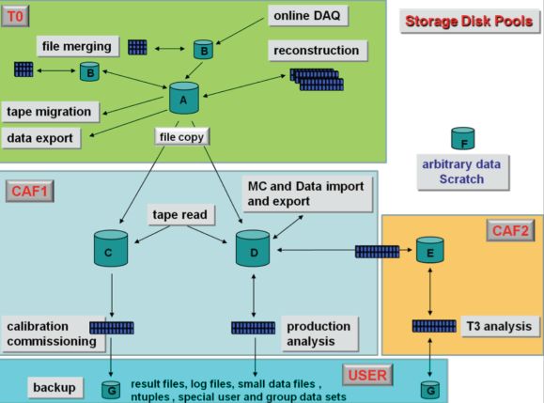
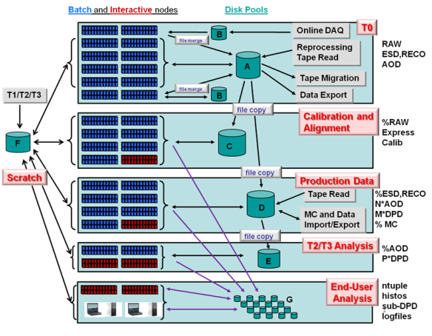
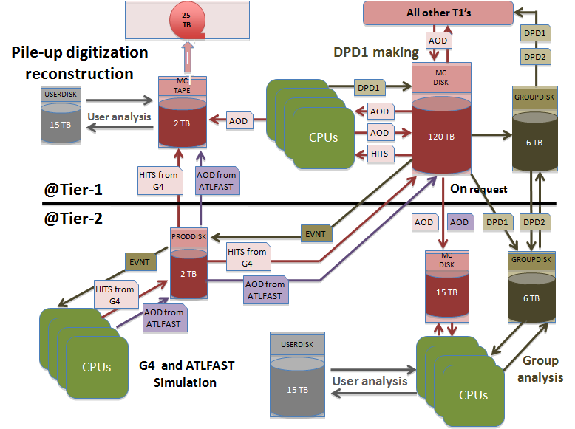
Why services ?
Examples from LHC experiment data management models
Two building blocks to empower data processing
  Data pools with different quality of services
  Tools for data transfer between pools

Slide 50
Example of Storage services
Data Management ensure the following solutions
  Data reliability
  Access control
  Data distribution
  Data archives, history, long term preservation
  In general:
    Empower the implementation of a workflow for data processing

Slide 51
In general we need to find compromises
For all services, where do you position the service ?
With thousands of users …
  Do you provide the best to everyone ?
  Do you provide the cheapest to everyone ?
One size fits all is too simplistic
  This is the main reason why complexity is constantly increasing
  Different quality of services is needed
High performance,
Highly available
Expensive
Slow, unreliable, cheap

Slide 52
But finding the right balance is not as simple
Many ways to define performance and cost
Performance has many sub-parameters
  Speed, throughput, latency, reliability, availability
Cost has many sub-parameters
  Purchase cost, amortization, electricity consumption, manpower
Electrical consumption
Performance
Cost
Ops Cost
(manpower)
Reliability
HW cost

Slide 53
Reality is more complicated than models
Key requirements for IT services: Simple, Scalable, Consistent, Reliable, Available, Manageable, Flexible, Performing, Cheap, Secure.
Aiming for “à la carte” services with on-demand “quality of service”

Slide 54

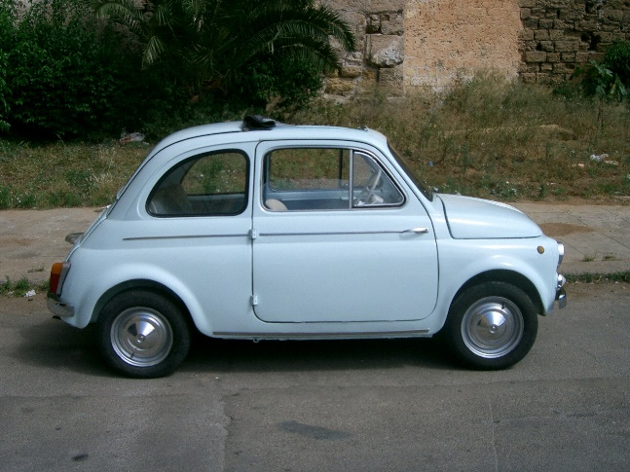
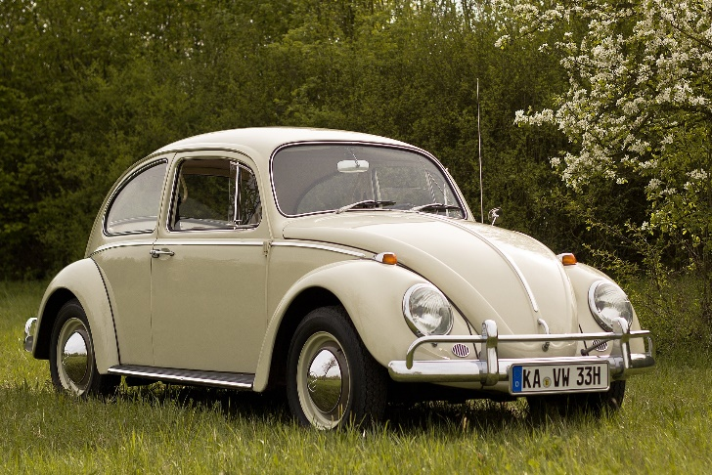



Same as in normal industry ...
In 1960 ... One size fits all
Today ... Try to find two equal cars or two identical Harley-Davidson

Slide 55
Computing industry is following
Early 2000
  Fixed size Virtual Machines
  Cloud Storage
  Network
Today:
  Virtual Machines, Containers, Application
    Ram, CPU, GPUs, ...
  Storage
    Online, Offline, Multiple replicas, ...
  Network
    Bandwith, Roundtrip times, Routes, redundancy ...

Slide 56
Where are we heading ?
Good Software + Cheap hardware can provide “Arbitrary Performance” (for any service)
Expensive
Expensive
Flash, Solid State Disks
Mirrored disks
Software defined service
+
cheap hardware
Tapes
Disks
Slow
Unreliable
Slow
Unreliable

Slide 57
What has recently changed ?
Computers can do a lot more than few years ago:
  The explosion of data processing possibilities
    CPU performance (10³ increase) and number of CPUs available (10³ increase)
  New storage possibilities
    From few GB to many PB (10⁶ increase) – Big Data
  The possibility of collect / transfer / store these data in a distributed environment
    From few Mbit/s to Gbit/s (10⁴ increase)
Imagine if trains would travel at 100’000 Km/h (10³ increase)
or at the speed of light (10⁵ increase)
The general population is unaware of this change
We are just at the beginning

Slide 58
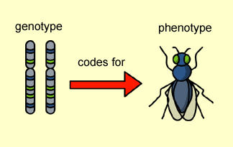

Where will we see most spectacular changes ?
High Energy Physics has been profiting, because the community is historically organized, but all other sciences can expect similar benefits:
  Biology, Medicine, Climate and Weather forecast, …
Finance and market analytics
  Insurances, loans, derivatives, forex, … anywhere there is a contract or a risk
Marketing, targeted advertisements, lobbying, identifying markets
  from data collected worldwide

Slide 59
Take home message:
All hard sciences learnt during your studies are still valid:
  Sciences do not change, but play increased roles in daily life
But … computers and networks can do more today than a few years ago
  Computationally unsolvable problems of the past can be solved today in the blink of an eye.
Owning data is strategic
Cannot fight progress
  Many of these approaches can bring significant improvements to everyone's life
    plenty of new business opportunities, ethical consequences must be understood and handled
  Education is of the utmost importance

Slide 60
Statement from the past chair of the school advisory board …
https://www.facebook.com/1334424117/posts/10232249117833997/?mibextid=rS40aB7S9Ucbxw6v
“Another reason for your optimism is the fact that you go to school every day to learn something new. I know you are usually not exactly thrilled about going and being in school, but consider the following arguments. For thousands of years, millions of people have tried to understand various things about nature and society. Some of them spent their entire lives trying to understand the basic laws of nature, what our planet looks like, how the universe looks like, how stars, planets, people etc were created. You learn most of these things in a few hours of teaching and working at school or at home. From that perspective you know more after a few years of school than some of the greatest scientists in human history. And you find out more and more every day.”

Slide 61
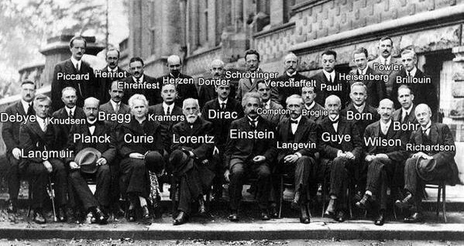
It is a small world …
All top scientists knows each other very well

Slide 62
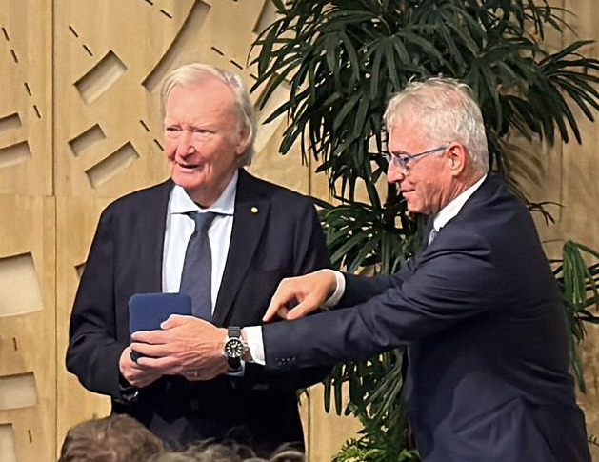
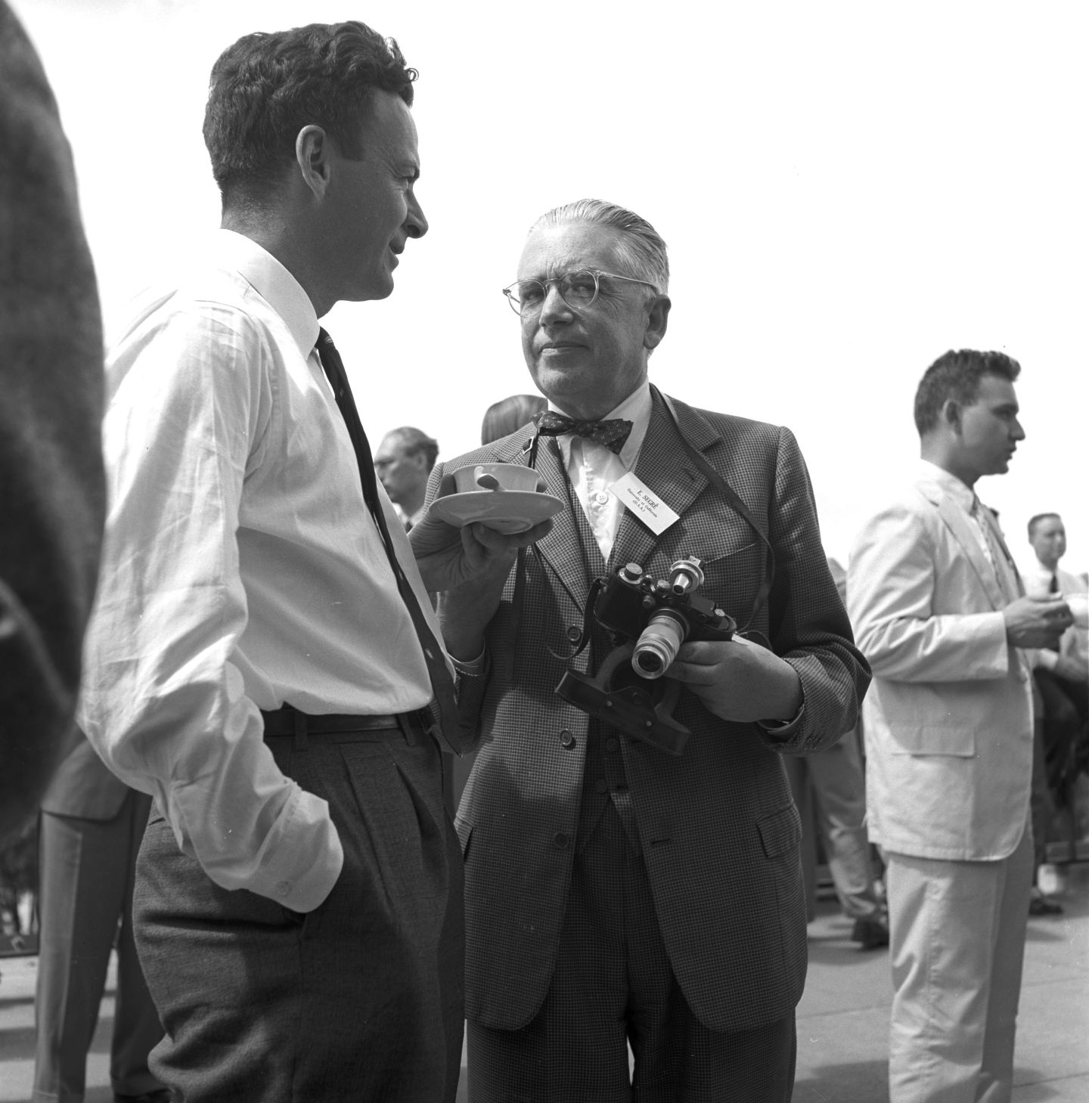
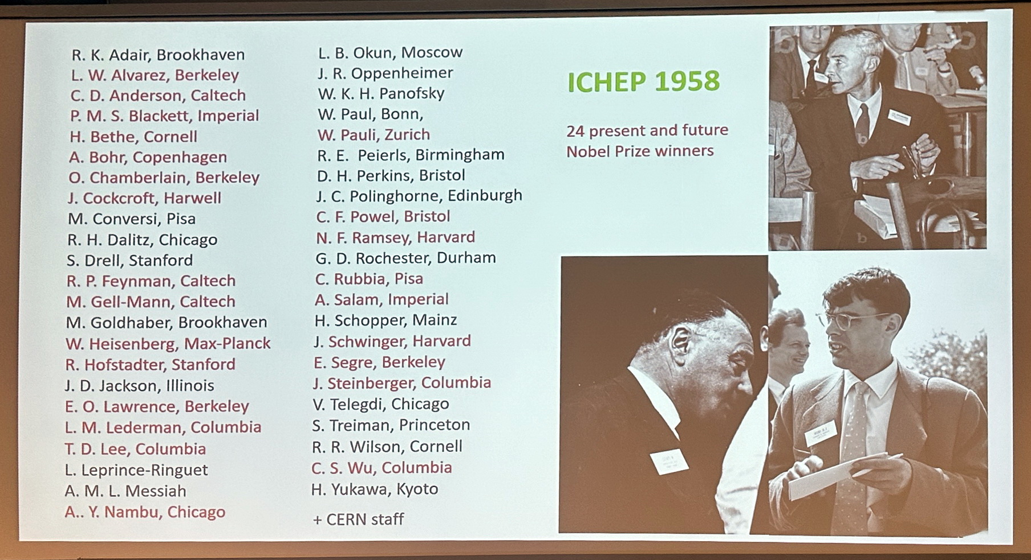
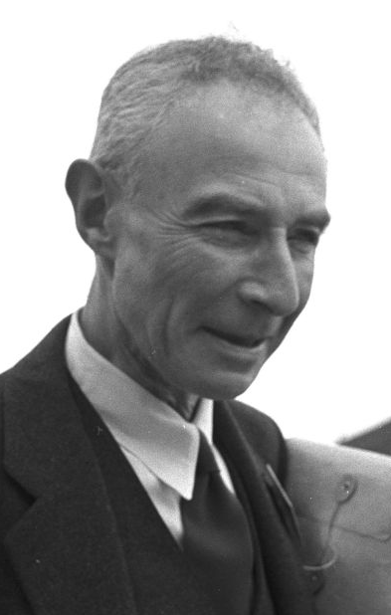
It is a small world …
All top scientists knows each other very well

Slide 63
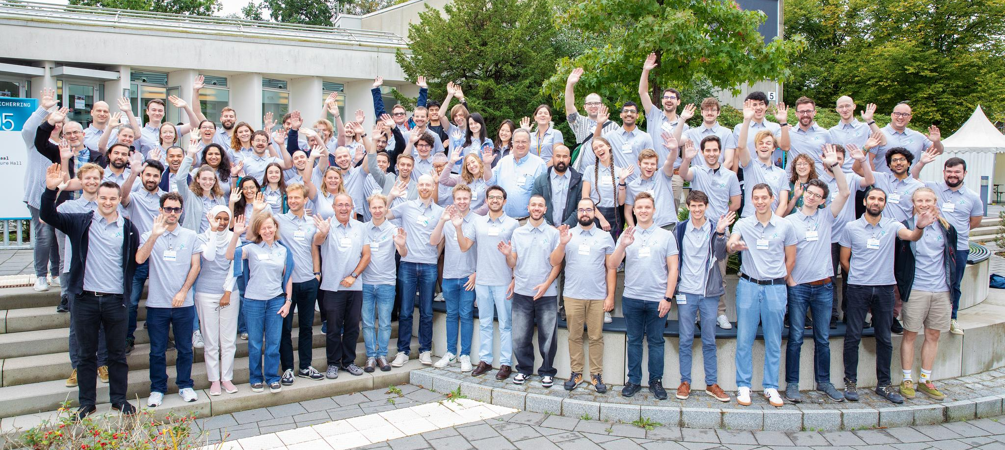
CSC 2024, Hamburg, Germany

Slide 64

CSC 2024 on IT Services
Are you ready to write history ?
School photo:
Friday before the
Closing Ceremony

Slide 66
Lightning talks tomorrow
Remember … you only have few minutes
No time to explain in depth a technology or a solution
What you can achieve is generate interest in a technology or a problem
  Find other persons working on similar topic and exchange experience
Give pointers to the detailed solution of the problem or to the challenges you are facing

