Slide 2
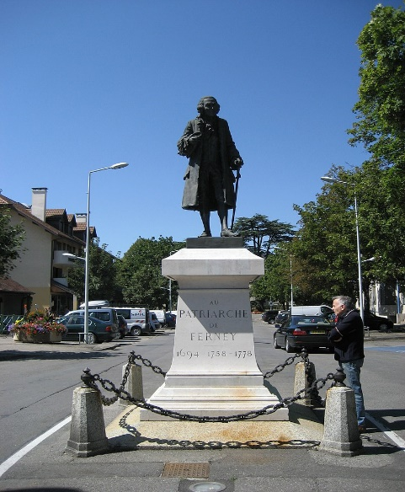
School Closing Address
Friday 8 November 2024
CSC 2024
On IT services
CSC 2024
On IT services
4-8 November 2024
Ferney-Voltaire
4-8 November 2024
Ferney-Voltaire

Slide 3
The new School on IT Services
The school on IT Services aims to empower CERN members of personnel (including Students, Fellows, Origin, Quests, Staff, and Users) to get the most out of the computing services delivered by the CERN IT Department to the community.
The school is for any person that use CERN IT services to deliver information, or analyzes data, or automates tasks or works in engineering projects.
Participation is from both active users who would like to be more proficient and newcomers at CERN that would like to discover and get an introduction to the ecosystem of computing services available to all CERN users.
Repetita iuvant

Slide 4
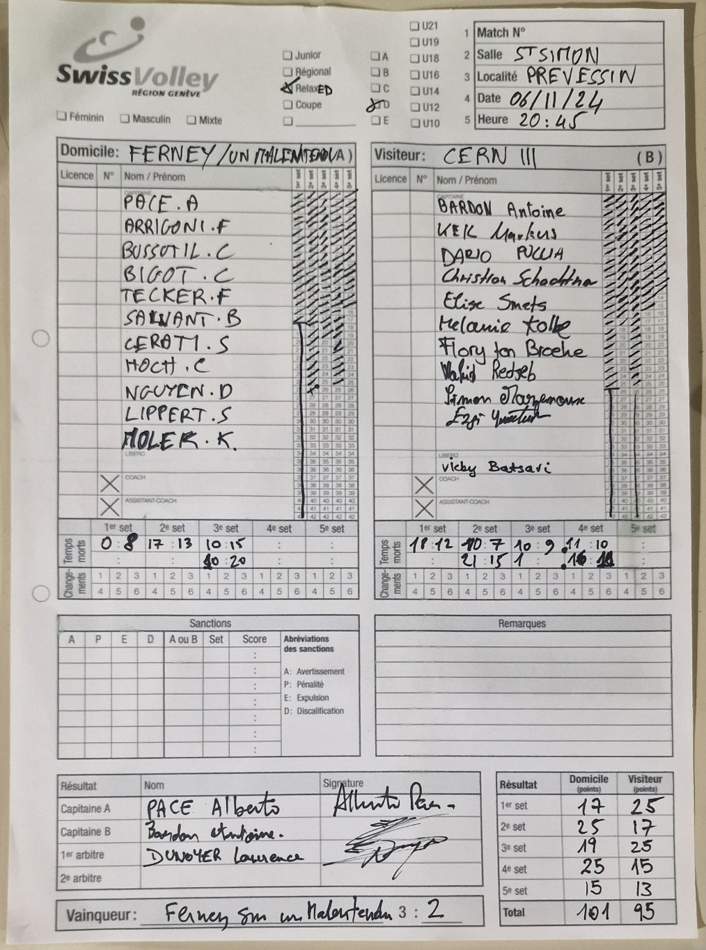
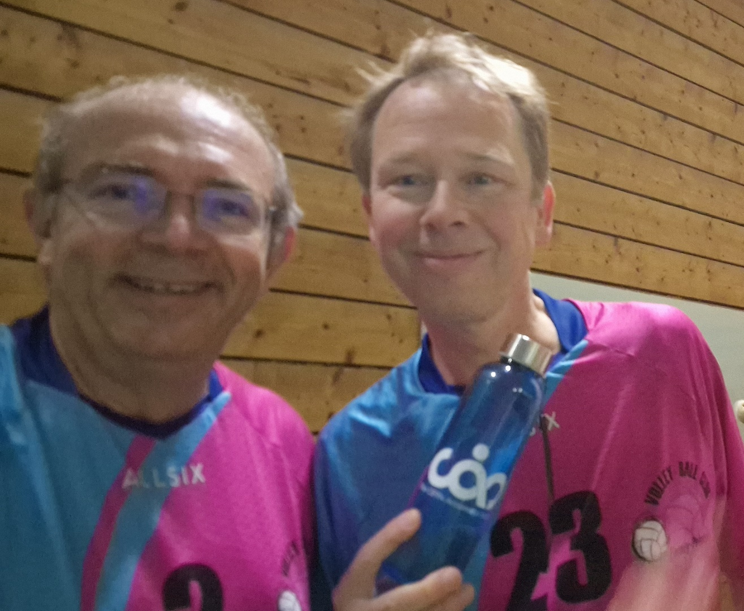
This Wednesday …

Slide 5
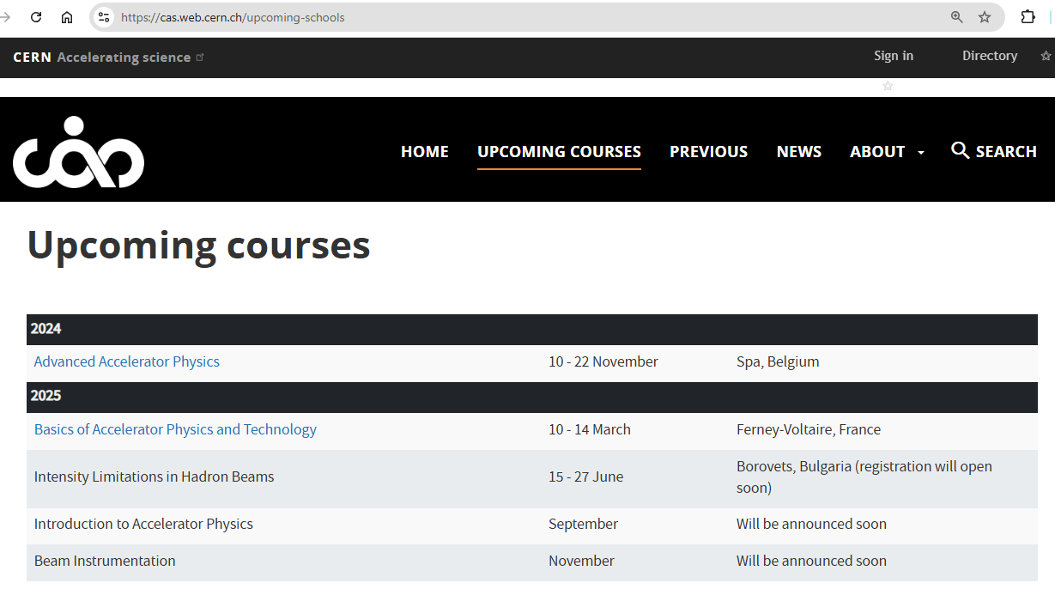
Our sister school …

Slide 6
This is the first school on IT Services
A pilot school
  Your feedback will be extremely important
Everything can be changed
  Location: At CERN or outside ?
  Topics: basic IT Services or advanced IT Services
  Shorter school or longer school ?
  Speakers: More speakers on shorter presentations or less speakers fovering services in depth ?
  Exercises: Hands-on (need time) ? Demos ? Interactive ?
  More social activities ? More dinners together ?
Repetita iuvant

Slide 7
Important: the feedback survey
Feedback questionnaire
  anonymous feedback about the School, lectures, exercises
  details will come by e-mail
  you must complete this feedback questionnaire
  really, please do – we need your input, so that we can evolve, and get even better!
All slides are published on the school indico website
All participants will receive a “certificate of attendance”

Slide 8
The school learning process
Mandatory
Learning process
  Lectures
  Exercises
  Exam (Self Evaluation)
Meet special persons, build trust with colleagues
  Lunches, dinners, coffee breaks, (evenings)
  Excursions
  (Music events)
  (Sport programme)
Optional

Slide 9
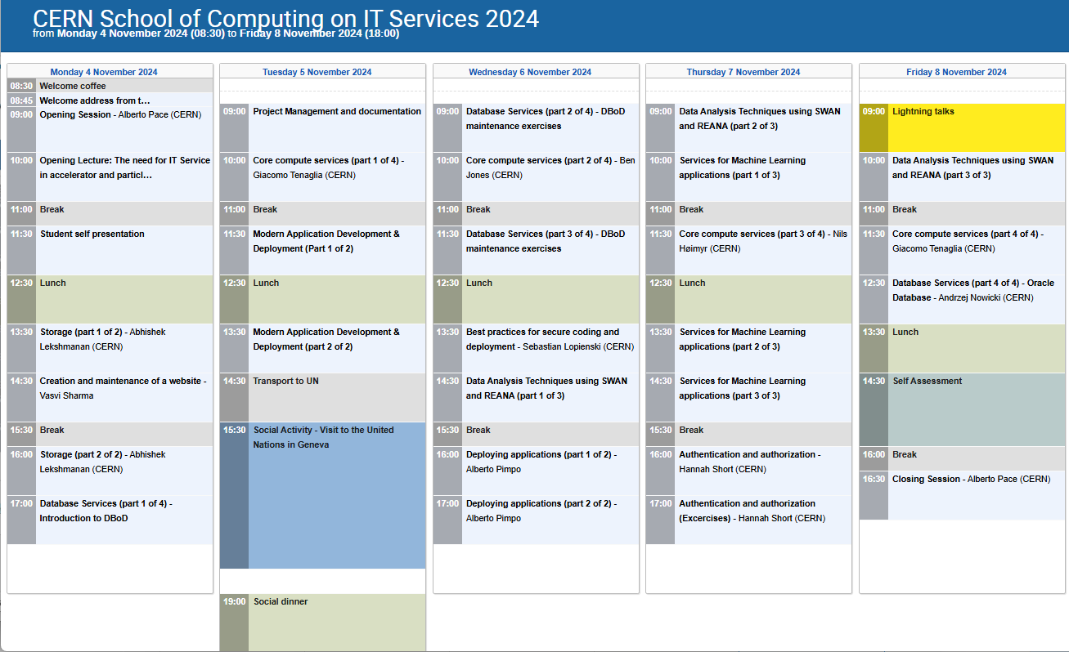
The Programme – 28 hours of lectures
Storage
Web content
Databases
Application Development
Security and authentication
Services for data analysis
Services for machine learning projects

Slide 10
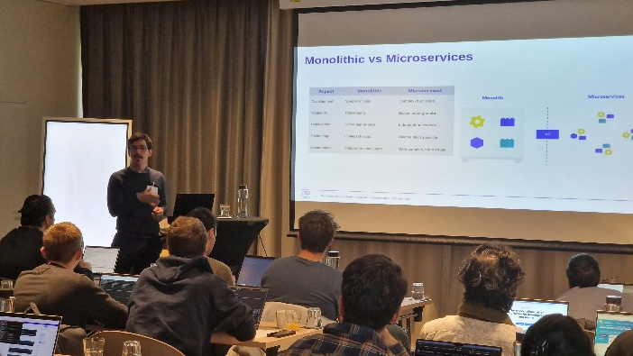
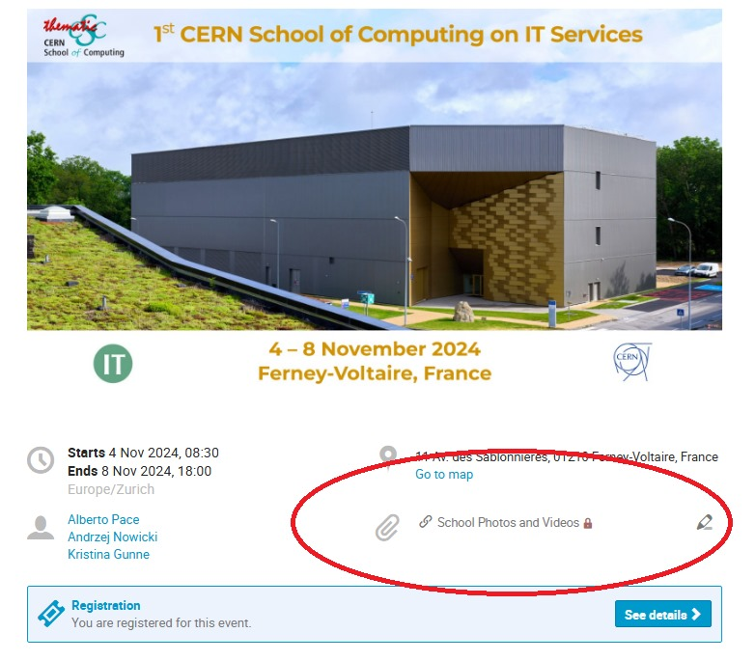
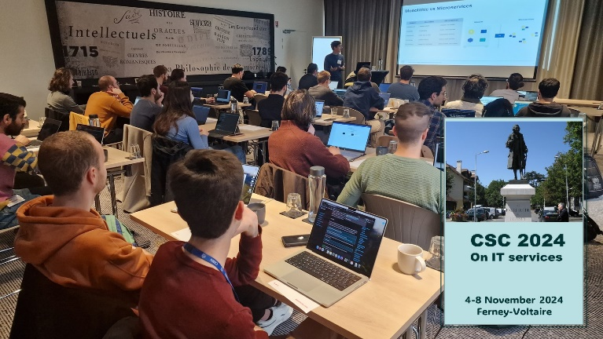
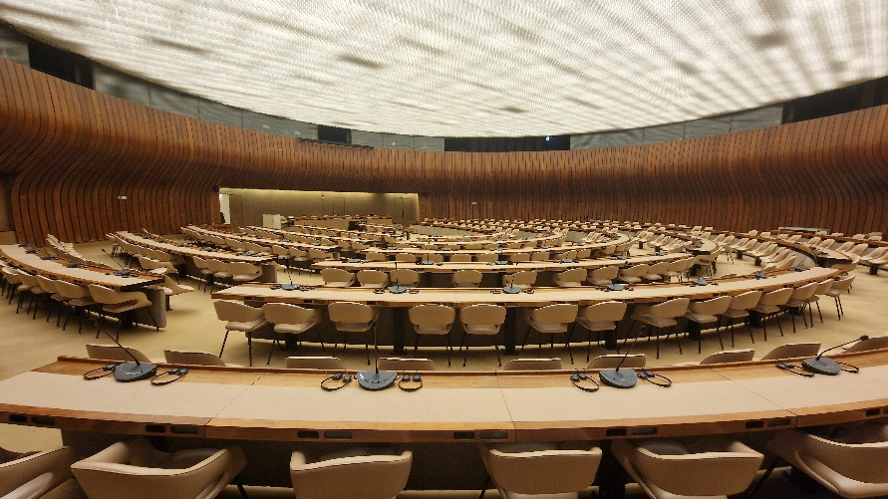
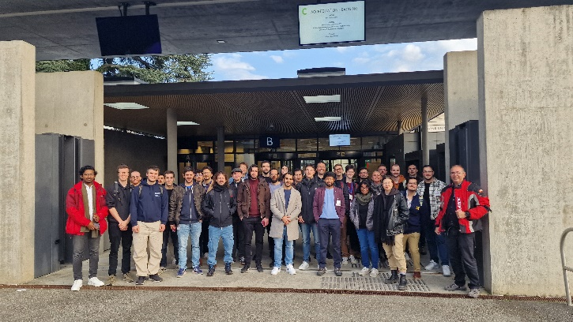
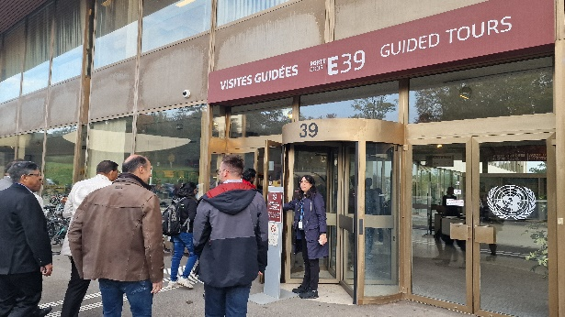
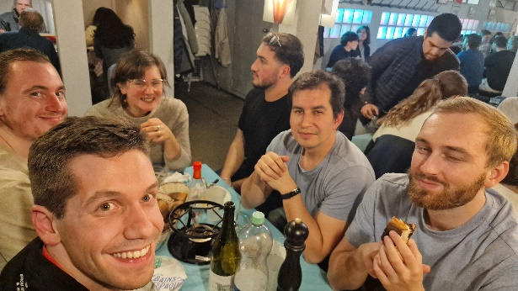
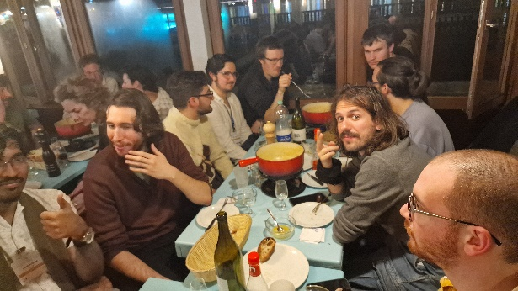
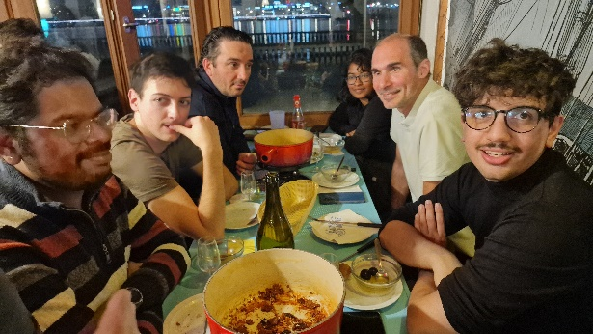
School pictures on CERNBOX

Slide 11
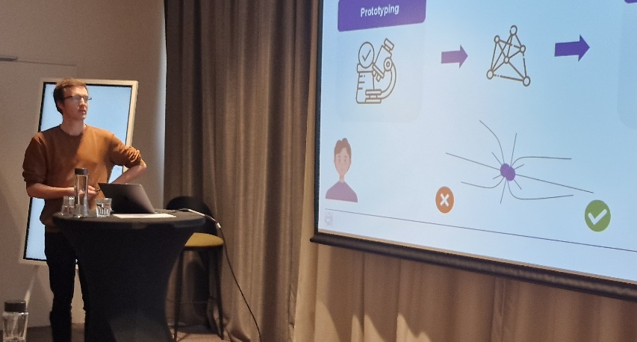
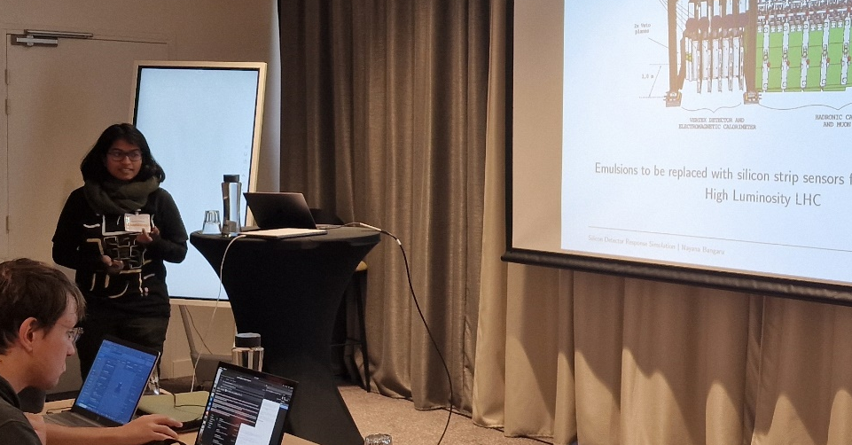
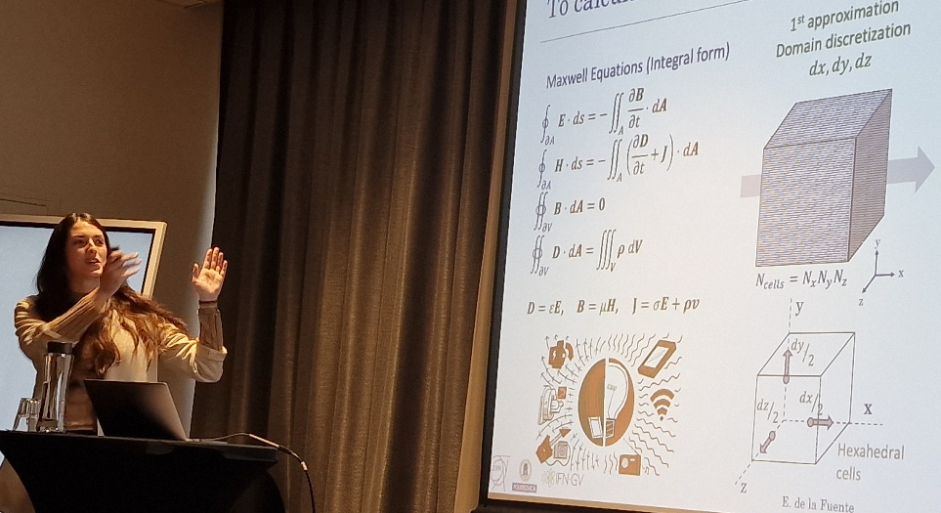
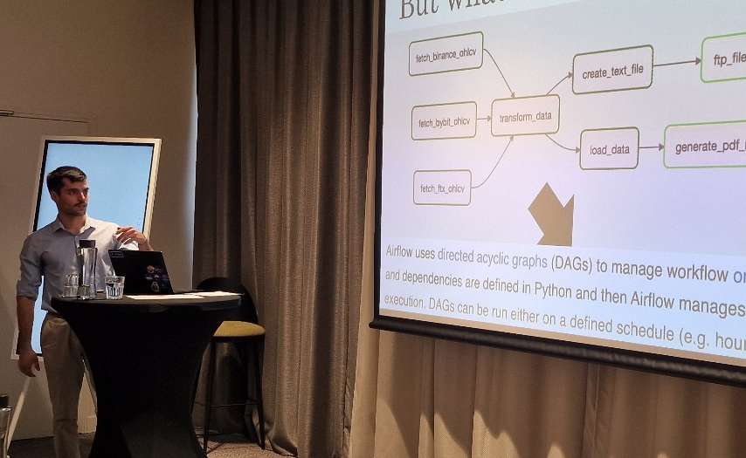
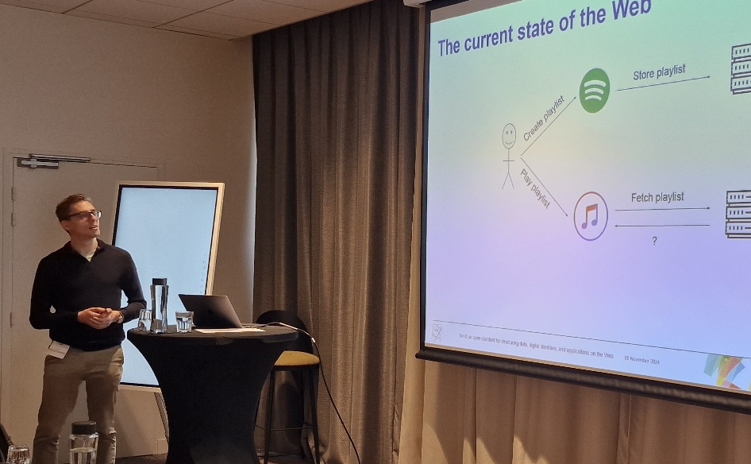
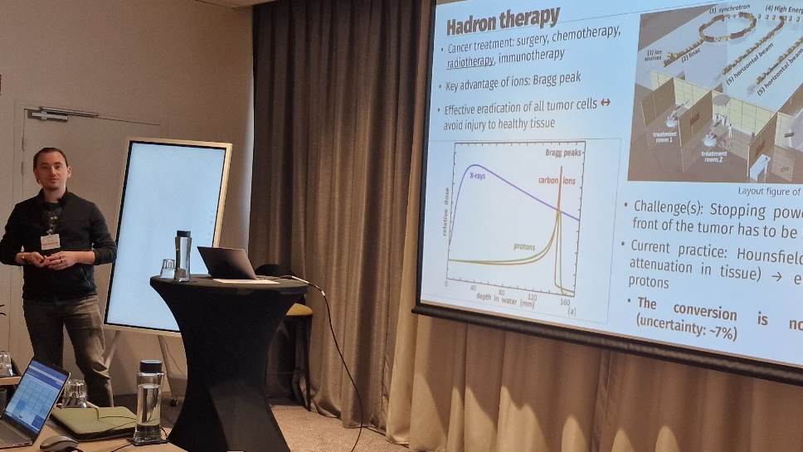
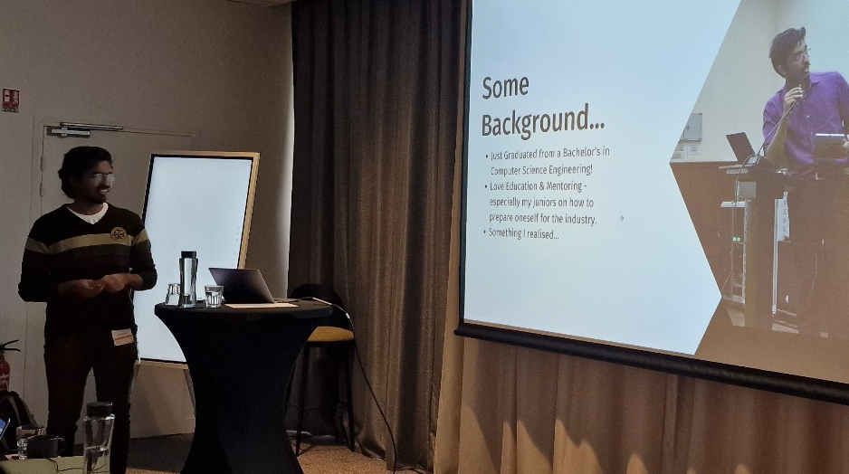
School lighting talks

Slide 12
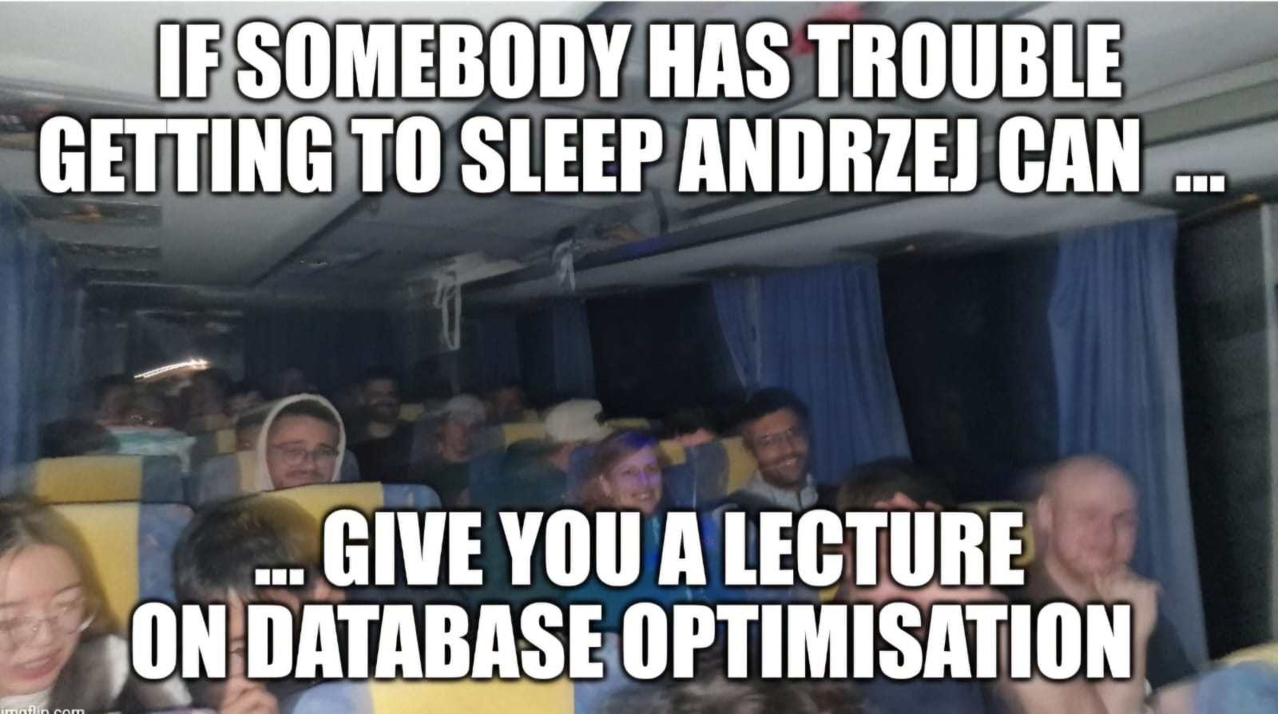
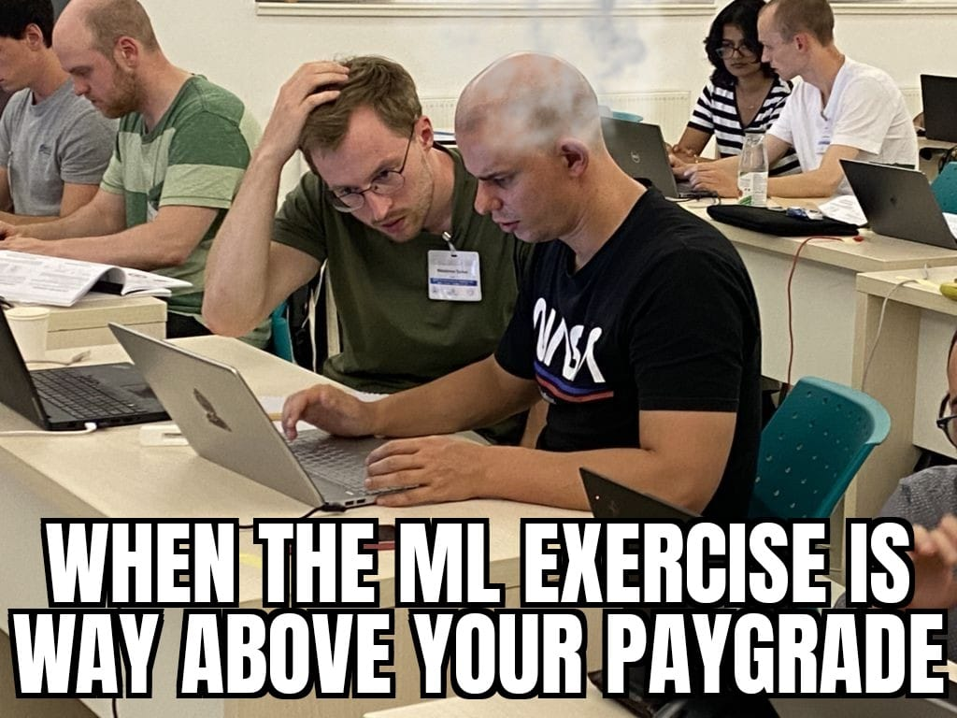
We did not have memes …

Slide 13
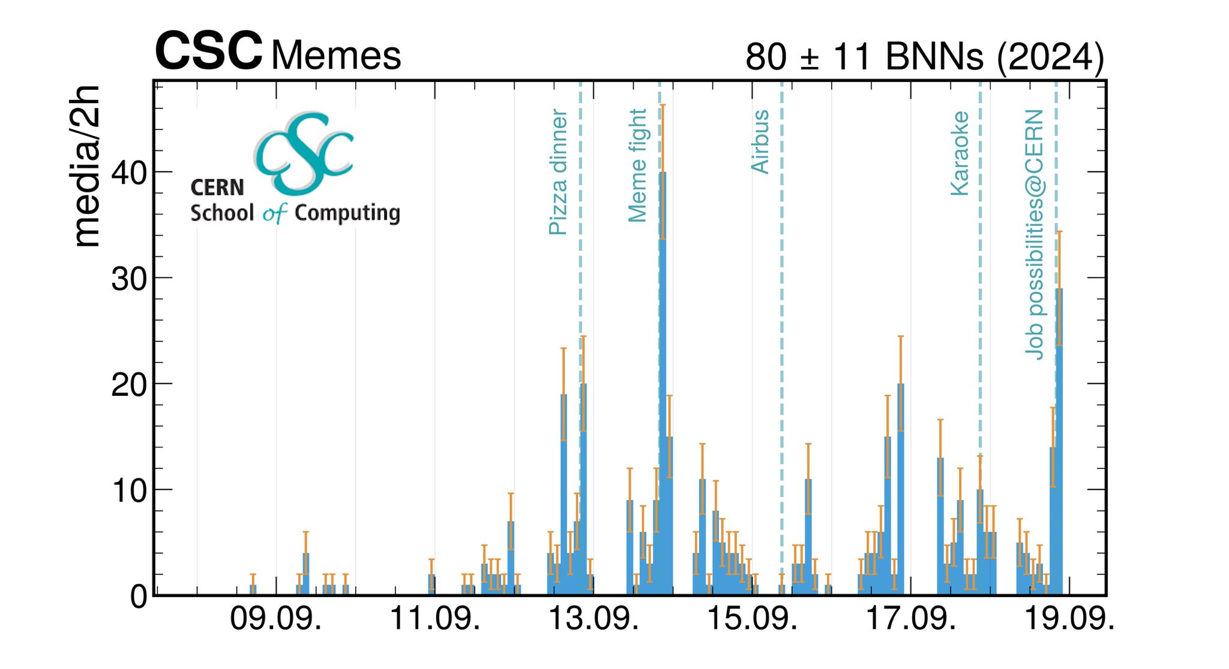
Do we need a memes competitions also at IT Services CSC ?
Increasing rate of memes at the last main school in Hamburg

Slide 14
Now, what’s next ?

Slide 15
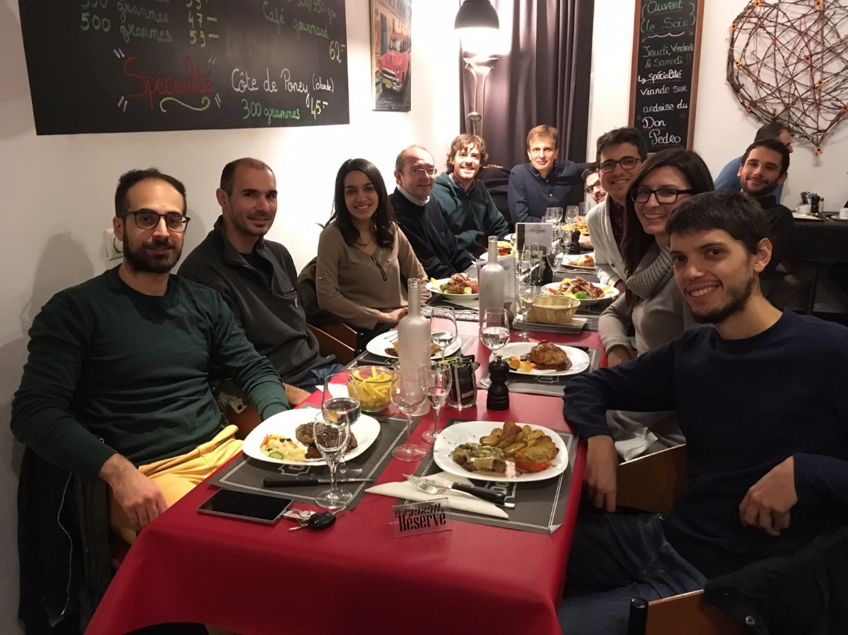
Post-school networking
You will meet at CERN
You can ask questions to students of the same promotion
You can support IT services within your working environment
You can continue ask questions to the lecturers you have met after the school …
Notes:
Xmas 2016 lunch

Slide 16
Upcoming CERN Schools of Computing
Unconfirmed
Unconfirmed
iCSC 2025
Inverted School
sCSC 2025
Computer
Security
tCSC 2025
Machine Learning
CSC 2025
tCSC 2025
Heterogeneous
Architectures
tCSC 2025
On IT Services
March 2025
Registration online
in February
CERN, Geneva
April 2025
Subscription
opens in December
Abingdon, UK
June 2025
Subscription
opens in February 25
Malmö, Sweden
July / August 2025
Subscription opens
In March 2025
Lund, Sweden
October 2025
Subscription
opens in June 25
TBD
November 2025
Subscription
opens in June 25
Ferney-Voltaire, France
Attend other CSCs ☺
Advertise CSC
to your colleagues
Advertise CSC
to your management

Slide 17

The inverted CERN School of Computing

Slide 18
Why an inverted CSC ?
At every CSCs, the sum of the knowledge of the students often exceeds the one of lecturer teaching, and that it is frequent to find in the room real experts on particular topics. This is the idea behind iCSC.
Reversing the roles
CSC n
iCSC n
CSC n+1

Slide 19
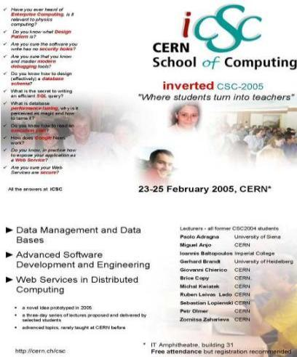
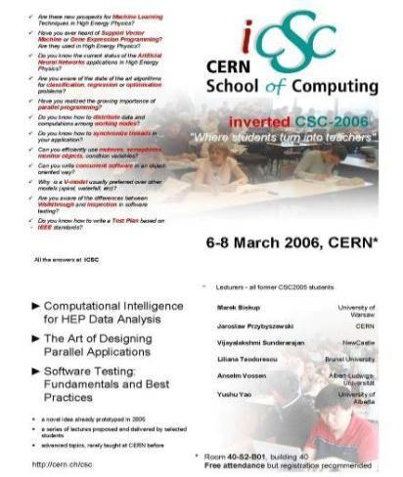
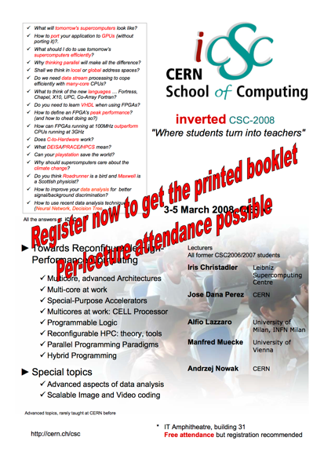
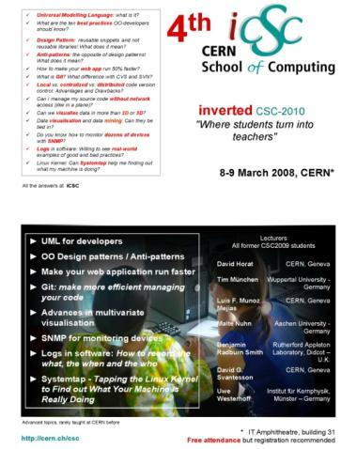
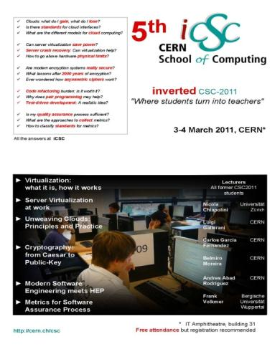
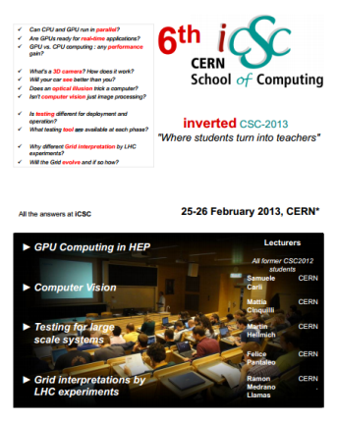
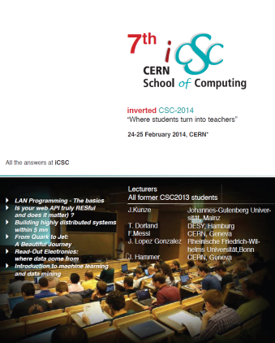
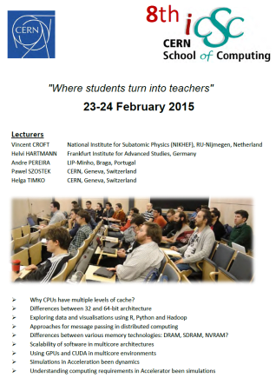
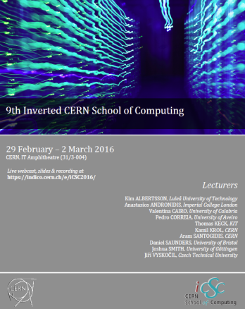
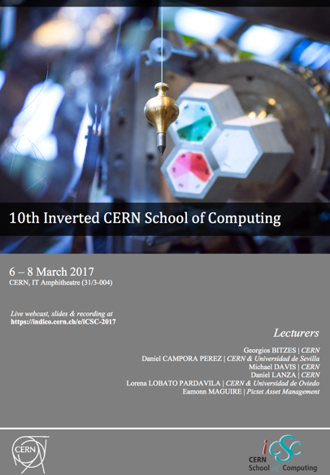
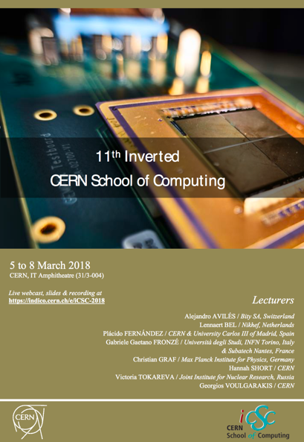
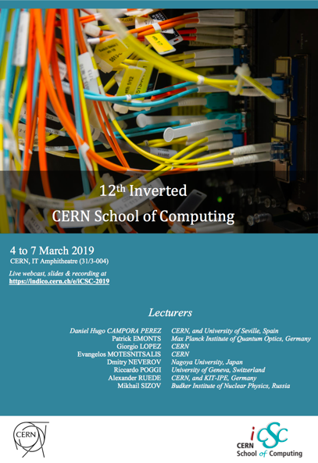
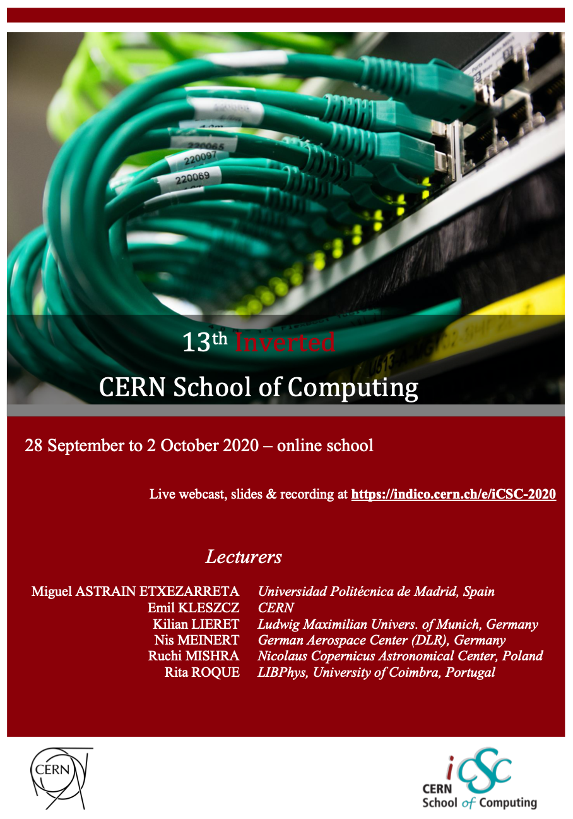

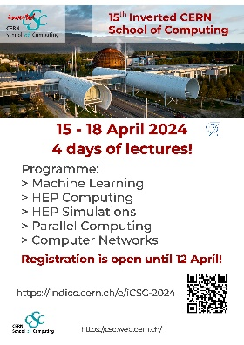
2025: will be the 16th edition of the iCSC
2005
2006
2008
2010
2011
2013
2014
2015
2016
2017
2018
2019
2020
2023
2024

Slide 20

The inverted CSC
At the end of each main school, we call students present to make proposals. When we receive sufficient proposals of appropriate quality, we organize an inverted school.
The students combine their skills and elaborate on CSC related subjects.

Slide 21
The iCSC lectures 2024 selection process
A tough competition
  We have received 24 outstanding proposals
  A total of 48 hours of lectures
  Hard choices had to be made
This provided an excellent school content!

Slide 22
Selection process for iCSC lectures
Discussions at the main / thematic school
Lightning talks at the school
Proposal after the school
Review and selection by the CSC Advisory committee
Lecture preparation and development with mentors
  (1-2 mentors for each lecturer) (December, January)
Finally, the presentation at the school

Slide 23
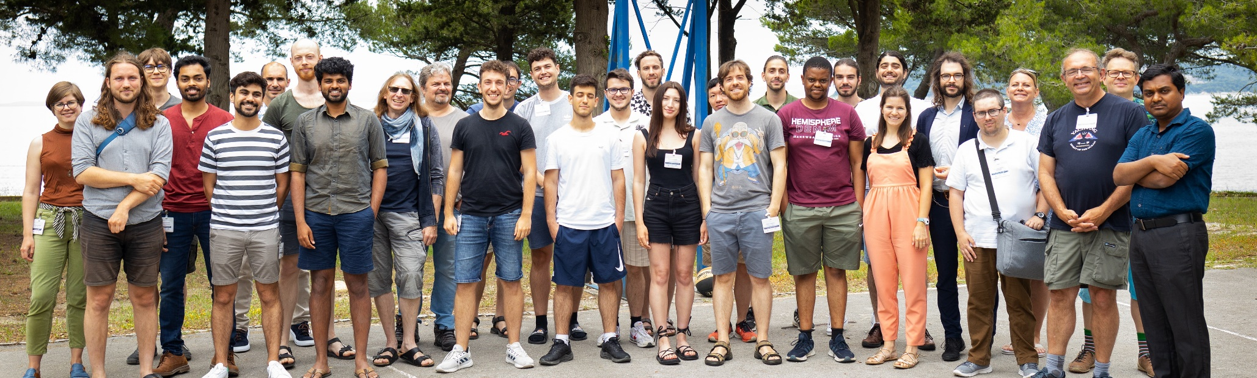
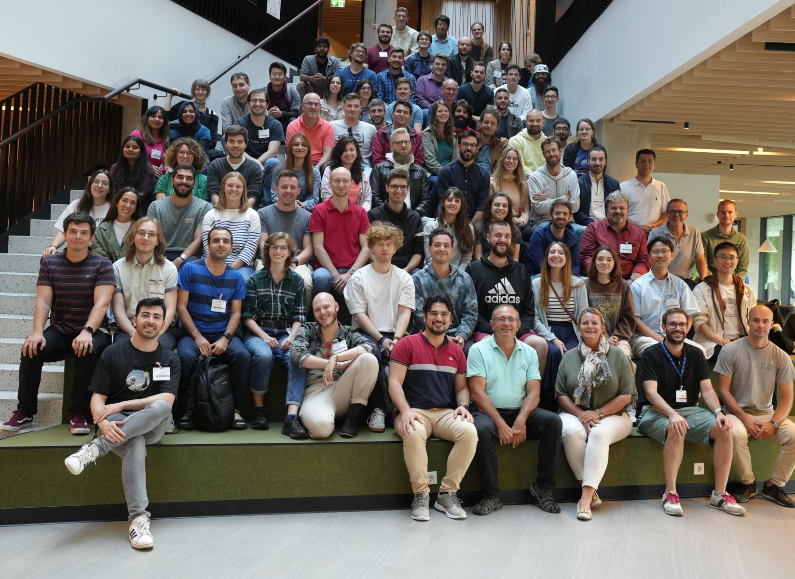
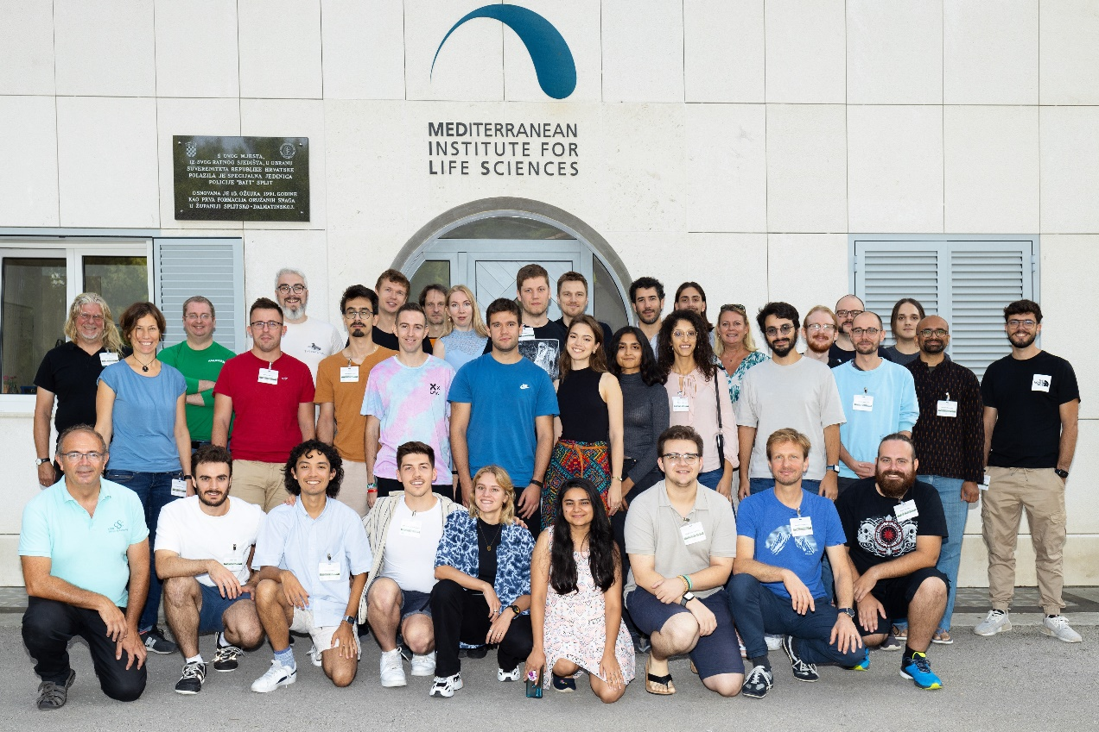
2023 -> 2024 …
thematic CSC, Split 2023
security CSC, Split 2023
Main CSC, Tartu 2023

Slide 24
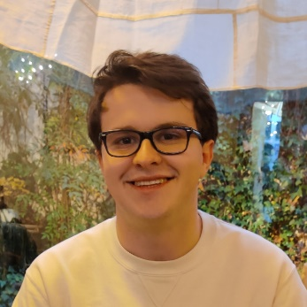
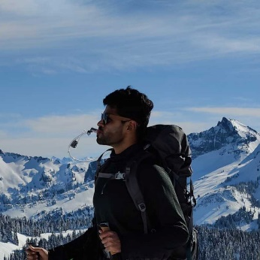
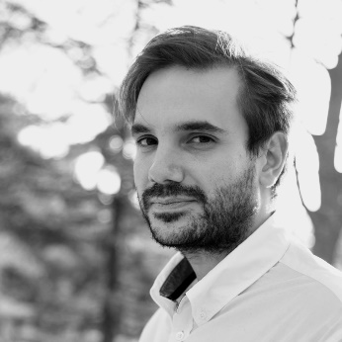
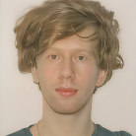
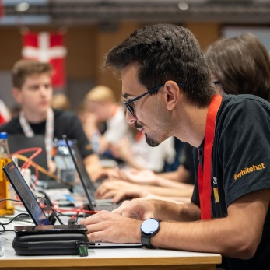
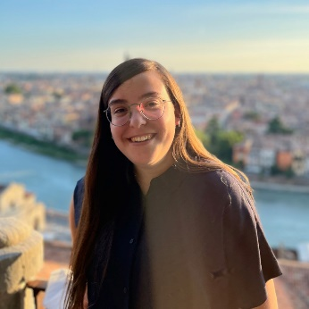
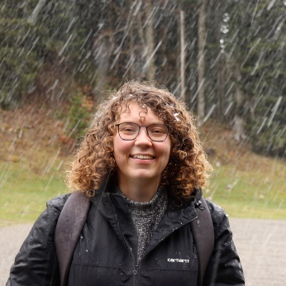
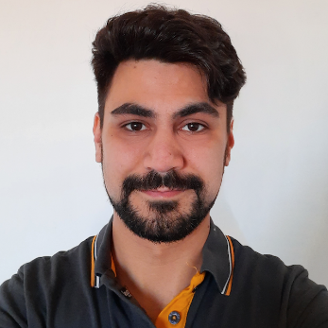




2024 iCSC lecturers
Bernardo Abreu Figueiredo
Karlsruhe HKA
Pratik Jawahar
University of Manchester
Spyridon Trigazis
CERN
Vlad-Andrei Badoiu
University Politehnica
Bucharest
Vlad Nastase
University Politehnica
Bucharest
Andrea Valenzuela Ramirez
CERN
Florine de Geus
CERN
Simone Rossi Tisbeni
Universita e INFN
Bologna
Francesco Vaselli
Scuola Normale Superiore
INFN, Pisa
Zenny Jovi Joestar Wettersten
CERN
Robin Hofsaess
KIT
Cristian Schuszter
CERN

Slide 25
Every presentation is supervised by mentors
This year’s mentors:
  Andrei Gheata
  Stephan Hageboeck
  Pere Mato
  Alberto Pace
  Danilo Piparo
  Sebastien Ponce
  Toni Sculac
  Are Strandlie
  Sofia Vallecorsa
THANK YOU !

Slide 26
The 2023 topics
Computer Science
and Engineering
Cloud & Containers - Everything you need to know
Everything that can go wrong in a message passing system
Authentication and Authorization for the WLCG
Quantum Computing
How a real-world C++ compiler works
CPU Performance Profiling on Linux in the HEP Context
Multiplatform Programming with Python
A simple introduction to accelerated computing
The most beautiful line you can draw with Kalman filter
An introduction to Bayesian neural networks and uncertainty quantification in neural networks
Graph Neural Networks: From fundamentals to Physics application
MLOps - Going from Good to Great
A Crash Course on Reinforcement Learning
Performance tuning
and optimization
Physics Computing
Data Science and
Machine learning

Slide 27
The 2024 topics
IPv6 adoption. How is it going?
Computer Networks in HEP
Networking for HPC
Functional programming and its relevance for HEP computing
Unraveling Grid Computing: From Basics to WLCG
Revolutionizing HEP Simulations: A Comprehensive Introduction to Generative Models
A Gentle Introduction to GPT Models and Their Impact on the HEP Community
A Practical Guide to Modern Natural Language Processing
Why do machines learn? Introduction to fundamentals and common misconceptions in ML
The perfectly parallel program
GPU Programming Made Easy with CuPy
Advanced git course: How to git good!
Computer Networks
HEP Computing & simulations
Machine Learning
Parallel Computing
IT Tooling

Slide 28
Lecturers at the iCSC
Many iCSC lecturers have become lecturers at various CSC schools
  Sebastian Lopienski (2005), Brice Copy (2005), Zornitsa Zaharieva (2005), Andrzej Nowak (2008), Benjamin Radburn-Smith (2010), Thomas Keck (2016), Daniel Campora (2017) , Eamonn Maguire (2017), Hannah Short (2018), Tom Dack (2023), Francesco Vaselli (2024)
... And one of them became director of the school

Slide 29


Inverted School 2024

Slide 30



Where students become teachers

Slide 31


Where teachers become students ….

Slide 32


tCSC in Belgrade (Heterogeneous Architectures)

Slide 33



Main CSC, Hamburg

Slide 34


tCSC (Machine Learning), Split

Slide 35



Check the dress code …

Slide 36
Thanks

Slide 37
We had 20 lecturers !
The CSC speakers put in a lot of effort to prepare relevant lectures and exercise
Without lecturers… no school !
It is a major commitment to come and lecture at the school
Francisco Borges | IT-PW-WA
Diogo Castro | IT-SD-GSS
Raulian-Ionut Chiorescu | IT-CD-PI
Marco Donadoni | IT-CA-OSR
Diana Gaponcic | IT-CD-PI
Ben Jones | IT-CD-CC
Nils Høimyr | IT-CD-CC
Abhishek Lekshmanan | IT-SD-PDS
Sebastian Lopienski | IT-PW-WA
Pedro Miguel Esteves | IT-DA-ASM
Andrzej Nowicki | IT-DA-DB
Alberto Pace | IT-GOV
Alberto Pimpo | IT-PW-WA
Sebastien Ponce | EP-LBC
Ricardo Rocha | IT-CD-PI
Vasvi Sharma | IT-PW-WA
Hannah Short | IT-PW-IAM
Tibor Simko | IT-CA-OSR
Enric Tejedor | IT-DA-ASM
Giacomo Tenaglia | IT-CD-CC

Slide 38

And a special thanks to … Andzrxey, Annjay, Andrzej

Slide 39

And …
Kristina !

Slide 40

Finally …
Thanks to you, the 31 participants !

Slide 41
Finally …
Thanks to you, the 31 participants !
Shahzaib Aamir | IT-RM
Berk Balci | IT-PW-IAM
Nayana Bangaru | EP-DT
Gábor Bíró | EP-UAI
Abhishek Bohare | EP - LHCb Experiment
Marco Buonsante | EP-UCM
Gianluca De Bonis | CD-CC
Elena de la Fuente Garcia | BE-ABP-CEI
Jesse Geens | IT-SD-GSS
Ediz Genc | EP-CMG
Panagiotis Georgopoulos | IT-DA-DS
Daniel Goncalves Portovedo | IT-PW-ARW
Panagiotis Gkonis | IT-CD-CC
Dmytro Gruzdo | IT-DA-DB
Hannes Jakob Hansen | PW-PI
Musa Kaymaz | EN-AA-AS
Idriss Larbi | IT-SD-TAB
Manuel Ramirez Garcia | LHCb
Rimsky Alejandro Rojas Caballero | EP-ADT-TR
Jonathan Samuel | IT-CD
Nikolaos Smyrnioudis | IT-DA-DB
Lorenzo Valentini | IT-CD-CC
Jan Hauke Voss | EP-UCM
Julian Weick | EP-DT
Joao Ramiro | RCS-SIS-TS
Lorenzo Ventura Vagliano | RCS-SIS-TS
Pascal Egner | RCS-SIS-TS
Jakub Jelinek | IT-CD-CLI
Luis Pelaez Bover | IT-PW-WA
Franciska-Leonora Toeroek | IT-PW-WA

Slide 42

Finally …
Thanks to you, the 31 participants !

Slide 43
A last message as School Director
Each school is a Marathon and takes between 1 to 2 years to organize
Some take-home messages … about the school

Slide 44
It was a dense week !

Slide 45


Beware … it could be two weeks !

Slide 46
Sometimes we hear …
There is too much to do, not enough time to rest or study
  Reminder: Several activities are optional
  Choice is freedom
Any opportunity can be taken to rest ….

Slide 47


Slide 48


Slide 49


Slide 50


Slide 51

Work
Hard

Slide 52

Play
Hard

Slide 53

The CERN CSC is not an everyday opportunity

Slide 54

If you liked it, tell your friend

Slide 55

The School Academic Dimension
The school …
  … is not a conference
  … is not a place for lecturers to present their work, promote their projects
  Does not replicate of common training available at home institutes, or in member state’s universities
  Does not deliver “technical training” courses
Focus on persistent knowledge, less notions
and knowhow
Training
Programme
C++
Java
Oracle SQL
Oracle Forms
Python

Slide 56
Education Science: Focus on Knowledge
Knowledge versus Knowhow
Knowledge | Knowhow
Articulated to other knowledge of the learner | Generally stand-alone information
By nature, when taken by the learner, different between learners | Initially, the same for every learner
Transferable, adaptable to other environments | Transfer requires effort
When taken by the learner, persistent | Will be forgotten if not practiced
Requires related knowledge pre-exist | Limited pre-requirements

Slide 57
Global Values versus Local Values
Global Values
  Science, Sports, Music, Literature, …
Local Value
  Religion, Language, Literature, Music, …

Slide 58
Becoming a Science ambassador
Science is universal, and the scientific approach to problem, in many fields, could resolve many conflicts and misunderstanding
Go beyond the pure science or computing skills
  Bridging different domains is a rare skill
Learn and improve also
  Your communication skills
  Teamwork
  Leadership
  Professionalism
  Respect for diversity

Slide 59
Be ambitious, be brave
Be just and fear not

Slide 60

That’s all Folks !

