Slide 1
Welcome to the Inaugural
School on IT Services
Enrica Porcari
4 November 2024

Slide 2
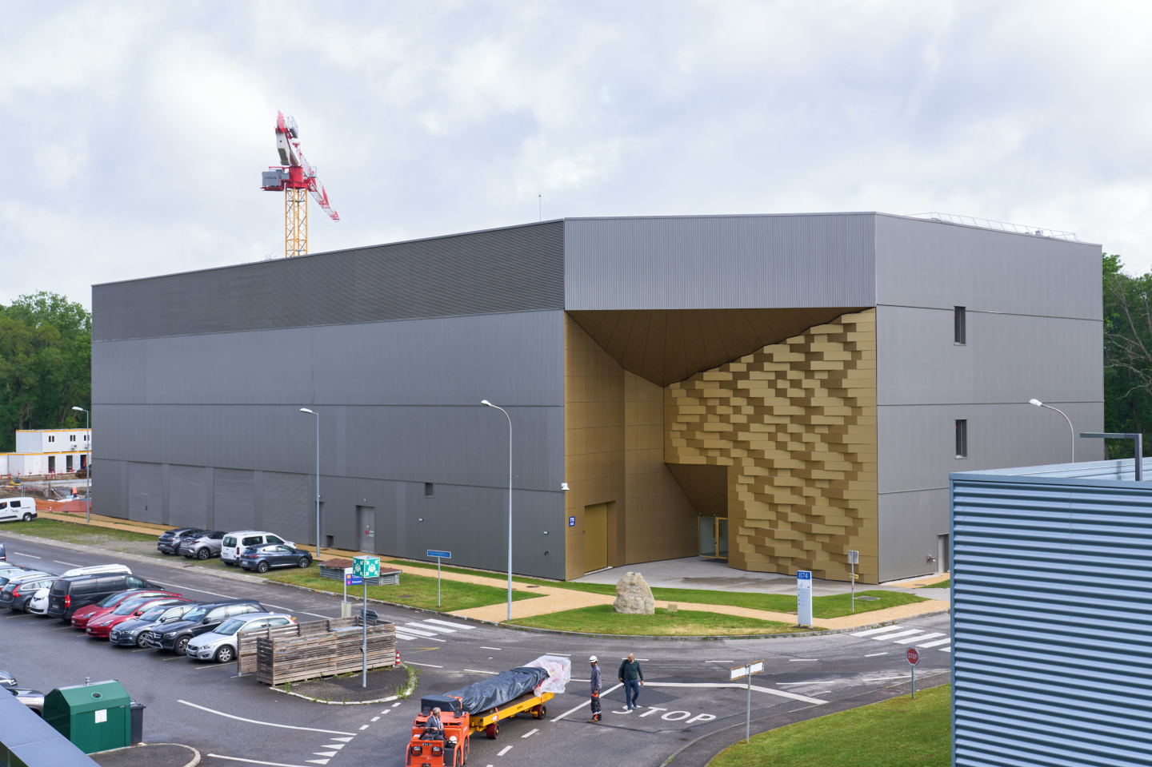
Why a school on IT Services ?
Science requires computing
Physics research is data and computing intensive
  Huge “data deluge” challenges ahead
  Huge computing challenges ahead
    x10 increase
    Beyond what Moore’s law predicts
Computing services for Science have increased complexity
  This school brings together computing users with service managers
  Bi-directional feedback and information flow to improve
    Productivity of computer users
    How IT services matches the need for scientific research

Slide 3
Areas of specific interest
Sustainability:
  Hardware efficiency and cost optimisation
  Refactoring, modernising, optimising code
  Operating date centres at full potential
  Fair and sustainable architectures
Leveraging innovations:
  Accelerators like GPUs and TPUs (and FPGAs) in readout chain
  Machine Learning and Deep Learning applied to all stages of analysis
  Storage infrastructures (across multiple research centres)
  Leverage High Performance Computing centres
Preparing possible future paradigm shifts
  Quantum Technology Initiative
  Next Generation Triggers
Enrica Porcari | Head of CERN IT Department

Slide 4
But, above all…
Empowering the future generations
Bringing together top computer users to address common future challenges!
  In multiple domains: communication, data science, data management, security, software development, software design, machine learning
Thanks to the dedicated IT service managers who will explain
how to “get the best” out of CERN IT services
Thanks to you for your contribution to a shared learning
Enrica Porcari | Head of CERN IT Department

Slide 5
Enjoy the first CERN School of Computing on IT Services

