Slide 1
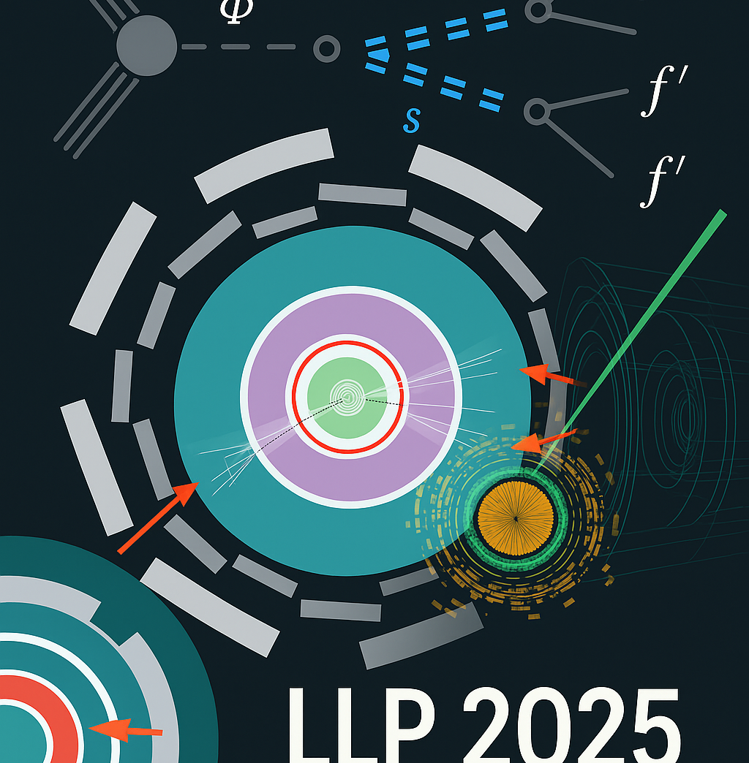
Search for long-lived particles in the ATLAS hadronic calorimeter in association with leptons or jets using 13 TeV collision data
Gordy Kane for the ATLAS Collaboration
June 3, 2025
15th LLP Community Workshop
Notes:
Add logos for UW and NSF and ATLAS

Slide 2


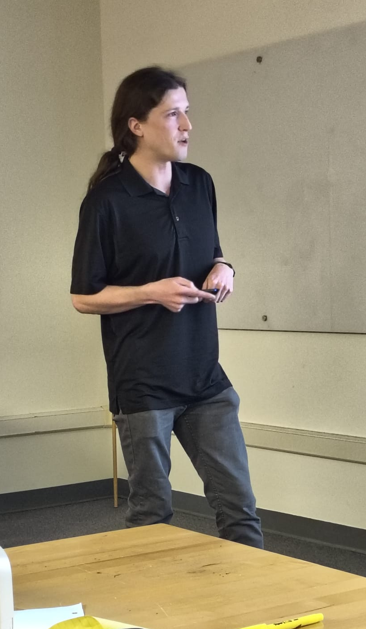
Victoria Sanchez Sebastian
Mariia Didenko
Mason Proffitt
(2-Jet Associated Production)
(W/Z Lepton Associated Production)

Slide 3
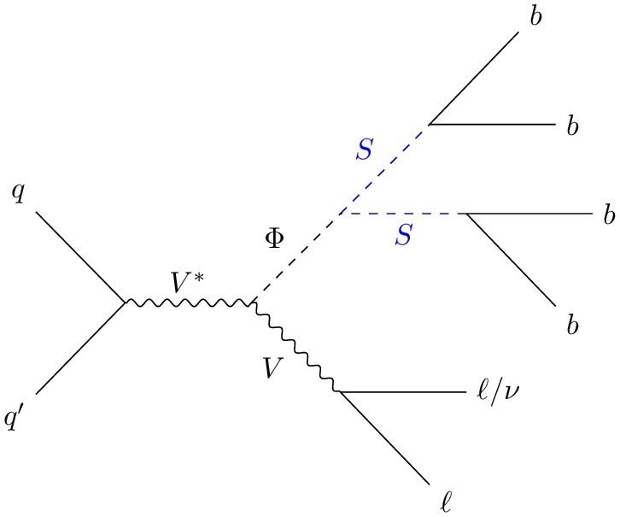
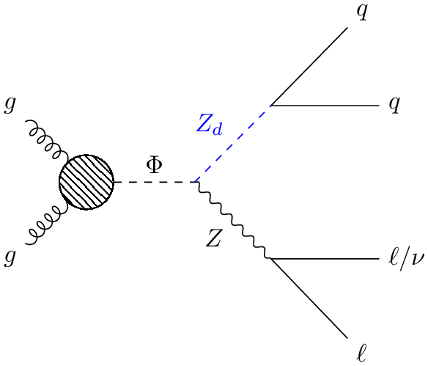
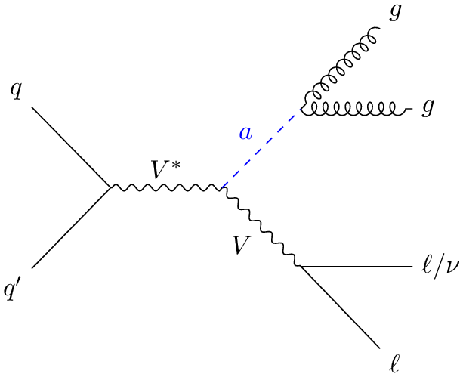
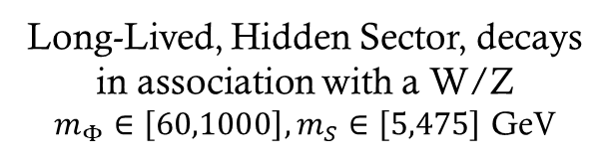
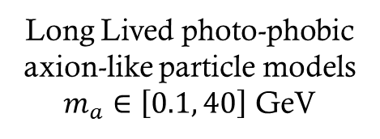
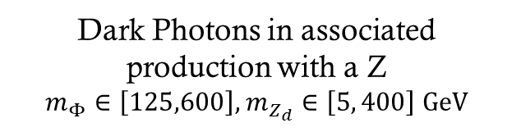
New physics: Associated Production
Long Lived photo-phobic axion-like particle models
$m_{a}∈\left[0.1, 40\right]$ GeV
Long-Lived, Hidden Sector, decays in association with a W/Z
$m_{Φ}∈\left[60,1000\right], m_{S}∈\left[5,475\right]$ GeV
Dark Photons in associated production with a Z
$$m_{Φ}∈\left[125,600\right], m_{Z_{d}}∈\left[5, 400\right] GeV$$

Slide 4
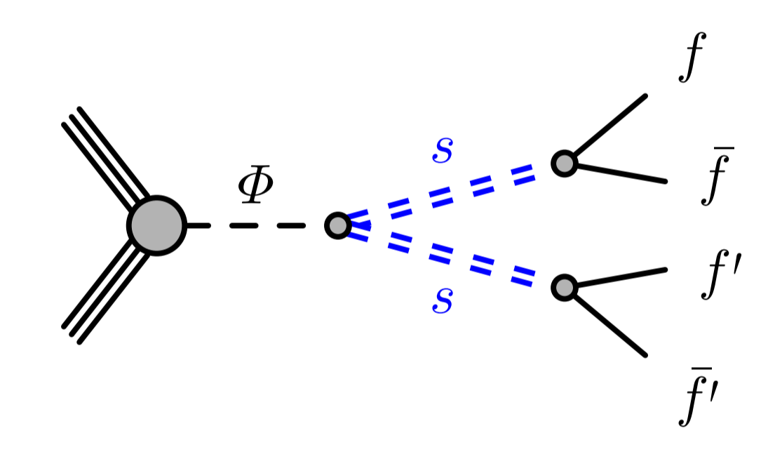
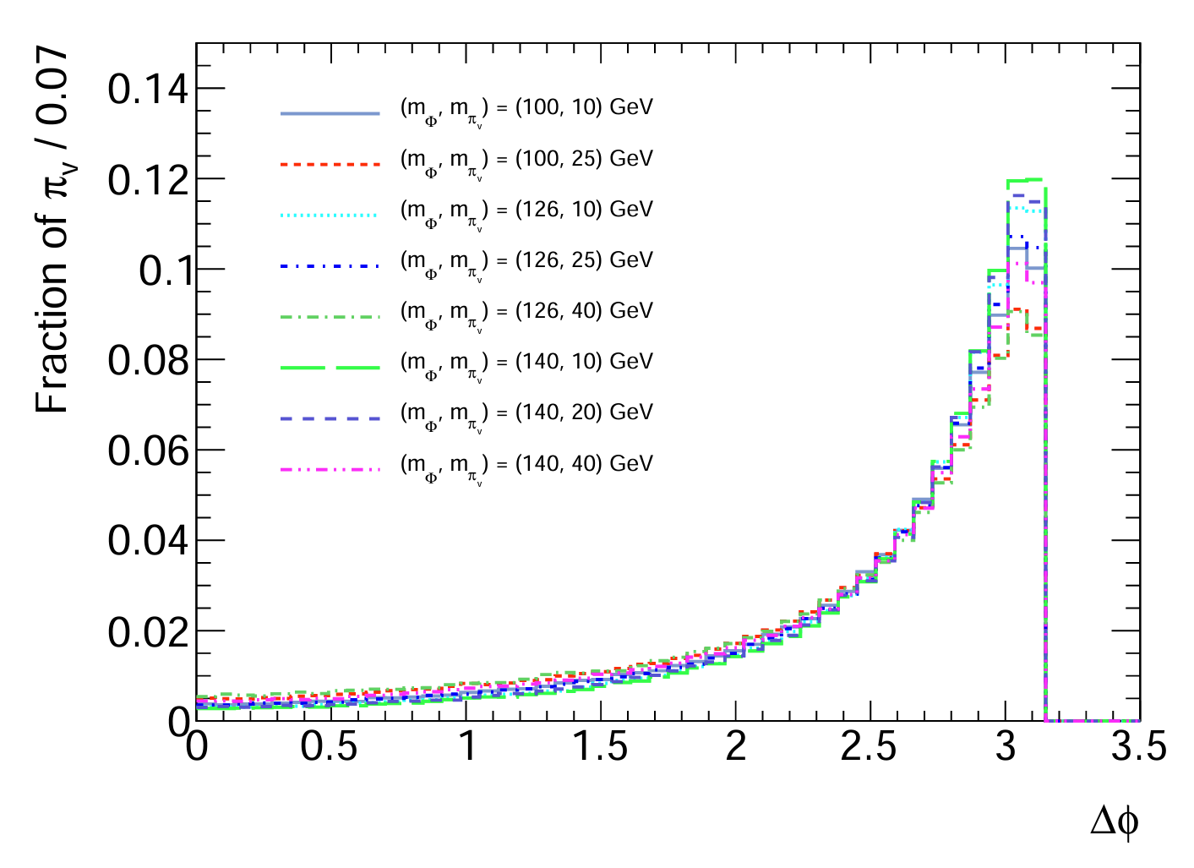
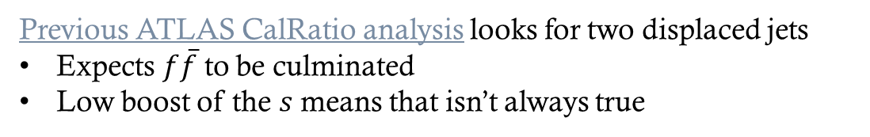
Low Mediator and LLP Mass
HSS Models
Previous ATLAS CalRatio analysis looks for two displaced jets
Expects $f\overline{f}$ to be culminated
Low boost of the $s$ means that isn’t always true
This is also relevant for the higher mass samples
400-1000 GeV
But effect is much less pronounced

Slide 5
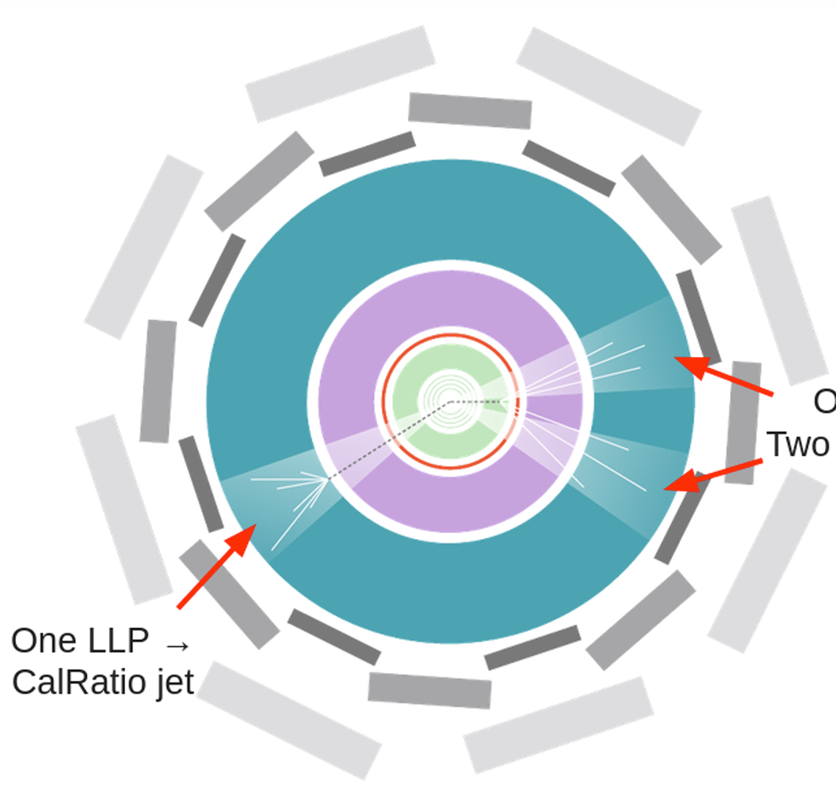
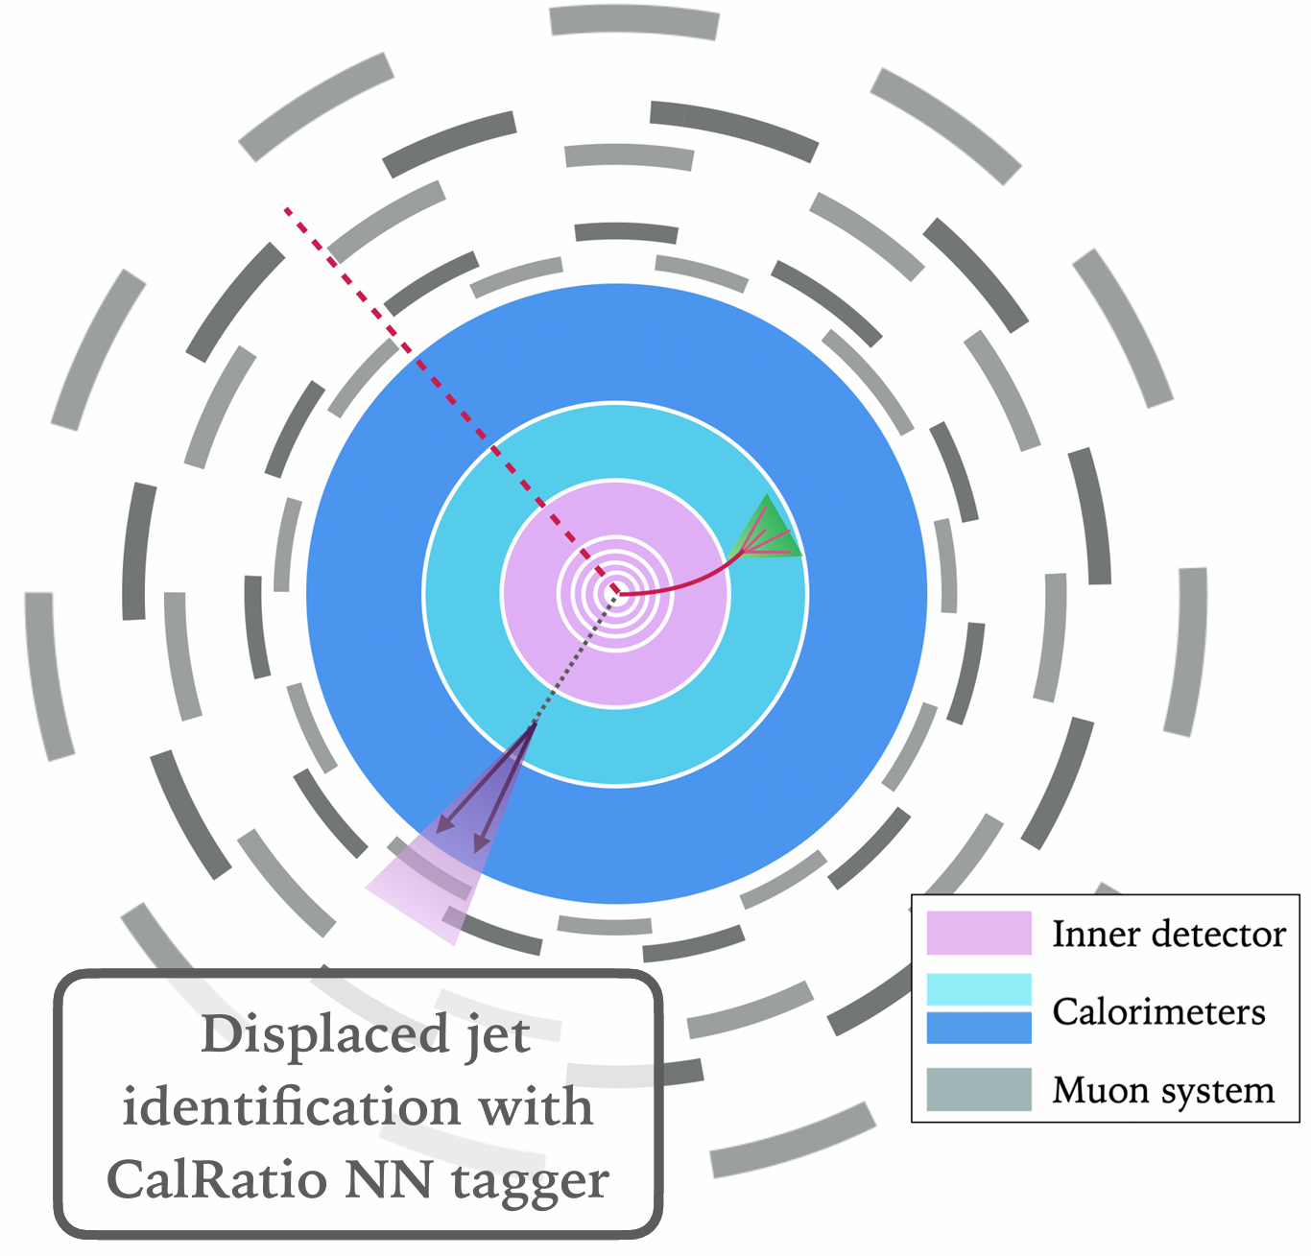
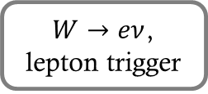
Final States
$W→eν$, lepton trigger
Two “displaced” jets
Associated W/Z Decay
Associated 2-Jet Decay

Slide 6
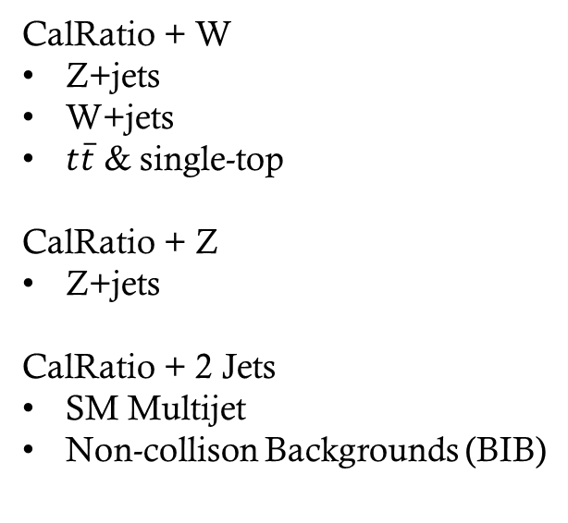
Final States
Background Challenges
Well Understood Tools
CalRatio + W
Z+jets
W+jets
$t\overline{t}$ & single-top
CalRatio + Z
Z+jets
CalRatio + 2 Jets
SM Multijet
Non-collison Backgrounds (BIB)
Triggers
Experiments well understood lepton triggers
CalRatio triggers well understood in previous analysis
CalRatio Jet Tagging
Reuse RNN from 2-jet analysis
Rejects BIB, along with SM Multijet

Slide 7
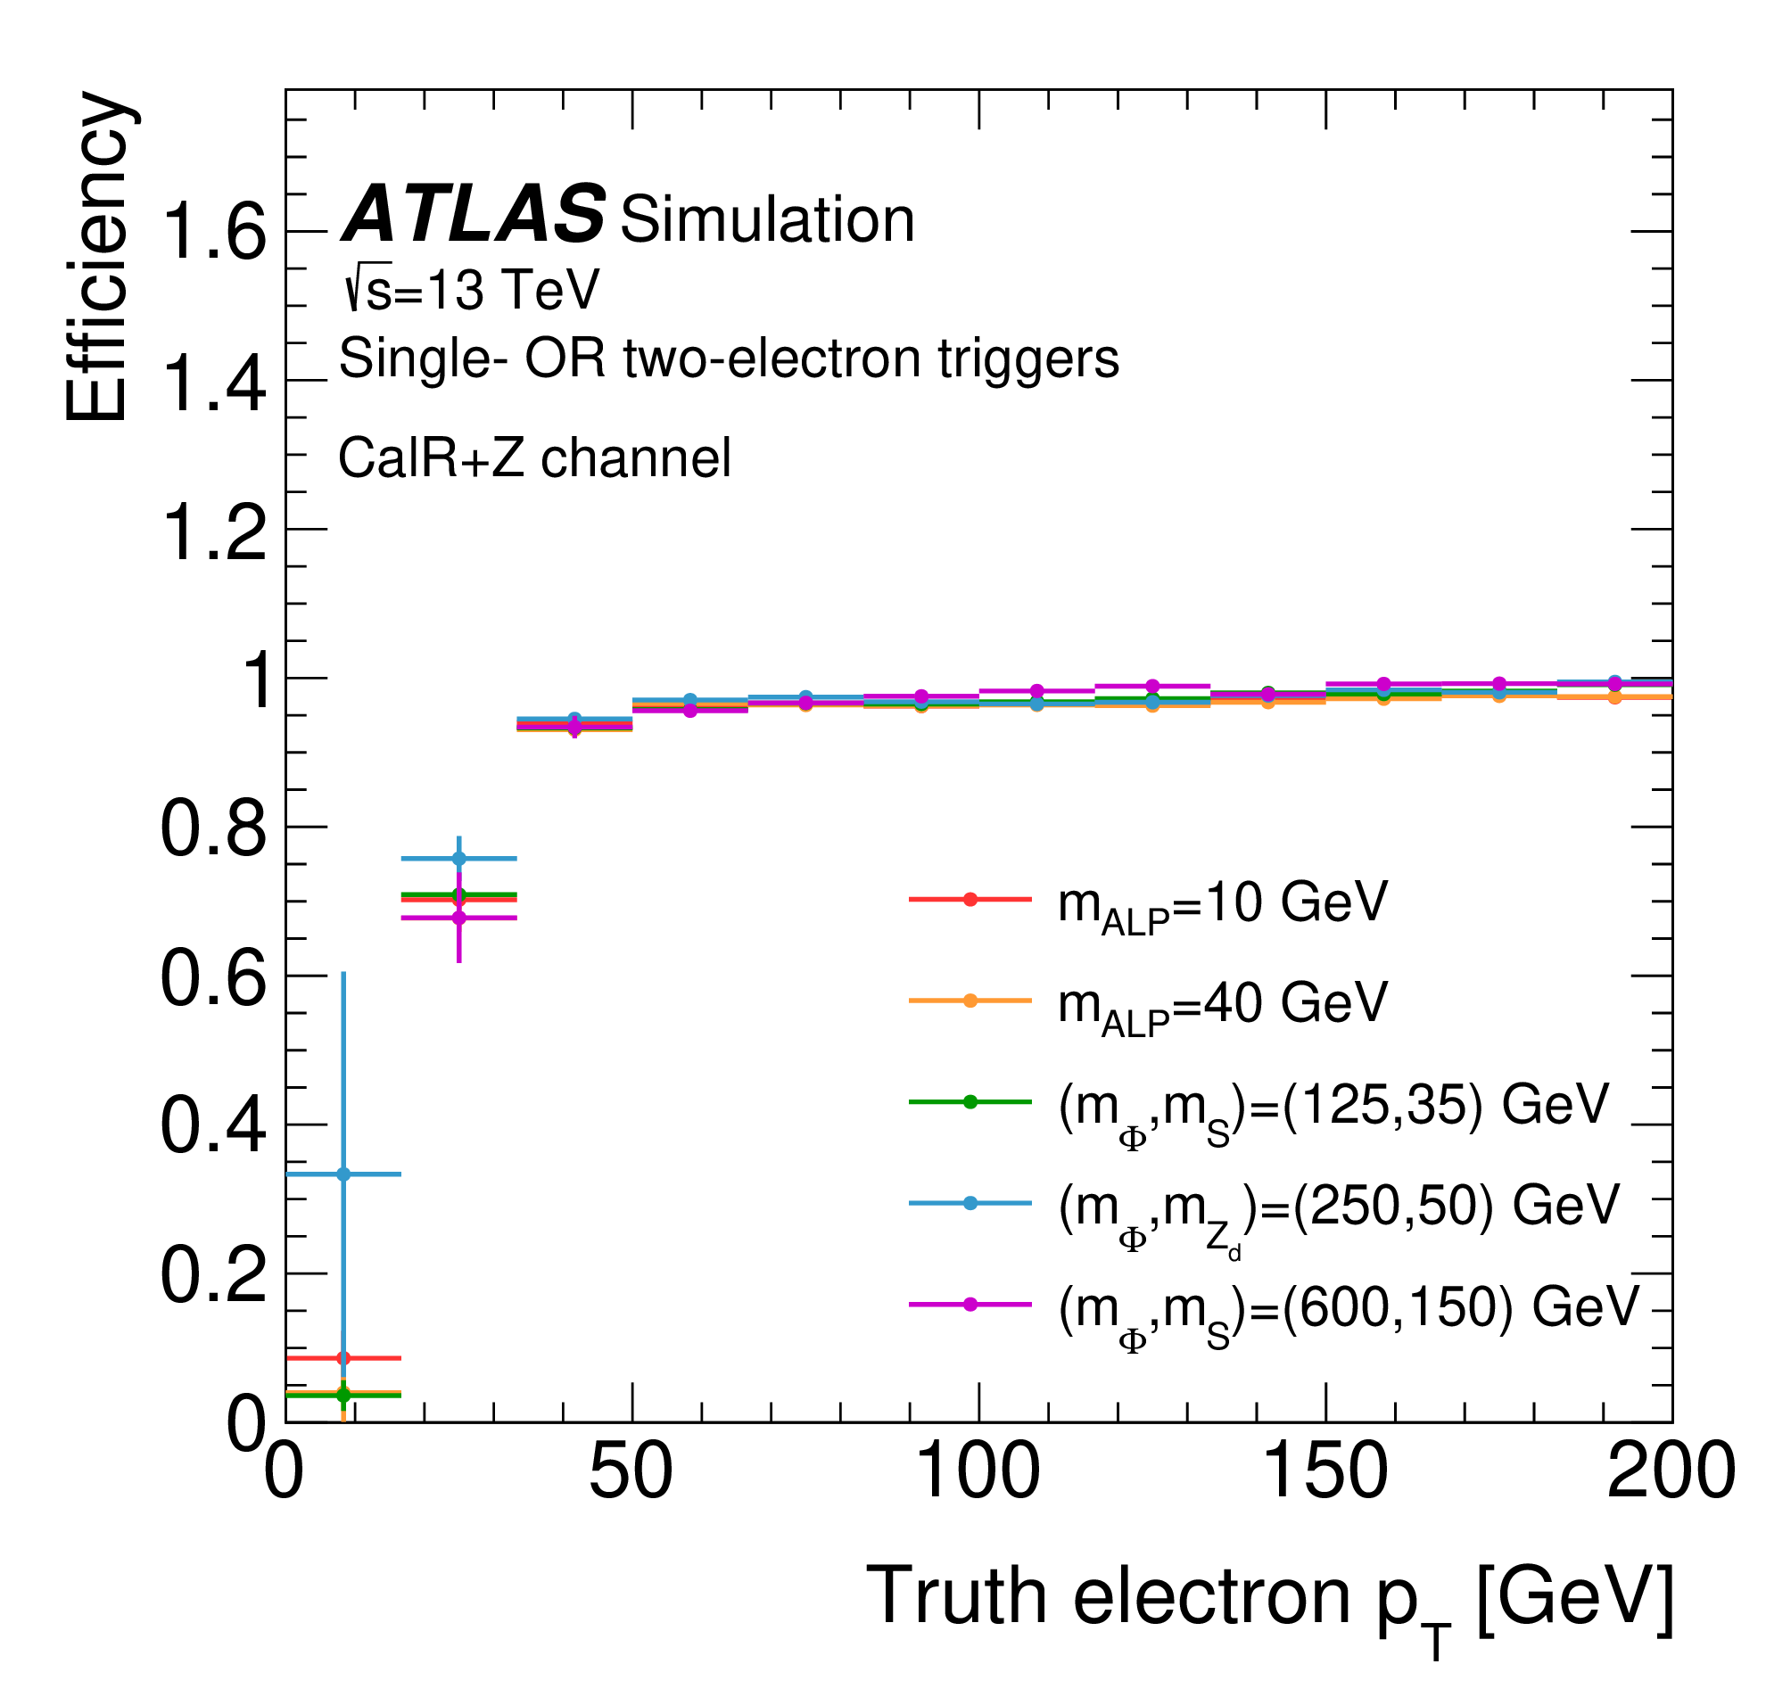
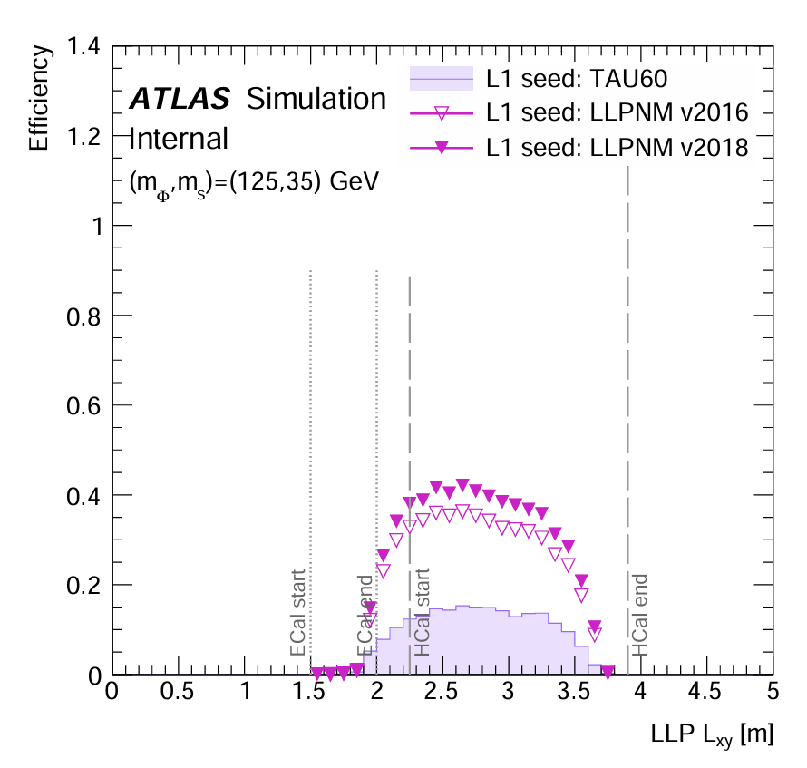

Triggers (vs. $σ_{prod}$)
Single Electron Trigger
(Associated W/Z Analysis)
CalRatio Trigger
(Associated Jets Analysis)

Slide 8
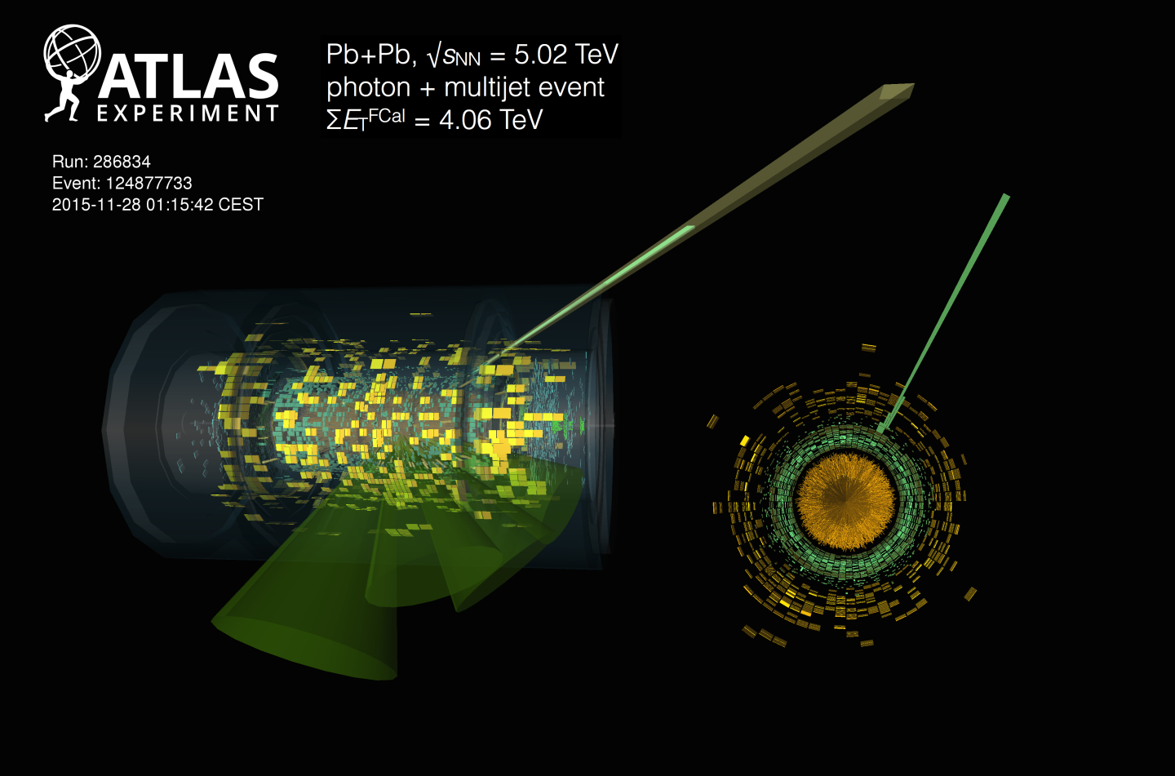
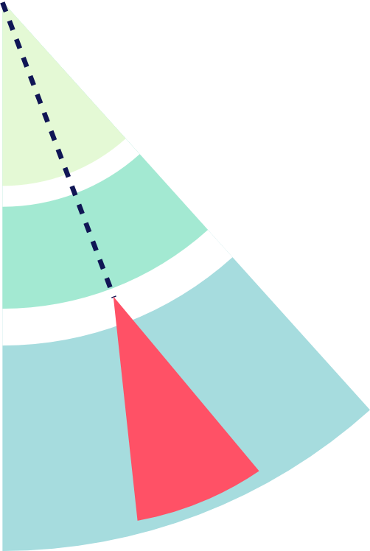
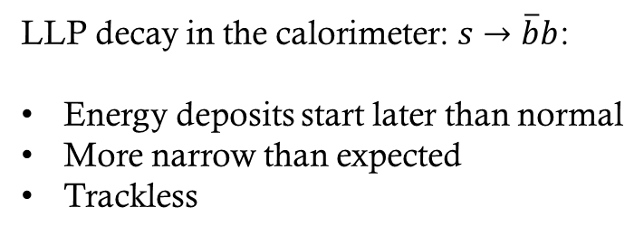
Displaced Calorimeter Jet Clustering
LLP decay in the calorimeter: $s→\overline{b}b$:
Energy deposits start later than normal
More narrow than expected
Trackless
Over the years we have used:
Straight cuts
BDT with high level inputs
Simple NN with calorimeter layer energy profile
RNN with calorimeter cell cluster inputs
Large number of cells, track information, etc.

Slide 9
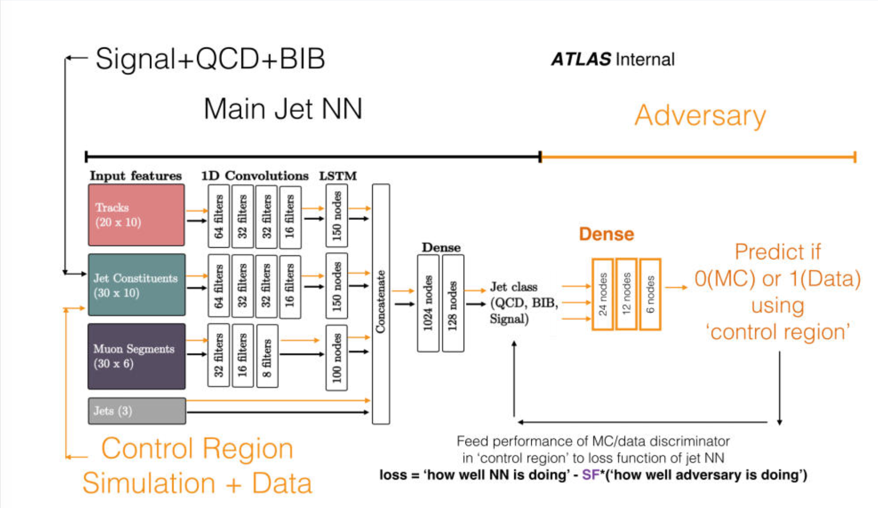
CalRatio Jet Tagger
(mixture of Data and MC!)
Main RNN:
Cal clusters for jet profile information
Tracks to QCD jets and window out pileup
Muon segments to reject Beam Induced Background
Adversary NN:
Trained on mixture of Data and MC.
Prevent RNN from telling difference between data and MC
Use QCD jets in data and MC
Reused weights from Run 2 2-jet analysis!

Slide 10
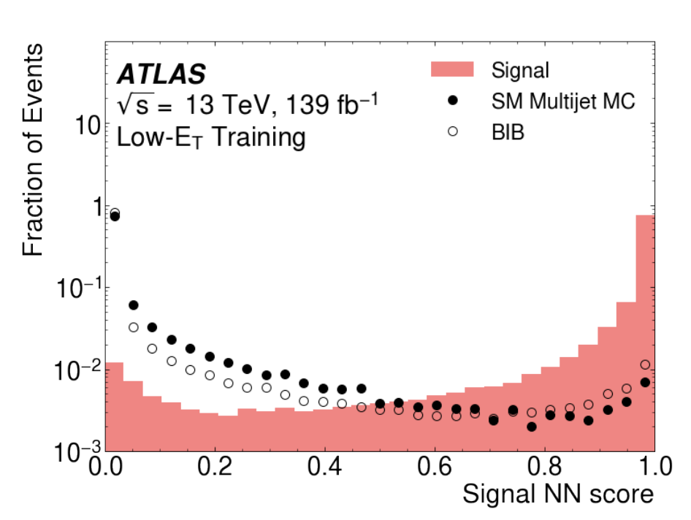
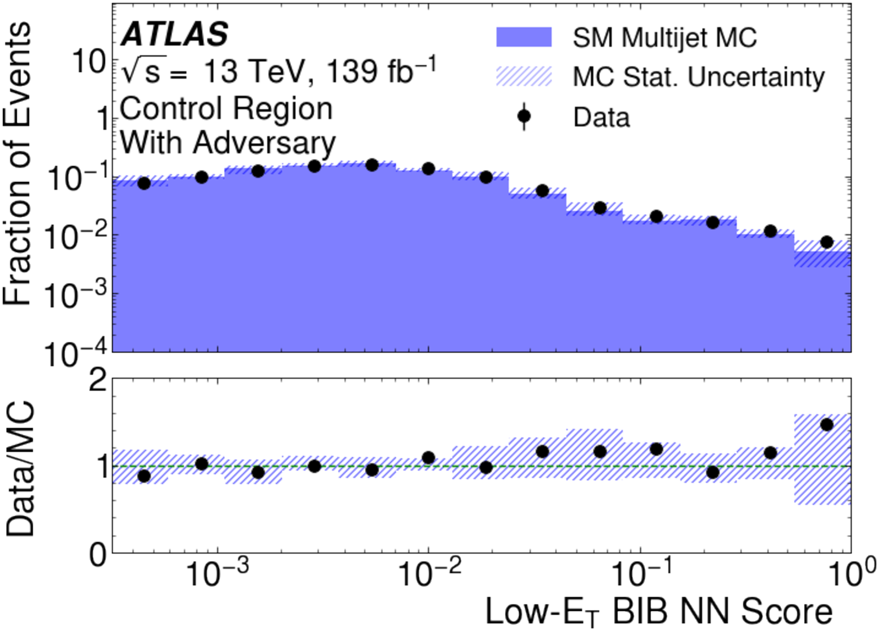
CalRatio Jet Tagger

Slide 11
W/Z Associated Production

Slide 12
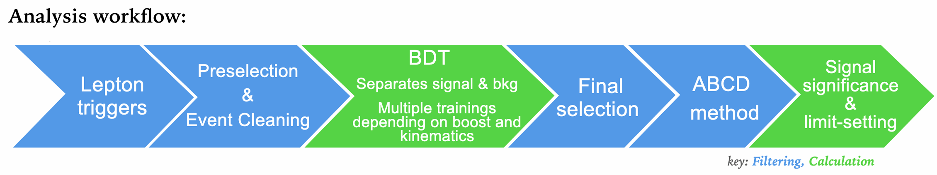
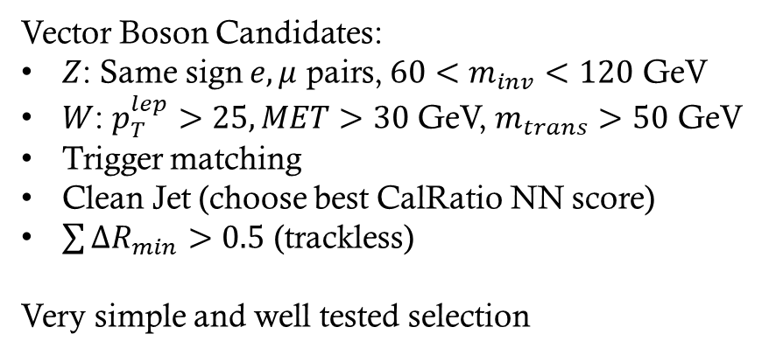
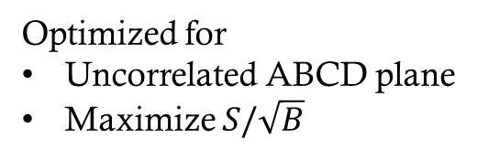
Single Lepton Triggers
(common use by ATLAS)
Optimized for
Uncorrelated ABCD plane
Maximize $S/\sqrt{B}$
Vector Boson Candidates:
$Z$: Same sign $e,μ$ pairs, $60<m_{inv}<120$ GeV
$W$: $p_{T}^{lep}>25, MET>30$ GeV, $m_{trans}>50$ GeV
Trigger matching
Clean Jet (choose best CalRatio NN score)
$\sum{ΔR_{min}>0.5}$ (trackless)
Very simple and well tested selection

Slide 13
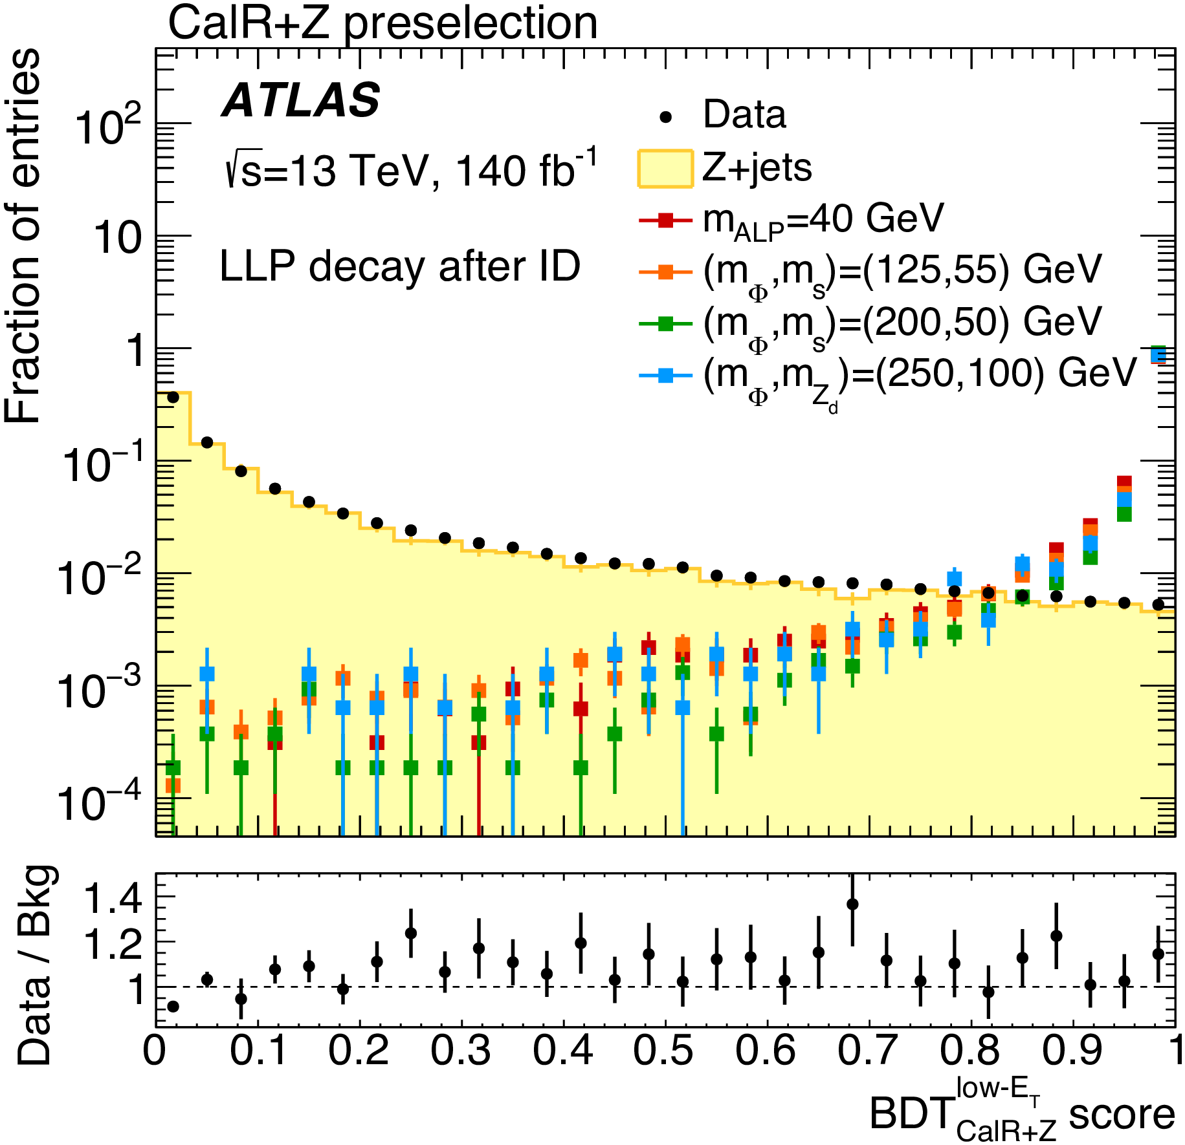
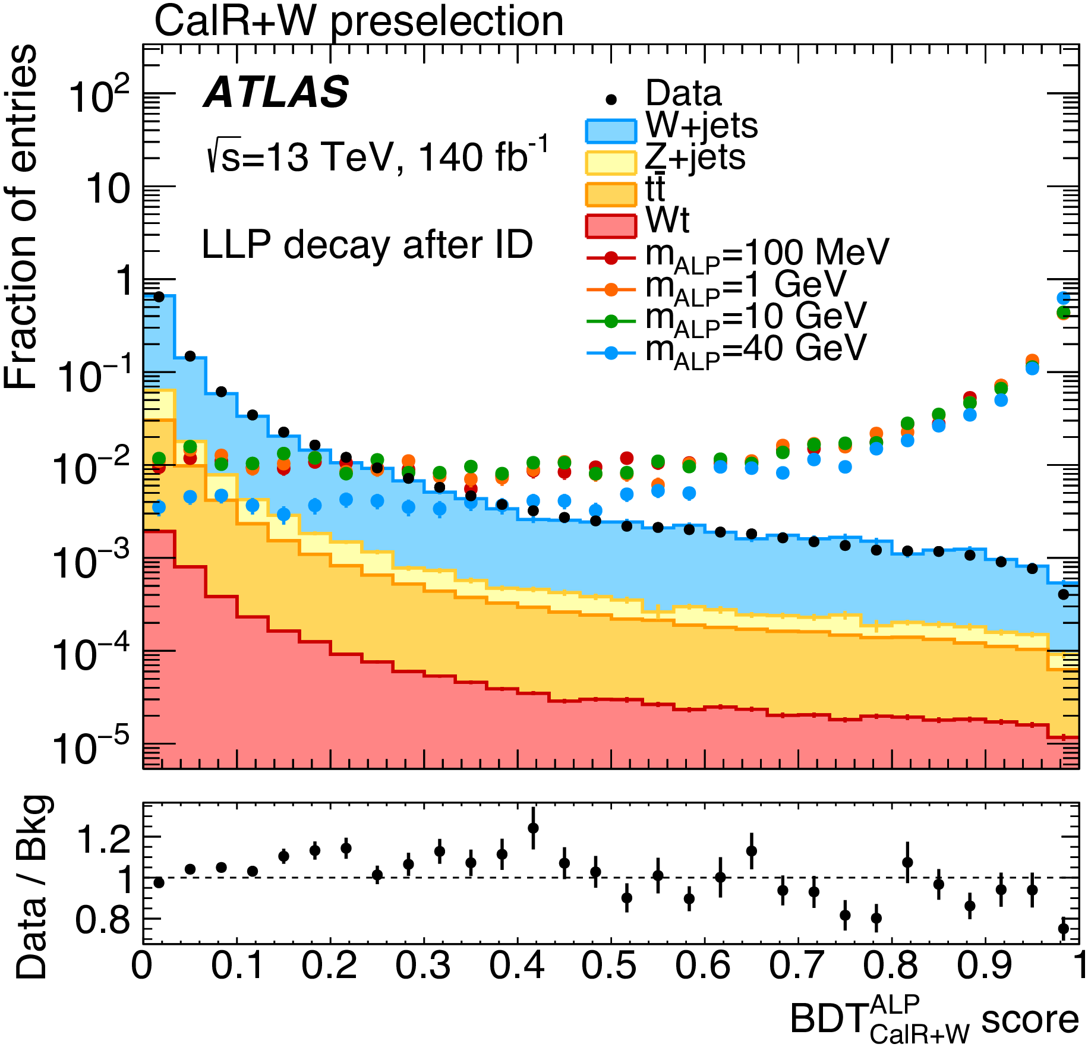
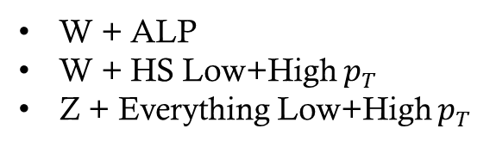
BDT’s
W + ALP
W + HS Low+High $p_{T}$
Z + Everything Low+High $p_{T}$
5 BDTs due to different topologies!
(include CalRatio Jet Tagger as input)

Slide 14
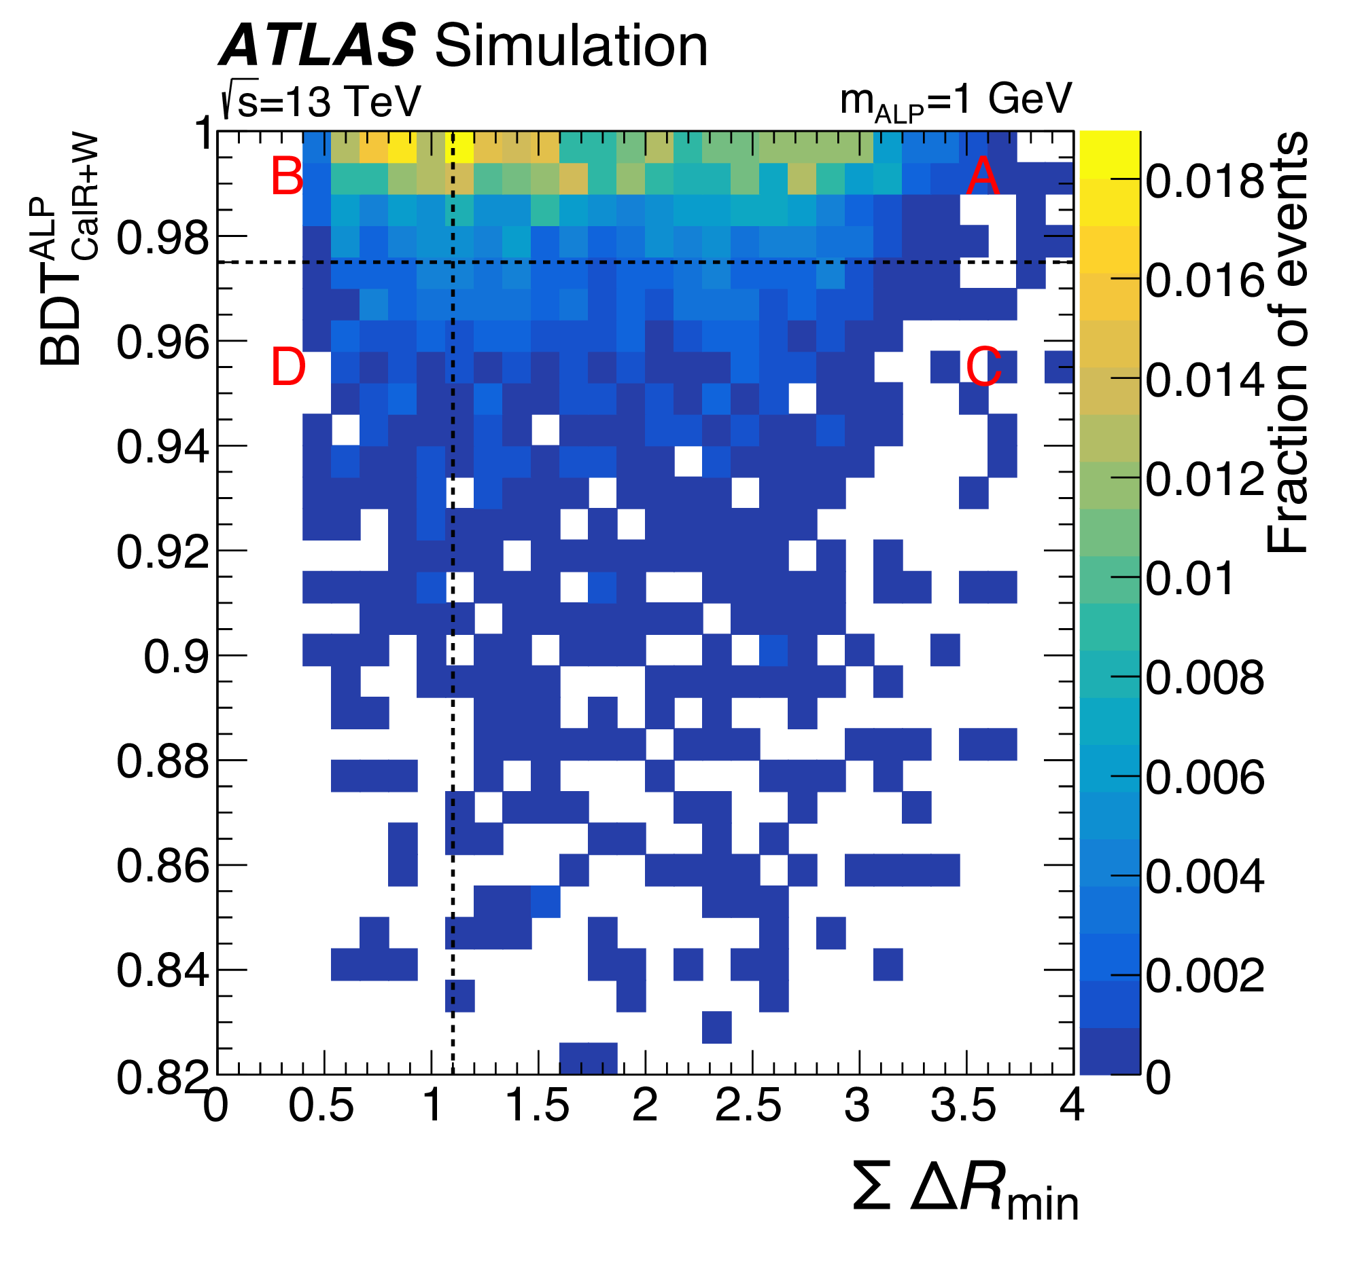
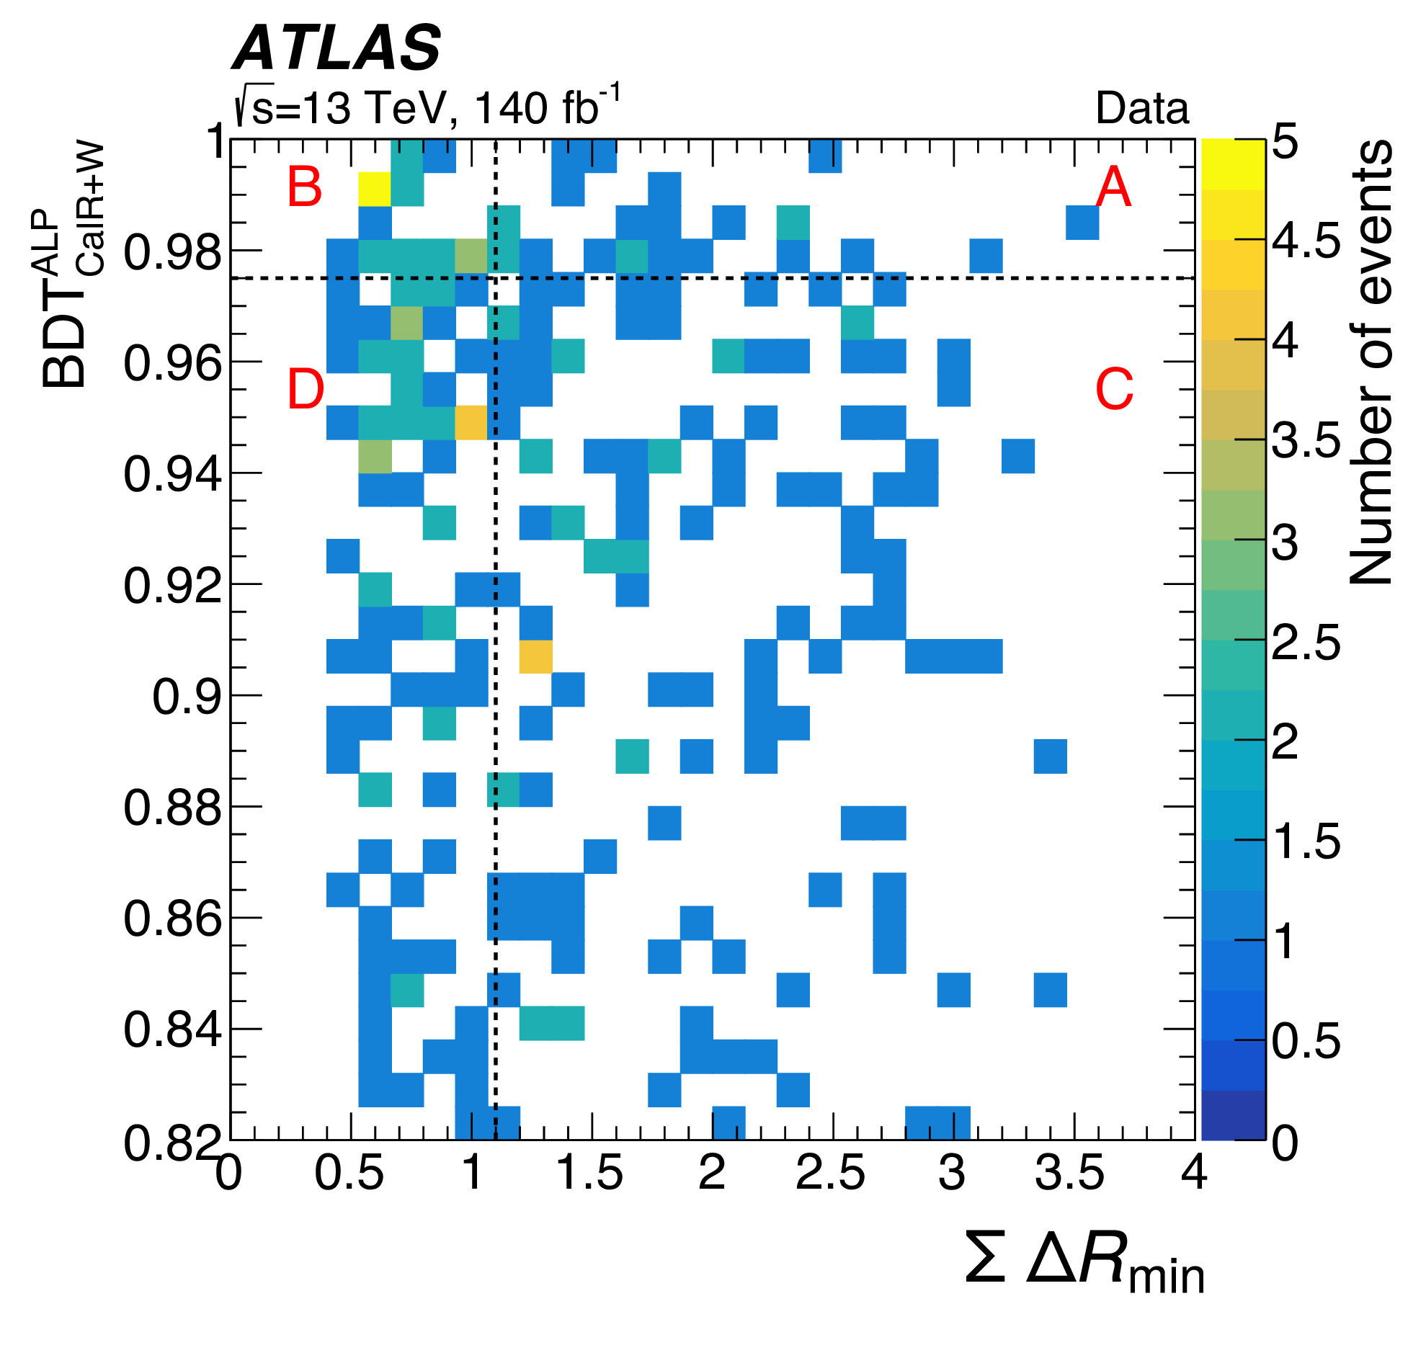
ABCD Method
Unblinded Data
($p_{T}>2$ GeV track & Jet axis)
Validation is checked in various validation regions

Slide 15
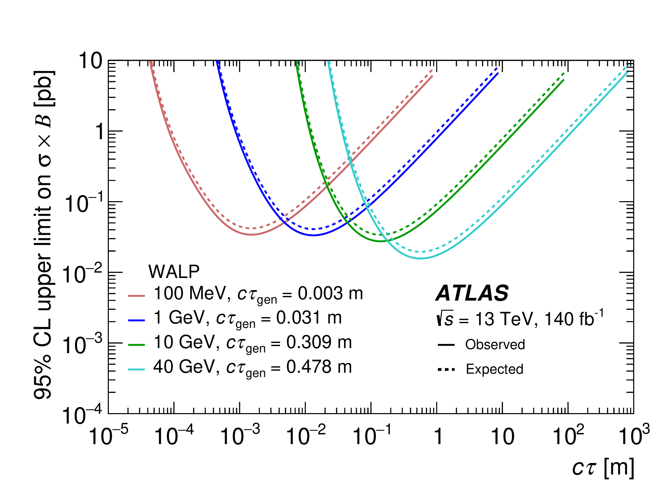
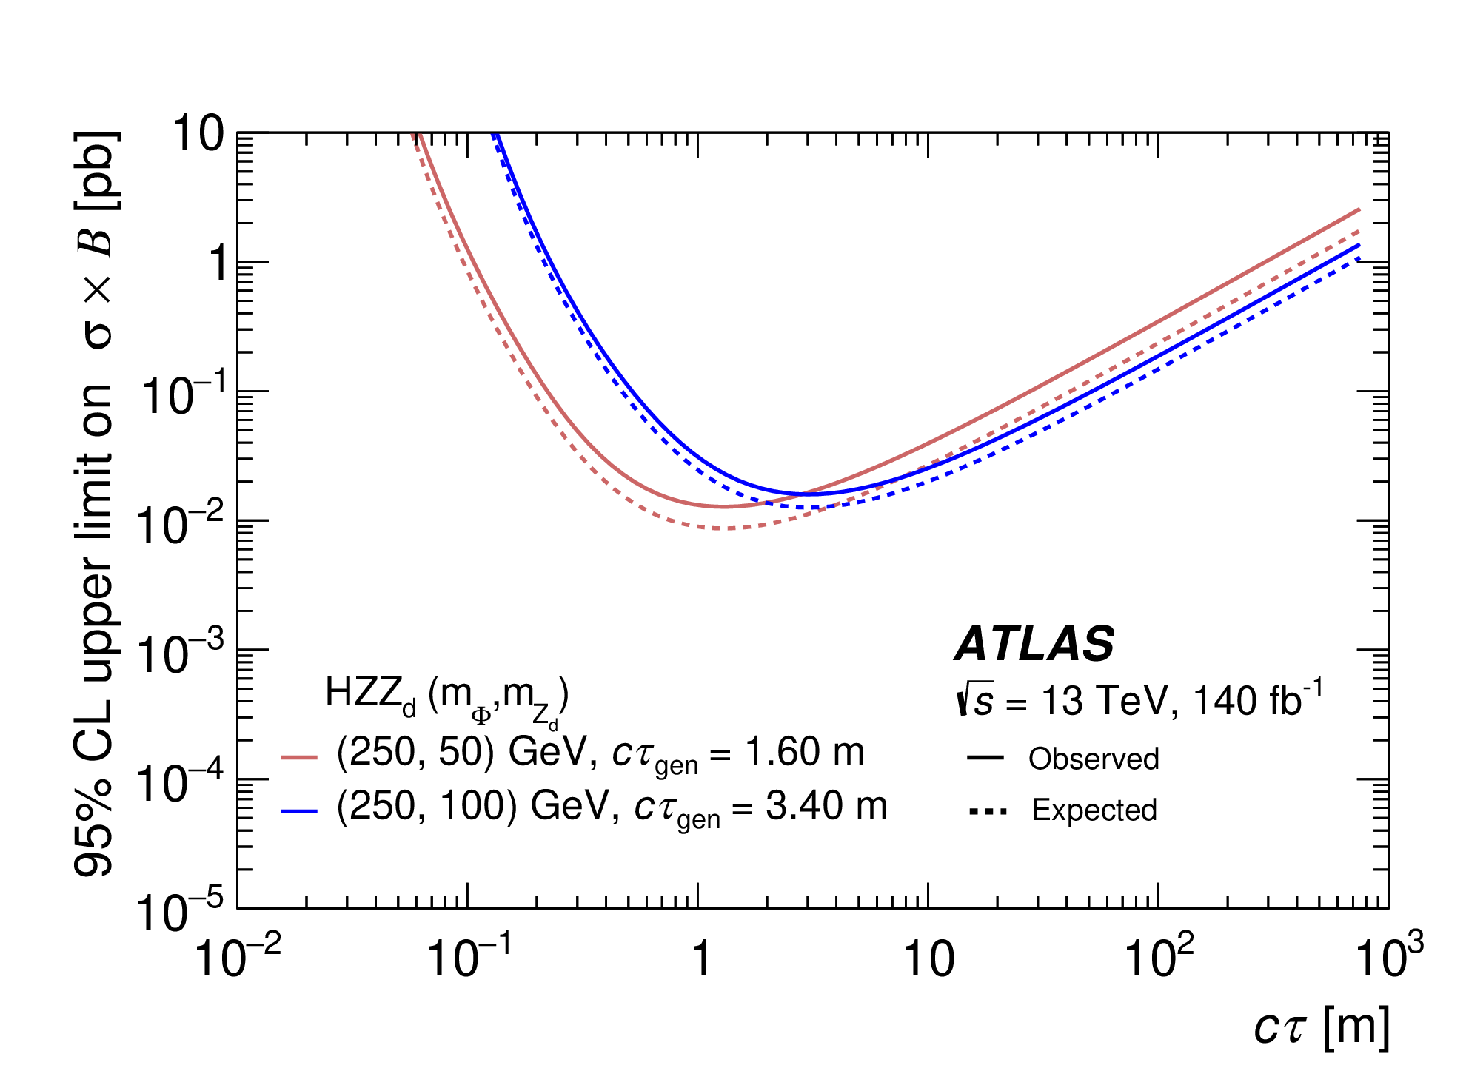
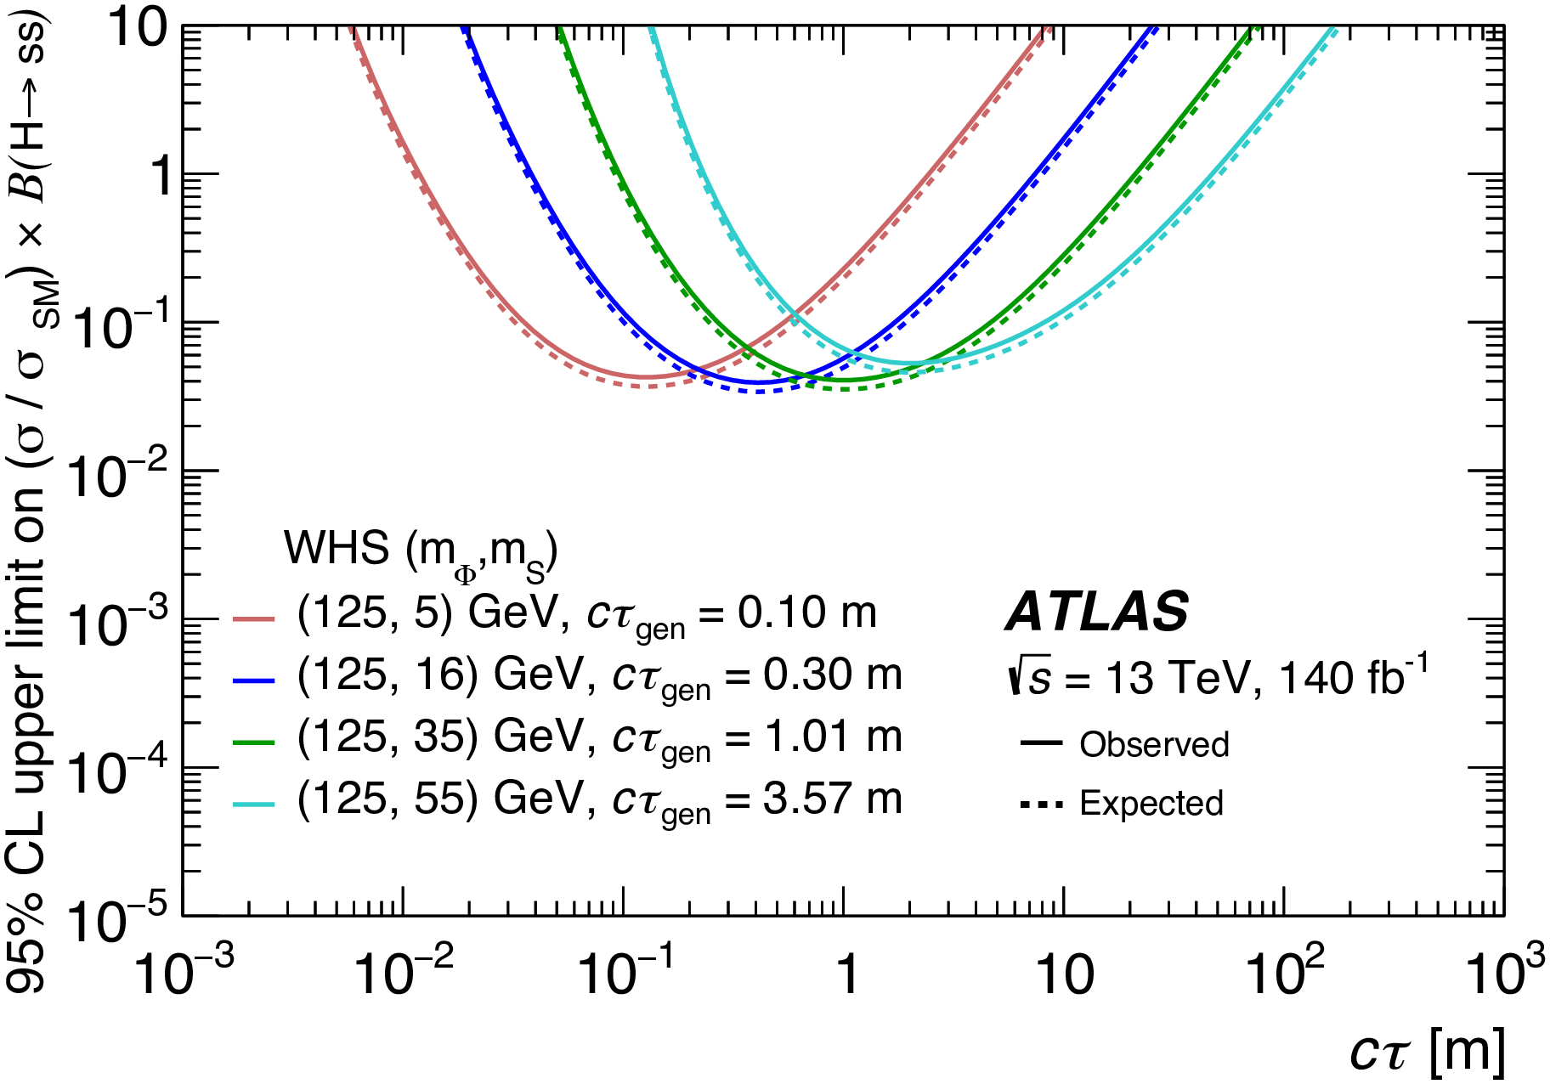
Limits
Statistics are the largest contribution to the systematic error
A sampling of the many limit curves produced in this analysis…
Complete set of limits available at the ATLAS archive

Slide 16
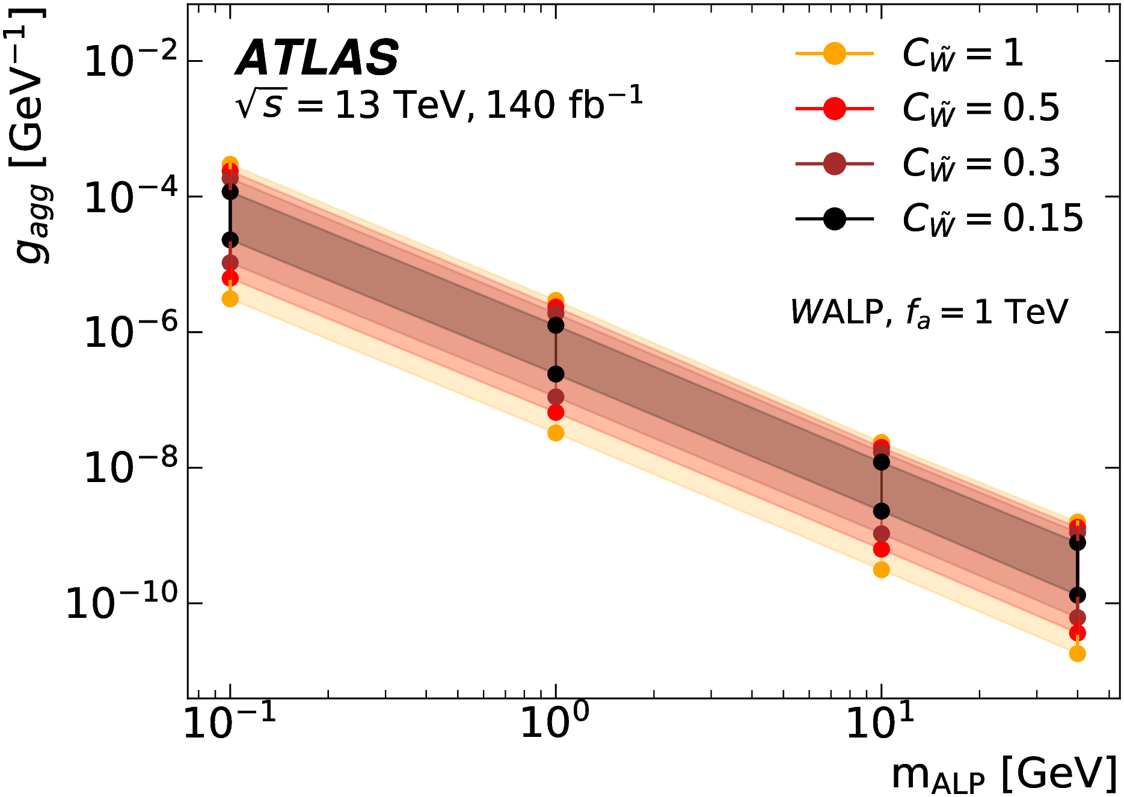
First limits on LL photo-phobic axion-like Models

Slide 17
2-jet Associated Production

Slide 18
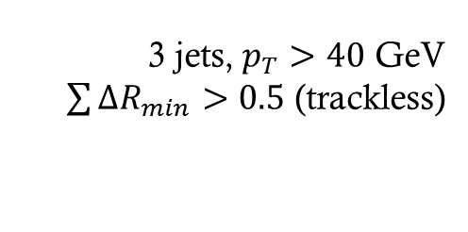
Analysis Workflow
Standard CalRatio Run 2 Triggers
Trigger
3 jets, $p_{T}>40$ GeV
$\sum{ΔR_{min}>0.5}$ (trackless)
Pre Selection
Two Trackless Jets
Build uncorrelated ABCD axes using a NN
ABCD (Disco)
Limits
Notes:
Note that jet pT is > 50 GeV for the sum.

Slide 19

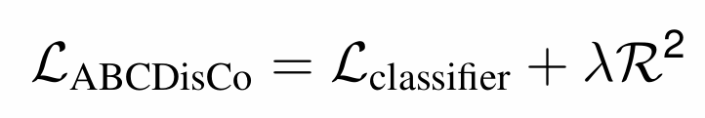
ABCD, but on DISCO!
Standard variables were correlated with anything we could build!
Used ABCDisCo method [arXiv:2007.14400]
Advantage: builds ABCD axies uncorrelated by construction
Key insight: The Loss Function
Trains for separation, using cross-entropy loss
Trains the output to be uncorrelated with a variable using the distance function.

Slide 20
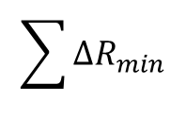
Network & Training
$$\sum{ΔR_{min}}$$
Jet information
Tracks associated with each jet
CalRatio Jet NN outputs
Angular Distances
3-layer fully connected
Loss Calculation
Trained Weights
Signal
BIB Background

Slide 21
Training Was Non-Trivial
We were not able to use the Double-DISCO method
Trains both axes at once, uncorrelated
Preserves almost all separation power
Could not make it work, even with further modifications of the loss function.
Using Single-DISCO
Training needs less input data
However you do lose some separation power
Also… it worked.
Working with blinded data
Training on unblinded data
Didn’t see the region that was blinded
So very easy for there to be a correlation!
BIB sample is not that large
Had real statistics problem
Especially in region “A”.

Slide 22
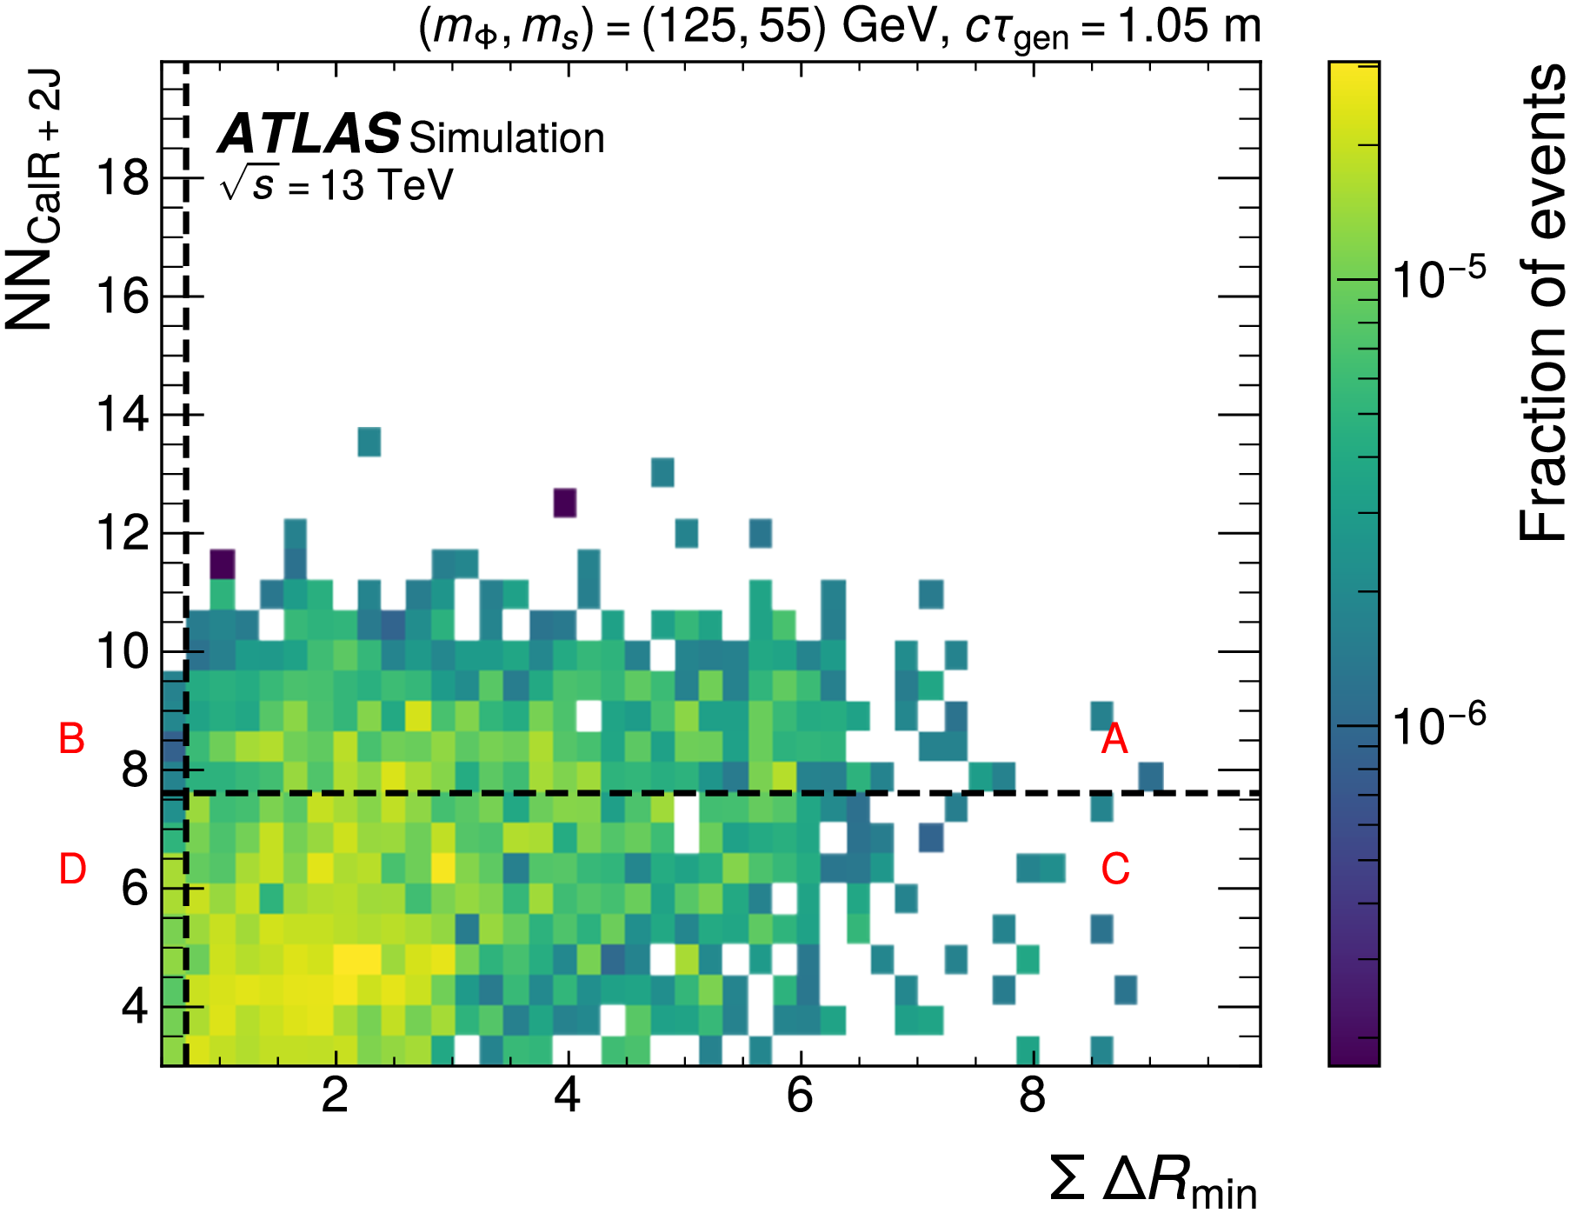
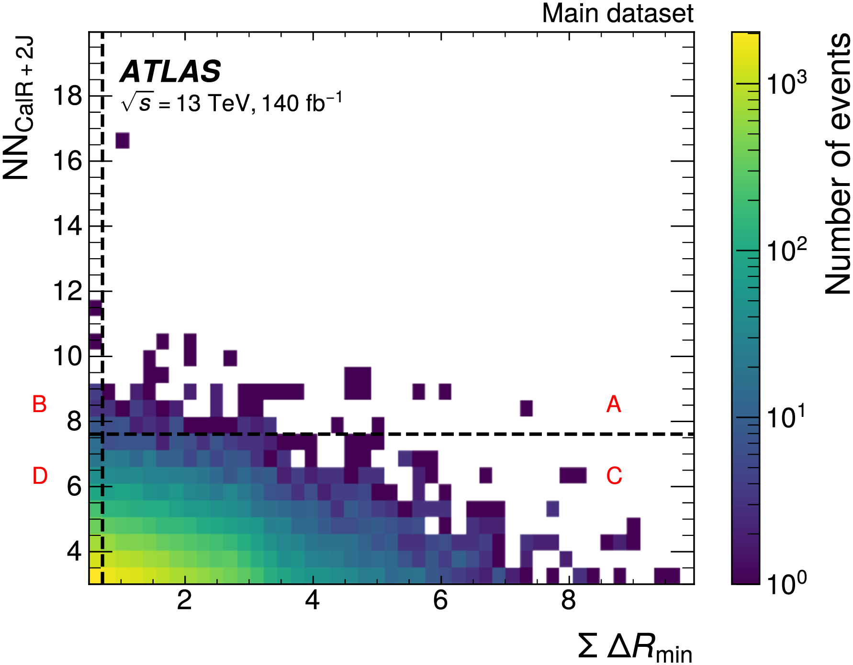
ABCD Plane
Signal
Unblinded Data

Slide 23
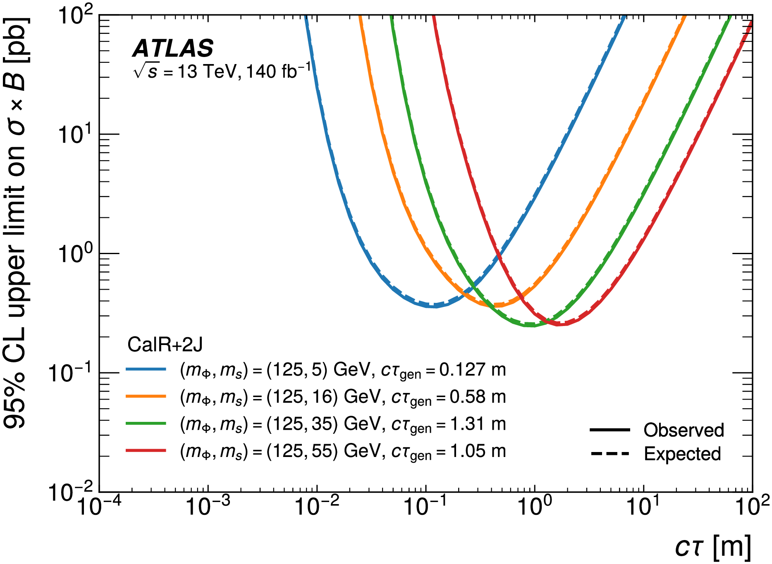
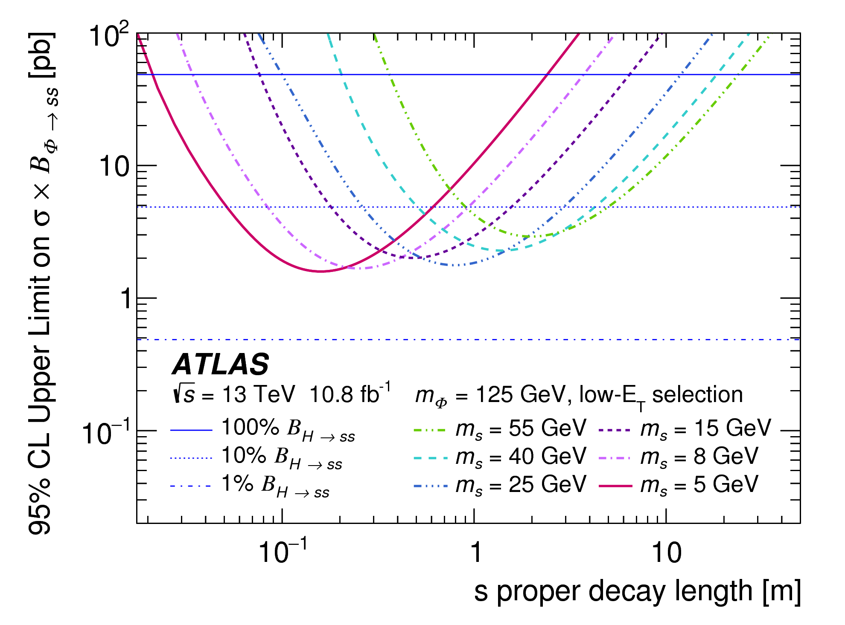
Final Limits
Original 2-J CalRatio Analysis

Slide 24
Conclusions I
3 New Final States to round out the LLP landscape
  Associated production with 2-jets, W, and Z
  Optimized for each channel
Reused many prior analysis components
  Especially the CalRatio jet Tagger…
  … and triggers!
For 2-jets + CalRatio Analysis
  Significant improvement in low mass limits!
  High mass does not improve
  But it is mostly orthogonal – to 2-jet analysis – combine?
Other possible improvements
  CalRatio Tagger could be re-trained, especially on ALPS!
DISCO method is difficult in low background searches
  Correlation in blinded area was difficult to enforce in unblinded dataset.
  Can this be improved?
And Ready for Reinterpretation!
  See talk by Abdelhamid Haddad earlier today!!

Slide 25
Backup

Slide 26
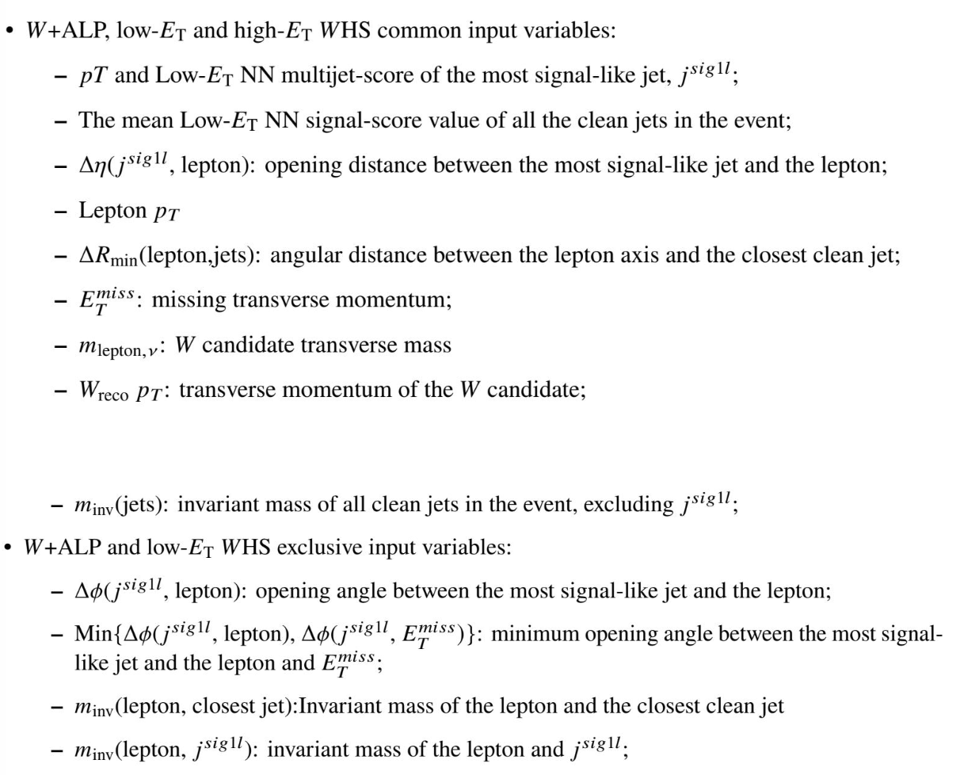
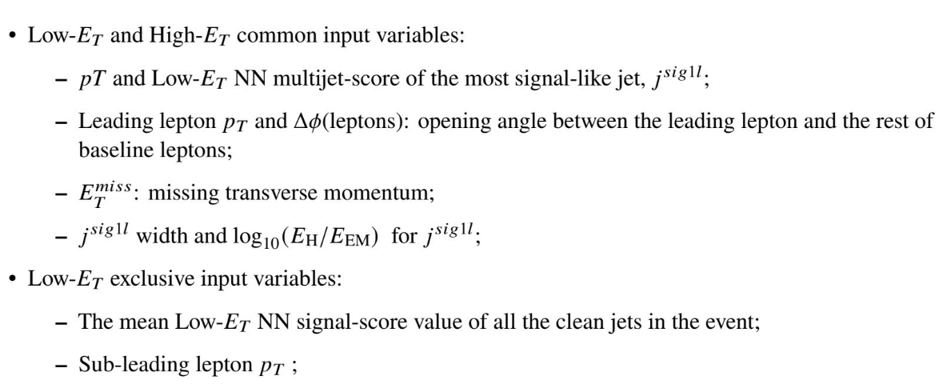
BDT Inputs for Associated Production

Slide 27
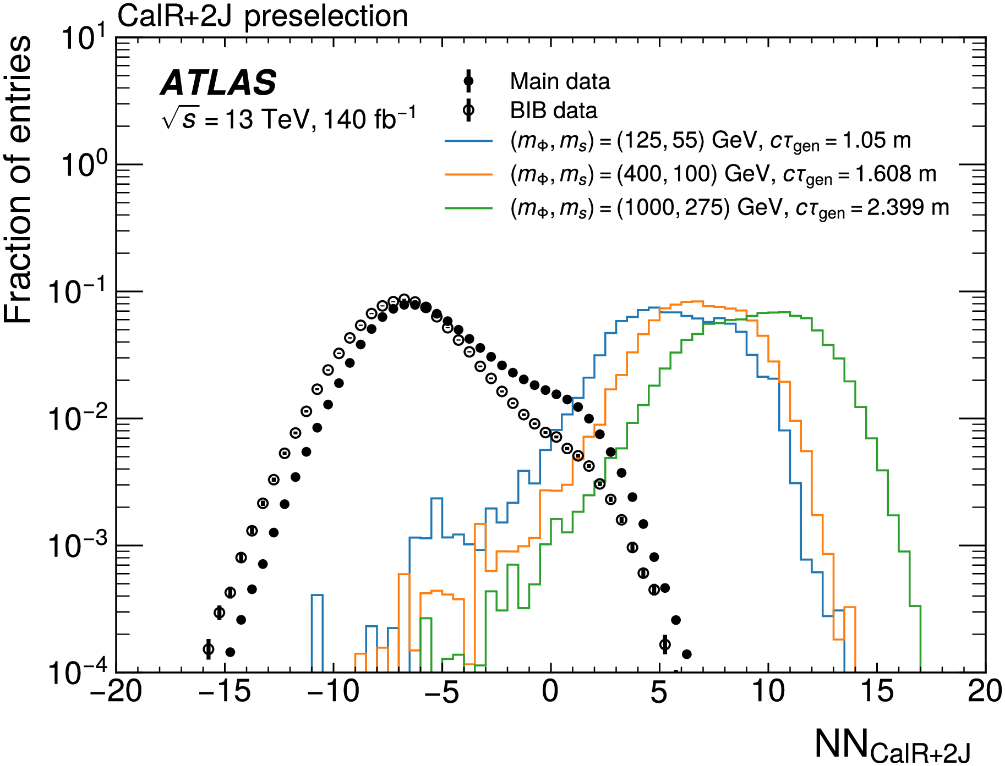
NN Performance
Given the unique jet signature, can we go after it?

Slide 28
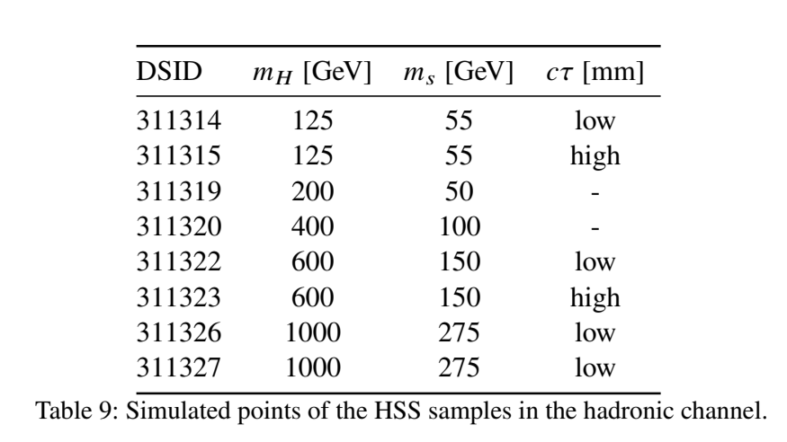
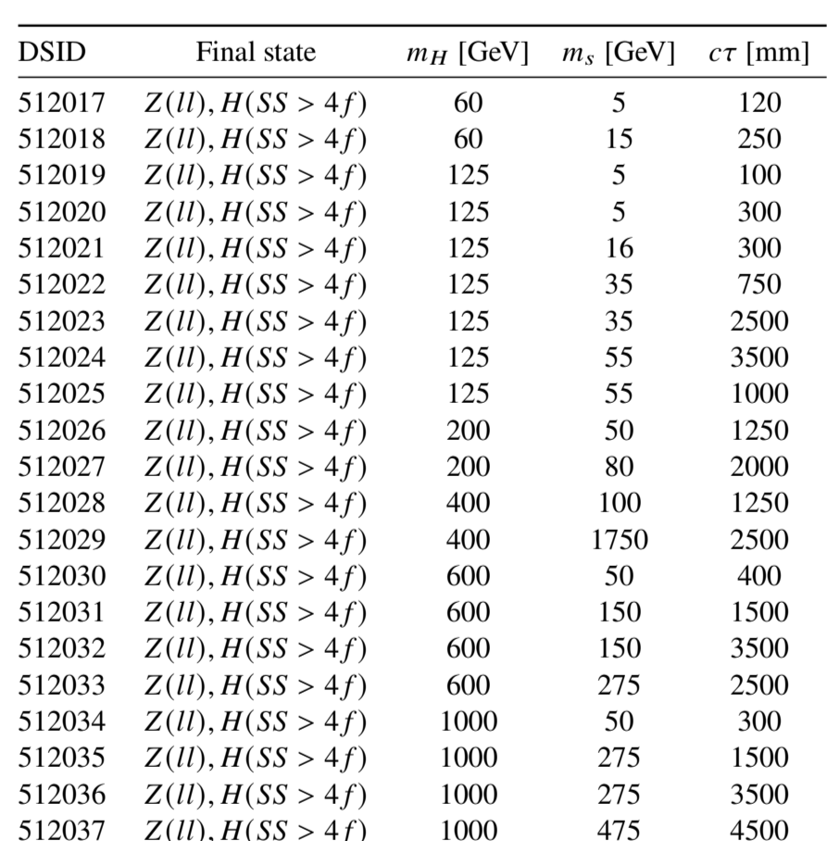
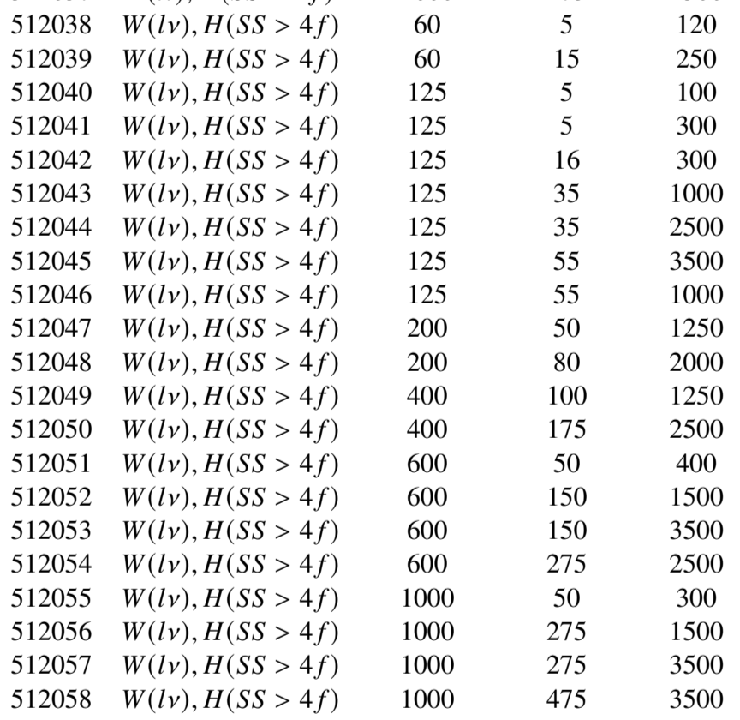
Signal Sample Phase Space – HSS Models

Slide 29
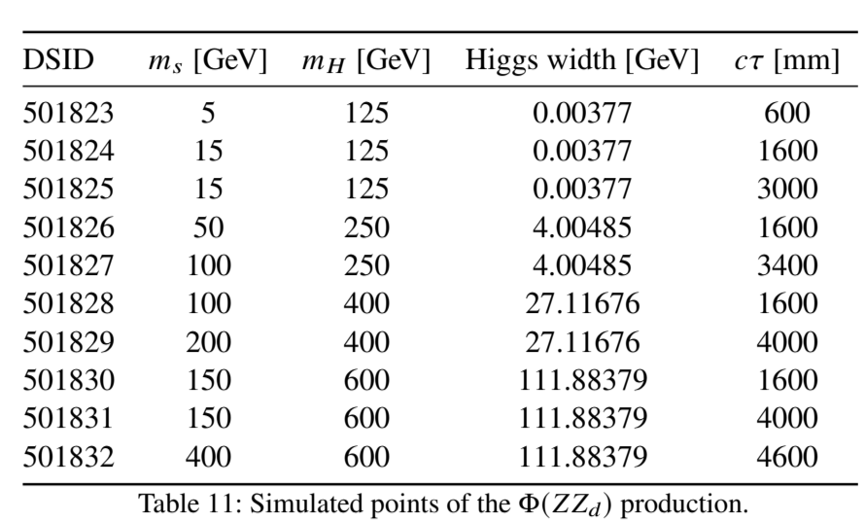
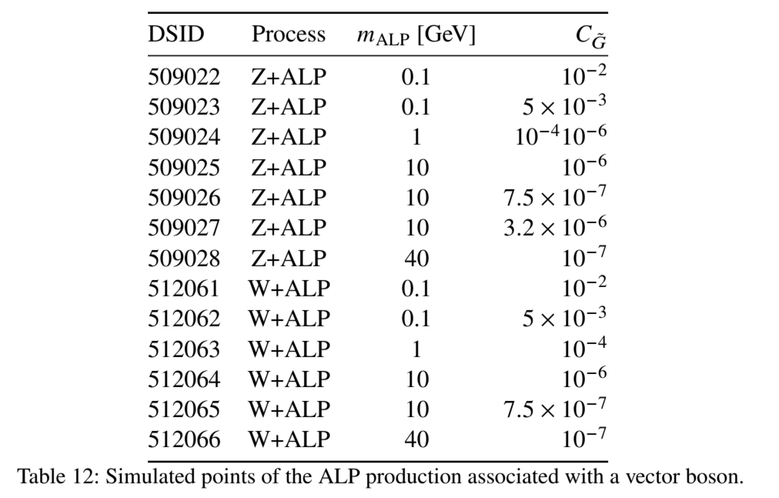

Signal Sample Phase Space – $Z_{d}$+ ALP Models

Slide 30

Triggers

Slide 31

What is BIB?

Slide 32

Can we get rid of it?

Slide 33

Conclusions

