Slide 1
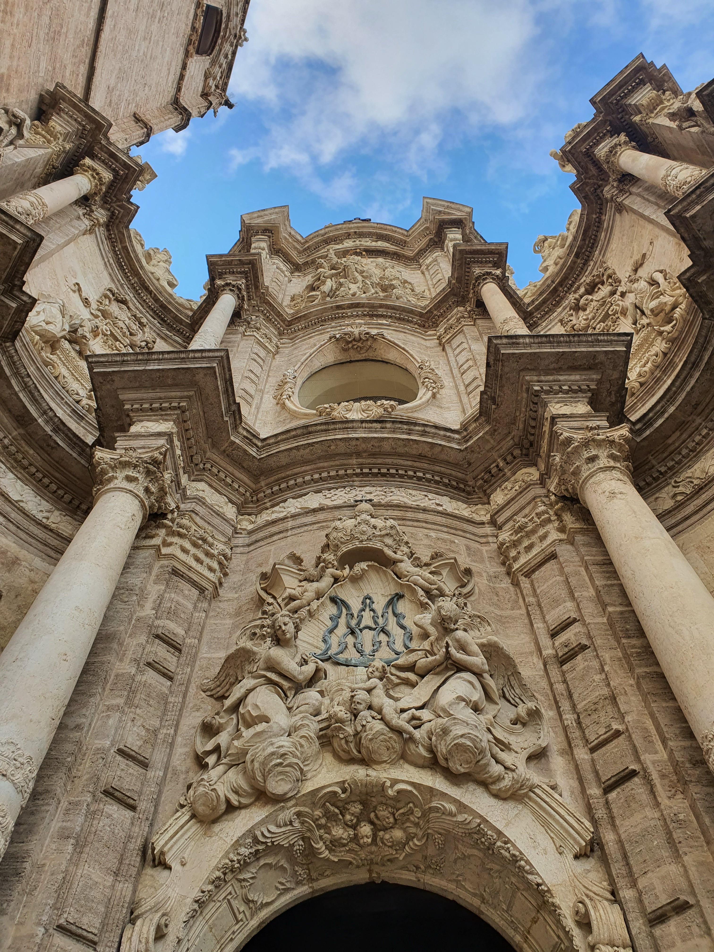
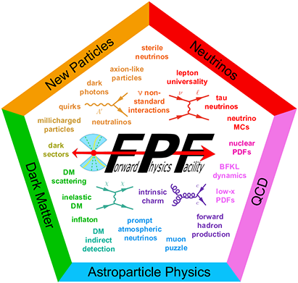



The Forward Physics Facility at the LHC
FLArE
Juan Salvador Tafoya Vargas (UC Davis)
on behalf of the FPF community
LLP2025, Valencia
2025.06.04

Slide 2
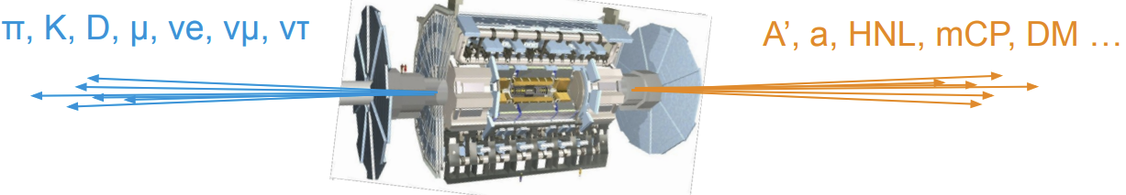
Motivation
Interest shifting towards new physics searches → limited by design of existing general purpose experiments
Take advantage of already-happening LHC collisions
  → forward region of e.g. ATLAS I.P. very rich in SM and potential new physics
Physics collisions already happening → no considerable additional operational cost
  → Initial investment needed for the construction of the facility in the forward region
  → Allows for design and installation of dedicated detectors

Slide 3
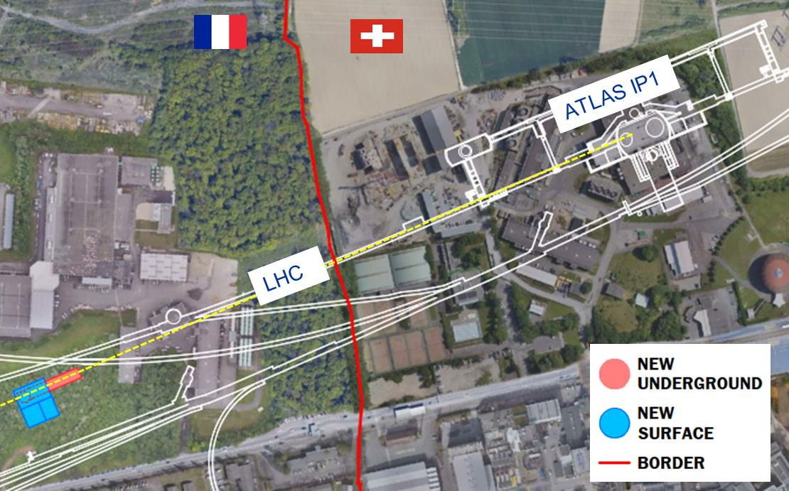
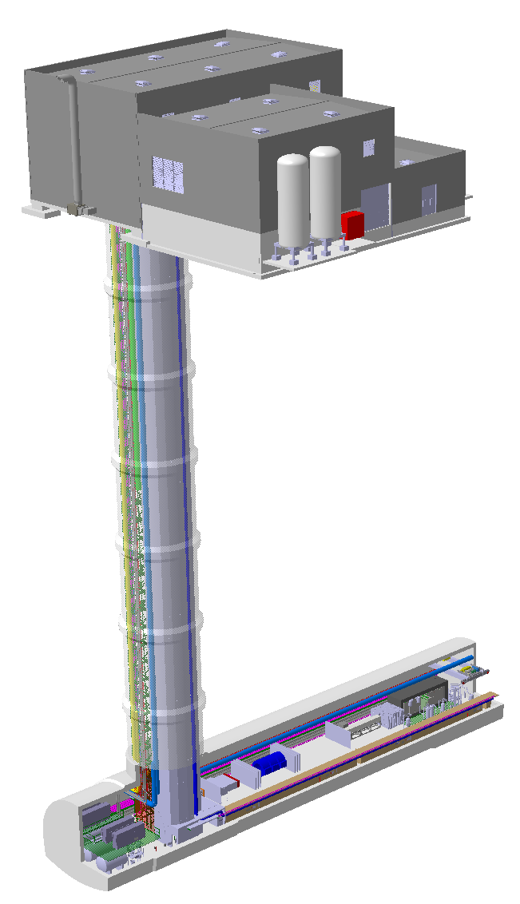
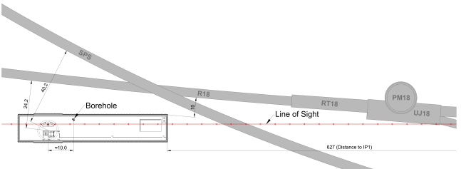
The facility
Location fixed!
627m away from ATLAS IP1 at 90m of depth on french soil
10m away from LHC tunnel → safe to access during stable beams
  Main dose given by collision muons from IP1
ATLAS IP1
SM18
L.O.S.
SMA18
LHC
Surface building
Shaft
Cavern

Slide 4
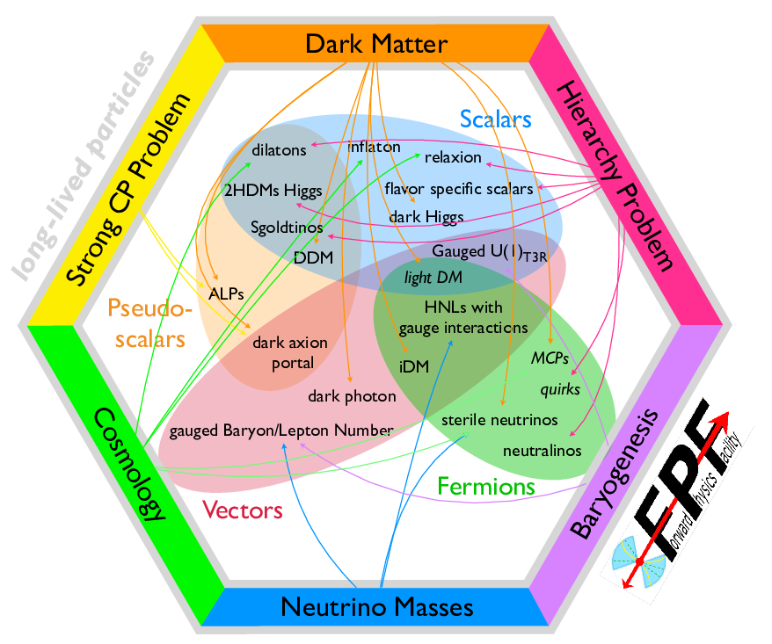
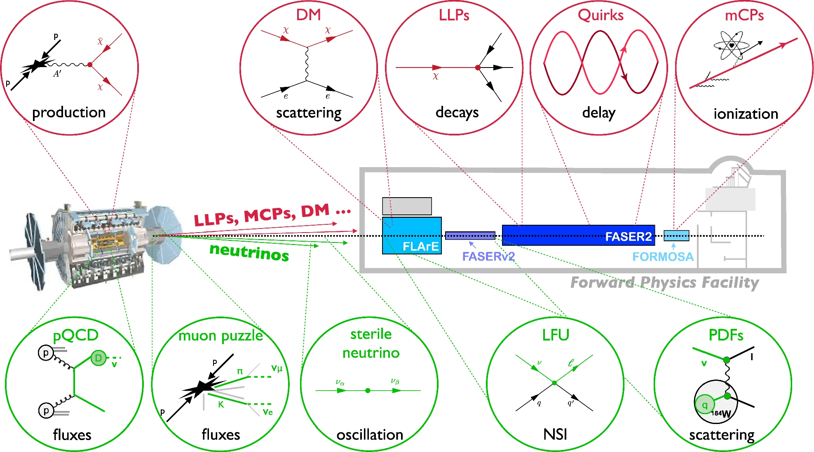
Physics objectives and experiments
Neutrino physics at TeV energies
Neutrino precision physics
FPF as neutrino-ion collider
Unique probe of small-x QCD
Impact for Astroparticle Physics
Dark matter and mediators
Millicharged particles
Other opportunities for new particle searches
See FPF’s input to ESPPU!
FPF experiments have discovery potential in every one of the PBC benchmark scenarios!

Slide 5
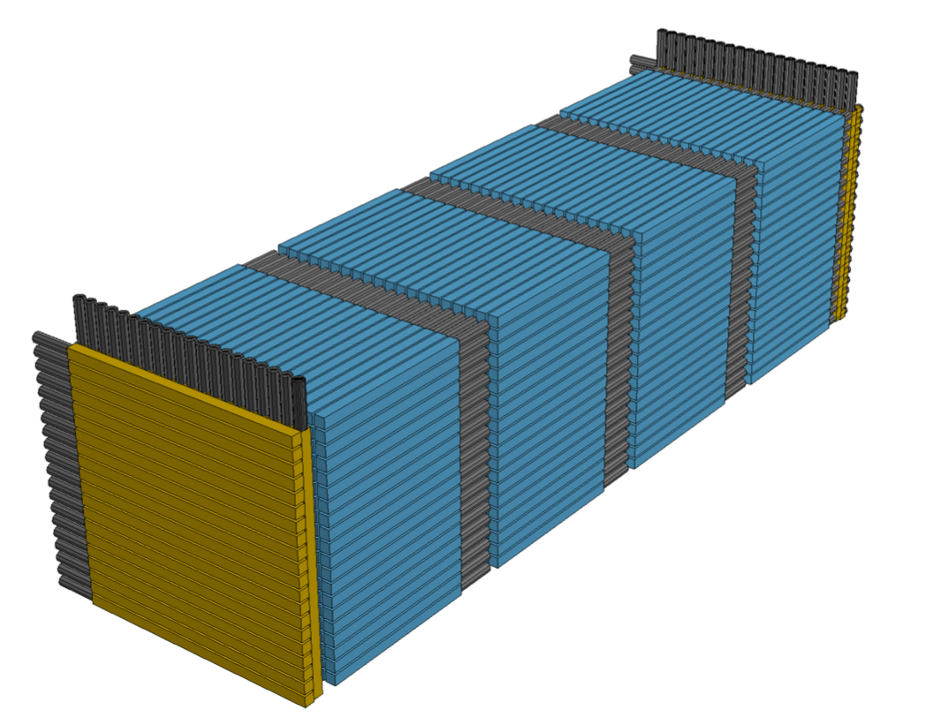
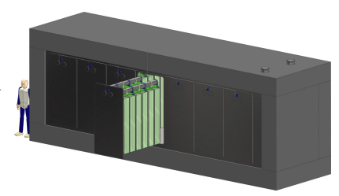
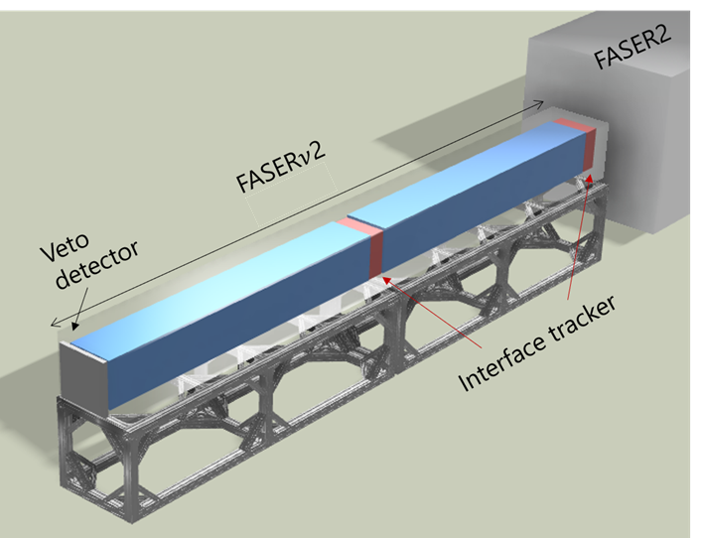
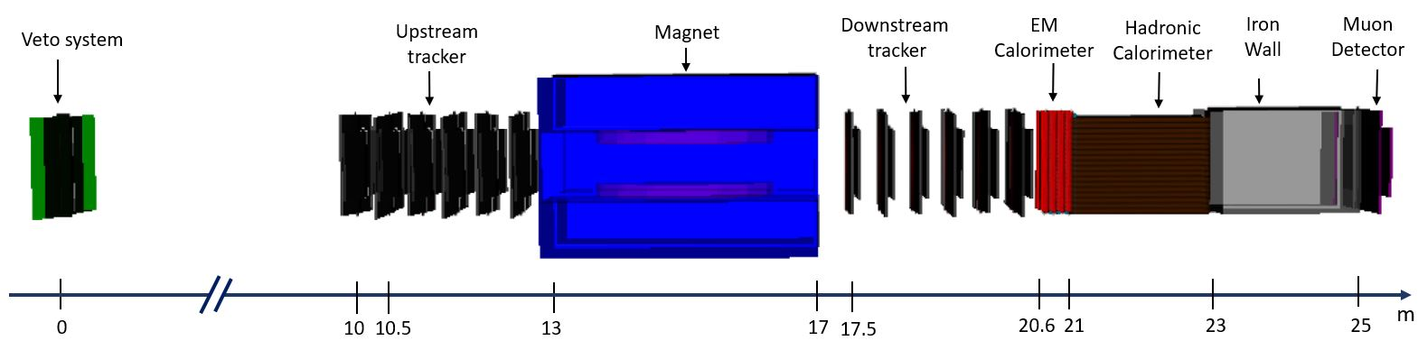
Tailored LLP detectors at the FPF
*new design!
FLArE: LAr TPC for neutrino detection
FORMOSA: plastic scintillator array for mCPs
FASER2: tracking spectrometer for LLP searches and muon charge ID
FASERv2: emulstion detector for neutrinos

Slide 6
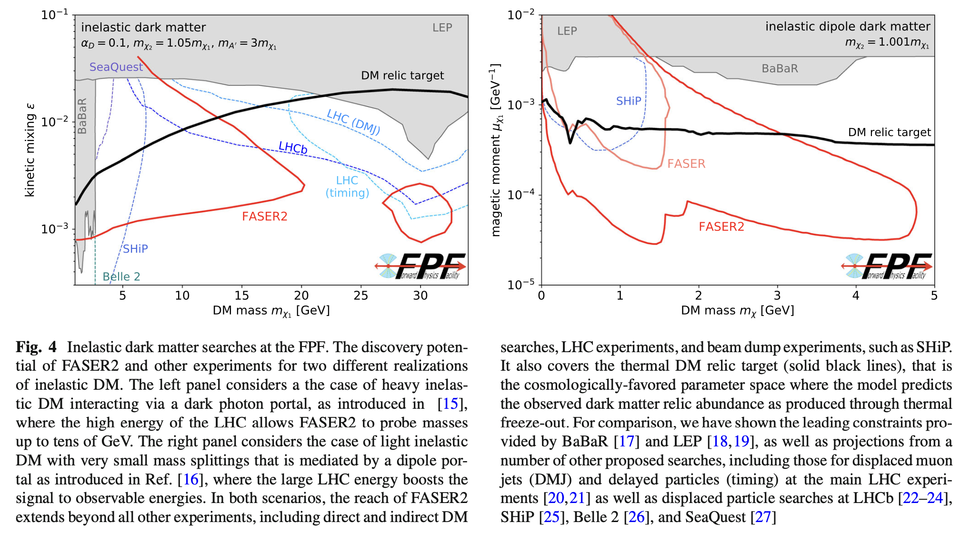
LLPs at the FPF
From FPF’s input to ESPPU

Slide 7
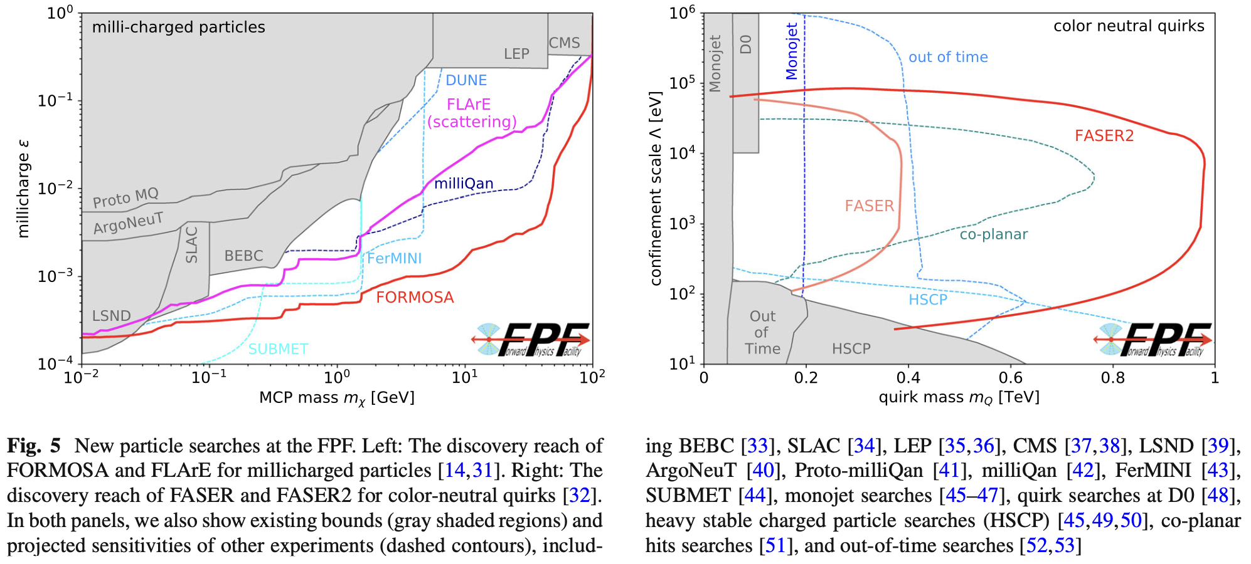
LLPs at the FPF
From FPF’s input to ESPPU

Slide 8
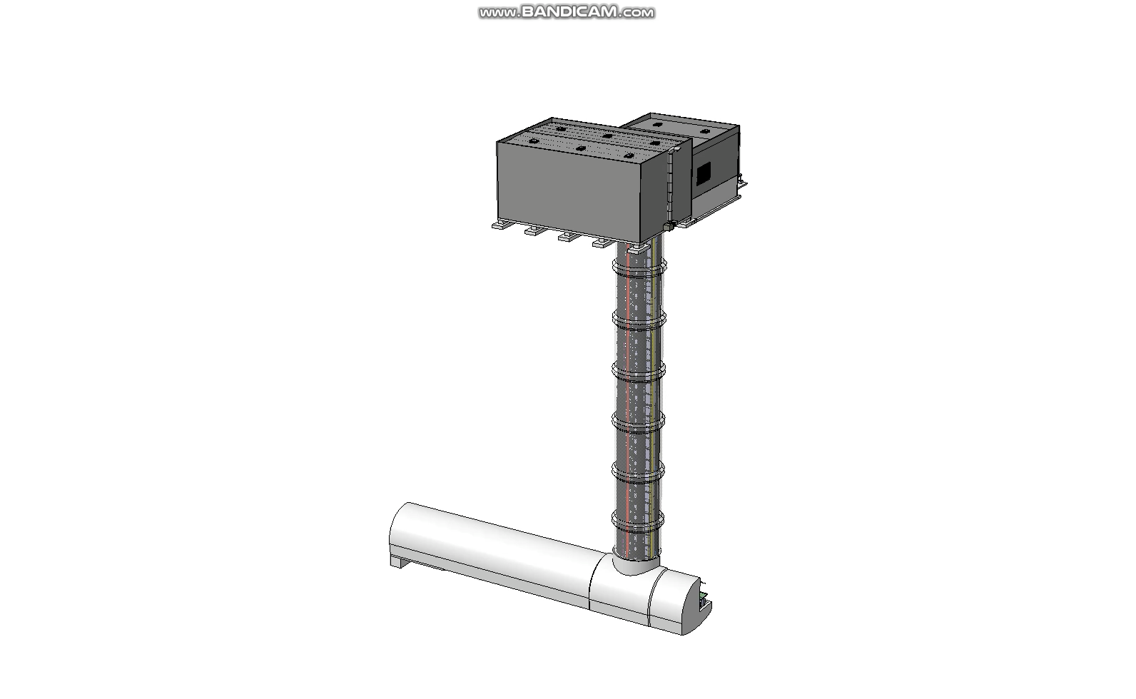
FPF integration
A global integration model is ready and constantly being updated with feedback from experiments
  Services and safety elements being integrated/optimised

Slide 9
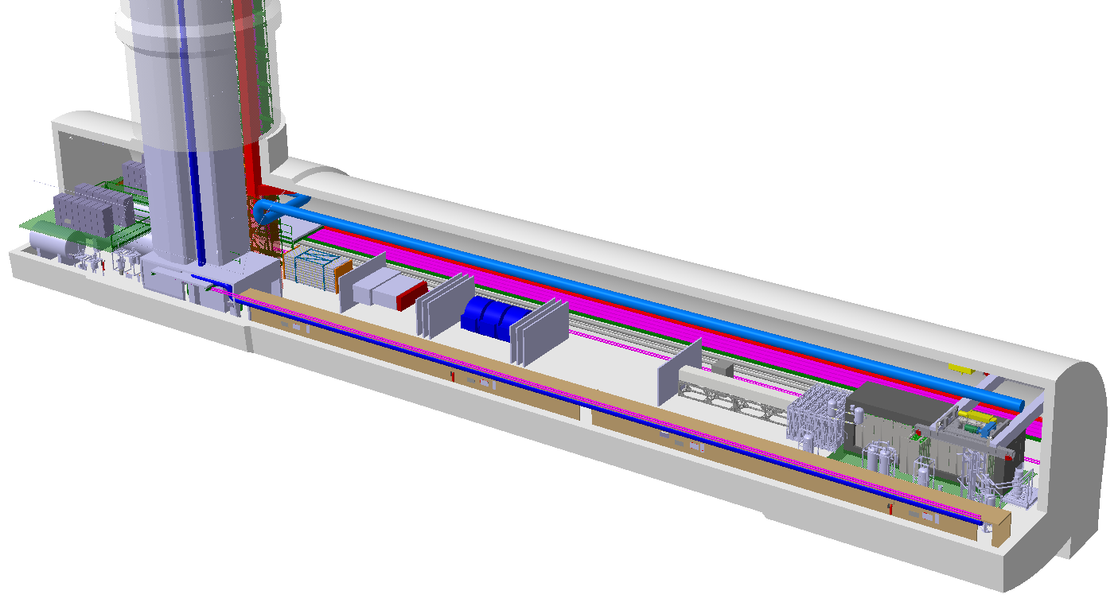
FPF experiment locations
Optimize physics across facility by combining complementary info from different experiments e.g. muons from neutrino interactions measured in FASER2 spectrometer
FASER2
FASERnu2
FLArE
Nominal Beam Axis
FORMOSA

Slide 10
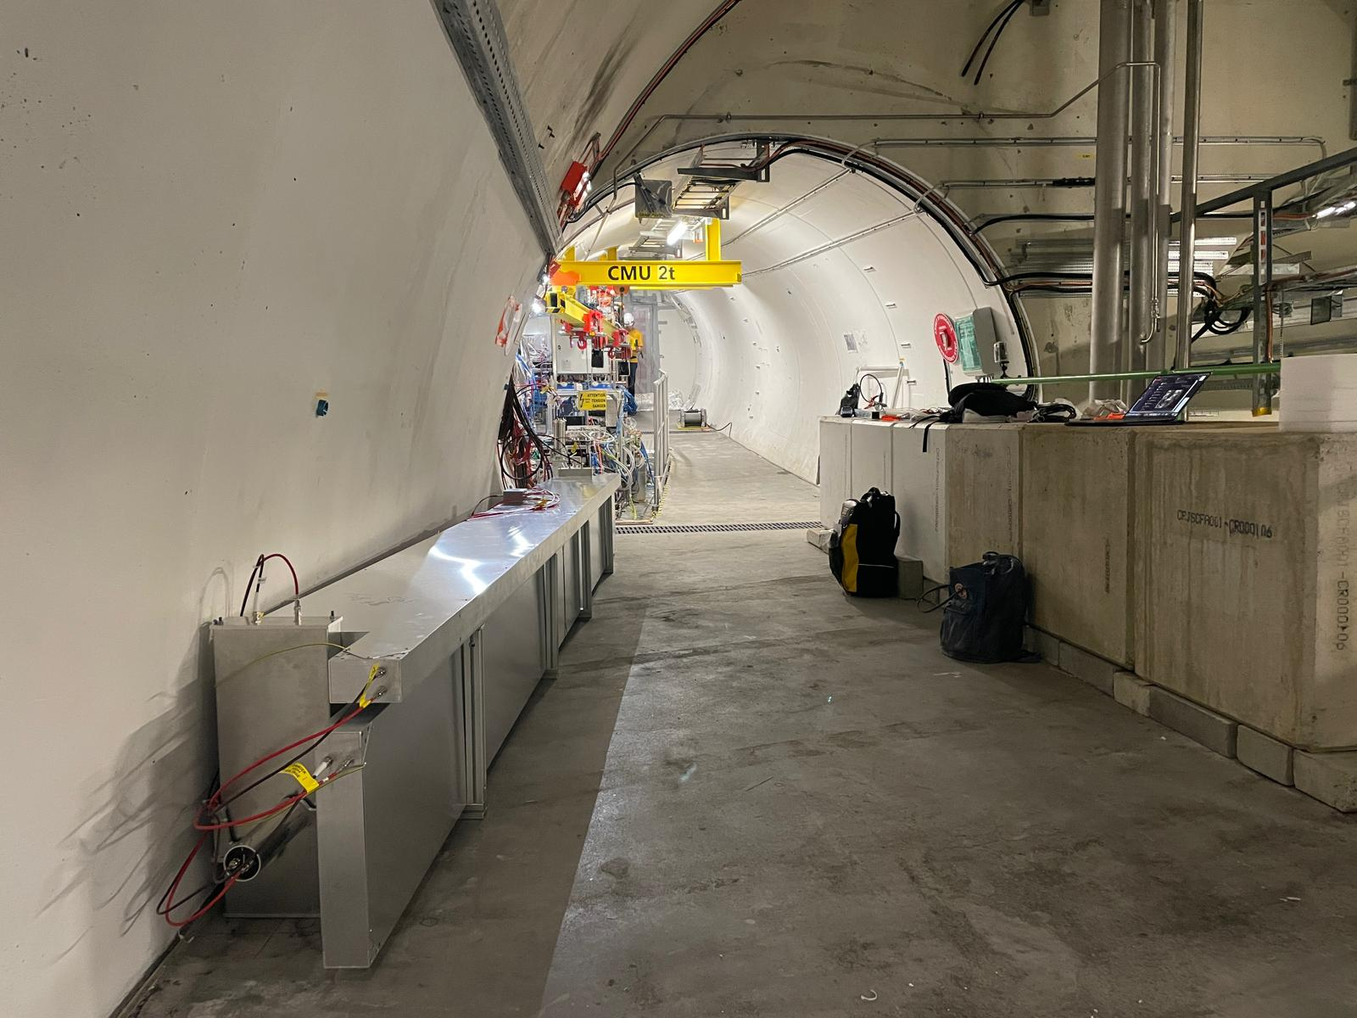
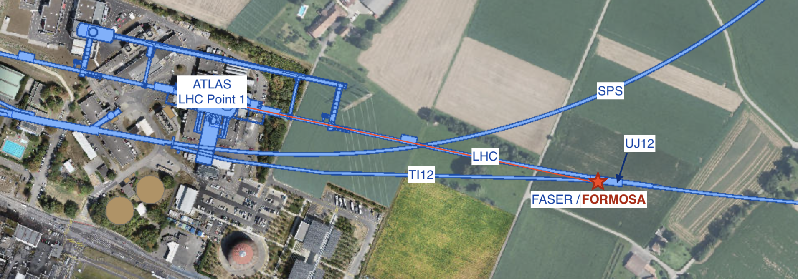
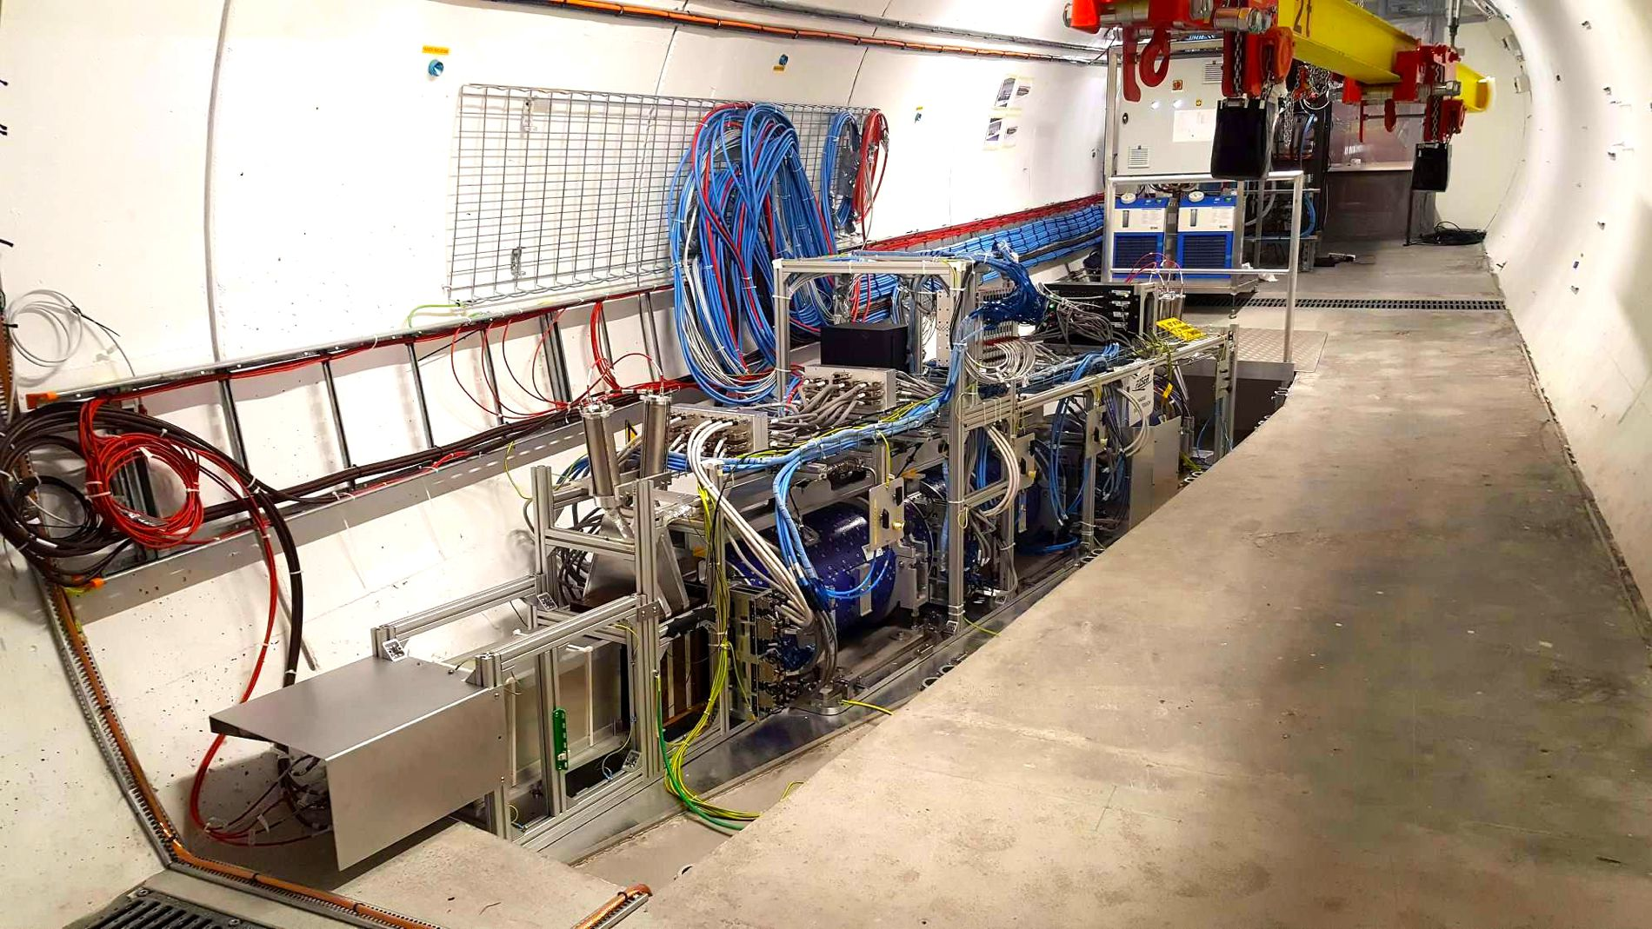

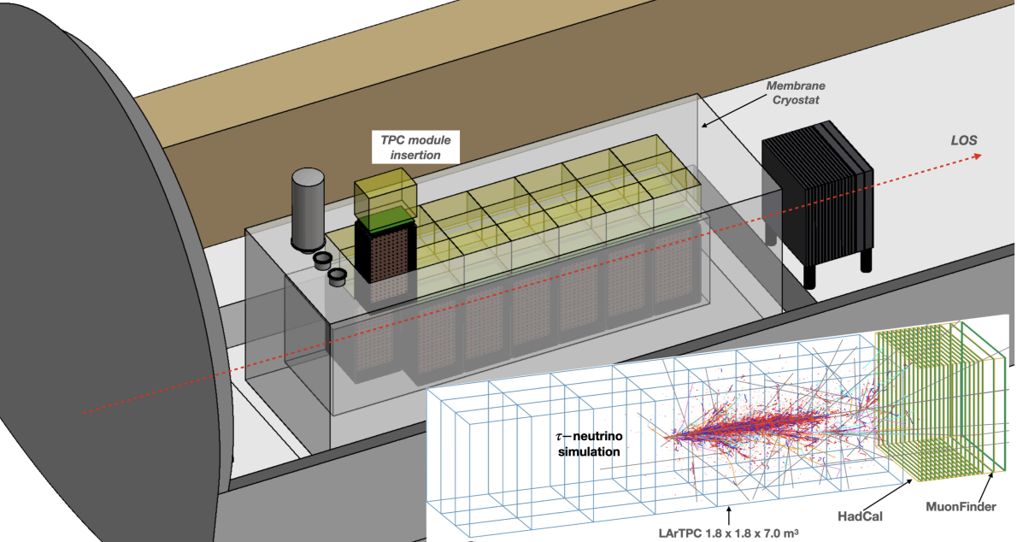
Pathfinder experiments
Proof of concepts: collecting data and validating designs/DAQs through Run 3
FLArE
Reference design in
https://www.osti.gov/biblio/1972463
FLArE inspired by the DUNE ND-LAr concept:
doi.org/10.3390/instruments5040031

Slide 11
Pathfinder experiments yielding first results

Slide 12
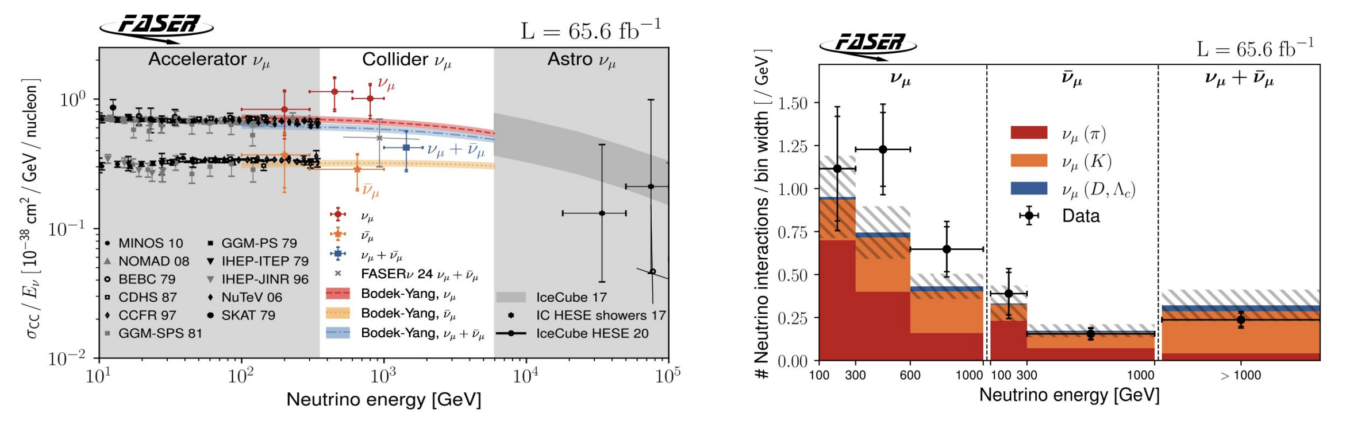
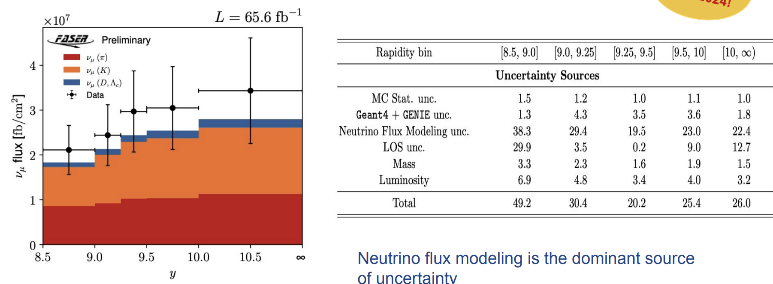
FASER
$$n_{ν,obs}=338.1±19.0(stat.)±8.8(sys.)$$
See Wissal Filali’s talk!
First differential neutrino interaction measurement in the TeV energy range (Phys. Rev. Lett. 134, 211801)
$ν_{μ}$ flux as a function of the rapidity $y$ (CERN-FASER-CONF-2025-001)

Slide 13
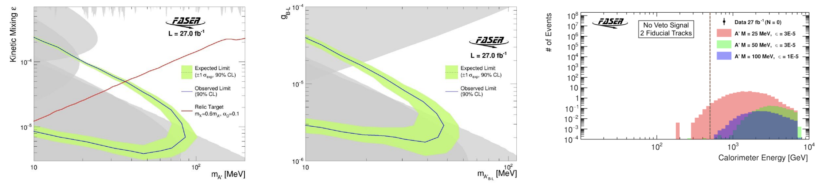
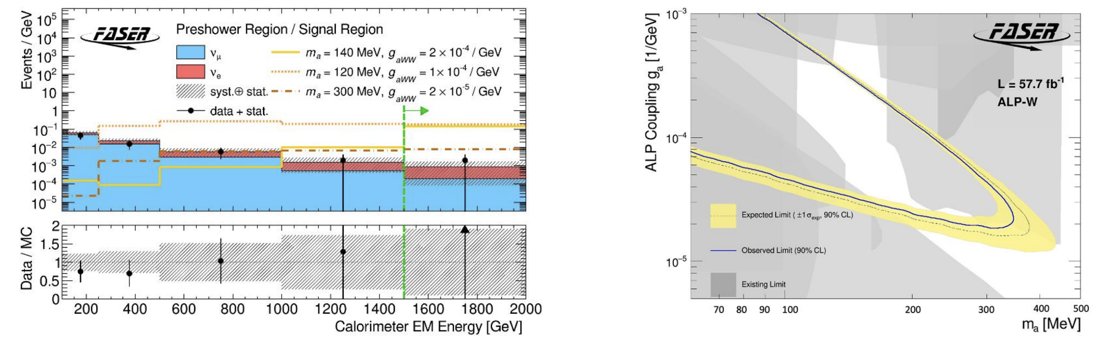
FASER
See Sinead Eley’s talk!
Dark photon ($A^{′}$)
$B-L$ gause boson ($A_{B-L}^{′}$)
Dark photon search with 2022 data (27 ${fb}^{-1}$) (2308.05587)
Axion-like particles search with 2022/2023 data (57.7 ${fb}^{-1}$)
(2410.10363)

Slide 14
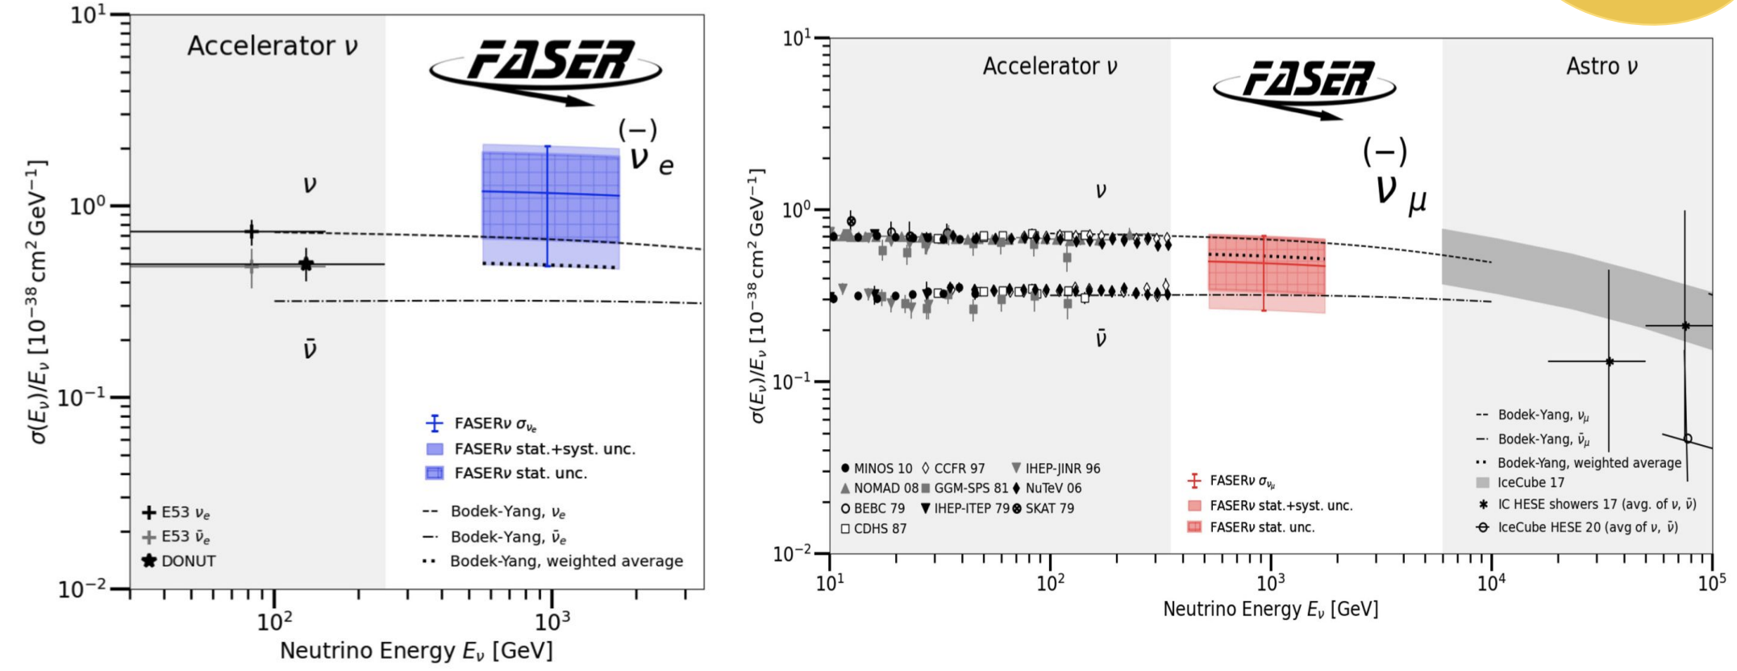
  FASER𝜈
See Wissal Filali’s talk!
Measurement of $ν_{e}$ and $ν_{μ}$ cross sections in the TeV range for 130 kg target mass x 9.5 ${fb}^{-1}$ (PhysRevLett.133.021802)

Slide 15
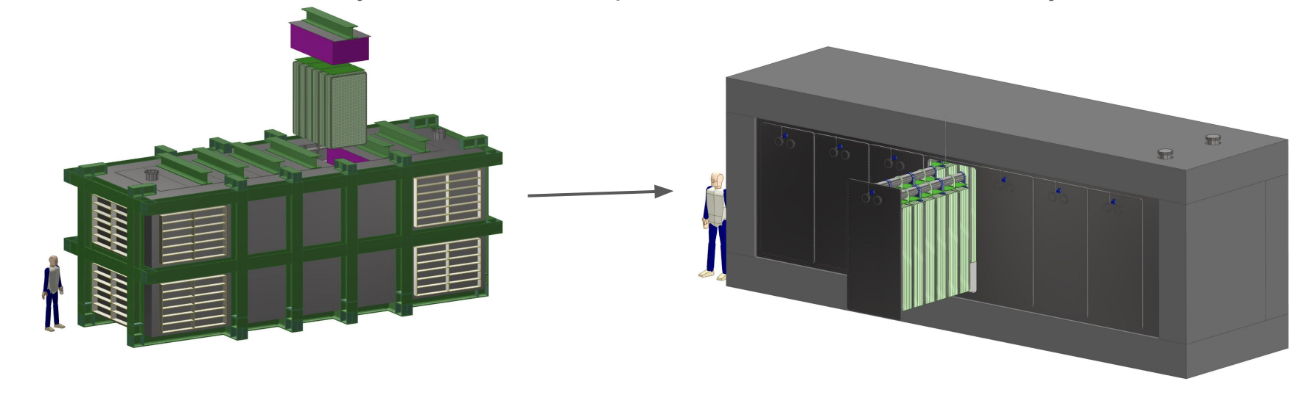
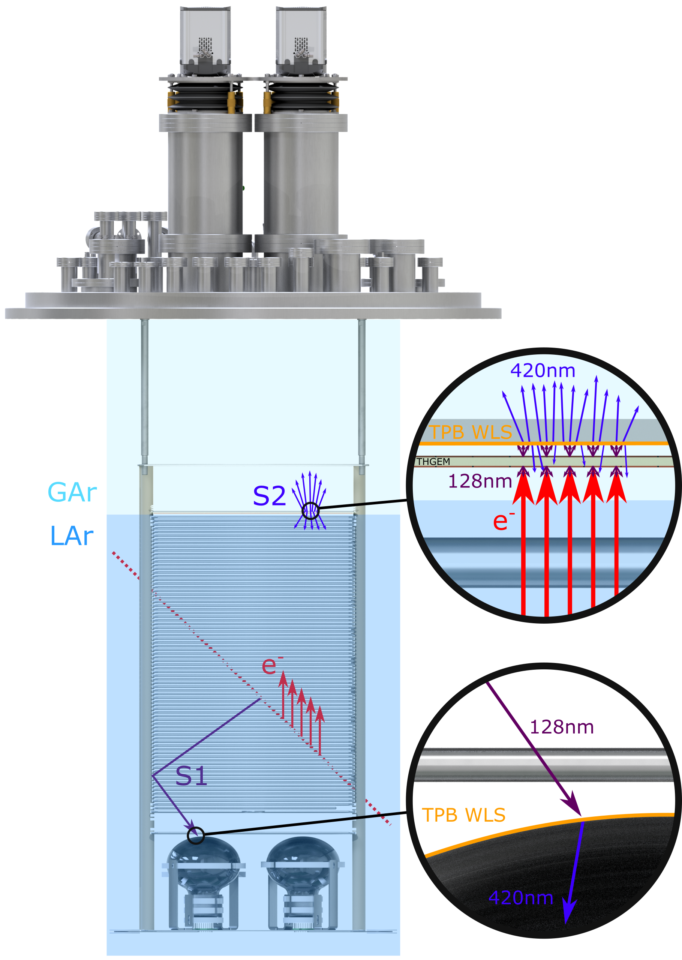
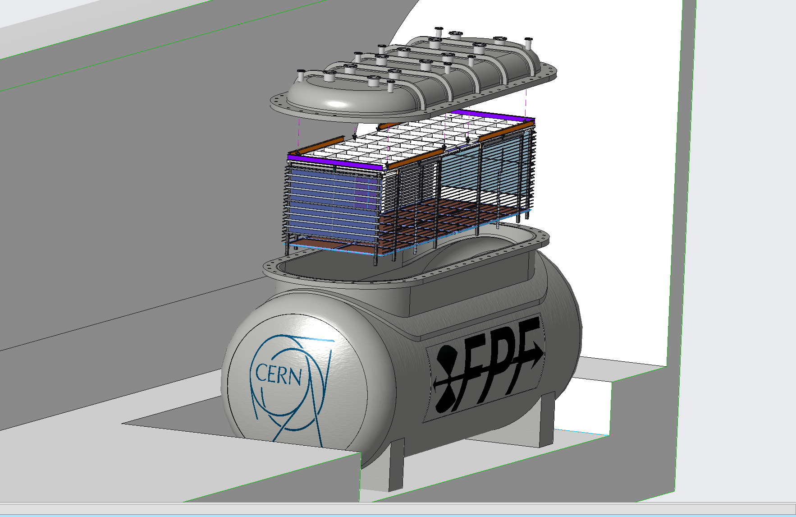
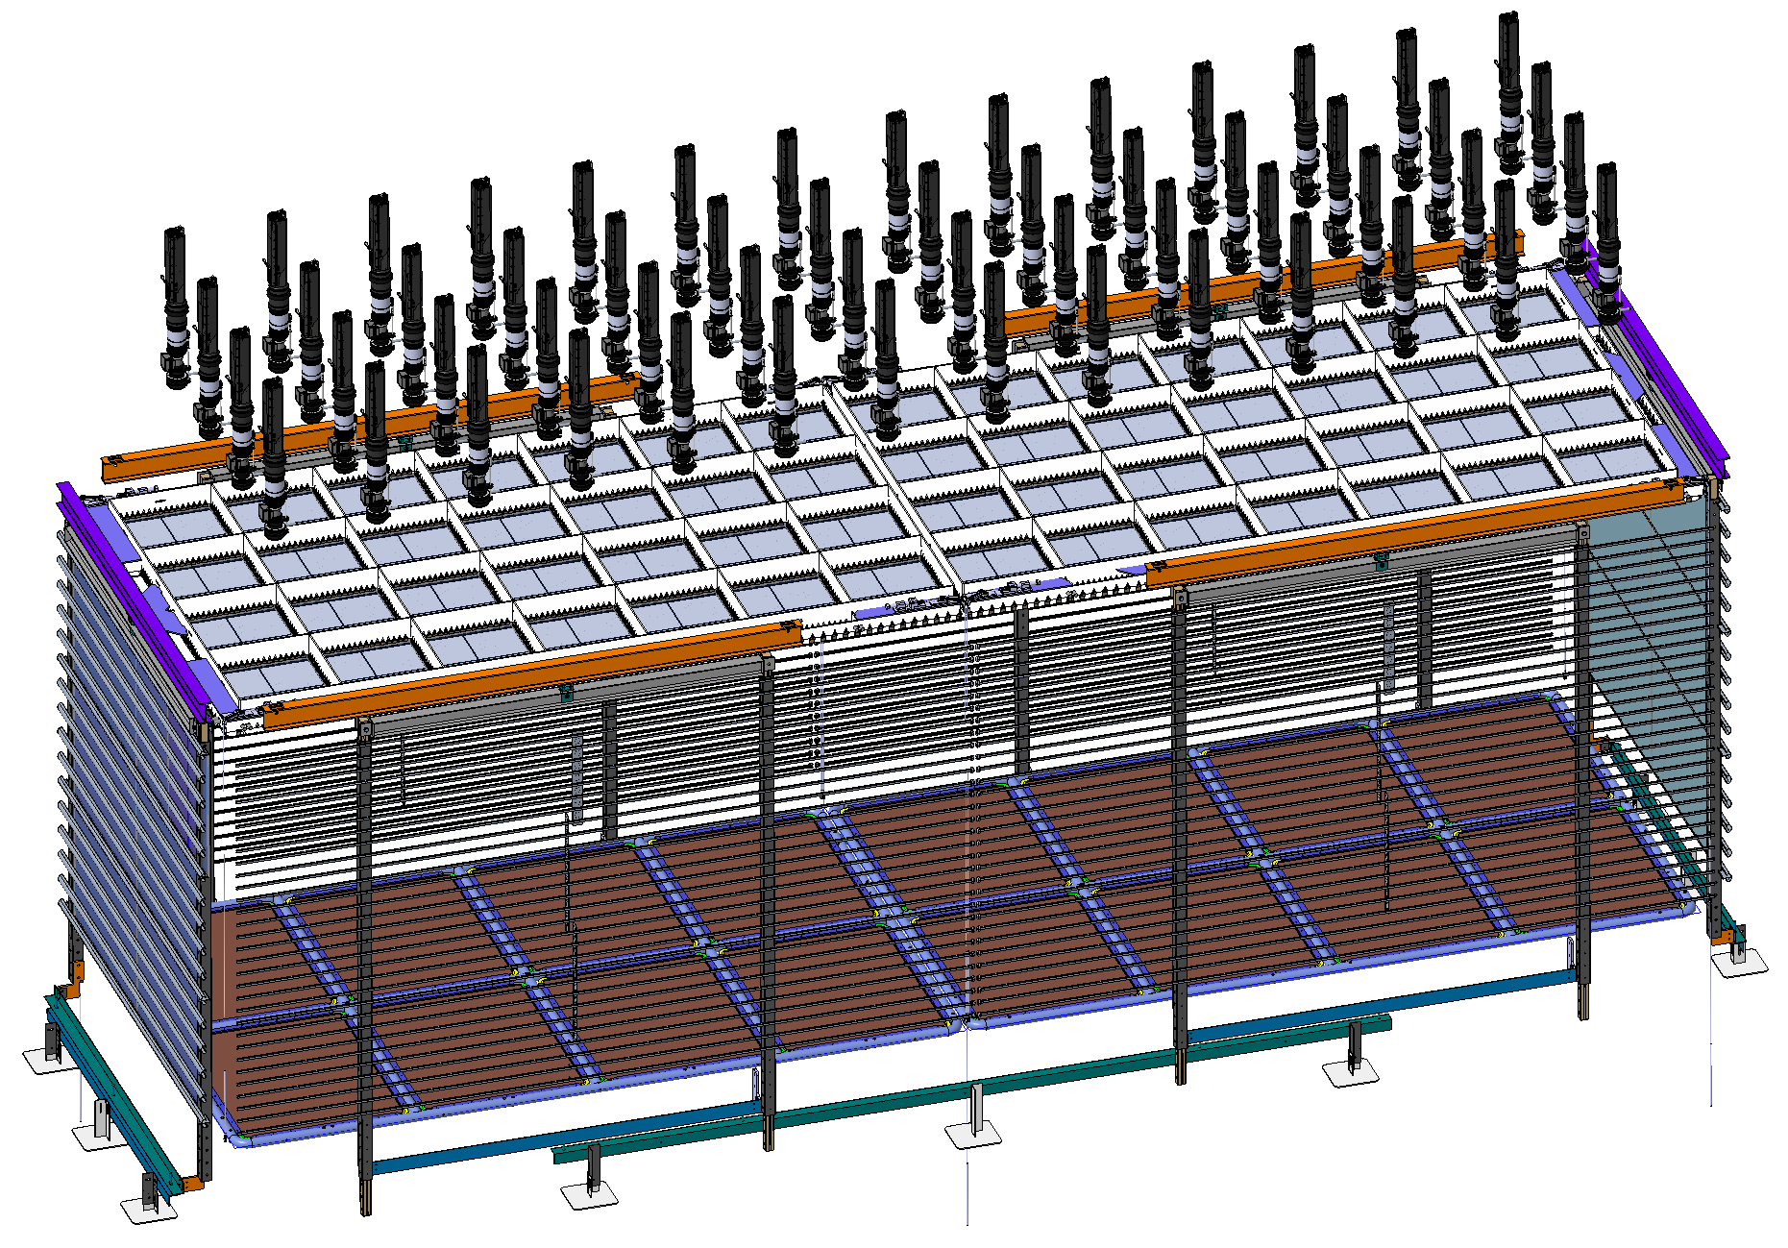
FLArE
Design evolving considering physics, installation and operation constraints!
Design changed from TPCs being top-loaded to side-installed “filling cabinet” design
Considering an alternative design using an ARIADNE-style (ARgon ImAging DetectioN chambEr) optical readout

Slide 16
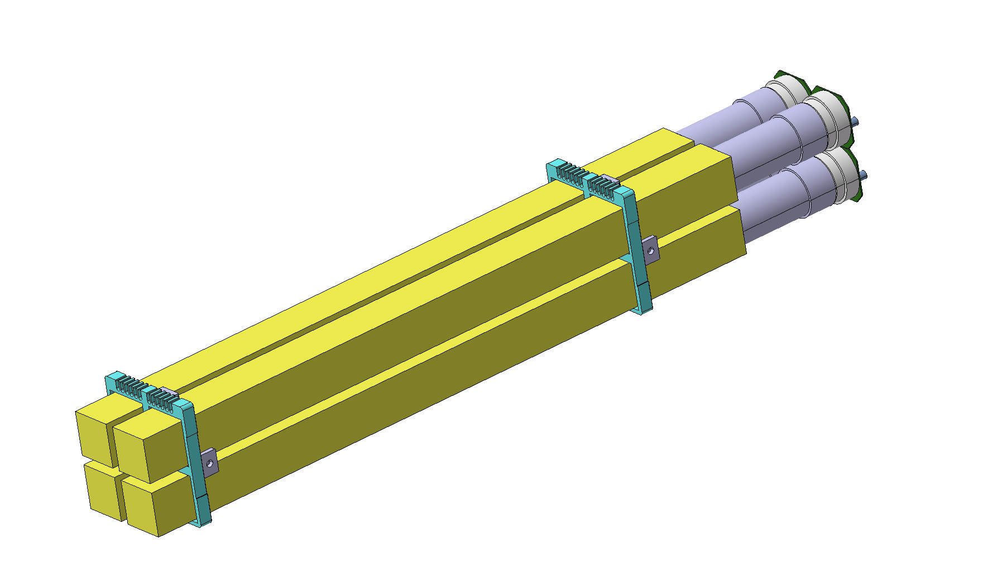
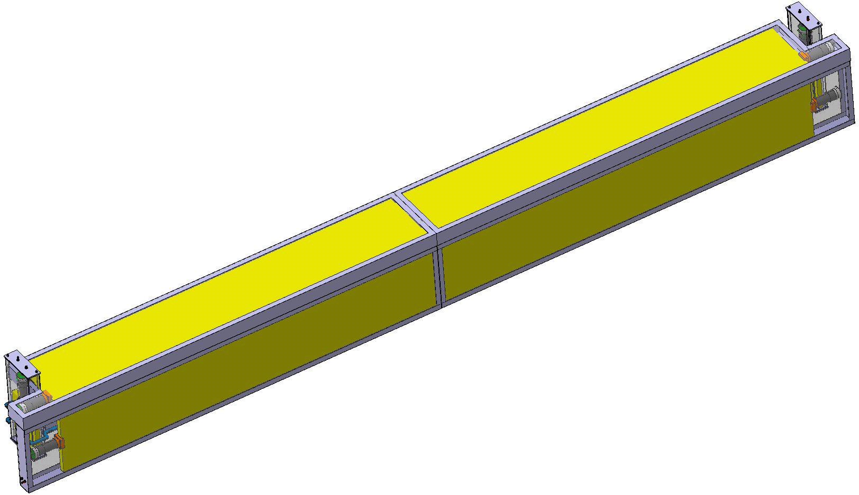
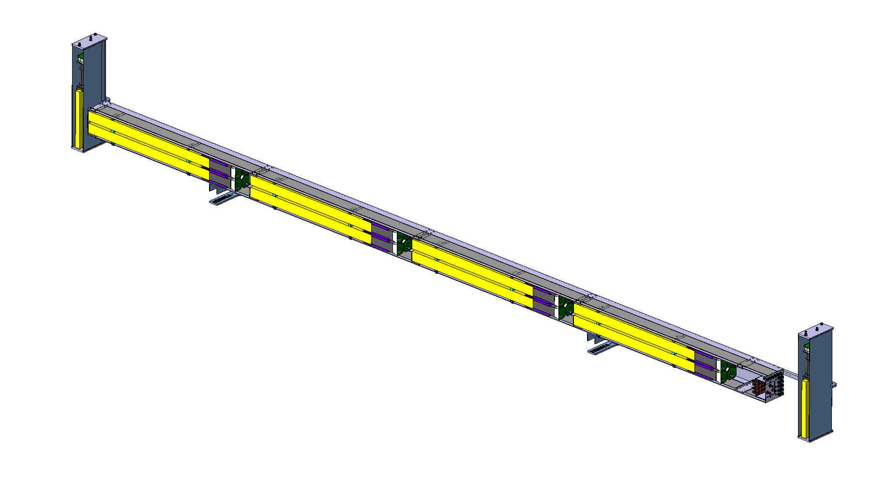
FORMOSA demonstrator, as of 2025
2024
2025
PMT
80cm
scintillator
$$⟨E⟩∝{\left(\frac{Q}{e}\right)}^{2}l_{scint}$$
~440cm
40cm
L.O.S.
20cm
Small scale prototype of the FPF FORMOSA:
  The same 16 bars as last year
    Replacing 4 HV bases (one per layer in the same line-of-sight) as a readout test
  Same front+back muon panels
  Hermetic coverage on the LHC-side (to probe radiation) and top (for cosmics)
  Additional test CeBr3 scintillator module installed
  Panel between main body and wall installed (to probe for side-showering)

Slide 17
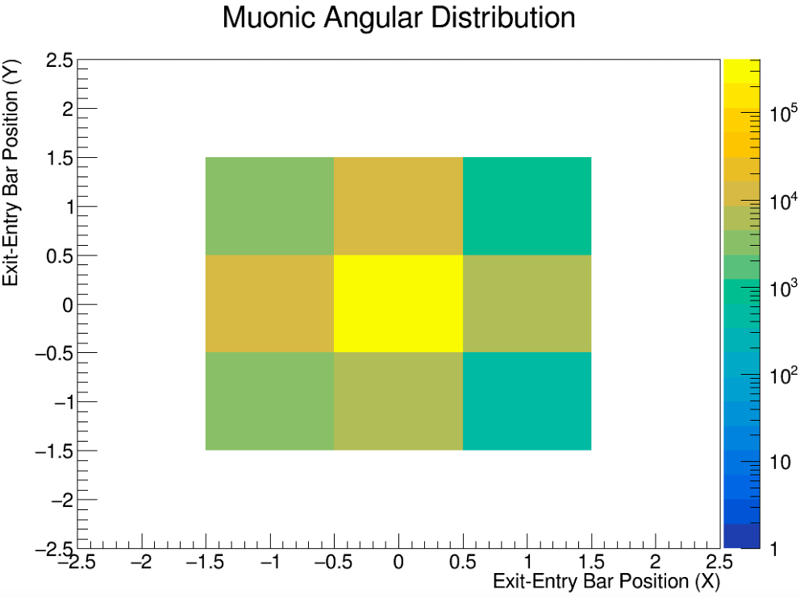
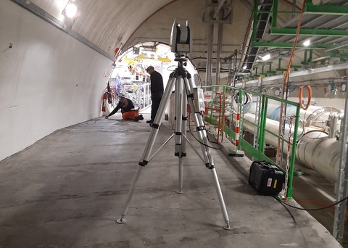
FORMOSA: alignment validation
Checking the distribution of the “exit - entry” bar number of collision muon events
→ LHC collisional data confirms alignment!

Slide 18
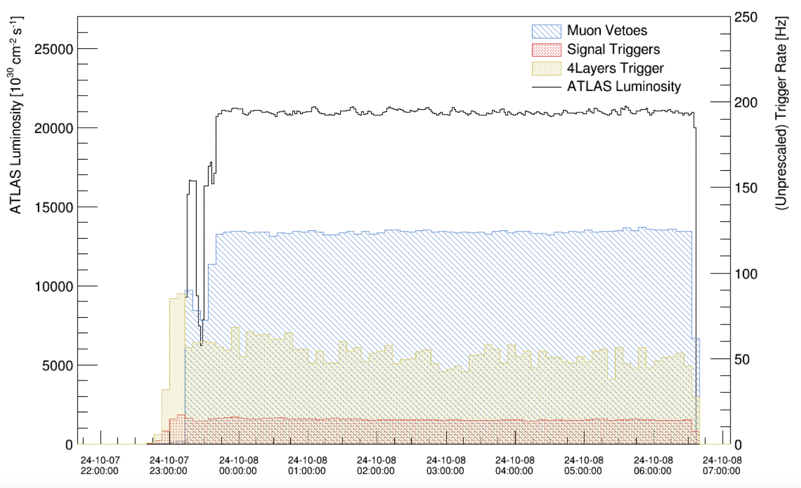
FORMOSA: DAQ validation
Preliminary rates
Signal triggers stably collecting data
Muons very effectively vetoed!

Slide 19
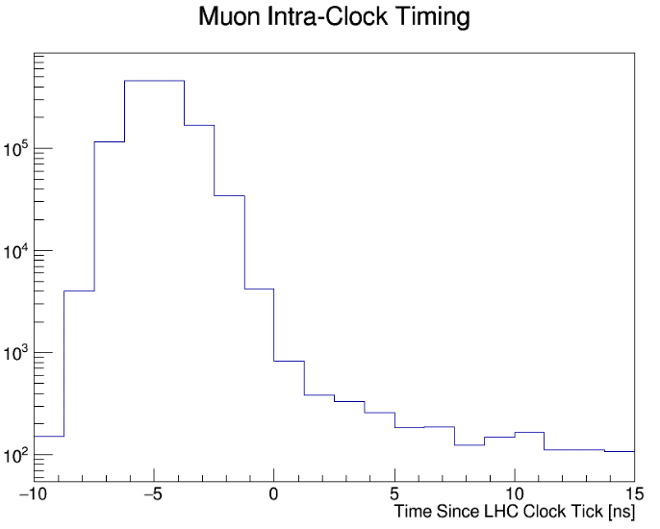
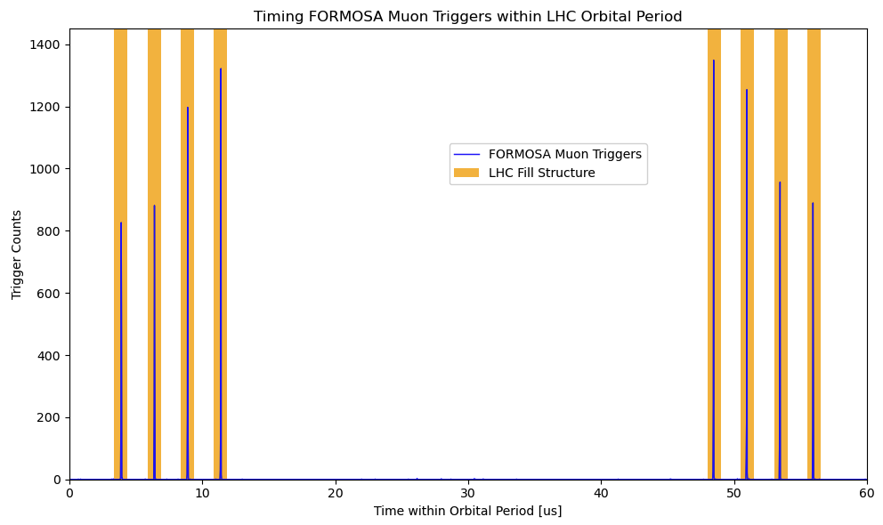
FORMOSA: timing studies
Muon arrival peak
Flat beam background
Looking between LHC clock-ticks
Looking within orbital of a 12b fill with 8 colliding bunches

Slide 20
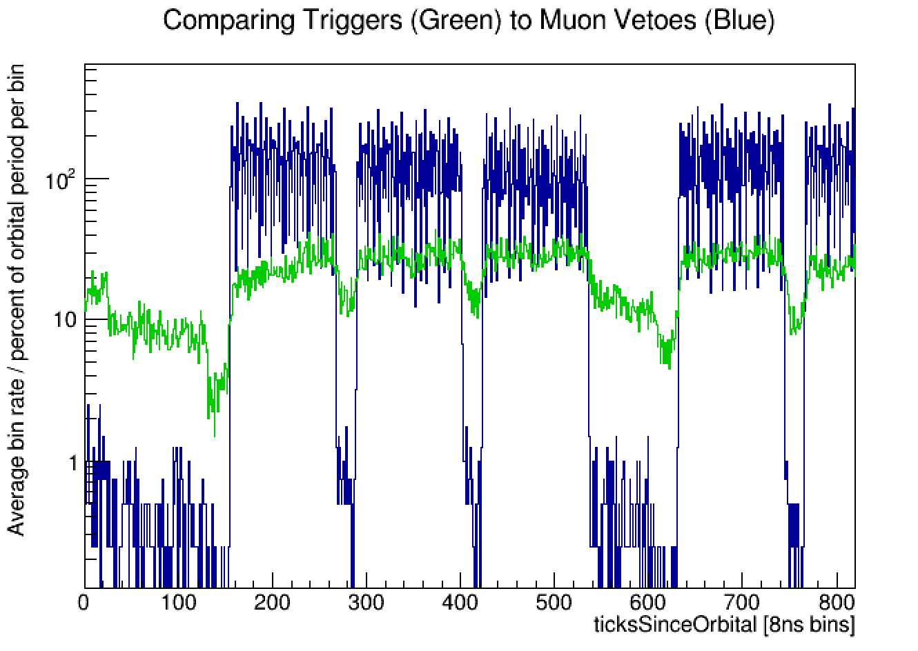
FORMOSA: muon veto studies
Fill with 2460b
N.B. LHC collisions every 25ns while DAQ clock runs at 8ns!
Crucial to determine when physics from collisions may be happening!

Slide 21
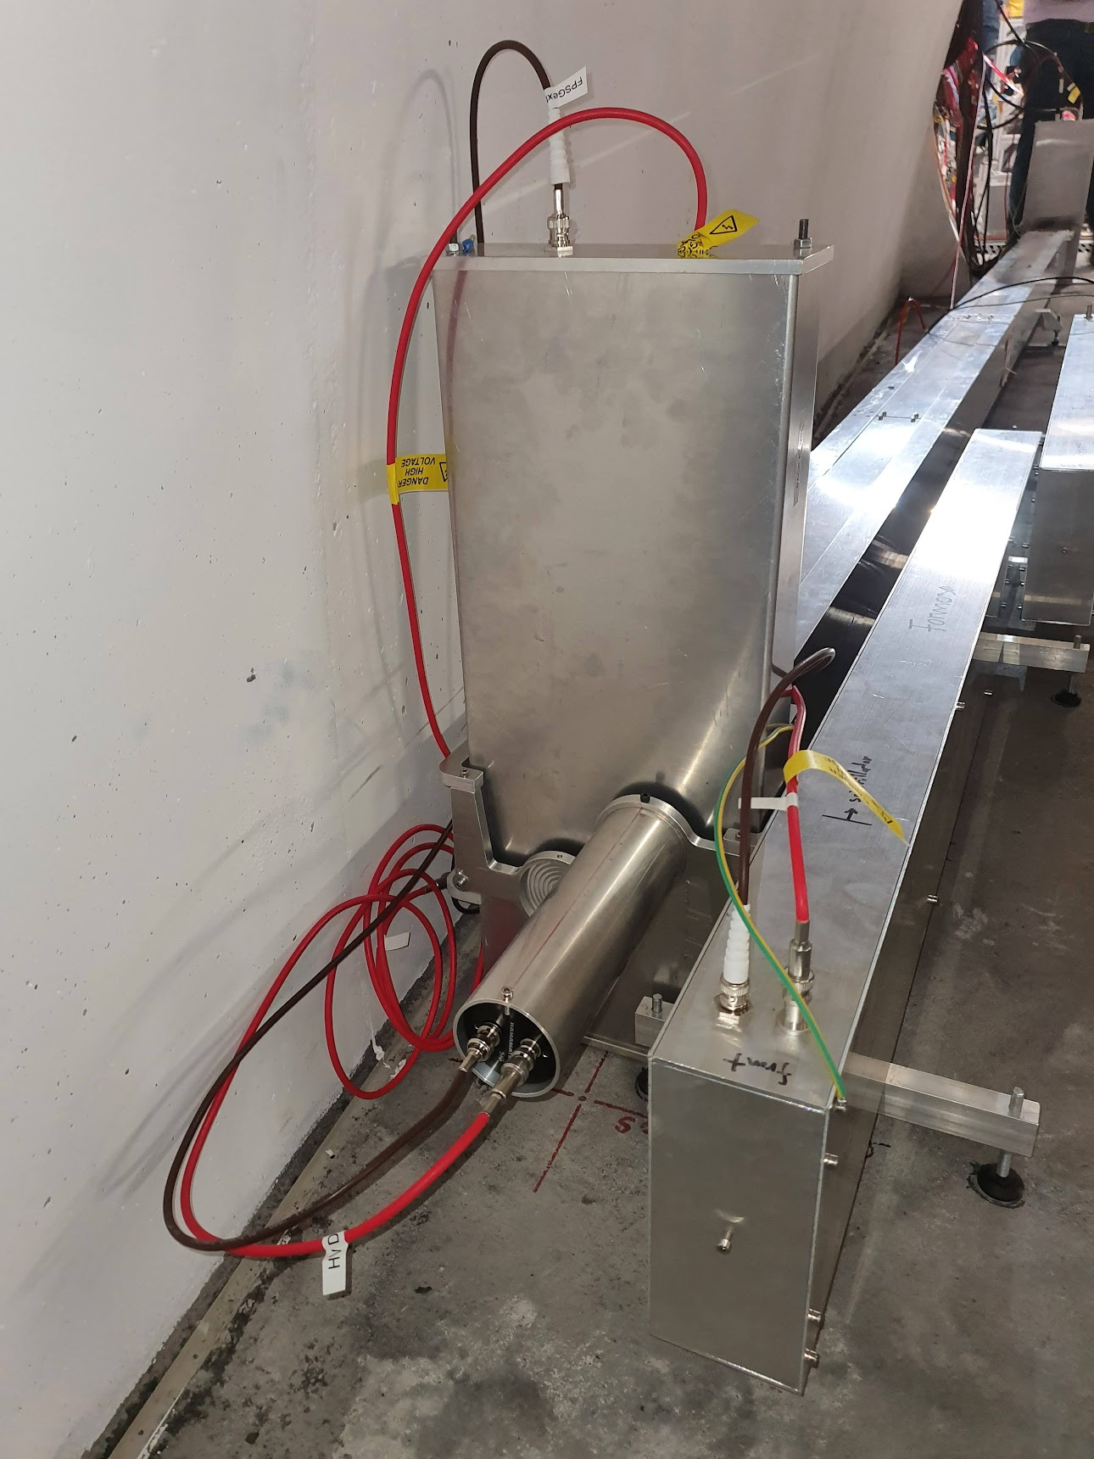
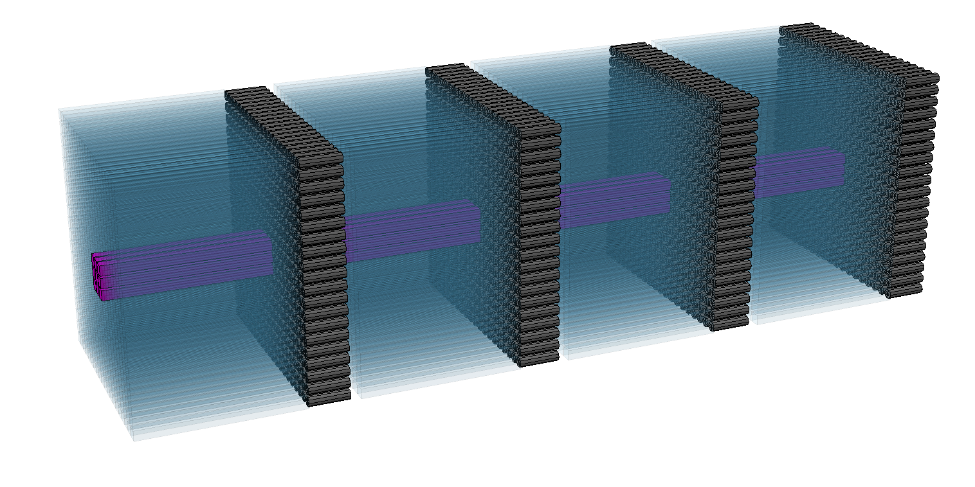
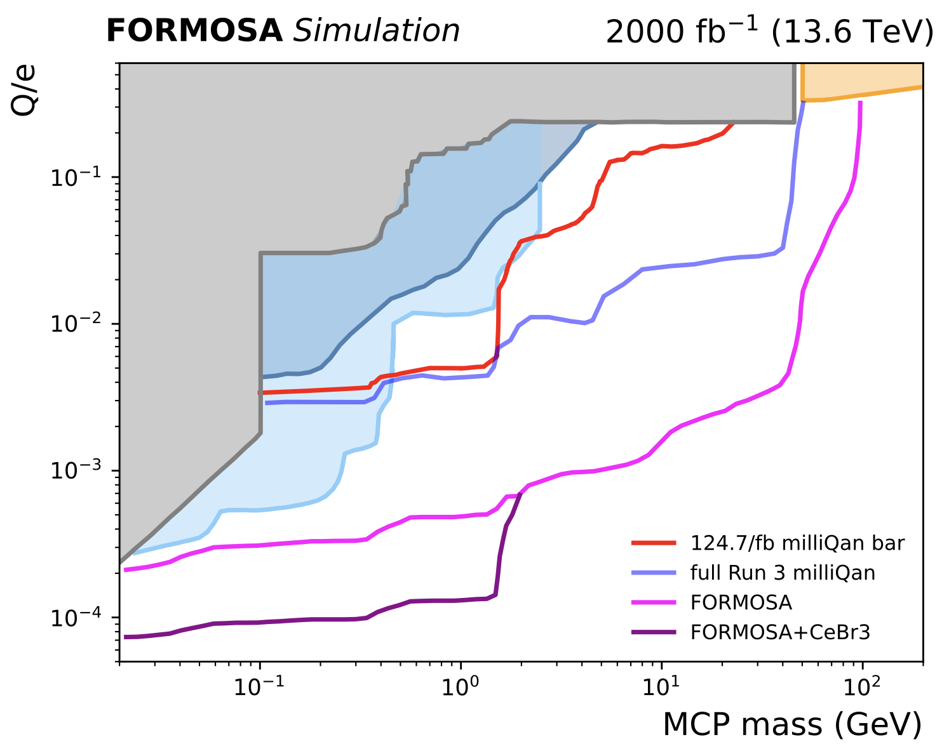

FORMOSA: CeBr3 module
Incorporated CeBr3 module into demonstrator in Sept 2024
CeBr3
Earlier constraints
Colliders
ArgoNeuT
Investigate feasibility of FORMOSA subdetector made from CeBr3
  Factor ~35 larger light yield for same length compared to plastic, fast with low internal radioactivity
Considerable sensitivity gain possible!
SENSEI

Slide 22
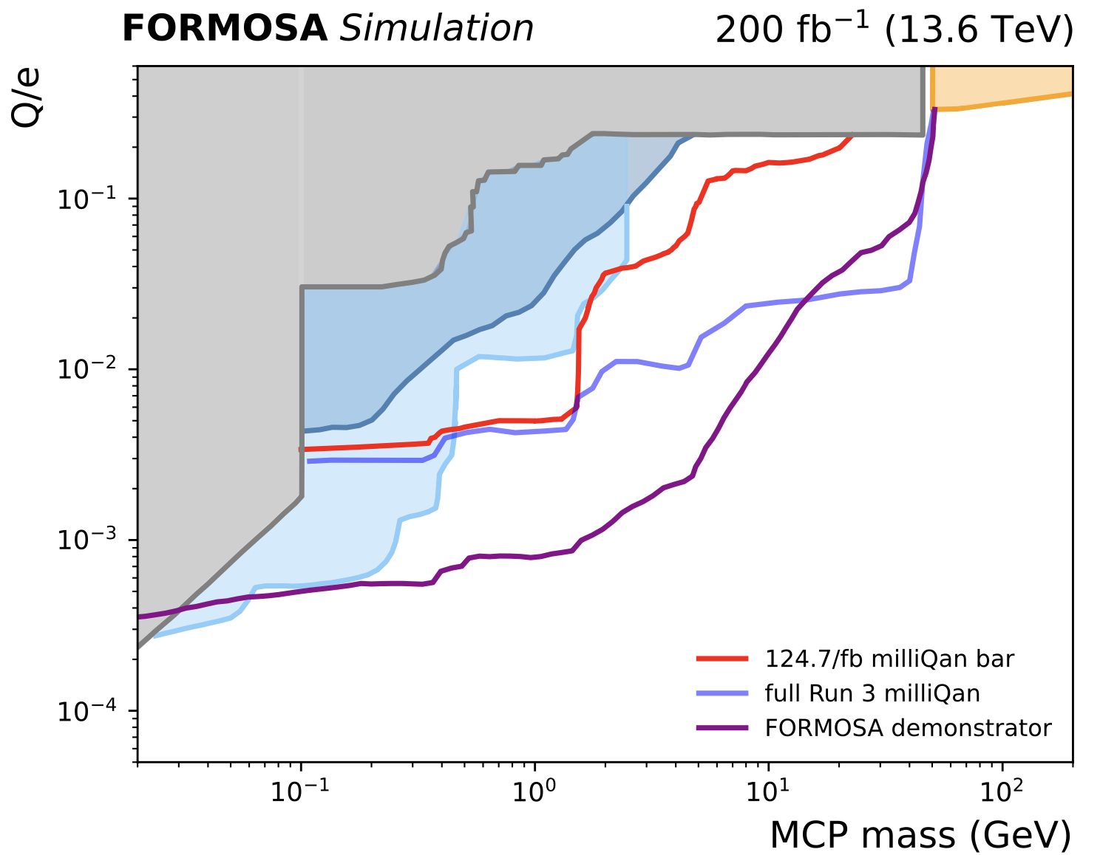
FORMOSA demonstrator sensitivity
Earlier constraints
Colliders
ArgoNeuT
Hermetic rejection panels added in earlier this year: will attempt search with 2025 LHC data!
Expand demonstrator size for early HL-LHC if funding allows
4x4 FORMOSA demonstrator
SENSEI

Slide 23
FPF updates

Slide 24
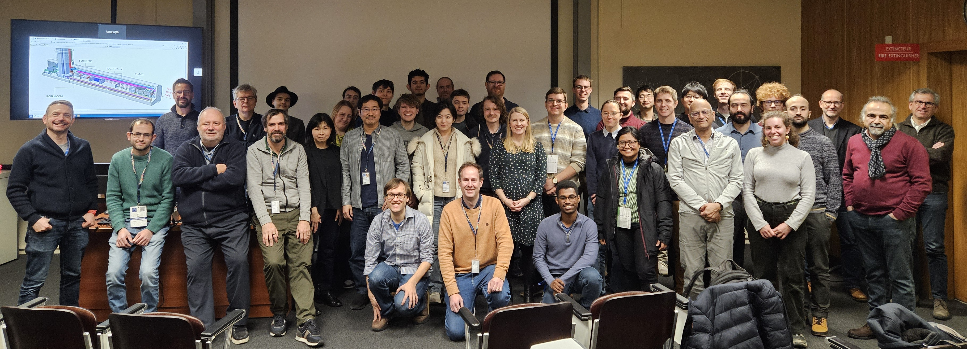
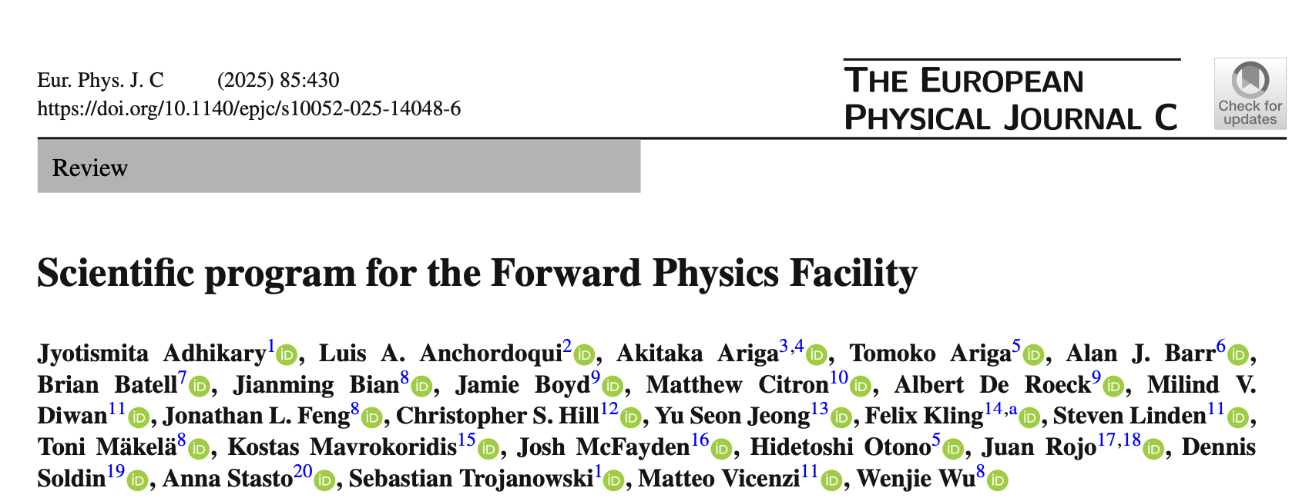
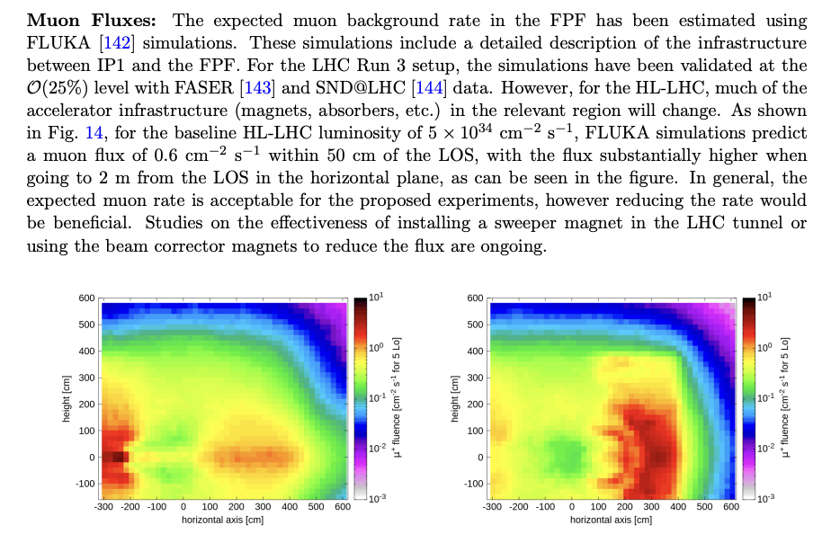
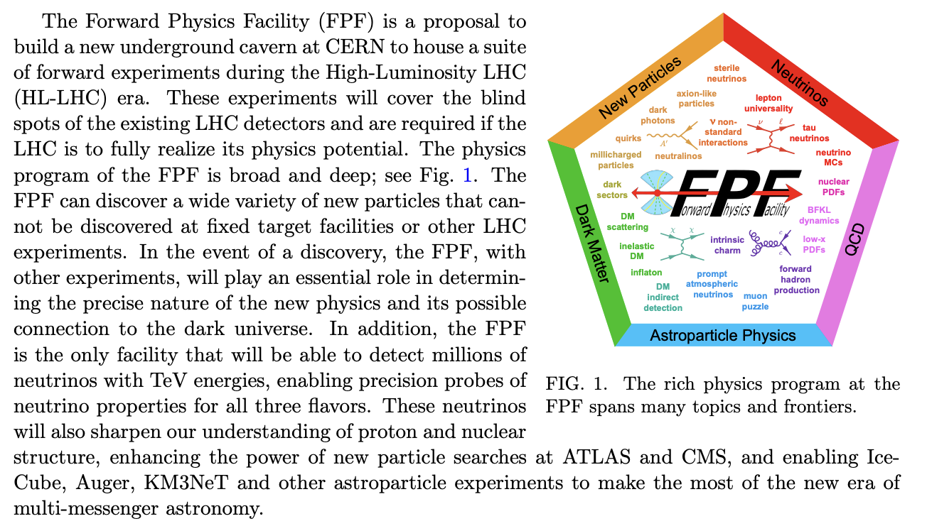
FPF documentation
FPF workshop series:
FPF1, FPF2, FPF3, FPF4, FPF5, FPF6, FPF7, FPF theory day, FPF8
FPF paper:
2109.10905
~75 pages, ~80 authors
Snowmass Whitepaper:
2203.05090
~450 pages, ~250 authors
Recent Summary:
FPF Update
Technical Documents:
Facility Technical Study
Muon Flux Study
Vibration Study
Geotechnical Report
ESPPU scientific program:
EPJ C: doi.org/10.1140/epjc/s10052-025-14048-6
~25 pages, ~26 authors

Slide 25
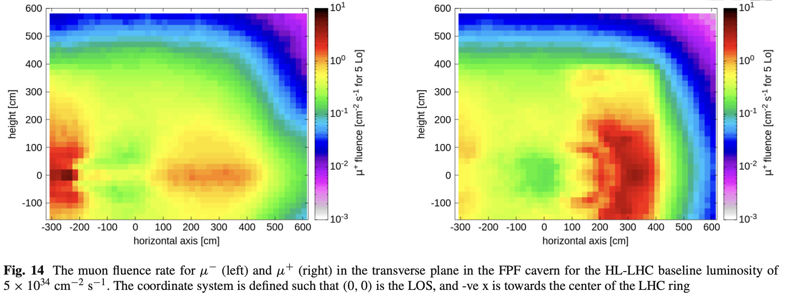
FPF technical progress
Location frozen (CERN civil engineering group)
Geological studies from core sample drilling look positive (CERN civil engineering group)
One access point + secondary corridor along facility OK for safety (CERN safety team)
Transport and installation study positive for all large components needed in facility (CERN handling group)
Vibration studies confirmed excavation possible during LHC operation (CERN beam physics group)
Cavern accessible during LHC operation (CERN radioprotection group)
Muon background/radiation flux simulated and validated (CERN FLUKA team)
  expected muon flux $O(1Hz/{cm}^{2})$ within 1m of LOS
  affected by triplet magnets
  studing if flux can be reduced with sweeper magnet
See FPF’s input to ESPPU for more details

Slide 26
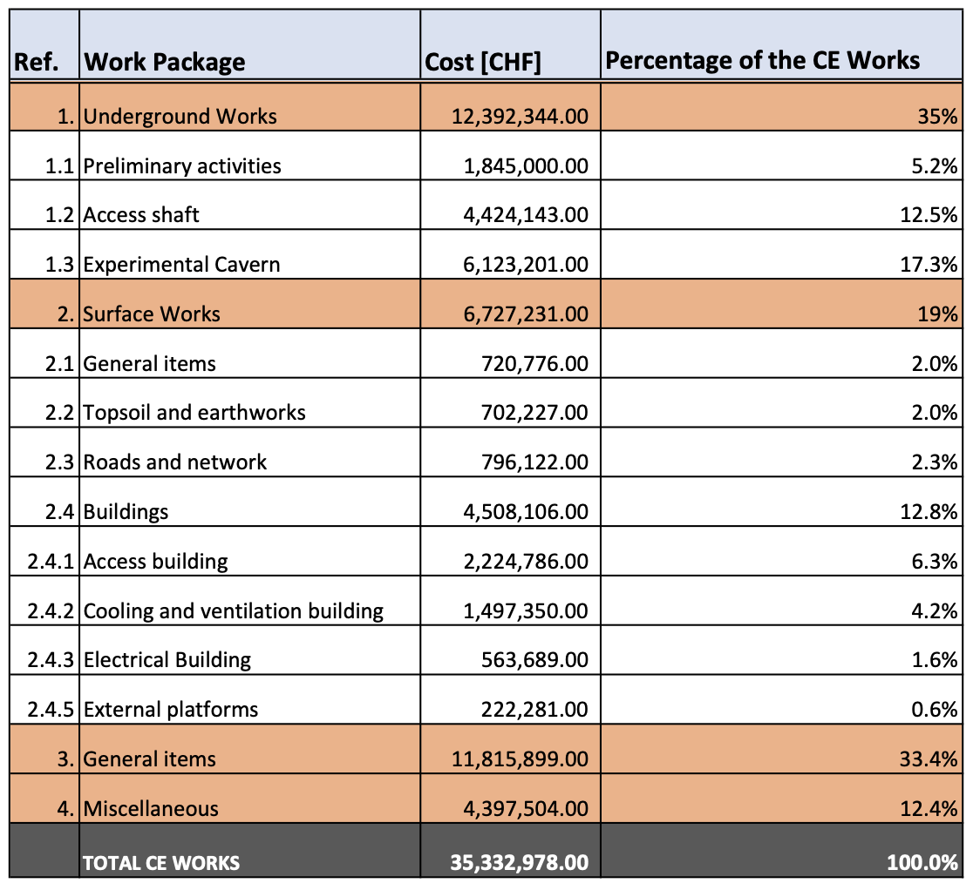
FPF timeline and cost
vibration study indicates that construction of the FPF possible during LHC operations
radiation protection studies indicate work in FPF possible while the LHC is running
→ not restricted to LS!
Timeline: construct in LS3/early Run 4, physics starts in late Run 4.
Capture as much HL-LHC luminosity as possible.
Cost Estimate: 35 MCHF (class 4)

Slide 27
Summary
Facility looking good from CERN side (radiation protection, safety, civ. eng., etc)
  Iterating with experiments for integration and service definition
FPF input to ESPPU summarising physics programme (see here)
Pathfinder experiments already showing results with Run 3 data and simulations:
  First neutrino measurements and BSM searches by FASER
  First electron and muon neutrino cross-section measurements by FASER𝜈
  FLArE design evolving/adapting
  FORMOSA demonstrator installed, DAQ validated and taking data now for background measurements
Construction currently expected to start in LS3

Slide 28
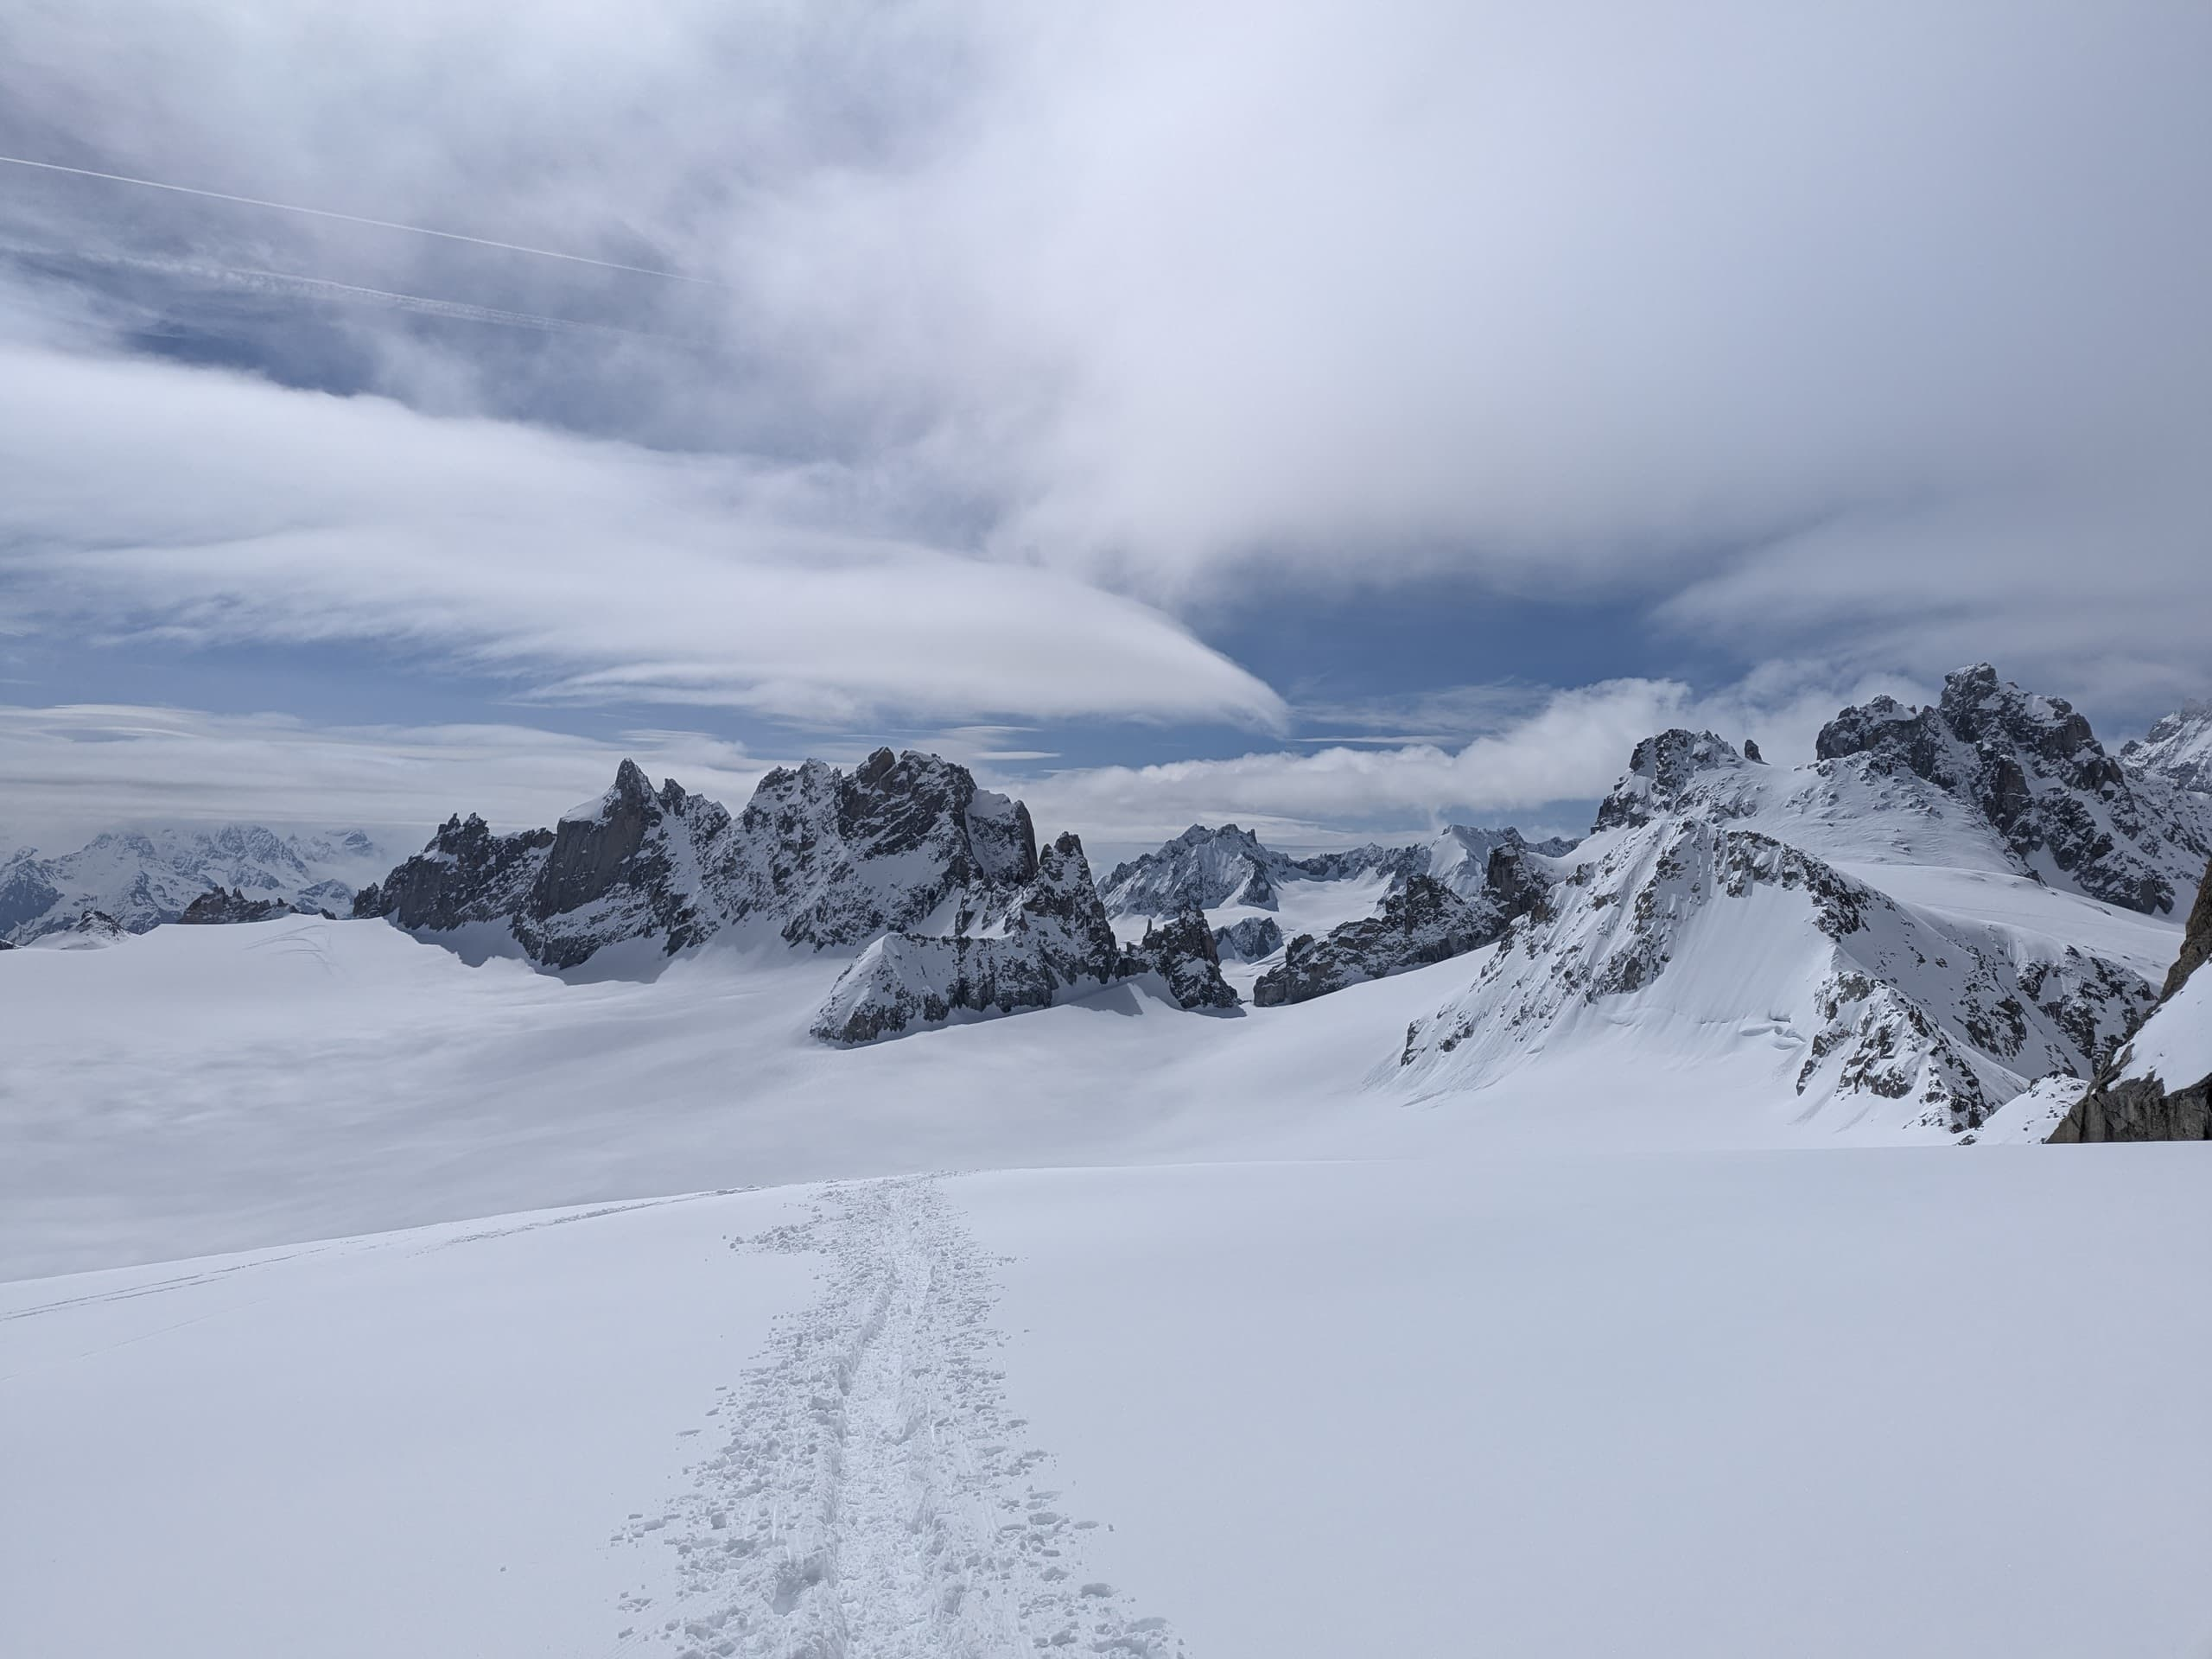
End

Slide 29
Backup

Slide 30
New physics and dark matter → Hidden Valley
U(1)
U(1)*
γ
photon
γ*
dark photon
electron
dark electron
strength: e
Natural strength (LO):
α/π ≈ 1/1000
strength: e’ ≈ e
No signs of new physics seen at the LHC (yet)
SM extensions that include dark (or hidden) sectors give the most plausible hint
Photons and dark photons originate from different $U(1)$
gauge groups, but they can interact through kinetic mixing
Interaction with dark electrons is around
1/1000 as strong as the standard model

Slide 31
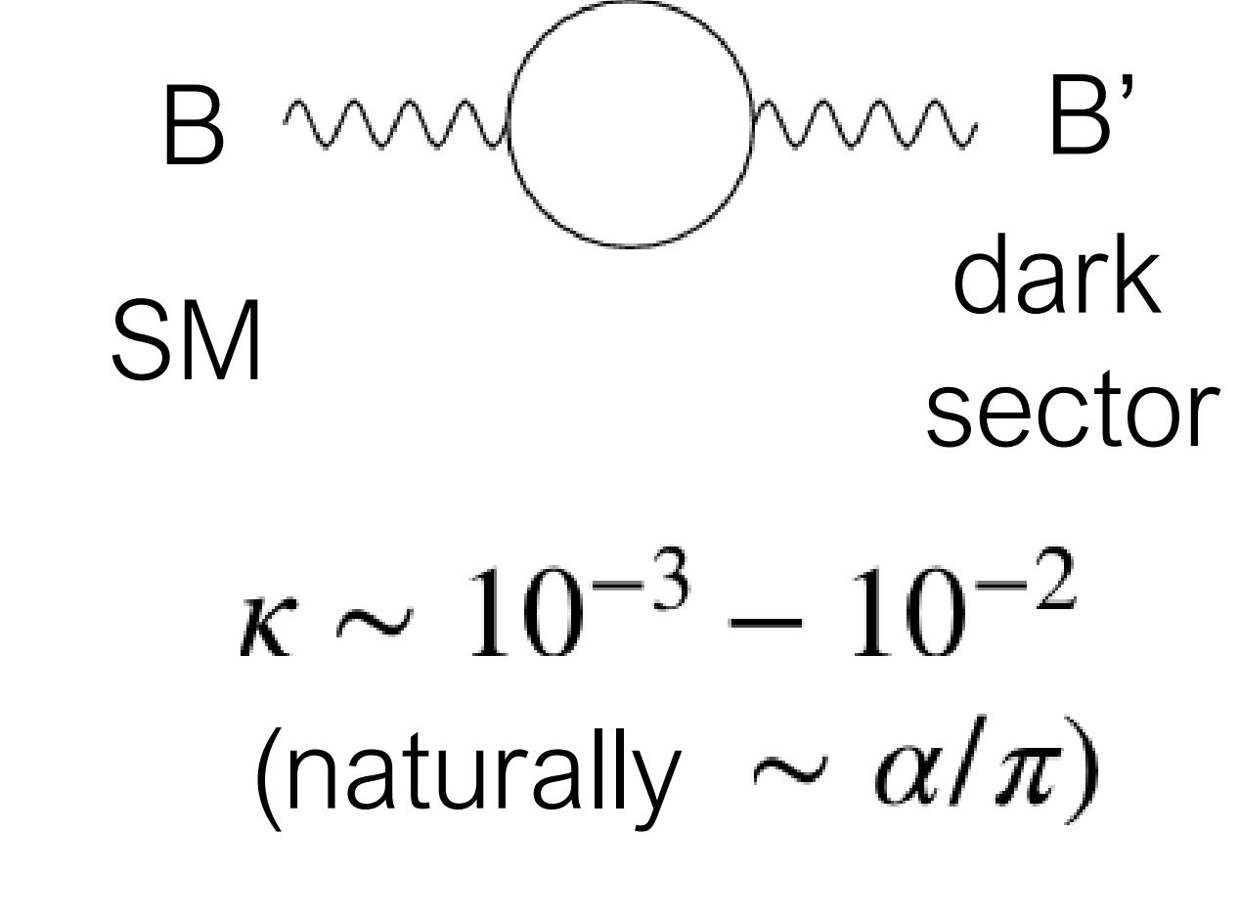
Why millicharged particles?
Standard motivation: Introduce new, hidden $U(1)$ with a massless field A', a “dark photon” that couples to a massive “dark fermion” ψ’
$ψ^{′}$ has mass $M_{mCP}$ and charge under the new $U(1)$ of $e^{′}$
Gauge transformation of $A_{μ}^{′}→A_{μ}^{′}+κB_{μ}$ introduces coupling $\overline{ψ^{′}}κe^{′}γ^{μ}B_{μ}ψ^{′}$
Conclusion: Coupling arises between dark fermion and SM photon of
charge $κe^{′}cosθ_{W}$ . mCP parameters are entirely defined by their mass and charge
see e.g. arXiv:2104.07151v2 for more details
massless “dark photon”
“dark fermion” with mass $M_{mCP}$ , charge $e^{′}$
mixing term

Slide 32

from arXiv:2104.07151v2
One can consider a dark sector containing a massless abelian gauge field, A′, that couples to a new dark fermion, χ, with order one coupling, e′. A kinetic mixing, κ, can be introduced between the A′ and SM hypercharge B. Under a convenient basis, A′ is decoupled from the SM sector and the Lagrangian can be written as
In this case, the χ acts as a field with hypercharge κe′. The new fermion is generically called a millicharged particle since a natural value for κ, and therefore the χ effective electric charge, of ~αe/π ~10⁻³e arises from one-loop effects. The parameter space 1 < m_{χ} < 100 GeV, an ideal mass range for production at the LHC, is largely unexplored by direct searches.

Slide 33

Direct millicharged particle searches at the LHC
Millicharged particles (mCPs) are well motivated in dark sector theories, but difficult to detect because the interaction strength is reduced by a factor (Q/e)².
Core concept: Use array of efficient long scintillator bars + PMTs to detect ionisation from mCPs.
Challenges:
Expect few scintillation photons to be produced → must be able to detect single scintillation photons
Well controlled backgrounds → “point” at the interaction point, triggering on sets of signals within small time windows (~15 ns)
$$⟨E⟩∝{\left(\frac{Q}{e}\right)}^{2}l_{scint}$$

Slide 34
FORMOSA overview
Demonstrator installed last year and taking data through 2024
DAQ (hardware and firmware) being tailored to improve signal collection
  Alignment with L.O.S. to I.P. validated
  Verified we are measuring physics correlated to LHC activity
  Capable of identifying beam muons
  Background nPE spectra has been identified
  Intra-clock timing proving useful for understanding of observed backgrounds
Upgrade on its way to add larger side and top panels for more comprehensive beam/cosmics background studies

Slide 35








The FORMOSA collaboration
Members from 8 institutions and growing!
This speaker supported by funding from DOE Office of Science

